Slide 1
DSCI 100
Introduction to Data Science

Slide 2


The Instructional Team
Instructor: Anjali Thapar
Pronouns: she/her/hers
Feel free to call me “Anjali”, “Professor Anjali”, or “Professor Thapar”
Email address: athapar@brynmawr.edu
My Drop-in Office Hours:
Wednesdays: 11:30 am to 1 pm and by appointment.

Slide 3
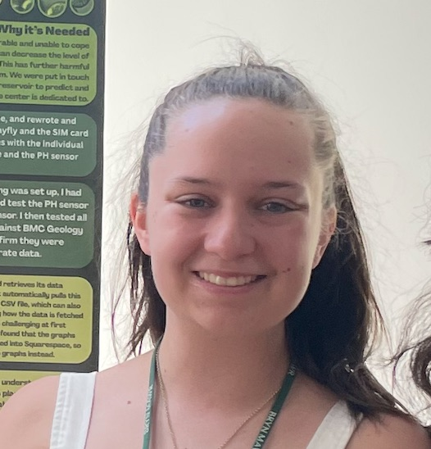
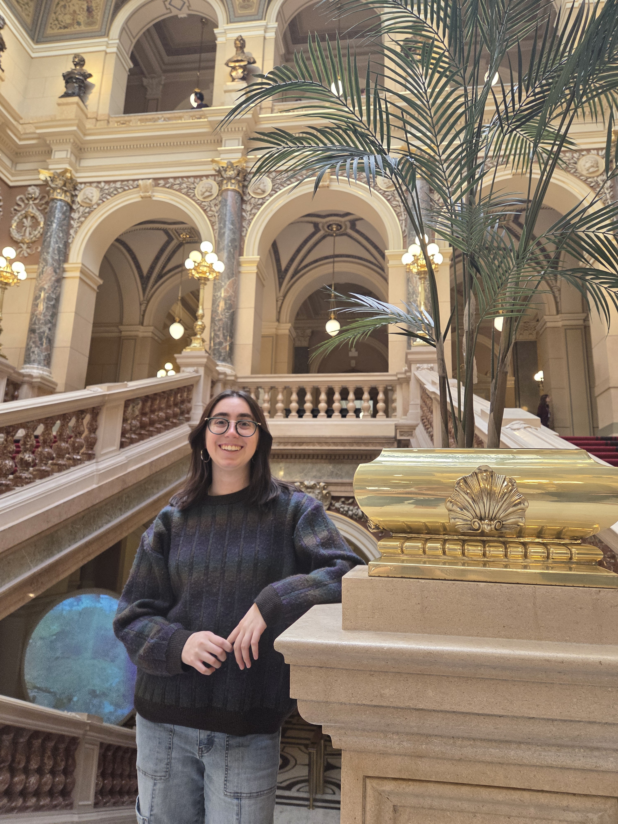


Instructional Team: Our Awesome TAs
Niki
Davidis
Olivia
Crolle
Mahveen Wani

Slide 4
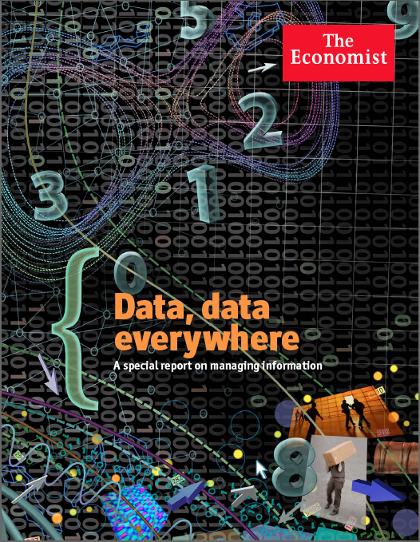
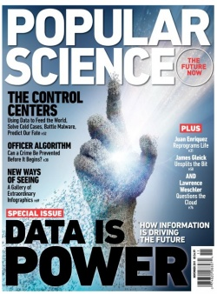
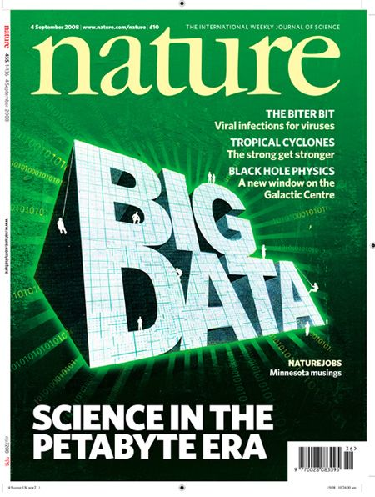
Welcome to DSCI 100

Slide 5
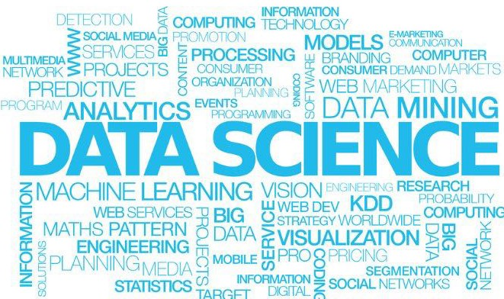
What is Data Science?
https://www.linkedin.com/pulse/putting-science-back-data-paul-dalen

Slide 6
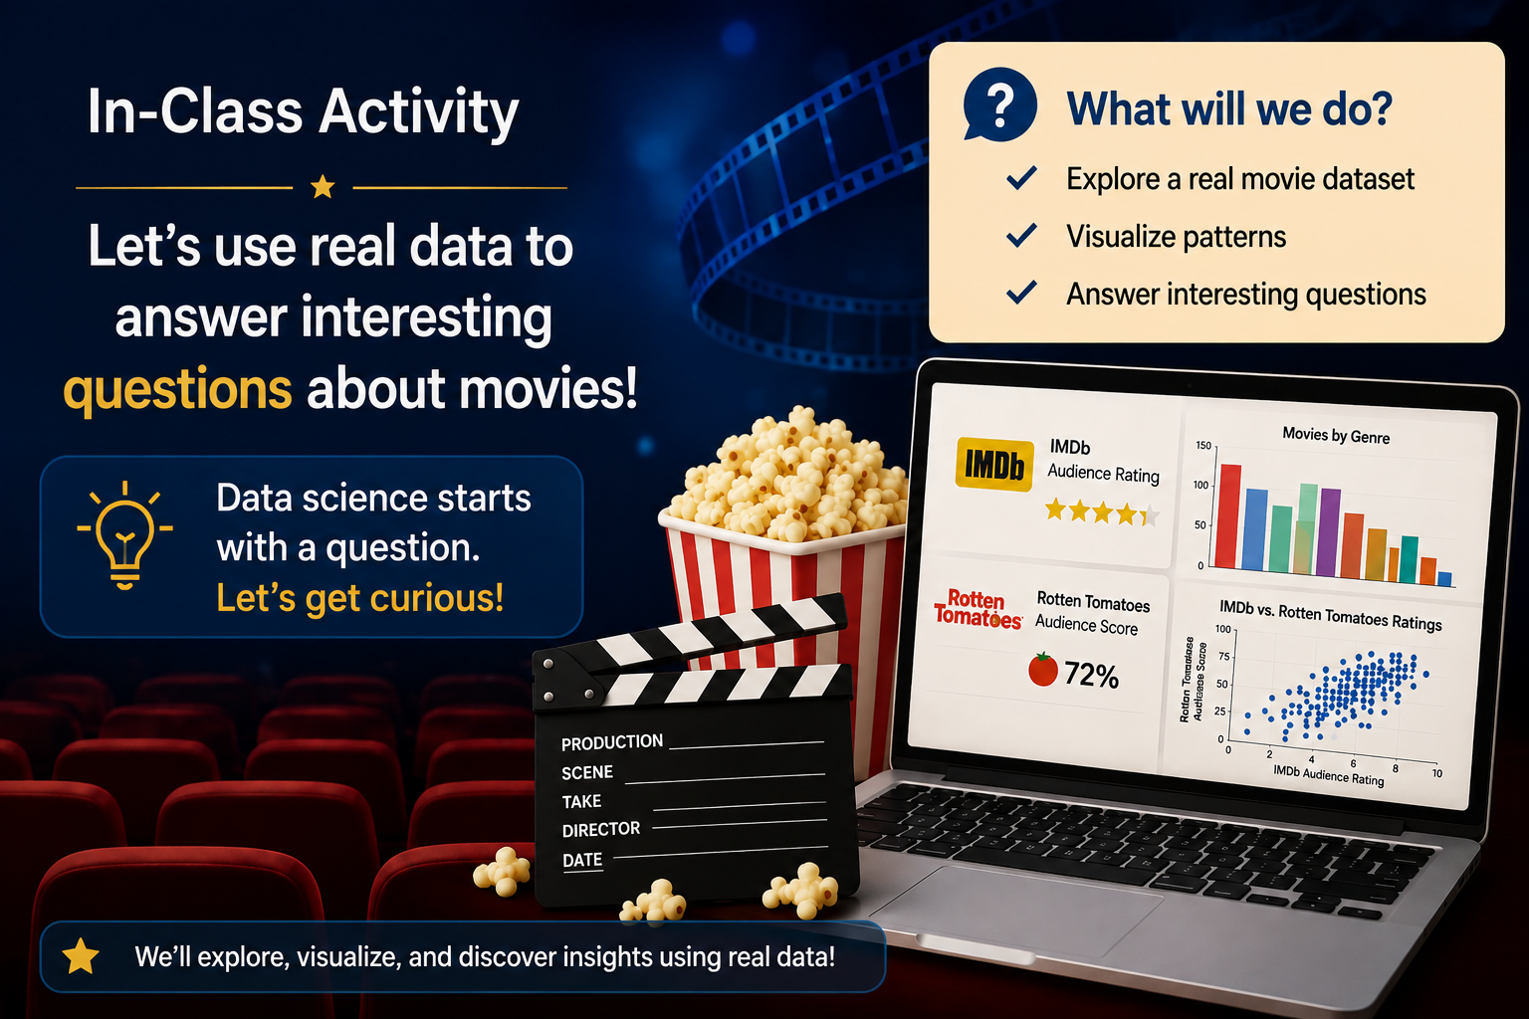
Data Science = Using Data to Answer Questions

Slide 7
What Questions Might We Explore with this Dataset?

Slide 8

What Questions Might We Explore with this Dataset?
How many genres are included? Which movie genres are the most/least common in the dataset?
Which genres tend to receive the highest/lowest IMDb ratings?
How similar are IMDb and Rotten Tomatoes audience ratings?

Slide 9
What is Data Science?
You Just Did Data Science!
Question or Dataset ….
→ Explore the dataset;
→ Analyze and Visualize variables and patterns;
→ Interpret patterns and communicate what you found;
→ Ask more questions based on what you discovered!
Data science is an iterative process!

Slide 10

Data Sources
Where does Data come from?
Government/Public/Civic Records
Organizations and Businesses
Websites & Online Platforms
Surveys
Experiments & Observations
Sensors and Devices
……

Slide 11
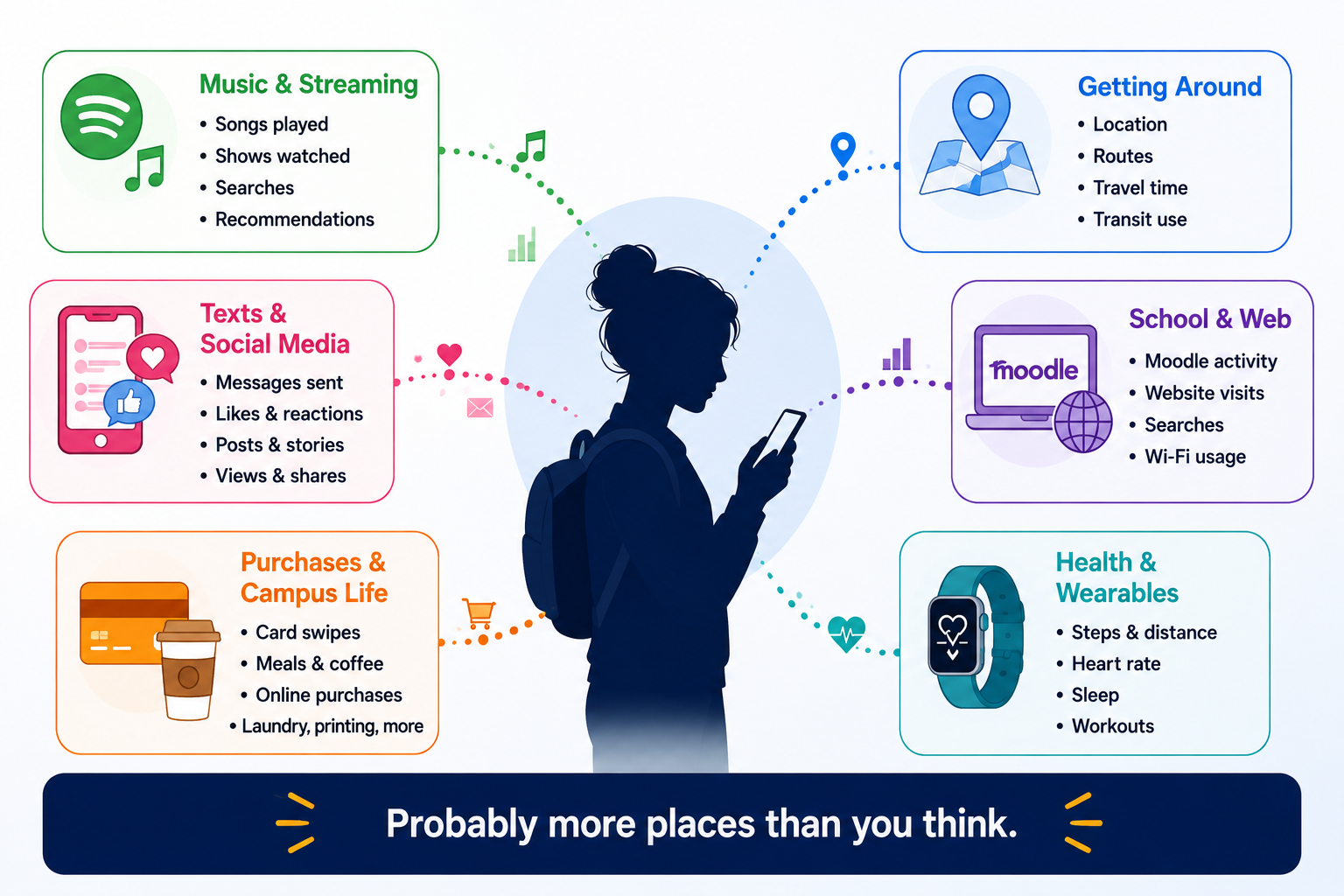
Data Sources: The Data You Create Every Day

Slide 12
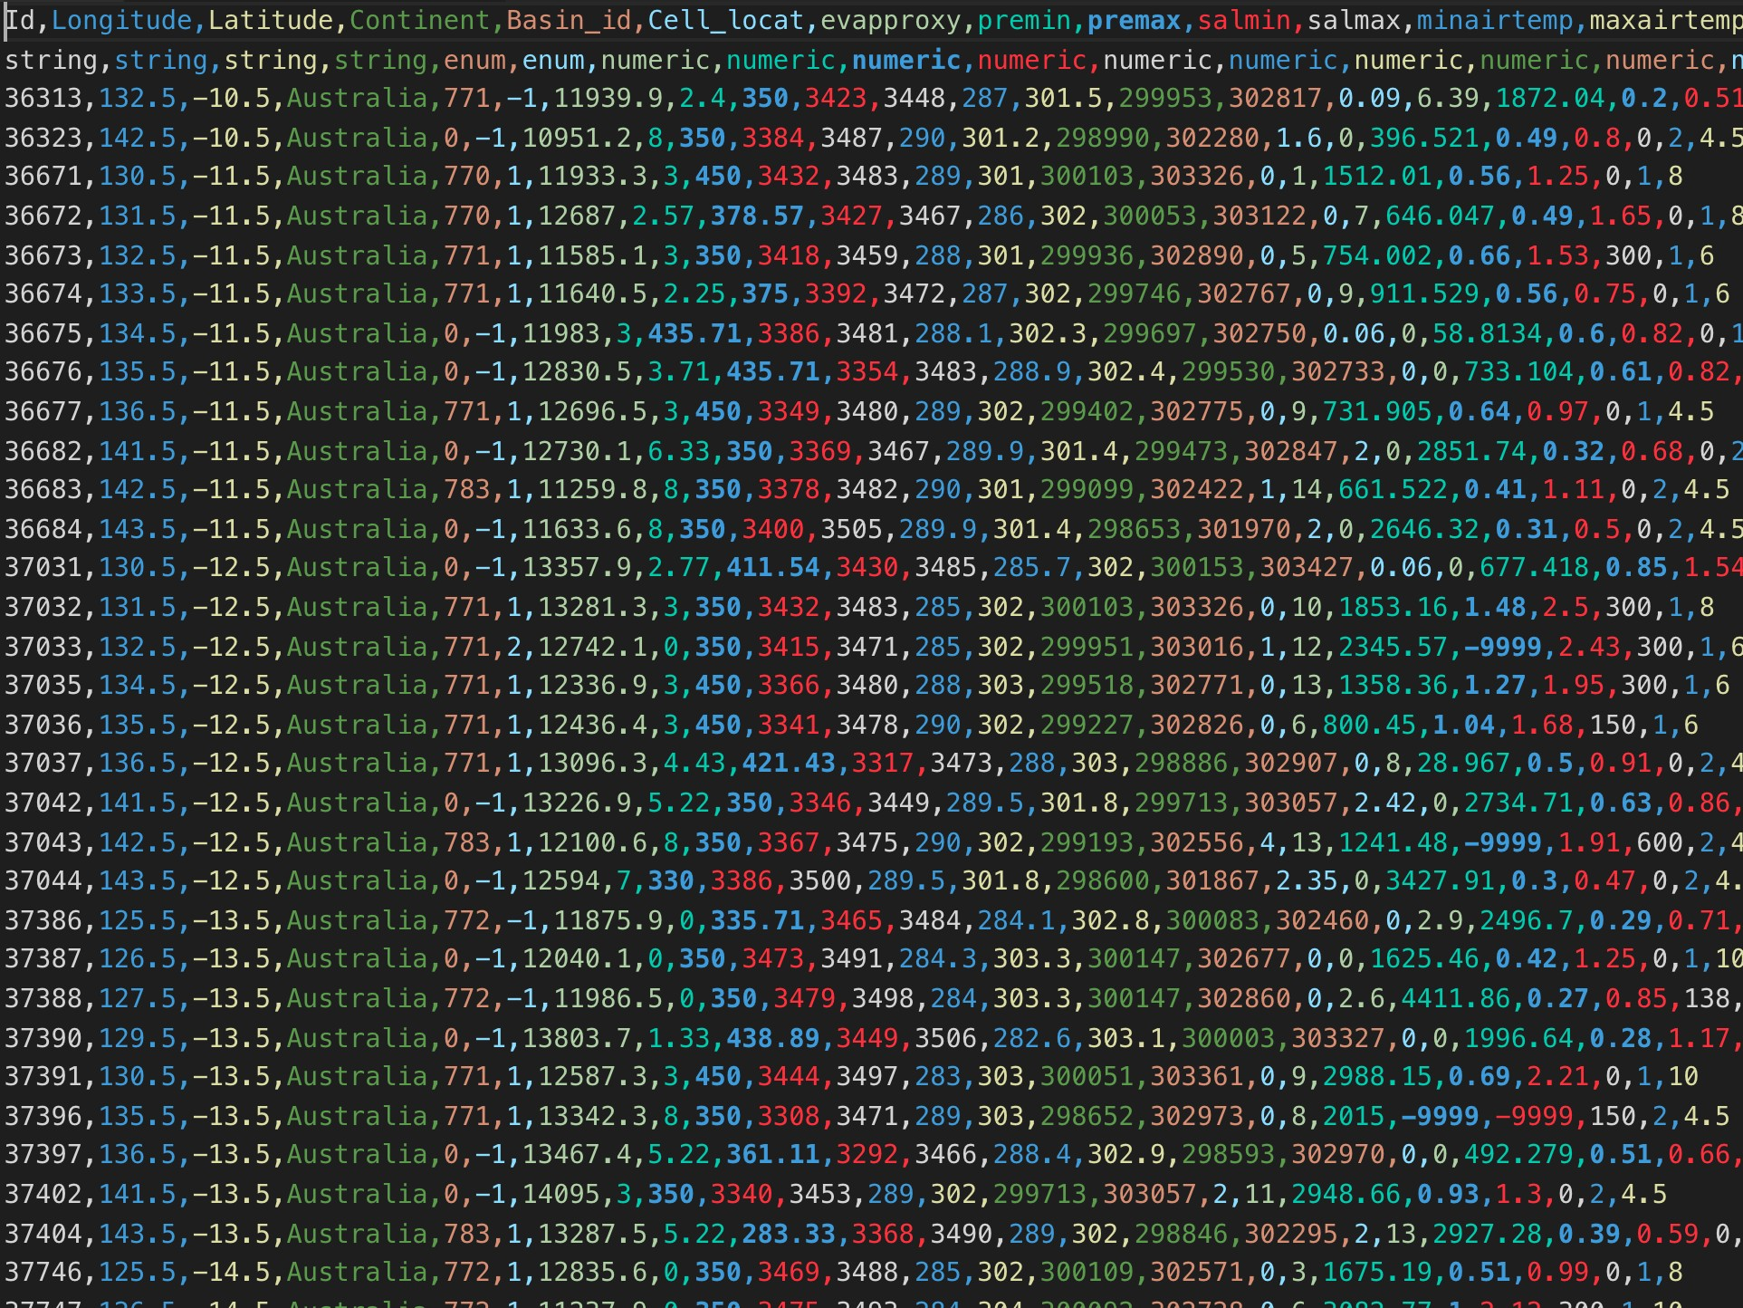

Data is (usually) Messy
CSV (comma separated file)

Slide 13
Overview of the Course
There are no prerequisites for this course. We assume no previous experience with R, computer programming or statistics.
Unit 1: Introduction to Data Science and the R Programming Environment
Unit 2: Basic Coding, Data Manipulation and Wrangling, Data Visualization of Numerical and Text Data
Unit 3: Introduction to Modeling and Prediction
Unit 4: Introduction to Data Ethics

Slide 14


R and R-Studio
http://rhrv.r-forge.r-project.org/
https://www.rstudio.com/about/trademark/
(posit.cloud)

Slide 15
Why R?
Free
Open source
Platform Independent (Mac/Windows/Linux)
Widely Used
Creates Great Visualizations
Huge Ecosystem
Your work can be saved, shared and reproduced.
http://rhrv.r-forge.r-project.org/

Slide 16
Our Data Science Toolkit for this Class
Laptop
R/RStudio (Posit.Cloud)
Curiosity
Critical Thinking
problem solving ability
Collaboration

Slide 17
Learning R can feel Uncomfortable at First
You are learning a new language…. You will encounter new and unfamiliar words, symbols, code and error messages.
You are not expected to understand everything immediately
Practice → familiarity → confidence
And so we are going to repeat things over and over and over.
And remember, the more you work with R, the more familiar it will become.

Slide 18
The “Truth” about Data Science
The hardest part about learning to work with data is the working memory load.
New language + new logic + new tools = Substantial Cognitive Load!
What helps?
  Repetition and practice
  Being curious: “What happens if I try this?”
  Working with others
  Asking/Answering Questions
  Getting comfortable making mistakes!

Slide 19
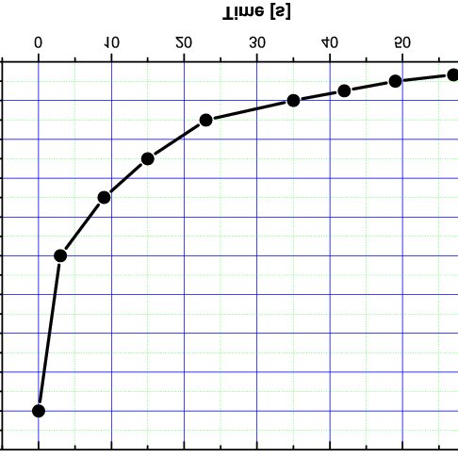
A Word of Encouragement …
Learning any new language is hard!
You Are
Here!
Data Science & the R Learning Curve

Slide 20
How I will Help You Acquire the Language and Logic of Data Science
Philosophy: Focus on accessibility + learning + lots of reminders to be gentle with yourself.
Materials: Readings, Videos, Lectures, and In-Class Activities
  Readings/Videos: basis for each week. Readings can be dense. Do not be discouraged! We will work together and discuss further.
  Lectures/Slides: present concepts in a (hopefully) more approachable way – the what and the why.
  In-Class Activities: reinforce concepts and demonstrate the how.
Resources: Instructional Team and Peers
  Instructional Team: Weekly Group and One-on-One Help Sessions
  Peers: Post and Answer questions on Piazza!

Slide 21

My personal teaching goals for this course:
Get students comfortable using R to work with real-world data.
Instill confidence in all students so that you will feel comfortable approaching unfamiliar data problems without being intimidated.
Excite students about Data Science and what you can do with R so that you will leave this class and apply the skills that you have learned!

Slide 22
When Assignments are Due
Assignments – Sunday @ Midnight (Target Deadline)
Monday @ Midnight (Submission Deadline*)
In-Class Coding Activities - Midnight Day Assigned
Course Assessments
Participation/Community Engagement 5%
In-Class Coding Activities (ICAs) 10%
Individual Assignments 30%
Midterm Exam 20%
Team Data Science Project 35%
Total 100%

Slide 23
Team Data Science Project
You will work with a team to...
🔎 Choose a real-world dataset: Find data on a topic your team finds interesting.
❓ Ask meaningful questions: Decide what you want to learn from the data.
🧹 Prepare & explore the data: Clean, wrangle, visualize, and investigate patterns.
📊 Analyze the data: Use the tools you learn throughout the semester to answer your questions.
💡 Tell the story of what you discovered: Interpret your findings and communicate what you discovered.
Your questions. Real data. Your analysis. Your story.

Slide 24
Important Course Details
Lectures – Tuesdays/Thursdays 2:40 – 4:00 pm
Class materials available on Moodle
Piazza – Q&A wiki for our class; post questions/answers here!
All assignments & readings due by the day/week they are cited on Moodle. 5 Free Late Days to be used as needed for IHAs.
Student Help Hours – TBD – See Piazza Poll
Opensource Resource:
  Wickham, H., Cetinkaya-Rundel, M., & Grolemund, G. (2023). R for Data Science (2e). Available at https://r4ds.hadley.nz/.

Slide 25
For Thursday’s Class…
Review Syllabus
Review Tutorial #1
Submit Course Introductory Survey

