Slide 1
How R Works: Data, Objects, and Functions

Slide 2

Getting to Know Each Other
Introduce yourselves to the folks sitting near you (name, year, major, where are you from, your interests)
Response to either of these 2 questions:
    If you could travel anywhere in the world, where would you go and who would you take with you?
    What’s a recent book, show, movie or podcast that you really enjoyed?

Slide 3

Important Course Logistics

Slide 4
Collaboration in this Course
Searching for/Reusing Code
  You can search for and reuse code.
  Cite the sources (including for “substantive inspiration”).
Individual Homework Assignments (IHAs)
  You may discuss concepts and ask for clarifications.
  The actual work (code, interpretation, writing, etc.) must be your own.
  Acknowledge peers with whom you have substantive discussions with.
Team Assignments
  Everyone contributes and is involved in each stage of the process.
  Everyone should understand the team's code and analyses.

Slide 5
Generative AI policy
The guiding principle that governs how you can use Generative AI tools (e.g., ChatGPT, Copilot) in this course is that working with AI should facilitate, not hinder, your learning¹.
    ✅ Attempt first: You should try all tasks on your own first. AI tools may be used when you are stuck or need help understanding a concept, but they should supplement—not replace—your own thinking.
    ✅ Ask for help, not answers: Use AI for hints, debugging, and explanations—not to do the work for you.
    ✅ Verify and understand: Check and be able to explain AI results in your own words.
    ✅Be transparent: if you use AI or other external resources, you must explicitly cite and describe how you used it.
    ❌ You may not use generative AI to generate the code or write the answers to the exercises or assignments for you. You are ultimately responsible for the work you turn in; it should reflect your understanding of the course content
Principles are based on materials shared by Mine Cetinkaya-Rundel, Ph.D. and developed by Joel Gladd, Ph.D.

Slide 6
Late Work Policy
Assignments will have target and submission deadlines.
5 free late day passes (24 hours each) to use across all Individual Homework Assignments (IHAs). You may use them all on one assignment, across different assignments, or any other combination of your choosing, but they must be used in 1-day increments.
Google Form posted to Piazza that you will use to let me know you will be submitting an assignment late and how many of your free days you’d like to use. You don’t need to tell me why you’re using the free day pass(es). Your extension will automatically be granted. If at some point during the semester you experience a medical or personal emergency, please get in touch with me so that we can discuss how best to proceed.

Slide 7

Questions about class/syllabus?

Slide 8

The Movies Dataset
How many genres are included? Which movie genres are the most/least common in the dataset?
Which genres tend to receive the highest/lowest IMDb ratings?
How similar are IMDb and Rotten Tomatoes audience ratings?

Slide 9
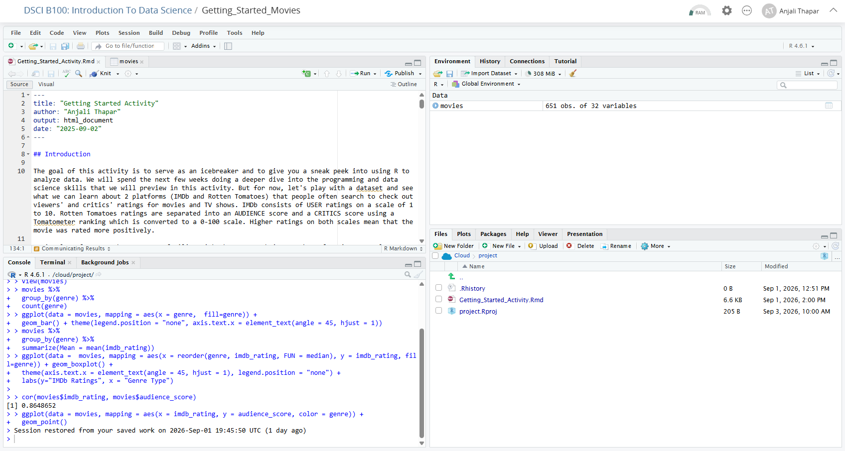
Source/Editor
Environment/History Workspace
Files and Plots
Console

Slide 10
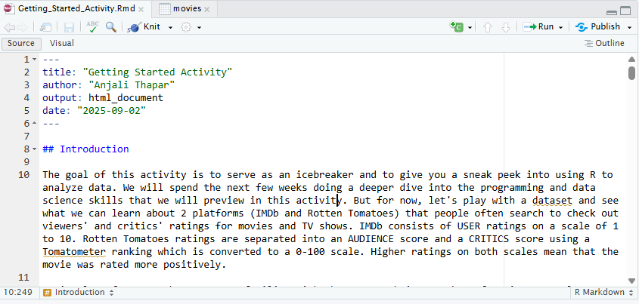
Source/Editor Pane
R Programming Environment
Where we write code that we want to be able to Save/Modify/Reuse.

Slide 11
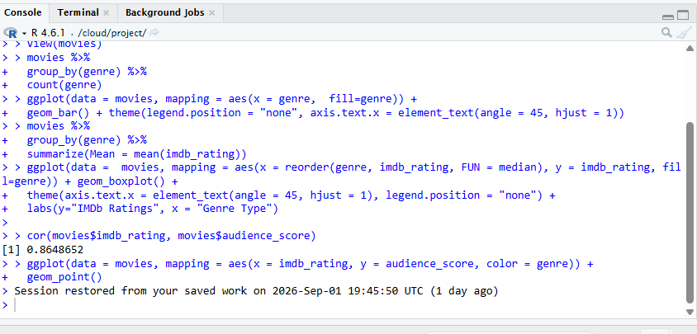
Console/Terminal Pane
R Programming Environment
Can type code directly into console and run. It is also where R responds to commands run in the Editor window.
Prompt

Slide 12
Environment/ History Workspace
R Programming Environment
Environment tab -> Tracks what datasets and objects have been created or loaded and are stored and available for use.
History tab -> Keeps track of commands/functions have been used.

Slide 13
Files/Plots plus Pane
R Programming Environment
Files tab -> See list of files available.
Plots tab -> Plots created by your R code will appear here.
Help tab -> Response to Help queries will appear under the Help tab.

Slide 14
Coding in R – Console vs. Script
The Console
  think of it like a post-it: useful for quick notes but disposable
  one chunk of code is run at a time (`Return`)
  code is not saved
The Script Editor
  think of it like a notebook; for code you want to save, modify and be able to run again
  R script files have a `.R` extension
  Quarto (qmd extension) files; (R-Markdown - .Rmd extension)
Most of the time, write code you want to keep as a Quarto document.

Slide 15
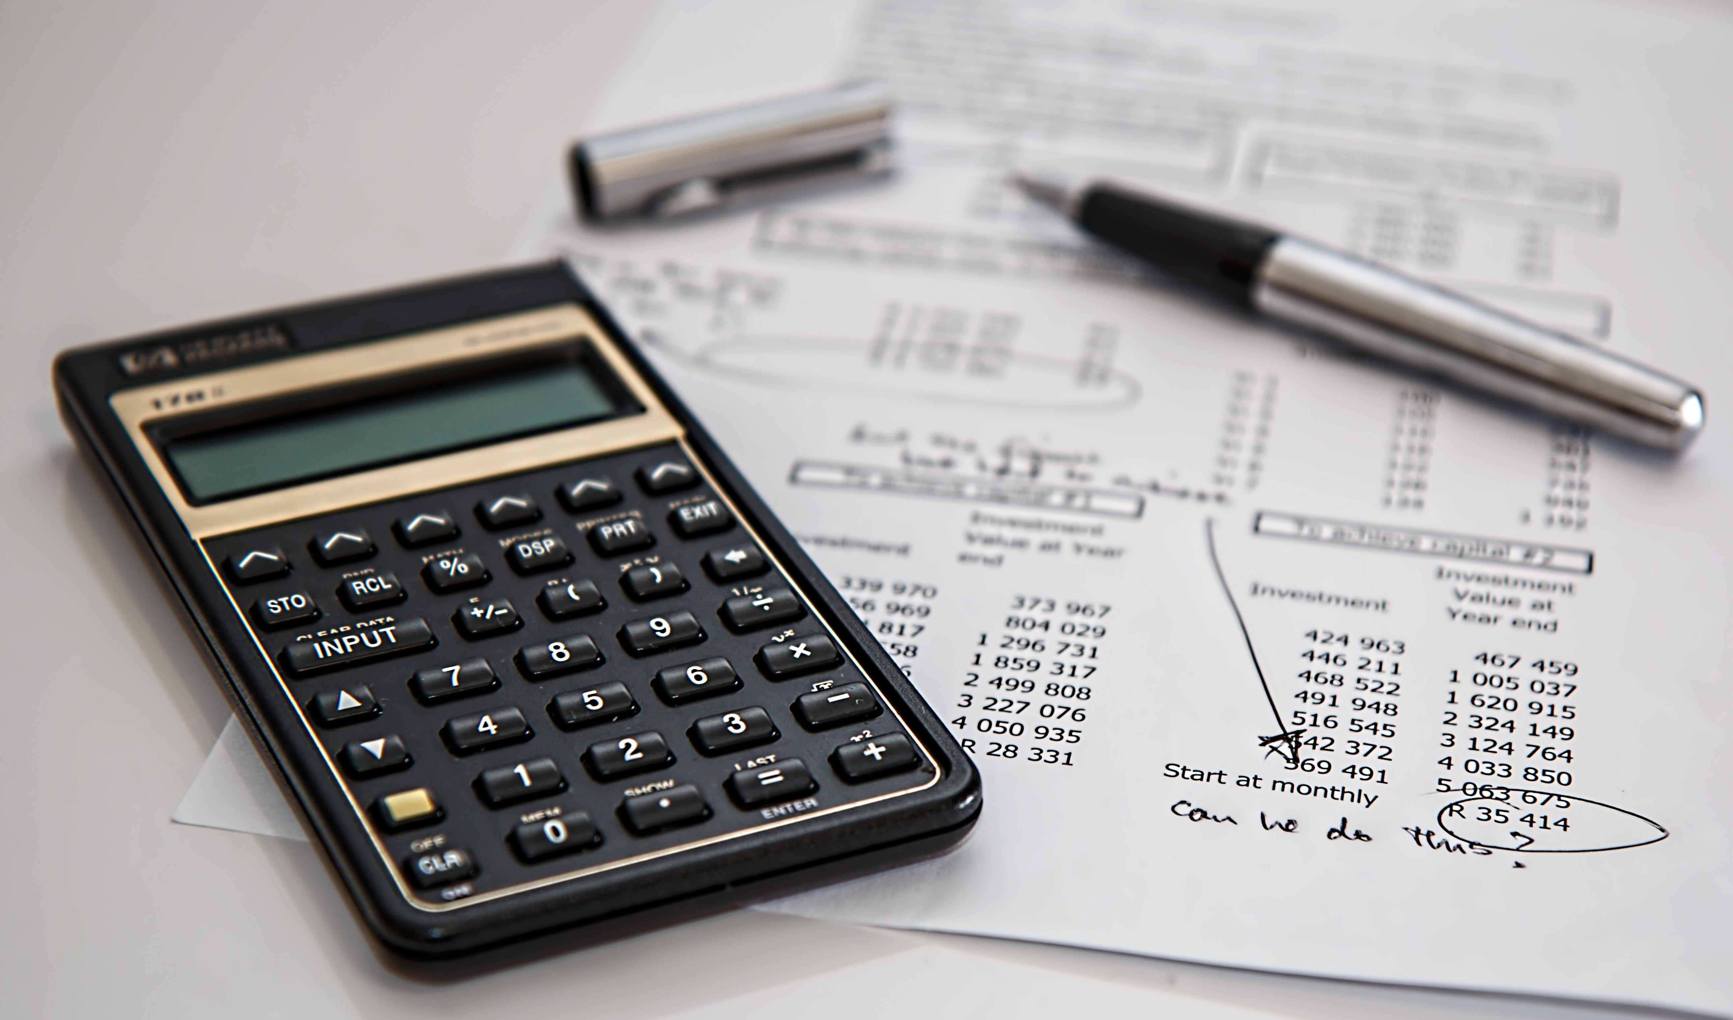
How R works: R as a Calculator – Functions and Arguments
R evaluates the instructions you give it and returns the results:
> 2 + 22
> sqrt (16) sqrt() is an example of a Function
> seq(from = 0, to = 5)
> seq (from = 0, to = 5, length = 6)
> seq(from = 0, to = 5, by = 2)

Slide 16
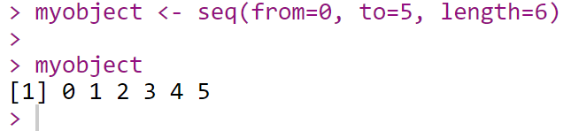
Creating Objects in R
New Object
The assignment operator, <- , assigns values on the right to objects on the left. Shortcut for the assignment operator:
Pressing the “Alt” key at the same time as the “-” key will enter <- in a single keystroke in a PC.
Pressing the “Option” key at the same time as the “-” key does the same in a Mac.

Slide 17
Naming Objects
There are some restrictions when giving an object a name:
  Object names cannot contain symbols like !, +, -, #.
  An underscore (_) is allowed and is useful.
  Object names cannot start with a number but can contain a number.
  R is case sensitive, X and x are two different objects, same goes for movie_rating, Movie_Rating and Movie_rating.

Slide 18
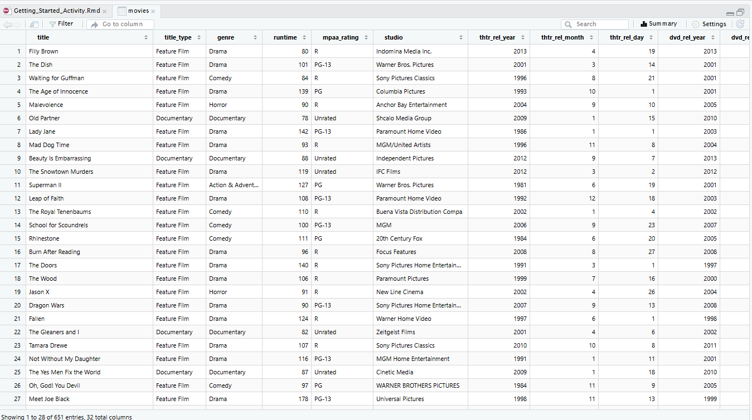
Data Structures – How Data is stored in R
Basic Data Structures: vectors, matrix, data frame, list, and factor.
Data frames
Rows = observations (aka cases)
Columns = variables
Cells = values

Slide 19
Basic Data Types in R
Basic Data Types | Example of Basic Data Types
integer | Real Numbers without Decimals - 7, -70, 0 (*L)
double | Real Numbers with/without Decimals 7, 3.06, -804.4
character | String/Text “apple”, “hello world”
logical | Boolean Data – 2 values: TRUE and FALSE (1/0)
complex | Data with Imaginary numbers (i) 3 + 2i, 0 + 1i
raw | raw_variable <- charToRaw("Welcome to DSCI 100") [1] 57 65 6c 63 6f 6d 65 20 74 6f 20 44 53 43 49 20 31 30 30
numeric
Most Common

Slide 20
Base R Functions to Explore Datasets
Question | R function
What does it look like? | View()
How big is it? | dim()
What variables does it contain? | names()
What do the first few/last few rows look like? | head() tail()
What can I learn quickly about all the variables in the dataset? | summary()

Slide 21
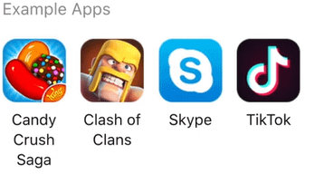
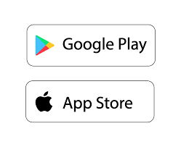
R Packages = Add on Toolkits
Packages give R additional functions, datasets, and capabilities.
Function to Install package: install.packages(“nameofpackage”)
Function to Load package: library(nameofpackage)
Install
Once
Packages give R additional functions, datasets, and capabilities. You can use the function search() to see the list of packages that are currently attached to the system.
Load/Run to use Every Time

Slide 22
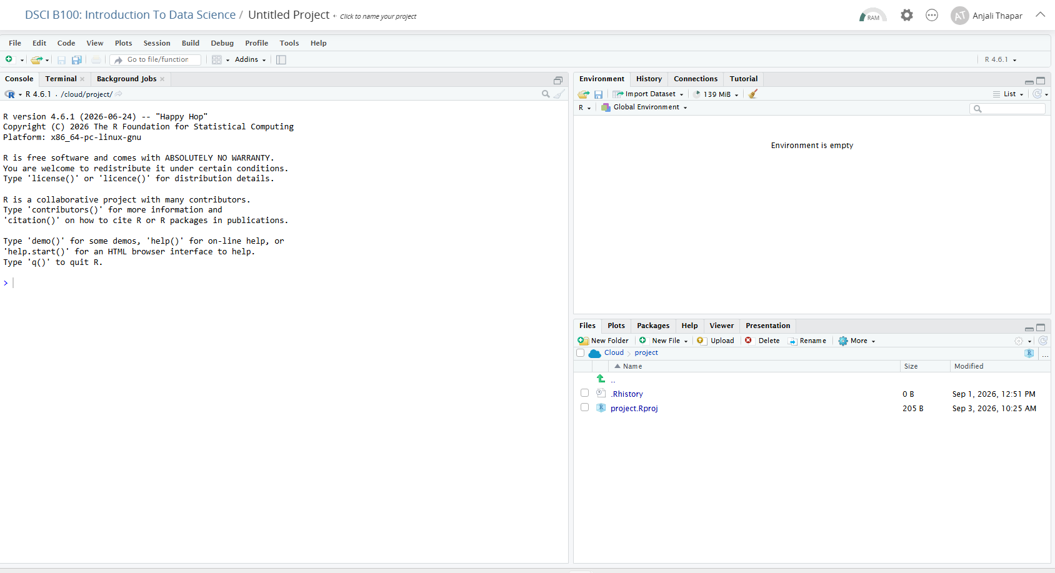
Starting a New Project

Slide 23
R Package dslabs
Let’s install a package called dslabs … ??????
Let’s load the dslabs package … ??????
To see all the datasets included in this package
data(package="dslabs")
Load us_contagious_diseases dataset: data(us_contagious_diseases )
To get info about dataset: ?us_contagious_diseases
Work with another student and complete the ICA Handout

Slide 24
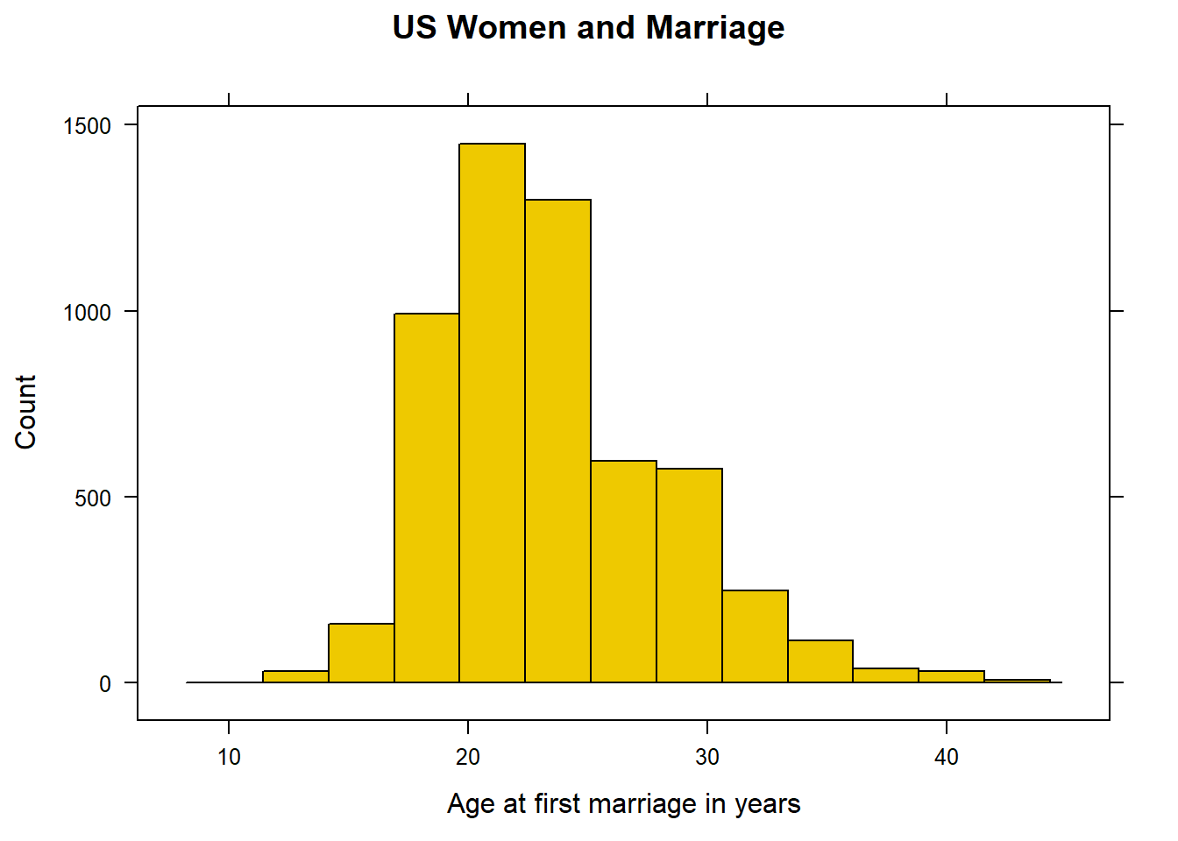
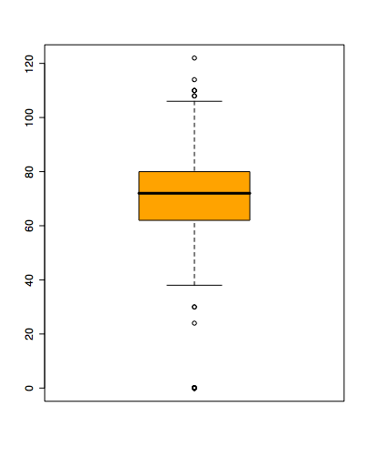
Base R Code for Visualizing Numerical Data
Histograms Boxplots
hist(ABC) boxplot(ABC)
(replace ABC with name of object/variable)

