Slide 1
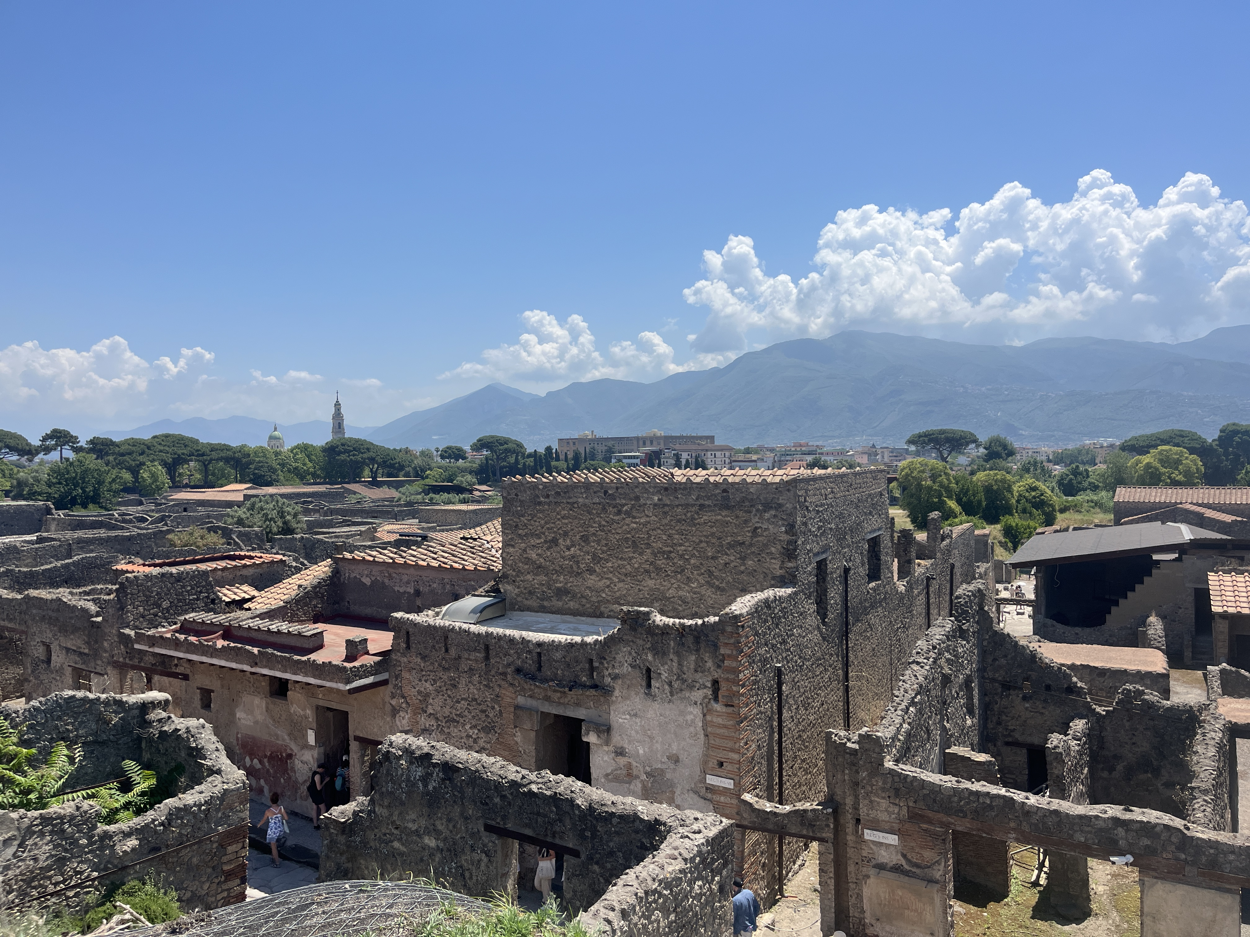
Pre-Roman Pompeii
September 8

Slide 2
Upcoming Reminders
Map quiz Thursday! (9/10)
Guidelines for Writing Assignment #1 now up on Moodle

Slide 3
Writing Assignment #1 Topic Ideas
Alexander Mosaic (in the House of the Faun)
Fresco from the Triclinium of the Villa of Mysteries
Brawl in the Amphitheater Fresco from the House of Actius Anicetus
Cave Canem Mosaic (in the House of the Tragic Poet)
Priapus Fresco (House of the Vettii)
Large Theater; Small Theater; Amphitheater
Stabian Baths; Forum Baths
Temples: Jupiter (Capitolium), Isis, Venus, Apollo
Eumachia Building
House of Loreius Tiburtinus
House of Lucius Caecilius Jucundus (Sculpture head or the altar)
Tomb of Mamia
Mosaic of Neptune and Amphitrite (House of Neptune and Amphitrite) (Herculaneum)
Villa de Papyri (Herculaneum)

Slide 4
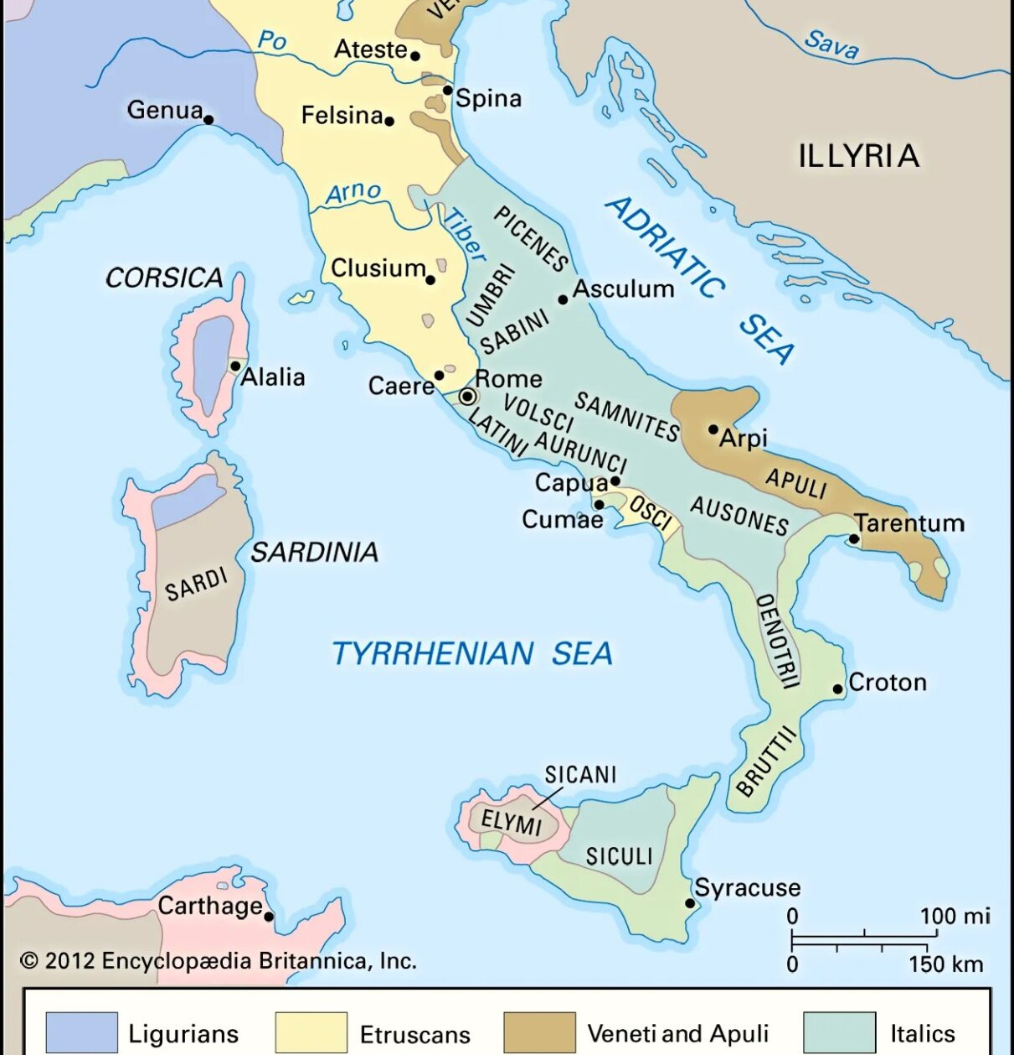
Ethnic Groups in the Bay of Naples
Oscans
Greeks
Samnites
Etruscans

Slide 5
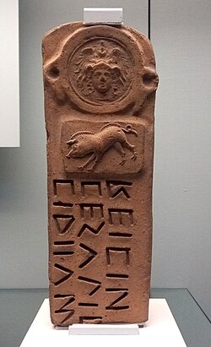
The Oscans (Osci)
The Oscans were an indigenous Italic people that inhabited the region of Campania, especially coastal regions.
They speak the Oscan language, distantly related to Latin and wrote in the Oscan alphabet (derived from the Etruscan script).
They were positioned between the Etruscans to the north and the Greek colonies to the south. As a result, they developed a highly syncretic material culture.
The earliest parts of Pompeii date to this region.
By the 5th century CE, they were absorbed by the expanding Samnites.
Oscan inscription with relief dated to the 3rd century BCE, found in a tomb near Capua, now in the British Museum

Slide 6
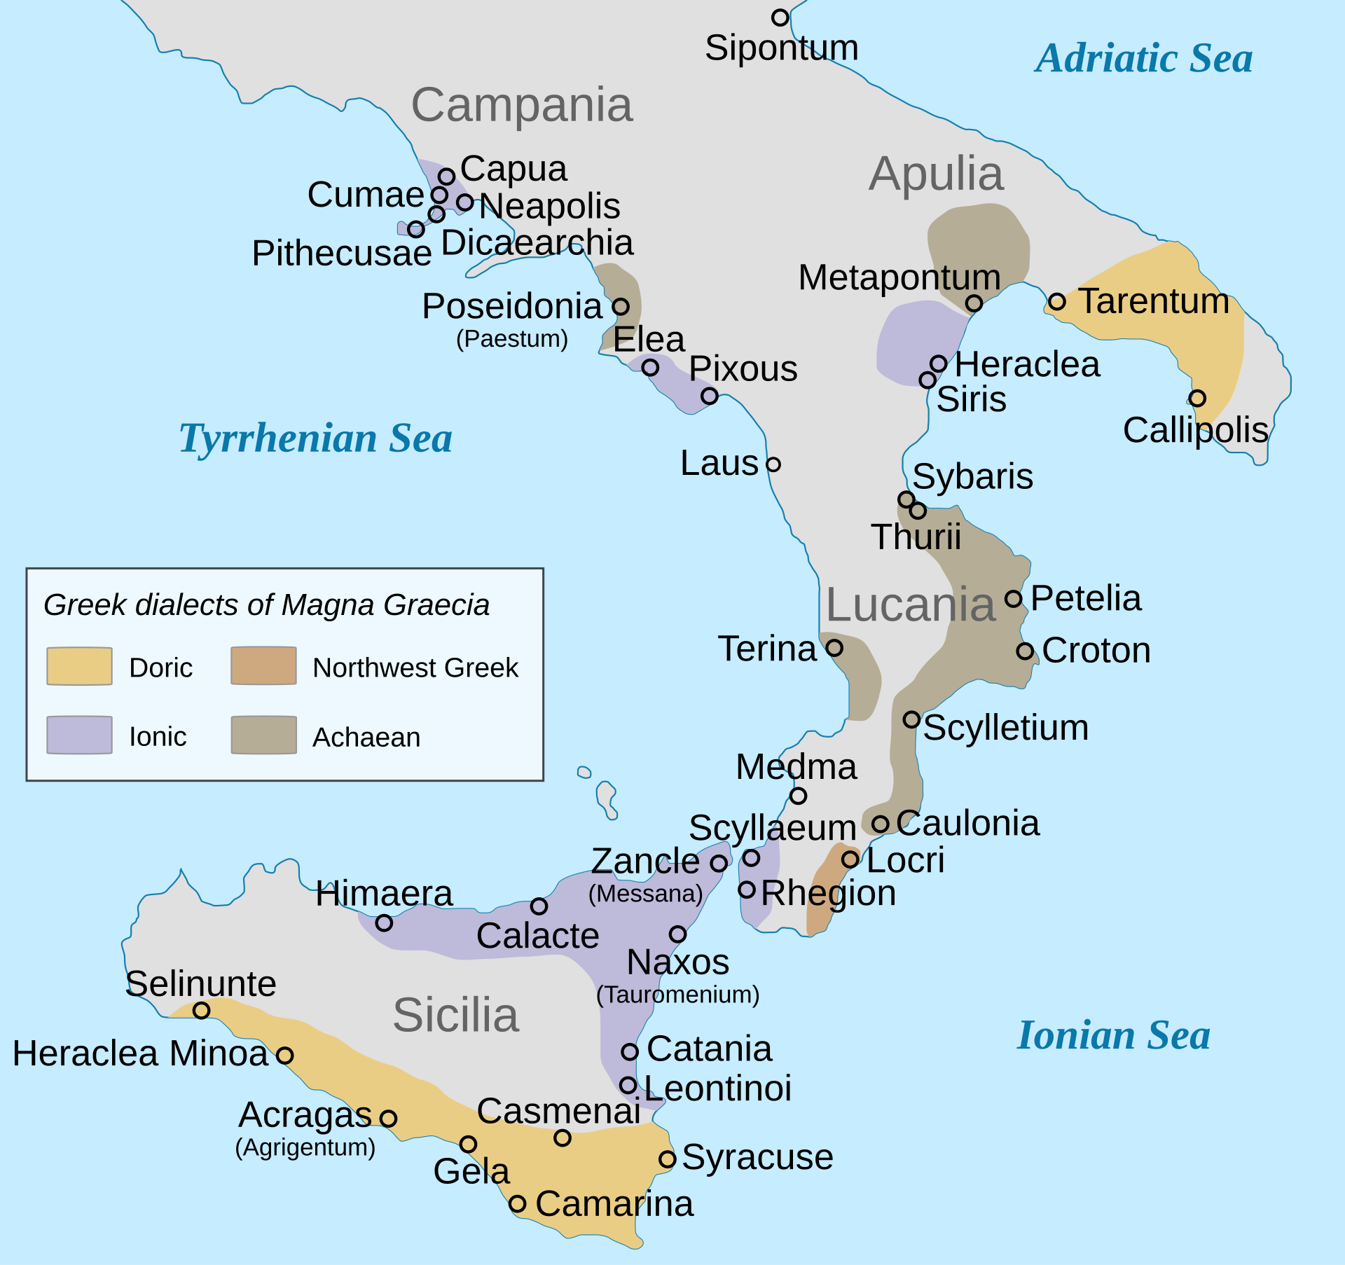
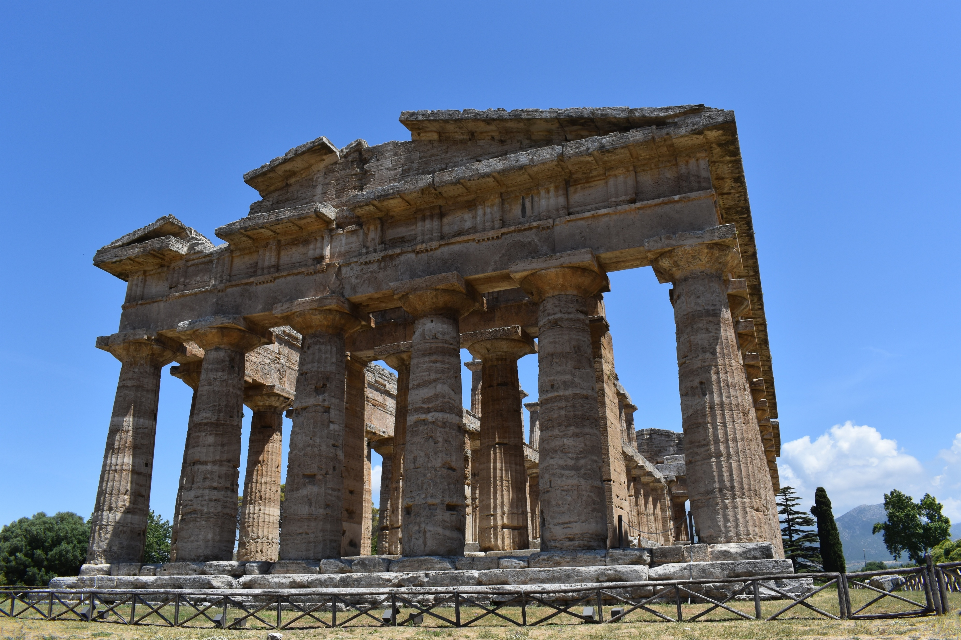
Magna Graecia
Pithekoussai 8th century BCE
Cumae first Greek colony 775 BCE
  Main political power in Campania
  Controlled other Greek sites in the region like Misenum, Puteoli, and Neapolis
During this period, we see increased trade between Greeks and Etruscans
Oldest Etruscan inscription was found at Cumae, dated 8th c. BCE, records gift giving between the two cultures
Temple of Hera II, Paestum

Slide 7
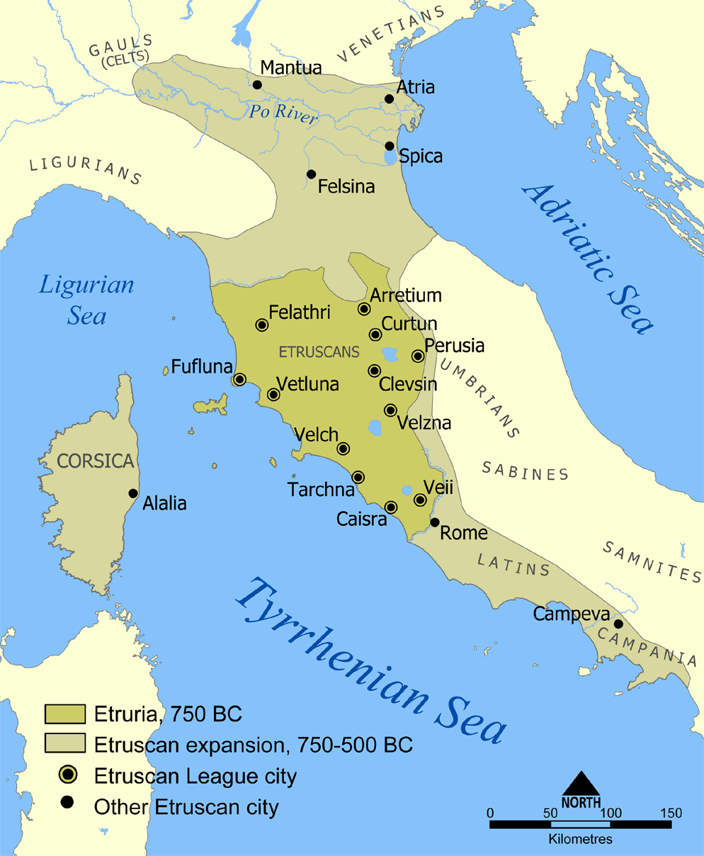
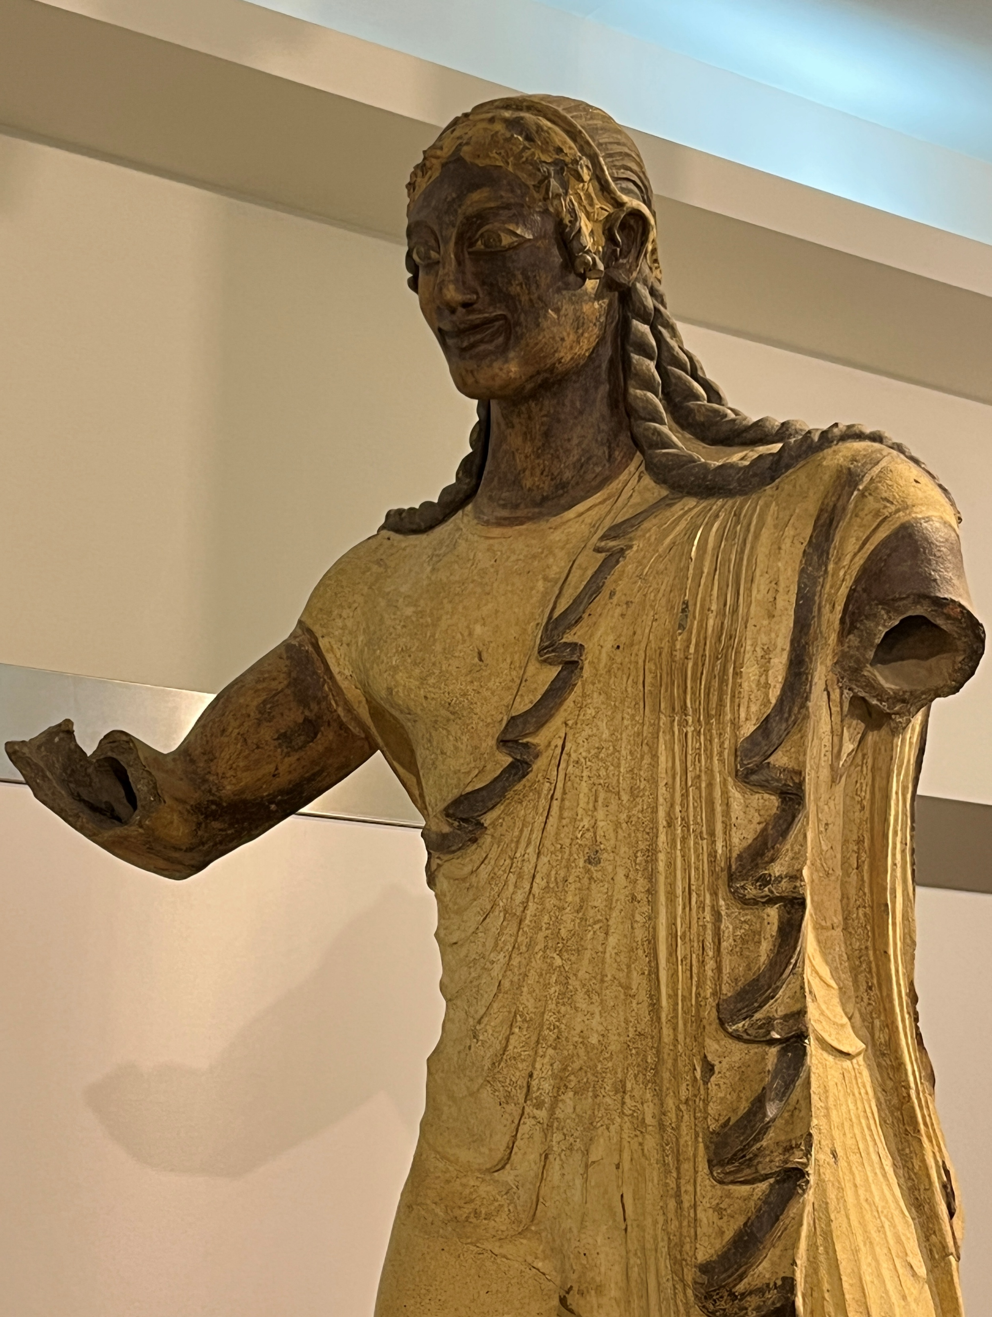
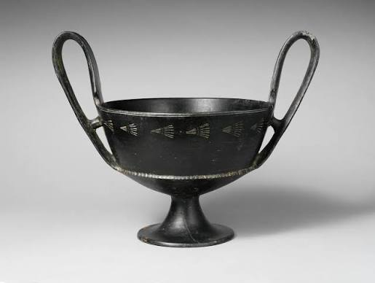
The Etruscans
Settle in Campania around the 7th century BCE
Have major settlements at Capua, Nola, Nuceria, and in the Sarno Valley
Their main pottery was bucchero, a high-fired black gloss ceramic

Slide 8
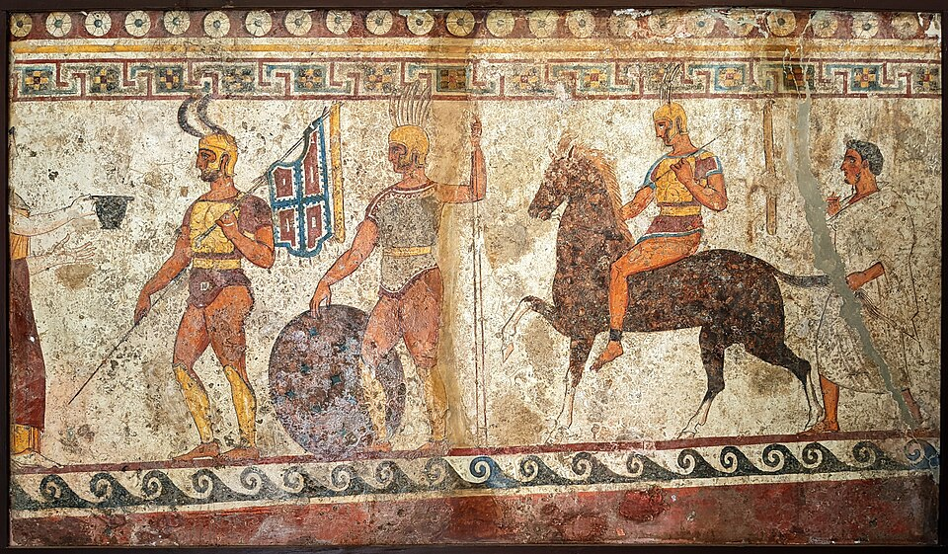
The Samnites
From the mountainous region of the southern Apennines, called Samnium.
The Samnites were organized into a formidable, decentralized confederation of four tribes.
Start settling in Campania in the 6th century BCE and take over the region, including the Greek colonies and Pompeii, by the end of the 5th century BCE.
They clash with the Romans several times during the Samnite Wars (343-290 BCE).
They also write in Oscan.
Samnite soldiers depicted on a tomb frieze from Nola (Campania). From the 4th century BCE.

Slide 9
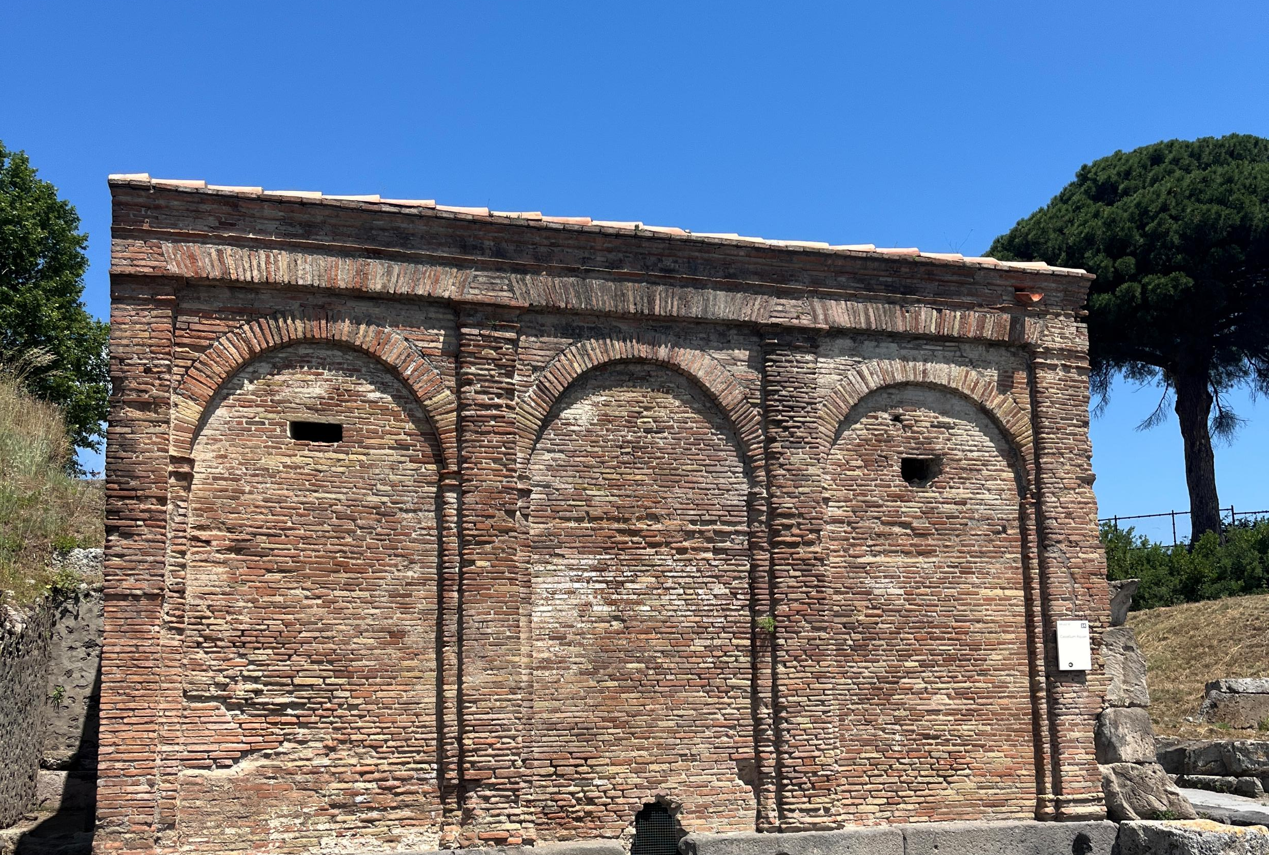
How do we date Pompeii? -Masonry Styles
Castellum Aqua at Pompeii made of Opus Testaceum.
Opus Quadratum (c. 650 BCE)
  Large square blocks of local tufo, without mortar
Opus Africanum (c. 500 BCE)
  Grids of large blocks of Sarno limestone filled with rubble, bonded with clay
Opus Incertum (c. 200 BCE)
  Concrete core with limestone and tufo rubble, faced on either side with small irregular stones
Opus Reticulatum (c. 60 BCE)
  Concrete-faced with pyramidal shaped blocks forming a regular pattern. Can also use bricks.
Opus Craticum (late 1st century BCE)
  Thin wall of opus incertum enclosed within a wooden frame, used for upper stories.
Opus Testaceum (c. late 1st century BCE)
  Core of concrete faced with fired bricks or tiles
Opus Vittatum Mixtum (35 CE)
  Concrete core faced with alternating rows of blocks and bricks/tiles.

Slide 10
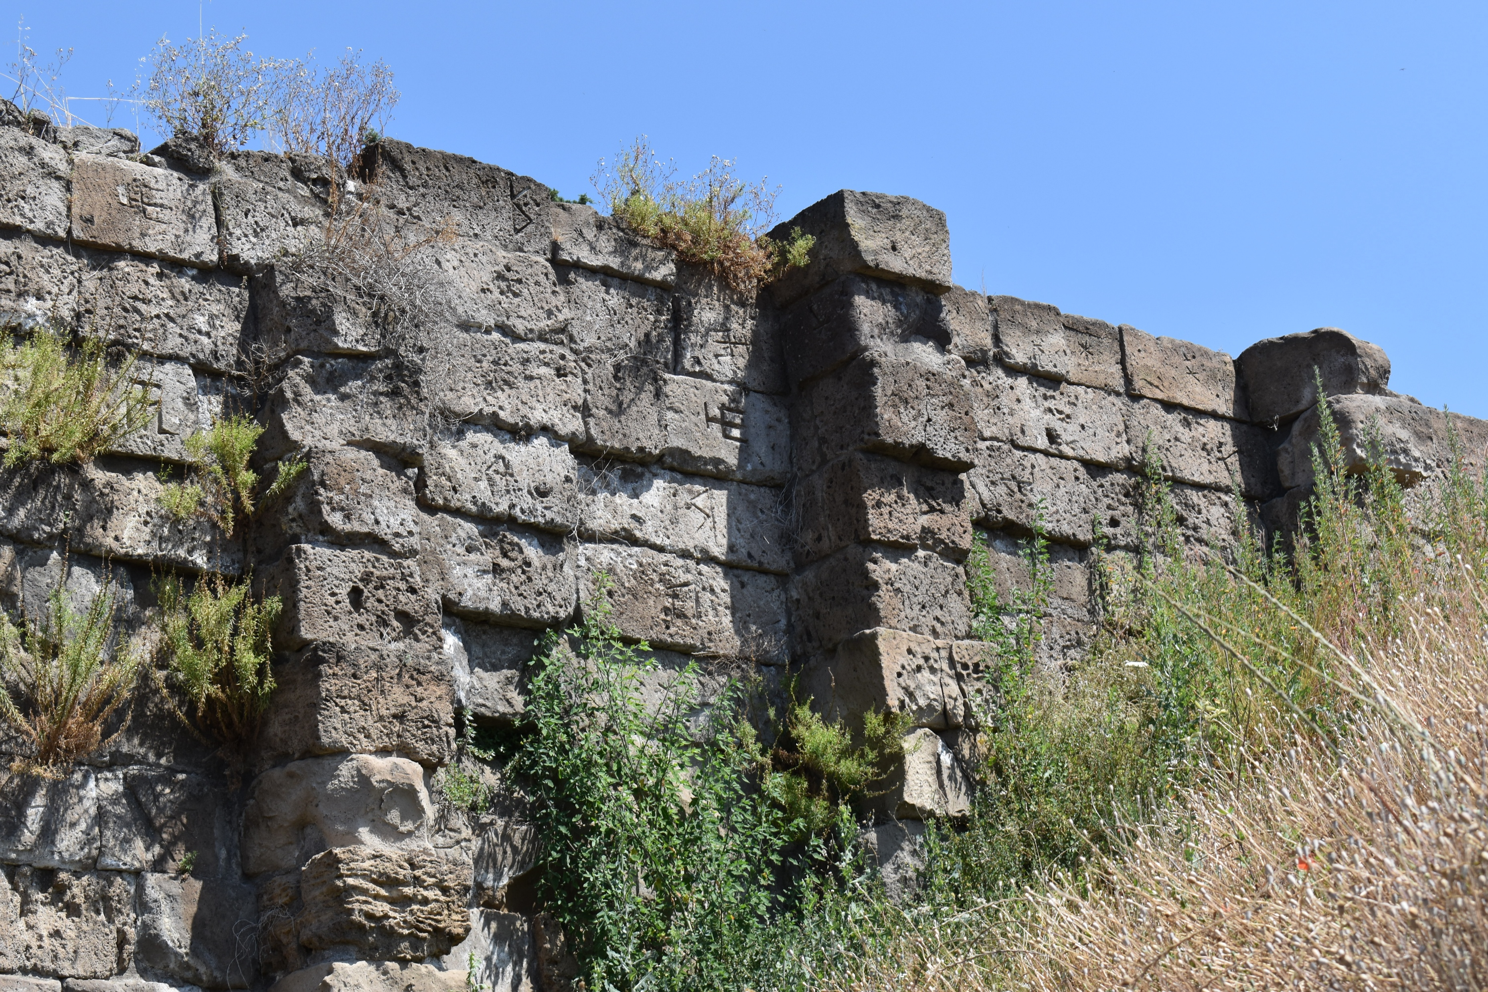
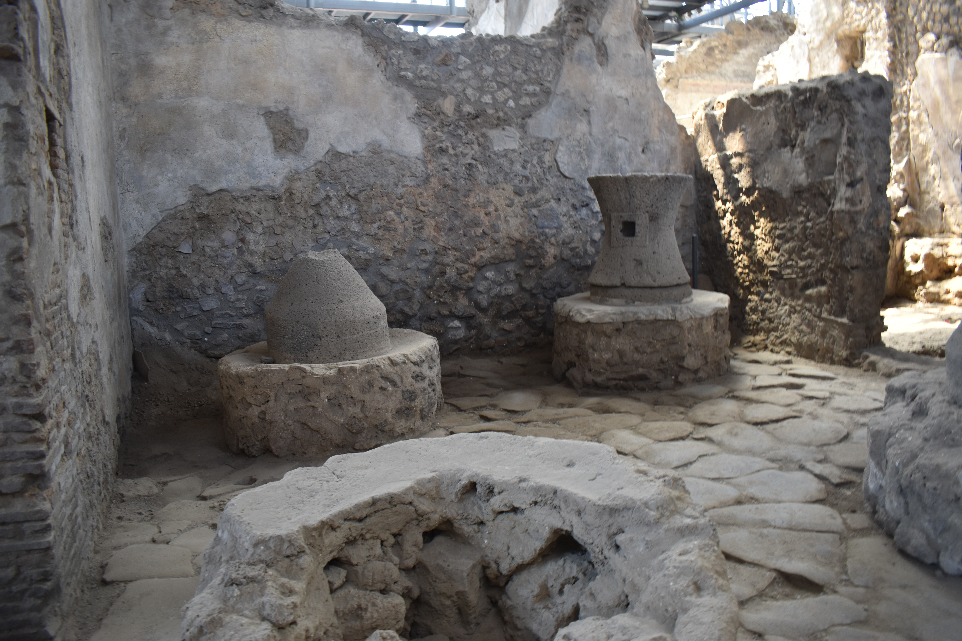
Opus Quadratum
Opus Incertum

Slide 11
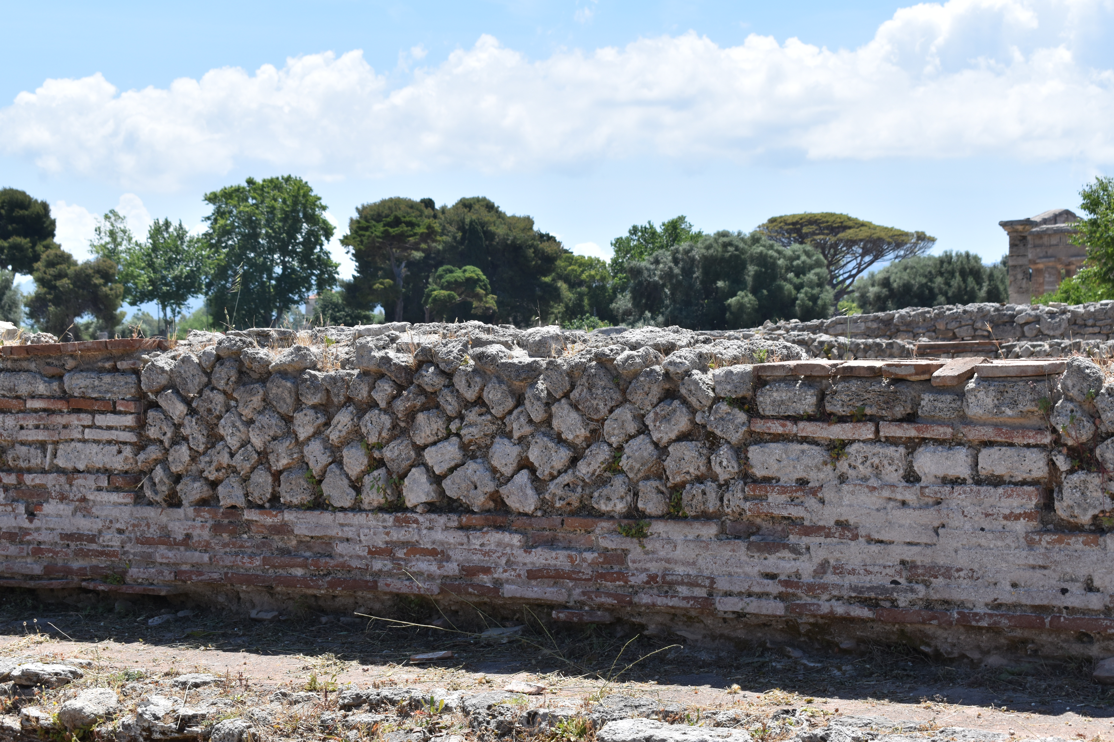
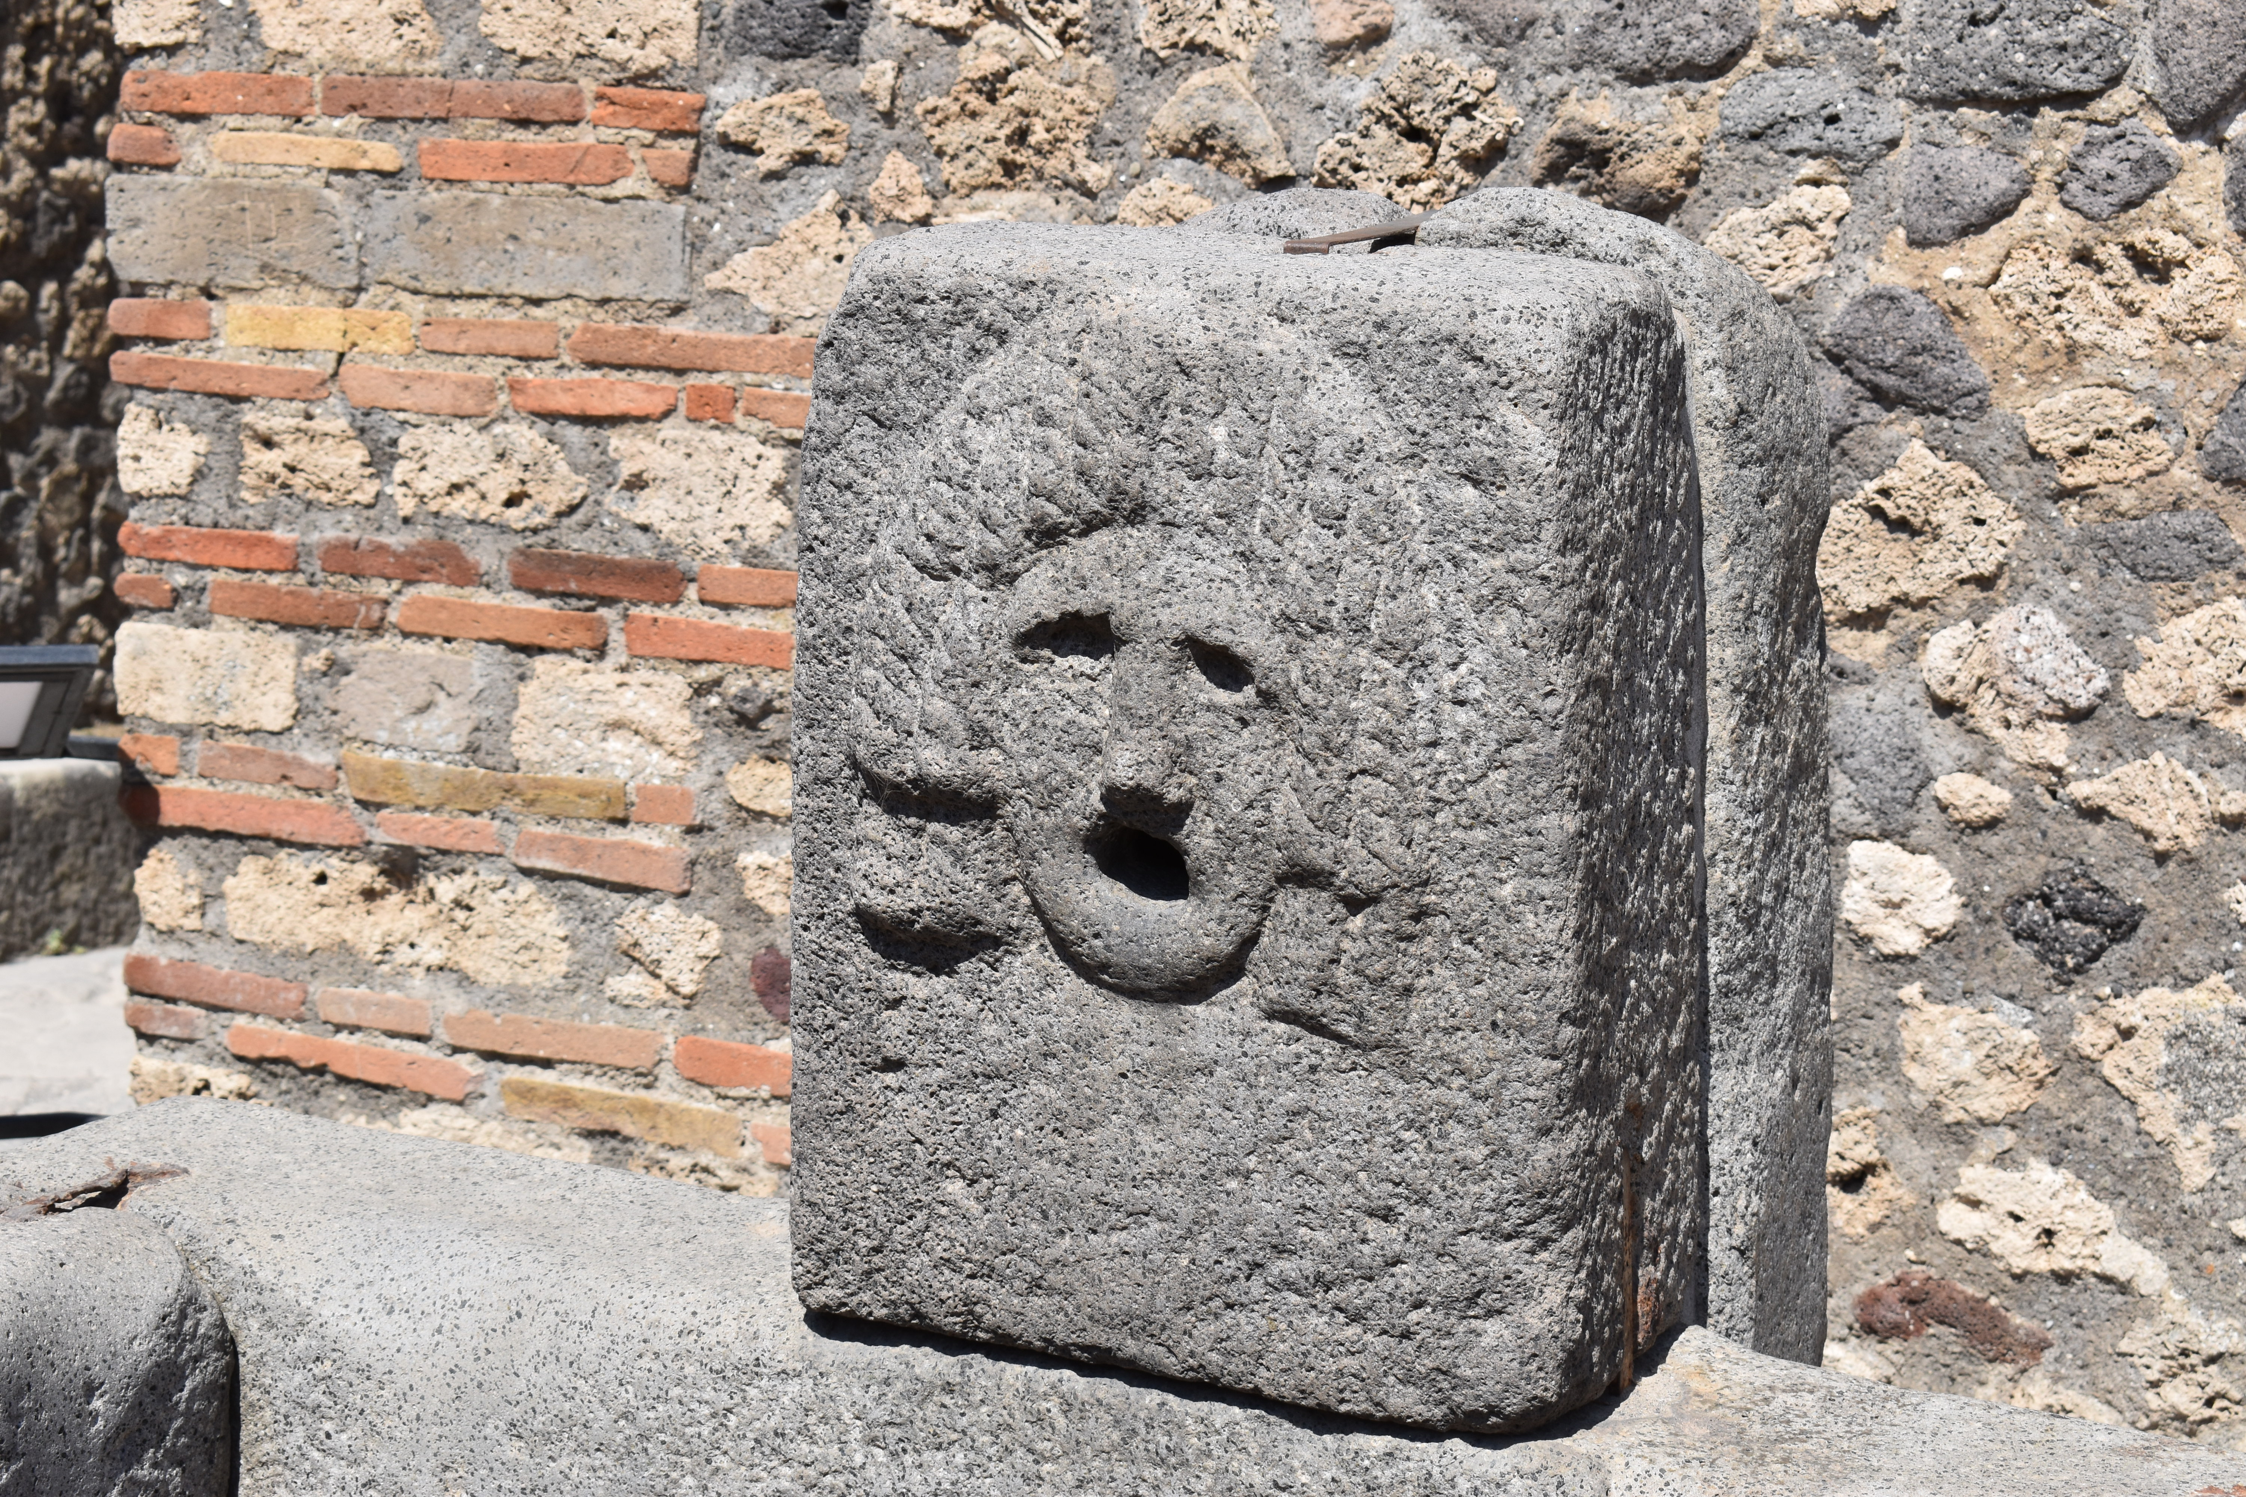
Opus Reticulatum
Opus Vittatum Mixtum

Slide 12
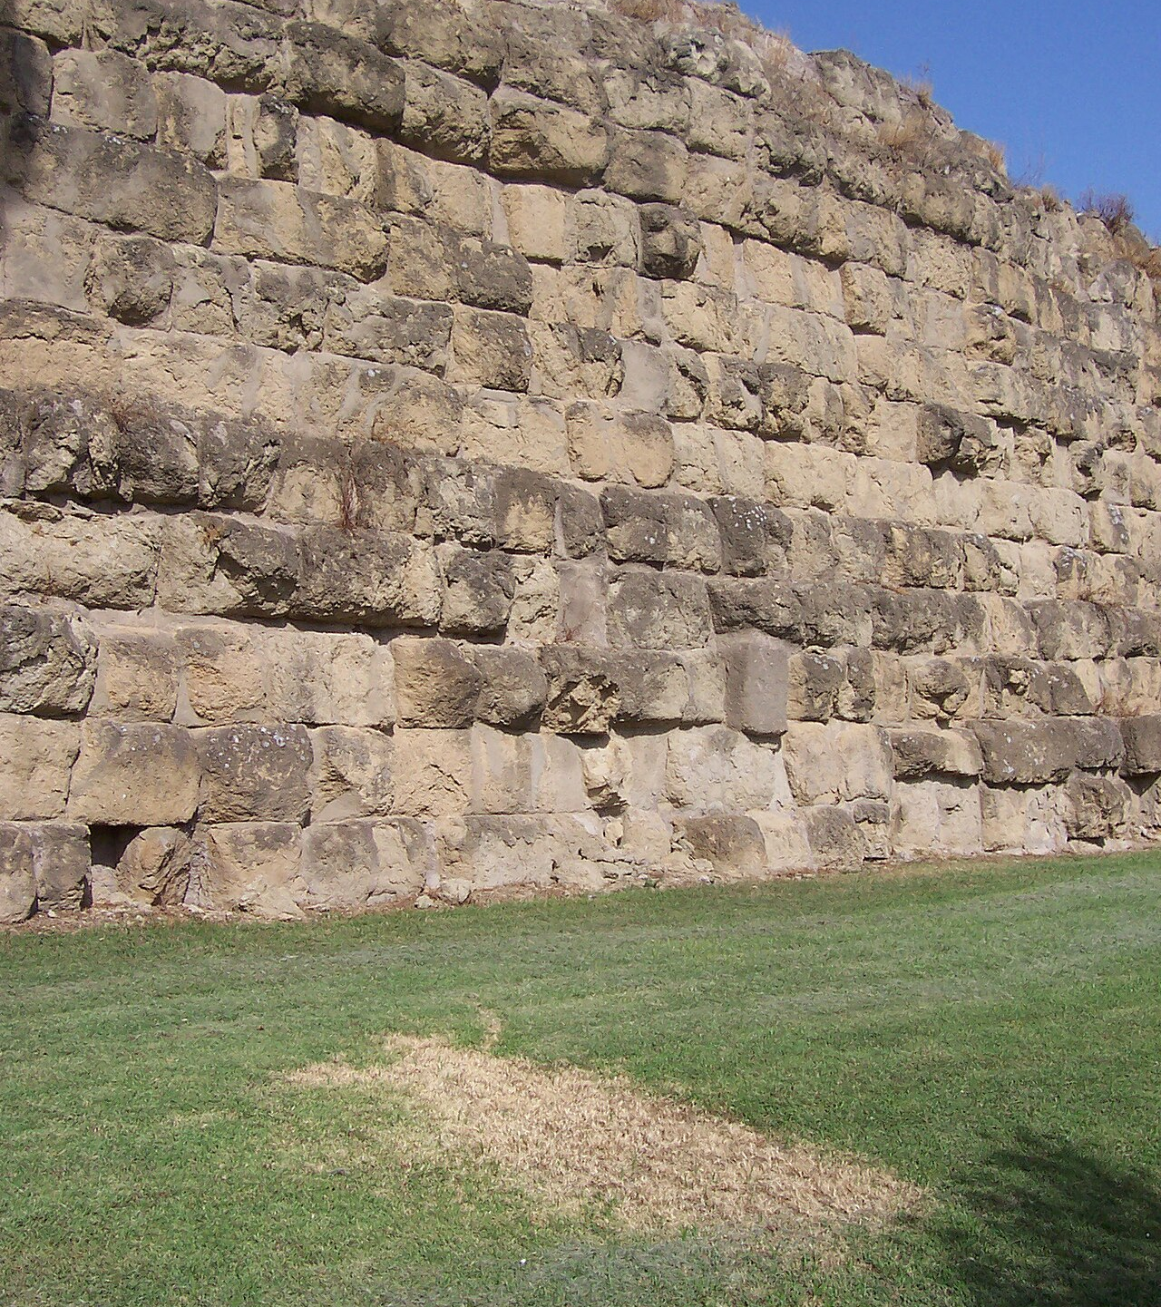
Common Italic Building materials
Tuff or tufo- an igneous rock made from volcanic ash (tophus). A soft rock and good for construction.
  Not to be confused with Tufa- a type of sedimentary stone made from calcium carbonate, a type of limestone
Pappamonte- volcanic tuff local to Campania
Sarno Limestone- local limestone in the Sarno Valley
Servian Walls, Rome. Made of Tufo. 4th century BCE

Slide 13
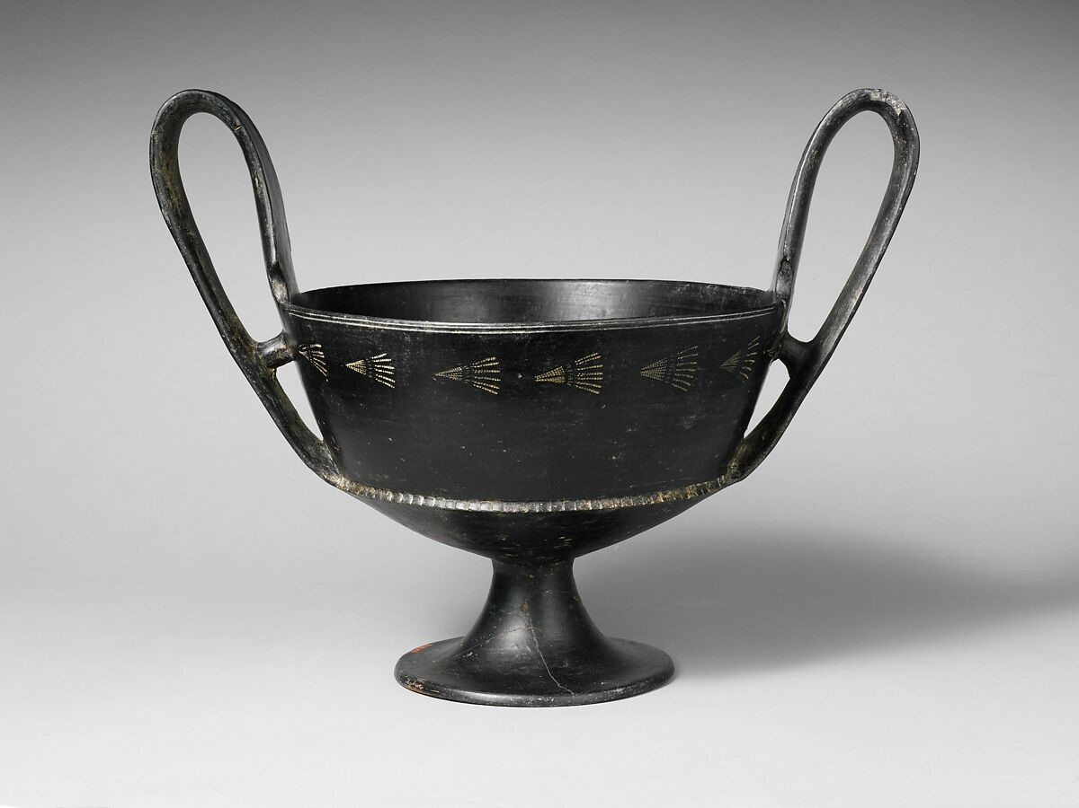
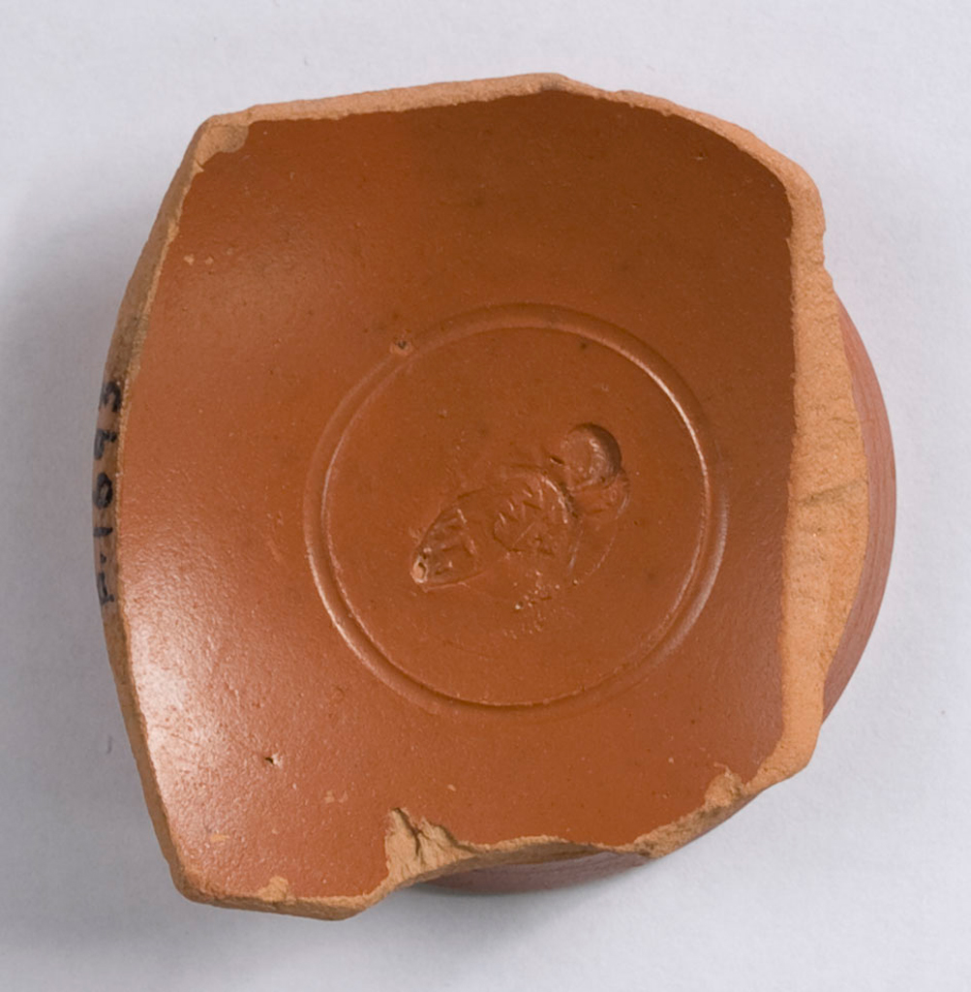
How do we date early Pompeii? -Ceramics
Black Gloss Wares and Etruscan Bucchero (7th century BCE - 400 BCE)
Arretine Ware/ Samian Ware
Terra Sigillata (1st c. BCE – 7th c. CE)
Etruscan Bucchero kantharos (drinking cup). 650-600 BCE. The Metropolitan Museum of Art 21.88.146.
Arretine Terra Sigillata Cup Base Fragment, 30 - 54 CE, Bryn Mawr Special Collections P.1693

Slide 14
Foundation of Pompeii
Oldest archaeological remains found at Pompeii date from the Neolithic, Bronze and Iron Ages. But no evidence of a permanent settlement until later around the 8th or 7th centuries BCE
What kind of settlement?
  During its earliest phase it was not a large urban center. Perhaps a series of villages placed close together.
Difficulties dating this period as many of the later Roman structures of the 2nd century BCE – 1st century CE are built on top of earlier remains.
The name Pompeii may derive from the Oscan pumpe meaning “five”, possibly referring to five villages that made up the original settlement. Other theories suggest from the Greek pompe meaning procession, referring to its earliest religious nature.

Slide 15
Strabo’s Description (early 1st c. CE)
“The city was once held by Oscans, then by the Tyrrheni and the Pelasgi, and after by the Samnites.” -Geography 5.4. 8
Tyrrheni= Etrsucans
Pelasgi= Greeks

Slide 16
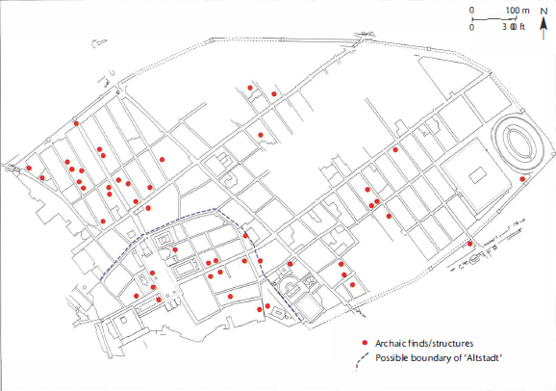
In Search of the Oscan Remains at Pompeii
Oldest remains date to the 6th century BCE.
  Fortification walls
  Temple of Apollo
  Temple of Athena/Heracles
Evidence suggests that the town was planned and laid out at its very foundation (possibly as early as the 6th century BCE).

Slide 17
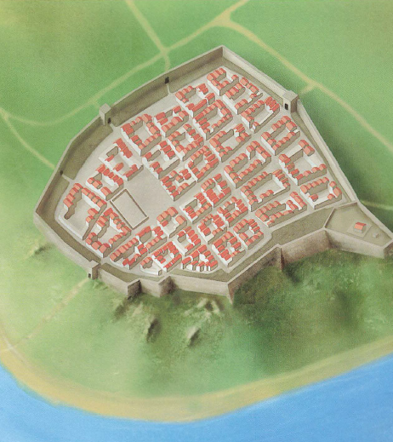
The Theory of the Aldstadt
Aldstadt- old town
Heavily debated theory on the early urban origins of Pompeii. =Proposed by 19th century scholar Heinrich Nissen.
Explains the irregular plan of Regio VIII compared to other rest of the city.
Theory:
  In the 6th century, an irregular cluster of streets in the southwest corner of the city was built on a plateau for defensive purposes, possibly by the Oscans or Etruscans
  In the 4th-3rd c. BCE, the city expanded into the surrounding region under the Samnites. As a result, the original Aldstadt was dismantled and a newer fortifications were built to create a new town.
Has largely been discarded. Now believed to have been a macro-urban project, which a massive perimeter wall encircled a large space which was filled with some settlement mixed with green space.

Slide 18
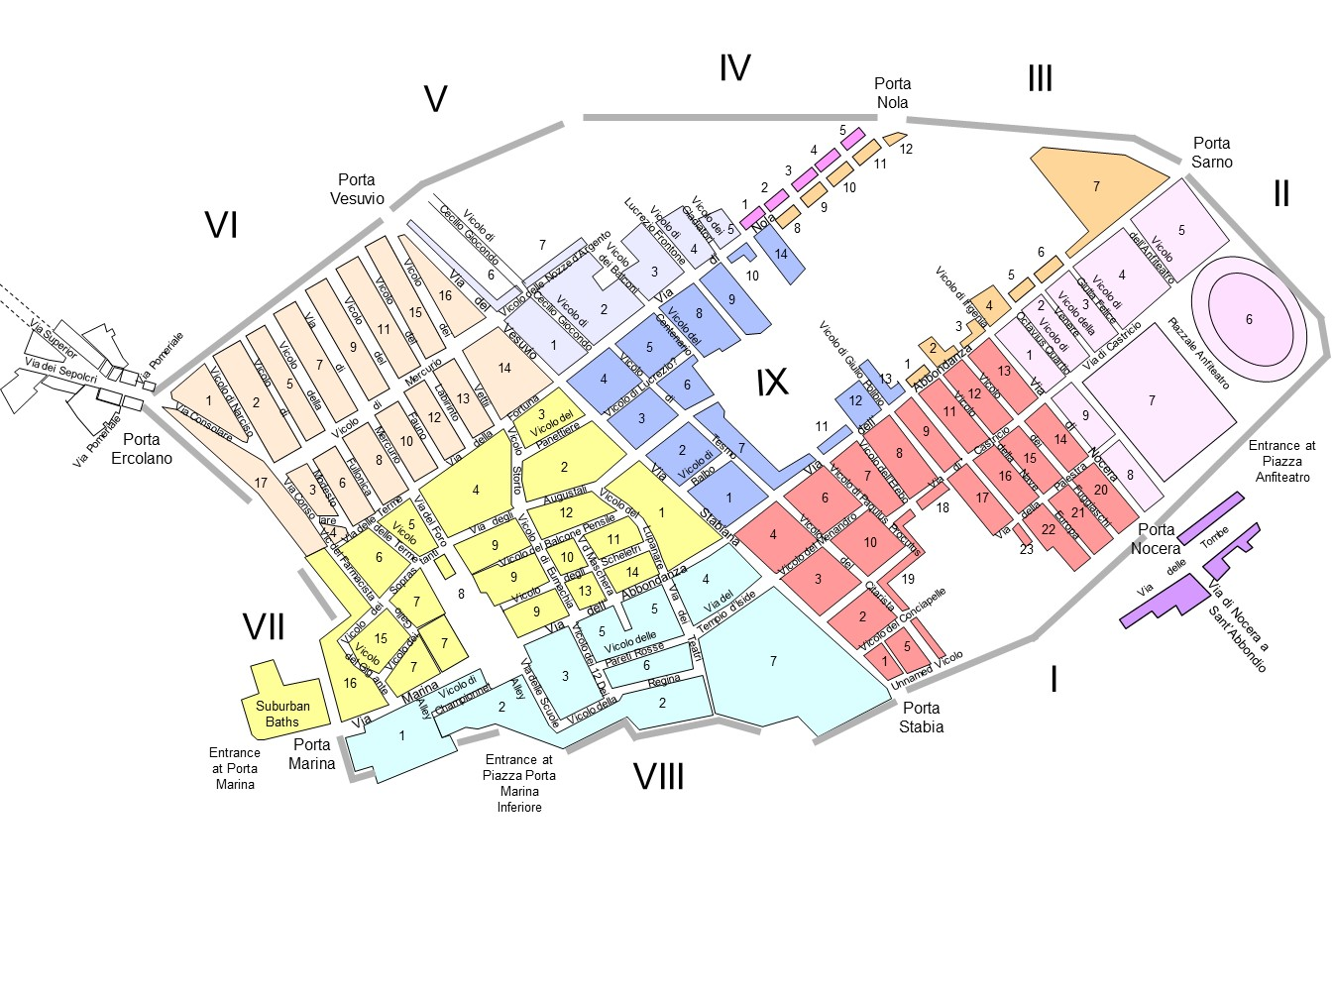
Regions of Pompeii

Slide 19
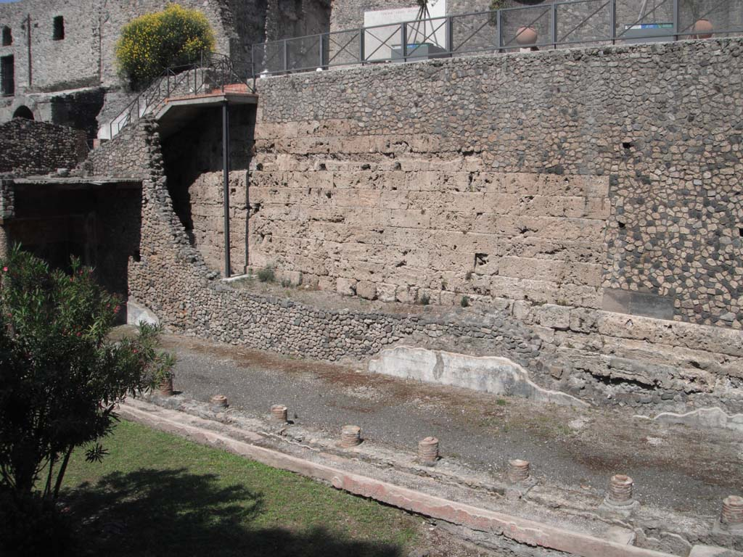
City Walls
6th century BCE- the earliest circuit wall made from blocks of pappamonte (local volcanic tuff).
4th - 3rd/2nd centuries BCE- Samnite phase, rebuilt as a double curtain wall made of Sarno limestone filled with earth and rubble core.
2nd/1st century BCE- Pre-Roman phase. 12 towers were added to points along the perimeter.
Why was it fortified in this period?
  Possible clashes between Greeks, Etruscans, and Samnites.

Slide 20
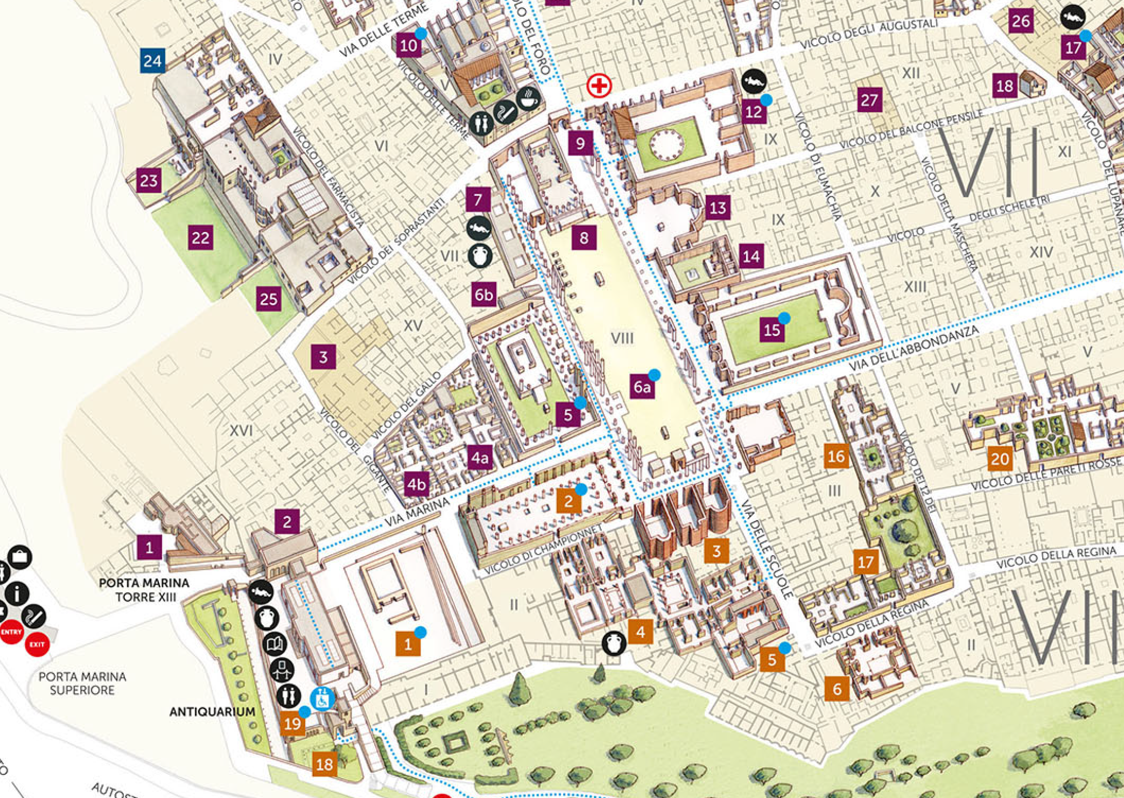
Temple of Apollo
Regio VII.7.32
To the west of the later Forum, on the road going up from the Porta Marina
Apollo is a god important and popular among Greeks colonists and Etruscans
  Apollo at Veii, and Apollo Archegetes in Naxos (Sicily), Temple C at Selinus, Temple of Apollo at Syracuse

Slide 21
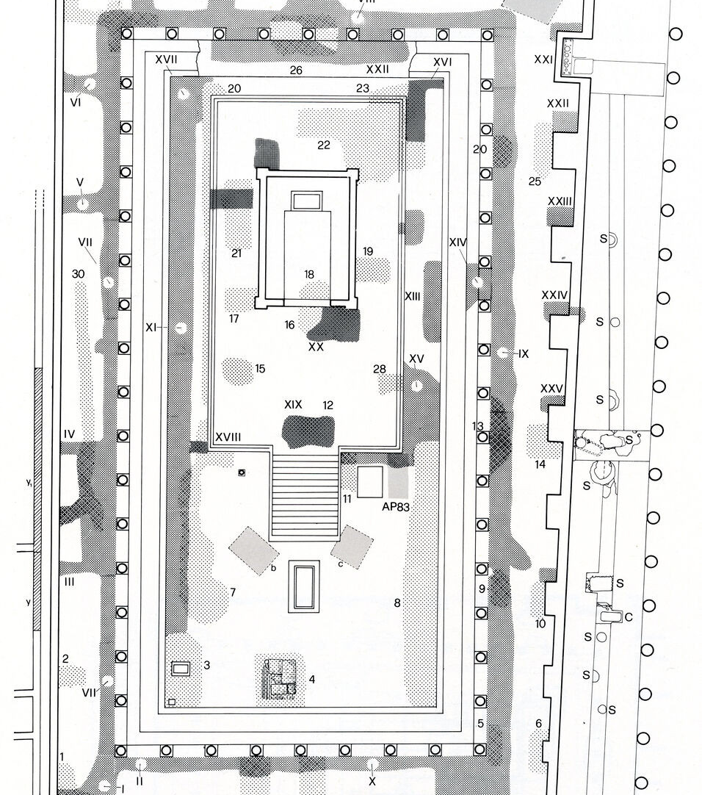
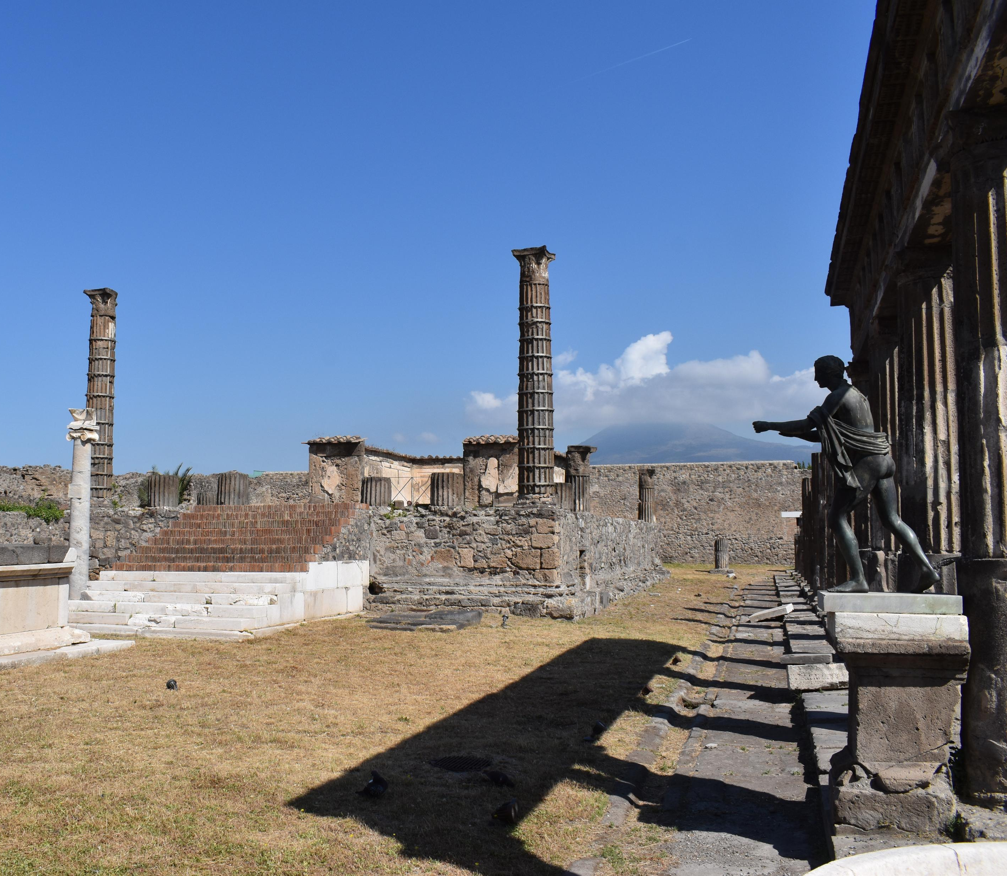
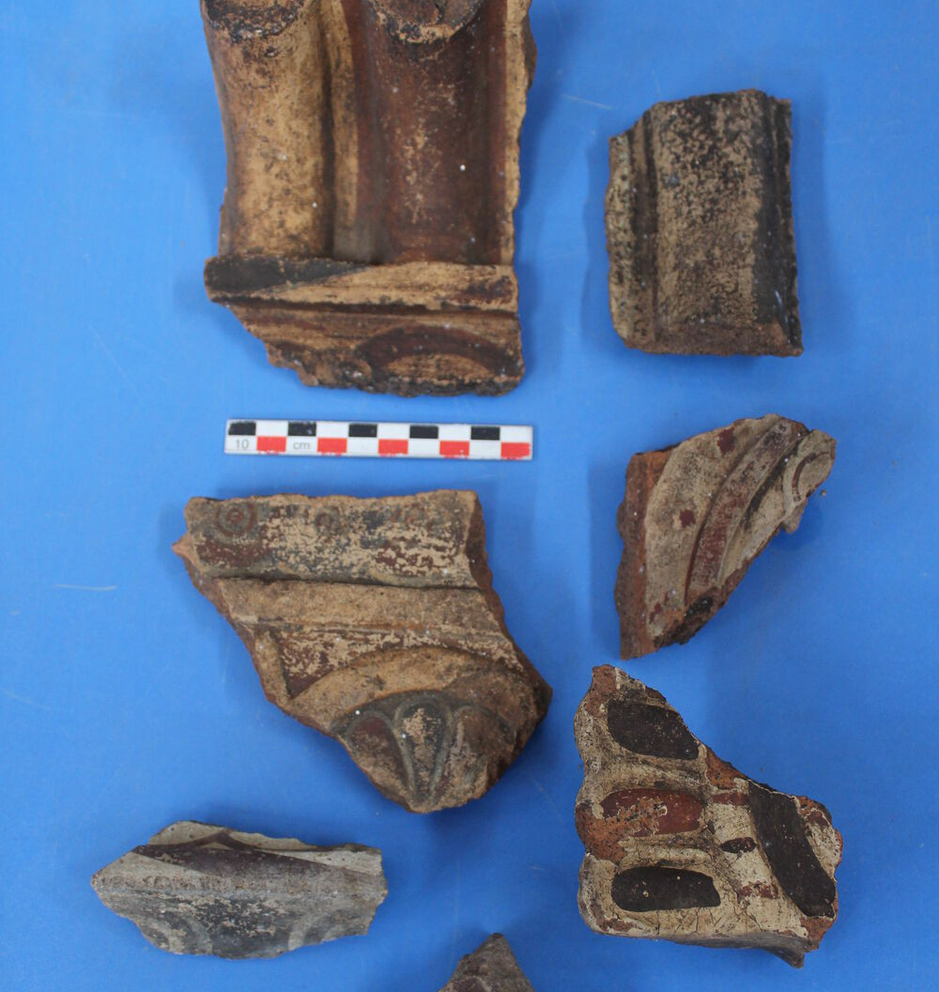
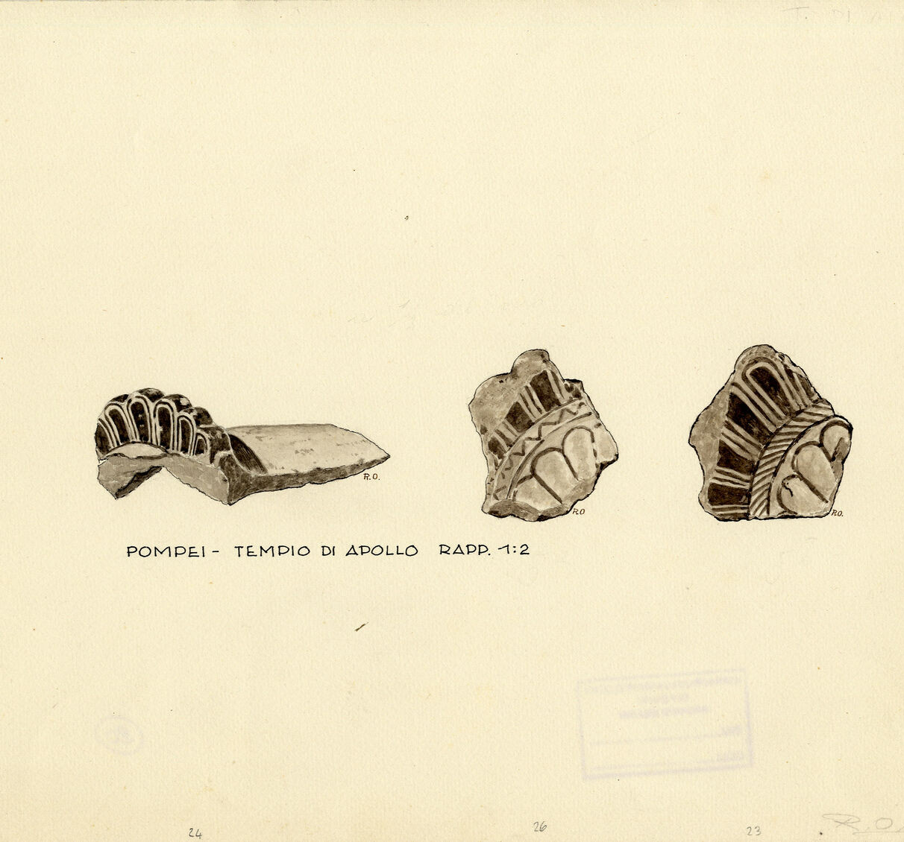
Temple of Apollo
Excavations by Maiuri (1931-1943) and more recently by the University of Campania (2015-2017)
6th century BCE architectural terracotta suggest earlier cult space, possibly Greek based on style
Corinthian pottery 575-550 BCE
Attic pottery 450 BCE

Slide 22
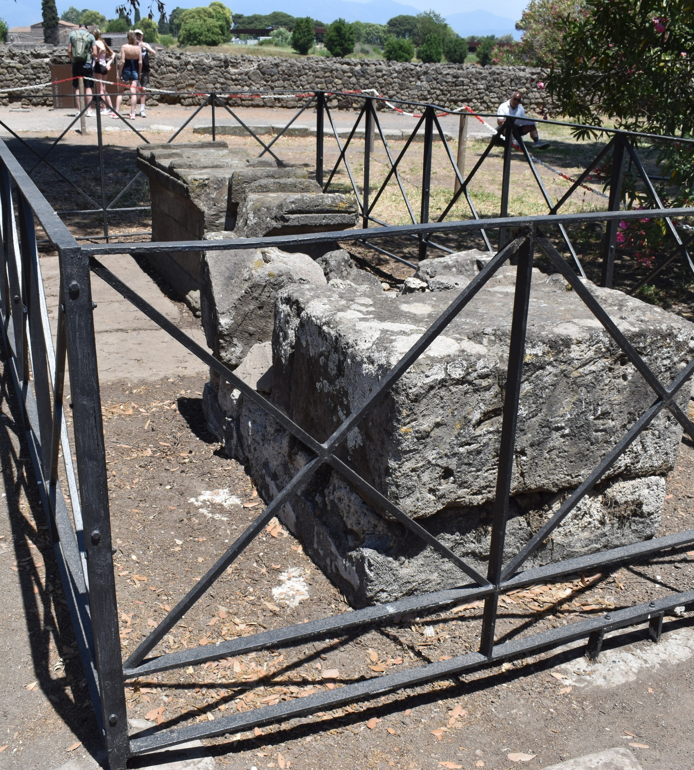
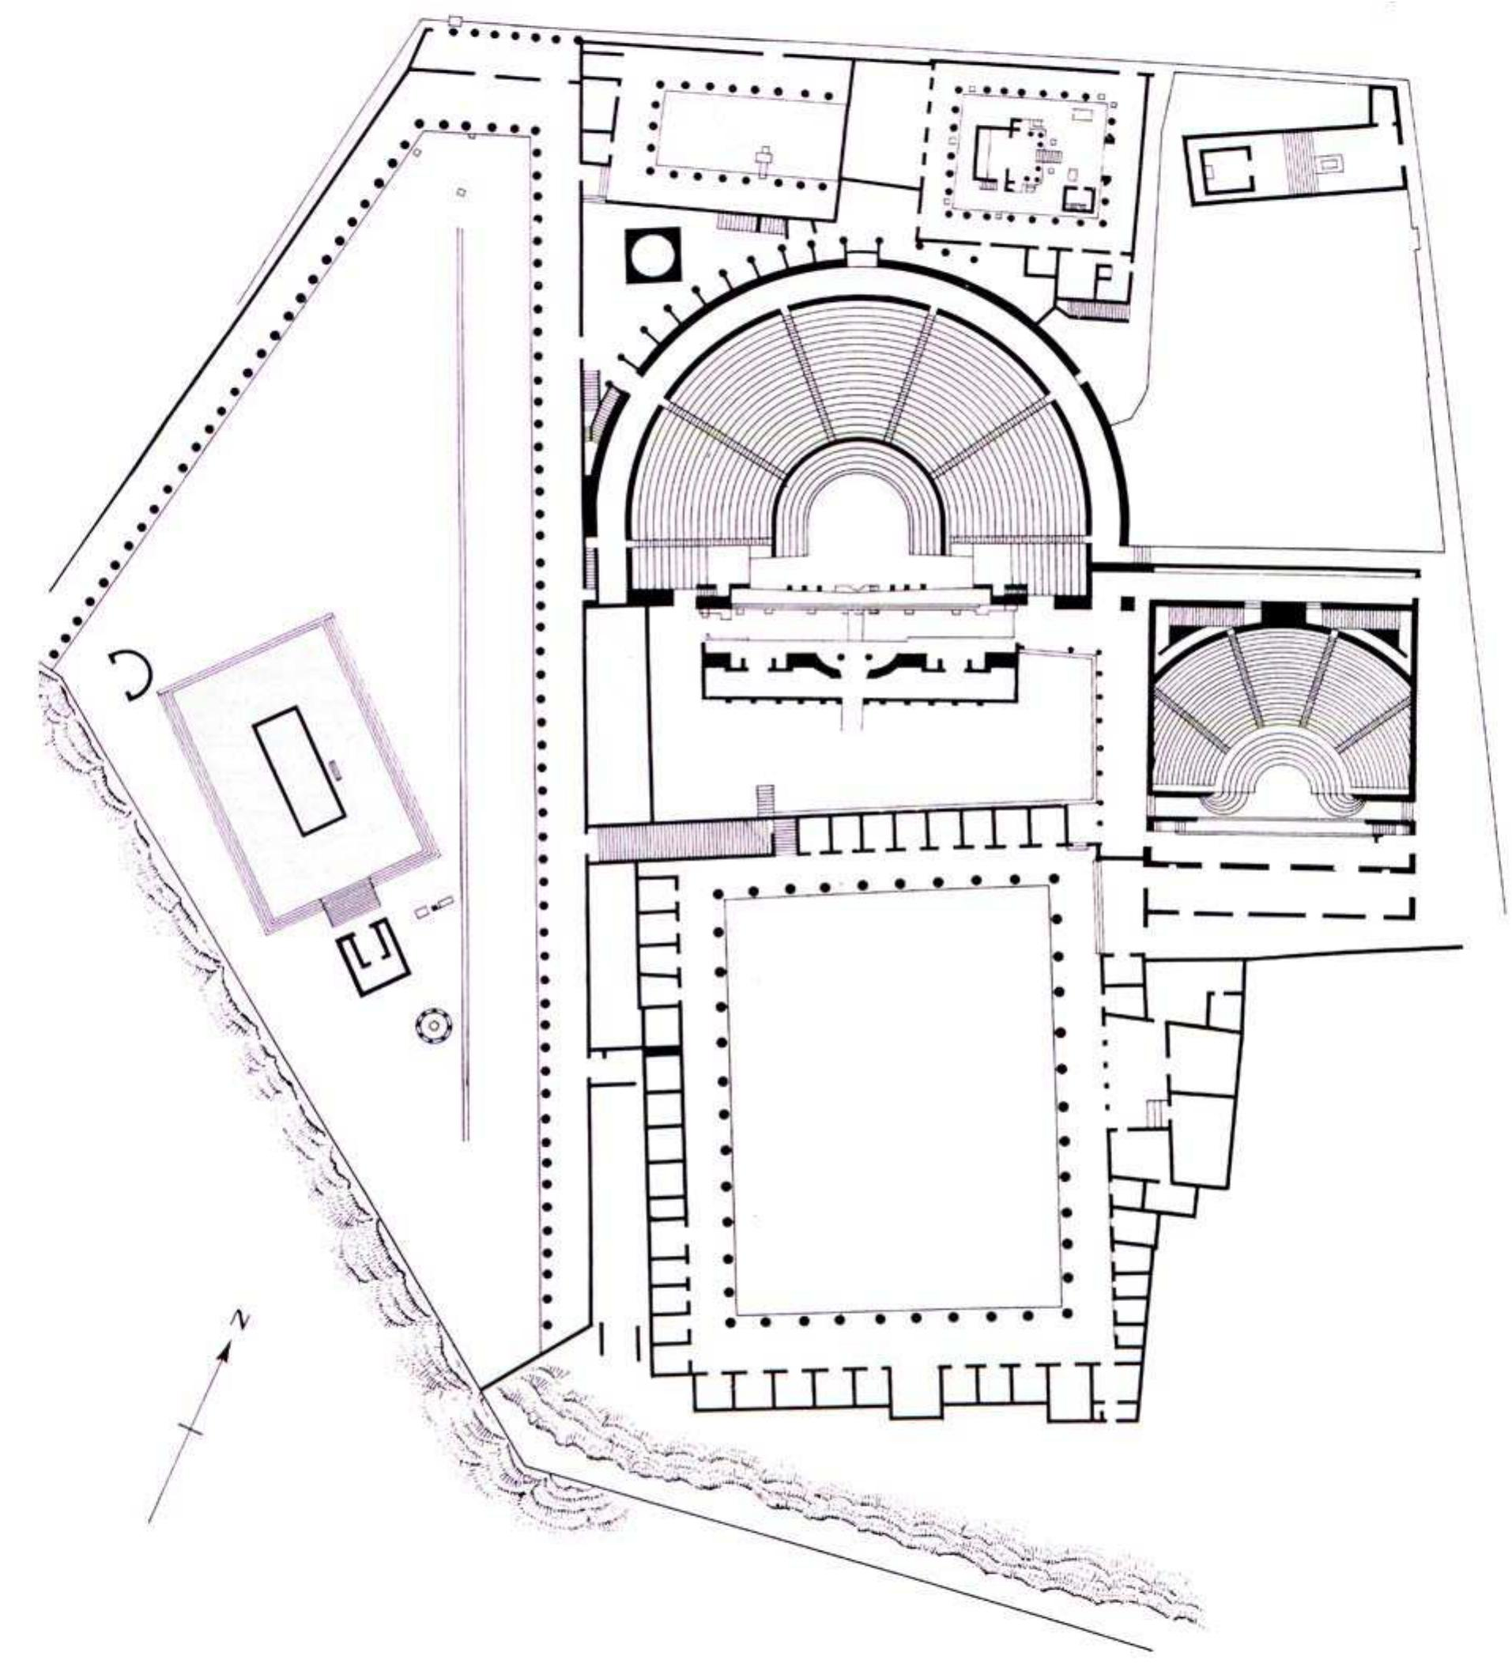
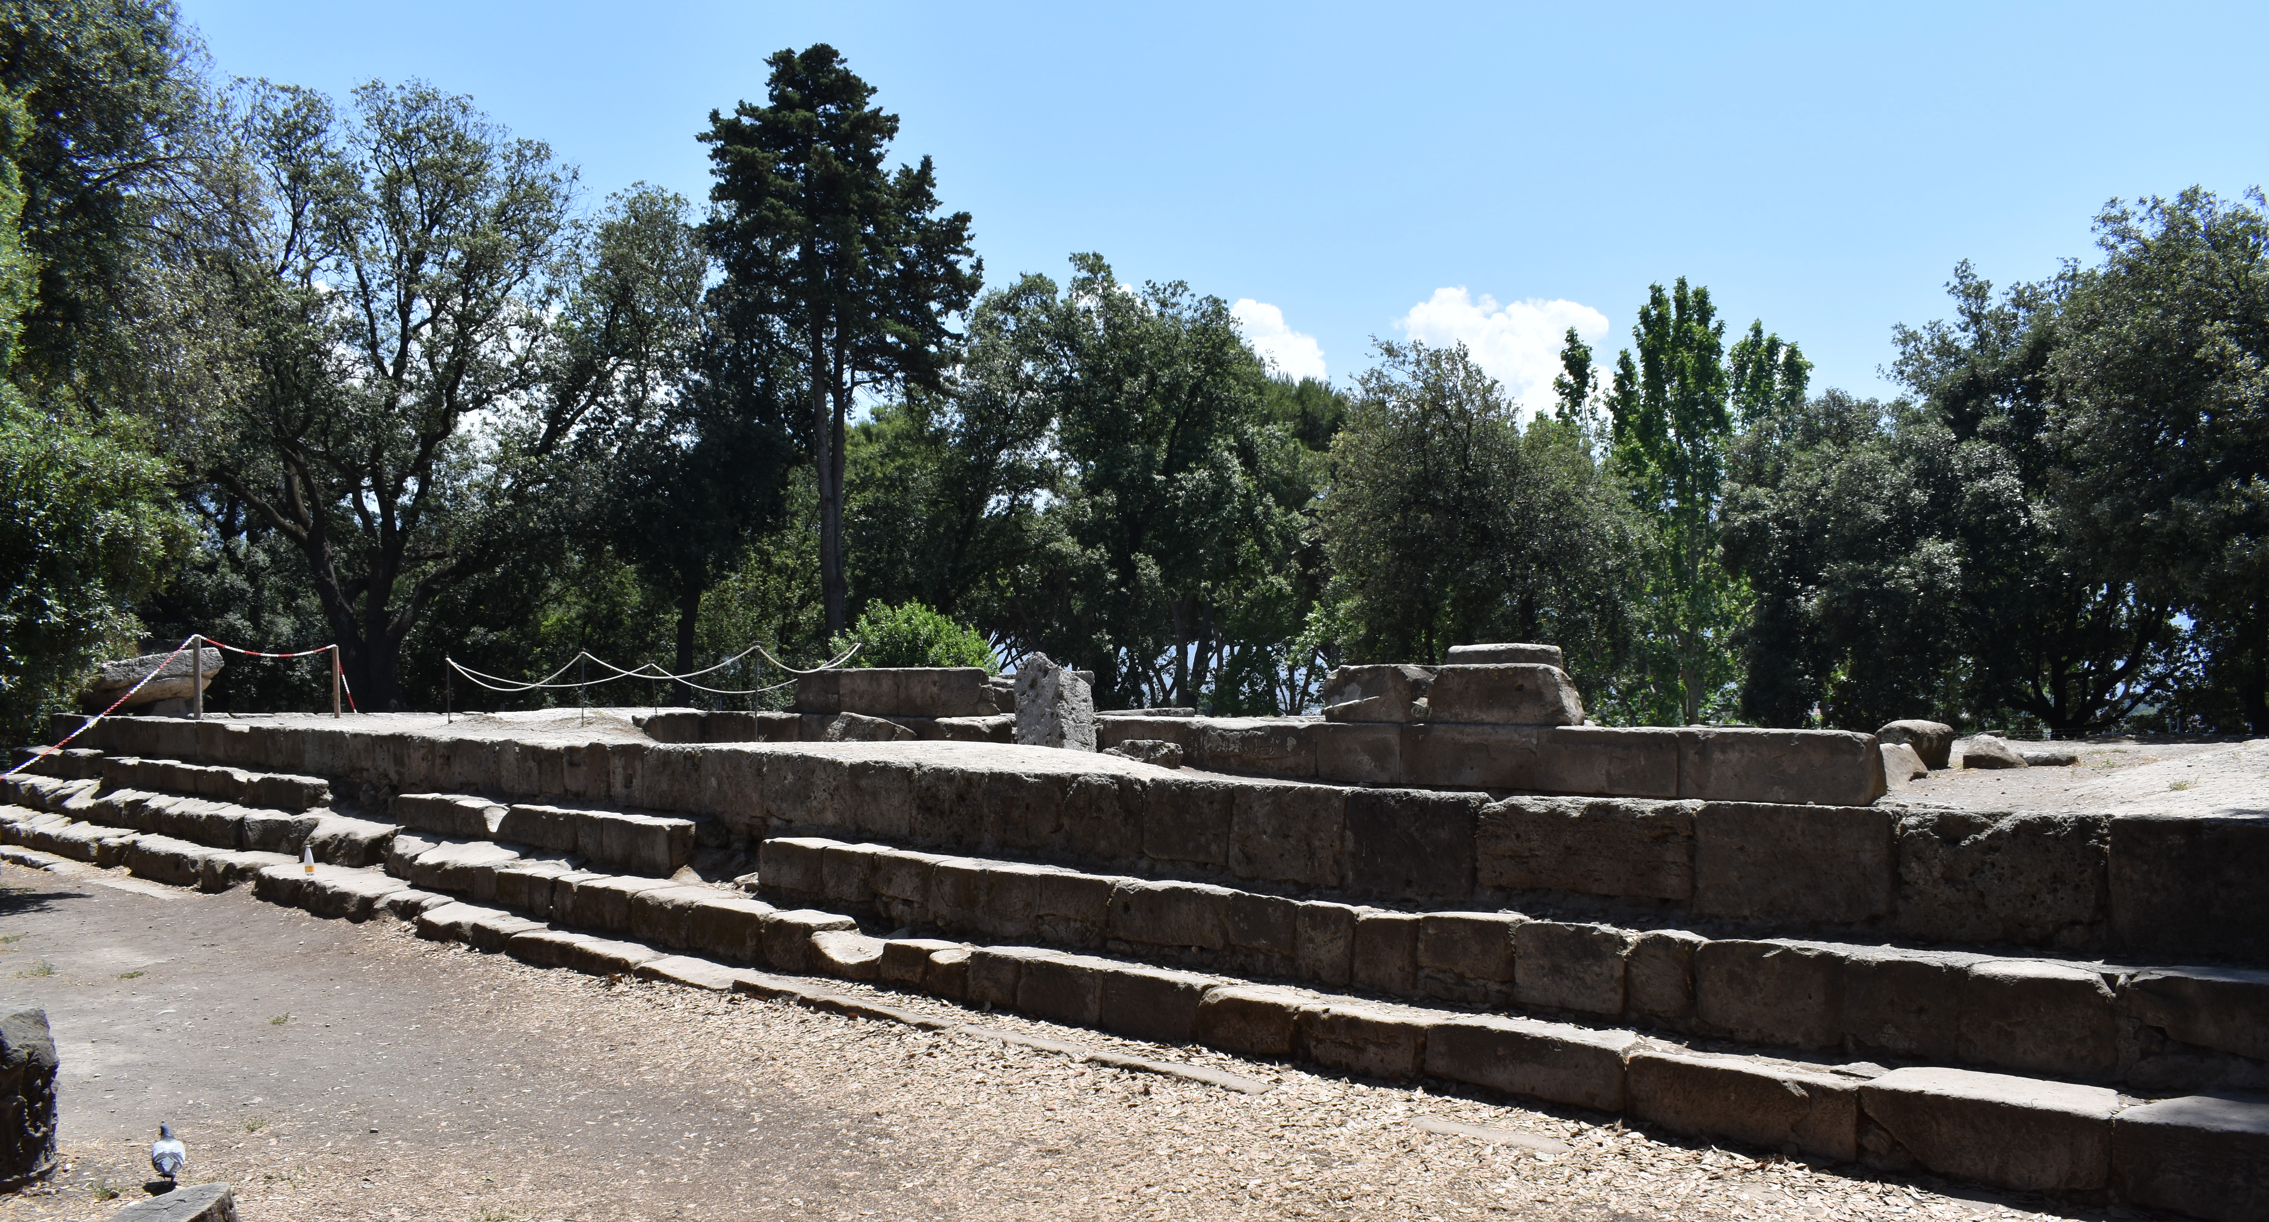
The Doric Temple (Archaic Temple)
Dated 6th century BCE
Located in the Triangular forum, the oldest part of the city.
Possibly dedicated to Athena or Heracles
Characterized by its archaic Greek doric colonnade with terracotta revetment
Similar to archaic Greek temples found at Paestum and Metapontum.
Continued to be in use in later periods. Continuity of cult or at least symbolic religious meaning.

Slide 23
Greeks or Etruscans at Archaic Pompeii?
By the 6th century BCE, it is clear there is a strong interaction with Greeks in Campania, probably from Cumae or Neapolis in the Bay of Naples.
To what degree the settlement at Pompeii was a Greek colony or not is debated.
Archaeological material clearly shows Greek and Etruscan influences.
  Greek style temples and architecture
  Etruscan style bucchero
  Oscan inscriptions
At nearby Stabiae, we have Etruscan inscriptions written in a local Nucerian alphabet.
By the end of the 5th century BCE, this region is clearly under Samnite rule.

Slide 24
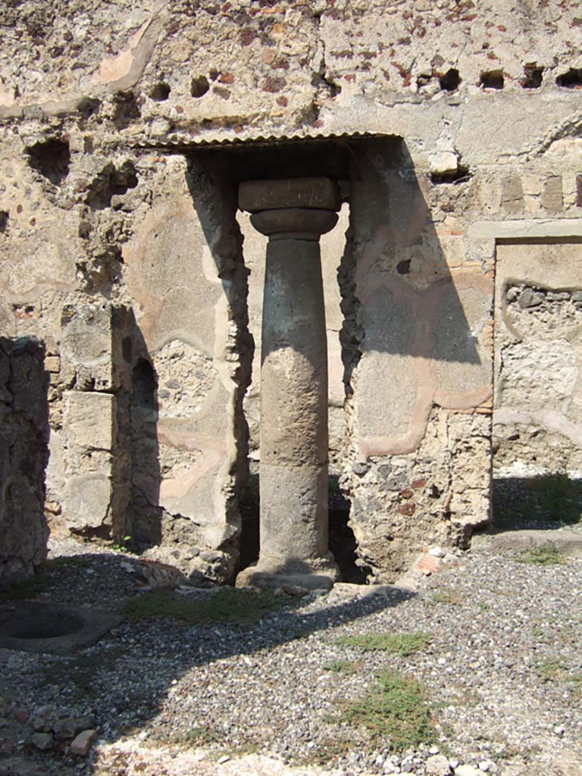
House of the Etruscan Column
Located in Regio VI.5.17
Contains a single stone column embedded in the atrium wall of the house.
The column is dated to the archaic period (6th century BCE).
The house is clearly later (c. 2nd century BCE).
So what is this column doing here? How do we interpret this?
The column was intended to be freestanding, possibly to hold a statue. Part of an earlier religious altar perhaps with a sacred grove.
6th century Greek pottery has been found in the area around it, as well as beech tree seeds.

Slide 25
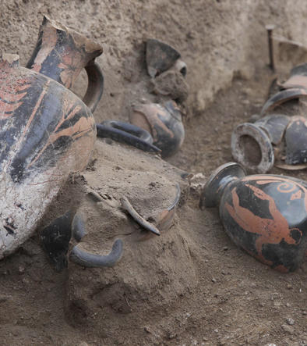
The missing 5th century BCE
The archaeological record preserves little remains from the end of the 6th century BCE to the end of the 4th century BCE.
For example, in 5th century BCE, there are no votive deposits found at the Temple of Apollo
What might this suggest?
This suggest a period of stagnation for Pompeii or at least a recession in economic/urban activities.
Small evidence for the 4th century BCE
  Earlier remains under the House of the Faun and House of Sallust
  Possibly earlier temple under the Temple of Venus
Samnite Tomb discovered in 2015!
  Outside the Herculaneum Gate dated to the 4th century BCE
  Dated by Attic style vases

Slide 26
The First Samnite Wars and the Coming of Rome (343-341 BCE)
This is the first of several conflicts the Roman Republic will have with the Samnites.
The Romans are asked to help free Campania from Samnite rule but Greeks and other Italic allies.
As a result, the Romans began to settle into region of Campania, putting up small colonies.

Slide 27
Second Samnite War (326-304 BCE)
Power struggle for dominance over central and southern Italy
Neapolis (Naples) was divided by pro-Samnite and pro-Roman factions.
The Samnite garrisons entered the city to secure it against Rome, two of the Neapolitan leaders conspired with Rome to take control of the city. Ended with the surrender of Neapolis.
Ended with Rome expanding control over southern Italy
  Foundation of military colonies to protect Roman interests
  Via Appia (312 BCE) built to connect Rome to Capua.

Slide 28
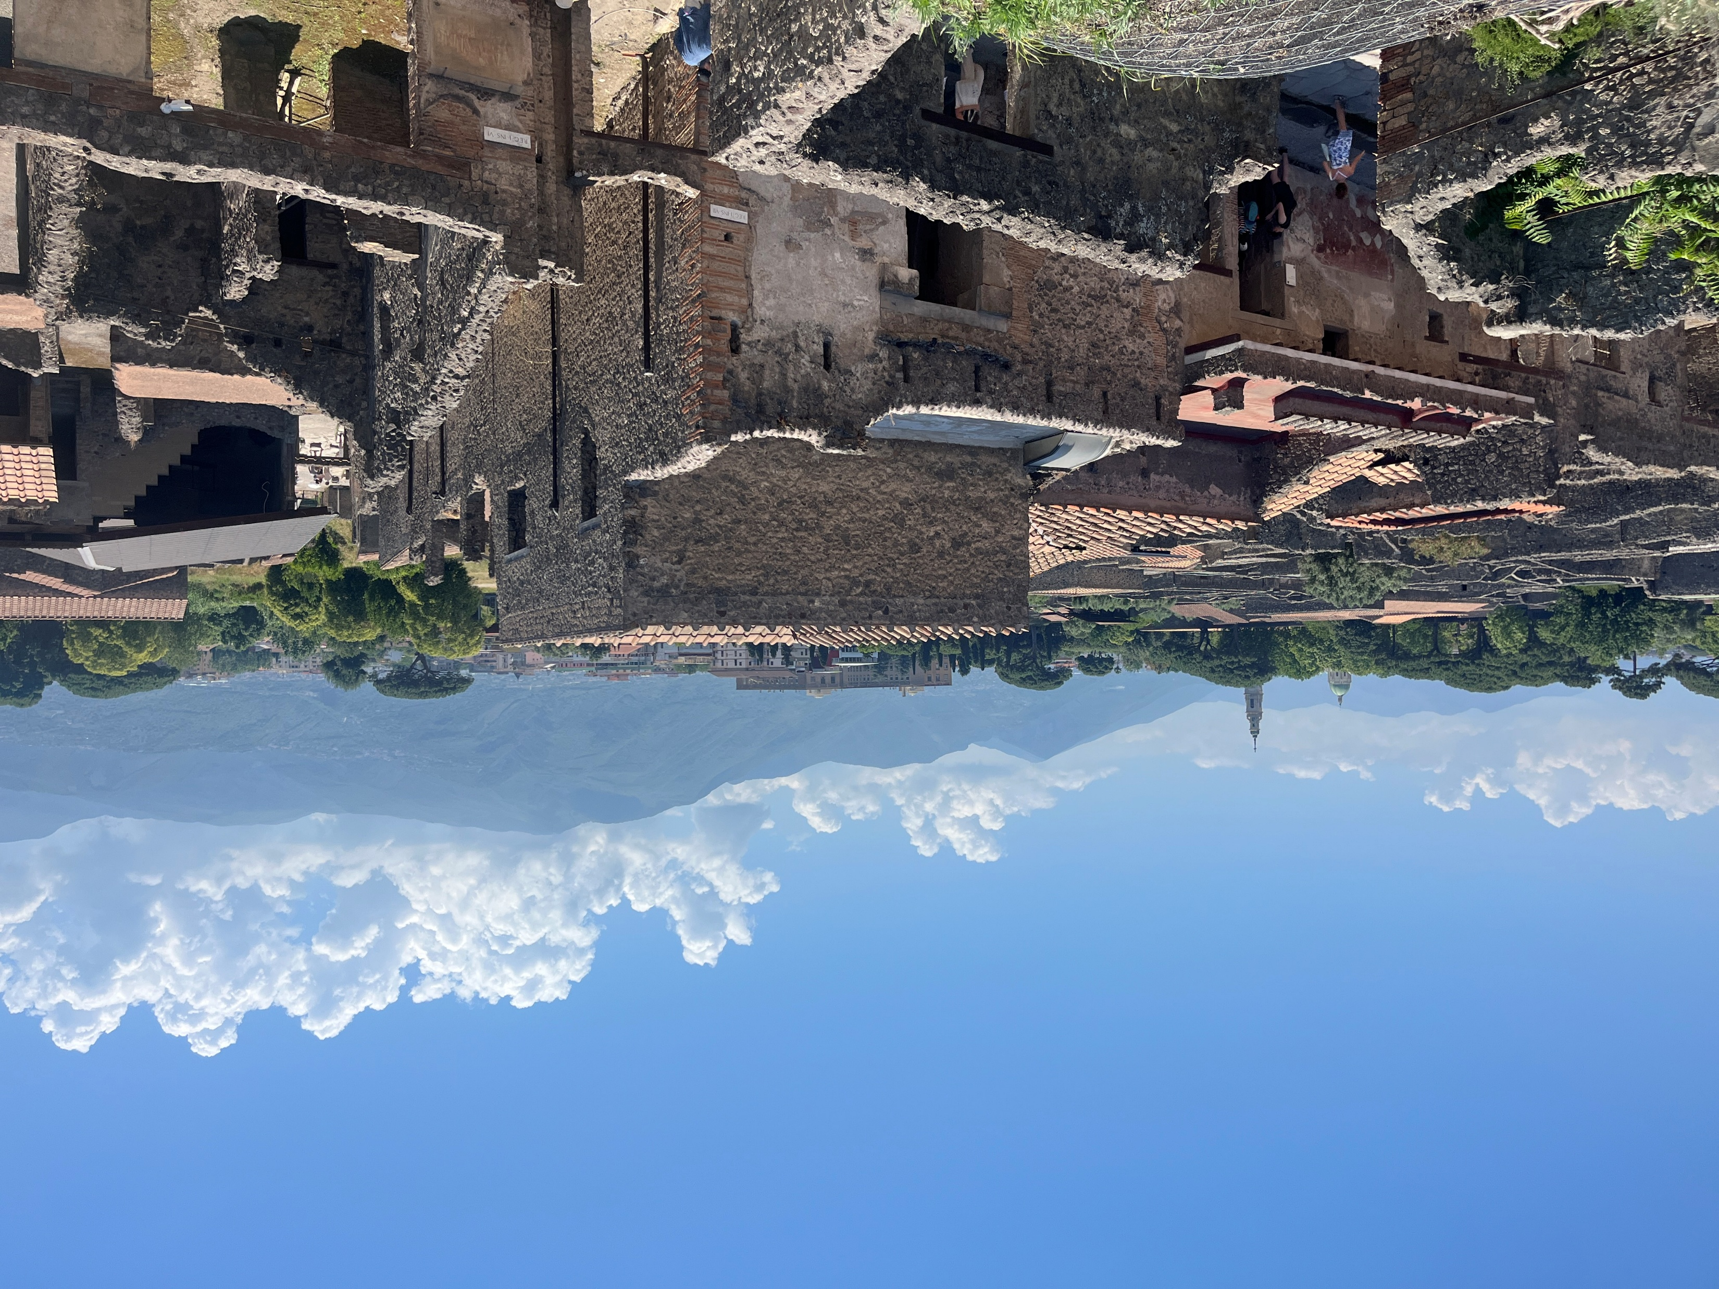
3rd and 2nd centuries BCE Development under the Samnites
In the 3rd century BCE, building activity increase drastically, which suggest that wealth and prosperity of the town increased.
Archaeological remains suggest this economic prosperity was due to increased trade, as the mainland Italy was gradually being connected to the globalized Mediterranean trade routes, with evidence connecting Pompeii to the Eastern Mediterranean and North Africa coast. i.e. coins from Egypt found
Atrium style houses like House of the Faun are initially constructed in this period
The Forum, consisting of a basilica, macellum and early temple (to Jupiter?) are built in the 2nd century BCE.

Slide 29
The Triangular Forum
Regio VIII.7
One of the oldest parts of the city
Situated on a rock promontory at the southern edge of the lava plateau
It overlooks the Sarno River and the Bay of Naples
Trapezoidal shape
Greek Hellenistic influences
  Theater
  Palaestra

Slide 30
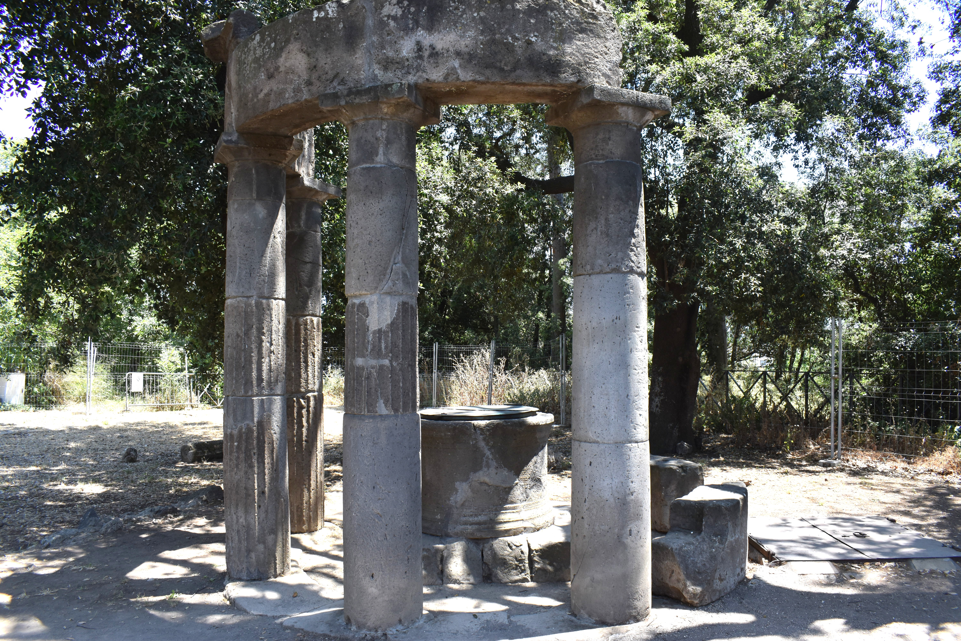
Sacred Area
Doric Temple (6th century BCE)
Tholos (c. 2nd century BCE)
  Circular doric colonnade made up of 7 or 8 columns that supported a conical roof
  Surrounds a sacred well.
  Possibly used for ritual cleansing?
  Inscription in Oscan states that Numerius Trebius (a Samnite government official) built it.

Slide 31
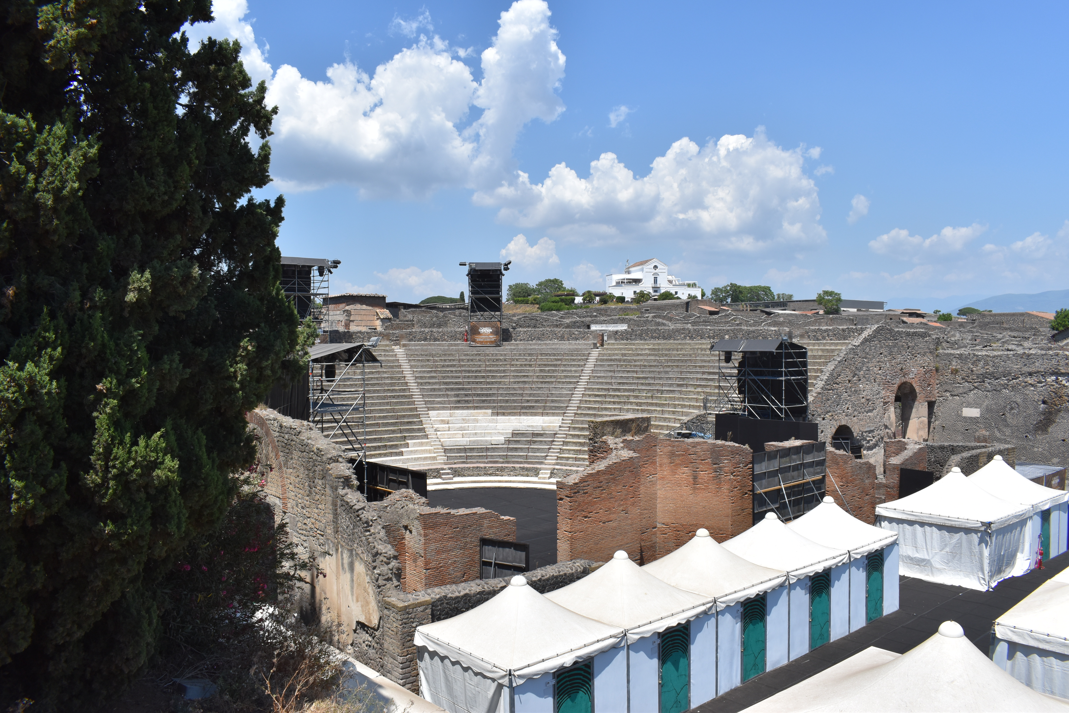
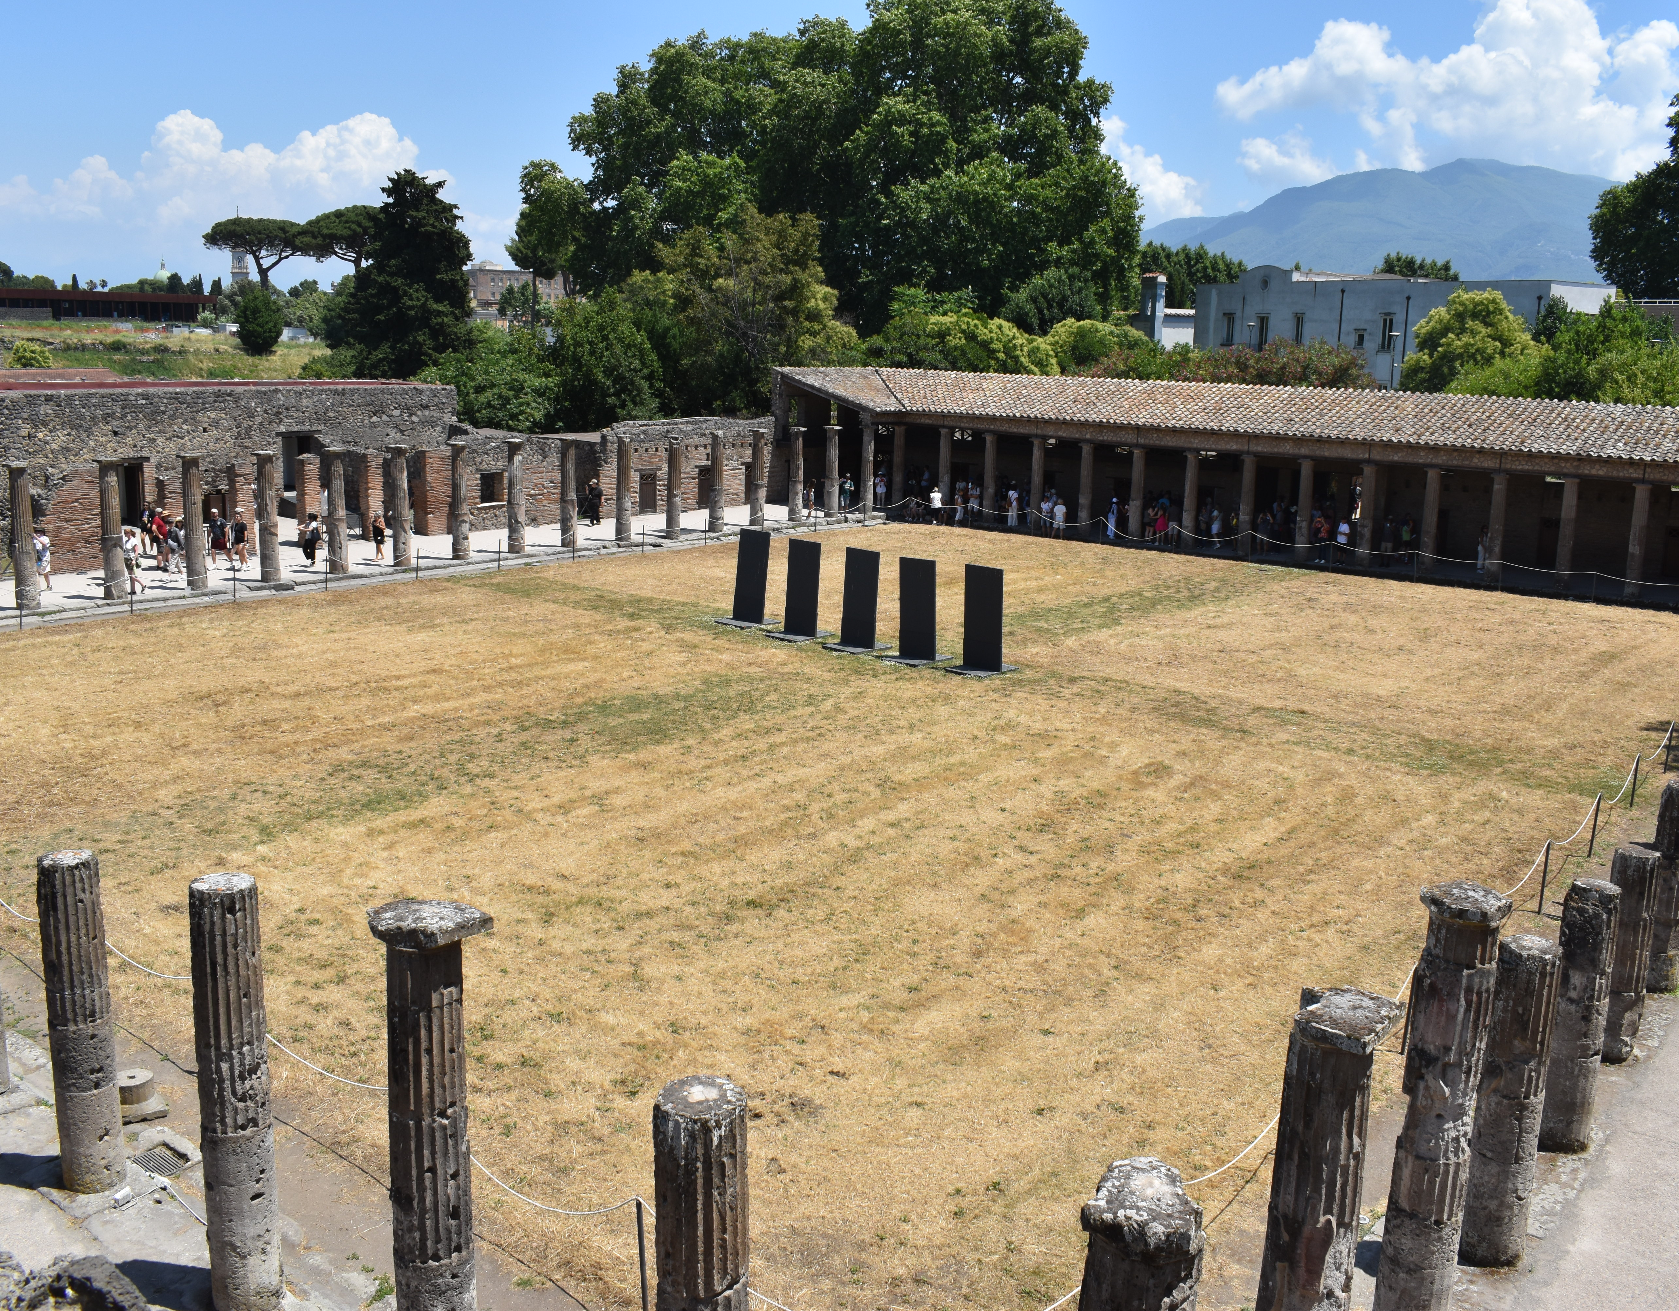
Theater and Quadriporticus
The initial phase of the large theater (teatro grande) was built into the natural slope of the hill in the 2nd century BCE, borrowing from Greek theatrical design.
In front of the theater was a large colonnaded square, modeled on Greek designs, called a quadriporticus.
  Qaudriporticus is a four-sided colonnade
  Quattuor=four and porticus=colonnade

Slide 32
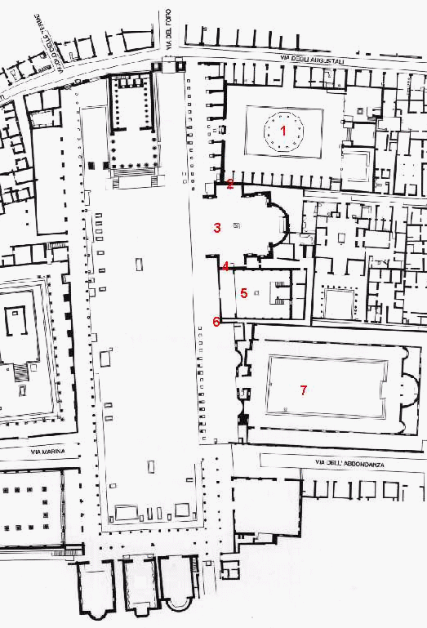
Forum
Originally some kind of market square from the 6th through 3rd centuries BCE
Including the archaic Temple of Apollo (6th c. BCE)
In the 2nd century BCE this area became high developed and planned as the main civic center of the city. Blending Greek and Roman influences.
The square was paved and a two story doric colonnade was constructed on all sides.
A basilica was built in the southwest comer of the plaza. Temple was built (possibly to Jupiter) in the north end of the Plaza

Slide 33
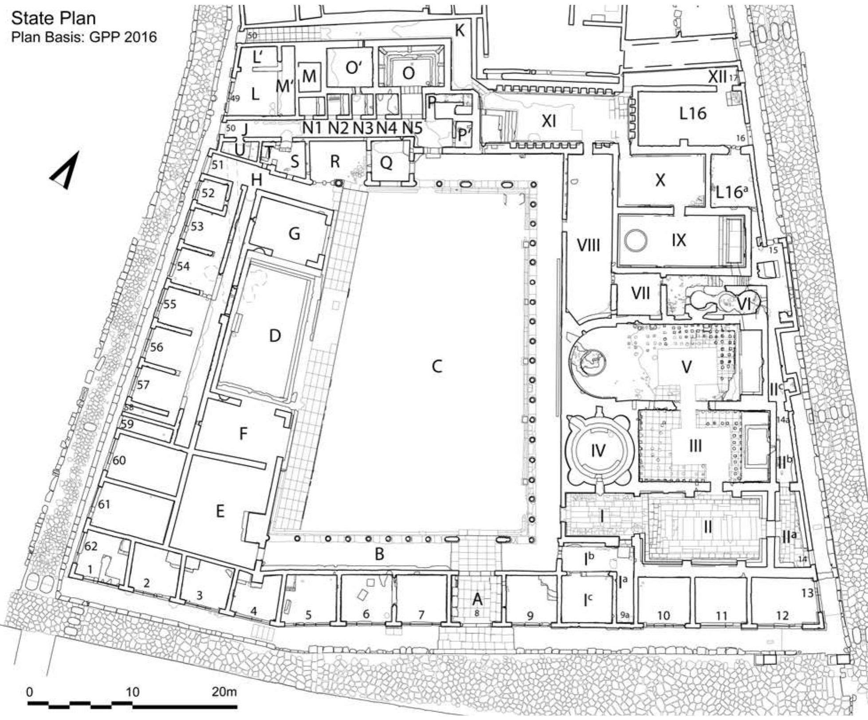
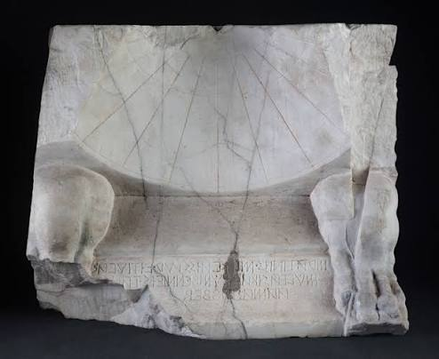
Stabian Baths
Located at the intersection between two main streets: Via dell’Abbondanza and the Via Stabiana
The oldest public bath complex at Pompeii
Earliest phase suggest that it was used as a palaestra- a space designated for training and exercise.
A sun dial with an Oscan inscription was found (dated c.125 BCE) attest that the first bath was built by a local magistrate.
It was organized around a central palaestra. Taking up the entire block of the regio.
It would be expanded and upgraded in later periods.

Slide 34
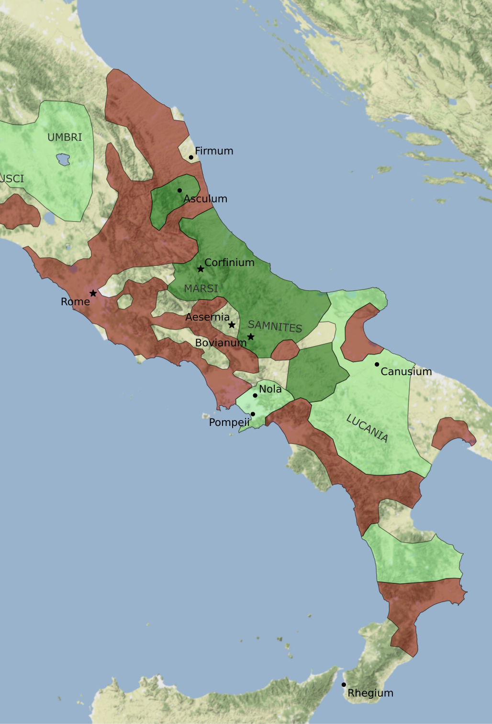
Rebellion of the Social Wars (91-87 BCE)
Italian allies (socii), including the Samnites and Campanians, rose up in rebellion against Rome.
They were mad that they provided soldiers for Rome but were denied basic civil rights:
  They could not vote or run for office
  Received smaller shares of military booty and land in comparison to citizens
In 91 BCE, Marcus Livius Drusus, a Roman tribune, proposed a bill granting citizenship to these allies. Drusus gets assassinated, which launches a rebellion.

Slide 35
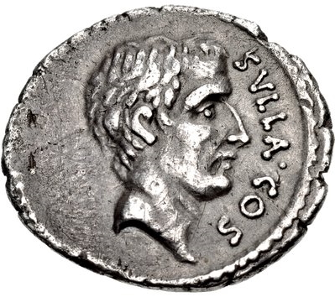
Pompeii and the Social War
The Romans attack the rebels in Campania under the General Lucius Cornelius Sulla
Herculaneum was conquered and Stabiae destroyed
Pompeii is besieged by Sulla and capitulates in 89 BCE
Ballista balls have been found near the Herculaneum gate, giving evidence to this attack.

Slide 36
Colonia Cornelia Veneria Pompeianorum
Pompeii is refounded a Roman veteran colony in 80 BCE and receives a new name: Colonia Cornelia Veneria Pompeianorum
Named after Sulla who was from the Corneli gens
Pompeii receives a new patron god: Venus.
Former inhabitants of Pompeii were forced to give up their land to these new veteran settlers
The city will receive new urban construction projects, the introduction of new Roman building types: arena, odeon, baths, etc.
Latin replaces Oscan as the main language
A new social hierarchy is established.

