Slide 1
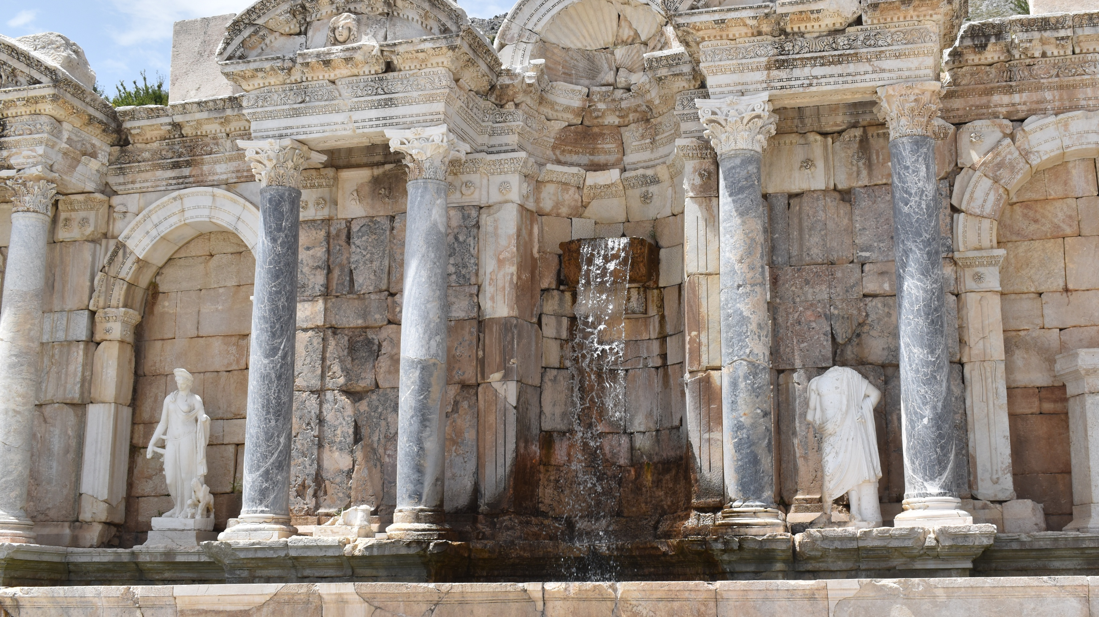
Water, Culture and Power in the Ancient Mediterranean
ARCH B398
August 31

Slide 2
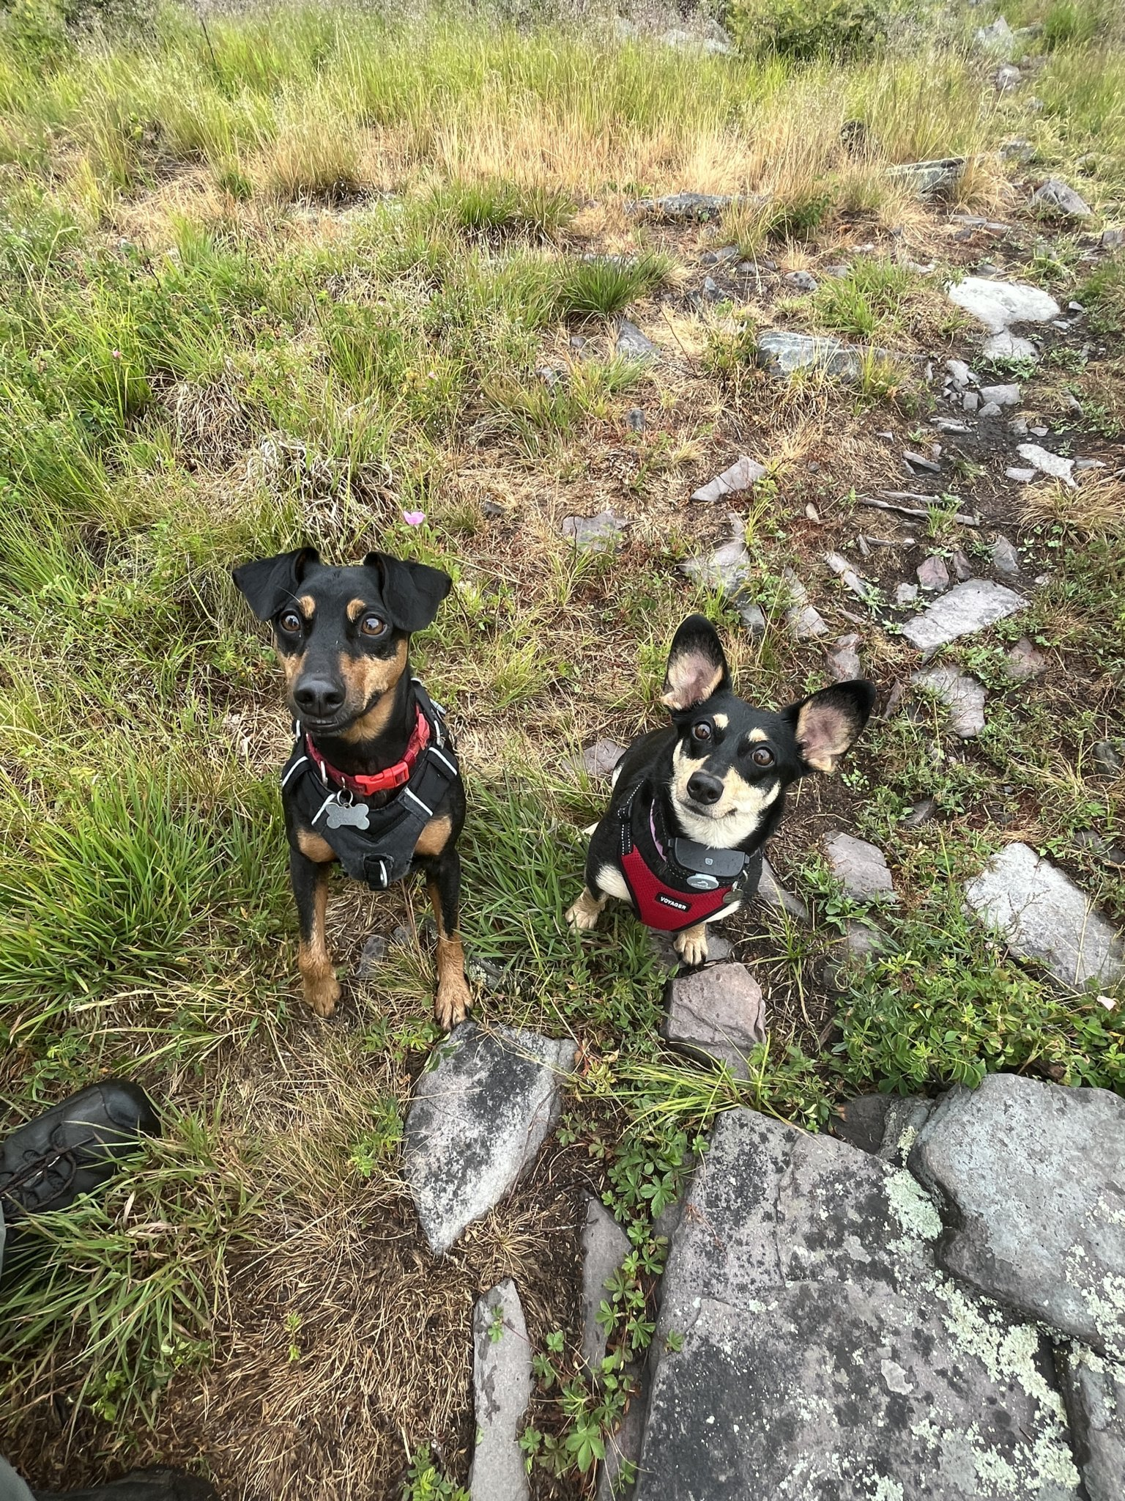
Clare Rasmussen (She/Her)
I will respond to whatever you call me (Prof, Dr., first name, etc). I don’t believe in formalities.
I am a Visiting Professor of Classical and Near Eastern Archaeology at BMC this fall. I am also a faculty member at Temple University in the Department of Greek and Roman Classics.
I am a Roman archaeologist, and I work mostly on Roman materials in Southwest Asia and the Eastern Mediterranean.
I wrote my dissertation on Roman Water Distribution and Use in the Transjordan Decapolis.
I am interested in all things water, but I am also a specialist in Roman imperial architecture, urban planning, and post-colonial approaches.
I am a field archeologist, and I currently excavate in Iraqi Kurdistan with Prof. Palermo but have done research and field work in Jordan, Türkiye, Greece, Italy, and the US.
Ollie (10) and Zoe (8)

Slide 3
Introduce yourselves
Name
What about the ancient world interests you?
What’s one goal or thing you’re looking forward to before you graduate?

Slide 4
Attendance and Participation
20% of your grade.
Attendance is mandatory.
Active participation in the course is expected.
Please do the readings before class and come to class with at least two or three questions to inspire discussion.
Please always be respectful of your other classmates.
There are no wrong answers.

Slide 5

20% Short Reports
You will complete two in-class reports during the semester.
Sign up on the sign-up sheet for topics and weeks.
Readings will be provided for these topics
First reports are September 14.
20 minutes presentation that provides an overview of the week's topic and its historical and archaeological significance.
  Provide a general overview of the subject matter.
  Summarize and analyze the assigned readings, highlighting key arguments, evidence, and scholarly debates.
  Concludes with 3-5 thoughtful discussion questions designed to encourage critical analysis and class participation.

Slide 6

25 % Term Paper
Throughout the semester, you will develop and complete an original research paper on a topic of your choice related to the themes of the course. (I.e. water in Greece and Rome)
I recommend coming by my office hours to discuss your topic. Your proposed topic must be approved by me.
Your paper should present a clear research question or thesis supported by critical analysis of primary and secondary sources. It must incorporate relevant archaeological, historical, literary, artistic, or material evidence, as appropriate to your topic.
20 pages, excluding bibliography and images.
  It sounds like a lot but don’t panic. Its going to be done in stages!
See syllabus for formatting guidelines
DUE DECEMBER 18

Slide 7
15% Presentation
You will present a 40-minute presentation to the class on your term paper topics.
You presentation should communicate you research question, methodologies, evidence, and overall argument/conclusions.
Please provide one to two scholarly readings for your classmates to read in preparation.
This must be done at least a week before your presentation.

Slide 8

10% Abstract and Annotated Bibliography
This assignment is mean to help you develop your topic for your term paper. Due October 5.
500-word abstract
Annotated bibliography with at least 5 scholarly sources for your research.
Annotations should be between 100-200 words.
Example:
Bellwald, Ueli, and Isabelle Ruben. The Petra Siq: Nabataean Hydrology Uncovered. Amman: Petra National Trust, 2003.
This book by Bellwald is a detailed monograph focusing on the hydrotechnology found in the Siq of Petra. The Siq aqueduct was one of the major aqueducts that supplied water to Petra and was an important part of the city’s water system. Bellwald examines the different types of water technology used in the area, with particular attention to pipes, conduits, and other features that helped transport water through the Siq. The book provides valuable information about how these systems were designed and constructed to meet the needs of Petra’s population. It also includes useful photographs, images, and maps that show the routes of the water supply and help readers understand the location and function of the various structures.

Slide 9
10% Term Paper Outline
Due November 2
Detailed outline of your proposed term paper. Expanding upon the ideas you expressed in your abstract.
I want to see the organization of your paper! It should read a roadmap to your final paper.
Use headings to delineate different sections of your paper.
Each section should explain the purpose each section, including descriptions of the evidence, sources used, etc.
Parts of the outline can be bullet points or full sentences, it doesn’t matter.

Slide 10
Find a new time?
Because I don’t want to be here when its hella dark outside.
Proposed new times:
  Mondays, anything before this time.
    Conflict is the archaeology talks 12-2pm
  Wednesdays: morning or afternoon?

Slide 11
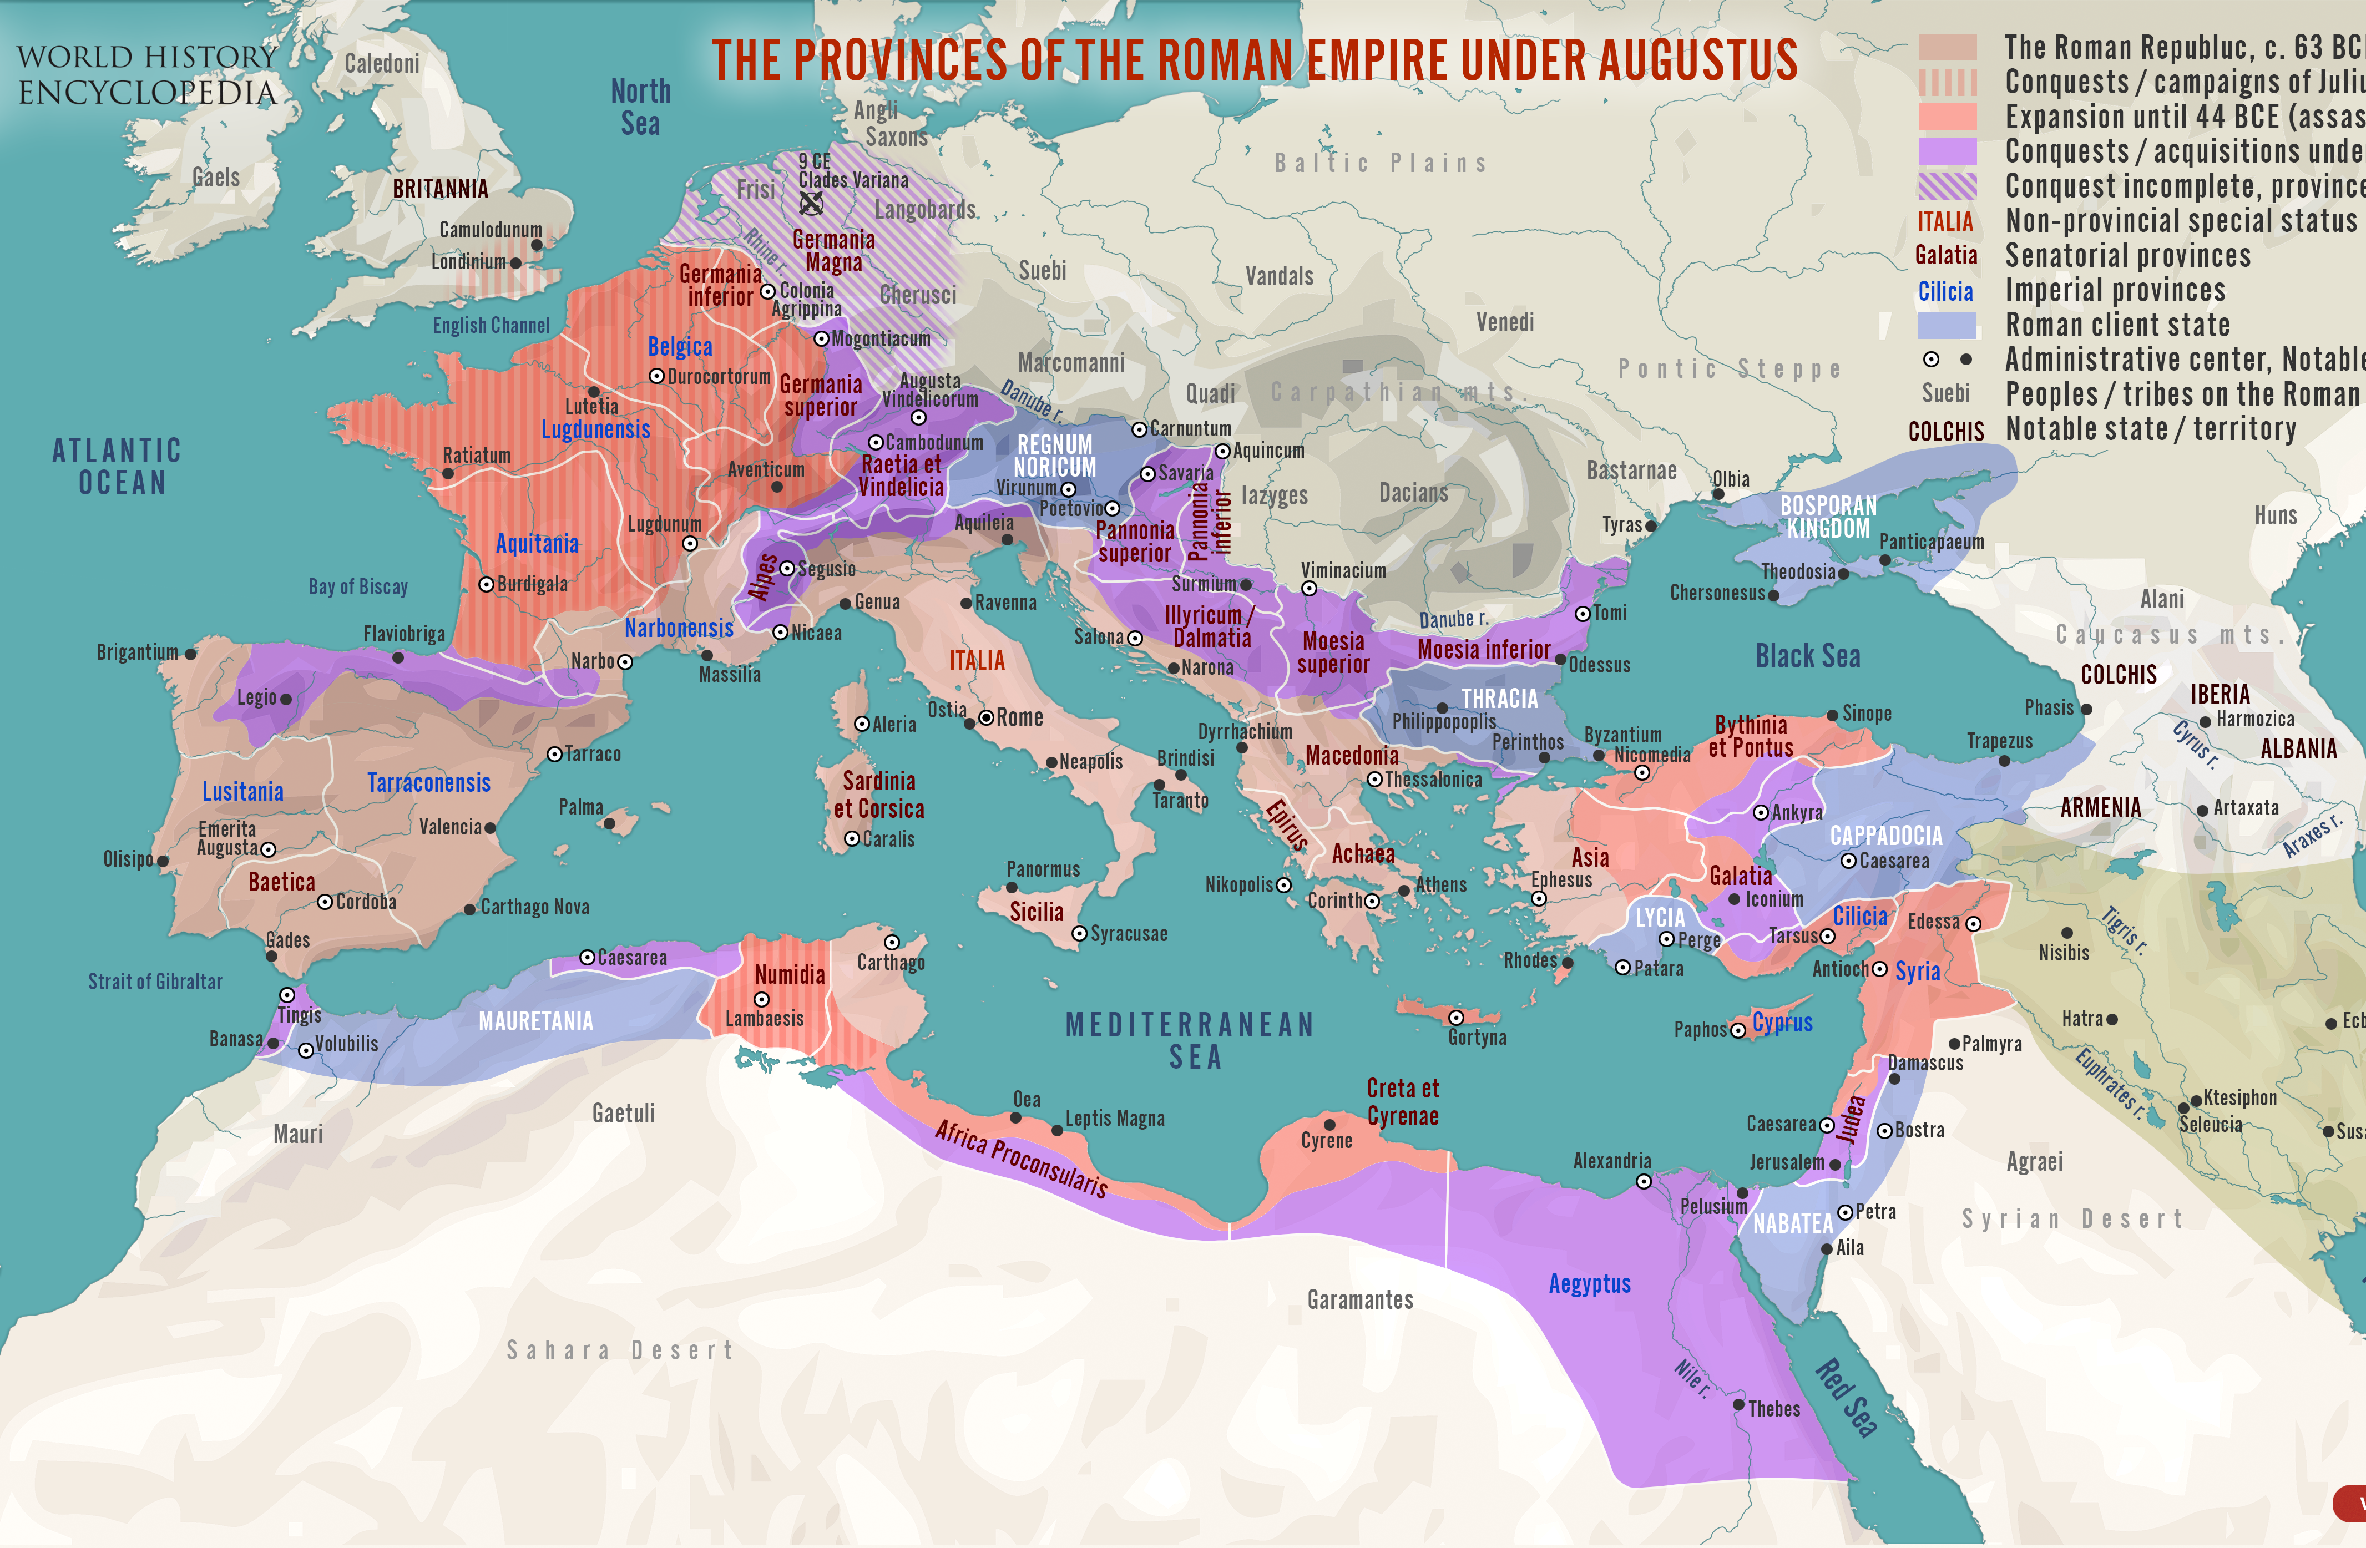
Geographical Scope
Core Zones of study
  Mediterranean Basin, including North Africa and the Levant
  Western Europe, focusing on the UK, Gaul, and Spain
Climates and Topography
  Contrast arid coastal zones with hyper-seasonal river valleys, mountainous interiors, semi-arid desert steppe
  Fluvial basins, like the Nile, Rhône, Po, and Tiber
The Mediterranean as a dynamic network connecting diverse polities through trade, colonization, and naval power.

Slide 12
Chronological Scope
Bronze Age Foundations (c. 3000–1100 BCE): Minoan and Mycenaean hydraulic engineering, Palace of Knossos drainage, storm-water management, and early Aegean maritime networks.
Archaic & Classical Greece (c. 750–323 BCE): City-state water supply (fountains, fountain houses), tyrant-led aqueduct projects (e.g., Eupalinos' tunnel on Samos), and sacred water sanctuaries (Delphi, Asclepieia).
Hellenistic Transformations (c. 323–31 BCE): Large-scale hydraulic innovations, Ptolemaic irrigation in Egypt, and expanding Mediterranean maritime trade routes.
Roman Empire & Late Antiquity (c. 31 BCE–600 CE): Monumentalization of water—gravity-fed aqueducts, public bath complexes (thermae), urban nymphaea, harbor engineering (Ostia/Portus).

Slide 13
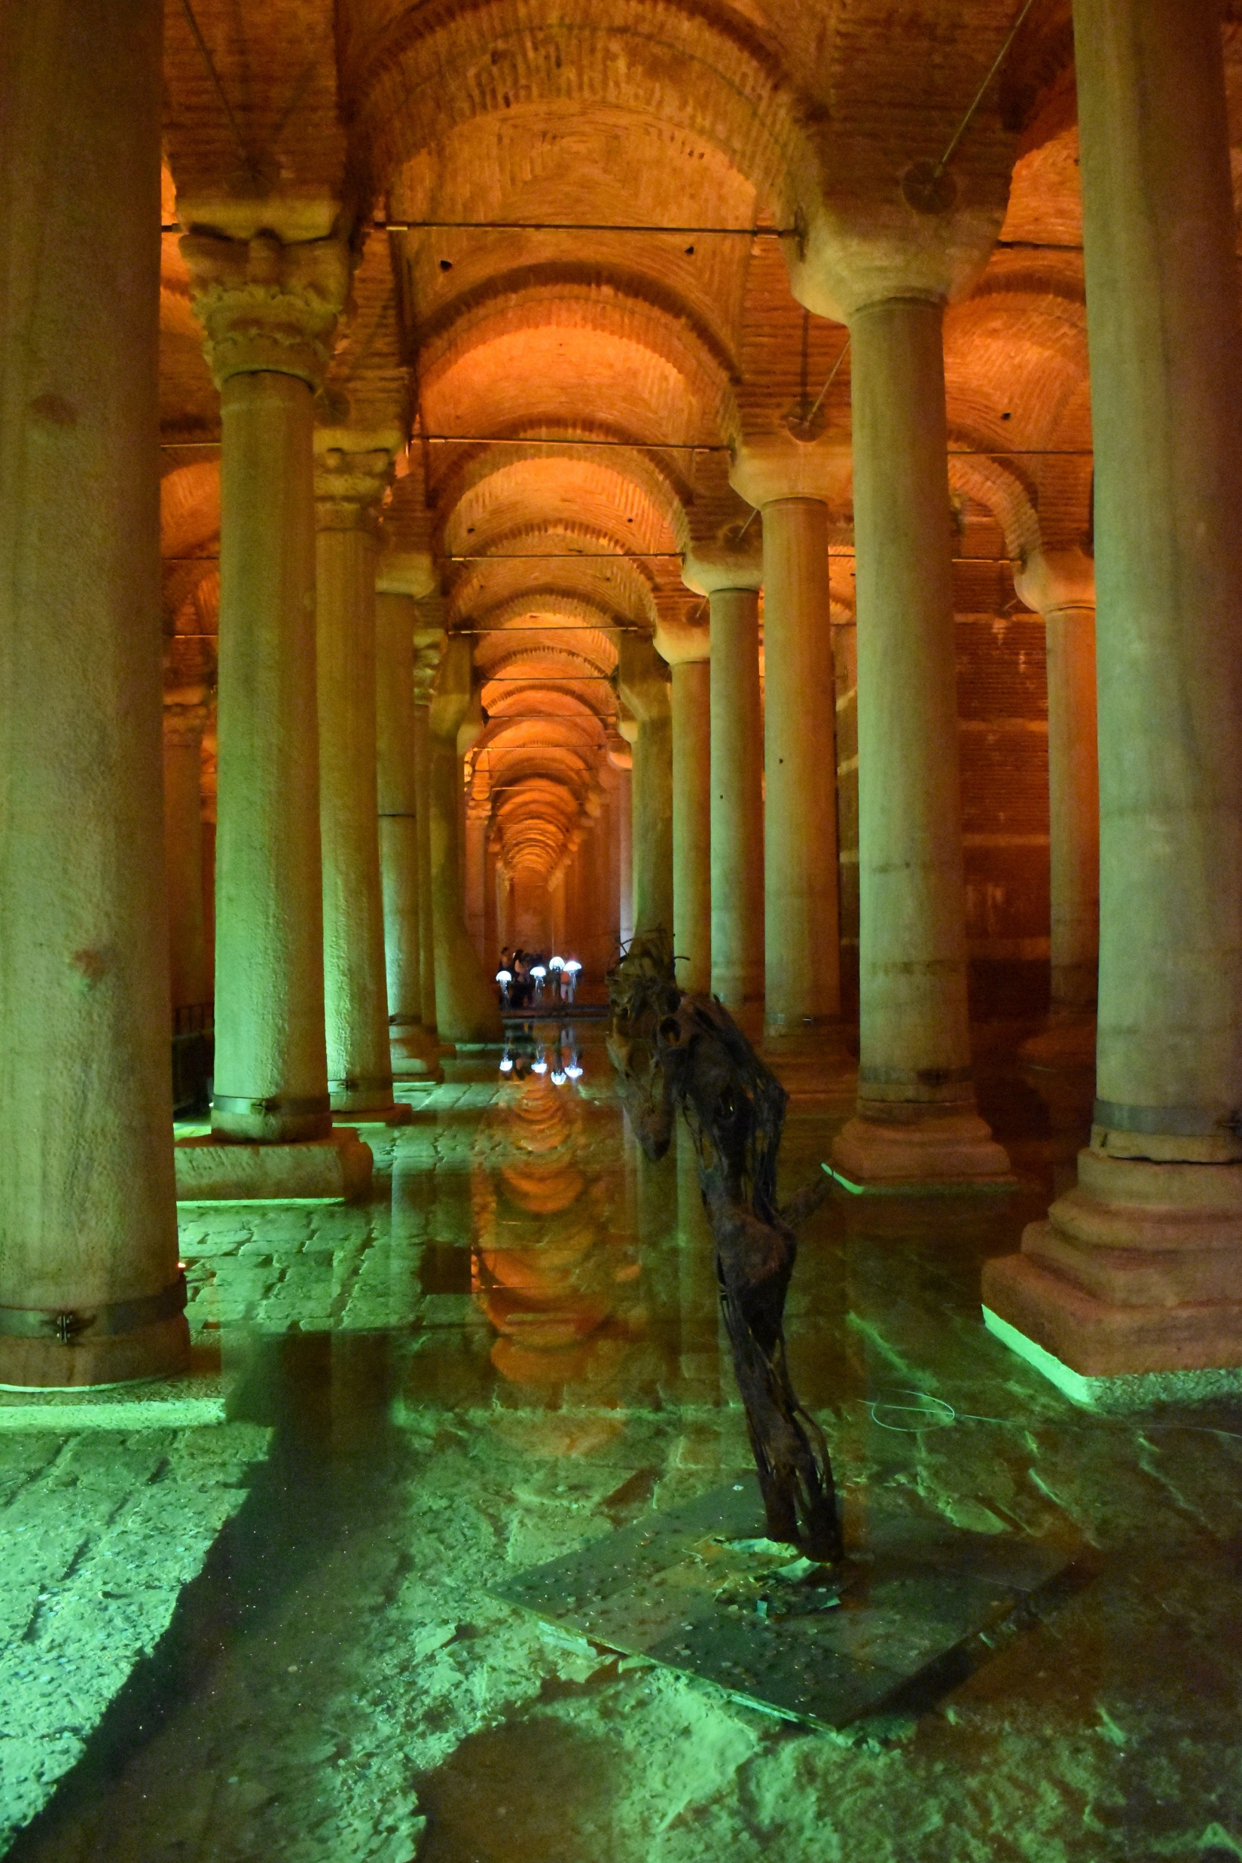
What did the ancients think about water?
Pre-Socratic Philosophy: Cosmos and Origins
  Thales of Miletus “πάντα ὕδωρ ἐστίν”, water is the primarly principle material
  Heraclitus of Ephesus: Framed water as part of a dynamic, cyclical flux governed by opposition and transformation (metabolē). "To souls it is death to become water, to water death to become earth, but from earth comes water, and from water soul."
Natural Philosophy: Elements and Qualities
  Plato (Timaeus, 55d–56d): Associated water with geometric, mathematical atomism.
  Aristotle: water is a combination of cold and wet. Constant state of transformation.
Water quality and medicinal properties
  Hippocrates Airs, Waters, Places: Analyzes how water quality impacts human physiology and regional character. He ranks water sources by healthfulness: spring water flowing east is best, while stagnant marsh water causes disease (splenomegaly, dropsy).
  Vitruvius De Architectura: dedicated book 8 entirely to water, Provides practical field methods for finding hidden groundwater, testing spring quality by boiling or observing the health of local inhabitants, and evaluating pipe materials (preferring terra cotta over lead for health reasons).
  Pliny the Elder Naturalis Historia: Catalogues thermal springs, mineral waters, and their therapeutic properties. He famously notes that "water is the element that rules all others," noting its capacity to heal, poison, or transform landscapes.

Slide 14
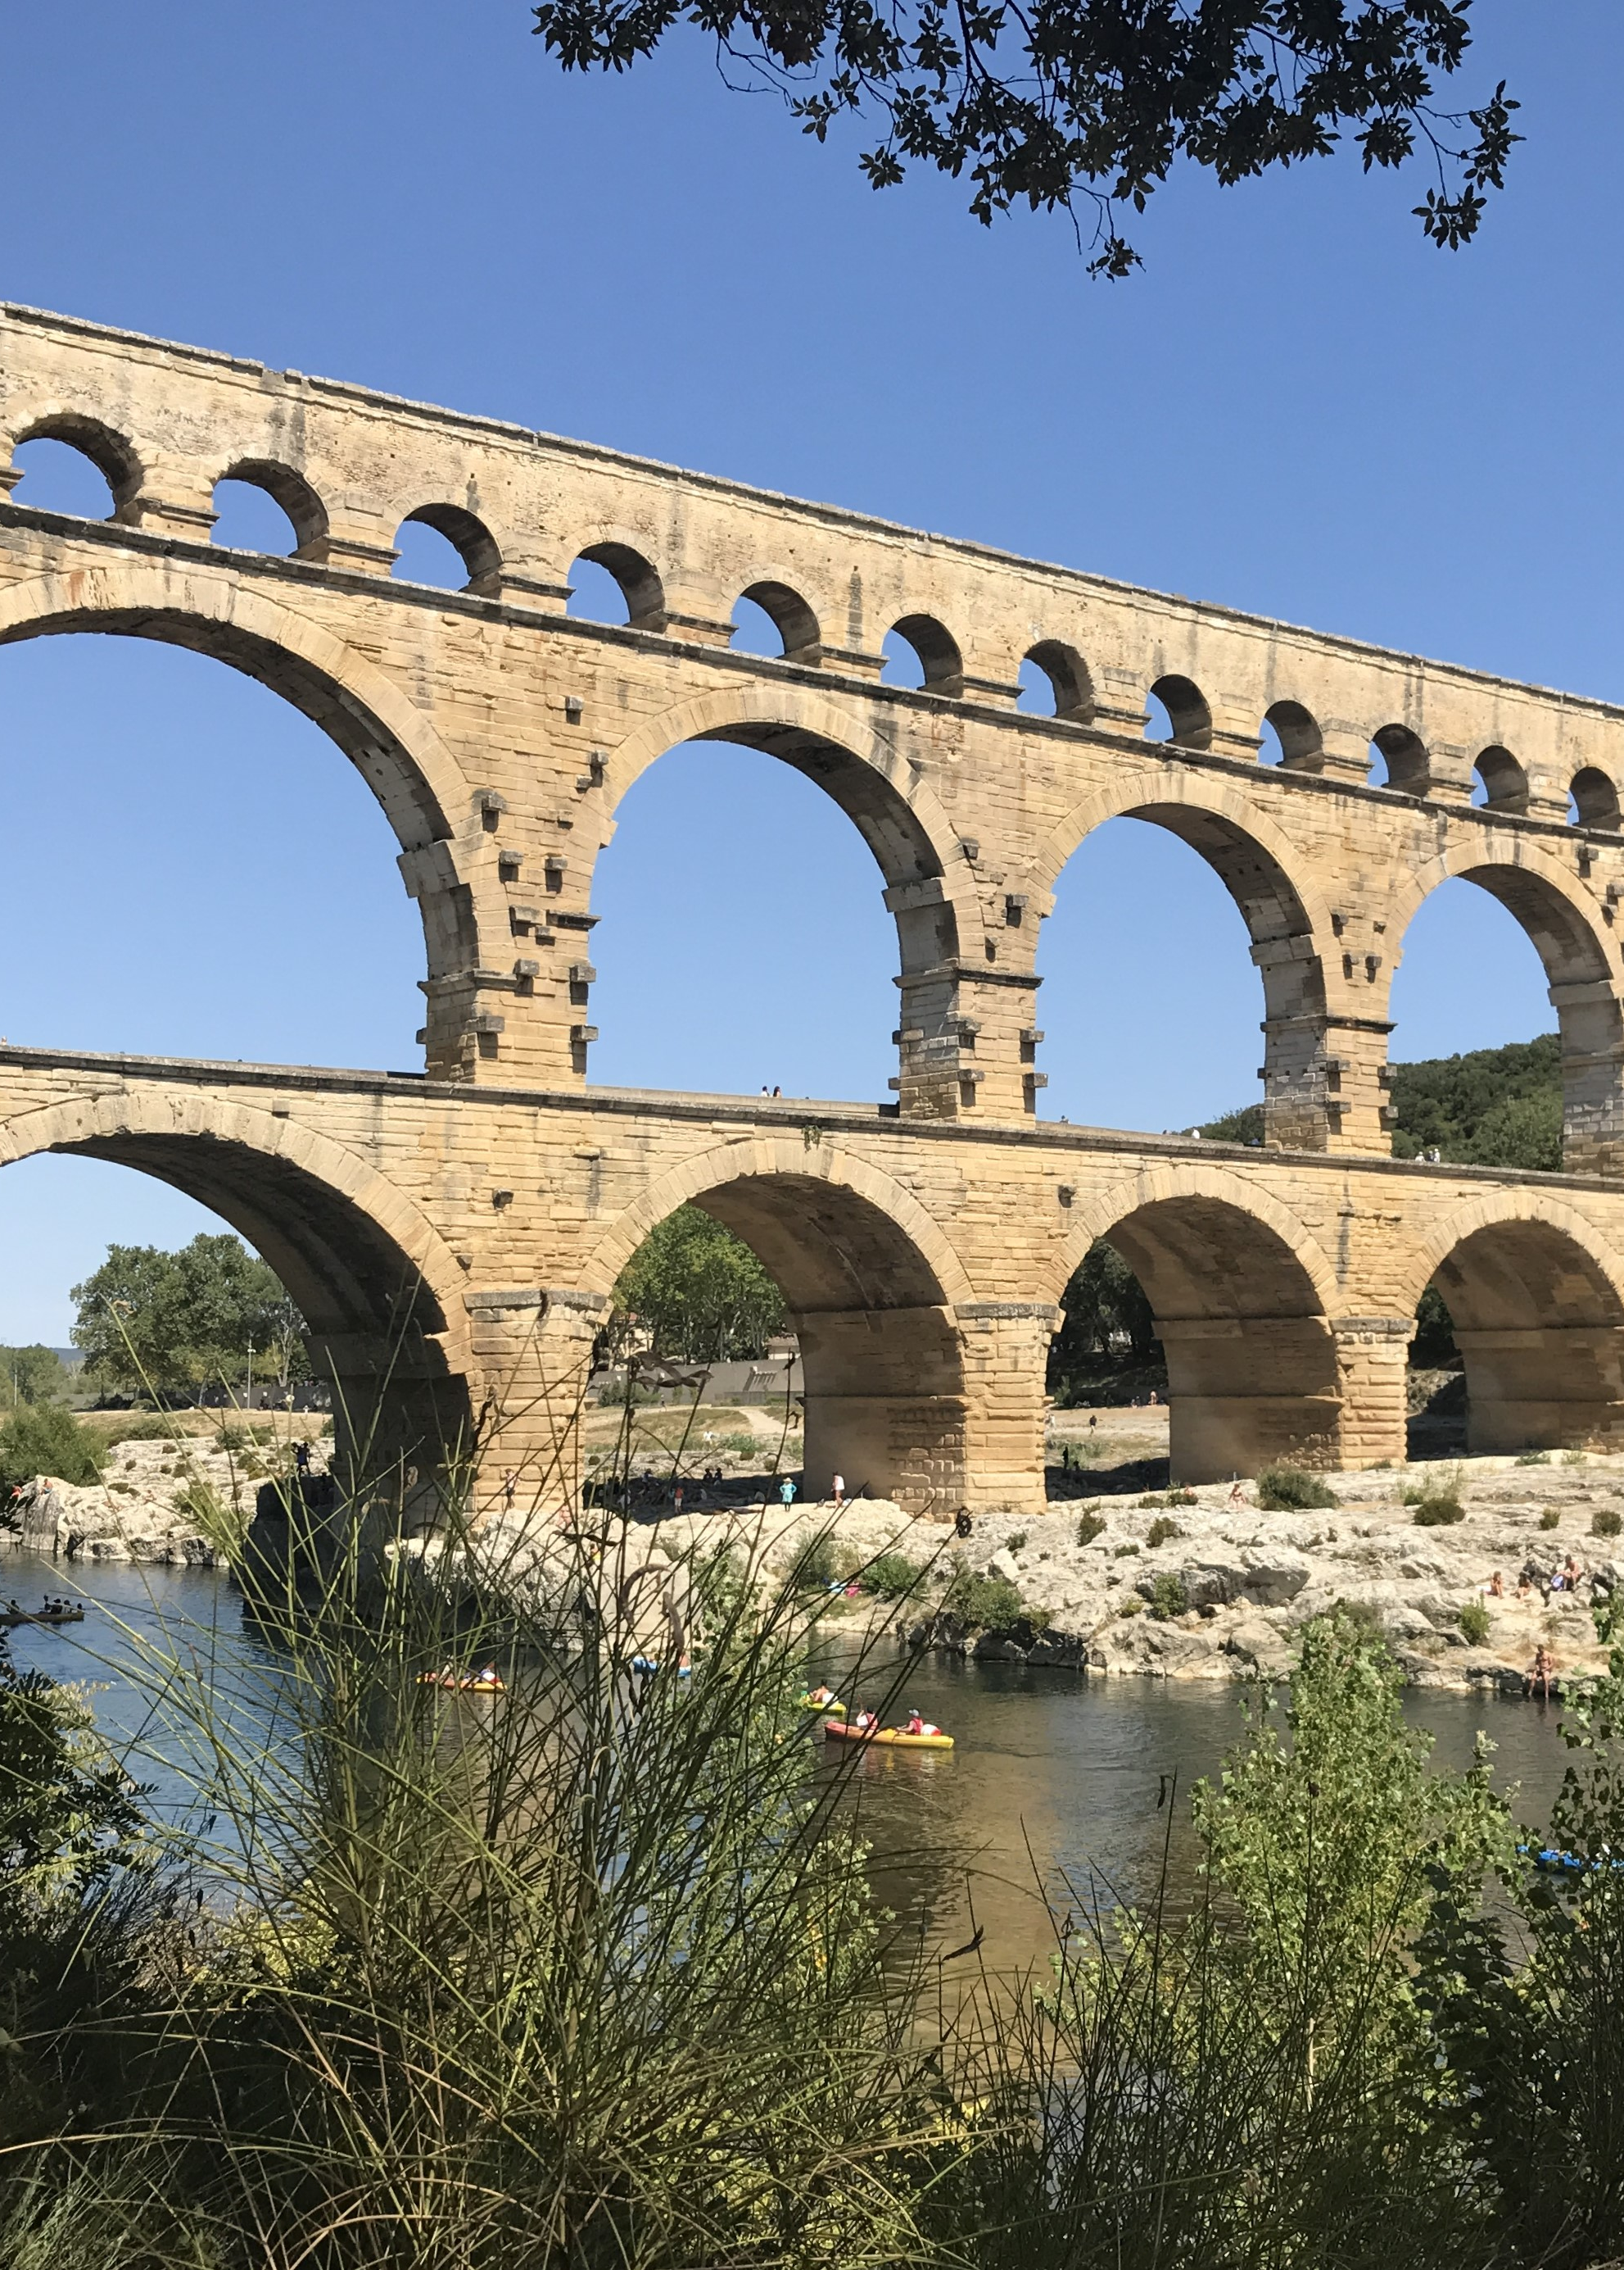
Infrastructure, Administration, and Imperial Power
  Frontinus De Aquaeductu Urbis Romae: Will anyone compare the idle Pyramids or the useless, though famous, works of the Greeks with these majestic structures carrying so many waters?“
  Strabo Geographica: "The Romans had extraordinary foresight in matters which the Greeks neglected... bringing water into the city through aqueducts in such quantities that rivers seem to flow through the city.“
Sacred, Literary, and Ethnographic Dimensions
  Herodotus (Histories): Framed the geography of Egypt entirely around its riverine landscape, coining the phrase that Egypt is "the gift of the Nile" (Histories 2.5), while detailing how seasonal inundations governed Egyptian social, political, and religious life.
  Virgil (Aeneid): Uses water as a metaphor for divine authority, political order, and chaotic destruction, from Neptune calming the sea in Book 1 to the sacred river boundaries of Tiberinus welcoming Aeneas to Latium.

Slide 15
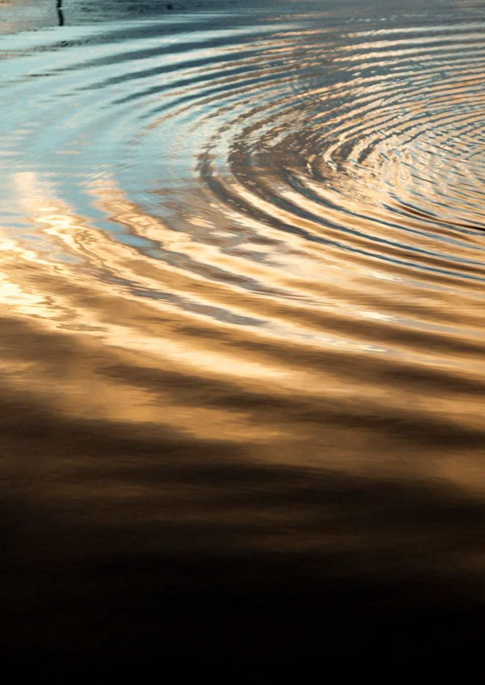
Waterscapes
What is a waterscape?
It extends the concept of landscape to the aquatic realm.
A dynamic intersection where physical water systems, human engineering, cultural beliefs, and social power converge to shape an environment.
Rather than treating water merely as a passive natural resource or a background setting, a waterscape framework analyzes water as an active force that structures human life, geography, and historical change.
Core dimensions of the waterscape:
  Physical and hydrological
  Built and technical
  Social and political
  Cultural and sacred

Slide 16
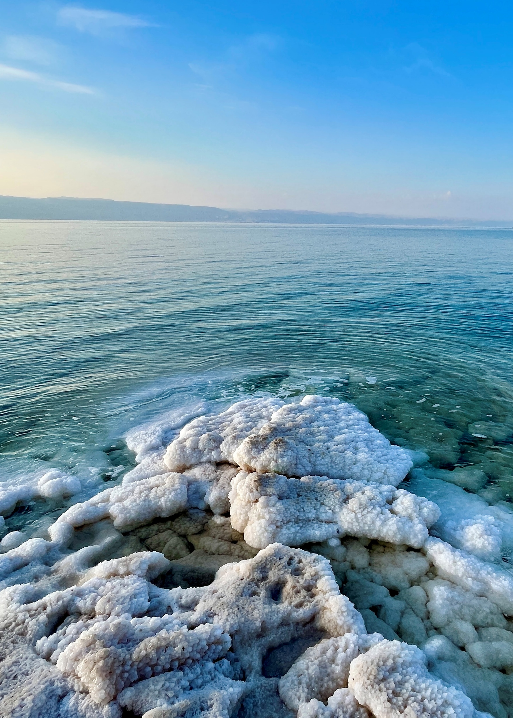
Physical and hydrological
Primary Water Types and Physical Typologies
  Inland freshwater: karst springs, perennial/seasonal rivers, wadis, alluvial streams, high water table marshlands
  Coastal and Marine: estuaries, lagoons, natural harbors, island chains
  Subterranean Systems: aquifers, karst cave networks, subterranean water tables, thermal/mineral springs
Hydrological Dynamics and Environmental Behavior
  Seasonal Volatility: Mediterranean seasonality, Winter and Spring flash floods contrasting with extreme summer drought.
  Geomorphology and Erosion: water as a physical sculptor- coastal erosion, deltaic expansions, river course shifts, the rapid silting of harbors (like Ostia)
  Water Chemistry and Properties: variations in salinity, mineral density, temperature, turbidity. Affect drinkability, agricultural utility, pipe corrosion.
Notes:
The physical landscape plays a huge role in the way water use and practice manifest itself in ancient societies.
For example, if the water table is too deep to access then people cannot build wells. Solution, lots of cisterns and rainwater harvesting! With the Romans, this will gradually shift to long distance aqueducts.

Slide 17
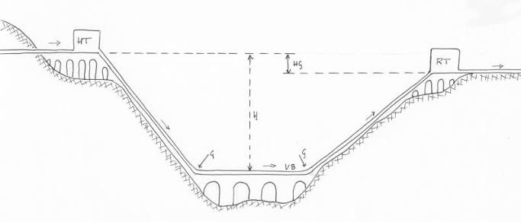
Built and Technical
The engineered environment.
Capture and Extraction: constructing spring houses, wells, digging subterranean tunnels to bring groundwater to the surface
Transport: designing gravity-fed masonry channels, aqueduct bridges, inverted siphons, settling basins.
Storage and Urban Distribution: managing water volume through tanks, massive reservoirs, subterranean cisterns, pipe networks.
Drainage and Sanitation: constructing underground sewers, street gutters, latrines.
Materials: hydraulic mortar like opus signinum (pozzolana), terracotta and lead pipes, survey tools like the groma and the chorobates.

Slide 18
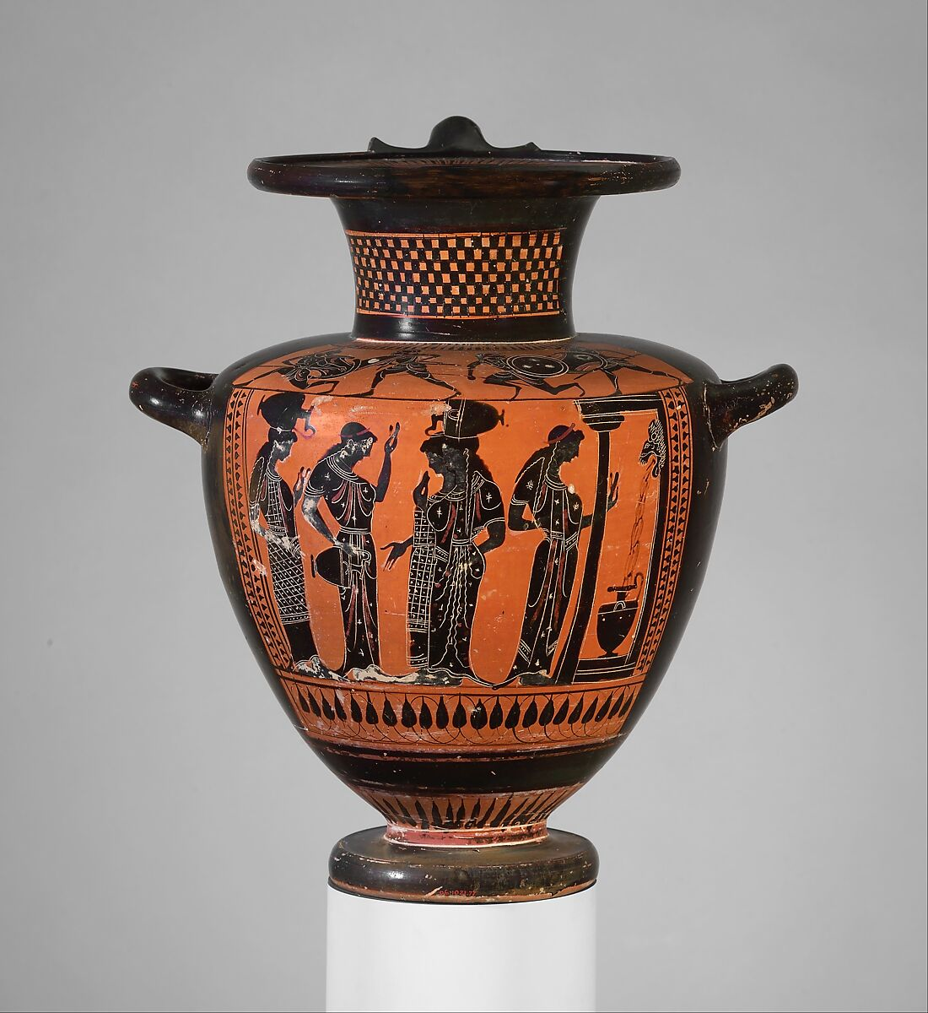
Social and Political
Terracotta Hydria (Water Jar), ca. 510–500 BCE. The Metropolitan Museum of Art, Object No. 06.1021.77.
Imperialism and State Control
  Aqueducts and waterworks as an expression of imperial power
  Legal water rights and water taxes
Civic Benefaction
  Wealthy elites and rulers financed hydrological projects like public baths, aqueducts, fountains to secure prestige, buy political support, and compete with other elites/cities.
Spectacles and Display
  Taming water into artificial displays signaled state power over nature itself
  Conspicuous consumption
Places of Community
  Fountain houses and nymphaea were often places of gathering where community members would interact
  Springs in the countryside often contain elements of communal gathering for religious worship
Gender and Daily Life
  Collecting water was a gendered labor. Most images of Greek water jars depict women gathering water at the public fountain house. A rare space where women could socialize outside the domus.
  Bathing culture. A bath could function as a micro-society where people from different social and economic levels could share space and interact.
  Water distribution as a way of mapping social class through water access (or lack of access).

Slide 19
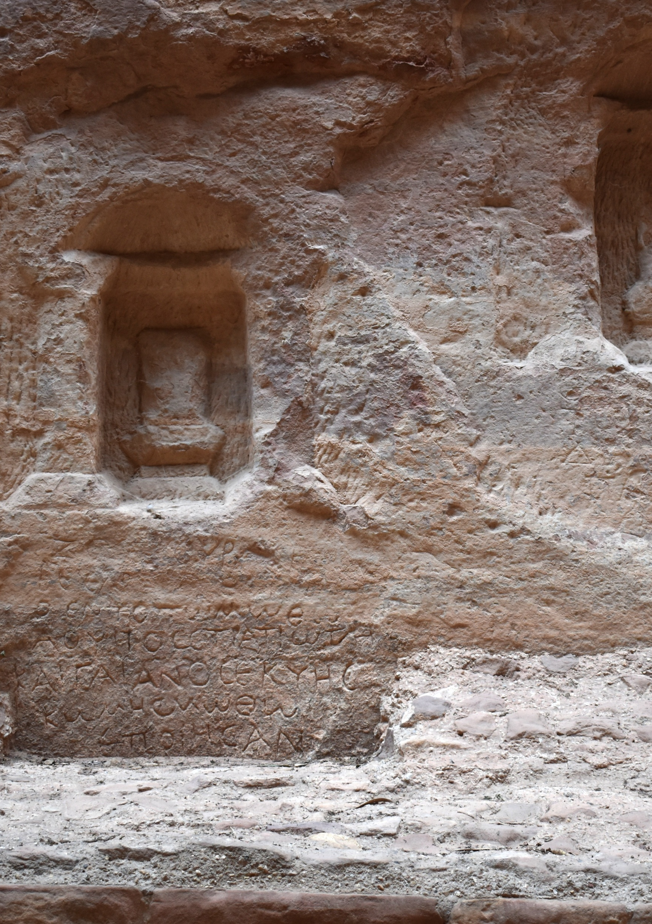
Cultural and Sacred
Water as a medium of divine power, ritual purity, and cultural identity
Identity and Local Memory
  Water sources function as monuments of local heritage and mythic origins.
Divine Personifications and Water Agency
  Natural water sources were understood as living entities possessing agency, gender, and mood. Rivers were often seen as male gods (like the river Alpheios in Olympia)
  Votive offerings in water features to appease local deities (curse tablets found in the fountain of Anna Perenna)
Sacred Geography and Sanctuary Placement
  Water as divine prerequisite for the placement of sanctuaries in the ancient landscape (think the Erechtehion temple on the Acropolis).
  Oracular and healing cults, like the Castalian Spring at Delphia where people cleansed before consulting the Pythia.

Slide 20
How do we study waterscapes?
Archaeological & Architectural Survey: Mapping the physical traces of hydraulic engineering, cistern volume, pipeline gradients, aqueduct courses, urban drainage networks, and bathhouse layouts, to reconstruct water flow and capacity.
Geoarchaeology & Environmental Science: Analyzing sediment cores, paleo-botanical remains, soil erosion, and isotope analysis to reconstruct ancient shorelines, silting patterns in harbors, flooding frequency, and regional climate shifts.
Spatial & GIS Analysis: Using Geographic Information Systems (GIS) to map visibility, accessibility, elevation, and terrain, revealing how ancient populations navigated coastal routes, catchment basins, and irrigation networks.
Textual & Epigraphic Analysis: Examining ancient historiography, legal codes, poetry, and inscriptions to reconstruct administrative management and cultural attitudes.
Phenomenology & Sensory Experience: Reconstructing how water was experienced through sight, sound, and movement within ancient spaces.

Slide 21
Modern Anthropologies of Water
The anthropology of water shifts the analytical lens from water as a purely physical to water as a social, cultural, and political agent.
Rather than asking "how much water was available?", anthropologists ask: How does water create social relationships, enforce hierarchies, shape ritual life, and define human perceptions of the environment?
The Meaning of Water, Veronica Strang 2004
  Explores why water holds such universal, deep-seated symbolic, emotional, and spiritual meanings across diverse human cultures, while simultaneously being treated as a commercial commodity in modern industrial contexts.
  Materiality and Meaning: How the physical characteristics of water (its fluidity, translucency, capacity to cleanse or destroy) directly shape the human imagination and cultural metaphors.
  Sacred vs. Profane: Traces how water transitions from a sacred, life-giving common good into a privatized asset bought and sold on the market.
  Bodily and Sensory Engagement: Examines how humans physically interact with water through drinking, bathing, and sensory experiences, and how these practices form cultural identities.

Slide 22
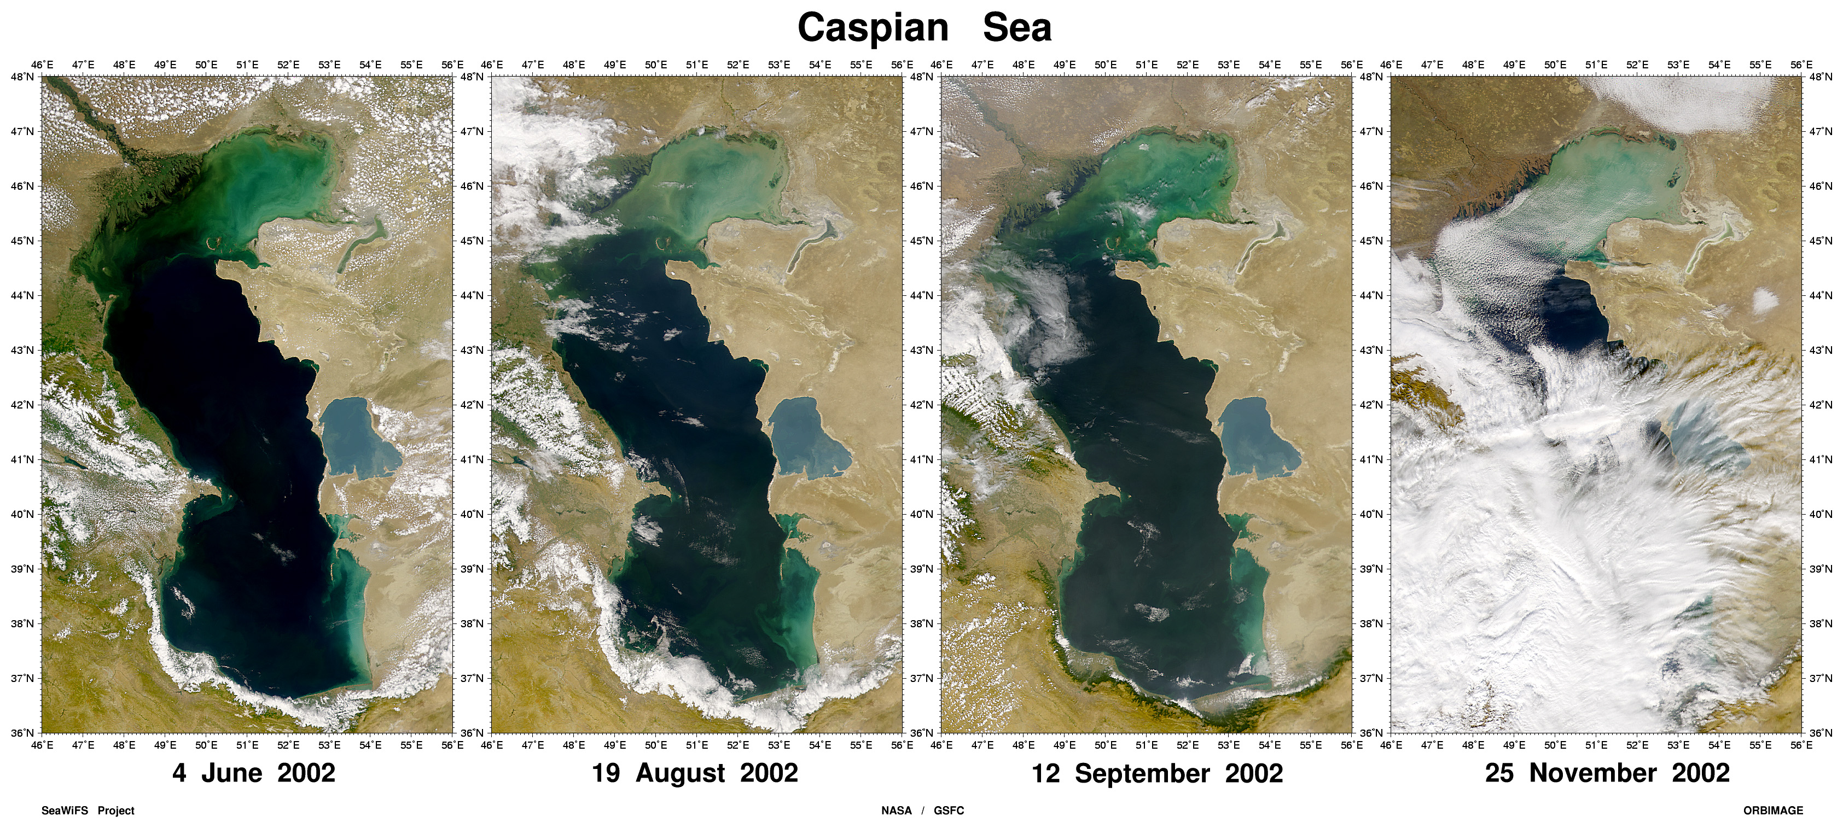
Water in our own society
How has our relationship with water been transformed since ancient times?
Invisibility
  Modern infrastructure buries pipes between concrete. There is no visibility from source to tap.
  Alienation from the physical origins of the water. How often do you think about the source of your water?
  Creates a cultural perception of infinite abundance.
Climate and Environment
  Severe droughts, mega flood, declining aquifers forcing modern societies to confront physical limits of hydrological systems
  Infrastructure fatigue. Many 19th and 20th century water works are struggling to be maintained or adapt to current weather events. Think about all the water main breaks going on in Philadelphia today.
  Land reclamation projects, restructure waterscapes and can cause huge impacts on the landscape.
Access
  Most water is privatized, and is a highly regulated commodity that you have to pay for.
  Can be weaponized during times of scarcity.

Slide 23
Ways I’ve been thinking about water in my own

Slide 24
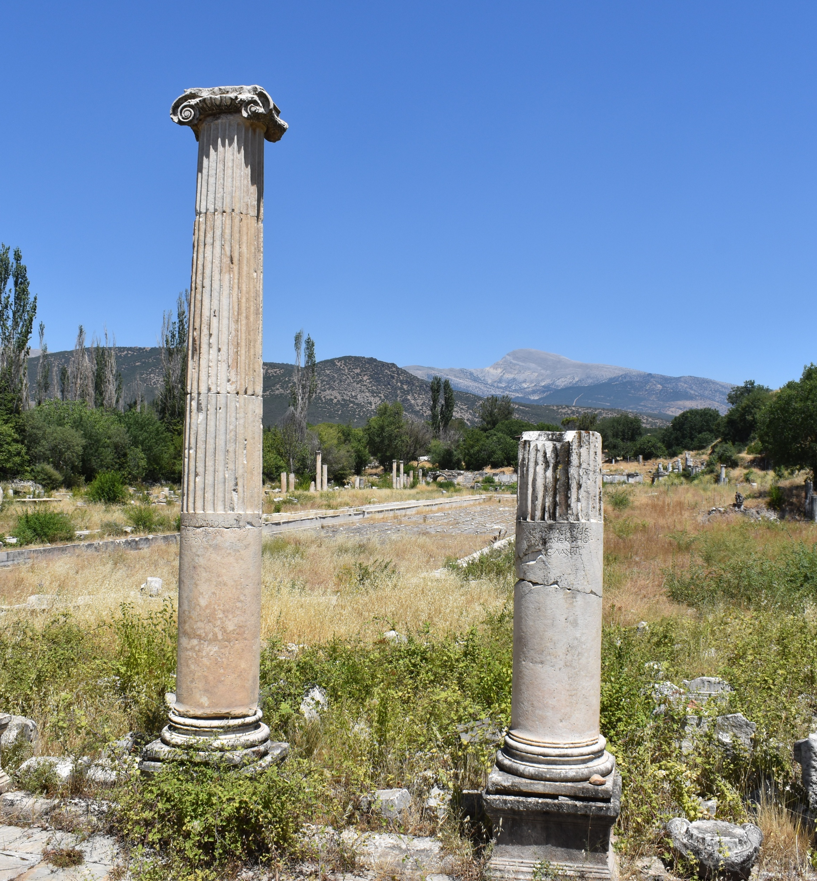
Topics of Interest
Look over the syllabus topics and let me know what you would be interested in learning about.
What is not covered that you would want to cover?

Slide 25
Next Week….
Labor Day.
Find a make up time.

