Slide 1
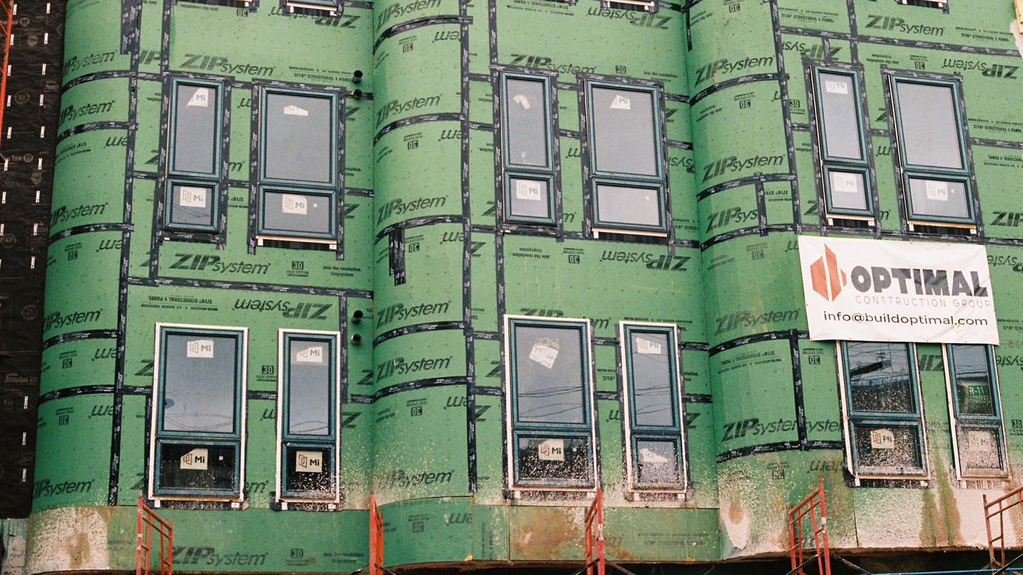
Gentrification (CITY B207)
Dr. Stanley Collins, Ph.D.

Slide 2
Agenda
Recap
Warm up: Don’t Say the G-Word
Gentrification: Evolution of a Concept
Class discussion
Wrap-up
For Next Class

Slide 3
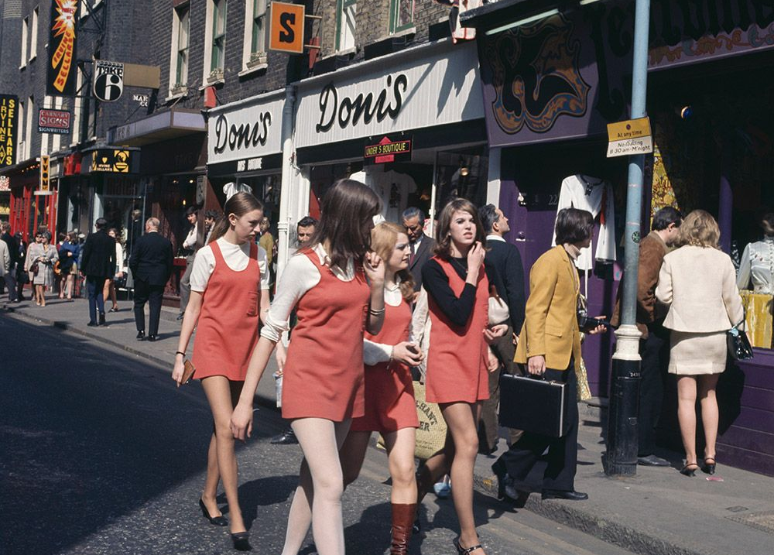
Recap London: the 1960s
Laissez-faire: policy of minimum governmental interference in the economic affairs of individuals and society
  Individualism, freedom, and liberty were depicted as opposed to the stifling bureaucratic ineptitude of the state apparatus and oppressive trade union power (Harvey 2005)
  “Development rights have been de-nationalized, development values have been unfrozen; real estate speculation has thus been ‘liberated.’ In conjunction with the relaxation of rent control have given the green light to the continuing inflation of property prices” (Glass 1964)
“Gleam of affluence in Central London and many of its suburbs: abundance of goods, gadgets, cars, and new buildings; glossiness”
The Swinging Sixties

Slide 4
Recap Notes
Goal of Article/Book/Chapter:
  Glass is seeking to address the rapid changes in London, namely the displacement of the original working-class occupiers as “the whole social character of some districts” is changing, while the remaining pockets of blight are becoming denser
Question/Problem Being Addressed:
  A changing London is unfolding before Glass. A new, postwar iteration that is glossier and wealthier; more inefficient and socially isolated
Argument:
  Glass suggests that gentrification is guided by the middle-class’ shifting ideological orientations toward the city → “One by one, many of the working-class quarters of London have been invaded by the middle classes – upper and lower”

Slide 5
Recap Notes
Conclusions:
  London has grown in a conservative fashion, by a process of aggregation…in the course of expansion, the old social boundaries have been perpetuated and extended
  There are shifts in the orientation of the upper and middle classes themselves: their anti-urban bias has been substantially modified
Key Quote:
  “Once this process of ‘gentrification’ starts in a district, it goes on rapidly until all or most of the original working-class occupiers are displaced, and the whole social character of this district is changed”

Slide 6
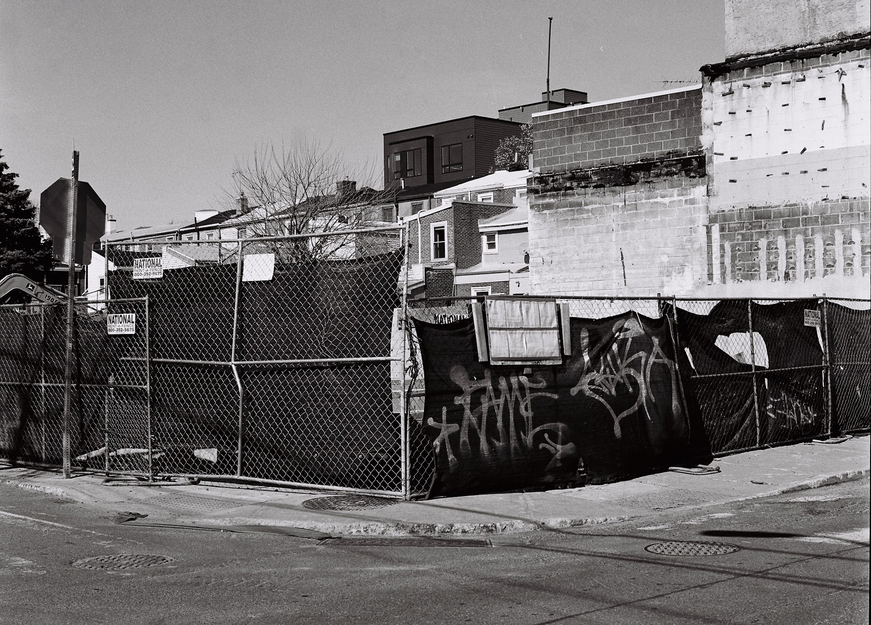
Gentrification: evolution of a concept
Gentrification is typically associated with:
  Generalized upscaling
  Appropriation by elites of something once belonged to working class, particularly ethnic and racial minorities
  The loss of authenticity and community
  Involuntary change
Gentrification no longer narrowly refers to urban residential change – we now have a more flexible and nimble evocations of the term that are increasingly detached from urban political-economic transformation

Slide 7

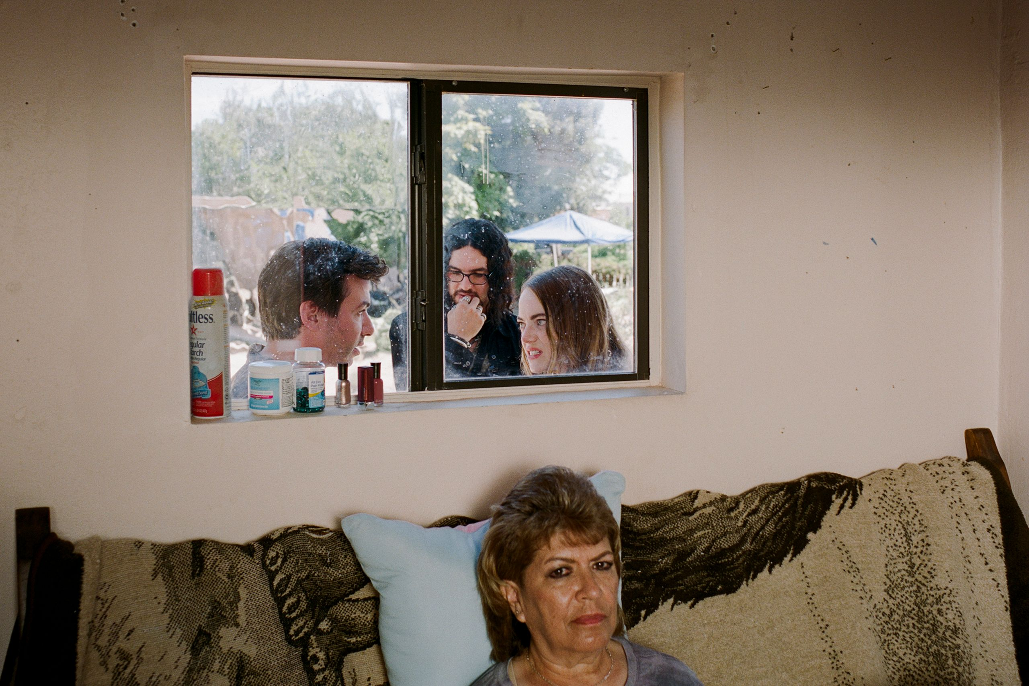
Don’t say the g-word, “The Curse” (2023)
Notes:
To begin today’s lecture, I wanted to start with a brief viewing of an episode from the 2023 show called “The Curse” – a satirical dark comedy about many things, but about housing speculation. This clip will bring us into the world of how cultural producers – artists, showrunners, writers – use gentrification in their art to communicate their ideas about the world. This will also bring us into how gentrification exists “out in the world.”
How do these cultural producers frame gentrification?

Slide 8
Don’t say the g-word, “The Curse” (2023)
How do these cultural producers frame gentrification?

Slide 9

Japonica Brown-Saracino
Sociologist and Ethnographer (Boston University): How meanings and concepts take shape and influence social life
The Death and Life of Gentrification: A New Map of a Persistent Idea (2026)
How Places Make Us: Novel LBQ Identities in Four Small Cities (2017)
A Neighborhood that Never Changes: Gentrification, Social Preservation, and the Search for Authenticity (2009)

Slide 10
Group discussion
Group 1
What is goal of this chapter?
What question(s) is the author asking? Why are they asking it?
Group 2
What problem is this text seeking to address?
What argument is the author making?
Group 3
What types of methods/data does the author use?
Why does the author engage with these types of data?

Slide 11
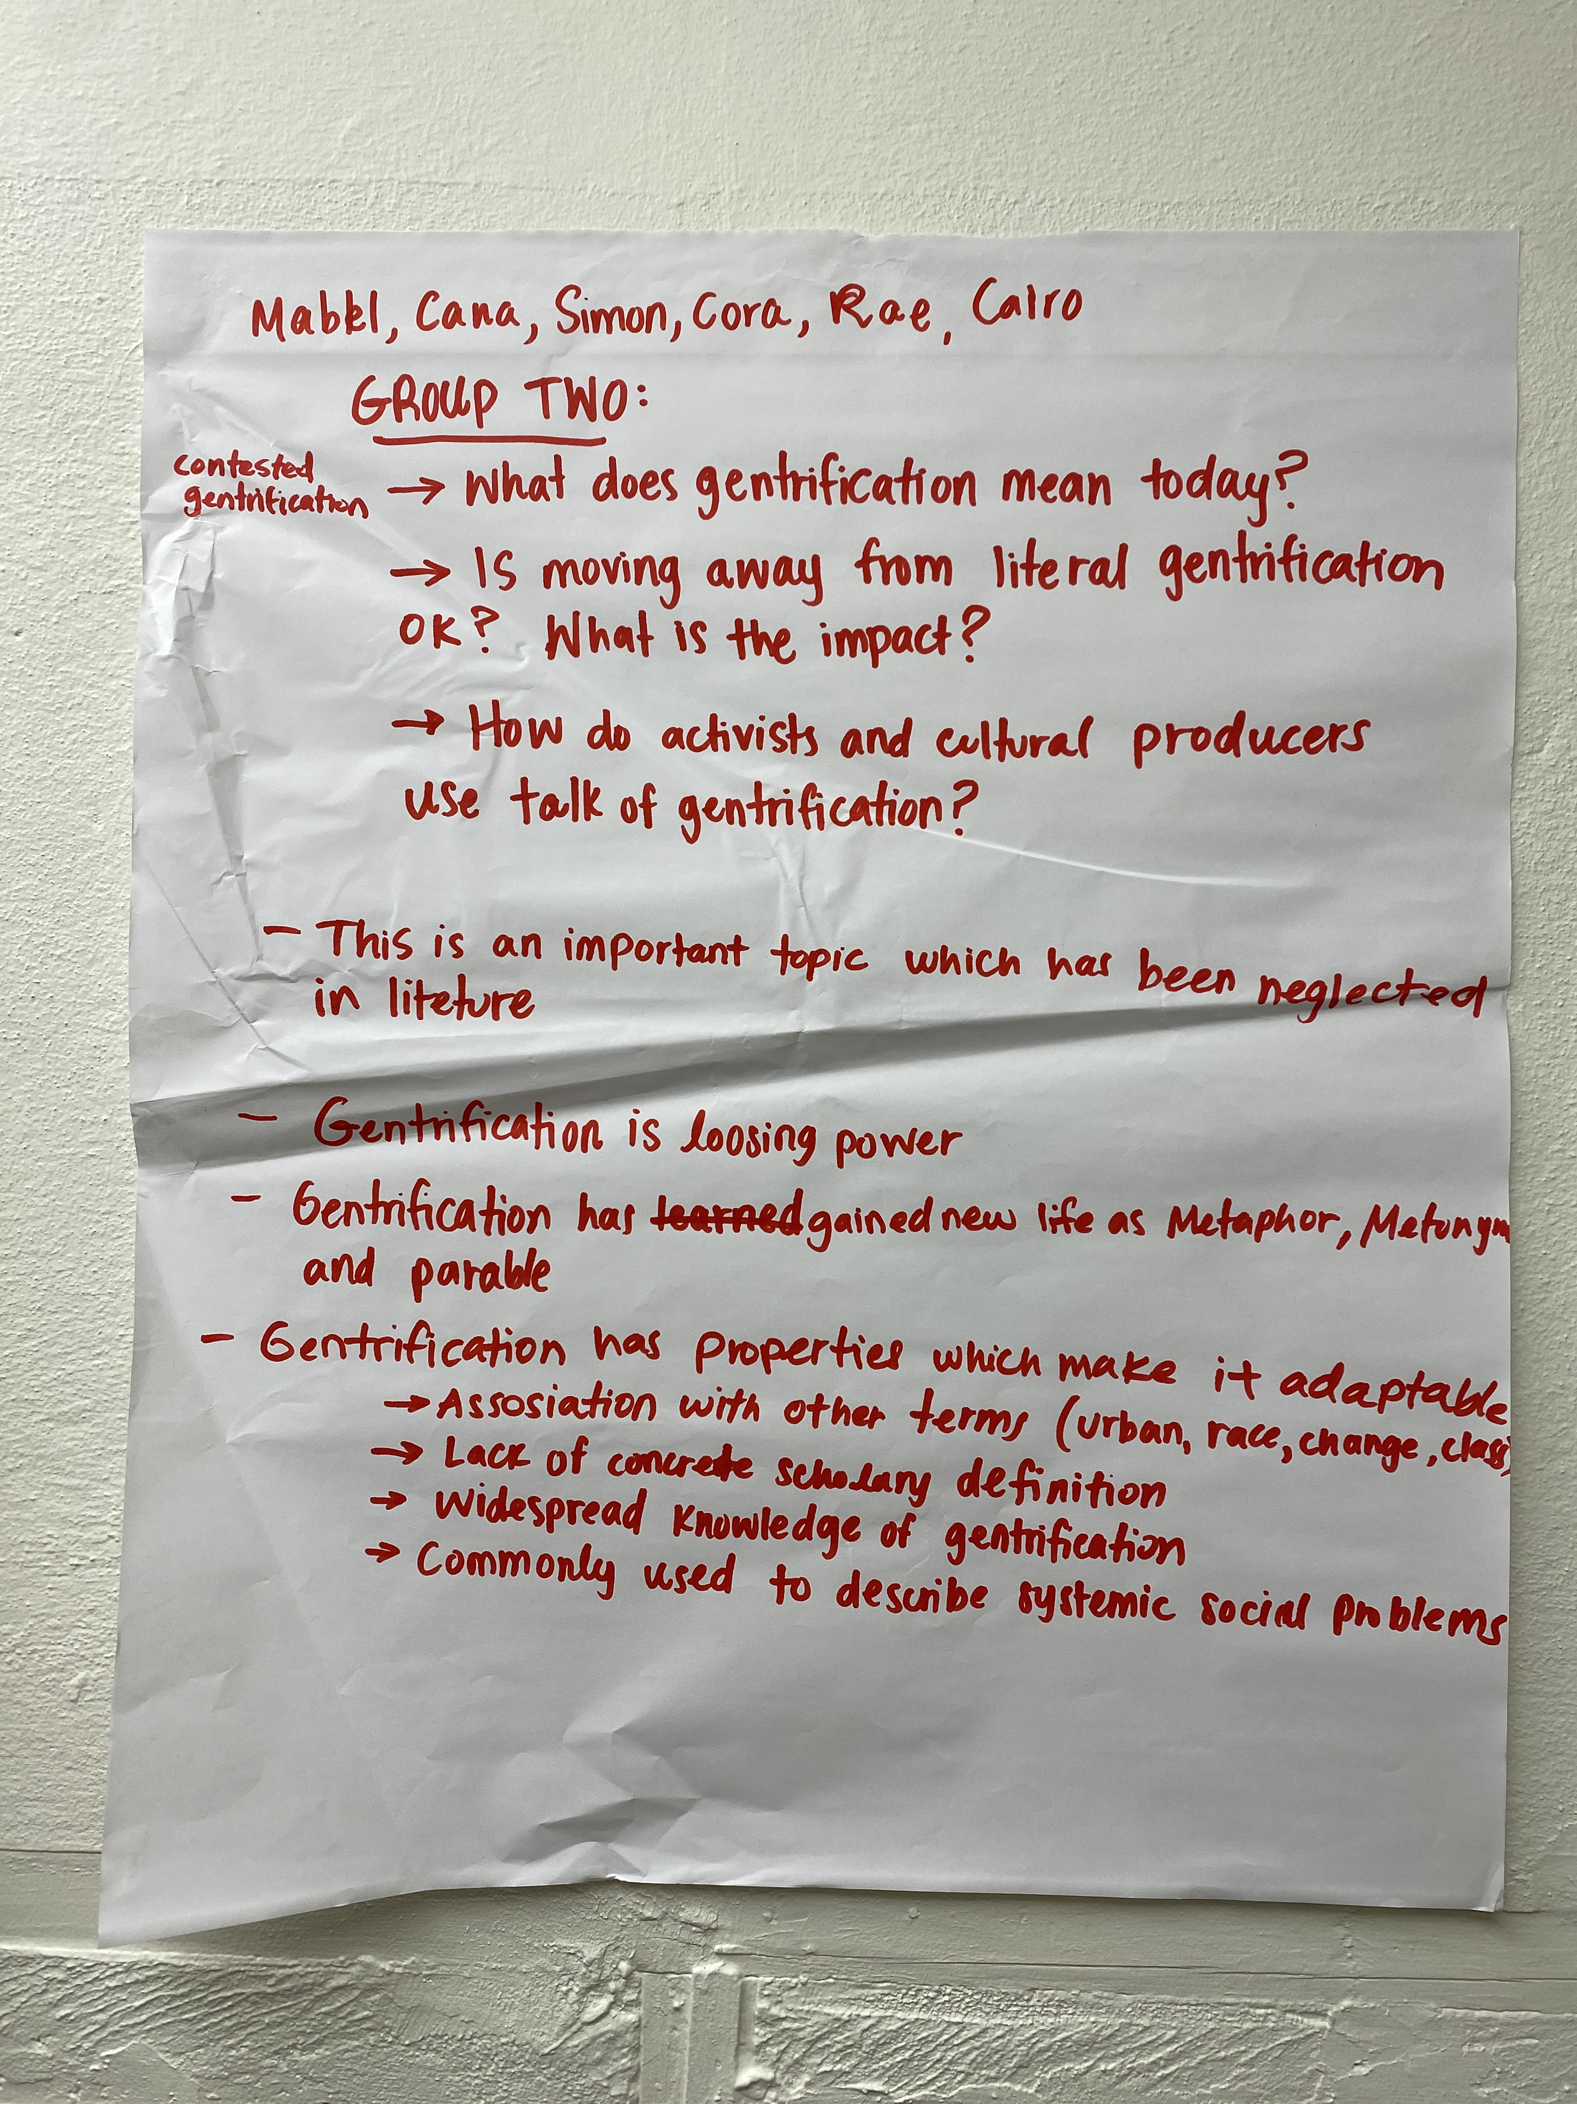
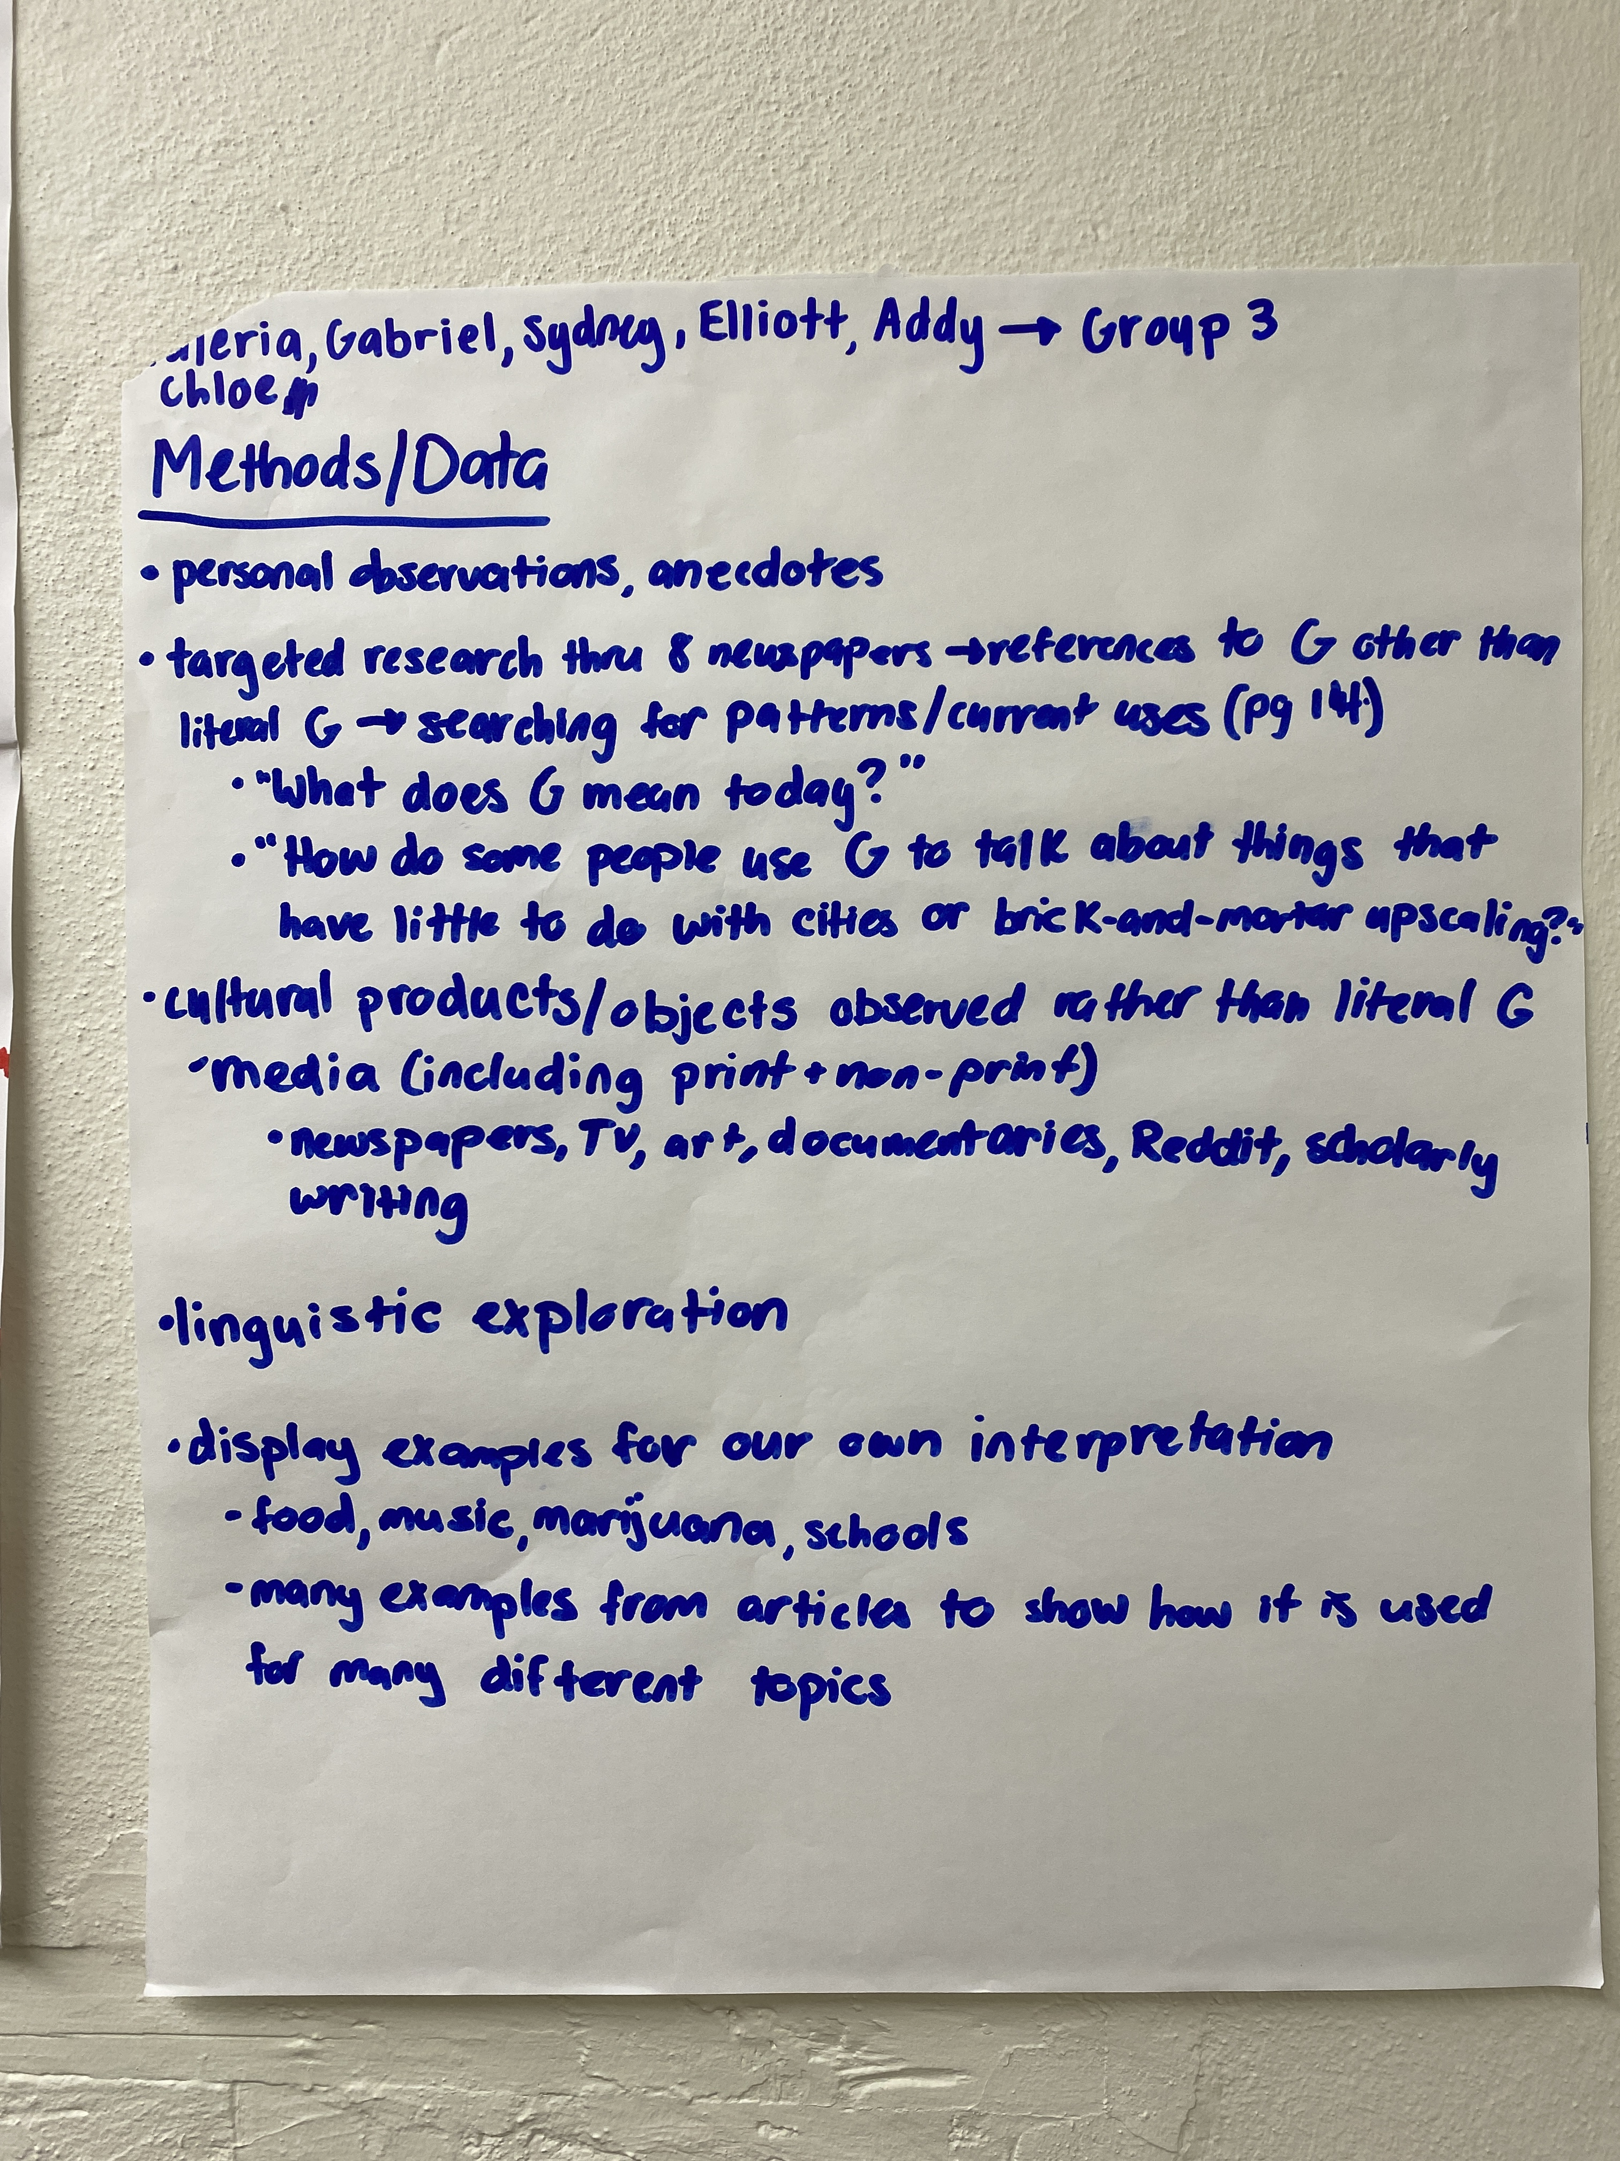
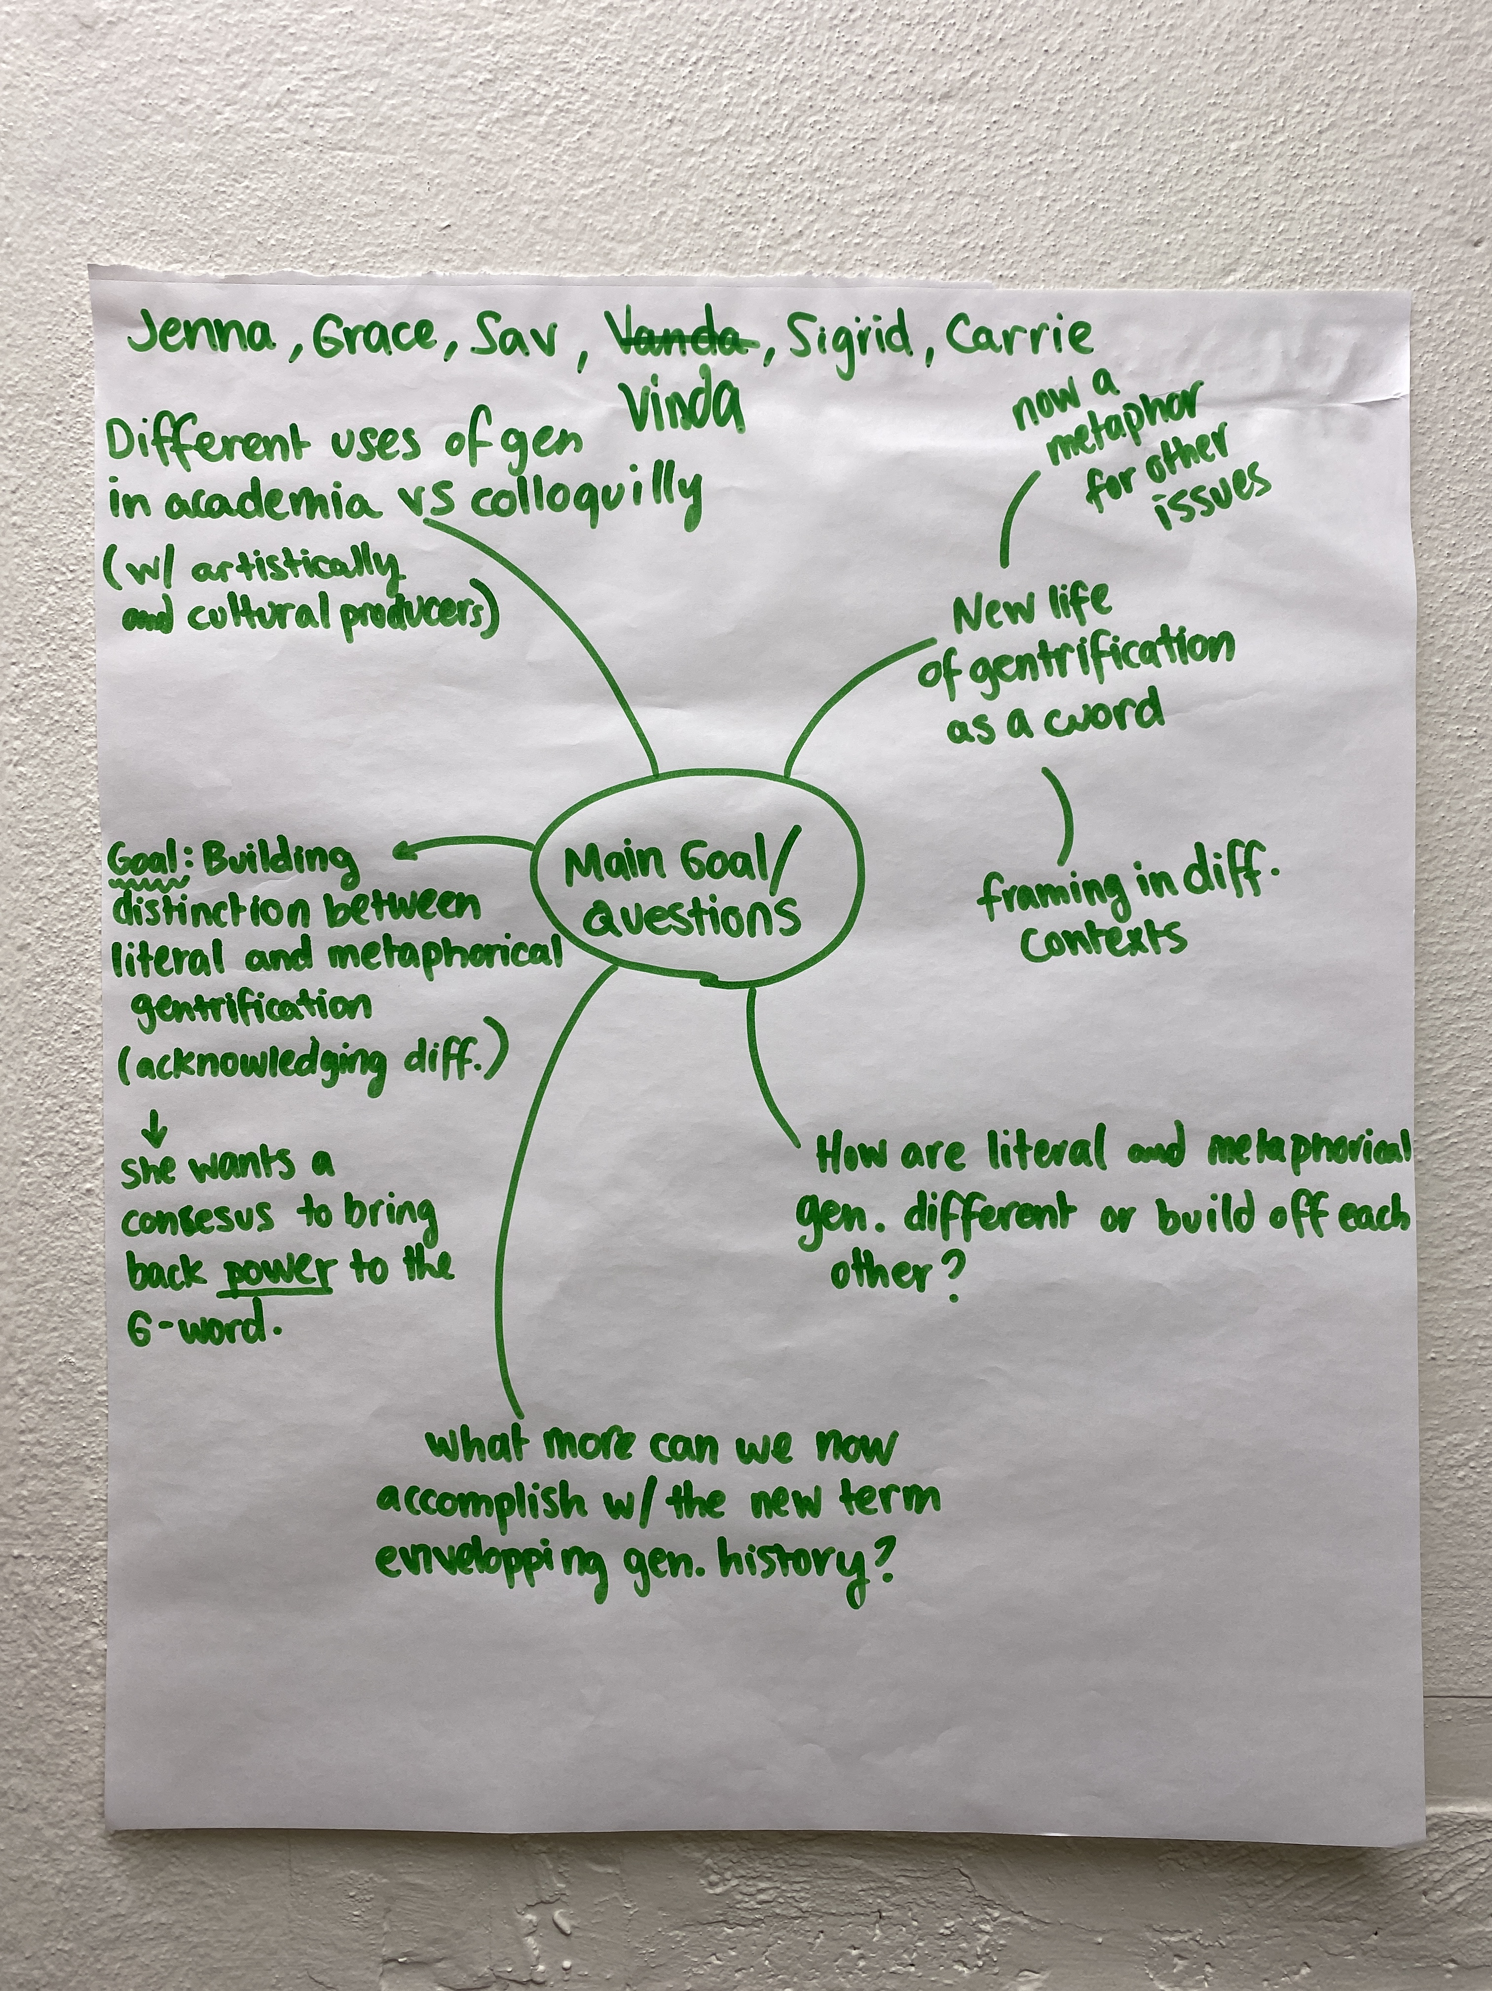
Group Discussion notes

Slide 12
For next class
Required Reading:
Neil Smith, A Short History of Gentrification (1998), Pp. 31 – 36
Sharon Zukin, Gentrification as Market and Place (1991), Pp. 37 – 44

