Slide 1
Histories of Utopias
Powerponts are not ideal for eminars but we need visual information as well

Slide 2
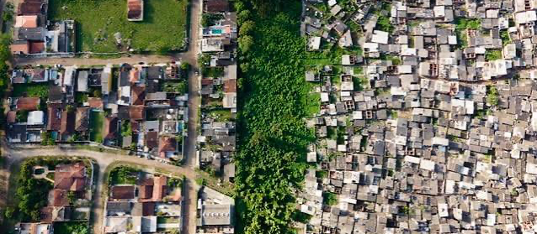
SLODCZYCK
Before History, What is the relationship of ”good” architecture and good society?

Slide 3
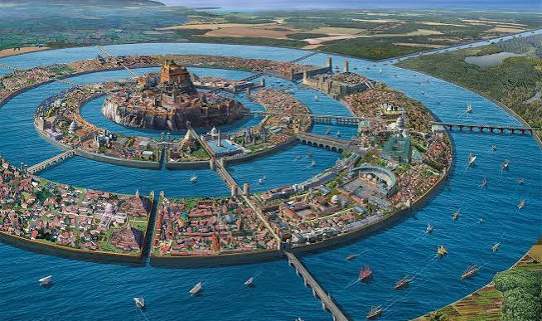
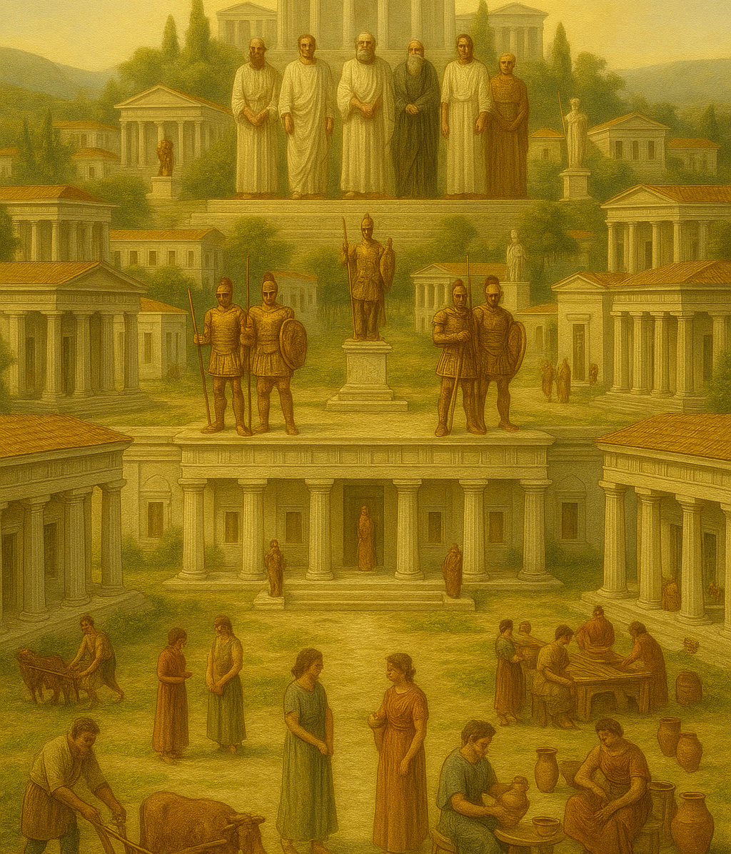
Plato 427-348 BCE Greece
The Republic: hierarchical society with communal ownership but strict rules. Women given equal education but without households, women and children shared (or vice versa).
Slavery unclear
The City of Atlantis (in the Timaus) wealthy and powerful city but becomes corrupted and is destroyed by Poseidon

Slide 4

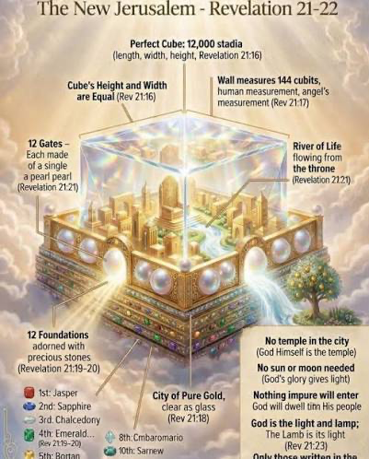
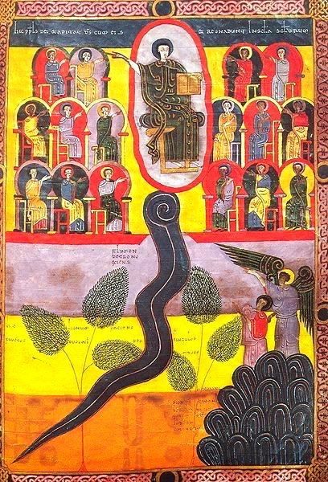
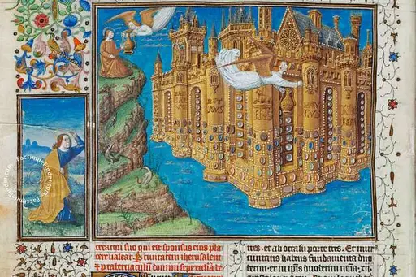
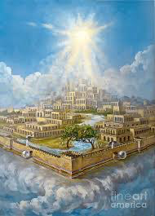
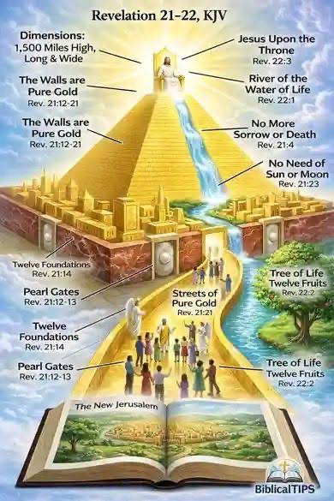

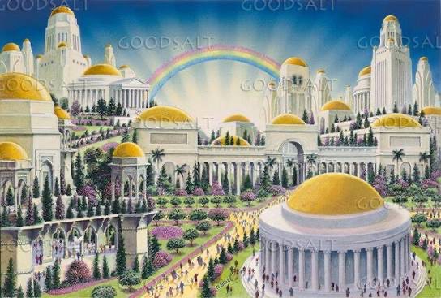
The New Jerusalem

Slide 5
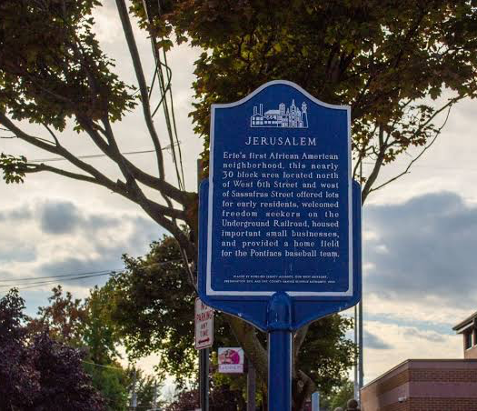
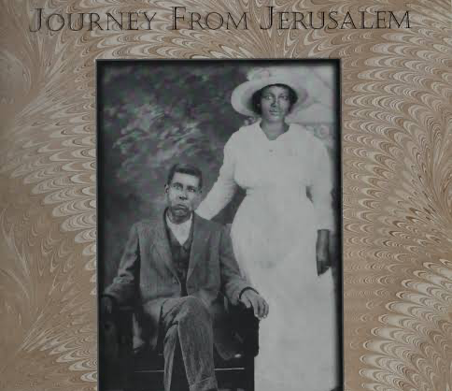
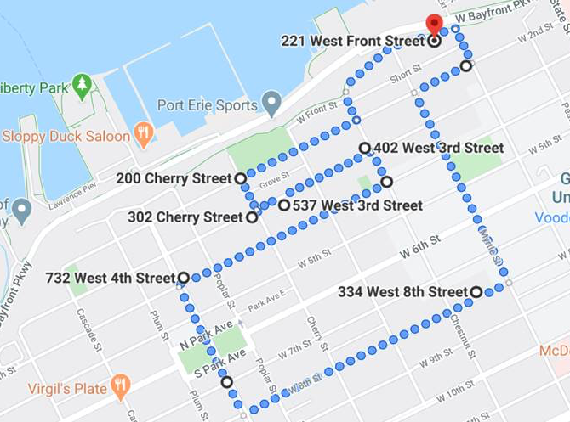
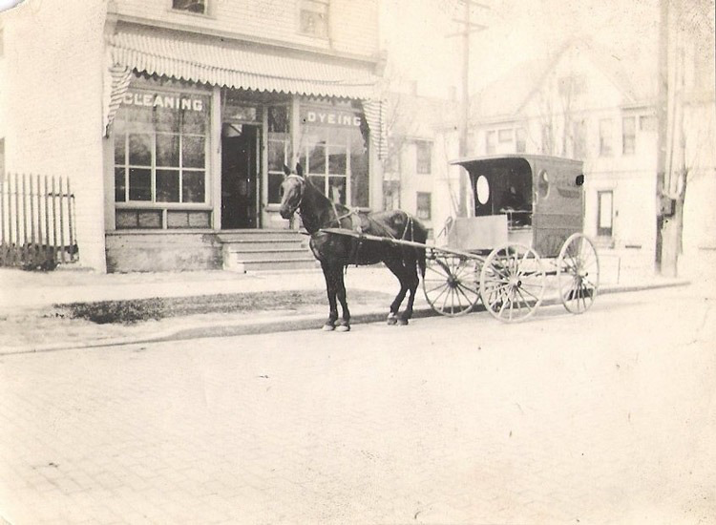
New Jerusalem PA Founded 1827, Erie PA
White Abolitiionist created a haven for escaped slaves and destitute whites to whom he sold lots and offered schoosl.Separated from the city center by a ravine (canal) that was eventually filled in, linking to city and iminishing black identity. Urban renewal and reshaping area eliminated most. Not predominantly black today

Slide 6
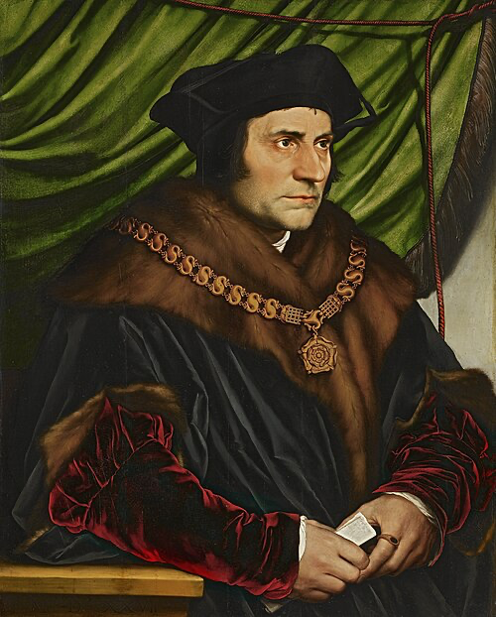
Sir/St. Thomas More, England 1478-1535. Utopia 1516
Catholic lawyer/statesman from legal family; trained in law and attracted by monastic life and literature.
Married twice, four children, wards –sought to educate women.
Political career rises from parliamentarian to advisor under Cardinal Wolsey, whom he follows as Chancellor to Henry VIII.
While he persecutes Protestant ”heretics” possibly including torture and burning, he is reluctant to publicly accept claims of Henry VIII to make policies for an English church (marriage). This allows his enemies ways to accuse him of treason.
Beheaded 1535. Canonized 1935.

Slide 7
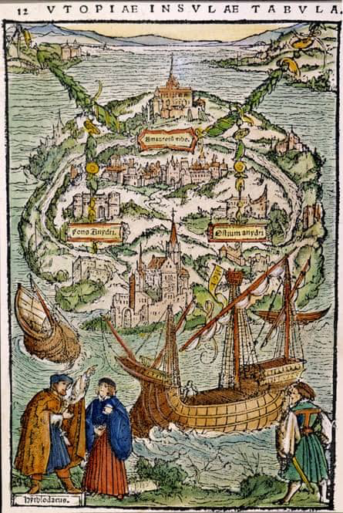
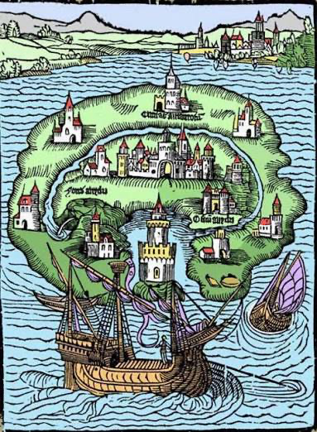
Form and Function
40000 sq mi (almost PA)
Population 54 cities up to 6000 households (up to 10 including two slaves) up to 3.25 million
Hierarchies
Geometries
Separation

Slide 8
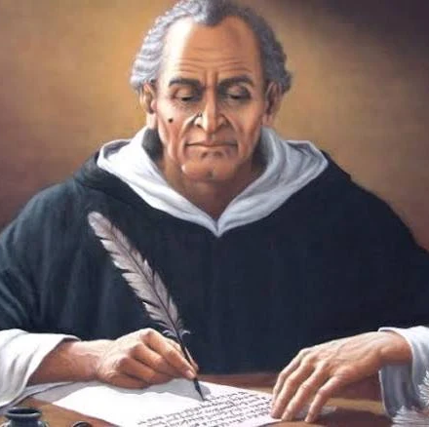
The Renaissabce Utopia: Tommaso Campanella, 1568-1639. Philosopher, Astrologer and Prisoner
Born in poverty enters religious life at 14. By 1594 active as philosopher but put in house arrest for heresy. Accused of plotting against Spanish rule in South Italy, where he planned millennial communal community. Tortured and imprisoned 1599-162§ during which he writes CITY OF THE SUN (1602) and other works. Released to serve the Pope as astrologer and magician until forced to flee to French court in 1634 after more secular politics.

Slide 9
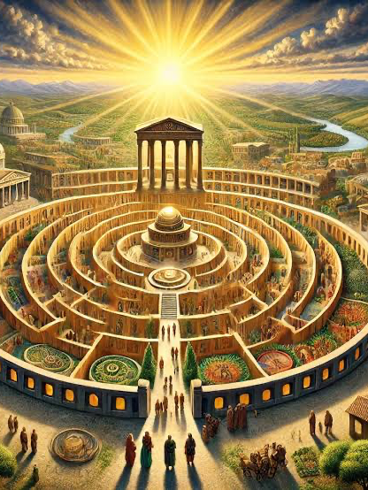
Governance (no sense of origins except people come from India
Communal under rule of magisters The great ruler among them is a priest whom they call by the name Hoh, though we should call him Metaphysic. He is head over all, in temporal and spiritual matters, and all business and lawsuits are settled by him, as the supreme authority. Three princes of equal power—viz., Pon, Sin, and Mor—assist him, and these in our tongue we should call Power, Wisdom, and Love. To Power belongs the care of all matters relating to war and peace. He attends to the military arts, and, next to Hoh, he is ruler in every affair of a warlike nature. He governs the military magistrates and the soldiers, and has the management of the munitions, the fortifications, the storming of places, the implements of war, the armories, the smiths and workmen connected with matters of this sort….. Love is foremost in attending to the charge of the race. He sees that men and women are so joined together, that they bring forth the best offspring. Indeed, they laugh at us who exhibit a studious care for our breed of horses and dogs, but neglect the breeding of human beings. Thus the education of the children is under his rule. So also is the medicine that is sold, the sowing and collecting of fruits of the earth and of trees, agriculture, pasturage, the preparations for the months, the cooking arrangements, and whatever has any reference to food, clothing, and the intercourse of the sexes. Love himself is ruler, but there are many male and female magistrates dedicated to these arts.

Slide 10
Social Relations
Labor: All are trained in many offices but do those they do best. Women sedentary: “It is customary to choose women for milking the cows and for making cheese.” Given this shared labor, most work only 4 hrs/day.
No private families or friends; reproduction to better population.
“When their women have brought forth children, they suckle and rear them in temples set apart for all. They give milk for two years or more as the physician orders. After that time the weaned child is given into the charge of the mistresses, if it is a female, and to the masters, if it is a male. And then with other young children they are pleasantly instructed in the alphabet, and in the knowledge of the pictures, and in running, walking, and wrestling; also in the historical drawings, and in languages; and they are adorned with a suitable garment of different colors. After their sixth year they are taught natural science, and then the mechanical sciences. The men who are weak in intellect are sent to farms, and when they have become more proficient some of them are received into the State. And those of the same age and born under the same constellation are especially like one another in strength and in appearance, and hence arises much lasting concord in the State, these men honoring one another with mutual love and help. Names are given to them by Metaphysicus, and that not by chance, but designedly, and according to each one's peculiarity, as was the custom among the ancient Romans. Wherefore one is called Beautiful (Pulcher), another the Big-nosed (Naso), another the Fat-legged (Cranipes), another Crooked (Torvus), another Lean (Macer), and so on”

Slide 11
Additional Themes
WAR:
The triumvir, Power, has under him all the magistrates of arms, of artillery, of cavalry, of foot-soldiers, of architects, and of strategists; and the masters and many of the most excellent workmen obey the magistrates, the men of each art paying allegiance to their respective chiefs. Moreover, Power is at the head of all the professors of gymnastics, who teach military exercise, and who are prudent generals, advanced in age…..The women also are taught these arts under their own magistrates and mistresses, so that they may be able if need be to render assistance to the males in battles near the city. They are taught to watch the fortifications lest at some time a hasty attack should suddenly be made. In this respect they praise the Spartans and Amazons
FOOD AND HEALTH: Their food consists of flesh, butter, honey, cheese, garden herbs, and vegetables of various kinds. They were unwilling at first to slay animals, because it seemed cruel; but thinking afterward that is was also cruel to destroy herbs which have a share of sensitive feeling, they saw that they would perish from hunger unless they did an unjustifiable action for the sake of justifiable ones, and so now they all eat meat. Nevertheless, they do not kill willingly useful animals, such as oxen and horses. They observe the difference between useful and harmful foods, and for this they employ the science of medicine. The length of their lives is generally 100 years, but often they reach 200. …..As regards drinking, they are extremely moderate. Wine is never given to young people until they are ten years old, unless the state of their health demands it. After their tenth year they take it diluted with water, and so do the women, but the old men of fifty and upward use little or no water. They eat the most healthy things, according to the time of the year

Slide 12
Religion
The chief priest is Hoh, and it is the duty of all the superior magistrates to pardon sins. Therefore the whole State by secret confession, which we also use, tell their sins to the magistrates, who at once purge their souls and teach those that are inimical to the people.
Beyond all other things they venerate the sun, but they consider no created thing worthy the adoration of worship. This they give to God alone, and thus they serve Him, that they may not come into the power of a tyrant and fall into misery by undergoing punishment by creatures of revenge.…
The inhabitants of the City of the Sun do not fear death, because they all believe that the soul is immortal, and that when it has left the body it is associated with other spirits, wicked or good, according to the merits of this present life.
They do not bury dead bodies, but burn them, so that a plague may not arise from them, and so that they may be converted into fire, a very noble and powerful thing, which has its coming from the sun and returns to it. And for the above reasons no chance is given for idolatry.

Slide 13
Comparisons with More and Plato?

Slide 14
One Genealogy of Utopian Thought
Early Men and Patriarchal Contol of Communal Place –Plato to Mor
Renaissance Models: Emphasis on Physical Form
Enlightenment Projects Fourier, Howard

Slide 15
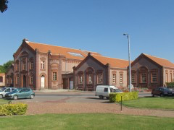
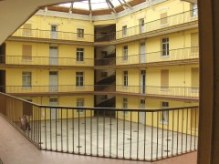
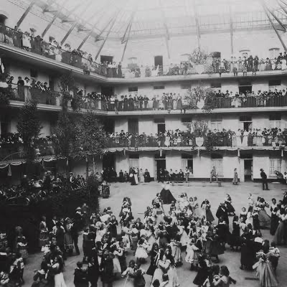
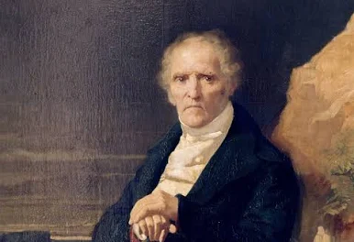
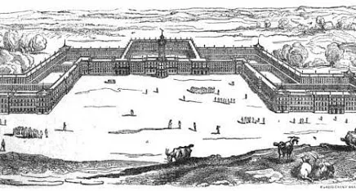
Industrial Utopias: Charles Fourier 1772-1837. Petit bourgeois heir who wrote after 1810 iso others built “phalansteres “
A single building communal society with productive wings and a communal space as well as wings for visitors. The size was 1620 which included the number of people needed to supply all the passions of others according to a wide template ranging from passion to rule or to taste to sexual activities or not. He laid this out in a book called the NEW AMOUROUS WORLD which is regarded as a precursor for contemporary queer theory.
Many sort-lived settlements were founded in France and the US.

Slide 16
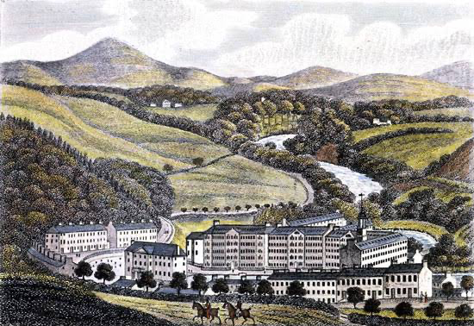
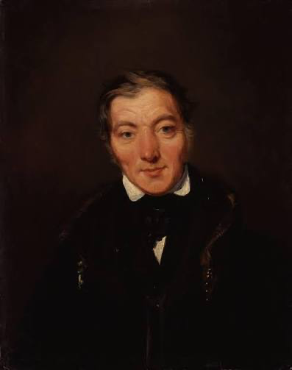
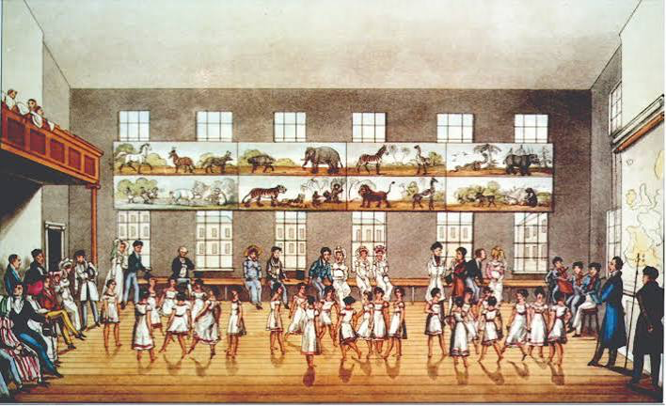
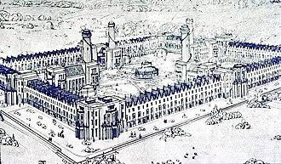
Robert Owen, UK
1771-1858
Established city divided among industrial, residential and central zone that handled communal education for children. In 1824 moved to US and established New Harmony Indiana, which took over from George Rapp of Ambridge… It failed in 1824. Ownes fought for reforms including no child
employment under 10, child
\. Care and education.

Slide 17

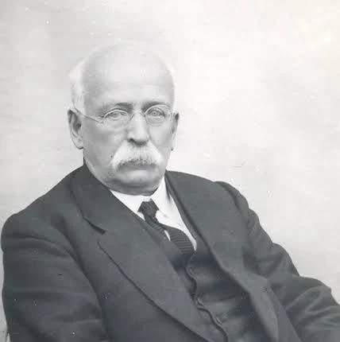
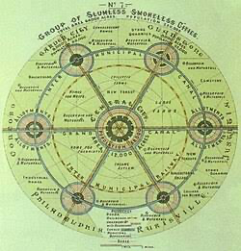
Ebenezer Howard UK 1850-1928
Left school early; 1871-1876 in U.S. (Chicago Rebuilding); worked most of his life with a firm that produced transcripts of Parliament. Amateur inventor and planner, influenced by contemporary utopian models

Slide 18
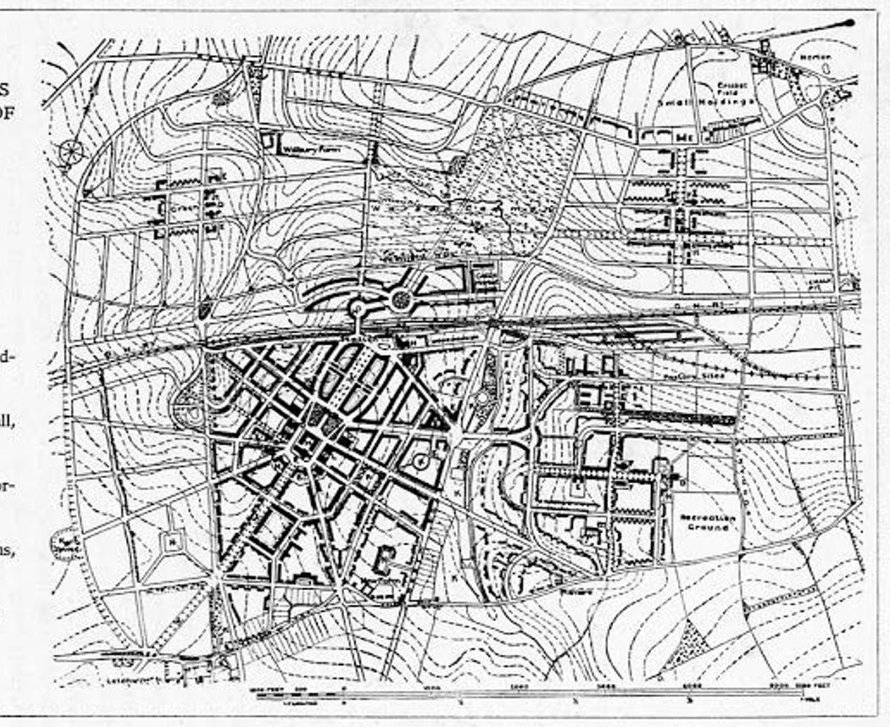
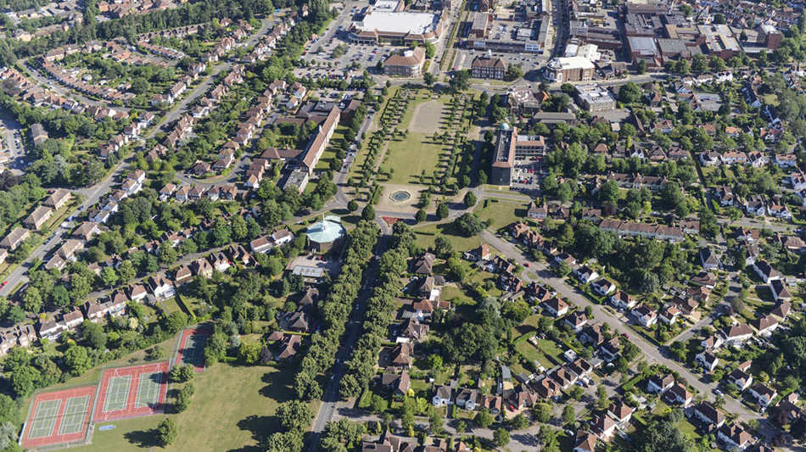
Letchworth Garden City 1903
Begun under Howard’s leadership on agricultural plot 51 km from London. Run by First Garden City until 1960s when it gained public control. Population 33.000+ Landlord reinvests for Heritage Foundation, large conservation areas.

Slide 19
Life and Heritage
https://www.bbc.com/news/av/uk-england-beds-bucks-herts-26631835
https://www.youtube.com/watch?v=j7wwHIP0EsQ “Today, most garden cities look like any other English town with a fountain in the center.”
Failed to deal with growth and change, practicality over vision.

Slide 20



Frank Lloyd Wright Usonian Homes & Broadacre City

Slide 21

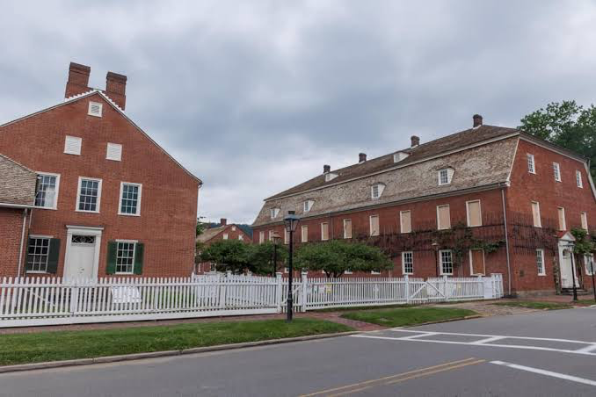

Counterpoints from Experience Economy PA and Lexington MA

Slide 22
Counterpoints From Other Positions
Ability –Leeson and the dystopia of poor care
Gender –
(What Else?)

Slide 23
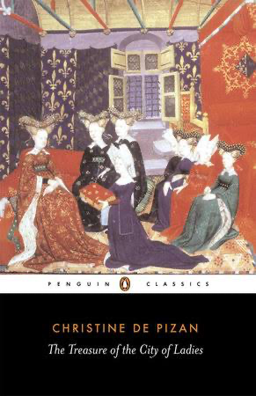

Johns’ Feminist Overview
Compare and alternate genealogy as well as alternate viewpoints –where is More? Howard?
Characteristics of feminist utopias, according to Johns:
Focus on education (continuing, but not always critical)
Human nature adaptable –perhaps not men (Separatist utopias)
Gradualist
Pragmatic

Slide 24
Feminist Separatist Utopias https://www.theguardian.com/books/2022/may/25/sandra-newman-female-utopian-fiction
Charlotte Perkins HERLAND –explorers land in a female country
“Women excel in all occupations. Older women gain prestige instead of losing it; the women are physically formidable and easily subdue their male captives. Charmingly, the narrator says of the national costume: “I see that I have not remarked that these women had pockets in surprising number and variety.” Their babies never cry.
Much less charmingly, we’re assured the Herland women are Aryans, and their society is focused on the perfection of their race. In fact, many of the hallmarks of fascism are here: the paganism, the obsession with cleanliness, the emphasis on gymnastics, the eugenics. The Herlanders also have no erotic or even romantic feelings for each other; they have bred those dirty things out.” (Newman 2022)

Slide 25
FOR OUR MODELS How do Separatist Utopias Fit our model?
Multi/plicity versus shared velief

Slide 26
Which comes first –plan/vision or community?

Slide 27
What is aesthetically pleasing?

Slide 28
How do we govern? And when people are bad?

