Slide 1
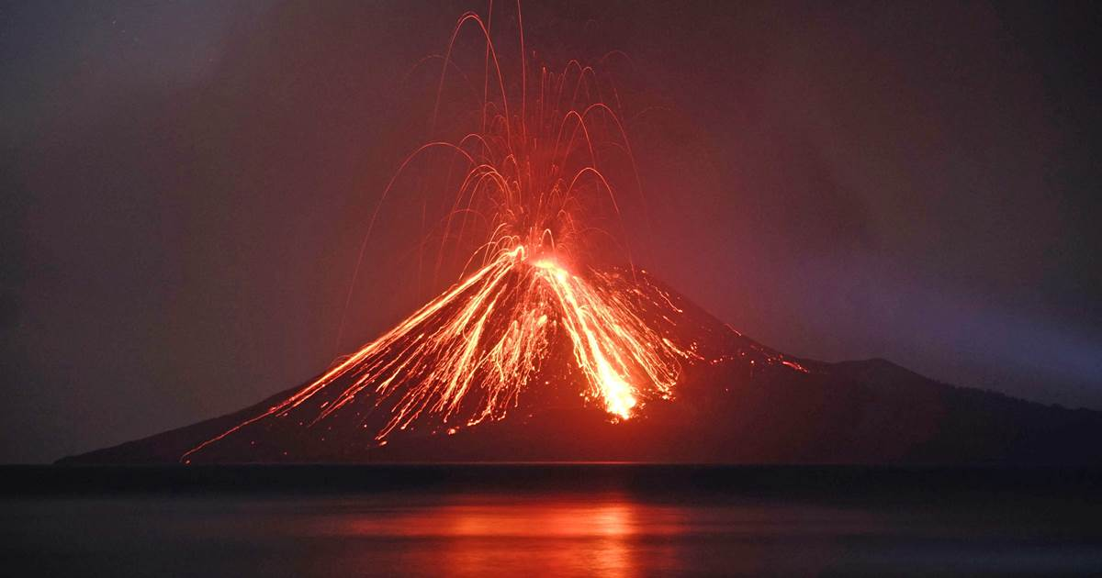
Chapter 3
The Ever-Changing Earth: The Biosphere and Biogeochemical Cycles

Slide 2
Which has a greater influence on Earth’s environment today: natural processes or human activities? Why? Give one example that supports your stance.

Slide 3
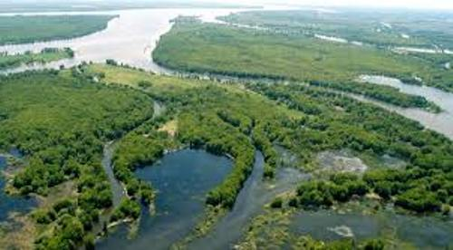
Ch 3 Introduction—Environment
The environment is everything that surrounds you, including the air, the land, the oceans, and all living things.
The natural environment is subdivided into two parts:
  Biotic: the biological environment, which includes all life forms
  Abiotic: the physical environment (nonliving matter)

Slide 4
Environment as a System—
Key System Traits
A system is a “set of components functioning together as a whole.”
  bike, insect, ecosystem, global environment, solar system
Most systems are hierarchical; smaller systems are made of smaller interacting parts.
The global environment can be analyzed in terms of three key system traits:
  Openness
  Integration
  Complexity

Slide 5
Key System Traits—Openness
Openness
  Openness refers to the degree of isolation of a system.
  Earth is essentially closed to matter, which cycles over and through the four spheres.
  The Earth is open to energy, which flows in and out of it.
    Higher quality energy is lower quality energy (entropy).

Slide 6
Energy Flow in Earth’s Open System
Approximately 30% of incoming solar energy reaching the upper atmosphere is immediately reflected back into space.
19% is absorbed by water vapor in the atmosphere.
Only about 51% reaches the Earth’s surface.
Less than 1% of the sun’s energy directly supports organisms (mainly through photosynthesis).

Slide 7
Key System Traits—Integration
Integration
  Integration refers to the strength of the interactions among the parts of the system.
example: organs of the body - highly integrated
  The degree of integration of the global environment is under debate.

Slide 8
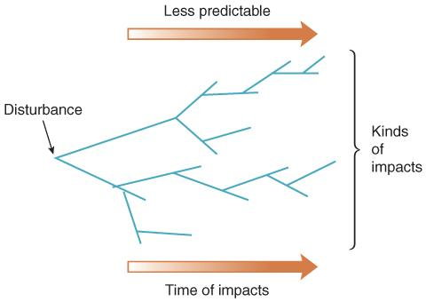
Key System Traits—Complexity
Complexity
Number of KINDS of parts a system has
The global environment is moderately integrated and highly complex.
This complexity makes the effects of disturbance difficult to predict.
Hardin’s first law of ecology states, “We can never do merely one thing.”
Figure 1.6 “We can never do merely one thing.” Whenever we do something, we cause a cascade of impacts. These
impacts become less predictable with time.

Slide 9
Positive Feedback and Negative Feedback Loops
  Positive Feedback occurs when a part of the system responds to change in a way that magnifies the initial change.
  Positive feedback usually bad; exacerbates

Slide 10
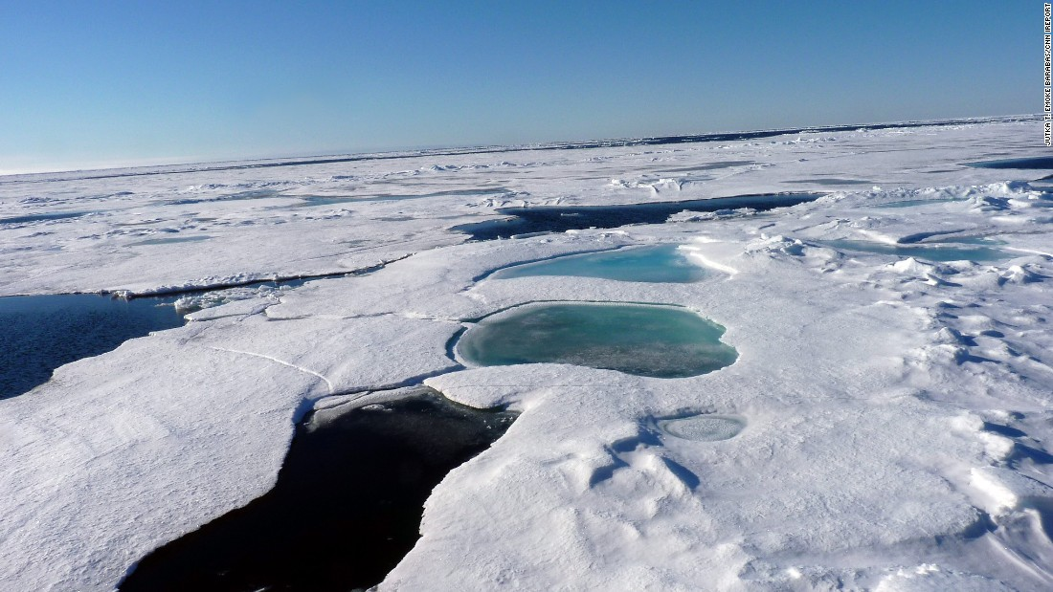
Positive Feedbacks
    Example:
      An increase in global temp
      melts some of the glaciers and snow
      decreased albedo lowers reflection of sunlight back into space
      This results in more surface area absorbing, instead of reflecting, heat.
      causes further warming increase

Slide 11
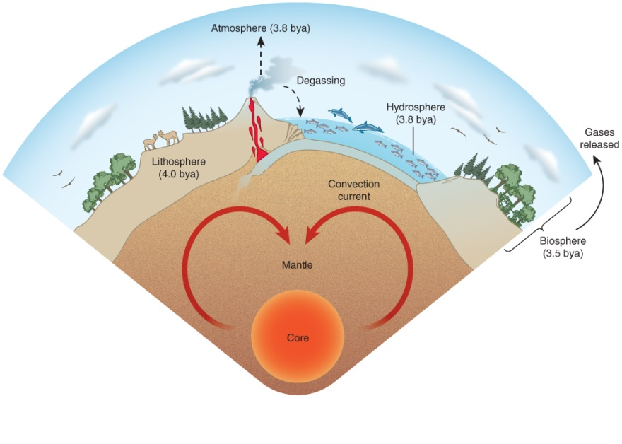
Abiotic Spheres
The physical environment (abiotic) is divided into three basic states of physical matter, which have evolved together over the course of Earth’s history:
  The lithosphere (solid)
  The hydrosphere (liquid)
  The atmosphere (gas)
  Together the four spheres make Earth a dynamic planet.

Slide 12
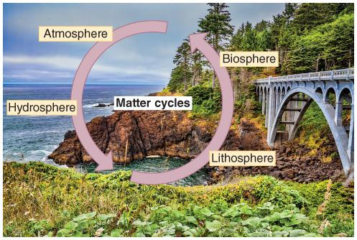
Biosphere
The Biosphere is:
the biological environment, which includes all life forms
Components of Earth system
Lithosphere,
Atmosphere,
Hydrosphere,
Biosphere
Looking at these overlapping components as a system can help better understand the environment and people’s impact on these spheres.
Notes:
usually hierarchical; composed of smaller sets of systems with even smaller interacting parts.

Slide 13
Four Spheres
We’ll talk about each of the spheres
  Lithosphere - today.
  Hydrosphere - today
  Biosphere - Next lecture
  Atmosphere - Ch 5.

Slide 14
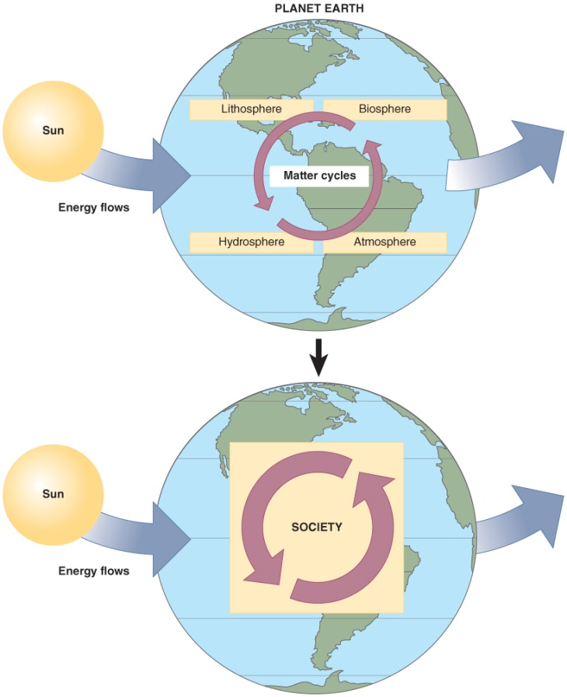
Society and the Environment
Society accelerates the cycling of matter through the four spheres, depleting resources and causing pollution.
Depletion occurs when the cycling removes matter and energy faster than natural processes are renewing them.
Ex: Groundwater
Figure 01.08 Society accelerates the cycling of matter through the four spheres, which depletes resources (matter inputs to society) and causes pollution (matter outputs by society). This acceleration is increasing because of increasing population (P) and consumption (C). Slowing population growth and reducing personal consumption will reduce this acceleration.

Slide 15
Water, Air, and Energy:
Three Major Aspects of the
Physical Environment
The surface conditions of Earth are very active and constantly changing.
  Water: Earth’s surface almost entirely covered with water
  Air: The atmosphere: 78.1% nitrogen (N); 20.9% Oxygen (O)
  Energy: Earth is bathed in radiation (heat and light energy)
The dynamic nature of Earth allows for complex overlapping cycles that maintain ecosystem services.
    CO2 = 0.04%

Slide 16
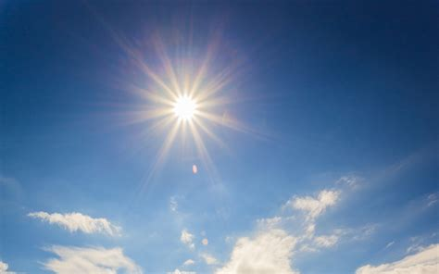
The Hydrologic Cycle

Slide 17
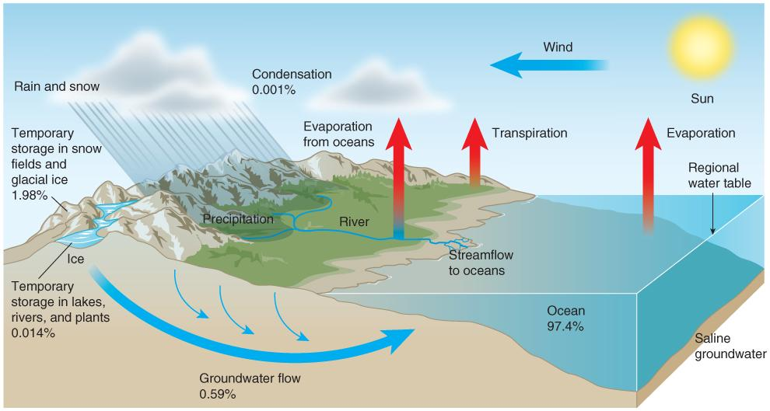
The Hydrologic Cycle
More than 97% of Earth’s water is found in seas and oceans; only 0.0015% is accessible fresh water.

Slide 18
Weather vs. Climate
The hydrologic cycle (along with atmospheric movements) is predominantly responsible for shifts in weather and climate.
Weather: the short-term, daily fluctuations in the atmospheric temperature, precipitation, and winds
Vs.
Climate: the long-term average of these same variables over time ranges of a year to thousands or millions of years
Shifts in weather and climate due to changes in the hydrosphere can directly impact the other spheres

Slide 19
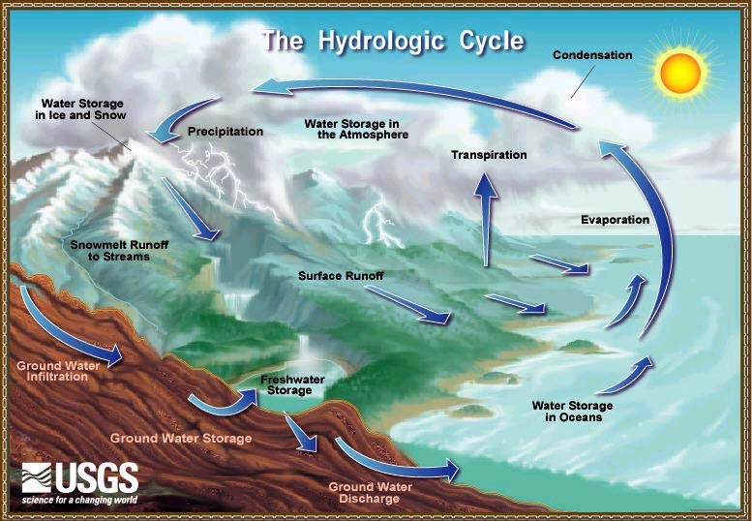

Slide 20
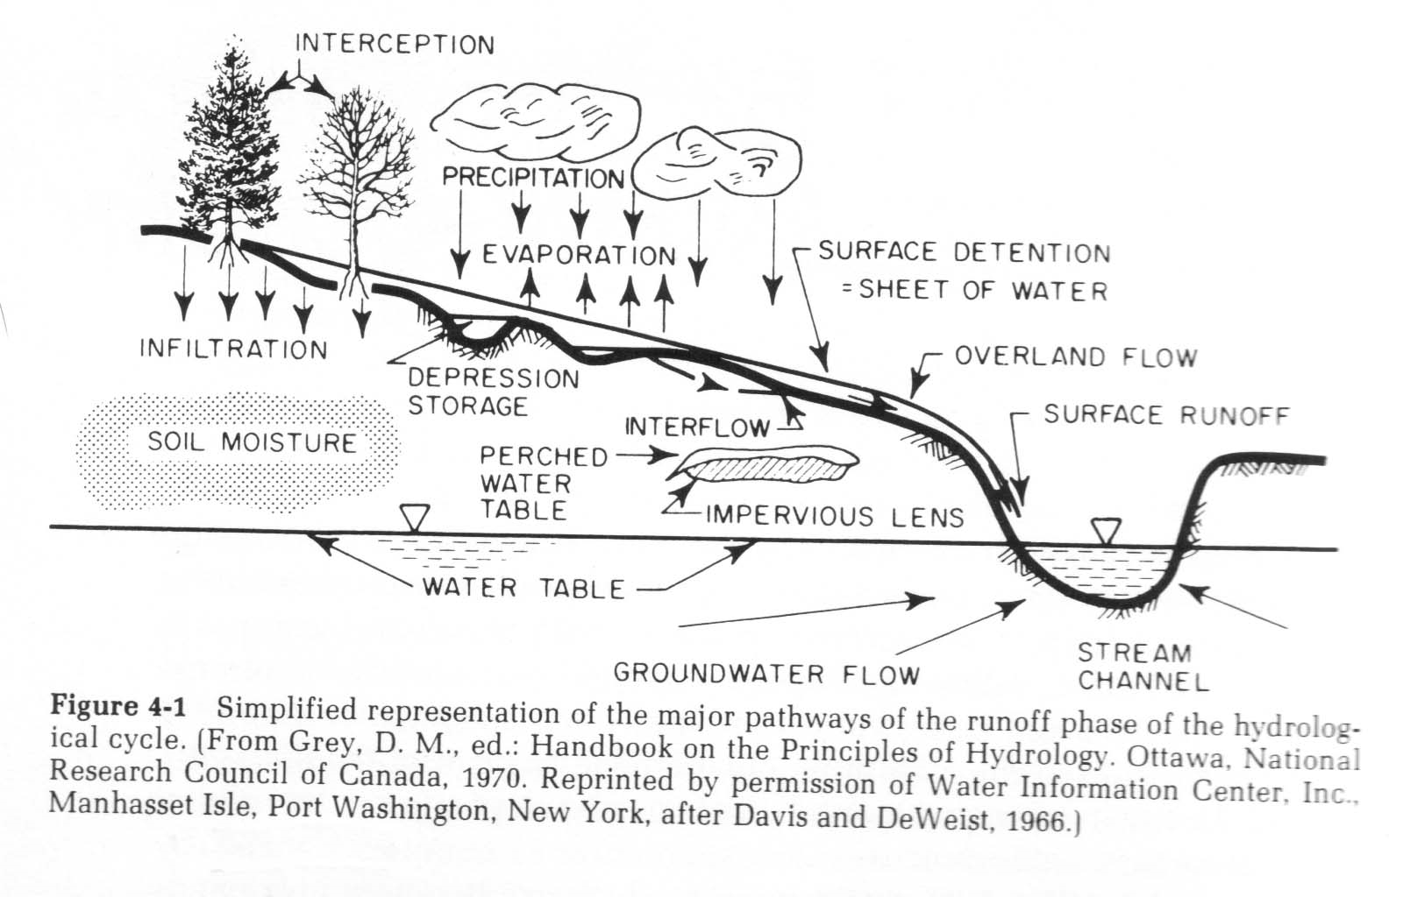
Hydrologic Cycle

Slide 21
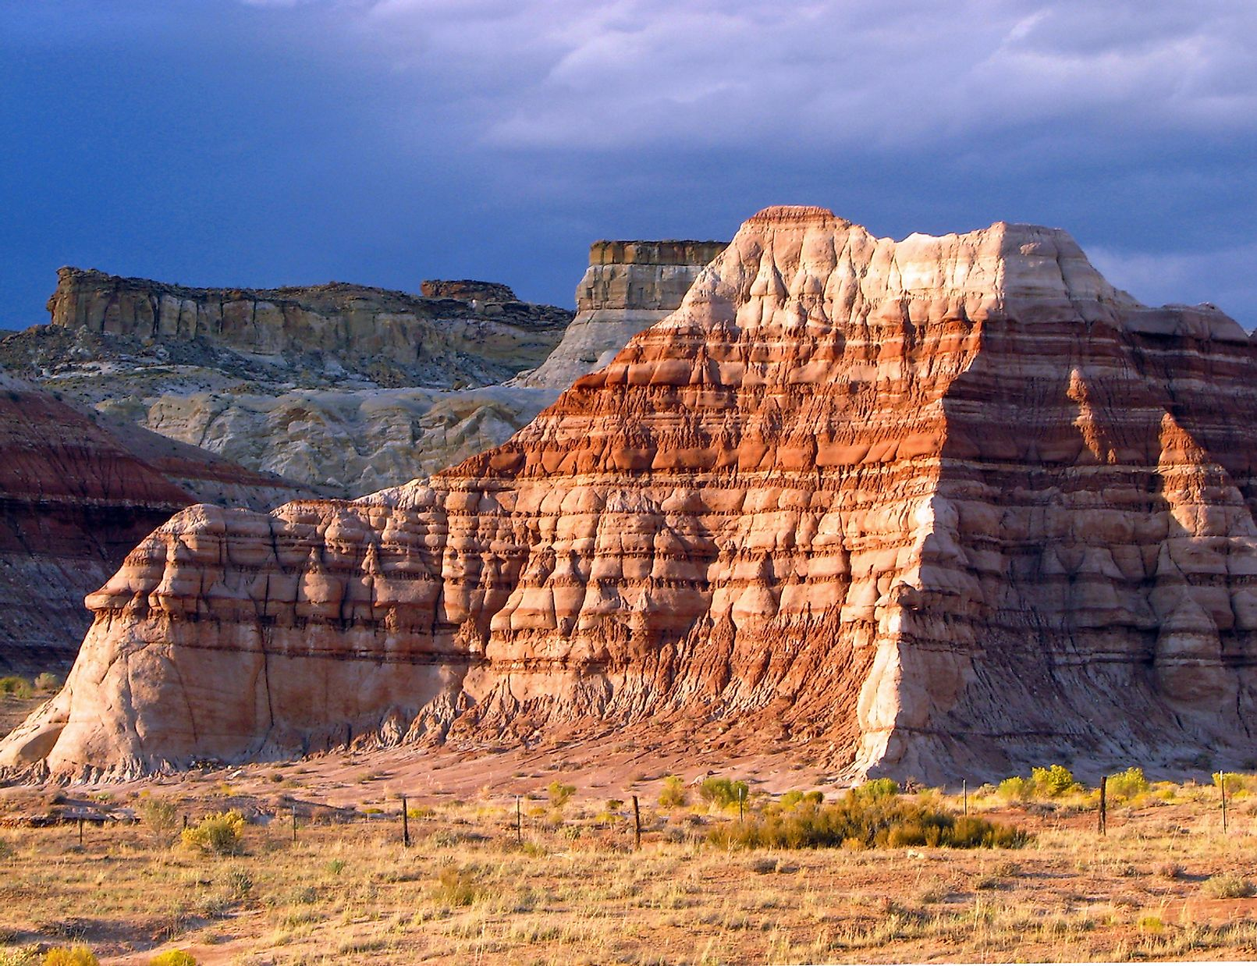
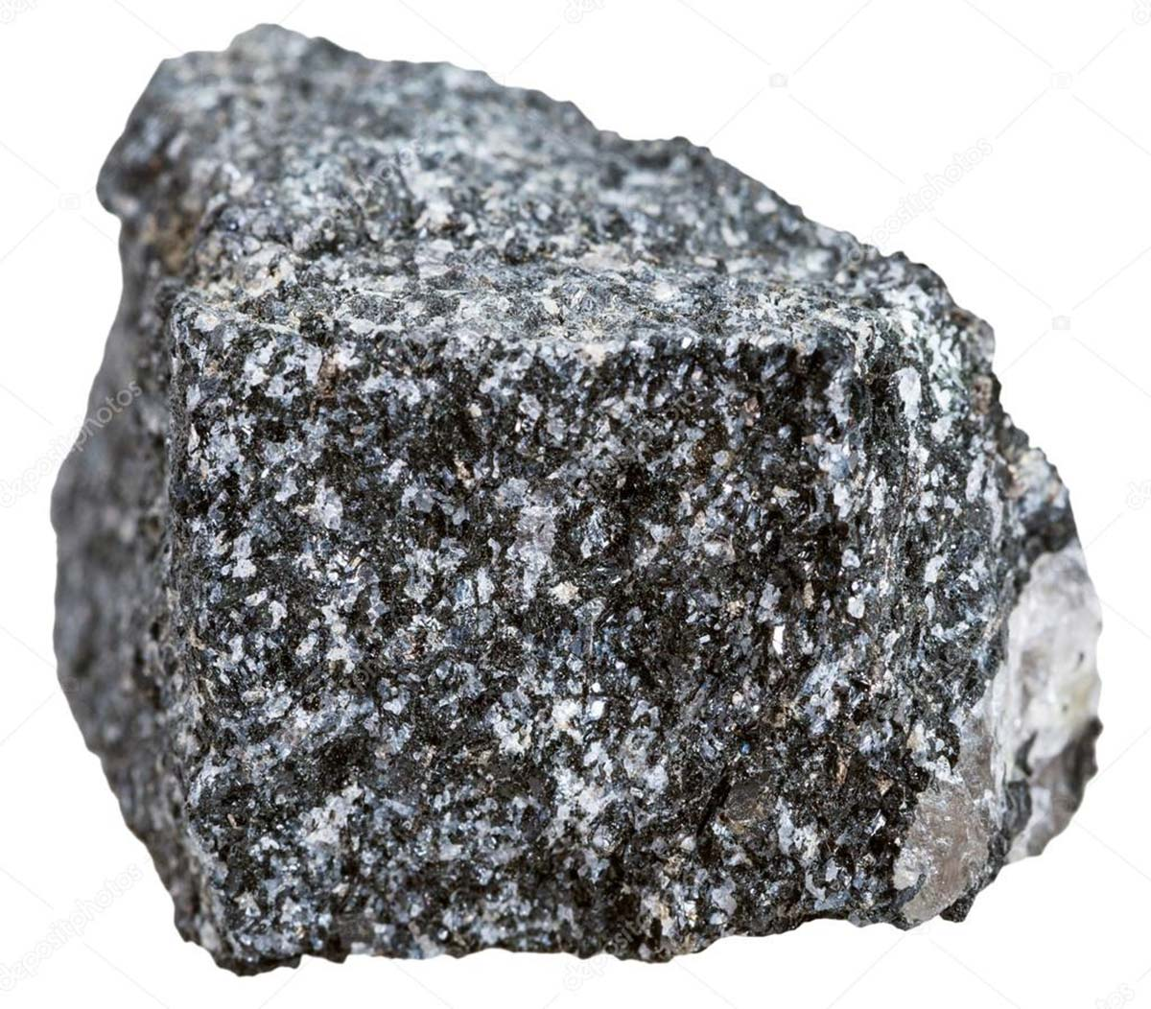
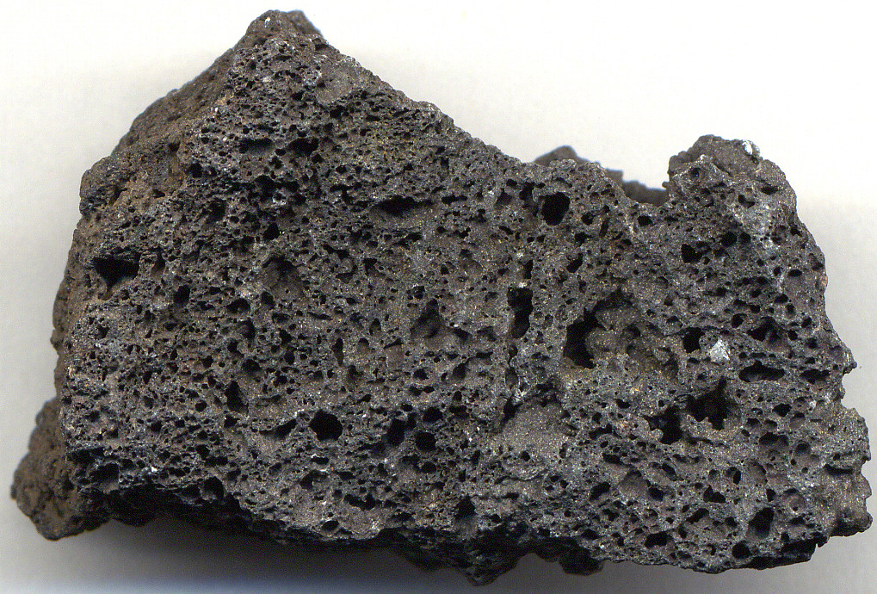
Rocks, Tectonics, and the
Record of Life
Uniformitarianism: The present is the key to the past.
The rocks’ record indicates clues to events in past, including the connection between climate change and mass extinction.
There are three main types of rocks:
  Sedimentary rock is a product of sedimentation and weathering (clastic, biochemical, or chemical)
  Igneous rock is product of magma (volcanic/extrusive or plutonic/intrusive); contains crystals
  Metamorphic is formed when parent rock is subjected to extreme rise in heat and pressure.

Slide 22
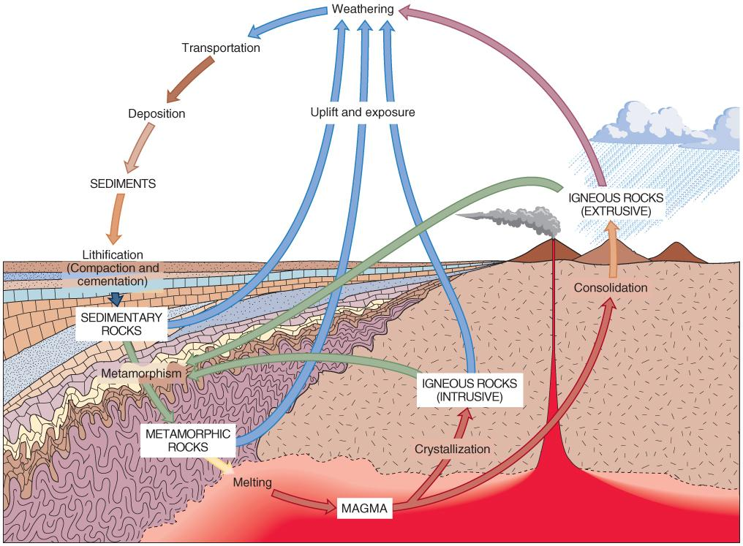
The Rock Cycle
Figure 03.10 The rock cycle with no beginning or end; any rock can be exposed to different parts of the cycle.

Slide 23
Tectonic Cycle
Subdivided sections of the lithosphere (plates) move in relation to one another.
Plates move in three directions
  1) past one another, 2) toward, or 3) away from one another
  Plates moving away from one another
form spreading zones (divergent boundaries), ridges
  Plates sliding past one another
form transform plate boundaries. San Andreas fault
  Plates sliding toward one another
form subduction zones (convergent boundaries) where plates move down into asthenosphere to complete the cycle.

Slide 24
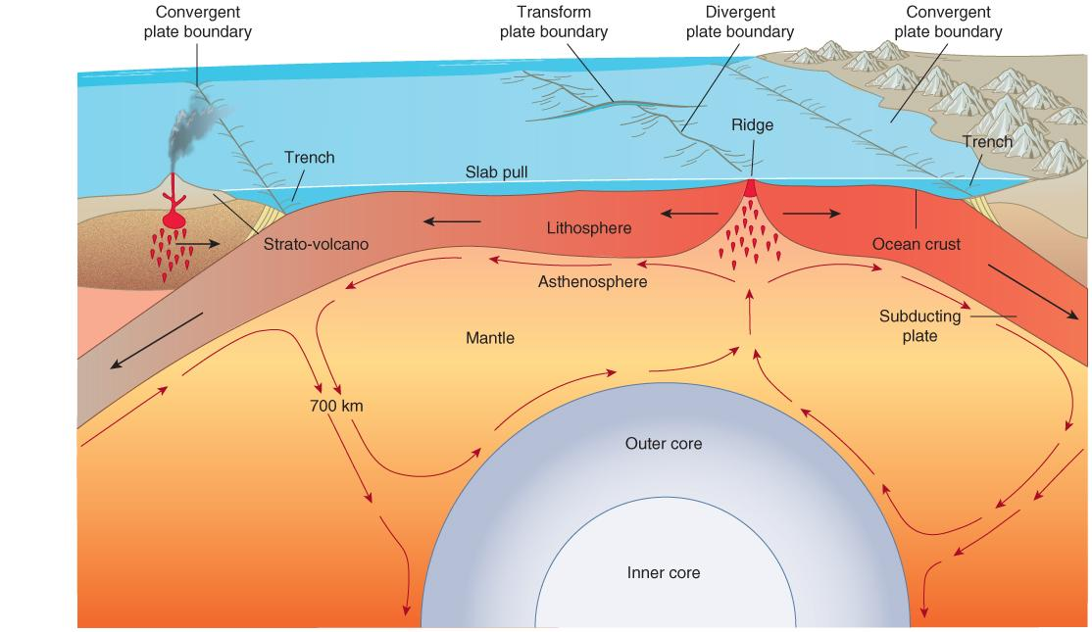
Tectonic Cycle—
Recycling of Materials
Material is recycled back into the mantle as other material rises at the Earth’s surface.

Slide 25
A Brief History of Earth
Fossils are remnants of life found within sedimentary rock and provide clues about the history of Earth.
  Trace fossils show glimpses of an organism’s behavior (such as footprints or a burrow).
  Fossil succession shows the vertical record of life over a period of evolutionary history.
  Radiometric dating uses the known radioactive decay of materials to accurately date a sample.
  Through fossil evidence a geological time scale shows major events in Earth’s history.

Slide 26
Overview of Eras (1 of 2)
Precambrian (4.56 bya – 3.8 bya)
  Beginning of Earth’s existence; over time molten mass cooled, atmosphere and oceans formed; early cells present capable of photosynthesis.
Paleozoic (542 mya – 245 mya)
  Cambrian period (“Great Explosion of Life”); sea levels rose, warming trend occurred at beginning, evolution of large animals; climate events lead to cooling then mass extinction; warming period followed, new habitats including forests, that were largely enveloped by shifting plates; Era ends with oxygen depletion of oceans and disappearance of 93–97% of all species in rock record.

Slide 27
Overview of Eras (2 of 2)
Mesozoic (252 mya – 66 mya)
  Over time continents drifted to areas they occupy today.
  Reefs, mammals, flowering plants, and dinosaurs evolved. Marine and terrestrial environments supported a wide diversity of life. Mass extinction marked the end of the era.
Cenozoic (65 mya – present)
  Beginning marked by warming trend; evolution of tree-dwelling mammals, whales evolved; coral reefs expanded.
  Climate changes drove selection pressures; Homo sapiens appeared in fossil record 200,000 years ago. Cooperation evident in early humans.

Slide 28
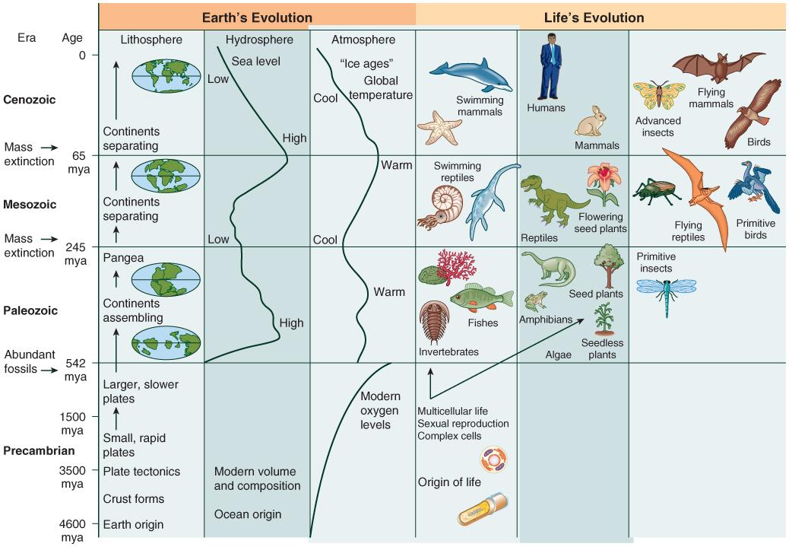
Geologic Time Scale—Major Events

Slide 29
Today’s Era (Anthropocene)
The land and resources that support human civilization today took 4.6 billion years of natural history to put it place.
Beginning with the industrial revolution, human impact on the environment has been widely documented.
Currently we live in a time of the Earth’s sixth mass extinction event.
Looking at geologic time scale, scientists have named our current era the Anthropocene as a way to document this time span.
Human choice and policy continue to impact the unfolding of this era in real time.

Slide 30
Which has a greater influence on Earth’s environment today: natural processes or human activities? Why? Give one example that supports your stance.

Slide 31
End of Lecture
For next class:
Reading: The rest of Chapter 3

