Slide 1

Library Research and Citing Sources
ANTH 354: Political Economy in Vietnam
Kate Blinn – Social Sciences Librarian – kblinn@brynmawr.edu
Photo credit: https://news.virginia.edu/sites/default/files/styles/uva_basic_article/public/article_image/rice_paddy.jpg

Slide 2
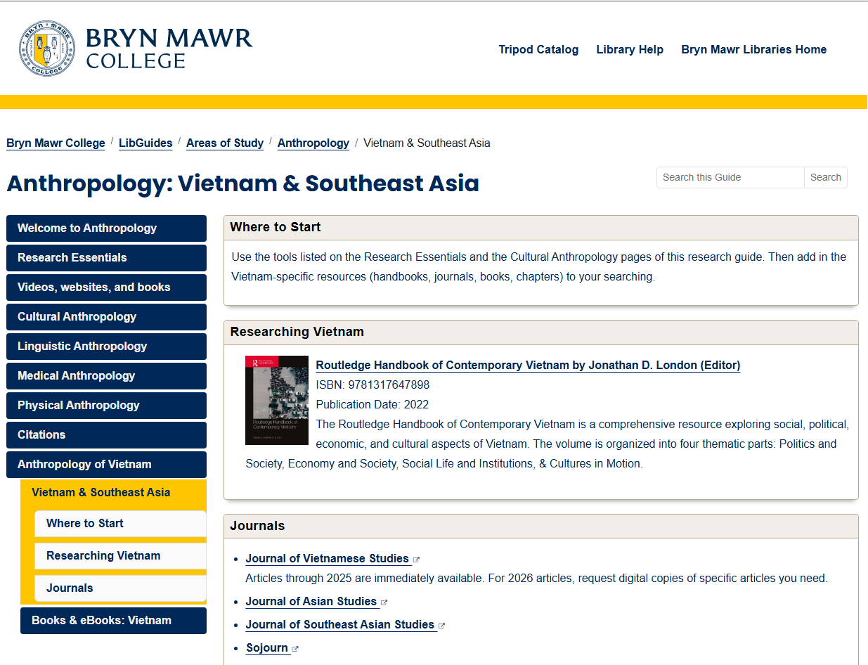
Getting started: https://libguides.brynmawr.edu/anthropology/AnthVietnam

Slide 3
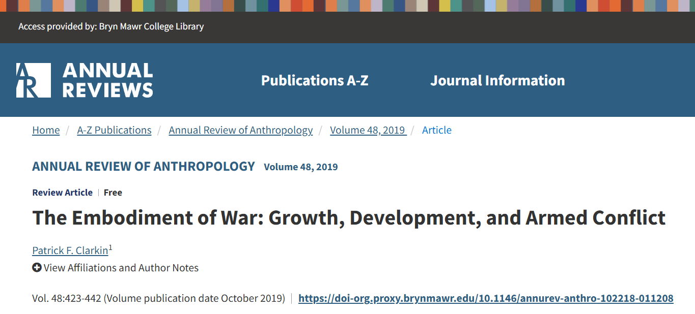
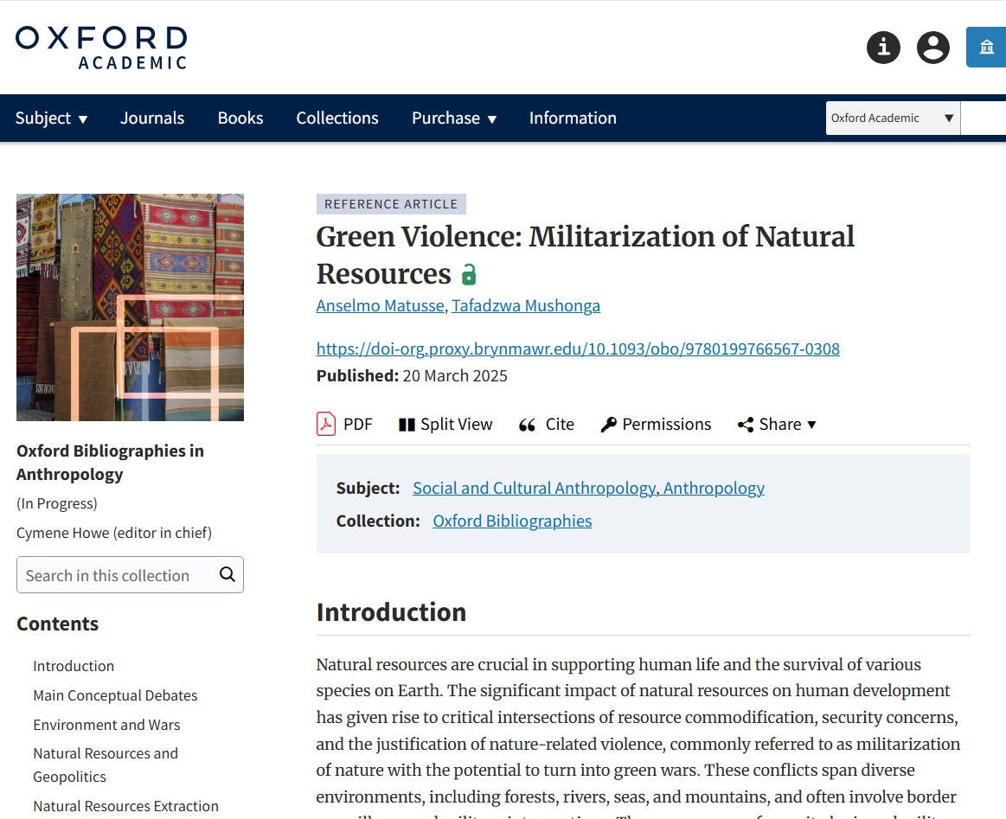
Research Essentials Tab: Background, context, shortcuts
Annual Review example:
“The Embodiment of War” (2019)
Oxford Bibliographies example:
“Green Violence” (2025)

Slide 4
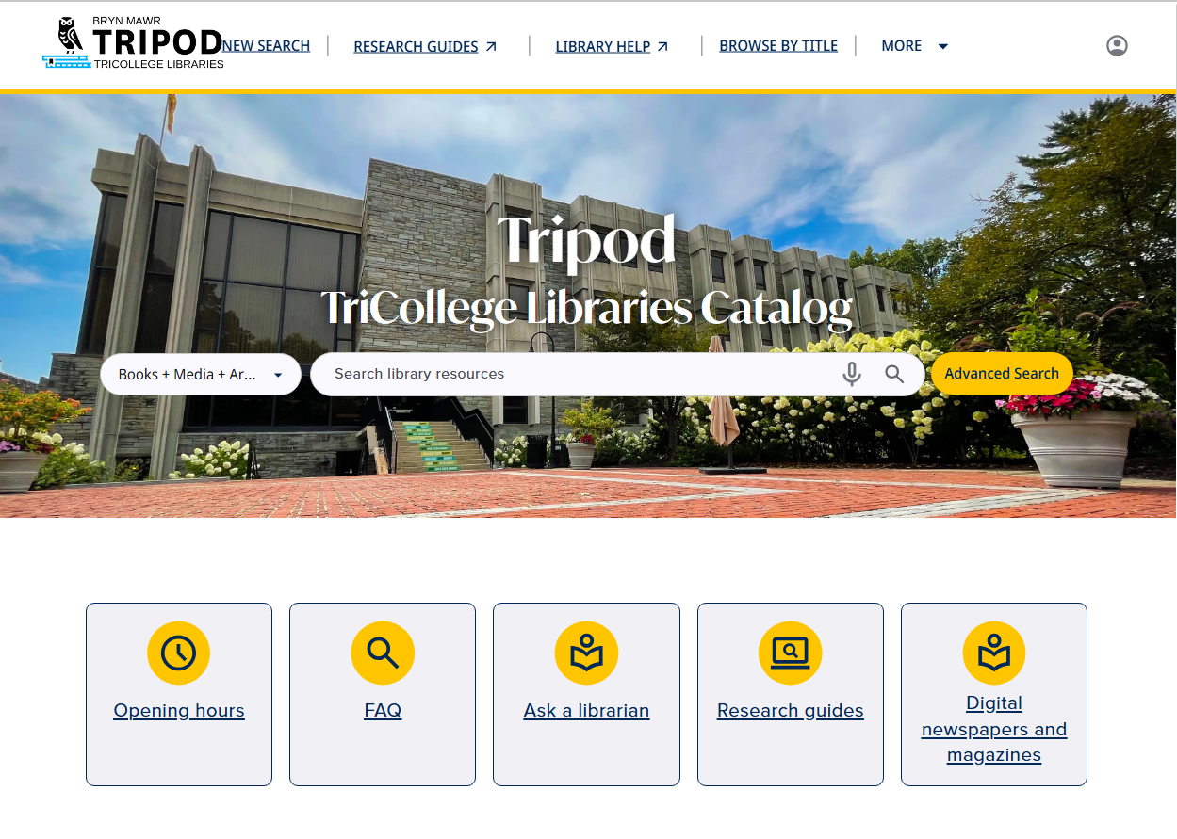
Research Essentials Tab: Tripod Catalog

Slide 5
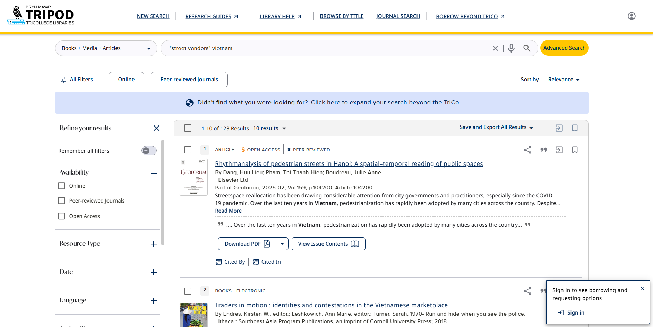
Research Essentials Tab: Tripod Catalog

Slide 6
Research Essentials Tab: Databases
AnthroSource | AAA journals A full-text database Abstracts and keywords always included References are linked to Google Scholar Related article suggestions are generally good
Anthropology Plus | EBSCO platform A citation database/indexing service – indexes many journals, links to full text elsewhere Many times no abstract - search results are sometimes poor Offers suggestions when you are typing search terms
JSTOR (limit by subjects; limit to articles) ProQuest platform – you might also want to look at… • Gender Watch • International Bibliography of the Social Sciences • Social Science Database EBSCO platform – you might also want to look at… • Family and Society Studies Worldwide • Women’s Studies International • Topic specific databases on education, religion

Slide 7
Research Essentials Tab: Extending your Research
Dissertations & Theses | TL;DR Great for bibliographies Example dissertation: “Bargaining with the State” (2023)
WorldCat | Catalog of materials from thousands of libraries worldwide Use subject terms to help you search Example from WorldCat: Traders in Motion (2018)

Slide 8
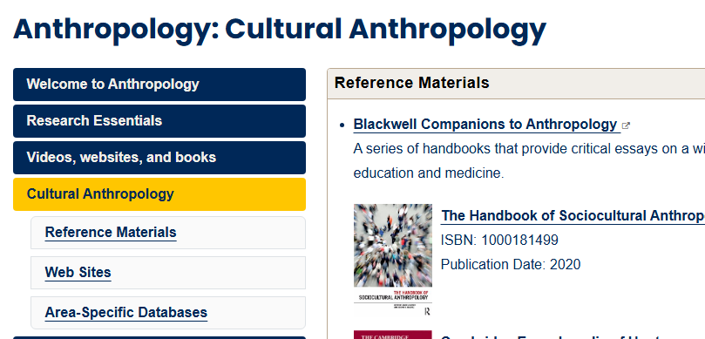
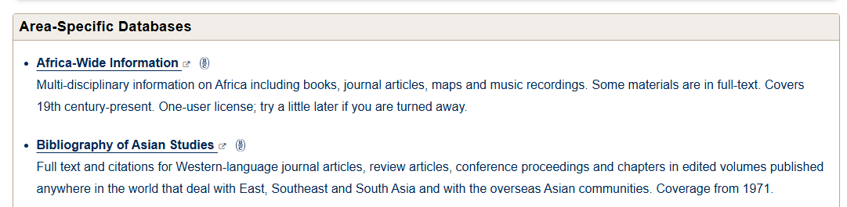
Cultural Anthropology Tab: Bibliography of Asian Studies

Slide 9
  Be Strategic about your Search Terms
Keep a running list of search terms and synonyms for each major concept in your research topic
Remember
  Alternate spellings and alphabets
  Translations and transliterations
  Alternate place names
May need to shift to broader, related or narrower topics
Example: How have Doi Moi economic reforms impacted street vendors in Hanoi?
 | Concept | Concept
Broader:
Related:
Street Vendors
Workers
Shop owners
Doi Moi
Doimoi
Economic reforms
Market economy

Slide 10
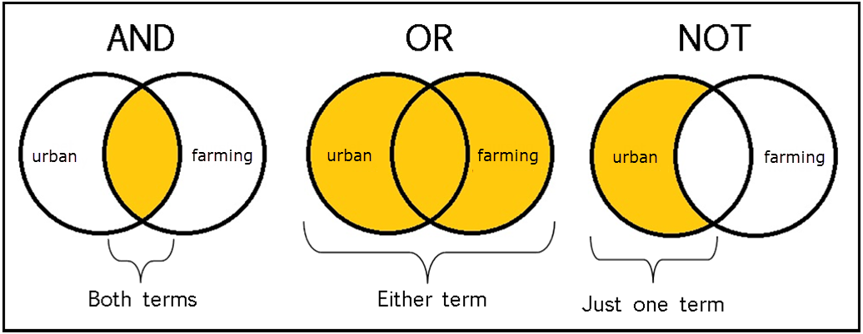
Search terms in combination(s)
Example search: Viet* AND (seller* OR vendor*)
Viet* AND (seller* OR vendor*)
vendors in Vietnam Vietnamese market sellers Vietnam’s street vendors vendor-customer relationships in Vietnamese open-air markets …
Viet*
Vietnam Viet Nam Vietnamese …
vendor*
vendor vendors vendor-related …

Slide 11
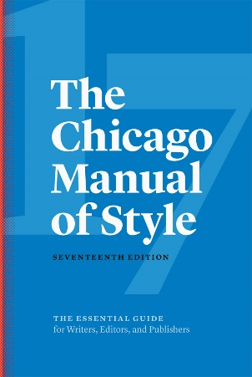
Citations Tab: AAA Style (based on Chicago)
In-Text Citations
(Asad 2003)
(Asad 2003, 146-7)
(Bessire and Bond 2014, 10)
(Comaroff 1996; Daser 2014)
References
Asad, Talal. 2003. Formations of the Secular: Christianity, Islam, Modernity. Stanford, CA: Stanford University Press.
Comaroff, Jean. 1996. “The Empire’s Old Clothes: Fashioning the Colonial Subject.” In Cross-Cultural Consumption: Global Markets, Local Realities, edited by David Howes, 19–38. London: Routledge.
Bessire, Lucas, and David Bond. 2014. “Ontological Anthropology and the Deferral of Critique.” American Ethnologist 41 (3): 440–56.

Slide 12
Identifying types of sources
Look for distinguishing details in the citation:
Books (a.k.a. “scholarly monographs”) | Simmons, Alan H. 2007 The Neolithic Revolution in the Near East: Transforming the Human Landscape. University of Arizona Press, Tucson.
Chapters in edited books | Rollefson, Gary O. 2000 Ritual and Social Structure at Neolithic ‘Ain Ghazal. In Life in Neolithic Farming Communities: Social Organization, Identity, and Differentiation, edited by Ian Kuijt, pp. 165–190. Plenum, New York.
Journal articles | Zeder, Melinda A. 1999 Animal Domestication in the Zagros : A Review of Past and Current Research. Paléorient 25(2): 11–25.
Agency/NGO publications | US Department of Agriculture Economic Research Service 2008 Adoption of Genetically Engineered Crops in the US. Office of Inspector General, USDA, Washington, DC.
Books
(a.k.a. “scholarly monographs”)
 | Simmons, Alan H. 2007 The Neolithic Revolution in the Near East: Transforming the Human Landscape. University of Arizona Press, Tucson.
 | Rollefson, Gary O. 2000 Ritual and Social Structure at Neolithic ‘Ain Ghazal. In Life in Neolithic Farming Communities: Social Organization, Identity, and Differentiation, edited by Ian Kuijt, pp. 165–190. Plenum, New York.
 | Zeder, Melinda A. 1999 Animal Domestication in the Zagros : A Review of Past and Current Research. Paléorient 25(2): 11–25.
 | US Department of Agriculture Economic Research Service 2008 Adoption of Genetically Engineered Crops in the US. Office of Inspector General, USDA, Washington, DC.
Chapters in edited books
Journal articles
Agency/NGO publications

Slide 13
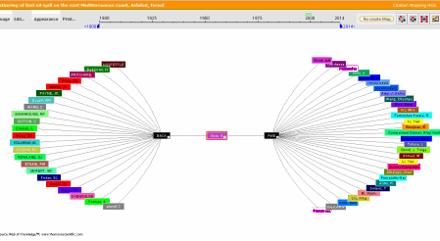
How to Follow Your Leads: Citation Network

Slide 14
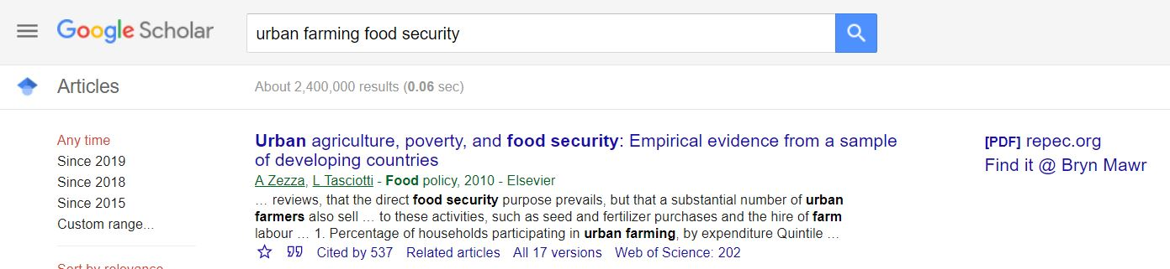
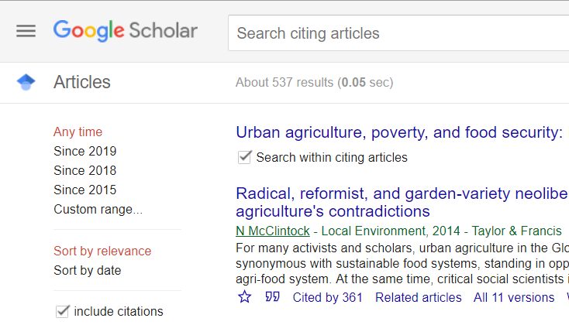
How to Follow Your Leads: Google Scholar

Slide 15
Citation Management using Zotero
Zotero library
Browser
Cloud backup
Word or Google Docs
Sync and store your library in the cloud
Collect sources with one-click from your browser –
PDFs, websites, anything.
Zotero saves the PDF or a screenshot AND
all the info you need to create the citation.
Cite and format automatically as you write.
Zotero inserts the ( ) citations and creates a list of references based on who you have cited.
You choose your citation style (MLA, APA, etc.)
Organize your own searchable library
with subfolders, notes, tags.
Start at Zotero.org
Watch the Daily Digest for in-person and Zoom workshops!

Slide 16
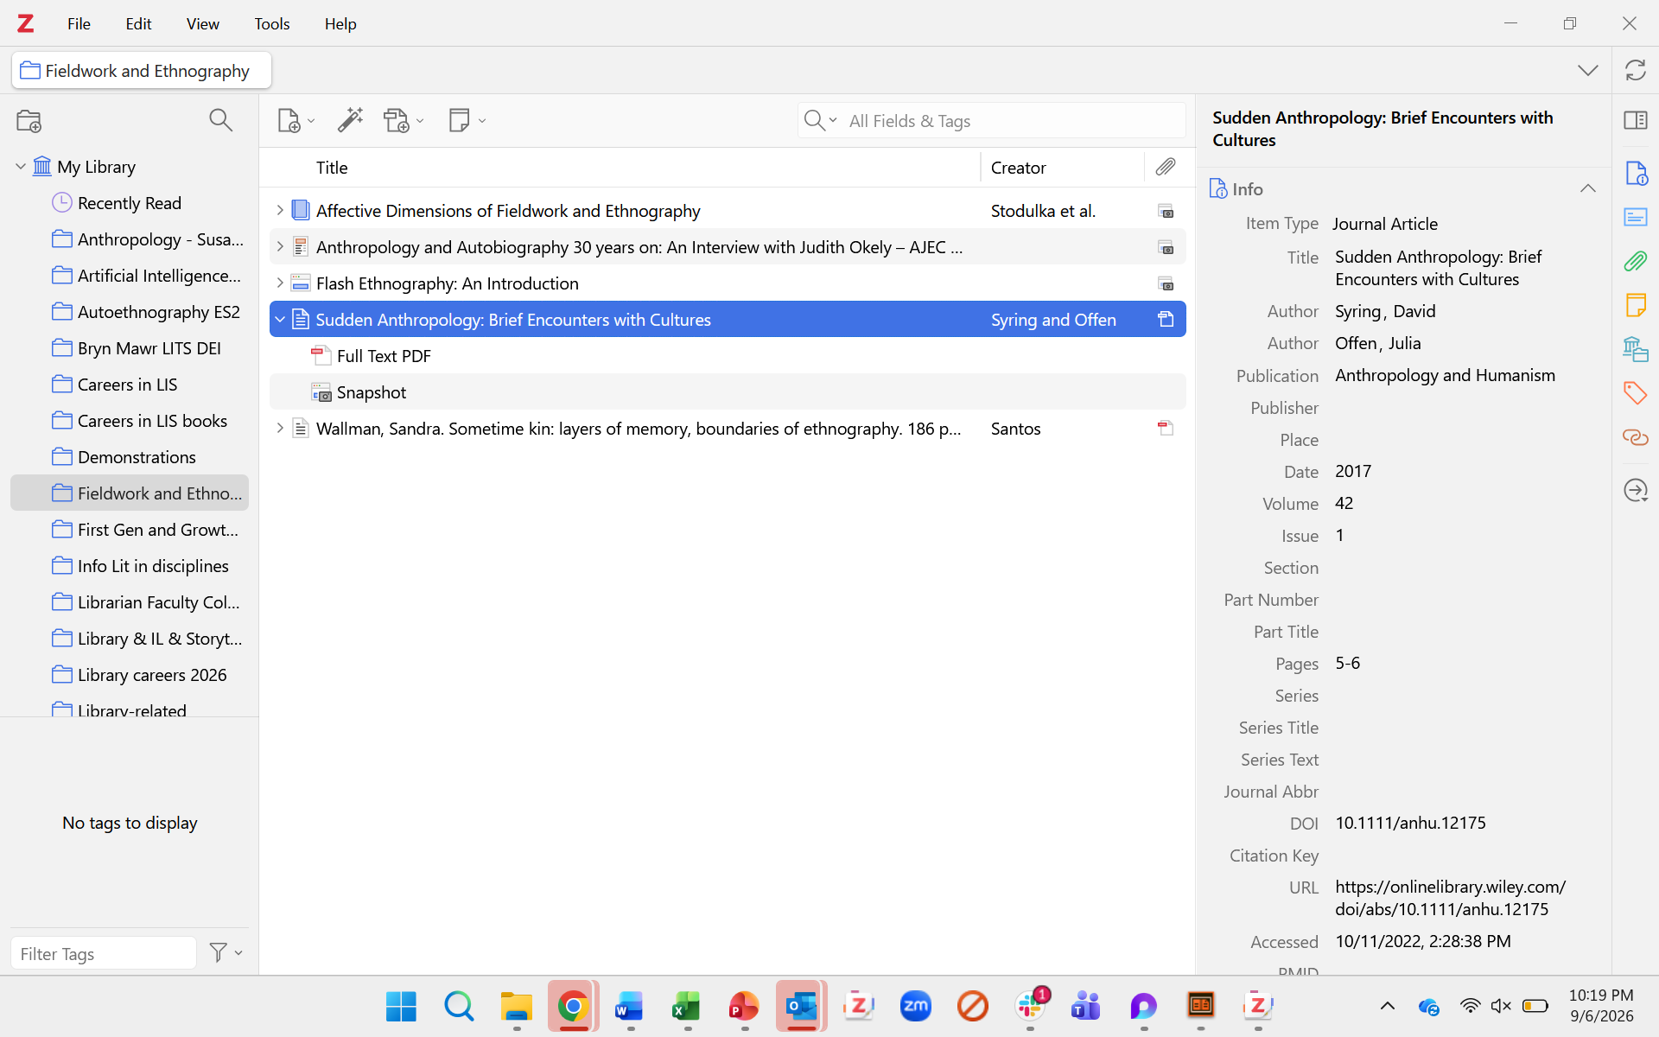
  Citations Tab: Using Zotero to keep track

Slide 17
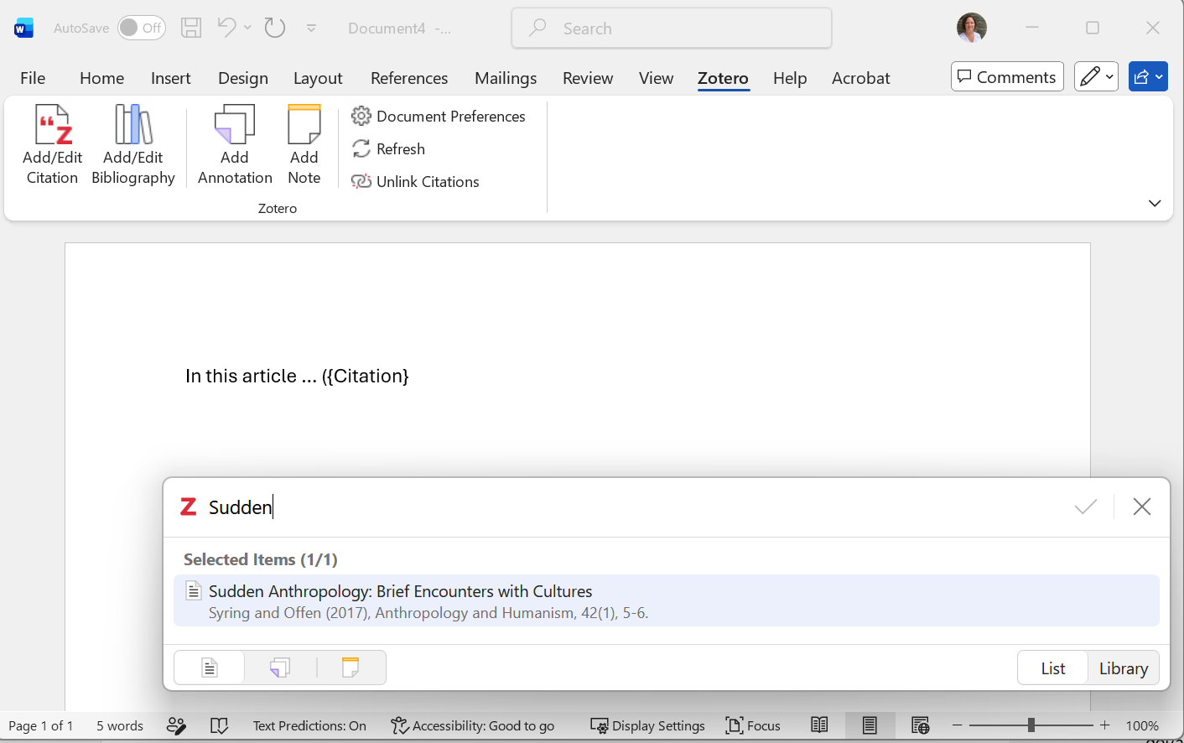
  Citations Tab: Using Zotero to create citations

Slide 18
