Slide 1
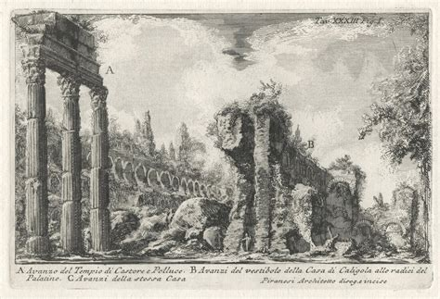
Week 2 – Wonders of Italy
Venice – Part One

Slide 2
Today’s agenda:
Group work: artists in Venice
(Short) Lecture: History of Venice
Writing: How should I write a college paper?
Remember to book your one-on-one conference on Moodle!

Slide 3
1 – Group work
In groups of 4-5 students, reflect on the excerpts from McCarthy, Brodsky, and Vidal. Discuss your notes (if you have any) and highlighted passages.
Be ready to share your group’s findings with the class.
Did your group like the readings? Why/Why not?
Can you find any similarities/striking differences?
What point are they trying to convey?
To what audience are they talking to?
What did you think of Krotz’s take on tourism?

Slide 4
0 - Warm-up
Go to our shared document via Moodle (Symposium)
https://docs.google.com/document/d/1iVeM74WLHLzy4J0Ks6a_IpA5ni5z-0UZh3XAmYVlvsM/edit?tab=t.0
and write down a sentence or passage that struck you from the reading material. Remember to identify it with the author’s last name and year of publication. For example:
”And there is no pretending that the tourist Venice is not the real Venice.” (McCarthy 1956).

Slide 5
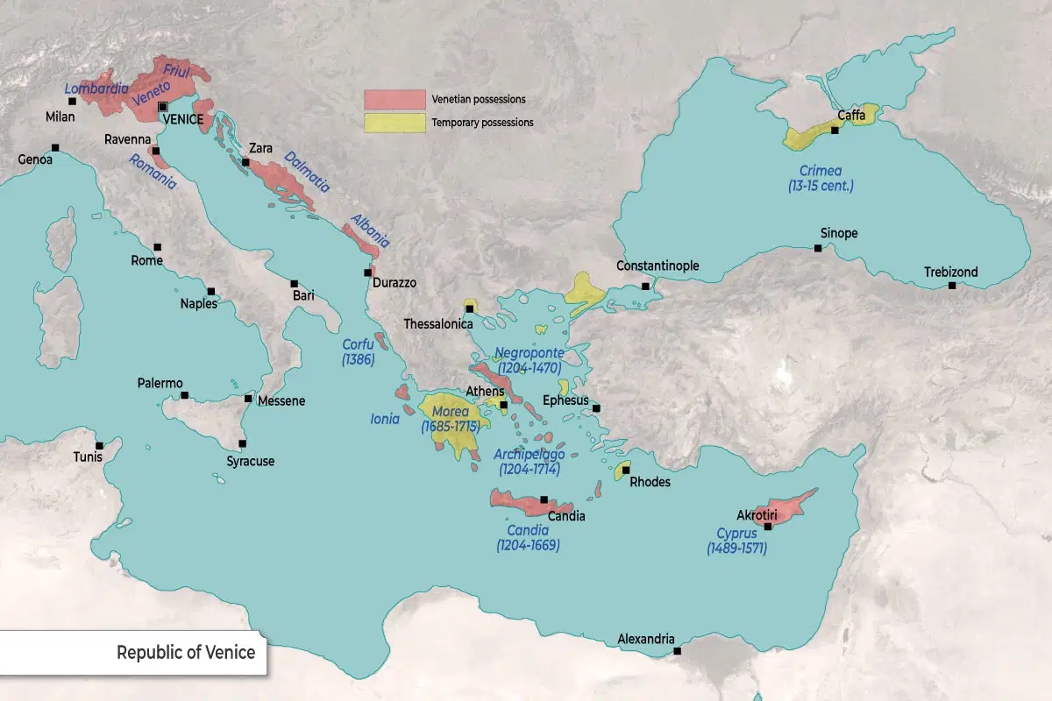
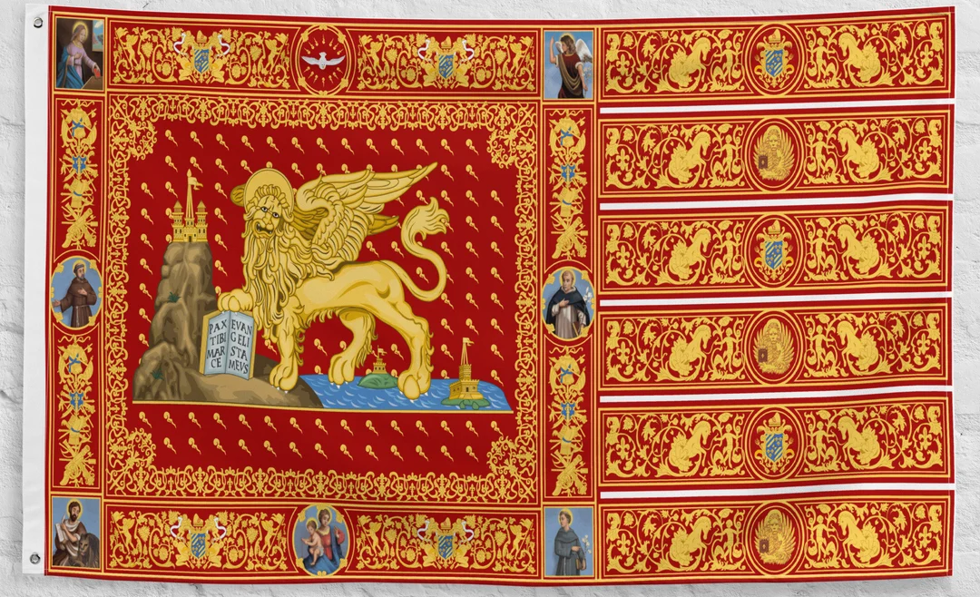
2 – History of Venice
Interested in learning more? I highly recommend The Venetian Empire: A Sea Voyage by Jan Morris (1990)

Slide 6
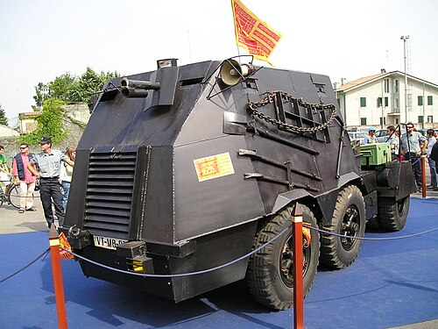
2 – History of Venice
697 – Legendary foundation of the city in the Venetian lagoon. For the following two centuries, Venice was part of the Byzantine Empire.
976 – First document of a Domino Venetiarum (‘Lord of Venice’), certifying the existence of Venice as an independent state
1109 – The Venetian conquer Dalmatia and Croatia on the other side of the Adriatic
1204 – The Venetians greatly benefitted from the Crusades, providing ships and food for the soldiers heading to the Holy Land. The Doge Enrico Dandolo forced the entire army of the Fourth Crusade to crush and loot Constantinople (a Christian city!) as payment for the transportation costs. The Church of St. Mark was built with the spoils of the Byzantine Empire.
The temporary dismemberment of the Eastern Roman Empire (Byzantium) gave life to the Stato da Mar, or oversea territory. Venice was now a colonial power.
1453 – The collapse of the Byzantine Empire and the expansion of the Ottomans blocked the routes to the East. Cut off from the spice trades, Venice turned inland and conquered what is now called Veneto. (cfr. Amitav Ghosh, The Nutmeg’s Curse, 2021)
1575 – The Venice-led league of Cambrai defeated the ottomans at Lepanto.
1787 – Venice is a tourist destination for nobleman artists. The German poet Goethe visits the city.
1797 – After a long decline, the Venetian Republic was dismantled by Napoleon and ceded to the Austrian Empire. It stayed under Habsburg rule until 1866, when it became part of the Italian Kingdom.
2006 – Some people in Veneto still push for an independent state. In 2006, a commando tried to proclaim Venice a sovereign state by occupying St. Mark’s square.
2020 – After almost 20 years, the MOSE dam system is inaugurated in Venice.

Slide 7
3 – How Should I write?
Your first paper is going to be a personal position on the topic of Venice.
Goals: expression; critical reading; summary; quoting; thesis sentence; claims and support.
How does it work?
Week 2-3 – Free-writing, brainstorming, submit first draft
Week 4 – One-on-one conference; submit final draft

Slide 8
INSTRUCTIONS:
As we learn about the history of Venice, please write a personal essay based on the readings, discussions, and lectures we had so far:
Briefly summarize the reading material, quoting from the text and pointing out similarities and other things that stood out to you;
State your feelings regarding the texts and their topics. You can also mention if you knew any of the authors prior to this reading.
Explore one aspect in greater depth, gathering information online (if you wish). You can focus on a person, a historical fact, a scene, one of the authors, a person you know that might be related to the topic… anything!
Be original. There is no right or wrong way to write a personal essay! Try to devote at least 2 ½ pages out of 4 to your thoughts.

Slide 9
3 – How Should I write?
The first draft should be in handwriting. This will allow you to focus on the act of writing with no distractions.
The final draft should be typewritten. This way, you can also practice formatting.
My formatting style is very simple. A double-spaced text in Times New Roman or Garamond, 12. Title and subtitles in bold or italics.
MLA style citation.
https://libraryguides.mcgill.ca/ld.php?content_id=37555817

Slide 10
3 – How Should I write?
Final suggestions. Feel free to check the following books if you want to improve the clarity or coherence of your writing:
1)
2)
As you write your personal essay, please keep in mind that each paragraph should be meaningful.
If you need to do a little research to support your claims, you can look online or ask your professor.

Slide 11
3 – How Should I write?
FIRST DRAFT:
Brainstorm and come up with a general summary of what you want to say. Then, start writing!
You can use the remaining class time to gather ideas for your first paper, ask questions to me or your peers, and brainstorm.

