Slide 1
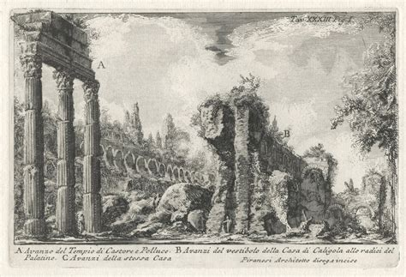
Week 2 – Wonders of Italy
Venice – Part One

Slide 2
Today’s agenda:
Symposium: reflecting on our readings
Venice today: Overtourism (structured debate)
Working on your first paper

Slide 3
1 - Symposium
Go online to our shared document and answer the prompts you will find there.
Please remember to be logged out of your Google Account so that your answers appear anonymous.
https://docs.google.com/document/d/1iVeM74WLHLzy4J0Ks6a_IpA5ni5z-0UZh3XAmYVlvsM/edit?pli=1&tab=t.0

Slide 4
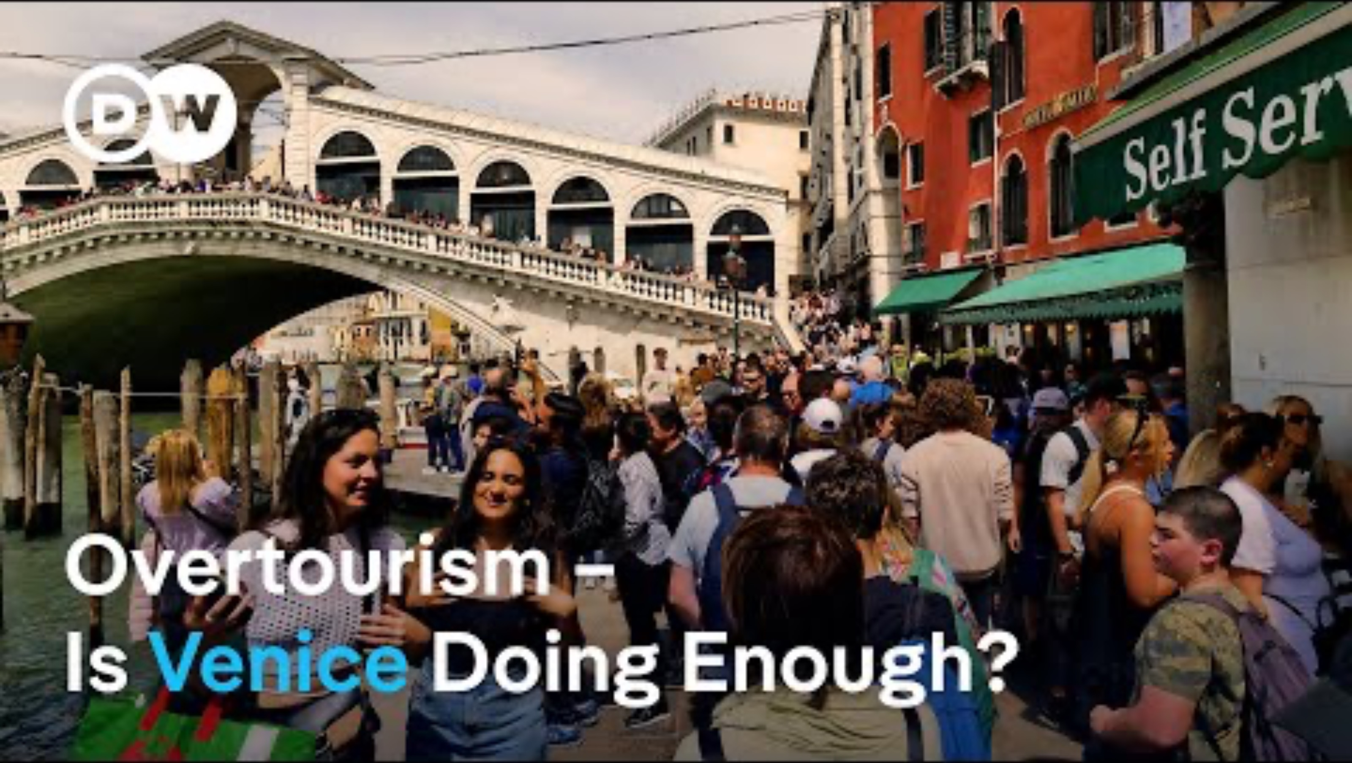
2 – Venice today: overtourism
A tourist’s dream, the locals’ nightmare
An excellent report on how overtourism is affecting the local population—and of how Venetians are fighting back.

Slide 5
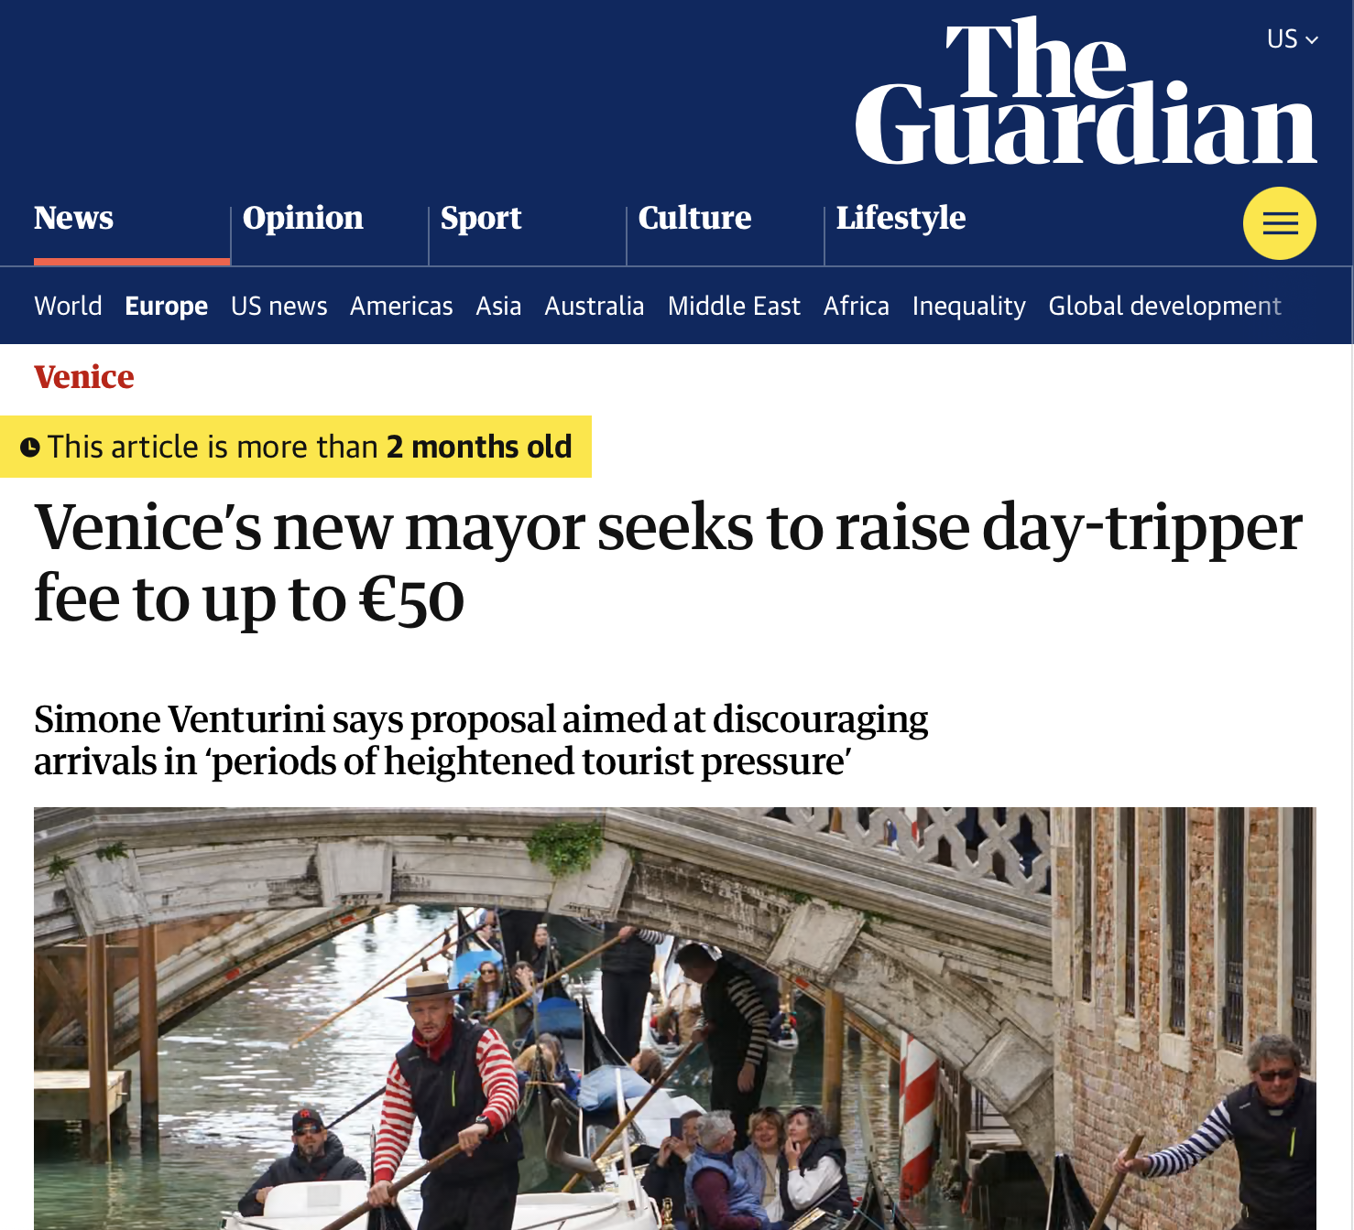
2 – Venice today: overtourism
“Venice’s new mayor has said he hopes to raise a controversial entrance fee for day-trippers to the lagoon city to as much as €50 ($46). Simone Venturini, the rightwing former tourism concillor who was elected as mayor in late May, said the proposal was aimed at further discouraging arrivals during “periods of heightened tourist pressure.”

Slide 6
2 – Venice today: overtourism
“In 2024, Venice became the first tourist city in the world to charge people to enter, introducing a €5 fee on 29 peak dates between April and July.
Although the scheme has had little impact on visitor numbers, it did rake in €2.4 m for the city’s coffers in its first year, much more than expected.
Anyone who books an overnight stay in Venice is exempt from paying the fee.

Slide 7
2 – Venice today: overtourism
Structured debate:
The class will act as Venice’s city council. You will have to vote on mayor Venturini’s new entry fee policy.
Half of the classroom will act as the majority (Venturini’s party). The other half will act as the opposition.
Structure your points and prepare to counter-argue. Search online, if you wish.
The future of Venice depends on it!

Slide 8
3 – First paper
Take advantage of the remaining class time to work on your paper.
Remember: the final draft should be 4 (typewritten) pages long.
You can keep referring to last week’s material or build on what we have watched/learned today.

