Slide 1
Exploratory Data Analysis
Univariate Analysis: Exploring one variable at a time
September 8th 2026

Slide 2
Important Announcements
ICA Deadlines – Fridays at Midnight (Originally Thursdays)
TA Help Sessions Schedule
  Friday: 4:00 to 5:00 pm Zoom Only
  Sunday: In-person and Zoom
    BMC 3-5 pm
  Monday: In-person and Zoom
    BMC 7-9 pm
Prof. Anjali’s Drop-in Hours: Wednesday 11:30 am – 1 pm

Slide 3
Exploring and Visualizing Data
Exploratory Data Analysis (EDA): the process of examining, visualizing, and summarizing data to understand what is there, identifying patterns and unusual observations, and generating/investigating questions about the data.
EDA techniques are used to investigate:
What does the data look like?
What is typical?
How much does it vary?
Are there unusual observations or missing values?
What patterns might be worth investigating?

Slide 4

Exploring and Visualizing Data
Univariate EDA: Exploring One Variable
By the end of class, you should be able to:
Decide whether a variable is categorical/ qualitative or numerical/quantitative.
Choose appropriate way to visualize it.
Choose useful numerical summaries.
Describe what the variable tells you.
Exploring Relationships Between Variables
How are these variables related?

Slide 5
Steps in Exploratory Data Analysis
Examine questions: identify data types.
Explore/summarize distribution of responses using tables and/or graphs.
Explore/summarize the “typical” response and the variability in the responses using measures of central tendency and variability.
Interpret data: Describe pattern of responses and shape of the distribution.
Explore relationships between variables: Examine variables one by one, then look at the relationship among the different variables.

Slide 6
Examples of Variables and their Values
Variable | Example Values (Responses)
Movie Genre | Comedy, Drama, Action
Pain Severity | Mild, Moderate, Severe
Time spent on Social Media in Minutes | 85, 120, 245 minutes
What's different about the information contained in these three variables?

Slide 7
Types of Variables: Levels of Measurement
Data Types
Qualitative
(Categorical)
Quantitative
Nominal
Ordinal
Interval
Ratio
Numerical

Slide 8
Nominal (Categorical - Unordered) Data
Responses (labels) identify different groups or types.
Movie genre: Comedy | Drama | Action | Documentary
Computer Brands: Dell | Apple | HP | Lenovo
Responses identify different groups or types, but there is no meaningful order among them.
We can ask how many or what proportion have each response.
Rearranging the responses doesn't change their meaning.
Numbers don’t necessarily mean numerical! Sometimes numbers are simply labels (e.g., Jersey number: 8, 12, 27, 81).

Slide 9
Ordinal (Categorical – Ordered) Data
Responses (labels) identify different groups or types and there is a meaningful order.
Pain Severity: Mild | Moderate | Severe
Race finish: 1st | 2nd | 3rd
Values have a meaningful order or ranking, but the distance between positions is not inherently meaningful.
We know which comes before or after, but we don't necessarily know how far apart the responses are.
Notes:
But we don't know that the distance from Poor to Fair is the same as the distance from Good to Excellent.(distance from Poor to Fair is the same as the distance from Good to Excellent.)
Can I put the categories in a meaningful order?
Yes → Ordinal
A Gray Area: Rating Scales
Strongly Disagree → Disagree → Neutral → Agree → Strongly Agree
Technically, the response options are ordered categories.
In practice, researchers often code them numerically and treat them as approximately interval, particularly when several items are combined into a scale.
That would actually be pedagogically useful because it reinforces a broader data-science lesson:
Variable type is partly about what the values mean and partly about how we choose to represent and analyze them.
Is the difference between Strongly Disagree and Disagree necessarily the same as the difference between Agree and Strongly Agree?
We don't know.
Therefore:
Ordinal tells us order, but not necessarily equal distance between categories.

Slide 10
Ordinal Data: Rating Scales
Rating Scales are a Gray Area: Likert Scales
Strongly Disagree → Disagree → Neutral → Agree → Strongly Agree
Technically, the response options are ordered.
In practice, researchers often code these responses numerically and analyze them as though the distances between response options are approximately equal.
How we analyze a variable depends both on what its values represent and on the assumptions we are willing to make about those values.

Slide 11
Quantitative (Numerical – Interval/Ratio) Data
Responses (values) represent quantities or amounts, and the numerical differences between responses are meaningful.
Time Spent on Social Media: 85 mins → 120 mins → 245 mins
Number of TVs in your house: 1, 2, 3, 4, etc.
A 10-minute difference means the same amount (distance) anywhere on the Time Spent on Social Media Scale (equal interval).
It makes sense to ask: How much larger? How far apart? What is the average?

Slide 12
Summary Slide: Types of Variables
Level | What Do the Values Tell Us | Example
Nominal (Categorical Unordered) | Different types/groups; no inherent order. | Movie Genre (Action, Drama, Comedy, etc.)
Ordinal (Categorical Ordered ) | Values represent different types and have meaningful order/rank. | Pain Severity (Mild, Moderate, Severe)
Quantitative (Numerical) | Values represent quantities for which numerical differences are meaningful. | Time Spent on Social Media: (85 mins, 120 mins, 245 mins etc.)
Special Case: Likert Rating Scales are often treated as numerical in practice even though their response options are ordered categories.

Slide 13
Identify Type of Variable: Categorical vs. Quantitative; if Categorical is it Nominal (unordered) or Ordinal (ordered).
Type of high school attended (Public = 1, Private = 2)
Number of times someone has been snorkeling
Score on a Chemistry Test
Ranking of student’s talent in chess by coach
Zip code
T-shirt sizes (small = 1, medium = 2, large = 3, extra-large = 4)

Slide 14

Questions about Data Types?

Slide 15
EDA for Categorical (Nominal/Ordinal) Data
Identify response options (levels) in the original scale.
Plot graphs to visualize variation in data – bar charts.
Identify frequency of occurrences of each level.
  For nominal data, track percent frequency – note modal response.
  For ordinal data, track percent frequency – note modal and median responses.
Questions to consider: Missing data? What responses are common/rare? Does pattern match expectation? See anything noteworthy? What might be influencing pattern?
Interpret results. What have we learned from the data?

Slide 16
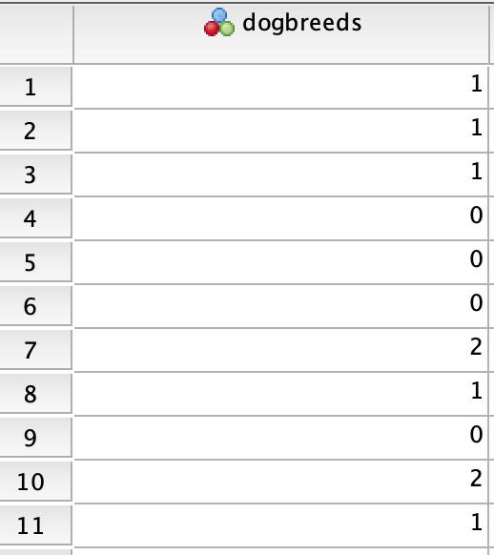
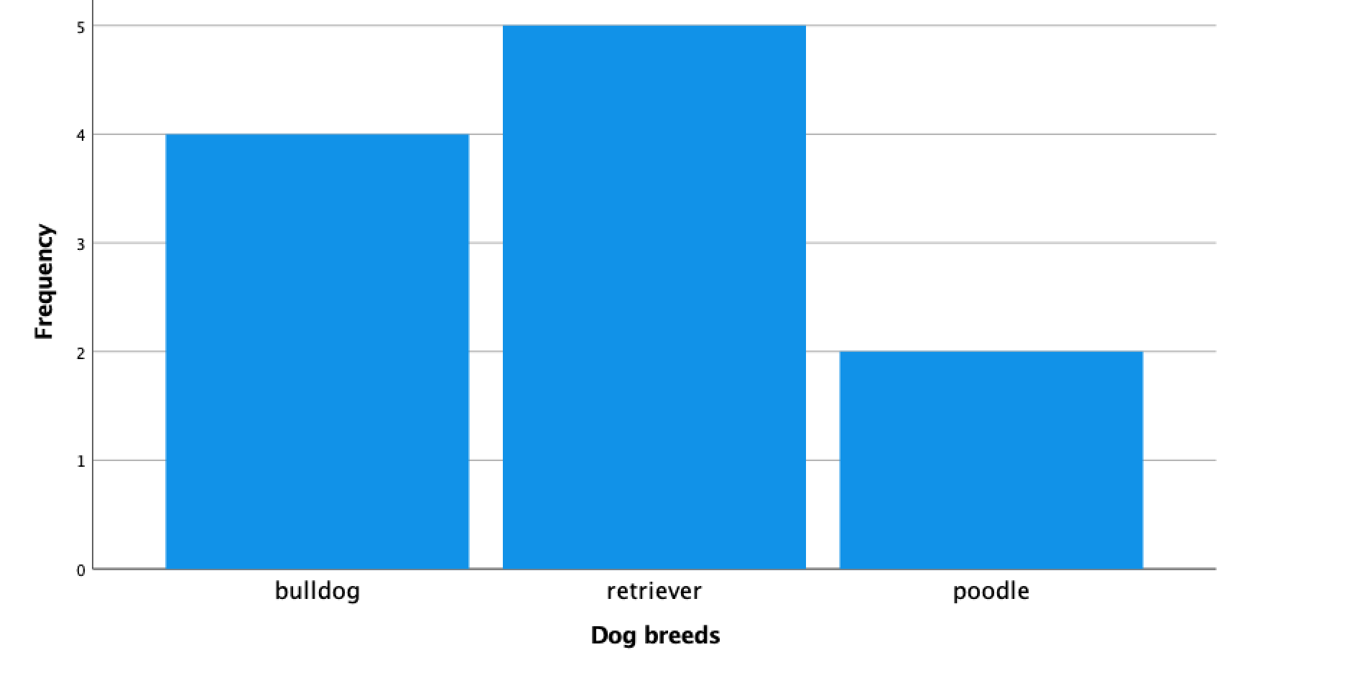
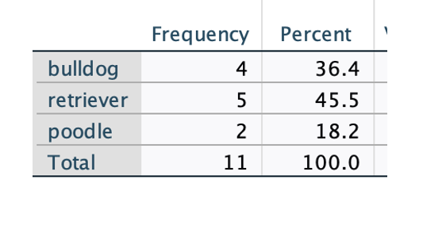
Graphing Nominal Data (Example: Dog Breeds)
Raw Data
Bar Chart
Frequency Table
0 bulldog
1 retriever
2 poodle
From B. Hazen’s Slides,
BMC PSYC 205, Fall 2022

Slide 17
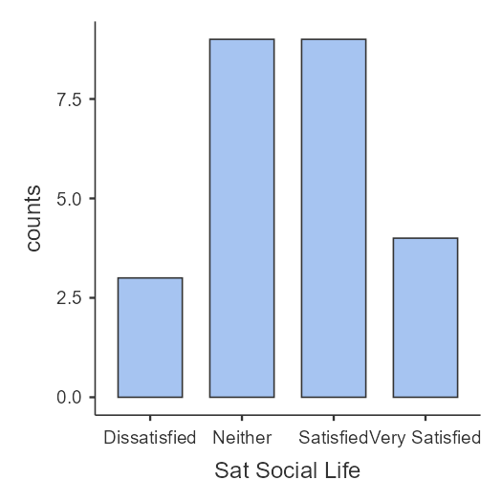
Graphing Ordinal Data (Example: How Satisfied with SL)
Frequency Table
Bar Chart

Slide 18
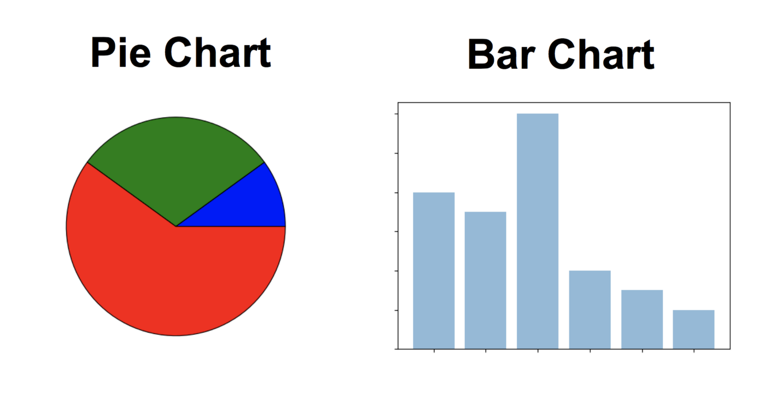
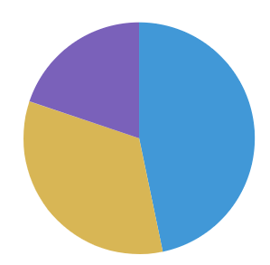
Base R Functions for EDA of Categorical Data
Numerical Methods
Frequency: table(ABC)
Proportions: prop.table(table(ABC))
Percentages: prop.table(table(ABC))*100
Identify mode (Nominal/Ordinal - most frequent response).
Identify median (Ordinal - response in the middle of the distribution): median(ABC)
Graphical Displays
Bar graphs: barplot(table(ABC))
Pie charts: pie(table(ABC))
(replace ABC with name of object/variable)

Slide 19
EDA for Quantitative (Numerical) Data
Identify response options (levels) in the original scale.
Plot graphs to visualize distribution (variation in data) – histogram and boxplot. Examine shape, center and spread.
Report appropriate summary statistics based on the shape of the distributions.
Questions to ask: Missing data? Shape of data (symmetrical/skewed)? Are there responses that were permissible but not observed? Influential outliers? Does pattern match expectation? See anything noteworthy?
Interpret results. What have we learned from the data?

Slide 20
Summary Statistics for Quantitative Data
Central tendency: center/typical response. Given by:
  Mode = most frequent value; rarely mentioned in practice
  Median = middle value if ordered from most to least
  Mean = arithmetic average
Variability: spread/how much do values vary. Given by:
  Range = difference between minimum and maximum scores
  IQR = distance from 25th-75th percentile, spread around middle 50%
  Standard Deviation (SD) = average distance of any observation (e.g., data point) from the mean.

Slide 21
EDA for Quantitative (Numerical) Data
Identify response options (levels) in the original scale.
Plot graphs to visualize distribution (variation in data) – histogram and boxplot. Examine shape, center and spread.
Report appropriate summary statistics based on the shape of the distributions.
  For normally distributed data – mean, standard deviation and range.
  For skewed distributions – median, IQR and range.
Questions to ask: Missing data? Shape of data (symmetrical/skewed; unimodal, bimodal,…;)? Are there responses that were permissible but not observed? Influential outliers? Does pattern match expectation? See anything noteworthy?

Slide 22
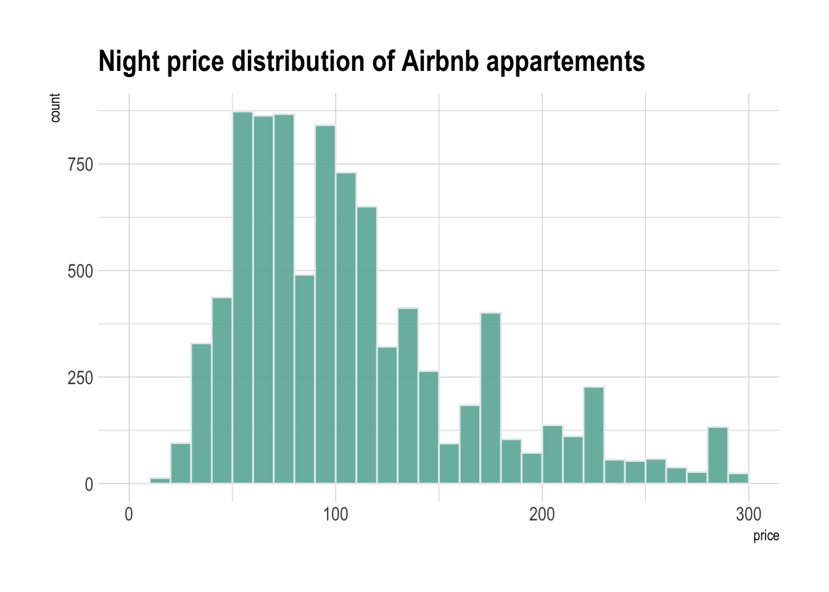
Two Useful Plots for Examining Quantitative Data
Histogram: Shows the shape of the distribution: clusters, gaps, symmetry/skew, and possible multiple peaks.
Boxplot: Shows the Compact summary of center, middle 50%, spread, and potential outliers.

Slide 23
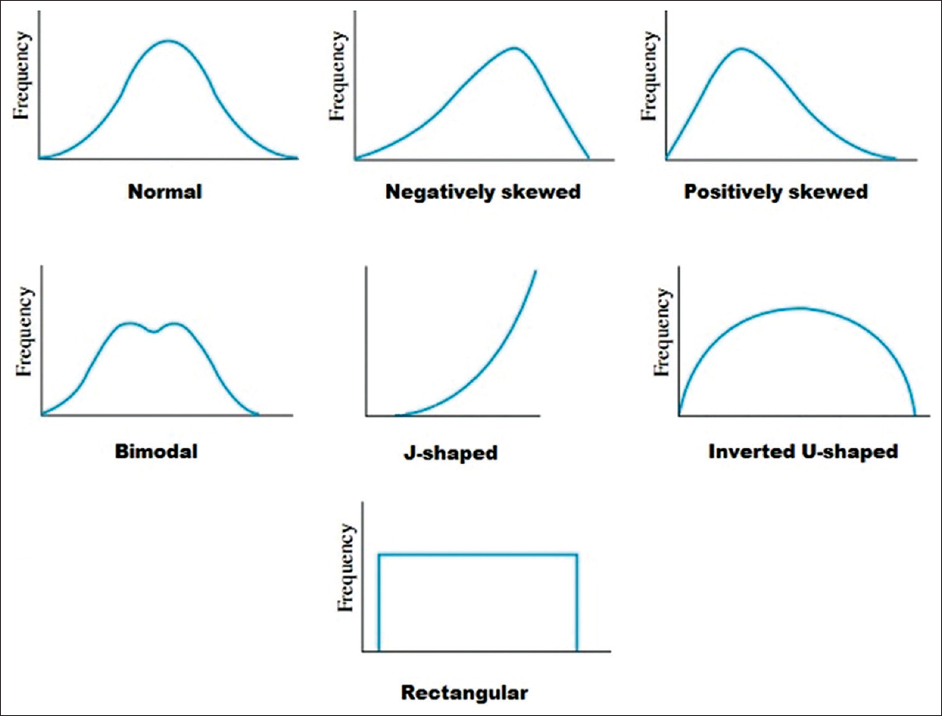
Examining the Shape of the Distribution

Slide 24
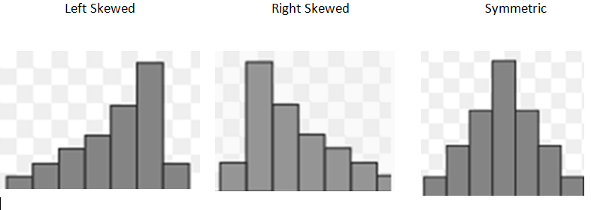
Examining the Shape of the Distribution: Skew
Negatively Skew Positively Skew Normal
Skewness is named for the direction of the longer tail!

Slide 25
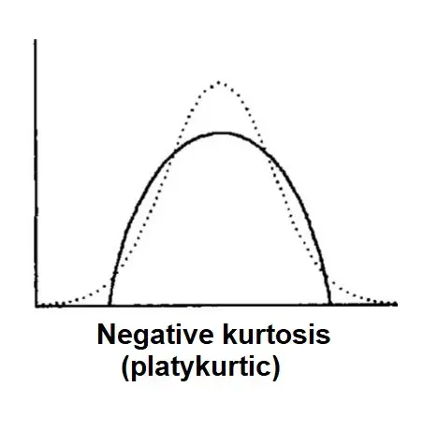
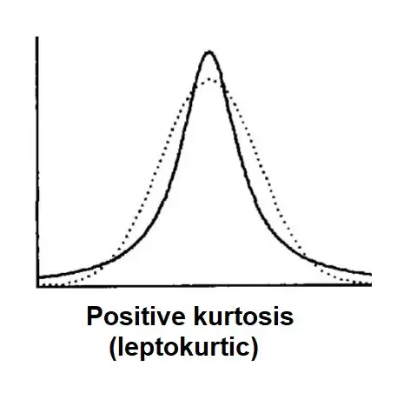
Examining Shape of the Distribution: Kurtosis
Kurtosis is a statistical measure of the heaviness or lightness in the tail of the distribution.
Normal Distribution is displayed in dashed lines.
Adapted from B. Hazan’s slides.
Source: https://www.simplypsychology.org/kurtosis.html

Slide 26
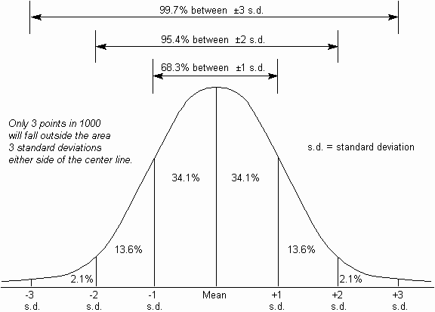
Examining Shape of the Distribution: Approximately Normal Distribution
Bell-shaped
Symmetrical around the centre
“Standard” statistical methods rely on the properties of the normal distribution.
But we often don’t have normally distributed variables!!

Slide 27
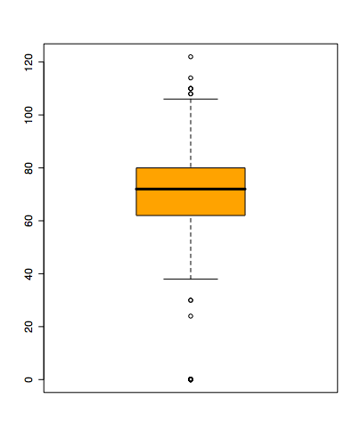
Two Useful Plots for Examining Quantitative Data
Histogram: Shows the shape of the distribution: clusters, gaps, symmetry/skew, and possible multiple peaks.
Boxplot: Shows the Compact summary of center, middle 50%, spread, and potential outliers.

Slide 28
Boxplot
Shows a Lot of info about a variable
3
4
Median
IQR
Outliers
Range
Skewness
2
5
1
6

Slide 29
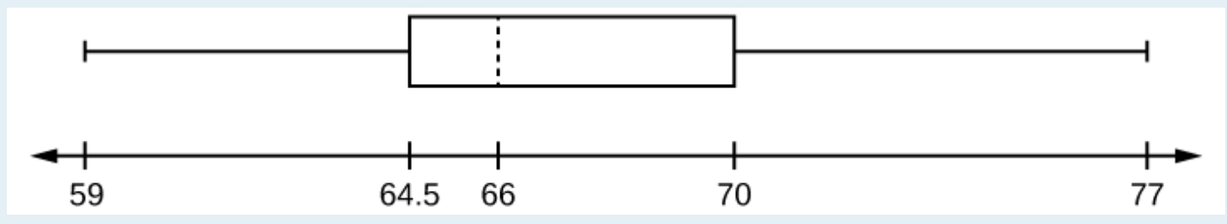
Graphing Continuous Variables
Minimum value =
Maximum value =
Q1: First quartile =
Q2: Second quartile or median =
Q3: Third quartile =
Range:
Interquartile range:
From B. Hazen’s Slides
Cote et al., 2021, p.40)
https://courses.lumenlearning.com/introstats1/chapter/box-plots/

Slide 30
Why the Shape of the Distribution Matters for Quantitative Data
Roughly symmetric; no influential outliers
Mean + SD often provide useful summaries.
Skewed and/or influential outliers
Median + IQR are often more representative.
This is why we visualize the data before deciding which numerical summaries to report.

Slide 31
R functions for Summarizing Quantitative Data
Quick overview
Center
Spread
summary(ABC)
mean(ABC)
median(ABC)
sd(ABC)
IQR(ABC)
range(ABC)
Calculate what helps you understand the variable.
Report the summaries that best describe the distribution.

Slide 32
R functions for Visualizing Quantitative Data
Histogram
See the overall shape.
Boxplot
See center, middle 50%, spread, and potential outliers.
hist(ABC)
boxplot(ABC)
Use graphs and numerical summaries together - they answer different questions.

Slide 33
Scale | Graphs | Measures of Central Tendency | Measures of Variability/Spread | Notes
Nominal | Bar Graph* Pie Chart | Mode only | None | Report as percentages or proportions
Ordinal | Bar Graph* Pie Chart | Median, Mode | Range, IQR | Mean & SD not appropriate (assumes equal spacing).
Numerical (Data Normally distributed) | Histogram Box Plots | Mean, Median, Mode | Standard deviation (SD), Range, IQR | Data are Normally Distributed
Numerical (Data not Normally distributed) | Histogram Box Plots | Mean, Median, Mode | Standard deviation SD, Range, IQR | Data are not Normally Distributed

Slide 34
You Decide: How Would You Explore This Variable?
Variable: Annual Household Income
Suppose this is a new variable in a dataset.
1. What kind of variable is it?
2. What visualization(s) would you use?
3. What numerical summaries would you calculate?
4. What would you look for before deciding what to report?
27

