Slide 1
EMERGENT MULTILINGUAL LEARNERS IN U.S. SCHOOLS
Fall 2026
Dr. Kelly Gavin Zuckerman

Slide 2
Checking In
Window seat or aisle seat?

Slide 3
  Today’s Class
  Checking In
  Preview of Today’s Class/Next Class
  Today’s Invitation
  Demographic Profile and Implications
  How Are They Identified?
  Alternative Methods Activity
Notes:
[Start with a warm and welcoming tone to engage the audience.]
Welcome, everyone! Today, we’re going to navigate through some exciting topics and discussions that will set the tone for our class. Let's dive in!
[Pause for a moment to allow the audience to settle in.]
First, let's look at what we’ll cover today and preview what’s coming up next. We'll start by reviewing the syllabus—it's our roadmap for the semester, so it's crucial to get familiar with it. [Emphasize the importance of understanding the syllabus.]
Now, an important part of today’s class is our discussion on “What’s in a Name? Labels as Limitations.” We’ll explore how names—and the labels we attach to them—can shape perceptions and experiences. It’s a powerful conversation that invites us to reflect on identity and meaning.
[Encourage participation.]
As we move through these topics, I invite you to think about your own experiences and prepare to share your thoughts. This is a space for open dialogue and learning from one another.
[Conclude with a positive note.]
Let's make this session interactive and insightful. I’m looking forward to hearing your perspectives and stories. Remember, your voice adds value to our collective learning experience.

Slide 4
  For Next Class
Focus: What is your own relationship with language and how does that shape how you may enter the field and view the subject matter?
Assigned Reading/Viewing/Doing:
  Select 5 pieces to read from Tongue Tied Part 1
  Read: "Teenagers on What Their Families' Native Languages Mean to Them"
  Listen to Brief NPR profile
  Bring in a line that spoke to you from your reading or listening.
Discussion Post #2 Due Sunday by 12:59 pm; Goal-Setting Sheet by Next Wednesday
Notes:
https://www.youtube.com/watch?v=ST3LBmJt3nM

Slide 5
  Today’s
What piece of demographic data stood out to you in your reading? Surprised you? Challenged you?
invitation

Slide 6
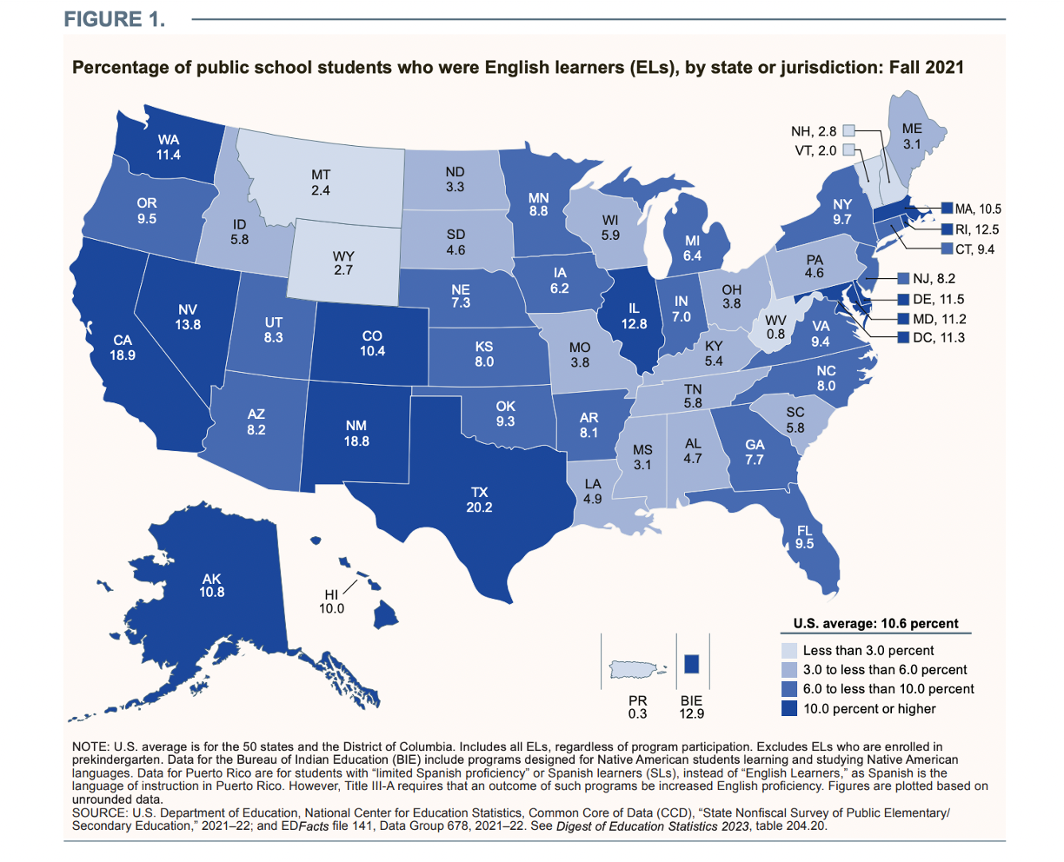

Slide 7
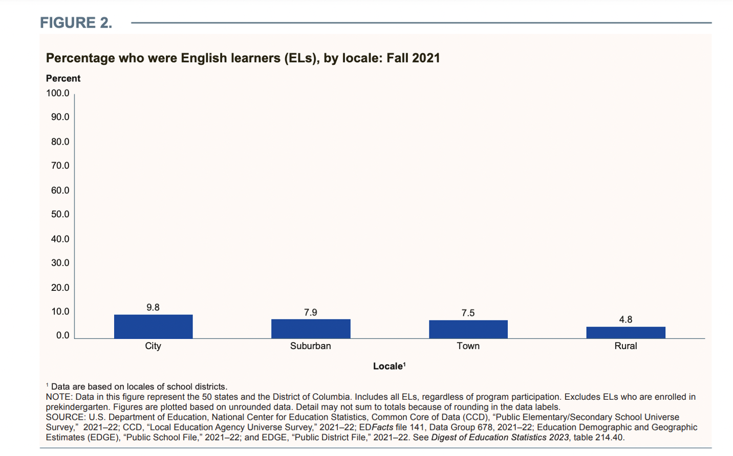

Slide 8
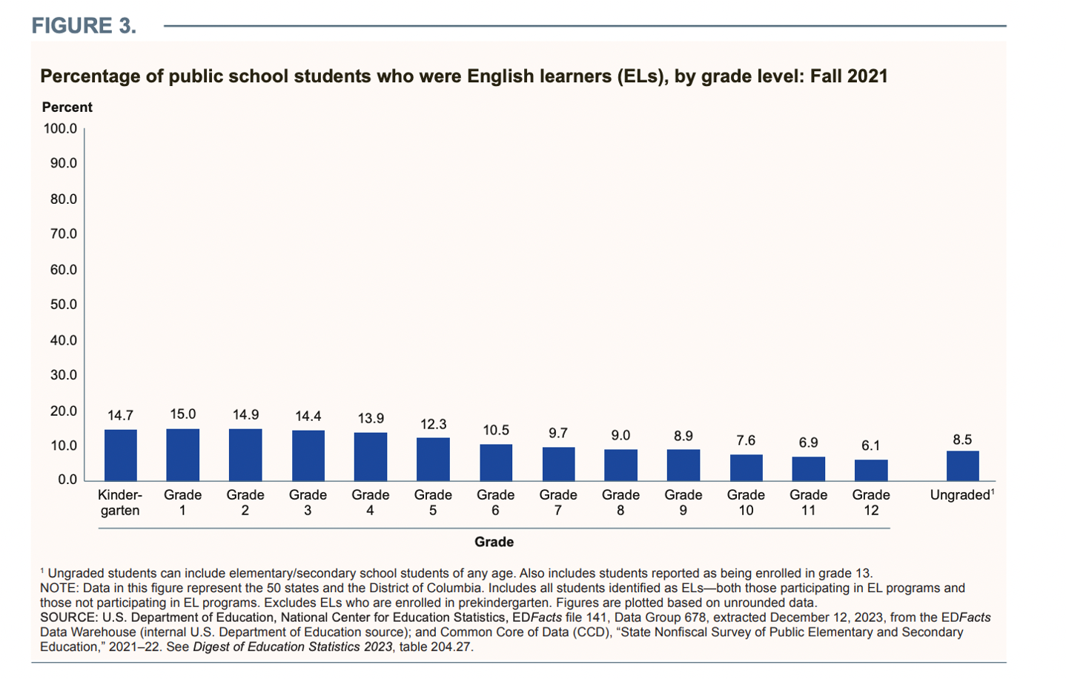

Slide 9
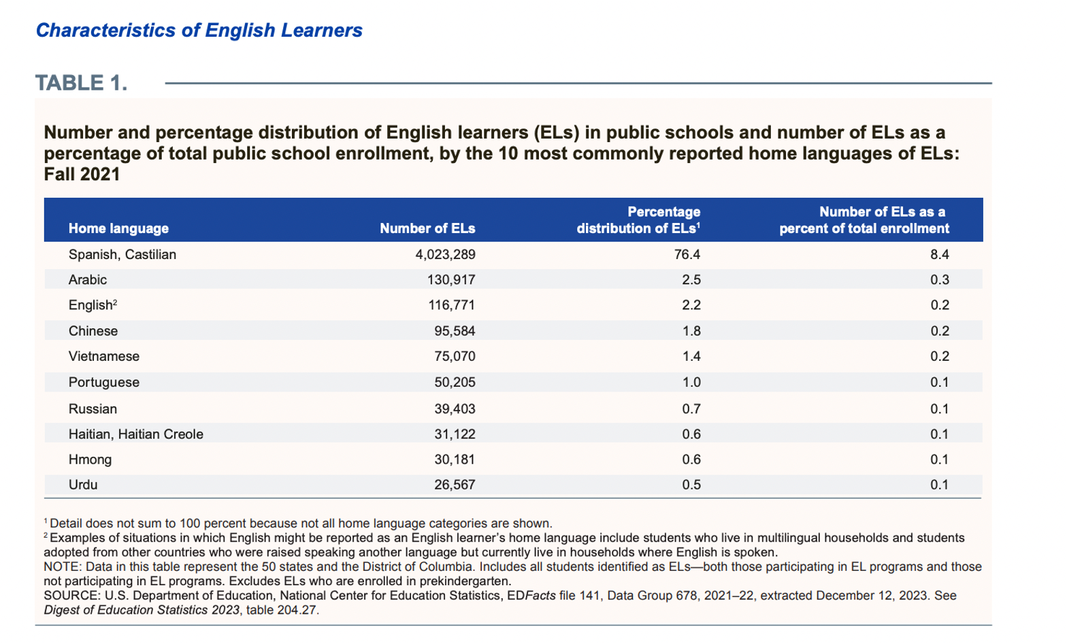

Slide 10
Philadelphia?
  What about in
The percentage of students who were English Learners (ELs) in the School District of Philadelphia (SDP) grew from 9% in 2014-15 to 17% in 2022-23
Nearly half are born in the United States. A growing number are from Central America.
In 2022-2023, 160 home languages (including English) home languages were spoken. Around half of these languages were were spoken by only five or less students in the SDP.
In 2022-2023, Spanish was the home language of 47% of ELs. The next four most spoken languages were Portuguese (9%); Chinese (Mandarin) (9%); Arabic (5%); Russian (4%).
The number of schools where ELs made up 20% or more of the student population more than doubled, from 26 in 2014-15 to 62 in 2022-23.
The number of schools with zero ELs enrolled decreased from 48 in 2014-15 to 25 in 2022-23. Over the same period, the number of schools where ELs made up 20% or more of the student population more than doubled, from 26 in 2014-15 to 62 in 2022-23.
Notes:
English Learner (EL) Home Language and Enrollment Trends in the School District ofPhiladelphia: 2014-15 to 2022-23

Slide 11
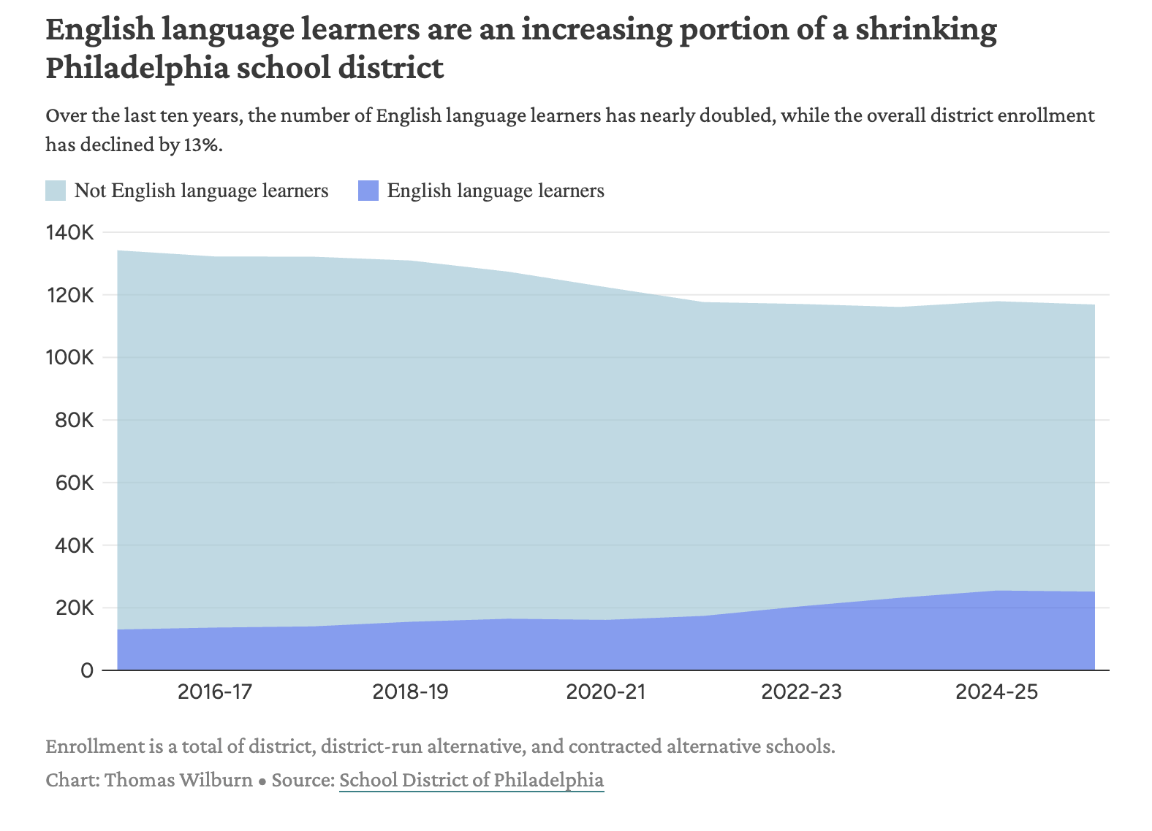
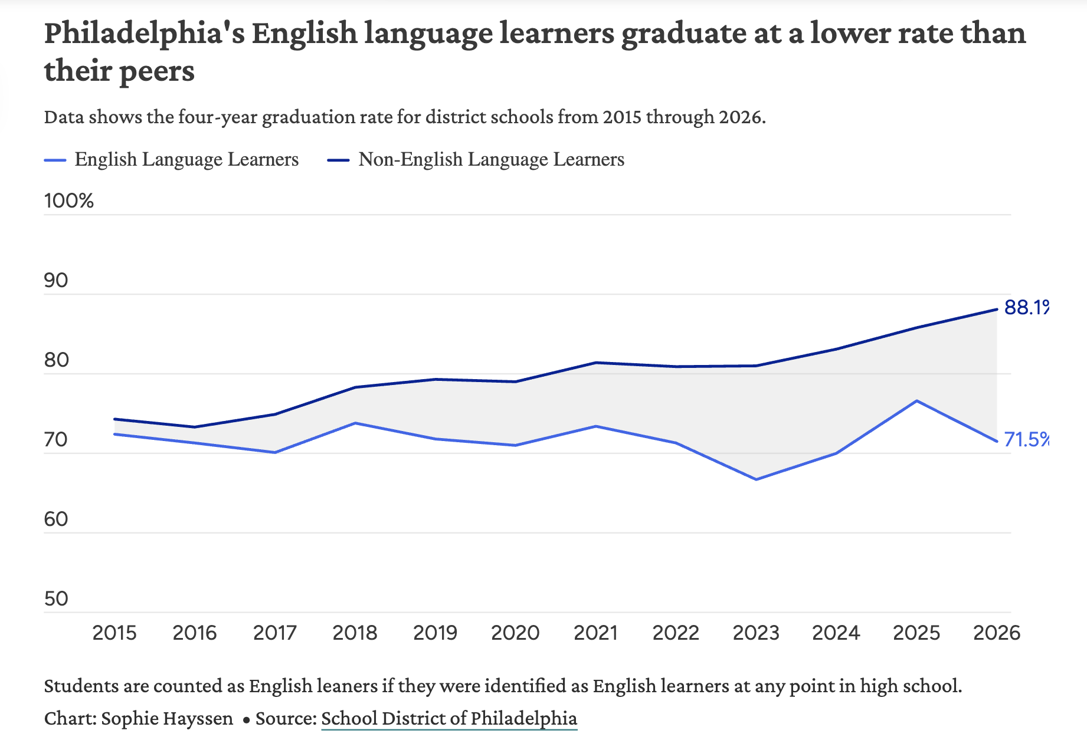

Slide 12
https://www.youtube.com/watch?v=ol1yRjdRzH8

Slide 13
EMLLs?
  What methods are used to identify
“Unlike other categories of identification such as ethnicity, race, and gender, the English Learner (EL) classification is fluid—that is, students move in and out of being classified according to their progress” (Garcia & Kleifgen, 2025. p. 12)
“At least 21 states explicitly require the administration of a home language survey in the identification process, while 27 states require the use of an English language proficiency screening assessment for students whose primary or home language is not English. Some states also incorporate additional criteria, including a home interview, a review of a student’s academic achievement, and teacher observations and recommendations.” (50-State Comparison: English Learner Policies. Education Commission of the States. )

Slide 14
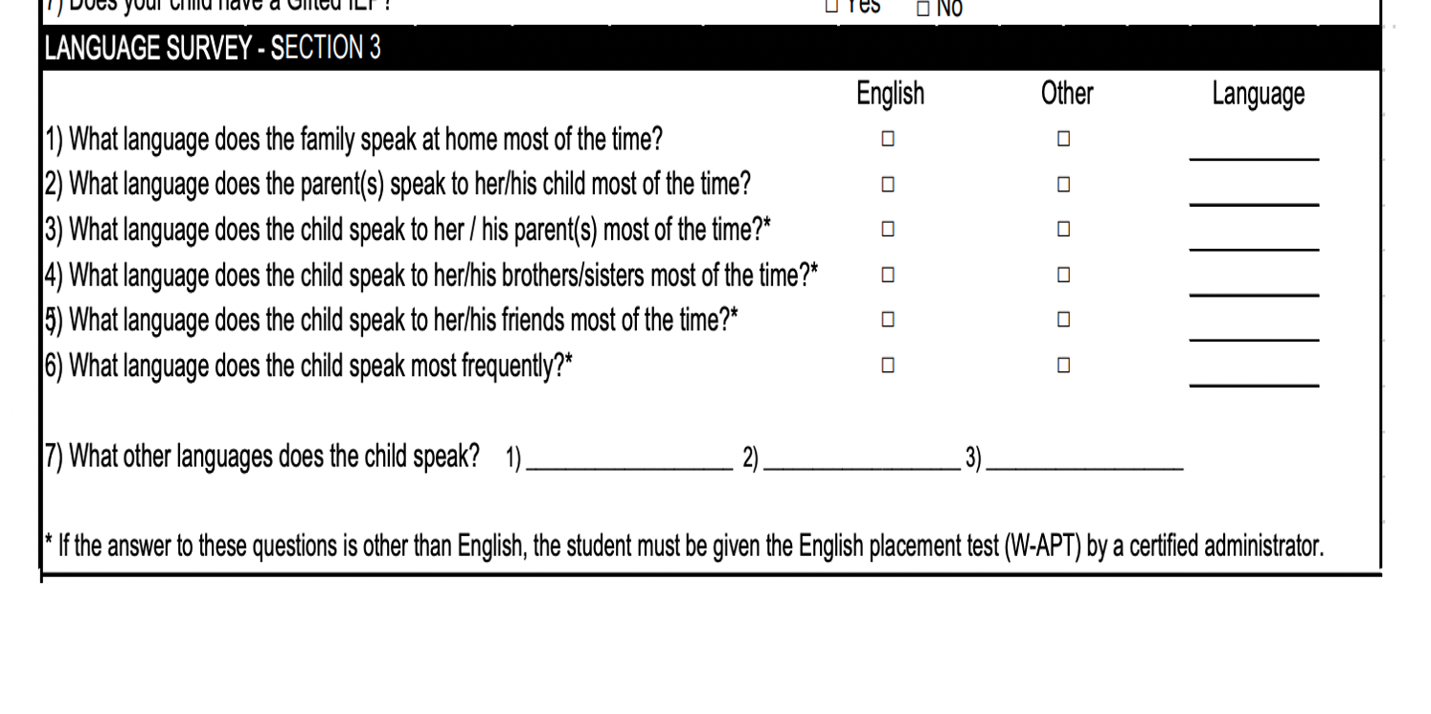
Philadelphia?
  What about in

Slide 15
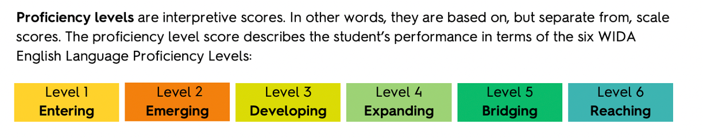
  How are they identified?
•Initial assessment for EMLLs uses the WIDA Screener.
•Assessment for current EMLLs used by SDP is ”Assessing Comprehension and Communication in English State-to-State for ELLs” (ACCESS). Students receiving services are assessed yearly.
•Almost half of Philadelphia’s EMLLs in 2014-2015 were either Level 1 or Level 2 (out of 6).
•In Pennsylvania, students can exit ELL programs once they achieve Level 5 proficiency (in addition to minimum state test score and GPA requirements). District’s goal is to have students test out of ELL in 6 years.
•Nearly 2 in 5 EMLLs in grades 6-8 and 2 in 5 EMLLs in grades 9-12 were either Level 1 or 2.

Slide 16
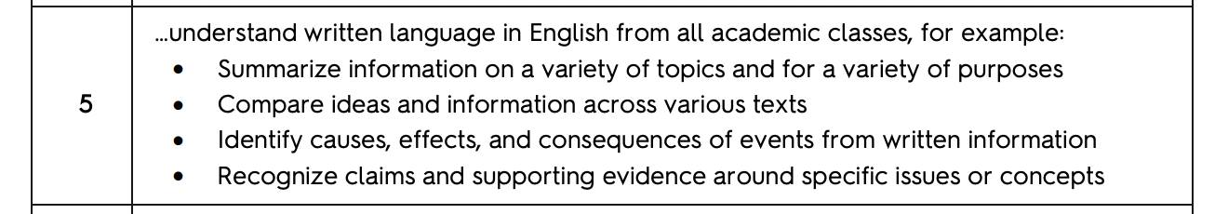
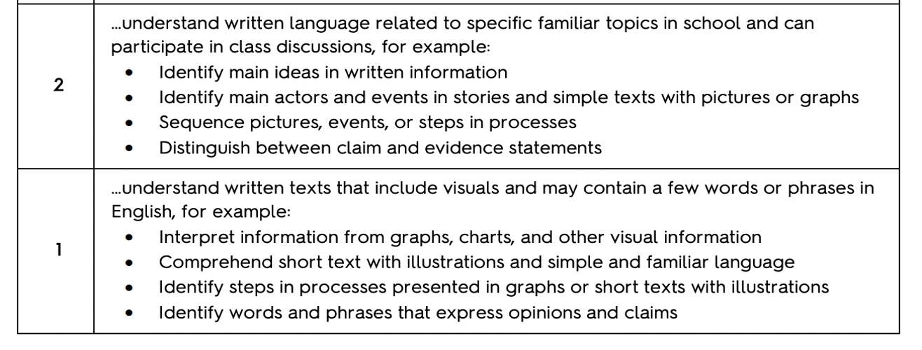
WIDA Speaking: students at this level can generally…
versus

Slide 17
For Discussion
A Few Considerations:
-Modality
-Personnel
-Format
-Time Commitment
•What are the affordances and limitations of the current identification process?
•What information is important to gather about a new EMLL?
•What would be an effective means of gathering this information?

