Slide 1
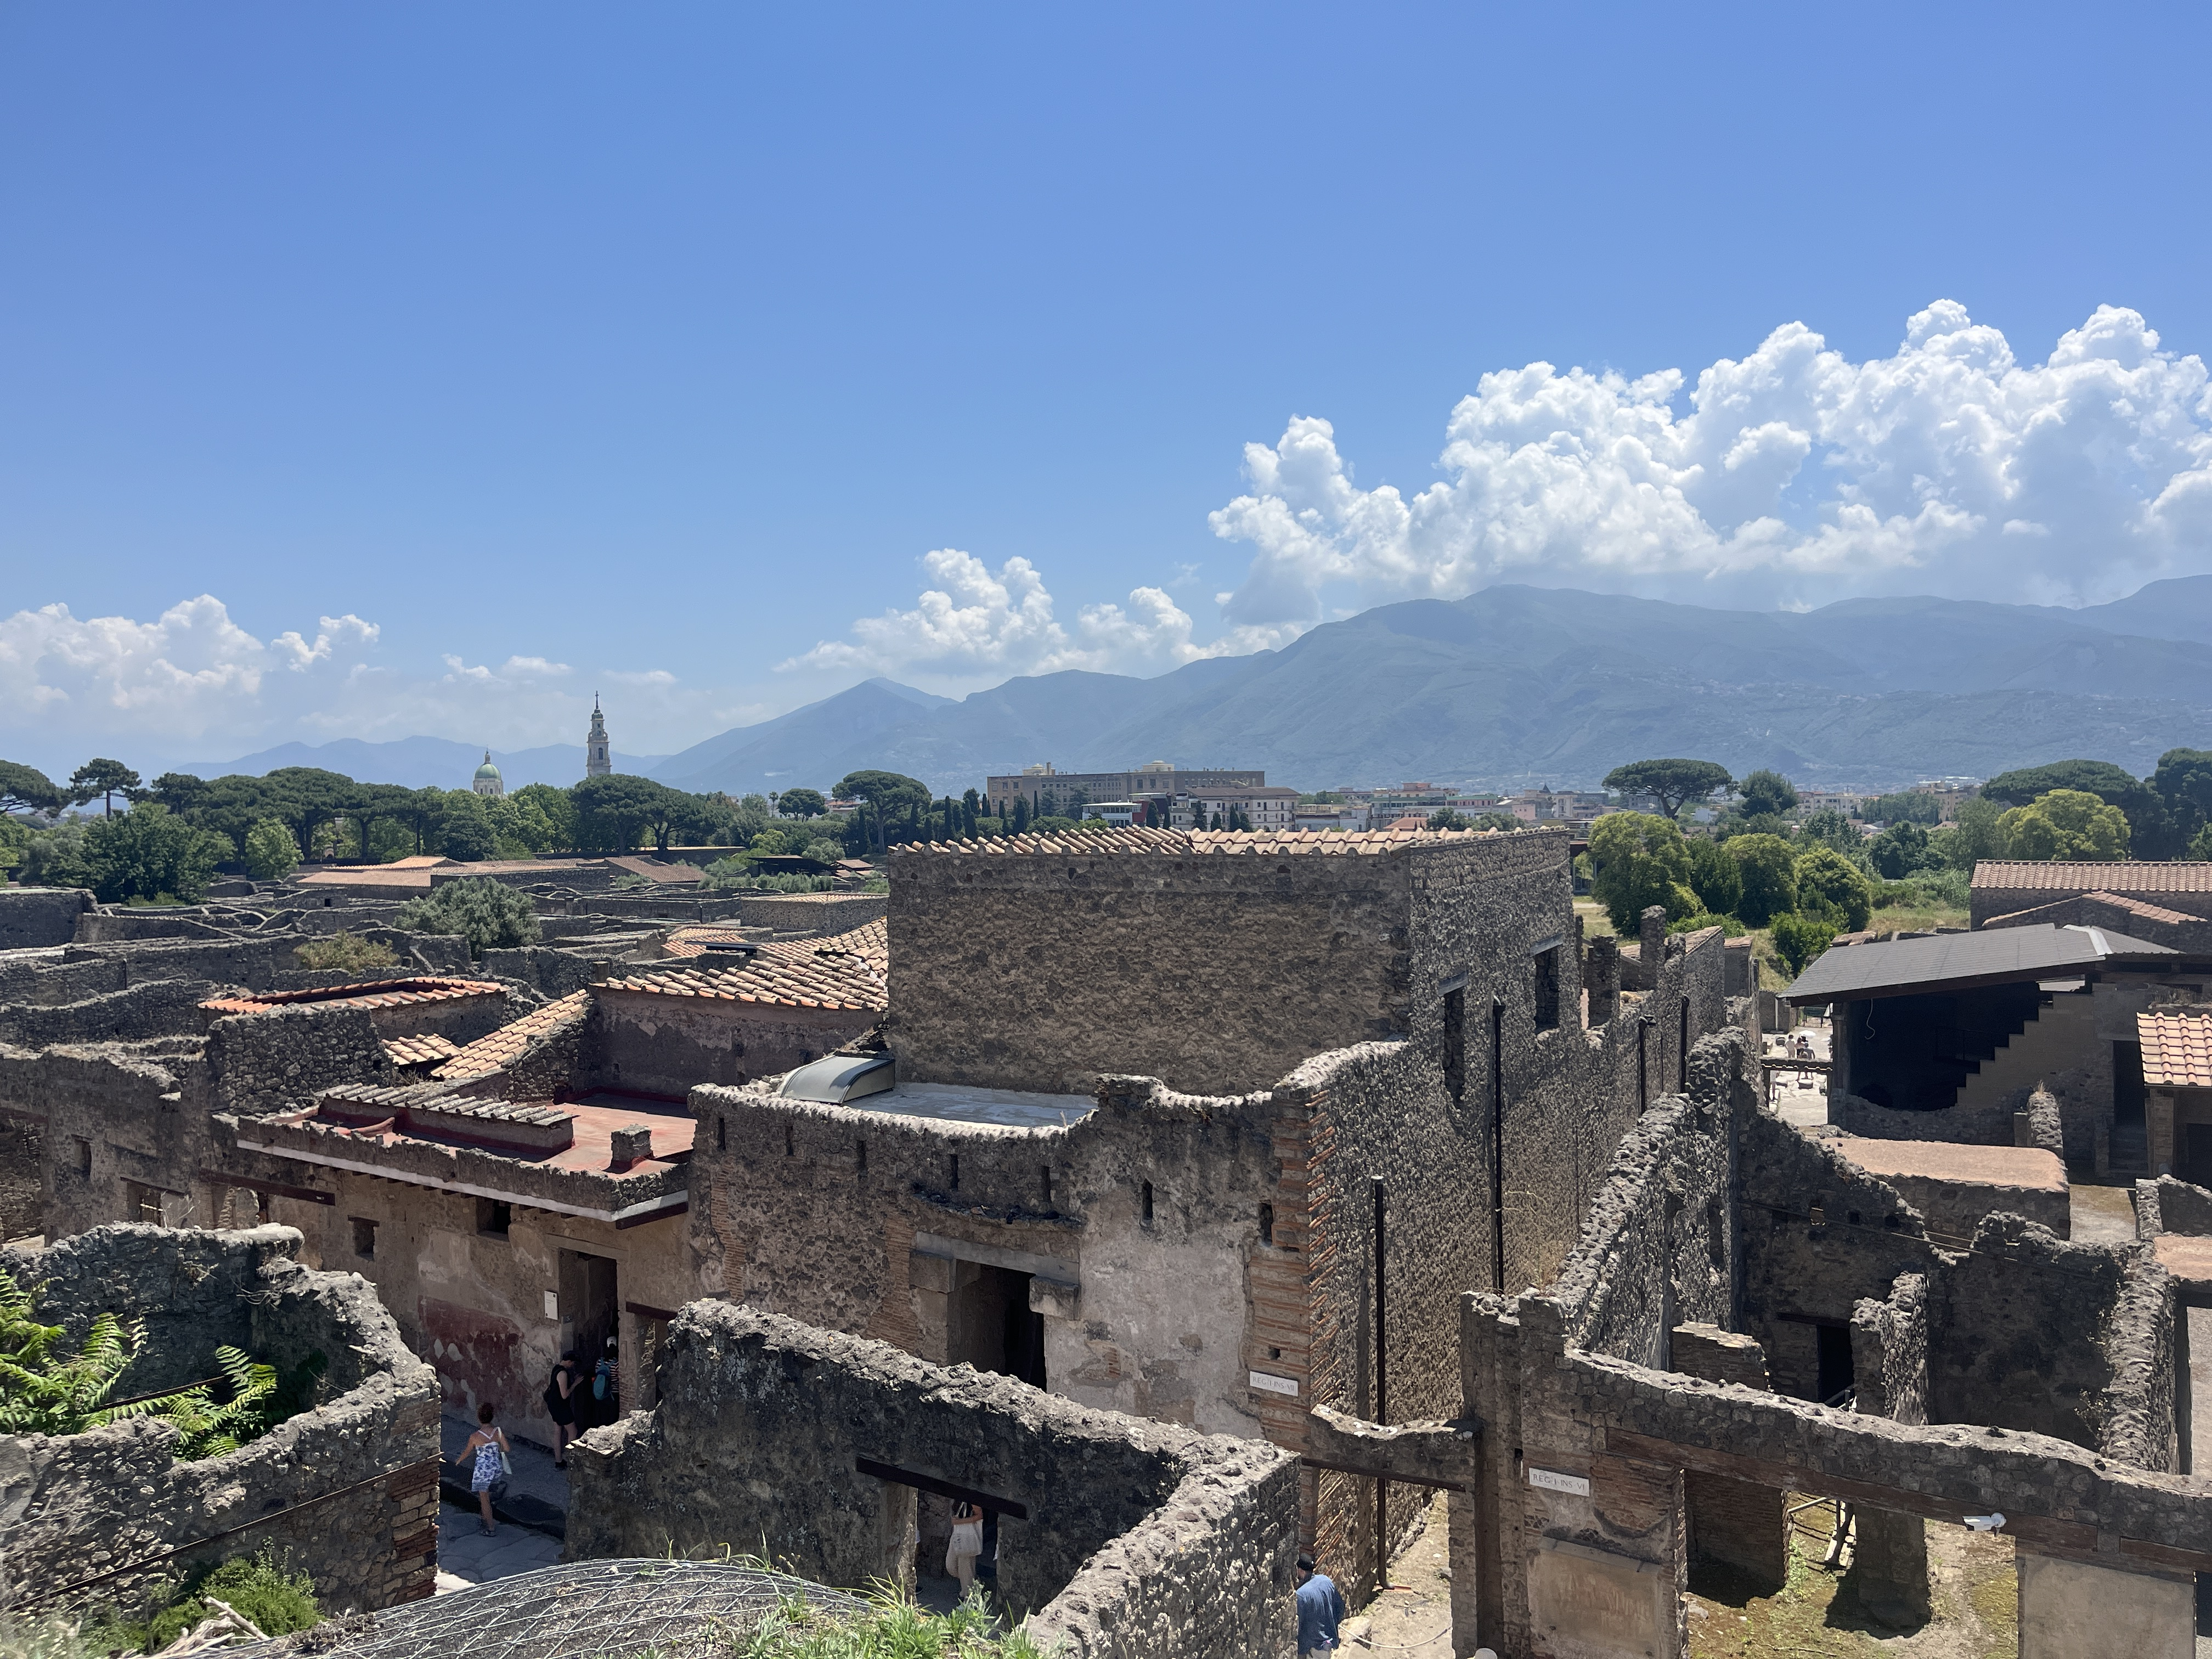
The City’s Urban Development
September 10

Slide 2
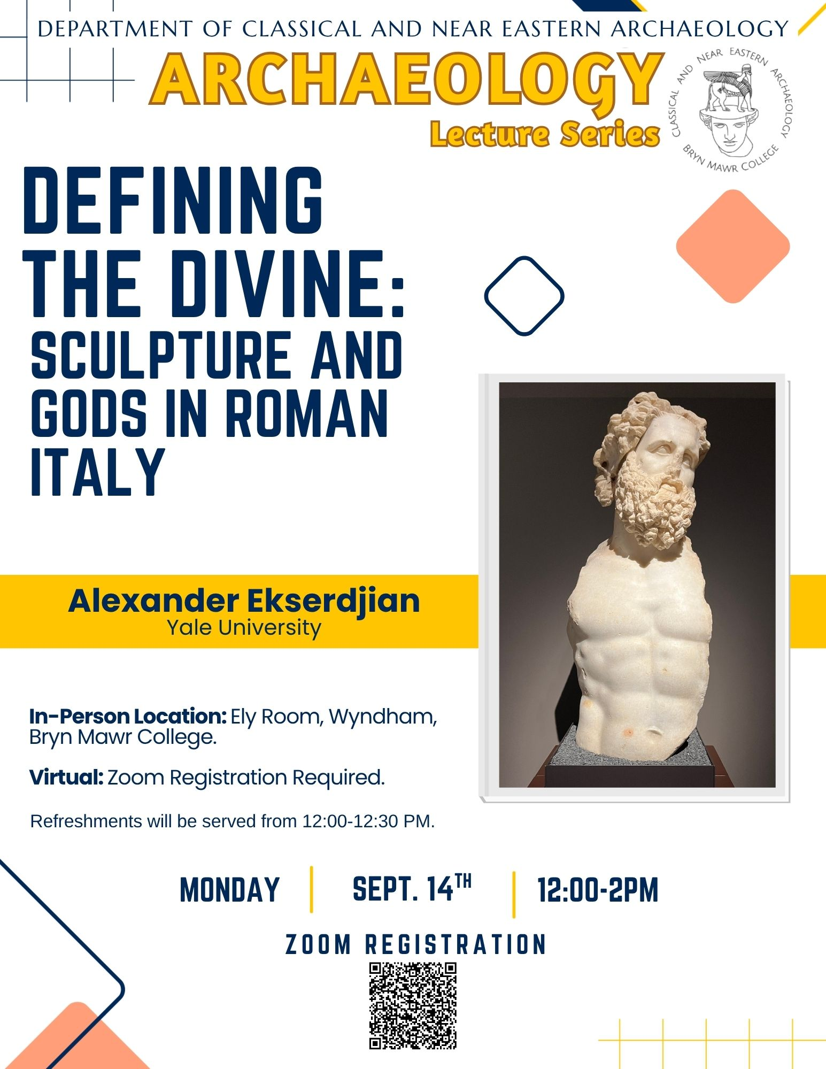

Slide 3
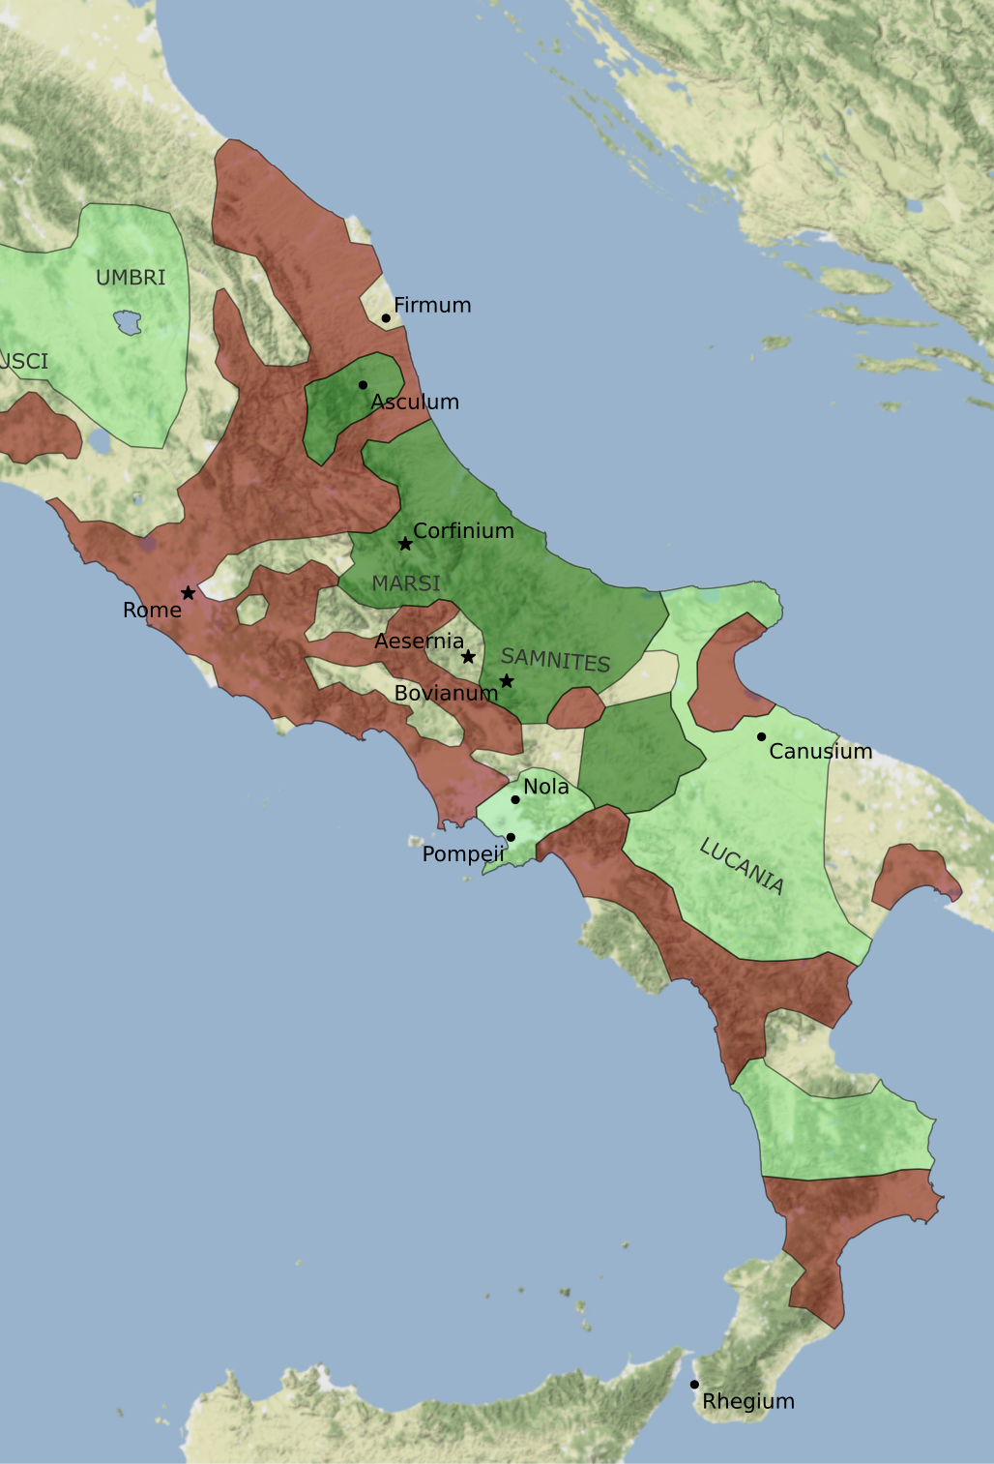
Rebellion of the Social Wars (91-87 BCE)
Italian allies (socii), including the Samnites and Campanians, rose up in rebellion against Rome.
They were mad that they provided soldiers for Rome but were denied basic civil rights:
  They could not vote or run for office
  Received smaller shares of military booty and land in comparison to citizens
In 91 BCE, Marcus Livius Drusus, a Roman tribune, proposed a bill granting citizenship to these allies. Drusus gets assassinated, which launches a rebellion.

Slide 4
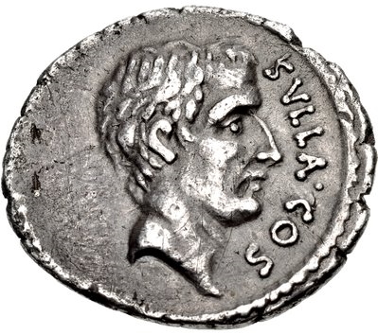
Pompeii and the Social War
The Romans attack the rebels in Campania under the General Lucius Cornelius Sulla
Herculaneum was conquered and Stabiae destroyed
Pompeii is besieged by Sulla and capitulates in 89 BCE
Ballista balls have been found near the Herculaneum gate, giving evidence to this attack.

Slide 5
Colonia Cornelia Veneria Pompeianorum
Pompeii is refounded a Roman veteran colony in 80 BCE and receives a new name: Colonia Cornelia Veneria Pompeianorum
Named after Sulla who was from the Corneli family
Pompeii receives a new patron god: Venus, who was also the patron god of the Corneli family.
Latin replaces Oscan as the main language in inscriptions.
A new social hierarchy is established, colonists vs old Samnites.

Slide 6
What is a Roman colony? What is Roman colonization?
A Roman colony, colonia, was an intentional settlement by Rome on newly conquered territory.
There are three types of colonies
  Roman Colonies: settlers retain full Roman citizenship, including voting rights and legal protections under Roman law.
  Latin Colonies: settlers held “Latin rights”. If a full Roman citizen moved to a Latin colony, they surrendered their Roman voting rights. Settlers would receive very large plots of land to own and farm.
  Veteran Colonies: Became common at the end of the Republic. Settlers were retired Roman legionnaires and Roman citizens. Generals like Caesar and Augustus will grant land as part of a retirement pension for veterans. This insured loyalty of the soldier and helped secure land in the provinces.
The earliest colonies were set up in Central Italy during the Roman Republic
  Ostia, the port of Rome in the 4th c. BCE
  Cosa 273 BCE
Colonies were often strategically placed, being used for military defense, territorial control, or acting as a buffer zone.

Slide 7
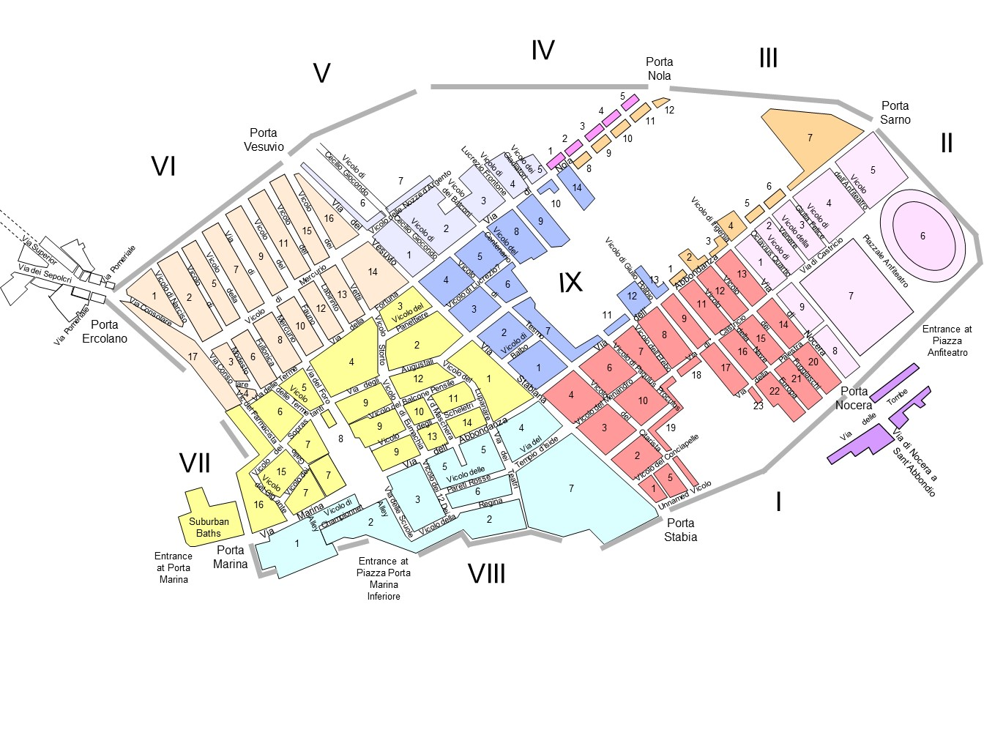
The Early Roman Colony at Pompeii
The Roman colony was imposed on the pre-existing plan of the city
There is an absence of new housing projects during this period, which suggests that the new colonist either 1) displaced Samnites and took over their existing properties OR 2) lived outside the city walls.
The influx of new colonists created a new set of social and cultural priorities. As a result, there will be an increase in building projects across the city funded by colonists.

Slide 8
Conflict with the New Settlers
“Sulla,” he says “set them at odds with the new settlers in order to use the division and dissension he had caused to get control of the town with the aid of the inhabitants of Pompeii.” In the first place, the whole quarrel between the inhabitants and the new settlers was reported to the patrons when it had grown chronic and had been pursued for many years. … Although they quarreled with the new settlers about promenades and elections, they were of one mind about their joint safety… - Cicero Pro Sulla 60-62

Slide 9
Layout of Pompeii
From the Samnite period onward the site’s size and layout was fixed.
The irregularly planned parts of the city in Regio VII and VIII are likely due to an earlier urban orientation from the 6th – 4th c. BCE.
  Triangular Forum area being the oldest part of the city.
  The theory of the “Aldstadt”
It seems that in the end of the 4th or early 3rd century BCE, at the height of the Samnite power, the city was organized orthogonally. Likely inspired by other Greek cities in Campania and the Etruscans.

Slide 10
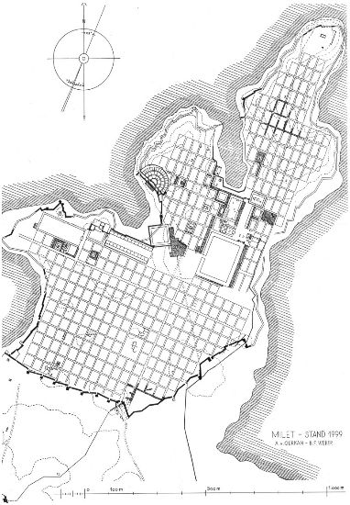
Orthogonal Grid Planning- Greeks
Plan of Miletus
Greek cities began slowly developing organized axes of space around the late 6th century BCE. Especially in Magna Graecia, at places like Paestum in Campania (c. 550-500 BCE).
Hippodamian grid plan
  An approach to urban design characterized by streets intersecting at right angles to form rectangular blocks (insula).
  Named after Hippodamus of Miletus (5th century BCE)- “the father of urban planning”, who planned the cities of Miletus, Piraeus, and Thurii.

Slide 11
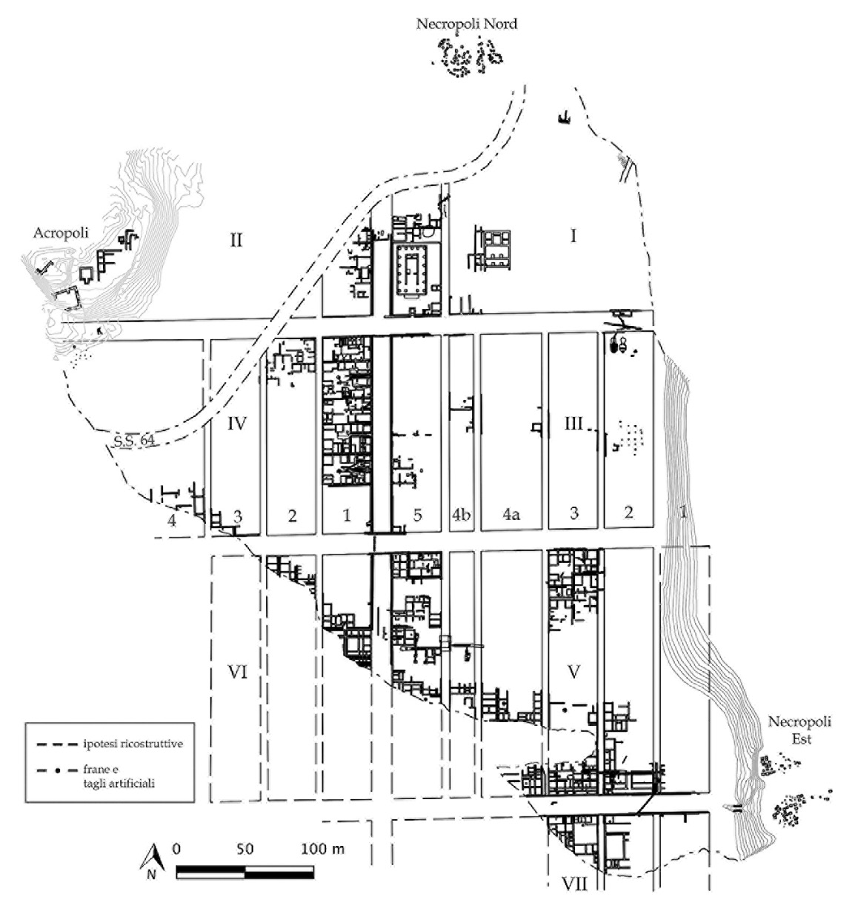
Orthogonal Grid Planning- Etruscans
The Etruscans tied urban planning to their cosmology, using religious divination to determines a cities orientation.
A special type of priest (augur) would project a celestrial cross onto the landscape, dividing the space into four quadrants aligned to cardinal directions. This would also establish the sacred boundary of the city (pomerium).
Marzabotto (plan on the left)
  Etruscan site near modern Bologna was founded in c. 500 BCE, but was abandoned by the 4th c. BCE
  City was planned on a strict grid of streets and divided into standardized rectangular insulae blocks

Slide 12
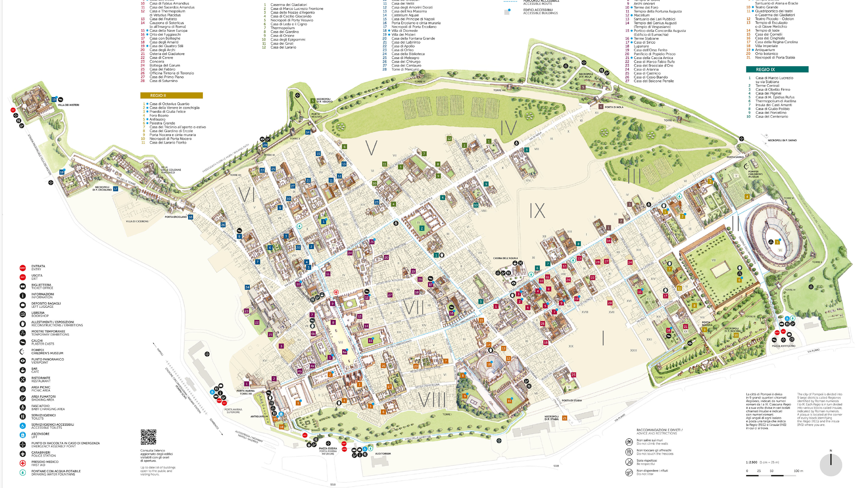
The Development of the Sullan Colony

Slide 13
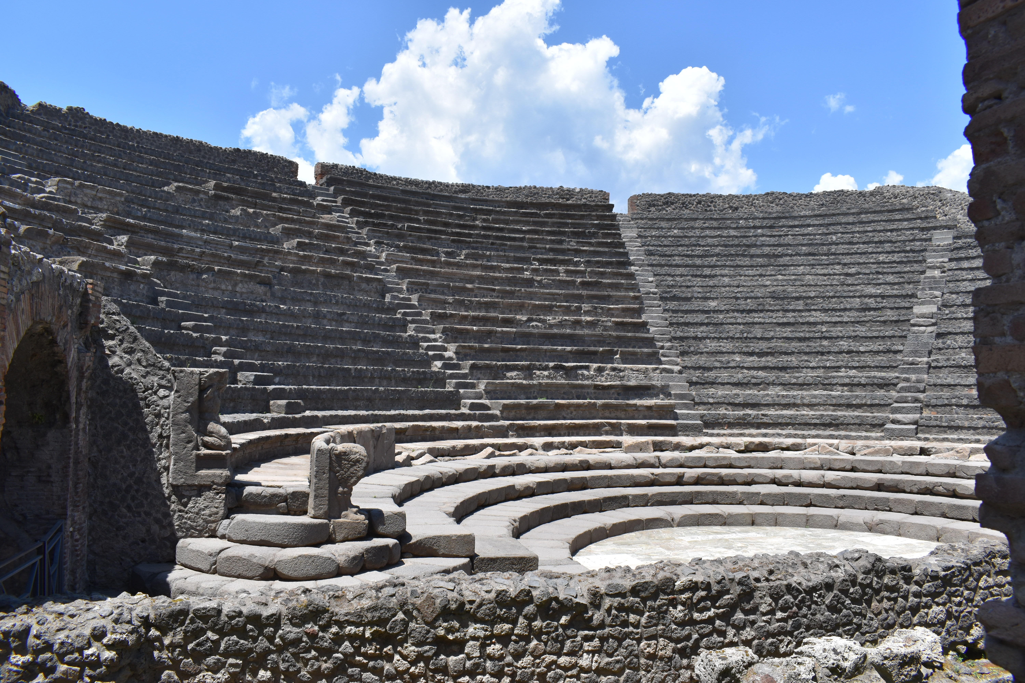
Covered Theater (Odeon)
An odeon is a Greek style concert hall, which can be used for dramatic performance or as an assemble hall for city magistrates (bouleterion).
It is smaller than a traditional theater, and often roofed.
Built in 80-75 BCE, by C. Quinctius Valgus and M. Porcius, who were both colonists and high-ranking local magistrates
It was built next to the large theater.
Capacity 1300-1500 people

Slide 14
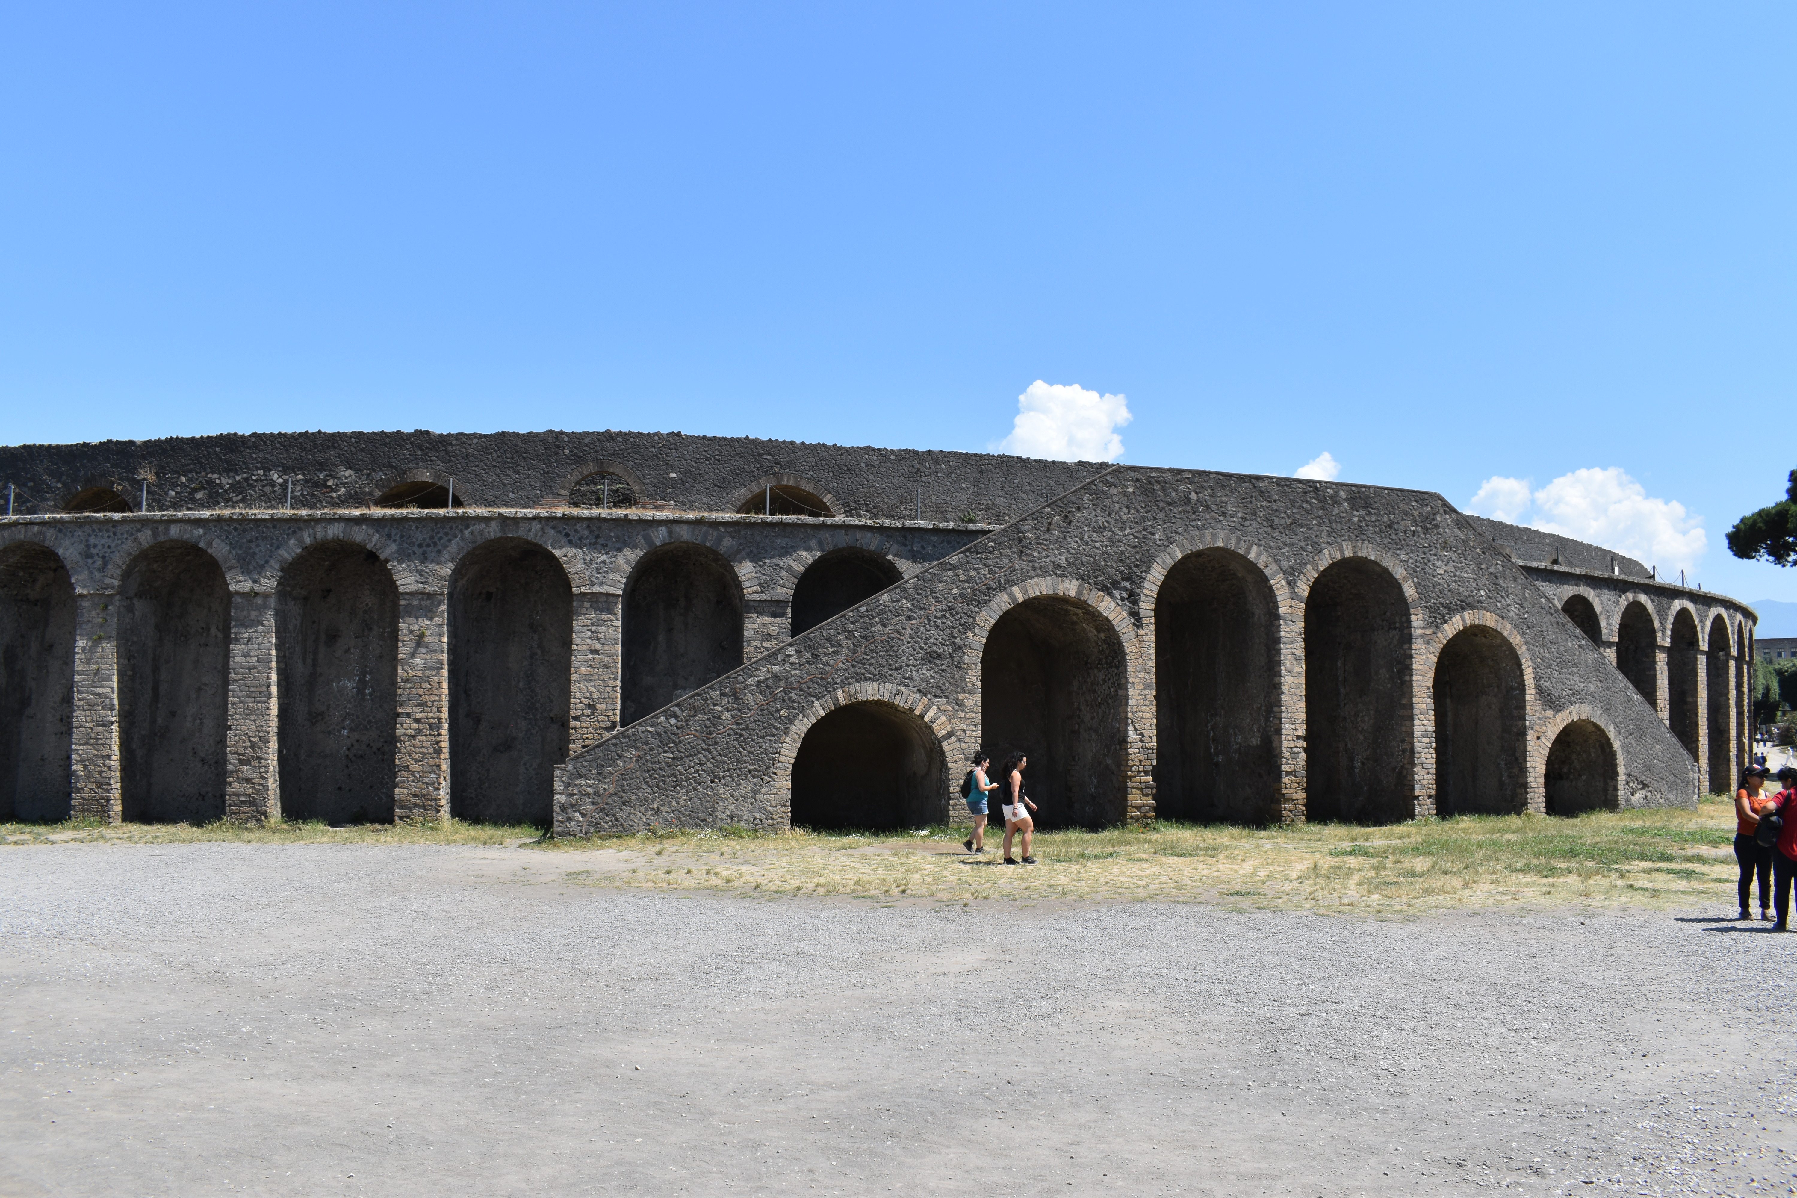
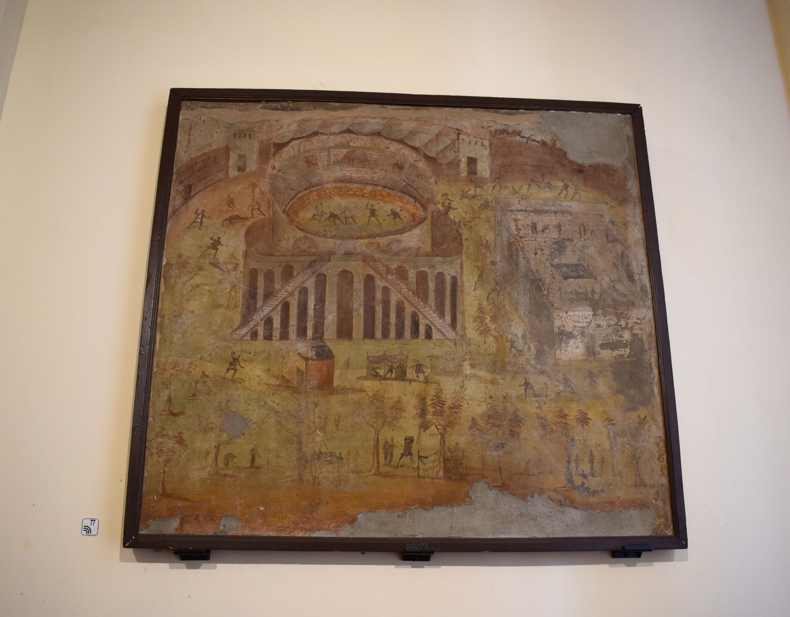
Amphitheater (Arena)
Built by the same two men: C. Quinctius Valgus and M. Porcius.
Constructed slightly later, around 70 BCE
Located on the eastern side of the city, further from the traditional urban core.
Used for Roman style entertainments
Inscription: colonia honoris caussa “for the honor of the colony”.
15,000 to 20,000 spectators capacity
Fresco depicting the amphitheater at Pompeii from the House of Actaeon (Regio I.3.23). 59-79 CE. MANN.

Slide 15
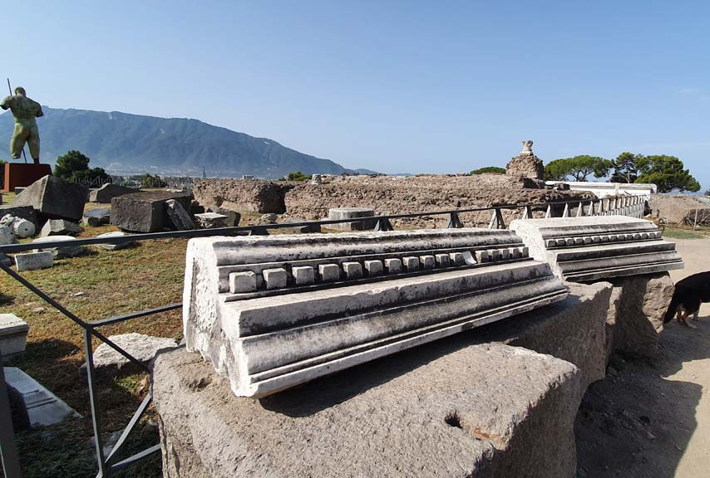
Temple of Venus
Venus was the patron goddess of Sulla’s family. Also, part of the name of the colony: Veneria.
A new temple was built to honor the new patron goddess of the city.
In a way, it was symbolic of the new Roman colonial elite over the indigenous population.
It was located near the Marine Gate on the southwest side of the city.
Located at a very visible spot along the lava plateau, would have overlooked the Sarno river valley and the sea.

Slide 16
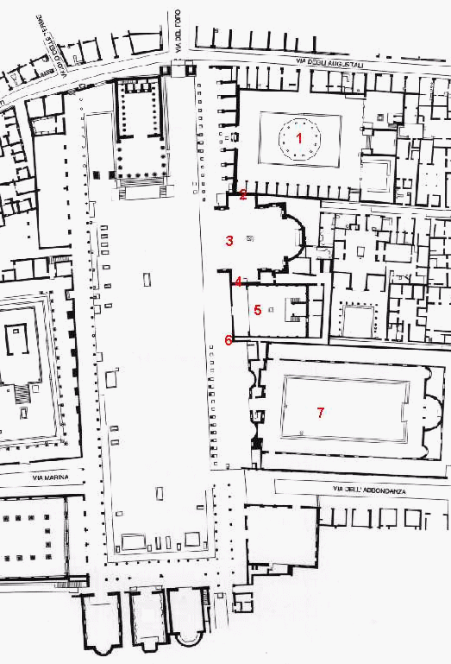
Redesign of the Forum
Influenced by the Forum Romanum in Rome
The main commercial and administrative part of the city
Several buildings are added to this space, including an updated temple, a comitium (voting enclosure)

Slide 17
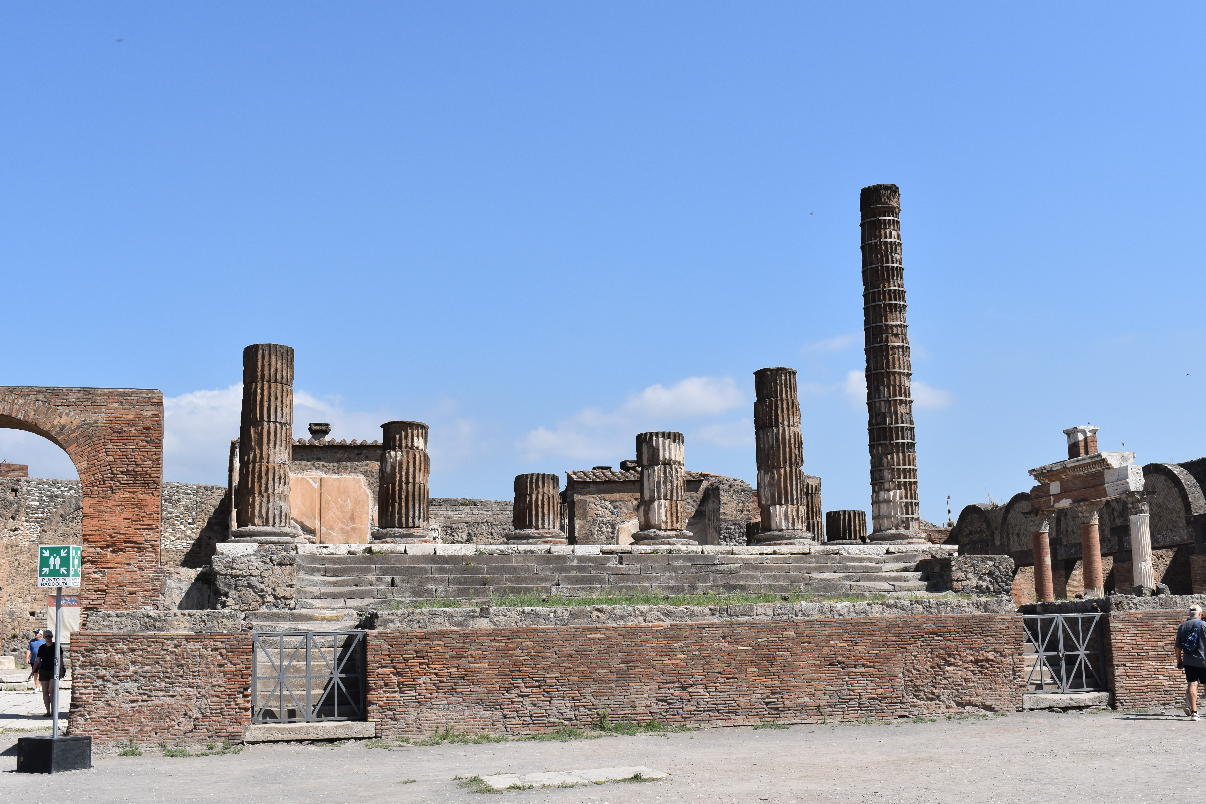
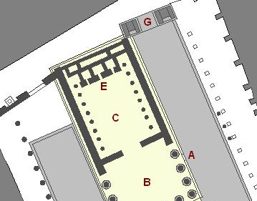
Temple to Jupiter (Capitolium)
Directly influenced by the Temple of Jupiter Optimus Maximus on the Capitoline Hill in Rome
The previous temple (c. 150 BCE) from the Samnite period is retrofitted with an interior tripartite cult room design. This is for the worship of the Capitoline triad: Jupiter, Juno, and Minerva.
Symbolic allegiance to Roman state religion.

Slide 18
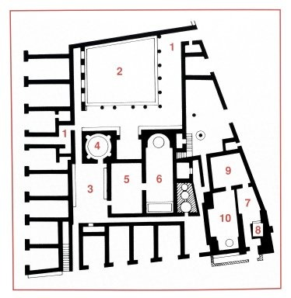
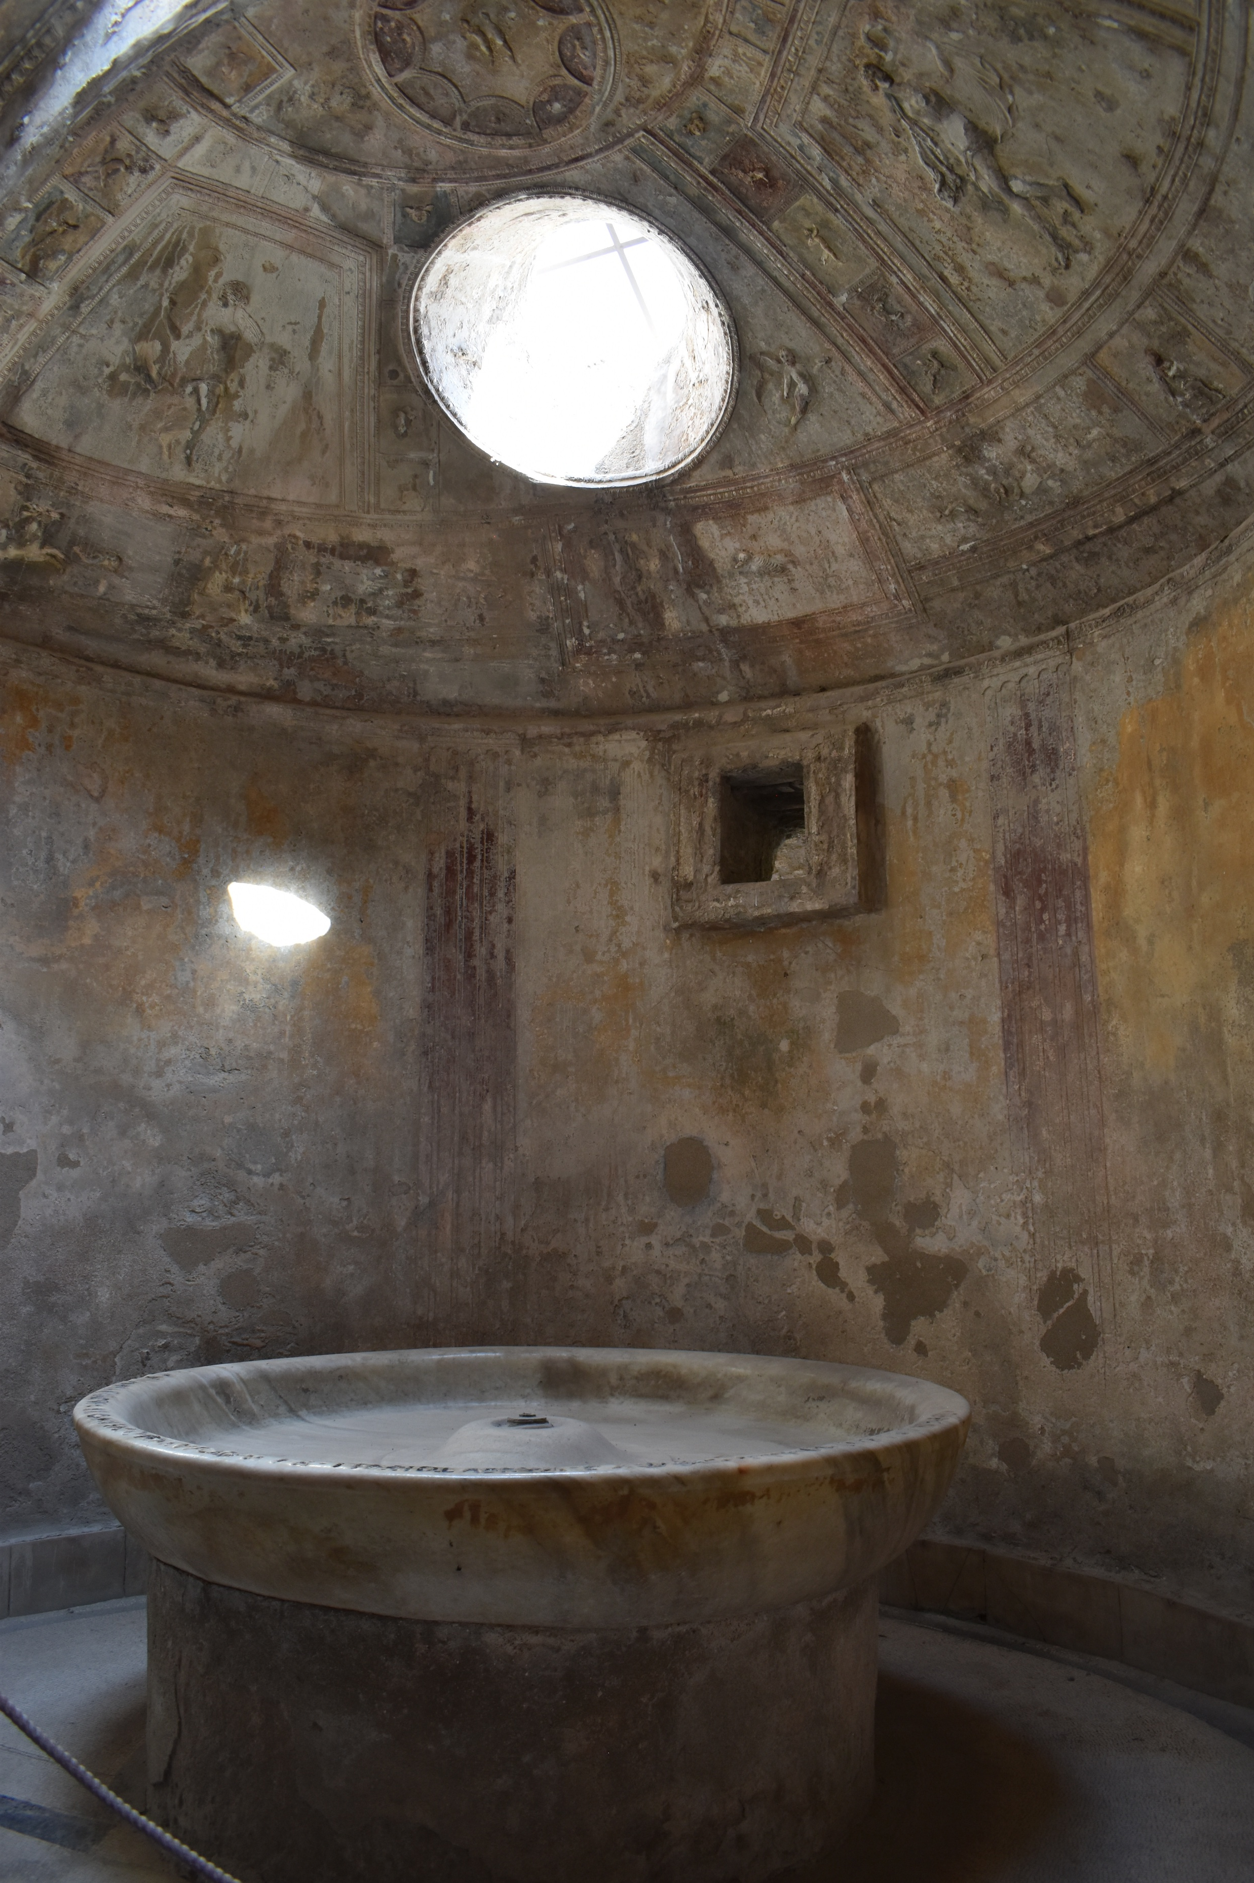
Forum Baths
The Stabian baths were not enough to support the growing population in Pompeii, so a new bath complex was built close to the Forum.
It was built ex pequnia publica, from the public expense between 80-70 BCE.
The new bath complex consisted of hot and cold rooms, is one of the best examples of early vault-construction.

Slide 19
Discussion
Based on what we discussed on Tuesday and Today, how do we see the change in urban development and urban priorities as Pompeii went from being a Samnite City to a Roman colony?
What are some examples from both periods?

Slide 20
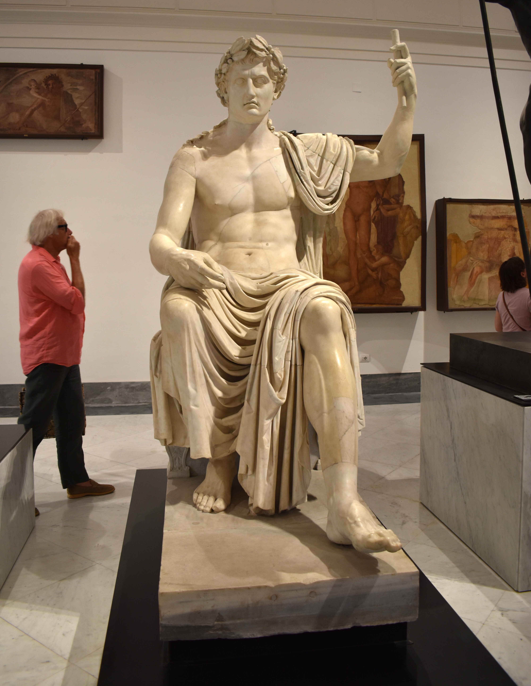
Pompeii and the Early Empire under Augustus and the Julio-Claudian Dynasty
Rome’s transition from Republic to Empire begins in the second half of the 1st century BCE.
Octavian, the nephew of Julius Caesar, becomes the sole ruler of the Empire. Given the title Augustus (great, venerable) and princeps “first among equals” in 27 BCE.
He is considered the first emperor and rules until 14 CE.
He founds the Julio-Claudian dynasty, which will rule the Empire until 69 CE: Tiberius, Caligula, Claudius, and Nero.
The Augustan period is a period of stability and prosperity, often referred to as the Pax Romana.
Statue of Augustus styled a Jove on his throne. Grom the Augusteum (Basilica) at Herculaneum. MANN 6040.

Slide 21
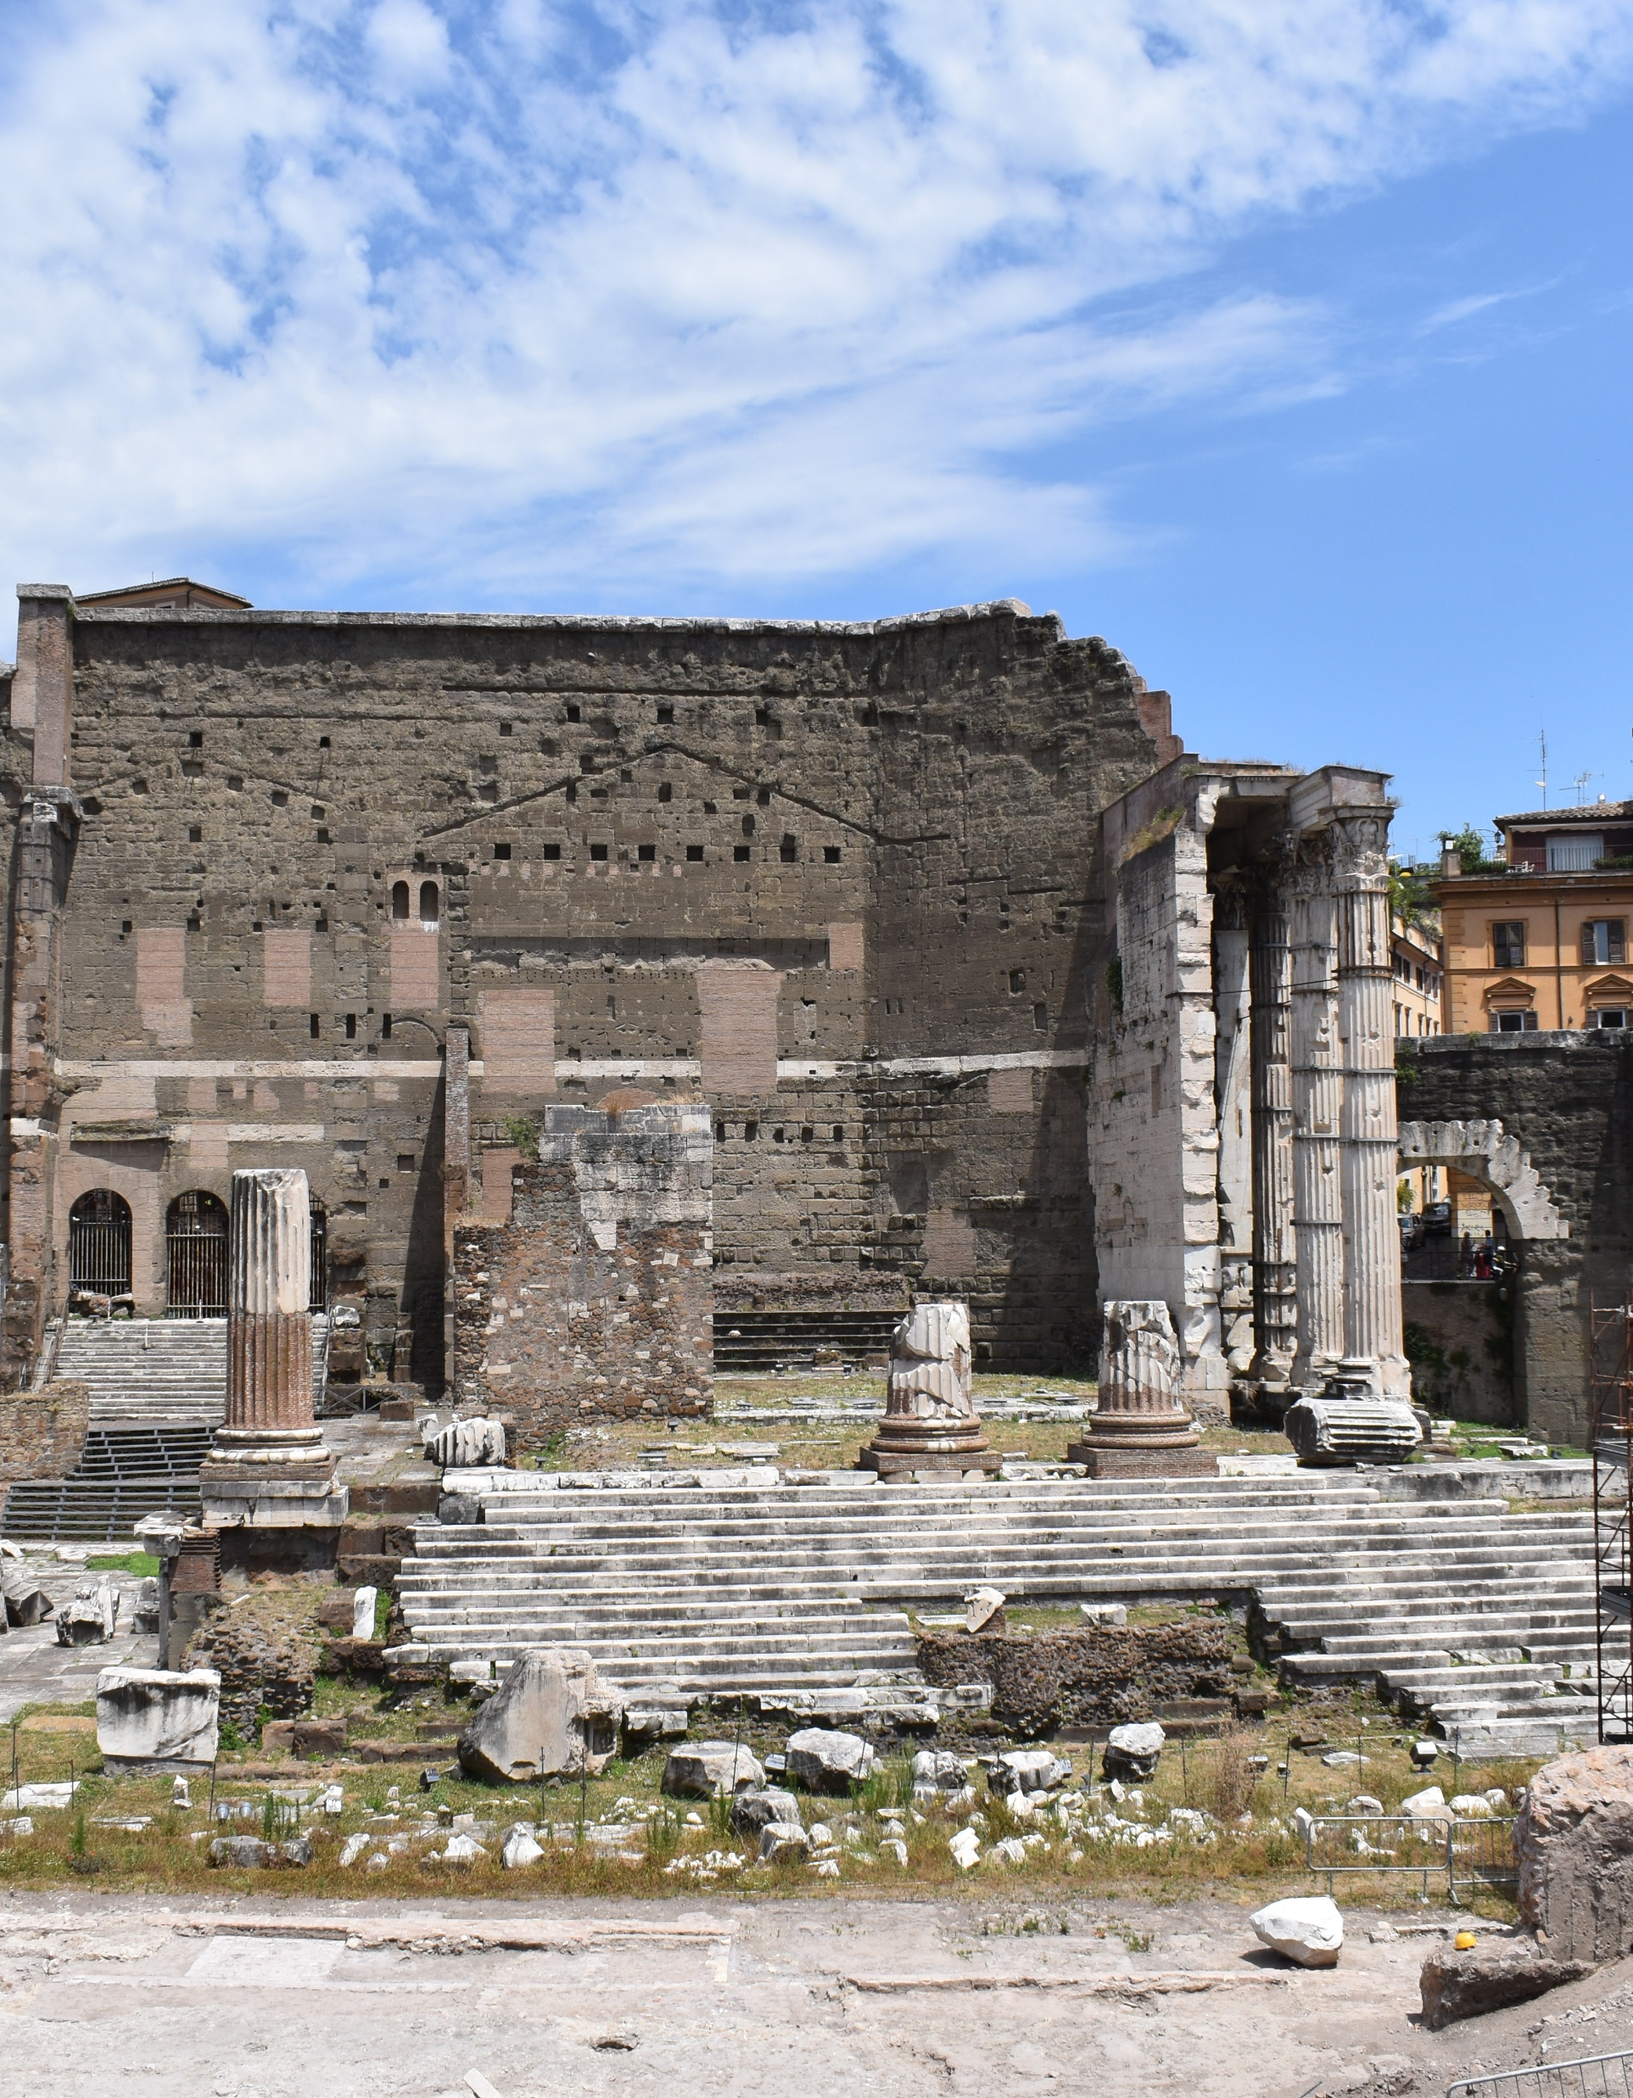
Augustan Building Program in Rome and the Pax Romana Ideology
Temple of Mars Ultor in the Forum of Augustus, Rome.
Augustus will start a massive building program in Rome, but also outside of Rome in the provinces.
He transforms the city of Rome especially, as an ideological and symbolic form of propaganda and urbanism.
In Rome, he will build numerous public works:
  Forum (next to Caesars) with a Temple of Mars Ultor (Avenger)
  Decorative altar called the Ara Pacis
  Monumental mausoleum in the Campus Martius
  Theater of Marcellus
  Temple of Apollo Palatinus (on the Palatine Hill), the patron god of Augustus

Slide 22
The Development of the Augustan City

Slide 23
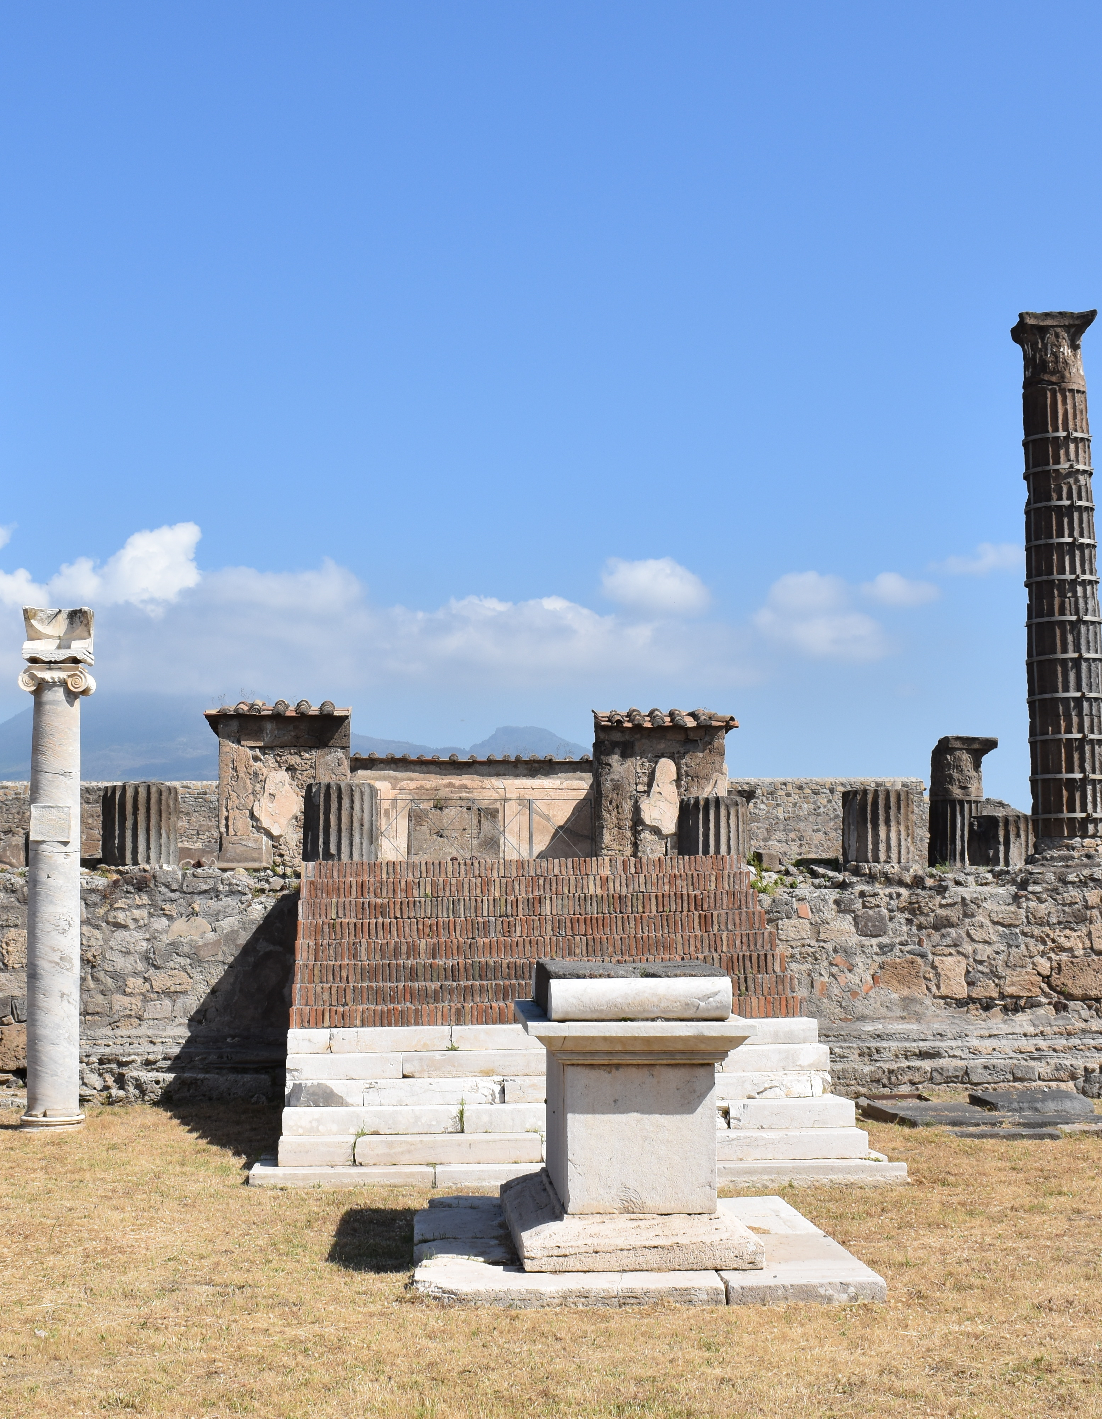
Temple of Apollo
Religious activity dates to the 6th century BCE. An earlier Samnite temple made of tufo with ionic columns, around the 2nd century BCE.
During the Augustan period, the temple of Apollo is completely refurbished.
For example, all of the columns are replaced with Corinthian capitals. Marble decorative altar added.
Apollo was the main god for Augustus. This period of reconstruction of the temple symbolically connects to Augustus’ own construction of the Temple of Apollo Palatinus in Rome.

Slide 24
The Imperial Cult
When Julius Caesar is assasinated (44 BCE), he is deified by Augustus (Divus Julius) in 42 BCE. Augustus will claim the title Divus Filius (divine son), allowing him to claim divine heritage while still alive.
As a result, the emperor and his family become worshipped as divine gods and are deified when they die. Worship of the emperor becomes symbolic of civic loyalty to Rome. Basically, function as a state religion.
Cities and towns across the Empire will build temples and shrines to the divine worship of the emperor (and his family).

Slide 25
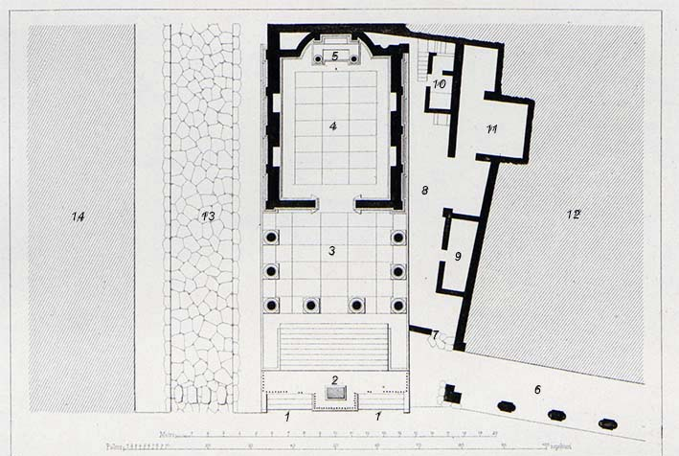
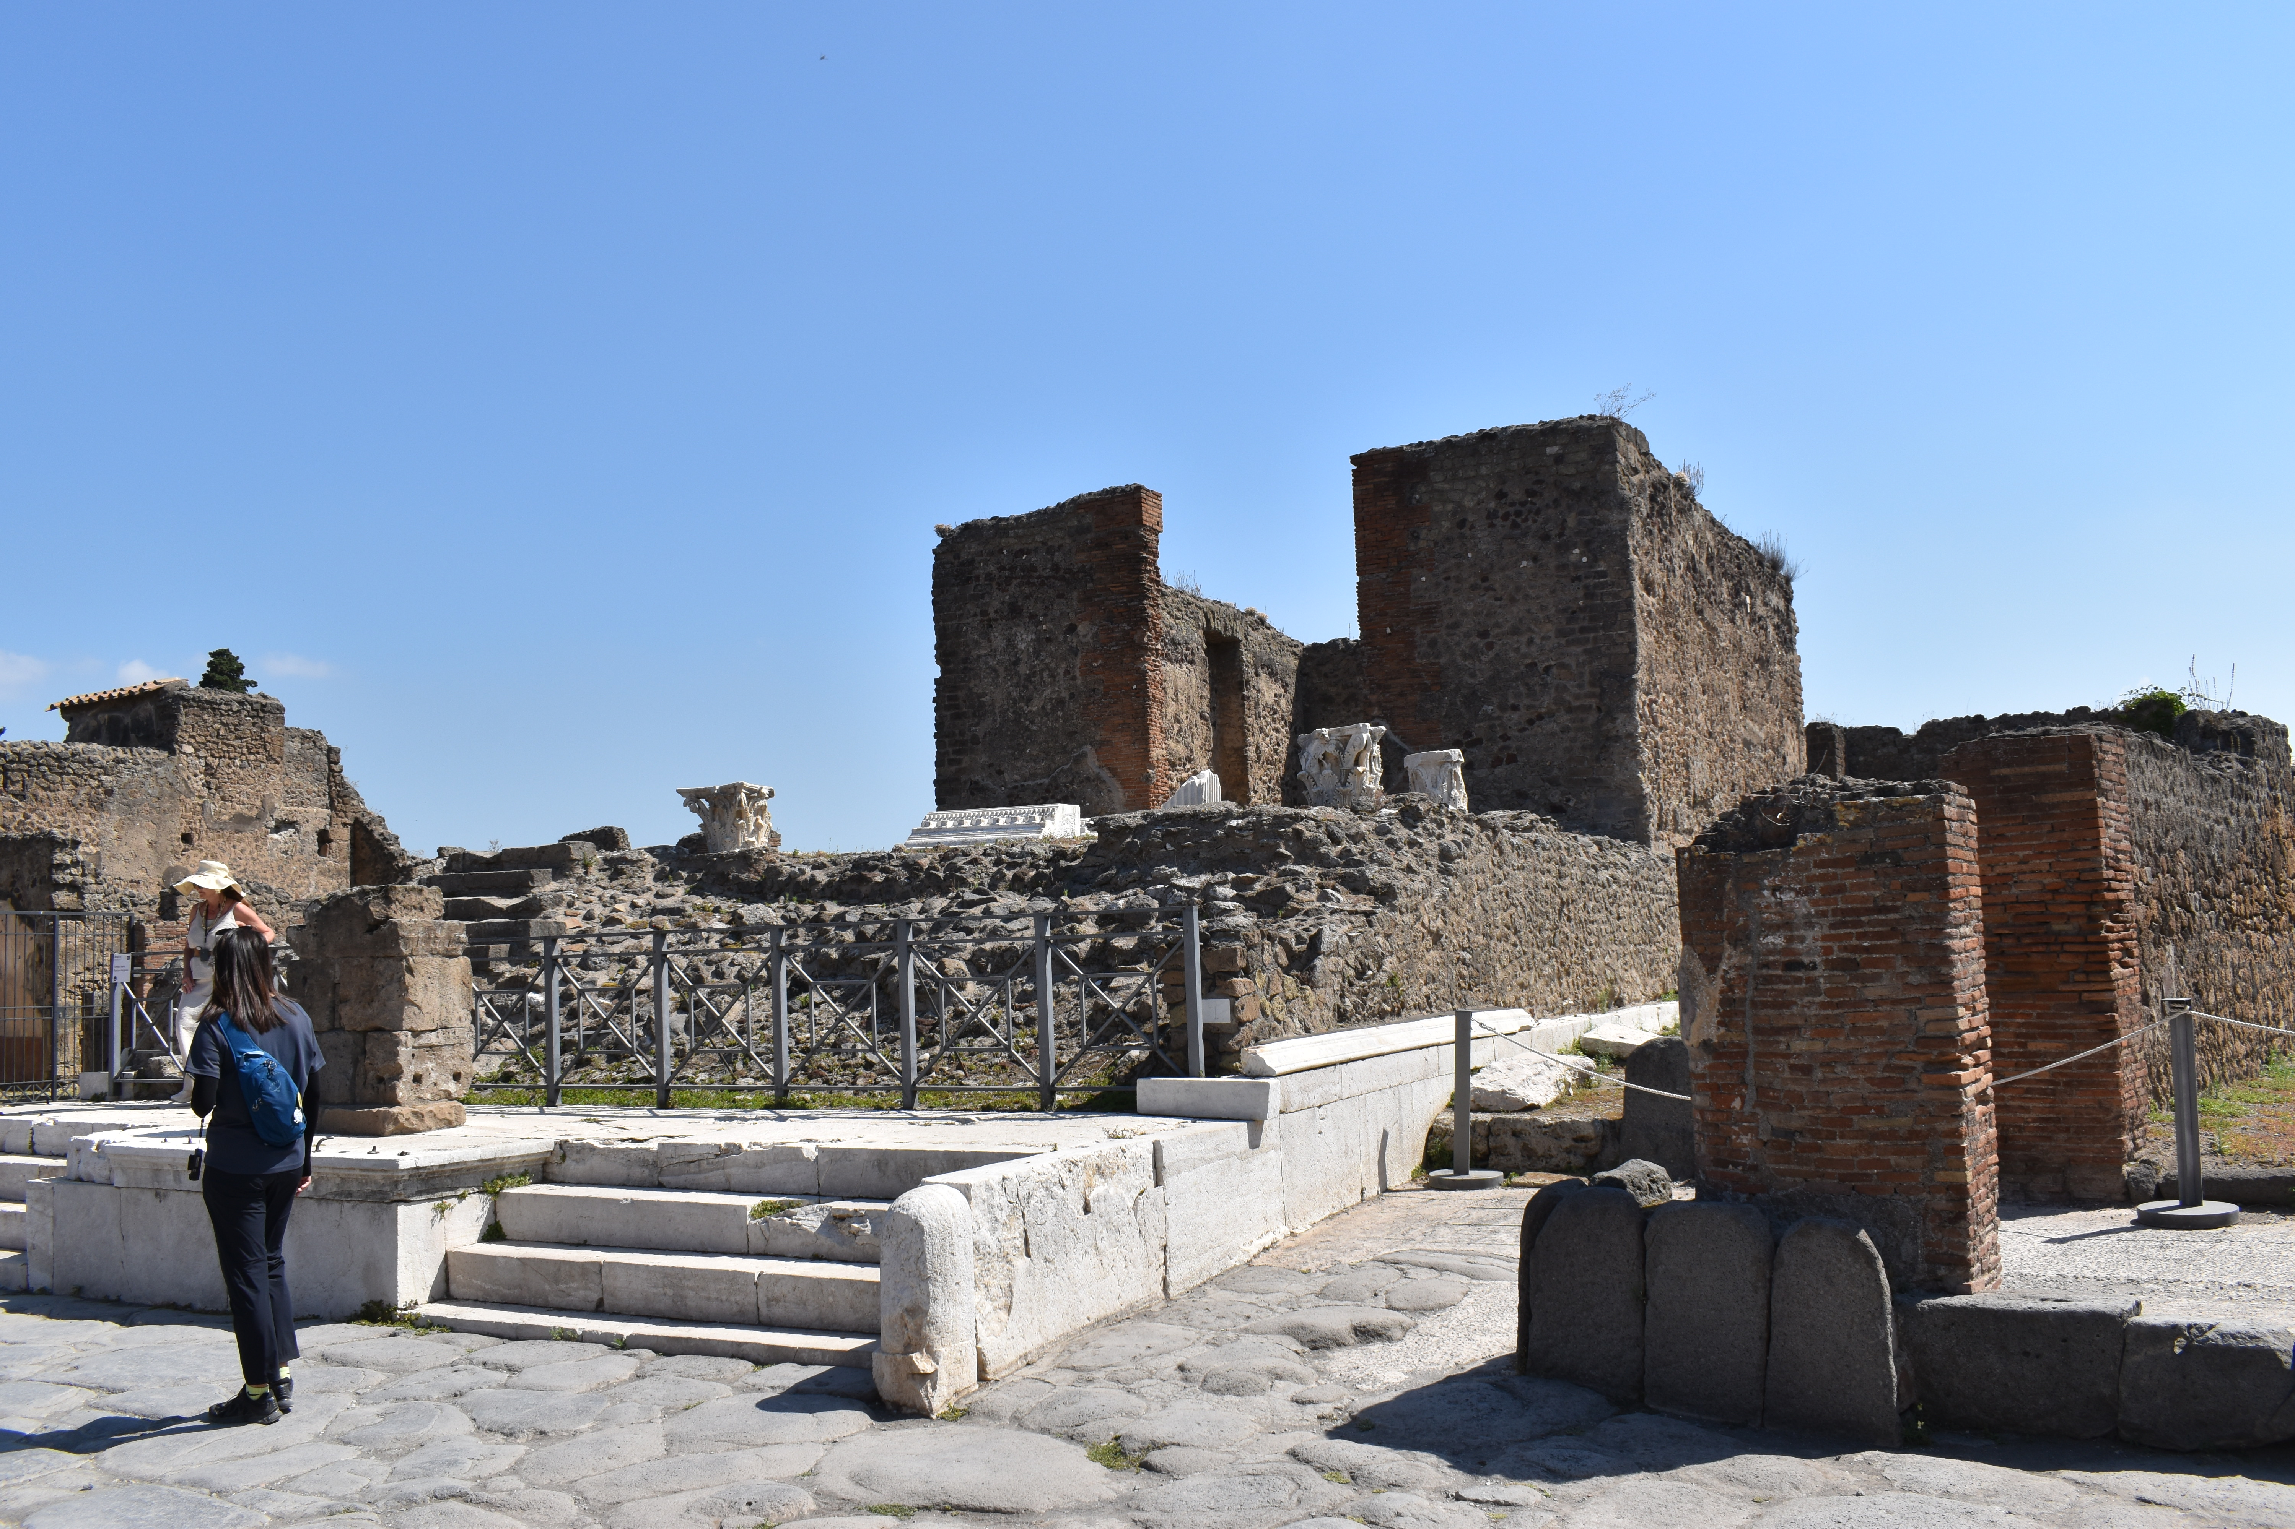
Temple of Fortuna Augusta
One of the earliest shrines to the dedication of the imperial family at Pompeii.
Built by M. Tullius in the late 1st century BCE. It is a statement of loyalty and elite benefaction.
“Marcus Tullius, son of Marcus, duovir with judicial power three times, quinquennalis, augur, military tribune chosen by the people, [built] the Temple of Fortuna Augusta on his own land and at his own expense.“ (CIL X, 820)
Corinthian style temple located across from the Forum baths.
Niches along the sides would have held statues of the imperial family, as well as M. Tullius the donor.

Slide 26
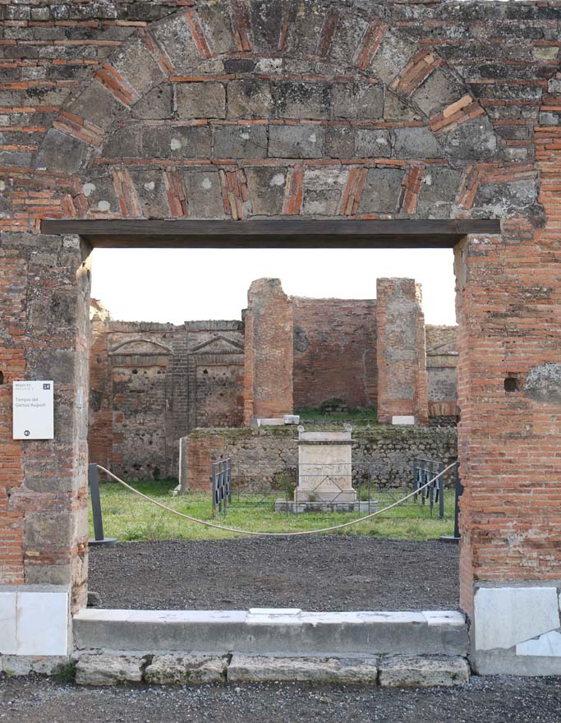
Sanctuary of the Genius Augustus
The date of the construction is contested.
Located in the Forum.
Probably originally constructed in the early 1st century CE
Clearly rebuilt in the Flavian period, rededicated as the Temple of Vespasian.
Erected to serve the Augustales, a civic college composed of wealthy freedmen who were responsible for administering the local cult the genius (spirit) of the emperor.

Slide 27
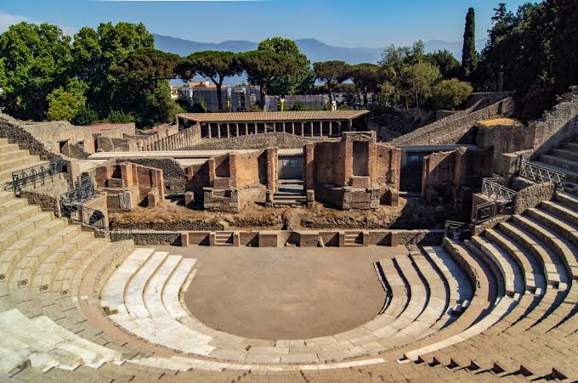
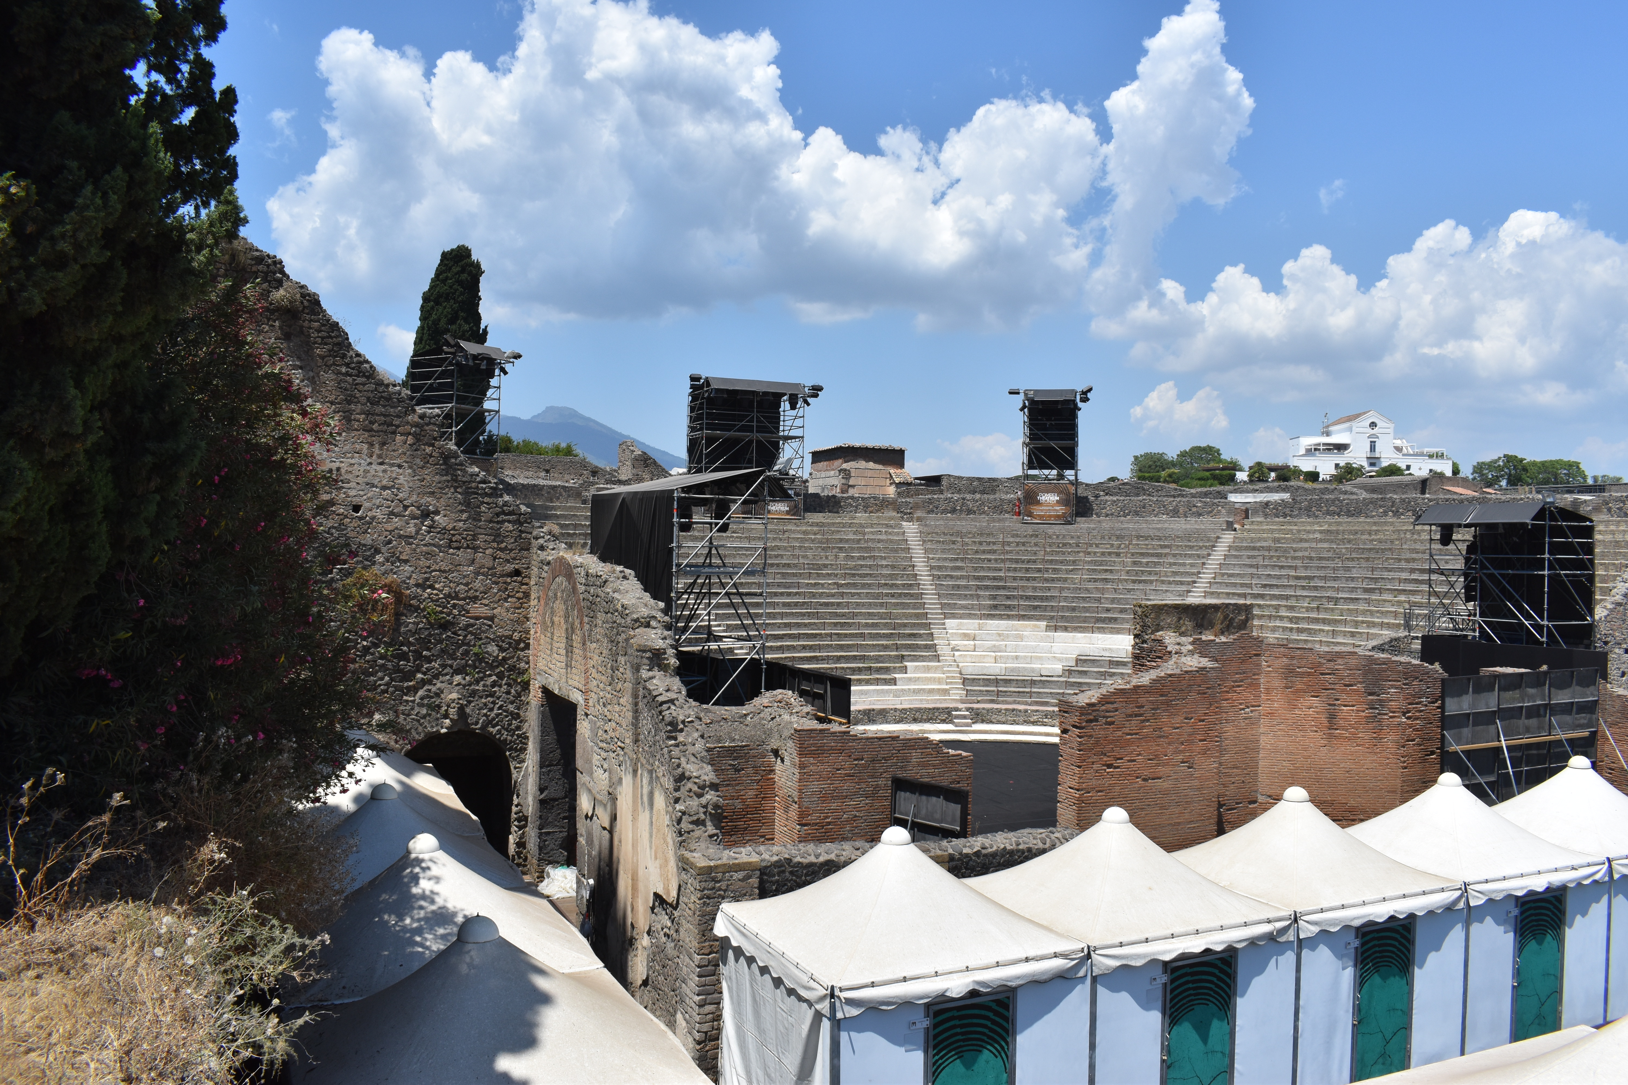
Large Theater
The original Greek theater was expanded in the Augustan period
The seating area (cavea) was increased and a tribunalia was added.
This was done by local elites and brothers M. Holconius Rufus and M. Holconius Celer
Inspired by the theater of Marcellus in Rome (another Augustan Building project in Rome)

Slide 28
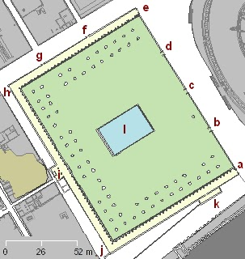
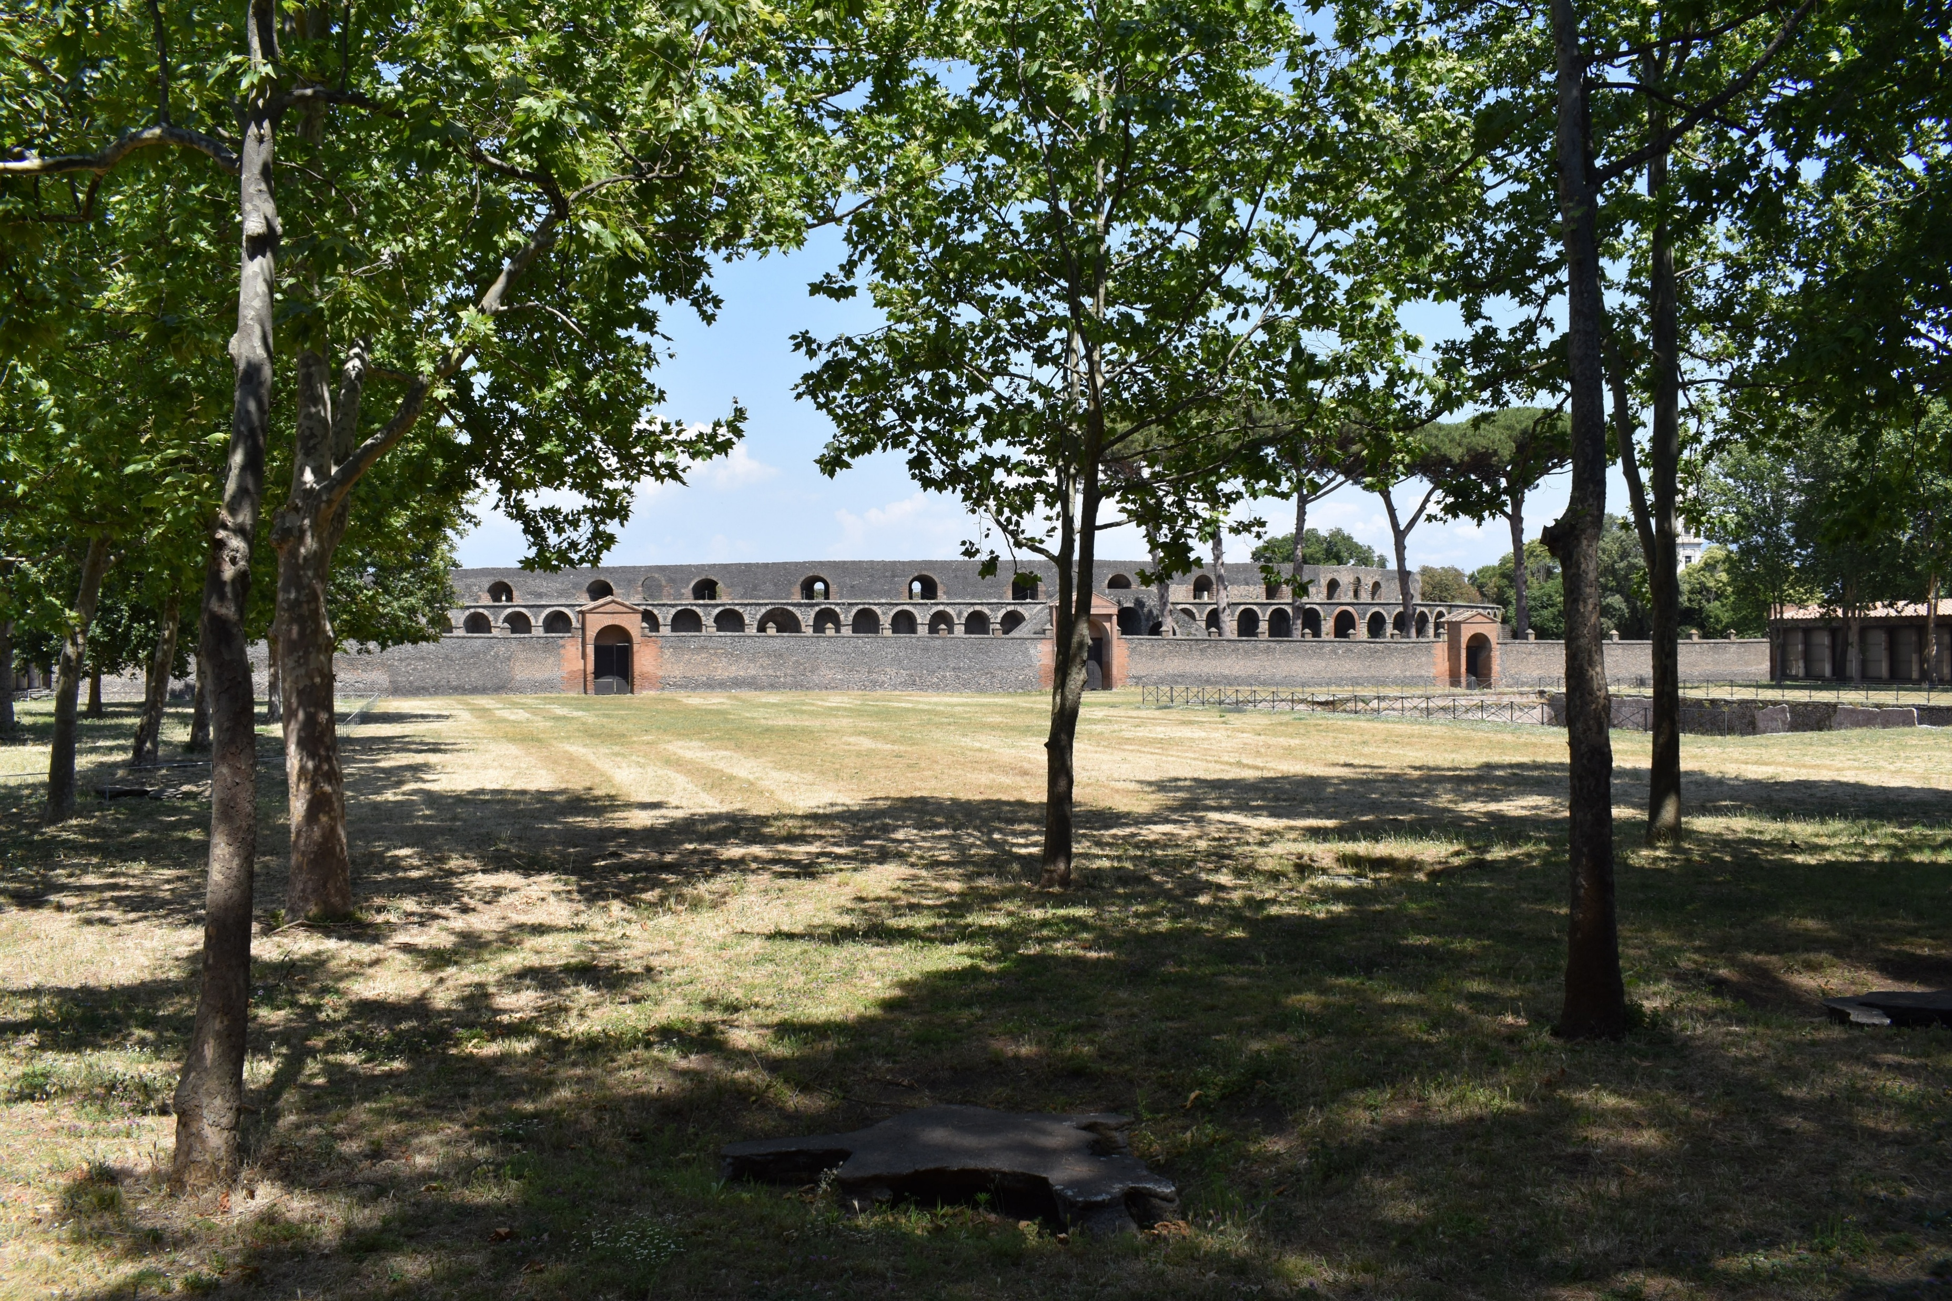
Large Palaestra
Constructed near the amphitheater
Massive building project that took up 6 insulae blocks
Built over earlier properties, so a reorganization of space in Regio II.
Functioned as a gymnasium, or place of exercise.
Had a pool and grove of trees.

Slide 29
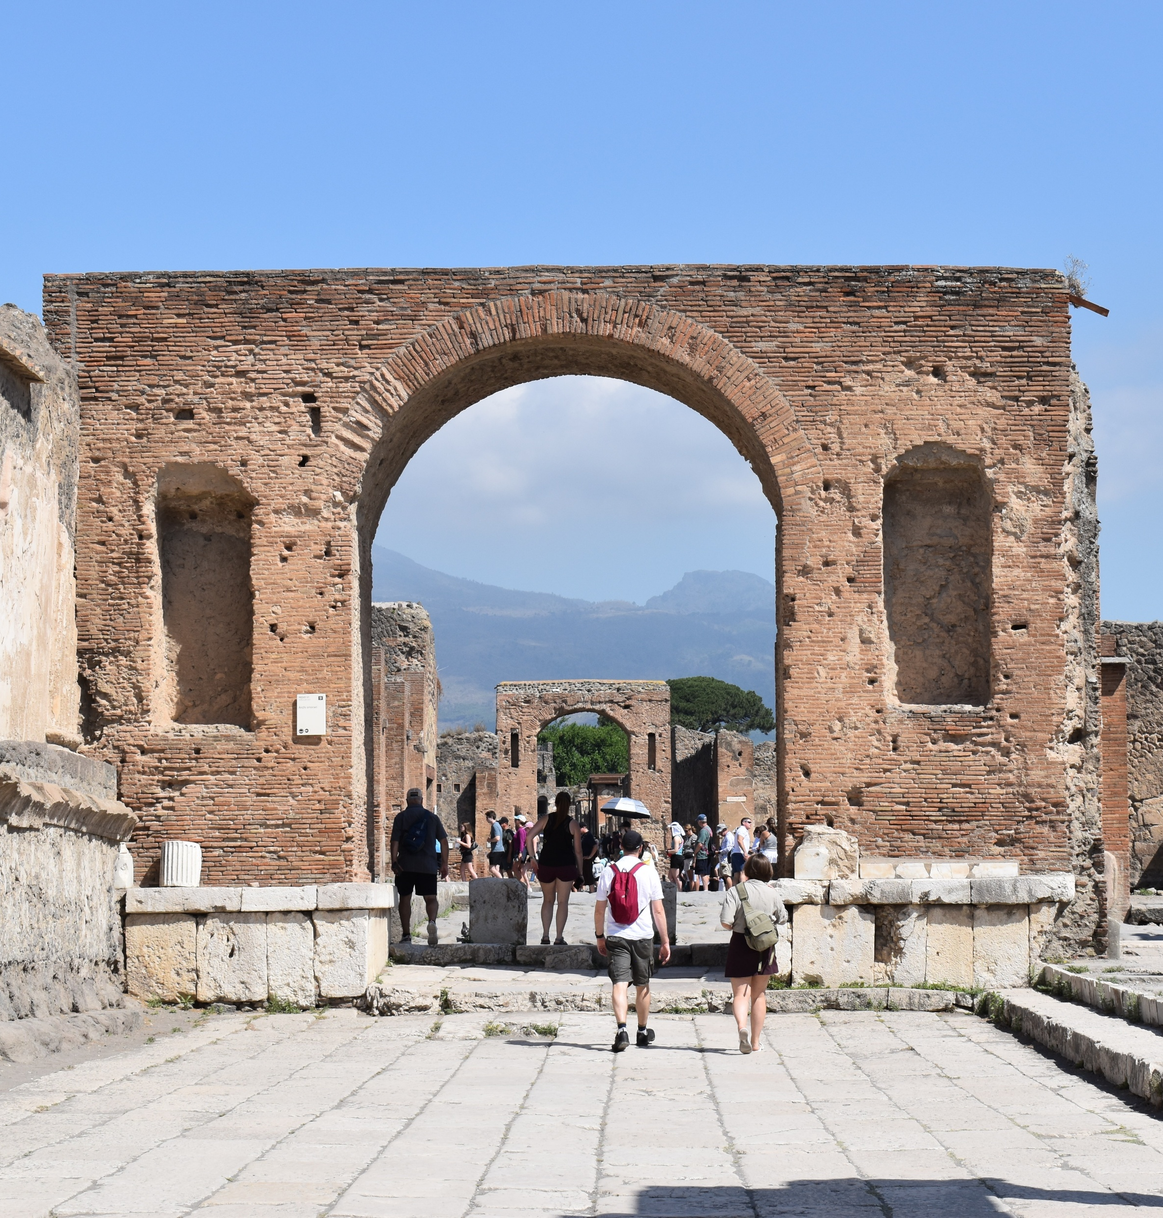
Arch of Augustus
Located at the northwest corner of the forum
Dated roughly within the reign of Augustus. Its dating is hard because it lacks an inscription. Sometimes attributed to the reign of Tiberius.
Built directly adjacent to the Tempel of Jupiter.
Single passageway arch as a ceremonial gateway.
The arch was originally decorated with marble.
Niches on the façade once held statues of the imperial family.
On the other side of the Temple of Jupiter, Tiberius will build another arch to mirror this one.
Again an example of symbolic civic devotion to the new Augustan principate.

Slide 30
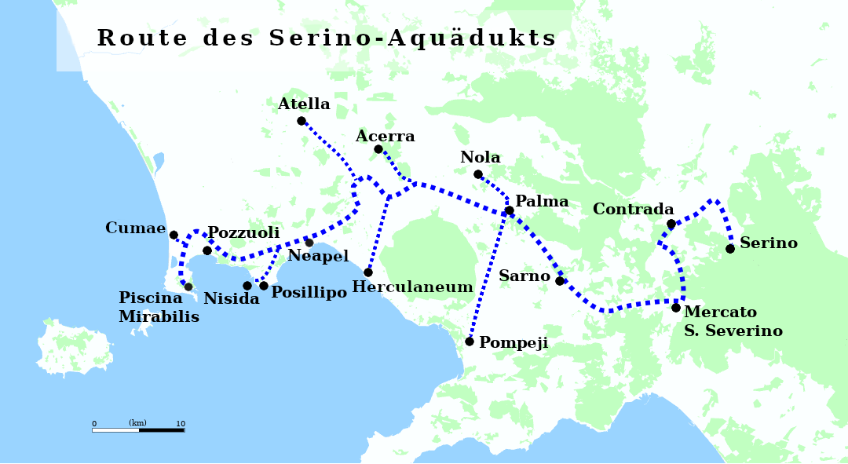
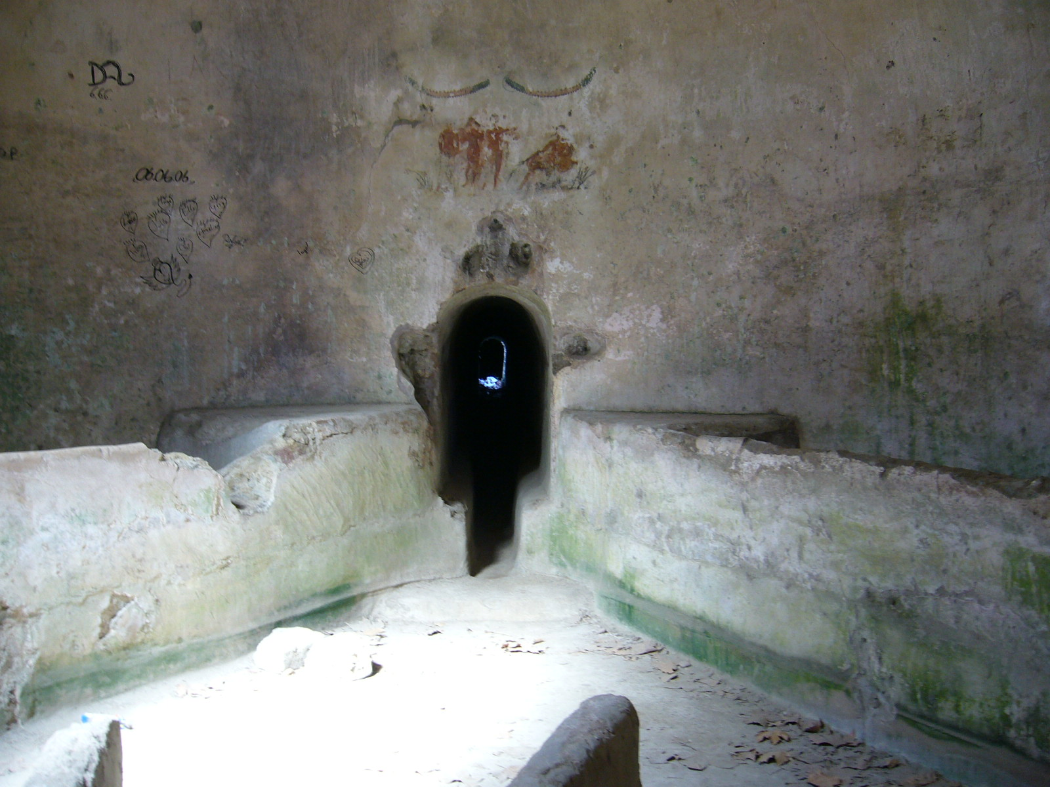
Aqueduct
The Serino Aqueduct (Aqua Augusta) was built c. 30-20 BCE to supply drinking water to the growing cities in the Bay of Naples, including:
  Pompeii
  Herculaneum
  Neapolis
  Puteoli
  Cumae
  Baiae
  Military encampment at Misenum.
Traveled about 96 km total

Slide 31
Discussion
How has the Augustan period urbanization changed Pompeii?
How is different from the earlier periods?
In what ways are seeing Roman imperialism?

Slide 32
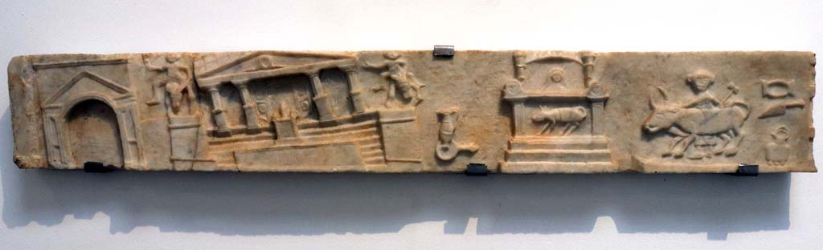
62 CE Earthquake and the Flavian Period
In 62 CE, Pompeii is heavily destroyed by an earthquake
Much of the later Julio-Claudian period under Nero and later under the Flavian emperors was spend on restoration and renovation of the city.
Rededication of Imperial Cult
Central Baths
Reconstruction of the Tempel of Isis
Restoration to the Forum

