Slide 1
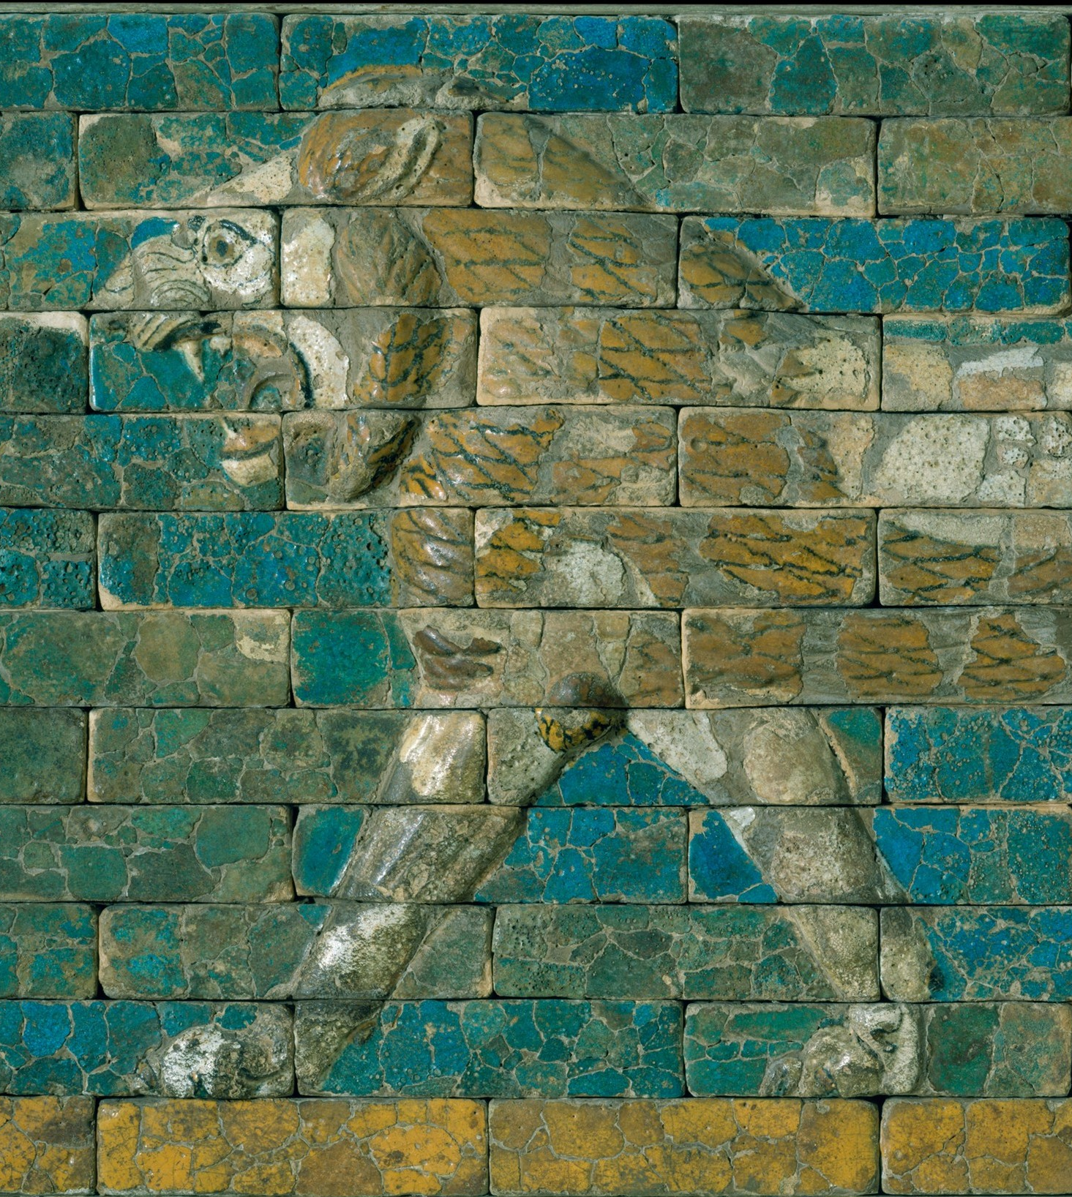
Grass: A Nation’s Battle for Life
ARCH B101 – Archaeology of the Ancient Near East and Egypt
Fall 2026
September 9 & 11

Slide 2
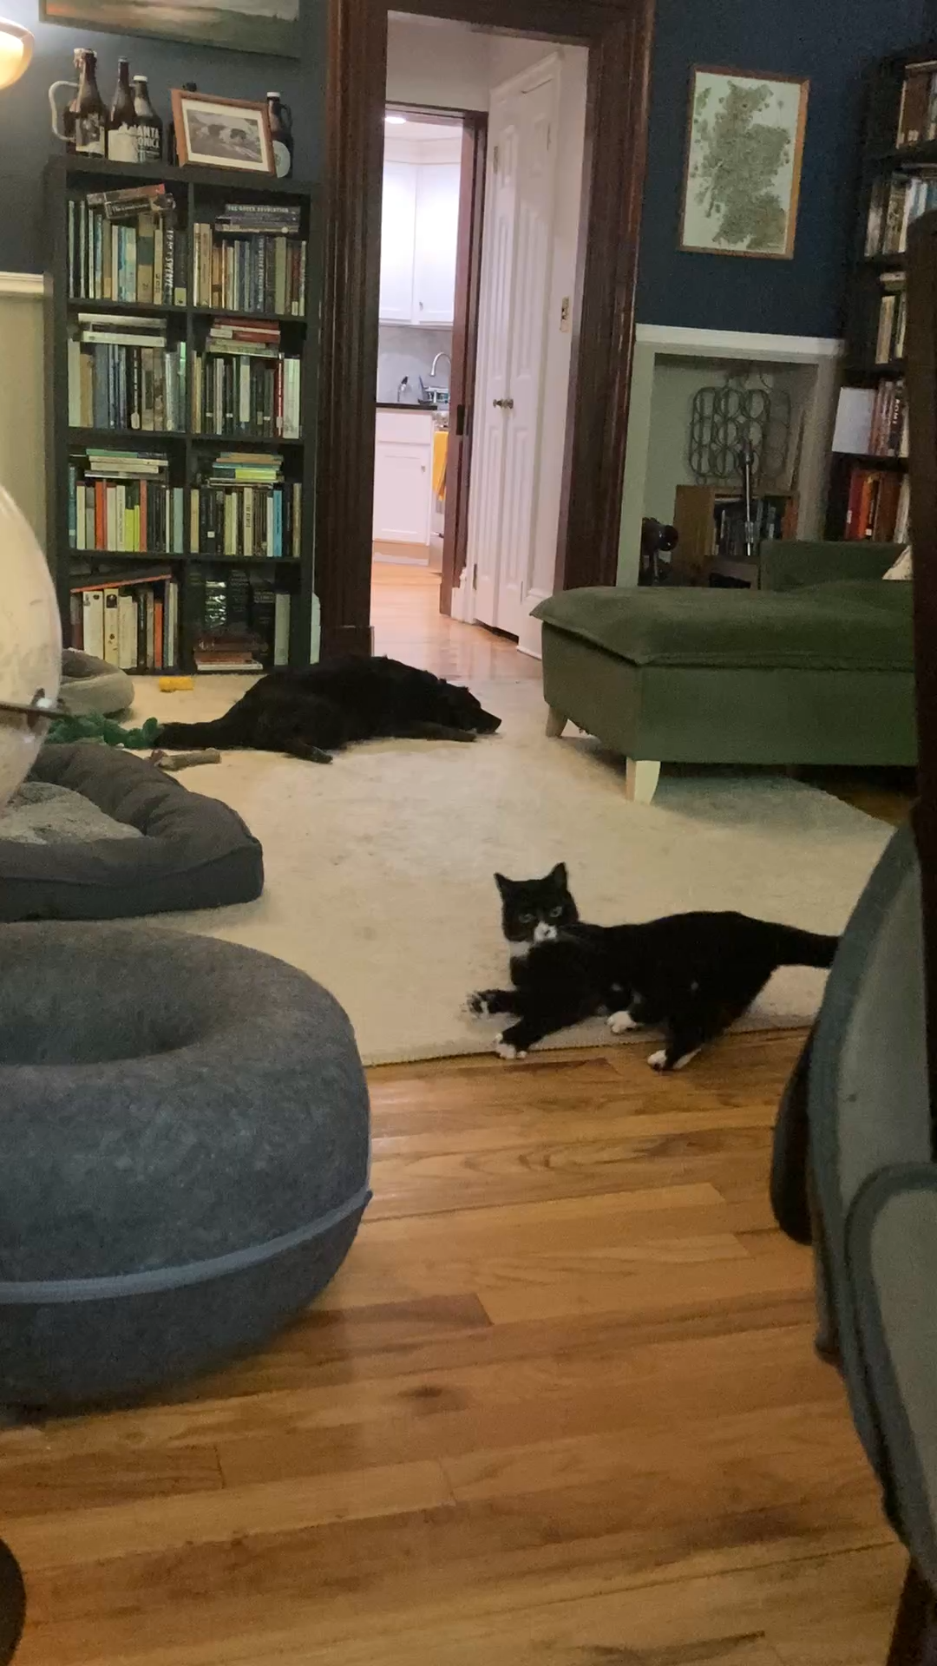

Slide 3
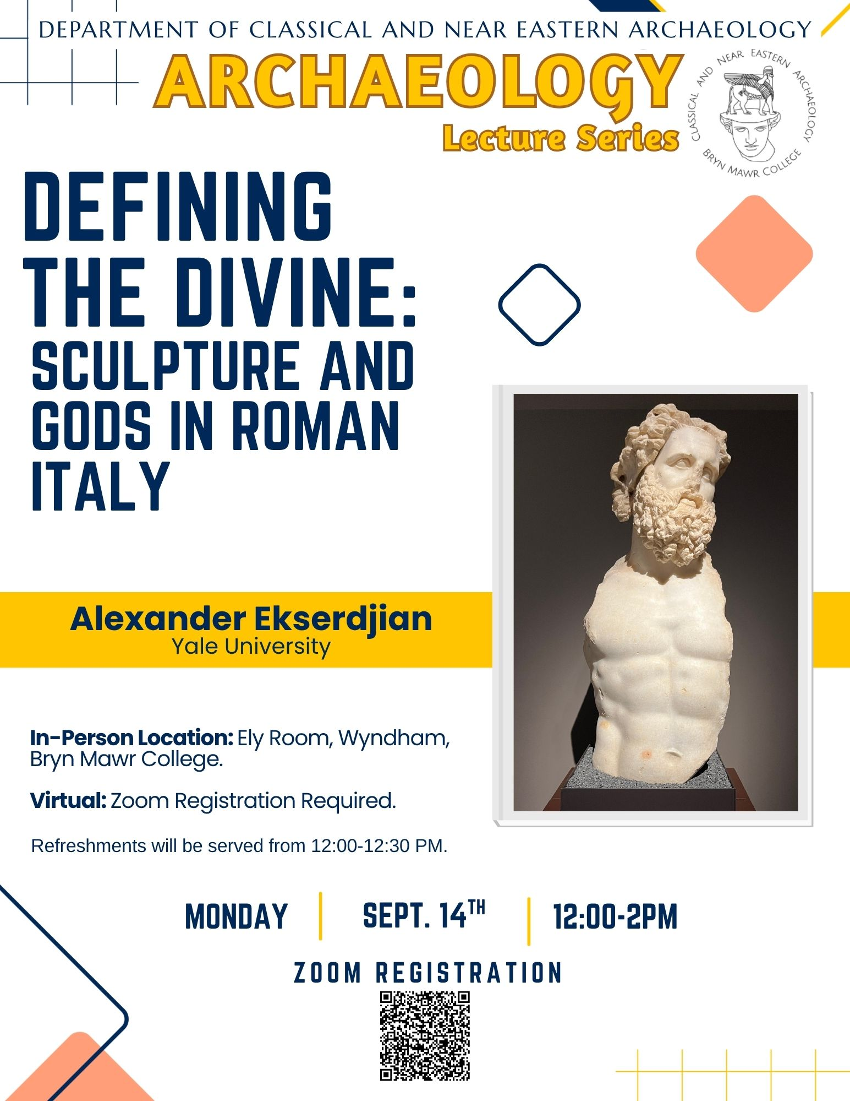
Looking Ahead
Wed 9/9 and Fri 9/11: Grass
Mon 9/14, 12:30 PM: Archaeology Lecture (poster at right)
Fri 9/18: Discussion sections begin and Map Quiz 1
  Study map is on Moodle
Fri 9/25: Written Assignment 1 due (at 11:59 PM)

Slide 4
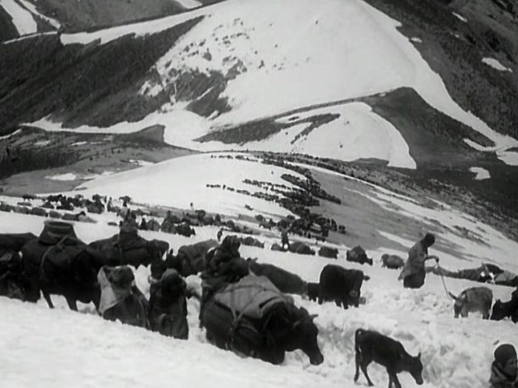
Grass: A Nation’s Battle for Life
1925 silent documentary
71 minutes long
Follows the seasonal journal of the Bakhtiari tribe in search of pastures
Written and directed by Merian C. Cooper and Ernest B. Schoedsack (who later made King Kong together)
Starring Marguerite Harrison, American journalist and intelligence operative during the First World War

Slide 5
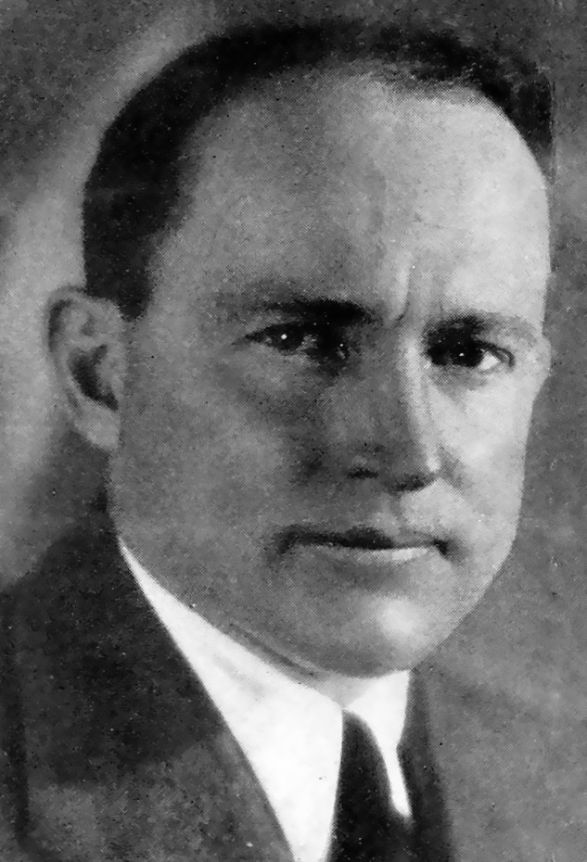
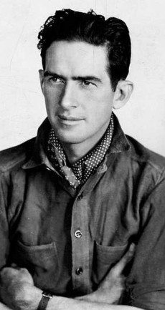
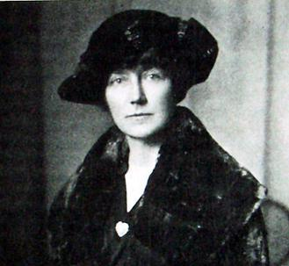
Grass: A Nation’s Battle for Life
Merian C. Cooper
(1893-1973)
Ernest B. Schoedsack
(1893-1979)
Marguerite Harrison
(1879-1967)

Slide 6
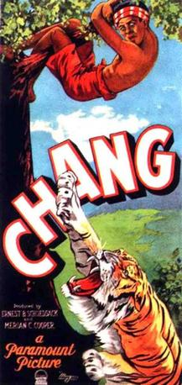
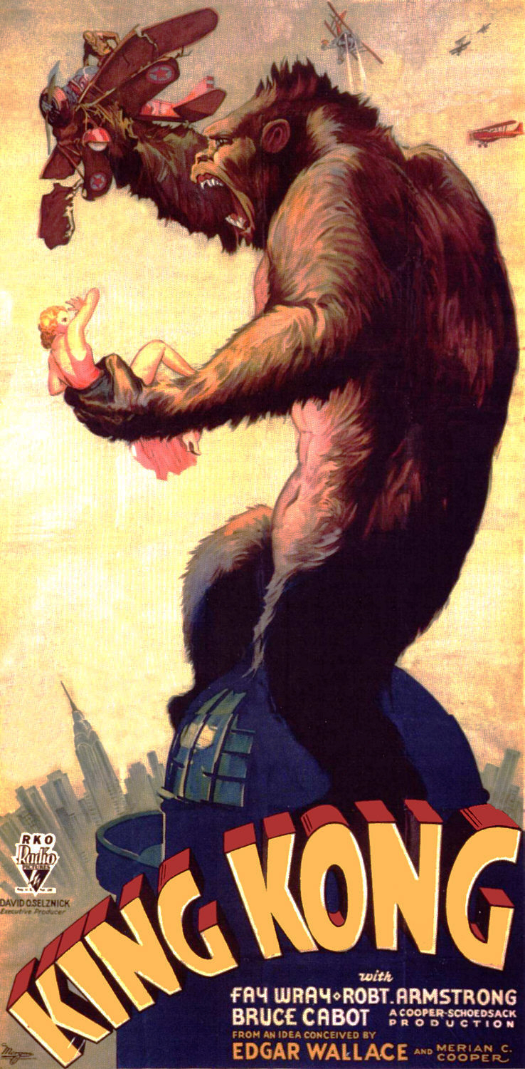
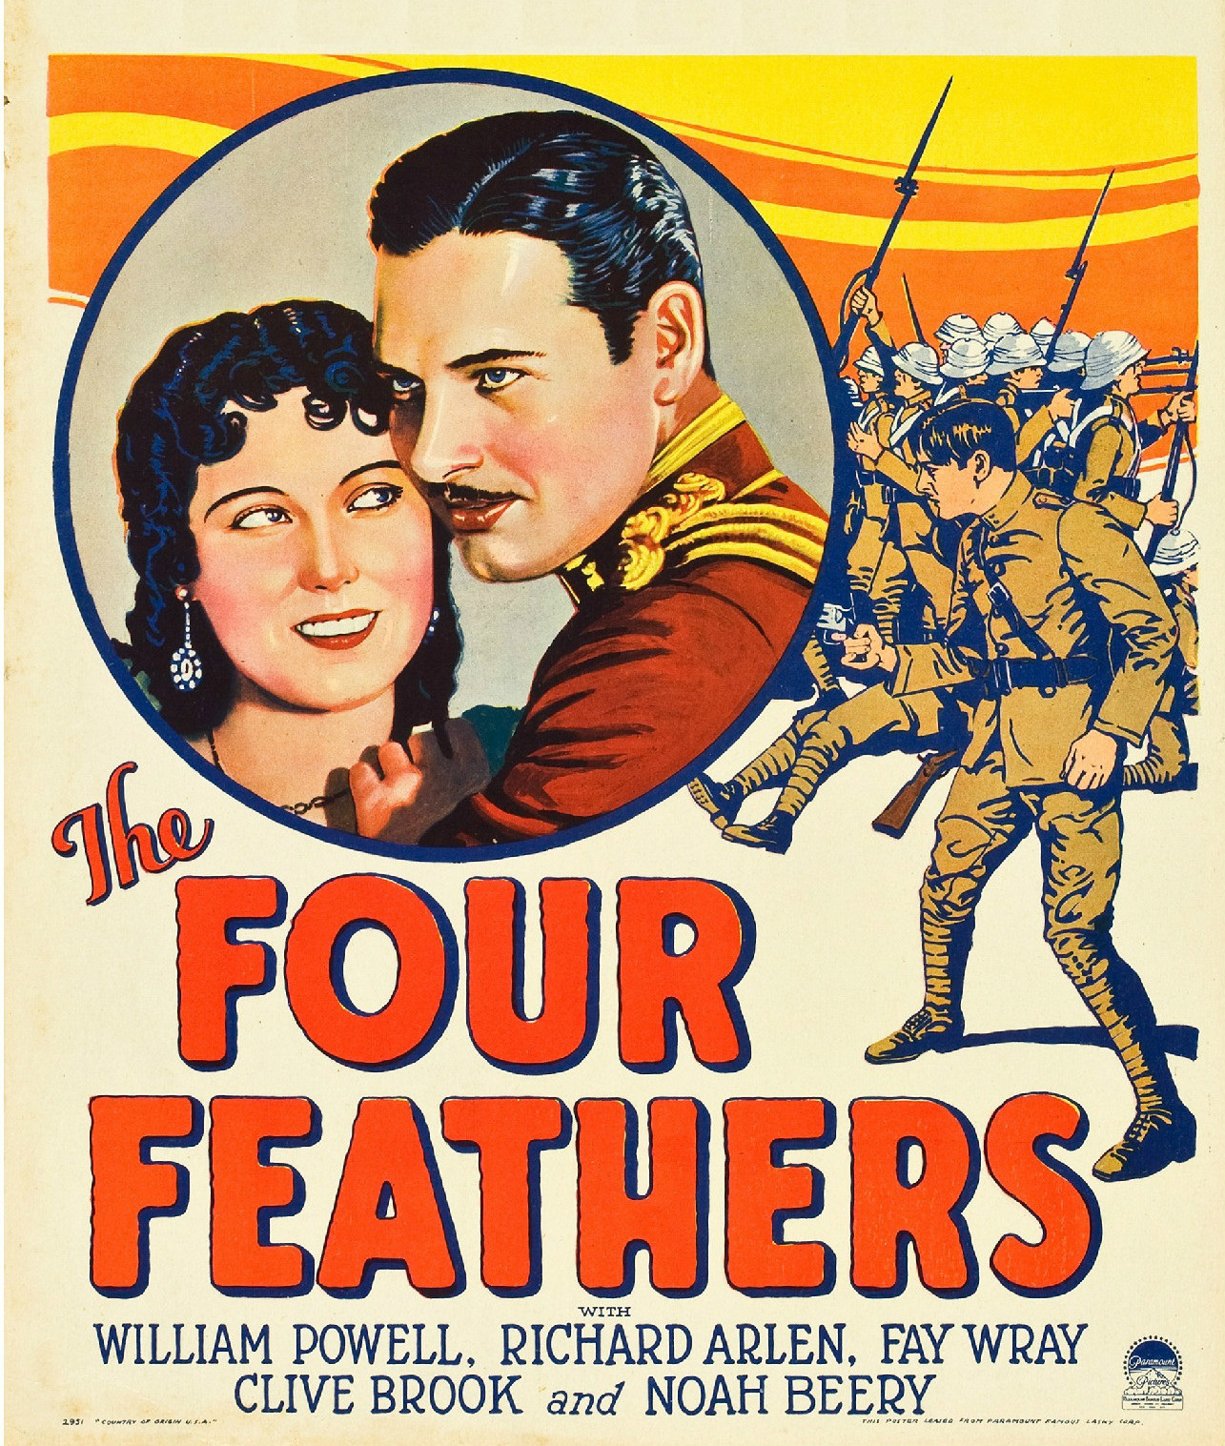
1929
1927
1933

Slide 7
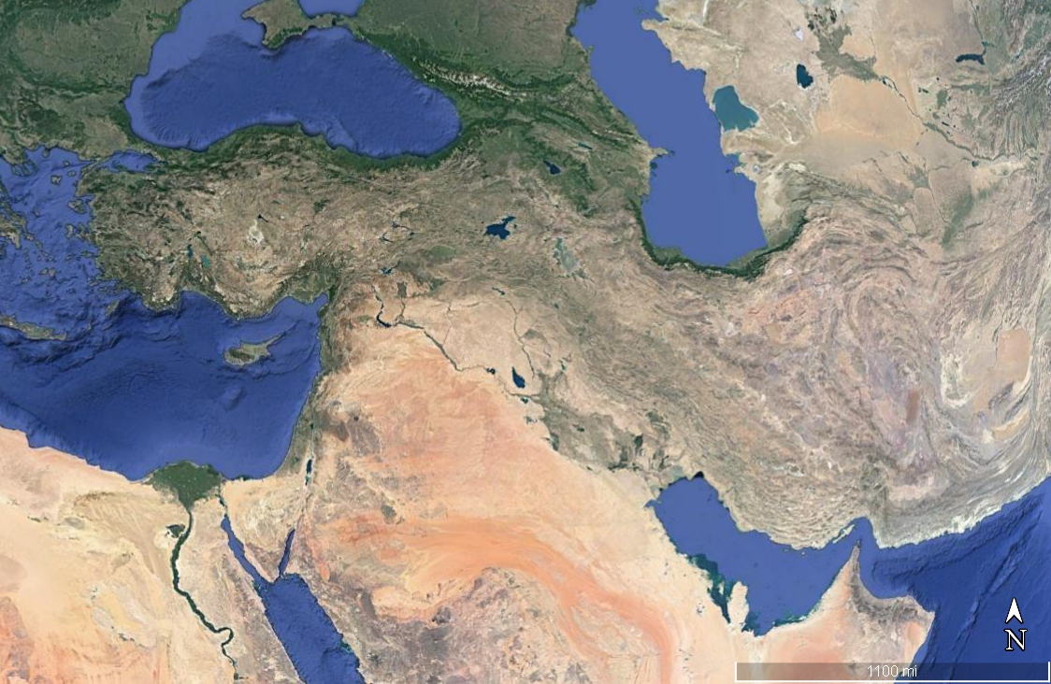
Türkiye/Anatolia
Syria & Iraq/
Mesopotamia
Luristan
(Iran)

Slide 8
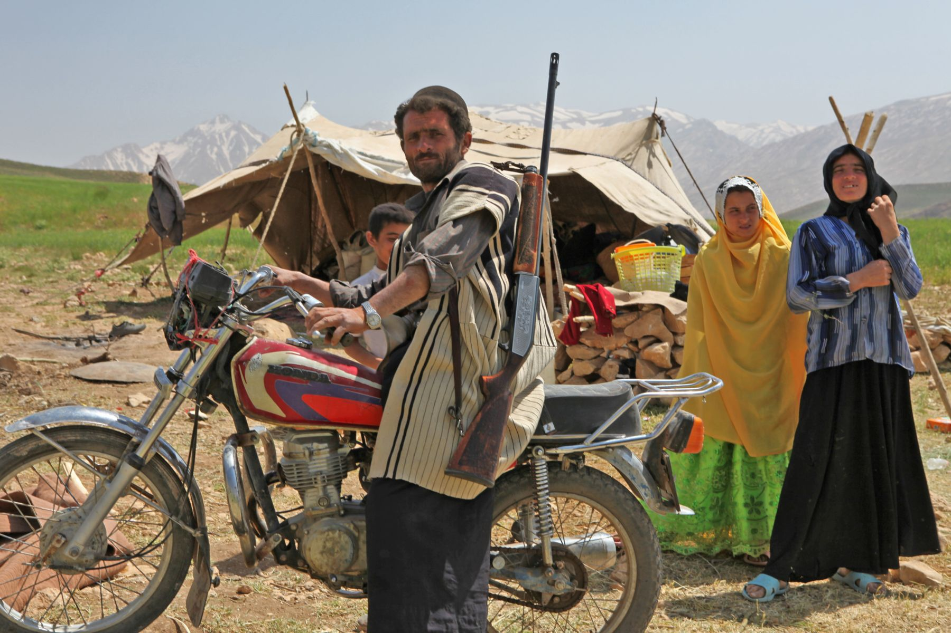
The Bakhtiari
Native to Luristan in western and Khuzestan in southwestern Iran
Traditionally pastoral nomads; many still are

Slide 9
Grass: A Nation’s Battle for Life
How would you characterize the Iranian landscape, especially in comparison with that of Iraq? Is it different from what you expected? How does it define the lives of the Bakhtiari?
How are the Bakhtiari and other Middle Eastern people characterized in the film? Are these characterizations biased in any way?
Who are the Forgotten People? How are they forgotten? Is this an appropriate characterization? Why or why not?
What role do animals in the film?

Slide 10
Written Assignment 1
400-600 words
Due September 25 by end of day
Submit through Moodle
I am looking for:
  Evidence for close engagement with the film
  Some consideration of the issues it raises for you
  Clean and clear writing, free of errors
Please give your paper a title!

