Slide 1
Sound Studies Antecedents

Slide 2
The World Soundscape Project
http://www.sfu.ca/~truax/wsp.html
World Forum for Acoustic Ecology
https://wfae.net/
Murray Schafer The Soundscape and the Tuning of the World (1977)
Barry Truax Handbook for Acoustic Ecology (1978)
The Vancouver soundscape (1973)
Soundscapes of Canada CBC Radio Program 1974
Five Villages project (1977)
https://www.sfu.ca/sonic-studio-webdav/WSP/FVS/fvs.html
Hildegard Westerkamp https://hildegardwesterkamp.ca/main/

Slide 3
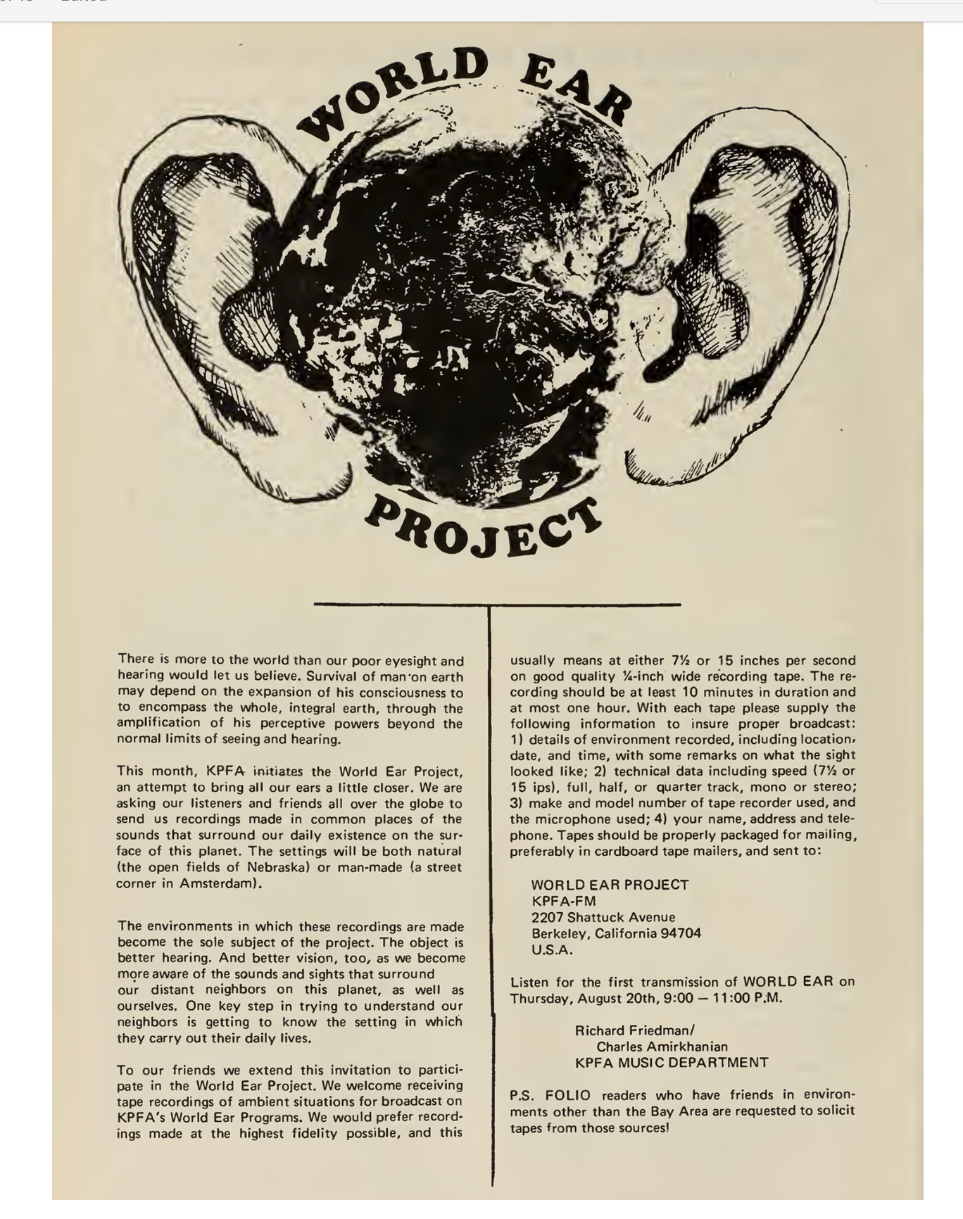
The World Ear Project (1970-1987)
Influenced by:
Musique Concrete (Pierre Schaeffer, 1940s)
“Etude aux chemins de fer”
https://www.youtube.com/watch?v=N9pOq8u6-bA
Composers John Cage, Luc Ferrari
Media theorist Marshall McLuhan
”The medium is the message”
Pauline Oliveros- “Deep Listening”
https://www.deeplistening.rpi.edu/deep-listening/

Slide 4
Alan Lomax, folklorist
With his father, John Lomax: Library of Congress Archive of American Folksong
1930s-40s: recordings in American South, Mississippi Delta
https://www.loc.gov/collections/alan-lomax-manuscripts/about-this-collection/
Association for Cultural Equity
https://www.culturalequity.org/
https://www.theattic.space/home-page-blogs/2019/2/15/where-the-songs-live
Lomax Digital Archive
https://archive.culturalequity.org/
Folk song radio programs-- 1940s, 50s
“cantometrics”- comparative project on song structure and social structure
https://theglobaljukebox.org/

Slide 5
Steven Feld (1949-), American ethnomusicologist
Mentions:
Alan Lomax (1915-2002), folklorist and recordist
Alan Merriam (1923-1980), early ethnomusicologist
Colin Turnbull (1924-1994), anthropologist influential in beginnings of ethnomusicology

