Slide 1
Q-center: https://www.brynmawr.edu/inside/offices-services/q-center/q-center-schedule
Office Hours: M 1:30pm – 3:00pm
(in Park 169) W 11:00am – 12:00pm
or by appointment (email me)
or just email me with questions!
TA Hours w/ Dana: Th 6:00pm – 7:00pm
(in Park 273) F 4:30pm – 6:00pm
Isotopes
Naming Compounds (Nomenclature Rules)
9/11/2026
Achieve HW #2 due Monday 9/14 at 10:00am
Achieve HW #3 due Thursday 9/17 at 8:00pm
Exam 1 in lecture a week from today! (everything through naming)
Quiz #1 in Recitation today (9/11) – all material up through unit conversions

Slide 2
Chemistry ice cream social
Today @ 4pm in Park atrium courtyard

Slide 3
Learning Objectives
Define isotopes and give examples for several elements
Write and interpret symbols that depict the atomic number, mass number, and charge of an atom or ion
Define the atomic mass unit and average atomic mass
Calculate average atomic mass and isotopic abundance
Define ionic and molecular (covalent) compounds
Predict the type of compound formed from elements based on their location within the periodic table
Determine formulas for simple ionic compounds
Derive names for common types of inorganic compounds using a systematic approach
Know the polyatomic ion names, charges, and formulas indicated in the table on slide 16, and how to use them in nomenclature

Slide 4
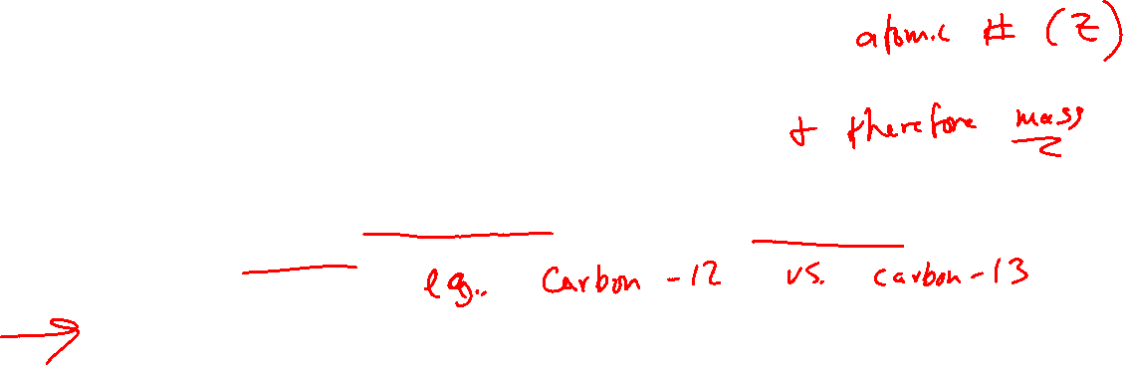
Isotopes: When the Number of Neutrons Varies
All atoms of a given element have the same number of protons.
They do not necessarily have the same number of neutrons.
Atoms with the same number of protons but different numbers of neutrons are called isotopes.
All elements have their own unique percent natural abundance of isotopes.

Slide 5
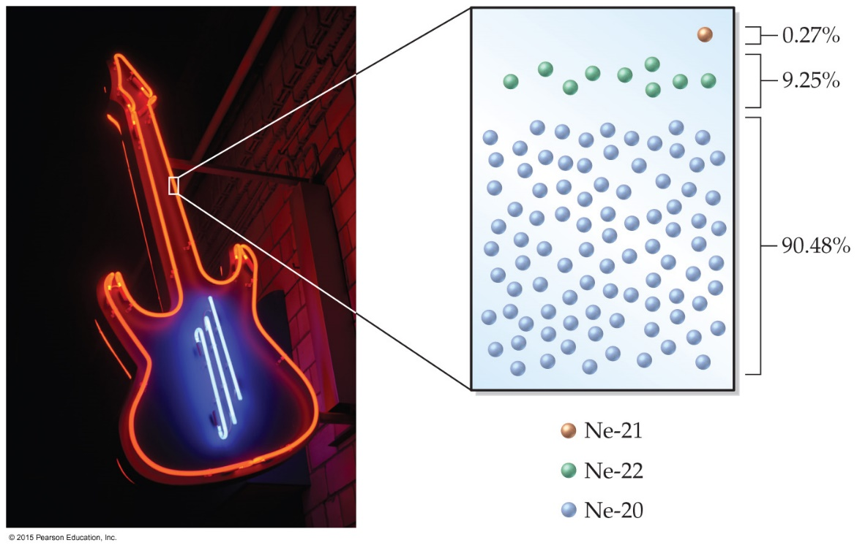
Isotopes: Natural Abundance of Isotopes in Neon
Naturally occurring neon contains three different isotopes:
 | # protons | # neutrons | Mass Number (A) | Percent Abundance
Ne-20 | 10 | 10 | 20 | 90.48%
Ne-21 | 10 | 11 | 21 | 0.27%
Ne-22 | 10 | 12 | 22 | 9.25%

Slide 6
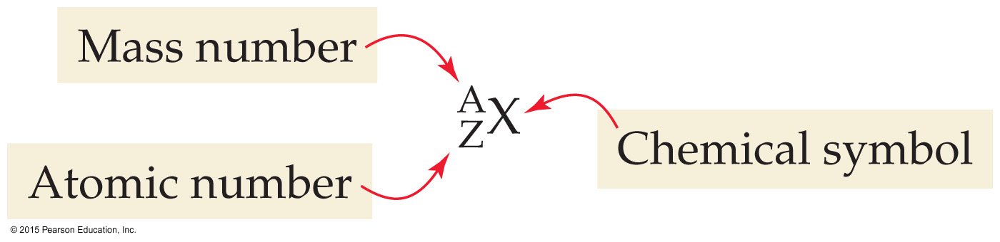

Isotope Symbol Notation
Isotopes of Neon:
Mass number (A) = # protons + # neutrons

Slide 7
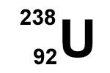
How many protons and neutrons are in this isotope of Uranium?

Slide 8
If an atom has a mass number of 32 and has 17 neutrons, it is an isotope of which element?
What is unique for each element?

Slide 9
What are the atomic number, mass number, and symbols for the chlorine isotope with 18 neutrons?

Slide 10
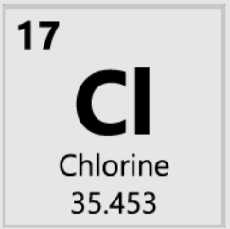
Atomic Mass
Atomic mass: mass of element listed in periodic table
Atomic mass on periodic table is a _______________ __________
based on the natural abundance of each isotope!
 | # protons | # neutrons | Mass Number (A) | Mass (amu) | Percent Abundance
Cl-35 | 17 | 18 | 35 | 34.97 amu | 75.77%
Cl-37 | 17 | 20 | 37 | 36.97 amu | 24.23%
Atomic mass = (75.77% x 34.97 amu) + (24.23% x 36.97 amu)
= (0.7577 x 34.97 amu) + (0.2423 x 36.97 amu) = 35.45 amu

Slide 11
Calculate the atomic mass of magnesium:
  isotope 1: 23.99 amu, 78.99% abundance
  isotope 2: 24.99 amu, 10.00% abundance
  isotope 3: 25.98 amu, 11.01% abundance
Atomic mass = (78.99% x 23.99) + (10.00% x 24.99) + (11.01% x 25.98)
= (0.7899 x 23.99) + (0.10000 x 24.99) + (0.1101 x 25.98)
= 18.9497 + 2.499 + 2.860398
= 24.309099 = 24.31 amu

Slide 12
Molecules & Compounds
Molecule: two or more atoms held together by chemical bonds (ex: O₂, H₂O)
Compound: Pure substance consisting of two or more different elements combined in whole-number ratios (ex: H₂O)

Slide 13
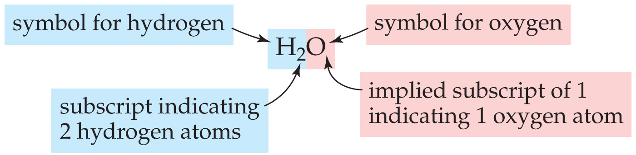
Chemical Formulas
Indicate the ratio of each element in the compound
Ratio is always the same for a given compound
Example: H₂O
H = symbol for hydrogen; subscript 2 means 2 H atoms
O = symbol for oxygen; implied subscript 1 means 1 O atom
Table Sugar: C₁₂H₂₂O₁₁
12 C atoms, 22 H atoms, 11 O atoms in every molecule
Ratio 12:22:11

Slide 14
Chemical Formulas
Metal elements are listed first (example NaCl, KBr)
For nonmetals, list the most metallic element first (left-most in periodic table) (Example: CO₂, NO)
Example: Write a chemical formula for a compound containing two silver atoms for every sulfur atom.

Slide 15
Polyatomic Ions
Charged species (ion) made up of two or more atoms
Example: Nitrate ion = NO⁻₃
Magnesium Nitrate Mg(NO₃)₂
___ nitrate ions for every ___ magnesium
___ Mg and ___ NO⁻₃
in total: __ Mg, __ N, ___ O

Slide 16
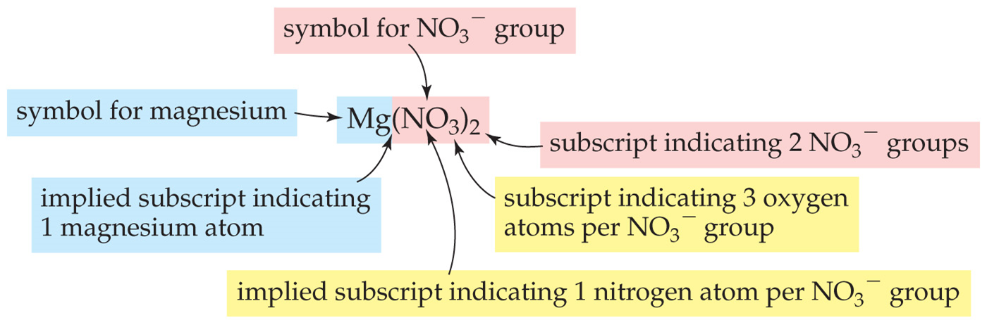
Polyatomic Ions
Polyatomic Ion | Name | Polyatomic Ion | Name
NO₃⁻ | Nitrate | ClO₄⁻ | Perchlorate
NO₂⁻ | Nitrite | ClO₃⁻ | Chlorate
SO₄²⁻ | Sulfate | ClO₂⁻ | Chlorite
SO₃²⁻ | Sulfite | ClO⁻ | Hypochlorite
PO₄³⁻ | Phosphate | *Pattern above applies to other halogens as well (i.e. bromate, iodite)
CO₃²⁻ | Carbonate | CN⁻ | Cyanide
HCO₃⁻ | Bicarbonate | OH⁻ | Hydroxide
C₂H₃O₂⁻ | Acetate | NH₄⁺ | Ammonium
MnO₄⁻ | Permanganate
Memorize these names, formulas, and charges!
Flash cards!

Slide 17
Example:
Determine the number of each type of atom in Al₂(SO₄)₃

Slide 18
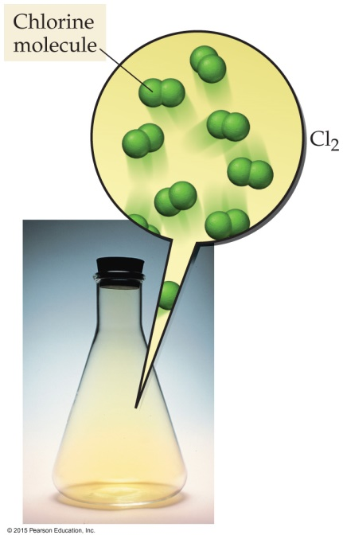
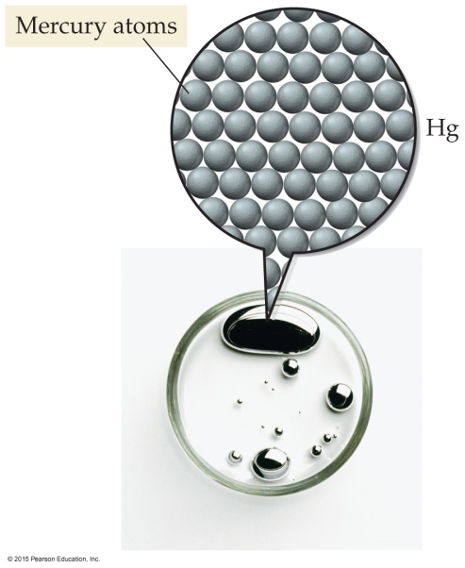
Elements and Compounds
Elements = cannot be simplified
Compounds = composed of two or more elements
Atomic Elements: Exist as single atoms; Most elements; Example: Helium, Copper, Carbon
Molecular Elements (“Diatomic Elements”): Exist as two atoms bonded together; There are seven: H₂, O₂, N₂, Cl₂, F₂, I₂, Br₂

Slide 19
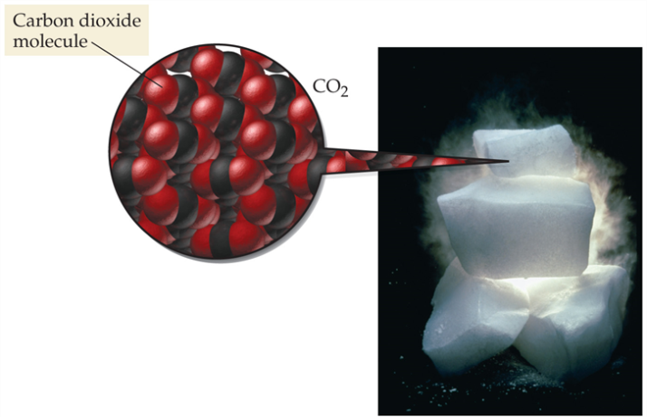
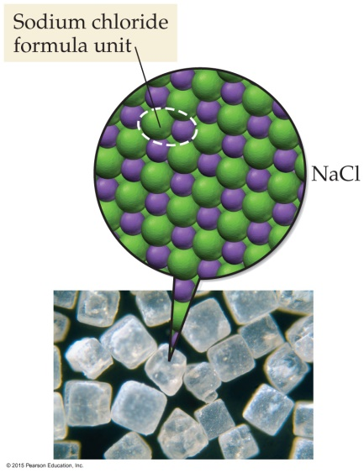
Ionic Compounds: formed from a metal and a nonmetal
Not a real “bond” between ions: just + and – attraction. metals have positive charge (lose electrons), nonmetals have negative charge (gain electrons)
Covalent Compounds (also called molecular compounds): two or more nonmetals (example: H₂O, CO₂, many organic molecules are made of C H and O)

Slide 20
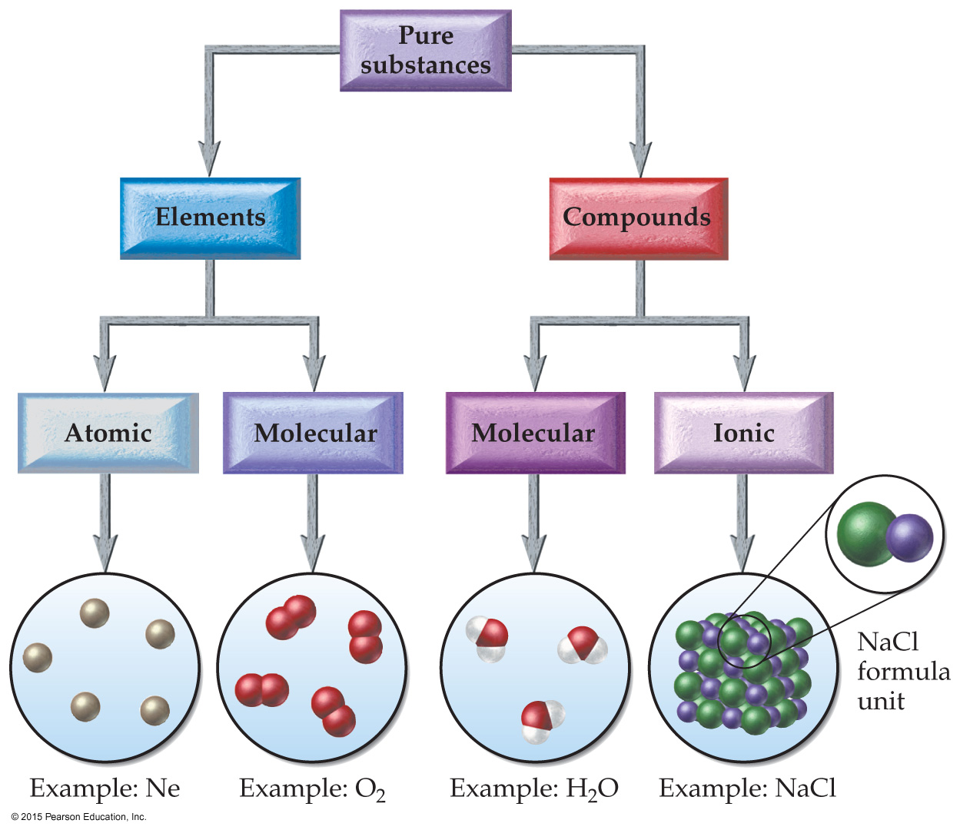
Classification of Elements and Compounds

Slide 21
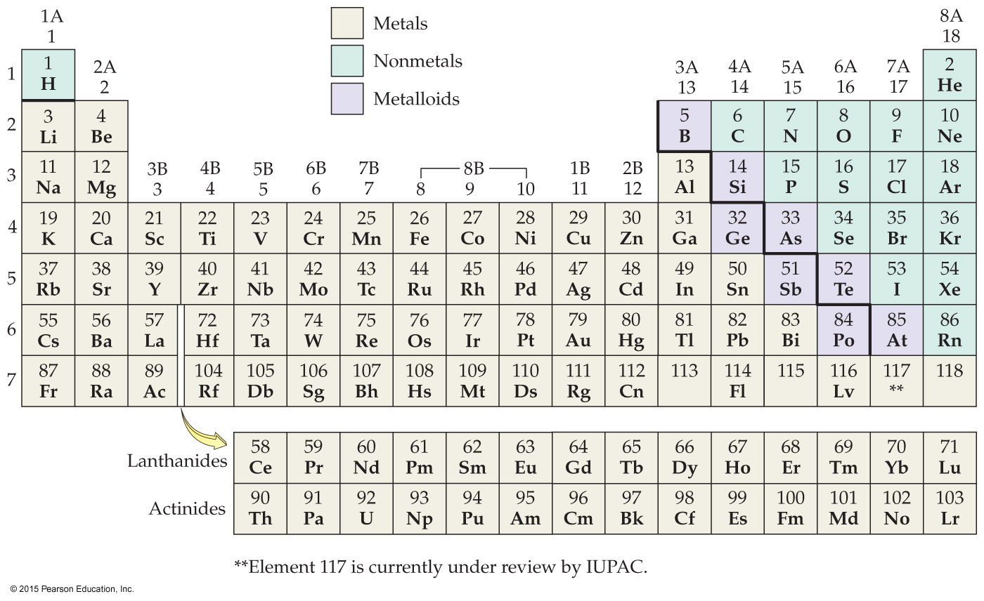
Practice: Classify each element (as atomic or diatomic/molecular) or compound (as covalent/molecular or ionic).
Chlorine
NO
gold (Au)
Na₂O
(e) CrCl₃

Slide 22
Writing Formulas for Ionic Compounds
Ionic compounds are neutral (charges cancel out)
Formulas can be predicted based on periodic table (charge rules)
Example: Na_{x}Cl_{y}

Slide 23
Mg and Cl
Aluminum and Oxygen:

Slide 24
Writing formula with polyatomic ions
Ionic compounds often contain one or more polyatomic ions
  Polyatomic ion: charged species (ion) made up of two or more atoms
Example: Mg(NO₃)₂
2 goes outside the parenthesis to indicate there are 2 NO₃⁻ ions.

Slide 25
K and CO₃²⁻
Al and SO₄²⁻
Mg and O
Na and hydroxide

Slide 26
Nomenclature: Naming Ionic Compounds
The first step in naming an ionic compound is identifying it as one.
  If there is a metal and a nonmetal together in a chemical formula,
  the compound is ionic.
  Covalent compounds (made of nonmetals only) use different naming rules.

Slide 27
Naming Cations in Ionic Compounds
For naming:
Type 1 cation - name is just name of element
ex: Na⁺ =
Type 2 cation - name includes the charge as a roman numeral
ex: Fe²⁺ =
Fe³⁺ =
If the cation is a polyatomic ion, just use its name
ex. NH₄⁺ = ammonium
Type 1 Metal: only forms one type of ion
ex: Na only forms 1+ ion (Na⁺)
    Group 1A, 2A, 3A
Zinc = Zn²⁺ and Silver = Ag⁺
Type 2 Metal: can form more than one type of ion
ex: Fe forms Fe²⁺ and Fe³⁺
Most transition metals form more than one type of ion
Type II Metal | Charges
Cr | 2+, 3+
Fe | 2+, 3+
Co | 2+, 3+
Cu | 1+, 2+
Sn | 2+, 4+
Pb | 2+, 4+
Hg₂²⁺ / Hg²⁺ | 1+, 2+

Slide 28
Naming Anions in Ionic Compounds
Drop ending of nonmetal’s name and change it to –ide
If the anion is a polyatomic ion, just use its name.
Nonmetal | Symbol | Base Name | Anion Name
fluorine | F⁻ | fluor- | fluoride
chlorine | Cl⁻ | chlor- | chloride
bromine | Br⁻ | brom- | bromide
iodine | I⁻ | iod- | iodide
oxygen | O²⁻ | ox- | oxide
sulfur | S²⁻ | sulf- | sulfide
nitrogen | N³⁻ | nitr- | nitride

Slide 29
Naming Ionic Compounds

Slide 30
NaCl
KBr
Zn₃N₂
FeCl₃
PbCl₄
PbO

Slide 31
Cu(NO₂)₂
Fe(OH)₂
KNO₃
NaClO
NaHCO₃

Slide 32
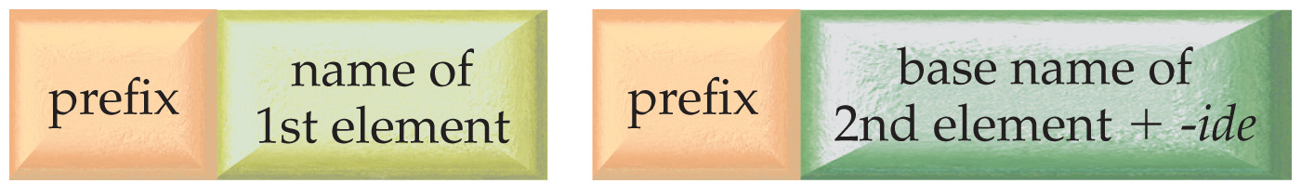
Naming Molecular/Covalent Compounds
Molecular (covalent) compounds – two nonmetals
  Use prefixes
  mono = 1 penta = 5
di = 2 hexa = 6
tri = 3 hepta = 7
tetra = 4 octa = 8
  Mono is omitted for the first element (but used for the second element)

Slide 33
CO₂
NO
N₂O
CCl₄
SF₆
N₂O₄

Slide 34
Achieve HW has very thorough practice with naming!
Most difficult part? When given a mixture of ionic/covalent compounds….
  First have to decide which naming scheme to use???
  Does the compound have nonmetals only? (covalent compound)
    Use prefixes (di, tri, tetra, etc)
  Does the compound have a metal + a nonmetal? (ionic compound)
      No prefixes (di, tri, etc) in name!
      Is the metal in a column that follows charge rules?
        If Yes – name is simple
        If No – must find charge on metal and list as roman numeral!

