Slide 1

Naming Alkanes
Isomerism
Q-center: https://www.brynmawr.edu/inside/offices-services/q-center/q-center-schedule
Office Hours: M 1:30pm - 3:00pm
(in Park 169) W 11:00am - 12:00pm
or by appointment (email me)
or just email me with questions!
TA Hours w/ Sodtugs: T&Th 7:00pm - 8:00pm
(in Park 273)
9/11/2026
Exam 1 next Friday during lecture
Quiz 1 in Recitation today

Slide 2
Chemistry ice cream social
This Friday 4pm in Park atrium courtyard

Slide 3
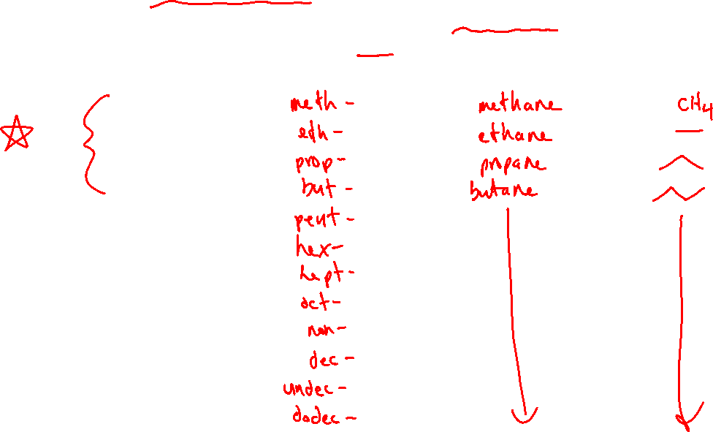
IUPAC systematic naming
Identify the longest carbon chain (the “parent chain”) in the molecule.
a. The prefix denotes the number of carbons in the parent chain.
b. The suffix for naming an alkane is “-ane”. Other functional groups will get their own suffixes.
# of Carbon atoms in chain | prefix | Name of alkane | Drawing
1
2
3
4
5
6
7
8
9
10
11
12

Slide 4
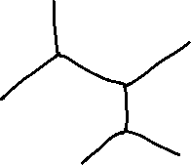
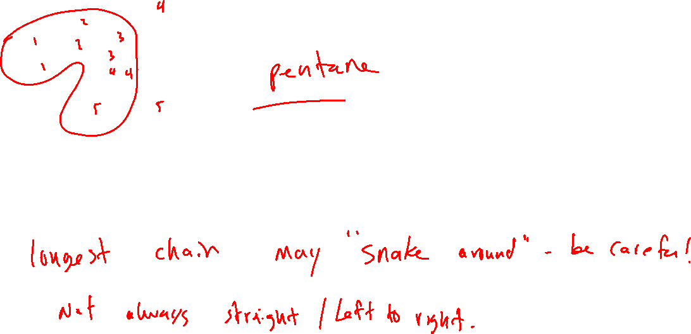

Slide 5
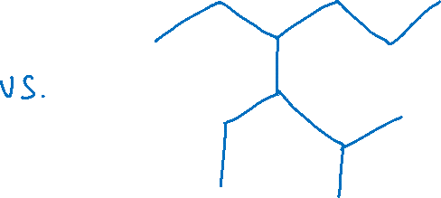
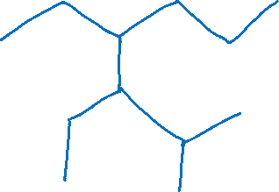
What if there are two possible “parent chains” that have the same length?
Choose the chain with the most substituents (groups that branch off the chain)

Slide 6



If the longest chain is a ring…

Slide 7
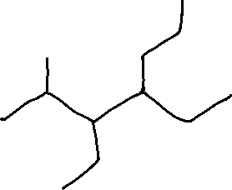

2. Name the substituents attached to the parent chain.
# of Carbon atoms in substituent | Name of substituent | Drawing
1
2
3
4
5
6
7
8
9
10

Slide 8
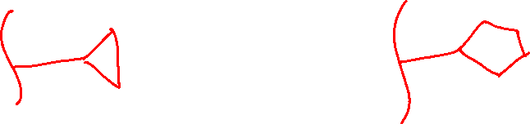
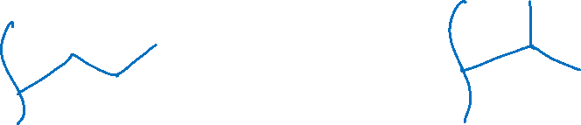
Other alkyl substituents
Cycloalkanes can be substituents:
The “propyl” group can have two different forms:

Slide 9
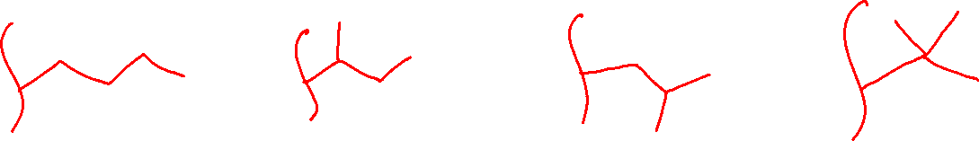
Other alkyl substituents
The “butyl” group has four different forms:

Slide 10
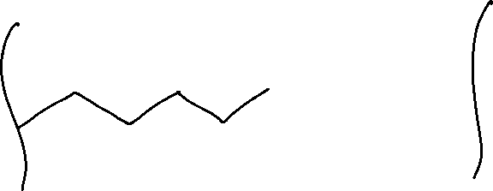


Other alkyl substituents
Pentyl has many different forms, but only two we will discuss:

Slide 11
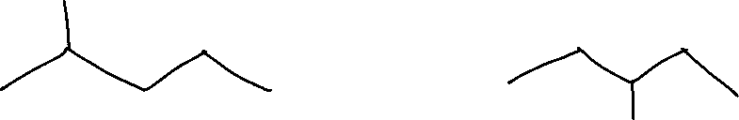
3. Number the parent chain and assign a “locant” to each substituent
Parent chain should be numbered so that substituent gets the smallest locant # possible.

Slide 12
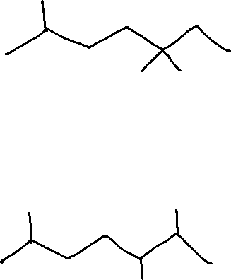
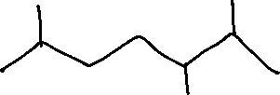
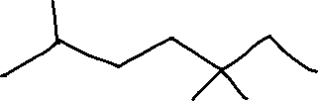
When there are multiple substituents, number the parent chain so that the first substituent has the lowest locant # possible.
If there’s a tie, go to the second substituent, etc.

Slide 13
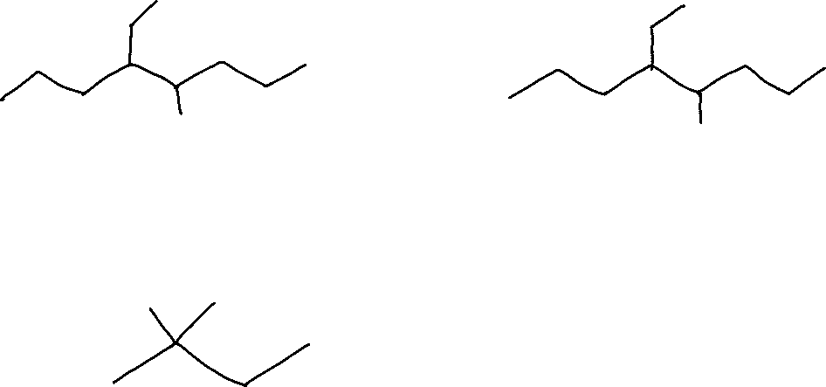
If there’s still a tie after checking all substituents, go alphabetically.
Multiples of the same substituent are denoted with di, tri, tetra, etc.
These prefixes do not count alphabetically (i.e. dimethyl vs ethyl)

Slide 14
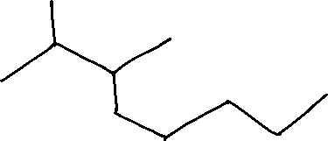

4. Order substituents alphabetically in front of the parent chain name
These prefixes count alphabetically
iso
neo
cyclo
These do not count
di
tri
tetra
sec-
tert-

Slide 15
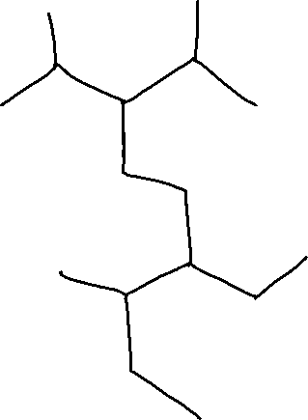
Practice

Slide 16
Isomerism
HW Ch 1. #8e: Draw the [Lewis] structure of C₃H₆
C₄H₈
Notes:
Flow chart figure 5.11 on p200 of book

Slide 17
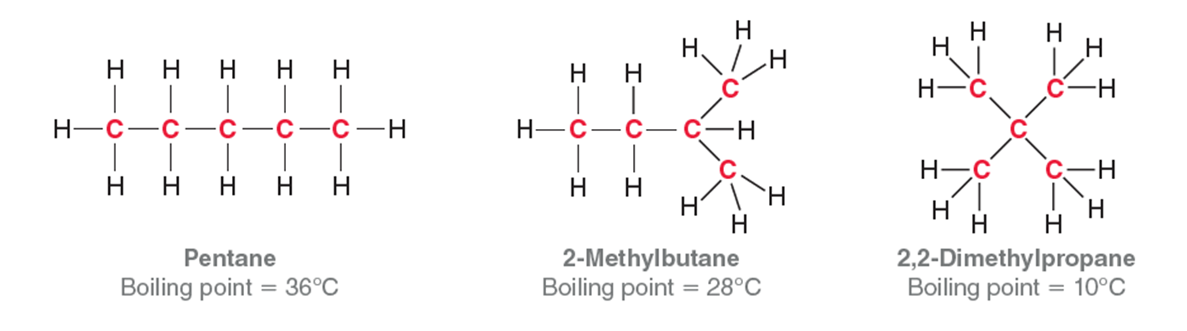
Constitutional isomers (structural isomers)
Notes:
Same formula, different connectivity
In general, alkanes are Cn H2n+2 (except cycloalkanes – more on this in lab eventually)
Do not worry about problems where you have to enumerate every const isomer – waste of time

Slide 18
Identifying Constitutional Isomers
w same MF, different connectivity
1) Ensure the molecular formula is the same
2) Find the longest chain containing the most double/triple bonds
3) # the carbons as in naming
4) If there is any difference in…
the size of the longest chain,
#’s assigned to multiple bonds, and/or
#’s assigned to the C’s with substituents
Then the connectivity is different and they are constitutional isomers.

Slide 19
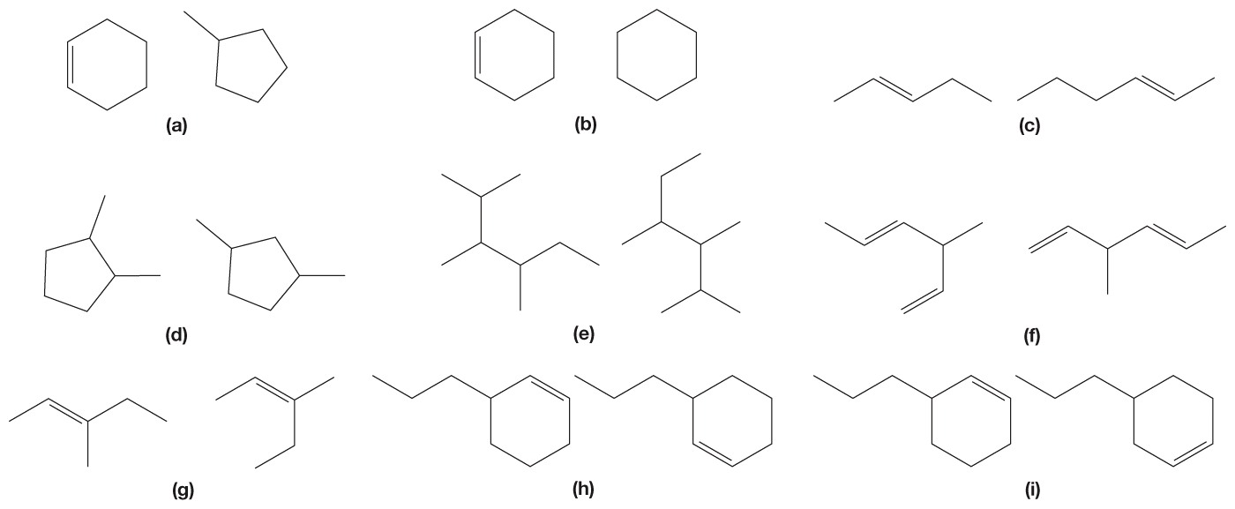
Poll
pollev.com/timcook653 or text timcook653 to 22333
Or use Android/iPhone app
Which of these pairs of molecules are constitutional isomers?
A
B
C

