Slide 1
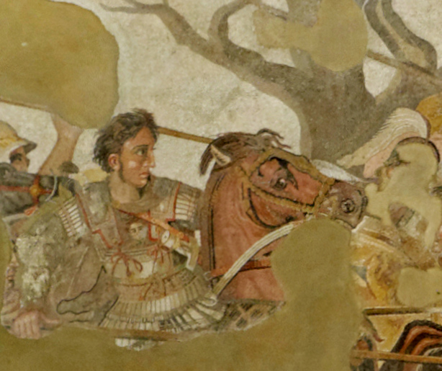
The Successor to Alexander
ARCH B222 – The Age of Alexander
Fall 2026
September 9

Slide 2
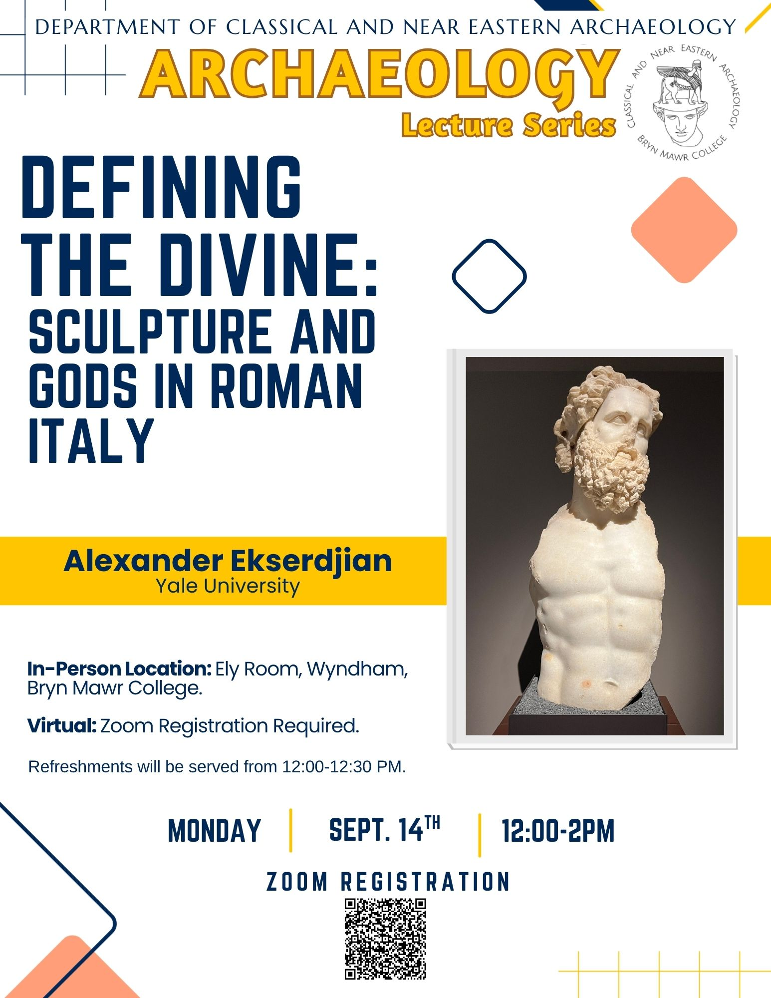
Looking Ahead
Mon 9/14, 12:30 PM: Archaeology Lecture
This talk analyses the material culture of cult places in late-Republican Italy to propose a visual language of the sacred specific to Roman Italy. Cult statues and sanctuary dedications demonstrate the ways that sculptural choices expressed relationships between worshippers and their gods. The vast gulf between the divine and the human was made manifest through material choices, sculptural scale, and modes of display. First sketching out the mechanics for this system of visual communication, I then turn to exemplary works of Republican sculpture to illustrate its workings. Finally, surviving statues from the city of Ostia are used to test the application of these ideas to a chronologically and spatially bounded context. Drawing on the methods of archaeology, art history, and anthropology, I aim to show how much may be gained by more fully incorporating close analysis of sculpture into histories of Roman religion.

Slide 3
A Note on Spelling Proper Names
Greek: Ἀλέξανδρος (Alexandros)
Latin: Alexandrus
French: Alexandre
English: Alexander
Greek: Πτολεμαῖος (Ptolemaios)
Latin: Ptolemaeus
French: Ptolémée
English: Ptolemy (“Tall-eh-me”)
Greek: Σελεύκεια (Seleukeia)
Latin: Seleucia
French: Séleucie
English: Seleucia (“Sell-oo-shah”)
Greek: Ἀντιόχεια (Antiokheia)
Latin: Antiochia
French: Antioche
English: Antioch (“An-ti-ock”)

Slide 4
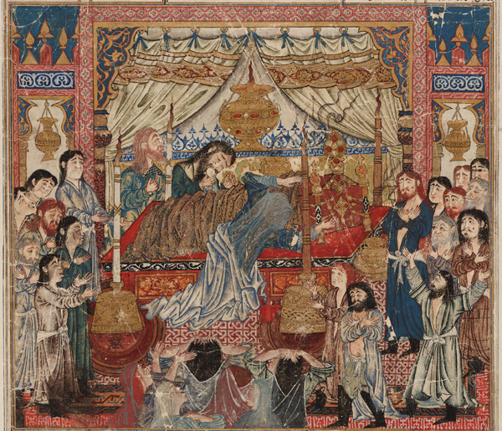
The Death of Alexander
June 10, 323 BCE in Babylon
Died of a fever
Could have been murdered, but we have no way of knowing
The death of Iskander (Alexander) as depicted in a manuscript of the Shahnameh by Firdowsi

Slide 5
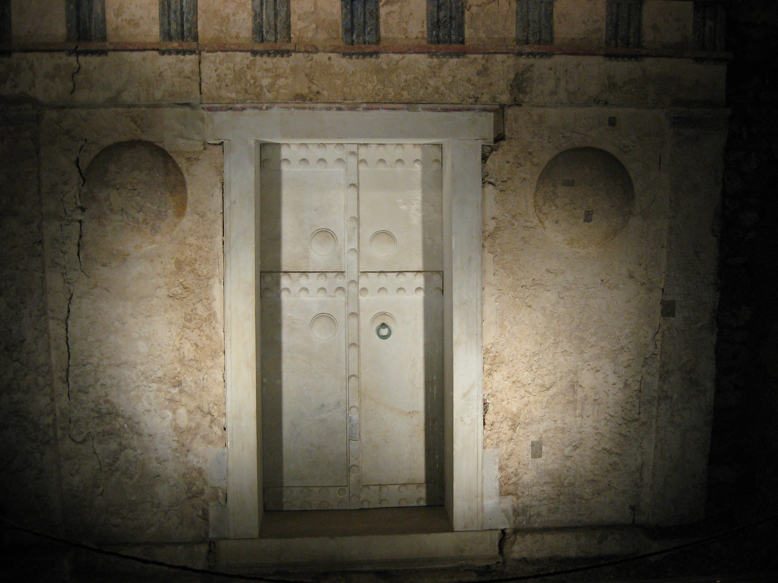
Alexander’s Heirs
Alexander IV
Philip (III) Arrhidaeus
Son of Alexander the Great and Roxane of Bactria
Born in August 323 BCE
  i.e. two months after Alexander’s death
Murdered by Cassander in 309
Son of Philip II and Philinna of Larissa
  i.e. half brother of Alexander
“Arrhidaeus was Philip's son by an obscure and common woman named Philinna, and was deficient in intellect owing to bodily disease. This, however, did not come upon him in the course of nature or of its own accord, indeed, it is said that as a boy he displayed an exceedingly gifted and noble disposition: but afterwards Olympias gave him drugs which injured his body and ruined his mind.” (Plutarch, Alexander 77.6)
Executed by Olympias in 317
Tomb III at Vergina, possibly the burial place of Alexander IV

Slide 6
Partition of Babylon (June 323)
“Straightway they made Arrhidaeus, son of Philip, their king and changed his name to Philip; Perdiccas, to whom the king had given his ring as he died, they made regent of the kingdom;⁠ and they decided that the most important of the Friends and of the Bodyguard should take over the satrapies and obey the king and Perdiccas.” (Diodorus Siculus 18.2.4)
Diadochoi = ‘successors’

Slide 7
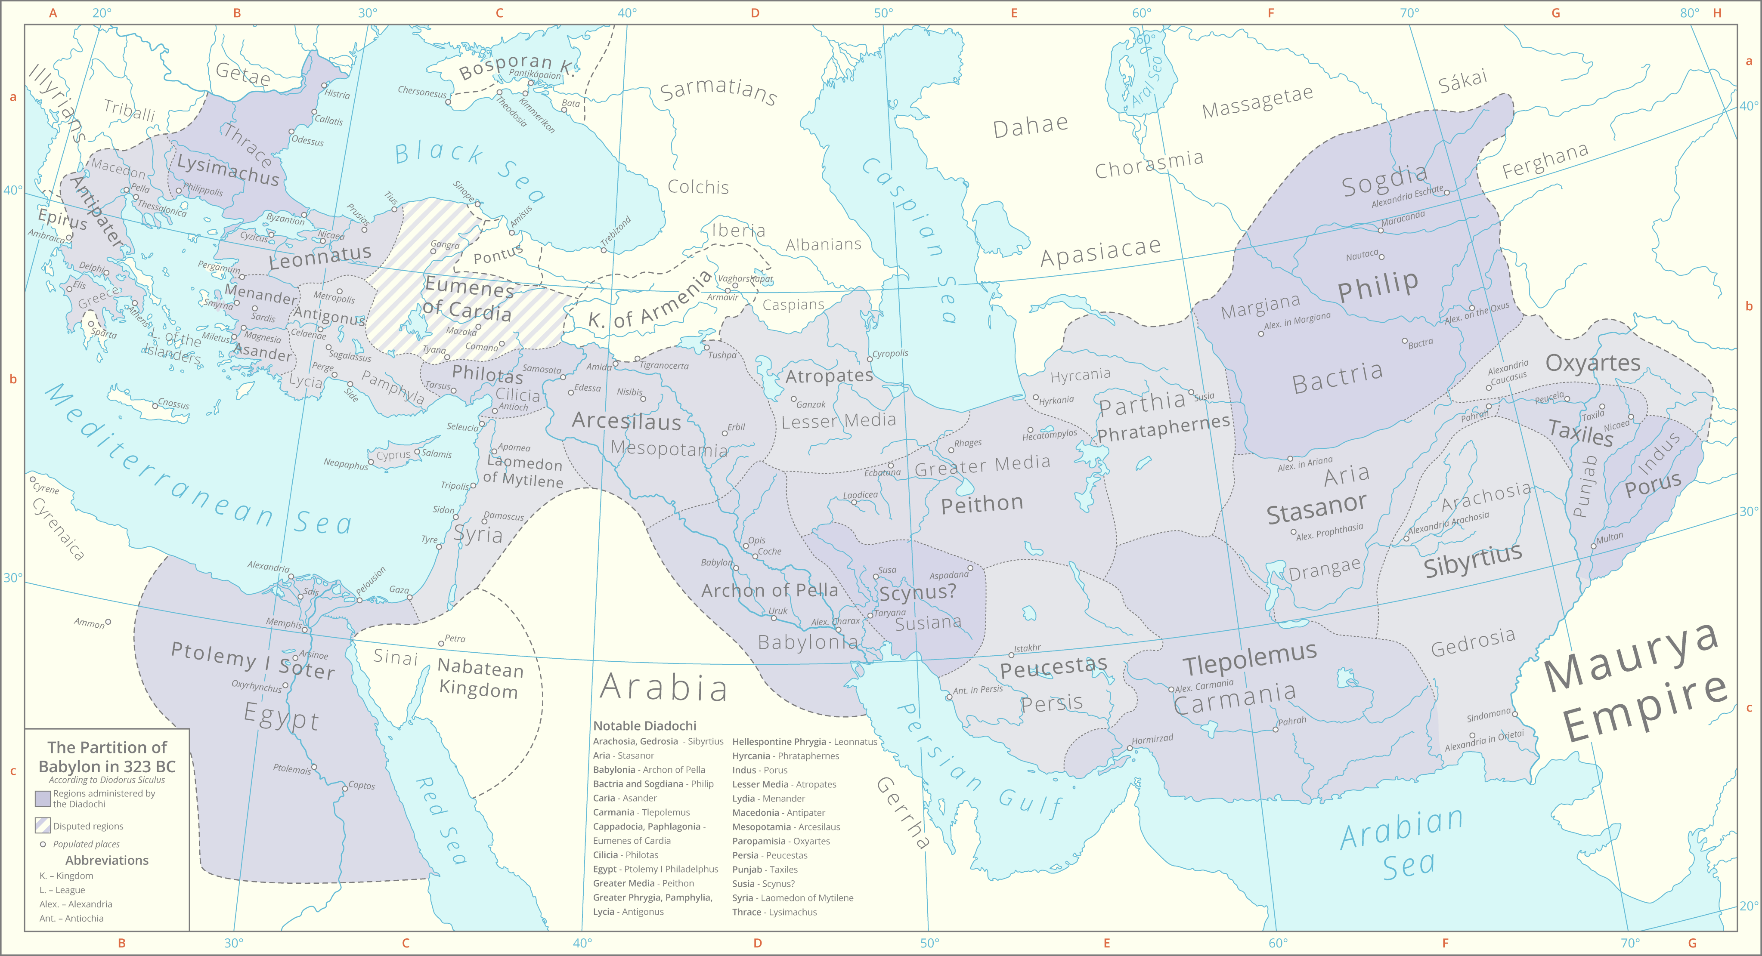

Slide 8
Role/Region | Babylon (323) | Triparadisus (320) | Role/Region | Babylon (323) | Triparadisus (320)
King | Philip III | Philip III & Alexander IV | Babylonia | Archon | Seleucus
Regent | Perdiccas | Antipater | Media | Atropates | Peithon
Macedon & Greek mainland | Antipater | Antipater | Susiana | Scynus | Antigenes
Thrace | Lysimachus | Lysimachus | Persia | Peucestas | Peucestas
Hellespontine Phrygia | Leonnatus | Arrhidaeus | Carmania | Tlepolemus | Tlepolemus
Central Anatolia (Greater Phrygia, Lycia, Pamphylia) | Antigonus | Antigonus | Hyrcania and Parthia | Phrataphernes | Philippus
Caria | Asander | Asander | Sogdiana and Bactria | Philippus | Stasanor
Lydia | Menander | Clitus | Drangiana and Aria | Stasanor | Stasanor
Cappaodica and Paphlagonia | Eumenes | Nicanor | Arachosia and Gedrosia | Sibyrtius | Sibyrtius
Cilicia | Philotas | Philoxenus | Paropamisia | Oxyartes | Oxyartes
Egypt | Ptolemy | Ptolemy | Punjab | Taxiles | Taxiles
Syria | Laomedon | Laomedon | Indus | Porus | Porus
Mesopotamia | Arcesilaus | Amphimachus | Gandhara | Peithon | Peithon
Antipatrid dynasty (Greece); Kingdom of Thrace; Antigonid dynasty (Greece and western Anatolia); Ptolemaic dynasty (Egypt); Seleucid dynasty (Anatolia to Bactria); native rulers confirmed in their positions

Slide 9
Wars of the Successors
“When men whose greed recognizes no limits set by sea or mountain or desert, and whose desires overleap even the boundaries that define Europe and Asia—when such men are neighbors, with adjacent territories, it would be foolish to think that they could remain content with what they have, without doing one another wrong.”
- Plutarch, Life of Pyrrhus 12

Slide 10
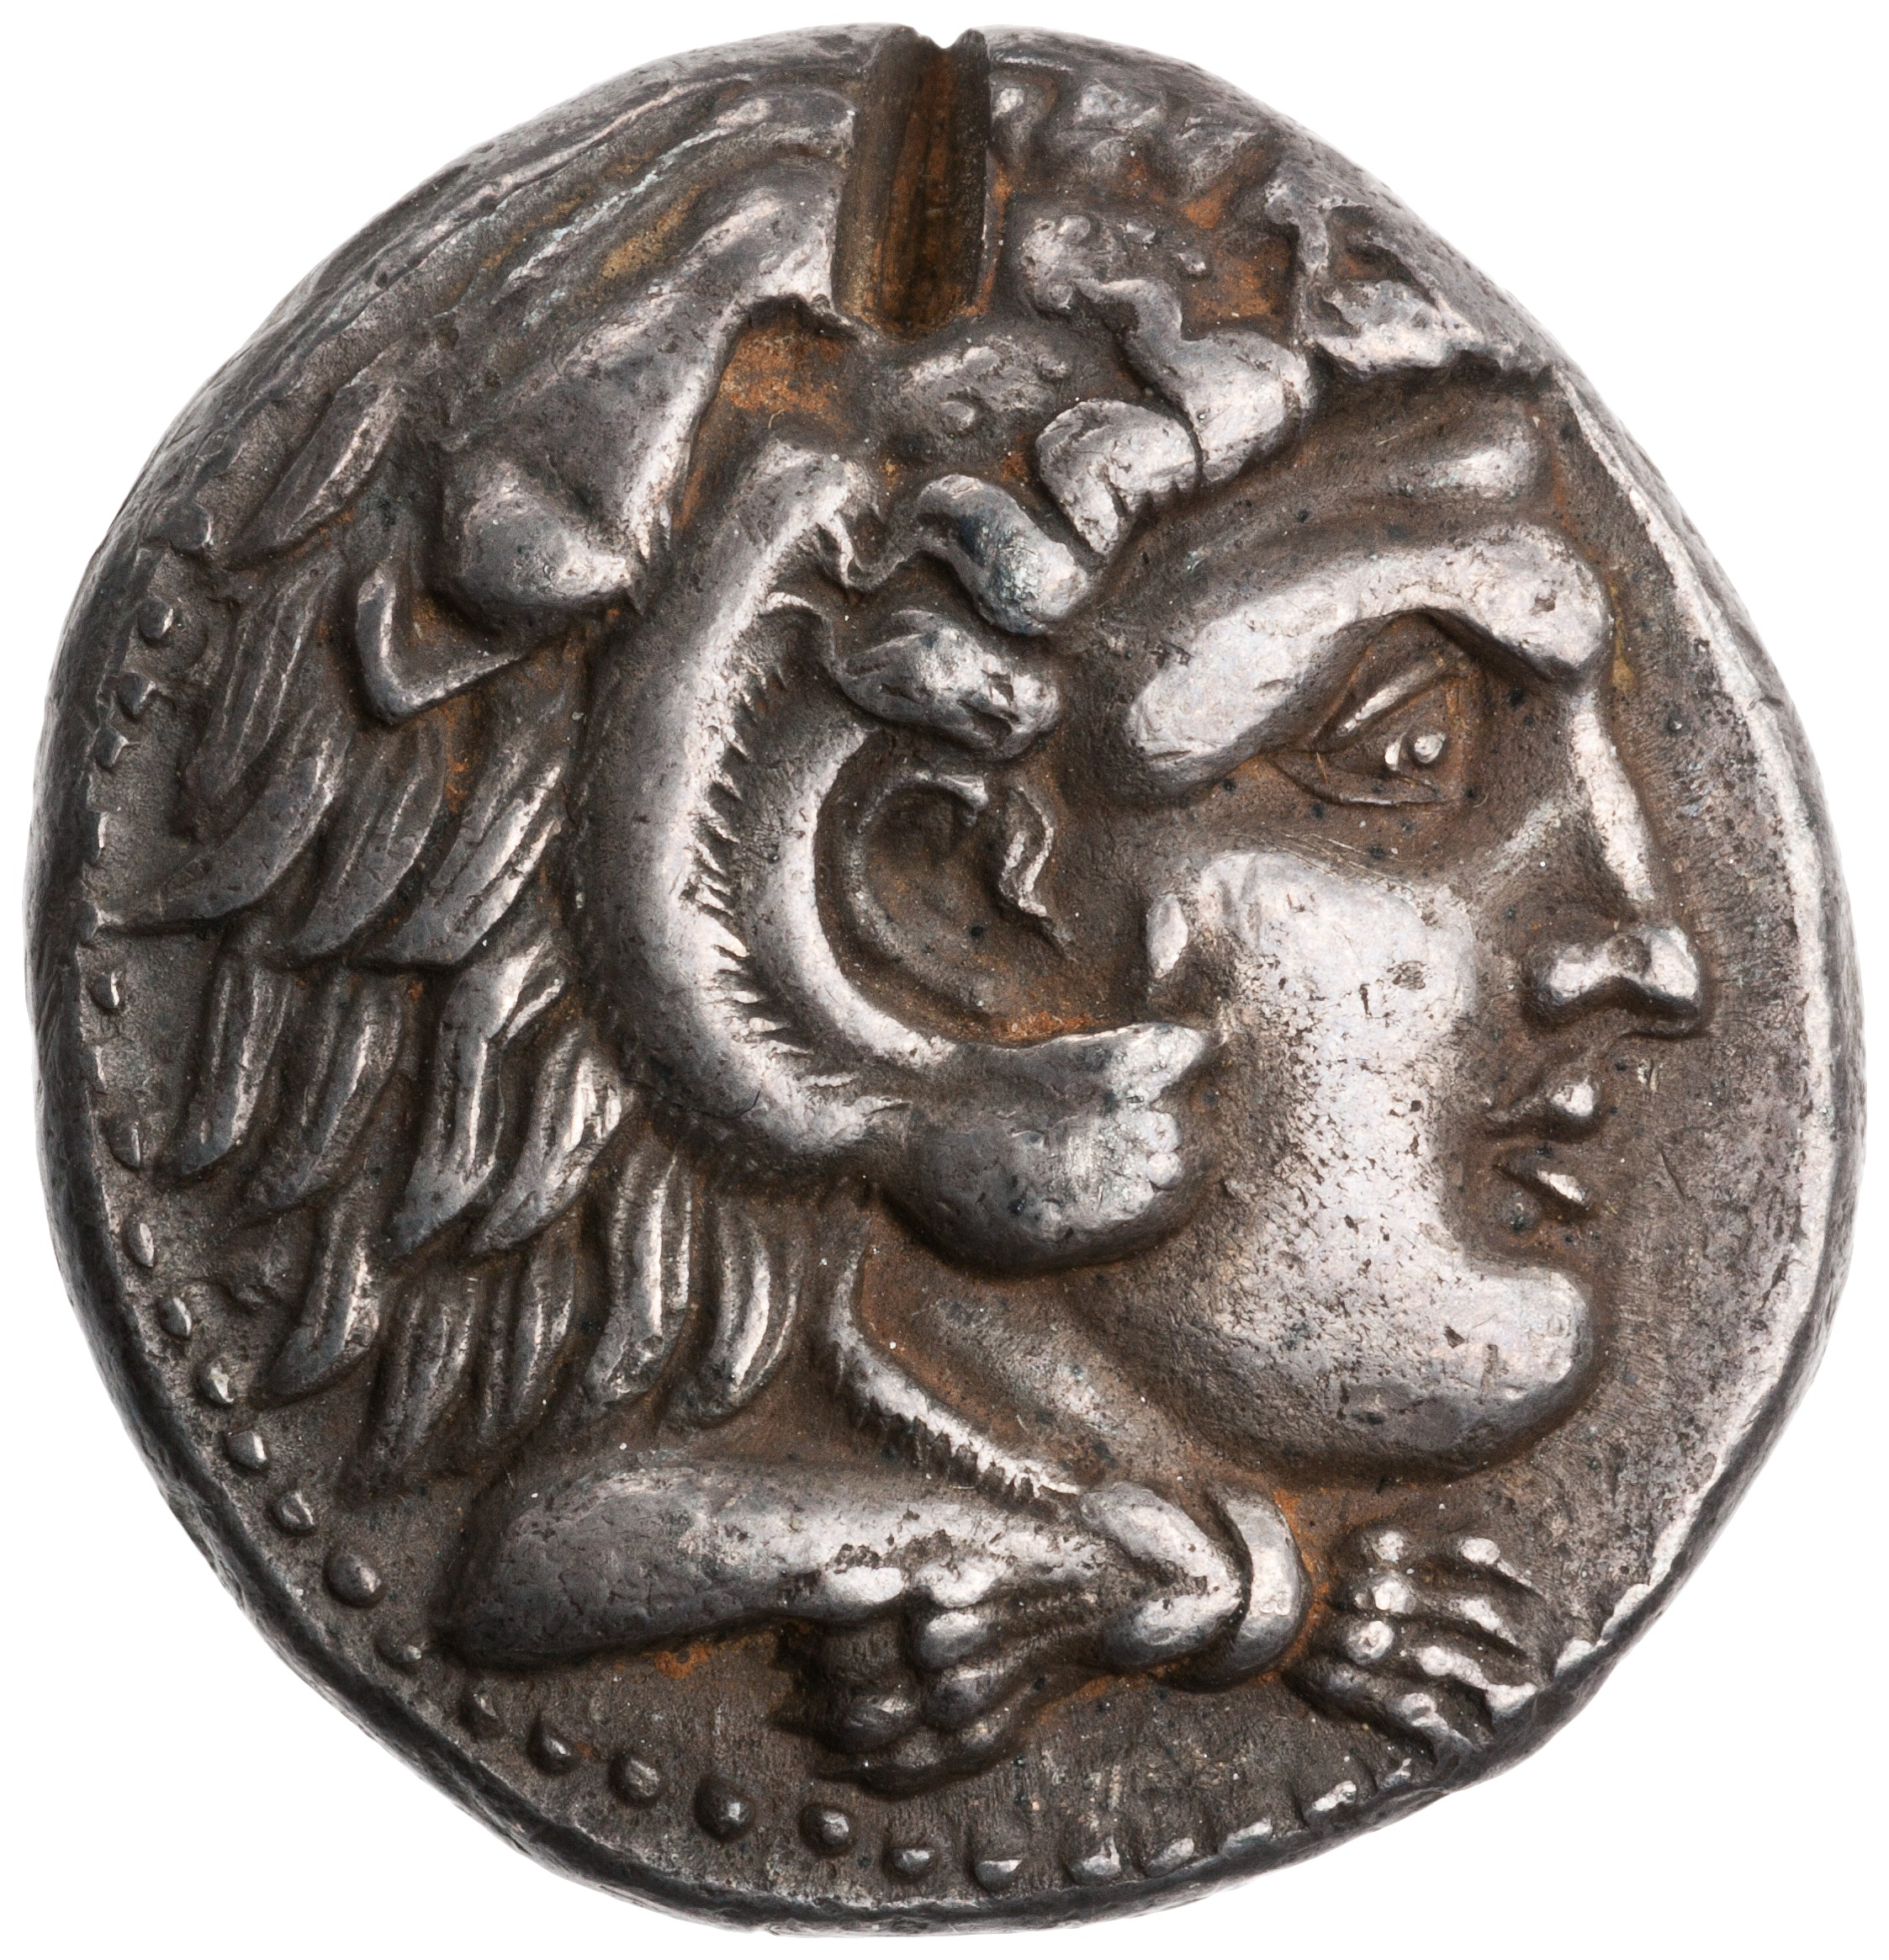
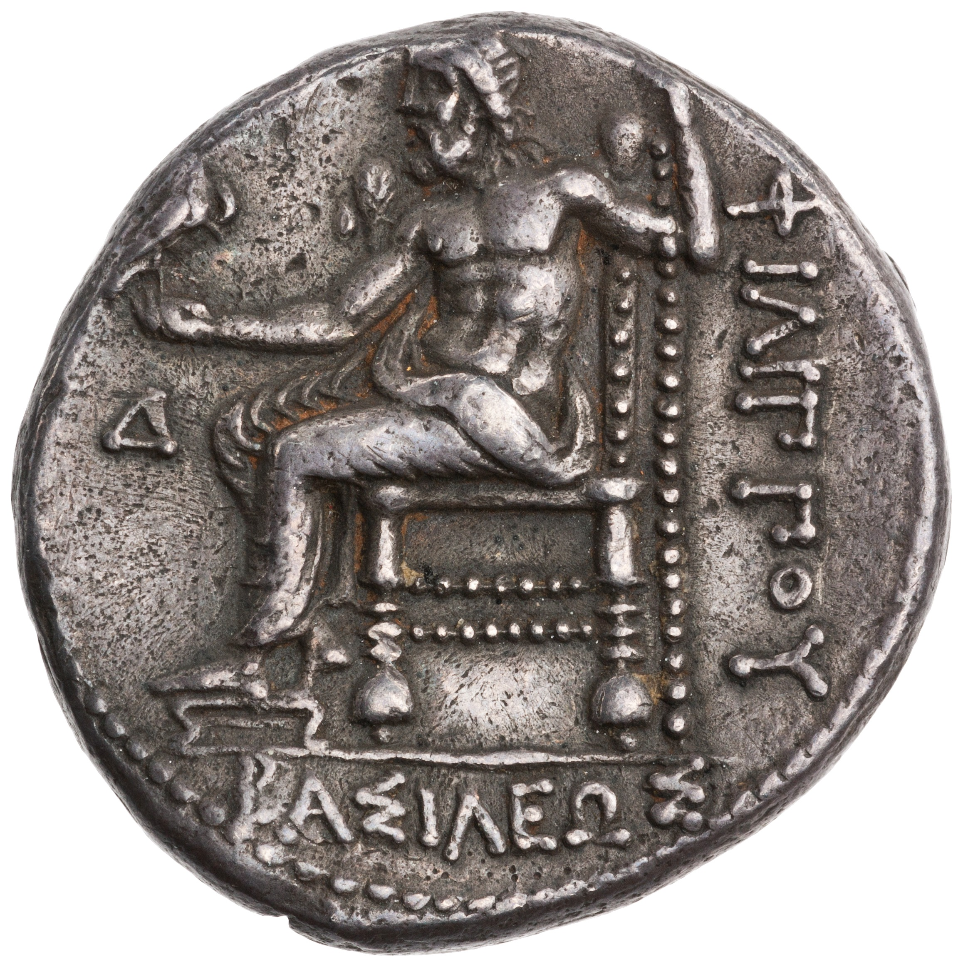
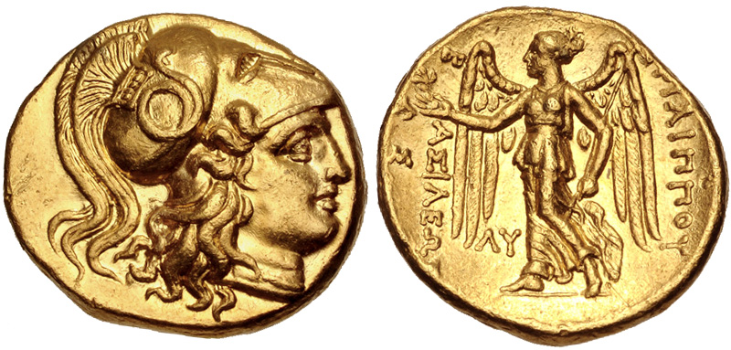
Philip III Arrhidaeus (and Perdiccas)
*
Silver tetradrachm coin minted by Philip III at Ecbatana, ca. 323-317 BCE; obv.: head of Heracles; rev.: Zeus enthroned; legend: “of King Philip”
Gold coin minted by Philip III at Babylon, ca. 323-317 BCE; obv.: head of Athena; rev.: Nike; legend: “of King Philip”

Slide 11
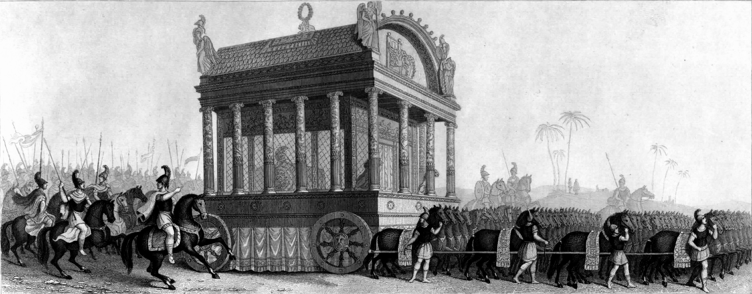
Alexander’s Corpse
Alexander’s funerary procession, as imagined by a 19th century artist

Slide 12
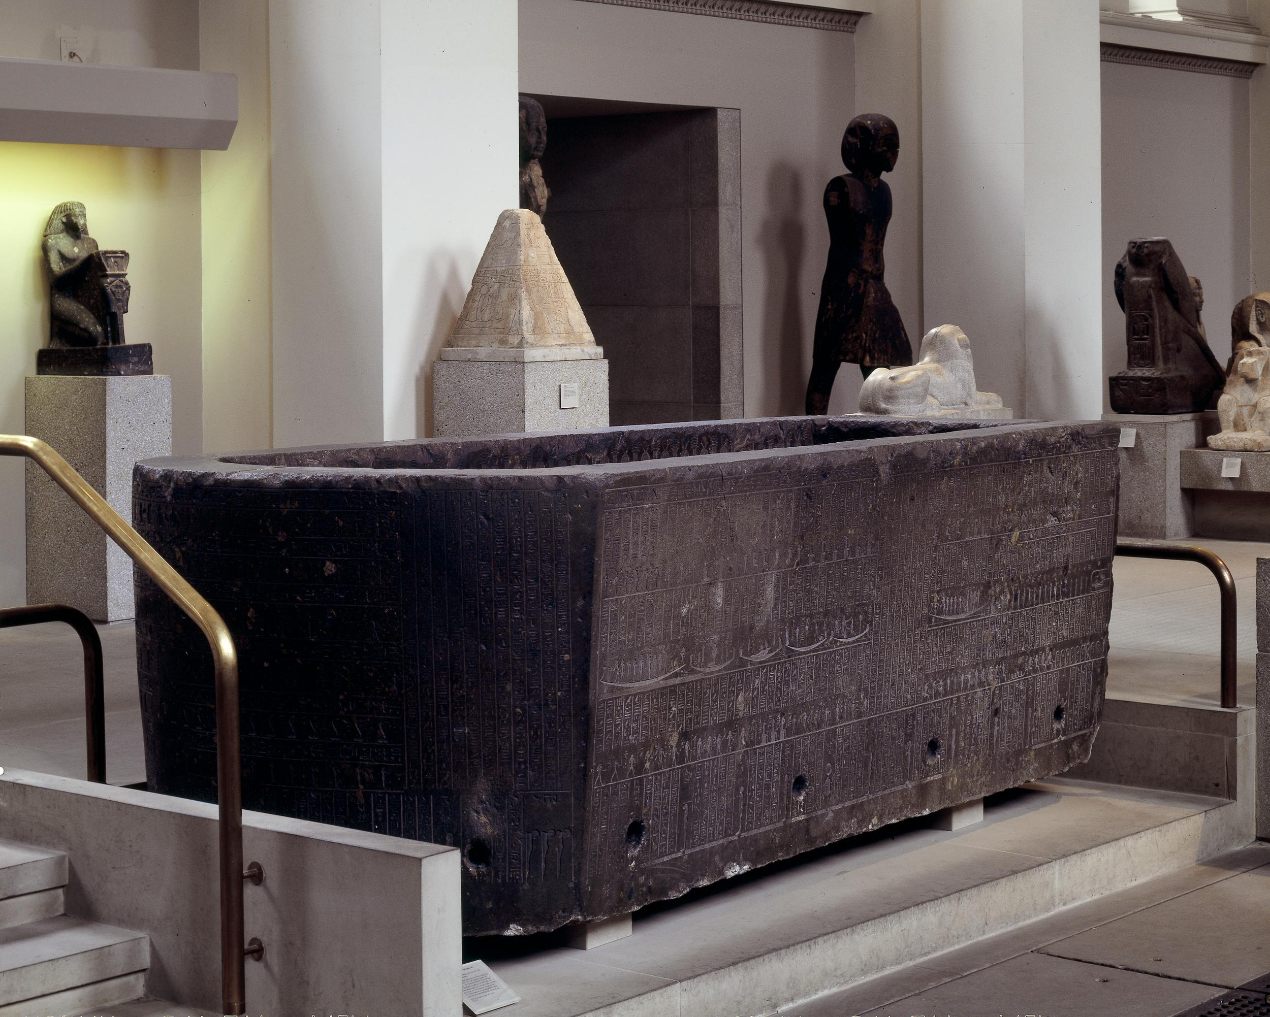
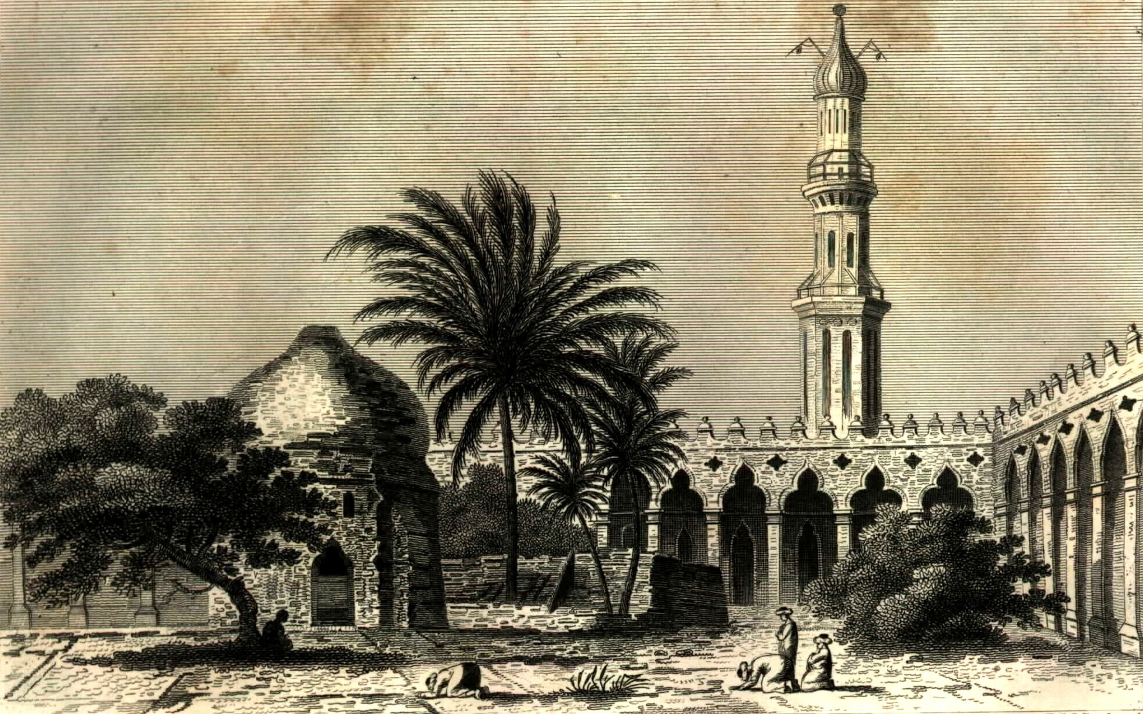
Very likely buried in Alexandria
Possibly in the sarcophagus of Nectanebo II
  Last king of the 30th Dynasty
  Fled to Nubia during the Persian invasion in 340 BCE, leaving his sarcophagus
The Attarine Mosque in Alexandria, where the sarcophagus was found repurposed as a basin

Slide 13
Antipater
Antigonus
Perdiccas
Ptolemy

Slide 14
Role/Region | Babylon (323) | Triparadisus (320) | Role/Region | Babylon (323) | Triparadisus (320)
King | Philip III | Philip III & Alexander IV | Babylonia | Archon | Seleucus
Regent | Perdiccas | Antipater | Media | Atropates | Peithon
Macedon & Greek mainland | Antipater | Antipater | Susiana | Scynus | Antigenes
Thrace | Lysimachus | Lysimachus | Persia | Peucestas | Peucestas
Hellespontine Phrygia | Leonnatus | Arrhidaeus | Carmania | Tlepolemus | Tlepolemus
Central Anatolia (Greater Phrygia, Lycia, Pamphylia) | Antigonus | Antigonus | Hyrcania and Parthia | Phrataphernes | Philippus
Caria | Asander | Asander | Sogdiana and Bactria | Philippus | Stasanor
Lydia | Menander | Clitus | Drangiana and Aria | Stasanor | Stasanor
Cappaodica and Paphlagonia | Eumenes | Nicanor | Arachosia and Gedrosia | Sibyrtius | Sibyrtius
Cilicia | Philotas | Philoxenus | Paropamisia | Oxyartes | Oxyartes
Egypt | Ptolemy | Ptolemy | Punjab | Taxiles | Taxiles
Syria | Laomedon | Laomedon | Indus | Porus | Porus
Mesopotamia | Arcesilaus | Amphimachus | Gandhara | Peithon | Peithon
Antipatrid dynasty (Greece); Kingdom of Thrace; Antigonid dynasty (Greece and western Anatolia); Ptolemaic dynasty (Egypt); Seleucid dynasty (Anatolia to Bactria); native rulers confirmed in their positions

Slide 15
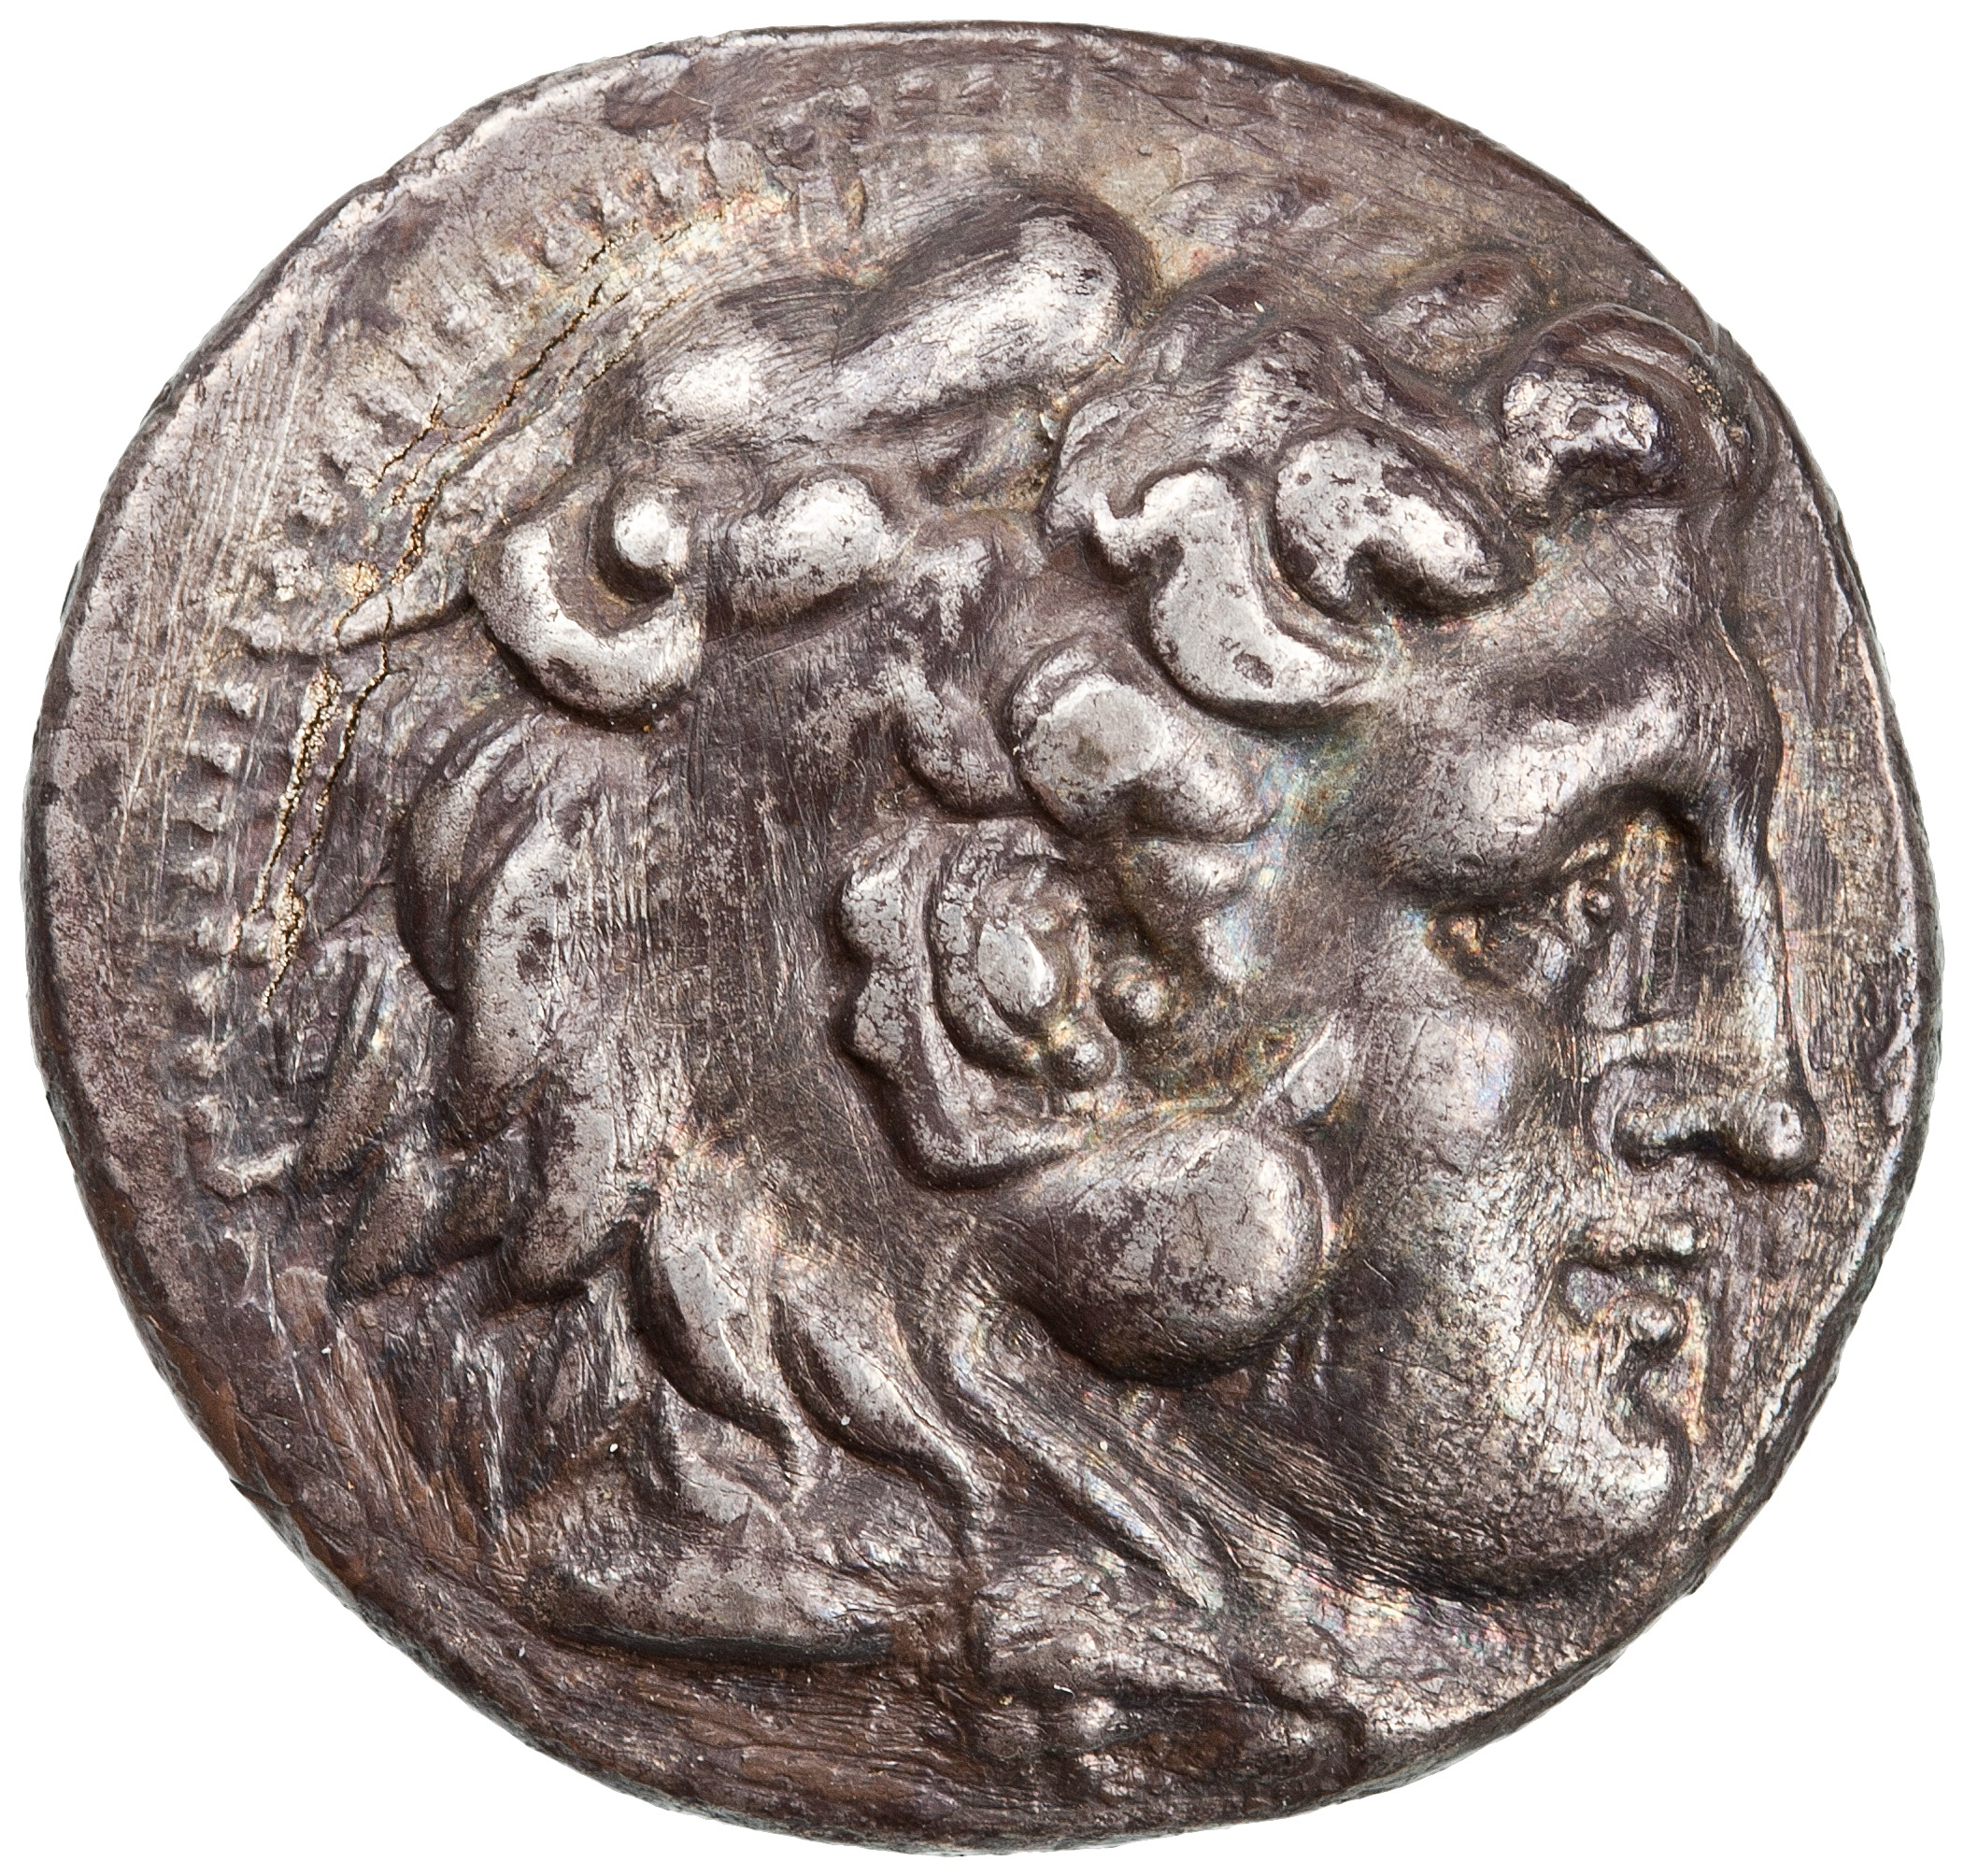
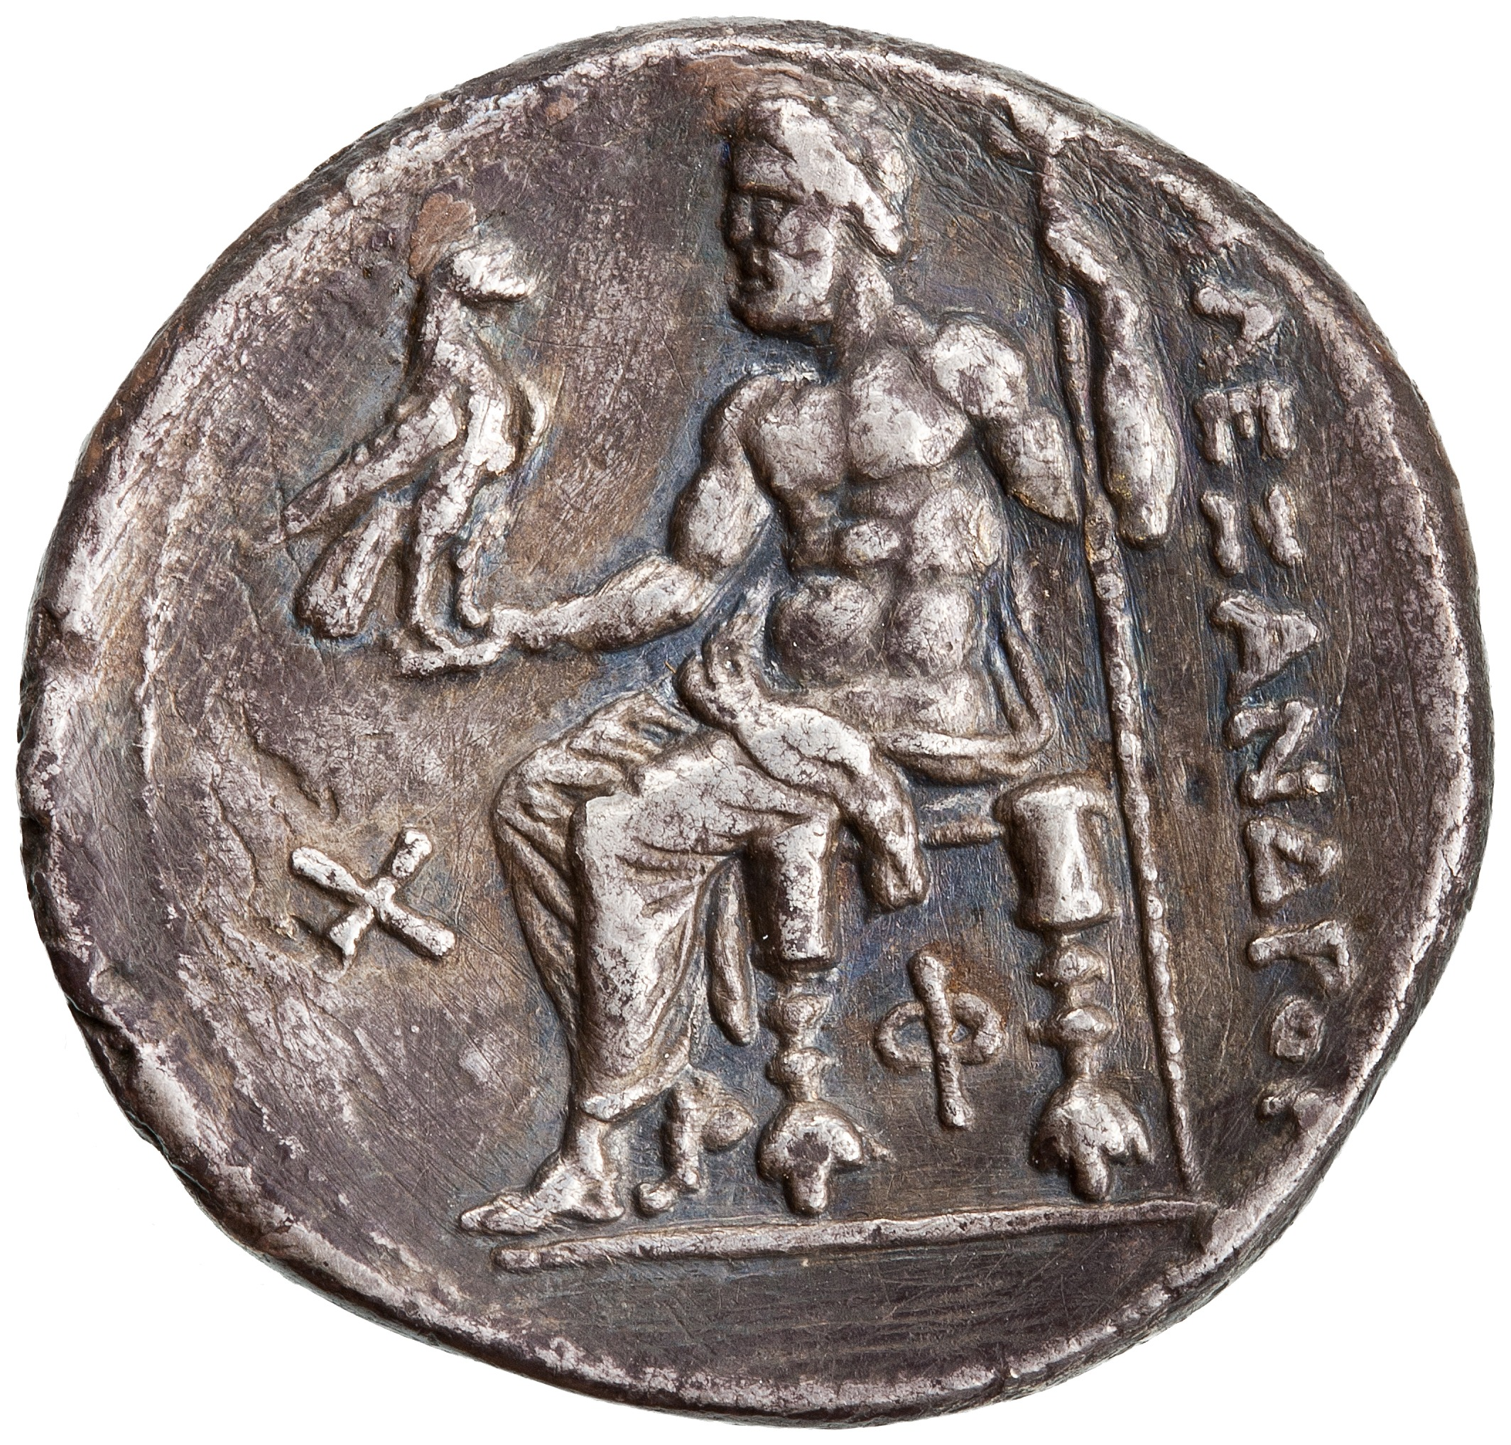
Antigonus I Monophthalmus
Antigonus ‘the One-Eyed’
382-301 BCE
Macedonian general of Alexander
Received control several territories in central Anatolia at the Partition of Babylon
Revolted against Perdiccas in 321 BCE
Eventually captures southern Greece, the rest of Anatolia, Cyprus and Syria
Declares himself king after the Battle of Salamis in 306
Father of Demetrius Poliorcetes and founder of the Antigonid dynasty
Silver tetradrachm coin minted by Antigonus at Antioch, Syria, ca. 306-301 BCE; obv.: head of Heracles; rev.: Zeus enthroned; legend: “of Alexander”

Slide 16
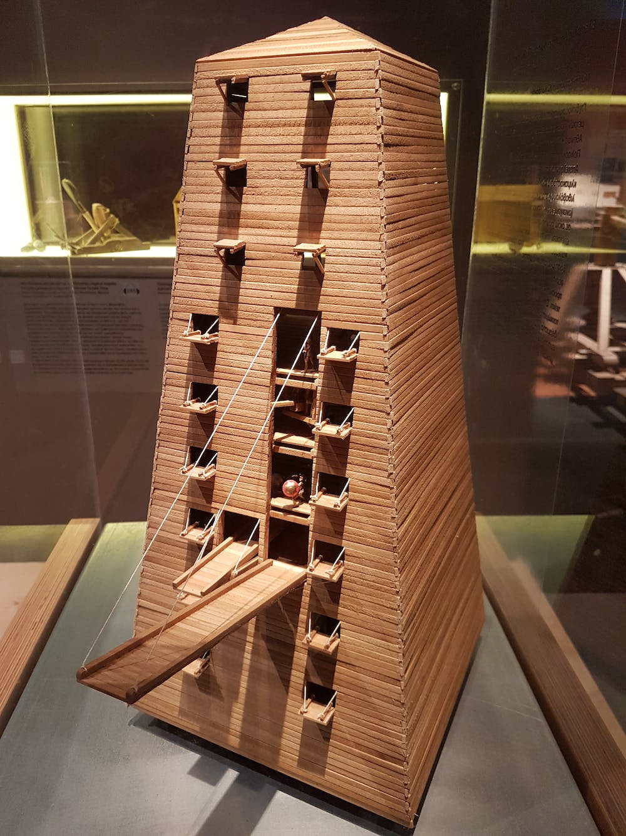
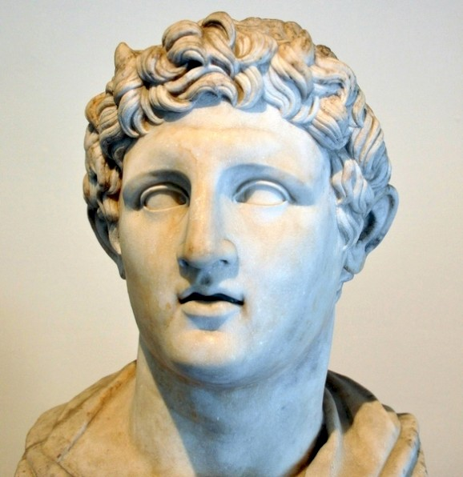
Demetrius Poliorcetes
Poliorketes = ‘the besieger of cities’
*
Roman marble version of a bust of Demetrius, original ca. 306-282 BCE
(National Archaeological Museum of Naples)
Model of Demetrius’ siege tower at the Thessaloniki Science Center and Technology Museum

Slide 17
Demetrius Poliorcetes
“The outward appearance of Alexander is best represented by the statues of him which Lysippus made, and it was by this artist alone that Alexander himself thought it fit that he should be modelled. For those peculiarities which many of his successors and friends afterwards tried to imitate, namely, the poise of the neck, which was bent slightly to the left, and the melting glance of his eyes, this artist has accurately observed.”
- Plutarch, Alexander 4.1
*
Roman marble version of a bust of Demetrius, original ca. 306-282 BCE
(National Archaeological Museum of Naples)

Slide 18
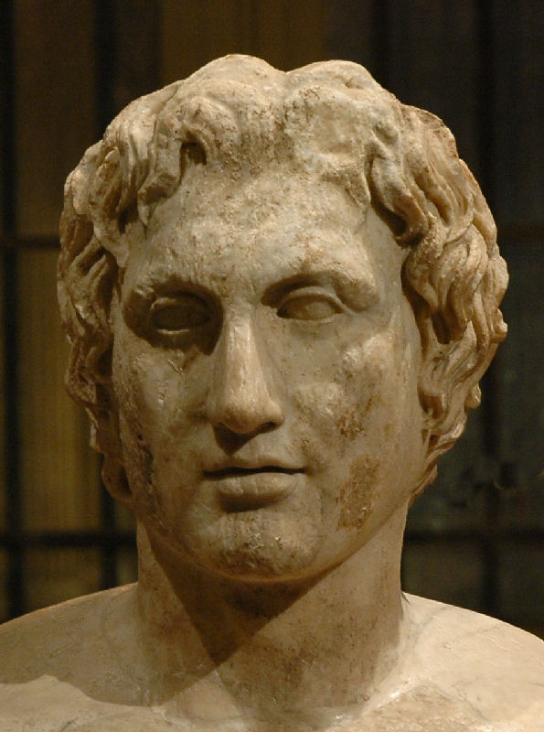
Demetrius Poliorcetes
*
*
Roman marble version of a bust of Demetrius, original ca. 306-282 BCE
(National Archaeological Museum of Naples)
The Azara Herm, with a Roman version of Lysippus’ statue of Alexander, ca. 335-320 BCE (Louvre)

Slide 19
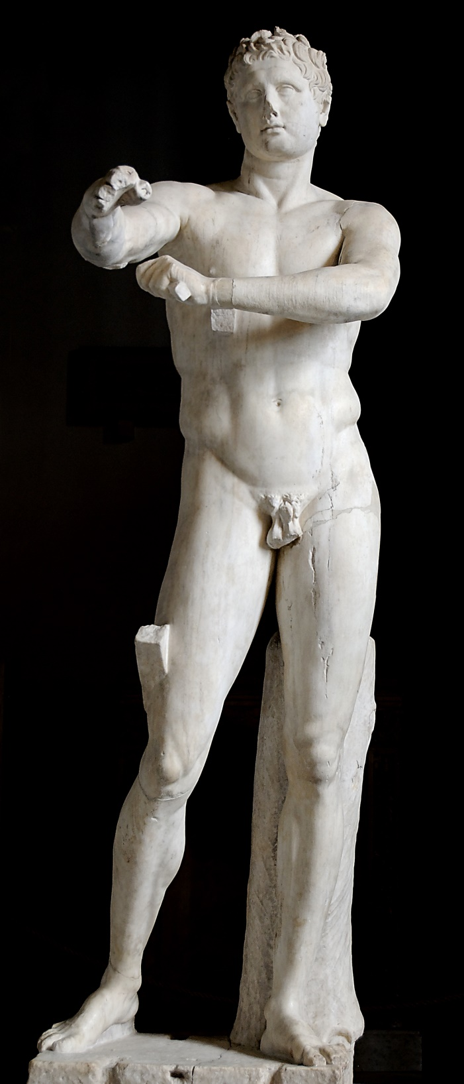
The Apoxyomenos (‘Scraper’) by Lysippus, ca. 330-320 BCE, in a Roman version
(Museo Pio-Clementino)
The Azara Herm, with a Roman version of Lysippus’ statue of Alexander, ca. 335-320 BCE (Louvre)

Slide 20
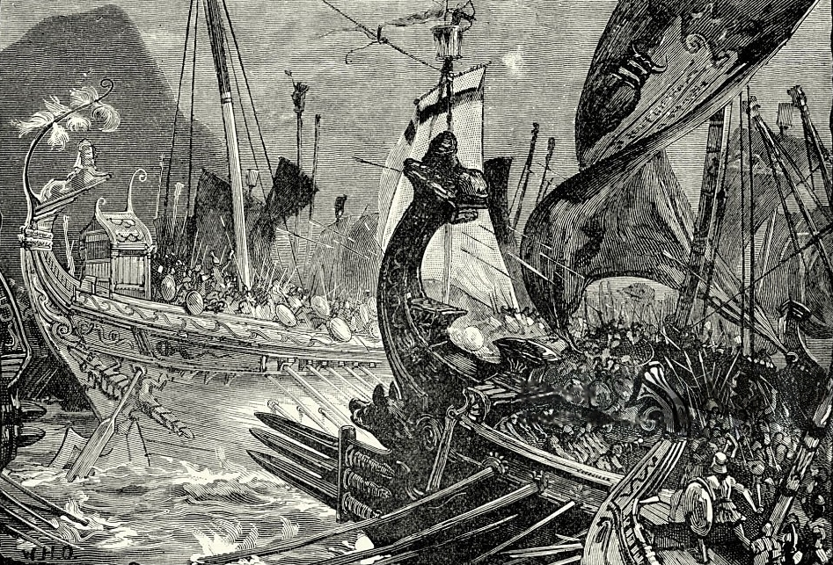
Battle of Salamis (306 BCE)
Naval battle fought off the coast of Salamis, eastern Cyprus
Demetrius Poliorcetes invaded Cyprus, ruled by Ptolemy’s brother Menelaus, and laid siege to Salamis
Ptolemy launched a relief fleet from Alexandria
The battle was inconclusive, but Ptolemy ultimately retreated
Used as a pretext by Antigonus to declare himself king
The Battle of Salamis as imagined by a 19th century artist

Slide 21
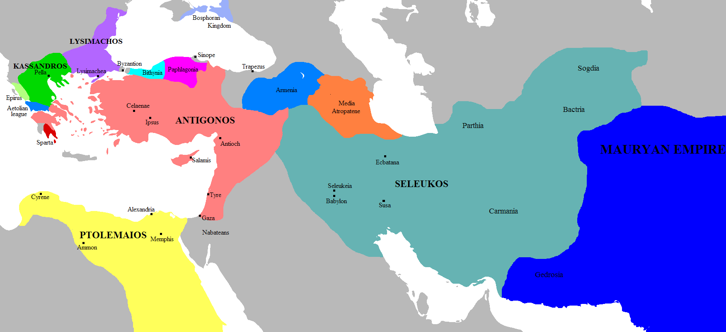

Slide 22
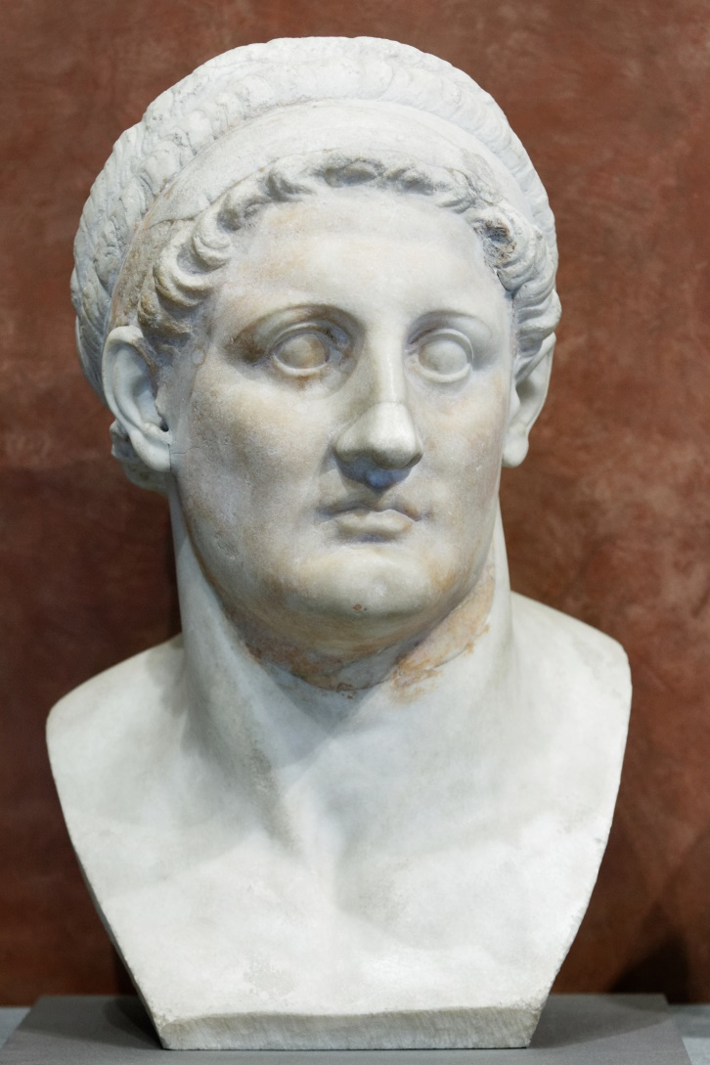
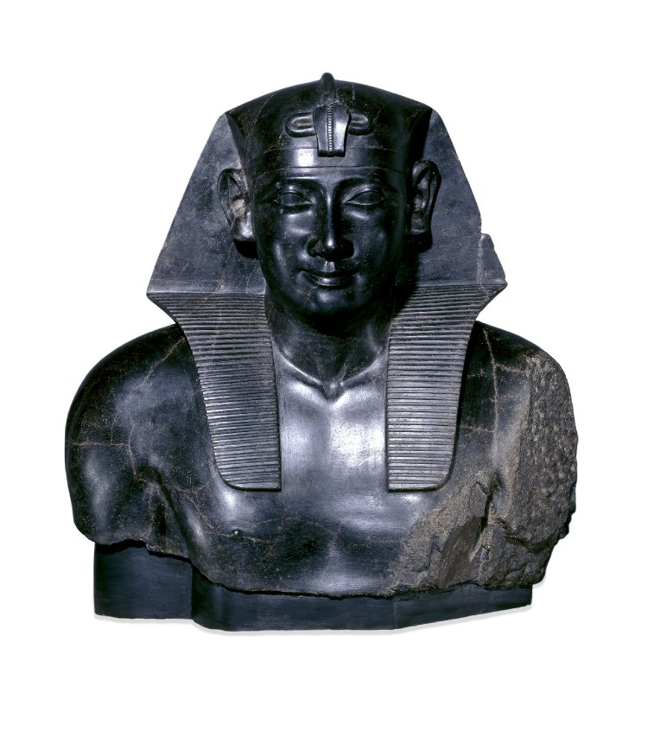
Ptolemy
ca. 369/8-282 BCE
Close friend and general of Alexander
Received Egypt in the Partition of Babylon
Hijacked Alexander’s corpse and buried it in Alexandria
Revolted against Perdiccas
Seized Cyprus from Antigonus and Syria and Palestine from Laomedon
Declared himself king in 305
Left: Marble bust of Ptolemy I, ca. 305-282 BCE (Louvre)
Right: Remains of a basalt statue of Ptolemy I, ca. 305-282 BCE (British Museum)

Slide 23
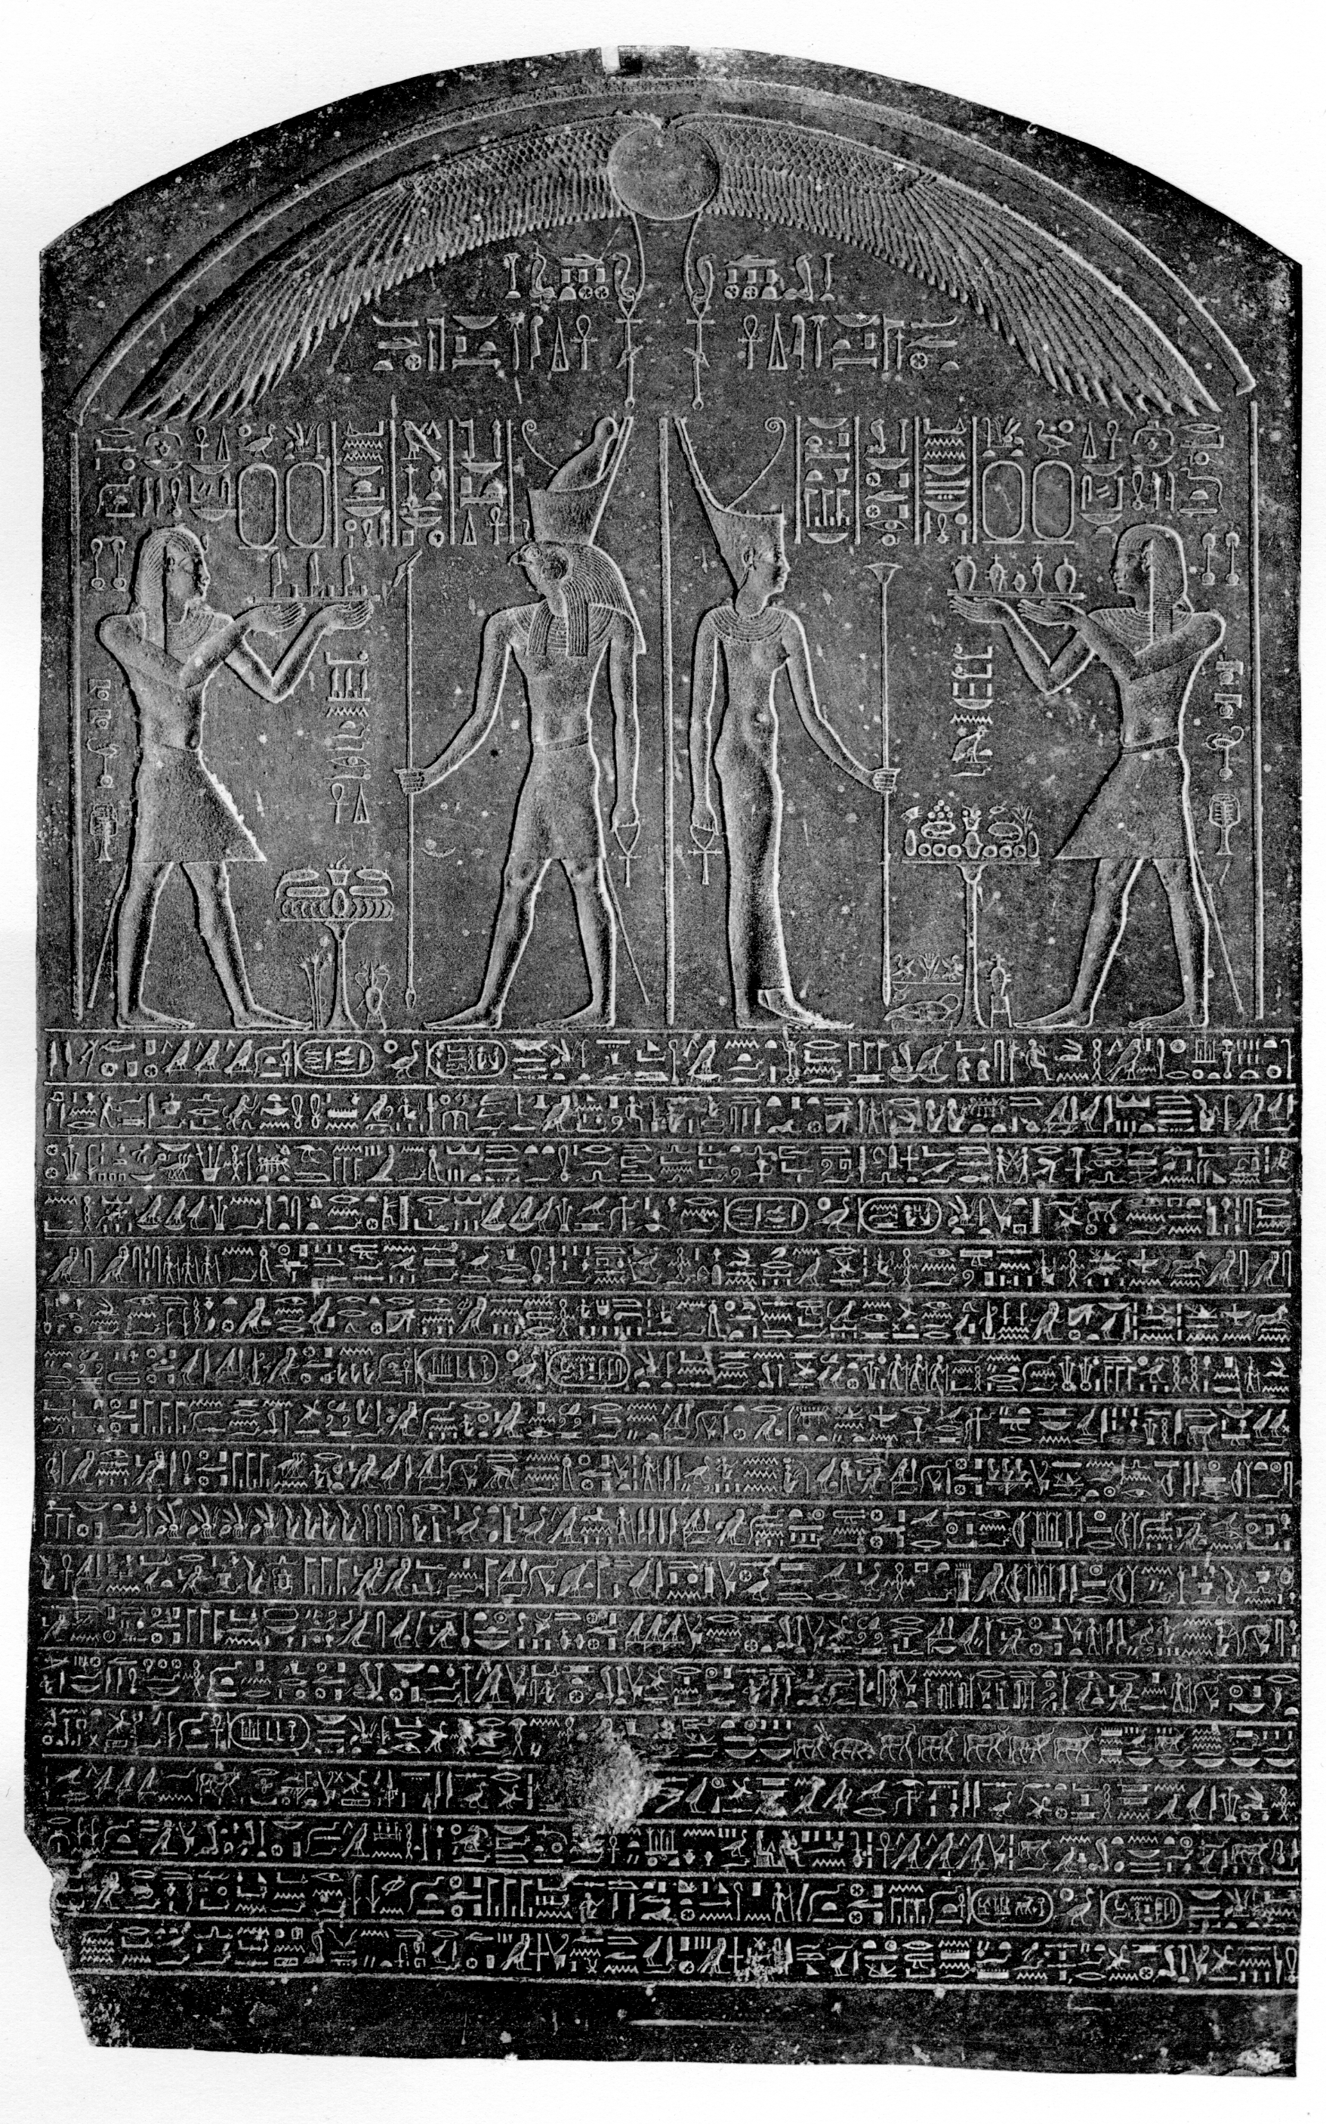
The ‘Satrap Stela’
“Regnal year 7, first month of Inundation season, under the Majesty of the Horus: ‘The youthful one, great of strength;’ The Two Ladies: ‘The beloved of the gods, to whom was given the office of his father;’ The Horus of Gold: ‘The ruler in the entire land;’ the King of Upper and Lower Egypt, Lord of the Two Lands, Haaibre-Setepenamon, the Son of Re, Alexander, living forever, beloved of the gods of Pe and Dep.”

Slide 24
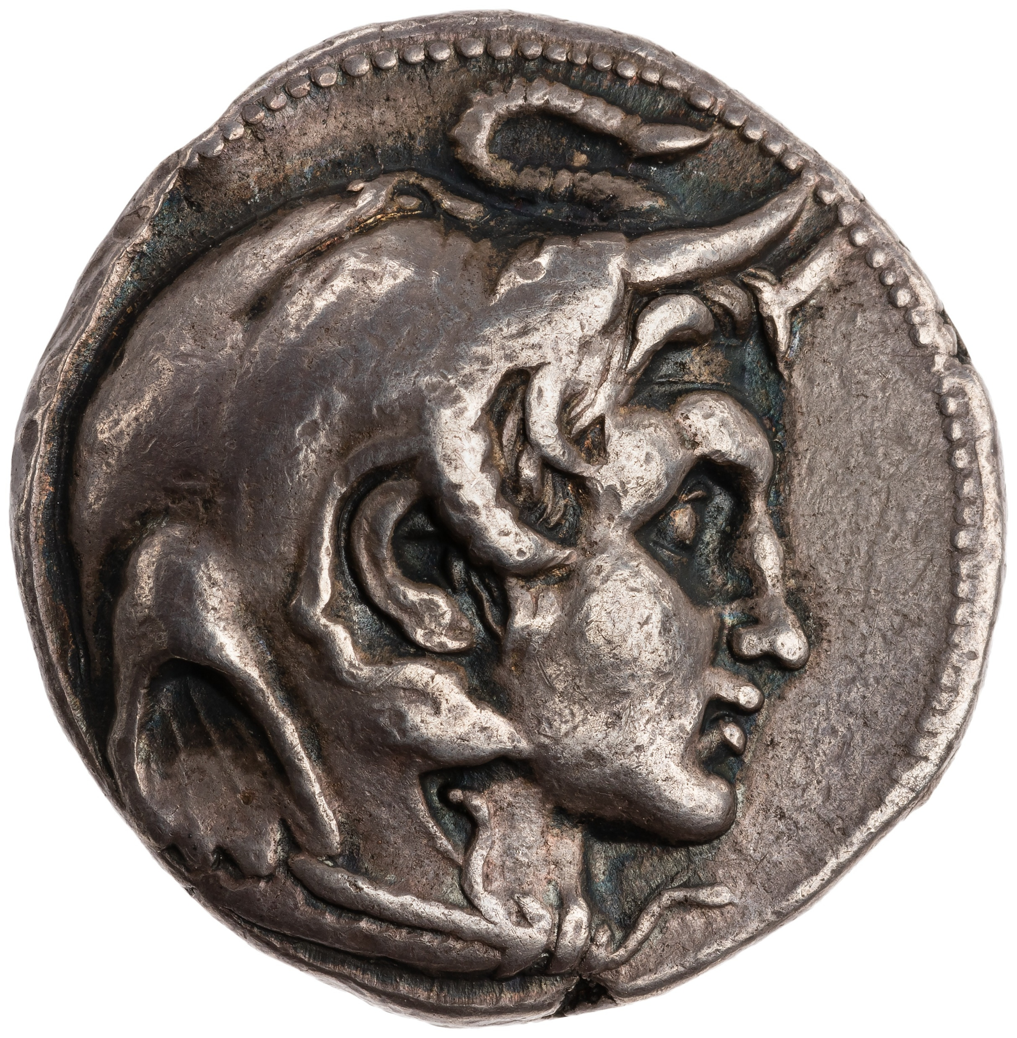
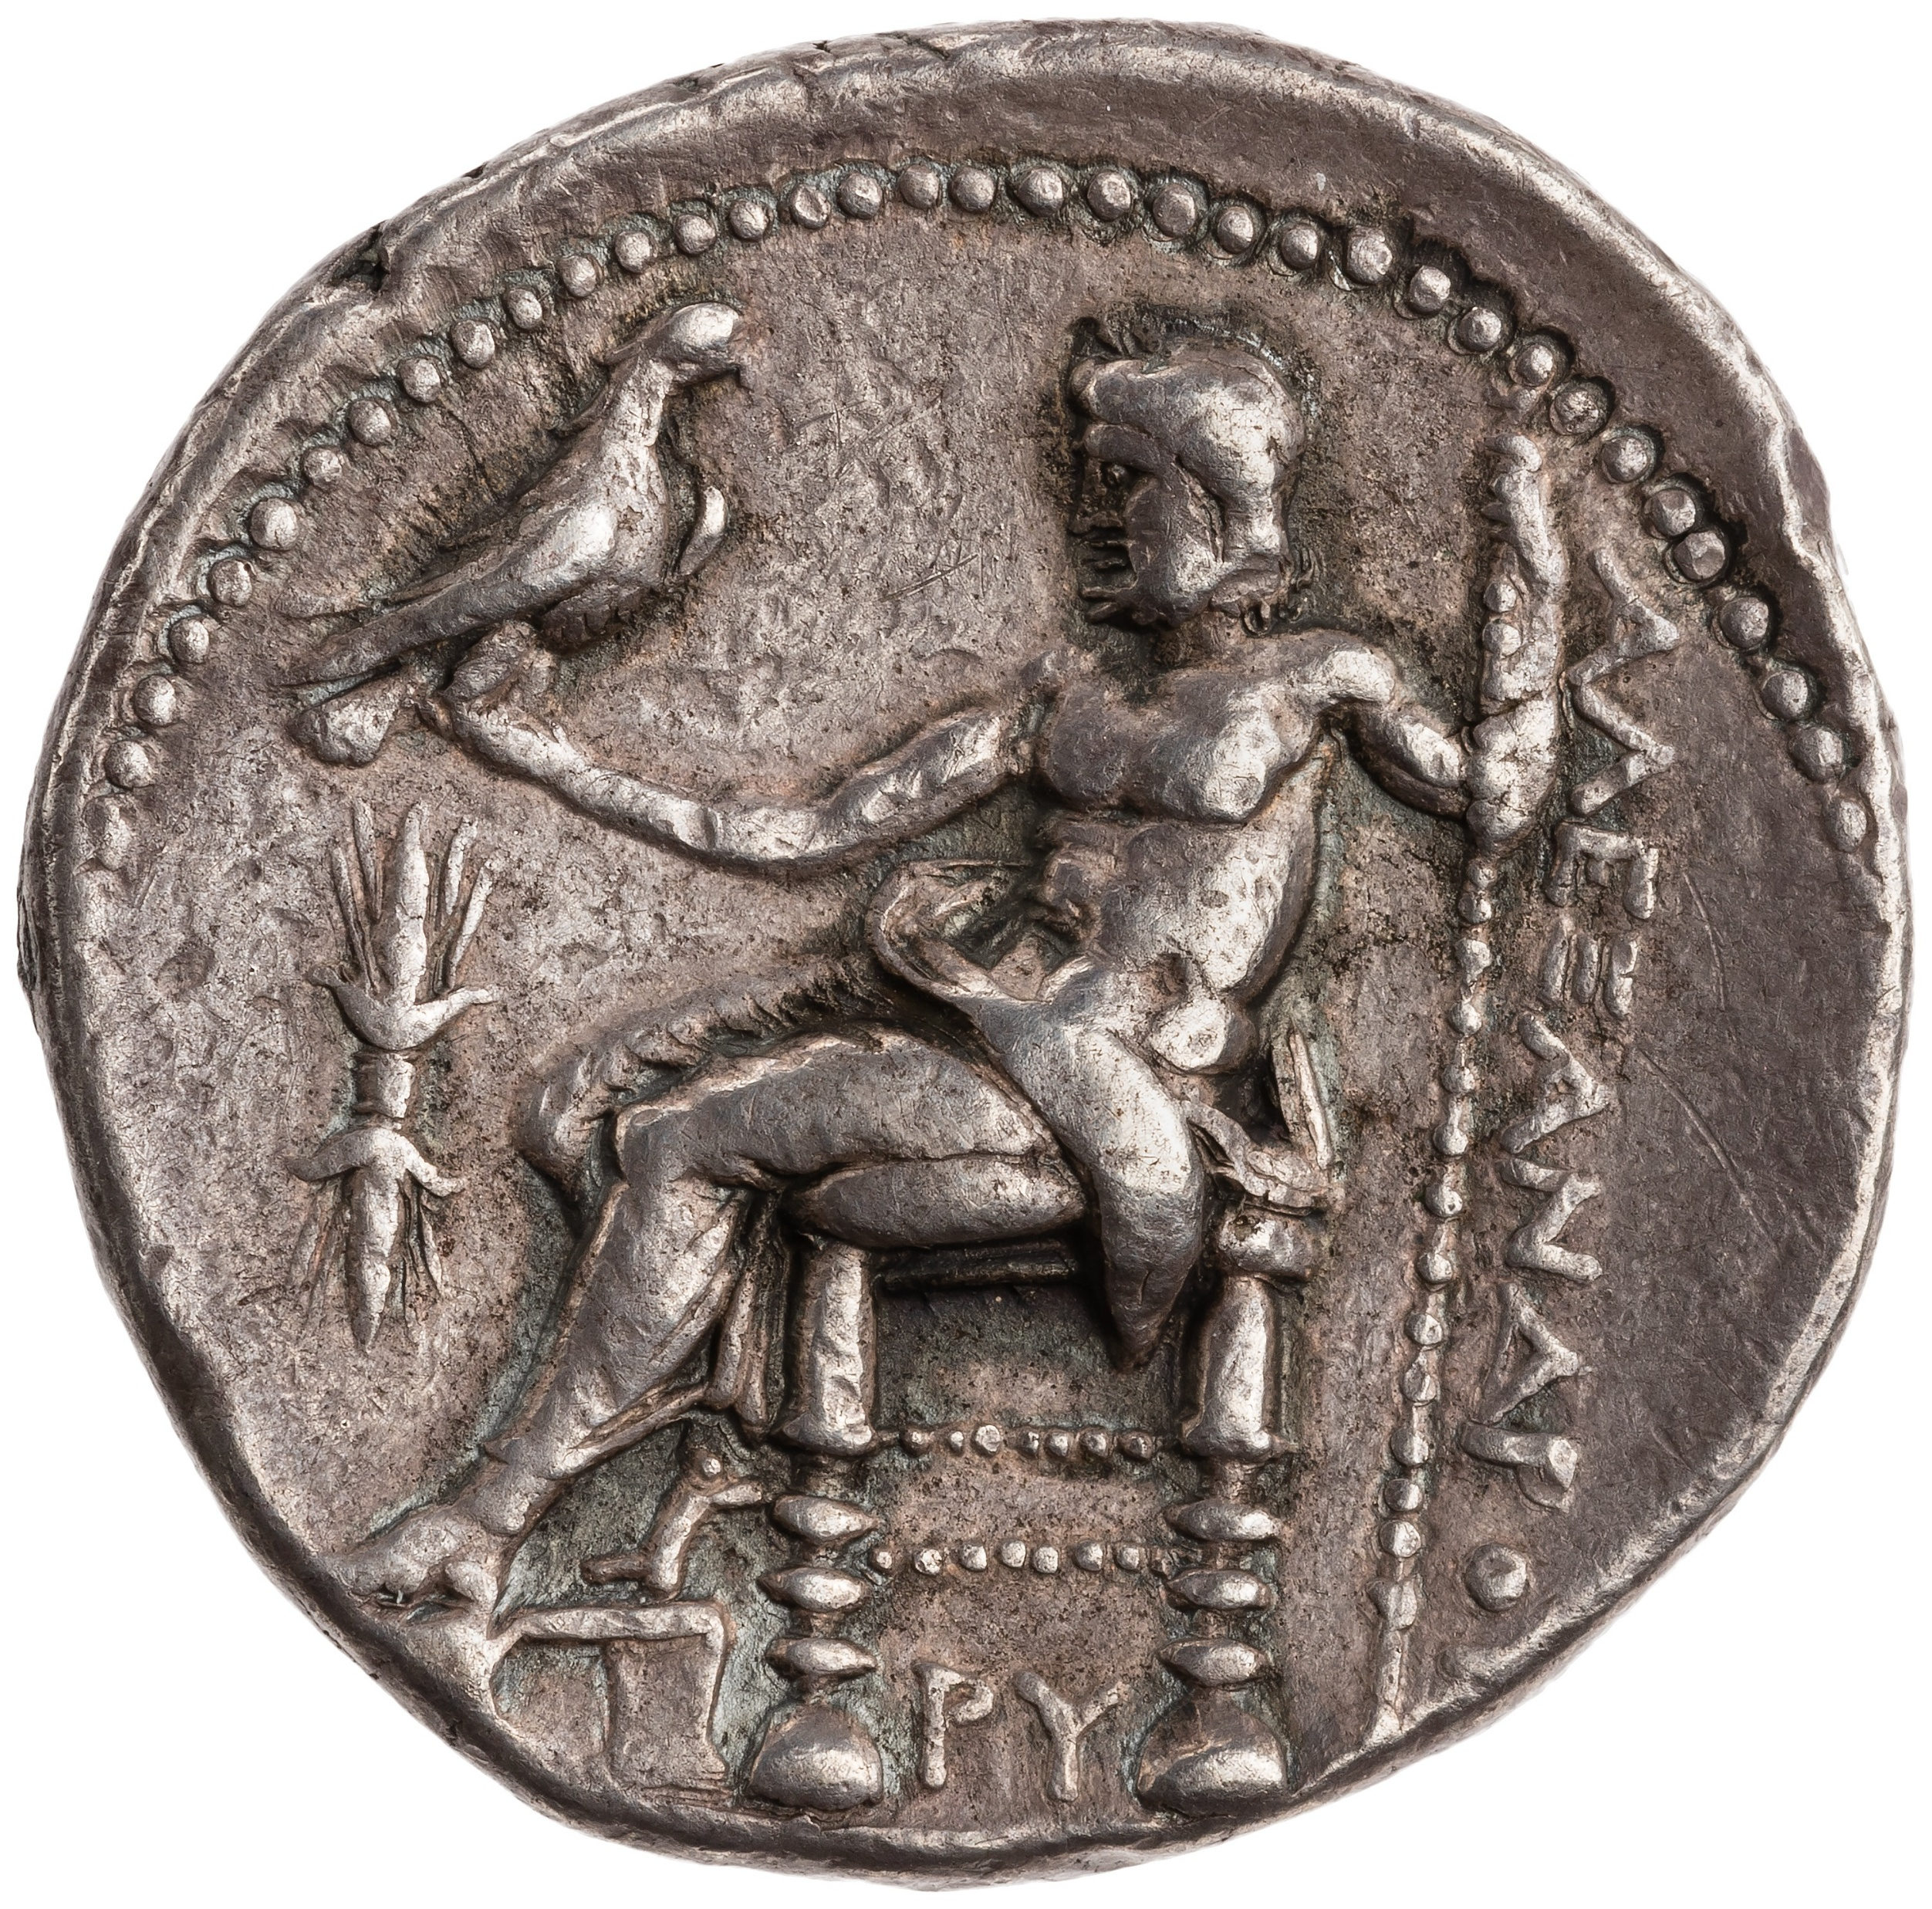
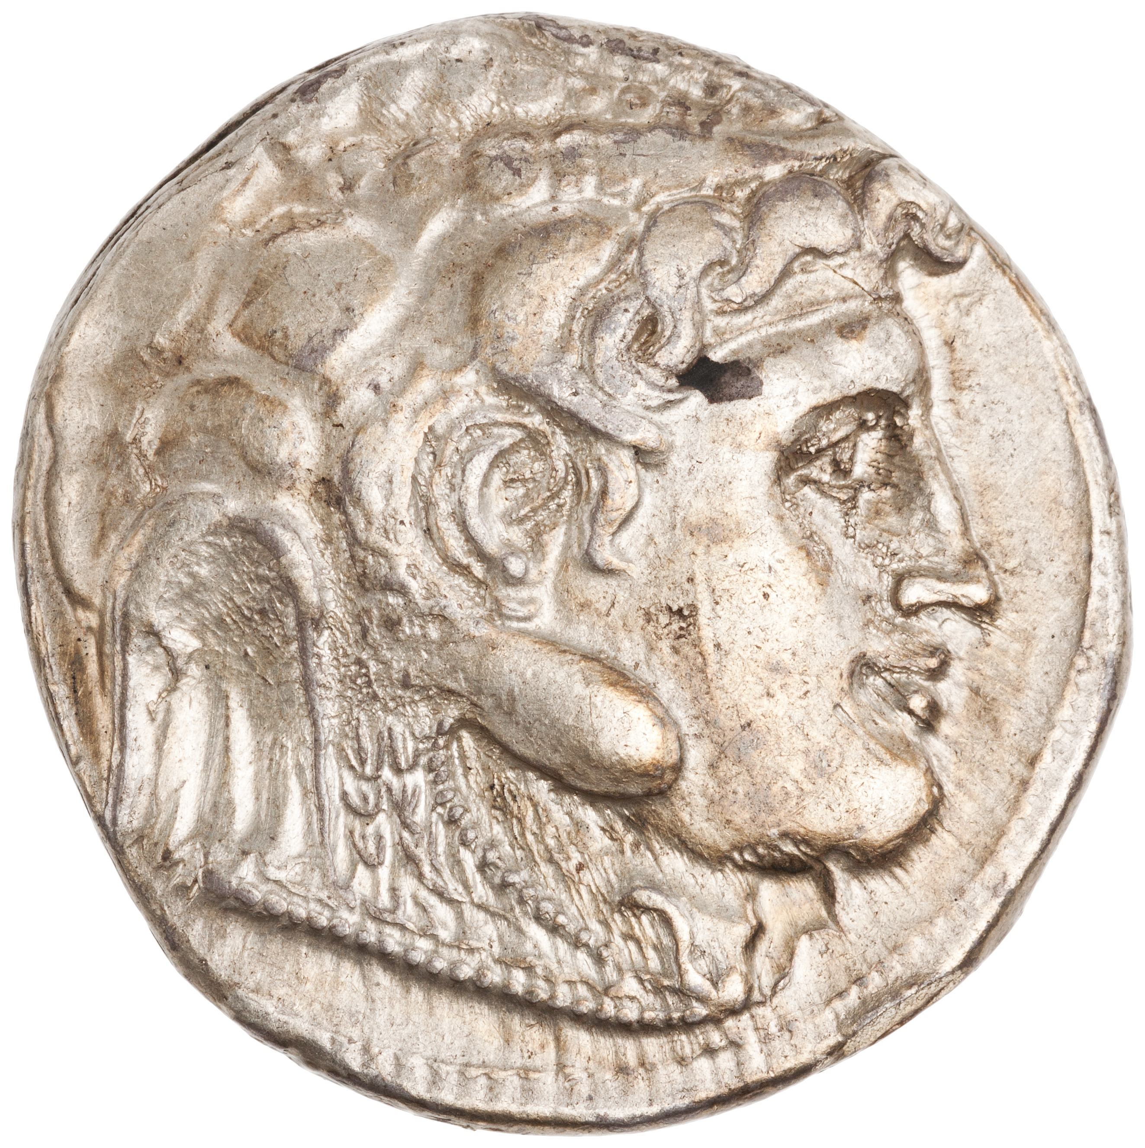
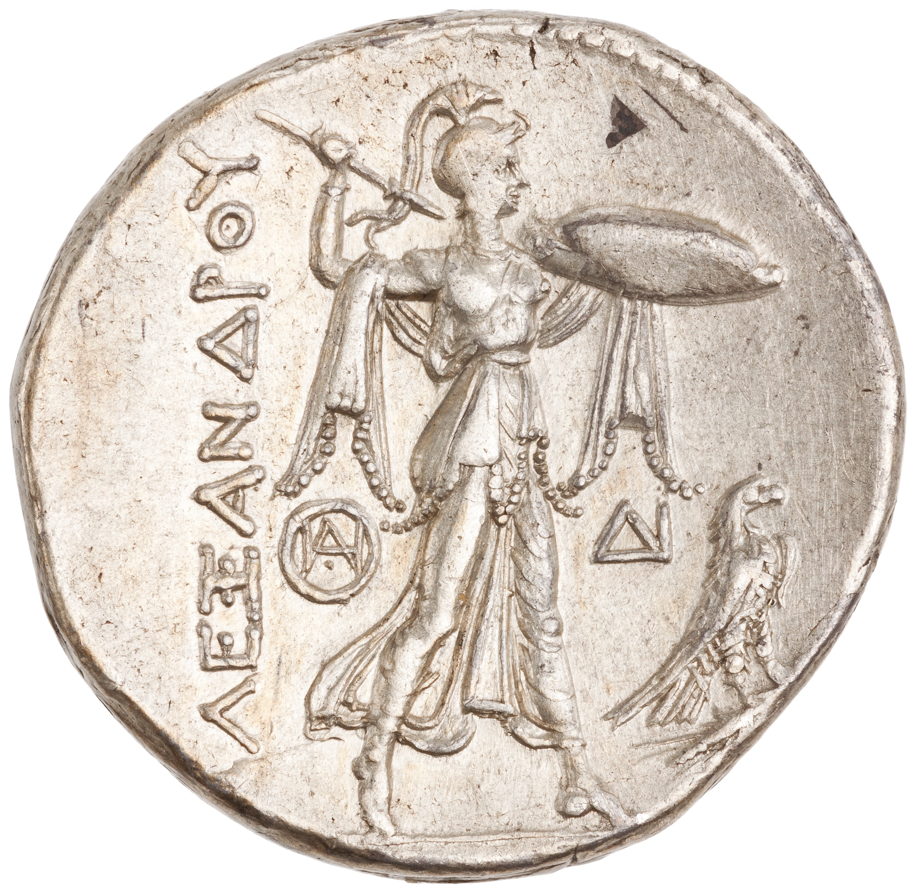
Ptolemy
Silver tetradrachm of Ptolemy I, Alexandria, Egypt, ca. 317-311 BCE; obv.: head of Alexander wearing elephant’s scalp; rev.: Zeus enthroned; legend: ‘of Alexander’
Silver tetradrachm of Ptolemy I, Alexandria, Egypt, ca. 310-295 BCE; obv.: head of Alexander wearing elephant’s scalp; rev.: Athena standing; in front eagle clutching thunderbolt; legend: ‘of Alexander’

Slide 26
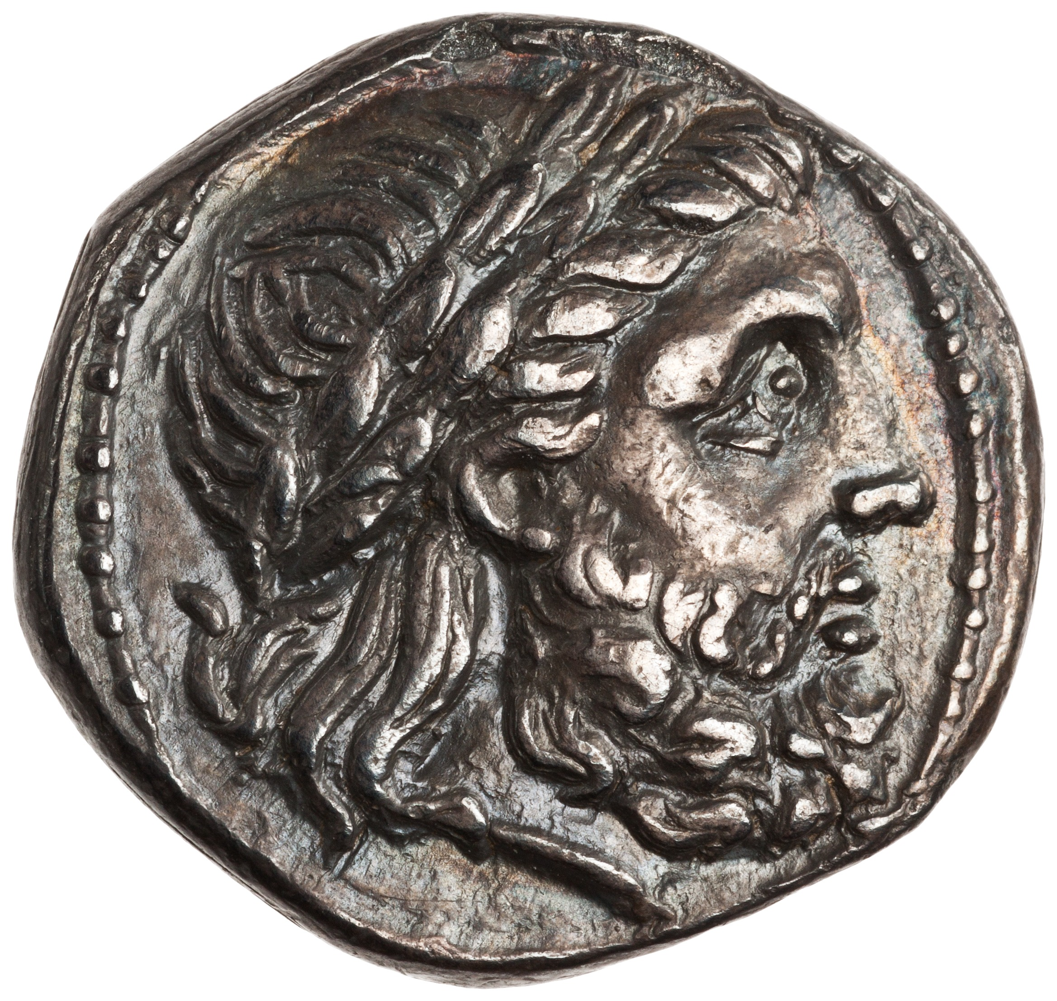
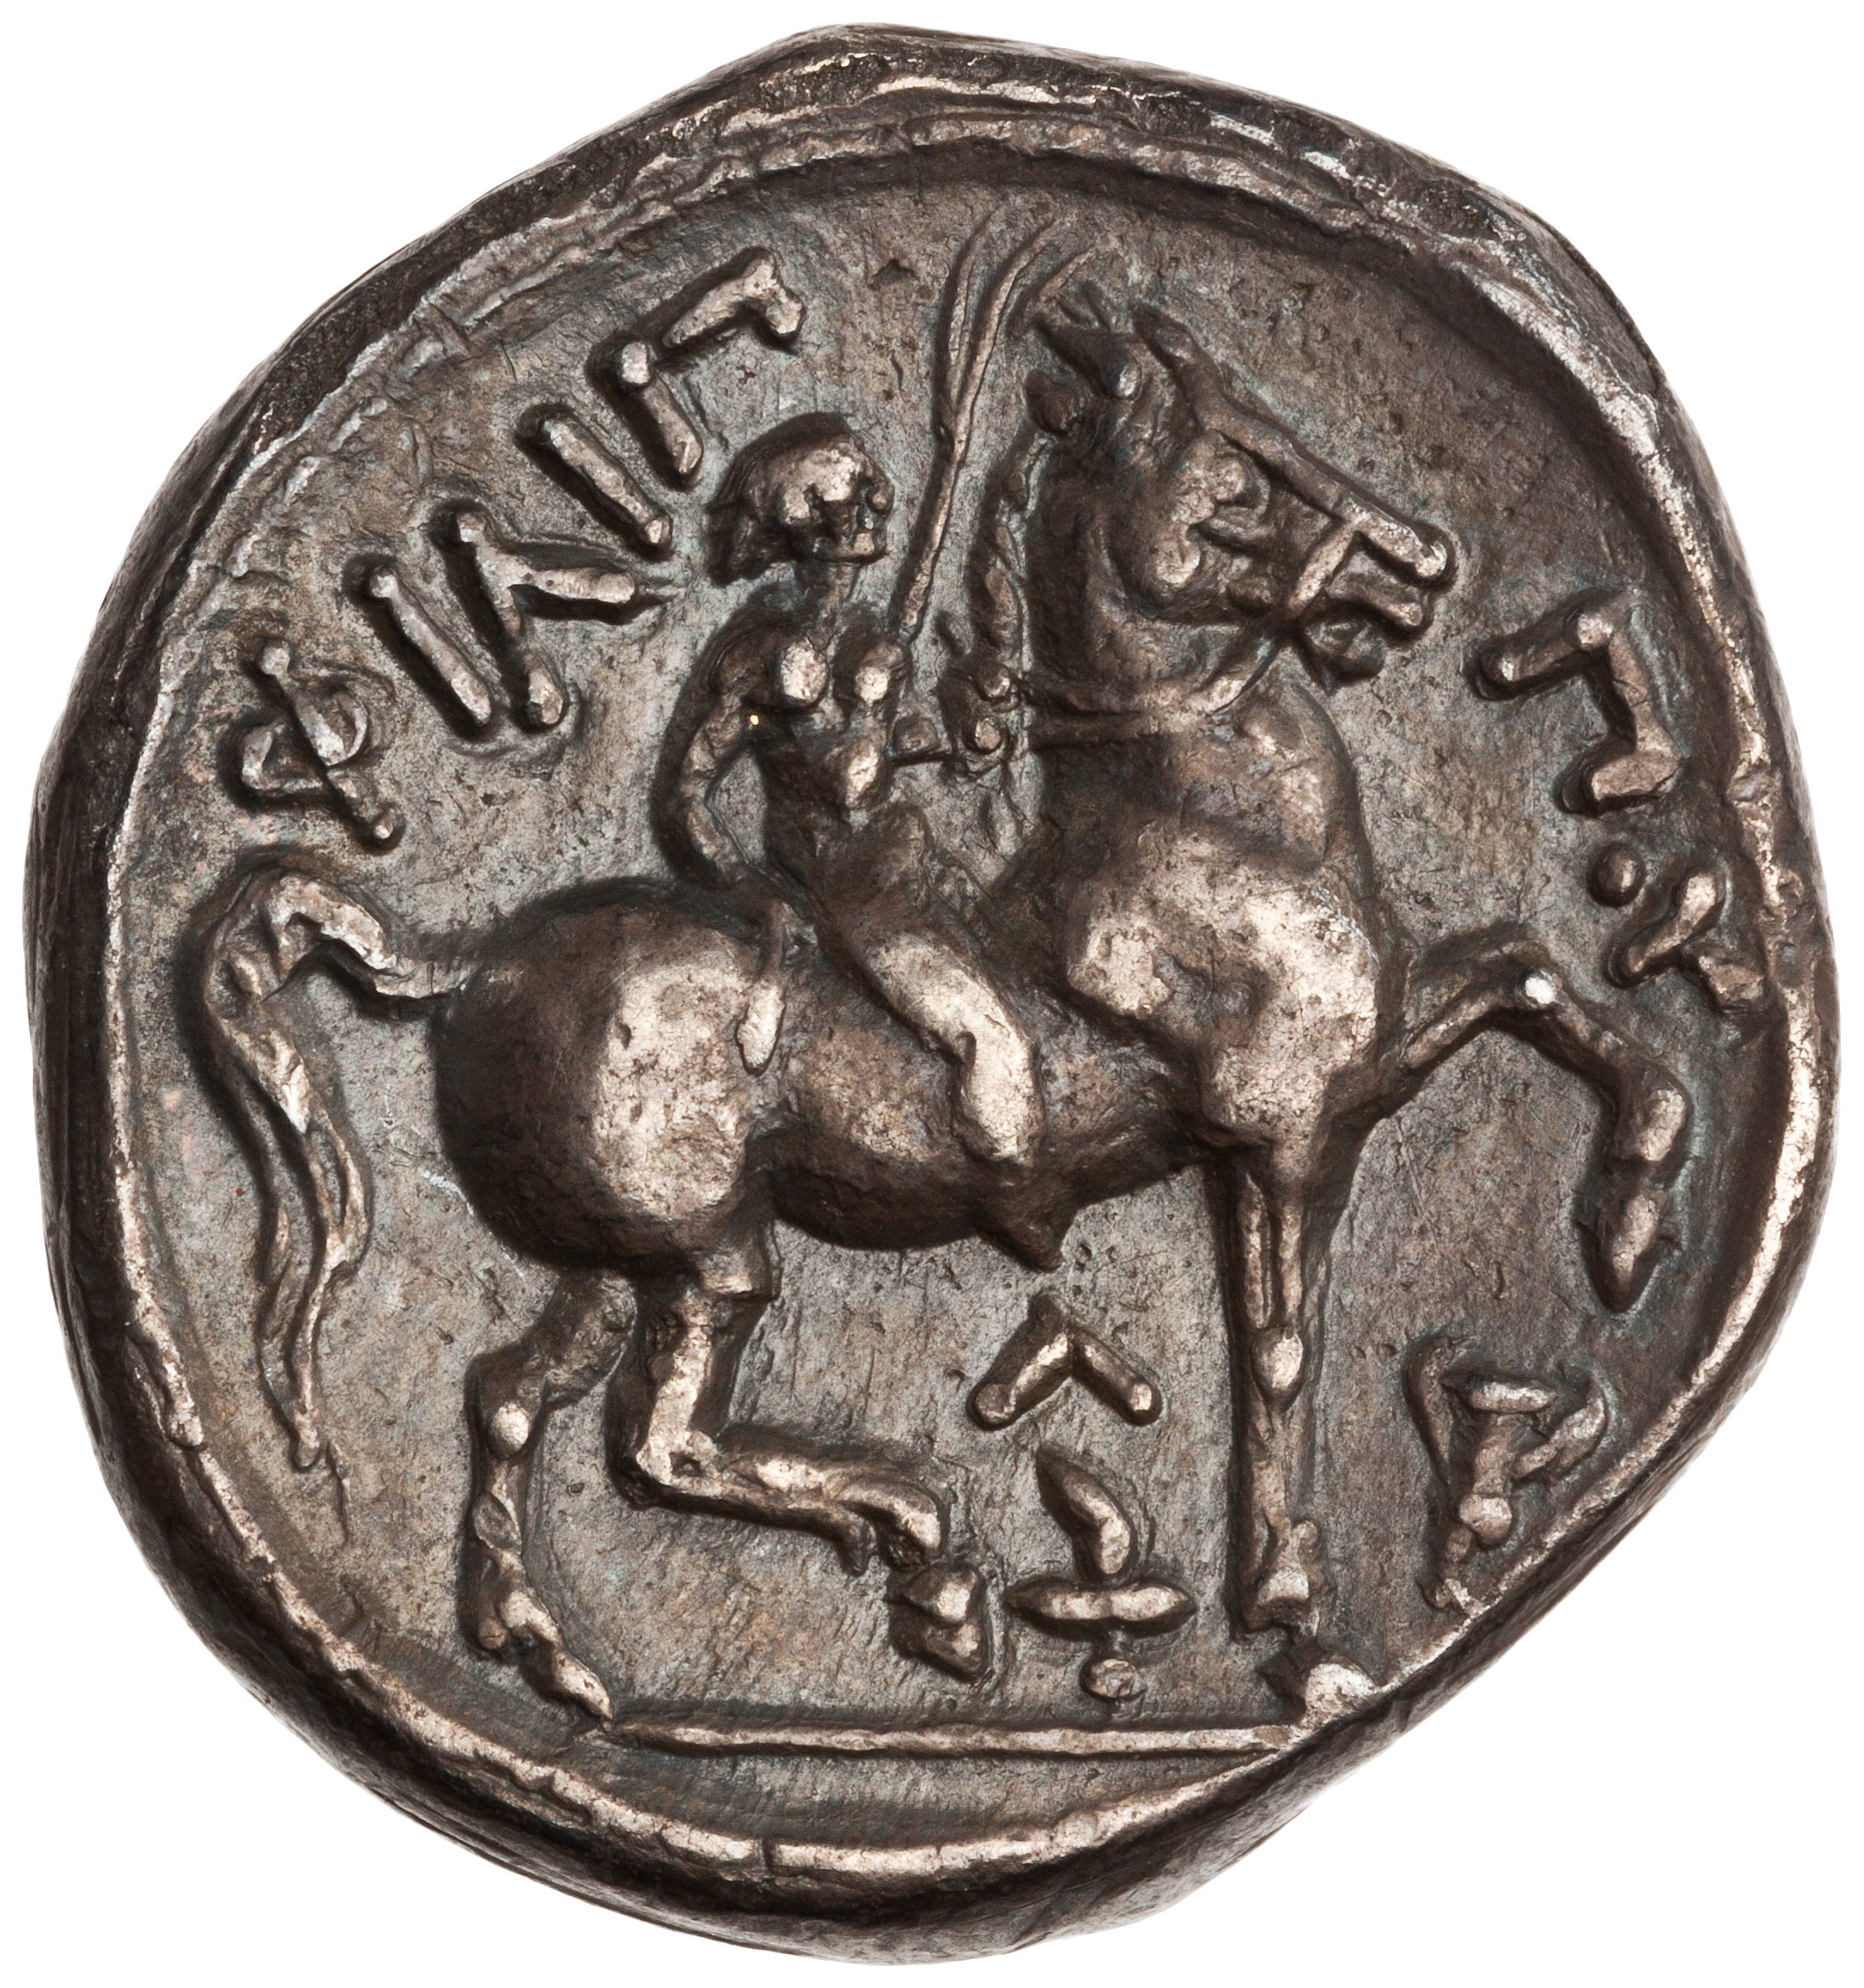
Cassander
ca. 355-297 BCE
Son of Antipater, regent for Alexander IV and Philip III from 320 (Triparadisus) to 319
  Antipater appointed Polyperchon his successor
  Cassander allied with Antigonus, Ptolemy and Lysimachus to oppose Polyperchon
Declares himself King of Macedon (and Greece) in 305
Driven out of southern Greece by Demetrius Poliorcetes in 304
Contributed forces to the Battle of Ipsus in 301
Died in 297
  Succeeded by his sons Alexander V and Antipater II, who were defeated by Demetrius Poliorcetes in 294
Silver tetradrachm of Cassander, Amphipolis, Macedon, ca. 316-295 BCE; obv.: head of Zeus; rev.: rider; legend: ‘of Philip’

Slide 27
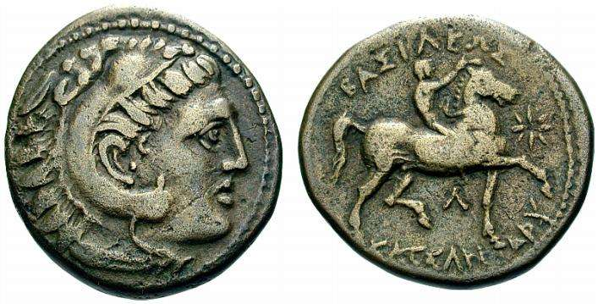
Cassander
Silver tetradrachm of Cassander, Amphipolis, Macedon, ca. 316-295 BCE; obv.: head of Zeus; rev.: rider; legend: ‘of Philip’
Bronze coin of Cassander, Amphipolis, Macedon, ca. 316-297 BCE; obv.: head of Heracles; rev.: rider; legend: ‘of King Cassander’

Slide 29
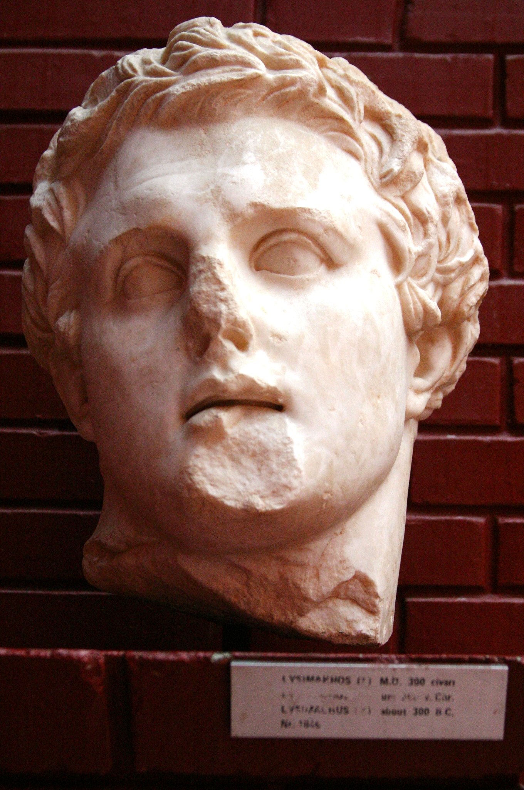
Lysimachus
ca. 360-281 BCE
One of Alexander’s generals
Appointed governor of Thrace in 323
Made himself king of Thrace in 306
  Also western Anatolia from 301
Established his capital at Lysimachia (near modern Bolayır on the Gulf of Saros)
Died in 281 in battle against Seleucus
Bust of Lysimachus, ca. 300 BCE (Ephesus Archaeological Museum)

Slide 30
Lysimachus
“The outward appearance of Alexander is best represented by the statues of him which Lysippus made, and it was by this artist alone that Alexander himself thought it fit that he should be modelled. For those peculiarities which many of his successors and friends afterwards tried to imitate, namely, the poise of the neck, which was bent slightly to the left, and the melting glance of his eyes, this artist has accurately observed.”
- Plutarch, Alexander 4.1
Bust of Lysimachus, ca. 300 BCE (Ephesus Archaeological Museum)

Slide 31
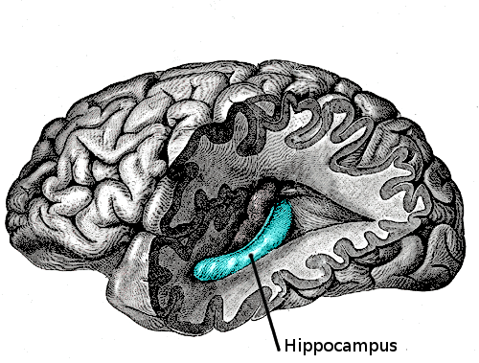
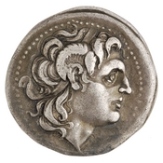
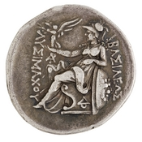
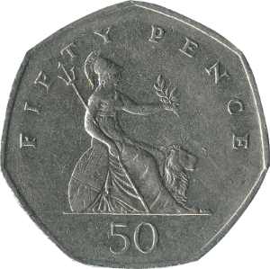
Lysimachus
*
Hippocampus = ‘cornu ammonis’
Silver tetradrachm of Lysimachus, Lysimachia, Thrace, ca. 297-281 BCE; obv.: head of Alexander, wearing horn of Ammon; rev.: Athena seated, holding winged Nike; legend: ‘Of King Lysimachus’
British 50 pence coin

Slide 32
Amun
“At this point Alexander was seized with a longing to visit Ammon in Libya; his intention was to consult with the god, as the oracle of Ammon was reputed to be truthful and it was said that Perseus and Heracles had consulted it…Alexander wanted to rival Perseus and Heracles, since he was descended from them both, and was also seeking to trace his birth back to Ammon, just as mythology traces that of Heracles and Perseus back to Zeus. He therefore set out for Ammon in this frame of mind, with the intention of finding out more exactly about his origins, or of claiming he had found out.”
- Arrian, Anabasis 3.3

Slide 34
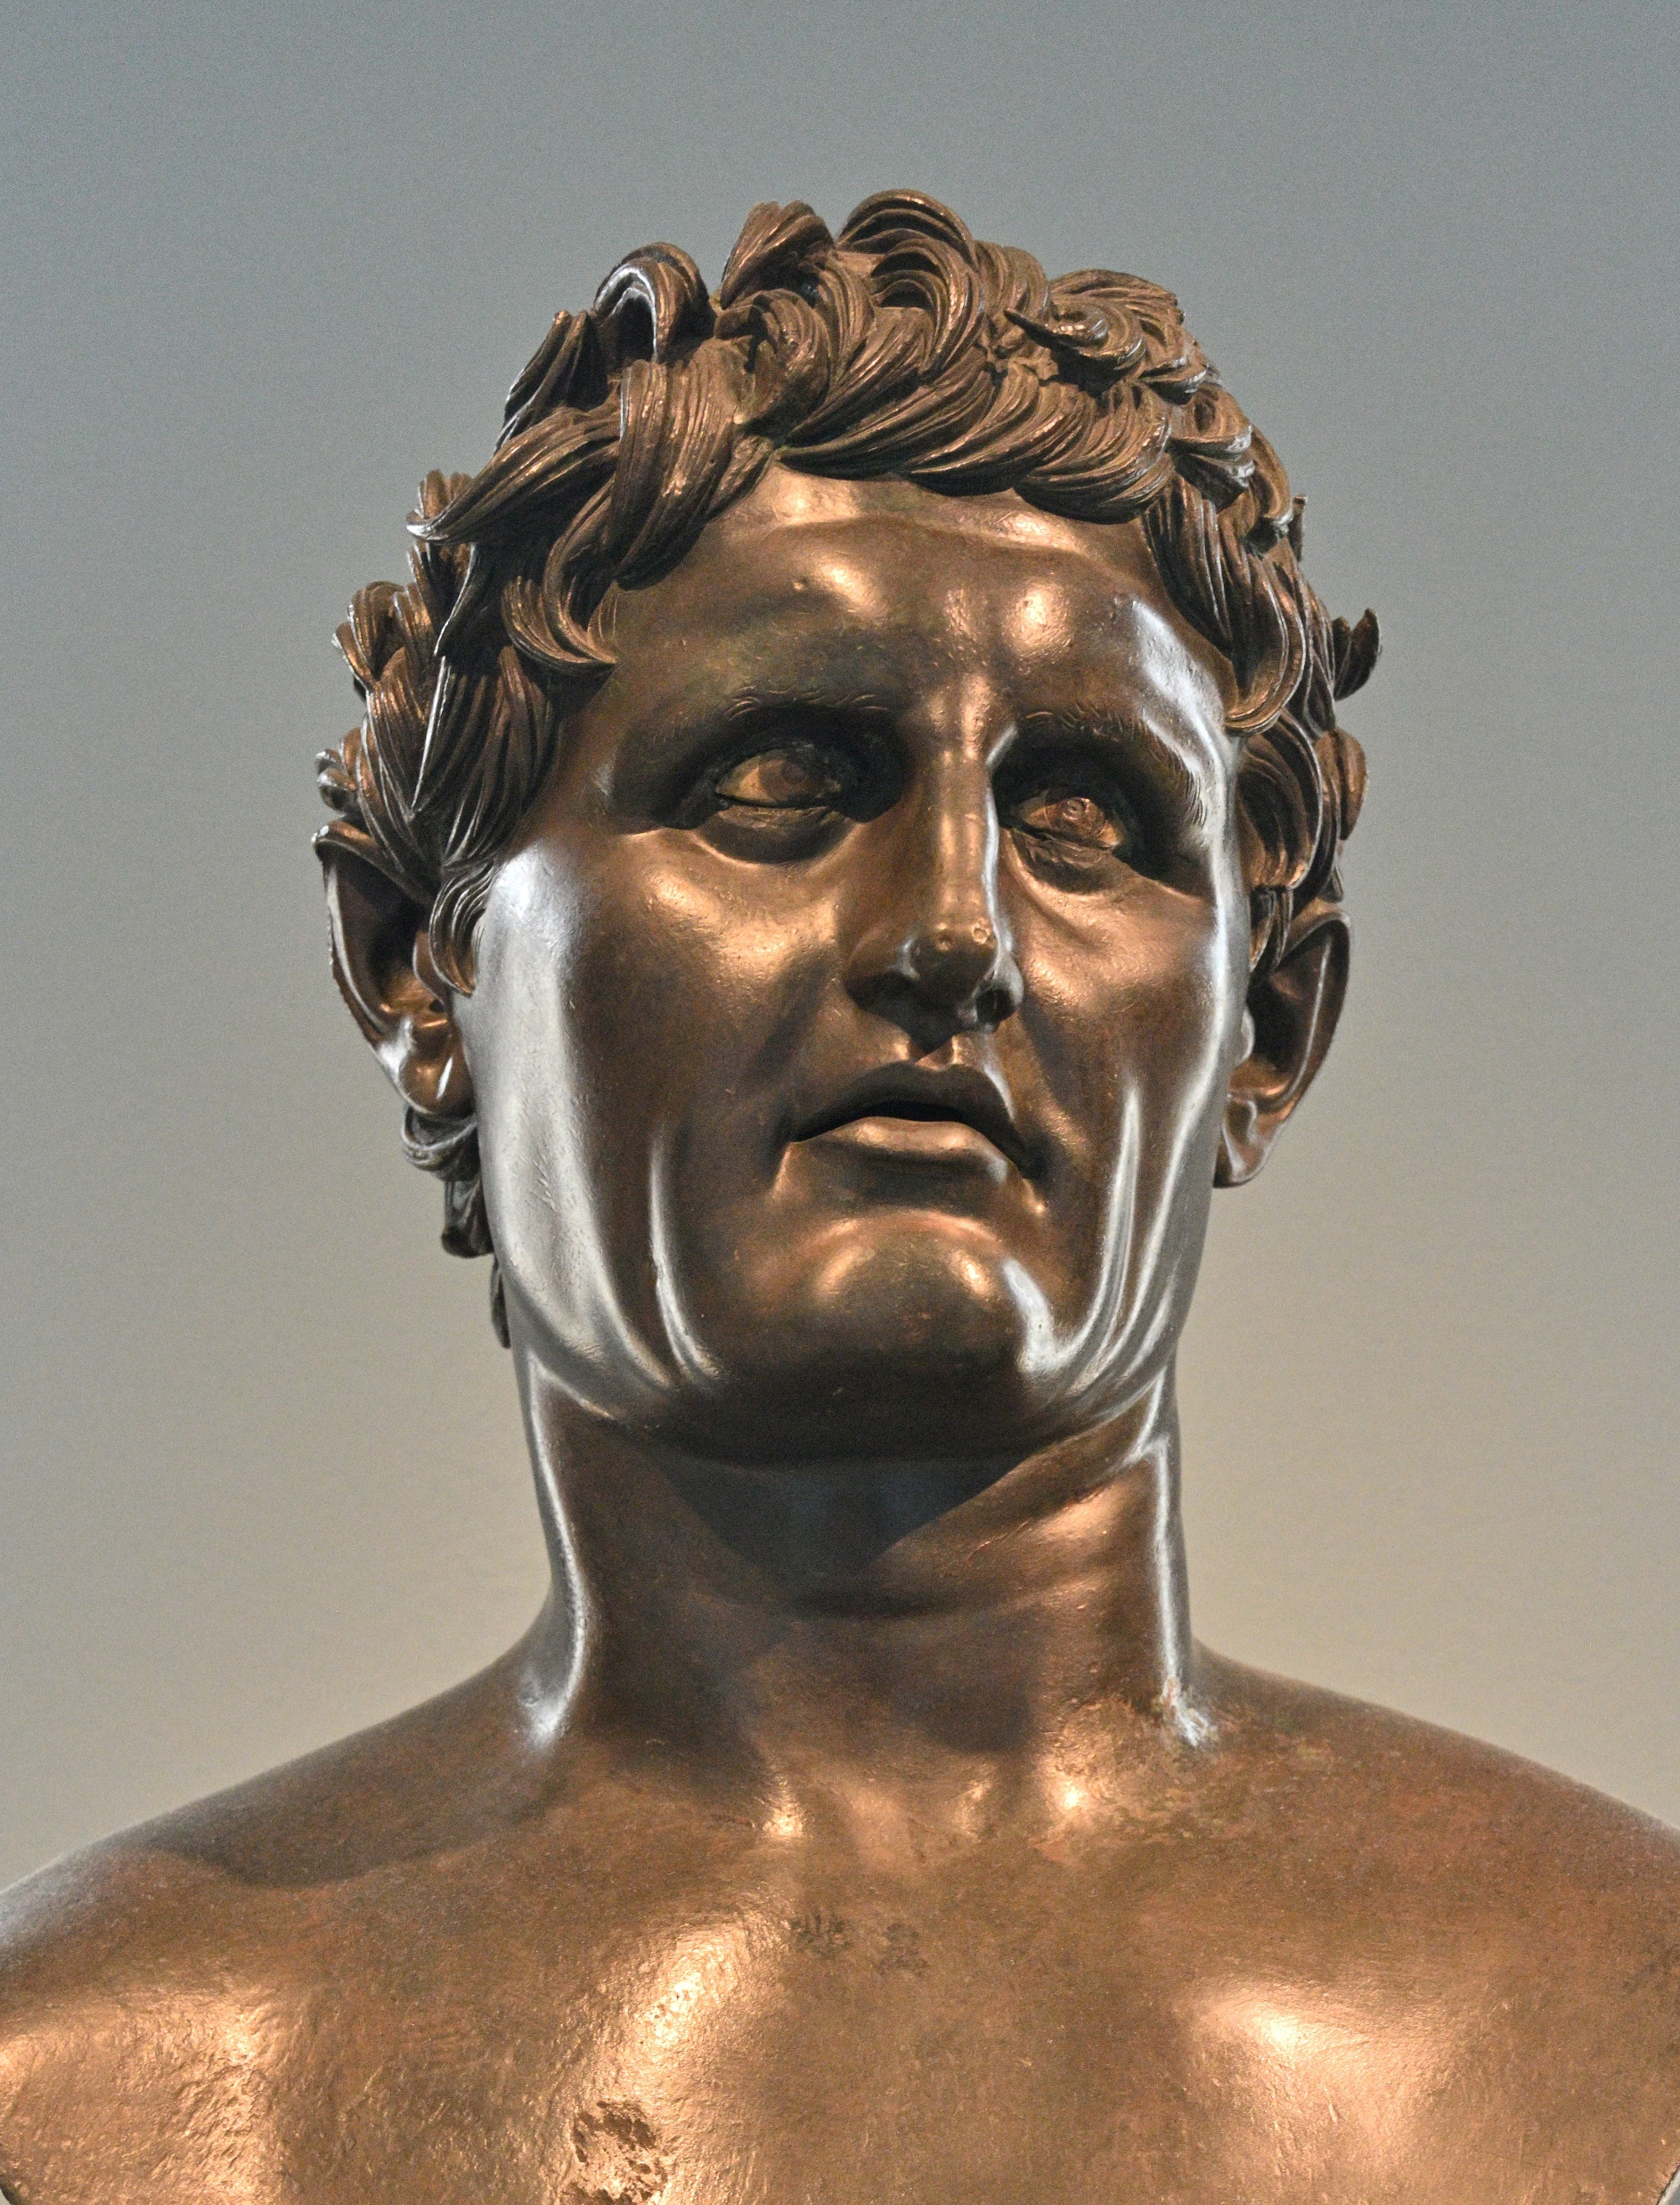
Seleucus
ca. 358-281 BCE
Macedonian military officer
Originally supported Perdiccas, but rebelled against him in 321
Given control of Babylon in the Partition of Triparadisus in 320
Driven out of Babylon by Antigonus in 315; reconquered it in 312 with Ptolemaic support
Declared himself king in 306
Founded a new capital at Seleucia-on-the-Tigris (near modern Baghdad)
Allied with Cassander and Lysimachus against Antigonus at Ipsus in 301
Defeated and captured Demetrius Poliorcetes in 286
Defeated and killed Lysimachus in 281
Assassinated by Ptolemy Ceraunus in 281
  Last of the Successors to have lived in Alexander’s lifetime
Roman bronze statue of Seleucus from Herculaneum (Naples National Archaeological Museum)

Slide 35
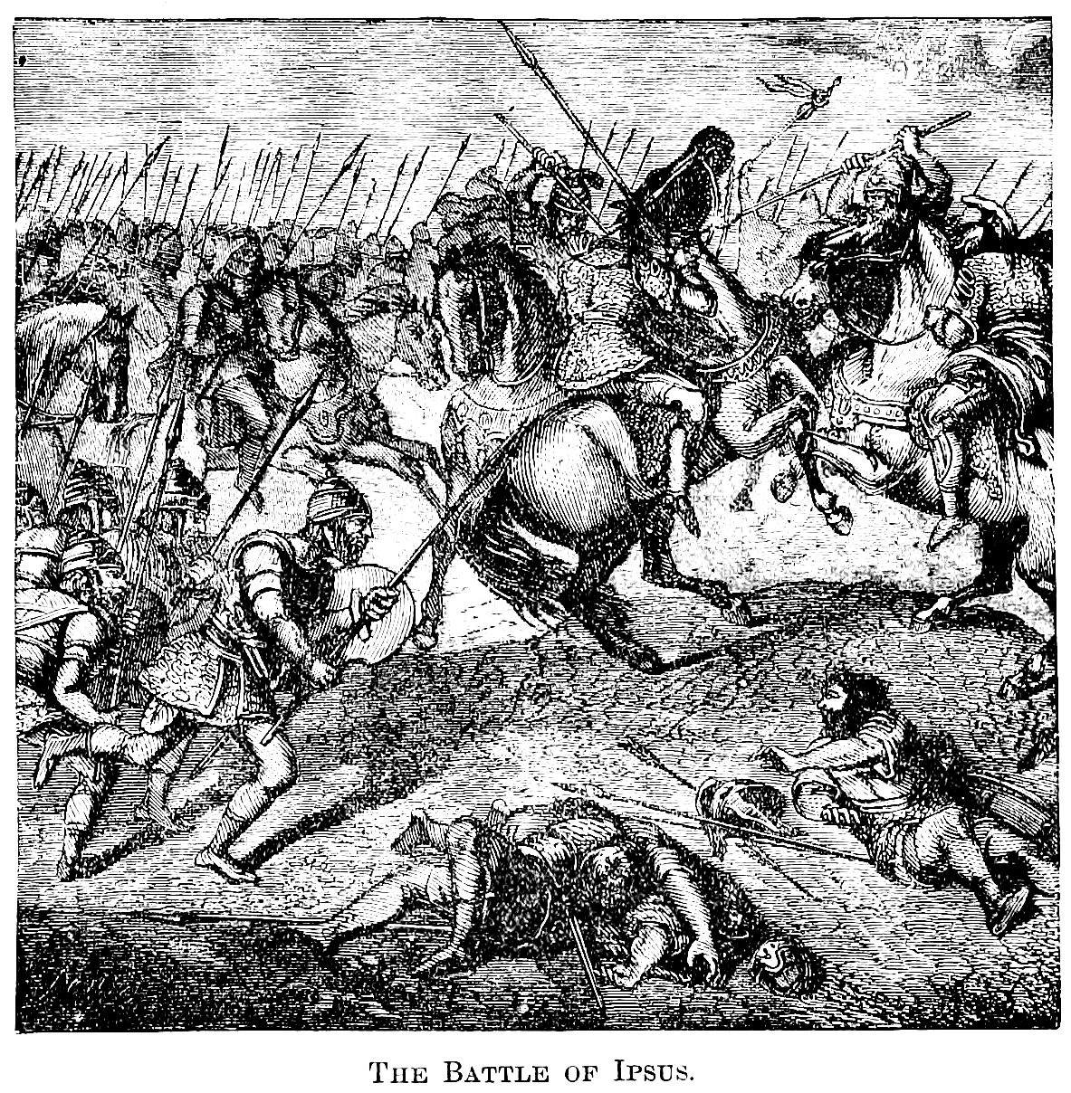
Battle of Ipsus (301)
Fought near modern Çayırbağ, western Turkey
  A major producer of pickles, apparently
Fought between Antigonus and Demetrius on one side, and Cassander, Lysimachus and Seleucus on the other
Antigonus died in battle; Demetrius fled to Greece
The Battle of Ipsus as imagined by a 19th century artist

Slide 36
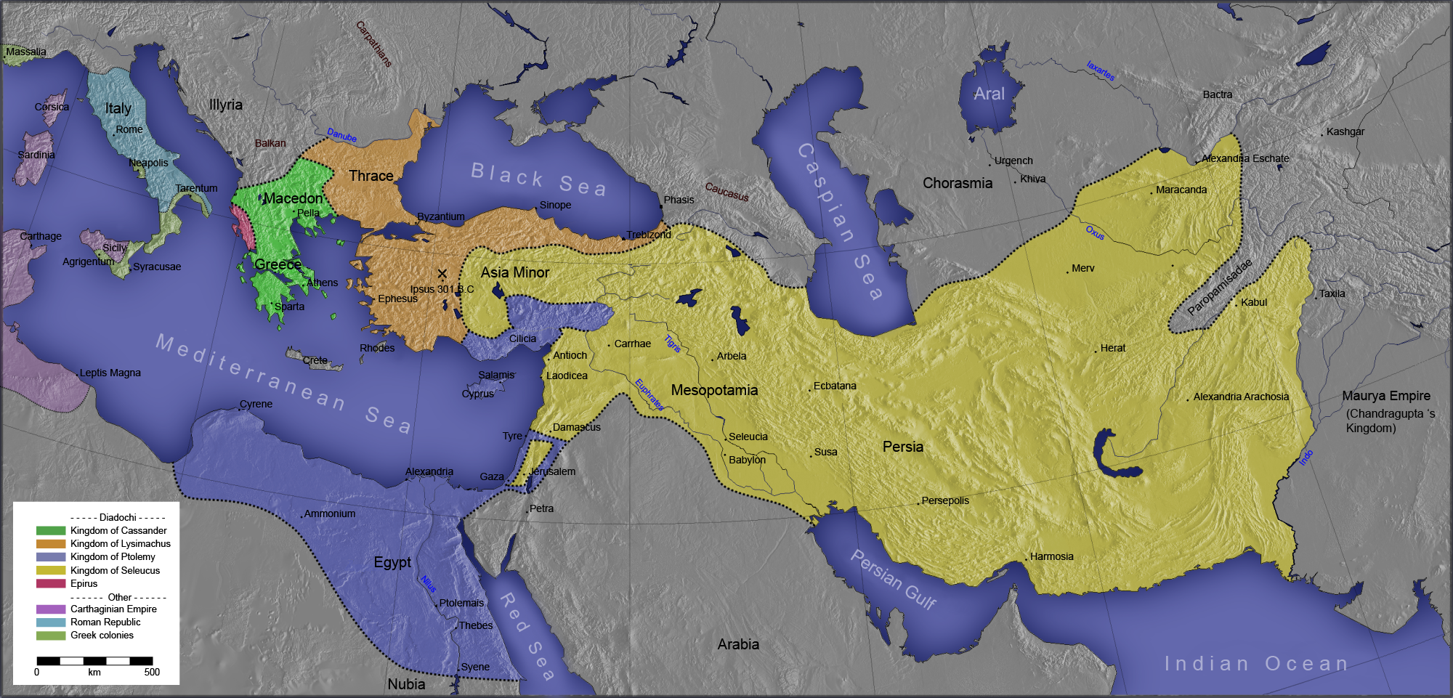

Slide 37
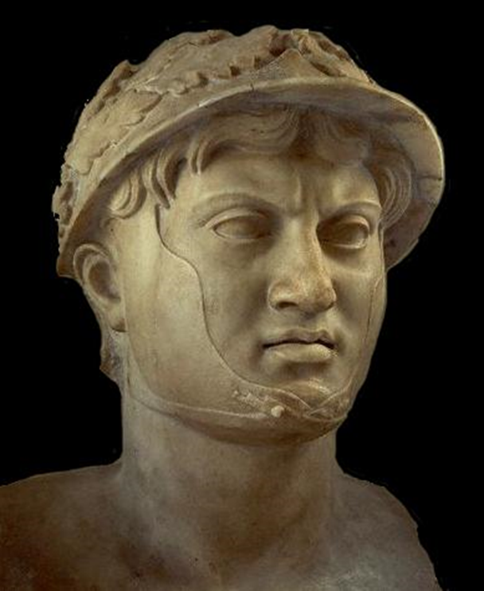
Pyrrhus of Epirus
317-272 BCE
Alexander’s cousin
King of Epirus, west of Macedonia
Invaded Magna Graecia; later tried to conquer Macedonia and Sparta
Died in Argos when an old woman dropped a roof tile on his head
Roman bust of Pyrrhus, 1st cen. CE
(National Archaeological Museum of Naples)

Slide 38
Pyrrhus of Epirus
“If we are victorious in one more battle with the Romans, we shall be utterly ruined.”
- Plutarch, Life of Pyrrhus 21

Slide 39
Pyrrhus of Epirus
“The outward appearance of Alexander is best represented by the statues of him which Lysippus made, and it was by this artist alone that Alexander himself thought it fit that he should be modelled. For those peculiarities which many of his successors and friends afterwards tried to imitate, namely, the poise of the neck, which was bent slightly to the left, and the melting glance of his eyes, this artist has accurately observed.”
- Plutarch, Alexander 4.1
Roman bust of Pyrrhus, 1st cen. CE
(National Archaeological Museum of Naples)

Slide 40

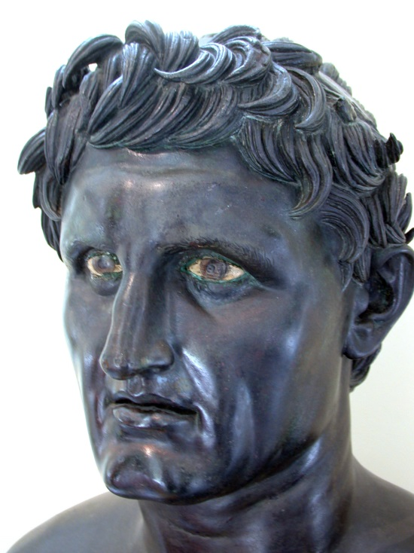
The Successors
Ptolemaic Kingdom
(Egypt)
Seleucid Empire
(Middle East)
Elsewhere
Kingdom of Macedonia
Included most of mainland Greece
(ruled by the Antigonid dynasty)
Kingdom of Epirus
Included parts of northwestern Greece
(most famous king was Pyrrhus)
Kingdom of Thrace
Northern Greece and western Asia Minor
(ruled by Lysimachus)
Attalid Kingdom
Based in Pergamum in Asia Minor
(kings named ‘Attalus’ and ‘Eumenes’)
Greco-Bactrian Kingdom
Central Asia and northern India
Kings named ‘Ptolemy’
Kings named ‘Seleucus’ and ‘Antiochus’

Slide 41
Today’s People
Alexander the Great
Alexander IV (son of Alexander the Great)
Philip III Arrhidaeus (half-brother of Alexander the Great)
Antigonus I Monophthalmus (king of Anatolia, Cyprus, Syria and southern Greece)
Demetrius Poliorcetes (son of Antigonus, king of Greece)
Ptolemy (king of Egypt)
Cassander (king of Macedon)
Lysimachus (king of Thrace)
Seleucus (king of Mesopotamia, Syria, Iran and further east)
Pyrrhus (king of Epirus)

