Slide 1
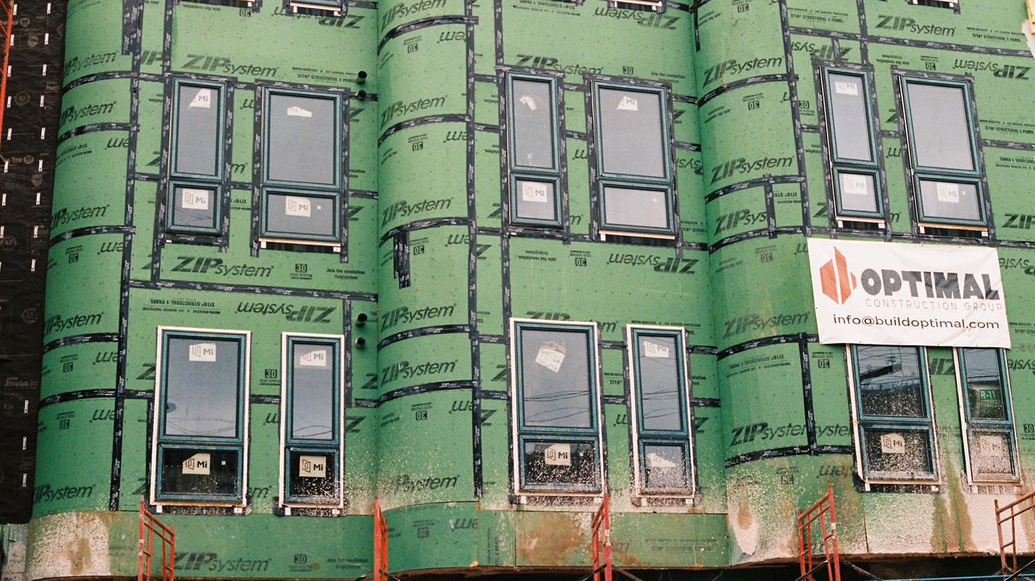
Gentrification (CITY B207)
Dr. Stanley Collins, Ph.D.

Slide 2
Agenda
Recap
Warm up: Neoliberalism
Discussing the readings
Wrap up
For Next Class

Slide 3
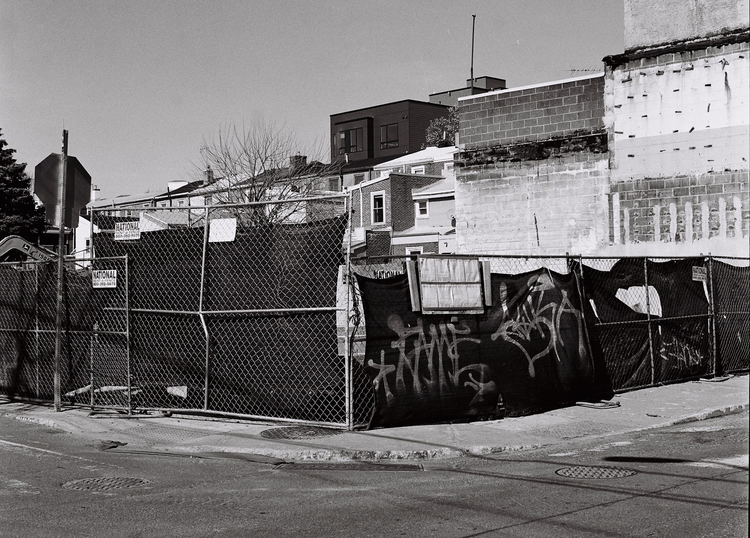
RECAP Gentrification: evolution of a concept
Gentrification is typically associated with:
  Generalized upscaling
  Appropriation by elites of something once belonged to working class, particularly ethnic and racial minorities
  The loss of authenticity and community
  Involuntary change
Gentrification no longer narrowly refers to urban residential change – we now have a more flexible and nimble evocations of the term that are increasingly detached from urban political-economic transformation

Slide 4
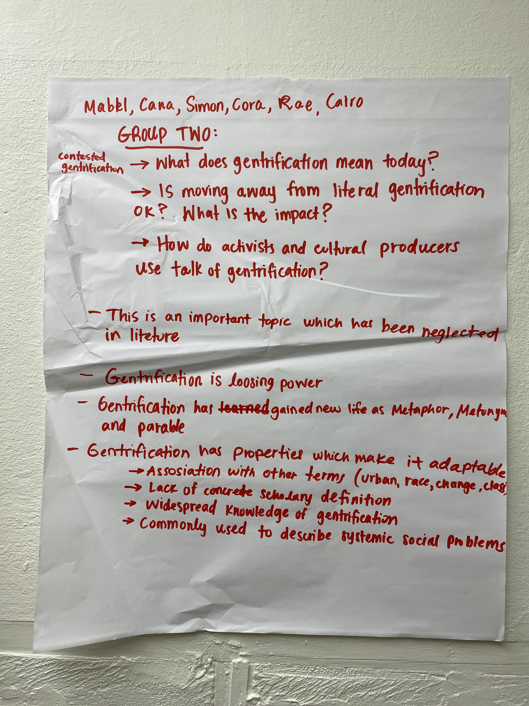
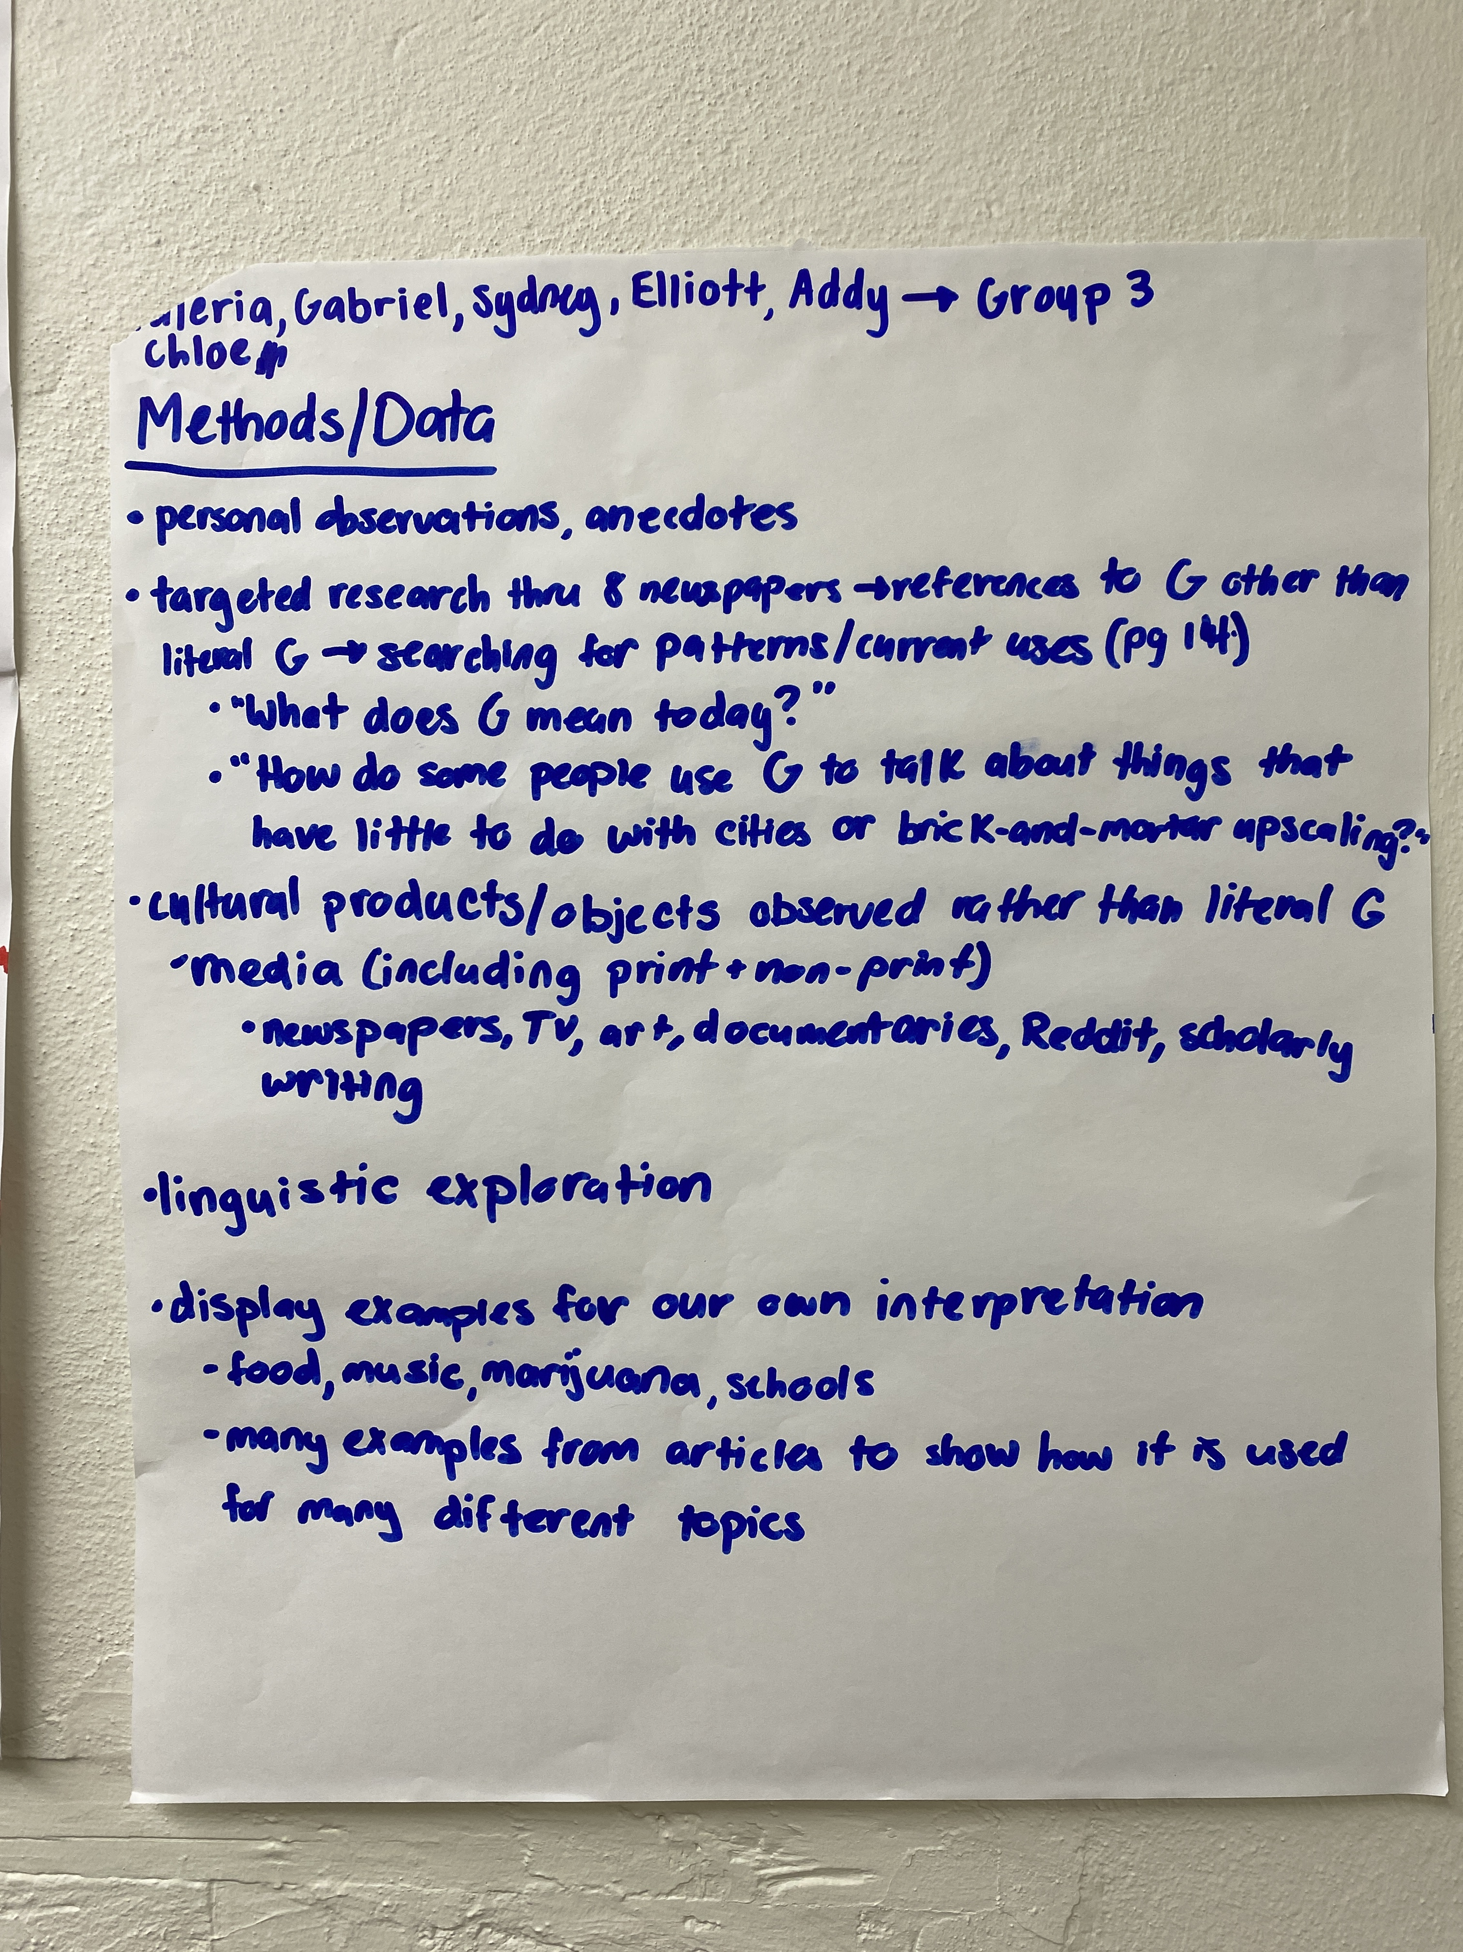
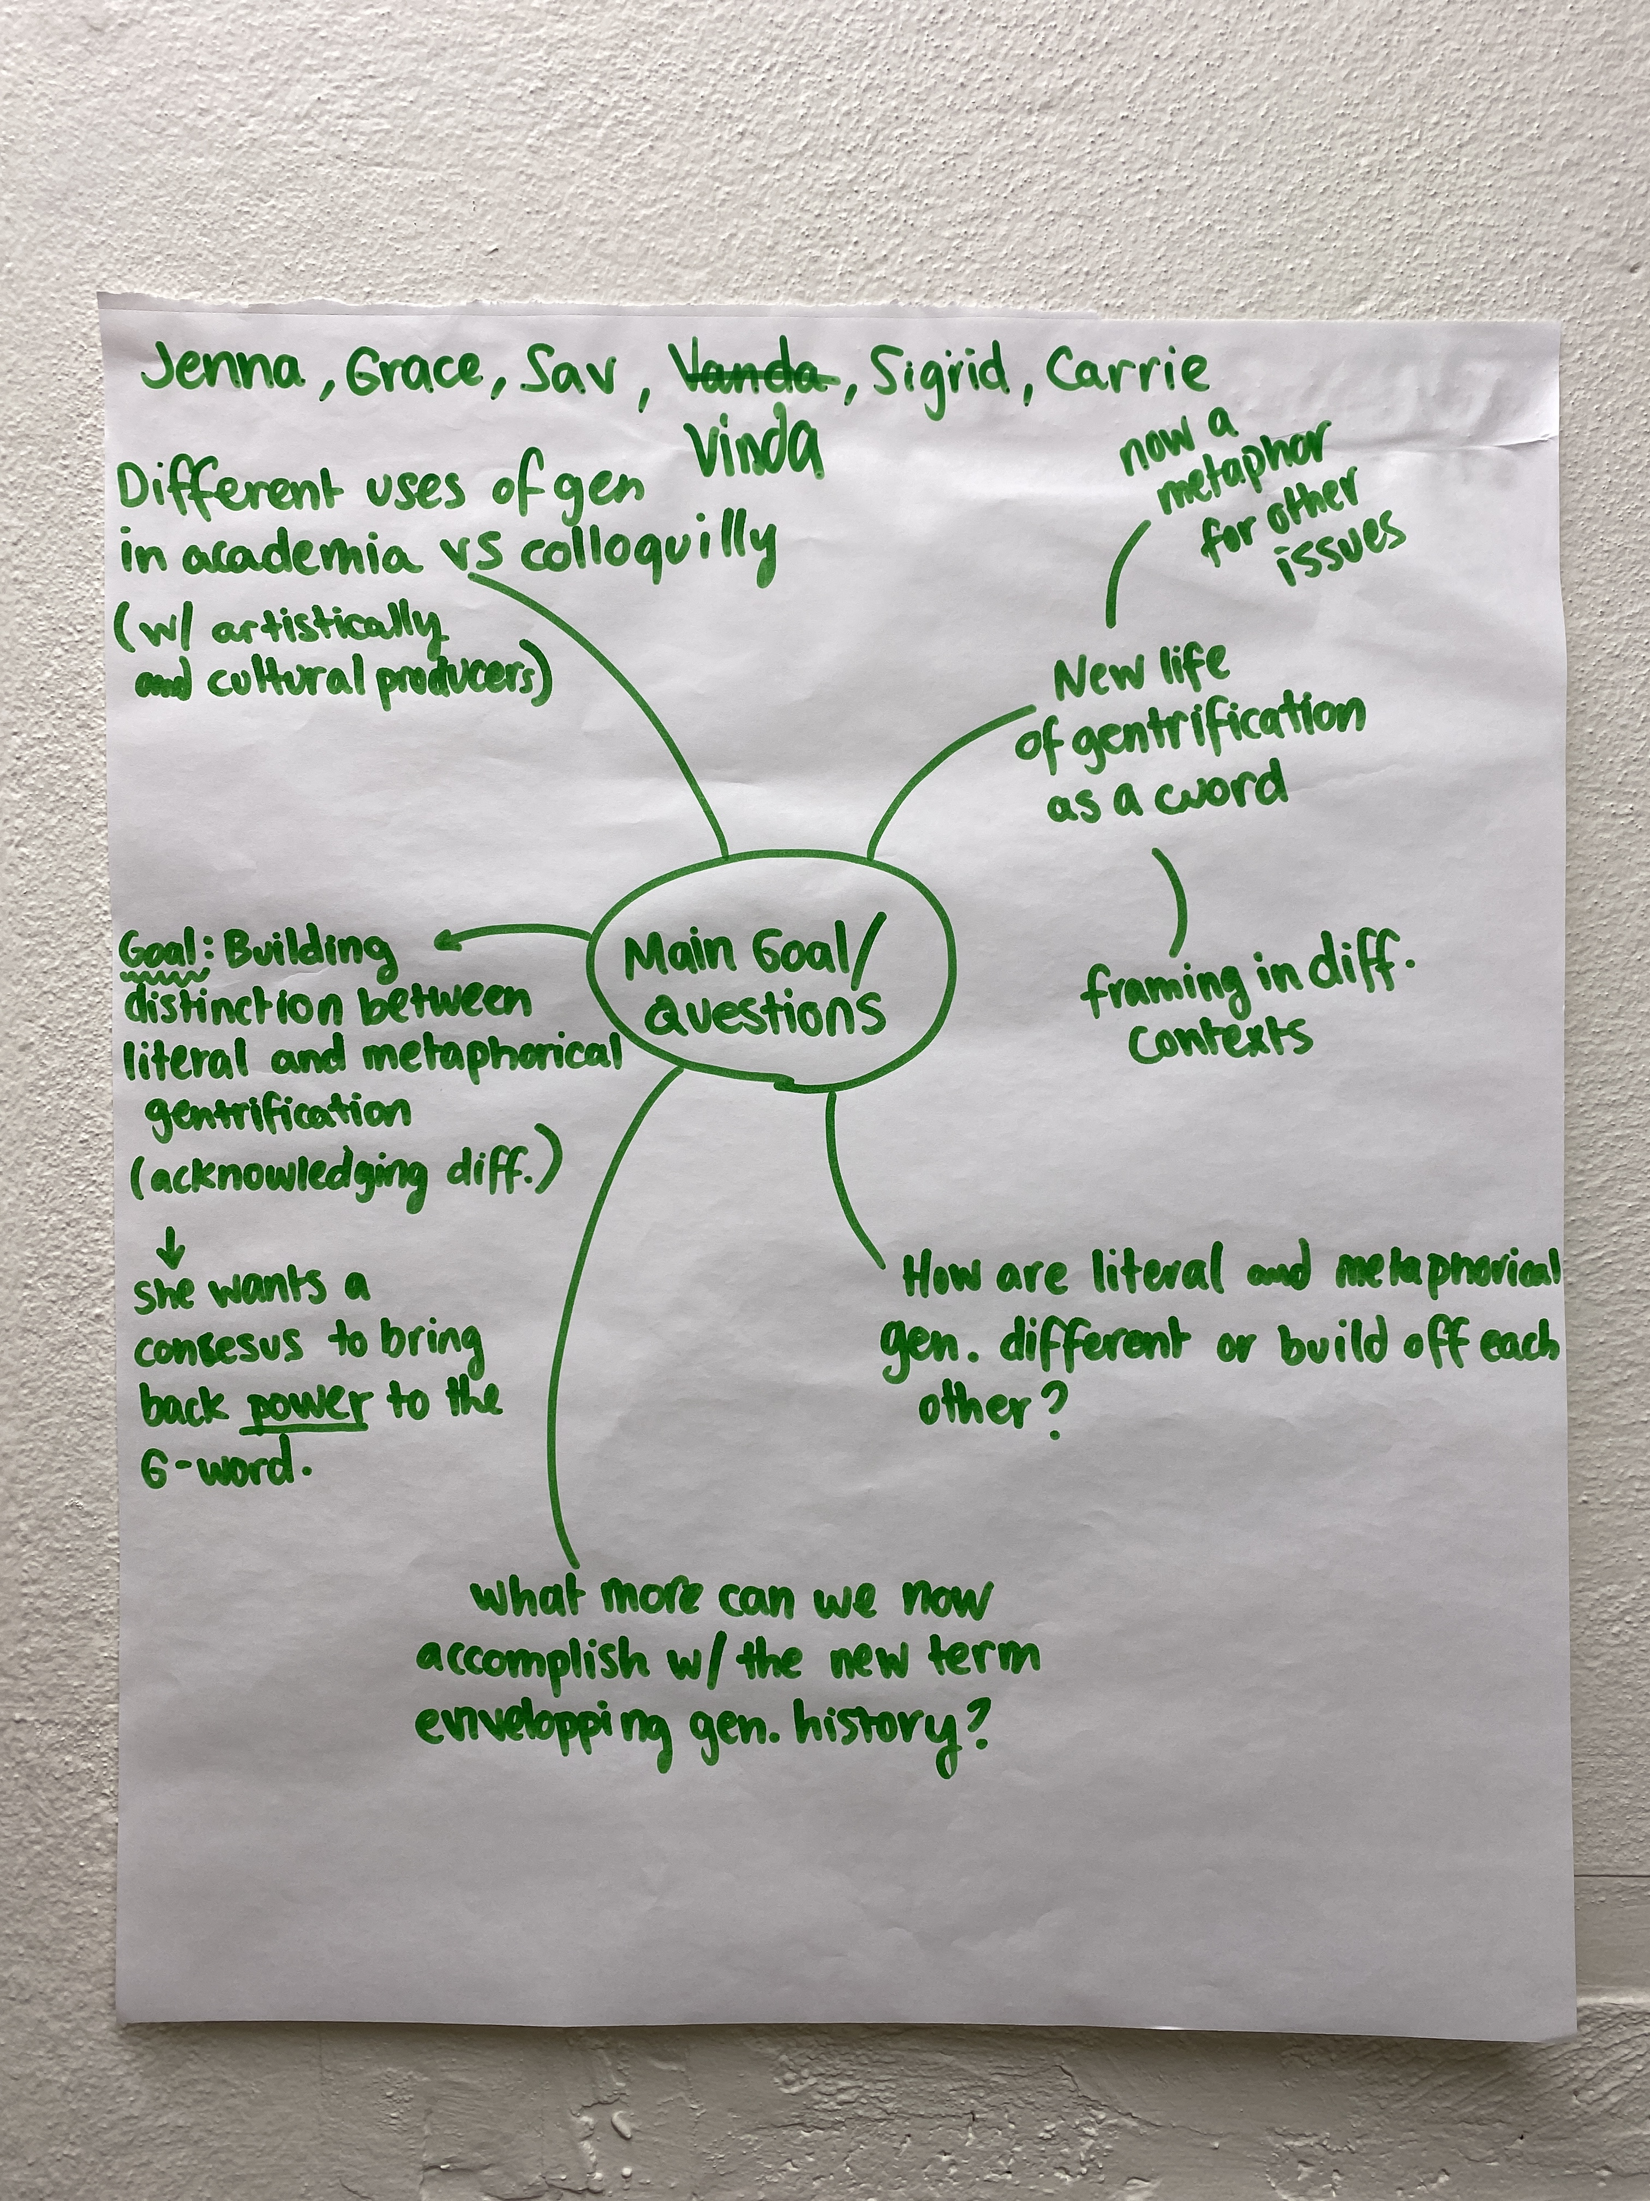
RECAP Group Discussion notes

Slide 5
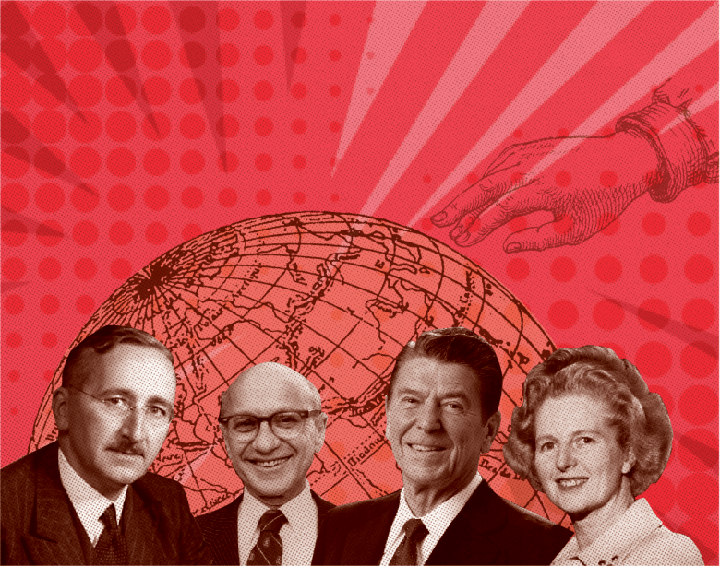
Introduction Neoliberalism
Neoliberalism is […] a theory of political and economic practices that proposes human well-being can best be advanced by liberating individual entrepreneurial freedoms and skills within an institutional framework characterized by strong private property rights, free markets, and free trade. The role of the state is to create and preserve an institutional framework to such practices (Harvey 2005)
Ronald Reagan Inauguration Address (1981)
Bill Clinton State of the Union Address (1996)
Notes:
Reagan (4:32)
Clinton (8:45)

Slide 6
Introduction Neoliberalism
How does each speech exemplify the tenants of neoliberalism?

Slide 7
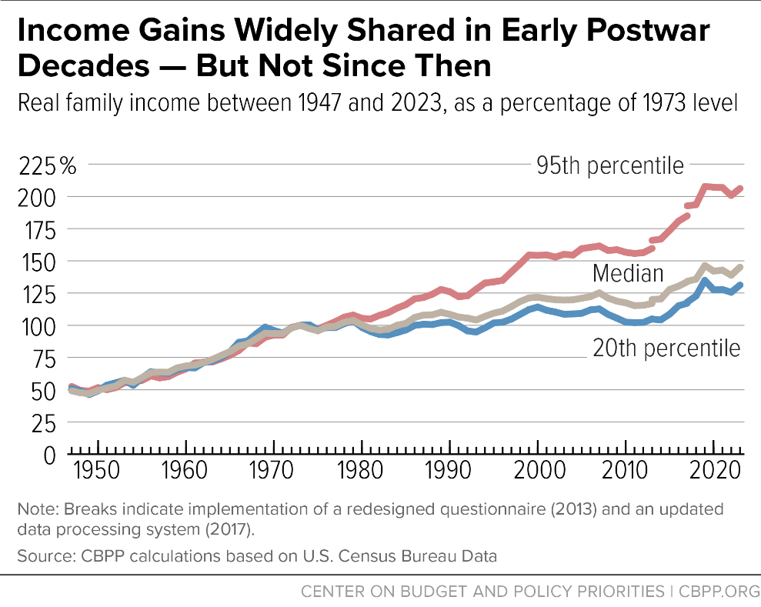
Wealth inequality in America
Beginning in the 1970s, income disparities began to widen, with income growing much faster at the top of the income ladder than in the middle or bottom.
Wealth is much more highly concentrated than income, and concentration at the top has risen since the 1980s.
Economic security programs such as Social Security, food assistance, refundable tax credits, and housing assistance have not only lifted millions of people above the poverty line but also reduced key measures of racial and ethnic inequity in children’s exposure to poverty
Notes:
Federal Reserve data show that the least-wealthy 50 percent of U.S. households hold very little of the nation’s wealth (less than 4 percent), while the households with wealth in the top 10 percent hold over two-thirds. The concentration of wealth at the very top has increased over the past 35 years.

Slide 8
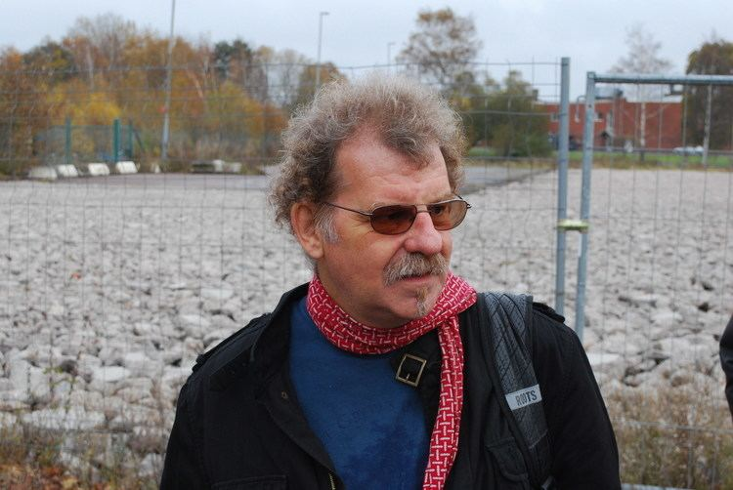
Neil Smith
Marxist Geographer and Anthropologist (1954 – 2012)
How capitalism and class power serve to make, unmake and remake the natural habitat
The New Urban Frontier: Gentrification and the Revanchist City (1996)
Uneven Development: Nature, Capital, and the Production of Space (1984)
The End Game of Globalization (2005)

Slide 9
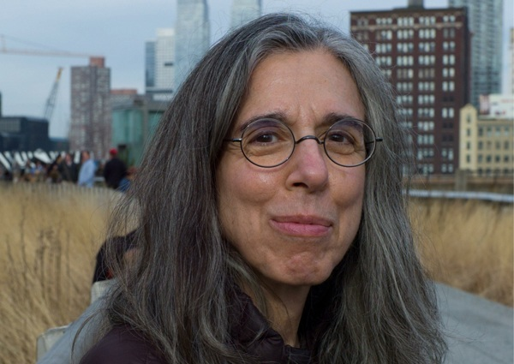
Sharon zukin
Urban Sociologist
Consumer culture and art markets; how urban space is deliberately produced to suit the needs of capital
Landscapes of Power: From Detroit to Disney World (1991)
Naked City: The Death and Life of Authentic Urban Places (2010)
Loft Living: Culture and Capital in Urban Change (1982)
The Innovation Complex: Cities, Tech, and the New Economy

Slide 10
Group discussion
Group 1 (Smith, Zukin)
What is goal of this chapter?
What question(s) is the author asking? Why are they asking it?
Group 2 (Smith, Zukin)
What problem is this text seeking to address?
What argument is the author making?
Group 3 (Smith, Zukin)
What elements of gentrification does each other highlight in their respective pieces? How do they align? Where do they differ?

Slide 11
For next class
Upcoming:
Complete availability poll for walking tour. Poll will be sent on Friday, 9/11 via Moodle.
Reading Notes Check 1, due, by 11:59 PM, Friday, 9/18
Required Reading:
Loretta Lees, Super-gentrification: The Case of Brooklyn Heights, New York City (2003), Pp. 45 – 50
Lance Freeman, Displacement or Succession?: Residential Mobility in Gentrifying Neighborhoods (2005), Pp. 463 – 491
Paul R. Levy and Roman A. Cybriwsky, The Hidden Dimension of Culture and Class: Philadelphia (1979), Pp. 285 – 293

