Slide 1
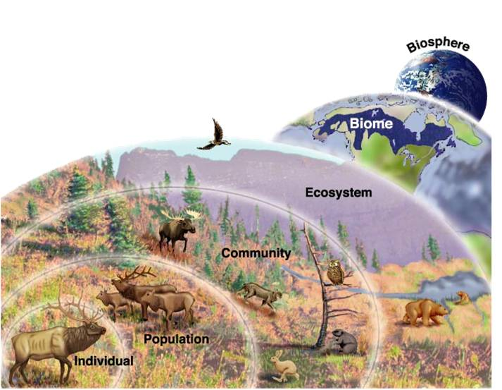
Ch 3 continued
Fundamentals of Ecology
Species interactions

Slide 2
What determines which species live in an ecosystem—and what happens to that ecosystem when conditions change?

Slide 3
Biosphere Interactions Populations to the Biosphere
Population
is a group of organisms of the same species living in the same area.
Community
consists of all the populations that inhabit a certain area.
Ecosystem
consists of the local community plus its physical environment.
Landscape
consists of a mosaic of communities.
Biome
Global ecological region, determined primarily by climate
Biosphere
the living component of the earth. 4th sphere.

Slide 4
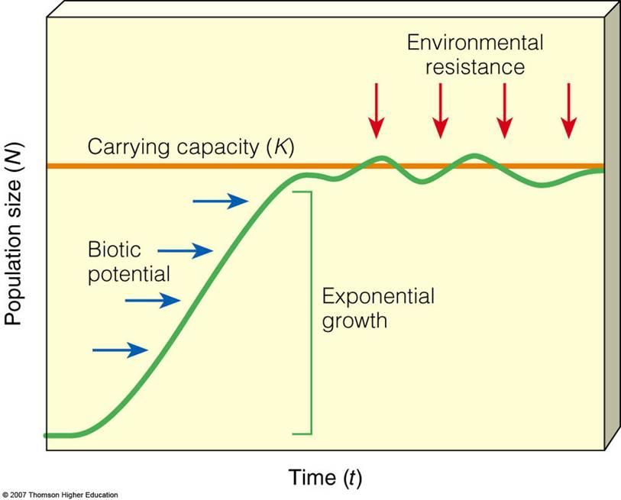
Biosphere Interactions Populations Make Communities
A population is a group of organisms of the same species living in the same area.
Resource availability
Predation
Disease & death
Chance events
  stochastic
Env. Change

Slide 5
Community Ecology
Community
consists of all the populations that inhabit a certain area. Small or large
Habitat
Where an organism lives. Requirements vary btwn sp.
crow vs beaver vs wolverine
Niche
How an organism lives - its ‘occupation’. How it fits into the local community.
“Nitch”, “Nish”, or “Neesh”???
crow vs beaver vs wolverine

Slide 6
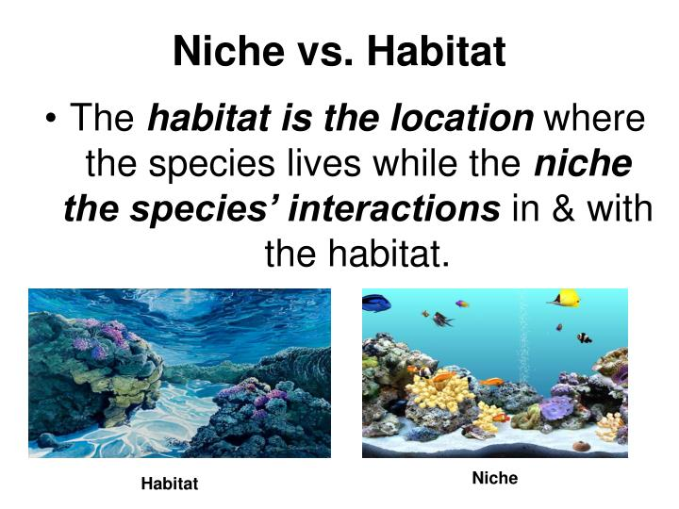
Notes:
https://image1.slideserve.com/1745960/niche-vs-habitat-n.jpg

Slide 7
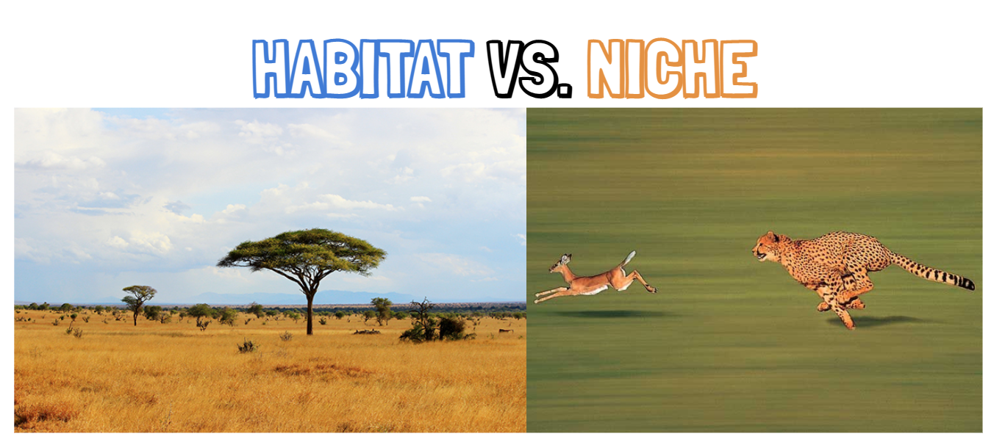

Slide 8
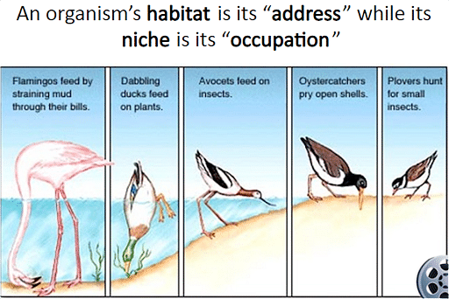
Notes:
https://static.prepp.in/public/image/cea28e5d111e88599c80ac72f3a6c9c4.png?tr=w-512,h-342,c-force

Slide 9
Symbiotic Relations
Symbiosis
any type of a close and long-term biological interaction between two different organisms
Symbolic Classification of Symbiosis
Form of Symbiosis | Species A | Species B | Example
Mutualism | + | + | Mycorrhiza attachment to plant’s root.
Commensalism | + | 0 | Spanish moss hanging on oak trees
Amensalism | 0 | – | Incidental impact—elephants crashing vegetation
Predation and parasitism | + | – | Predation: fox and rabbit Parasitism: tick and dog
Competition | – | – | Coyotes and red fox

Slide 10
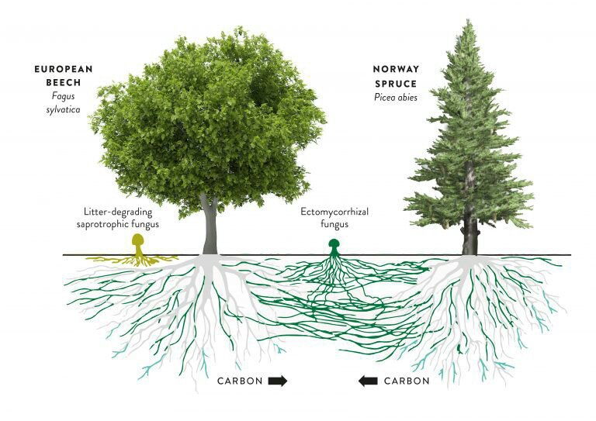

Slide 11
Symbiotic Relations
Symbiosis
any type of a close and long-term biological interaction between two different organisms
Symbolic Classification of Symbiosis
Form of Symbiosis | Species A | Species B | Example
Mutualism | + | + | Mycorrhiza attachment to plant’s root.
Commensalism | + | 0 | Spanish moss hanging on oak trees
Amensalism | 0 | – | Incidental impact—elephants crashing vegetation
Predation and parasitism | + | – | Predation: fox and rabbit Parasitism: tick and dog
Competition | – | – | Coyotes and red fox

Slide 12
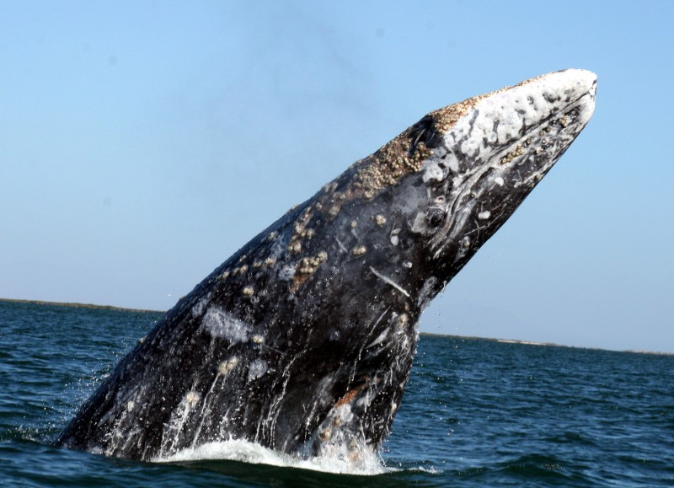

Slide 13
Symbiotic Relations
Symbiosis
any type of a close and long-term biological interaction between two different organisms
Symbolic Classification of Symbiosis
Form of Symbiosis | Species A | Species B | Example
Mutualism | + | + | Mycorrhiza attachment to plant’s root.
Commensalism | + | 0 | Spanish moss hanging on oak trees
Amensalism | 0 | – | Incidental impact—elephants crushing vegetation
Predation and parasitism | + | – | Predation: fox and rabbit Parasitism: tick and dog
Competition | – | – | Coyotes and red fox

Slide 14
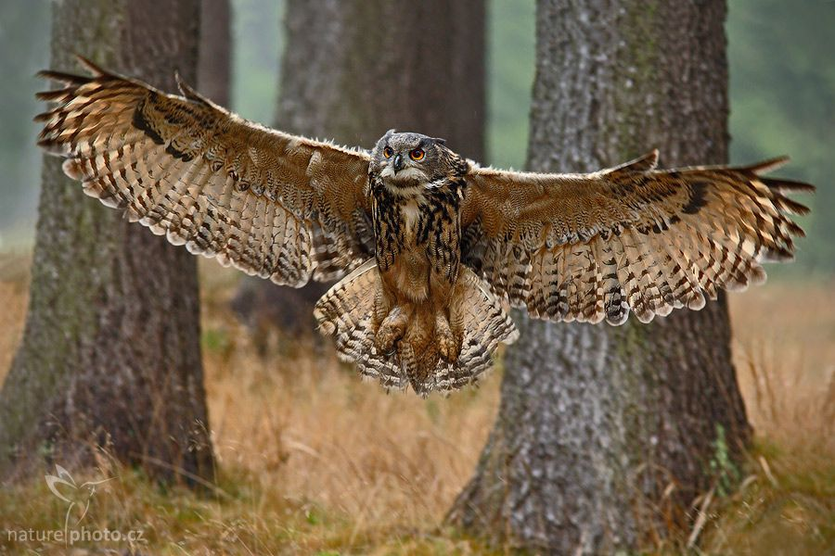
Predation—Consumption of
Other Living Organisms
Predators divided into
carnivores: preying on animals (predation)
herbivores: preying on plants (depredation)
omnivores: preying on both
Why don’t predators consume prey to extinction?
  Many prey have evolved camouflage, poisons, spines
  Evolved ability to flee to burrows or tree tops to avoid predation and extinction
  Predators will switch prey choice when one population declines.

Slide 15
Symbiotic Relations
Symbiosis
any type of a close and long-term biological interaction between two different organisms
Symbolic Classification of Symbiosis
Form of Symbiosis | Species A | Species B | Example
Mutualism | + | + | Mycorrhiza attachment to plant’s root.
Commensalism | + | 0 | Spanish moss hanging on oak trees
Amensalism | 0 | – | Incidental impact—elephants crashing vegetation
Predation and parasitism | + | – | Predation: fox and rabbit Parasitism: tick and dog
Competition | – | – | Coyotes and red fox

Slide 16
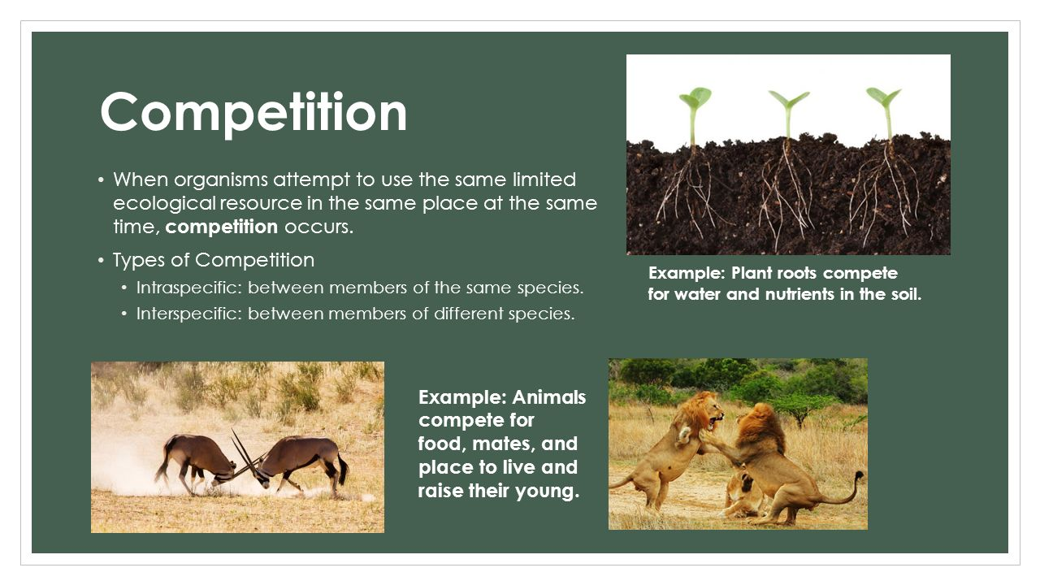

Slide 17
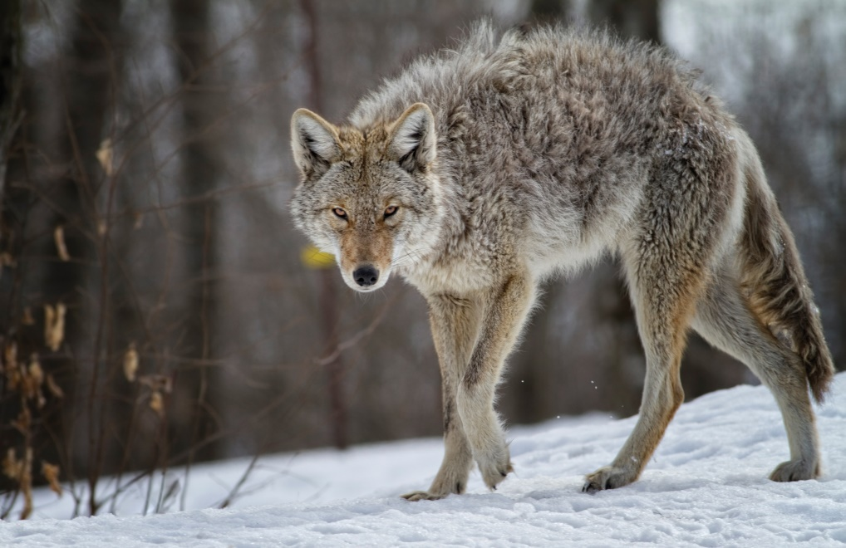
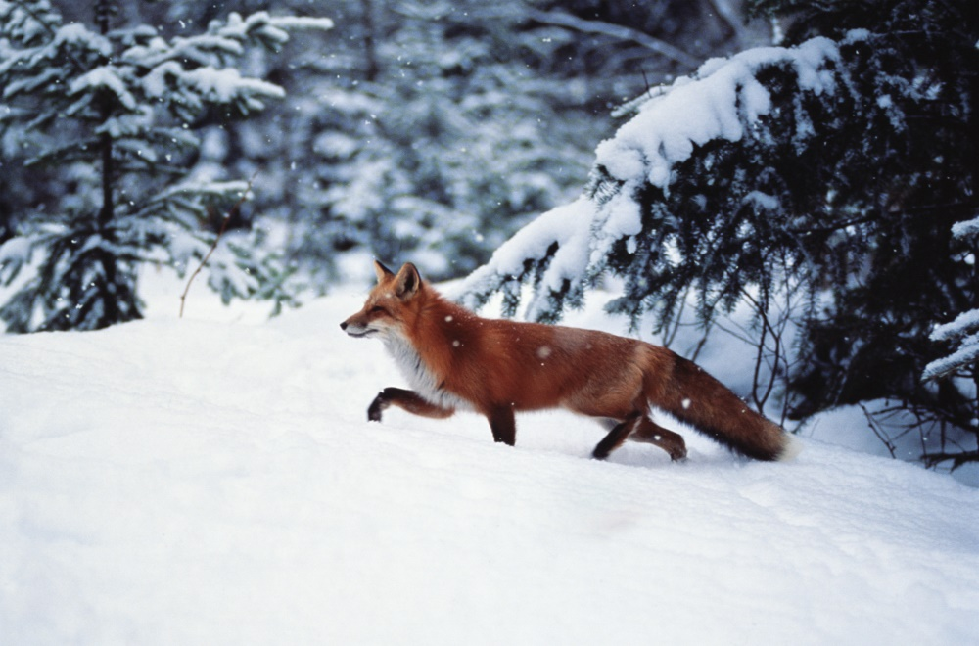
Interspecific competition can lead to
Competitive Exclusion
Minor niche overlap can limit abundance of both species.
High niche overlap can exclude the less efficient competitor.
(a) © LeFion/iStock/Getty Images. (b) © Photodisc.

Slide 18
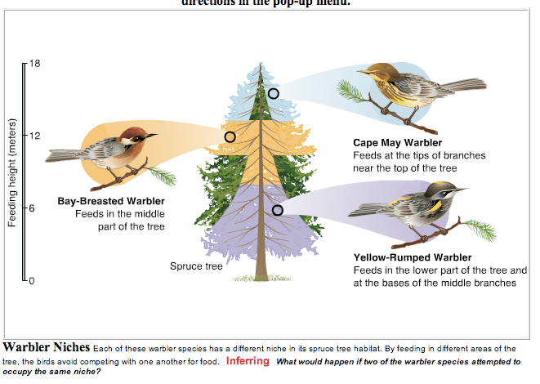
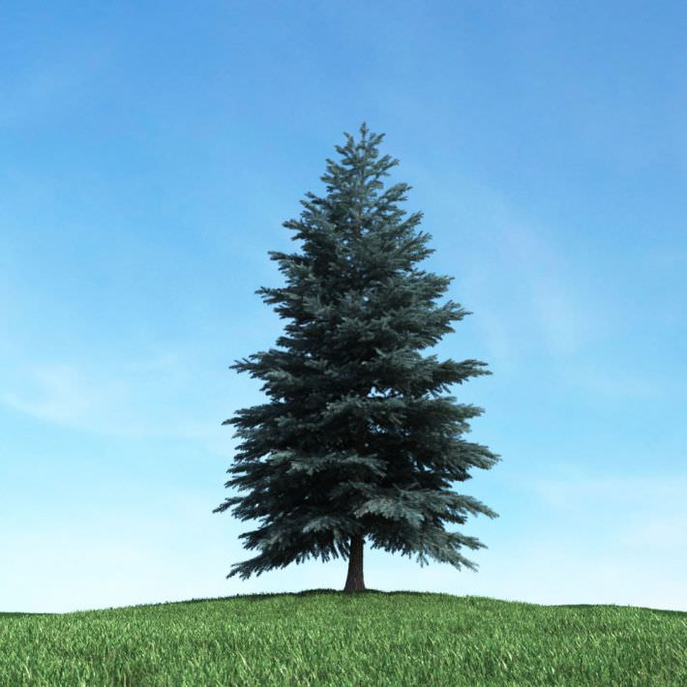
Nitch partitioning

Slide 19
Population Decline
Population numbers rise and fall over time; most species eventually become extinct.
99% of all species ever recorded are now extinct.
Causes for decline & extinction
Environmental changes, asteroid impacts, competition from new arrivals, and human impact
Human impact on population mainly from 2 factors that disrupt natural cycles of populations.
(1) population growth by removing limitations and
(2) population decline by imposing new limitations.
Notes:
move to population ecology

Slide 20
Human Impact on Growth and Decline
Four Ways Humans Impact Population Growth
Cause | Example
Increase available resources | Nutrient pollution in lake (farming)
Competitive release | Poisoning of Insect pests
Predator release | Overhunting of large carnivores
Introduction to new areas | Game releases
Four ways Humans Impact Population Decline (and extinction)
Changes | Example
Habitat disruption | Draining swamp; toxic pollution
Introduction of new species | New predator
Overkill | Big-game hunting
Secondary extinctions | Loss of food species

Slide 21
Human Impact on Growth and Decline
Four Ways Humans Impact Population Growth
Cause | Example
Increase available resources | Nutrient pollution in lake (farming)
Competitive release | Poisoning of Insect pests
Predator release | Overhunting of large carnivores
Introduction to new areas | Game releases
Four ways Humans Impact Population Decline (and extinction)
Changes | Example
Habitat disruption | Draining swamp; toxic pollution
Introduction of new species | New predator
Overkill | Big-game hunting
Secondary extinctions | Loss of food species

Slide 22
Ch 3 continued
Ecosystems, Succession
& Landscape Ecology
Landscape

Slide 23
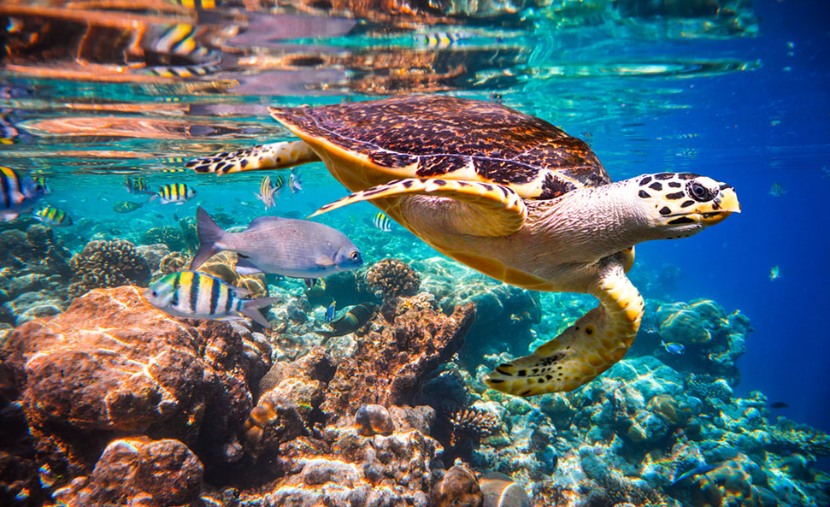
Biosphere Interactions: Communities and Ecosystems
An ecosystem is the community plus its physical environment.

Slide 24
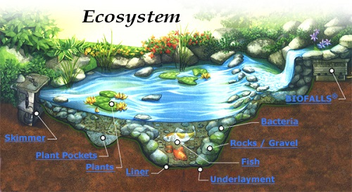
Communities and Ecosystems
“Structure vs function”
Community analysis is “structural” because it emphasizes the distribution of organisms through space and time.
Ecosystem analysis is “functional” because it emphasizes the flows of energy and cycling of matter.

Slide 25
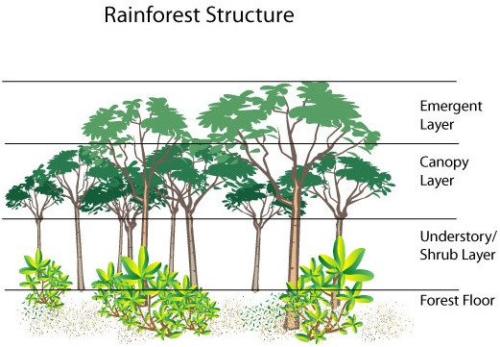
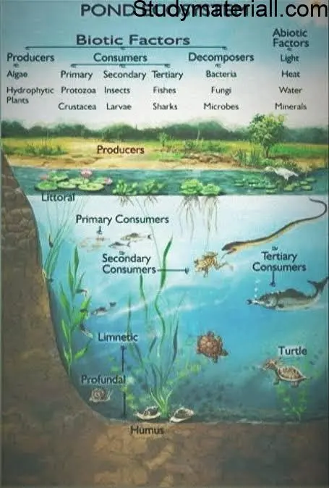
Ecosystem structure
Biotic + abiotic components + interactions in an ecosystem

Slide 26
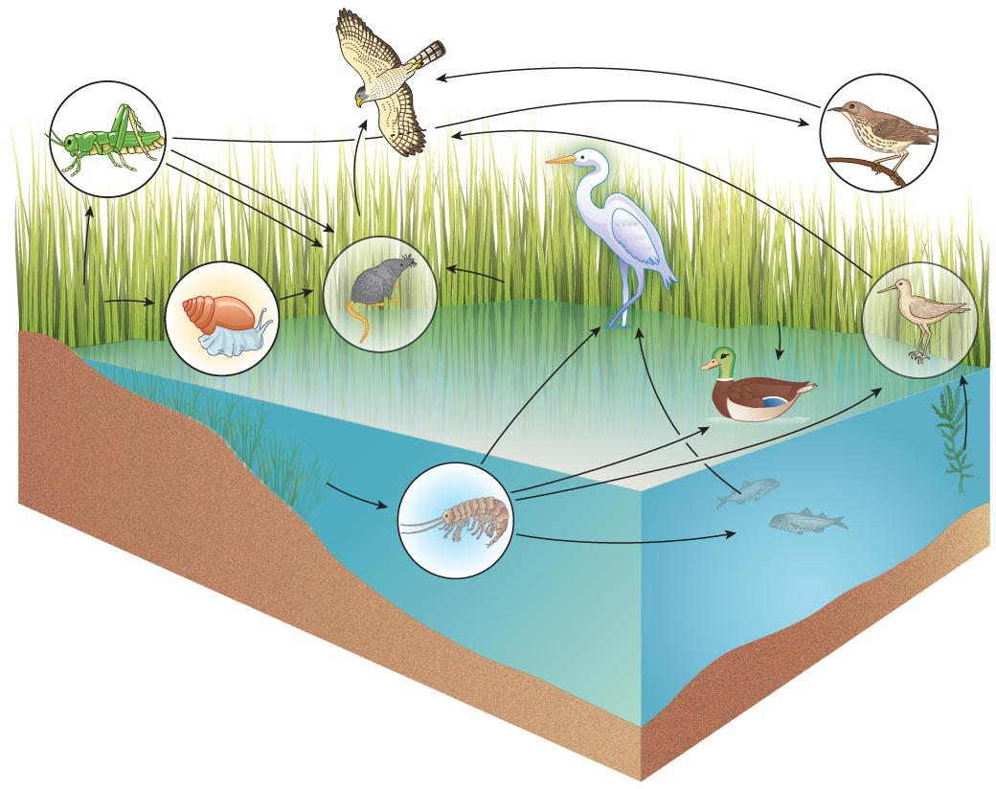
Food Web
What relationships exist in system?
A food web describes the complex interrelationships by which organisms consume other organisms.
Energy flows are routed through feeding relationships in the ecosystem.
Notes:
Another way of measuring ecosystem structure: evaluate the relationships in system

Slide 27
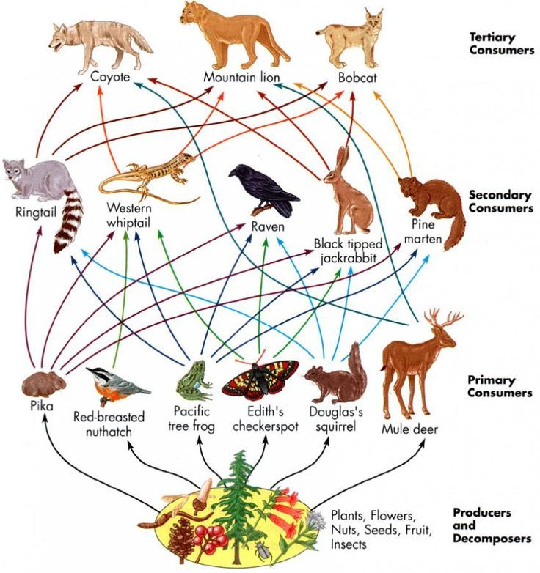
Food Web
How are sp interacting?
Why is diversity important?

Slide 28
Biodiversity
Many types & measures of biodiversity
  population, community, ecosystem
Abundance
Number of individuals in a pop. Not diversity measure.
Species Richness
A community diversity measure, referring to how many kinds of organisms occur in a community.
What is driving diversity? Depends on Scale. At large scale:
  Latitudinal diversity gradient describes increase in terrestrial diversity closer toward equator
  Depth diversity gradient aquatic diversity increases moving toward 2000 meters (6,560 feet) then decreases
Notes:
Moved this slide to next week

Slide 29
Ecosystem and
Community Function
Communities vary in structure but are alike in that they all carry out basic processes.
The most basic processes are:
  Energy flow
  Matter cycling
All organisms eat to stay alive, causing energy and matter to move through the community.
Energy flows and matter cycles through all four spheres.

Slide 30
Ecosystem Productivity
Ecosystem productivity varies greatly with the ecosystem.
The term NPP (Net Primary Productivity) is the rate at which producers can create biomass.
Primary producers are autotrophs; they make energy from the sun
Biomass is the weight of living matter.
The term NSP (Net Secondary Productivity) is the rate at which consumer and decomposer biomass is produced.
Secondary producers (aka consumers & decomposers) are heterotrophs; they make energy from eating primary producers

Slide 31
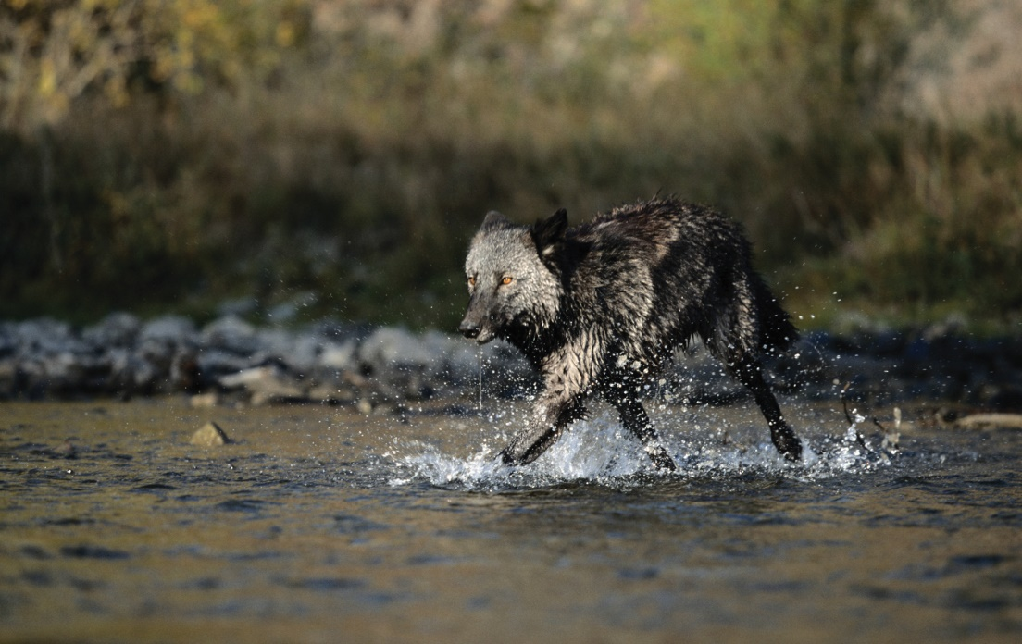
Trophic levels
The first trophic (feeding) level is the producers; capture energy from the non-living environment.
Consumers derive energy from the chemical energy stored in the bodies of producers or other consumers.
© Alan and Sandy Carey/Photodisc/Getty Images.

Slide 32
Food Web
How do these vary?
Apex predator
Mesopredator
Omnivore
Herbivore
Producer

Slide 33
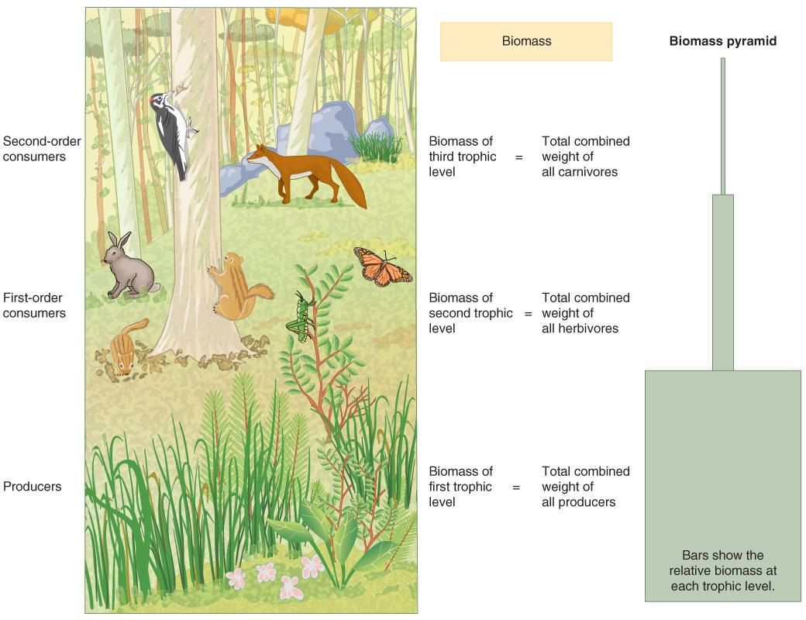
Energy Flows
Biomass declines with each higher trophic level because progressively less food is available.
In general, 80–95% of the energy is lost in the transfer between each level.
© Nicholas Rjabow/Shutterstock.

Slide 34
A Biomass Pyramid
Figure 03.32: A biomass pyramid. In most land food webs, biomass decreases from one feeding (trophic) level to the next highest.

Slide 35
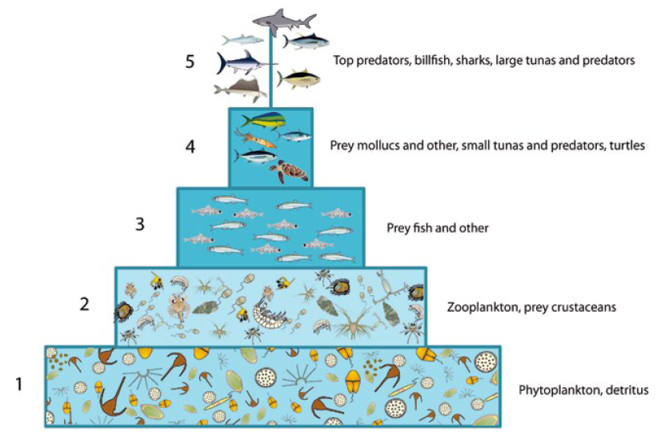
A Biomass Pyramid - marine systems

Slide 36
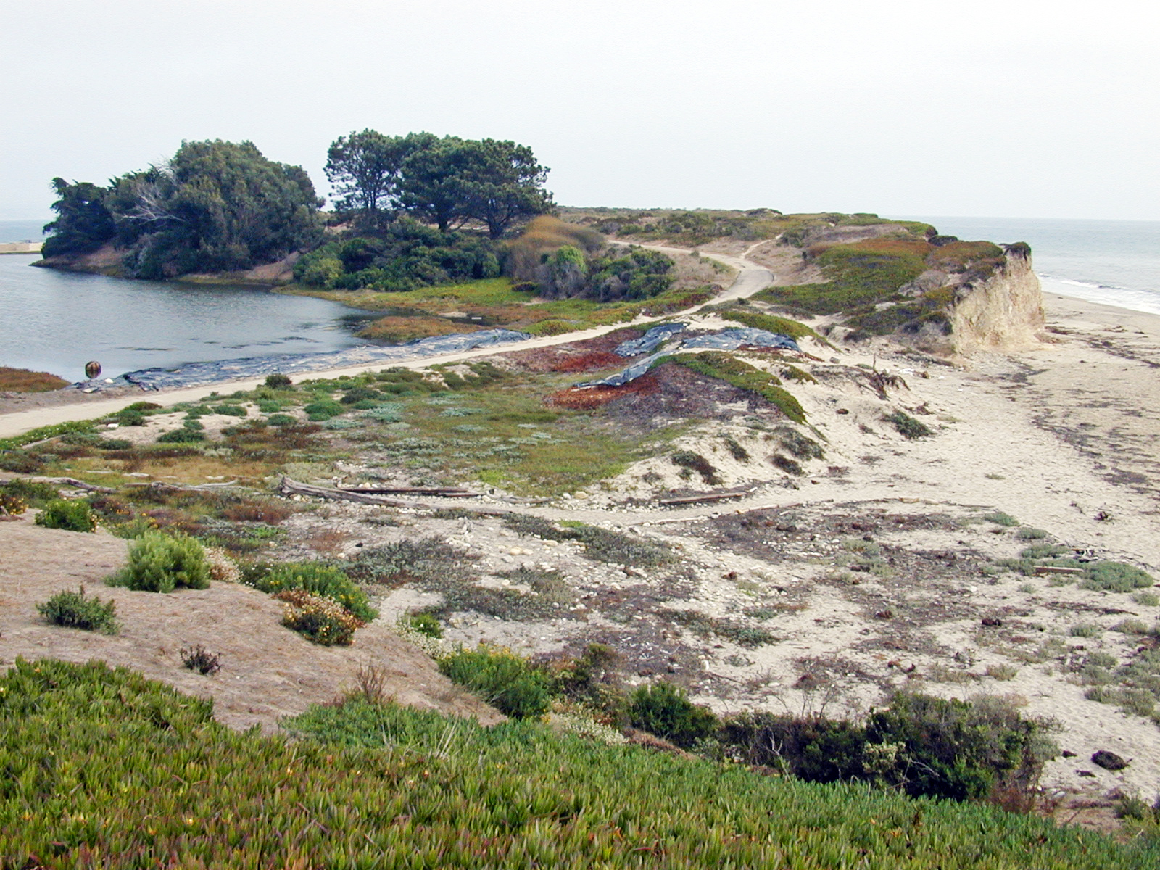
Community Succession

Slide 37
Community Succession
Succession
the sequential replacement of species in a community by immigration of new species and local extinction of old ones.
2 types
Primary Succession
Secondary Succession
Pioneer species colonize a site that was opened by disturbance. These populations are replaced by intermediate species, which are eventually replaced by a climax community.

Slide 38
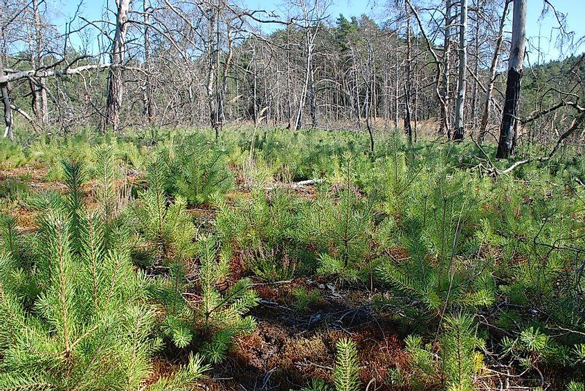

Slide 39
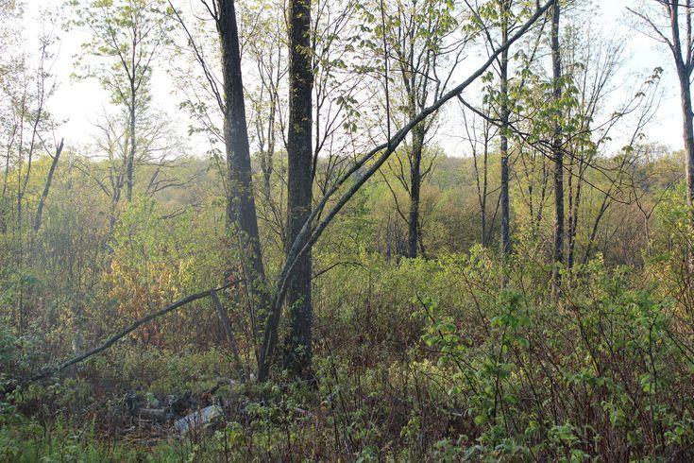

Slide 40
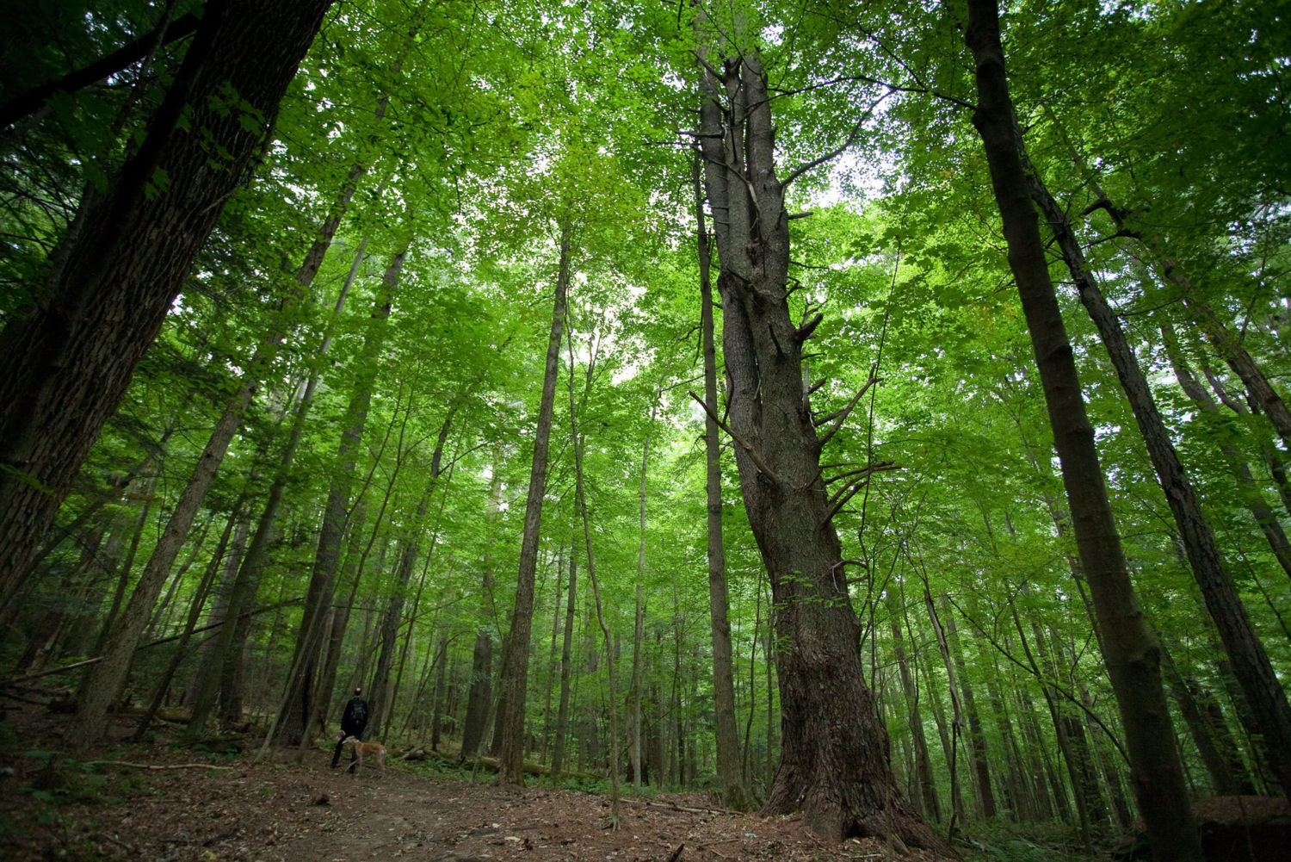

Slide 41
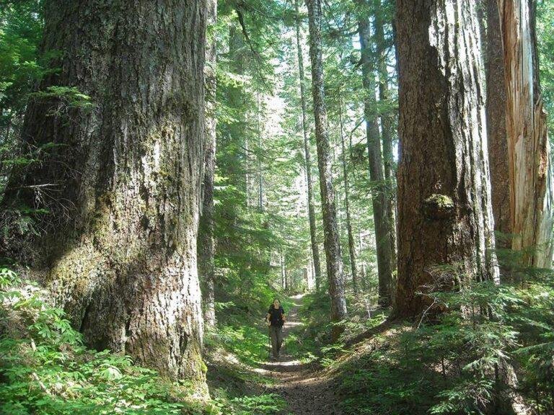

Slide 42
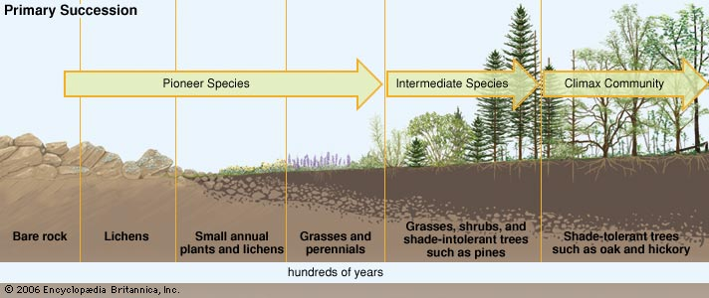
Succession
Succession occurs because each community, pioneer to climax, prepares the way for the stage that follows by altering environmental traits.
Succession is characterized by several trends:
  Decreasing productivity (maybe)
  Increasing diversity
  Increasing biomass

Slide 43
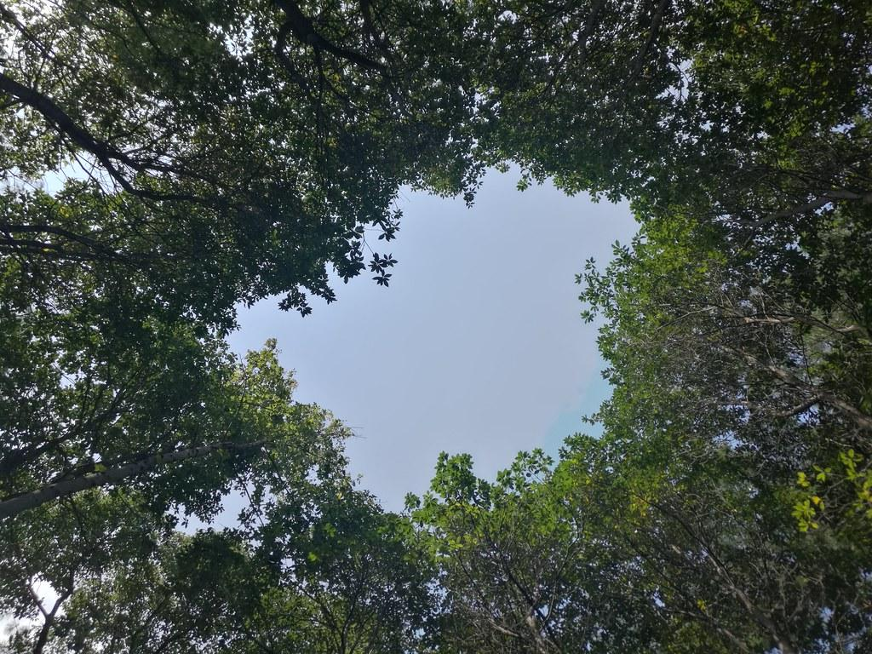
Where do we find highest diversity?

Slide 44
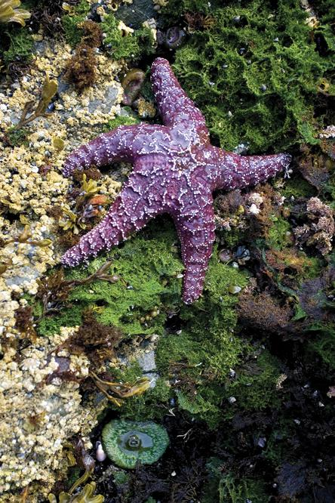
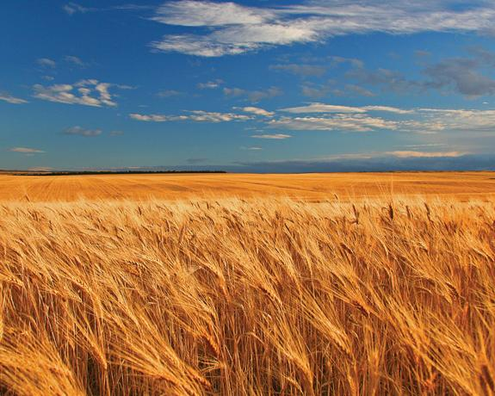
Figure 3.30 Crops grown as vast expanses of one species, such as the wheat shown here, are more at risk of widespread crop damage caused by species-specific pests and diseases.
Figure 03.29 The environmental conditions along a rocky shoreline and the physical assault of waves can be so extreme that less-resilient succession species never replace the tough colonizers, such as the barnacles, starfish, seaweeds, and sea anemones.

Slide 45
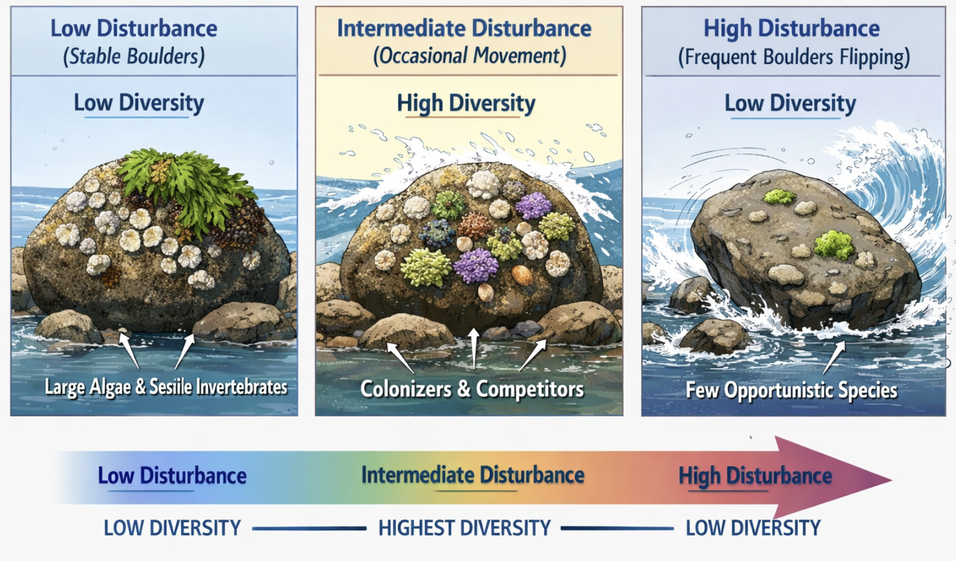
Intermediate Disturbance Hypothesis
Areas where a moderate level of disturbance occurs produces the highest level of species richness

Slide 46
What determines which species live in an ecosystem—and what happens to that ecosystem when conditions change?

Slide 47
End for today
Lab Monday (9/14/26): Scientific Reading Lab

