Slide 1
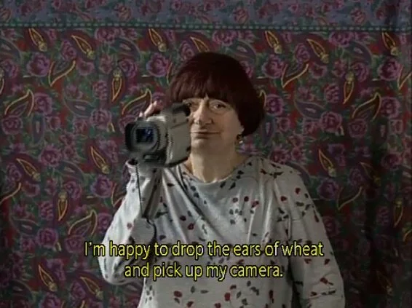
HART 380/680 - Topics in Film: Digital Media
Professor Homay King
Fall 2026
Bryn Mawr College

Slide 2
Short Brainstorming Exercise
List as many synonyms for using a computer, internet browsing, or searching as you can think of
- What associations or connotations do these words bring to mind?
- What affects, feelings, or emotions to they evoke for you?
- How do they imagine the user? Is this user gendered, raced, etc?
- Same questions as above.
List as many brand names of internet browsers, search engines, and operating systems as you can think of, past or present. Same questions as above.

Slide 3
Digital Media Show-and-Tells
Me at the Zoo. Short video by user jawed (uploaded to youtube April 23, 2005)
World Is Mine / ryo (supercell). Video documentation of a live holographic performance by vocaloid musical artist Hatsune Miko (uploaded to youtube June 10, 2013)
The Art of Color. Google Arts & Culture navigable pocket gallery in partnership with over twenty museums. Date unknown.
Bad Apple!! Played on Minecraft Sheep. Short video by user Treyzania (uploaded to youtube October 10, 2020)
Hollow Point 103 VR by Nancy Baker Cahill (2016). Vimeo documentation.

Slide 4
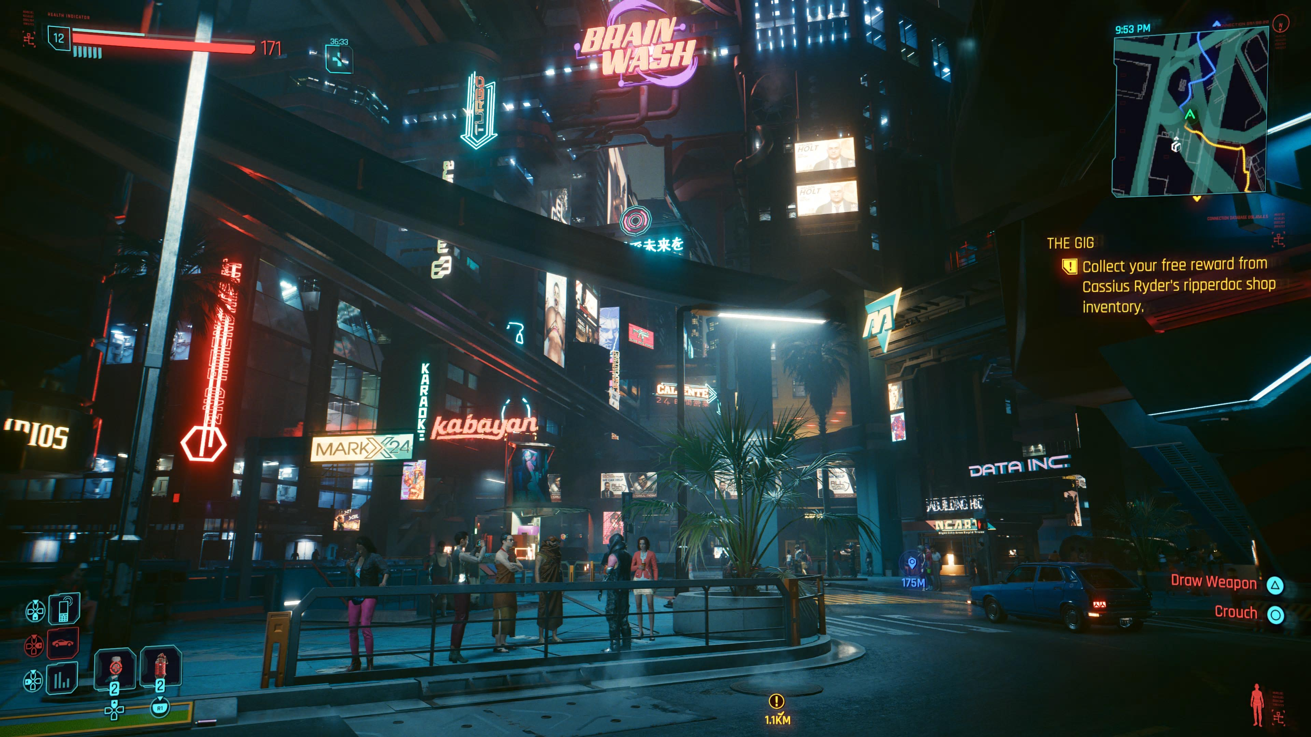
Digital Media Show-and-Tells cont.

Slide 5
Digital Media Show-and-Tells cont.

Slide 6
Lev Manovich, The Language of New Media
Five principles of new media (p. 27-48)
Numerical representation (1s and 0s)
Modularity (blocks or objects can plug in and substitute for one another)
Automation (some operations runs by themselves)
Variability (template and open-ended series of variations, could go on)
Transcoding (capable of being ported to different file formats, and rendered on different screens or devices)
Additional features of new media:
Database aesthetics (not narrative aesthetics)
Simulation (not representation)
Random Access (not linear)

Slide 7
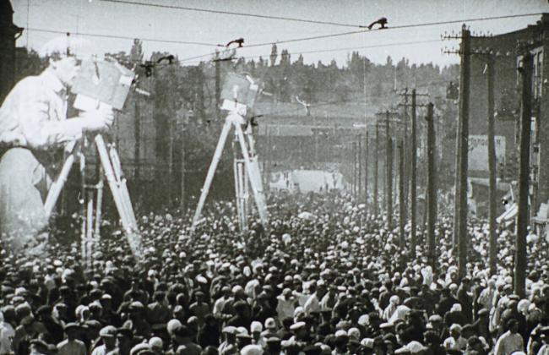
Manovich
Database aesthetics versus Narrative aesthetics
Paradigm versus Syntagma
Man with a Movie Camera as early example of “database cinema”

Slide 8
Database vs. Narrative (Manovich p. 219-20)
A set of materials A product made with those materials
Raw footage for a film The final film
Notes, outlines, scraps of writing A finished novel or essay
A collection or archive An exhibition of some objects from it
A website The path I navigate on the website
A comprehensive museum The path I navigate through it, or a
curated selection of objects from it
A dictionary of words A written text: selects some of those
words and puts them in a particular order
Random Access capability Meant to be accessed in a fixed sequence
Paradigm Syntagm

Slide 9
Representation vs. Simulation (Manovich p. 112)
Renaissance painting Fresco, Mosaic, Mural
Photograph Panorama, diorama
Cinema (traditional) Cinema (IMAX)
Computer screen, smartphone, tablet Virtual Reality headsets
Board game Immersive amusement park ride
Theater with a proscenium arch Theater in the round, Greek theater
Portable In situ, installed
Framed, closed, separate Open-edged, extensive, contiguous
Viewer is meant to be immobile Viewer moves, or can move, around
One “ideal” vantage point Many possible vantage points

Slide 10
Numerical representation, Modularity, Automation, Variability, Transcoding, Database Aesthetics, Simulation
Exercise A:
think of an example of “old” or analog media that demonstrates one of principles Manovich associates with ”new” media listed above and say how it does so
Exercise B:
think of an example of “new” or digital media that does not demonstrate one or more Manovich’s principles

Slide 12
This is a reminder that course evaluations will be available for students to complete starting XXX-XXX. Students will be prompted via email and Moodle to complete the evaluation online. You can review completion rates on your course evaluations dashboard in Moodle during the evaluation period.
Set aside time (~20 minutes) at the beginning of one class session for students to complete online evaluations during class. Faculty members should step out of the classroom while evaluations are in progress and have a student notify them when everyone is finished.
INSTRUCTIONS (to be read to the class by a student):
These teaching evaluations are used for three purposes: 1) they provide feedback that should be helpful to the course instructor in general, or when this course is taught again; 2) they are reviewed by various faculty members in the evaluation of teaching when the College considers an instructor for reappointment, tenure, or promotion; 3) they provide information that helps the College evaluate larger curricular initiatives and goals. Both the instructor and the College appreciate thoughtful, candid, comments whether positive or negative, and constructive suggestions for improvement. Please spend 20 minutes responding to the questions on this form. Your answers will not be attributed to you. The instructor will see the results only after course grades have been submitted to the Registrar.

Slide 13
Web resources and exhibitions for further study
Electronic Arts Intermix (arts organization): https://www.eai.org/
Rhizome.org (arts organization): http://rhizome.org/about/
SFMoMA Media Arts (arts organization): https://www.sfmoma.org/artists-artworks/media-arts/
Dia Artist Web Projects (arts organization, archive of projects designed for the web): https://diaart.org/program/artistswebprojects
Sundance New Frontier (film festival section): http://www.sundance.org/programs/new-frontier#/
Net.Art on Wikipedia (https://en.wikipedia.org/wiki/Net.art)
Ubu Web (archive): http://www.ubu.com/
Internet Archive (archive, including archived webpages from the Wayback Machine): https://archive.org/about/
Electronic Superhighway (exhibition), Whitechapel Gallery, London, 2016 http://www.whitechapelgallery.org/exhibitions/electronicsuperhighway/
Myths of the Marble (exhibition), ICA, Philadelphia, 2017 http://icaphila.org/exhibitions/8498/myths-of-the-marble
New Order: Art and Technology in the 21st Century (exhibition), MoMA, New York, 2019 https://www.moma.org/calendar/exhibitions/5033

Slide 14
Suggested additional readings
Aria Dean, “Poor Meme, Rich Meme”
Catherine Fowler, “Remembering ‘Elsewhere’: From Retrospection to Introspection in the Gallery Film”
Mashinka Firunts Hapokian, “Colonial AI Art History”
Donna Haraway, “Anthropocene, Capitalocene, Plantationocene, Chthulucene: Making Kin”
Tom Gunning, “What’s the Point of an Index? Or Faking Photography”
Timothy Murray, “Wounds of Repetition in the Age of the Digital: Chris Marker’s Cinematic Ghosts”
Zabet Patterson, Peripheral Vision: Bell Labs, the S-C 4020, and the Origins of Computer Art
D. N. Rodowick, The Virtual Life of Film
Vivian Sobchack, “The Scene of the Screen: Envisioning Photographic, Cinematic, and Electronic ‘Presence’”

Slide 15
Suggested artists to explore on your own
Cory Arcangel
Shu-Lee Cheng
Paul Chan
James Coupe
Nonny de la Peña
Stan Douglas
Cyprian Galliard
Jodi (Joan Heemskerk and Dirk Paesmans)
Lynn Hershman Leeson
Florian Meisenberg
Chris Milk
Marisa Olson
Sondra Perry
Paul Pfeiffer
Jason Rohrer
Jacolby Satterwhite
Fiona Tan
Ryan Trecartin
Stan VanDerBeek
Bill Viola (The Night Journey)

