Slide 1

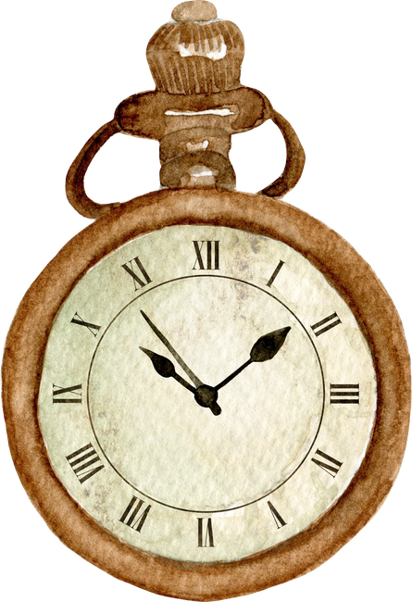
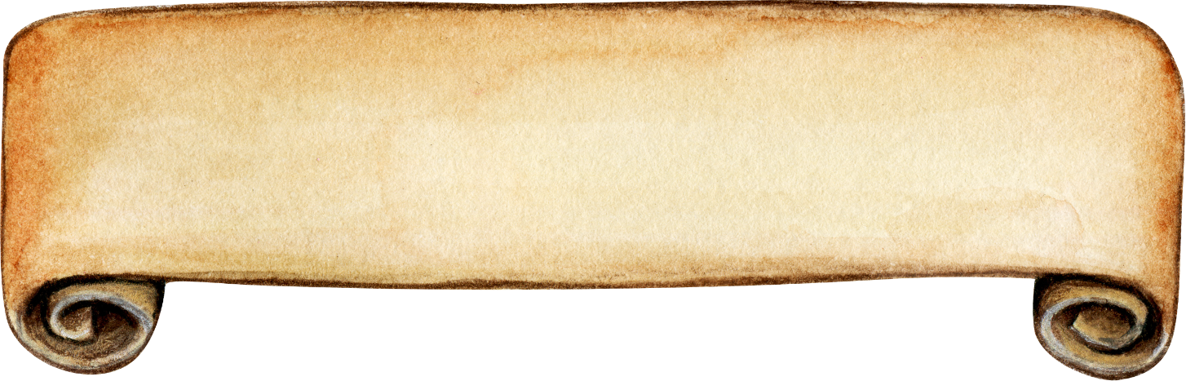
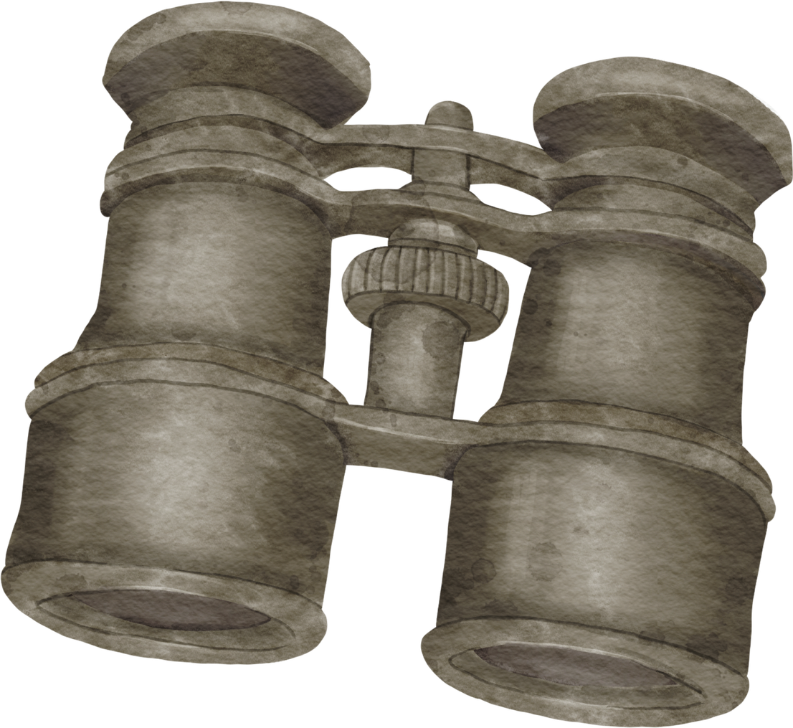
CITATIONS AS MAPS
Laura Surtees, Research Librarian

Slide 2

library@brynmawr.edu

Slide 3

REASONS FOR CITATIONS
Citations Give Credit
Citations Help Avoid Plagiarism
Citations Help Readers Find Sources
Citations Show Academic Conversation
Notes:
Citations Give Credit
They acknowledge the writers, researchers, and creators whose ideas you are using.
Citations Help Avoid Plagiarism
They show where borrowed words, ideas, evidence, data, and arguments come from.
Citations Help Readers Find Sources
A citation should give enough information for someone else to locate the same source.
Citations Show Academic Conversation
Citations reveal that writing is not done in isolation. Scholars and students respond to, build on, challenge, and revise one another’s ideas.

Slide 4

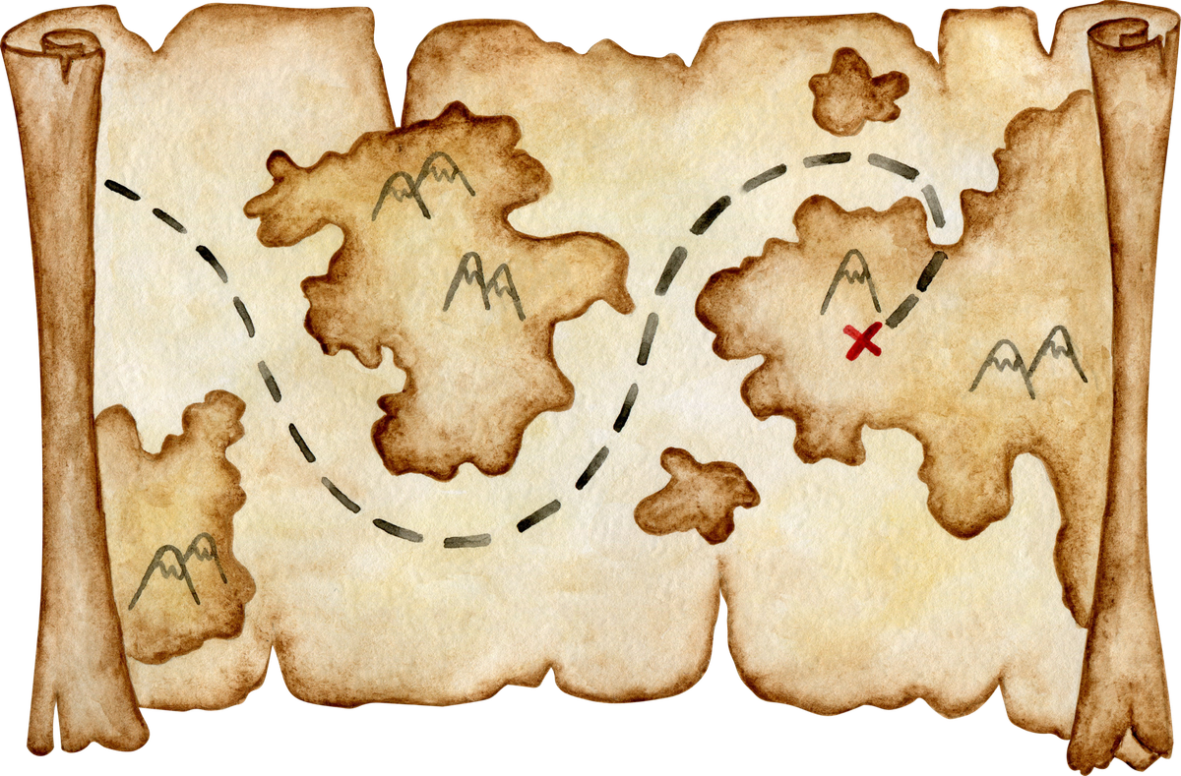
A citation is the map to your source

Slide 5
A citation is the map to your source
  where ideas came from
  what kind of source was used
  how to find that source
  how the writer is engaging with and joining the larger scholarly conversation.

Slide 6
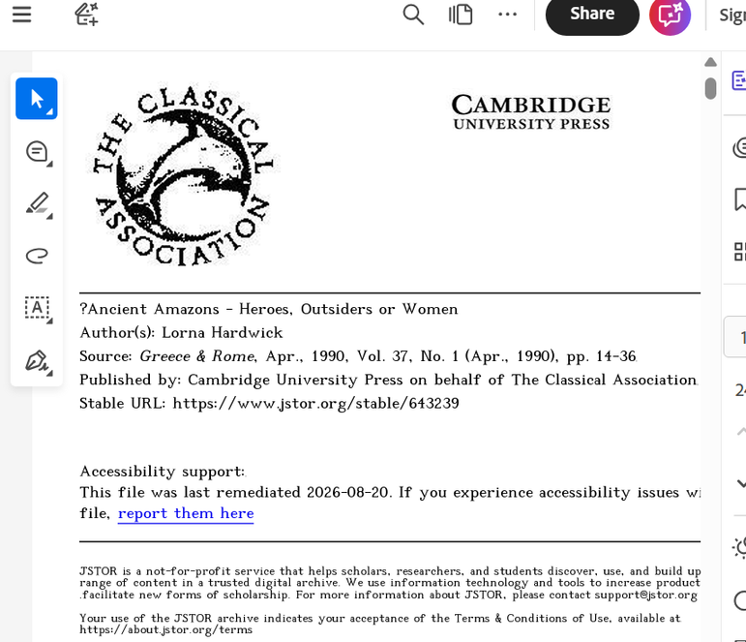
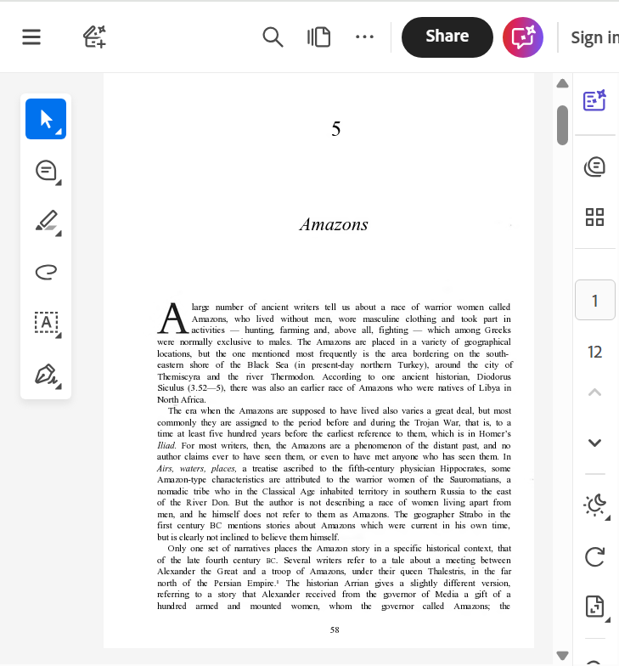
MORE THAN A PDF
Blundell, S. 1995. "Amazons", in Women in Ancient Greece. Cambridge. Pp. 58-62.
Hardwick, L. 1990. "Ancient Amazons - Heroes, Outsiders or Women?", Greece and Rome 37, pp. 14-36.

Slide 7
  Who wrote it?
  What is the title of the article? book?
  What is the title of the journal?
  What year was it published?
  What volume and issue is it from?
  What pages does it appear on?
  What kind of source is this?

Slide 8
Erskine, A. 2005. "Unity and Identity: Shaping the Past in the Greek Mediterranean", in E. S. Gruen (ed.), Cultural Borrowings and Ethnic Appropriations in Antiquity (Oriens et Occidens. Studien zu antiken Kulturkontakten und ihrem Nachleben 8). Stuttgart. Pp. 121-136.

Slide 9
Bamberger, J. 1974. "The myth of matriarchy. Why men rule in primitive society", in M. Z. Rosaldo and l. Lamphere (eds.), Woman, culture, and society. Stanford. Pp. 263-280.
Blundell, S. 1995. "Amazons", in Women in Ancient Greece. Cambridge. Pp. 58-62.
Carpenter, T. H. 2022. Art and Myth in Ancient Greece. A Handbook. London.
Erskine, A. 2005. "Unity and Identity: Shaping the Past in the Greek Mediterranean", in E. S. Gruen (ed.), Cultural Borrowings and Ethnic Appropriations in Antiquity (Oriens et Occidens. Studien zu antiken Kulturkontakten und ihrem Nachleben 8). Stuttgart. Pp. 121-136.
Hardwick, L. 1990. "Ancient Amazons - Heroes, Outsiders or Women?", Greece and Rome 37, pp. 14-36.
HURWIT, J. M. 2002. "Reading the Chigi vase", Hesperia 71, PP. 1-22.
Morford, M. P. O., R. J. Lenardon and M. Sham. 2024. Classical Mythology. 12th ed. New York.
RASMUSSEN, T. 2016. "Interpretations of the Chigi vase", Bulletin Antieke Beschaving 91, PP. 29-41.
Wood, S. E. 1999. Goddess or Woman? Whom or what does Bryn Mawr’s copy of the "Juno Ludovisis" portray?, Bryn Mawr Alumnae Bulletin, Fall, pp. 9-12.

Slide 10
Bamberger, J. 1974. "The myth of matriarchy. Why men rule in primitive society", in M. Z. Rosaldo and l. Lamphere (eds.), Woman, culture, and society. Stanford. Pp. 263-280.
Blundell, S. 1995. "Amazons", in Women in Ancient Greece. Cambridge. Pp. 58-62.
Carpenter, T. H. 2022. Art and Myth in Ancient Greece. A Handbook. London.
Erskine, A. 2005. "Unity and Identity: Shaping the Past in the Greek Mediterranean", in E. S. Gruen (ed.), Cultural Borrowings and Ethnic Appropriations in Antiquity (Oriens et Occidens. Studien zu antiken Kulturkontakten und ihrem Nachleben 8). Stuttgart. Pp. 121-136.
Hardwick, L. 1990. "Ancient Amazons - Heroes, Outsiders or Women?", Greece and Rome 37, pp. 14-36.
Hurwit, J. M. 2002. "Reading the Chigi vase", Hesperia 71, PP. 1-22.
Morford, M. P. O., R. J. Lenardon and M. Sham. 2024. Classical Mythology. 12th ed. New York.
Rasmussen, T. 2016. "Interpretations of the Chigi vase", Bulletin Antieke Beschaving 91, PP. 29-41.
Wood, S. E. 1999. Goddess or Woman? Whom or what does Bryn Mawr’s copy of the "Juno Ludovisis" portray?, Bryn Mawr Alumnae Bulletin, Fall, pp. 9-12.

Slide 11

Citations as maps to and about your sources
library@brynmawr.edu
Laura Surtees (lsurtees@bmc)
https://brynmawr-edu.zoom.us/zbook/laura-surtees

Slide 12
Hard, R. 2004. The Routledge Handbook of Greek Mythology. London and New York.
Klöckner, A. 2010. “Getting in Contact: Concepts of Human-Divine Encounter in Classical Greek Art,” in J.N. Bremmer, and A. Ersekine (eds.), The Gods in Ancient Greece. Identities and Transformations (Edinburgh Leventis Studies 5). Edinburgh. Pp. 106-125.
Kyrieleis, H. 2007. "Olympia. Excavations and Discoveries at the Great Sanctuary", in P. Valavanis (ed.), Great Moments in Greek Archaeology. Athens. Pp. 100-117.
Lorenz, K. 2016. Ancient Mythological Images and Their Interpretation: An Introduction to Iconology, Semiotics, and Image Studies in Classical Art History. Cambridge.
Newby, Z. 2016. Greek Myths in Roman Art and Culture: Imagery, Values and Identity in Italy, 50 BC-AD 250. New York.
Tersini, N. 1987. "Unifying Themes in the Sculpture of the Temple of Zeus at Olympia," Classical Antiquity 6, pp. 139-159.
Topper, K. 2007. "Perseus, the Maiden Medusa and the Imagery of Abduction", Hesperia 76, pp. 73-105.

