Slide 1
Tuesday, September 8
ESEM-016: What is Photography?
Room: Taylor D
11:40 – 1:00 p.m.
Dr. Meg Hankel

Slide 2
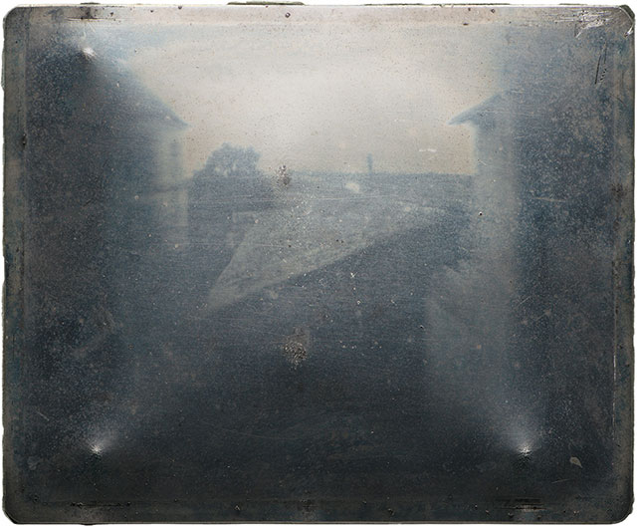
Niépce, View from the Window at Le Gras, around 1826-27, heliograph

Slide 3
Announcements
Drop Box on Moodle
Events Page on Moodle
PMA scheduling

Slide 4
Check in
Fall is coming! What type of activities are you looking forward to as the season changes?

Slide 5
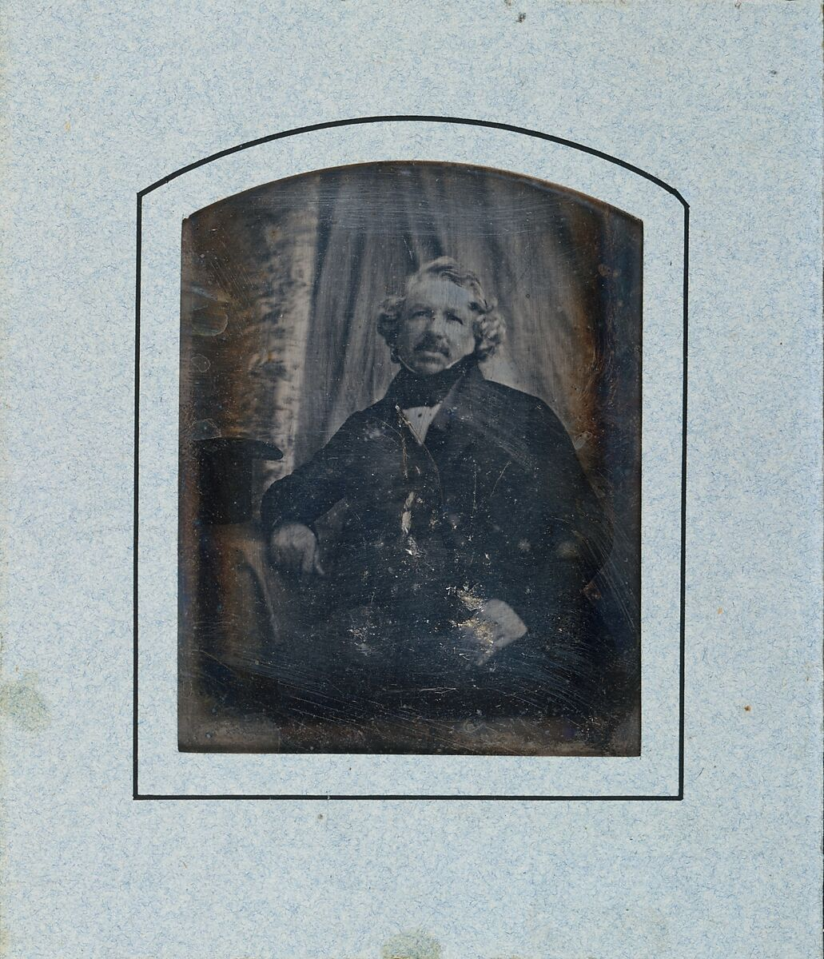
Unknown photographer, portrait of Louis-Jacques-Mandé Daguerre, ca. 1844, daguerreotype

Slide 6
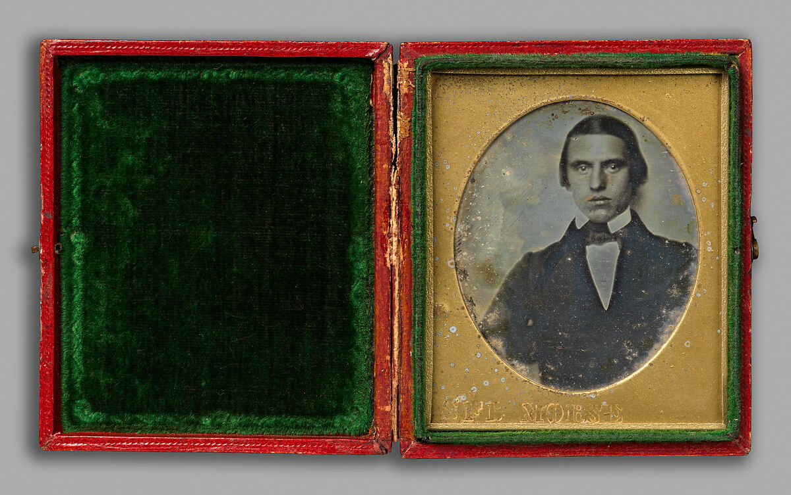
Samuel Morse, Portrait of a Young Man, 1840, daguerreotype

Slide 7
“by the action of light” (Niepce, 5)
“not merely an instrument which serves to draw Nature; on the contrary, it is a chemical and physical process which gives her the power to reproduce herself.” (Daguerre, 13)

Slide 8
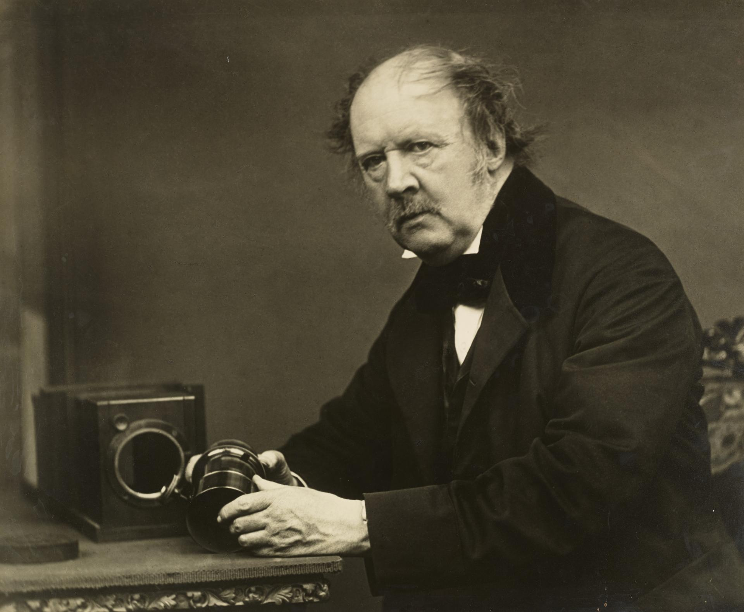
William Henry Fox Talbot (1800-1877)
An English, upper-class “gentleman” scientist
Traced botanical specimens with light-sensitive paper.
In 1833, he invented the salted paper print: paper treated with silver chloride and fixed with a solution of salt or potassium iodide.
John Moffat, William Henry Fox Talbot ‘Discoverer of Photography’, 1864, National Galleries of Scotland

Slide 9
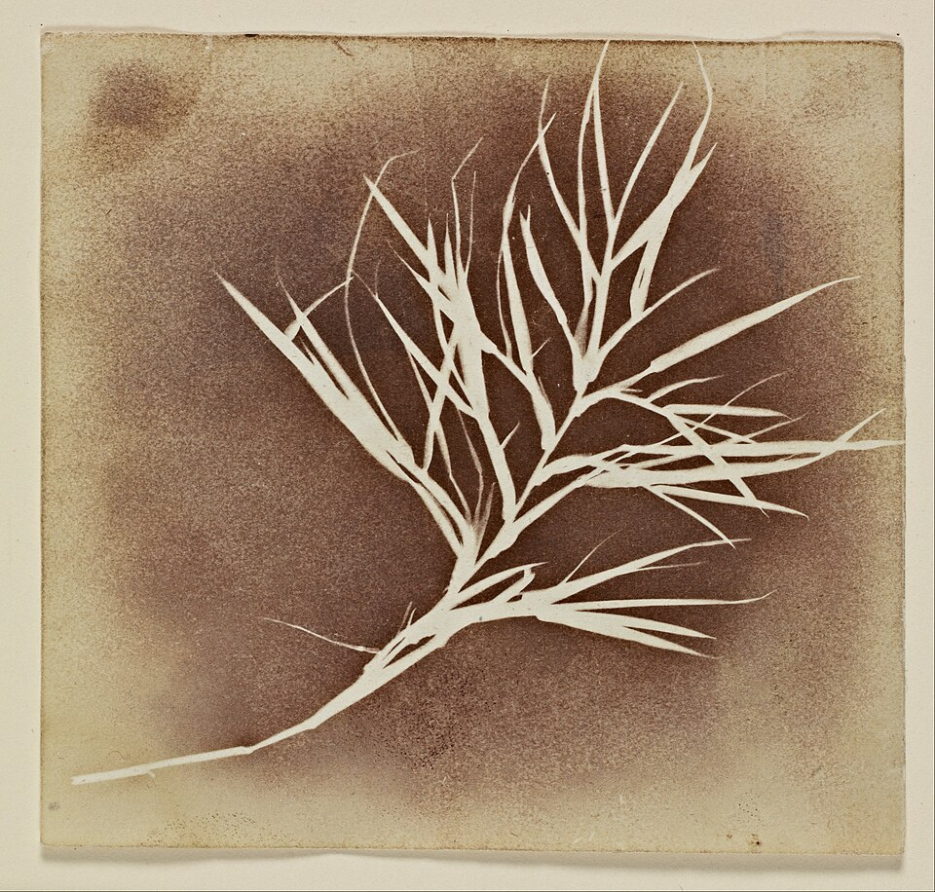
William Henry Fox Talbot, Plant, ca. 1835, salted paper print

Slide 10
Salt prints were different from Daguerreotypes in two important ways:
Unlike the Daguerreotype, which held a very thin layer of light-sensitive chemistry on top of its metal surface, the salted paper print absorbed the silver chloride into its fibers—thus fusing the two together.
Talbot’s images produced a “negative” image.

Slide 11
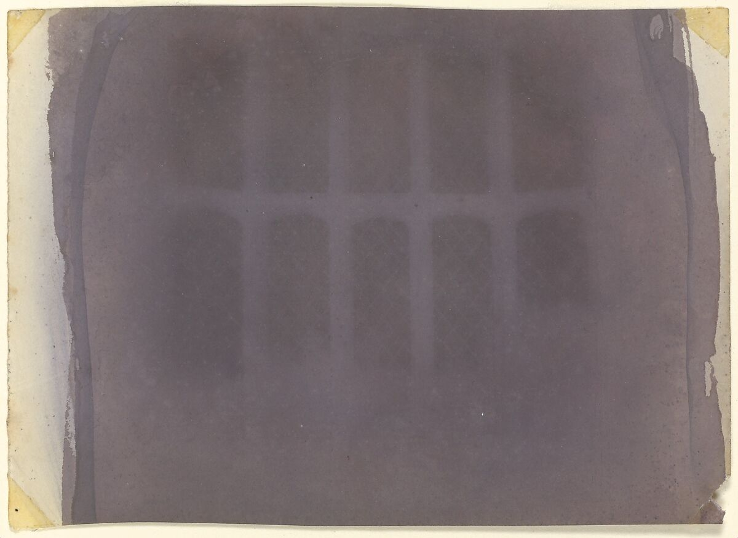
William Henry Fox Talbot, The Oriel Window, South Gallery, Lacock Abbey, probably 1835

Slide 12
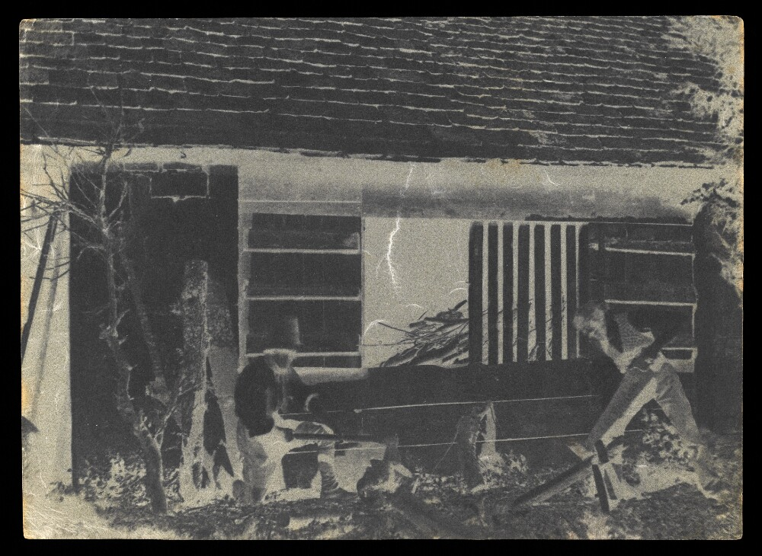
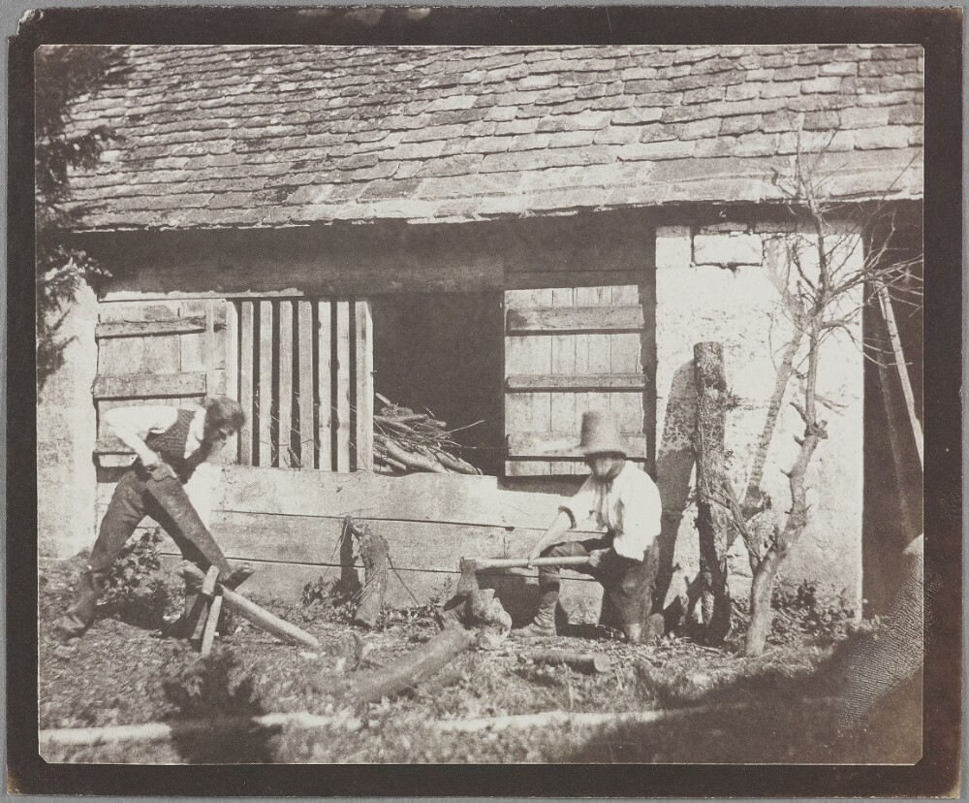
William Henry Fox Talbot, The Woodcutters, between 1835-1847, salted paper print (negative left, positive right)

Slide 13
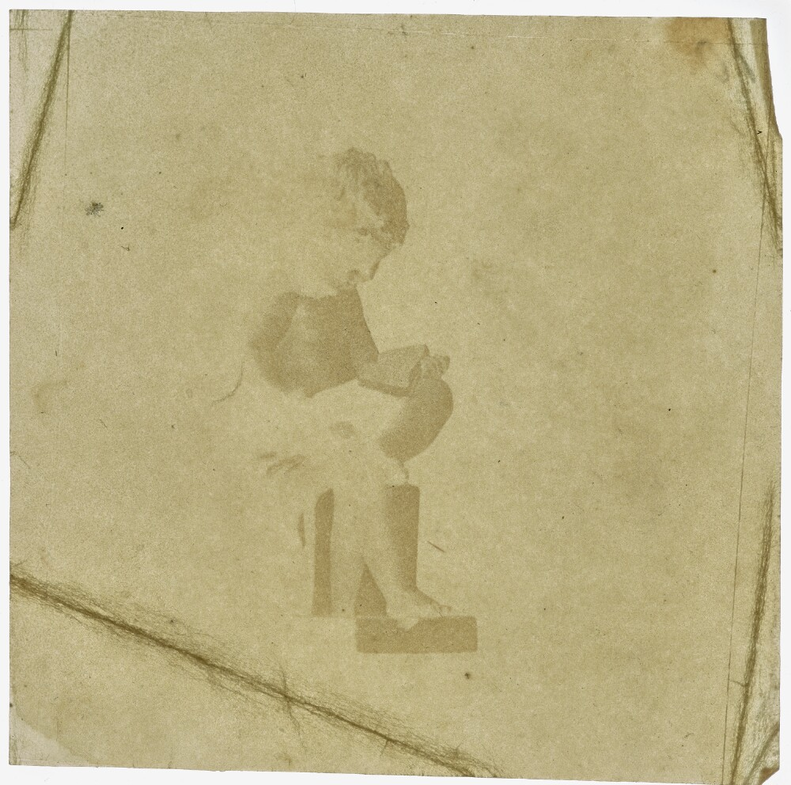
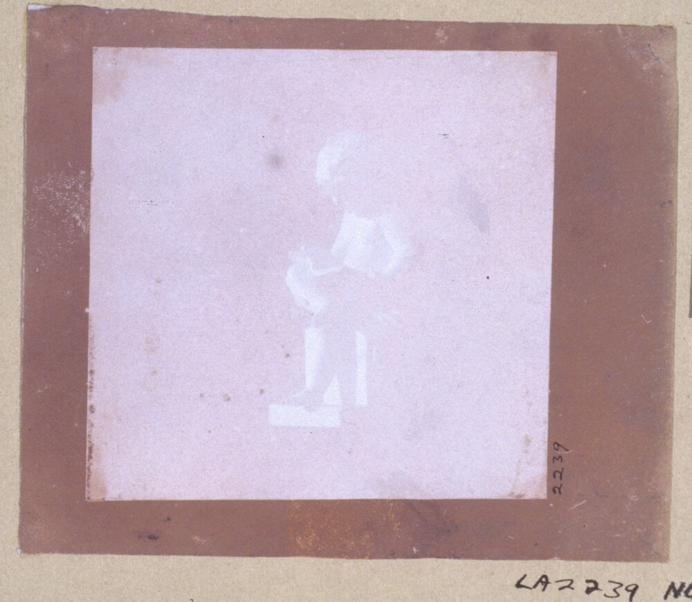
William Henry Fox Talbot, Statuette of a Seated Boy Reading, between 1835-1847, salted paper print (negative left, positive right)

Slide 14
1839 Announcement and the Calotype
When Talbot heard news of Daguerre’s invention in 1839, he quickly wrote to England’s Royal Society to announce his photographic process.
Talbot continued his experimentation with photography and improved his process.
In 1840, he discovered that iodized paper exposed to light could be developed after brushing it with gallic acid. This produced a strong enough negative image that could be more easily be printed into a positive.
He called this process the “calotype,” from the Greek words kalos and tupos together meaning “beautiful print.”
The calotype is also sometimes referred to as the Talbotype.

Slide 15
Animated Short on the History of the Talbotype:
https://www.youtube.com/watch?v=GMrDkcYiLC4 (SFMoMA)
How Calotypes are made:
https://www.youtube.com/watch?v=5jCWQTNWgyM (V&A)

Slide 16
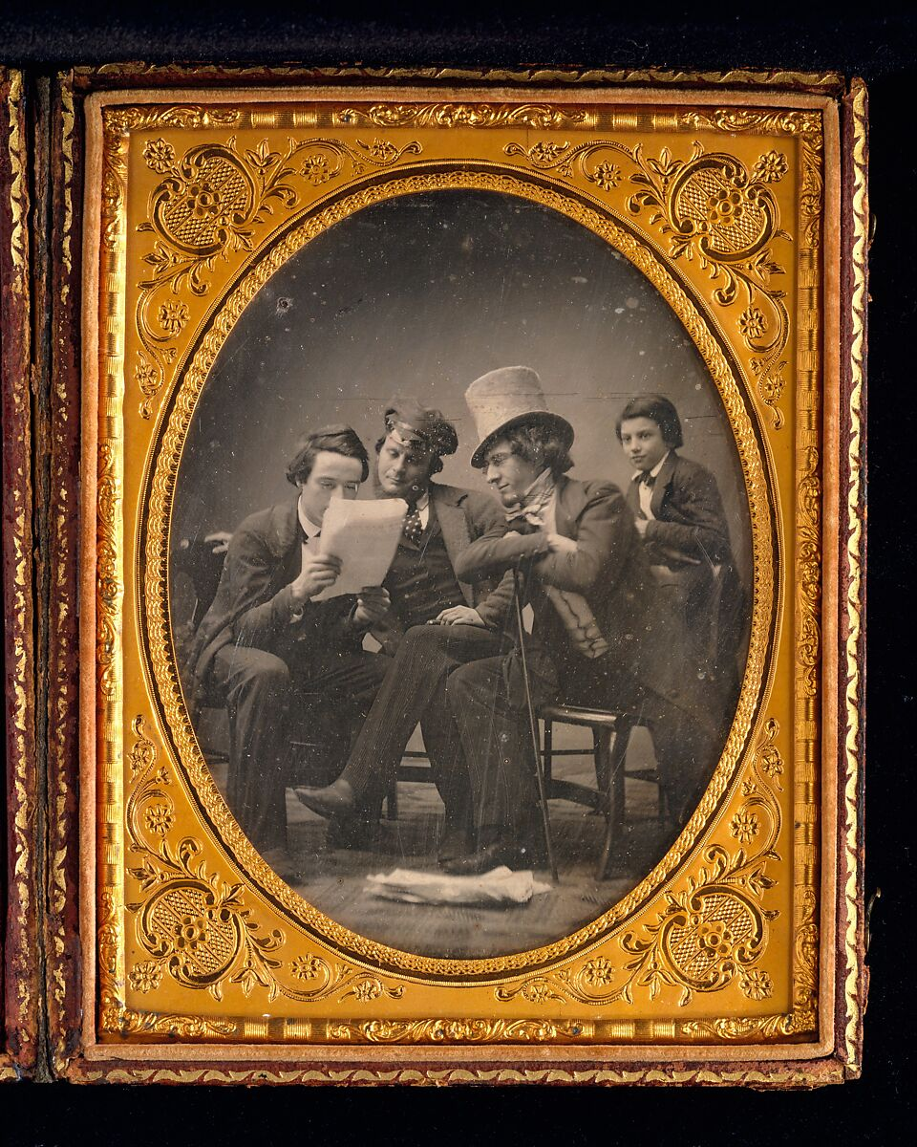
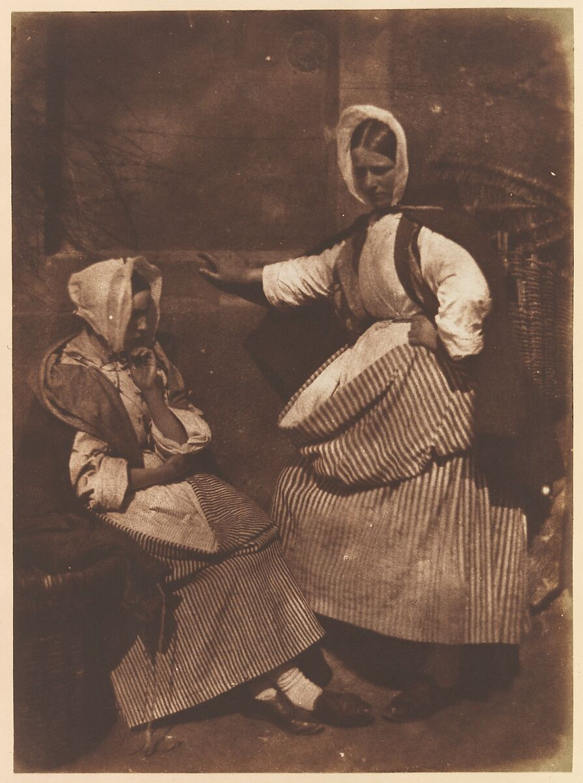
Daguerreotype or Salt Print?

Slide 17
Gabriel Harrison, California News, ca. 1850, daguerreotype
David Octavious Hill & Robert Adamson, Newhaven Fishwives, ca. 1845, salted paper print from paper negative

Slide 18
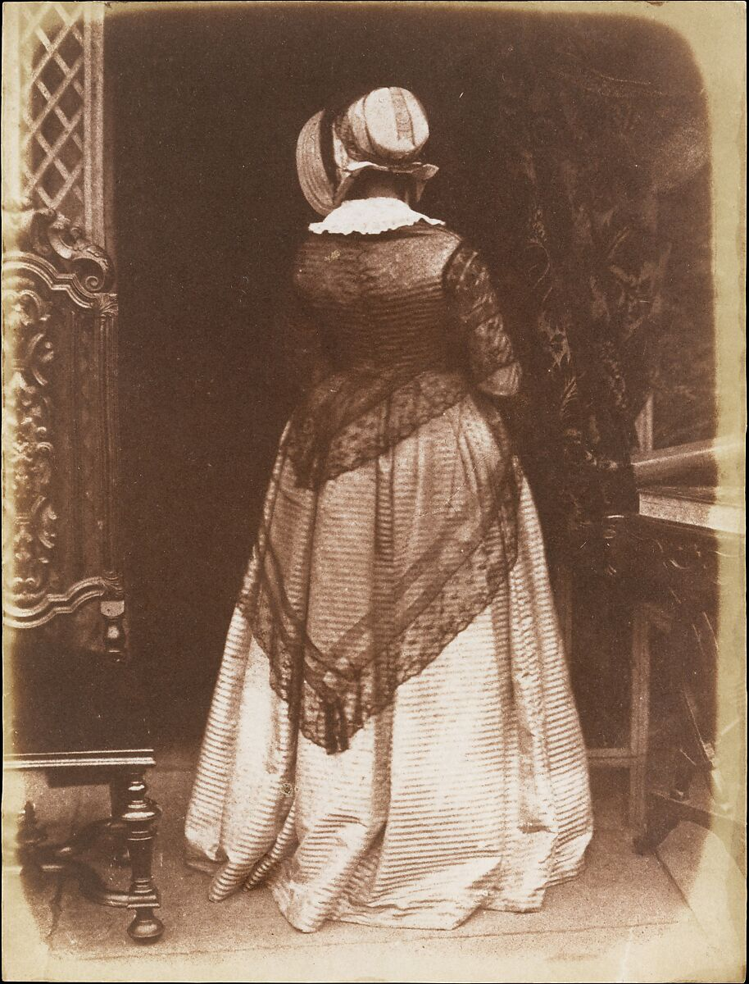
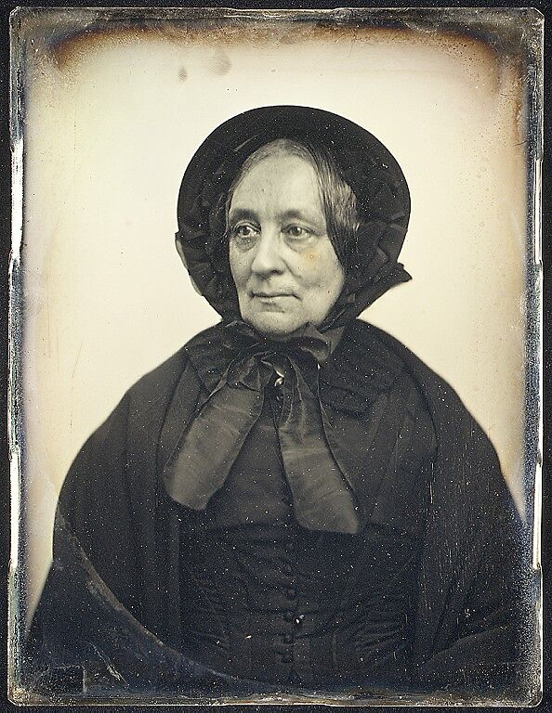
Daguerreotype or Salt Print?

Slide 19
David Octavious Hill & Robert Adamson, Lady Ruthven, ca. 1845, salted paper print from paper negative
Southworth and Hawes, Elderly Woman in Black Cape and Bonnet with Mourning Crape, ca. 1850, daguerreotype

Slide 20
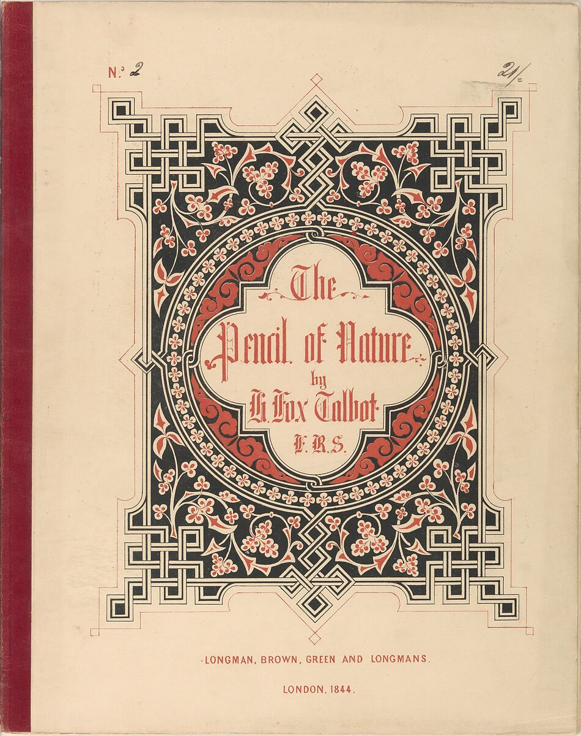
Reflect & Discuss
Review Talbot’s book and record your observations about how Talbot describes “photogenic drawing.” How does he explain what photography is? How does he illustrate what it can do?

Slide 21
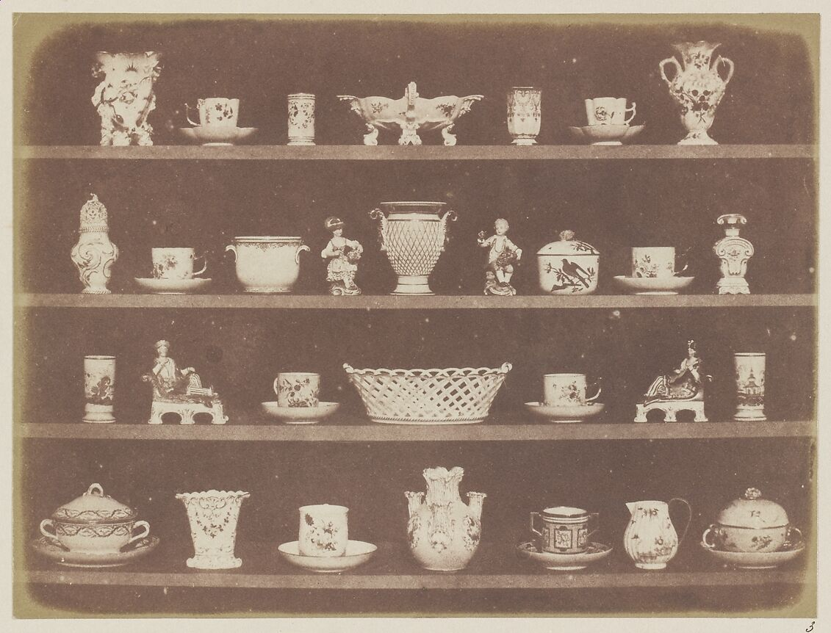
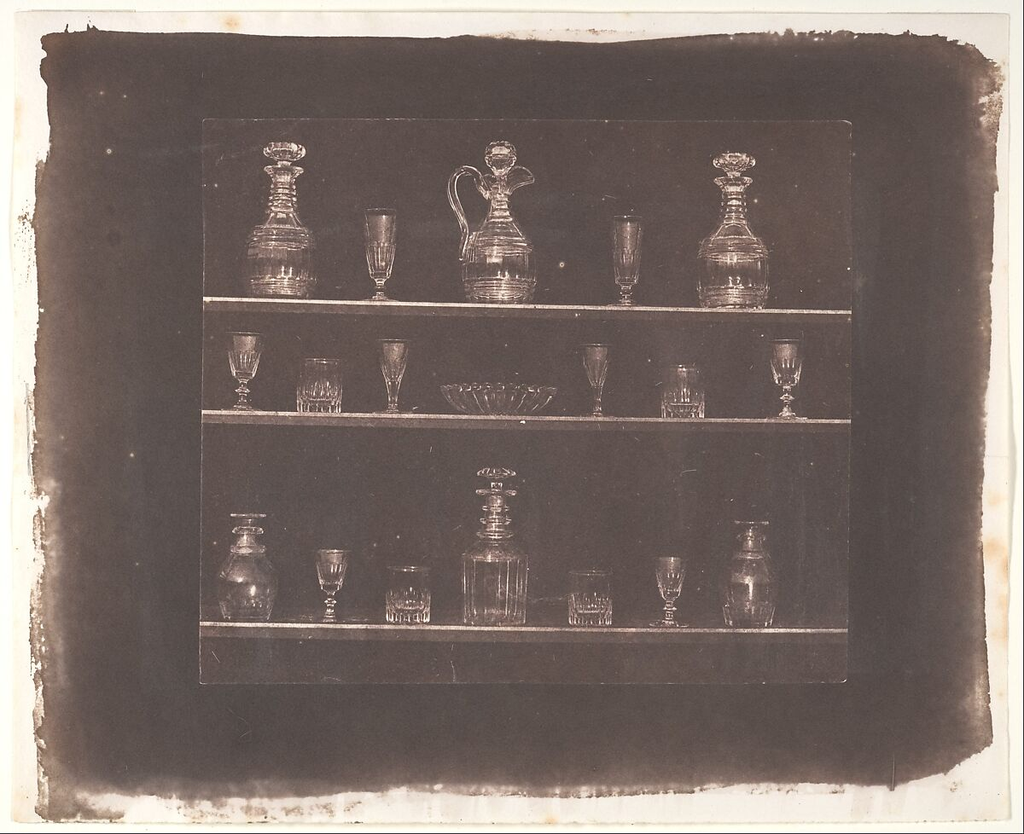
Articles of China
Articles of Glass

Slide 22
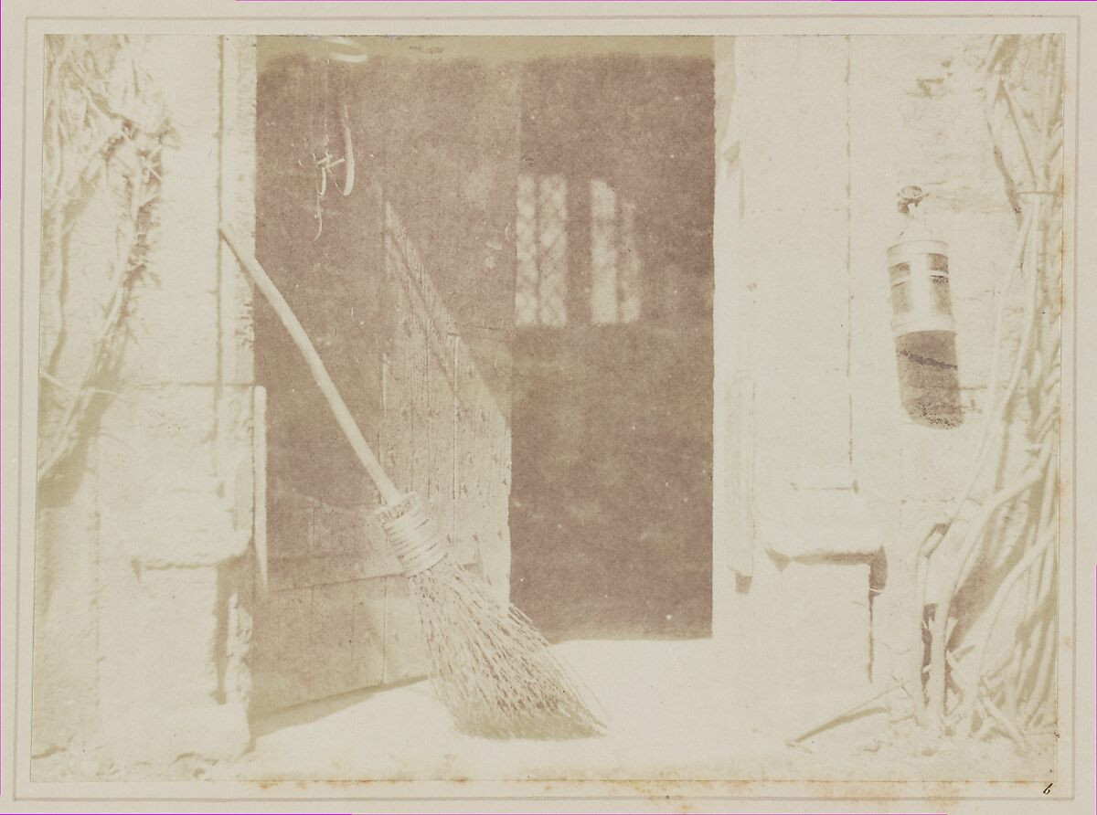
The Open Door

Slide 23
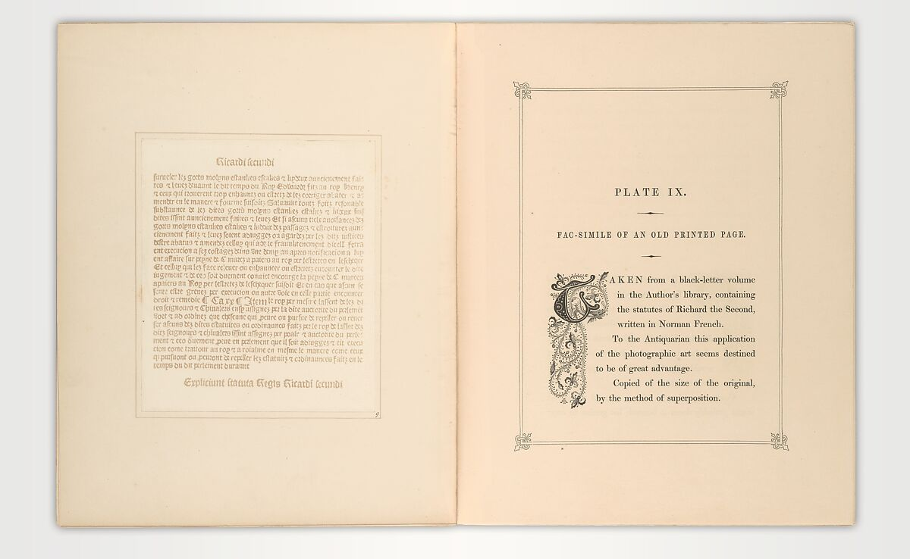

Slide 24
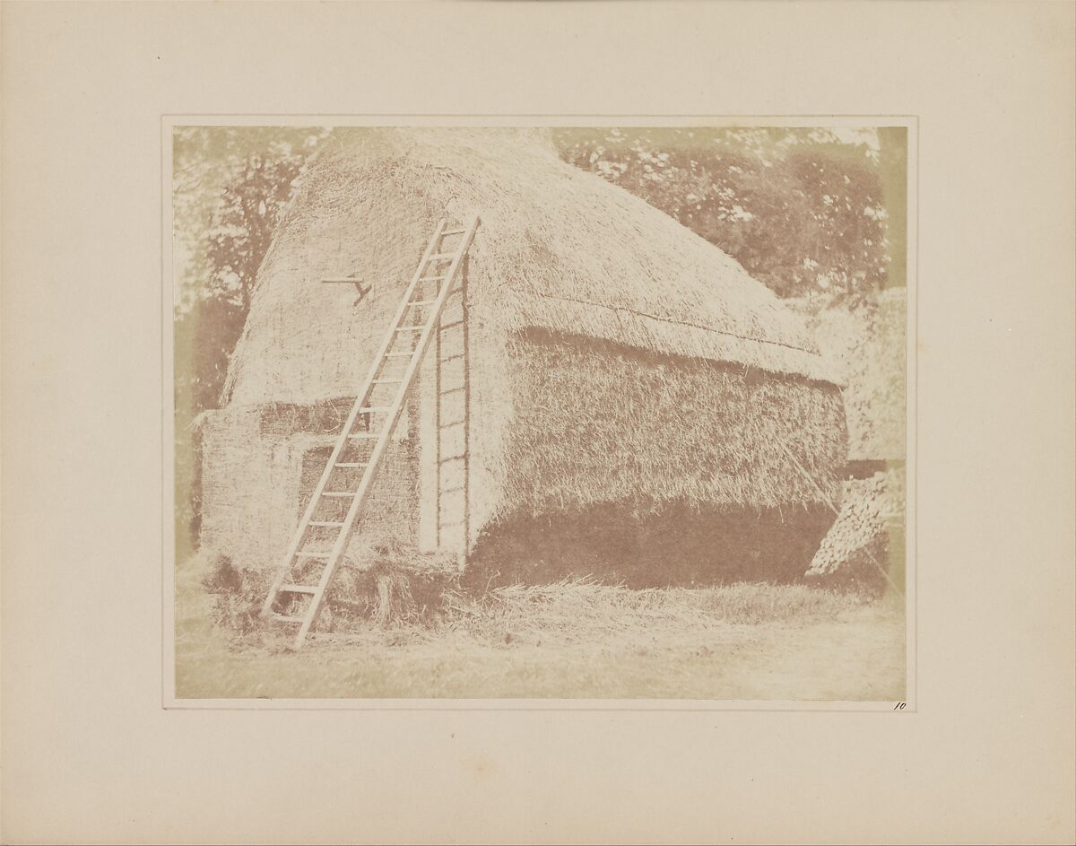
The Haystack

Slide 25
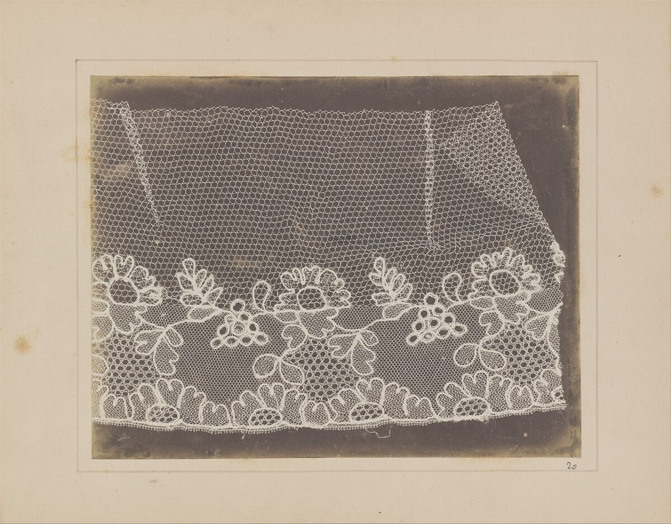
Lace

Slide 26
Thursday, September 10
ESEM-016: What is Photography?
Room: Taylor D
11:40 – 1:00 p.m.
Dr. Meg Hankel

Slide 27
Agenda
Attendance
Announcements
  Updated syllabus on Moodle
  Rubric Added
Talbot Response Essay
New Terms
Bayard & Florence Discussion
Writing Questionnaire

Slide 28
Useful Terms
Latent Image, the invisible impression of light on a photo-sensitive surface made visible after its contact with developer
Direct Positive, a photographic technique that does not produce a negative image.
Index, a linguistic term that refers to any kind of image or sign that points directly to the thing it signifies. For example: smoke, weather vane, wind sock, fossil , or photograph

Slide 29
Reflect & Discuss
This week, we encountered several other inventors of photography. Who were Hippolyte Bayard and Hercule Florence? How did they independently discover photography? How were their processes similar or different from the processes discovered by Niepce, Daguerre, and Talbot?

Slide 30
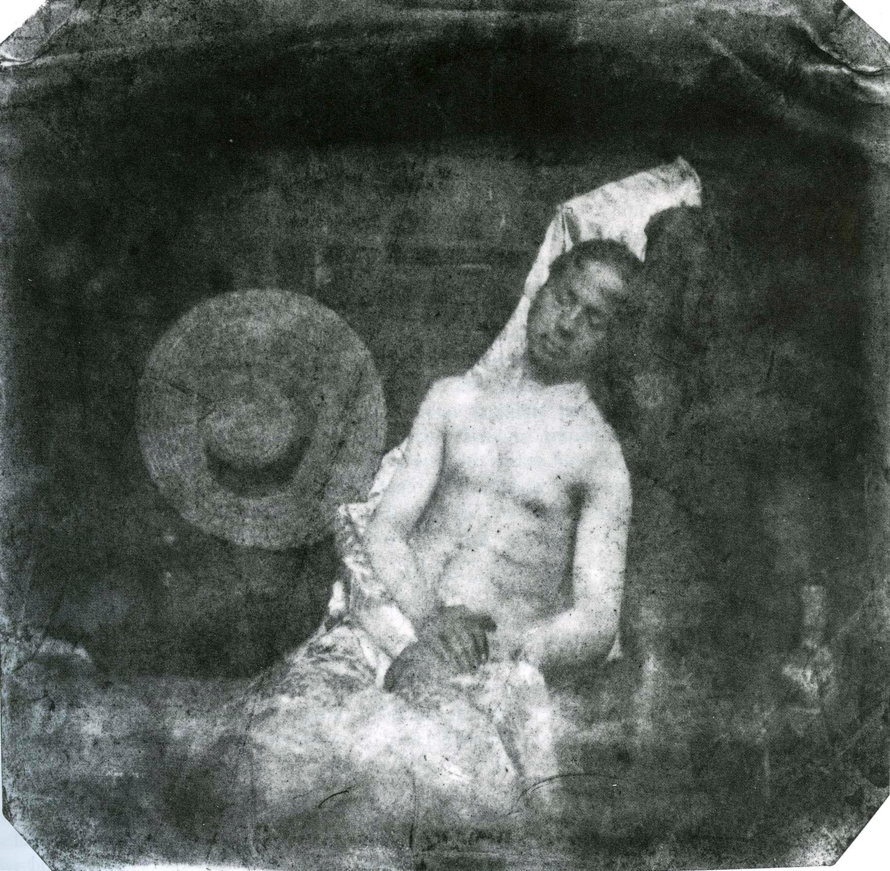
Hippolyte Bayard, Self Portrait as a Drowned Man, 1839, salt print

Slide 31
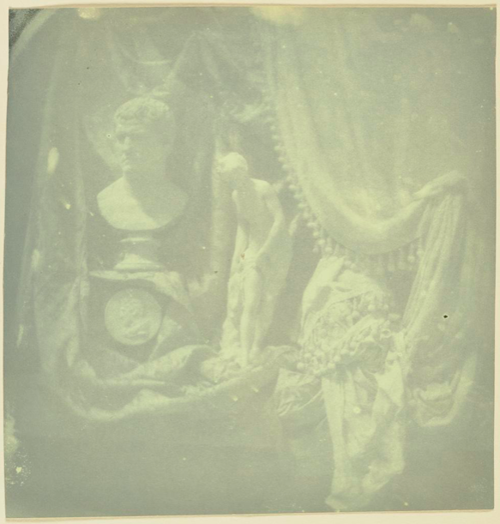
Hippolyte Bayard, Still Life with Statuettes, 1839, Direct positive [salt] print, Getty Museum

Slide 32
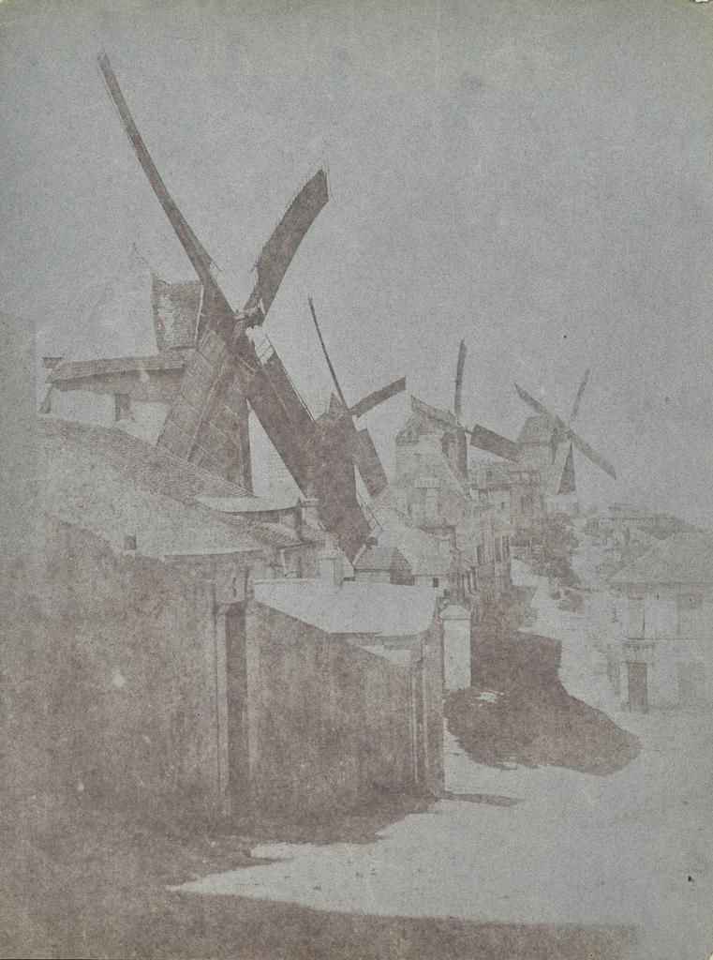
Hippolyte Bayard, Windmills of Montmartre, 1842, Salted paper print, Getty Museum

Slide 33
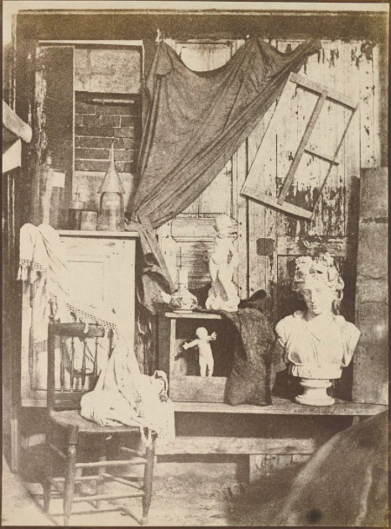
Hippolyte Bayard, In Bayard’s Studio, about 1845, Salted paper print, Getty Museum

Slide 34
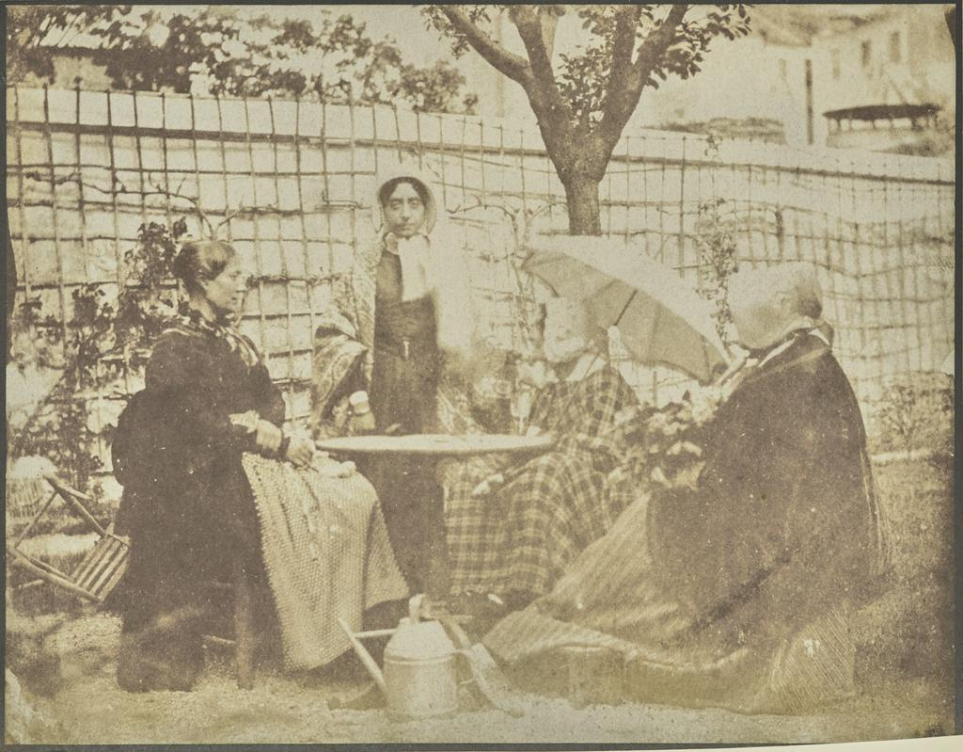
Hippolyte Bayard , Four Women Seated Outdoors, about 1840–49, Salted paper print, Getty Museum

Slide 35
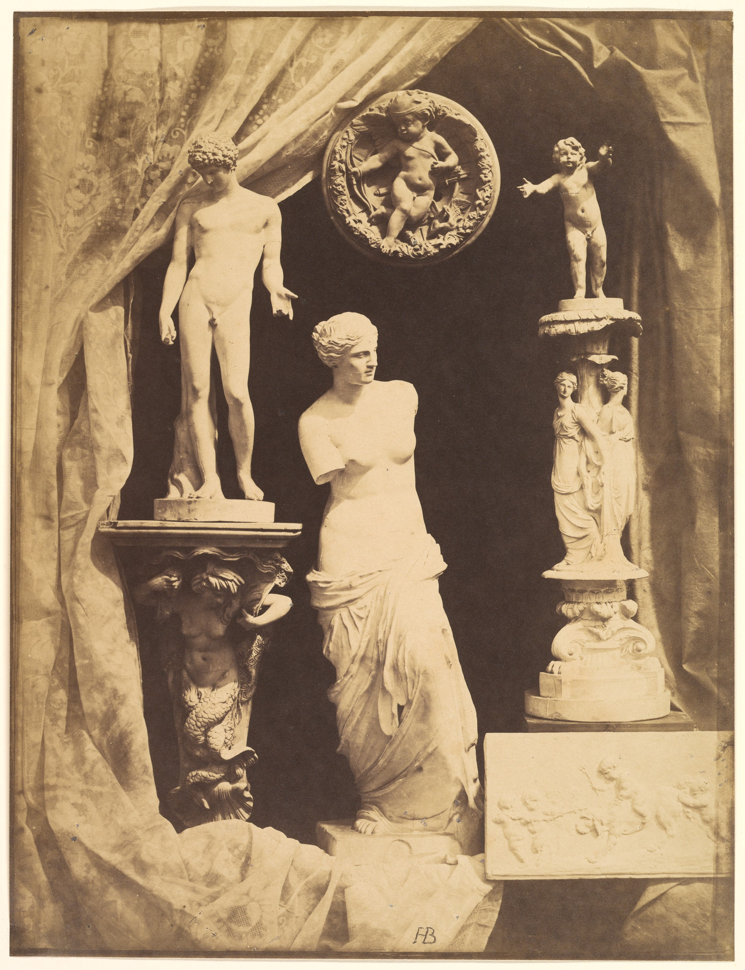
Hippolyte Bayard, Still Life with Statuary, early 1850s, albumen silver print from glass negative, Metropolitan Museum of Art

Slide 36
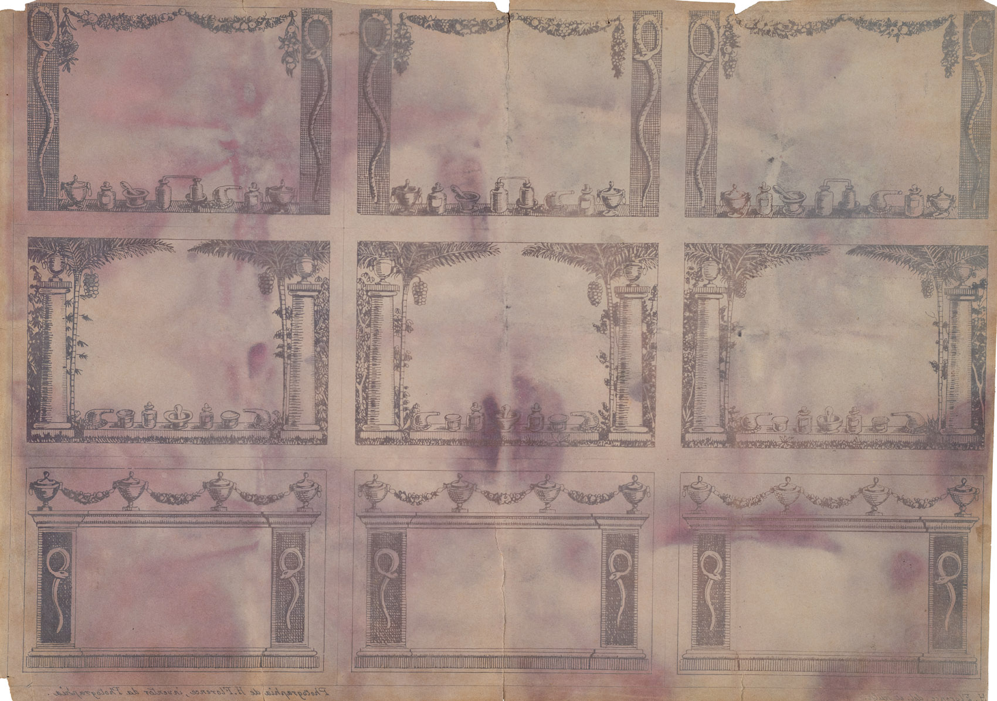
Hercule Florence, Photograph of nine pharmacy labels, c. 1833, contact copy with photosensitive paper, 21.0 x 29.4 cm, Institute Hercule Florence Collection (São Paulo)

Slide 37
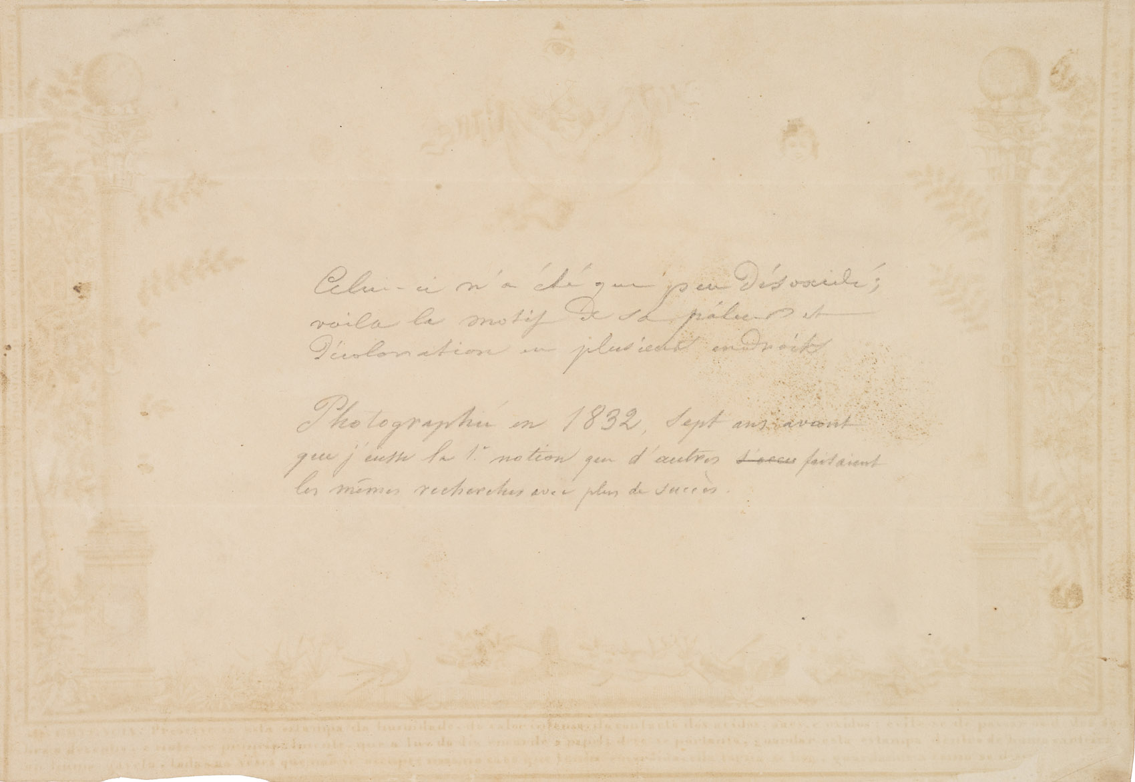
Hercule Florence, Photograph of Masonic diploma, undated, contact copy with photosensitive paper, 20.2 x 29.1 cm, Institute Hercule Florence Collection (São Paulo)

Slide 38
Reflect & Discuss
What were some of the contributing factors that made both Bayard and Florence unknown to photography history?

Slide 39
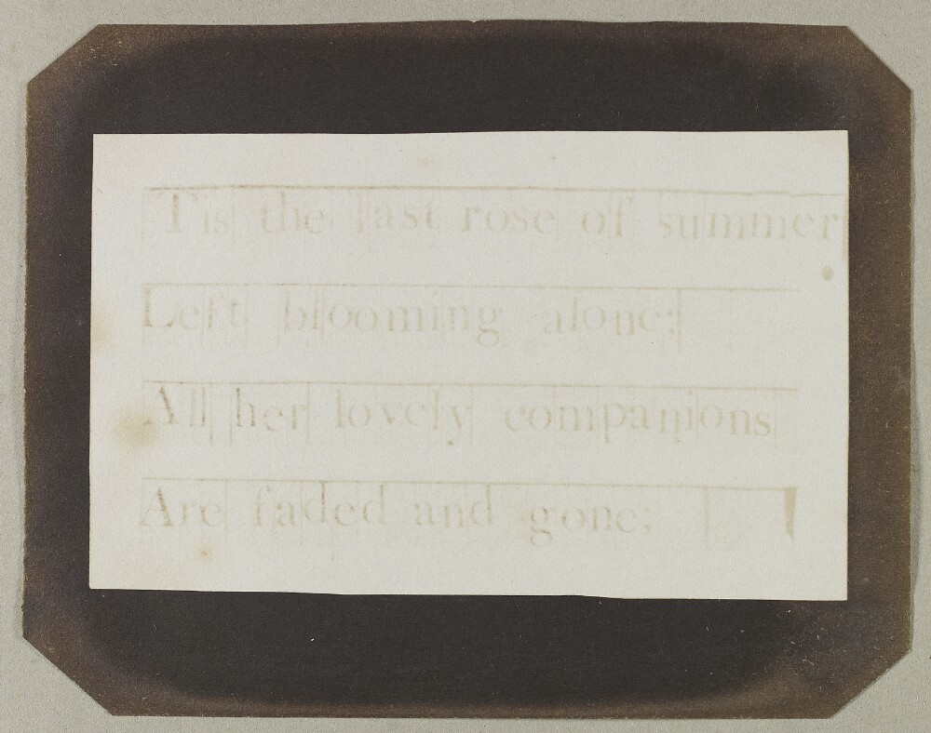
Other Early Figures
Constance Fox Talbot (1811-1880)
Constance Fox Talbot, Copy of a Typeset poem by Thomas Moore, “Tis the last rose of summer,” 1843, Bodleian Library

Slide 40
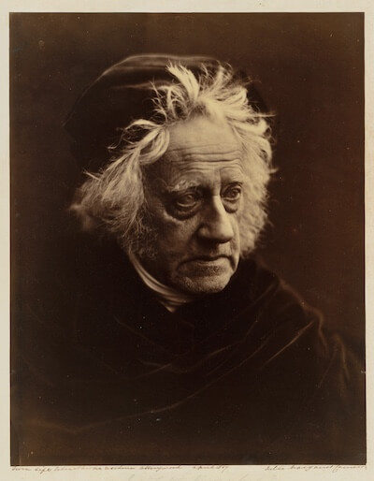
Other Early Figures
Sir John Herschel (1792-1871)
Astronomer, chemist, all-around polymath
In 1819, discovered that hyposulphite of soda (called “hypo”) would dissolve silver salts
Freely shared this information with Daguerre and Talbot after learning of their experiments in photography
Never patented or commercially sold his discoveries
Coined the word “photography” and verb “to photograph,” thus creating a shared terminology for the technology
Advised Talbot in 1839 that waxing a paper negative would make it more transparent and easier to print
He sensitized glass with silver halides, making the first glass plate negative
In 1842, invented the cyanotype (blueprint), a technique of photographic printing that used iron salts and water
And: He discovered Uranus (in 1781)
Julia Margaret Cameron, Sir John Herschel, 1867, albumen silver print from glass negative, Metropolitan Museum of Art

Slide 41
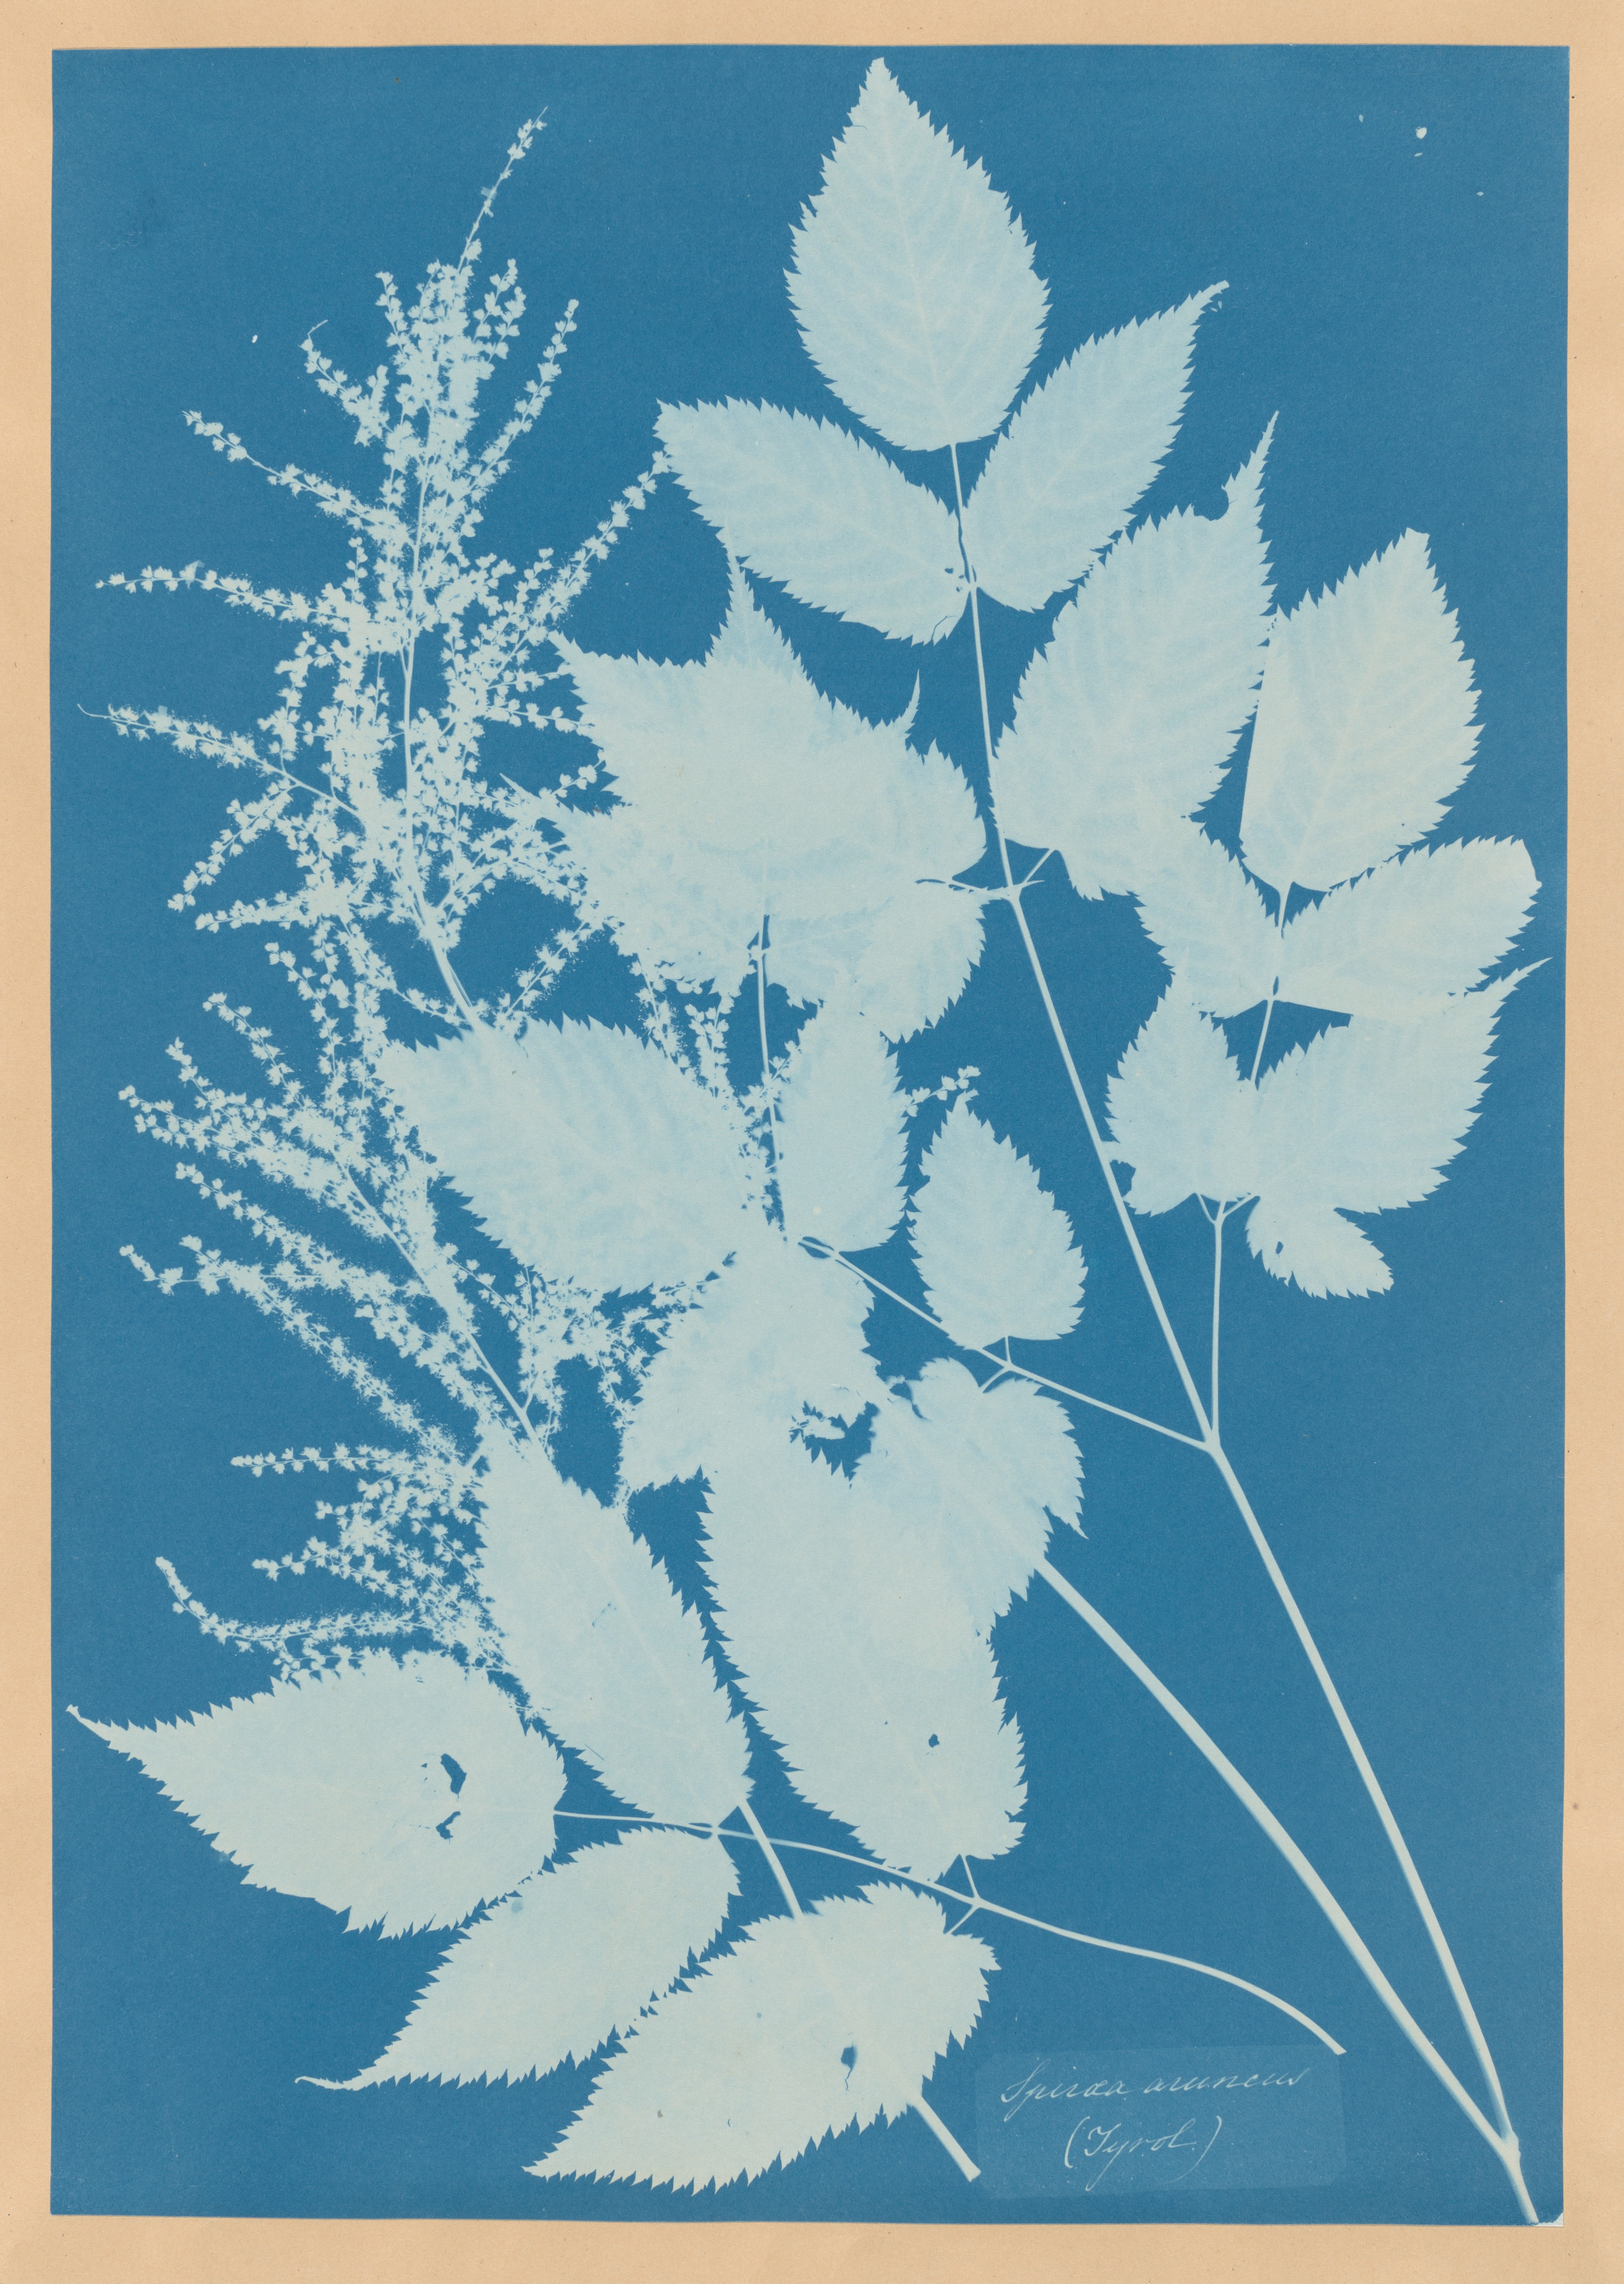
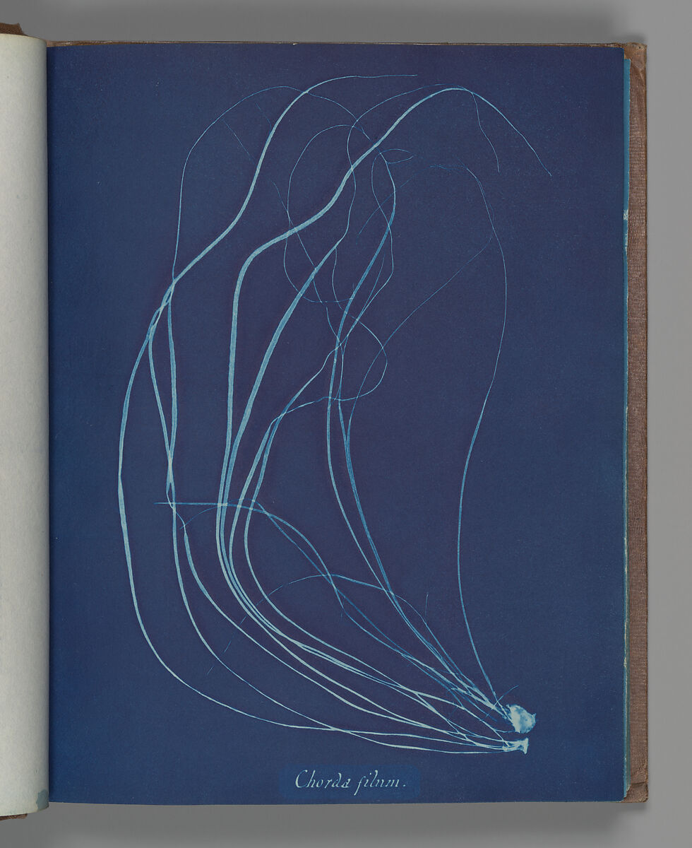
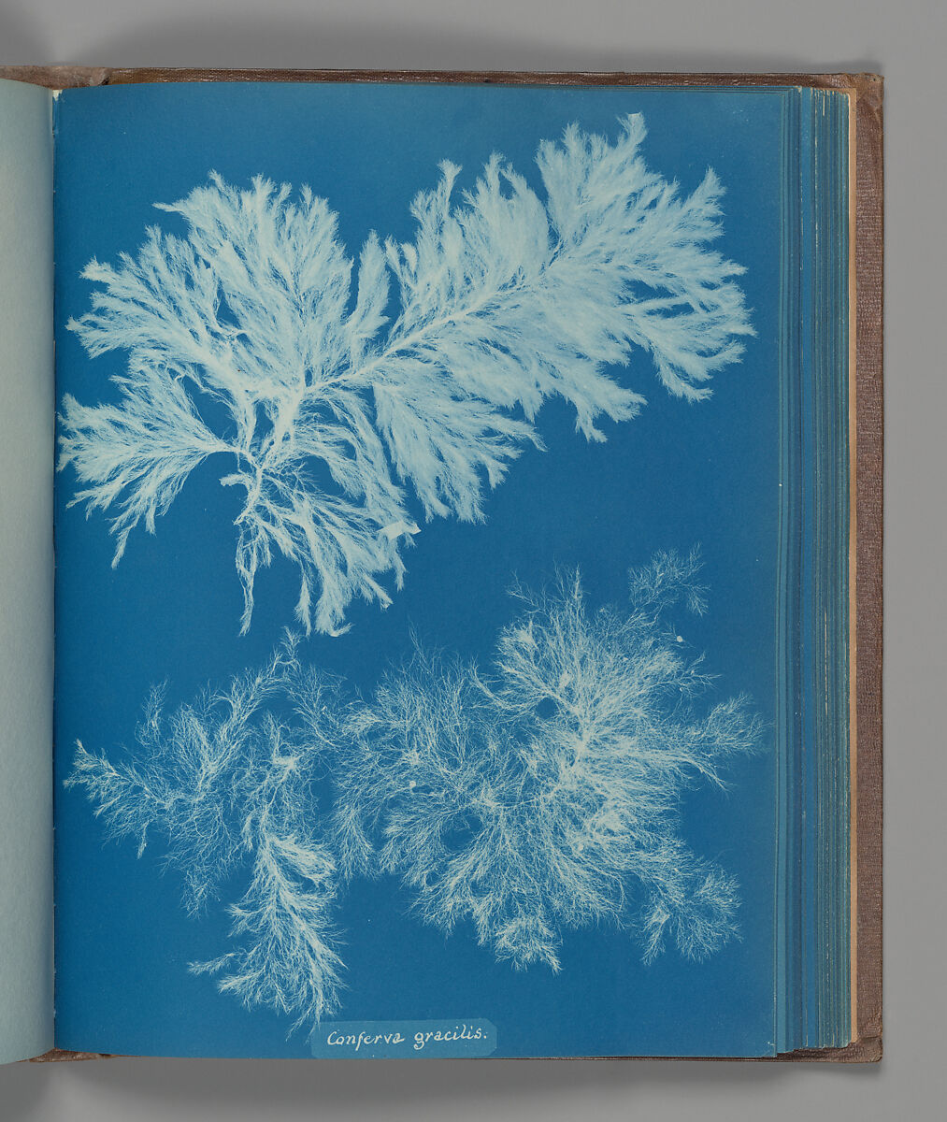
Other Early Figures
Anna Atkins (1799-1871)
Left to right: Chorda filum, 1853; Conferva gracilis, 1853; Spiraea aruncus (Tyrol), 1851-54, cyanotypes

Slide 42
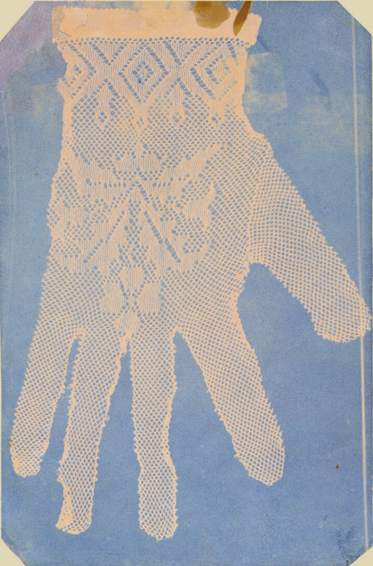
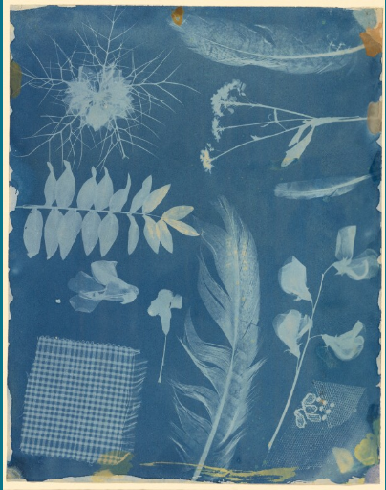
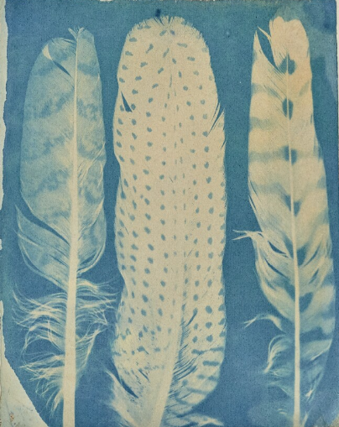
Bayard, Three Feathers, about 1842–1843, cyanotype, Getty Collection
Bayard, Arrangement of Specimens, around 1842, cyanotype, Getty Collection
Bayard, Lace Glove, about 1843–1846, cyanotype, Getty Collection

Slide 43
Reflect & Discuss
Does photography have an inventor?

Slide 44
Writing Questionnaire

