Slide 1

Theatrical Language

Slide 2
What is theatrical language?
Costumes
  Hair
Scenic Design
  Color
  Spectacle
  Mixed media (projections)
Lighting
Sound
  Vocality
    Dialects
    Volume
    Tone
    Inflection
  Music
  Sounds effects/atmospherics
Acting
  Virtuosity
  Deskilling
  Stage intimacy
Movement
  Blocking
  Choreography/dance
Make-up
Prosthetics
Props
Theater architecture
  Theater in the round
  Proscenium
  Thrust
  Black Box
  Amphitheater
Audience
  Reactions/laughter
  Fourth Wall
  Marketing/foyer
  Intimacy/size
  Demographics
  Stage dooring
Genre/Mode
  Interactive theater
  Devised
Context
  Historical
  Contemporary
  Famous productions
  Budget/tier of theater house/prestige
Casting
  Demographics
  With script or against script?
Notes:
Costumes
Set Design
Lighting
Sound
Props
Movement
Casting
Audience
Acting
Theater Architecture
New Media
Time
Scale
Context

Slide 3
What is a sign?
A sign is a figure that stands in for something else and is made up of two parts: the signifier and the signified
  The signifier is a tangible form or phenomenon that represents something. It could be a sound, a mark on a paper, a gesture, an object etc.
  The signified is an abstract concept or category that is referred to using a signifier.

Slide 4


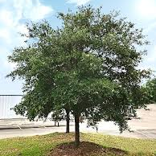
Tree

Slide 5
“in the theater light is brightness pretending to be other brightness, a chair is a chair pretending to be another chair, and so on. Put bluntly, in theater there is always a possibility that an act of sexual congress between two so-called signs will produce a real pregnancy.”
-Bert States, Great Reckonings in Little Rooms

Slide 6
Representational economy
Economy: a system of relative value
The value of a sign is determined by its relation to other signs
  For instance, in a sentence we understand certain words to be lode-bearing and others, positional: “That tree is full of rabid squirrels.”
High value signs: theatrical elements that communicate significant and layered meaning
Low value signs: theatrical elements that supplement or orient us to the meanings of higher value signs

Slide 7
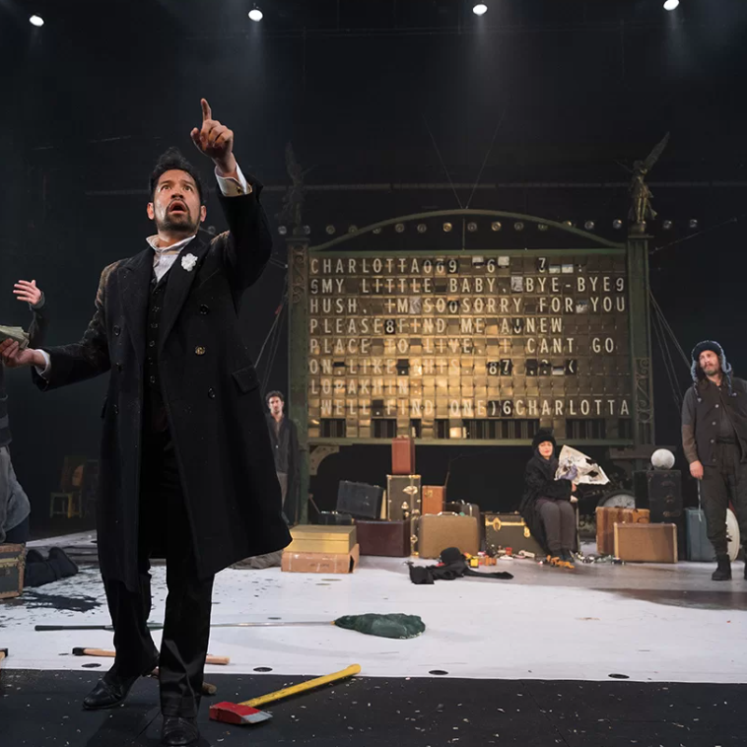
You come up with some very concrete idea, a theatrical idea, right? But it has to be this material idea that you can express through material, and you’re going to tell the story onstage through that material idea. To tell the audience that it’s all happening at the train station is to tell nothing. But if you can talk to that train board, all of a sudden you can talk, communicate with the board. Then it turns from the simple train board into an advisor or caring father or old grandfather who doesn’t understand anything sometimes, when in reality he understands everything. Or somebody who’s very jealous, or…
-Dmitry Krymov

Slide 8
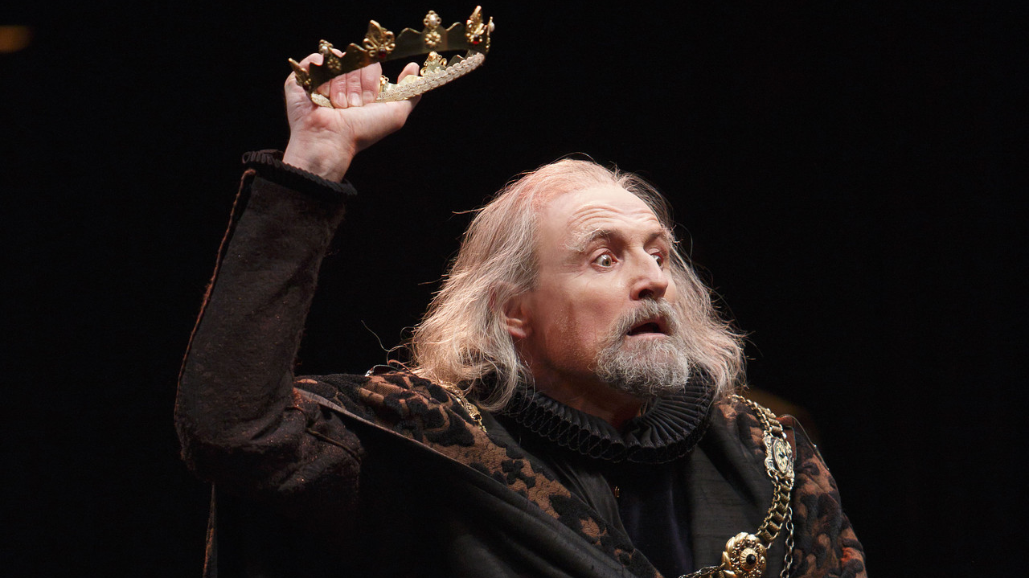

Slide 9
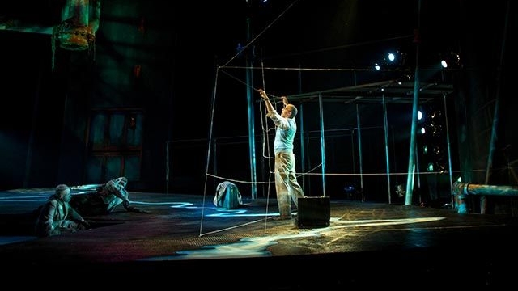

Slide 10
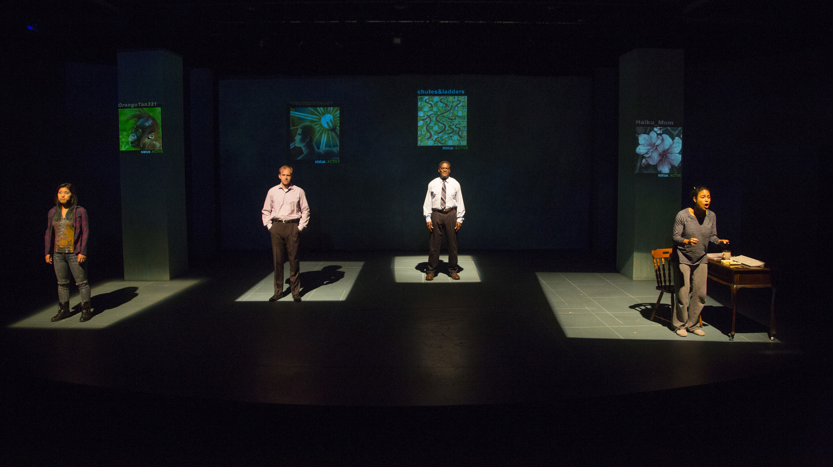

Slide 11
