Slide 1
Exploratory Data Analysis
Exploring the Relationship between Variables
September 10th 2026

Slide 2
Overview of Last Class: Exploring One Variable
Exploratory Data Analysis (EDA): the process of examining, visualizing, and summarizing data to understand the data.
For one variable, we ask:
What type of data? (Nominal/Ordinal/Quantitative)
What is the shape?
What is typical?
How much does it vary?
Are there unusual observations or missing values?
What patterns might be worth investigating?

Slide 3
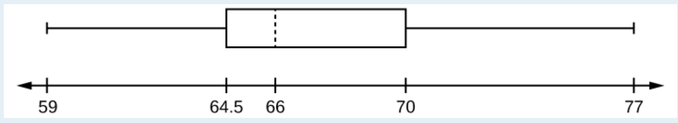
Practice Interpretation of Boxplot (9/8)
Minimum value =
Maximum value =
Q1: First quartile =
Q2: Second quartile or median =
Q3: Third quartile =
Range =
Interquartile range =
From B. Hazen’s Slides
Cote et al., 2021, p.40)
https://courses.lumenlearning.com/introstats1/chapter/box-plots/

Slide 4
Today: Exploring Relationships
Variables | What we want to know
Categorical + Categorical | Do proportions differ across groups?
Categorical + Numerical | Does the numerical variable differ across groups?
Numerical + Numerical | How do two numerical variables vary together?

Slide 5

A Familiar Dataset: Movie Ratings
Dataset includes 651 randomly selected movies scraped from the IMDb and Rotten Tomatoes websites from 1970-2014.

Slide 6
Questions to Explore with the Dataset
Does movie runtime differ by genres?
Is there a relationship between runtime and IMDb audience ratings?
Which genres are more likely to be nominated for Best Picture?
For each question, identify the two target variables and decide what type each variable is.

Slide 7
Exploring the Relationship Between Variables
Two Variables | What are we looking for? | Useful Tools
Categorical & Categorical | Do proportions differ across groups? Compare Proportions or Percentages | Segmented Bar Graphs
Categorical & Quantitative | Does the numerical variable differ across groups? Compare Distributions across Groups | Side by Side Boxplots
Quantitative & Quantitative | How do two numerical variables vary together? Examine the form, direction, and strength of the relationship | Scatterplot and Correlation

Slide 8
The Variable Types Determine the EDA
Two Variables | Visualize | Numerical Methods | Num. Methods Variability
Categorical & Categorical | Segmented Bar Graph | Proportions or Percentages, Mode | None
Categorical & Quantitative | Side-by-Side Boxplot | Median or Mean* | Minimum/Maximum + IQR OR SD*
Quantitative & Quantitative | Scatterplot | Correlation | Spread
* Assumes Approximately Symmetrical Distributions

Slide 9
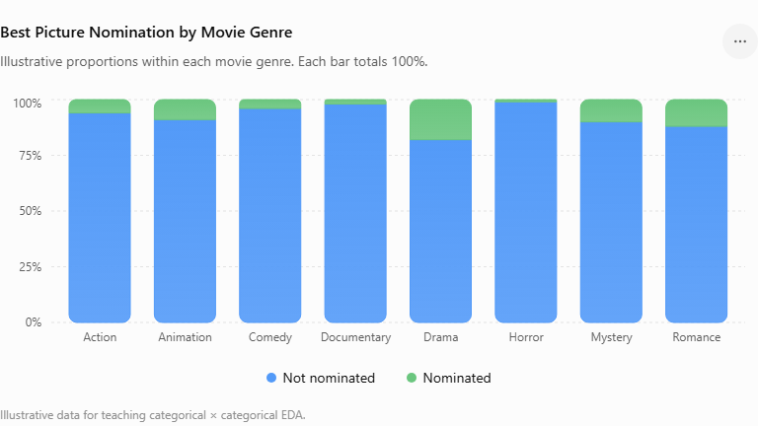
Two Categorical Variables
Is there a relationship between Movie Genres and Best Picture Nominations?
What are we asking?
Genre tells us which group each movie belongs to. Best picture nomination tells us if the movie was nominated.
Compare patterns of Yes/No across genres.

Slide 10
Base R Functions for EDA
Base R functions for Visualizing Two Categorical Variables:
barplot(t(object),
legend.text = TRUE,
xlab = "x-label", ylab = "y-label", main = "header")
Base R functions for Summarizing Two Categorical Variables:
table(movies$genre, movies$best_pic_nom)
prop.table(table(movies$genre, movies$best_pic_nom))
prop.table(table(movies$genre, movies$best_pic_nom), margin = 1)

Slide 11
Interpreting and Describing the Relationship
Interpret the Relationship, Not Just the Output
The graph and numerical summaries are EVIDENCE for your interpretation.
11

Slide 12
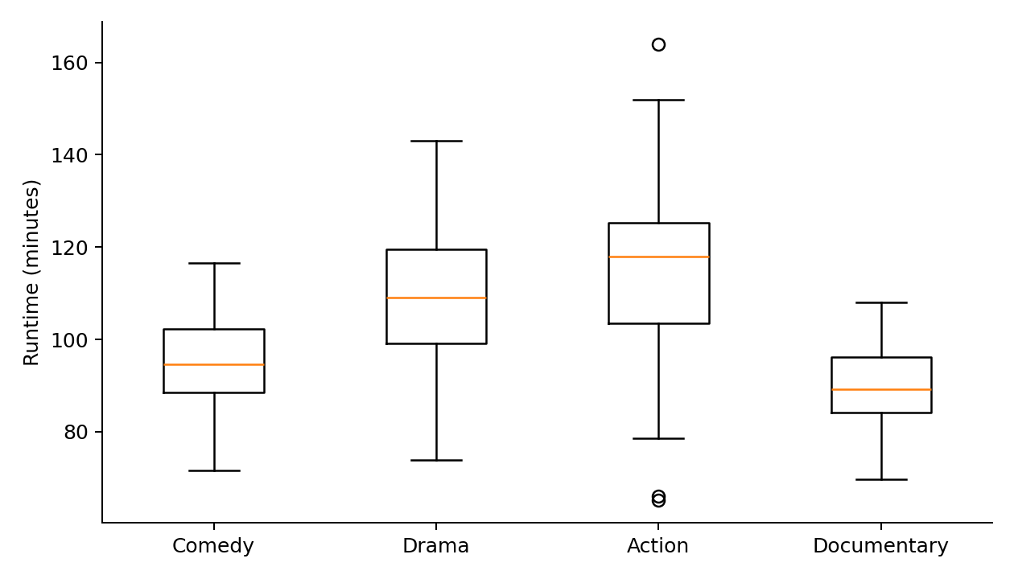
One Categorical + One Numerical Variable
Does movie runtime differ by genres?
What are we asking?
Genre tells us which group each movie belongs to.
Runtime is a numerical measurement.
We compare runtime distributions across genres.
Look for differences in:
Center, Spread, Shape, Unusual Values

Slide 13
Base R Functions for EDA
Base R function to Visualize the Data:
boxplot(dataset$variable ~ dataset$factor)
The formula tells R: Plot this numerical variable by groups of categorical variable.
Base R function for specific numerical statistic by factor:
aggregate(dataset$variable ~ dataset$factor, FUN = name of method)
The formula tells R: Compare the numerical variable across the groups.

Slide 14
Which Numerical Summaries to Interpret?
Visualize first → examine the distributions → choose appropriate summaries.
Roughly symmetric
No influential outliers
Skewed and/or
Influential outliers
Mean + SD
Median + IQR
This is the SAME decision we make when examining one variable at a time — now we make it within each group.
10

Slide 15
Interpreting and Describing the Relationship
Interpret the Relationship, Not Just the Output
Ask about the pattern
Which genres tend to have longer or shorter runtimes?
How much do the distributions overlap?
Do some genres vary more than others?
Any unusual observations?
The graph and numerical summaries are EVIDENCE for your interpretation.
11

Slide 16
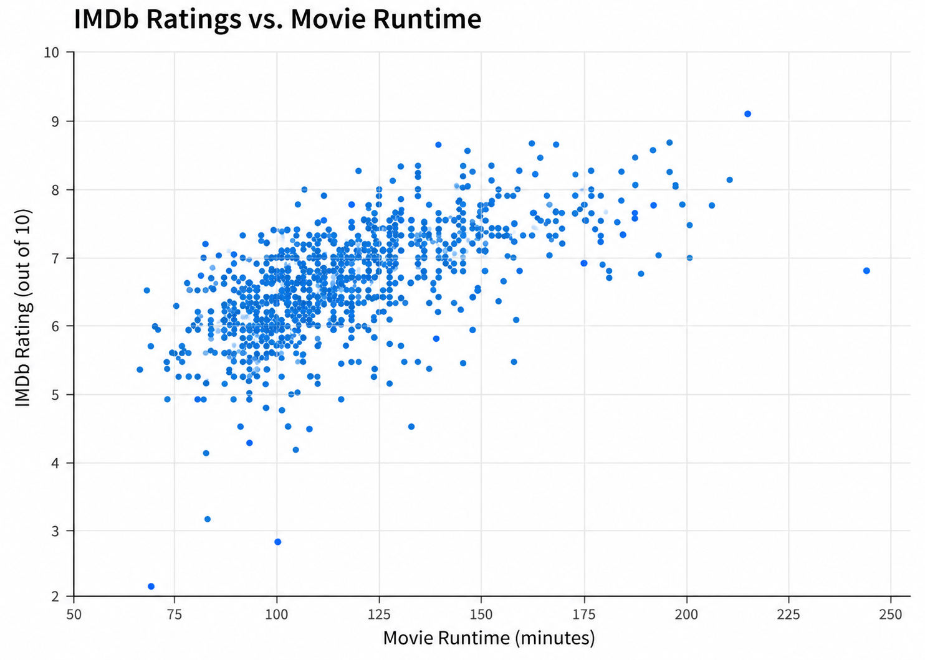
Two Numerical Variables
Is there a relationship between runtime and IMDb audience ratings?
What are we asking?
What is the relationship between these two variables?
If Linear, what is the strength and direction of this relationship?

Slide 17
Summarizing and Reporting Scatterplots
FORM
Does the pattern look approximately linear, curved, or something else?
DIRECTION
As X increases, does Y generally increase or decrease?
STRENGTH
How closely do points follow the overall pattern?
UNUSUAL OBSERVATIONS
Are there points that do not fit the general pattern?
Form → Direction → Strength → Unusual Observations
13

Slide 18
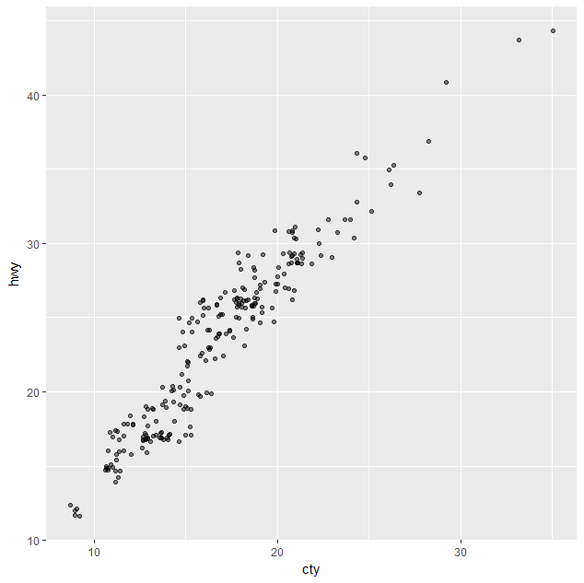
Base R Functions for EDA
Base R functions for the correlation coefficient:
cor(ABC, GHF, use = "complete.obs")
Standard Interpretation Guidelines:
small = r ~ .10,
medium = r ~ .30,
large = r ~ .5
Also depends on Research Context.
Base R function for plotting scatterplot
plot(ABC, GHF)
Scatterplot

Slide 19
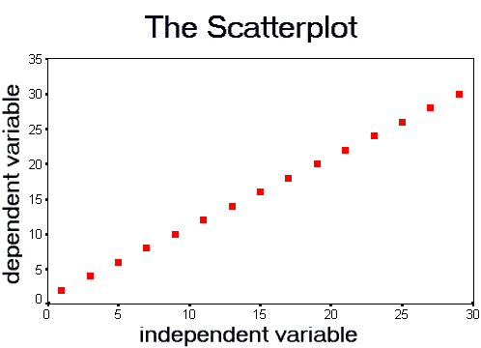
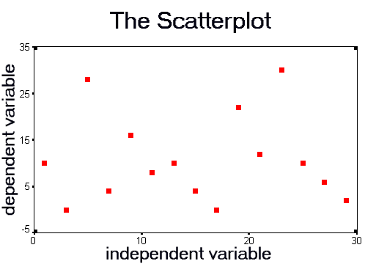
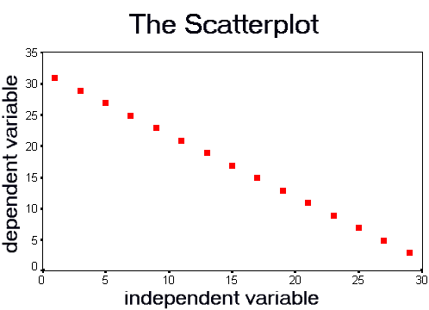
Interpreting Correlations & Scatterplots
Strong Weak Strong
+1 | Perfect Positive Linear Relationship
0 | No Linear Relationship
-1 | Perfect Negative Linear Relationship

Slide 20
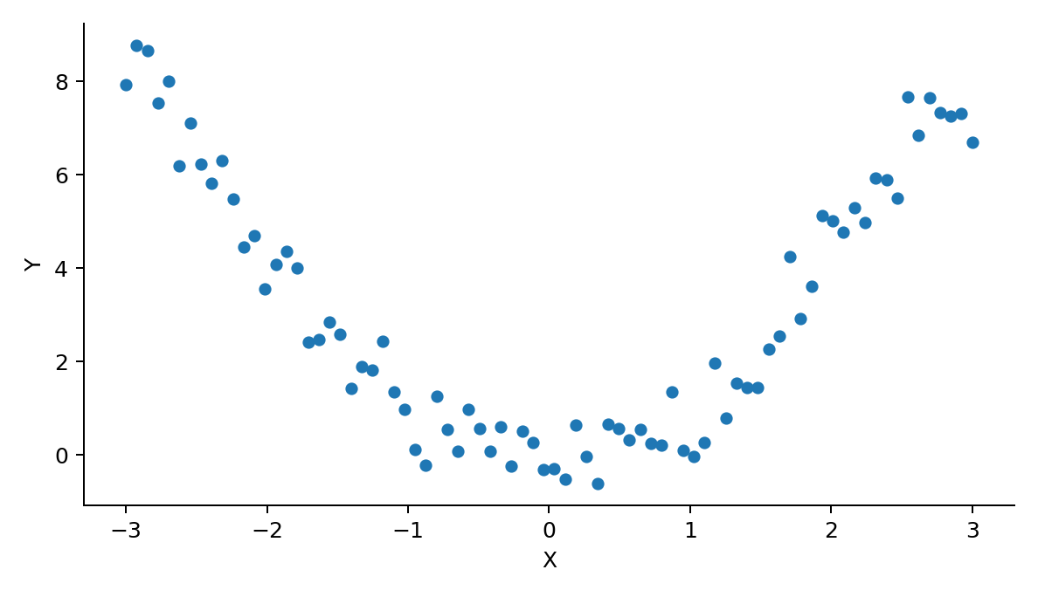
Important: r = 0 Does NOT always mean “No Relationship”
There is a clear relationship here.
But the relationship is curved,
not linear.
Correlation could be near 0.
Takeaway: ALWAYS look at the scatterplot.
15

Slide 21
Putting it All Together: Exploring Relationships between Variables.
Variable Types
What to Examine
Useful Tools
Categorical + Categorical
Compare proportions
Bar / segmented bar
Categorical + Numerical
Compare group distributions
Side-by-Side boxplots + group summaries
Numerical + Numerical
Form • Direction • Strength • Unusual Values
Scatterplot + correlation
QUESTION
→
VARIABLES
→
TYPES
→
VISUALIZE
→
SUMMARIZE
→
INTERPRET
16

Slide 22
Univariate EDA: Putting it All Together
Scale | Visualize | Summarize | Look For
Nominal | Bar Graphs | Proportions or Percentages; Mode | Common and rare responses
Ordinal | Ordered Bar Graphs | Proportions or Percentages; Mode; Median + IQR when useful | Common and rare responses; Ordering and distribution
Numerical | Histograms Box Plots | Minimum/Maximum + Mean + SD OR Median + IQR | Center, spread, shape, unusual values

Slide 23
Base R Functions for EDA of Categorical Data
Numerical Methods
Frequency: table(ABC)
Proportions: prop.table(table(ABC))
Percentages: round(prop.table(table(ABC)) * 100, 2)
Ordinal Data: median(ABC) and IQR(ABC)
Graphical Displays
Bar graphs: barplot(table(ABC))
Pie charts: pie(table(ABC))

Slide 24
Base R Functions for EDA of Quantitative Data
summary(ABC) hist(ABC)
mean(ABC, na.rm = TRUE) boxplot(ABC)
median(ABC)
sd(ABC) and IQR(ABC)
range(ABC), max(ABC) and min(ABC)
quantile(ABC) - Quantiles 25%
fivenum(ABC) - Returns Tukey's five number summary (minimum, # lower-hinge, median, upper-hinge, maximum)
(ABC = name of object; missing values coded as NA)
Calculate what helps you understand the variable.
Report the summaries that best describe the distribution.

