Slide 1

Isomerism
Alkane Conformations
Cycloalkanes
Q-center: https://www.brynmawr.edu/inside/offices-services/q-center/q-center-schedule
Office Hours: M 1:30pm - 3:00pm
(in Park 169) W 11:00am - 12:00pm
or by appointment (email me)
or just email me with questions!
TA Hours w/ Sodtugs: T&Th 7:00pm - 8:00pm
(in Park 273)
9/14/2026
Exam 1 Friday during lecture
No recitation this week

Slide 2
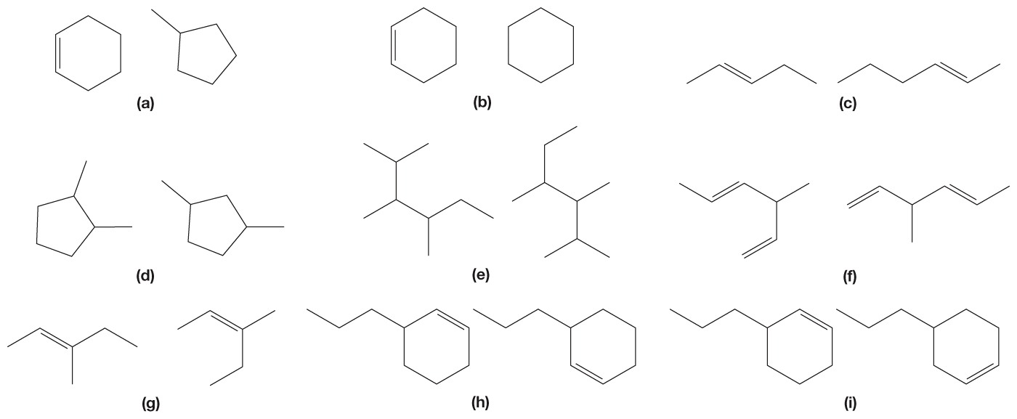
Poll
pollev.com/timcook653 or text timcook653 to 22333
Or use Android/iPhone app
Which of these pairs of molecules are constitutional isomers?
A
B
C

Slide 3
Alkane conformations
Conformational isomers (conformers) -

Slide 4

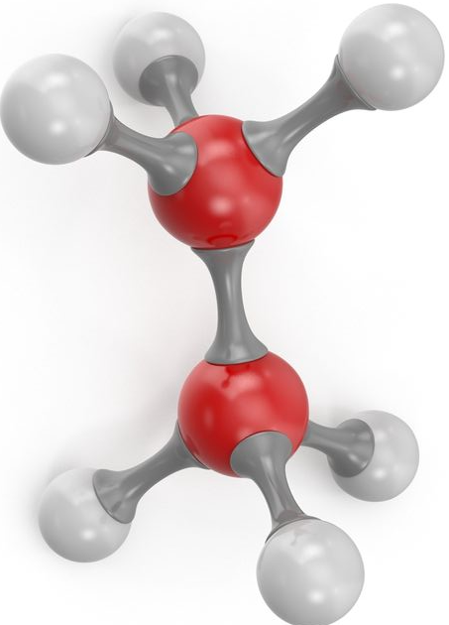
Newman projections

Slide 5
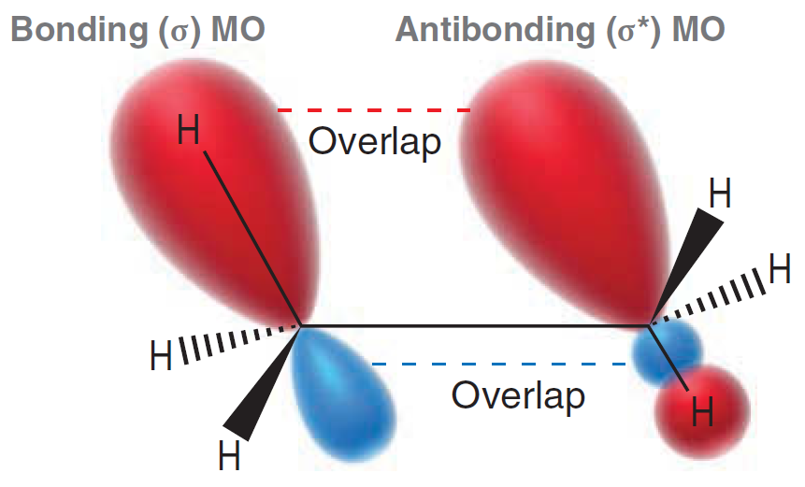
Conformational Analysis and Strain
Torsional strain:
Steric strain:
the lack of this orbital interaction causes torsional strain

Slide 6
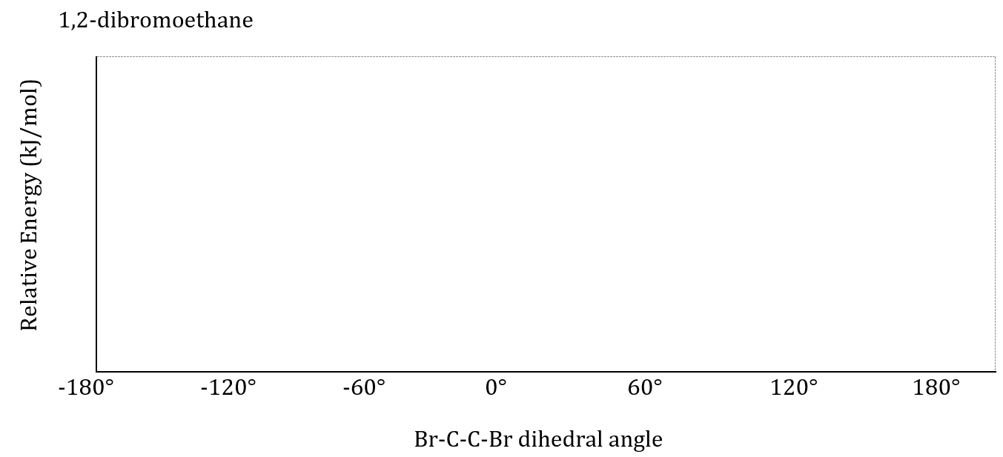

Slide 7
Be able to:
Convert bond-line drawings to Newman projections & vice versa
Identify the relative stability of conformations of a specified bond
(for exam - show all possible staggered and eclipsed conformations and rank their stability)
Identify types of strain in a given conformation
Draw/identify staggered vs eclipsed conformations
  Classify staggered conformations as “anti” or “gauche”

Slide 8
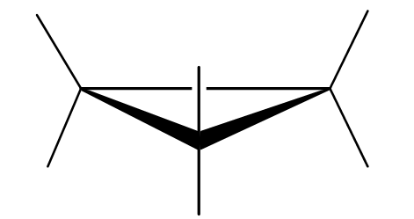
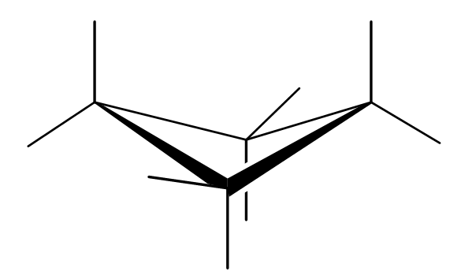
Conformations of cycloalkanes and ring strain
Cyclopropane Planar ring
Cyclobutane Puckered ring

Slide 9
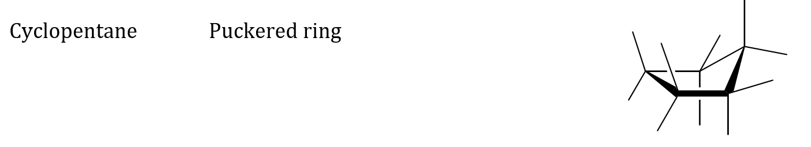
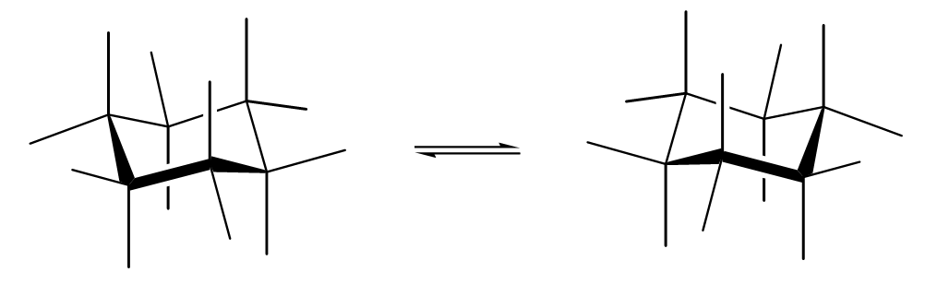

Slide 10
Drawing cyclohexane (textbook method is good too)

Slide 11
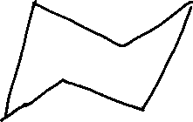
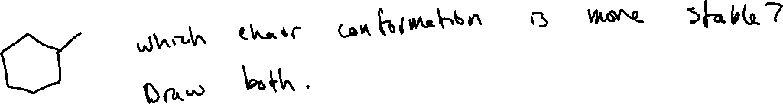
Monosubstituted cyclohexanes and drawing chair flips

Slide 12
Cyclohexane Newman Projections

Slide 13
Disubstituted cyclohexanes – naming/drawing

Slide 14
Disubstituted cyclohexanes - stability

Slide 15
Disubstituted cyclohexanes - stability

