Slide 1
Q-center: https://www.brynmawr.edu/inside/offices-services/q-center/q-center-schedule
Office Hours: M 1:30pm – 3:00pm
(in Park 169) W 11:00am – 12:00pm
or by appointment (email me)
or just email me with questions!
TA Hours w/ Dana: Th 6:00pm – 7:00pm
(in Park 273) F 4:30pm – 6:00pm
Mol Calculations
Mass % Composition
9/14/2026
Achieve HW #2 due Monday 9/14 at 10:00am
Achieve HW #3 due Thursday 9/17 at 8:00pm
Exam 1 in lecture on Friday (everything before mass % composition)

Slide 2
Learning Objectives
Calculate formula masses for covalent and ionic compounds
Define the amount unit mole and the related quantity Avogadro’s number
Explain the relation between mass, moles, and numbers of atoms or molecules, and perform calculations deriving these quantities from one another
Calculate the percent composition of a compound (by mass)

Slide 3
How many donuts are there in 7 dozen?

Slide 4
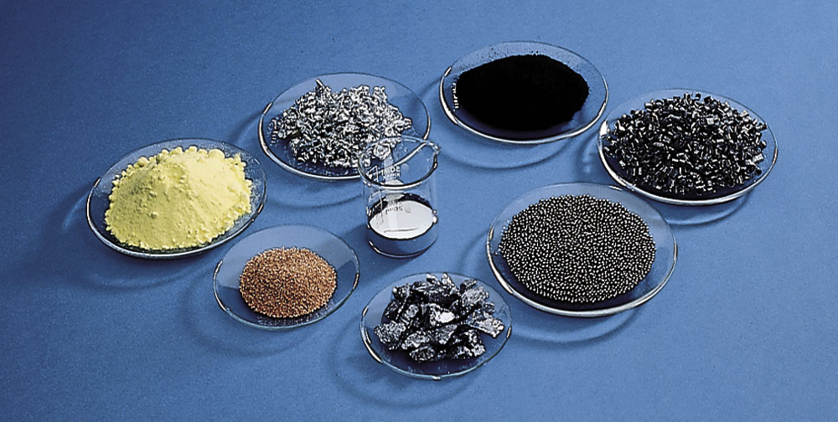

Slide 5
The Mole and Avogadro’s Number
The mole is the SI unit for counting particles.
Useful for counting very very large numbers of things (like atoms and molecules)!
1 mole of C atoms = 6.02 x 10²³ C atoms
1 mole of H₂O molecules = 6.02 x 10²³ H₂O molecules
The number 6.02 x 10²³ is Avogadro’s number.

Slide 6
The Mole and Avogadro’s Number
Avogadro's number
Atoms or
Molecules
Moles
1 mol
6.02 x 10²³ atoms
or
6.02 x 10²³ atoms
1 mol
1 mol
6.02 x 10²³ molecules
or
6.02 x 10²³ molecules
1 mol

Slide 7
The Mole and Avogadro’s Number
How many molecules are contained in 4.0 moles
of water (H₂O)?
1 mol = 6.02 x 10²³ “things” (i.e. atoms, molecules, etc)

Slide 8
The Mole and Avogadro’s Number
Example: A silver ring contains 1.1 x 10²² silver atoms.
How many moles of silver are there?
1 mol = 6.02 x 10²³ “things” (i.e. atoms, molecules, etc)

Slide 9
How many carbon atoms are in 5.02 mol of carbon?

Slide 10
Avogadro's number
Molar
Mass
Atoms/Molecules
Moles
Grams

Slide 11
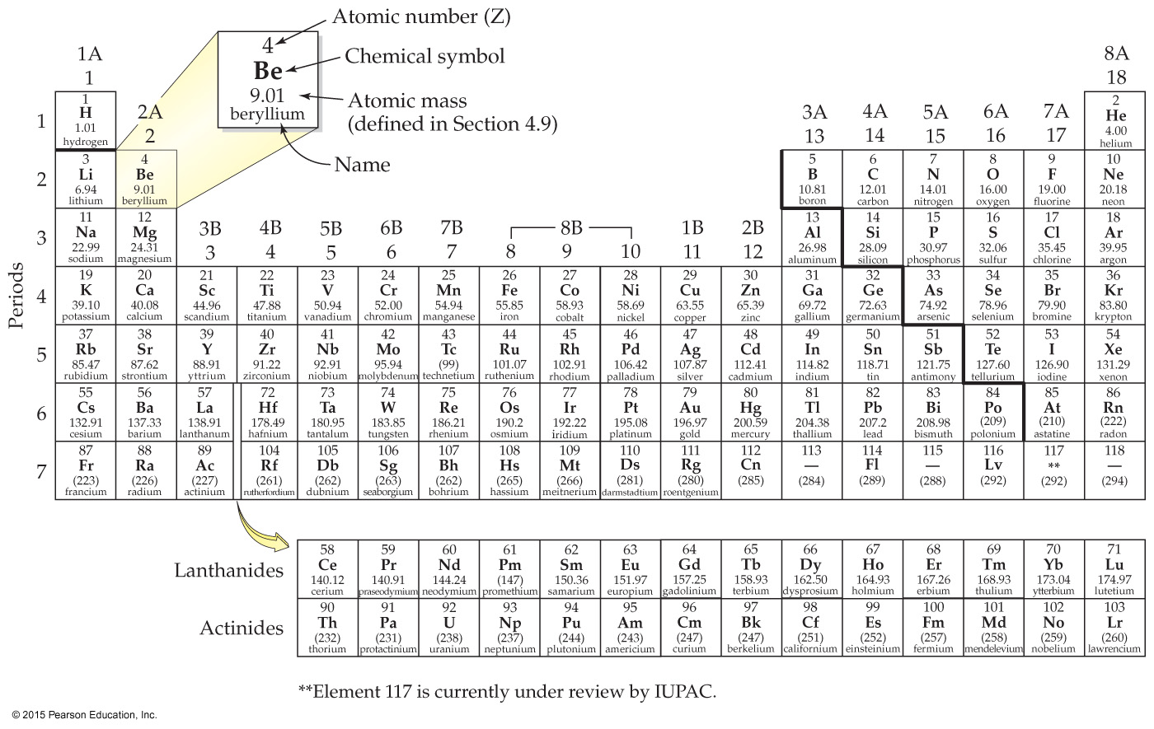
Molar Mass
The molar mass is the mass of one mole of any
substance, reported in grams.
The value of the molar mass of a compound in
grams equals the value of its formula weight in amu.

Slide 12
Molar Mass (from periodic table)
g
mol
Units:
g/mol
Can use as a ______________ ___________ to convert between grams and moles for a given subtance
What is the molar mass of S ?
What is the molar mass of O₂ ?
What is the molar mass of CaCO₃?

Slide 13
Mass to Mole Conversions
Relating Grams to Moles
How many moles are present in 101 g of sulfur?
Molar
Mass
Grams
Moles

Slide 14
Mass to Mole Conversions
Relating Grams to atoms
How many atoms are present in 101 g of sulfur?
Molar
Mass
Avogadro's number
Grams
Moles
Atoms

Slide 15
How many aluminum atoms are there in an aluminum can with a mass of 16.2 g?
Molar
Mass
Avogadro's number
Grams
Moles
Atoms

Slide 16
Calculate the mass of 1.23 x 10²⁴ He atoms.
Avogadro's number
Molar
Mass
Atoms
Moles
Grams

Slide 17
Mass to Mole Conversions
Relating Grams to molecules
For compounds, Avogadro’s Number can also be used to express the number of molecules (not just the number of atoms)
Find the number of CO₂ molecules in 22.5 g CO₂.
Molar
Mass
Avogadro's number
Grams
Moles
Molecules

Slide 18
Find the mass of 2.54 x 10²² molecules of C₆H₁₂O₆
Notes:
Answer: E

Slide 19

If you have 1 dozen bicycles…
How many bicycles do you have?
How many wheels do you have?

Slide 20
If you have 1 mol bicycles…
How many moles of wheels are there?

Slide 21
for every 1 molecule of N₂O₄…
1 molecule N₂O₄
2 atoms N
1 molecule N₂O₄
4 atoms O
1 mole N₂O₄
2 moles N
1 mole N₂O₄
4 moles O

Slide 22
Calculate the number of moles of O in 18 moles of CO₂.
Determine the number of moles of O in 1.4 mol of H₂SO₄.

Slide 23
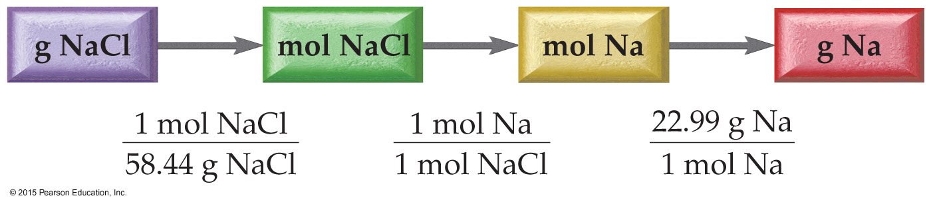
How many grams of sodium are in 15.0 grams of NaCl?
Notes:
Left off here monday

Slide 24
Example: Determine the mass of oxygen in a 5.8 g sample of sodium bicarbonate (NaHCO₃).

Slide 25
Mass % Composition of a Compound
The mass contributed by each element to the weight of a compound is the mass percent of that element.
If the mass percent of sodium in sodium chloride is 39%, then a 100 gram sample of NaCl contains 39 grams of Na
It also means that 39% of the molecular weight of NaCl is due to the weight of the Na atom.

Slide 26
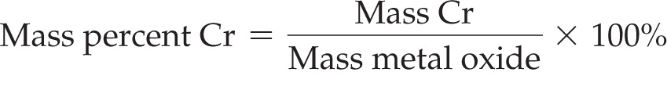
Finding Mass Percent Composition
A 0.358-g sample of chromium reacts with oxygen to form 0.523 g of the metal oxide.
Find the mass percent of chromium in the product.

Slide 27
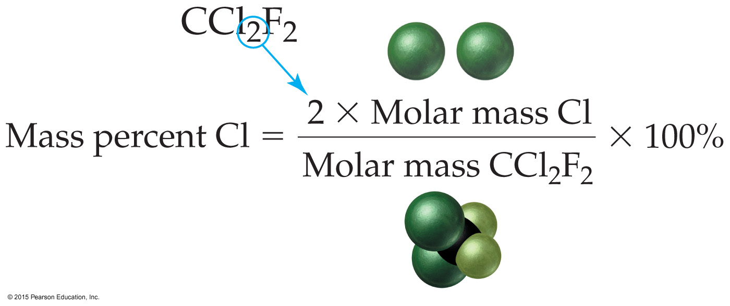
Mass Percent Composition from a Chemical Formula
What is the mass percent of Cl in the compound CCl₂F₂ ?

Slide 28
Example: Calculate the mass percent of Cl in C₃Cl₄F₂.

Slide 29
Example: Calculate the mass percent of H in C₁₂H₂₂O₁₂.

