Slide 1
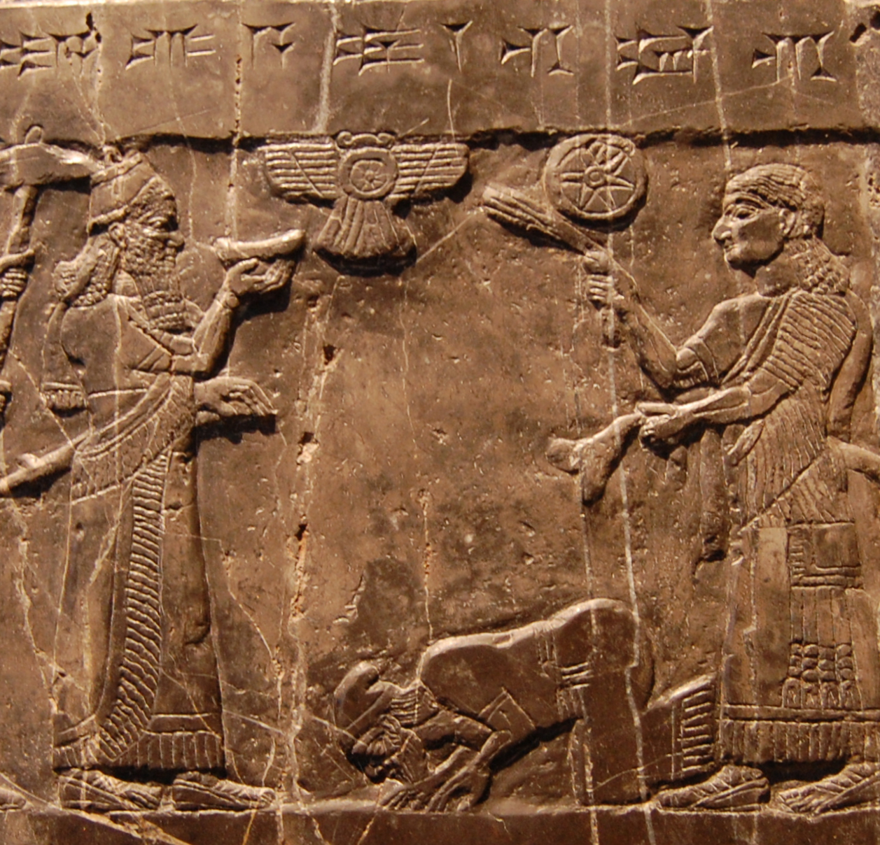
The Archaeology of Empires
ARCH B313/513 – The Archaeology of Ancient Near Eastern Empires
Fall 2026
September 11

Slide 2
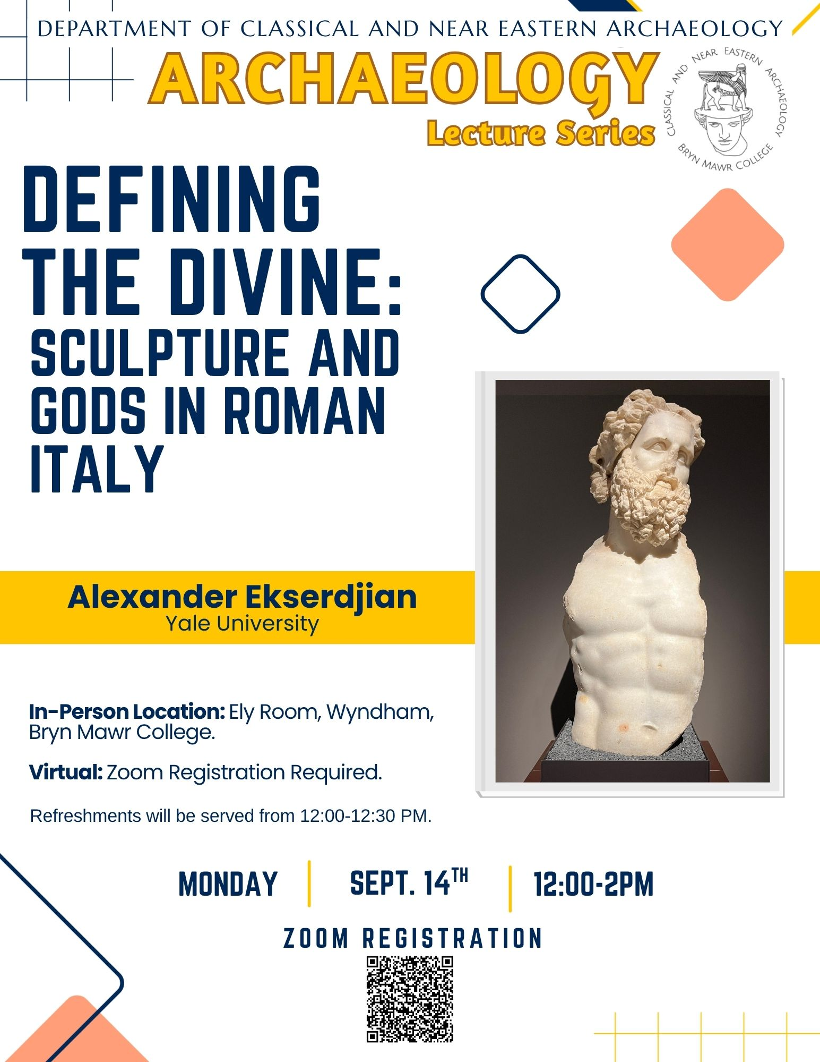
More Archaeology!
Mon 9/14, 12:30 PM: Archaeology Lecture
This talk analyses the material culture of cult places in late-Republican Italy to propose a visual language of the sacred specific to Roman Italy. Cult statues and sanctuary dedications demonstrate the ways that sculptural choices expressed relationships between worshippers and their gods. The vast gulf between the divine and the human was made manifest through material choices, sculptural scale, and modes of display. First sketching out the mechanics for this system of visual communication, I then turn to exemplary works of Republican sculpture to illustrate its workings. Finally, surviving statues from the city of Ostia are used to test the application of these ideas to a chronologically and spatially bounded context. Drawing on the methods of archaeology, art history, and anthropology, I aim to show how much may be gained by more fully incorporating close analysis of sculpture into histories of Roman religion.

Slide 3
C. Sinopoli, “Empires,” in G. Feinman and T. Price, Archaeology at the Millennium (New York: Kluwer Academic/Plenum Press, 2001), 439-71
R. Matthews, The Archaeology of Mesopotamia: Theories and Approaches (London: Routledge, 2003), Ch. 5 (“Archaeologies of Empire”)
T. N. D’Altroy, “Empires Reconsidered: Current Archaeological Approaches,” Asian Archaeology 1 (2018), 95-109

Slide 4
Core and Periphery
What is the distinction between core and periphery? What are the features of each (including both archaeological and textual material)? How can we distinguish between core and periphery on archaeological grounds? What are the problems with this approach?
What is world-systems analysis? What was its original purpose? How applicable is it to antiquity?
How can a core dominate a periphery? What does this look like archaeologically?

Slide 5
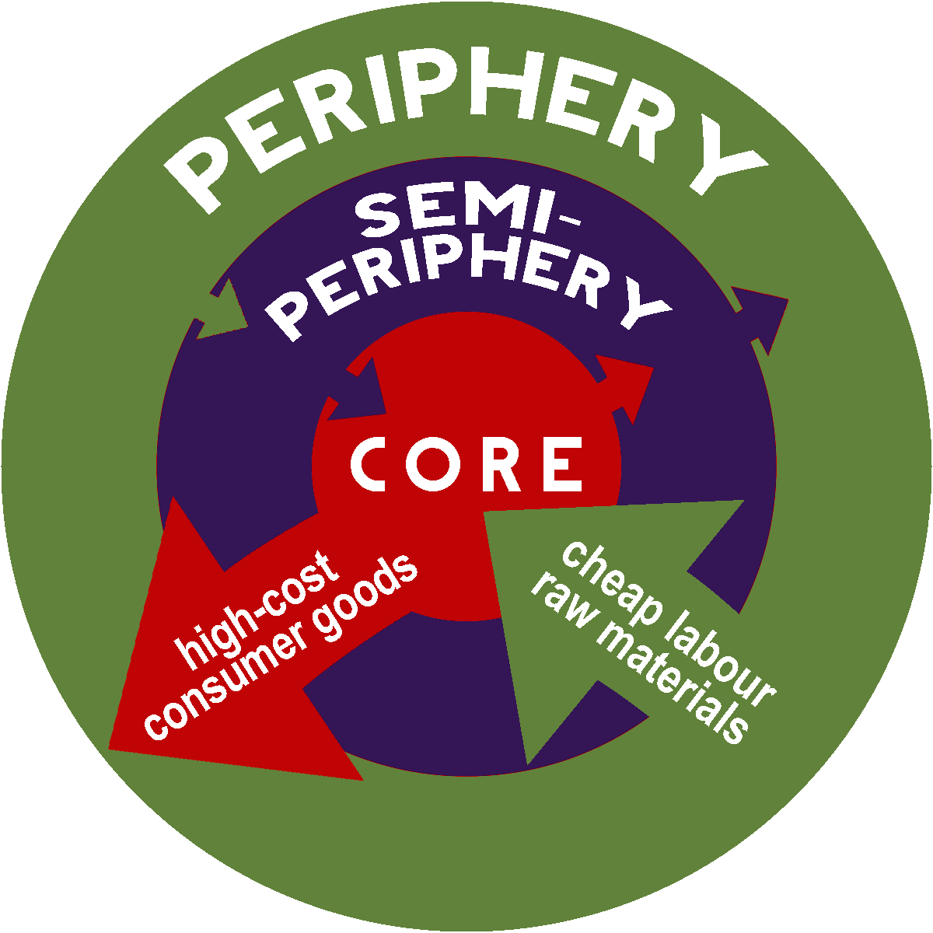
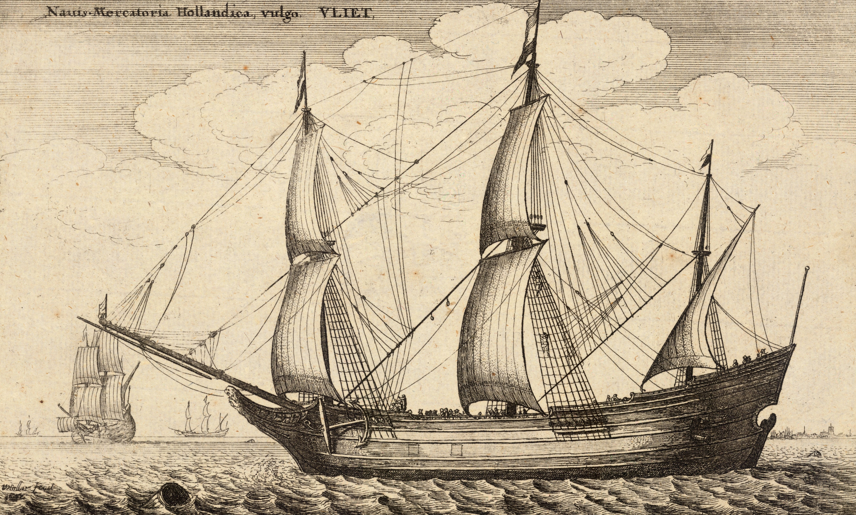
World-Systems Theory
Illustration of a Dutch fluyt by Wenceslaus Hollar (1667)

Slide 6
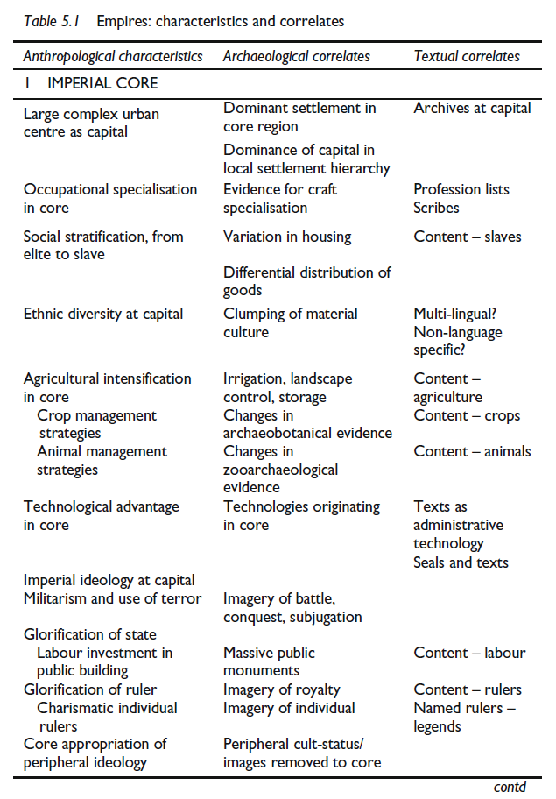
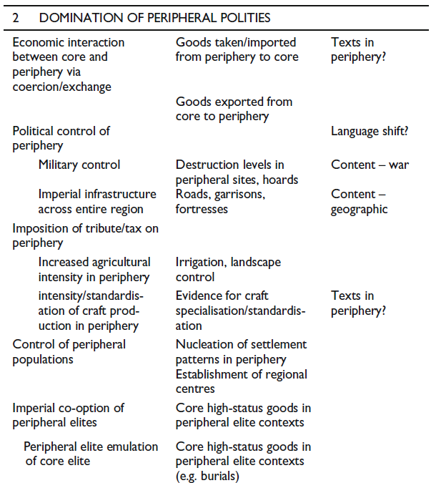
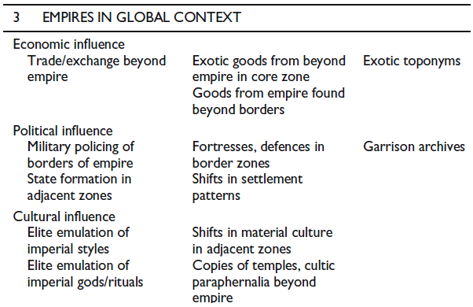
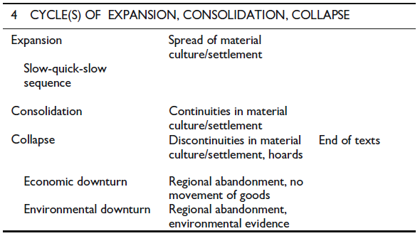

Slide 7
Plans of Khorsabad from Matthews 2003, figs. 5.1-2

Slide 8
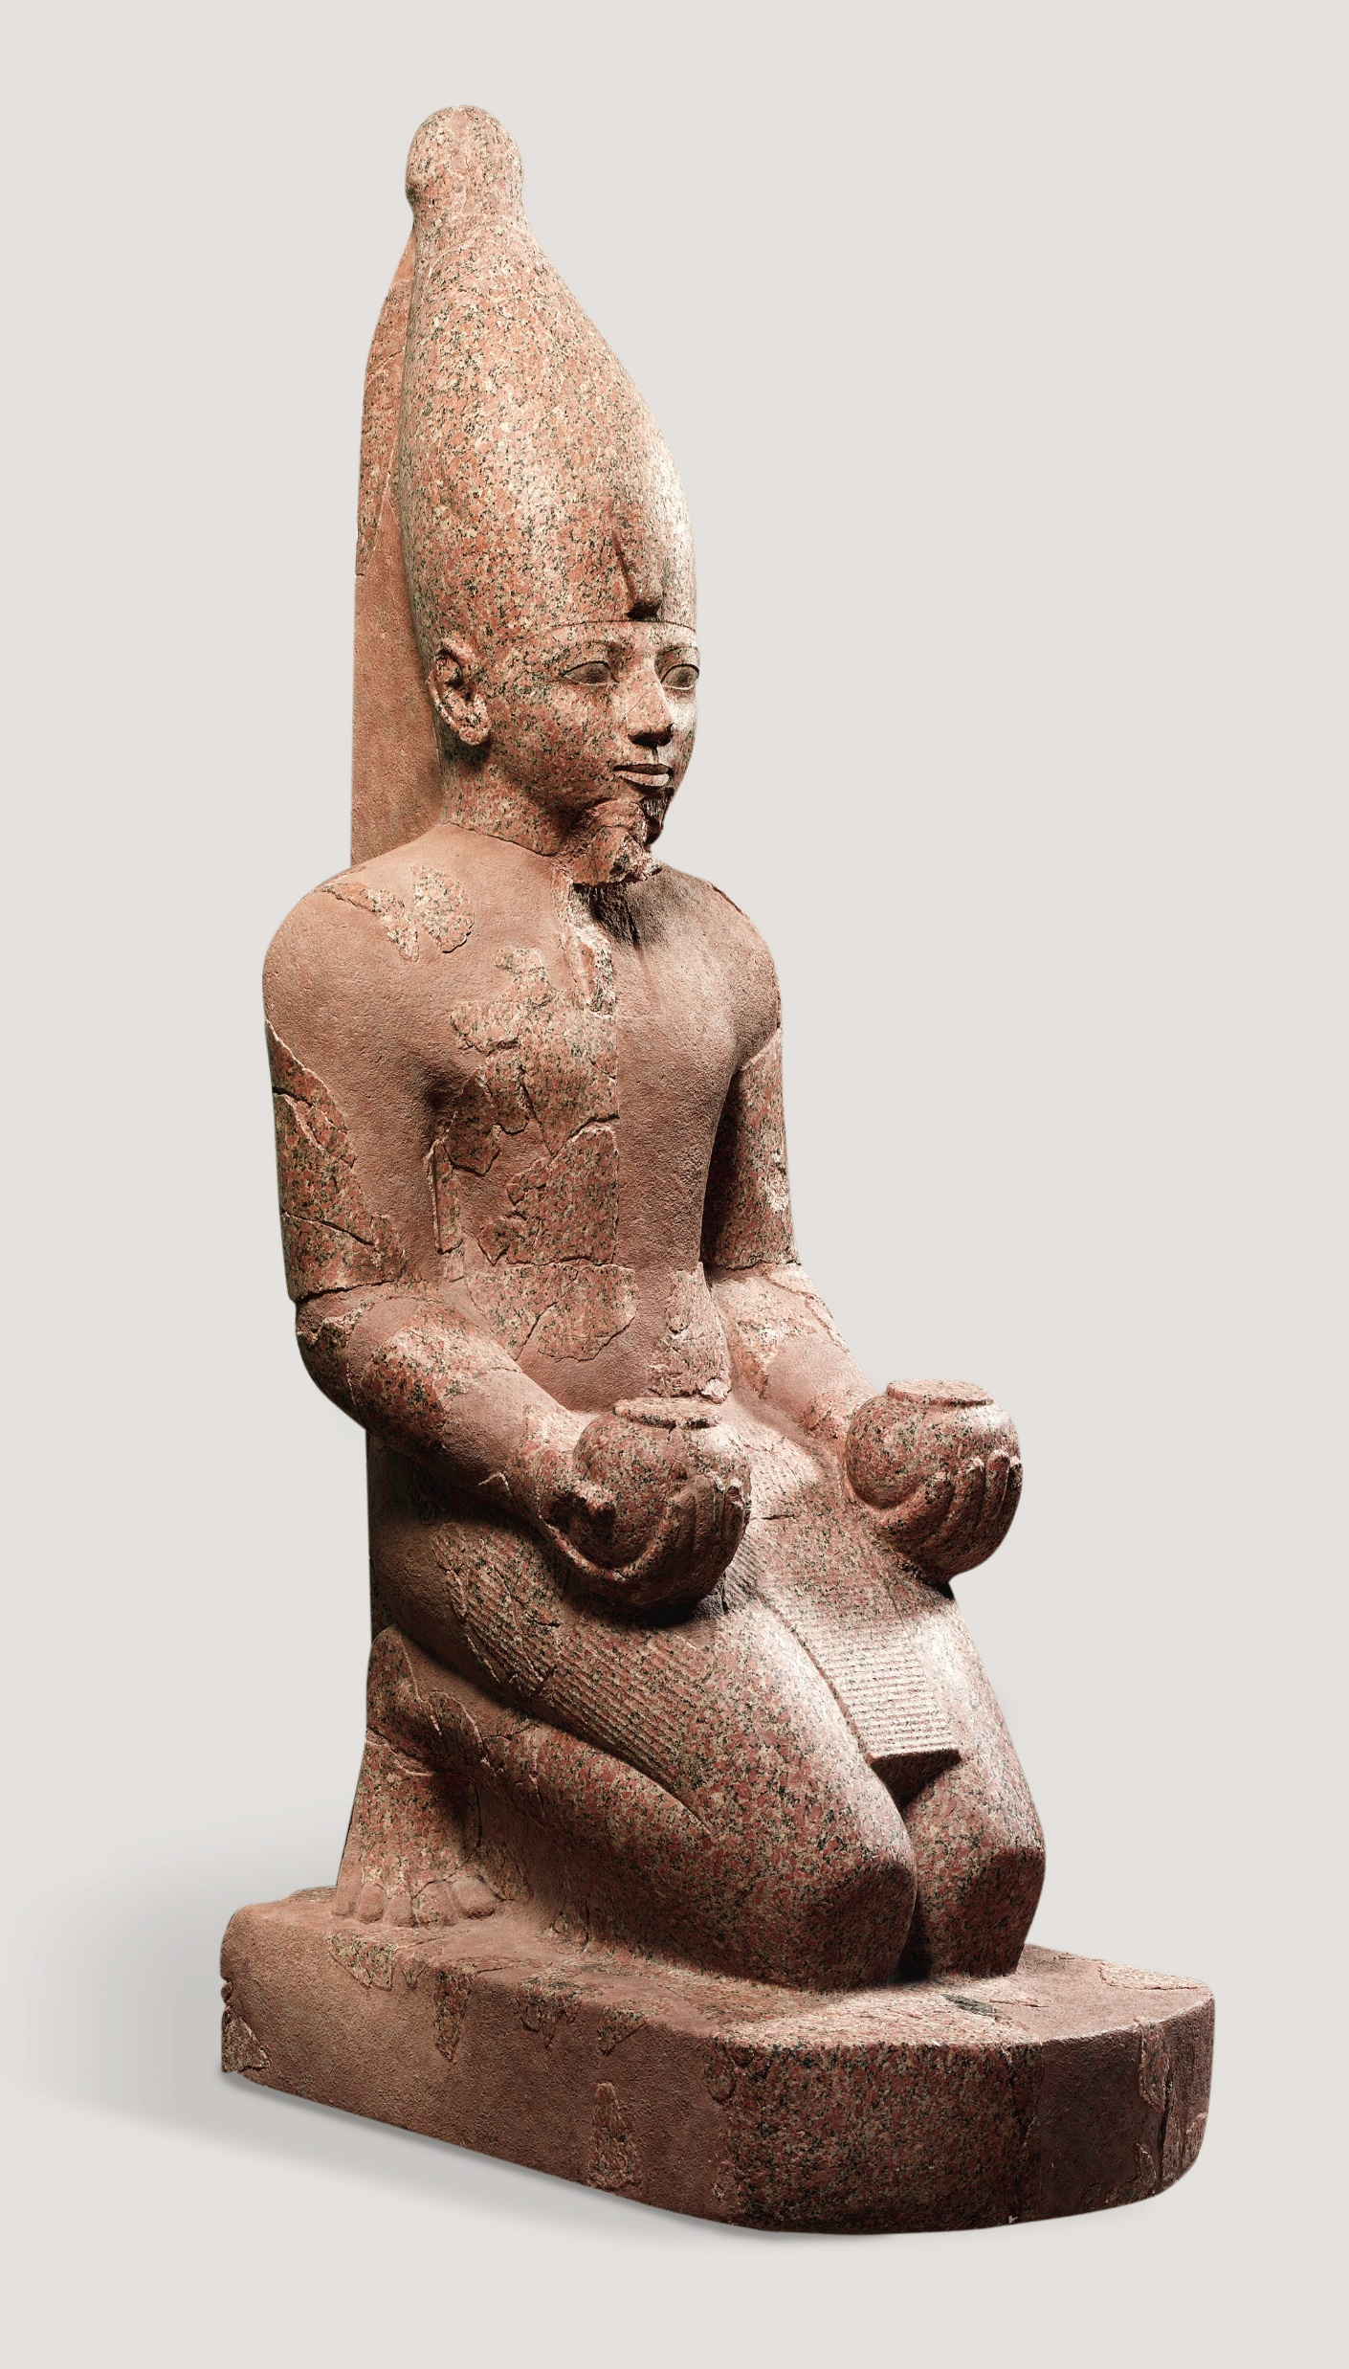
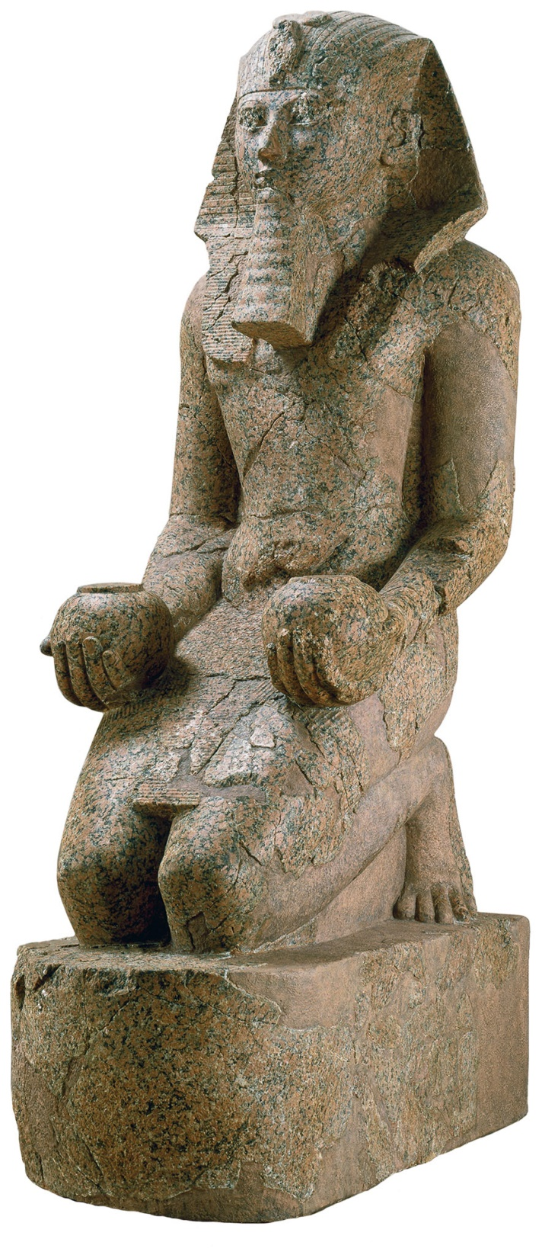
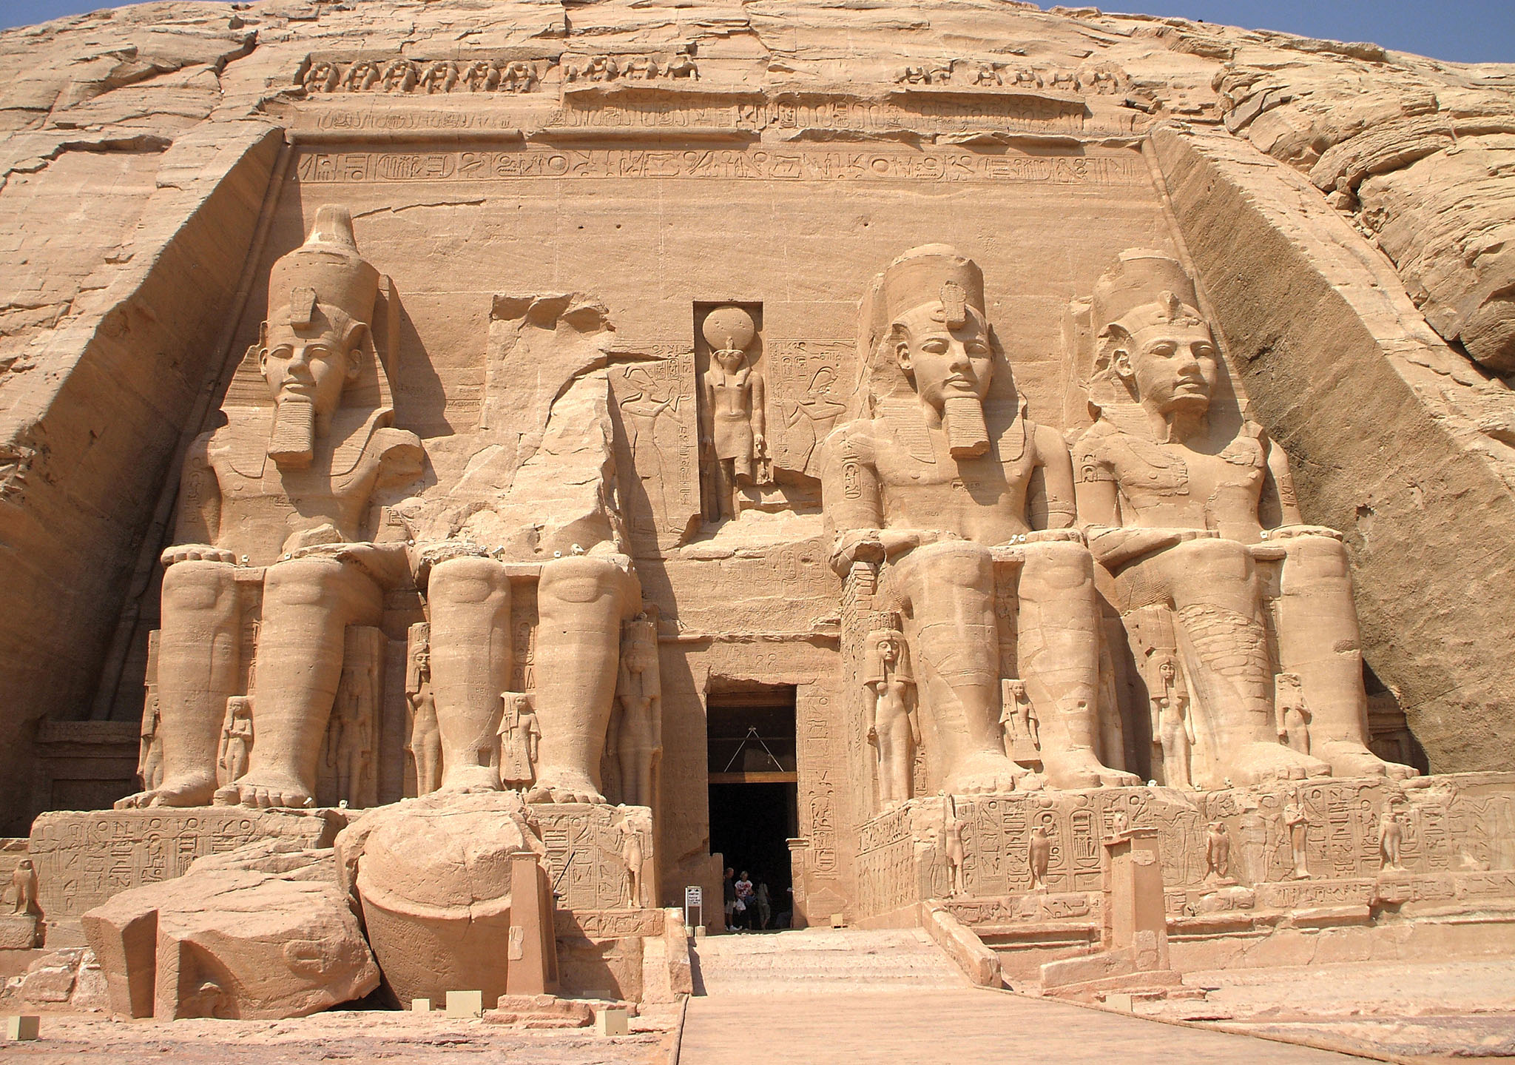
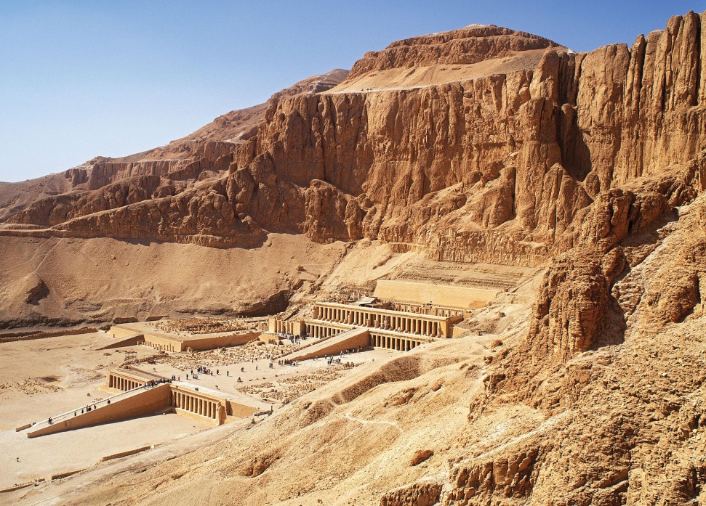
Above: Temple of Ramses II, Abu Simbel, ca. 1279-1213 BCE (New Kingdom)
Left: Mortuary temple and statues of Hatshepsut, Deir el-Bahri, ca. 1473-1458 BCE (New Kingdom)

Slide 9
Core and Periphery
What is the distinction between core and periphery? What are the features of each (including both archaeological and textual material)? How can we distinguish between core and periphery on archaeological grounds? What are the problems with this approach?
What is world-systems analysis? What was its original purpose? How applicable is it to antiquity?
How can a core dominate a periphery? What does this look like archaeologically?

Slide 10
Hegemony & IEMP
What is hegemony? How is it different from imperialism (if it is at all)? How can we distinguish between imperialism and hegemony from an archaeological standpoint?
What is Michael Mann’s IEMP model? Are you glad I didn’t make you read more about it? How can we apply this to archaeology?
  Ideological, Economic, Military, Political

Slide 11
Scales
How do we identify the geographical scale of an ancient empire? What challenges arise from the large geographical scales of empires?
How do we identify the chronological parameters of an ancient empire? Why is this hard?

Slide 12
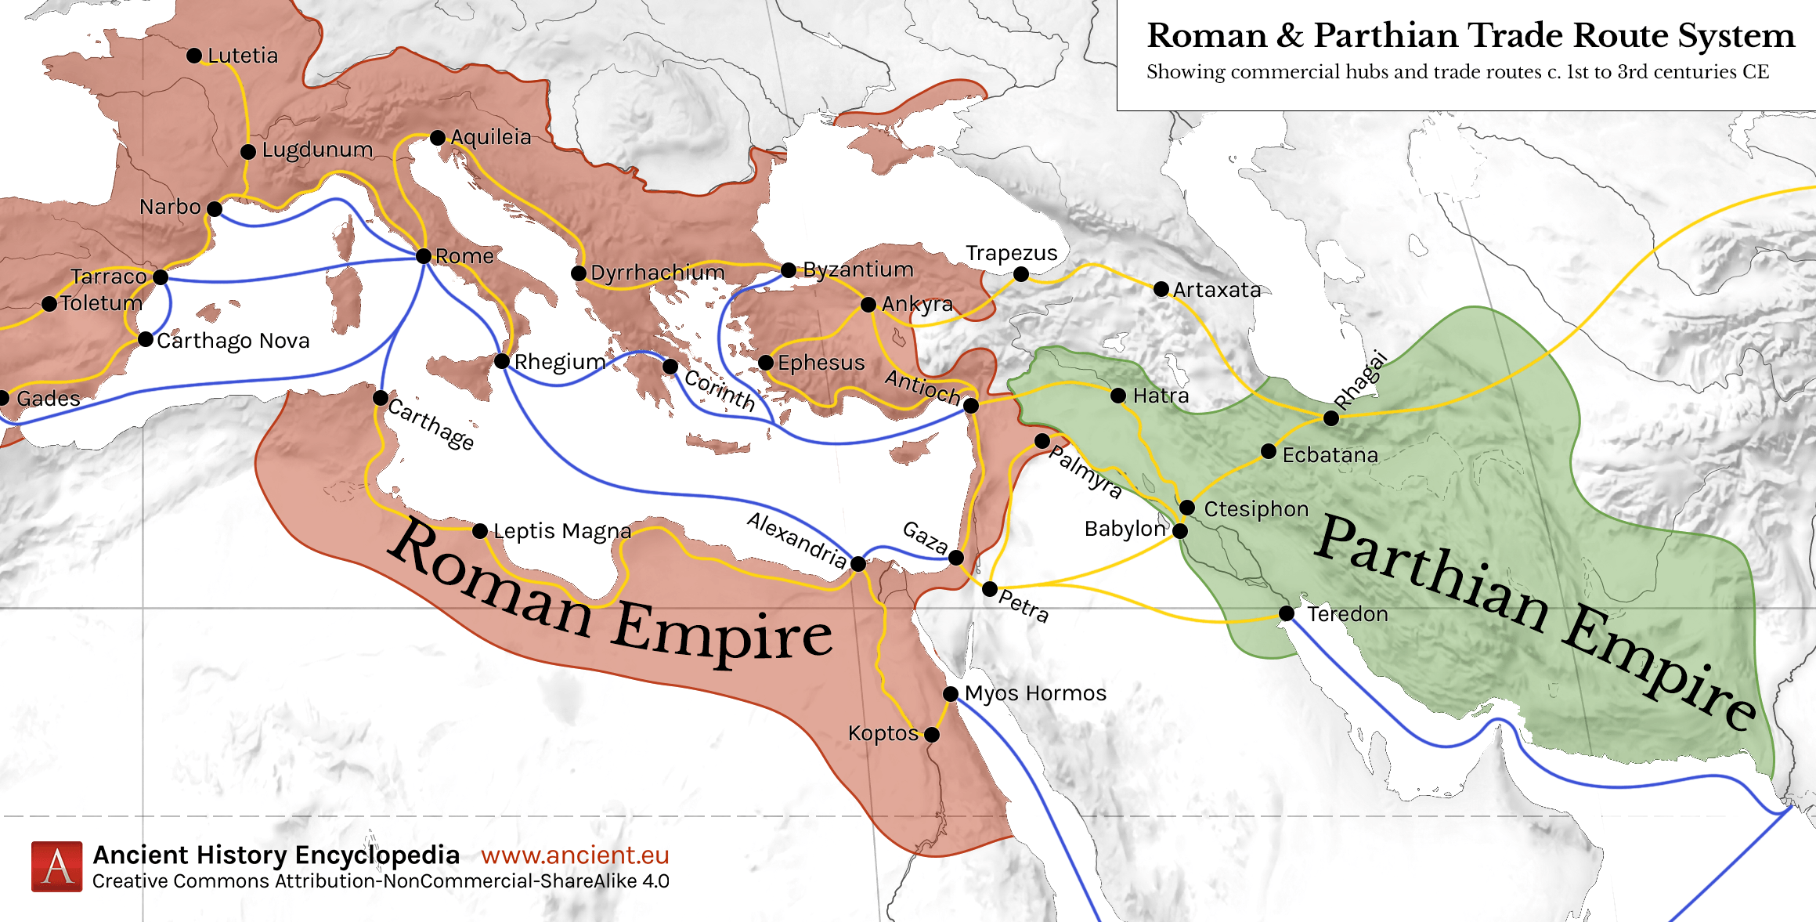

Slide 13
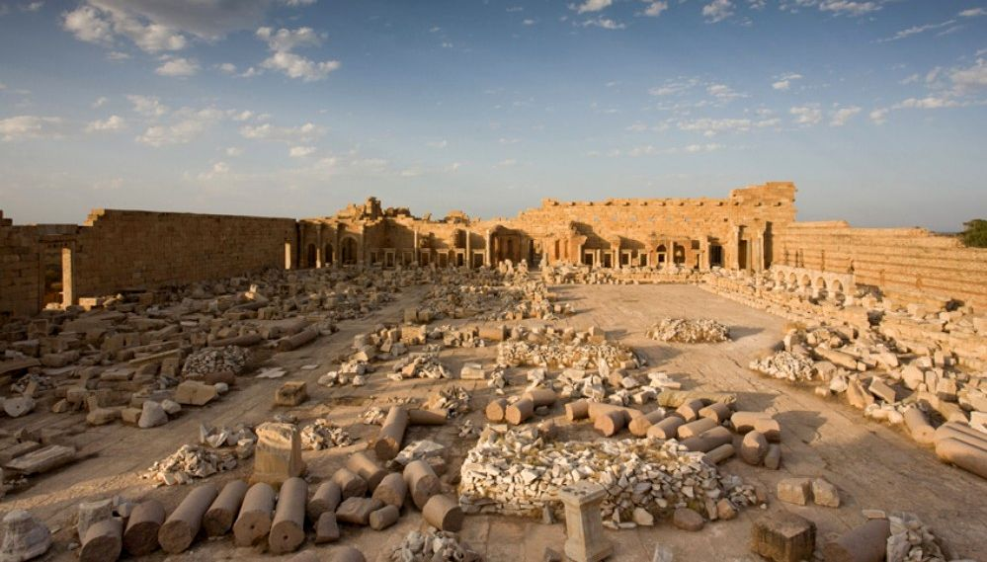
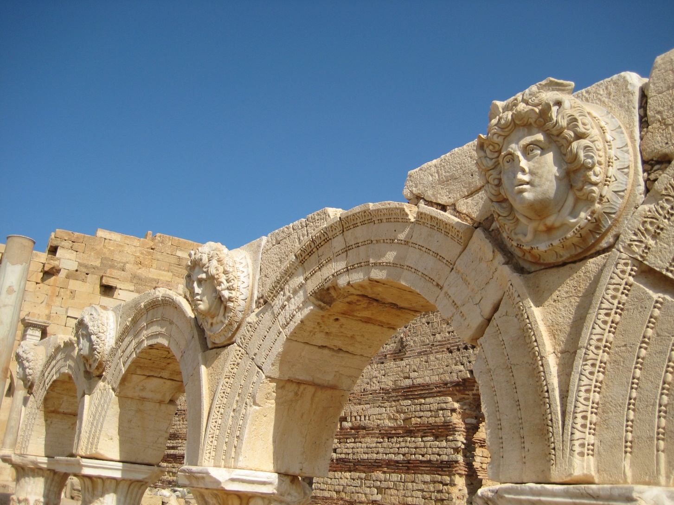
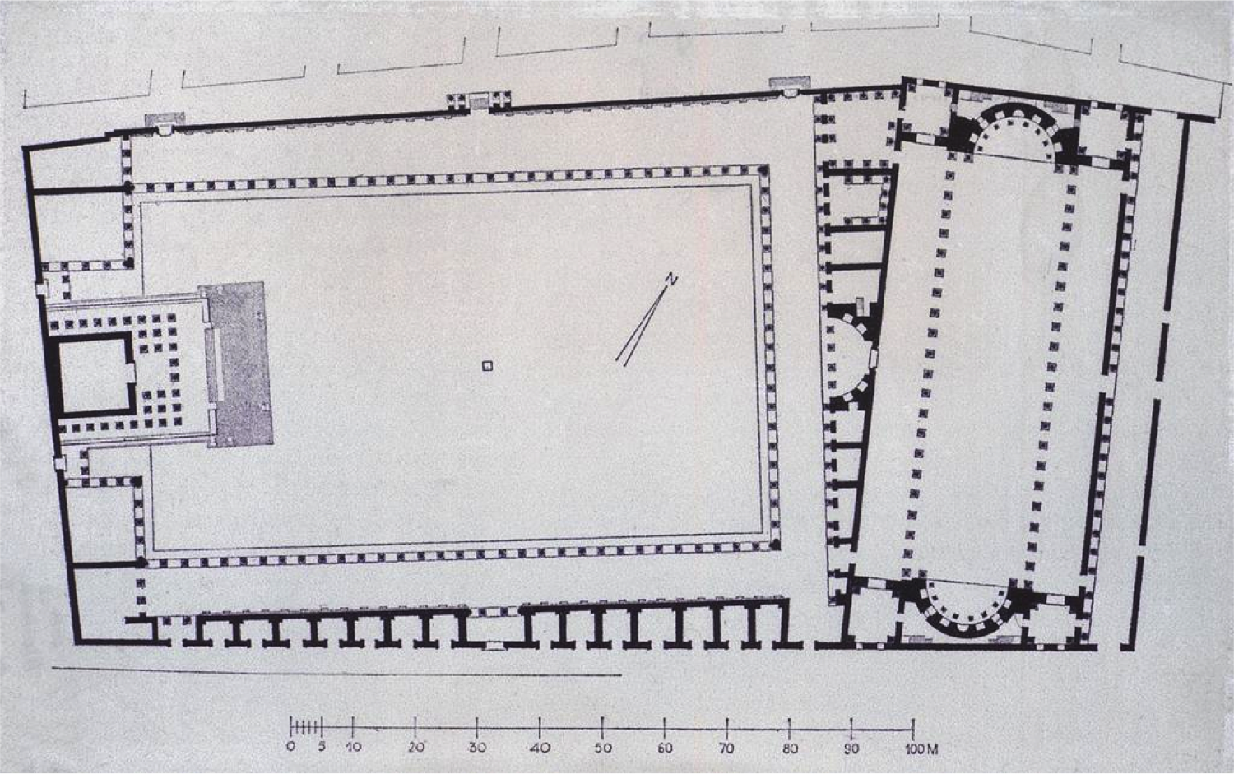
Lepcis Magna
Forum of Lepcis Magna, ca. 216 CE

Slide 14
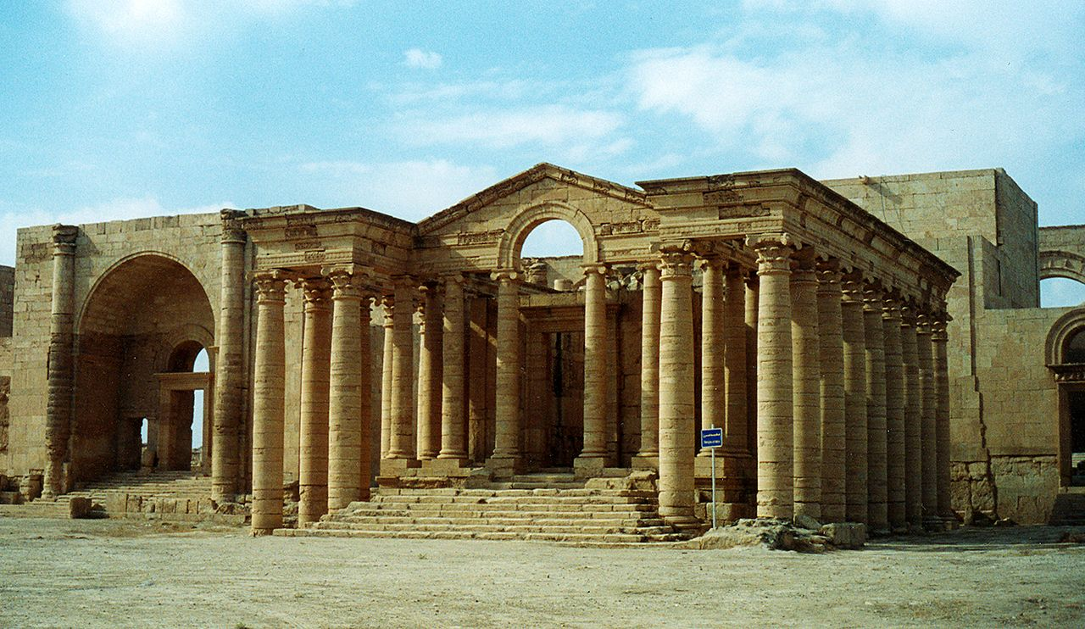
Hatra
Sacred precinct of Hatra, ca. 100-240 CE
Forum of Lepcis Magna, ca. 216 CE

Slide 15
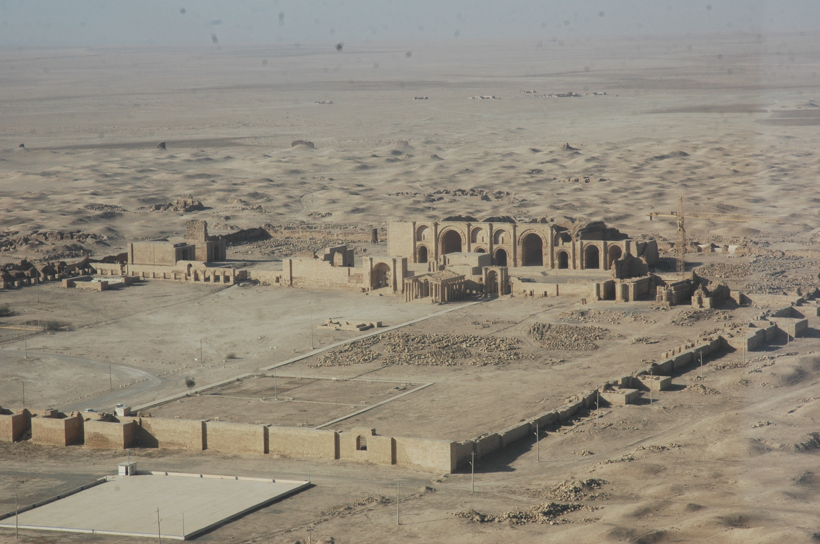

Slide 16
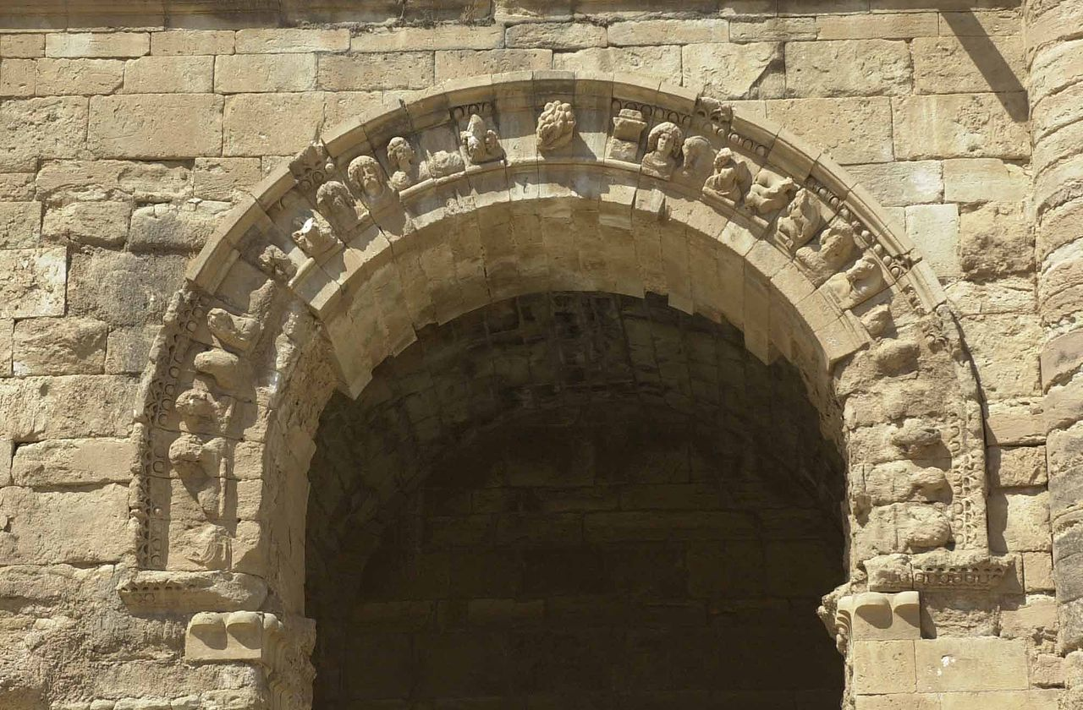
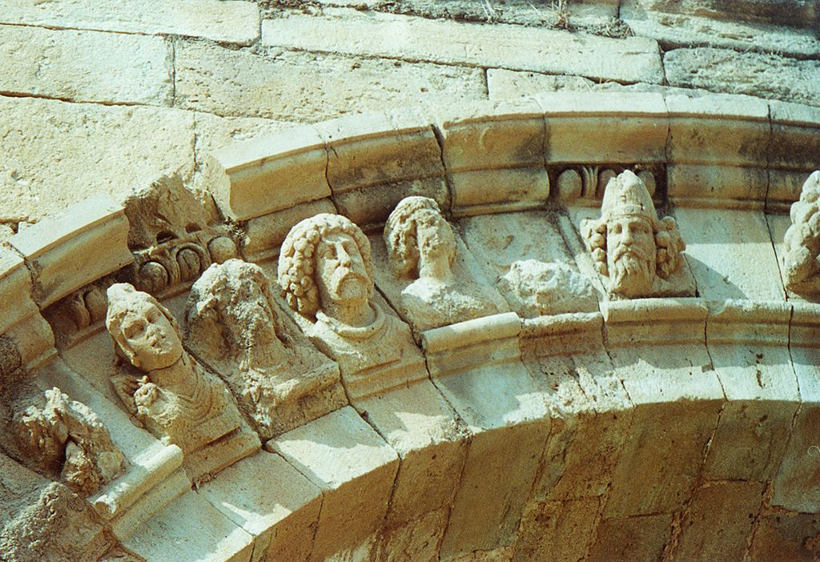
Hatra

Slide 17
Scales
How do we identify the geographical scale of an ancient empire? What challenges arise from the large geographical scales of empires?
How do we identify the chronological parameters of an ancient empire? Why is this hard?

Slide 18
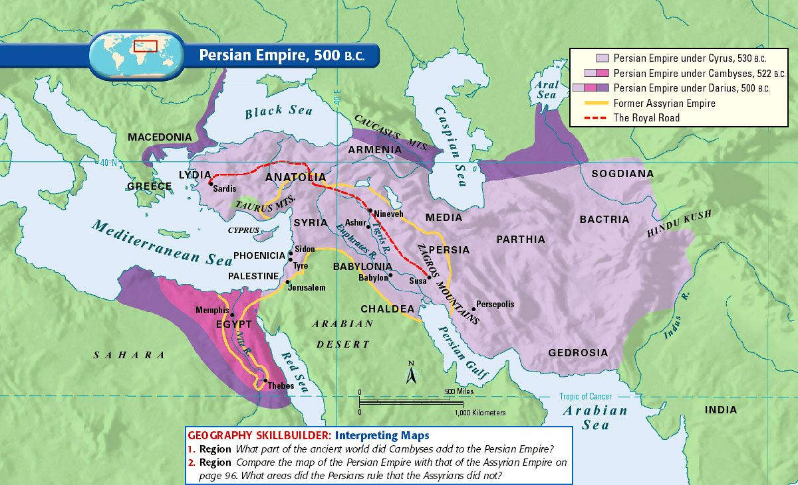

Slide 19
Elites
Why are elites important for the study of ancient empires? Why are elites important archaeologically? Why are archaeologists often more concerned with them than with commoners?
What role do ruling elites play in empires? What role do local elites play in empires?

Slide 20
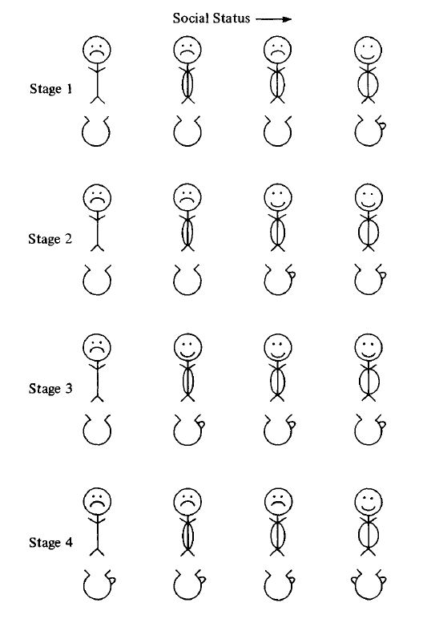
D. Miller, “Structures and Strategies: An Aspect of the Relationship
between Social Hierarchy
and Cultural Change,” in I. Hodder (ed.), Symbolic and Structural Archaeology (CUP, 1982), fig. 1

Slide 21
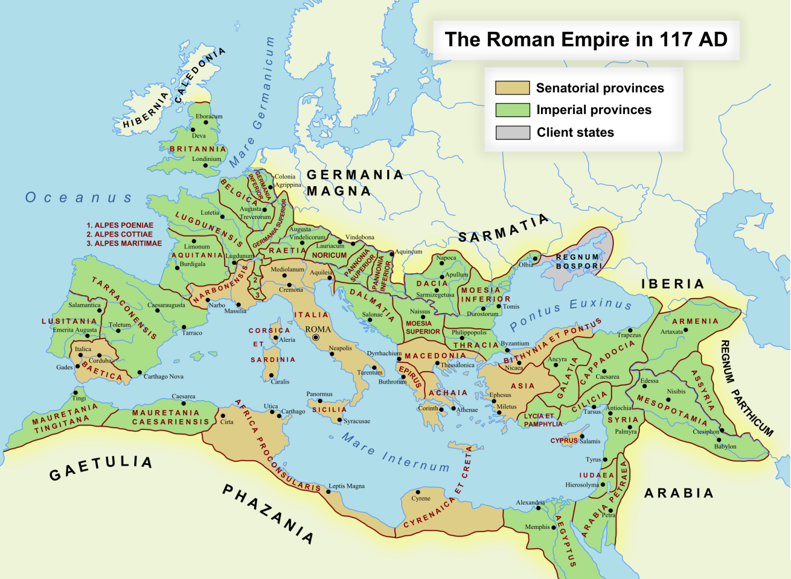
Berthouville

Slide 22
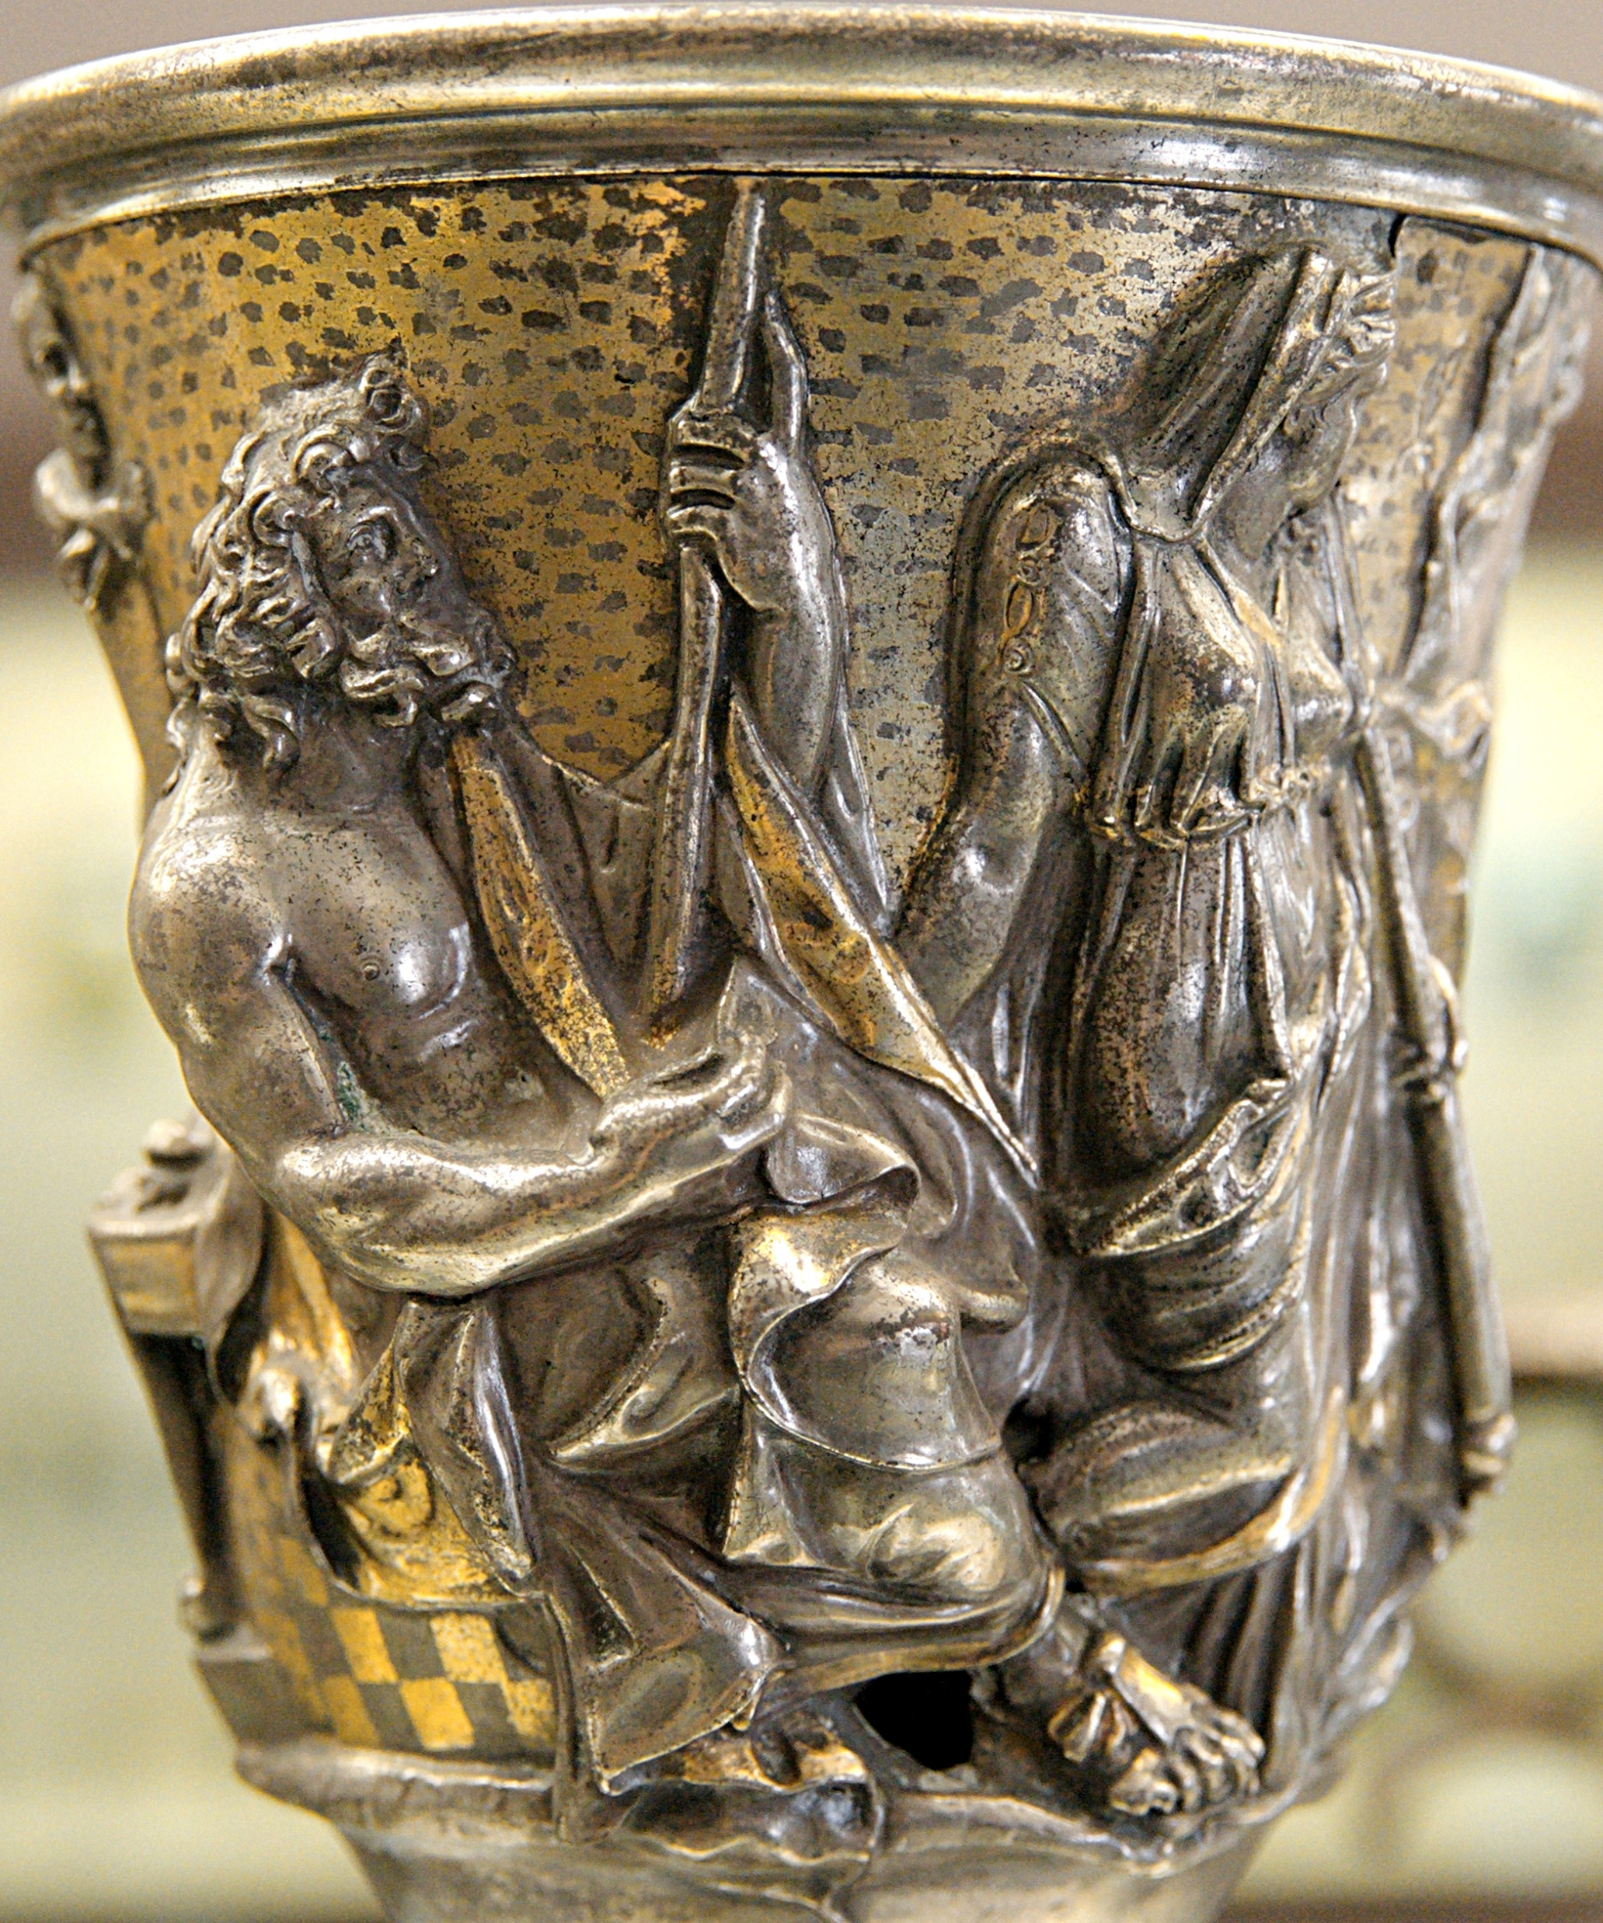
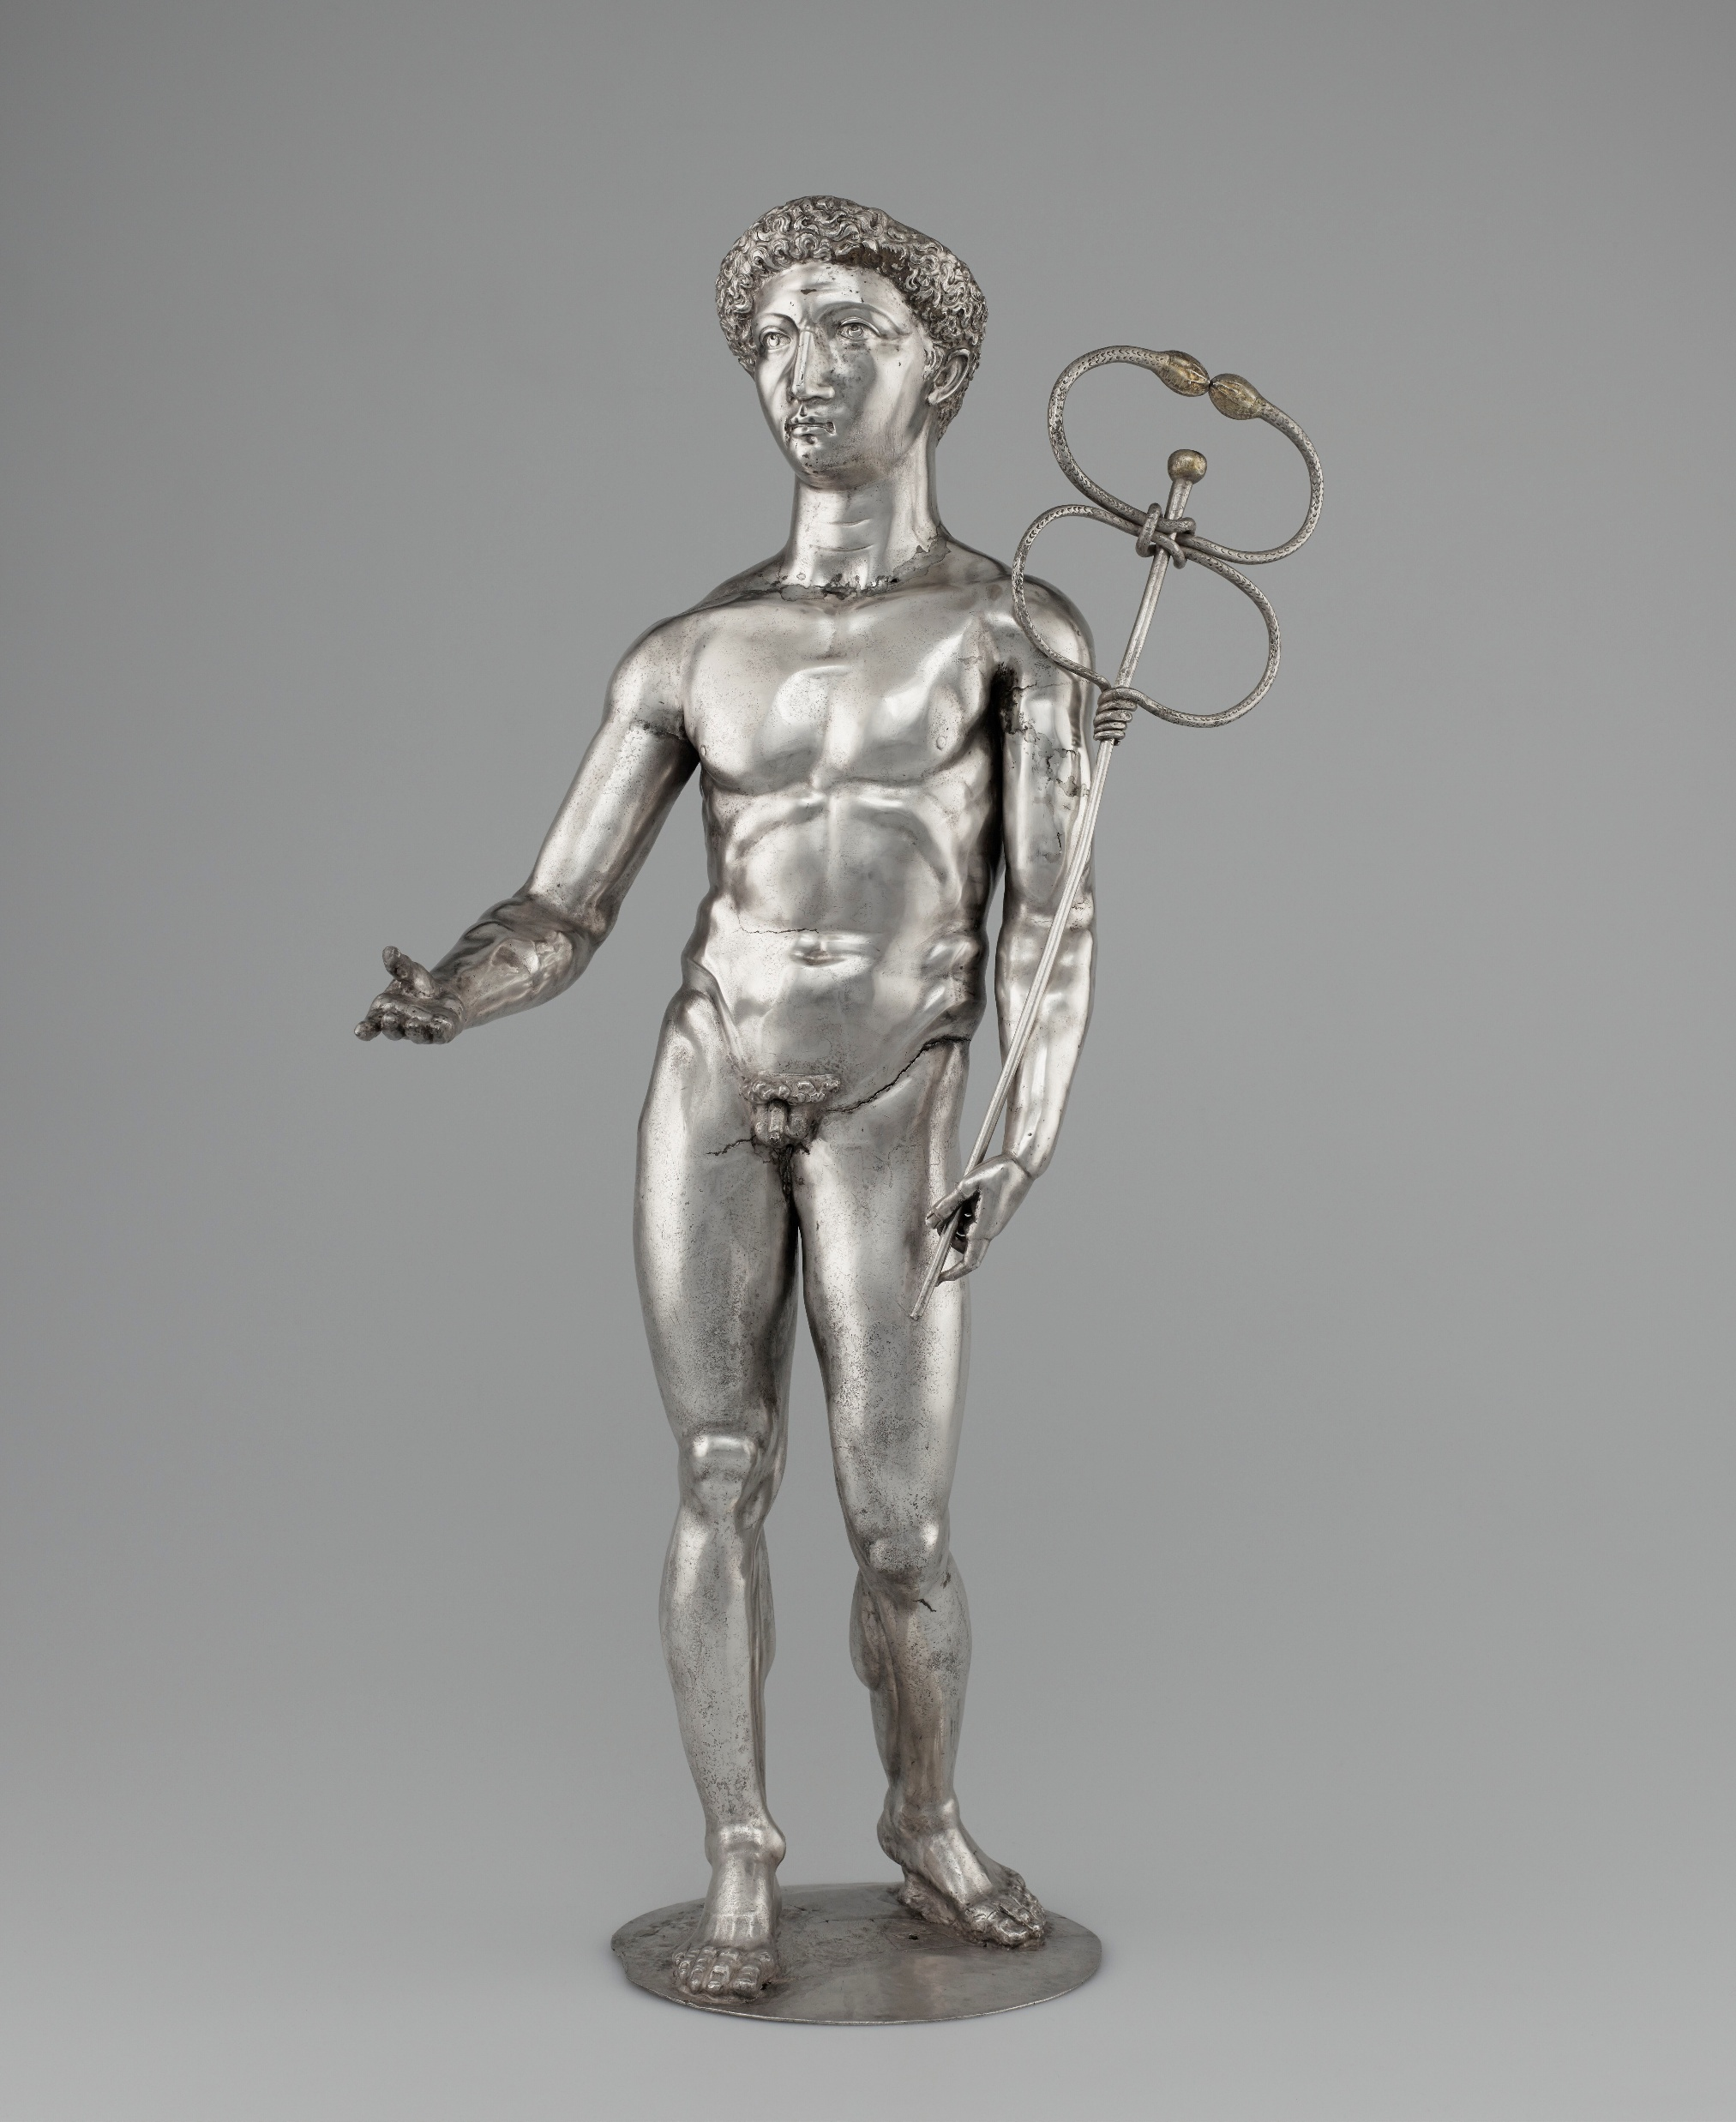
Dedications by Q. Domitius Tutu to Mercury Canetonsis from Berthouville, 2nd cen. CE

Slide 23
Palmyra

Slide 24
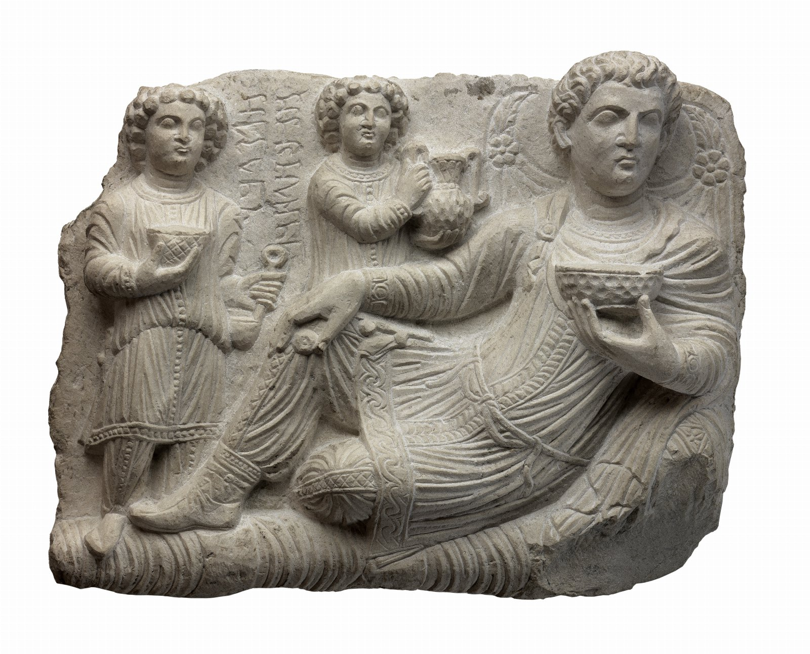
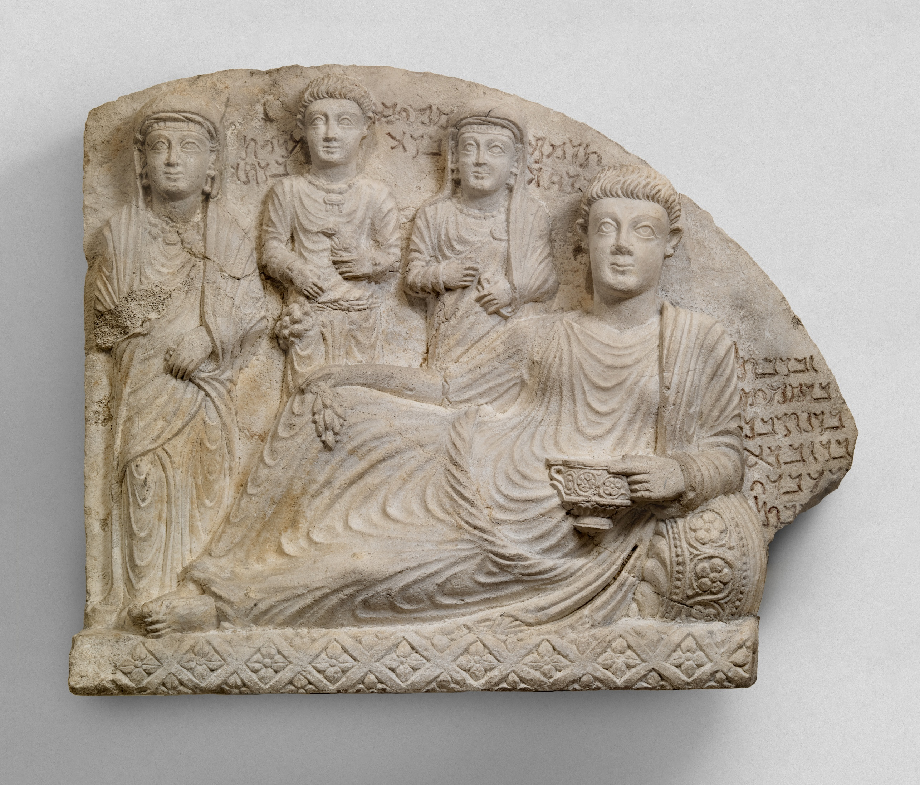
Palmyra
Palmyrene funerary relief of Malku, son of Moquimu, early 3rd cen. CE (Penn Museum B8902)
Palmyrene funerary relief of Zabdibol, son of Moquimu, 2nd-3rd cen. CE (MMA 02.29.1)

Slide 25
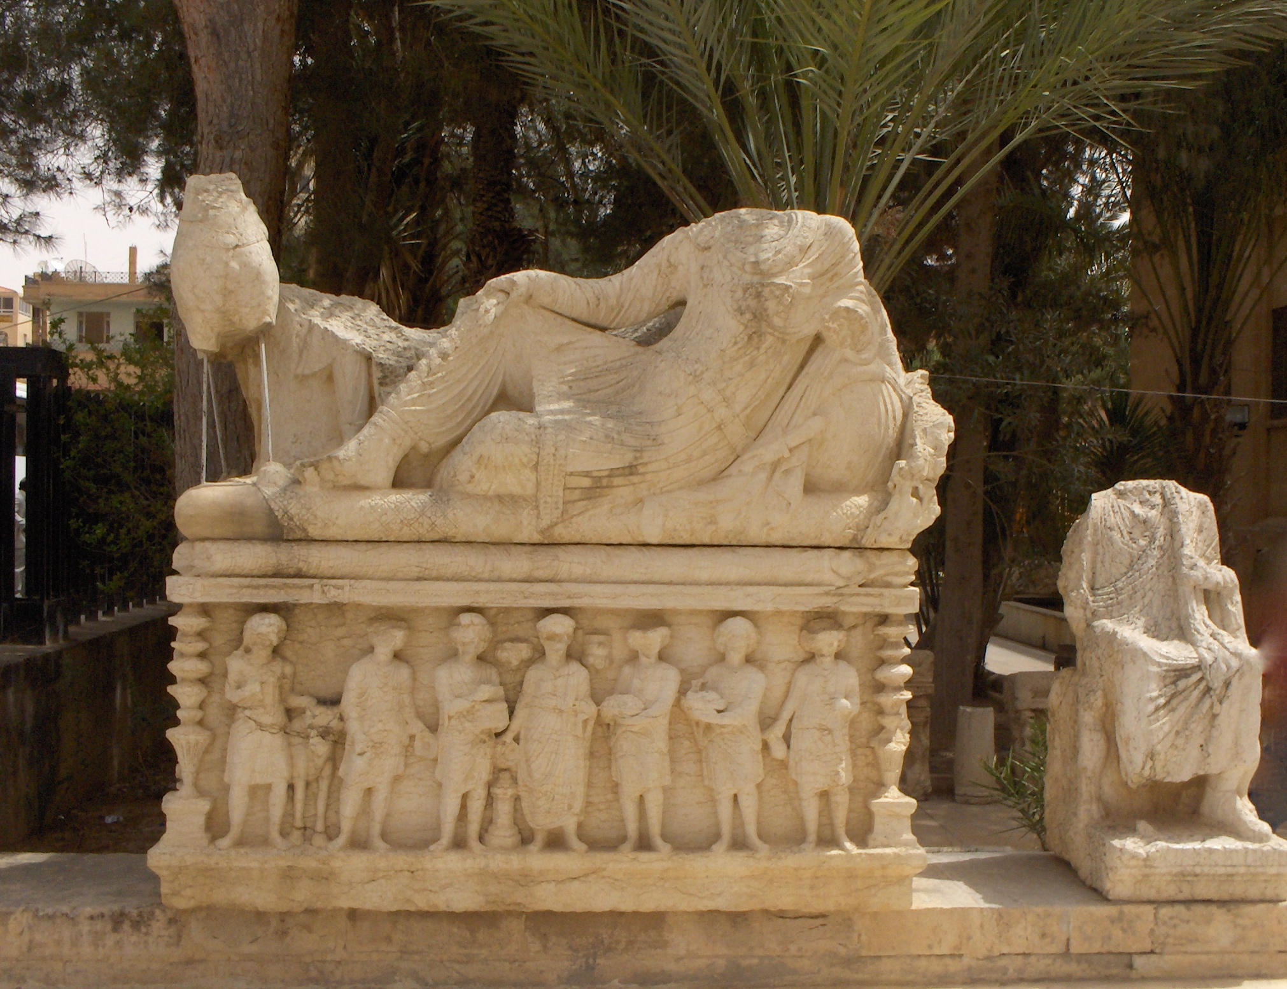
Sarcophagus from Palmyra, 3rd cen. CE (Palmyra Museum 2677B/8983)

Slide 26
Networks
What is the value of characterizing an empire as a network? What advantages does this offer over other approaches?

Slide 27
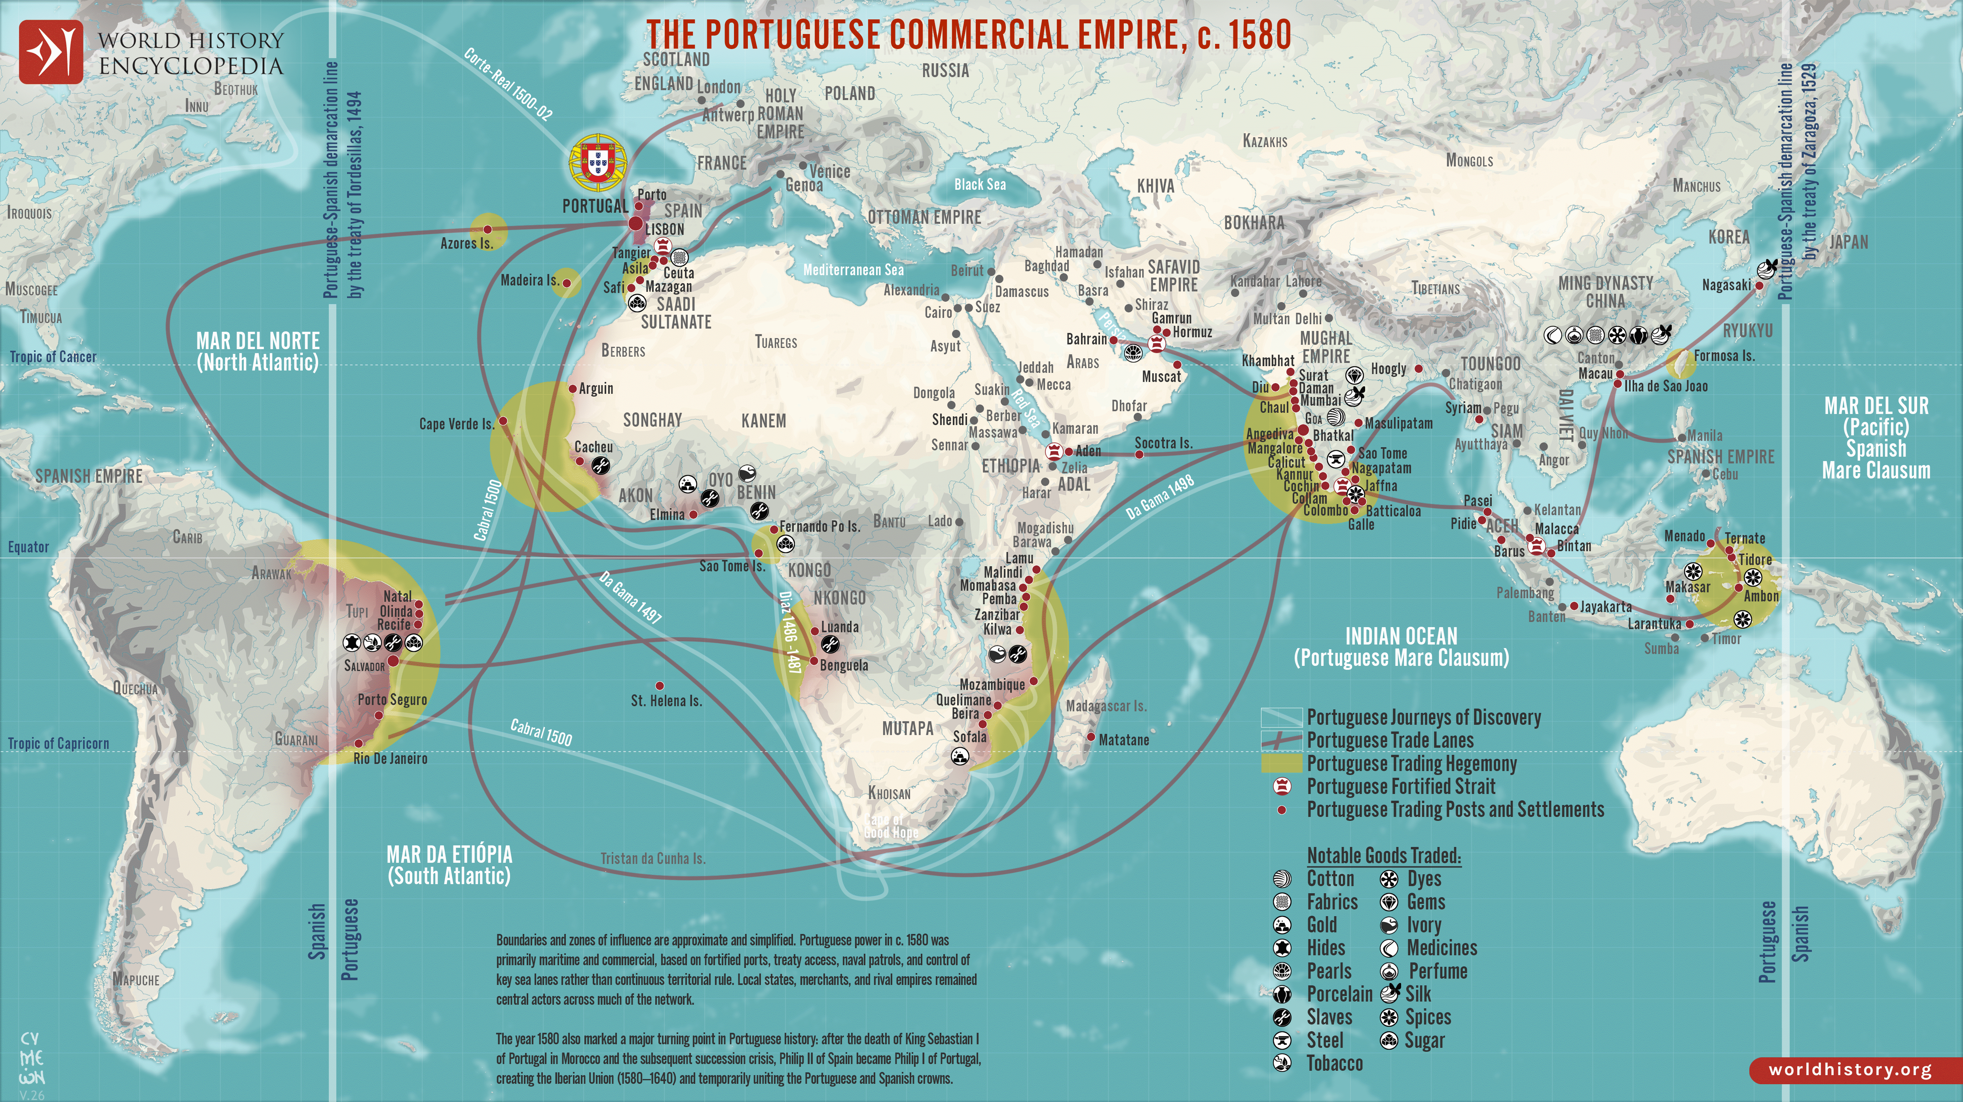

Slide 29
Materiality, Agency, Inscribed Knowledge
What is materiality?
Can objects have agency? How can objects participate in imperialism?
What does D’Altroy mean by ‘inscribed knowledge?’ How does it relate to memory? What role does it play in imperialism?

Slide 30
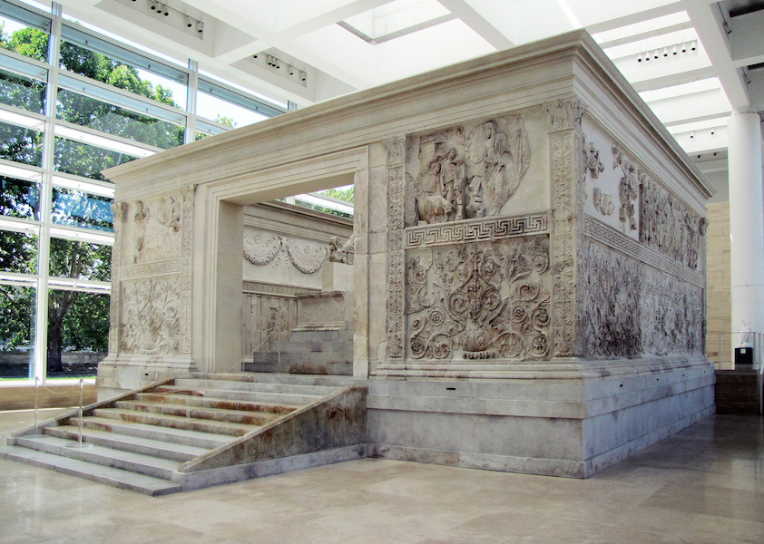
Ara Pacis
‘altar of peace’
13-9 BCE
Luna marble; 11 m x 10 m, with reliefs 1.6 m high
Dedicated by Augustus, the first Roman emperor
Decorated with mythological scenes relating to the foundation of Rome, and images of processions featuring contemporary Romans
*

Slide 31
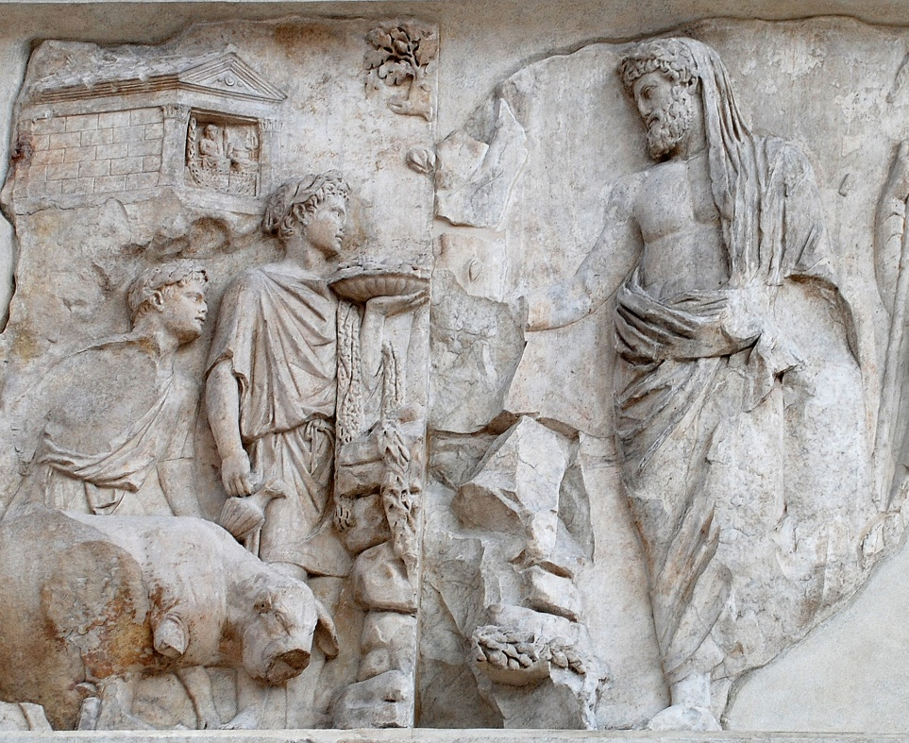
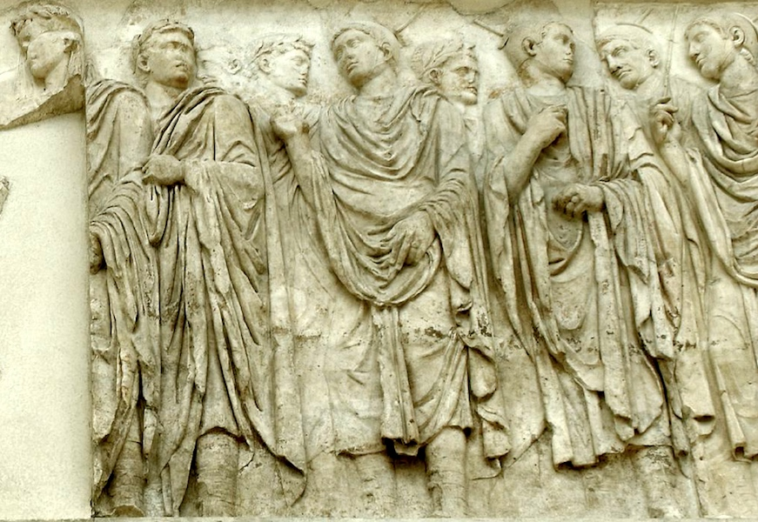
Ara Pacis
Relief of a religious procession featuring an image of Augustus (among others) from the south wall of the Ara Pacis, Rome, 13-9 BCE
Relief of Aeneas making a sacrifice from the west wall of the Ara Pacis, Rome, 13-9 BCE

Slide 32
Biology
What are the biological dimensions of imperialism? How can it affect human biology? How can it affect animal and plant biology? How can we identify these effects archaeologically?

Slide 33
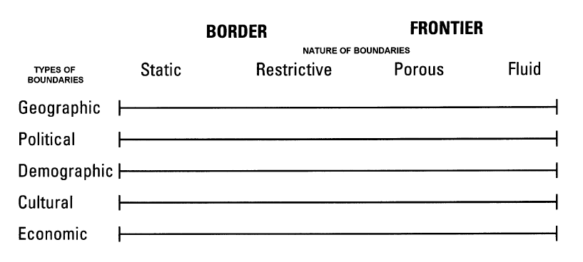
Parker 2006, figs. 2-3

Slide 34


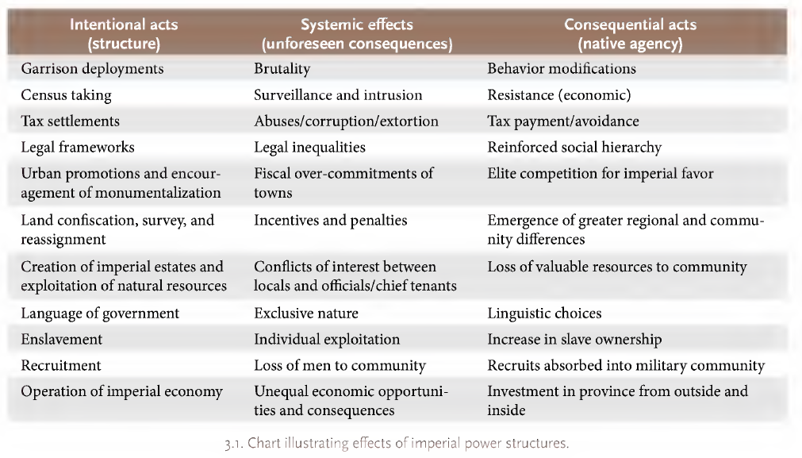
Mattingly 2014, 41-2

Slide 35
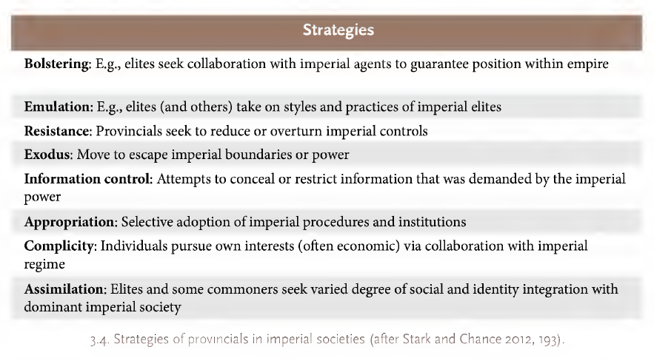
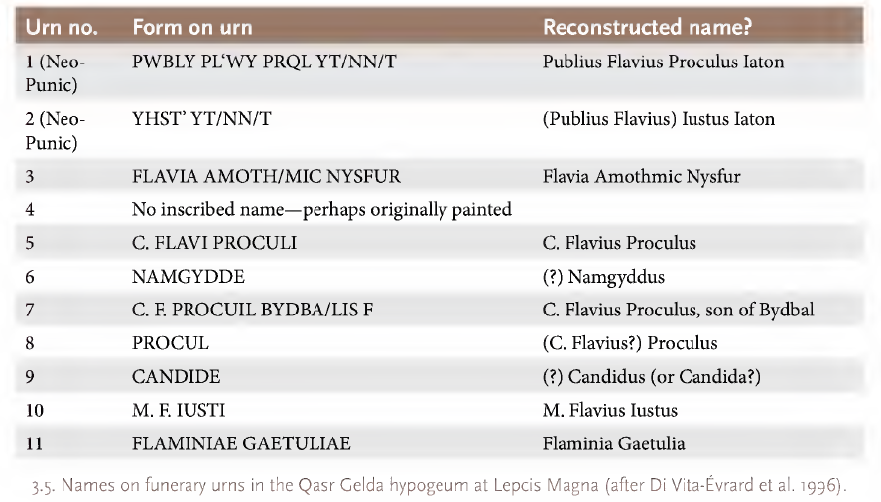
Mattingly 2014, 45, 48

