Slide 1
House And Home
Remember HoME? Where most of us spent the last 6 Months?
CITY 185: URBAN CULTURE AND SOCIETY September 14

Slide 2
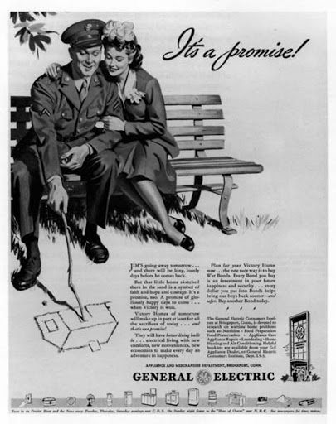
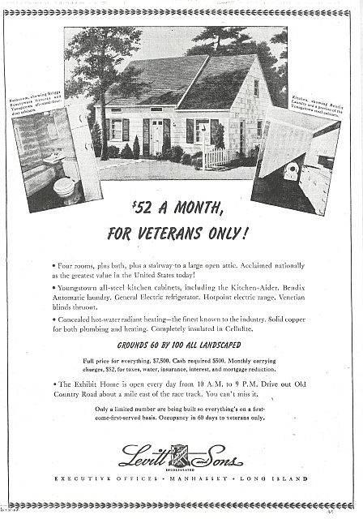
What Do the Ads Tell us about “The Postwar American Dream” (Lane)?

Slide 3
FEELINGS (from BarbaraMiller Lane): What does it mean if all do not have access to a shared ideal?
“The house was new, our family had never h ad a new house before. And it was new to us: we had come a distance to live there, and left our earlier families and neighborhoods behind. It was all ne w: bright new paint and floor s, a shiny kitchen and bathroom with new kinds of machines and fixtures, lots of light inside with big windows looking out frnt and back, a bedroom for each child or pair of kids, easy to move around in. A garage for the new family car. It seemed new in another way, too it seemed right for a new time. “
THE AMERICAN HOME WAS CONSTRUCTED AS A GOAL MEN WORKED (PASSIVELY) TO EARN FOR THEIR WIFE AND CHILDREN. WHERE ARE THE ISSUES?

Slide 4
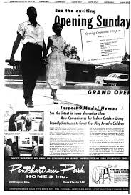
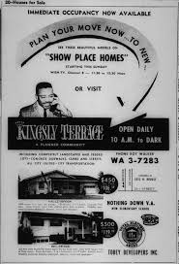
And these?

Slide 5
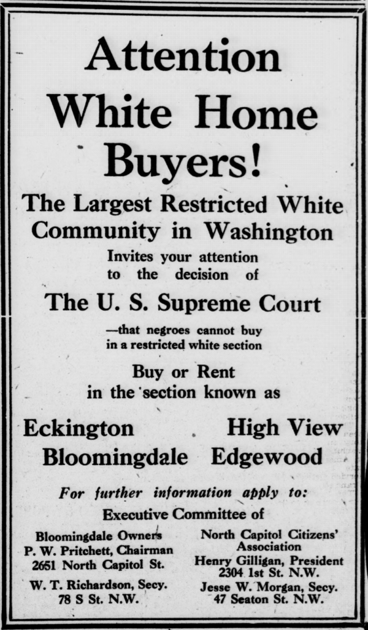
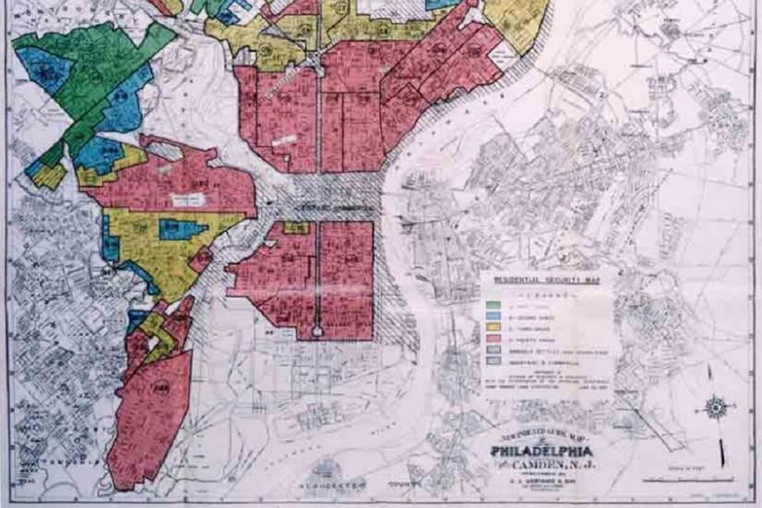
Why Didn’t Blacks Own/Buy Homes? Redlining/Covenants…
?
https://www.bunkhistory.org/resources/1534

Slide 6
And for those in favelas?
Ownership is precarious
Advances even from generation to generation may be undercut by deception, accidents or social changes
Their dreams are the same but realities impossibly distant

Slide 7
Houses are Building Blocks of the City as constructed by the larger society –we can live in many ways and spaces. They also speak to how we define PRIVATE/PRIVACY in the city
Houses are investments that create opportunities for generators of wealth and difference (private property) but also justify relations of labor and division (Hayden, Lane, Satter) via gov’t policies.
Homes are sites of meaning and reproduction (literally) in terms of roles of gender, sexuality, race, class and generation (privacy) (All)
Housing, public and private, also provides potential, even revolutionary laboratories of change.
Given these meanings, what does it mean not to have a home? An address? (Satter, Perlman)

Slide 8
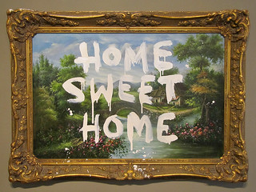
House vs. Home (Housing vs. Homing
Space. Vs. Place

Slide 9
1) Meaning is linked to ownership and economics but what does ownership mean?
In 1910, 46.7% of American families owned their own home. In 2018, 84.2%.As Hayden notes, this was achieved not by grassroots action but by a system that wanted productive workers. NB: this is calculated by families of ownership not actual percentage of owners –any adult child is included. AND, it does not differentiate those with a mortgage, paying for full ownership. If we exclude those, ownership drops to 34% --that is, 50% have bank-supported access to ownership.

Slide 10
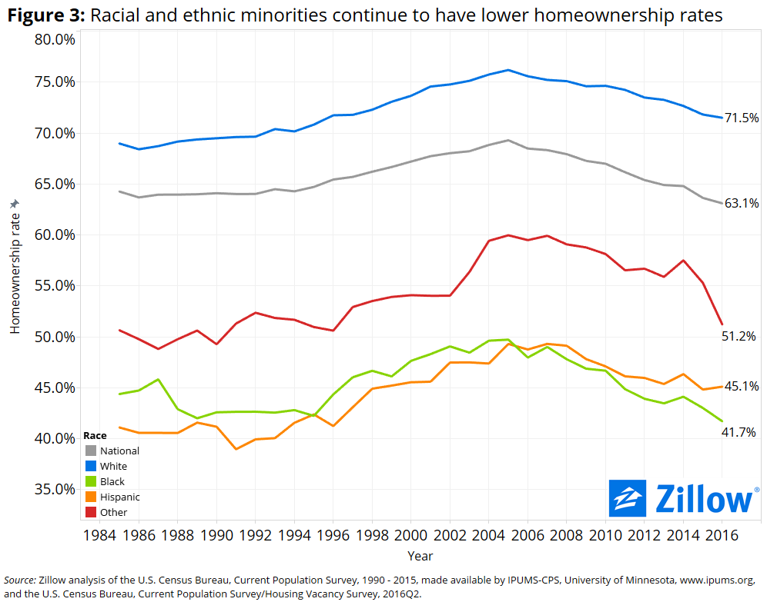
Differences in the U.S. (there are also differences by age, context, etc)

Slide 11
Global Comparisons and Questions: Cities and States shape “home”
Spain 76.3% (2020)
Brazil 72.4% (but what about favelados who own houses but not land?)
Hong Kong 49.2%
China 89.68%
Switzerland 33-37%, Geneva 18.3%
DO THESE CHANGE THE EXPERIENCE OF HOME? OF PRIVACY?
Ursina Kuhn and Markus Grabka (2018) “Homeownership and Wealth in Switzerland and Germany Social Dynamics in Swiss Society, 2018, Volume 9
https://realty.economictimes.indiatimes.com/news/residential/home-ownership-low-in-india-high-property-prices-loan-rates-major-deterrents-survey/57919274

Slide 12
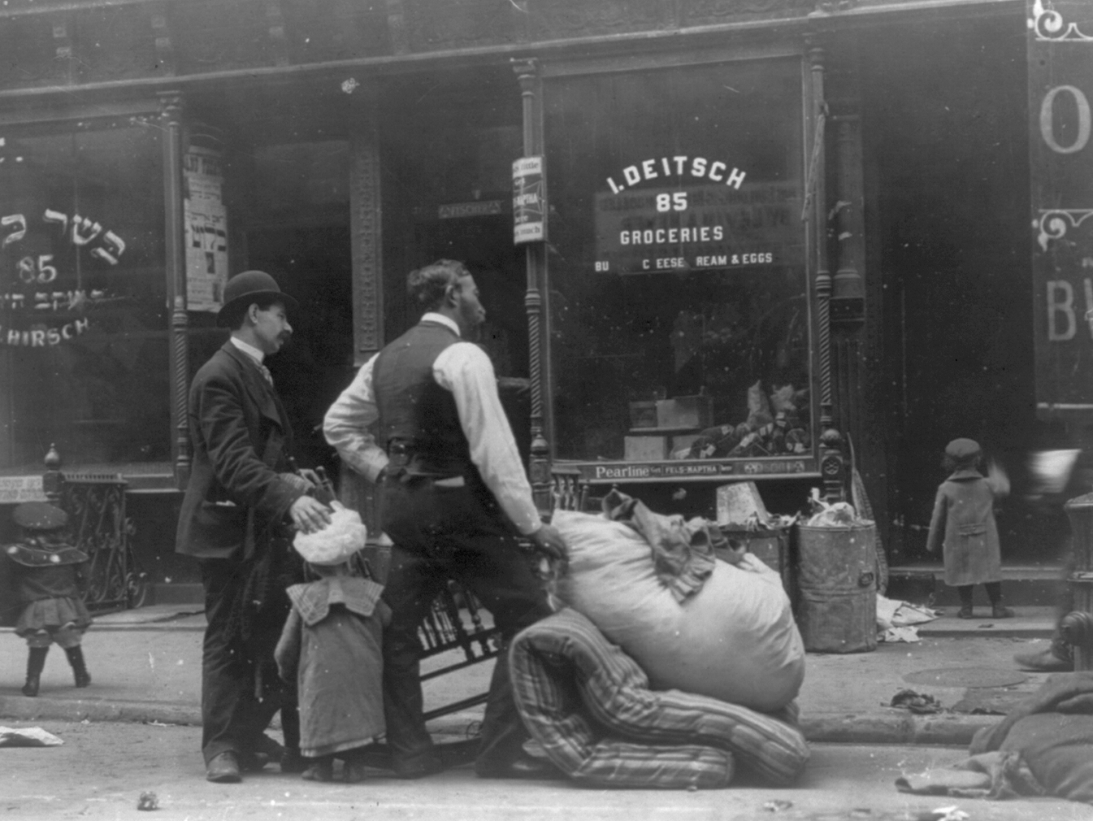
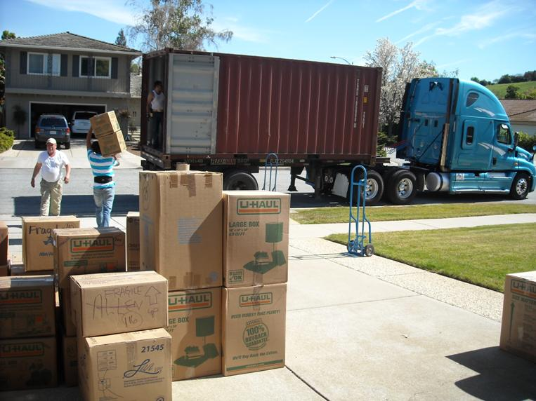
Mobility
The average American will move 11+ times and own three residences. While statistics on ethnic groups are classes are difficult to come by, the poor move more often (perhaps twice as often) and renters move three times as often as owners. This may be a chance to change/improve life (See Perlman) but movement, especially involuntary (eviction) also involves many disruptions of school, work and community.
How and Why do Favelados move?
Phinney, R. (2013). Exploring Residential Mobility among Low-Income Families. Social Service Review, 87(4), 780-815. doi:10.1086/673963

Slide 13
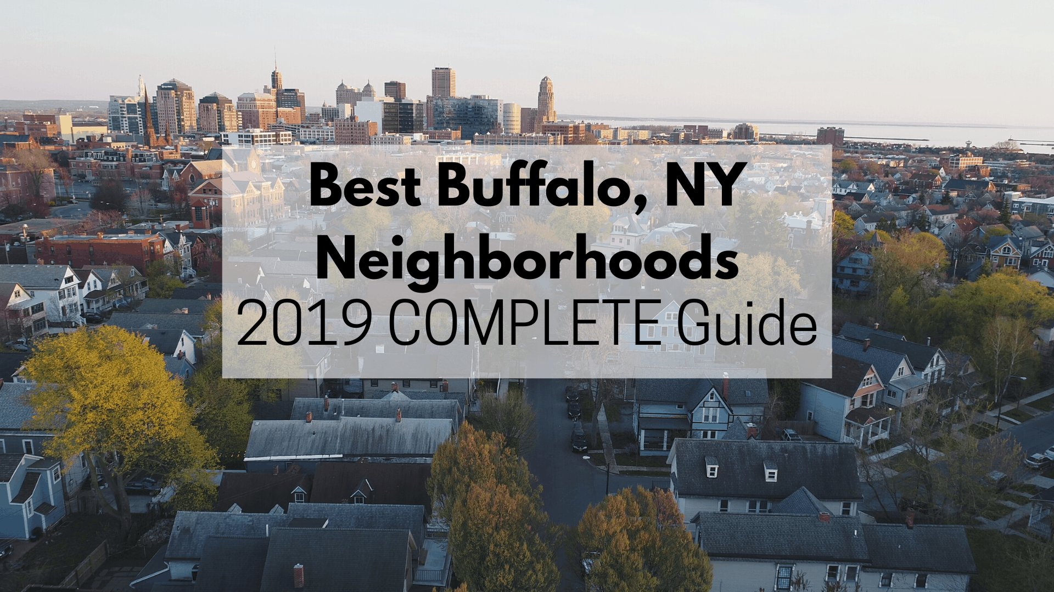
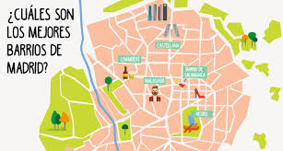

And then ownership is linked to are taxes, services, public health, education, etc …as we will see

Slide 14
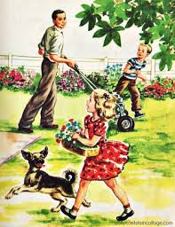
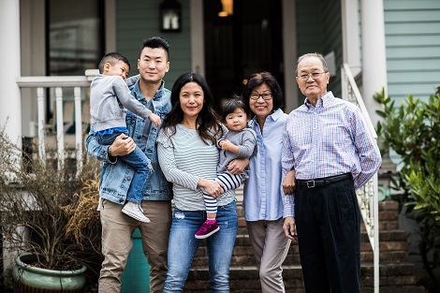


2) Home is a Site of Ideologies

Slide 15


A man’s home is his castle?

Slide 16
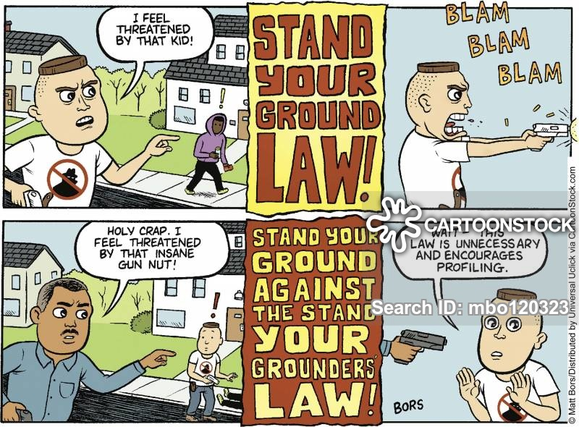

Privacy and Security

Slide 17




A Woman’s Home is Often her Workplace

Slide 18
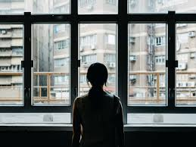
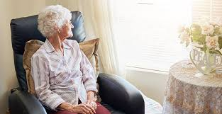
Both can feel isolation…. And pain with age or lack of opportunity

Slide 19
Gender and Home Evokes a History of Rights as Well
“New York gave women the most extensive property rights, passing the Married Women's Property Act in 1848 and the Act Concerning the Rights and Liabilities of Husband and Wife in 1860. Both of these laws expanded the property rights of married women and became a model for other states throughout the century. Under this set of laws, women could conduct business on their own, have sole ownership of gifts they received, and file lawsuits. The Act Concerning the Rights and Liabilities of Husband and Wife also acknowledged "mothers as joint guardians of their children" along with fathers. This allowed married women to finally have legal authority over their own sons and daughters.” www..thoughtco.com/property-rights-of-women-3529578

Slide 20

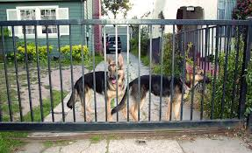
What do Front and Back Spaces Mean to Us in a House? An Apartment? Shared Housing?

Slide 21
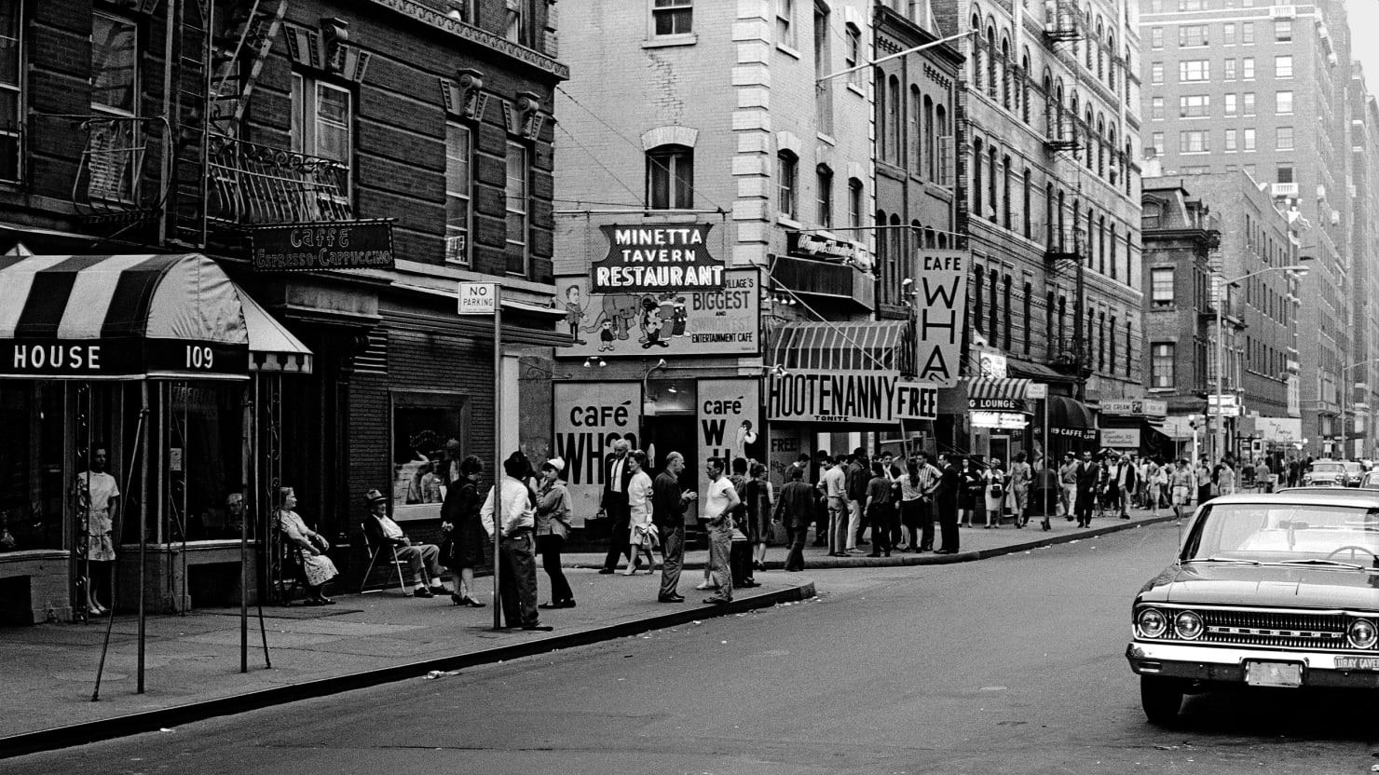
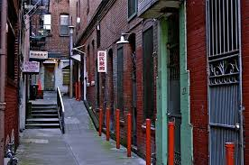
Social Life: Where does the house end? The porch, the yard, the alley, the choreography of the street (Jacobs) But that becomes a question of private and public…..

Slide 22


And problem neighbors?

Slide 23


Where do you take the mask off?

Slide 24
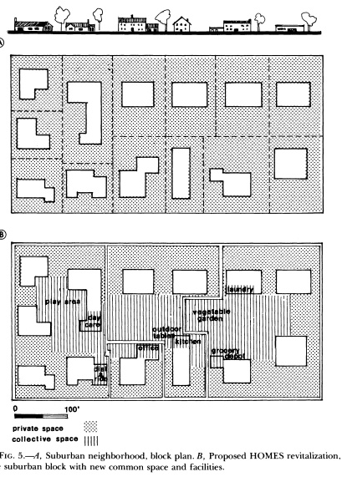
3) Imagining Alternatives - What Would Non-Sexist Housing Look Like? (Dolores Hayden)
If we start from the premise that American housing demands double labor from working women by fragmenting space and tasks, what do we do to find new models of work?

Slide 25
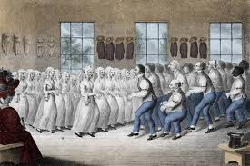
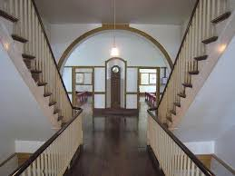
Utopians Histories of Rethinking Form and Society in Cities

Slide 26
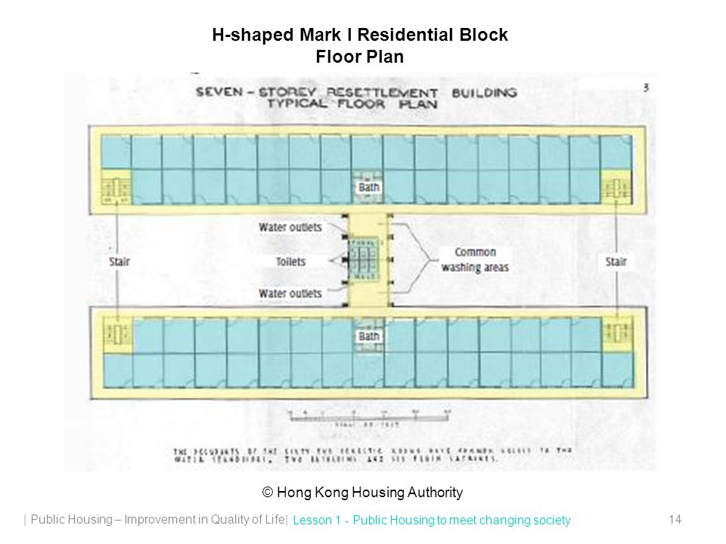
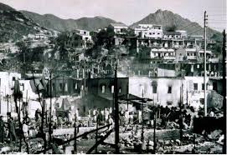
Public Housing as Egalitarian Response: Hong Kong 1953

Slide 27
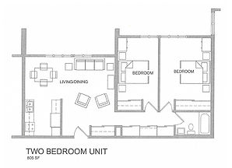
Public Housing Minnesota 2000s: Echoing the American Dream

Slide 28
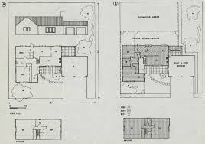
How do We Change Housing to Share Tasks and Spaces?

Slide 30
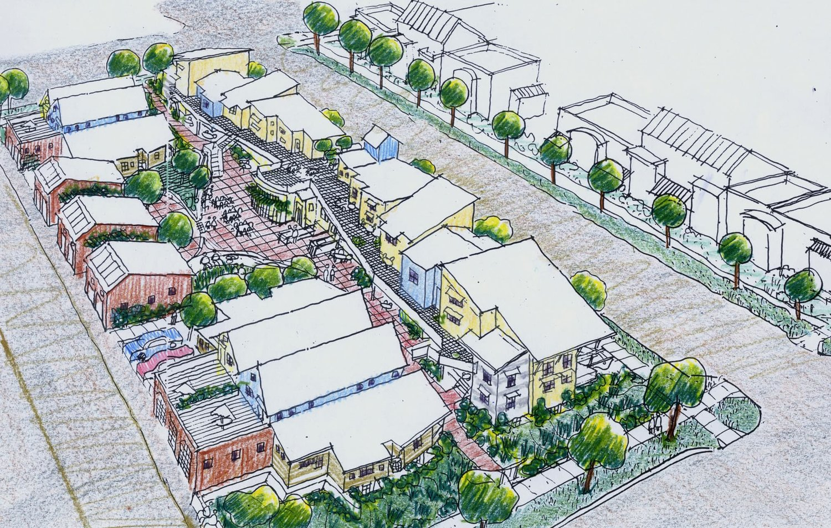
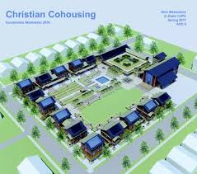
American Social Models: CoHousing in CO, Union Housing, PA

Slide 31
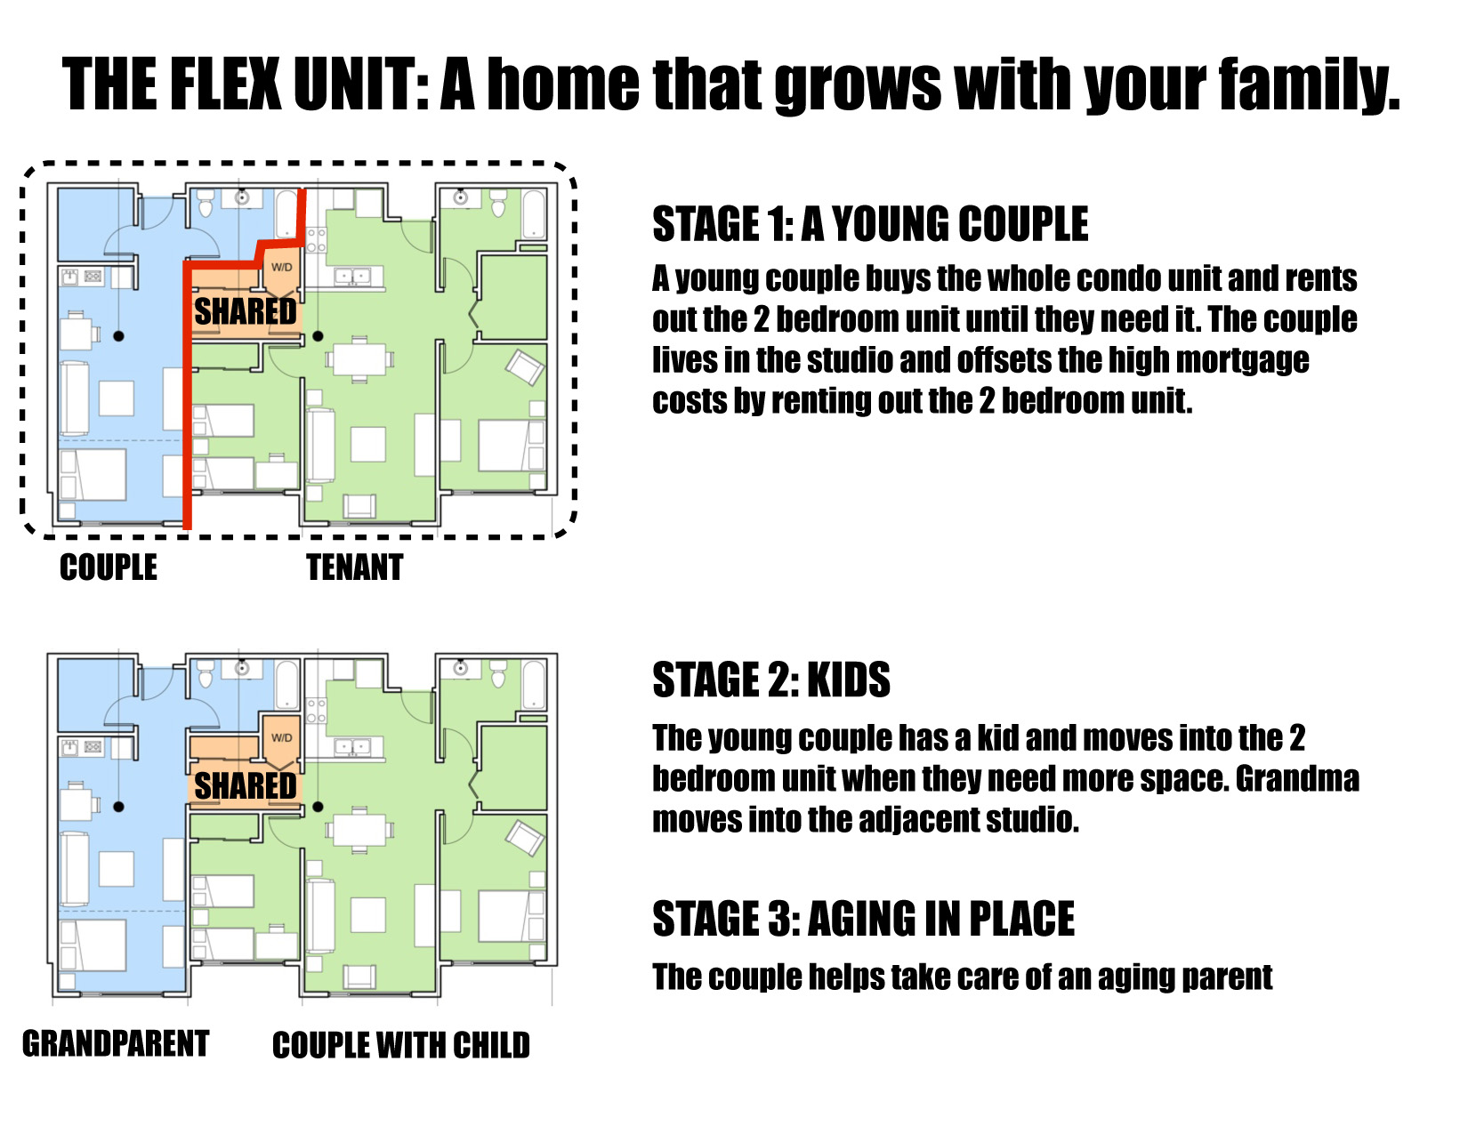
Flexible Visions for “Affordable” Housing –San Francisco
(what is the ideology of “affordable?) Can we change over the lifetime of a person/family?
sfpublicpress.org/seeking-san-francisco-affordable-housing-solutions-20-seconds-at-a-time/

Slide 32
Why Might People Object?
Home as investments: Government Subsidies
Gender Roles
Risks of Community and Change
NIMBY

Slide 33
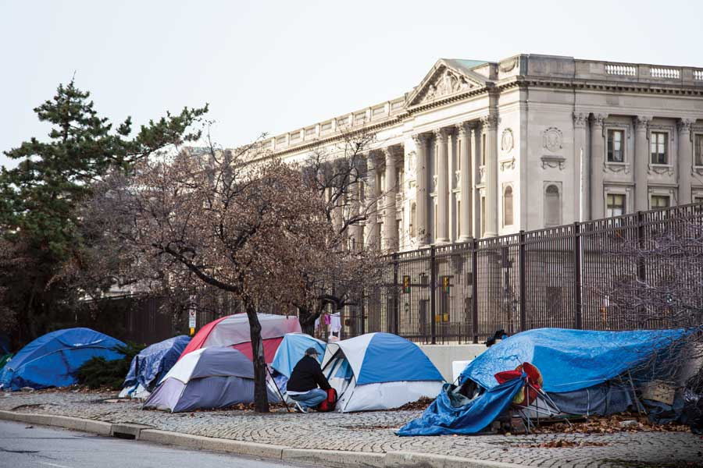
4) What does it mean NOT to have a house or a home? Philadelphia 2020
https://www.phillymag.com/news/2020/02/08/philadelphia-homeless-opioid-epidemic/

Slide 34
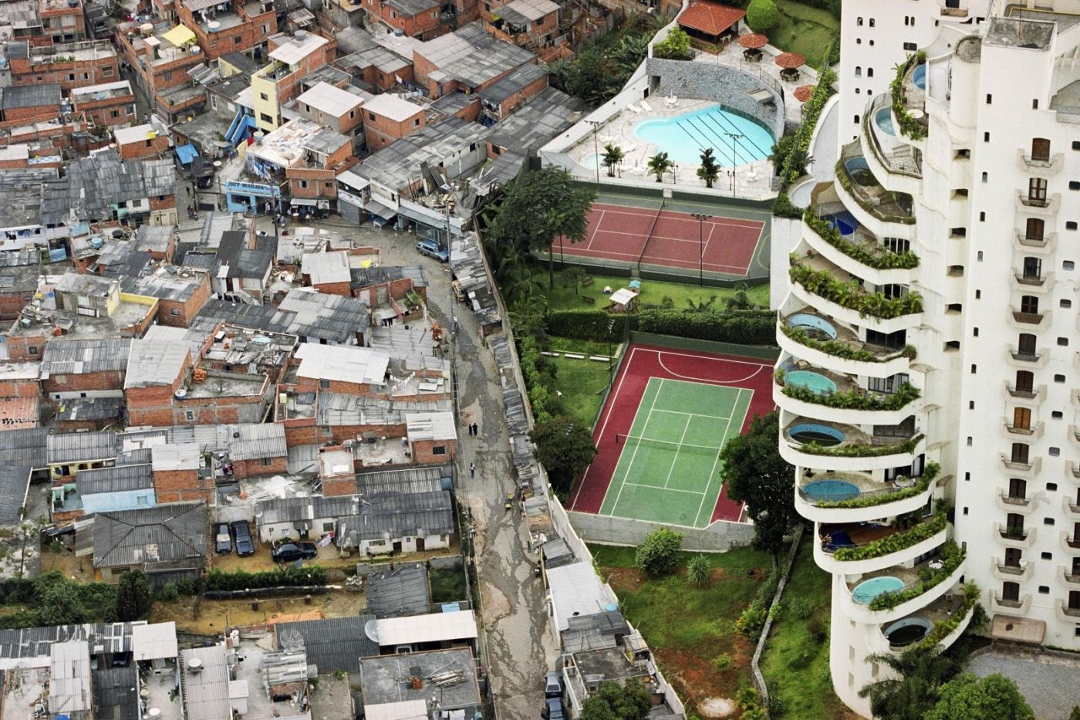
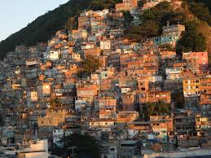
Precariousness and Contrasts of Housing? Favelas and Context (Sao Paulo)

Slide 35

Impacts of Inadequate Housing
Poverty
Health and Hygiene
Crime
Imagery of the Slums, the Homeless and Shantytowns
And implications for those who live there.

Slide 36
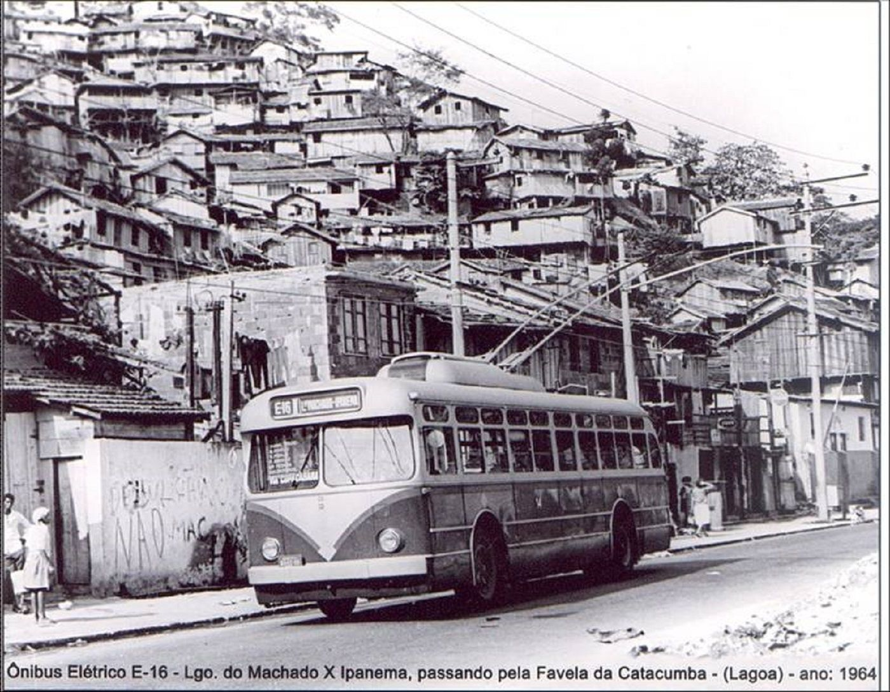
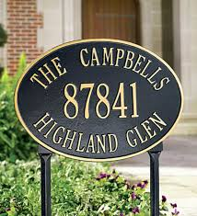
WHAT IS AN ADDRESS?
WHAT DOES IT MEAN TO HAVE AN ADDRESS?

Slide 37

What Happens if your Car, or Tent, or House in a Favela has no address?

Slide 38
From House/Home to Block/Neighborhood to City
Even if we start from the home as a familiar building block we must realize that as physical space, social asset AND site of cultural meaning, it is also a construct. And a challenge. Housing forms, distribution and connections reflect and reproduce power within cities at the same time homes allow us to imagine justice, equity and beauty.
Yet different meanings of home and private life are intimately linked to our sense of the public and public space as we will see next class.

Slide 39
Additional Bibliography
Bryson, Bill (2010) Home: A Short History of the Idea. NYC: Random House.
Lane, Barbara (2006) Housing and Dwelling. Routledge
Mask, Dierdre (2020) The Address Book. Profile Books.
Wong, Yue Chim (2015) Hong Kong Land for Hong Kong People.
Hong Kong University Press.

