Slide 1
Whose Dance Histories?
The organizational frameworks and politics of dance history

Slide 2
Poll about collective note-taking/sharing
xoyondo.com/ap/M3SvAErKp2EHycF

Slide 3
historiography
(noun): the study of historical writing

Slide 4
Historiography is important for a wide range of reasons. First, it helps us understand why historical events have been interpreted so differently over time.
Historiography also lets us study history with a critical eye. It helps us understand what biases and ideologies may have shaped the historical period.

Slide 5
Reading:
“Dance History”

Slide 6
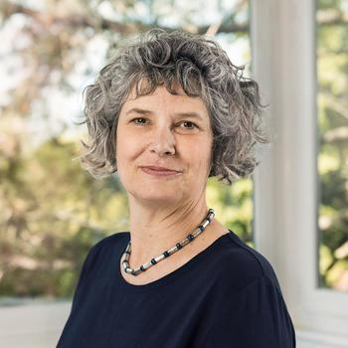
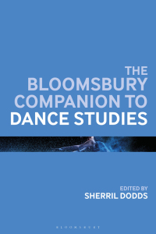
Susan Manning
Susan Manning (she/her/hers) currently serves as Chair of English and is the Bergen Evans Professor in the Humanities. Jointly appointed in English, Theatre, and Performance Studies, she teaches the history of theatrical modernism and avant-garde performance, specializing in dance and movement-based performance. She has worked as a curator and dramaturge as well as a scholar, and her writings have been translated into German, French, Italian, Spanish, and Polish.
“Dance History” (2019)
https://english.northwestern.edu/people/faculty/manning-susan.html

Slide 7
Historiography of dance (Manning 2019)
Twentieth-century to twenty-first century “shift from histories premised on the nation state to histories promising a transnational and global approach” (303).
Historical Models:
Nation state= choreographic families/generations/genealogies, distinguishes “theatrical” from “non-theatrical” genres, follows centres of innovation to periphery of derivation
Transnational= networks of exchange, emphasizes how “theatrical” often adapt “non-theatrical” genres, demonstrates how local conditions shape the assimilation and transformation of influences from abroad
Definitions:
Nation state
Transnational
Social, popular, folk, indigenous, or traditional dance (vernacular)
Modern dance/concert dance
Ideology

Slide 8
Historical events and ideological shifts shape how histories are written
Manning’s examples:
-the history of German “modern dance”, as written before, during, and after Nazism and the Second World War
“repression” and “cleansing” of historical accounts of Jewish artists (305)
-descriptions of American art and artists as linked to ideals of democracy and freedom (306)

Slide 9
Who writes dance histories?

Slide 10
Revising dance history with “critical theory”
“...revisionist works that incorporated black and white choreographers and pushed against the divide between (white) modern dance and Black Dance” (Manning 2019, 312).
(ideas from the humanities)

Slide 11
Who gets left out? (Why?)

Slide 12
Case Study:
Who gets left out?

Slide 13
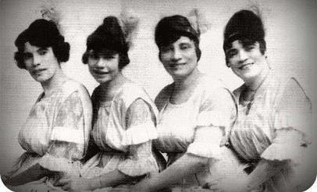
Nadine George-Graves (2000)
The Royalty of Negro Vaudeville:
The Whitman Sisters and the Negotiation of Race, Gender and Class in African American Theatre 1900-1940
Whitman Sister Archives | nadinegeorgegraves
The Whitman Sisters

Slide 14
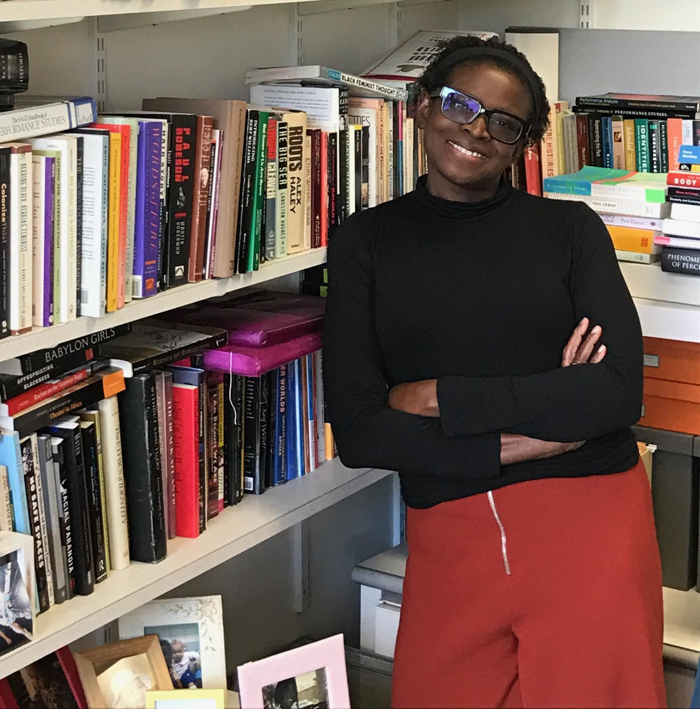
Nadine George-Graves
George-Graves’ work is situated at the intersections of African American studies, critical gender studies, performance studies, theatre history, and dance history. She is the author of The Royalty of Negro Vaudeville: The Whitman Sisters and the Negotiation of Race, Gender, and Class in African American Theater, 1900-1940 and Urban Bush Women: Twenty Years of Dance Theater, Community Engagement and Working it Out as well as numerous articles on African American performance. She is the editor of The Oxford Handbook of Dance and Theater, a collection of border-crossing scholarship on embodiment and theatricality. She has also written on primitivity, ragtime dance, tap dance legend Jeni LeGon, identity politics and performance, competition, social change, early African American theatre and the future of performance in the academy.
https://www.nadinegeorgegraves.com

Slide 15
George Graves (2000, xii-xiii)
“..many records regarding the Whitman sisters, like those of so many other early black artists, have been lost or have not been archived or cross-referenced, and research facilities devoted to this type of material are generally understaffed and underfunded...As a result, the Whitman sisters, like many other black acts of the era, has been largely forgotten or hidden from history.”
“Two words keep echoing as I contemplate this work: silence and survival. How do I survive studying a history that has silenced so many of my foremothers and threatens to silence me? How can the Whitman sisters survive the institutionalized silencing that has almost erased them from national memory and nearly deleted them from history? How do we black women survive the silencing to which we have been subjected for centuries and combat the silencing and warping of images of ourselves?”

Slide 16
Case Study:
Transnational Revisions

Slide 17
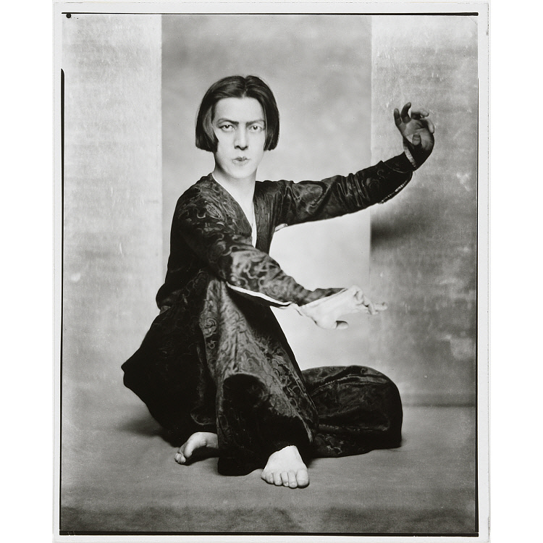
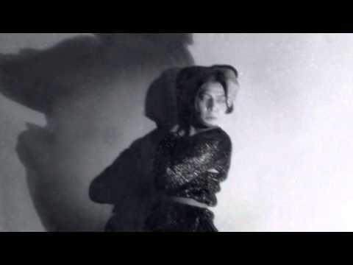
Born in Tokyo, studied in Germany and England, relocated to New York City and then Los Angeles, detained in 1941 and deported to Japan by the U.S.
Michio Ito
https://www.michioito.org/

Slide 18
Different disciplinary “lenses” reveal different aspects
Asian American studies
Japanese studies
Intercultural studies
Theories of globalization
Focus on local and regional contexts and adaptations of “outside” influences
“[dance theorists’] approaches model methods for tracing corporeal and intellectual exchanges across multiple registers and for situating these exchanges within overlapping local contexts” (Manning 2019, 318)

Slide 19
Next week:
Crafting a Research Project
To prepare for Wednesday, read: Layson (1983)
and
view: “Historiography” YouTube video-lecture
Wednesday’s Guest: Arlene Zimmerle, subject librarian

