Slide 1
Jazz Dance Historiography
Reflections on Roots, Branches, Circles, Stages, and Screens

Slide 2
JAZZ
Before you read and listened to the assigned materials,
what did the word “jazz” bring to mind?

Slide 3
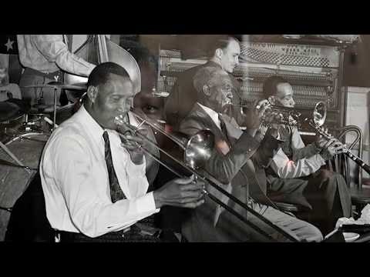
American Musical Genre and Tradition

Slide 4
Telling Different Stories about Jazz Dance
What is considered “jazz dance” and who gets recognized? Why?
Different definitions according to the perceived purpose of jazz dance
The differences between social/vernacular, theatrical, staged, and screened dancing

Slide 5
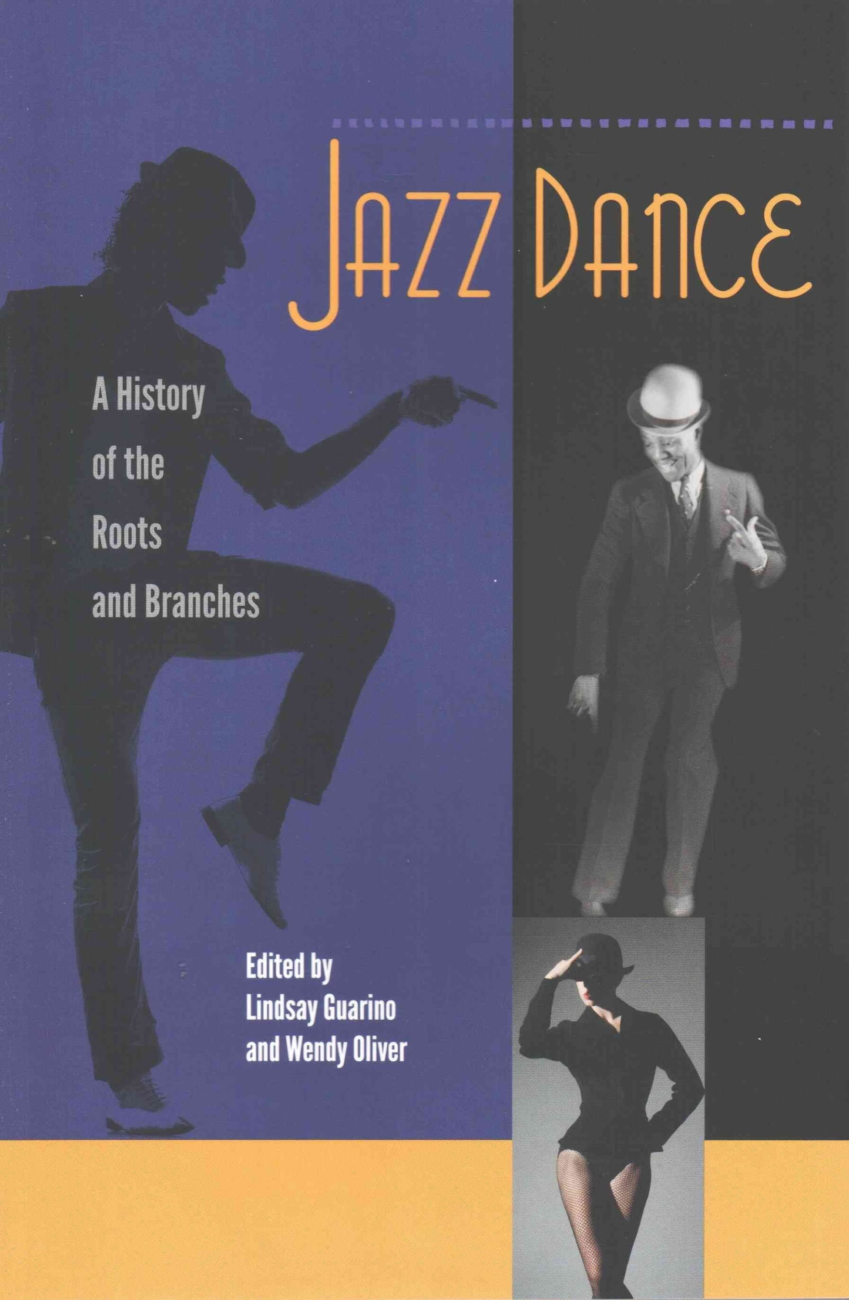
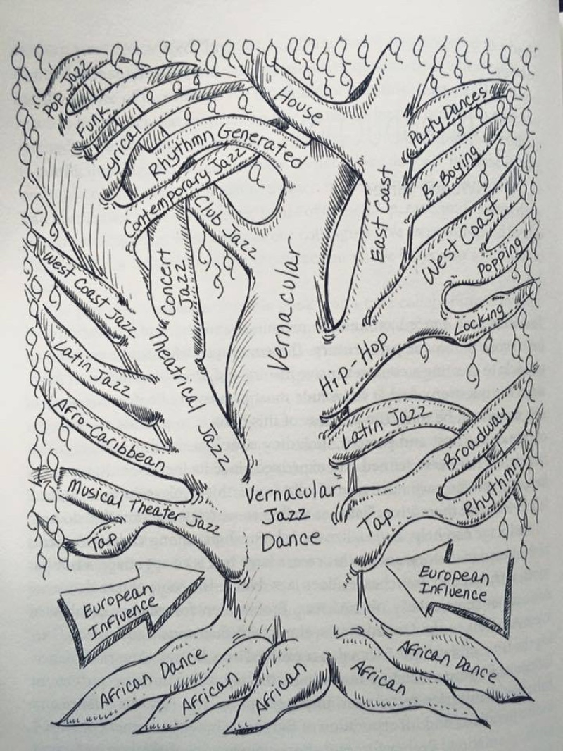

Slide 6
A Broad Historical Overview:
Four individual chapters

Slide 7
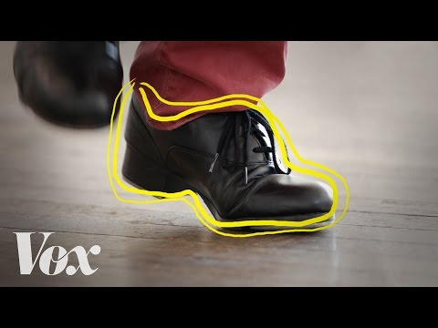
Tap Dance
Part of, but distinct from jazz dance history

Slide 8
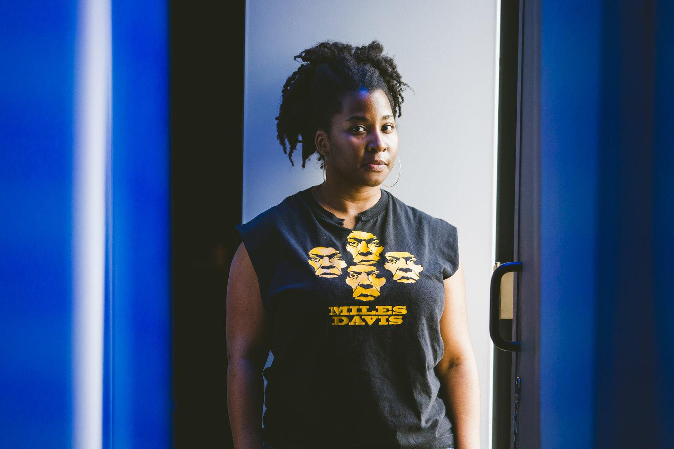
Dance scholar Melanie George; Pillow Voices (2019)
About Jazz Is... Dance Project
Melanie George is a dance educator, choreographer, dramaturg and scholar. She is the founder and director of Jazz Is… Dance Project and an Associate Curator at Jacob’s Pillow. She is a highly sought after teacher and choreographer, staging neo-jazz works on dancers throughout the United States. Her choreography spans concert dance, theatre, and vocal staging.

Slide 9
Jazz Aesthetics and Elements
Earthy movement
movement initiated from the pelvis
Bent limbs
Flat feet
Articulate, inclined torso
Rhythmic, polyrhythmic
Isolations
angular/asymmetrical movement
Improvisation

Slide 10
Jazz Social/Cultural Elements
Use of the circle
Vocal encouragement
Fluid exchange of roles
Call and response
The aesthetic of the cool

Slide 11
“America’s relationship to race, class, gender, and sexuality can be mapped out through the evolution of jazz dance.”

Slide 12
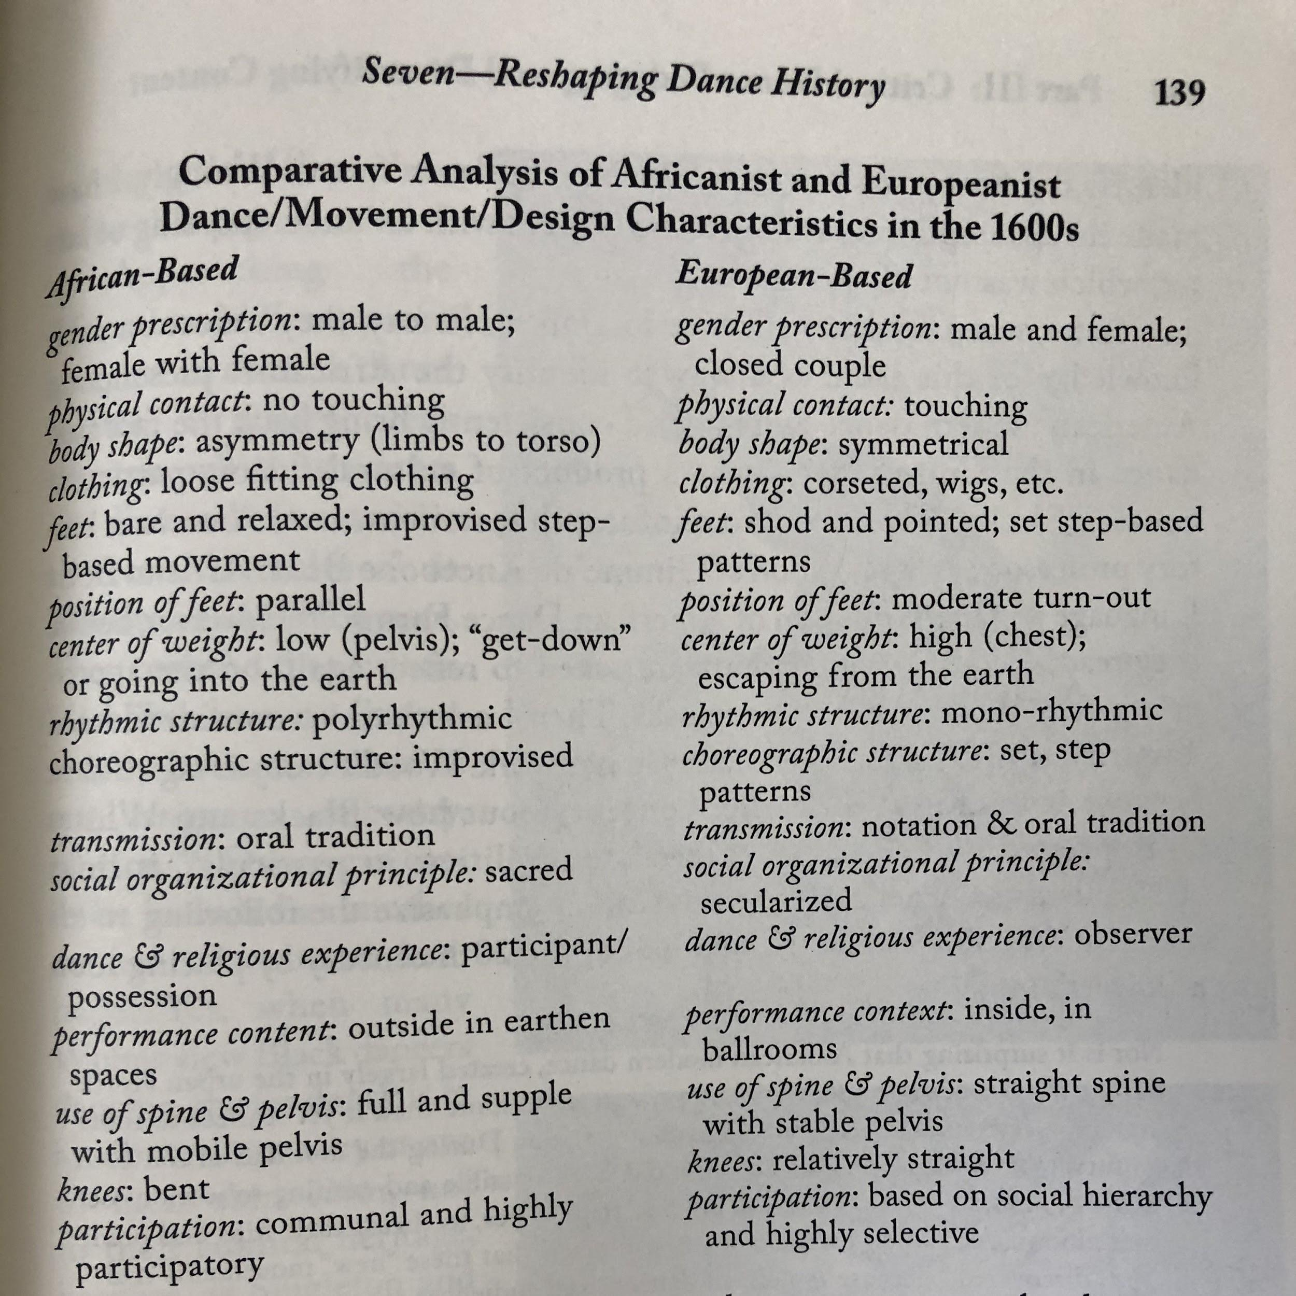
Embody these postures
Kerr-Berry, Julie. 2018. “Reshaping Dance History by Deconstructing Whiteness.” Dance Pedagogy for a Diverse World: Culturally Relevant Teaching in Theory, Research, and Practice, ed. Nyama McCarthy-Brown, 127–153, Jefferson, NC: McFarland.

Slide 13
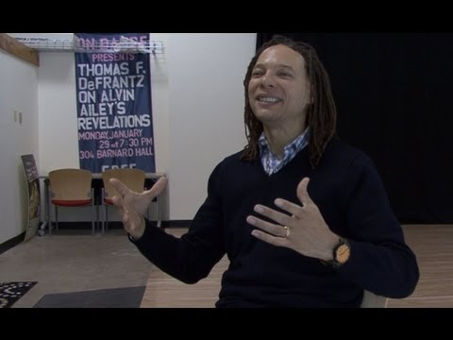
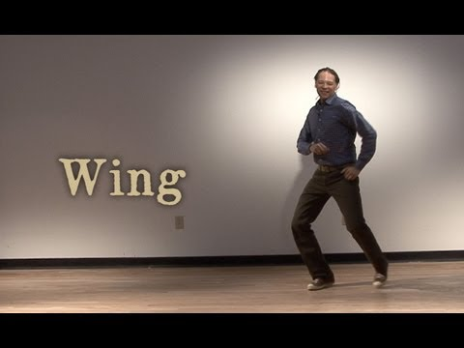
Dance scholar
Thomas F. DeFrantz
Professor of Dance at Duke University and specialist in African diaspora aesthetics, dance historiography, and the intersections of dance and technology. He is co-editor of Black Performance Theory: An Anthology of Critical Readings (with Anita Gonzalez) and editor of Dancing Many Drums: Excavations in African American Dance, and Dancing Revelations: Alvin Ailey’s Embodiment of African American Culture. He serves on various editorial boards and was recently President of the Society of Dance History Scholars (2011-2014). He has also produced and participated in many performance productions, and currently runs the research group SLIPPAGE at Duke University, a group that works to create innovative interfaces for the telling of alternative histories.

Slide 14
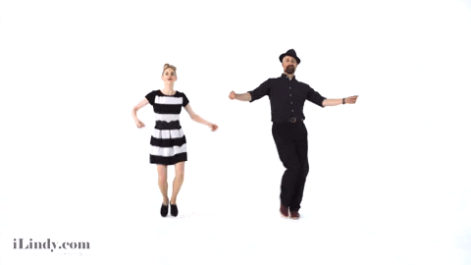
A Brief Stretch Break
5 minutes

Slide 15
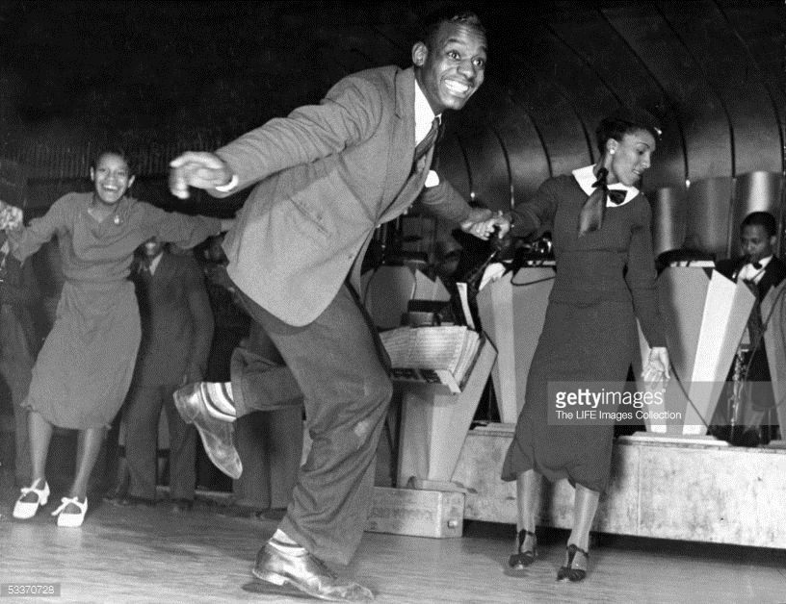
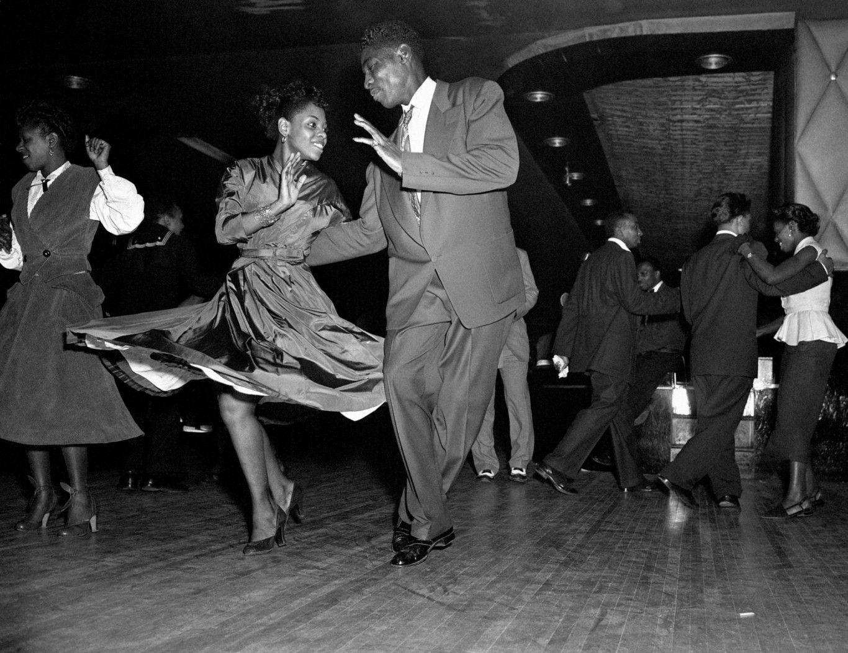
Social Dance

Slide 16
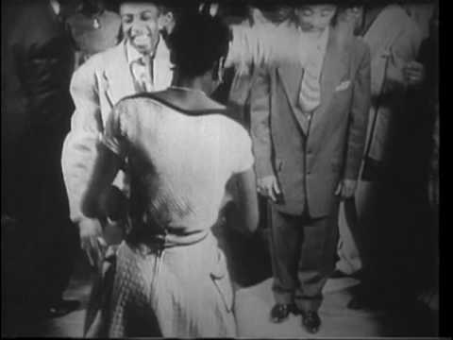
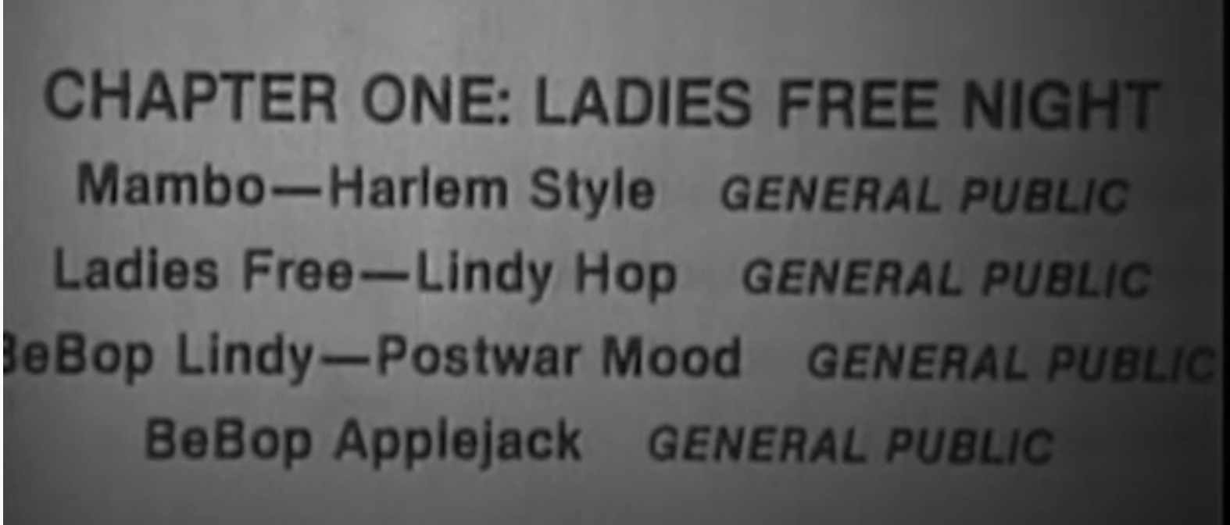
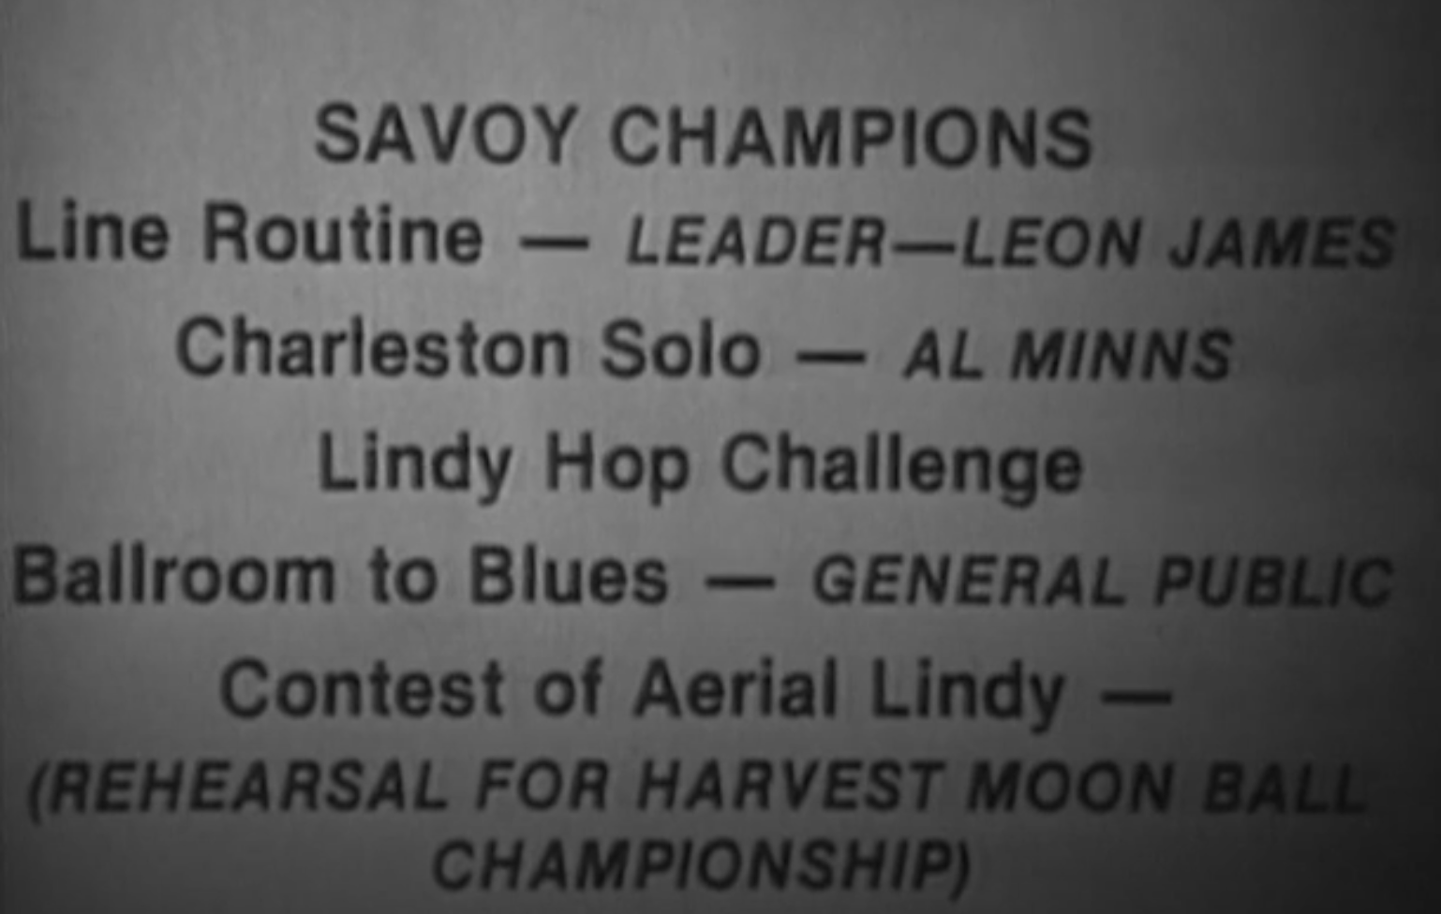
Primary Source Material?
Savoy Ballroom 1920s-1950s
The Spirit Moves: The History of Black Social Dance on Film 1900–1986,
by Mura Dehn

Slide 17
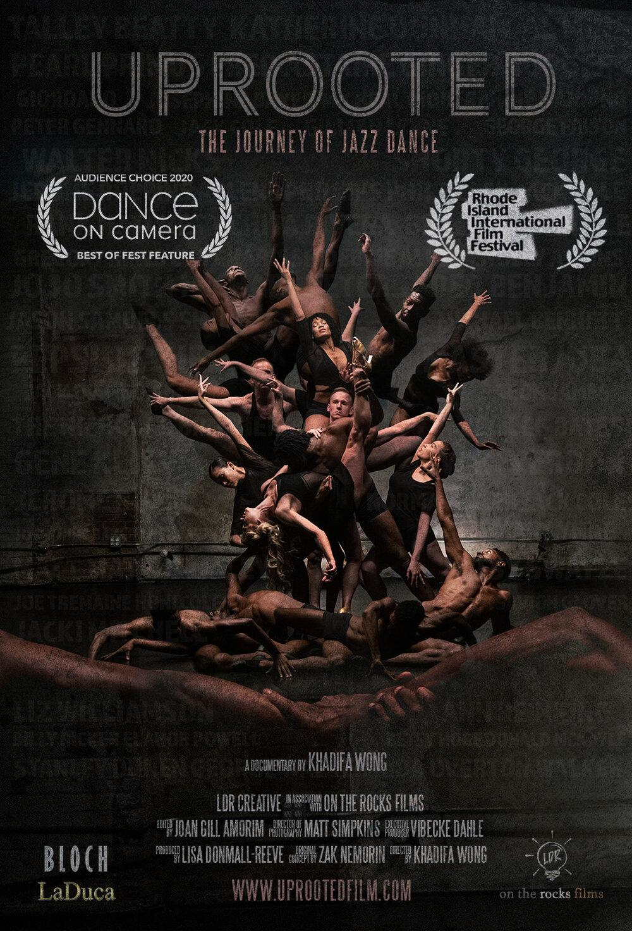
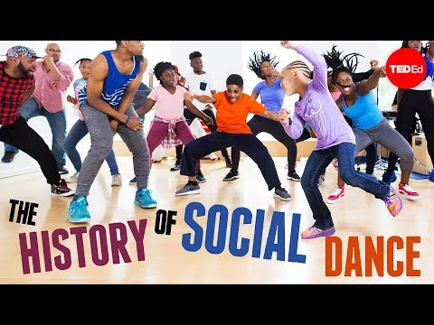
Secondary Source Material
Camille A. Brown, TED TALK https://www.blackdancemag.org/news
Uprooted (2020) doc
https://uprootedfilm.com/

Slide 18
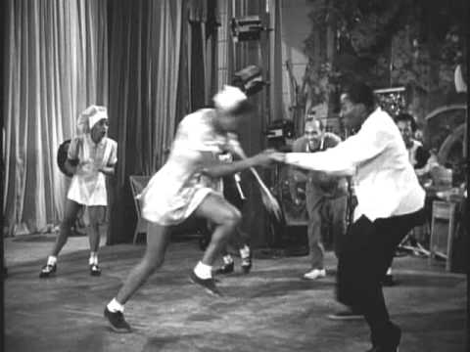
On Screen
Whitey’s Lindyhoppers in the film Hellzapoppin’ (1941)

Slide 19
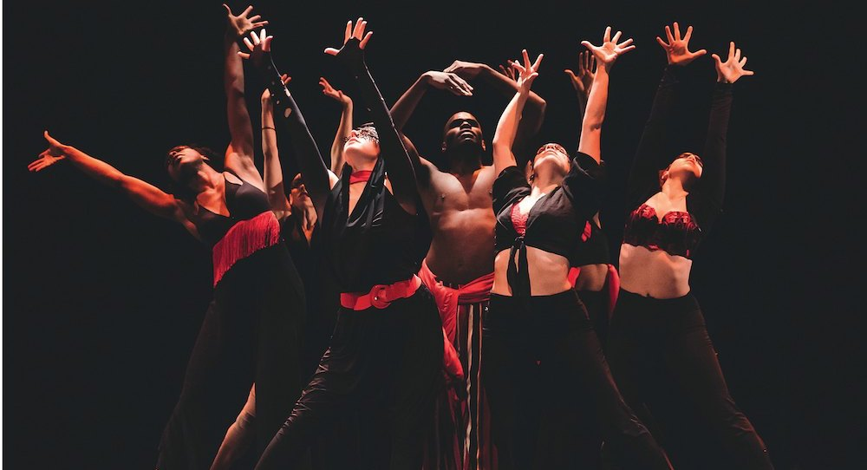
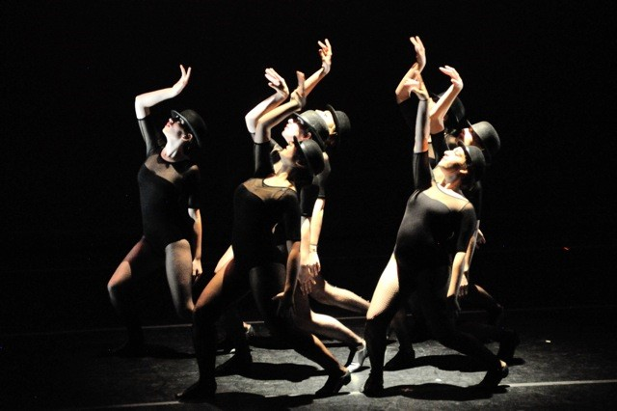
On
Stage

Slide 20
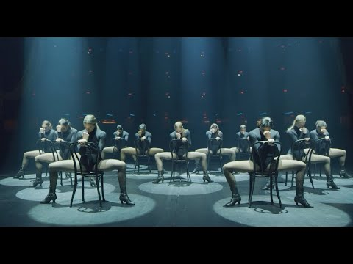
Theatrical Jazz Performance

Slide 21
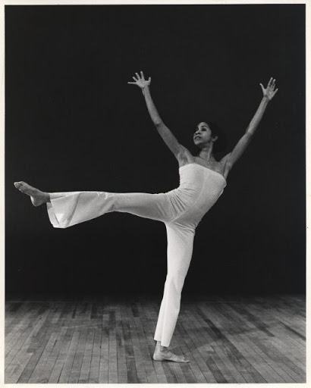
Dianne McIntyre is regarded as an artistic pioneer, with an impressive career spanning four decades with choreography for dance, theatre, television and film. A 2019 Dance/USA Honor Awardee and 2016 Doris Duke Artist Award recipient, her individualistic movement style reflects her affinity for cultural histories, personal narratives and the boldness, nuances, discipline and freedom in music and poetic text.
Dianne McIntyre & Lester Bowie: Invincible Flower

Slide 22
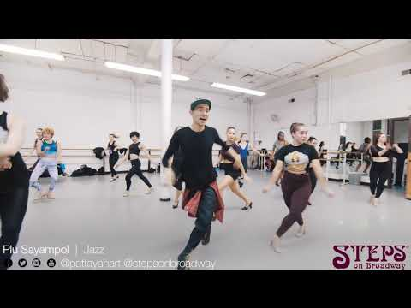
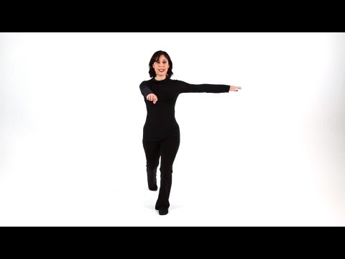
Jazz Dance Technique?

Slide 23
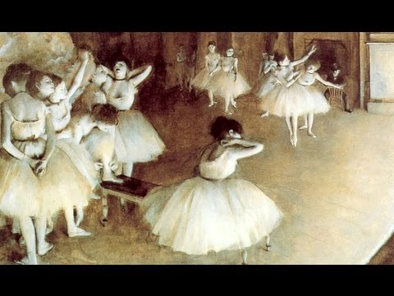
For Wednesday:
Post to Discussion Board 2: Jazz Dance Historiography (written/recorded)
Watch and try: “Ballet Evolved, the first four centuries”
7 minute lecture-demonstration
by the Royal Ballet (London, UK)
Read: Anderson, Jack. “Dance at the Royal Courts” AND “The Professionalization of Ballet.” Ballet & Modern Dance: A Concise History, 2nd Ed, by Anderson, Dance Horizons, 1992, pp. 31–44 and 51–67.

