Slide 1
Rio de Janeiro/Philadelphia
Urban Culture and Society September 25

Slide 2
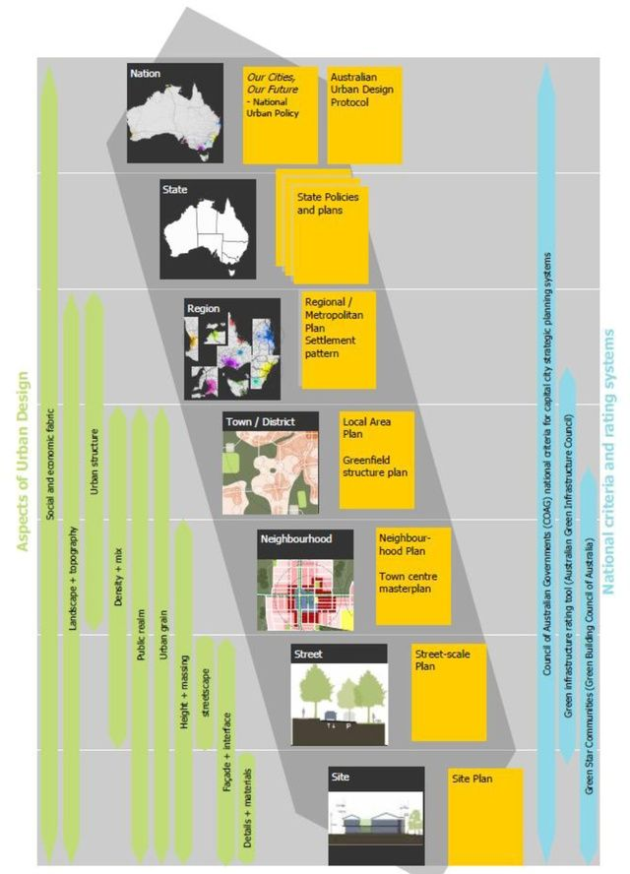
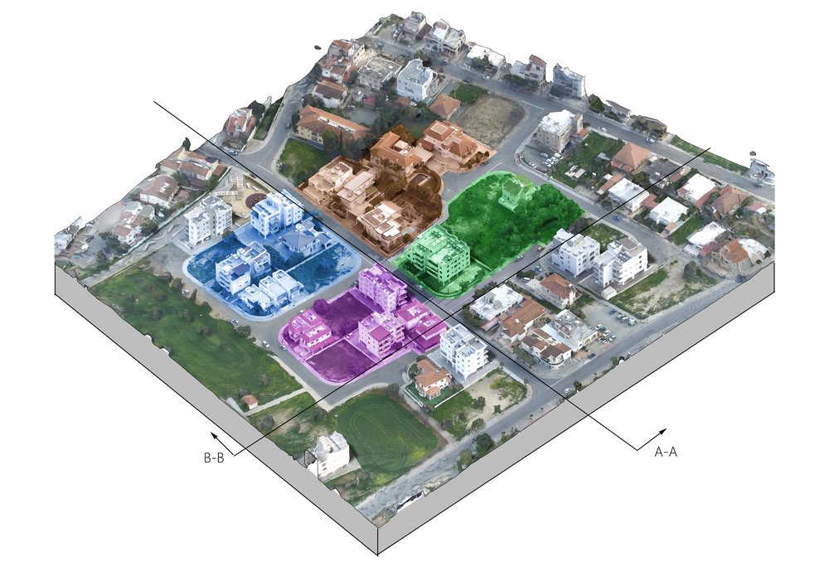
Recentering the City in Our Sense of Scale

Slide 3
Framing the Growth of the City as our Unit of Study
Using Models to Understand/Compare Cities
Identifying Shared Features and Comparing Them –History/Function
Exploring Differences –Race (Class, Gender) as Social and Cultural Products
Correcting for SCALE within and across Cities;Thinking about POSITIONALITY
And finding tools: https://www.chicagofed.org/region/community-development/data/pcit
(Federal Reserve Bank of Chicago Peer City Identification Tools)

Slide 4
Assignment 1.3/1.4 Building with maps
Over the next two weeks we ask you to take your original map and add context. The first, simpler assignment due next week is to add surrounding streets (think Lynch and Perry) and tell us what else you see. The second, due in two weeks, ask you to use census and Arc GIS to adduce data that complicates the context and helps you with paper 1.5. YOU DO NOT NEED TO MAKE THIS A RESEARCH PROJECT ; IT IS SHORT PRELIMINARY TEST OF SKILLS AND CHOICES – CONSIDER THEMES SUCH AS RACE, INCOME, HOME OWNERSHIP, AGE, SEX, FAMILY, ETC AS THEMES THAT MIGHT BE OF INTEREST.

Slide 5
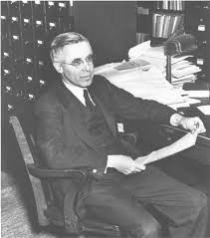
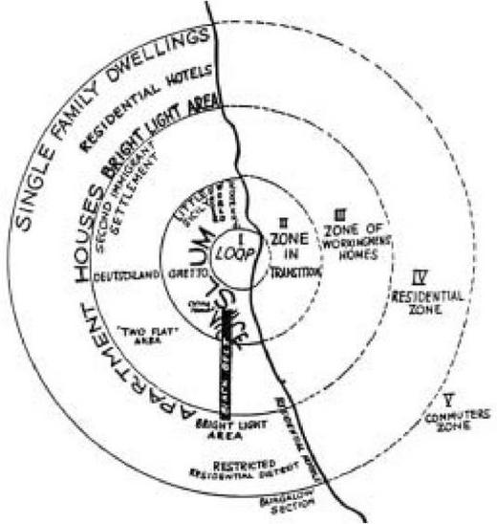
Modeling the City in Motion: Ernest Burgess (1916-66) and the Chicago School

Slide 6
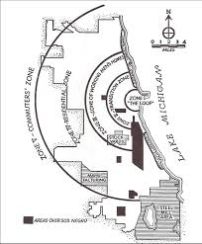
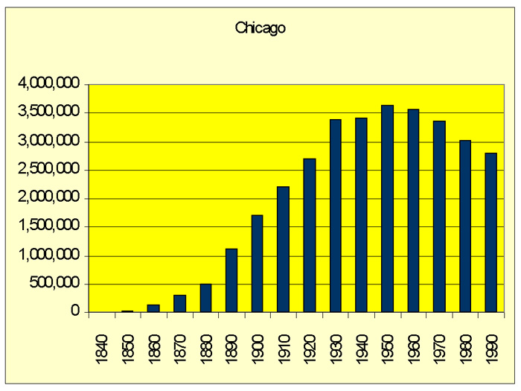
Making Chicago Universal

Slide 7
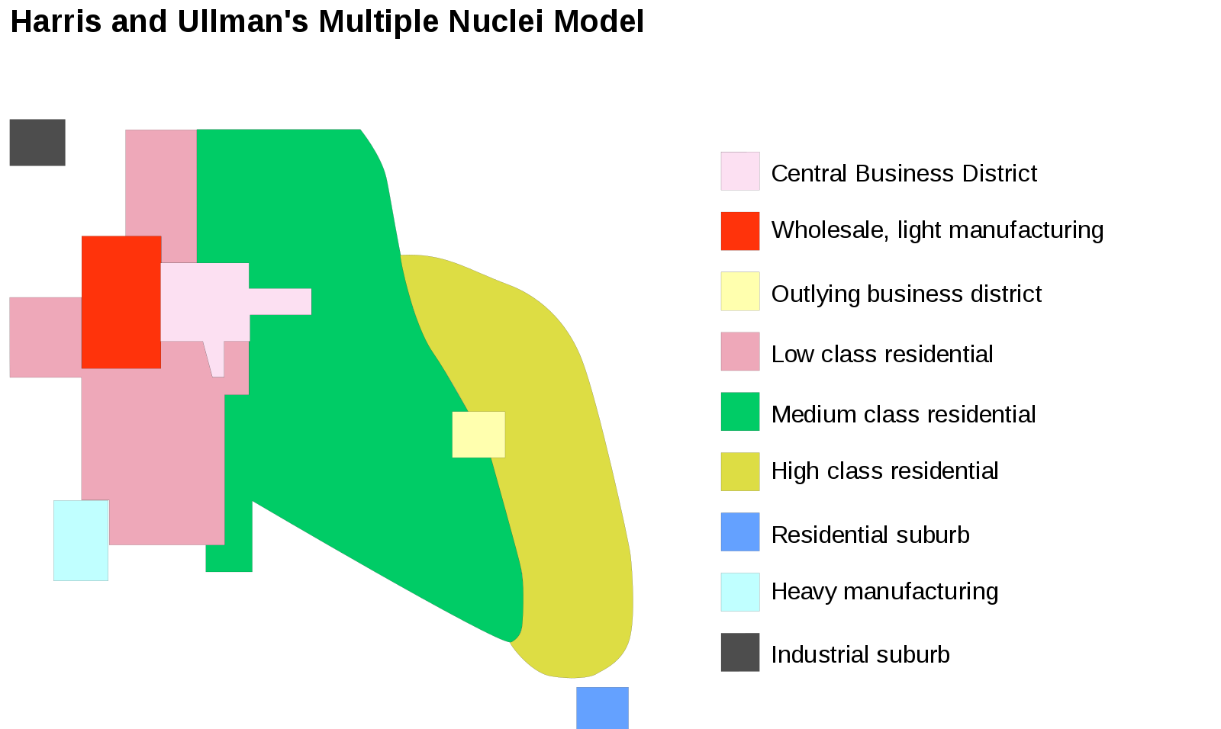
Movement is Complex and Variable
But is mobility the same if you move to tbe burbs as if your favela is torn down or your neighborhood hemmed in by disinvestment (redlining)?

Slide 8
What Features Can We Compare in Cities?
1.Cultures and Identities
2.Setting and Historical Processes: KNOW THE BACKGROUND and the places of the city.
3.Scale, Forms and Context of Growth
4. Economic and Political Developments/Structures of Inequality and Space (Race)
What has shaped the position/perspective of the observer?

Slide 9
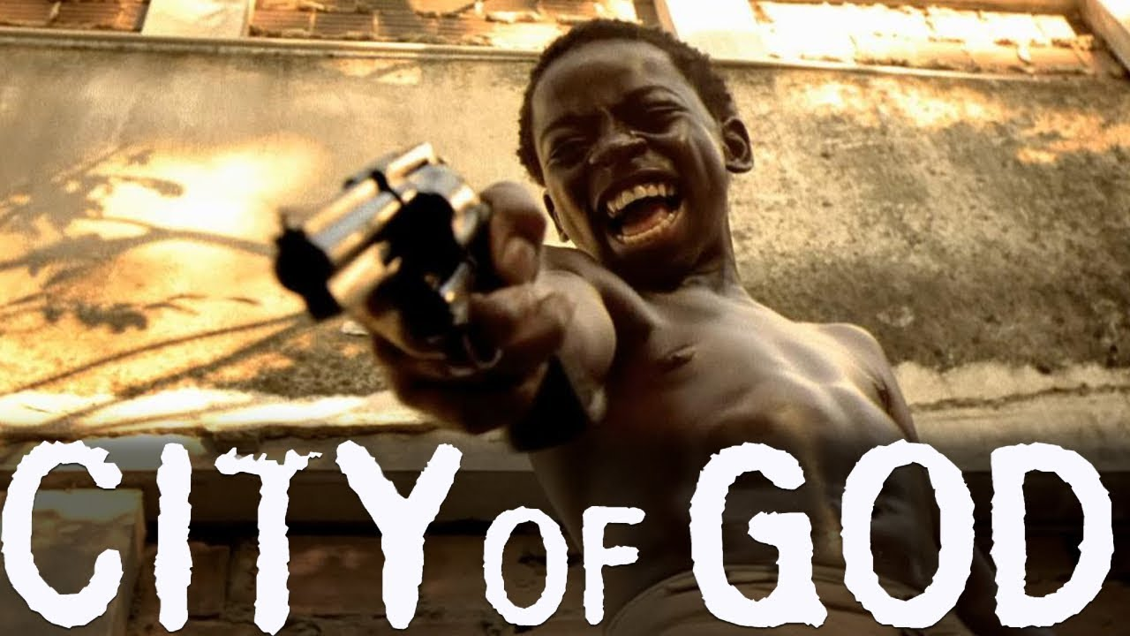
1. CULTURE: Images and Impressions of Difference:
https://www.youtube.com/watch?v=30HM-O9LajQ

Slide 10
A City of Many Images Which We have Channeled Through Favelas
Favelas, as Perlman notes, are ever present in the cityscape, politics and culture of the city, from discussions of inequality to crime to sambas at carnaval. At the same time, favelados, according to Perlman’s badly sourced and labeled chart, account for only 18.7% of the urban population, even though favelas were growing faster than the rest of the city (in population). And favelados have been drawn from other areas by the PROMISE of Rio as a city as well as its outreach to the world, even if they are denied those promises.

Slide 11
Philadelphia
https://www.youtube.com/watch?v=4z2DtNW79sQ

Slide 12
What Kinds of Diversity Does Each City Celebrate and Ignore?
https://www.prnewswire.com/news-releases/visit-philadelphia-debuts-new-african-american-travel-series-300519180.html
https://www.youtube.com/watch?v=KGoZG9sujyU
https://www.youtube.com/watch?time_continue=2&v=1WxTkIc7gVc&feature=emb_title

Slide 13
2. Setting History: Coastal and Colonial Port Cities

Slide 14
How is Philadelphia Similar?( Except for the lack of mountains and oceans)

Slide 15
What is the colonial city? What do we inherit?
“The colonial world is a world cut in two. The dividing line, the frontiers are shown by barracks and police stations…The zone where the natives live is not complementary to the zone inhabited by the settlers. The two zones are opposed, but not in the service of a higher unity.” Franz Fanon (1961, “Concerning Violence” WRETCHED OF THE EARTH)
PORTS of connection to the Metropolis
Divided against indigenous populations
Divided against subordinate (enslaved) populations
Divided by power local and global

Slide 16
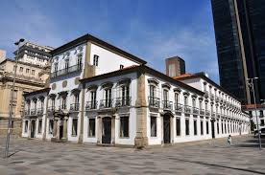
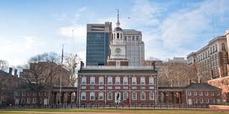
Architectures of Power
b. 1753 as State House, hosted U.S. Govt 1770s-1800
b. 1743 for Governor General, became Imperial Palace 1808

Slide 17
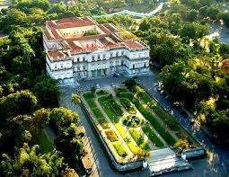
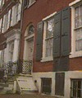
Divergent Political Trajectories
John Penn House, 242 S. 3rd, Home of Last Colonial Governor
(now private)
Imperial Palace, RJ –later museum until destroyed by fire, 2018

Slide 18
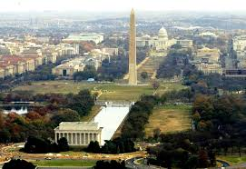
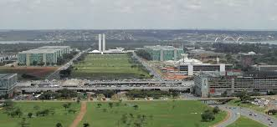
Replacing Capital Cities
Brasilia, 1960
Washington, D.C. 1800

Slide 19
3. Population & Growth Over Time
Philadelphia
Rio de Janeiro
Dates
1680s
1776
1820s
1890s
1920
1940
1960
1980
2000
2020
2030
600
28,522 1-3% colonial U.S.
63,802
847,000
1,823,779
1,931,334
2,002,512
region 3.3 million
1,688,310 (4.830)
1,517,000 (5.4)
1,851,000 (6.1)
1,900,000?
25,000 (20,000 slaves)
20,303 (1798 33,000)
113,000
520,000
1,100,000
1,750,000
3,300,000
region 4.8 million
5,051,091 (8.8 milliom)
11,306,000 metro
13,450,075
14,408,259

Slide 20
19th Century Growth: Slaveocracy and Government Rio 1864

Slide 21
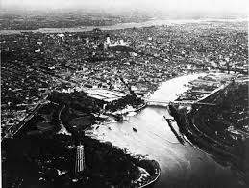
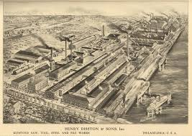
19th C. PHILADELPHIA: WORKSHOP OF THE WORLD

Slide 22
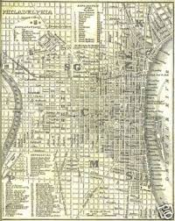
Philadelphia 1842/1854 The Political Industrial City

Slide 23
3. Population Growth Over Time
Philadelphia
Rio de Janeiro
Dates
1680s
1776
1820s
1890s
1920
1940
1960
1980
2000
2020
2030
600
28,522 1-3% colonial U.S.
63,802
847,000
1,823,779
1,931,334
2,002,512
region 3.3 million
1,688,310 (4.830)
1,517,000 (5.4)
1,851,000 (6.1)
1,900,000?
25,000 (20,000 slaves)
20,303 (1798 33,000)
113,000
520,000
1,100,000
1,750,000
3,300,000
region 4.8 million
5,051,091 (8.8 milliom)
11,306,000 metro
13,450,075
14,408,259

Slide 24
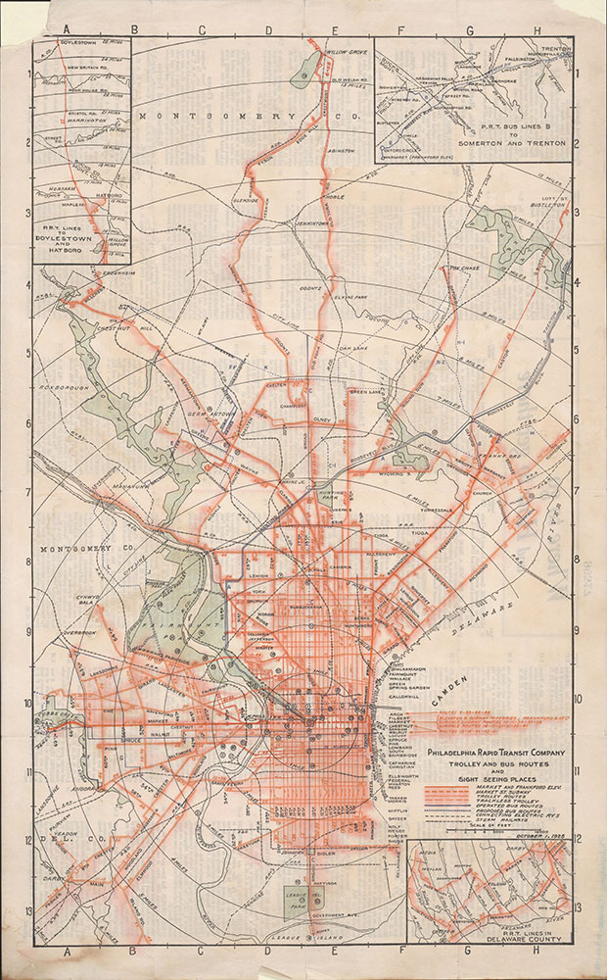
20th century Growth --Rio 1904/Philadelphia 1925

Slide 25
Tourism vs. Corporate Economics in Modenr Rio (the rest of the city beyond favelas)
Rio’s magnificent beaaches were too far away from Europe and North America to be more than a local amenity until the 1990s; tourism contributes less to Rio’s economy (4.9%) than that of Philadelphia (6.6%)

Slide 26
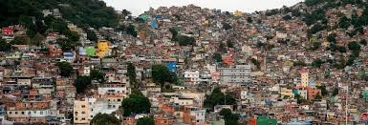
While post-industrial Philadelphia shrank, post-capital Rio became a pole for internal migration and growth

Slide 27
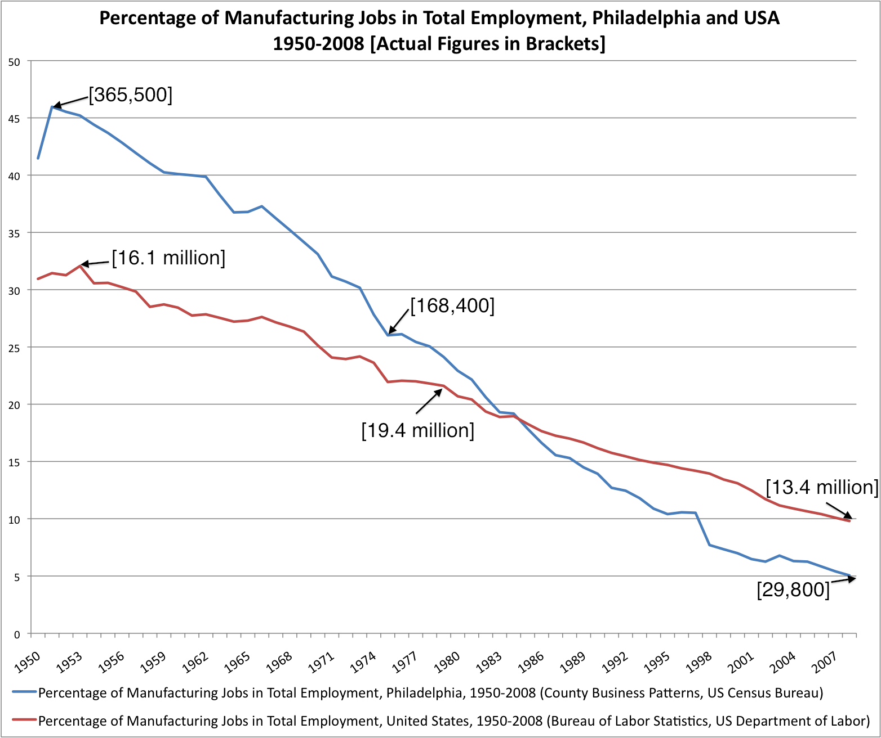
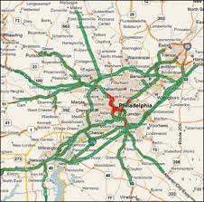
Decline and Suburbanization in Philadelphia

Slide 28
3. Population Growth Over Time
Philadelphia
Rio de Janeiro
Dates
1680s
1776
1820s
1890s
1920
1940
1960
1980
2000
2020
2030
600
28,522 1-3% colonial U.S.
63,802
847,000
1,823,779
1,931,334
2,002,512
region 3.3 million
1,688,310 (4.830)
1,517,000 (5.4)
1,851,000 (6.1)
1,900,000?
25,000 (20,000 slaves)
20,303 (1798 33,000)
113,000
520,000
1,100,000
1,750,000
3,300,000
region 4.8 million
5,051,091 (8.8 milliom)
11,306,000 metro
13,450,075
14,408,259

Slide 29
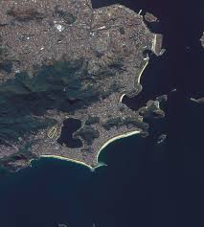
21st Century Growth Infill (RJ) vs. Sprawl (P) https://earthobservatory.nasa.gov/images/88103/rio-de-janeiro-a-changing-city
https://earthobservatory.nasa.gov/images/88103/rio-de-janeiro-a-changing-city

Slide 30
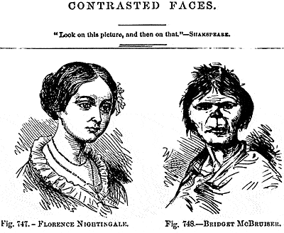
4. SOCIAL STRUCTURE: E.G. RACE/ETHNICITY
RACE is a culturally constructed interpretation of biological difference, often based on evaluations of visible physical features and concepts such as blood and mentality.
As an implicit model of shared descent, race is similar to ETHNICITY, which demarcates shared origins within a society (including immigration) and may emphasize shared cultural attributes (language, food, names) over biology.
RACE has been constructed, however, as a basic category entailing more categorical divisions, including the difference between being human and not being human, but also varies widely.

Slide 31
Different Manners of Talking and Acting
In Philadelphia and Rio “ethnicity” is often used as a subcategorization within ”race” and more likely to be recognized within the historically dominant group. That is, US Citizens speak of Jewish-(American) or Italian-(American) immigrants and neighborhoods in both cities, but do not distiguish Angolan-Americans or West African Americans. In Brazil, while people will say we are all mxed, they can identify Jewish neighborhoods but may also speak more easily of class divisions.

Slide 32
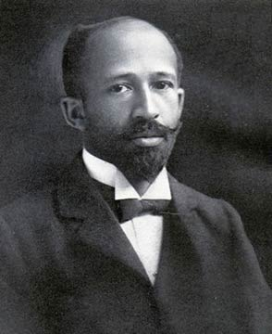
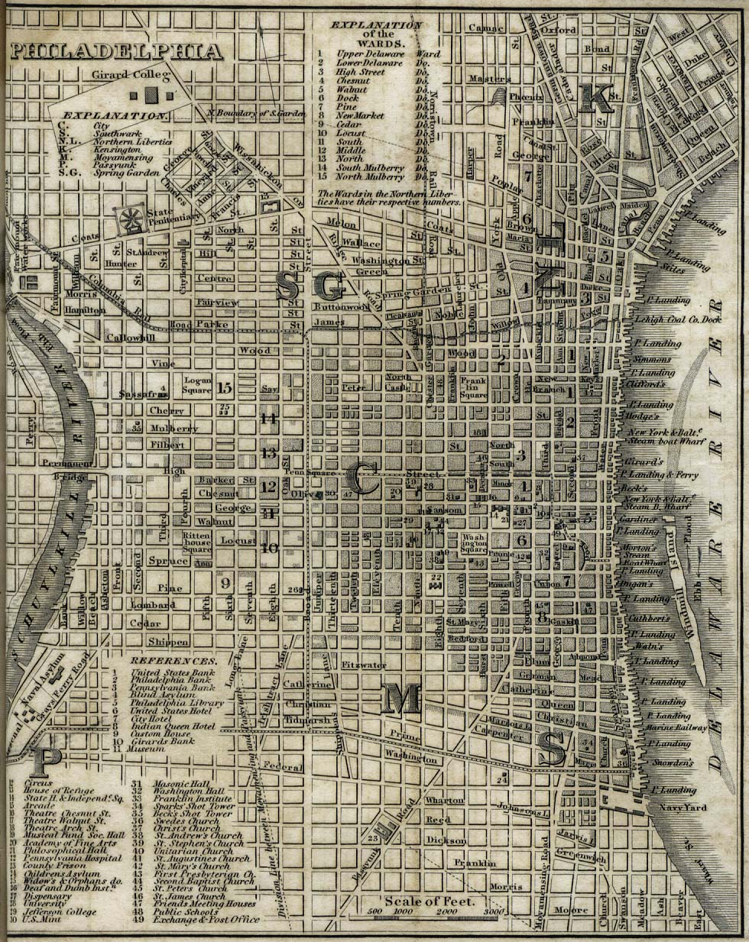
http://www.mappingdubois.org/maps.html
W.E. B. Dubois 1863-1960
Society Hill
Seventh Ward

Slide 33
The Philadelphia Negro (1899)
p. 5 “Here is a large group of people – perhaps forty-five thousand, a city within a city – who do not form an integral part of the larger social group. This is in itself not altogether unusual; there are other unassimilated groups: Jews, Italians, even Americans; and yet in the case of the Negroes the segregation is more conspicuous, more patent to the eye, and so intertwined with a long historic evolution, with peculiarly pressing social problems of poverty, ignorance, crime and labor, that the Negro problem far surpasses …
What is the real condition of this group of human beings?”

Slide 34
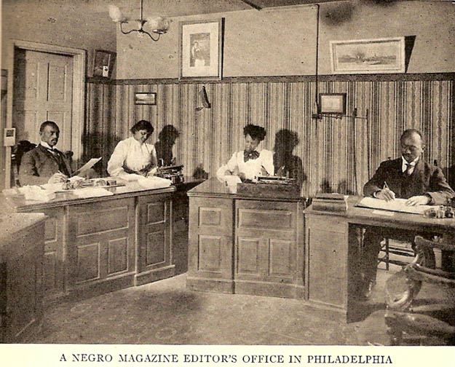
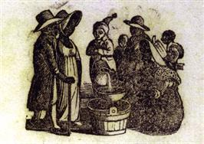
Differences of Class in CONFINED SPACE: Black Elites and Workers

Slide 35
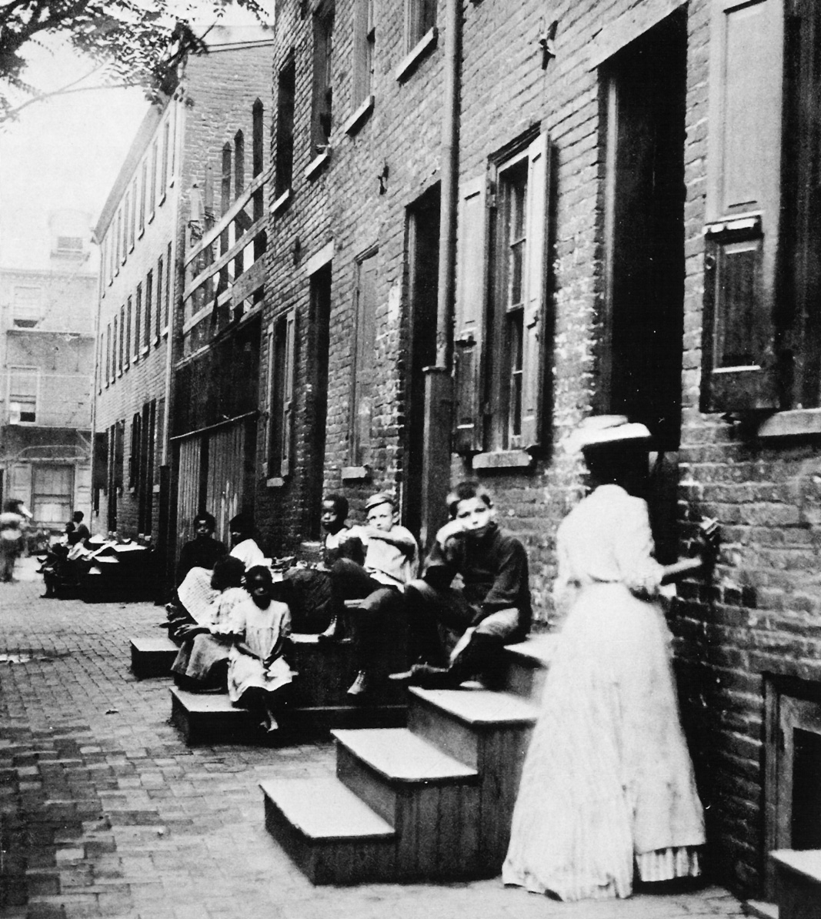
Gender, Family and Further Exclusion
pp. 66-7 “there is a large proportion of single men …. The number of married women, too, is small, while the large number of widows and separated indicates widespread and early breaking up of family life. The number of single women is probably lessened by unfortunate girls, and increased somewhat by deserted wives …. The causes of desertion are partly laxity in morals and partly the difficulty of supporting a family.”

Slide 36
Resolutions (p. 388-9)
The Negro is here to stay.
It is to the advantage of all, both black and white, that every Negro should make the best of himself.
It is the duty of the Negro to raise himself by every effort to the standards of modern civilization…
It is the duty of the white people to guard their civilization against debauchment by themselves or others; but in order to do this it is not necessary to hinder and retard the efforts of an earnest people to rise…

Slide 37
African Americans in Philadelphia A Century Later: Elijah Anderson ( Intro to new edition PN 1996)
“In 1890, the black population of the city of Philadelphia stood at only 39,371 (3.8 percent of the total population of 1,046,964): as of the 1990 Census, the black community numbered 631,936 (39.9 percent of the total population of 1,585,577). Heavy concentrations of the black population can now be found in West Philadelphia, North Philadelphia, South Philadelphia, and Southwest Philadelphia, but also Mount Airy and Germantown.” xxix

Slide 38
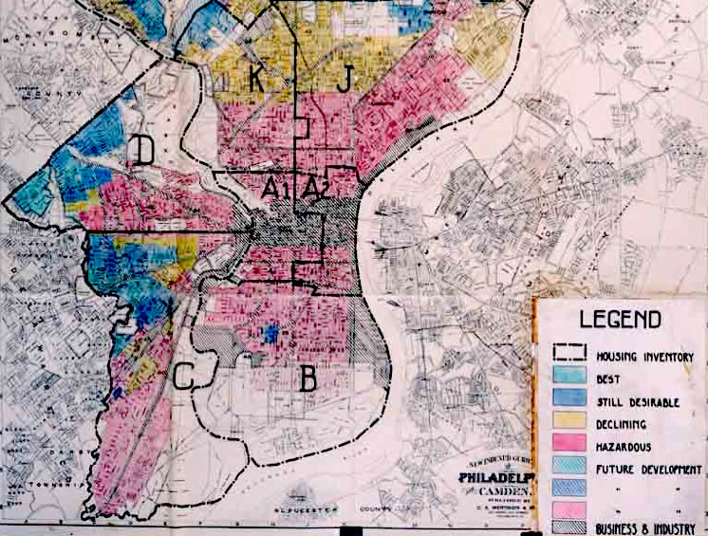
Redlining -Where does Chinatown fall?

Slide 39
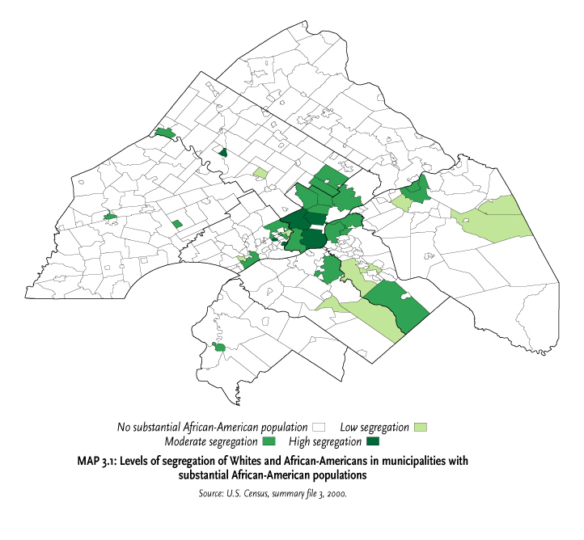
African-Americans in Space: From the Metropolitan Philadelphia Indicators Project (www.temple.edu/mpip)

Slide 40
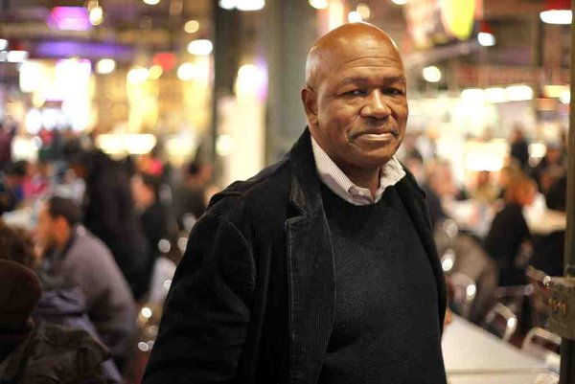
Elijah Anderson (CR) student of WJ Wilson, a student of Burgess
What does it mean when people with different ideas and trajectories share “the street” as a segregated space?
p.133 The fact that the decent people, as a rule civilly disposed, socially conscious,dself-reliant men and women, share the neighborhood streets and other public places with the street, the inconsiderate, the ignorant, and the desperate, places the ‘good’ people at special risk. In order to live and function in the community, they must adapt to a street reality that is often dominated by people who at best are suffering severely in some way and who are apt to resort quickly to violence to settle disputes. This process of adapting means learning and observing the code of the street. Decent people may readily defer to people, especially strangers who seem to be all street-oriented. When they encounter such people at theaters and other public spaces talking loudly or making excessive noise, they are reluctant to correct them for fear of verbal abuse that could lead to violence…

Slide 41
Comparative Racial Demographics (Wikipedia+)
PHILADELPHIA 2020
RIO 2010-20
White Alone 44.8%
White Alone Not Hispanic 34.3%
Hispanic 15.2%
Black 43.6%
Asian 7.8%
2 or more races 2.8%
Other 1.1%
White (Blanco) perhaps 51%
Black (Preto) 11%
Mixed (Pardo) 37%
Asian (Amarelo) 0.7%
Genomics 7-13% Amerindian, 18-31% African, 51-75% European
According to a 2000 survey held in Rio de Janeiro, the entire self-reported preto population reported to have African ancestry. 86% of the self-reported pardo and 38% of the self-reported White population reported to have African ancestors.

Slide 42

“Race” is Different in Brazil

Slide 44
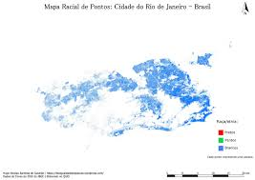
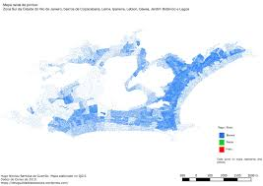
https://www.pri.org/stories/2015-11-02/brazilian-student-mapped-out-rios-racial-segregation-what-he-found-was-startling MAP BY Hugo Nicolau Barbosa de Gusmão

Slide 45
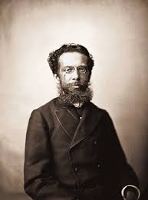
From W.E.B DuBois,Souls of the Black Folk (1903) to Rio’s Machado de Assis
BETWEEN me and the other world there is ever an unasked question: unasked by some through feelings of delicacy; by others through the difficulty of rightly framing it. All, nevertheless, flutter round it. They approach me in a half-hesitant sort of way, eye me curiously or compassionately, and then, instead of saying directly, How does it feel to be a problem? they say, I know an excellent colored man in my town; or, I fought at Mechanicsville; or, Do not these Southern outrages make your blood boil? At these I smile, or am interested, or reduce the boiling to a simmer, as the occasion may require. To the real question, How does it feel to be a problem? I answer seldom a word.
The problem of the twentieth century is the problem of the color-line…
Joaquim Ma MACHADO DE ASSIS (1839-1908), Father of Brazilian Literature, while the grandson of freed slaves, became part of the cultural elite bt almost never mentioned slavery in his work, much less offering any social or political critique of an institution that lasted until 1889 there

Slide 46
Differences and Convergences
In Philadelphia, Blacks have been segregated, becoming the marked category even as non-white populations dominate the city but not the region (city vs. suburb).
In Rio de Janeiro, the most unmarked category is “mixed.” White areas, however, may segregate themselves by race: upscale Leblon is 80% white with almost no Blacks who are not servants. Favelas are mixed but may also be the home of more who identify as black.

Slide 47
Race Changes with Culture
Du Bois sought to build a positive image for Blacks within their communities and demanded respect from others. With continnuing inequalities of race and class intersecting, the U.S. remains a multiracial but unequal society. This is marked in neighborhood segregation and wealth
Brazilians have borrowed from Black Power movements in the U.S. to reshape concepts of race, at the same time they have begun affirmative action programs to overcome inequalities. Yet the “mixed” ideology remains important despite what is evident in neighborhoods and wealth.

Slide 48
Other Contexts of State and Society Continue to Remake Both Cities
Natural Resources of the State and Economic Growth overall (Petrobras and oil in Brazil, Fracking in PA)
Defining Citizenship at the Local, regional and national level: corruption and polarization; immigration.
Global Power and Action – including Coronavirus response (tragic in both cases)

Slide 49
Putting Pieces Together
Why are favelas part of Rio Life and History? What are the spaces of the homeless in Philadelphia?
How do cariocas spatialize race, class and gender? How would this differ in Philadelphia? Considern systems of education, policing, even connection
How does race embody/empower resistance? What about class?

Slide 50
Celebrating the City?

