Slide 1
Questions?
Research Topic and Preliminary Bibliography

Slide 2
Sally Banes, Dancing Women (1998)
-Focus on gender and society; situates different eras of ballet and modern dance within their specific socio-historical context
-What does different approaches to ballet technique, choreographic form, and the plots and conflicts of narrative ballets reveal about the society in which they were created?

Slide 3
Romantic Ballet

Slide 4
What does Sally Banes suggest the romantic ballet reveals about Western Europe’s (France) social, cultural, and political climate in this historical moment?

Slide 5
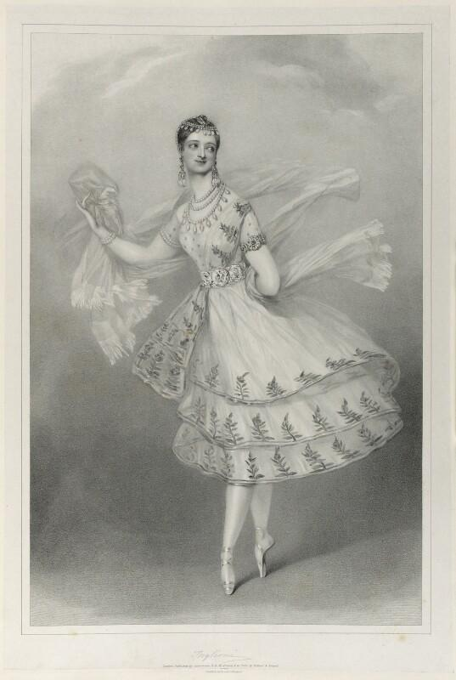
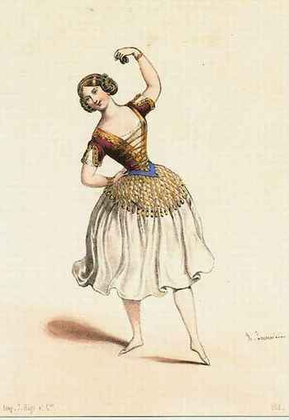
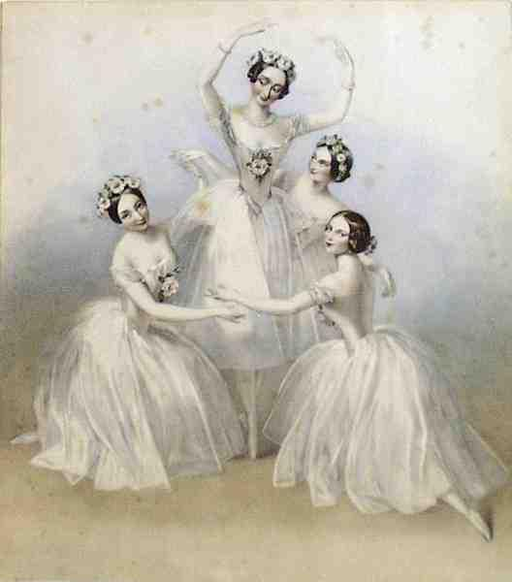
As performers, women dominate the Romantic era, even en travesti
Men dominate management, choreography, and criticism, but not the stage

Slide 6
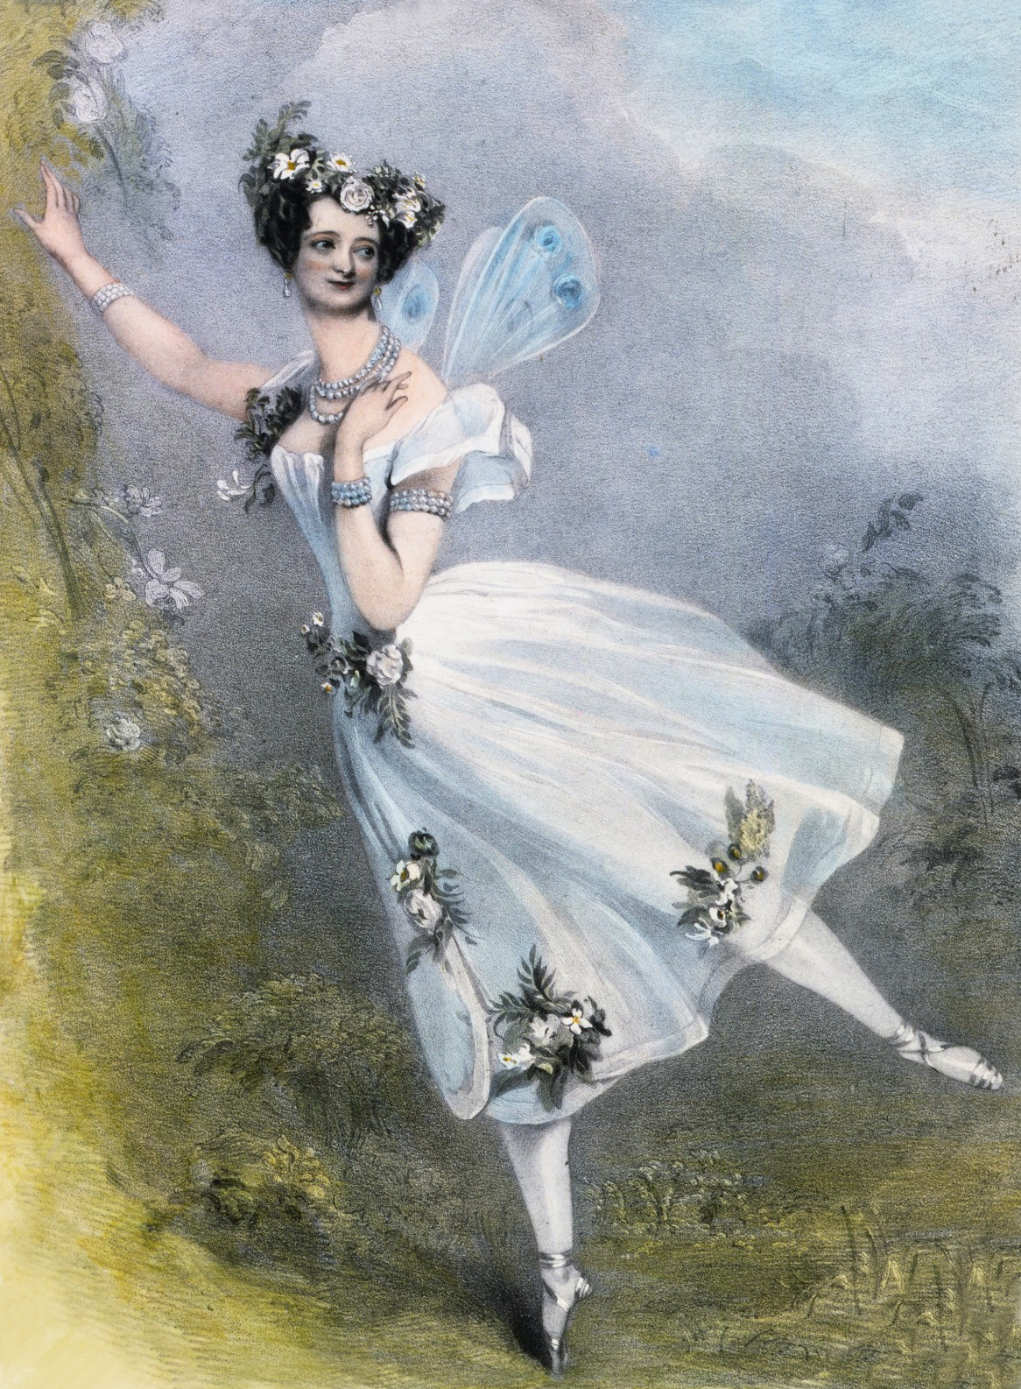
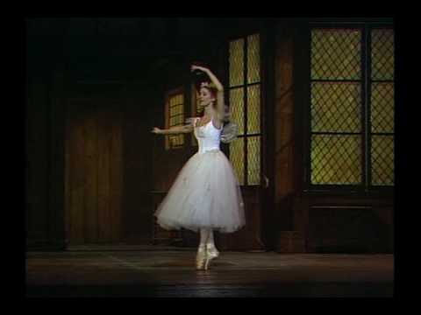
Marie Taglioni & La Sylphide (1832)
“...a cautionary tale, admonishing men on pain of death to marry inside their own community and not be lured outside their own folk into a world portrayed as Other and inhuman.” (Banes 1998, 14)

Slide 7
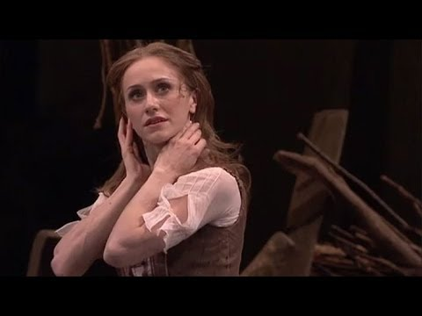
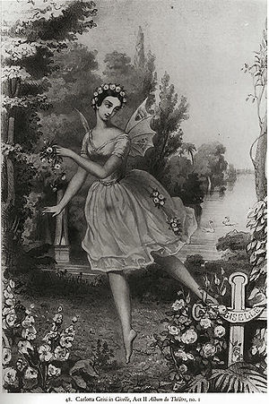
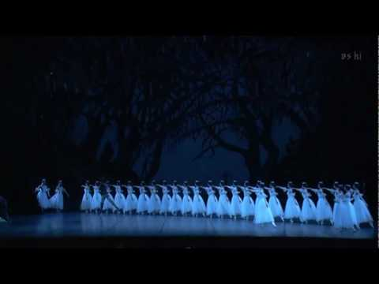
Carlotta Grisi, Theophile Gautier, & Giselle (1841)
“...an allegory for the assertion of bourgeoise individuality and as a metaphor for political compromise during a specific period of French history-the era of the ‘citizen-king’ Louis-Philippe, a political regime consciously built on those centrist middle-class principles and rhetoric.” (Banes 1998, 24)

Slide 8
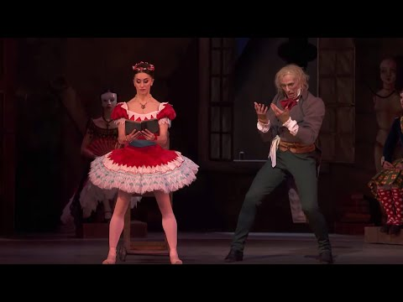
Coppélia (1870)
“The innovative technical bravura of the ballerina now made representations of powerful ballet heroines possible.” (Banes 1998, 40)

Slide 9
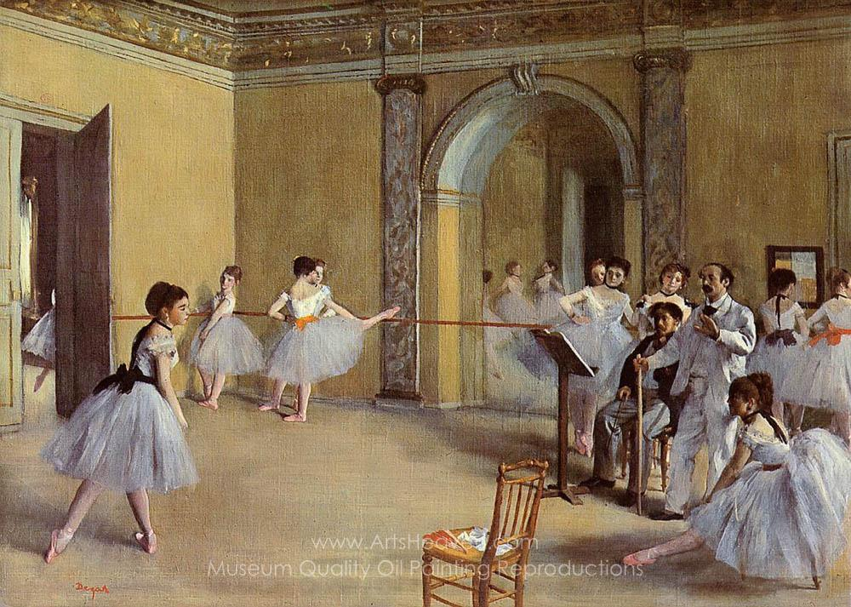

Slide 10
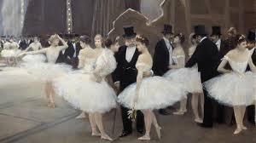
Sexual Exploitation Was the Norm for 19th Century Ballerinas

Slide 11
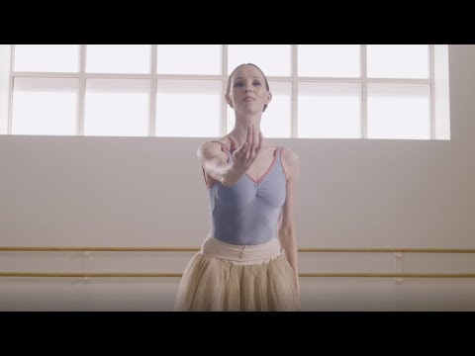
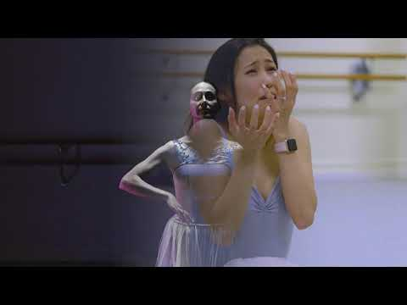
Ballet Pantomime: Embodied History

Slide 12
Imperial Ballet

Slide 13
What does Sally Banes suggest the imperial ballet reveals about Russia’s social, cultural, and political climate in this historical moment?

Slide 14
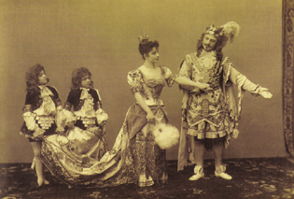
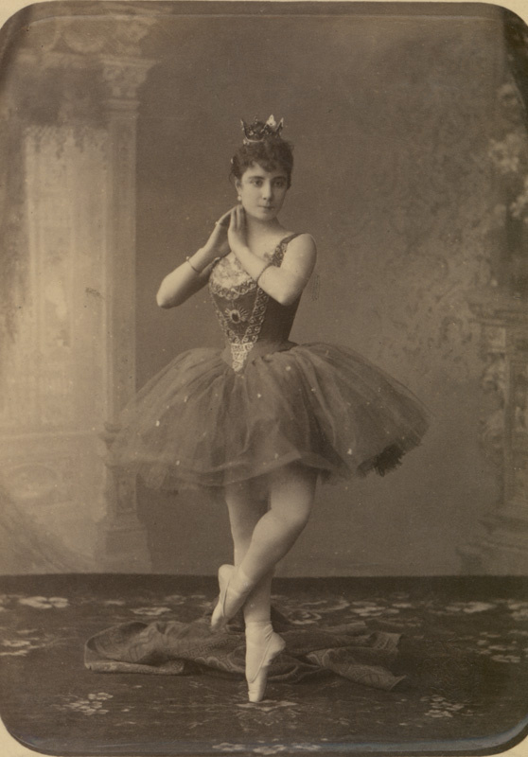
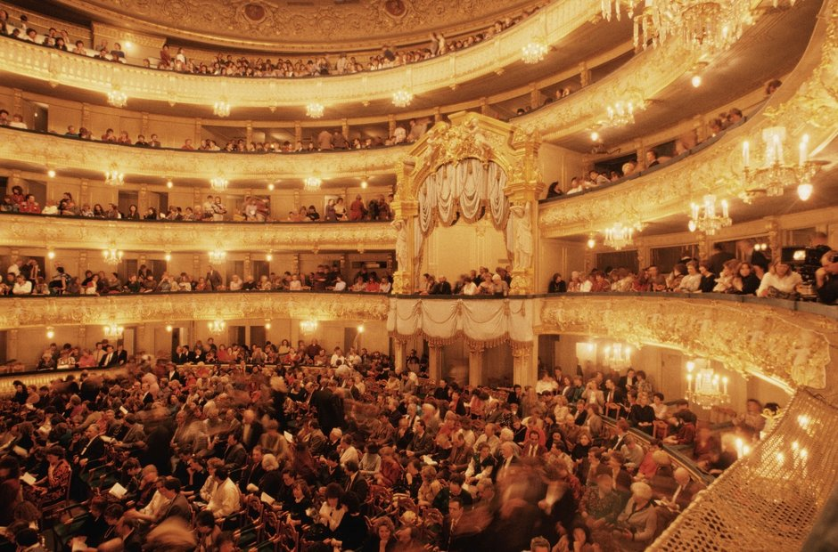
Imperial Ballet School
Founded 1738
by decree from Empress Anna in
St. Petersburg
First directed by a
French ballet master, and influenced by Italian, French, and Danish masters who created ballets for the Imperial Ballet

Slide 15
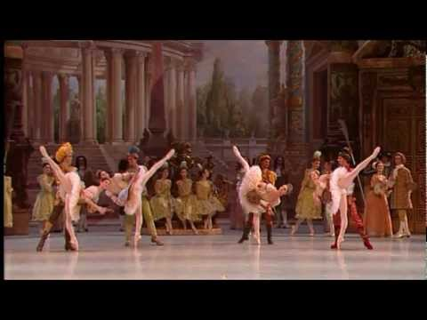
Marius Petipa & The Sleeping Beauty (1890)
“A compendium of several earlier styles of ballet, The Sleeping Beauty sets forth the canon of classical ballet vocabulary and choreographic structure. Through its plot and its setting, the ballet encapsulates the behavior and values of the courtly hierarchy that produced it.” (Banes 1998, 42)

Slide 16
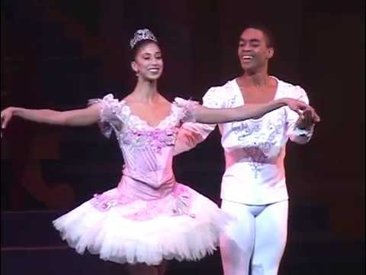
Petipa, Lev Ivanov & The Nutcracker (1892)
“...more conventional representations of women and fragile and dependent on men, even while the ballets still present alternative versions of female authority.” (Banes 1998, 59)

Slide 17
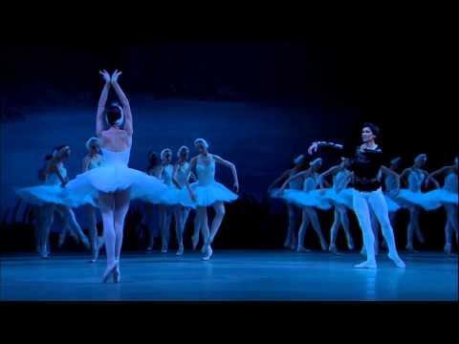
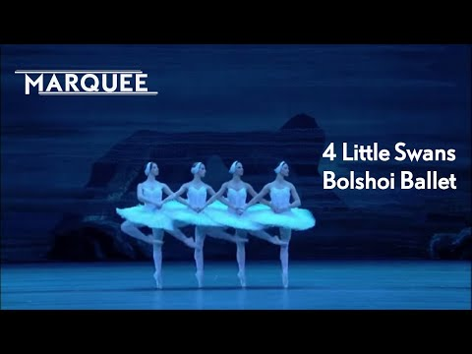
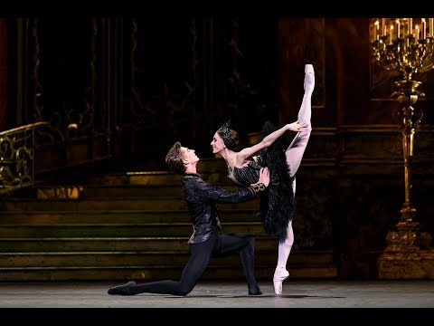
Petipa/Ivanov revival & Swan Lake (1895)

Slide 18
For next Wednesday:
Duncan, Isadora. “The Dance of the Future.” Dance as a Theatre Art: Source Readings in Dance History
from 1581 to the Present, edited by Selma Jean Cohen, Dance Horizons, 1992, pp. 123–129.
View “What Do You Dance?”, Part I of Free to Dance documentary
→ Research Topic and Preliminary Bibliography due Wednesday, September 30

