Slide 1
The Birth of “The Dance”
Foremothers, White Feminism, and Class

Slide 2
Research Methods and Historiography:
How Dance Histories are Created, Contested, and Revised
Who creates dance history? From what source material? What are the organizing models that structure any given narrative? What are the ideological biases that shape the ways histories are created?

Slide 3
biography
History as told through individual life and career stories
Allows histories organized around “family trees” or genealogies of influence

Slide 4
Free to Dance
Revisionary history of American modern dance
Why was this approach necessary in the first place?
Use of primary source material and secondary sources (talking heads)

Slide 5
History of Black Dance in the U.S
Staging Africanist Aesthetics, African American culture, and Dancing Diaspora:
Asadata Dafora, Katherine Dunham, Pearl Primus
(will pick up in several weeks)

Slide 6
The Birth of “The Dance”
Foremothers, White Feminism, and Class

Slide 7
Sociocultural and Political Contexts: U.S. and Europe
Post-Industrial Revolution, urbanization, immigration
“Between 1880 and 1920, more than 20 million immigrants arrive. The majority are from Southern, Eastern and Central Europe, including 4 million Italians and 2 million Jews. Many of them settle in major U.S. cities and work in factories” (https://www.history.com/topics/immigration/immigration-united-states-timeline); 1882 Chinese Exclusion Act followed by The Immigration Act of 1891
Technology Transforms and Connects : Electricity lighting large cities, transcontinental train travel, ocean liners
Feminism: Women’s Suffrage Movement and Dress Reforms

Slide 8
Broader Contexts: Performance, Physical Culture, and Spirituality
Pageantry and tableaux vivants/”living pictures”
World Fairs and pseudo-scientific displays of “cultures of the world” and discourses of civilization, progress, and “primitivism”; Hellenism and Orientalism
Vaudeville, variety, and burlesque versus “high art” and “legitimate theater”
Ragtime and other social and ballroom dances
Yoga, Spiritualism, Theosophy, Transcendentalism:
fascination with the natural and spiritual worlds, esp. Vedic philosophy
Delsarte and Dalcroze methods: somatic systems of self-cultivation and “self-expression”

Slide 9
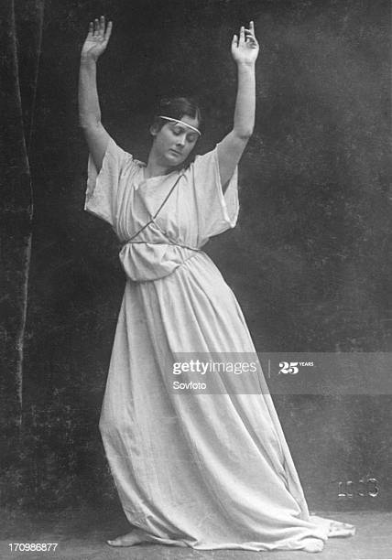
Aesthetic Dancing
White, middle and upper-class women searching for a high art form that they could be part of; made dancing and the human body spiritual and reflective of greater meaning (Foulkes, 2001)

Slide 10
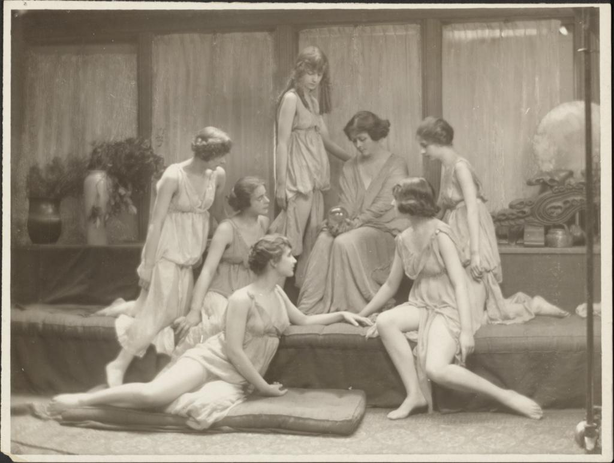
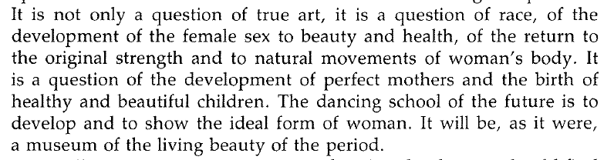
Rejection of Ballet
and
Vernacular Dance
-Isadora Duncan, 1902

Slide 11
Foremothers of what will be termed “modern dance”

Slide 12
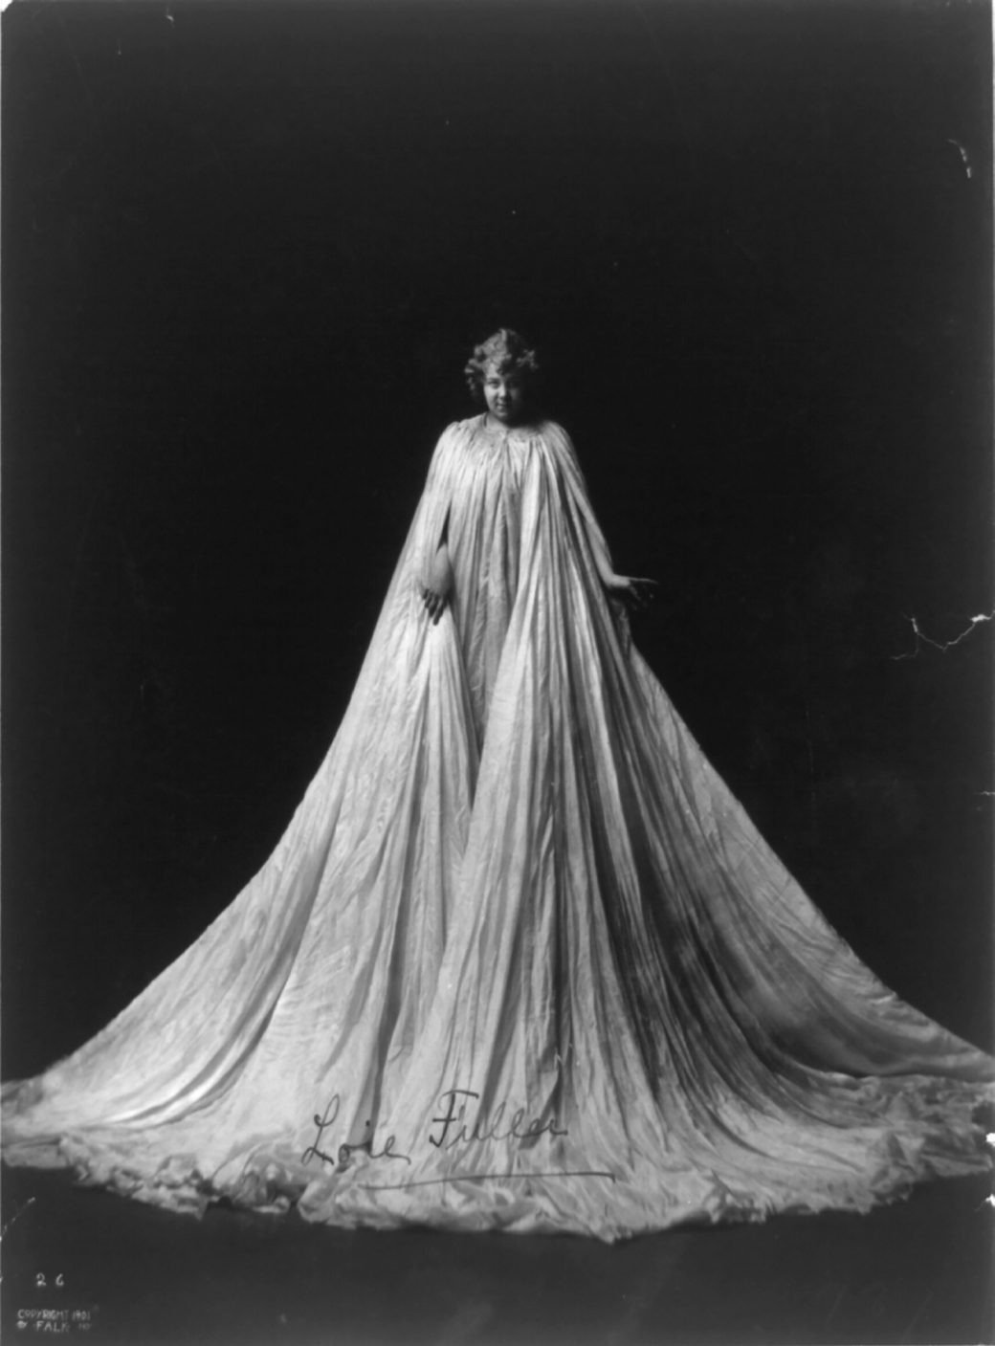
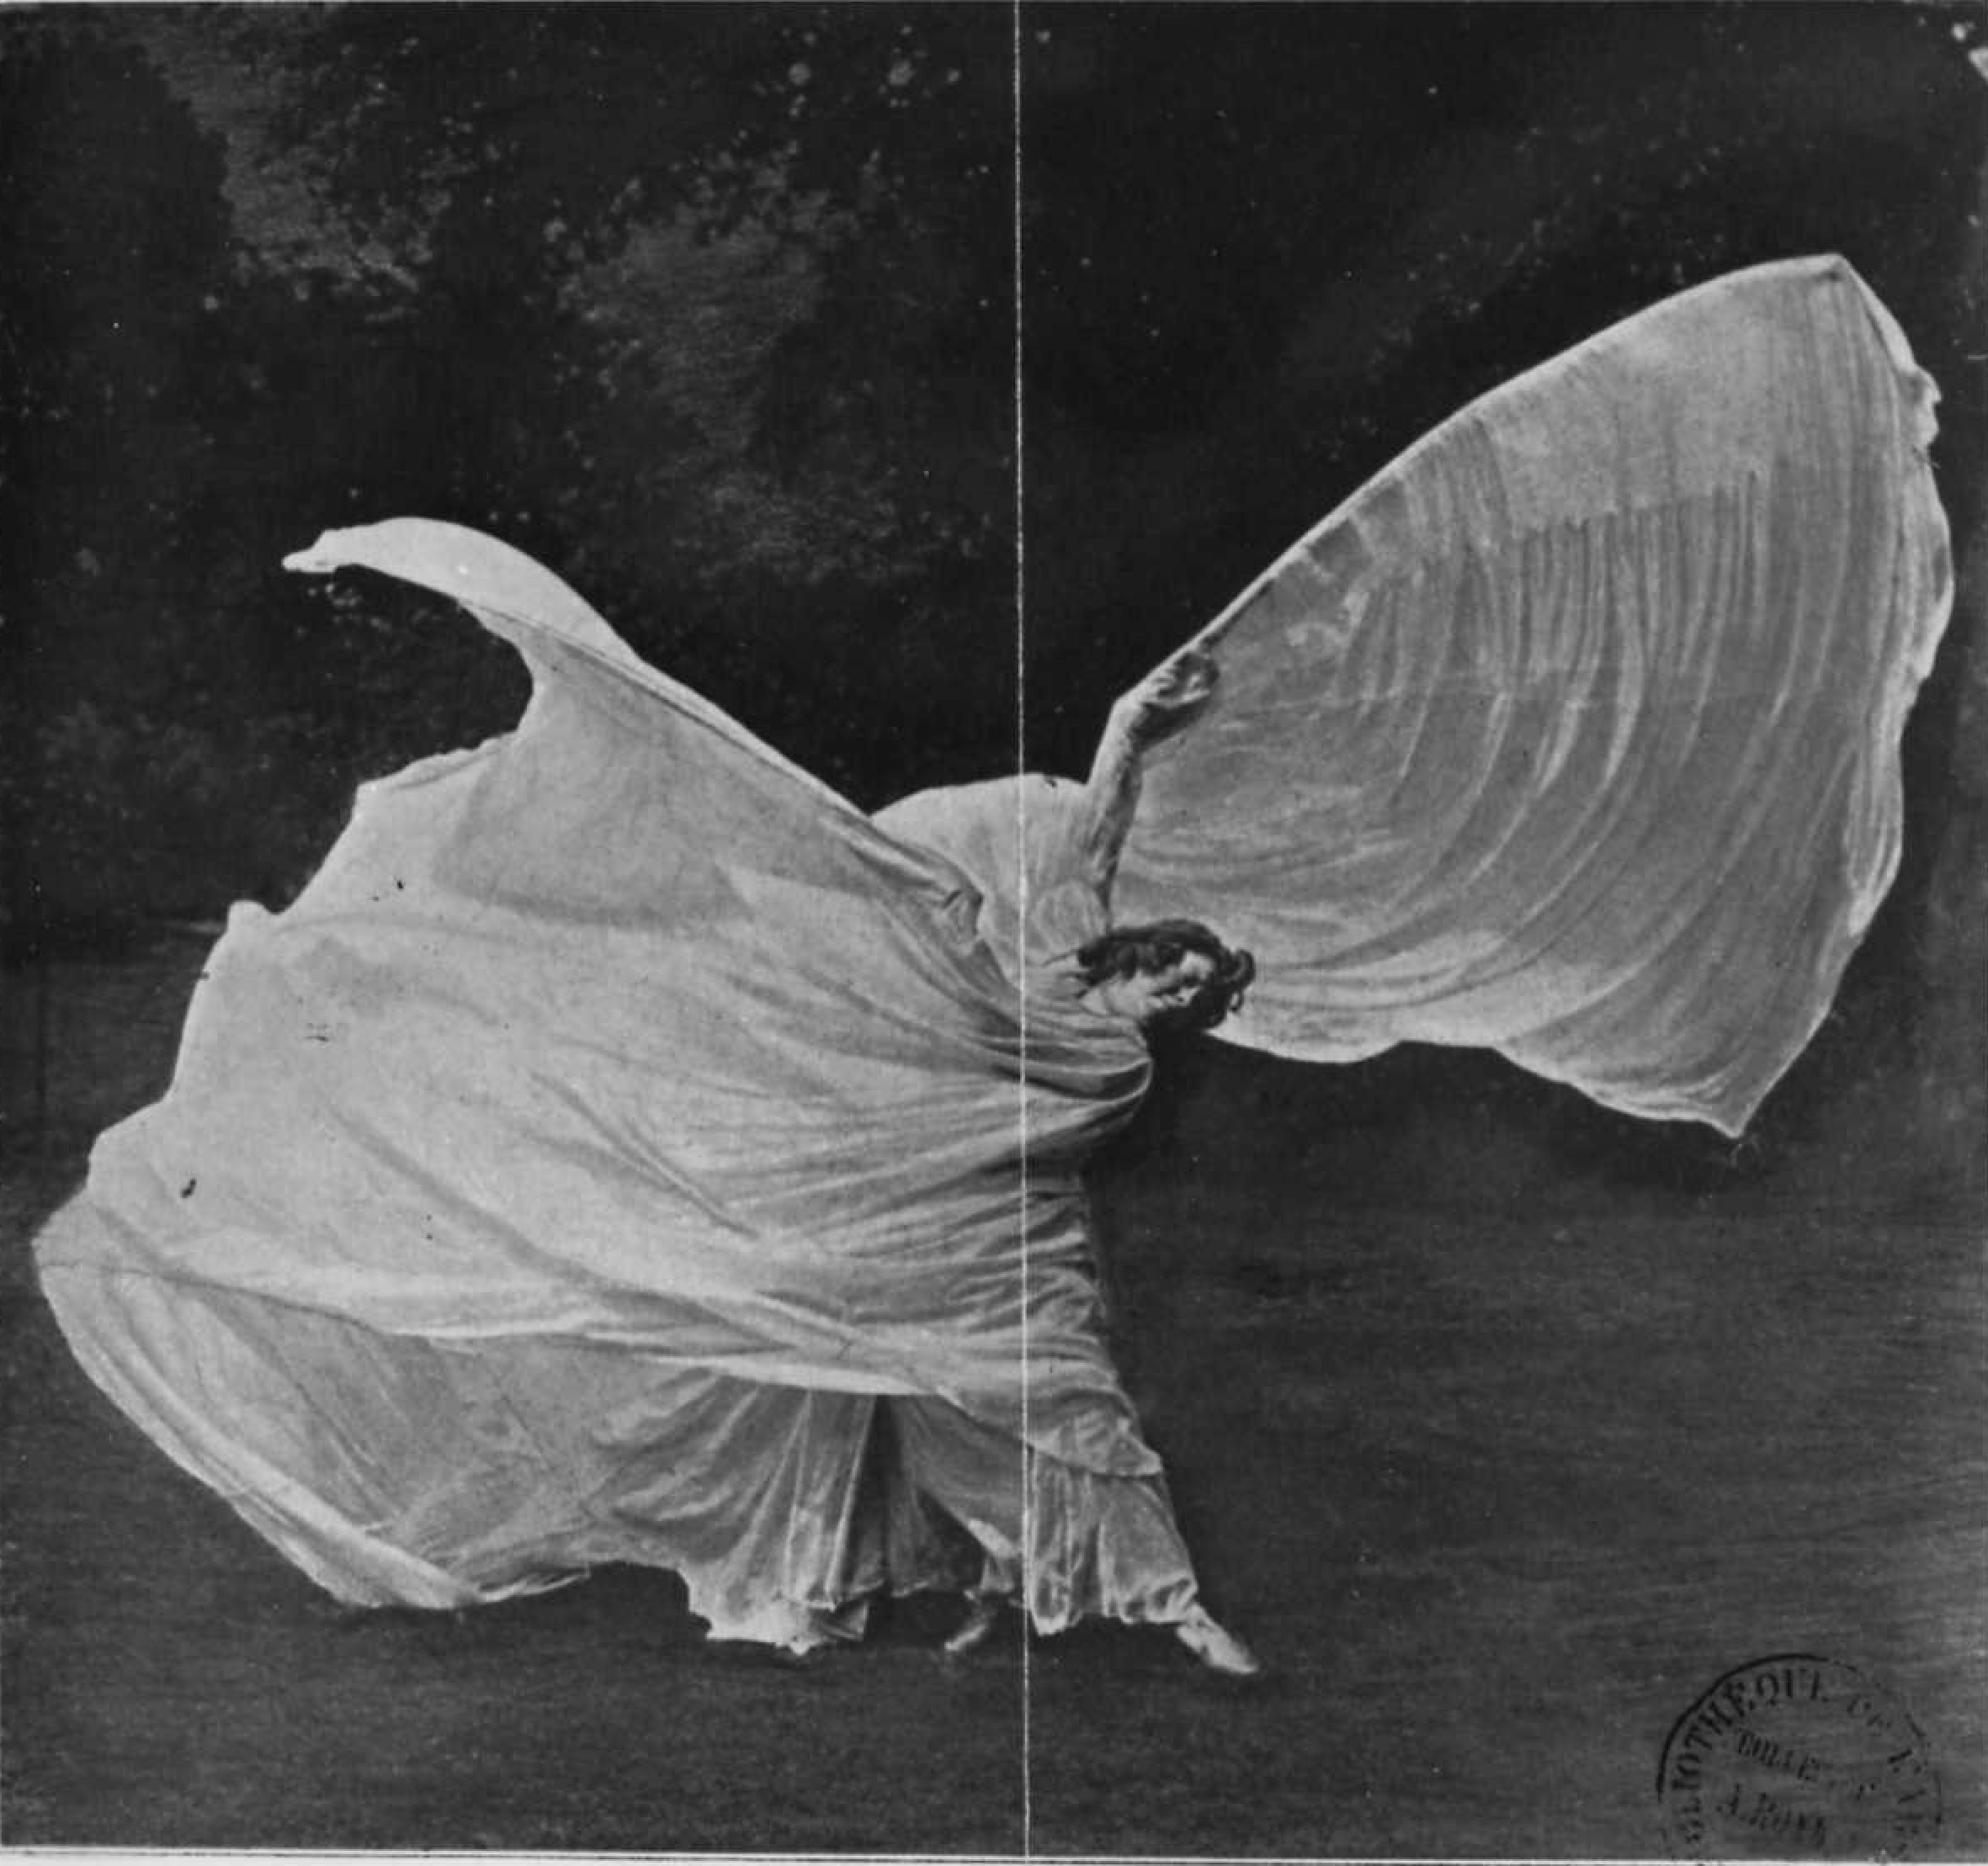
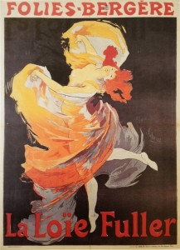
Loie Fuller (1862-1928)
https://www.britannica.com/biography/Loie-Fuller

Slide 13
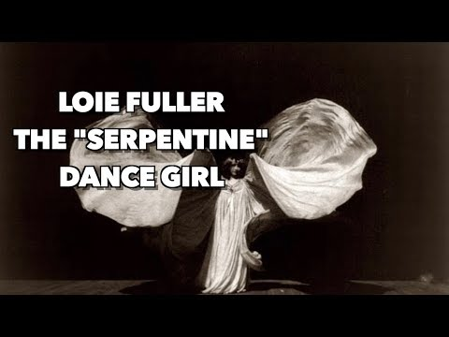
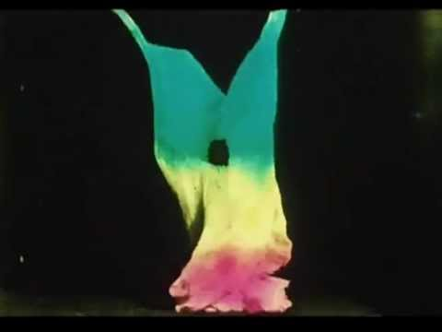
Always double-check your source material’s accuracy and authenticity
Misinformation on YouTube about Loie Fuller Footage

Slide 14
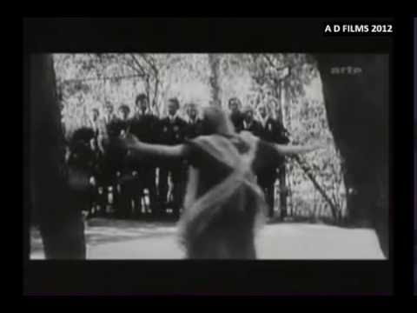
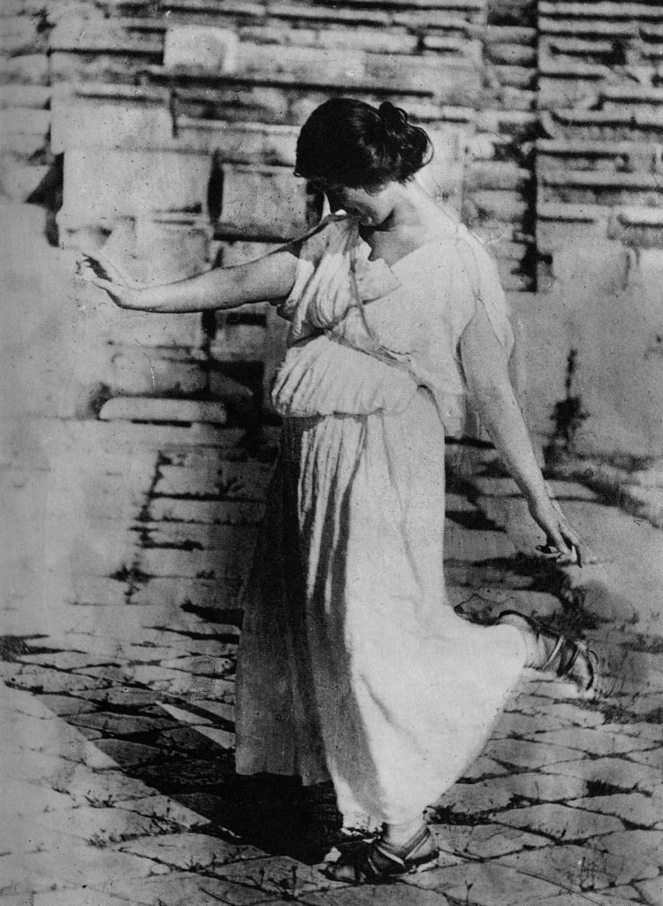
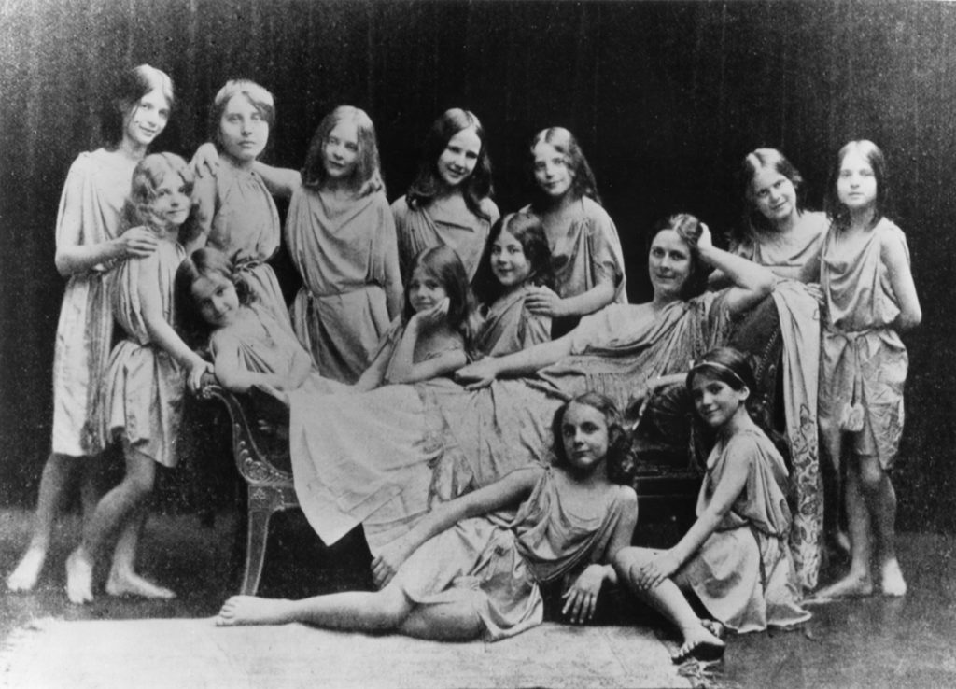
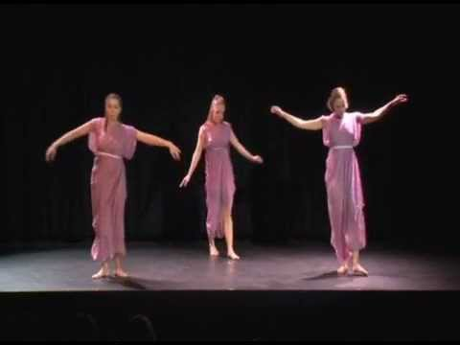
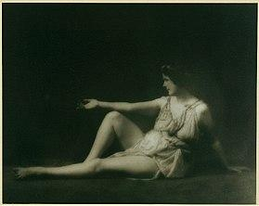
Isadora Duncan (1877–1927)
https://www.britannica.com/bography/Isadora-Duncan

Slide 15
Primary Source Engagement
“The Dance of the Future”
by Isadora Duncan (1902)
Discussion Board Post
Notes:
Ann Daly (2004) “The Natural Body”
-Use of primary source material to support larger claims about the “roots” of Duncan’s trope of the “natural body”, as well as contextualize her ideas within the larger cultural and intellectual terrain of the late 1800s
-Fascination with the ancient Greeks: Apollo symbolizing “formal purity and passionless perfection” and Dionysus symbolizing forces of nature
-Evolution theory (science) and monanism: belief in body/spirit as one (pp.292)
-Elevated dance into “high art” through Hellenistic ideals about the nobility of the body and “classical” art association with nudity

Slide 16
Analysis of Publishing Information:
When and where was this item created? How do you know? Who published this and why?
Analysis of Author/Reception:
What does this source tell you about its creator? What does the writing style convey? For what audience or purpose do you think this essay was created?
Analysis of Absence:
What evidence in the writing helps you know why it was written? What information might be missing? Is there anything that's confusing or unclear to you?
Placing Primary Source Material in Context:
What do you know about the time period and cultural moment from other secondary source material that enhances your understanding of this primary source text?

Slide 17
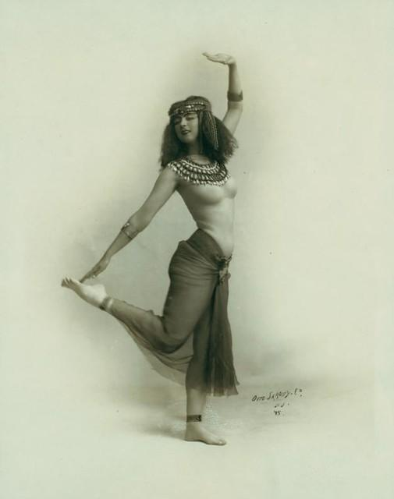
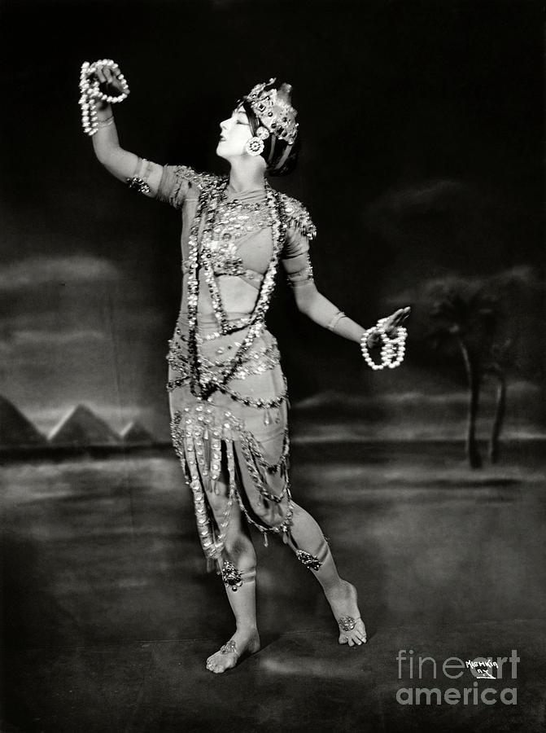
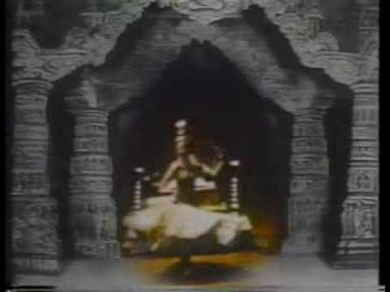
https://www.britannica.com/biography/Ruth-St-Denis
Ruth St. Denis
(1879–1968)

Slide 18
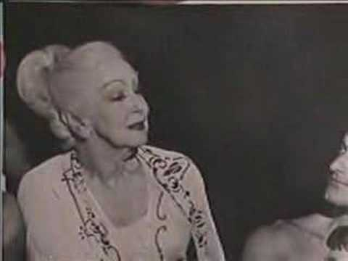
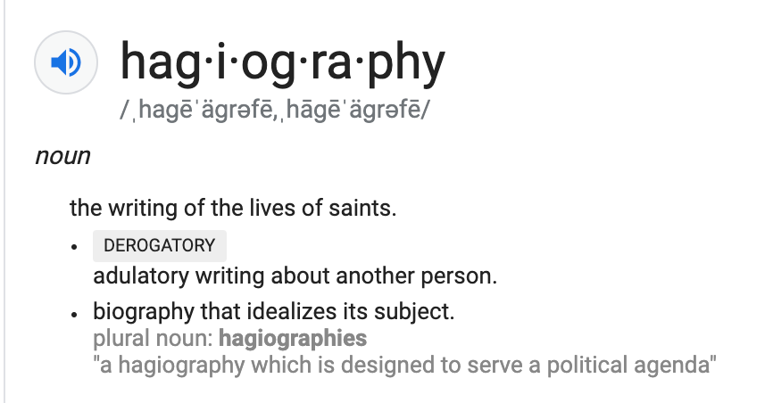
How to write oneself into dance history:
-Publish self-aggrandizing memoirs
-Publish treaties about aesthetics and composition
-Develop training schools and dance curriculum
-Tour nationally and internationally
How to become part of the public discourse:
-Get wealthy patrons and funders
-Receive (positive) critical reviews in national press
-Develop a consistent “star image”

Slide 19
Interest and Adoption of “Other” Cultural Materials
Hellenism
Orientalism
Primitivism
Appreciation and Appropriation

Slide 20
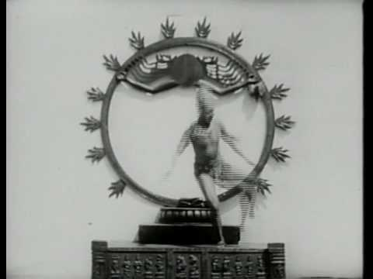
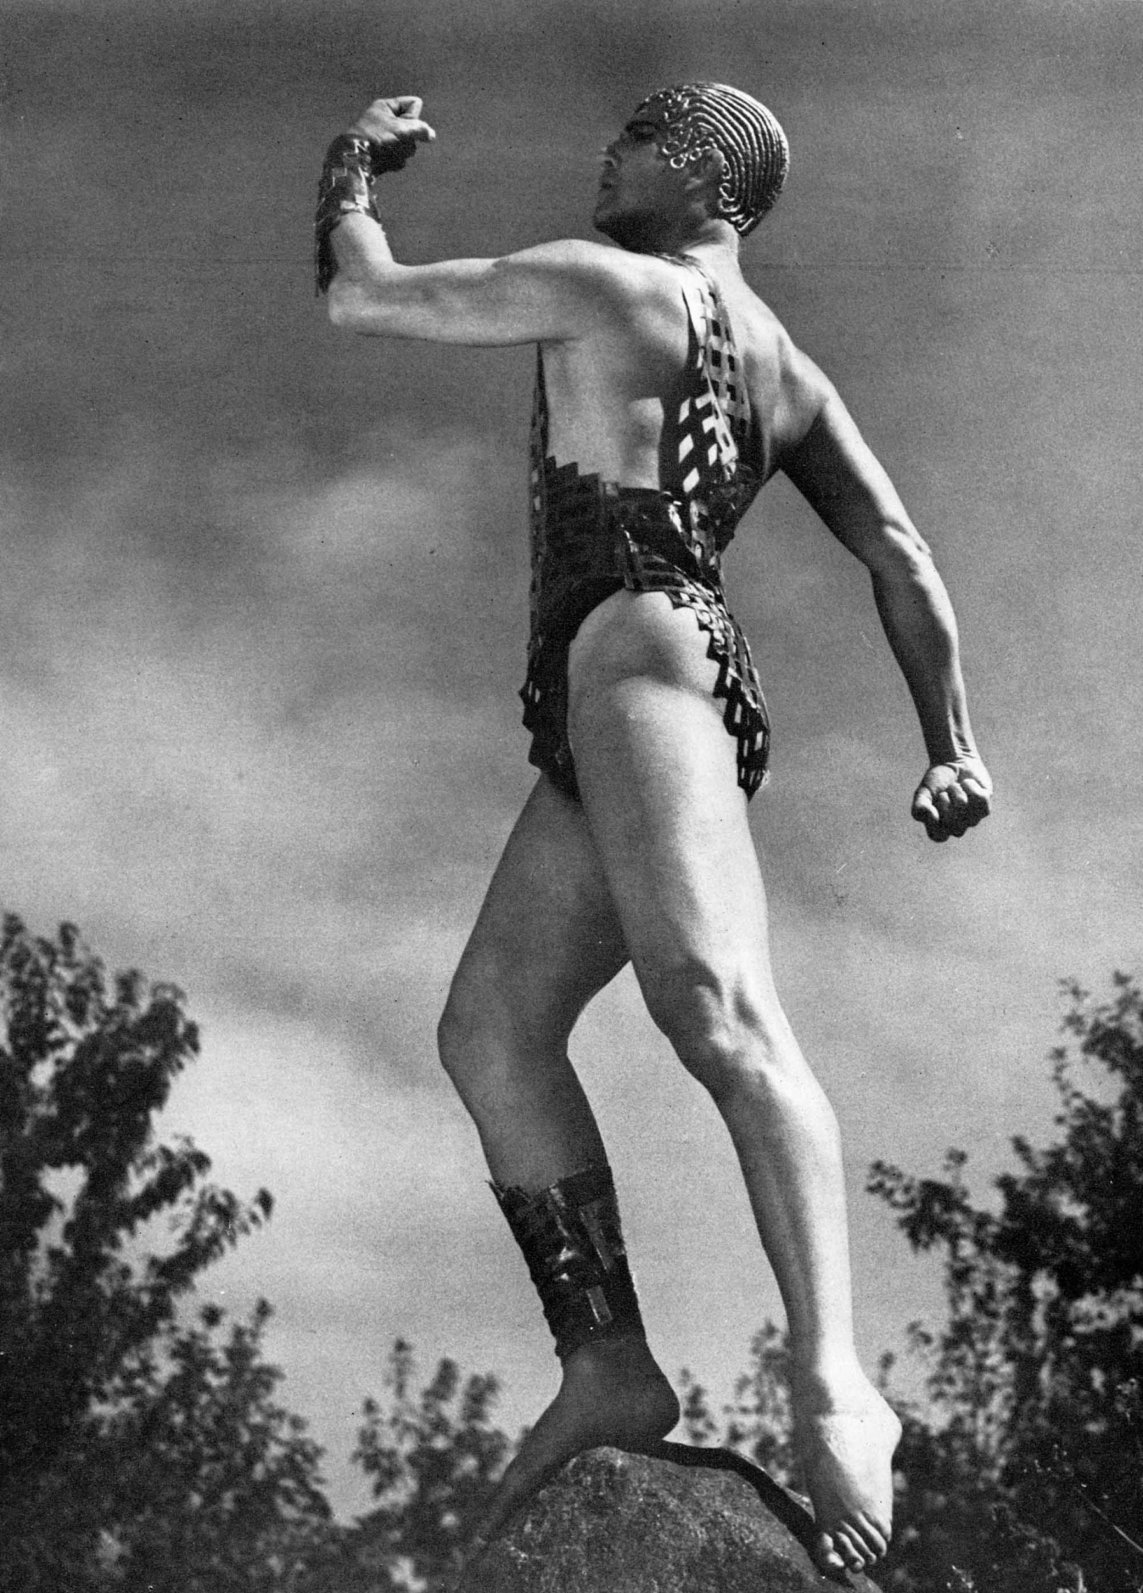
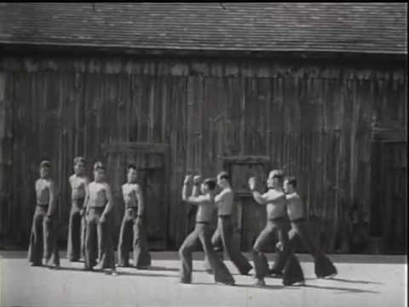
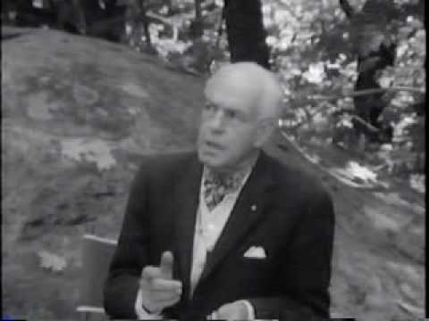
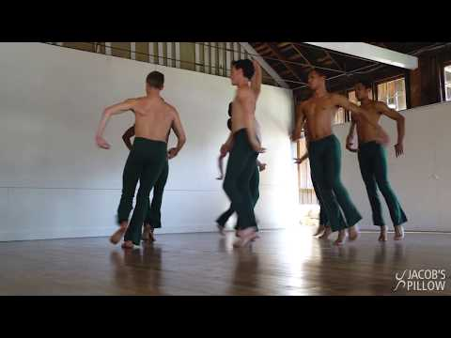
Ted Shawn
(1891-1972)
https://www.britannica.com/biography/Ted-Shawn

Slide 21
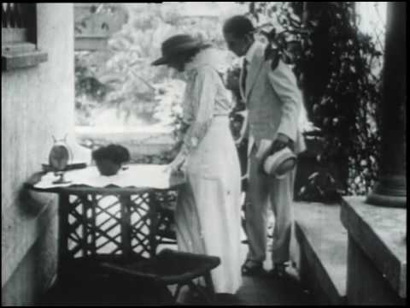
Denishawn Company and School (1915–1931)
Denishawn School of Dancing and Related Arts, dance school and company founded in 1915 by Ruth St. Denis and her husband, Ted Shawn. Considered a fountainhead of American modern dance, the Denishawn organization systematically promoted nonballetic dance movement and fostered such leading modern dancers as Martha Graham, Doris Humphrey, and Charles Weidman. Because St. Denis and Shawn believed that all dance techniques were valid and instructive, the school offered classes in Oriental, Spanish, and primitive dance; the fundamentals of ballet; their own innovative techniques; and, later, the modern-dance techniques that had been developed in Europe by Rudolf Laban and Émile Jaques-Dalcroze. Branches of the school were established in New York City and other American cities. The company’s repertoire, choreographed by St. Denis and Shawn, ranged from unadorned solos to opulent productions with Japanese, Hindu, Middle Eastern, or American Indian themes. The Denishawn dancers frequently toured the United States and performed in the Orient (1925–26). The organization disbanded in 1931 after St. Denis and Shawn separated. (Britannica 1998)
https://www.britannica.com/topic/Denishawn-School-of-Dancing-and-Related-Arts

Slide 22
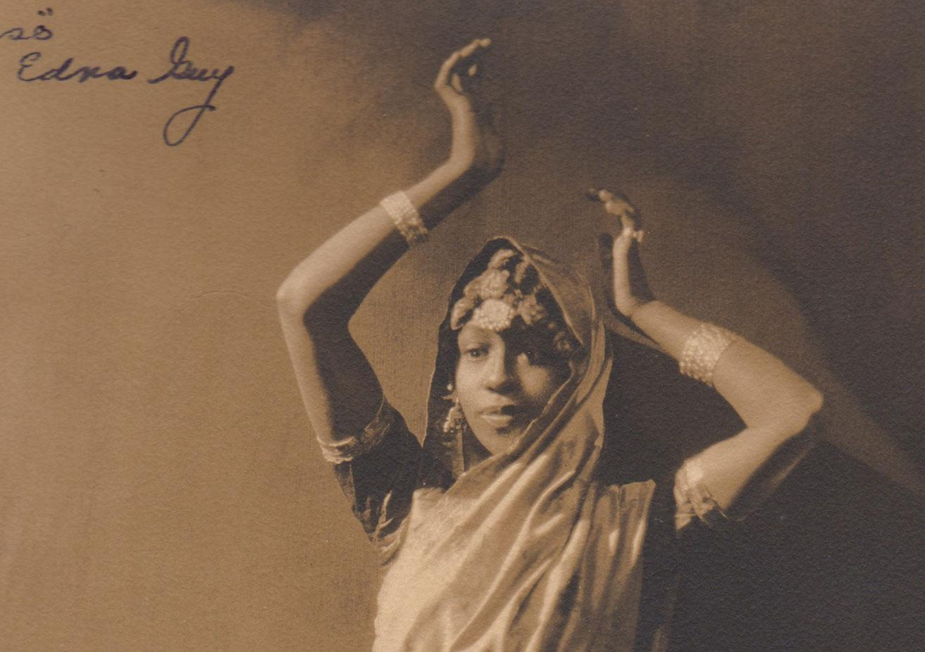
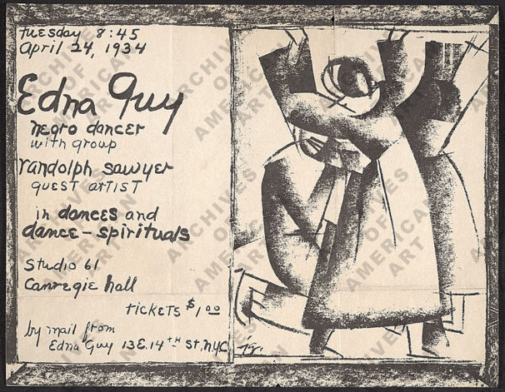
Free To Dance (PBS 2001)
-Uses the “case study” of Edna Guy and her interest in and experience with American “aesthetic dance” to explore the racial politics of early modern dance. This is a critical intervention in how St.Denis and Denishawn were typically discussed by white/mainstream historians and dancers.
-Documentary provides primary source evidence of the patronizing racism St.Denis personally expressed privately to Guy and secondary source commentary by Black dance historians about the systemic and institutional barriers that kept Guy from joining Denishawn as a professional dancer, forcing Guy to join forces with other African American artists.
Guy, Edna (1907–1983)

Slide 23
Saturday’s Guest Workshop
With Catherine Gallant, founder of Dances by Isadora
https://www.isadoraduncanarchive.org/dancer/44/

Slide 24
Due Wednesday: *Assign Readings To Groups
All listen to “The Life and Work of La Meri.” Pillow Voices: Dance Through Time. Podcast, 19:02. Jacob’s Pillow, March 21, 2020.
*Srinivasan, Priya. “Archival Her-Stories: St. Denis and the Nachwalis of Coney Island.” Sweating Saris: Indian Dance as Transational Labor, by Srinivasan, Temple UP, 2012, pp. 67–82.
*Shea Murphy, Jacqueline. “Authentic Themes: Modern Dancers and American Indians in the 1920s and 1930s.” The People Have Never Stopped Dancing: Native American Modern Dance Histories, by Jacqueline Shea Murphy, UP of Minnesota, 2007, pp. 111–147.

Slide 25
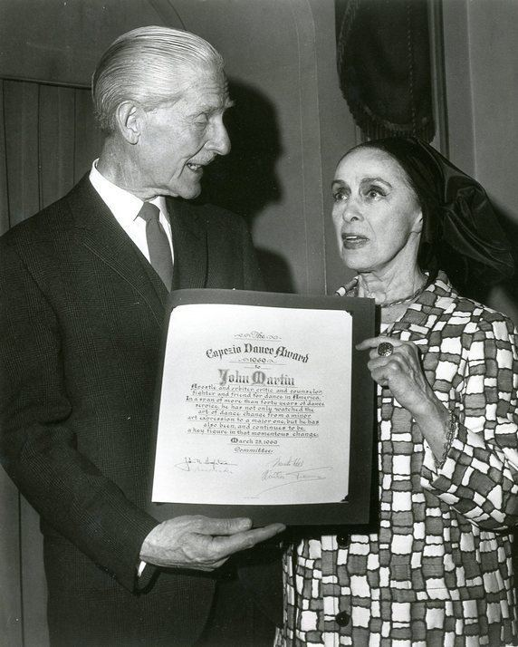
Dance Critics
John Martin, New York Times dance critics throughout the 1930s–1970s

Slide 26
Historical “primary source” evidence:
Martin, John. “DANCE RECITAL GIVEN BY NEGRO ARTISTS; Edna Guy and Group Prove Interesting in Primitive Ritual Dances.” New York Times, April 30, 1931. Accessed via ProQuest Historical Newspapers, July 4, 2020.
Recent critiques of this problem:
Wells, Charmain. 2017. “Wrong and Strong: On Ignorance and Modes of White Spectatorship in Dance Criticism.” Movement Research.
https://movementresearch.org/publications/critical-correspondence/strong-and-wrong-on-ignorance-and-modes-of-white-spectatorship-in-dance-criticism
Press Reviews: White Critics and Racial Prejudice

