Slide 1
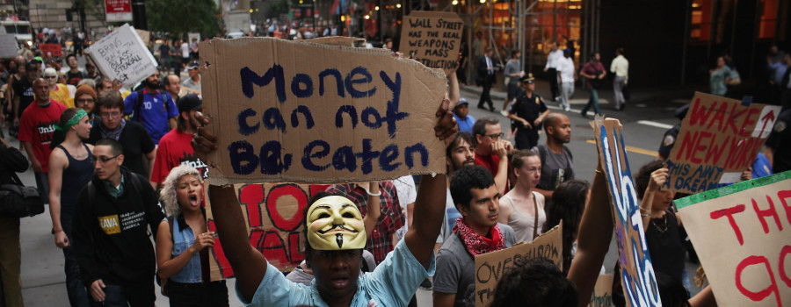
Economics of Space, Class, People in the City

Slide 2
Continue Working
Read 1.3 and learn from classmates
Read Instructions for 1.4 and play with tools like census and ArcGIS. Shared question period next week,
Work as process.

Slide 3
Questions for Urban Economics
We need to distinguish “cities” from agents and conflicts. Who owns and controls? Who labors and what access do they have to their production? These are socially-constructed facets of urban life that shape space, society, culture and difference, too. And link with public and private, race and gender Economists and policy makers analyze these themes well. We should learn to understand their techniques while keeping a vision of human needs, values and connections beyond the classical economic paradigm. And connect them to space, politics, social differences and cultural production.
LET’S TALK ABOUT CLASS

Slide 4
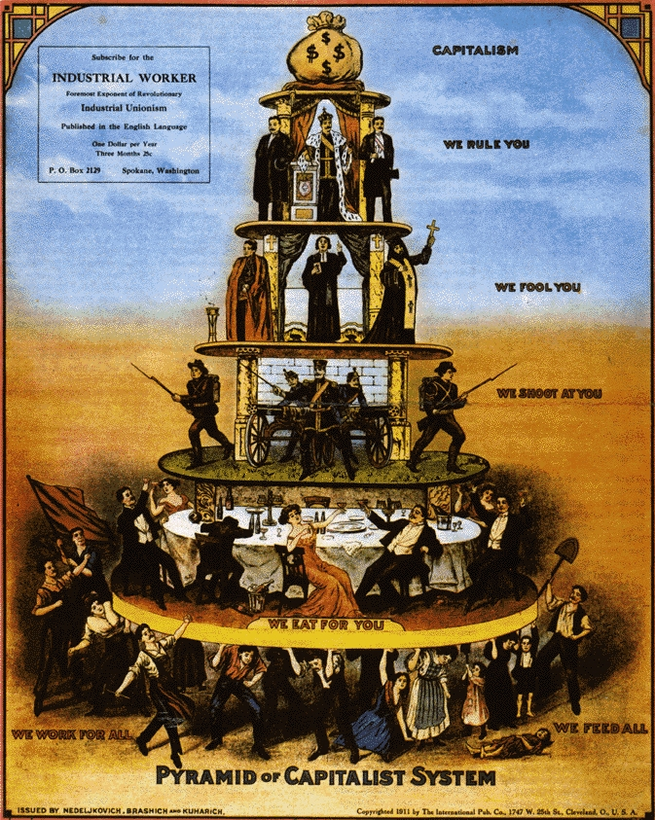
Thinking about Class

Slide 5
Class, in classical Marxist terms, is defined by RELATIONS to and through economic capital and control. Upper classes own the means of production; middling classes manage and the workers turn their lives and bodies into the only capital they have, which they cannot control. We can see these relations emerging in Engel’s vivid descriptions of Manchester, which he shared with Karl Marx before the 1848 Manifesto.

Slide 6
Blowing up Class
As we expand to socio-cultural terms, these relations become more contradictory and complex, involving management for of resources for others (position of executives, police), cultural production (academics, media) and global connection/disconnections. YET THEY ALWAYS INVOLVE POWER AND RELATIONS.
French anthropologist Pierre Bourdieu (1930-2002) asked us to think about different kinds of capital (s0cial, cultural) and consciousness.
American E.O. Wright (1947-2019) helped formulate the idea of contradictory class positions –managers, teachers, police

Slide 7
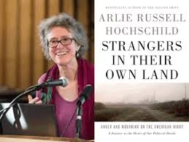
The Inverse of Place and Class

Slide 8
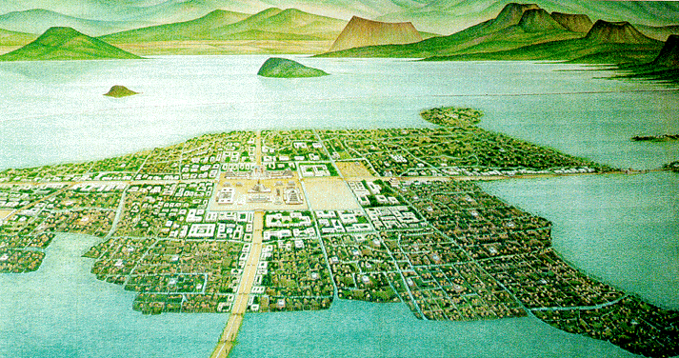
“Class” shapes the city over time: The Preindustrial City

Slide 9
What has happened in China?

Slide 10
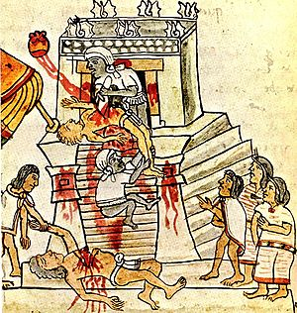
Making Economic Choices

Slide 11
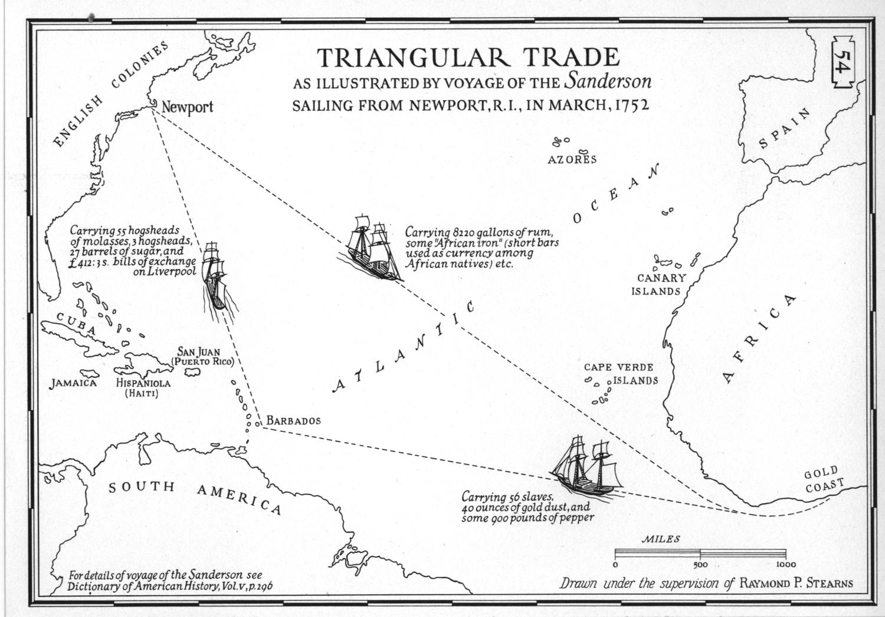
Global Cities and Trade (Warner) Boston from Ponzi scheme to international slaver

Slide 12
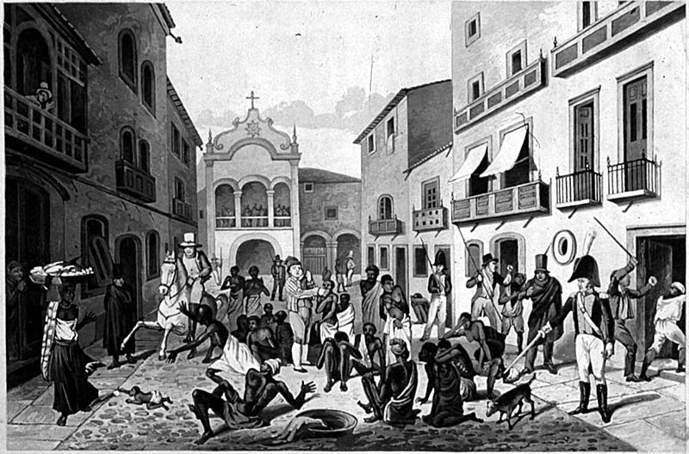
Mercantile Cities and Markets

Slide 13
From Trade to Production: Defining Capital
Capital is not money alone but money or goods (or equivalent resources) that can be used to create more of the same. Capital for merchants involves flows of exchange, buying with capital to sell for a profit and then buy more. Similarly, capital invested in tools of production should yield more capital. Hence, it is a social construct rather than a concrete amount or entity.
What does this mean? Consider relations of production, space and labor –what else can human capital be?

Slide 14
CLASS is not RACE
But the categories may be forced together, whether in identification of imported black people as slaves (whose labor falls “outside” the industrial class system) or incorporating Irish immigrants in the UK or varied European immigrants into U.S. industrialization. Yet, class systems “may” allow mobility and racial systems generally do not.

Slide 15
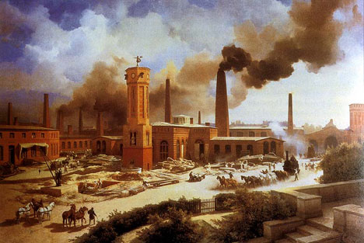
The Early Industrial City shaped by social and economic power

Slide 16
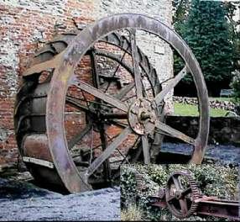
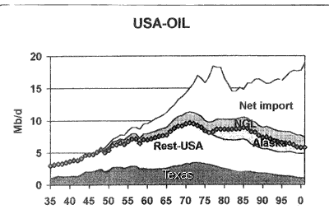
Control of Resources/Energy

Slide 17
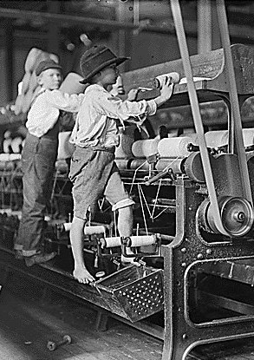
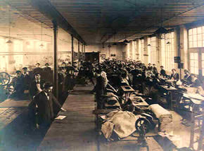
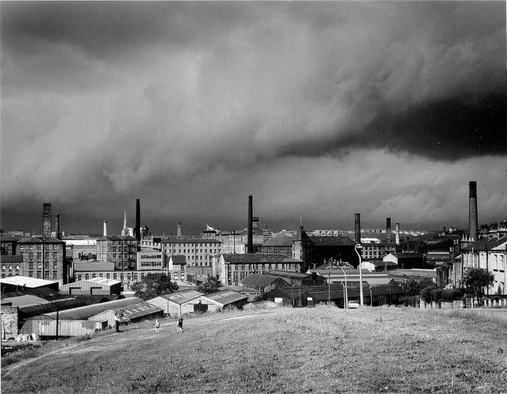
Control of Production and Lives

Slide 18
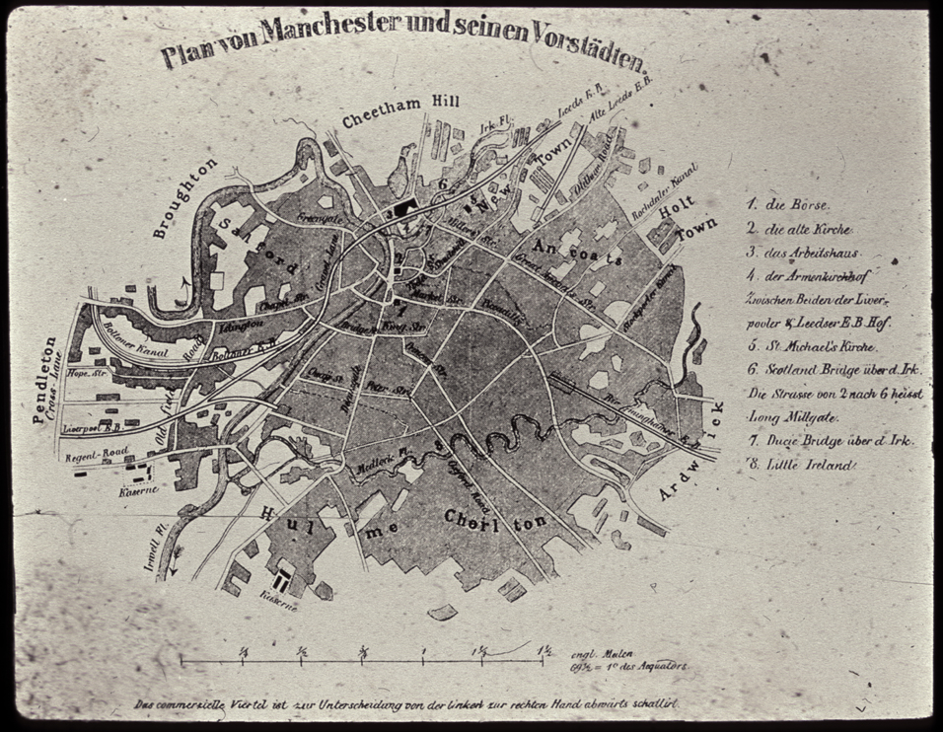
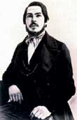
Spatializing Class and Power: Reading Engel’s Manchester

Slide 19
EACH FOR HIMSELF OR Classes in Industrial Society?
Capitalists (degrees, associations) INCLUDING WEALTHY MERCHANTS
Managers (private and government)
Middle classes (managers, shopkeepers, professionals)
Working classes (skilled/unionized labor,
working poor)
More marginal (partially employed, unemployed, illegal work
Contradictory class positions –intellectuals? Ideological leaders?
Other forms of distribution? (socialist)

Slide 20
And the transformation of people
“People regard each other only as useful objects; each exploits the other and the end of it all is that the stronger treads the weaker under foot ….”

Slide 21
Spaces of Industrial Capitalism
Factories
Banks
Connections –Streets, Rail, Highways, Ports, Airports
Residences (varied)
Supplies/Consumption
Leisure & Open Spaces
Culture & Memory: Religion, Memorials, Arts

Slide 23
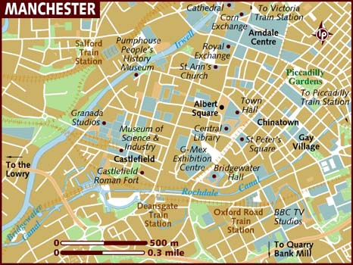

Slide 24
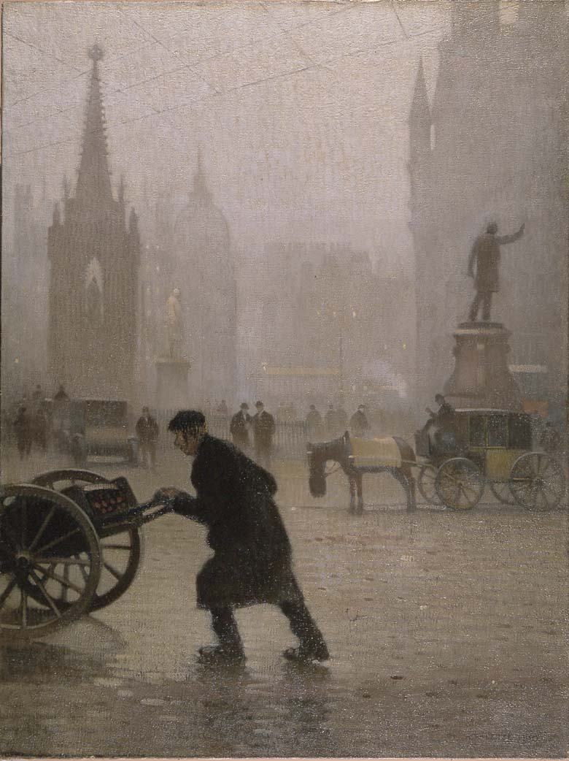
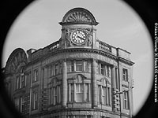
Central Spaces

Slide 25
Downtown?
“A person may live in it for years and go in and out daily without coming into contact with a working-people’s quarter…
“Manchester contains, at its heart, a rather extended commercial district….Nearly the whole district is abandoned by dwellers and is lonely and deserted at night; only watchmen and police traverse its narrow lanes…” 53

Slide 26
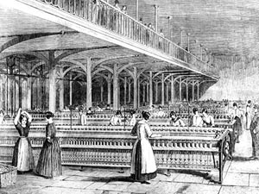
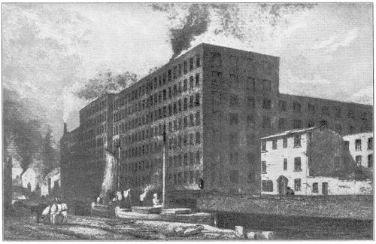
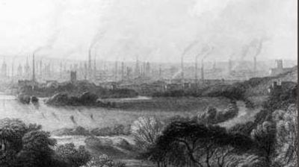
Factories

Slide 27
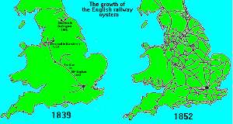
Transportation

Slide 28
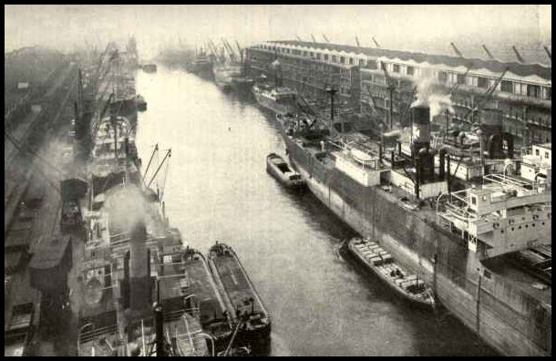
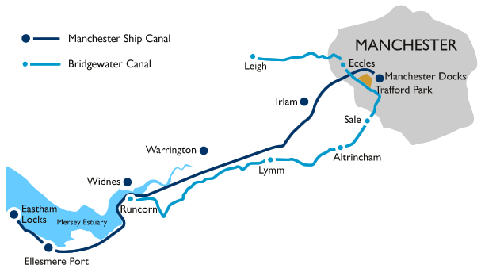
Manchester Ship Canal 1894

Slide 29
Transportation
Linking Local Production and Global
Linking workers and factories
Dividing Bourgeoisie and Middle Class from industrial centers
Flexibility

Slide 30
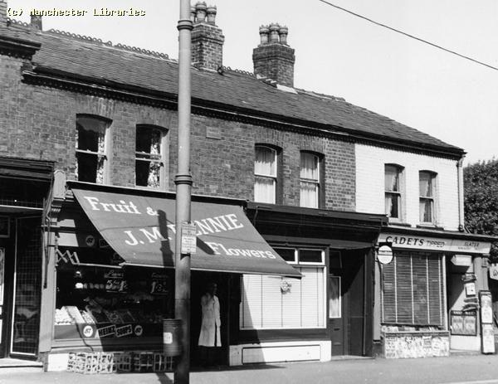
Mercantile Streets
“The members of this aristocracy can take the shortest road through the middle of the laboring districts to their places of business without ever seeing that they are in the midst of grimy misery….For the thoroughfares leading from the Exchange in all directions out of the city are lined, on both sides, with an almost unbroken series of shops and are so kept in the hands of the middle and lower bourgeoisie”

Slide 31
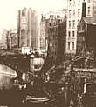
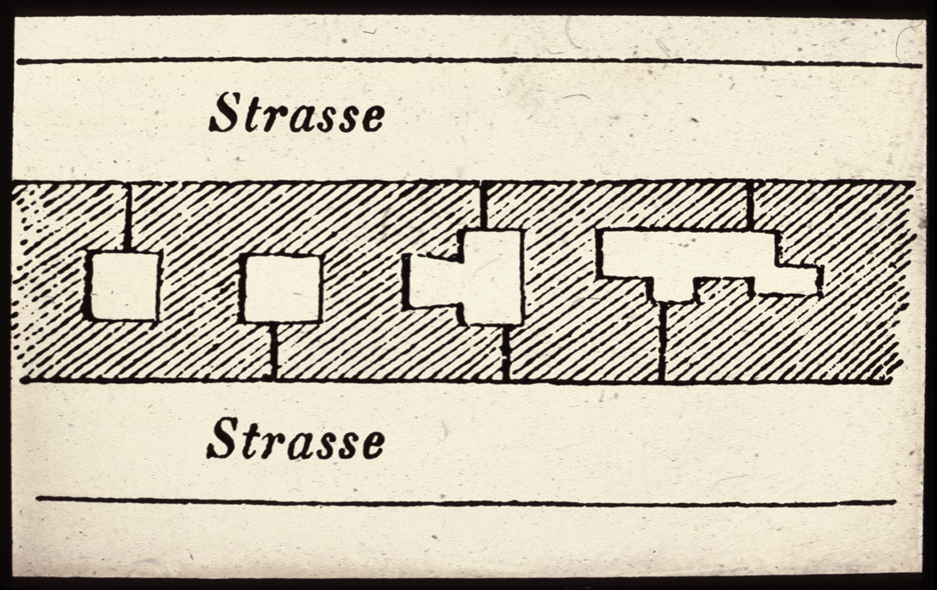
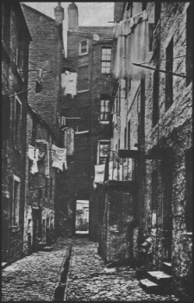
Working Class Housing

Slide 32
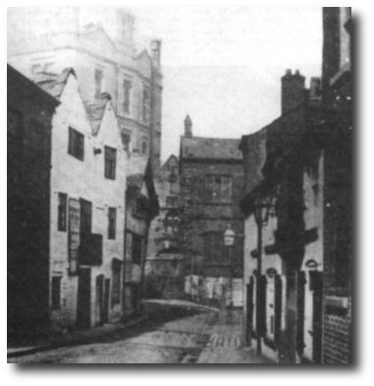
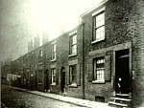
“Better” Slum Housing

Slide 33
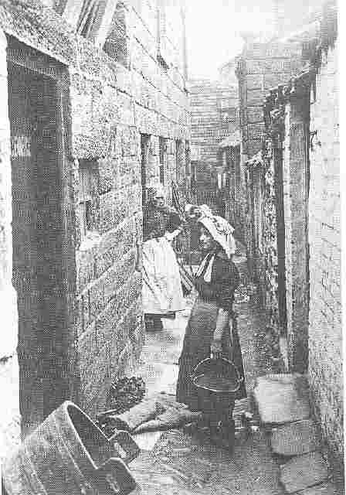
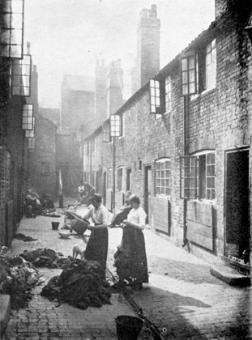
Families

Slide 34
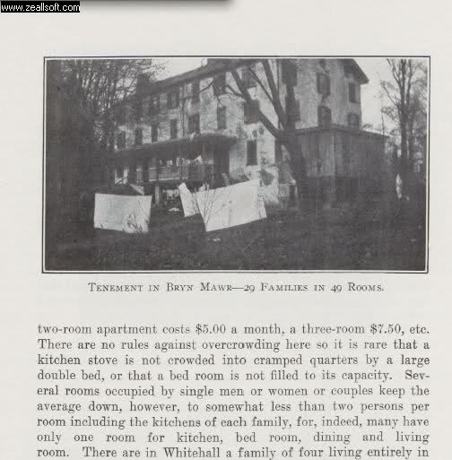
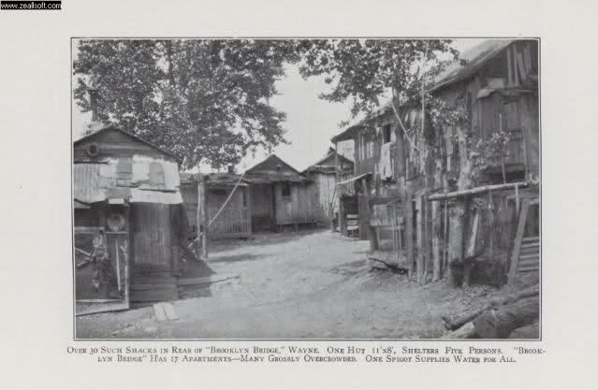
PHILADELPHIA AND MANCHESTER

Slide 35
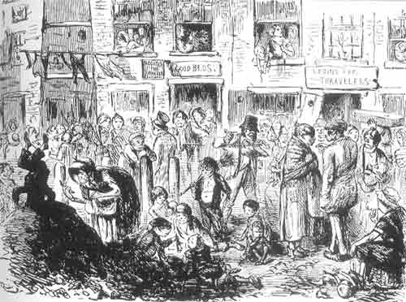
Housing, Health and Environment: the Poor Die More and Younger

Slide 36
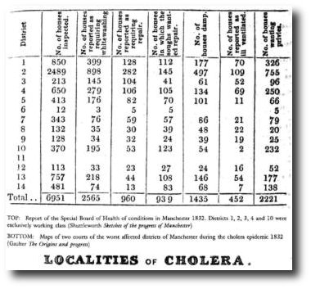
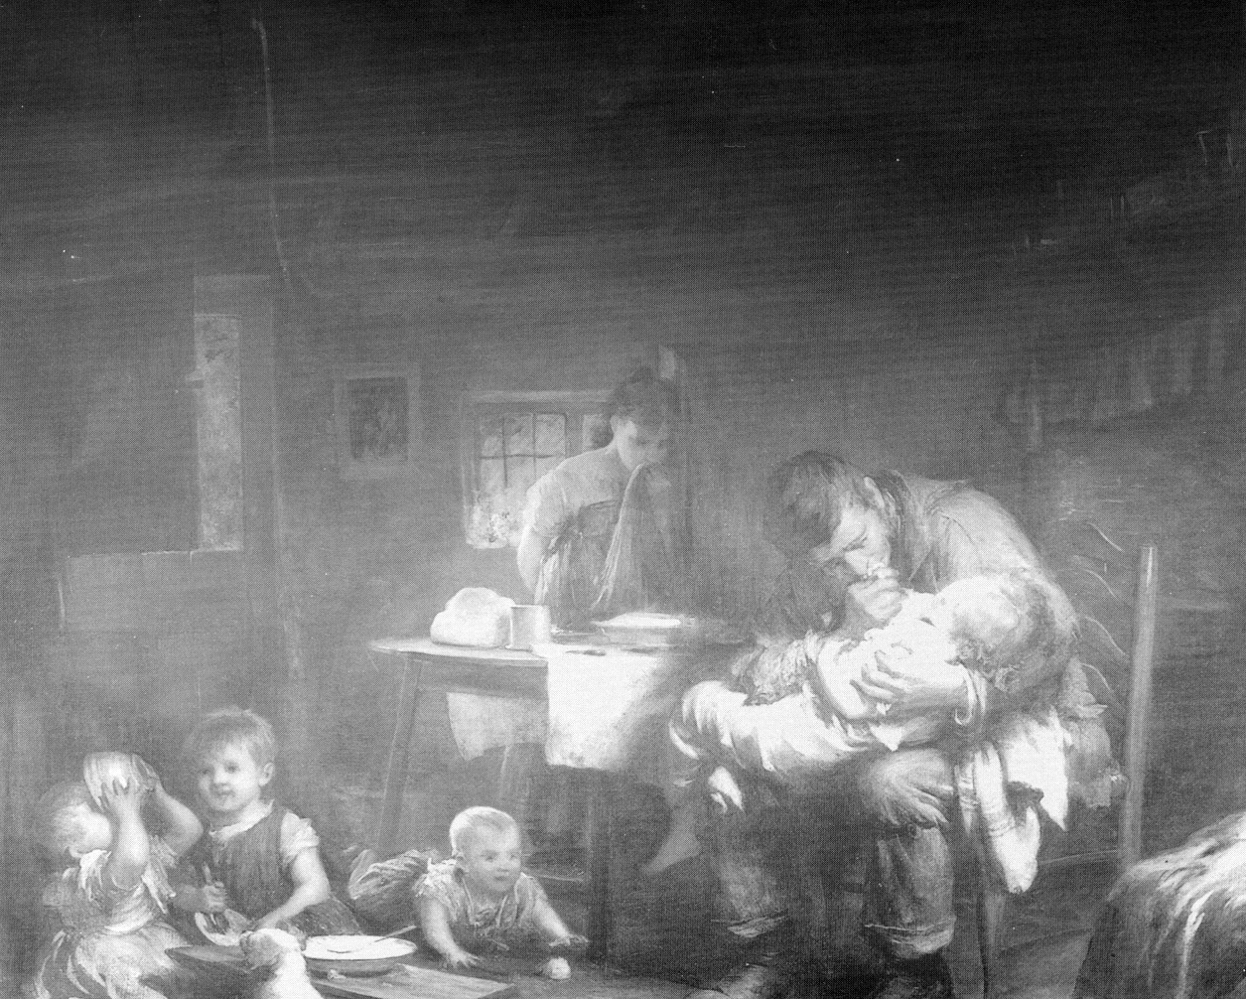
Cholera 1832 and Mortality

Slide 37
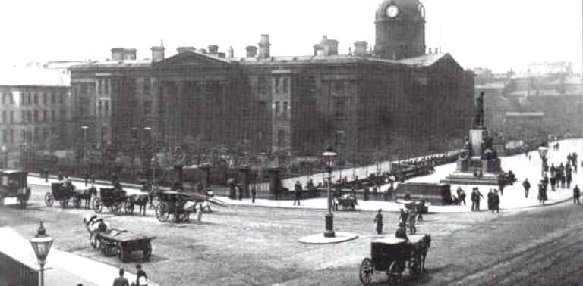
The Infirmary

Slide 38
DIVIDING THE LABORING CLASSES BY SOCI0-CULTURAL CATEGORIZATION
The Irish in Britain
Immigrants in the U.S.
The Question of Slavery and RACE
Chinese Global Cities: Opportunity, Migration, Separation

Slide 39
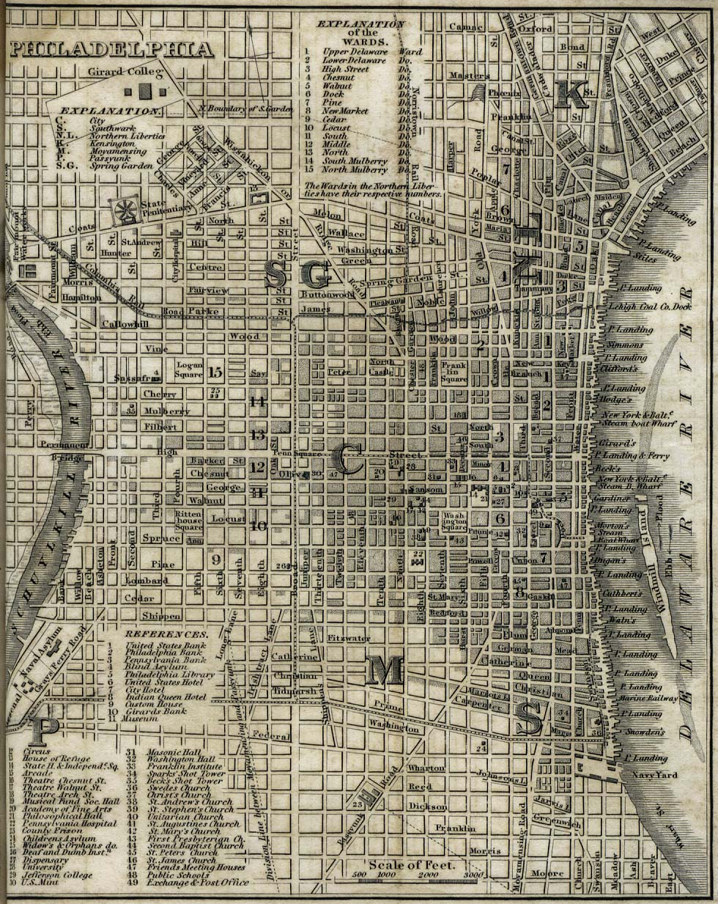
Elitee
Slavic and Russian
C’town
Elites
Society Hill
Seventh Ward
Italian and Jewish South Philly

Slide 40
Owners
Outside, beyond this girdle, lives the upper and middle bourgeoisie … the upper bourgeoisie in remoter villas with gardens in Chorlton and Ardwick or on the breezy heights of Cheetham Hill, Broughton and Pendleton, in free wholesome country air, in fine comfortable homes, passed once every half or quarter hour by omnibuses going into the city…

Slide 41
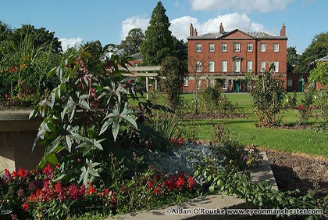
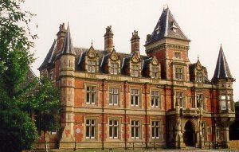
Suburban Mansions not unlike the Main Line: part of a Metropolitan Ecology (How are Suburbs like Corporations?)
Platt Fields, early 20th c.
Now a public park.
The Towers, 1874

Slide 42

Manchester United was formed in 1878 as Newton Heath LYR Football Club by the Carriage and Wagon department of the Lancashire and Yorkshire Railway depot at Newton Heath (Wikipedia)

Slide 43
What can laboring classes do? TRANSITION TO FORDISM
Purchase --factory products need clients (Warner)
Relax –development of leisure and alternative spaces (churches, streets, sports)
Organize/GLOBALIZE
Resist : Education, discussion, connection

Slide 44
Fordism Integrates the System
Mass Production/Standardization of Goods
Assembly Lines—Standardized Labor
Mass Consumption-–workers have enough money to buy
…………and distances grow to national scale

Slide 45
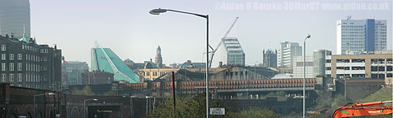
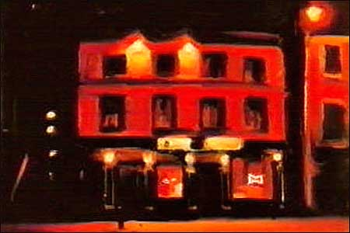
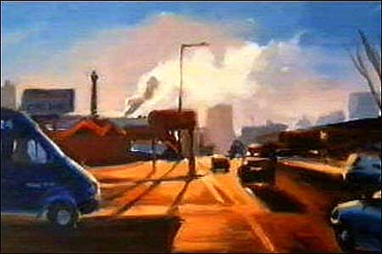
Rethinking Manchester
Liam Spencer (1964-), The Mancunian Way 1997-8

Slide 46
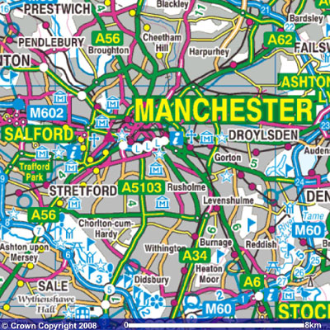
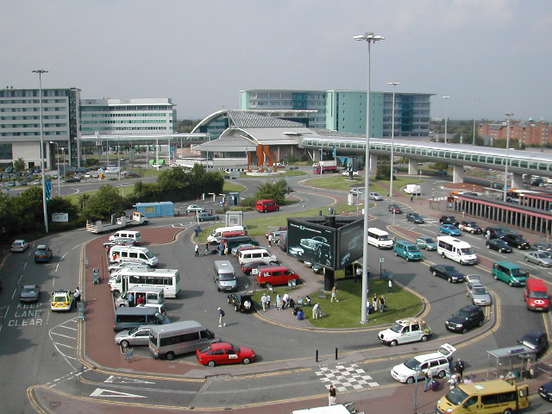
Transformation

Slide 47
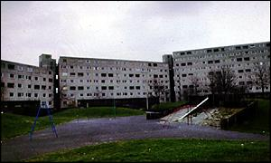
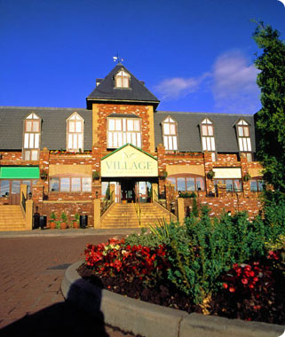
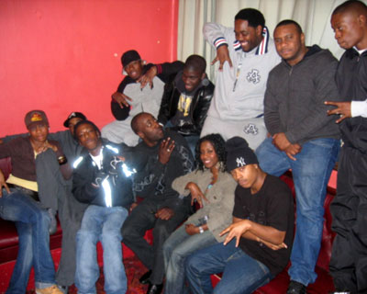
Contemporary Housing and Social Issues

Slide 48
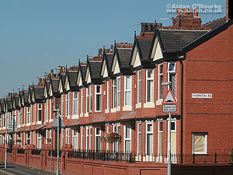
Remaking Moss Side Slums as Urban Housing Options

Slide 49


Ethnic vs. Class Minorities

Slide 50
20th Century Urban Choices:the Fordist and Post-Fordist City
Changing Values of Space: Individualized Sprawl Transportation vs. Urbanity
Changing Values of Form AND Governance: Fragmentation vs. Centralization
Changing Mass Populations: Unskilled (19th c), Skilled (20th), Creative and Individualized/marginal
GlobalsCities as Competing Venues; Public/Private Partnerships ---- and then the Pandemic

Slide 51


Manchester as Global City

Slide 52

Chinatown

Slide 53
Engels Returns

Slide 54

Is there anyplace more placeless?
This is Manchester Airport:
How do we Know?

Slide 55

And Global Relations: The Gig Economy and State Post-Fordism. Consider your Phone….

Slide 56
Economic and Political Citizenship
“Apple benefits from forced Uighur labor at its iPhone supplier factories in China, according to an explosive new report”
BUSINESS INSIDER May 2020 https://www.businessinsider.com/apple-forced-uighur-labor-iphone-factory-2020-3

