Slide 1
Modernism
International Modernism in Ballet

Slide 2
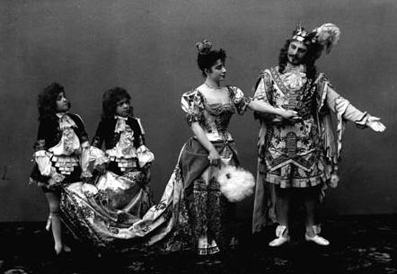
Imperial to Modern
The Marinsky Ballet performing The Sleeping Beauty in 1890 →
Political/ideological shifts in Russia:
-shift away from feudalism and serfdom
-anti-tsarist activism and socialist revolution
-interest in ancient Slavic culture and arts
-weakening of empire, need for French funding

Slide 3
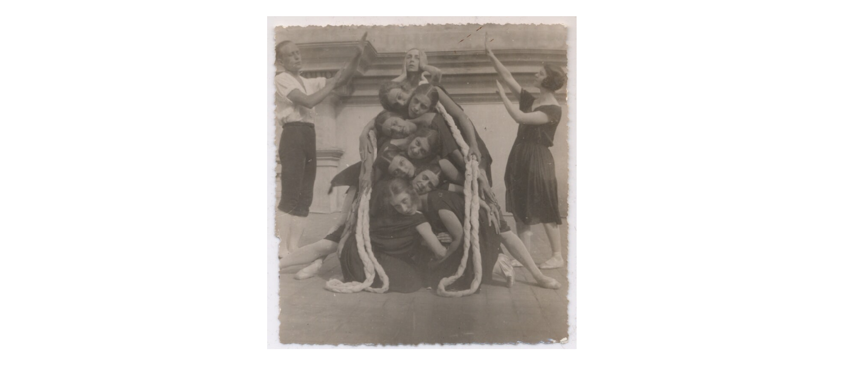
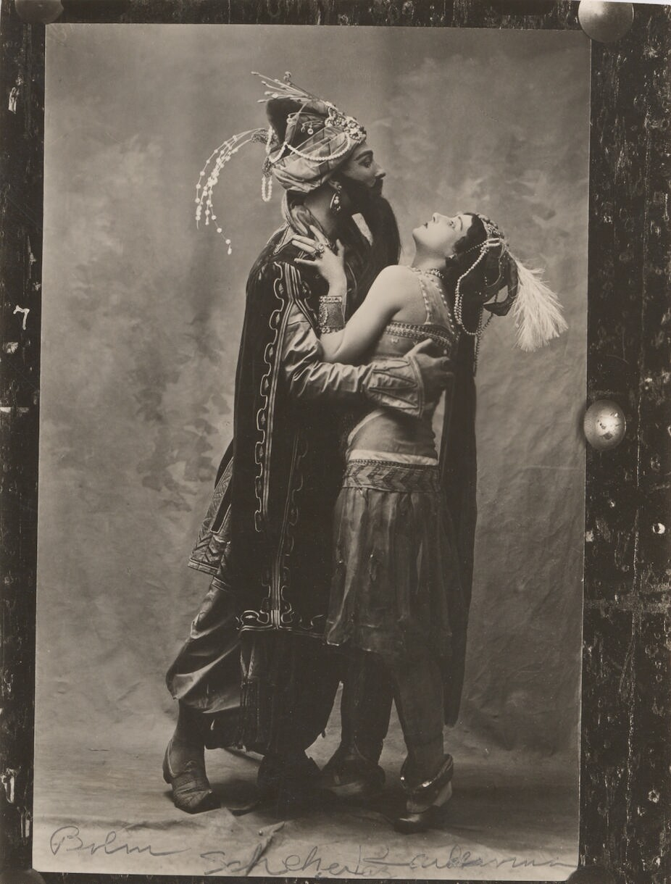
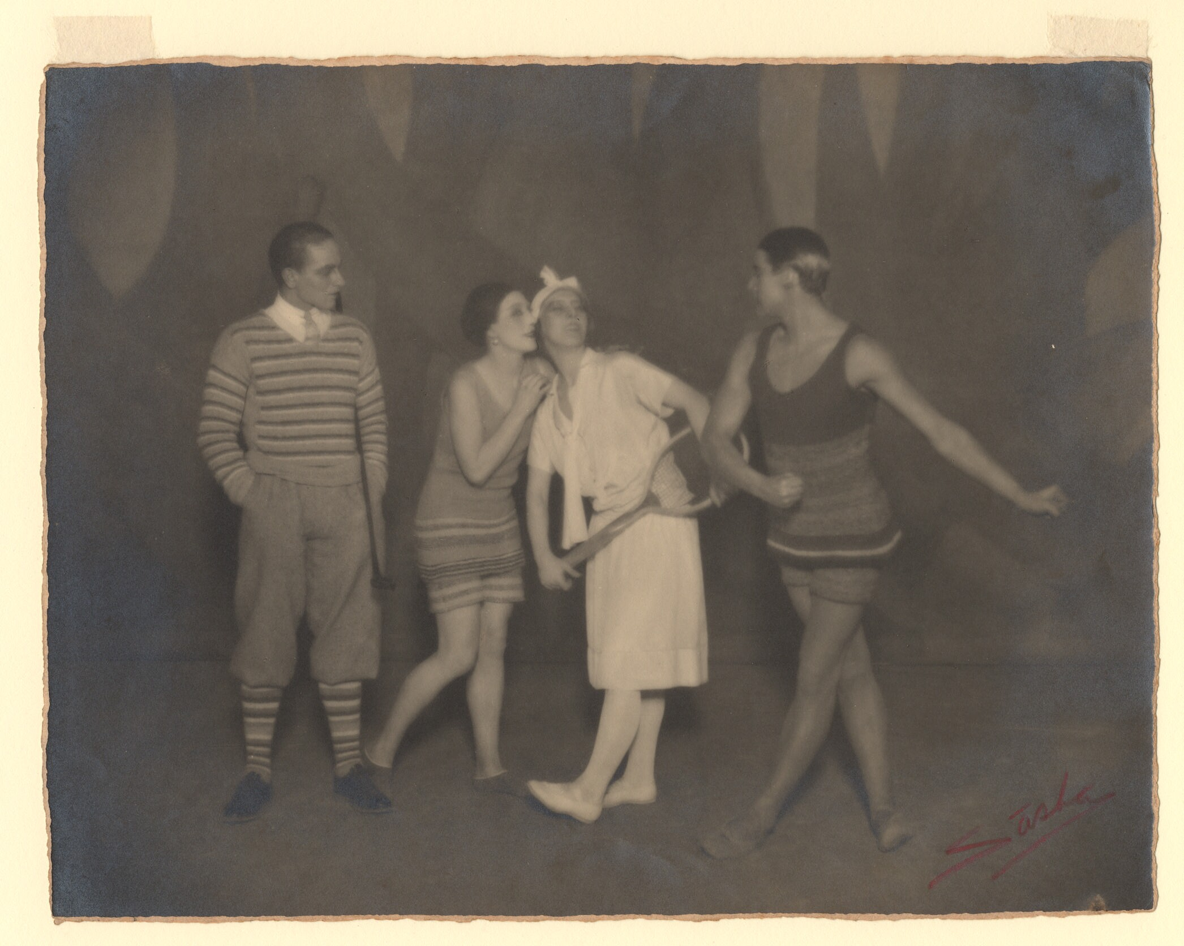
“A Break with the Past”
Modernity | culture
Modernism | Definition, History, & Examples
”Impresario” and “avant garde”

Slide 4
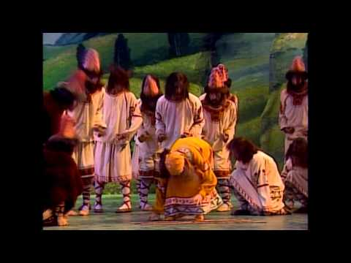
Diaghilev and the Ballet Russes (2013)
A production of the National Museum of Art, Washington, D.C.
-International contexts:
Russian Revolution
The Great War (World War I)
-Focus on interdisciplinarity and visual elements of the Ballet Russes
-Emphasis on the Ballet Russes’ influence on Western ballet in the twentieth century

Slide 5
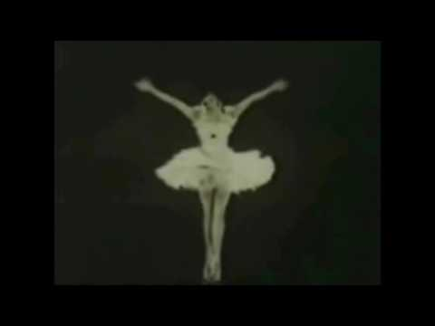
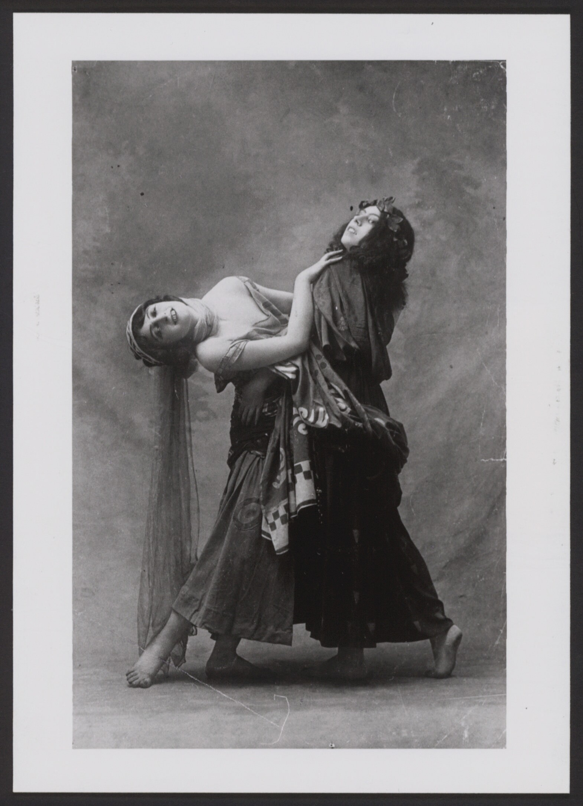
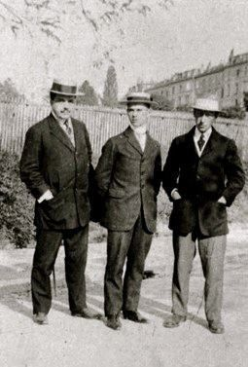
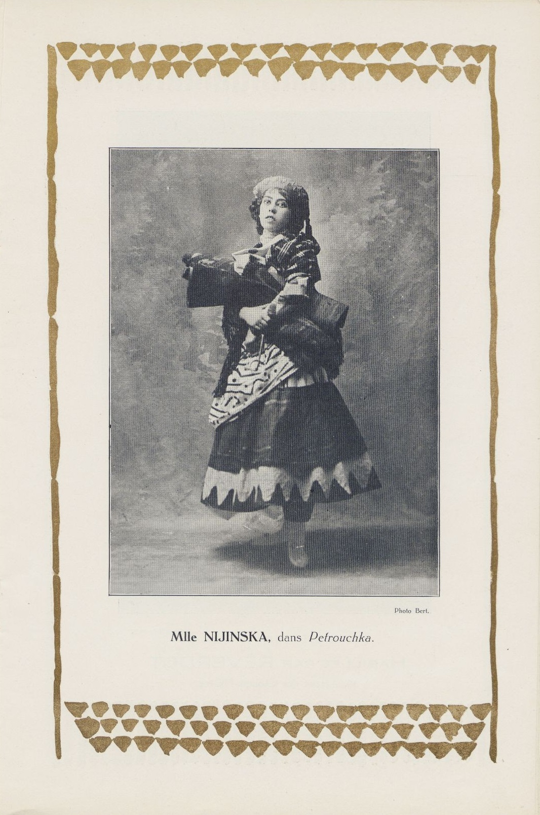
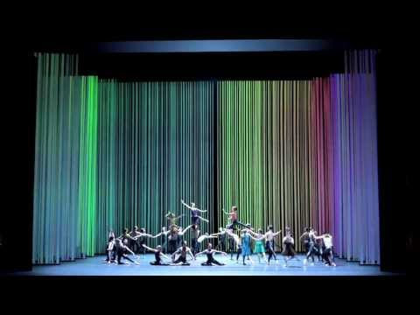
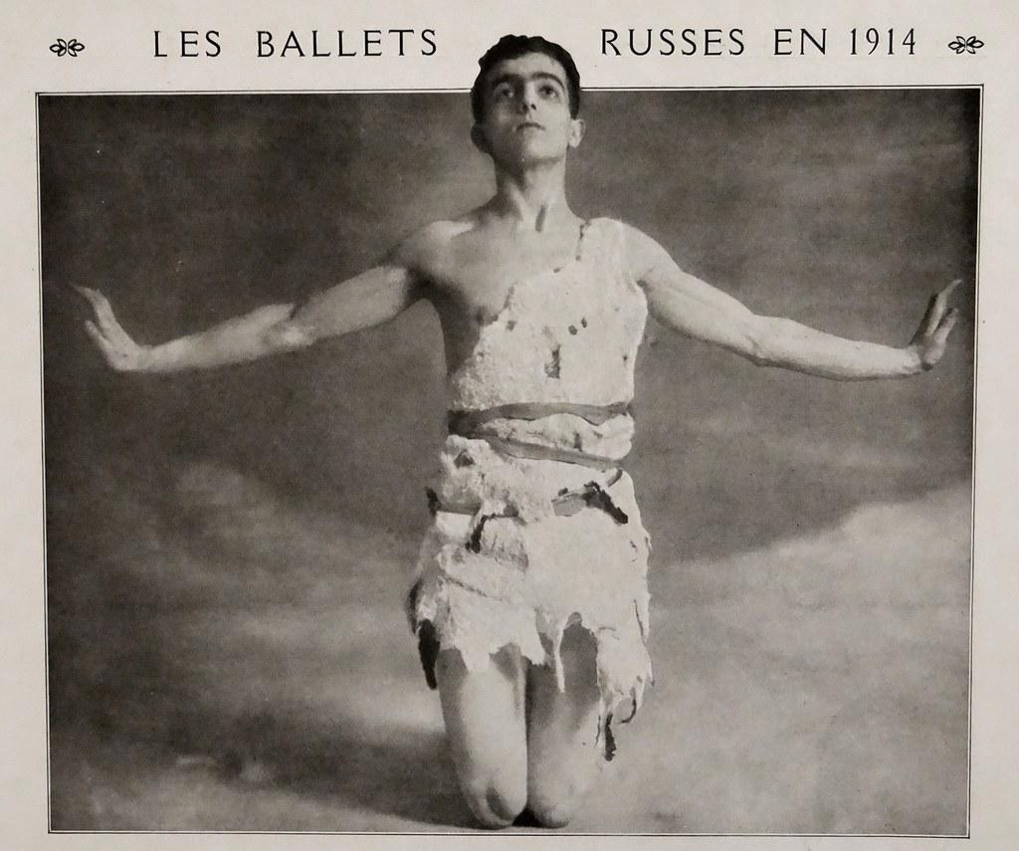
Michel Fokine
https://www.britannica.com/biography/Michel-Fokine
Anna Pavlova
https://www.britannica.com/biography/Anna-Pavlova
Serge Diaghilev
Serge Diaghilev | Russian ballet impresario
Vaslav Nijinsky
Vaslav Nijinsky | Russian dancer
Igor Stravinsky
Igor Stravinsky | Biography, Music, & Facts
Bronislava Nijinska
Bronislava Nijinska | American dancer, choreographer, and teacher
Léonide Massine
https://www.britannica.com/biography/Leonide-Massine

Slide 6
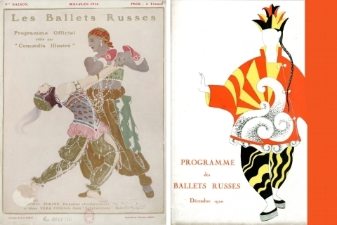
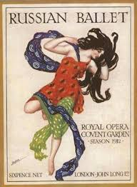
Leon Bakst (1866– 1924) https://www.britannica.com/biography/Leon-Bakst

Slide 7
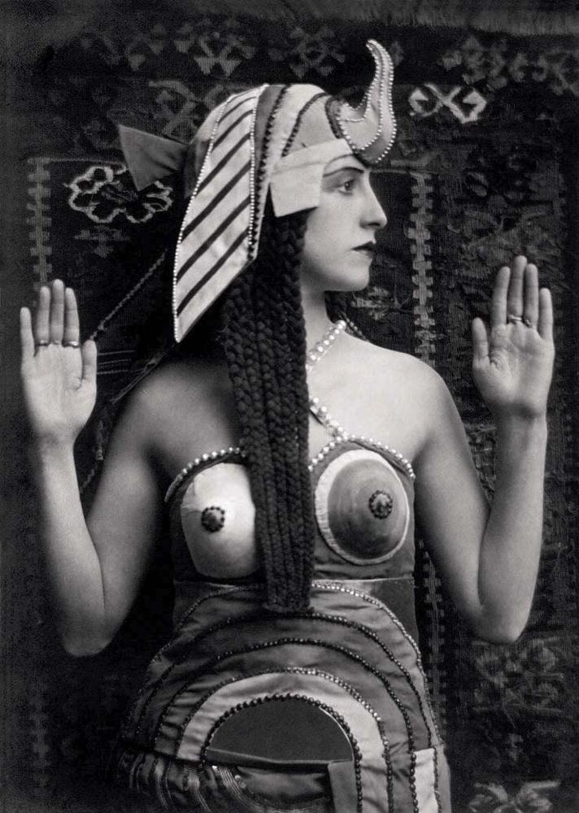
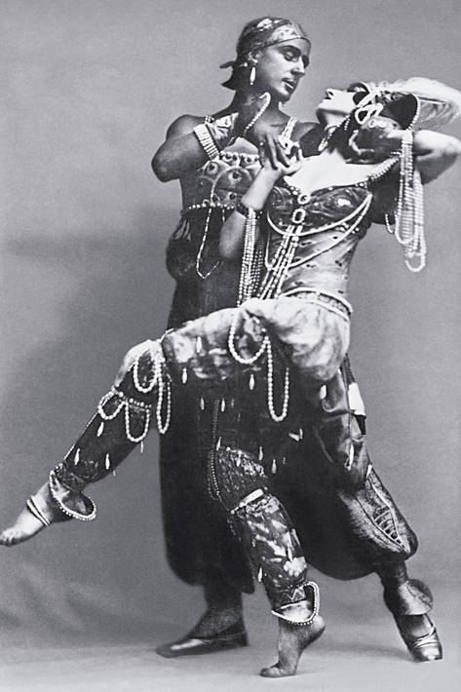
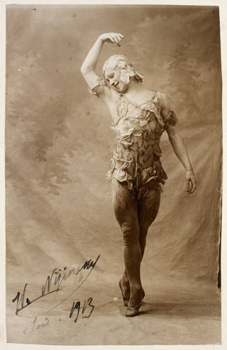
https://www.loc.gov/exhibits/ballets-russes/exhibition-items.html
Russian ballerina Lubov Tchernicheva in Cleopatra, 1920. © E.O. Hoppé Estate Collection/Curatorial Assistance Inc.

Slide 8
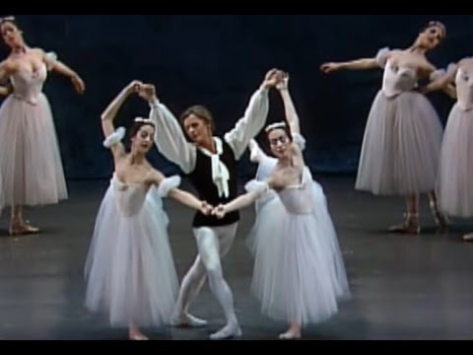
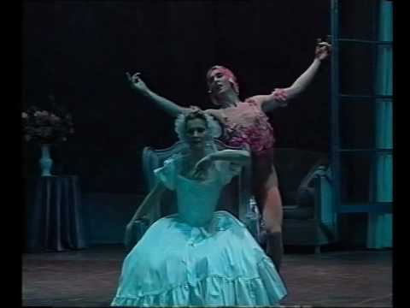
Les Sylphides (1909)
La spectre de la rose (1911)

Slide 9
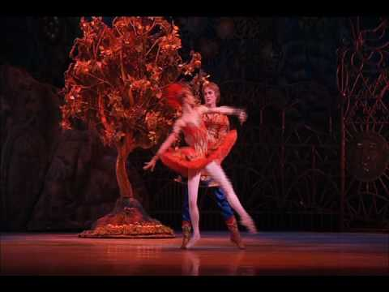
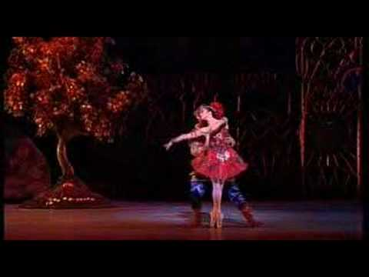
Firebird (1910)

Slide 10
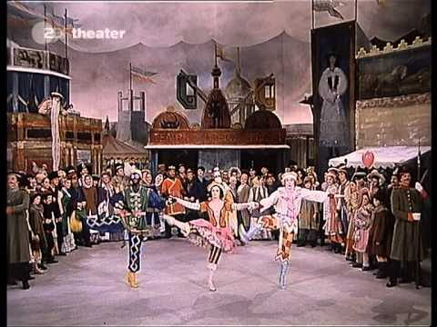
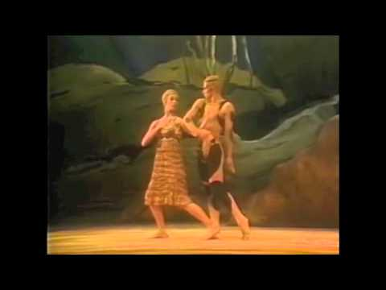
Petruschka (1911)
L’Apres-midi d’un Faune (1912)

Slide 11
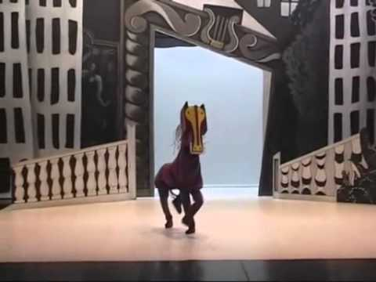

Parade (1917)

Slide 12
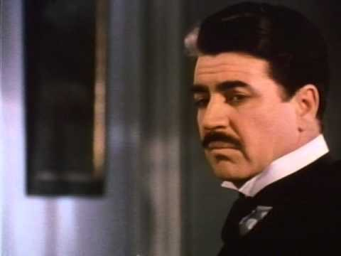
Nijinsky (1980)
A fictional feature film, starring George de la Pena, and directed by Herbert Ross.

Slide 13
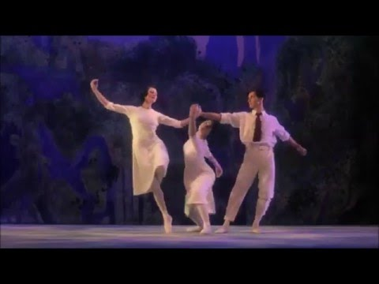
Depiction of “La Jeux” (1913) in Nijinksy (1980)
Choreographed by Vaslav Nijinksy for the Ballet Russes. Music by Claude Debussy.

Slide 14
Revisioning Past Choreographic Works

Slide 15
Choreographic Reconstruction
Millicent Hodson’s essay “Searching for Nijinsky’s Sacre” (1979)
-What were Hodson’s research methods? How did she gather material?
-What materials and information helped Hodson get closer to a sense of the “lost dance” from 1913?

Slide 16
Sources: a 1913 photograph of Ballet Russes dancers in costume, Valentine Gross's hierographic sketches alongside the musical score, Marie Rambert's oral recollection of the dance's posture, Millicent Hodson's sketches of the postures and groupings, and an excerpt of Stravinsky's score).
Embody: whatever these sources inspire you to feel/think/express about the physical and energetic essence of Nijinsky's "lost ballet" Sacre du Printemps.
Share: reflections on postural reconstruction as a research strategy anything you might have learned about the "original" dance from this process.

Slide 17
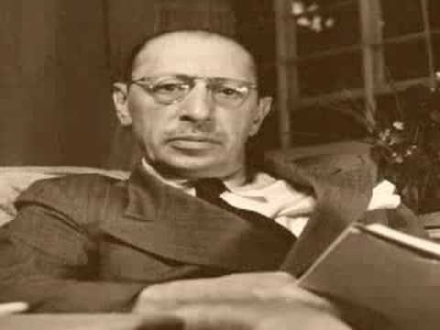
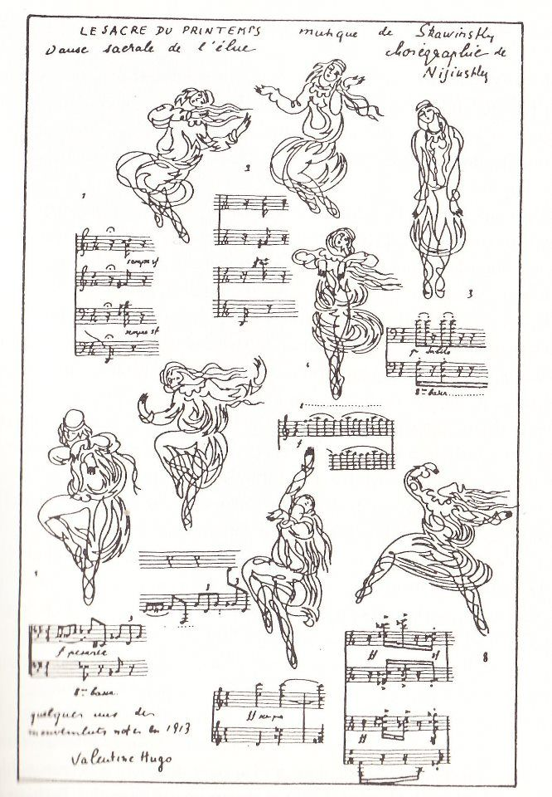
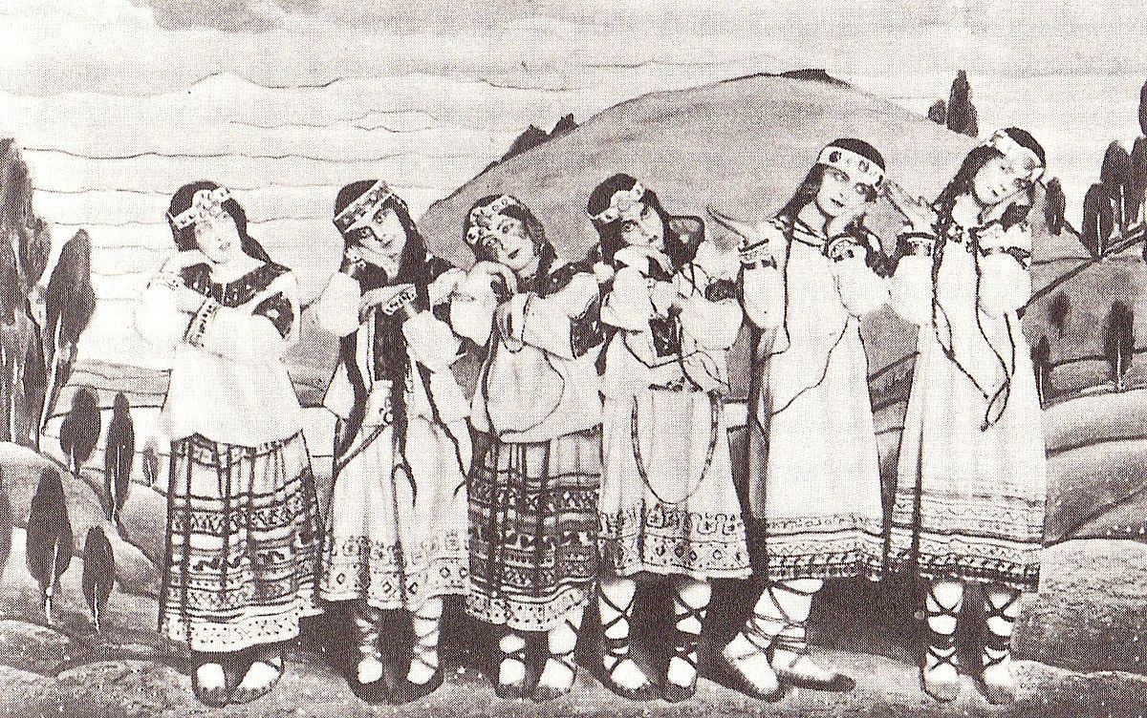
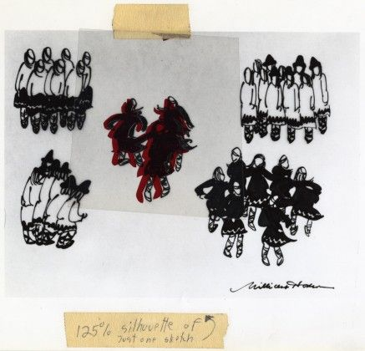
Choreographic Reconstruction: Sources
“The foundation of the choreography was the turned-in position. And bent. And questioning. And fists- not strong, not showing strength, just not opened yet… [...] That was one of the poses and you had to dance in that pose. When you had to jump with the feet in like this [demonstrating], turning in, the position was difficult to keep, and it came from terribly difficult rhythms which you had to remember. (Rambert quoted in Hodson [1979] 2004, 21)

Slide 18
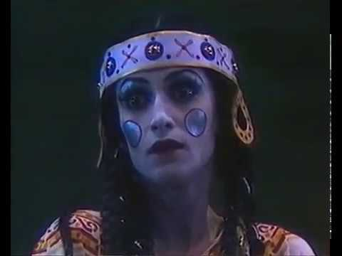
Sacre du Printemps (1913)
Choreographic reconstruction by Millicent Hodson and Joffrey Ballet (1987)

Slide 19
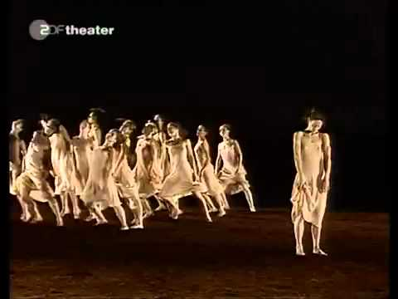
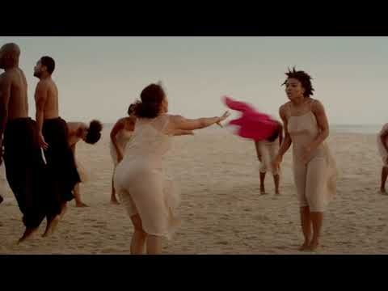
Pina Bausch’s Rite of Spring (1975)
Respectively performed by Tanztheater Wuppertal (Germany) and Ecole de Sables (Senegal)

Slide 20
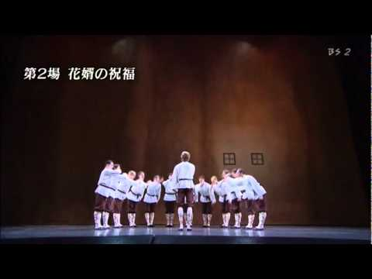
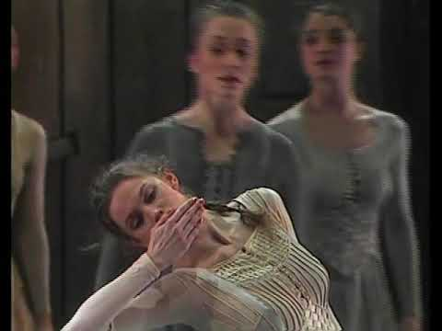
Los Noces (1920)
Originally choreographed by Nijinska; above, a faithful restaging and Jiri Kylian’s 1983 Svadebka
Respectively performed by the Marinsky Ballet in 2008 and Nederlands Dans Theater in the 1990s

Slide 21
For Wednesday:
Discussion/Forum Post Cancelled
→ Context Collage and Abstract* due Wednesday, October 14
Read:
Wigman, Mary. 1933. “The Philosophy of Modern Dance”.
Manning, Susan, and Melissa Benson. “Interrupted Continuities: Modern Dance in Germany.”

