Slide 1
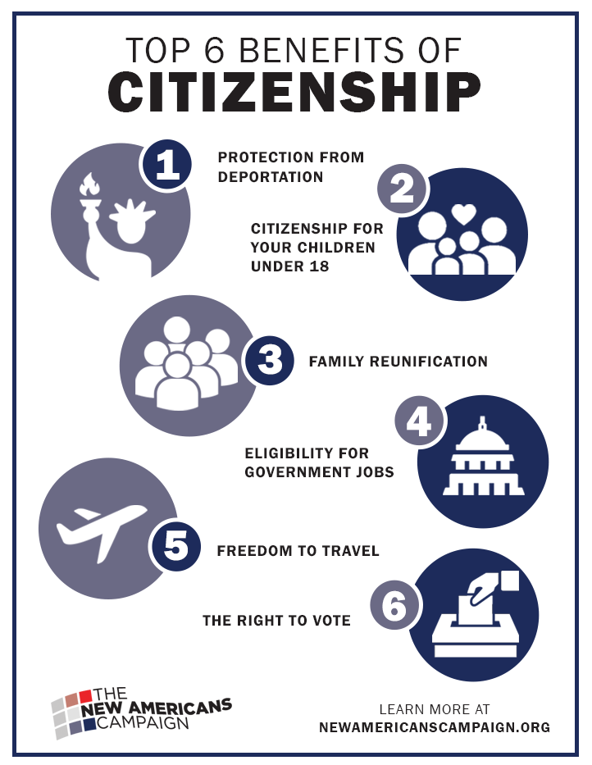
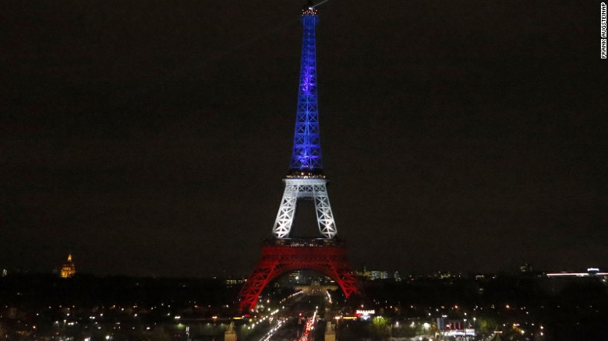
States, Borders, Barriers, cities and Citizenship
10/8/14
City 185
Notes:
Petula Clark downtown
https://www.youtube.com/watch?v=Zx06XNfDvk0

Slide 2
Paradoxes of Citizenship
1) Clearly derived from “city/civitas” yet since 1648 (Westphalia) associated with nation-states;
(2) Associated with territory and belonging but also defined by exclusion/borders;
(3) Constitutes a status of rights that entails obligations but may be abrogated;
(4) May be a passive identity given at birth that demands action

Slide 3
Finally, David Harvey on the right to the city
The city is man’s most complex creation that at the same time recreates man. To take up our rights, we must recreate the city that makes us better humans. For Harvey, this means taking the surplus whose manipulation has underpinned urban growth and crisis for the few and using it to create a just and inclusive city for the many. The right to the city is the right to be human and recreate humanity.

Slide 4
National Citizenship: States, Borders, Barriers
How do we read borders and barriers at multiple levels?
Who is kept out? How?
How are cities located in these global flows?
WHY DO WE DO A CENSUS? WHO IS COUNTED?

Slide 5
Citizenship and Nation States
Who does this address? Citizenship by birth vs. selection?
Benefits
Obligations?
Who can lose citizenship?

Slide 6
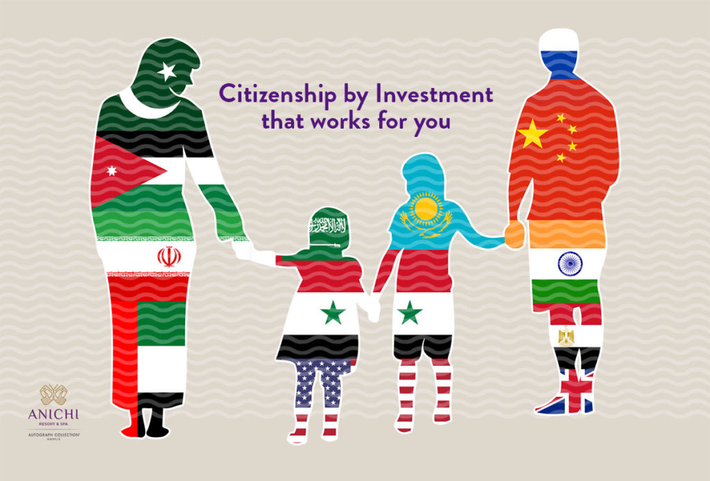
Markets of U.S.
Citizenship
U.S. Investment Visa demands $1.8 million ($900,000 in stressed areas) and 10 jobs in 2 years. https://travel.state.gov/content/travel/en/us-visas/immigrate/immigrant-investor-visas.html
Limits: by Race
--- non-European
Slave vs. free
Specific exclusions: Chinese 1882
Generalized patterns
Lotteries and exemptions (HB-1, chains)

Slide 7
Immigration, Cities and States
Cities grow through Immigration without h having their own controls
Global Cities may celebrate or protect immigrants in ways that oppose the rest of the nation-state.
Race, Class and Gender are also tied into immigrant citizenship

Slide 8
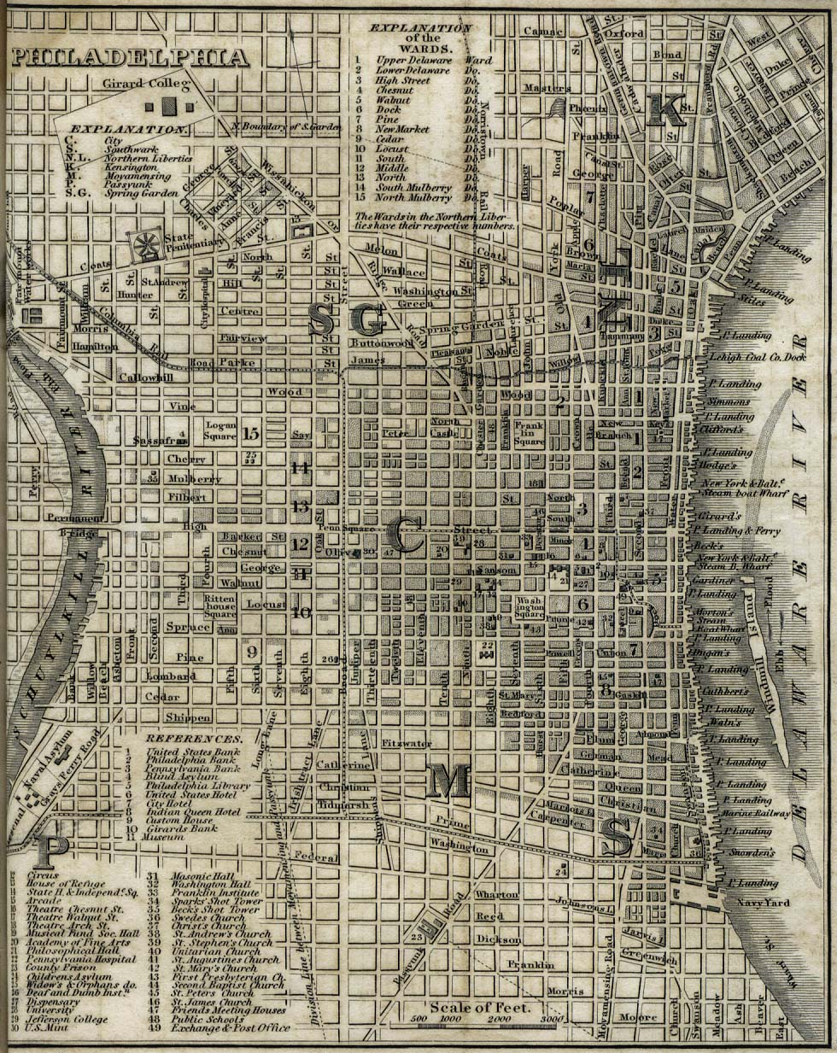
Elitee
Slavic and Russian
C’town
Elites
Society Hill
Seventh Ward
Italian and Jewish South Philly

Slide 9
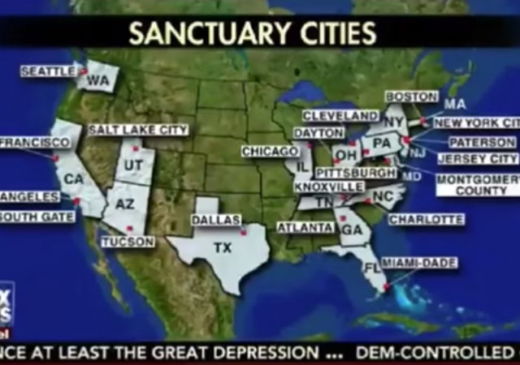
Sanctuary Cities

Slide 10
Politics and the Polis: What does it mean to be an URBAN citizen?
Nation: juridical status
City: choice of residence?
Obeying rules
Paying for shared goods
Receiving shared services
Participating in government
Serving in military
Obeying rules
Paying for shared goods (property taxes)
Receiving shared services (think about health, education, police)
Voting, serving
?
(global variations: hukou)

Slide 11
Civic Rights
What are the rights of those who live in civil units? How do you get them?
Voting
Education?
Libraries?
Recreational Facilities?
Culture

Slide 12
City Governance & Political Decisions
CITY does not make decisions. PEOPLE make decisions.
Who are the decision makers?
What are the purposes of those decisions?
  Publicly claimed purposes
  Whose interests do they represent (hidden or visible)?

Slide 13
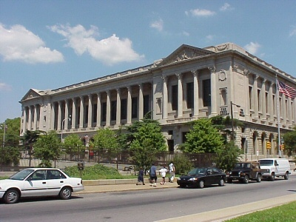
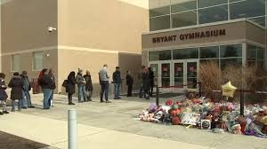
Civic Services:Libraries and Educational Services

Slide 14
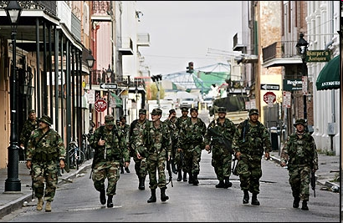
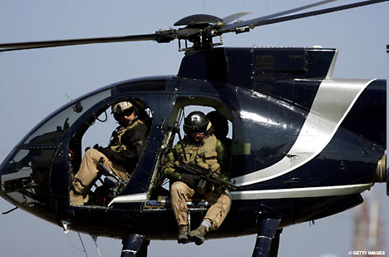
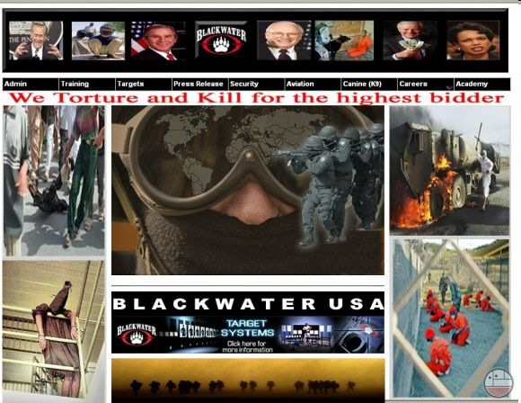
Civic Variations: National and Private Police

Slide 15
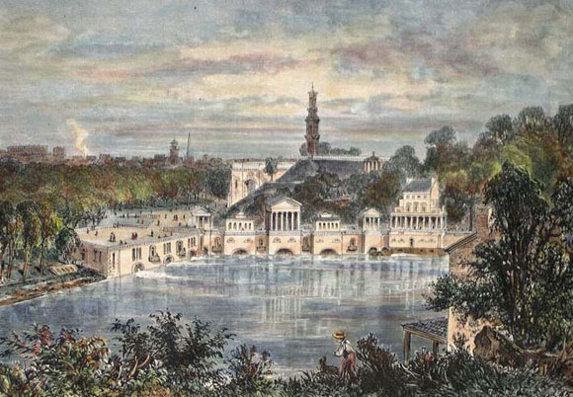
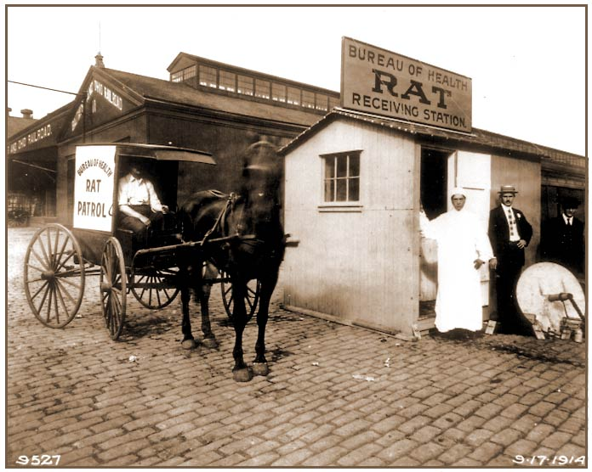
Parks and Public Health

Slide 16
The Morass of Transportation

Slide 17
And mor…

Slide 18
Civic Obligations determine rights
What Kind of Taxes do we Pay? (For JH later)
Property Taxes –Education (School Districts)
Income Taxes (Occupational Taxes)
Licensing/Transfer Fees
Business Taxes
Sales
Service Taxes aimed towards others –Hotel and Restaurant Taxes –
CAN WE PAY TAXES IN MORE THAN ONE PLACE? BE A CITIZEN OF MORE THAN ONE CITY?

Slide 19
How is politics urban?
Cities provide the everyday ground of all issues even when seen as too important to be left to mayors.
National issues are both local and larger, making solutions difficult.
Symbol and Structure intersect

Slide 20
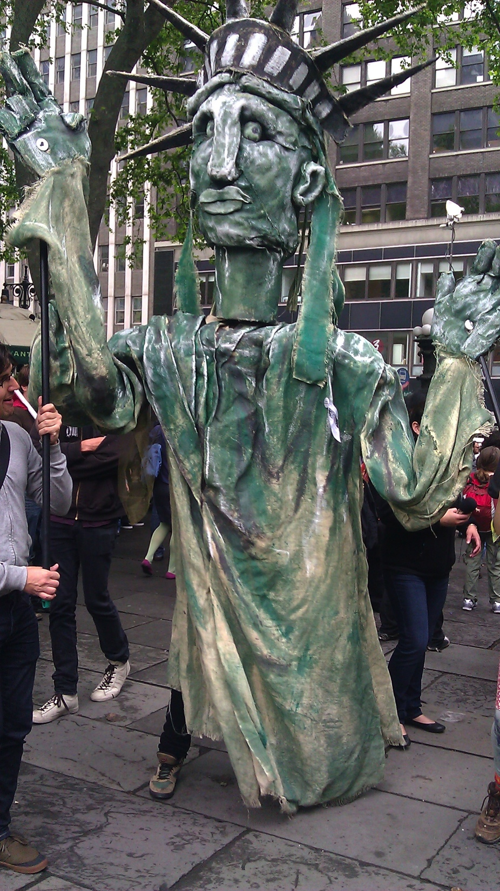
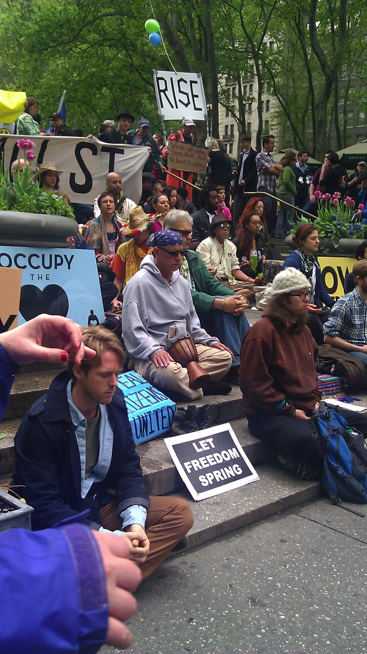
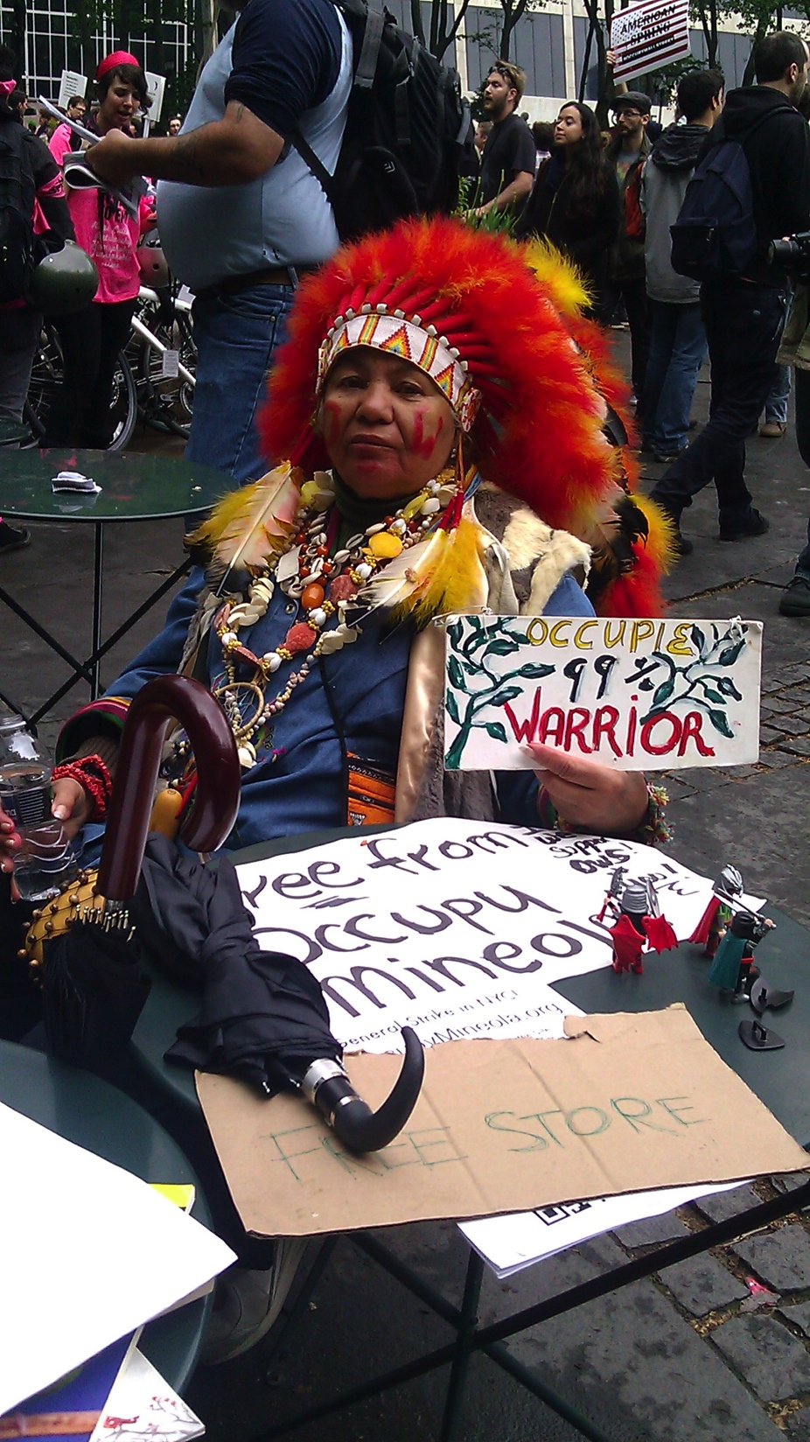
Cities as political spaces of contestations and negotiations
  Those in power organize the city in a way that they remain in power and benefit from their positions (Smith’s Society Hill)
  Different groups articulate and fight for their own interests (beyond the government and parities).
  Individual and mass action are both possible

Slide 21
Function and Governance
The city as a political and economic unit is defined by functions expected and agreed upon by citizens, including control of resources to pay for them. Yet no city is independent in resources or actions, which influences the structure of governance, which is at once local and intimate and national/international and structural.

Slide 22
Levels and Scales
When is a problem too large for a city (Covid)?
When do cities and states conflict? –protest, immigration
When do cities lead nations? Environmental issues?
When/how do citizens leave or enter cities?

Slide 23
What Else does Citizenship Mean?

Slide 24
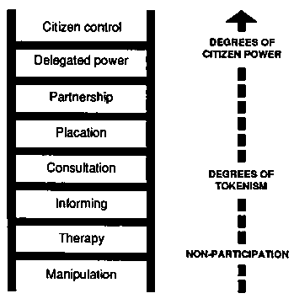
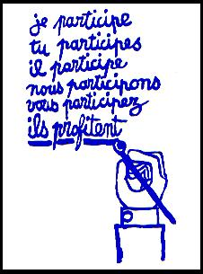
Citizens as
Agents

Slide 25
What do these Categories Mean?
Non-Participation
Apparent Participation
Participating with Power
But whose perspective and who controls? Not just citizens but allie

Slide 26
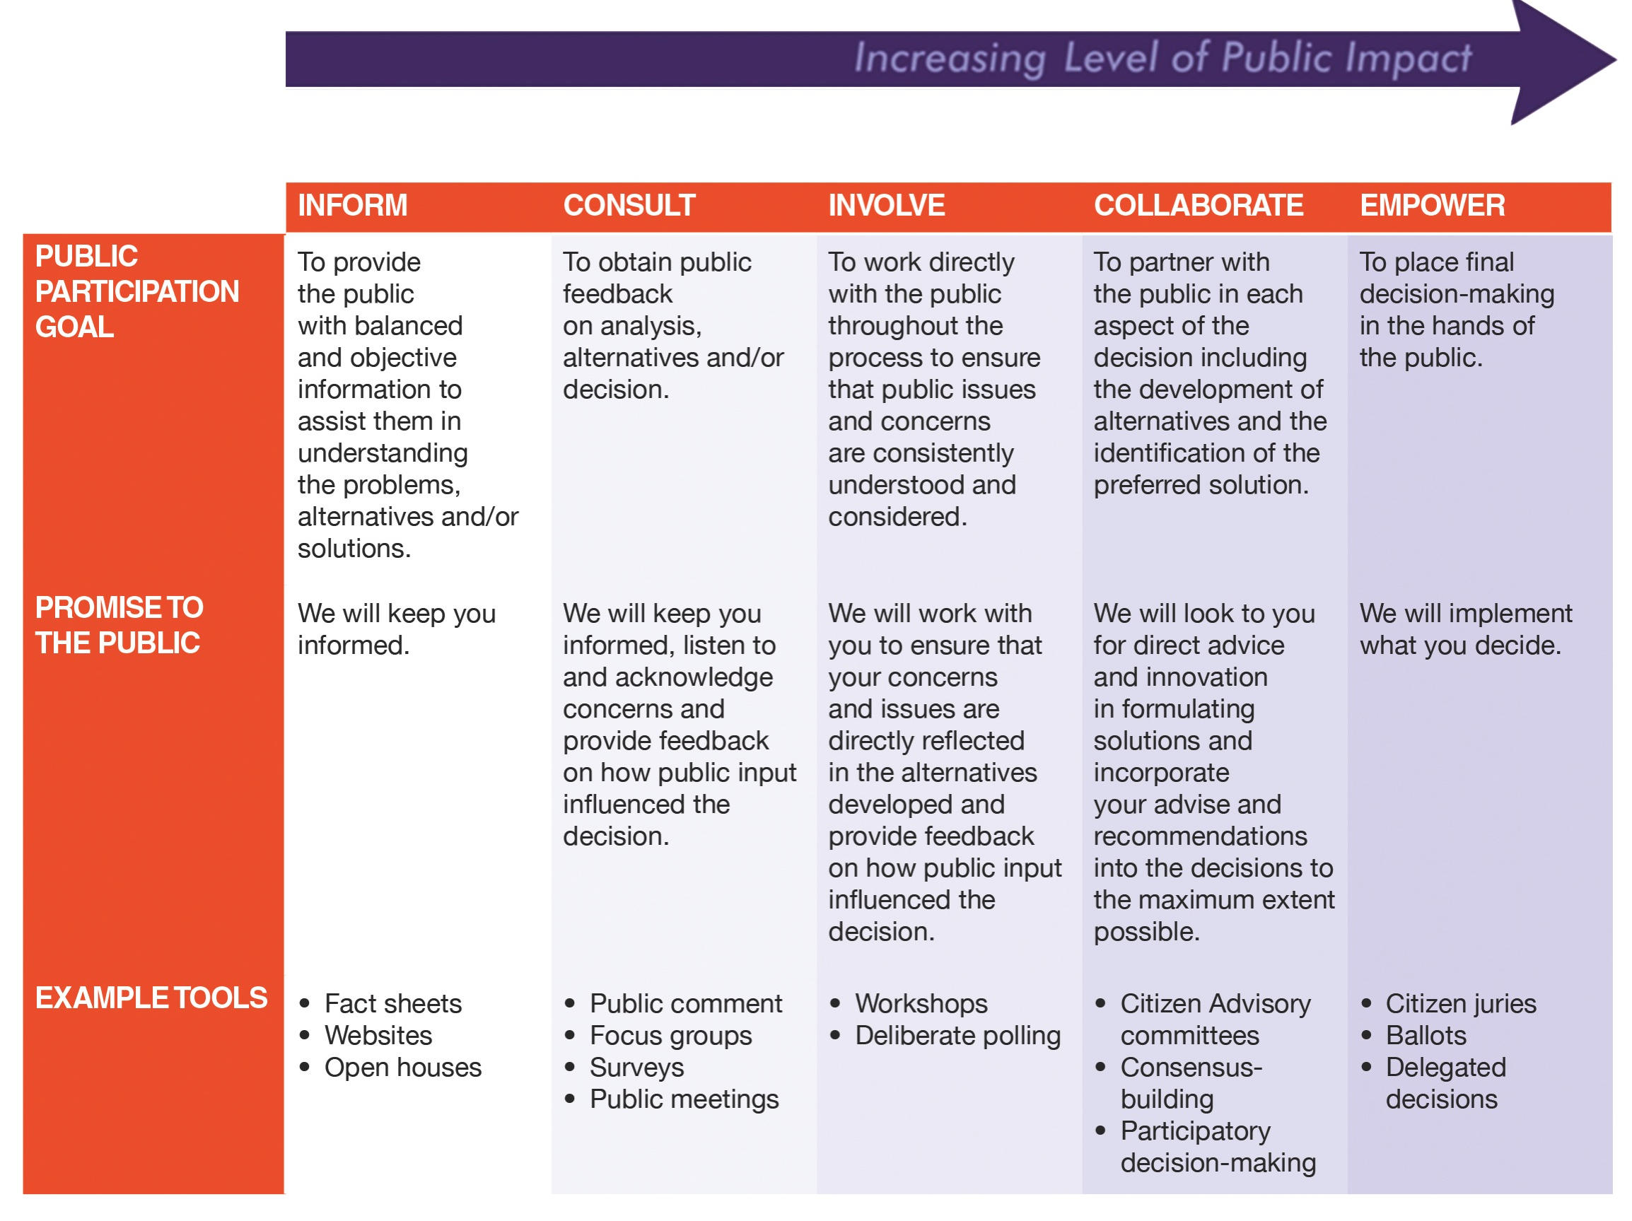
IAP2’s Public Participation Spectrum
How does this schema differ from Arnstein’s?

Slide 27
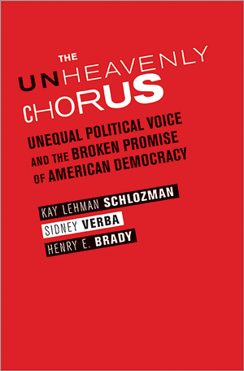
AND OPPONENTS:The Unheavenly Chorus: Unequal Political Voice and the Broken Promise of American Democracy
Kay Schlozman, J. Joseph Moakley Professor, Boston College
Sidney Verba, Carl H. Pforzheimer University Professor Emeritus, Harvard University, Henry E. Brady, Dean of the Goldman School of Public Policy
Henry E. Brady, Dean of the Goldman School of Public Policy and Class of 1941 Monroe Deutsch Professor of Political Science and Public Policy at the University of California, Berkeley
http://www.ash.harvard.edu/Home/News-Events/Events/Democracy-Seminar/Spring-2013-Seminars/The-Unheavenly-Chorus

Slide 28
Political Voice
Performs 2 democratic functions:
  Communicates information – citizens inform policymakers about their preferences
  Provides incentives – citizens place pressure on policymakers to respond to their preferences
Varieties of political voice:
  Voting
  Working on or donating money to campaigns
  Attending public meetings
  Writing letters/emails
  Protests
  Etc

Slide 29
In principle . . .
“While it matters for democracy that there be ample opportunities for the free expression of political voice and sufficiently high levels of participation across various political acts, the distribution of that participation across individuals and groups is also significant. Equal political voice does not require universal or even a very high level of activity; it requires only representative activity.”

Slide 30
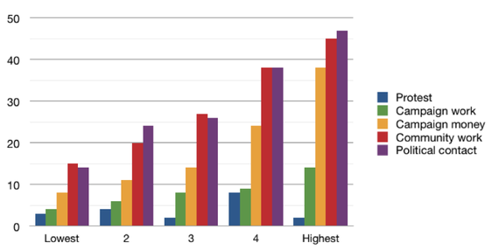
Inequalities of Political Voice
http://papers.ssrn.com/sol3/papers.cfm?abstract_id=2264877
Democracy in Poverty: A View from Below, Daniel Weeks
Data from 2008 Pew Internet and American Life Survey
From Schlozman, Verba, Brady:
“those who are disadvantaged by low levels of income and education are less likely to participate in politics.”

Slide 31
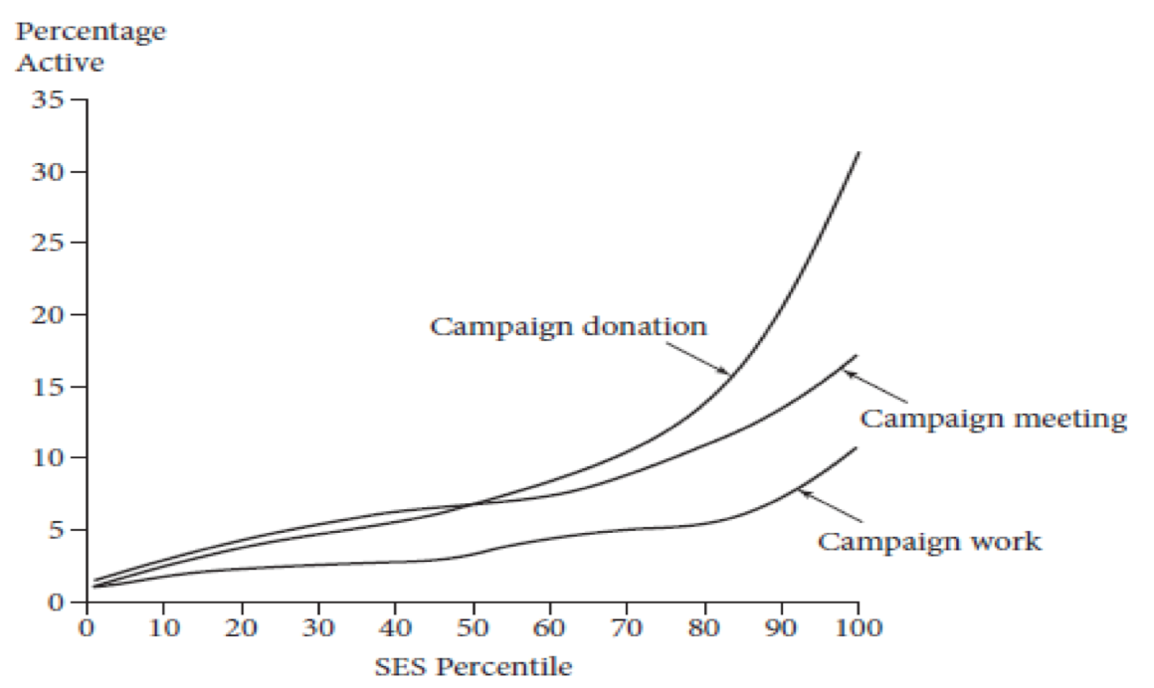

Slide 32
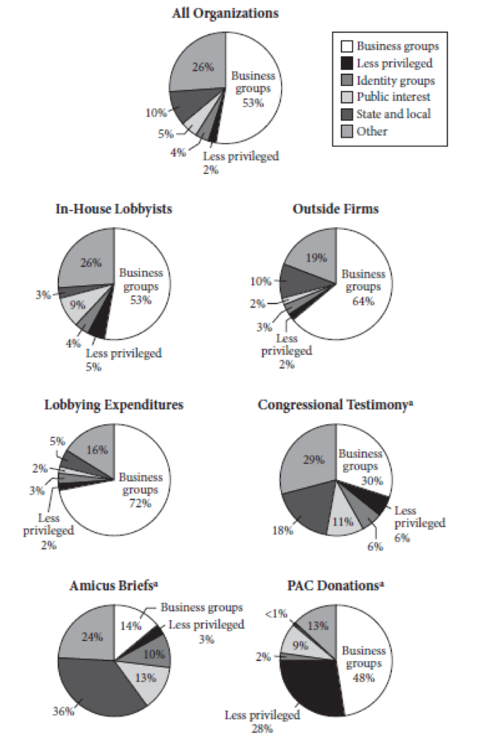
Organizations with lobbyists in DC
(before
Citizens United)
Organizational political participation is also unequal, compounding individual inequalities

Slide 33
And inequalities are persistent over time, socially and individually . . .
In 4 surveys spanning 1960 – 2008, “the average amount of political activity rises steeply across five quintiles of socioeconomic activity (SES).” Note: SES = educational attainment + family income
Intergenerational persistence: people whose parents were active politically are more likely to be active themselves
Impact of personal experience: individuals who are active at one time are more like to be active later in their lives

Slide 34
Why does it matter?
“where citizens were more active, there was stronger agreement between the public and political leaders on the most important issues facing the community.”

Slide 35
How does this work in Rio? Years after dictatorship, Perlman found:
Disappointment with Democracy
Corruption and Cronyism
Citizenship Rights and Duties Disconnect
Belief/Participation Disconnect

Slide 36
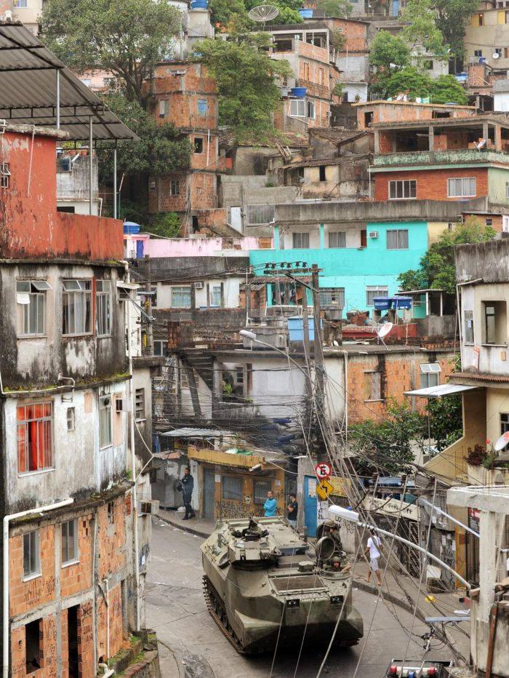
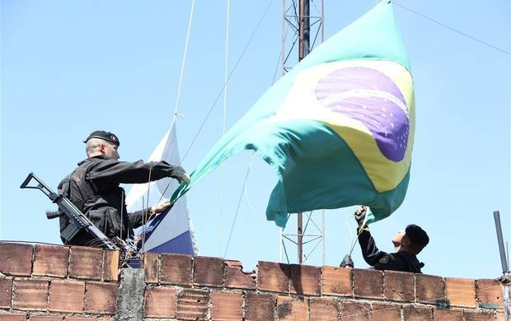
Democracy without democratic experiences -- Favela
Re-democratization and life in favelas
  Expectation that democracy would bring better quality of life
  Becoming citizens… with rights and responsibilities

Slide 37
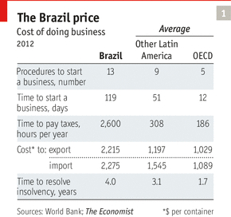
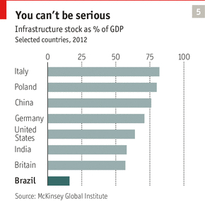
Yet…
Disappointment with Democracy
  the poor were not empowered
Corruption, clientelism and cronyism
  vested interests, drug lords & politicians
Citizenship, rights and duties
  Different citizenship for different people
Belief-behavior disconnect
  Belief in democracy, little political participation

Slide 38
Perlman: Which People Don’t Participate?
What is the relationship between democracy and citizen participation?
  What is the goal of democracy?
  What is the reality in favelas in Brazil?
  What hinders citizens’ participation?
    Democracy & nepotism
    Informal control (drug lords)
    Institutional incentives & belief
      Failure to vote and exclusion from government jobs, school and other benefits
      Belief, cynicism
      Social capital

Slide 39
Sidney Verba
AND, IN THE U.S.
“Political inequality begins in the family where the education of children begins, goes through the school system where you get differential education… It’s involved in the process of marriage. It’s involved in the process of getting a job. It’s involved in the organizations you belong to. So the inequality, those upward slopes, are not something put on us by a political elite; they are something that grows out of the very country and nature of the institutions in which we live, which is one of the reasons why it is very difficult to change.”

Slide 40
Where do we stand in the U.S.?

