Slide 1
What’s wrong with Arnstein?
Not contingent:
  Ladder states that “citizen control” is best – always, in every situation?
  Not (usually) possible under current law
Muddled:
  Mixes approaches that are never ok with approaches that are ok in some circumstances
  Informing is necessary – Manipulating is not ok
Not fine-grained enough:
  For planners, doesn’t give enough guidance about varieties of participation

Slide 2
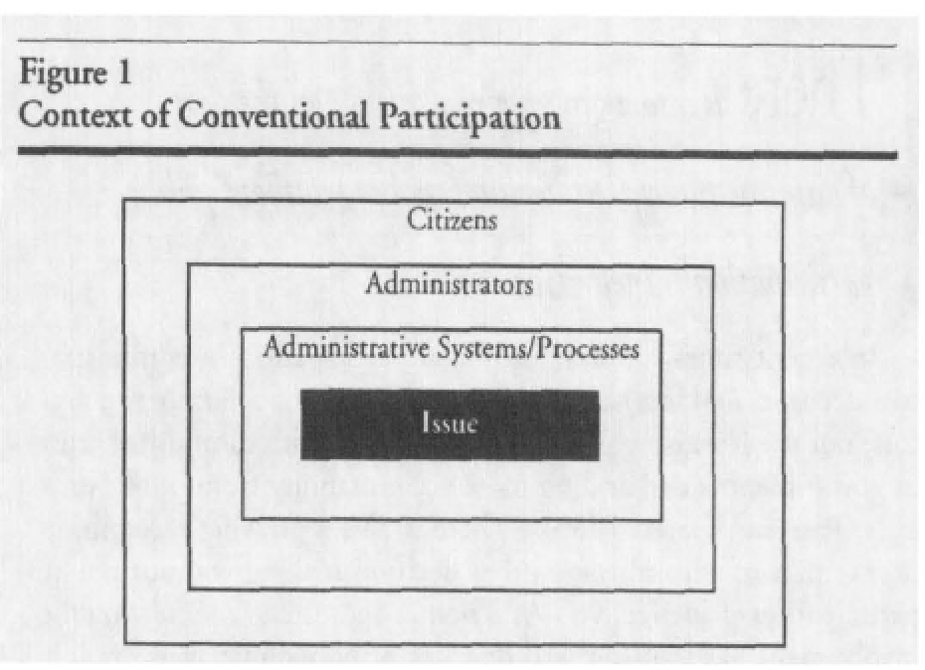
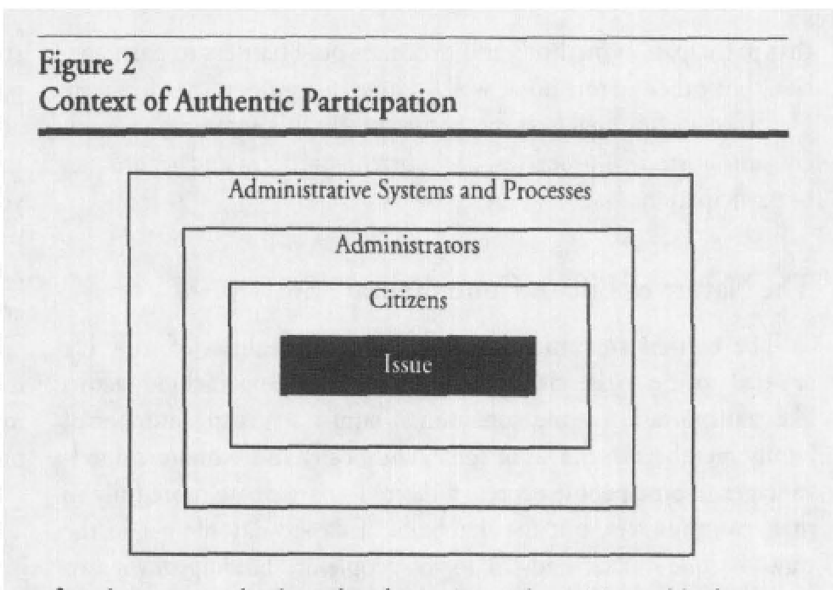
King, Feltey, Susel 1998
A later article presented a contrast of just 2 types of participation: Unauthentic or Authentic

Slide 3
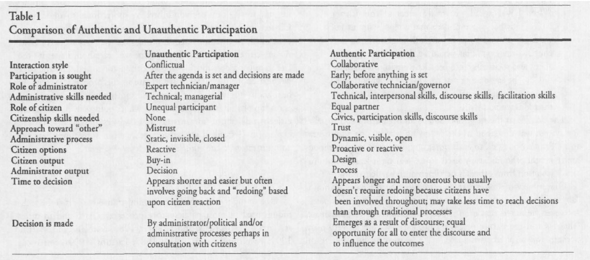
King, Feltey, Susel 1998

Slide 4
What I found in my dissertation interviews with planners:
Varieties of public participation
Manipulative: Predetermined outcome
Fake: Check-the-box input has no impact on outcome
Emergent: Planner-Focused
Emergent: Participant Focused

Slide 5
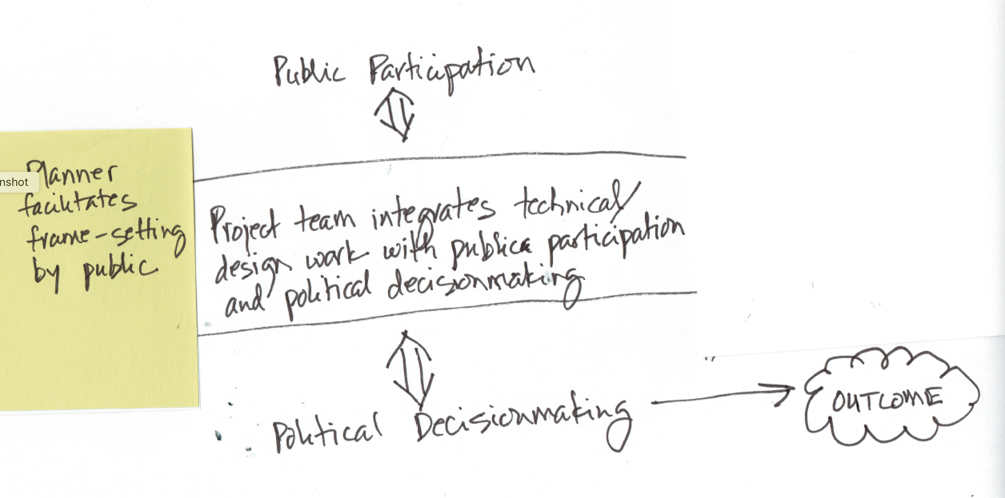
Varieties of public participation
Emergent: Participant Focused
Emergent: Participant Focused

Slide 6
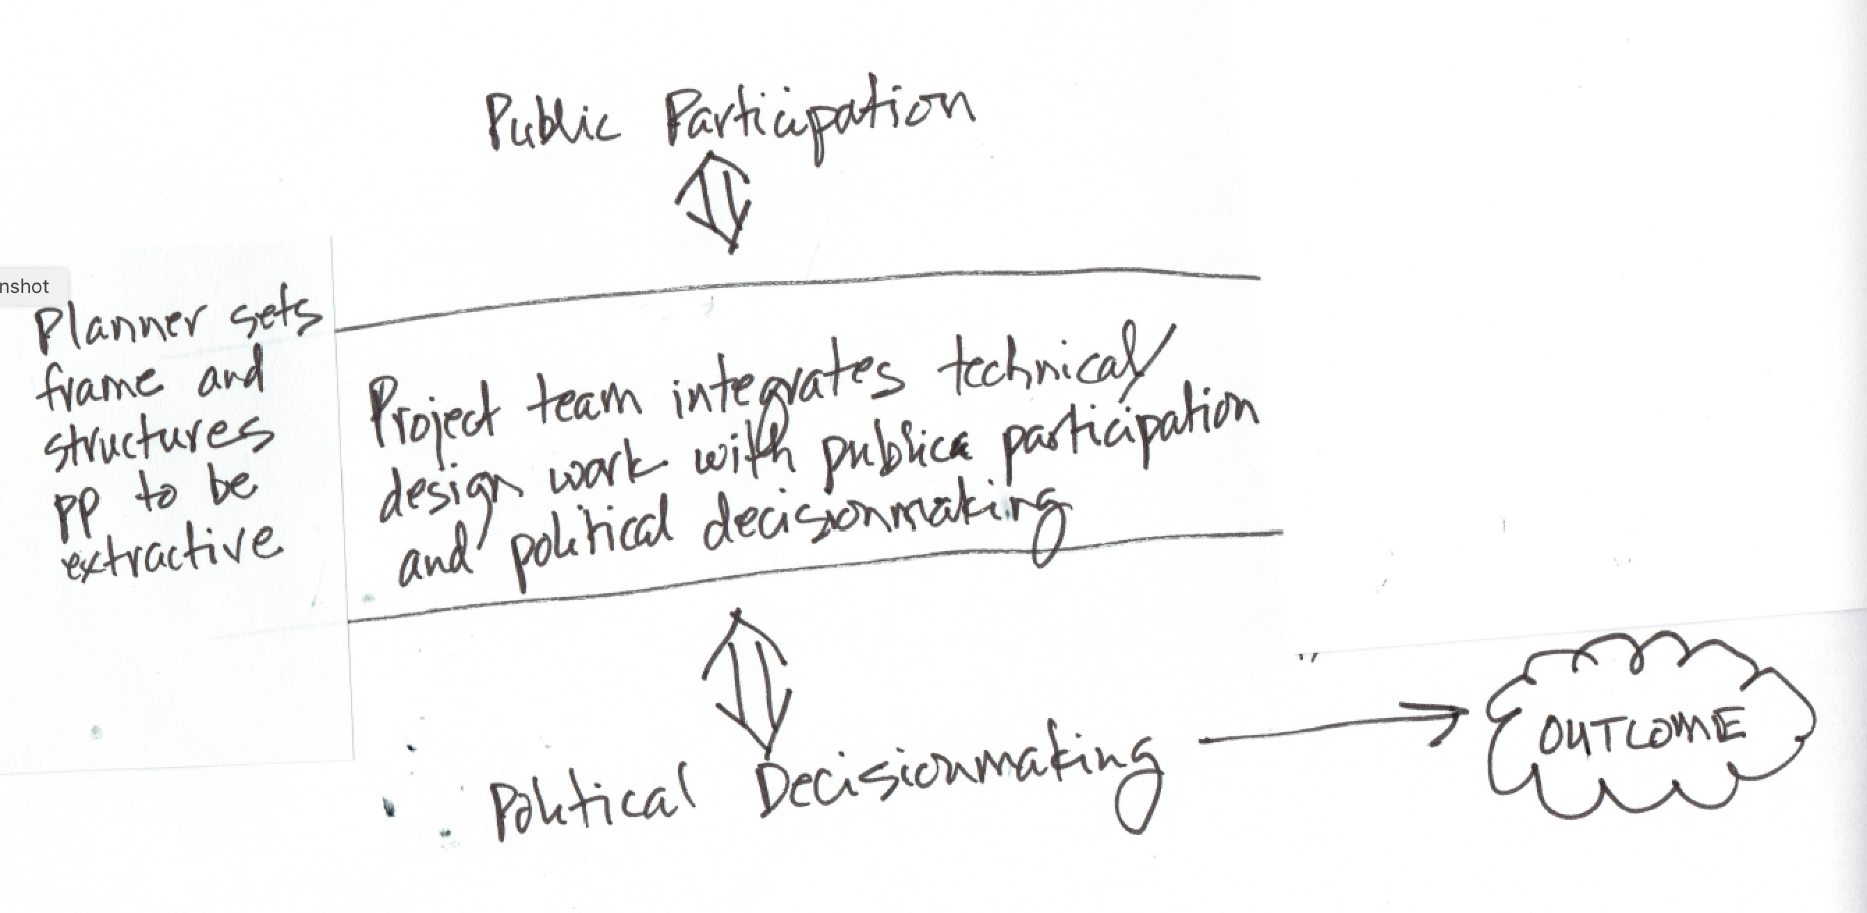
Varieties of public participation
Emergent: Planner Focused
Emergent: Participant Focused

Slide 7
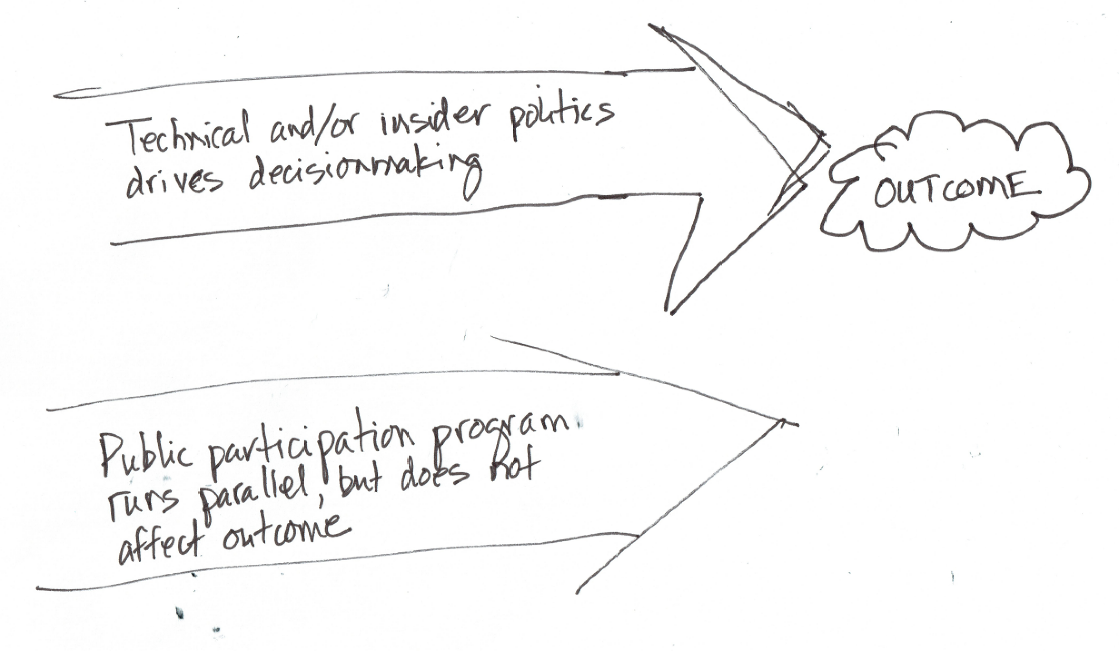
Varieties of public participation
Fake: No Impact
Emergent: Participant Focused

Slide 8
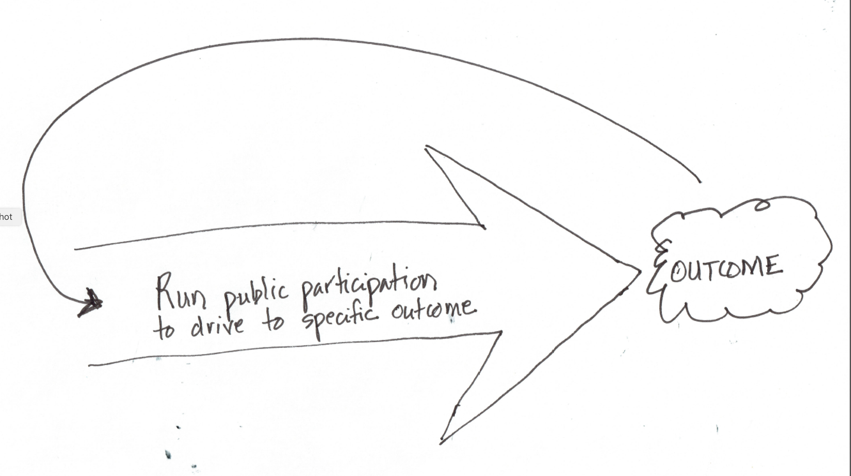
Varieties of public participation
Manipulative
Emergent: Participant Focused

