Slide 1
Modernism
German Modern Dance

Slide 2
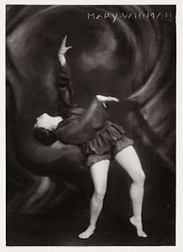
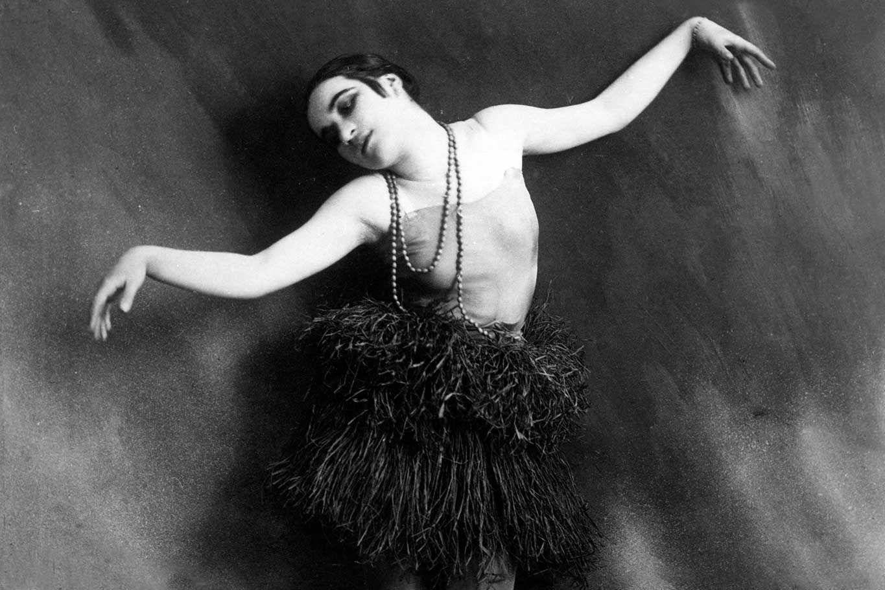
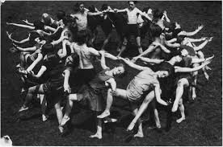
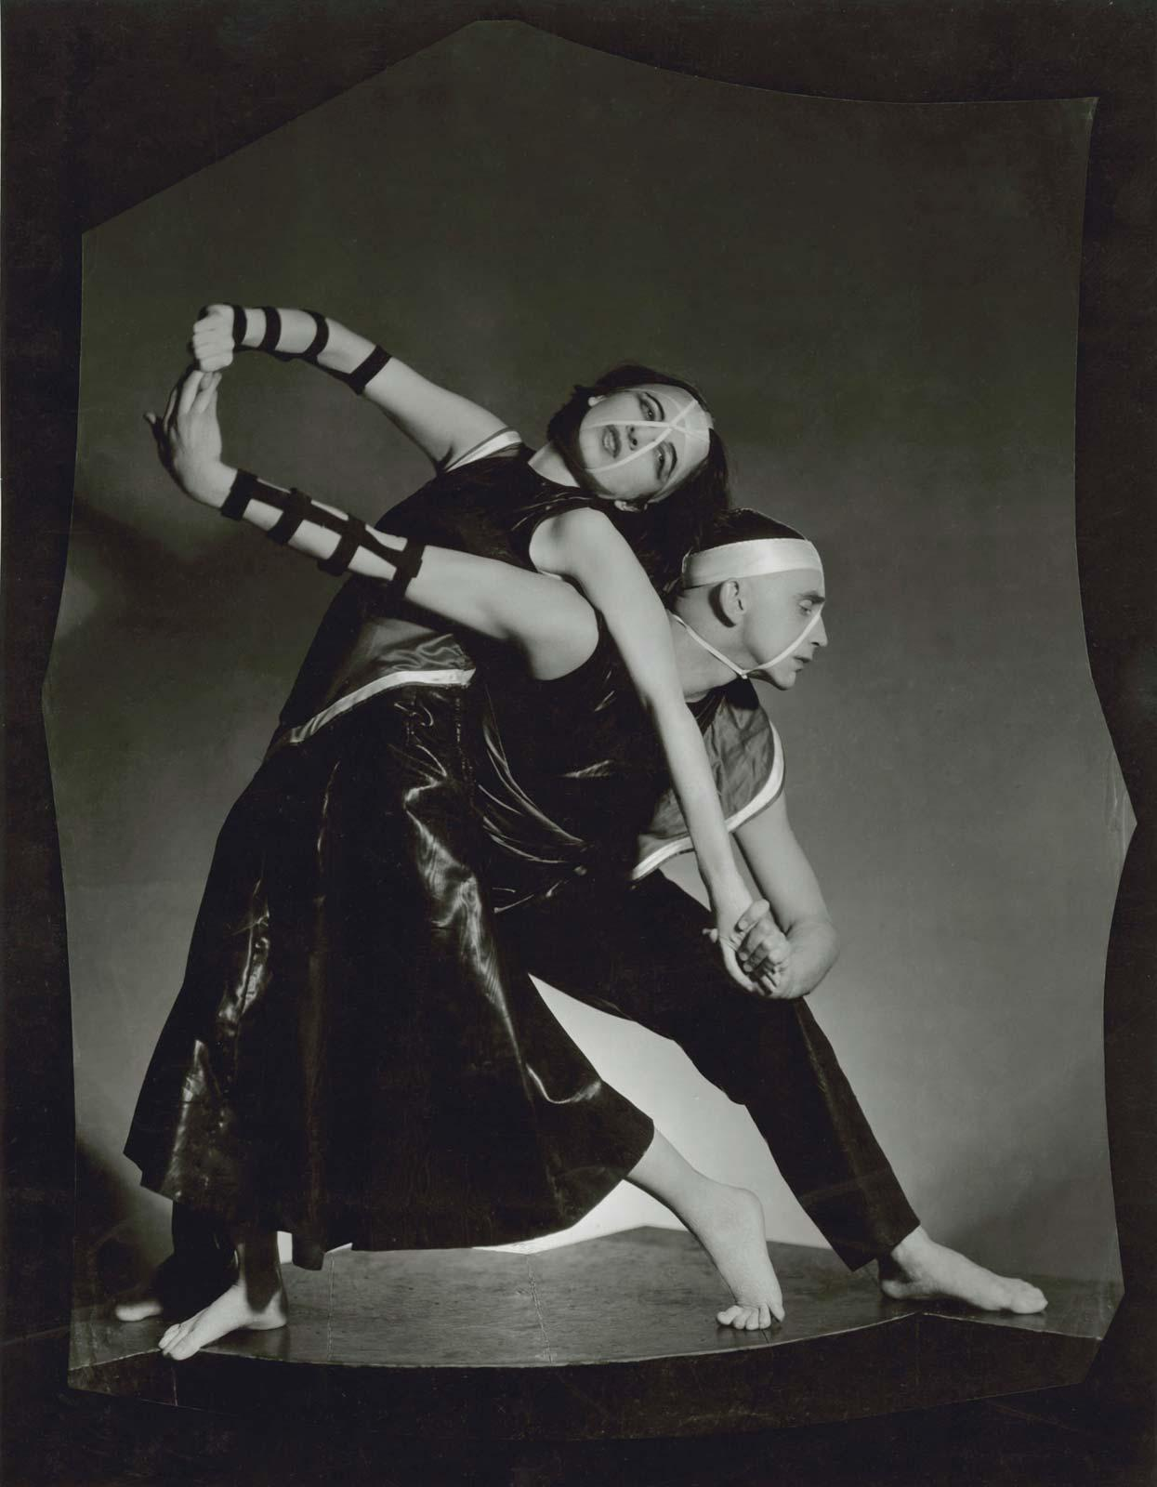
“A Break with the Past”
Modernity | culture
Modernism | Definition, History, & Examples

Slide 3
Germany
The Great War (aka World War I)
Weimar Era (cosmopolitan/cabaret)
Rise of Hitler: Facism/Nazism/National Socialism
The Second World War
1900s–1940s

Slide 4
Susan Manning and Melissa Benson: “Interrupted Continuities”
--written as a photo essay accompanying a U.S. museum exhibit in 1985 (before the fall of the Berlin Wall)
--historical forces affect/interrupt development of “modern dance” in Germany
--highlights of German modern dance before and after WW2:
Cultural context of development
Shared aesthetics, themes, approaches
Individual contributors and divergent visions

Slide 5
Ausdruckstanz
German Expressionism

Slide 6
German Expressionism/Ausdruckstanz
Cultural and sociopolitical influences
Major figures
Aesthetics
Purpose/self-definition
(Oskar Schlemmer/Bauhaus, Valeska Gert, etc: distinct from Ausdruckstanz’s focus on the body’s expressivity of emotion/feeling but also working with ideas of modernism, abstraction, and form)

Slide 7
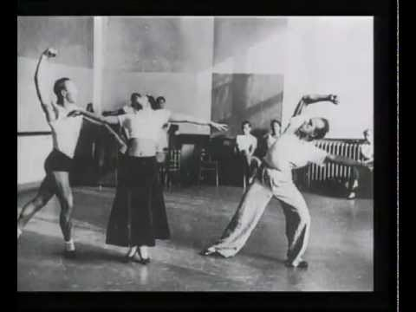
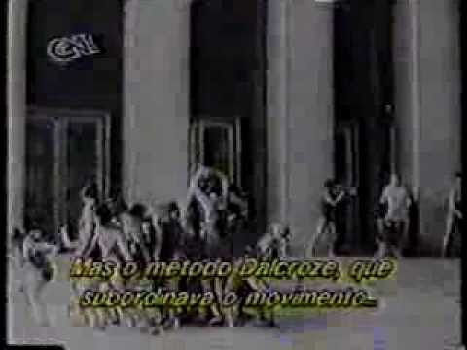
The Early Years: 1900s through the Second World War
Laban, Jooss, Wigman

Slide 8
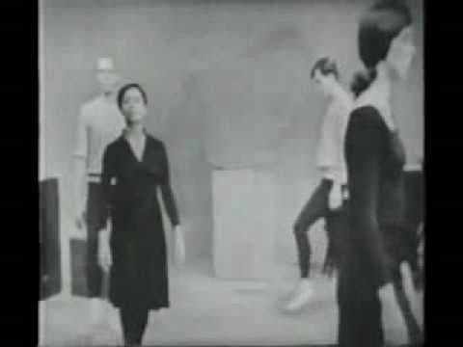
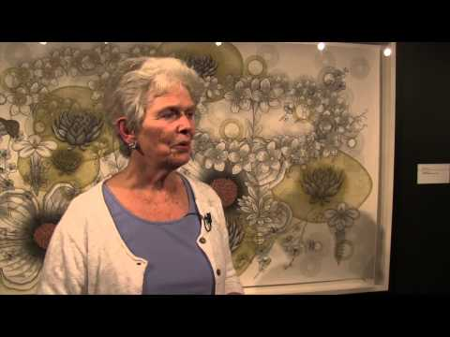
Dalcroze: Eurythmics

Slide 9
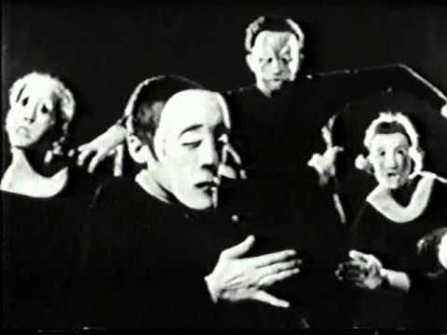
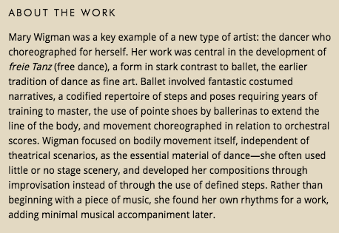
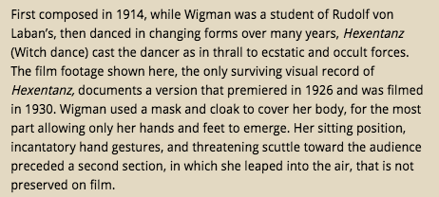

Mary Wigman (1886-1973)
https://www.moma.org/interactives/exhibitions/2012/inventingabstraction/?work=238

Slide 10
Mary Wigman: The Philosophy of Modern Dance

Slide 11
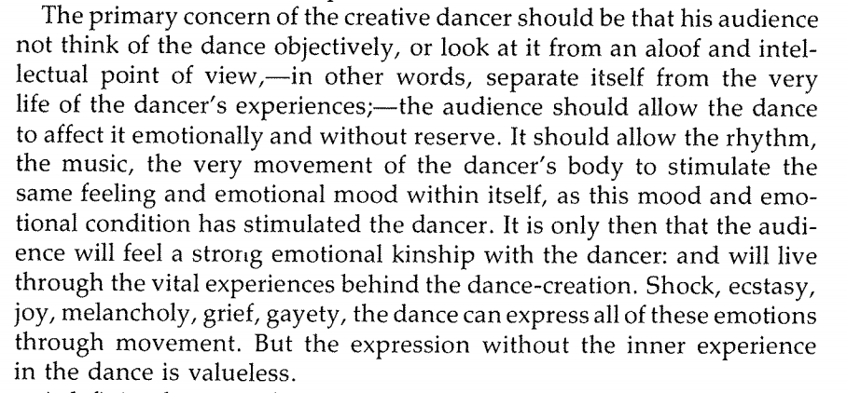

Slide 12
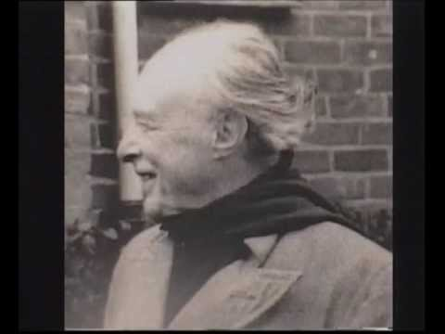
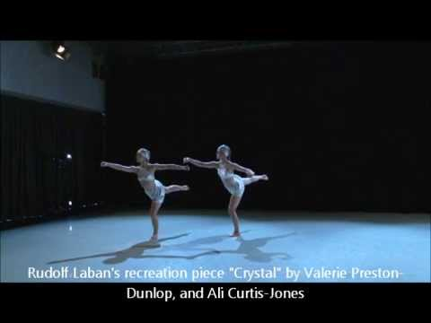
Rudolf von Laban
(1879 -1958)

Slide 13
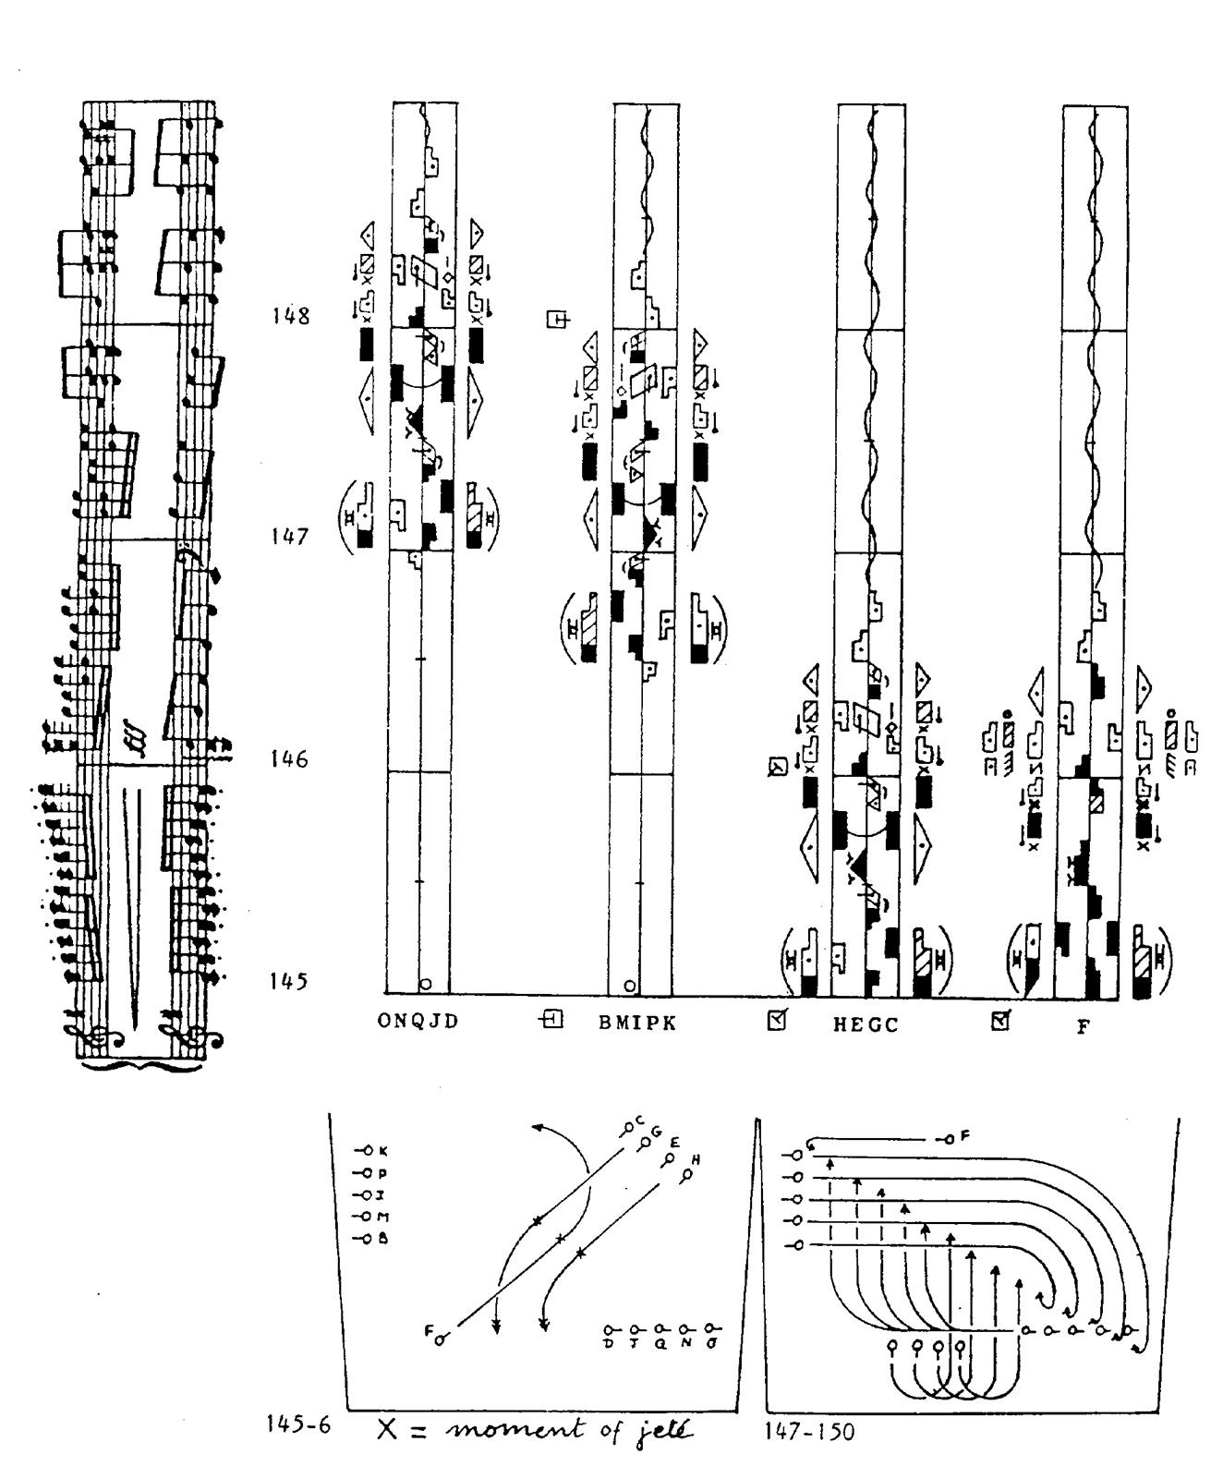
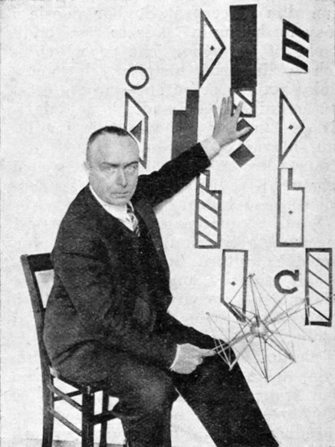
Labanotation

Slide 14
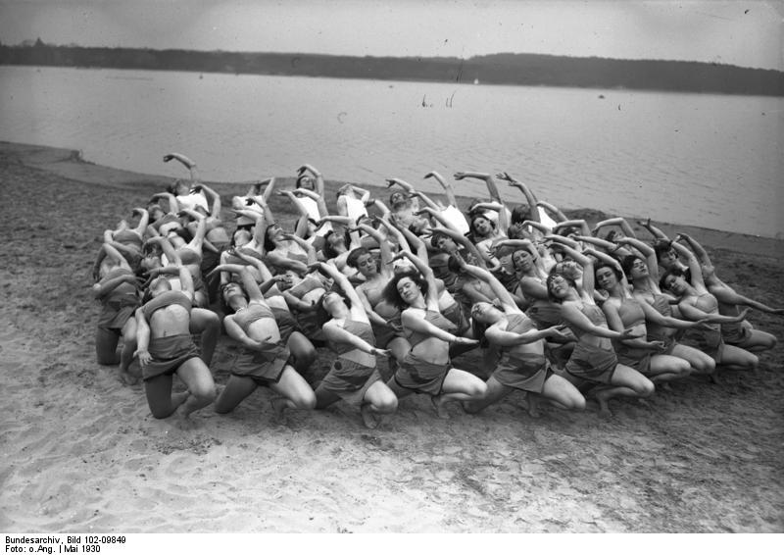
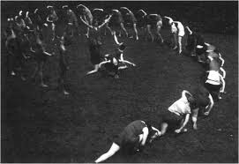
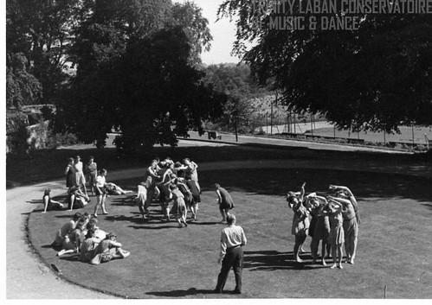
Movement Choirs

Slide 15
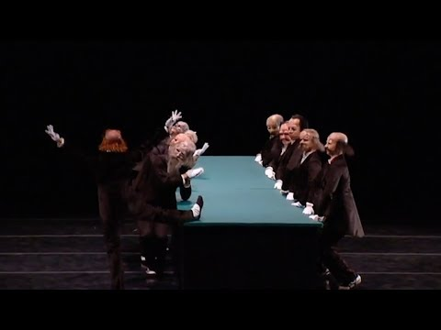
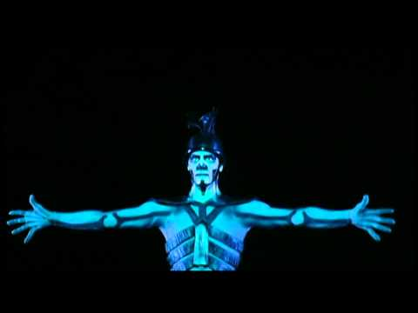
The Green Table (1932): Kurt Jooss

Slide 16
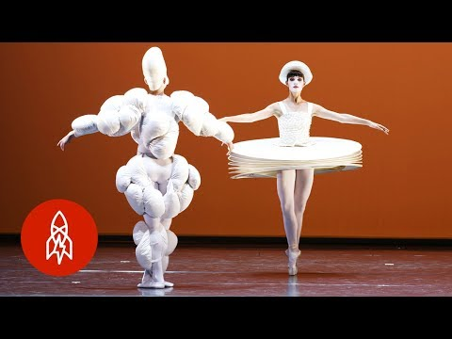
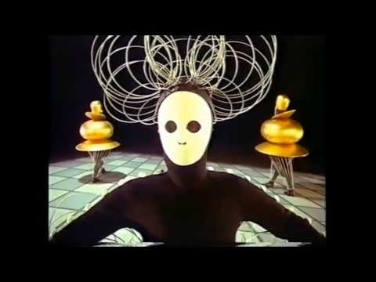
Oskar Schlemmer and the Bauhaus Dances

Slide 17
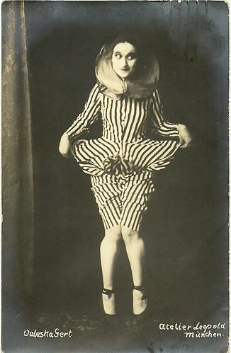
Valeska Gert
Tanzerische pantominen

Slide 18
Lineages/Traces of Ausdruckstanz
Susan Manning’s (2019) distinction between different ways that dance historians have organized the information/told the story about “modern dance”:
national and transnational frameworks
→ American modern dance via Hanya Holm
→ Japanese postmodern dance: “Butoh”

Slide 19
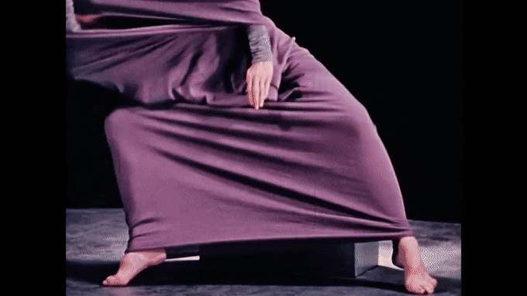
For Saturday:
“Modernism” in mid-century U.S modern dance
Read:
Susan Au (2020)
and
Ellen Graff (2004)

