Slide 1
“Modernism”
Modern Dance in the U.S

Slide 2
Historiography of Modern Dance
Susan Au (2003)
Ellen Graff (2004)

Slide 3
What is “modern dance”?
What is the purpose of modern dance?
Who/what is included and excluded in different definitions of “modern dance”?

Slide 4
Encyclopaedia Britannica’s entry
Modern dance
Modern dance, theatrical dance that began to develop in the United States and Europe late in the 19th century, receiving its nomenclature and a widespread success in the 20th. It evolved as a protest against both the balletic and the interpretive dance traditions of the time.
(Goes on to describe in detail some precedents, major figures, and approaches.)
Since its founding, modern dance has been redefined many times. Though it clearly is not ballet by any traditional definition, it often incorporates balletic movement; and though it may also refer to any number of additional dance elements (those of folk dancing or ethnic, religious, or social dancing, for example), it may also examine one simple aspect of movement. As modern dance changes in the concepts and practices of new generations of choreographers, the meaning of the term modern dance grows more ambiguous.

Slide 5
Susan Au
Ballet and Modern Dance,
2nd edition (2003)
“A straightforward narrative whose strength lies in the
author’s way of creating a seamless fabric of people and
activities that seem inevitable rather than accidental.”
-reviewer, Dance Research Journal
Susan Au was an archivist in the Jerome Robbins Dance Division at the New York Public Library for the Performing Arts, and a dance history researcher and author.

Slide 6
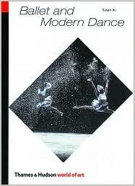
Truly Modern
Genealogy that traces “important” figures through shared training and larger thematic elements
Seeks to find cohesive way to explain multiple approaches and aesthetics

Slide 7
Susan Au’s summary at the end of “Truly Modern”
Modern dance of the 1930s and 1940s truly lived up to its name. It embodied many of the complexities and contradictions of the modern world. It was forward-looking and propounded visions of the ideal society with a crusader’s zeal, but it could also be introspective, intensely personal, and engrossed with the past. It confronted the grim realities of life, but also found places for lyricism and humor. It sought to express the American heritage, yet it also recognized the ethnic diversity of Americans and tried to convey this too through dance. Despite the diversity of its characteristics and purposes, however, modern dance was unified by its emphasis on the expression of feelings through dance, as opposed to a purely decorative display of technique. (2003, 78)

Slide 8
Dance history: contextualized

Slide 9
Graff (2004)
Seeks to “understand the ideas and forces that helped shape the era, to identify specific approaches and elements that could be characterized as revolutionary, and most importantly, to provide a voice for dancers who were part of what is now a forgotten movement.”
(2004, 321)
Situates “modern dance” in larger social, cultural, and political contexts of New York City in the 1930s

Slide 10
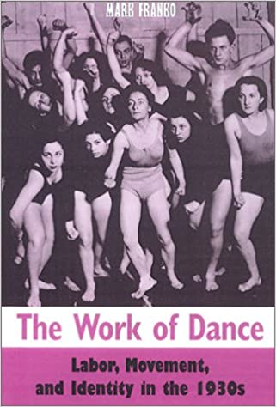
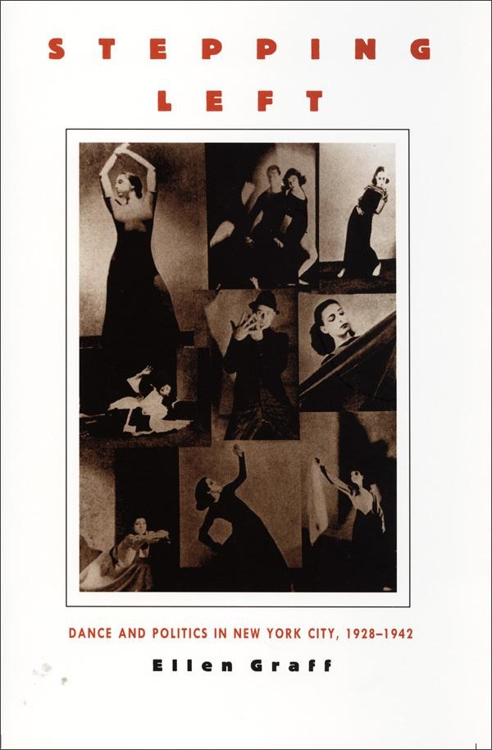
Revolutionary Movements: Dance and Politics
1930s through the 1940s
-Shifting historical contexts
-Shared ideals and strategies
-Social and aesthetic activism
-Dance “work” and “workers”
Graff (1997) and Franko (2003)

Slide 11
Workers Dance League/New Dance League
Founded 1932 by Anna Sokolow, Edith Segal, Miriam Blecher, and Nadia Chilkovsky
What are some of the central tenets of Communist ideology? What were the actions, institutions, and events used to spread their message? What is a union and what are its purposes? In the 1930s, who are the people who are pro- and anti-union? What about now?
What are the central concerns of the Workers Dance League? What were the actions and events used to spread their message? What is “agitprop”? If “culture is a weapon”, what is it supposed to fight? How? Is it effective?
What was the central debate within dance communities in the 1930s? What role did critic John Martin play in this debate? What does the author, Ellen Graff, conclude after her research into the period?

Slide 12
Citation of Sources:
All biographical and career information about the following influential choreographers and institutions is from the Dance Heritage Coalition’s now defunct website, “100 Dance Treasures.” Each entry was written by an expert in the field (including journalists, critics, historians, and dance scholars) and includes photographs, links to video, and links to archival and secondary sources.

Slide 13
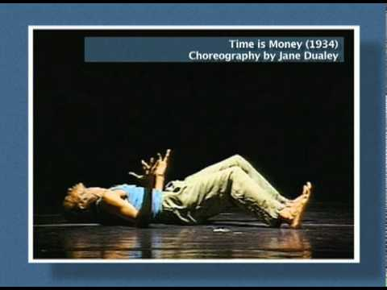
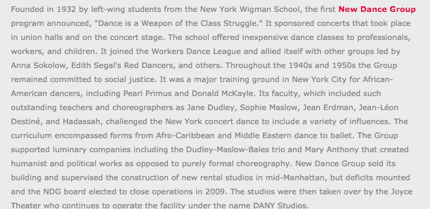
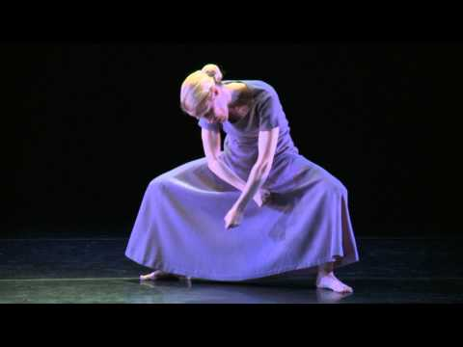
New Dance Group...
and its Lineages

Slide 14
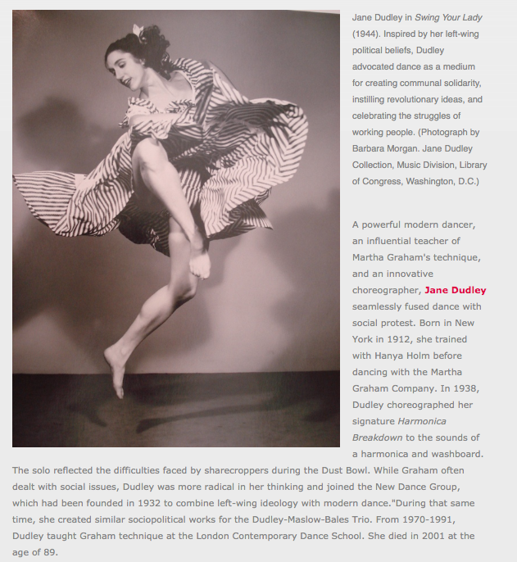
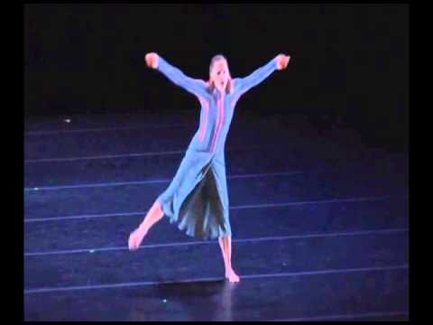
Jane Dudley (1912-2001)

Slide 15
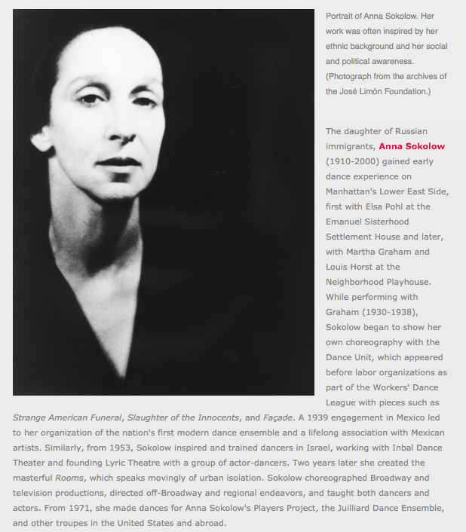
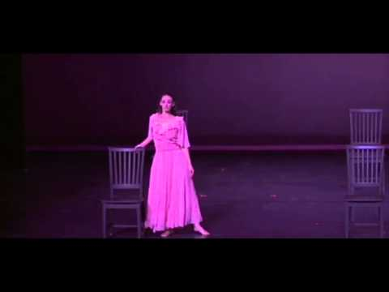
Anna Sokolow (1910-2000)

Slide 16
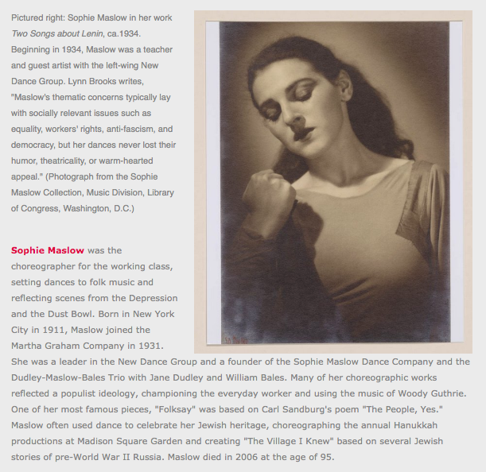
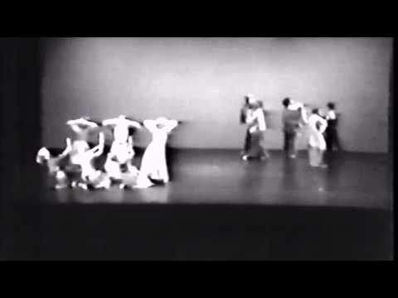
Sophie Maslow
(1911–2006)

Slide 17
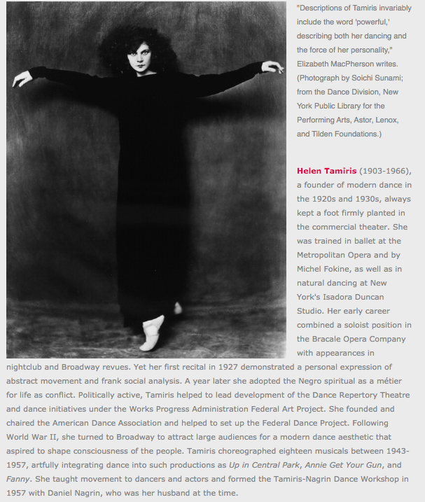
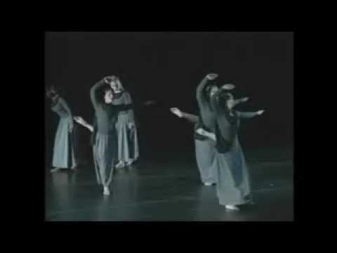
Helen Tamiris (1903-1966)

Slide 18
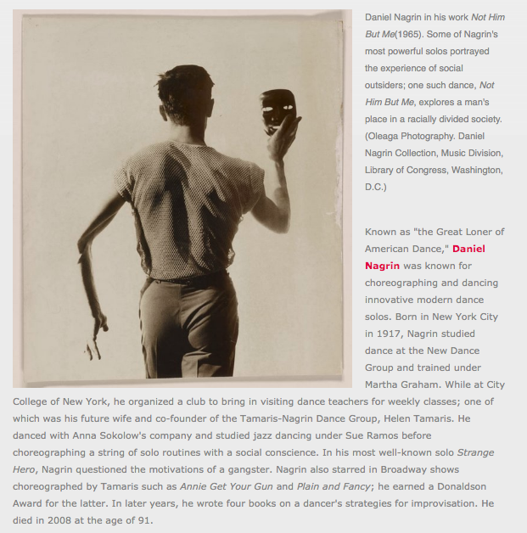
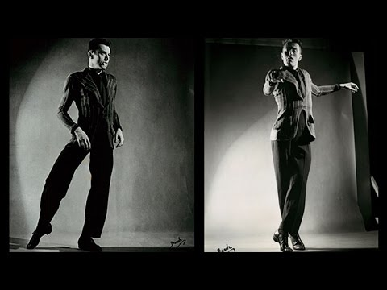
Daniel Nagrin (1917-2008)

Slide 19
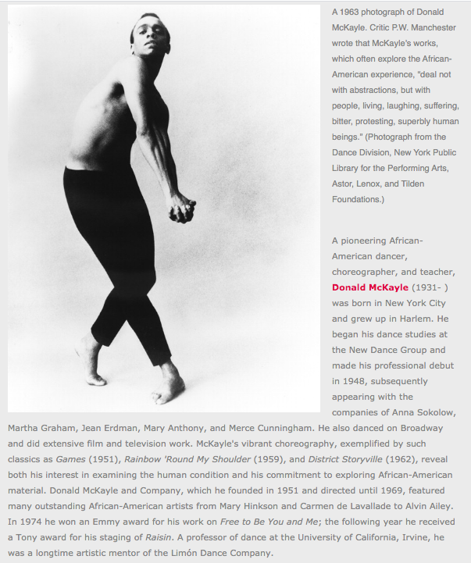
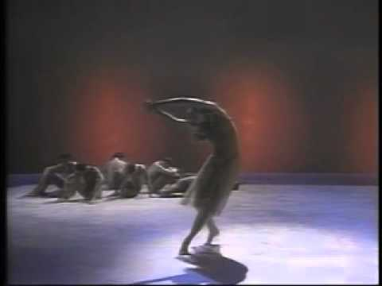
Donald McKayle (1931–2018)

Slide 20
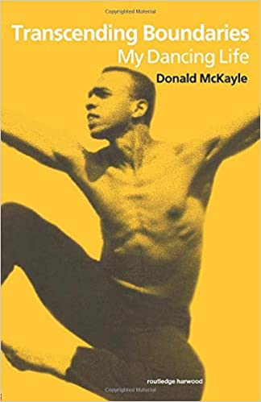
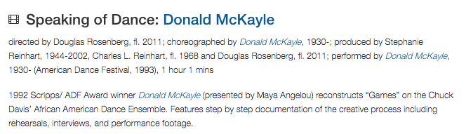


Slide 21
Major Figures and Institutions of
“Modern Dance” in the US

Slide 22
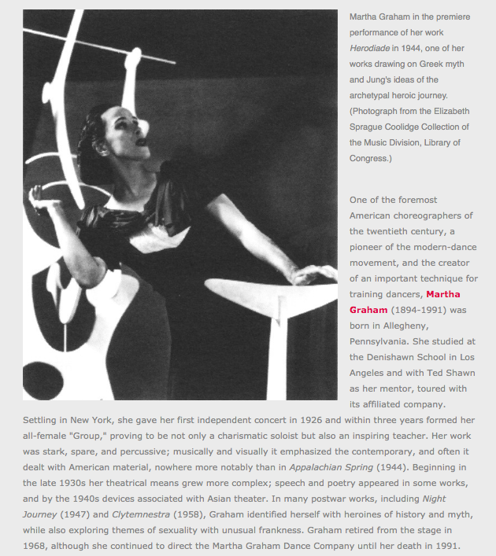
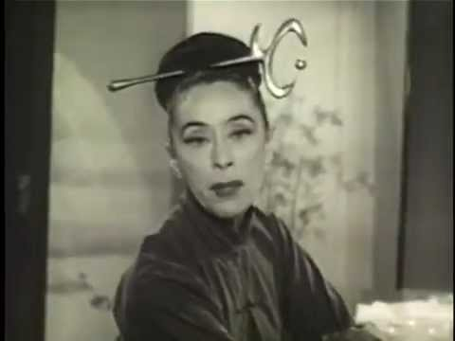
Martha Graham (1894–1991)

Slide 23
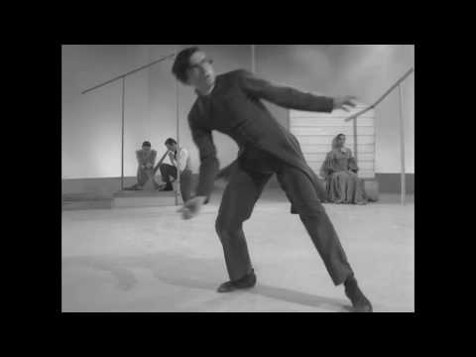
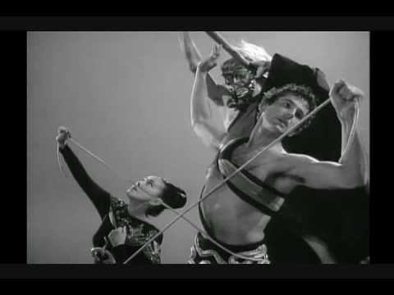
Appalachian Spring (1944), Night Journey (1947)

Slide 24
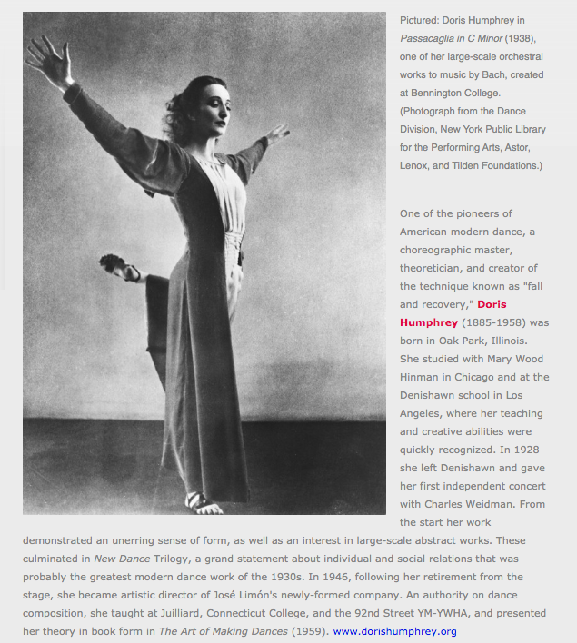
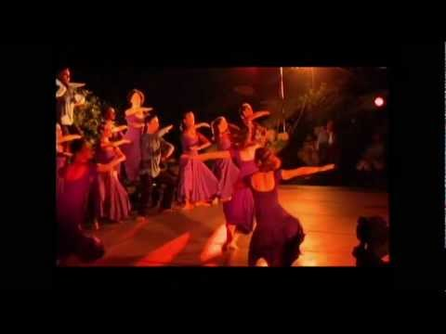
Doris Humphrey (1885–1958)

Slide 25
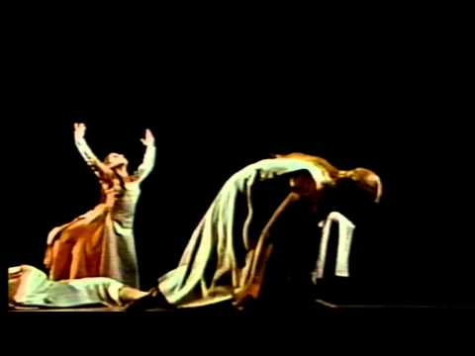
New Dance (1947)
Charles Weidman and Doris Humphrey

Slide 26
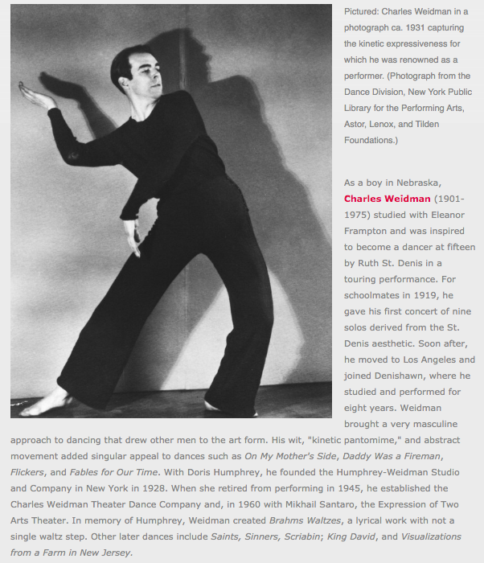
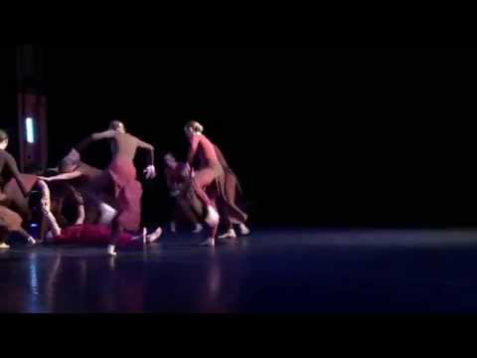
Charles Weidman (1901–1975)

Slide 27
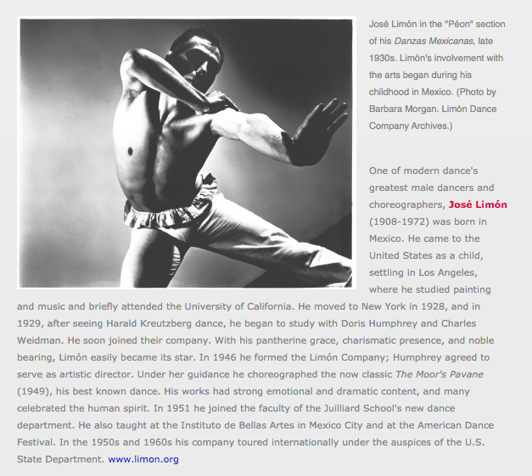
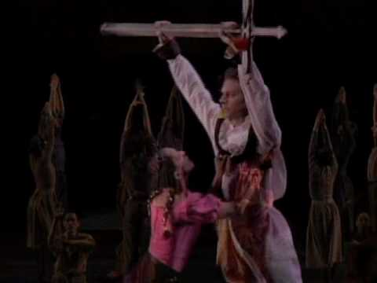
Jose Limon (1908–1972)

Slide 28
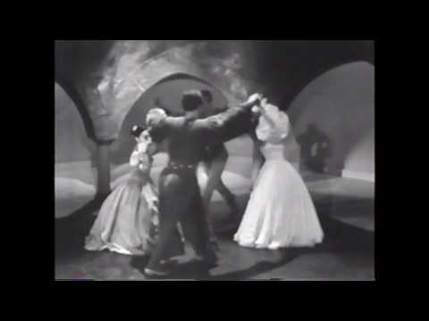
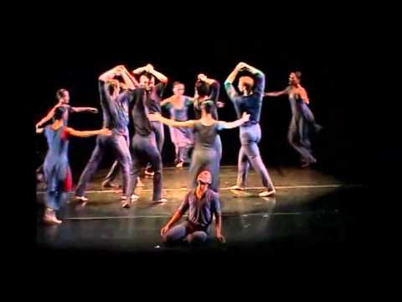
The Moor’s Pavane (1949) Psalm (1967)

Slide 29
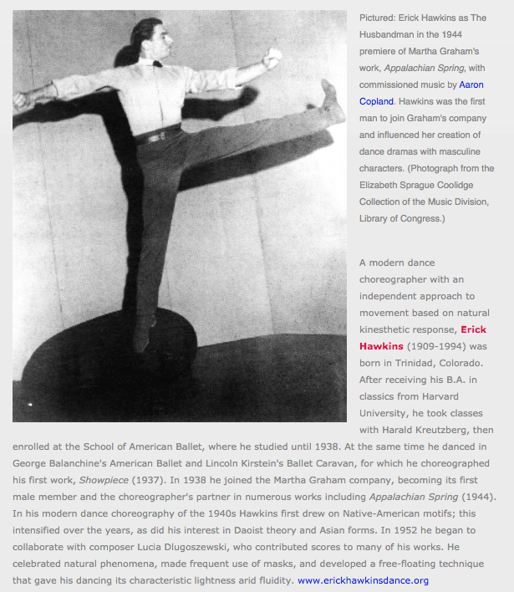
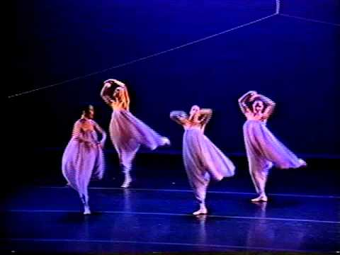
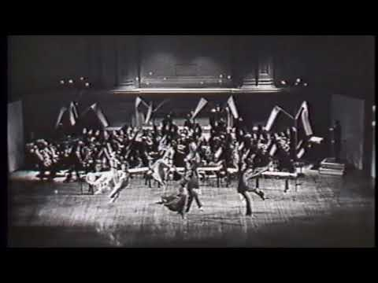
Erick Hawkins (1909–1994)

Slide 30
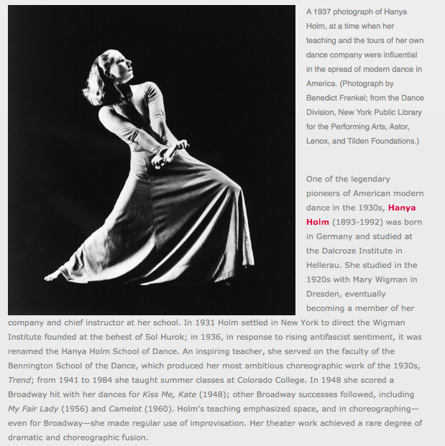
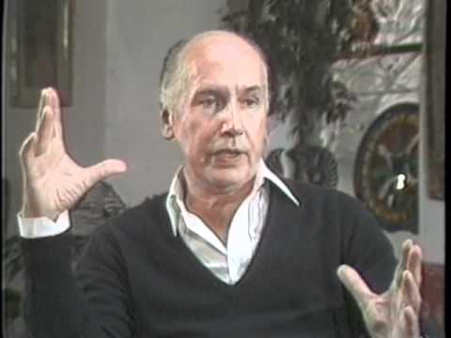
Hanya Holm (1893–1992)

Slide 31
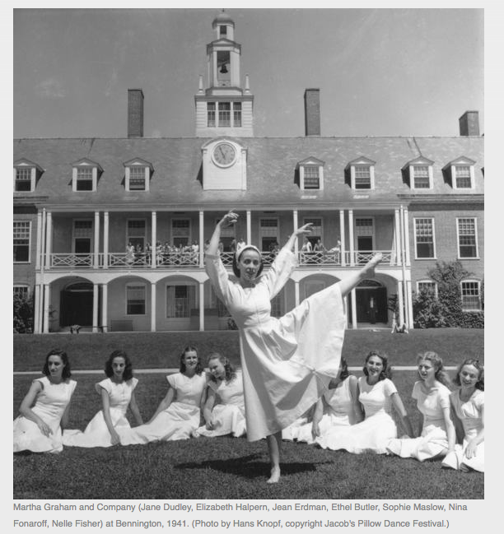
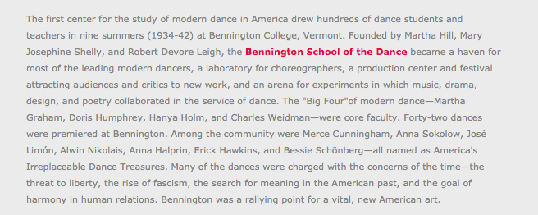
Bennington School of the Dance

Slide 32
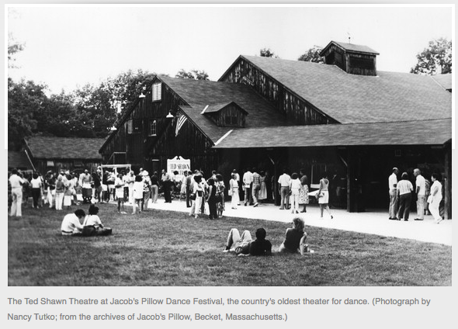
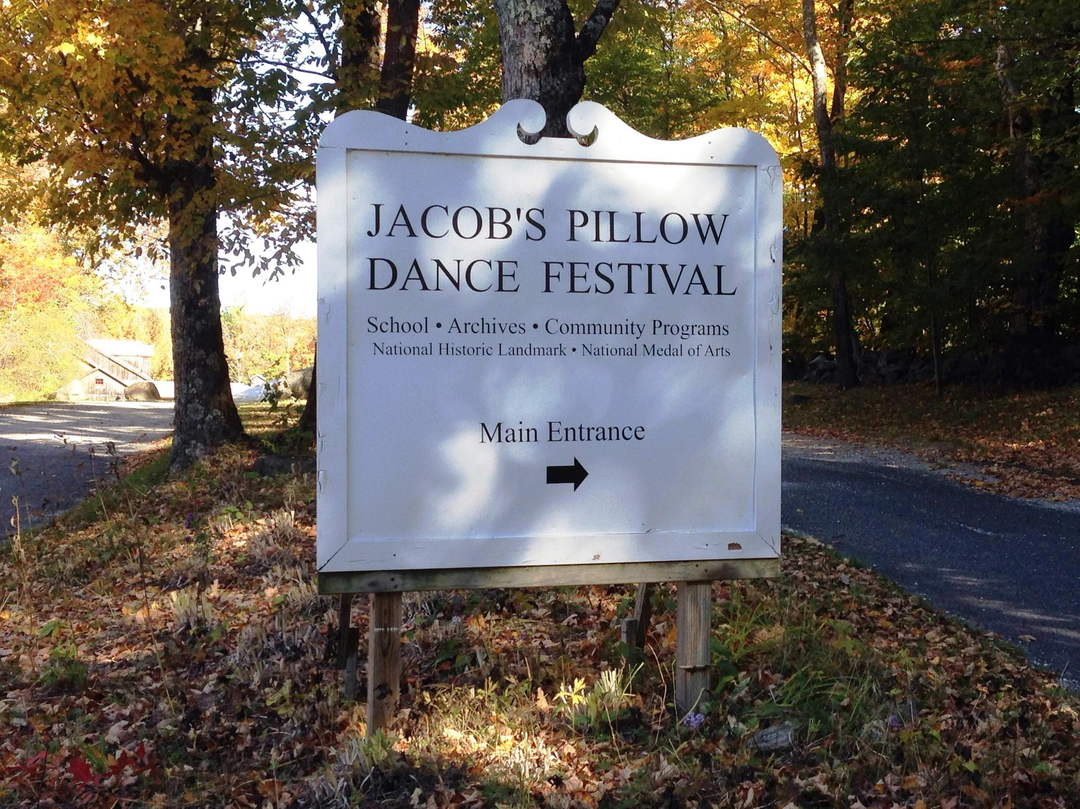
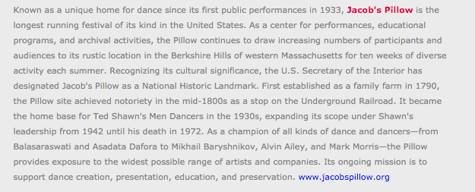
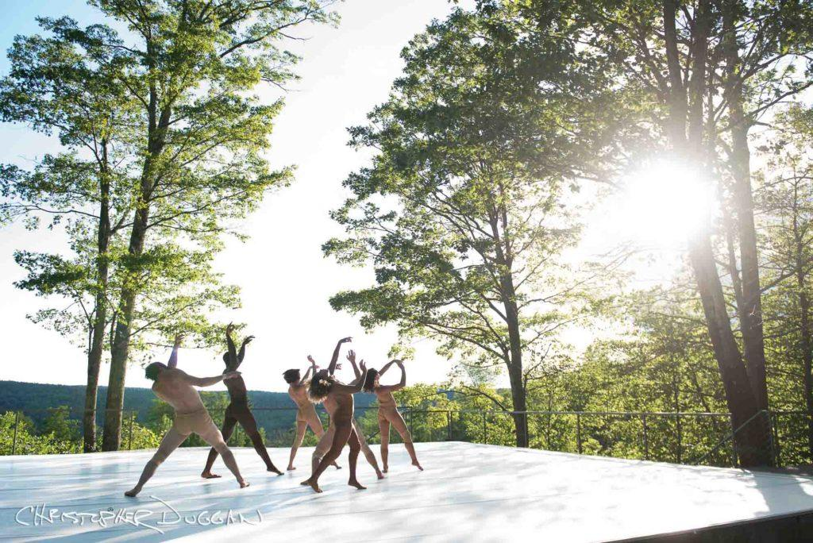
Jacob’s Pillow,
est. 1933

Slide 33
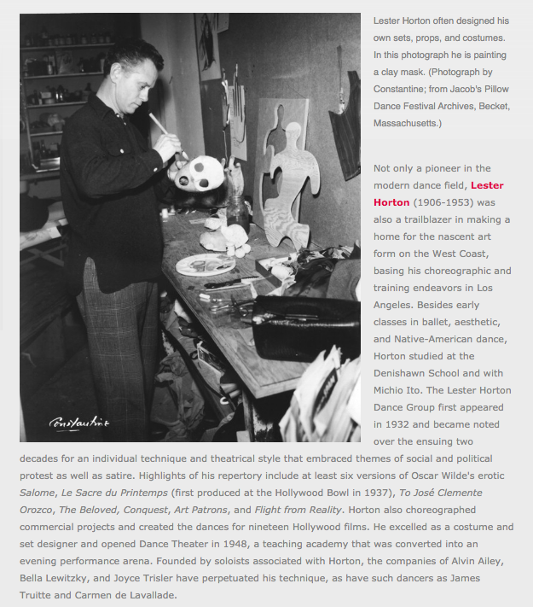
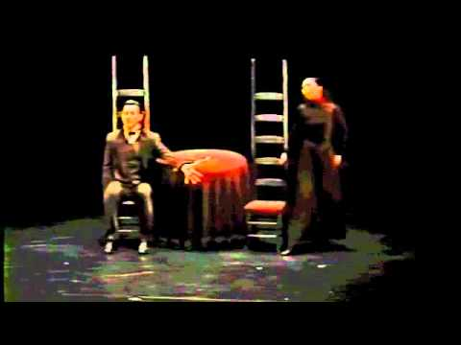
Lester Horton (1906–1953)

Slide 34
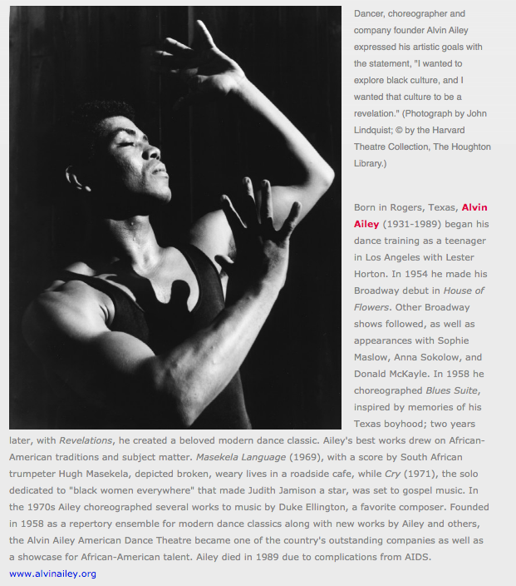
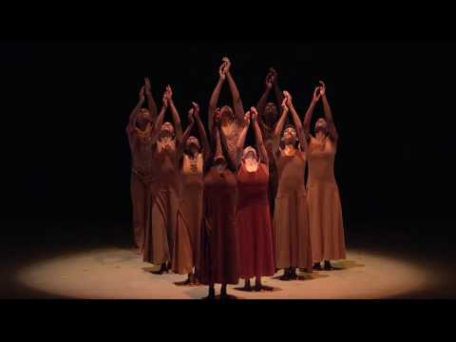
Alvin Ailey (1931–1989)
Alvin Ailey: A History

Slide 35
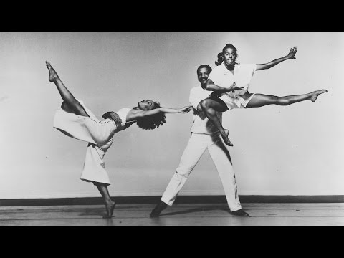

Slide 36
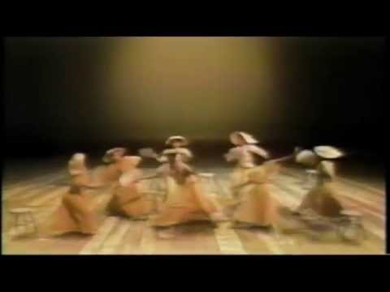

Revelations (1960) Blues Suite (1958)

Slide 37



/

Slide 38




Slide 39


Paul Taylor (1930–2018)

Slide 40


Slide 41


Merce Cunningham (1919-2009)

Slide 42


Slide 43

In modern dance, what is abstracted? How?

Slide 44
For Wednesday:
Read: Burt (1995) “Men, Modernism, and American Modern Dance.” 99-129.
Listen: PillowVoices podcast (2020). “A Study of Jose Limon: Artist and Immigrant.” 15 min.

Slide 45
Dance, Politics, and Activism in the Black Tradition
Dance, Politics, and Activism in the Black Tradition

Slide 46


New Negro
Art Theatre
Dance
https://www.thirteen.org/freetodance/timeline/timeline3.html

Slide 48

/

Slide 49



Talley Beatty
(1918–1995)
https://danceinteractive.jacobspillow.org/themes-essays/african-diaspora/talley-beatty/

Slide 50



Slide 51
Donald McKayle (1931–2018)

Slide 53


Eleo Pomare (1937–2008)

Slide 54



Geoffrey Holder (1930–2013)

Slide 55


Recreating Katherine Dunham’s Southland (1951)

