Slide 1
Podcasting and Video Stories
Virtual Intensive
October 21 – November 11, 2020

Slide 2
Digital Competencies
2.3 Audiovisual analysis and production
Developing this competency involves:
  Learning and using a range of methodologies to critically analyze images, film, audio recordings, animations, and other audiovisual “texts” and how they are used.
  Learning to effectively communicate ideas using audiovisual media (podcasts, video, etc.) and techniques (e.g. digital story-telling).
  Becoming familiar with and comfortable using a range of tools for publishing and sharing digital audiovisual content, and learning to identify those most appropriate to given audiences, topics, and content.
  Learning to format and optimize audiovisual media for sharing via different print and digital platforms.
  Learning how to give credit to other’s creative work and original ideas using attribution conventions appropriate for audiovisual media

Slide 3
More Digital Competencies
1.1 Networks and file management
1.2 Metacognition and life-long learning
1.3 Troubleshooting
1.4 Managing digital identity, privacy, security
1.5 Strategic web and database searching
5.2 Design thinking
5.3 Project management

Slide 4
The Nature of Digital Narratives
While storytellers have composed narratives (historical, informative, persuasive, and/or reflective) through oral and print-based media for centuries, emerging technologies allow for an increasing array of possibilities to develop and share the narratives that matter to our communities and to us as individuals. Using digital text, audio, images, and video together with research and narrative composition strategies, this workshop will introduce students to the use of digital tools, techniques, and resources for composing successful digital narratives in a variety of contexts.

Slide 5
7 Elements of Digital Storytelling
The Center for Digital Storytelling in Berkeley, California developed and disseminated the Seven Elements of Digital Storytelling, which are often cited as a useful starting point as you begin working with digital stories.
1. Point of View
What is the main point of the story and what is the perspective of the author?
2. A Dramatic Question
A key question that keeps the viewer's attention and will be answered by the end of the story.
3. Emotional Content (Choice of Engaging Content)
Serious issues that come alive in a personal and powerful way and connects the audience to the story.
4. The Gift of Your Voice (Clarity of Voice/Authorial Presence)
A way to personalize the story to help the audience understand the context.
5. The Power of the Soundtrack (The Quality of All Multimedia Elements)
Music or other sounds that support and embellish the story.
6. Economy
Using just enough content to tell the story without overloading the viewer.
7. Pacing
The rhythm of the story and how slowly or quickly it progresses.

Slide 6
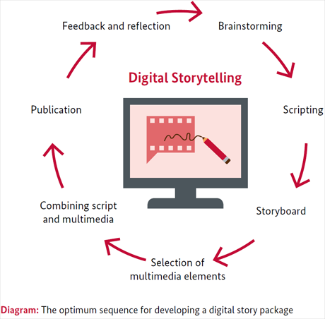
The Process is Iterative

Slide 7
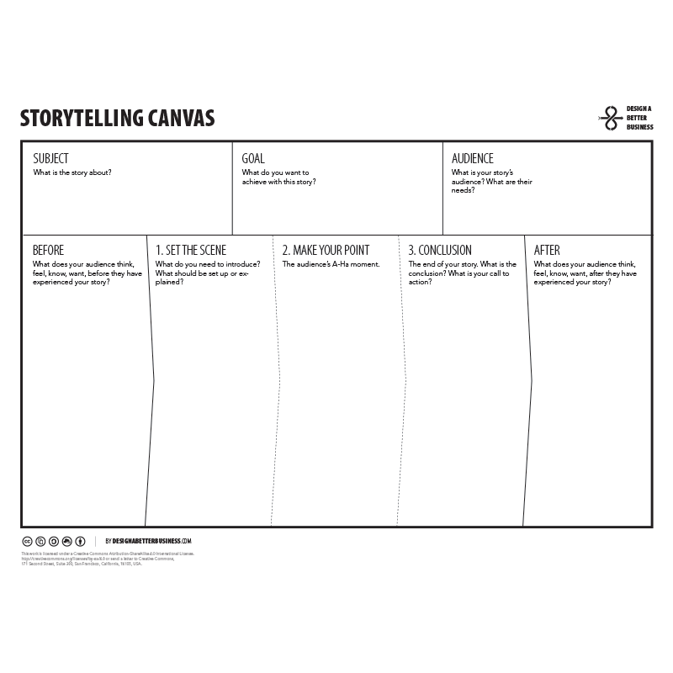
Brainstorming: Fill in Your Canvas

Slide 8
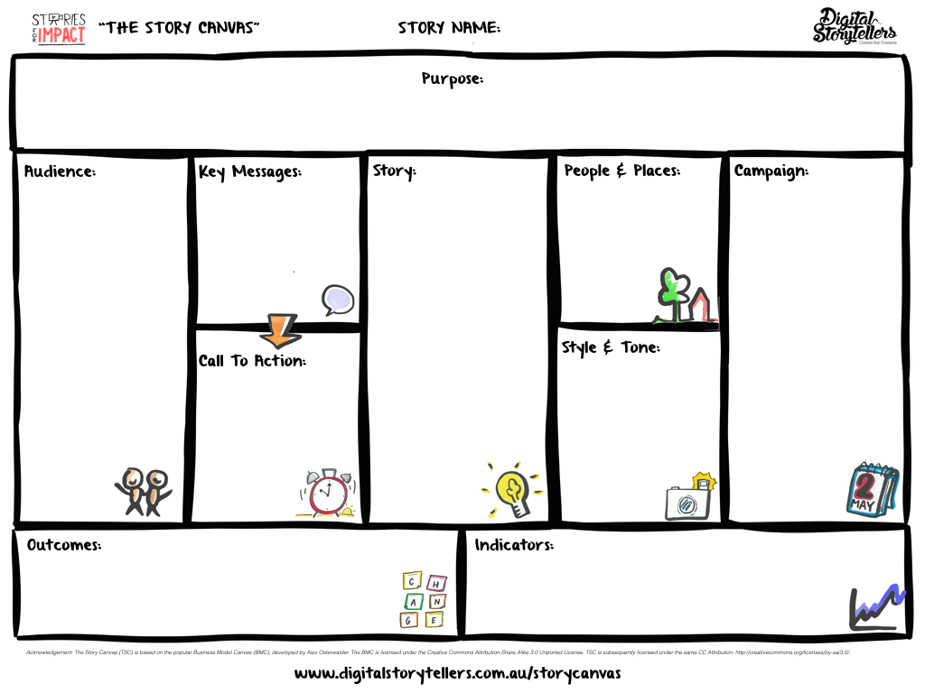
Brainstorming: Fill in Your Canvas

Slide 9
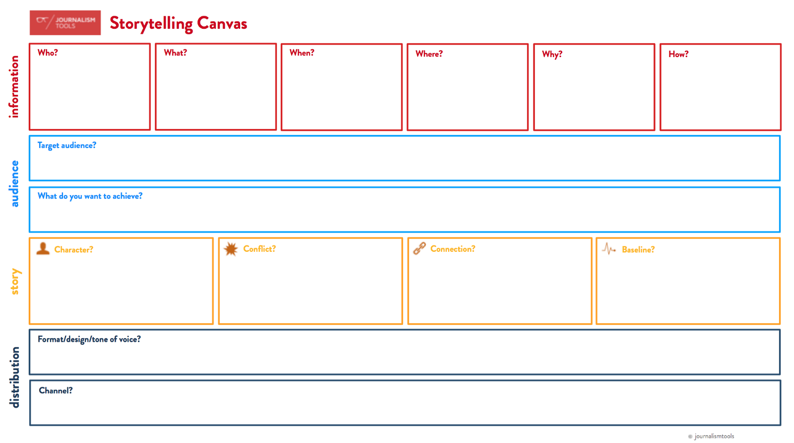
Brainstorming: Fill in Your Canvas

Slide 10
Breakout Room: ends at 1:25
Share a brief story idea with your partners – it doesn’t have to be the one you produce and share at the showcase on November 11.
Decide which canvas is most appropriate for the narrative you presented, or, if you’re not certain, how might the different canvasses change how you develop your story?

Slide 11
After today’s Zoom session…
View the “ENGAGE” slides, watching Anisa Ibrahim’s video “Still” during the activity. Post your reflections on its composition in the Moodle forum. Alternatively, you may attach a story canvas for “Still” to evaluate its design and effect.
Watch the LinkedIn Learning tutorial on digital audio recording with Audacity.
And don’t forget to go to…

Slide 12
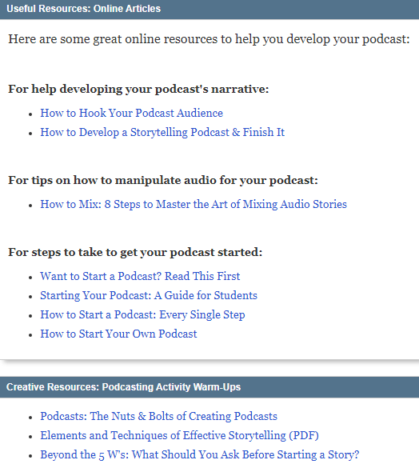
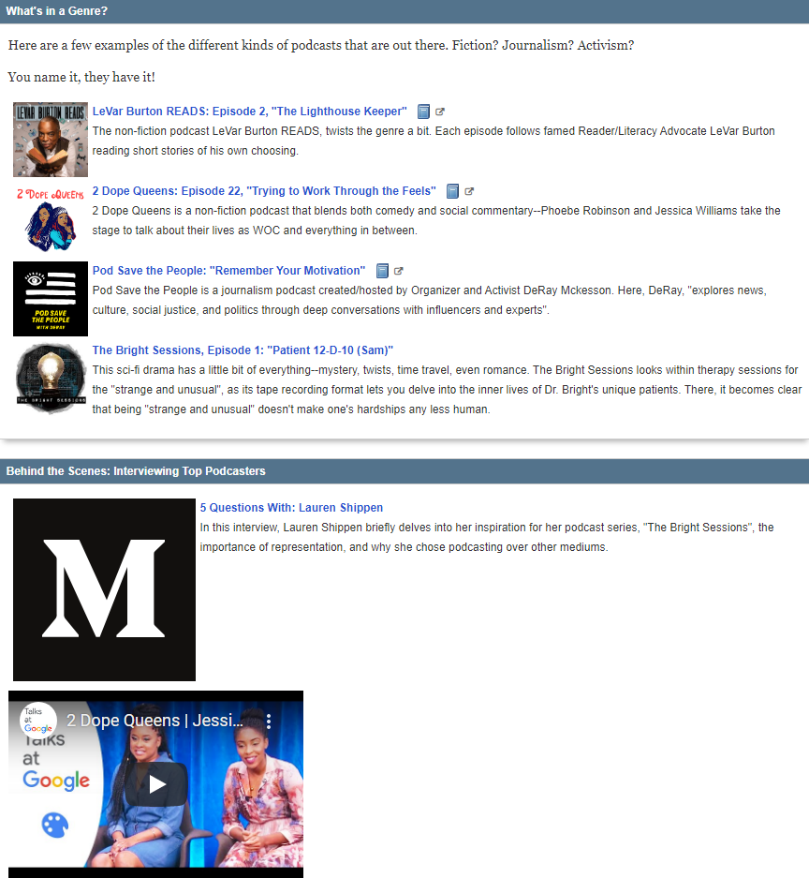
Podcasting 101: Tips and Resources

