Slide 1
Dancing Politics and Protest
Black Dance Traditions

Slide 2
Segregated histories?

Slide 3
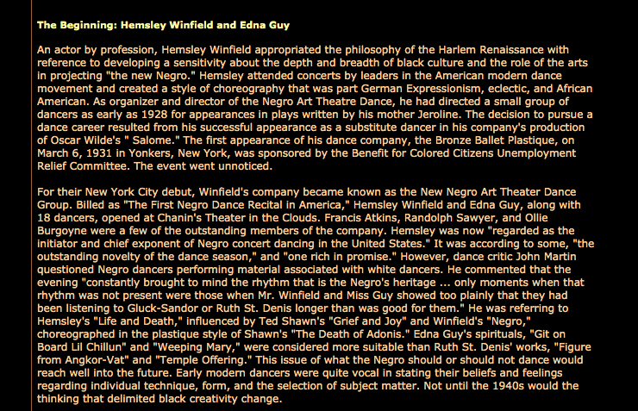
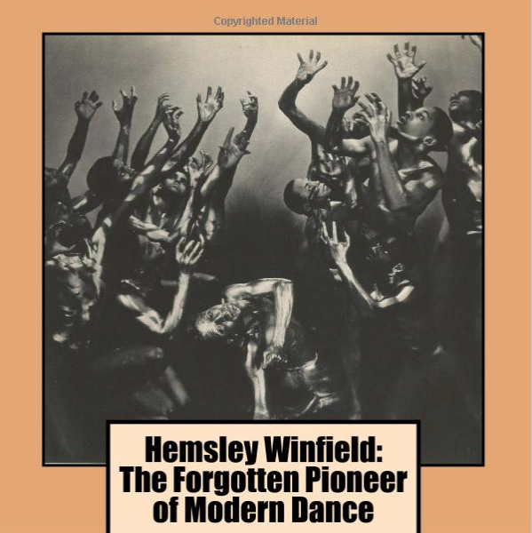
New Negro
Art Theatre
Dance
https://www.thirteen.org/freetodance/timeline/timeline3.html

Slide 4
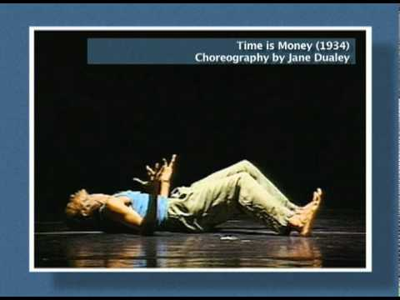
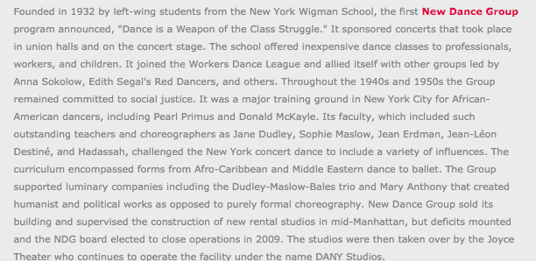
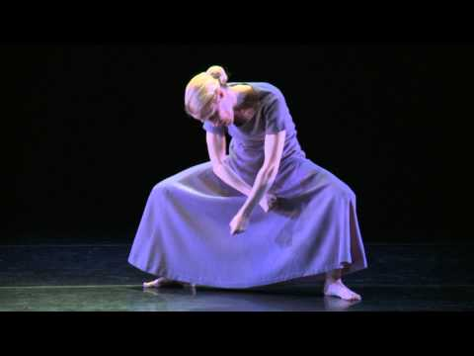
New Dance Group...
and its Lineages

Slide 5
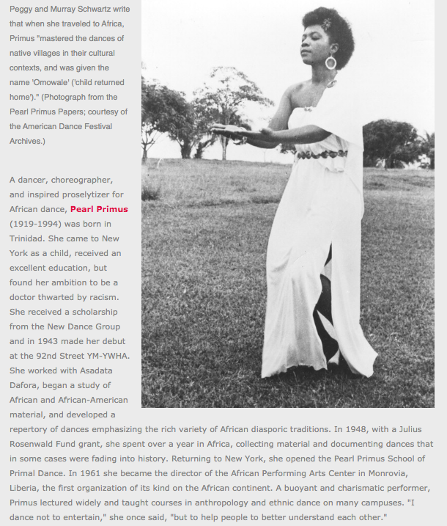
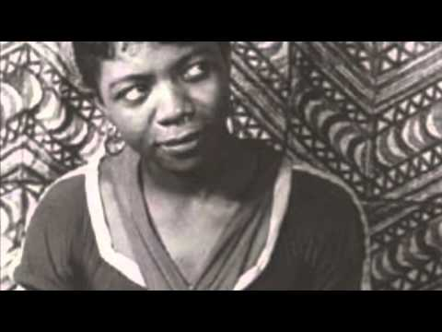
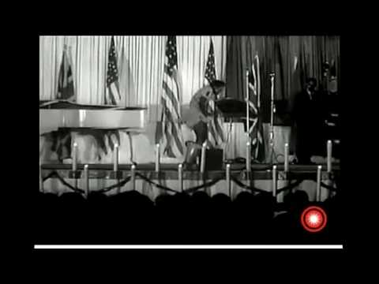

Slide 6
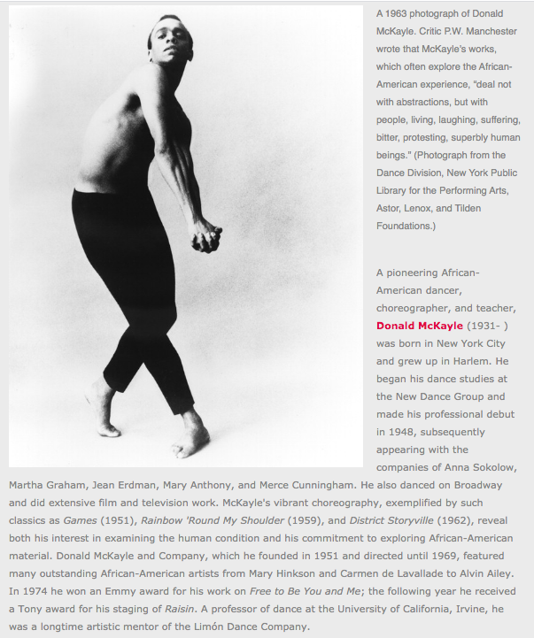
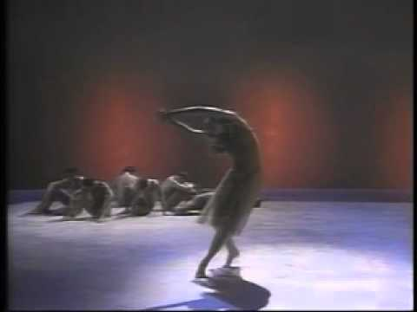
Donald McKayle (1931–2018)

Slide 7
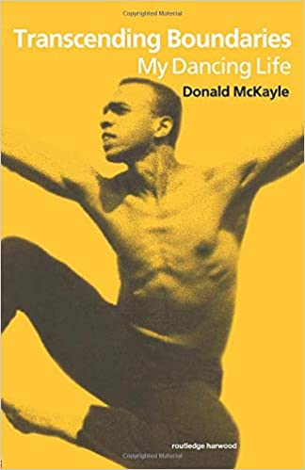
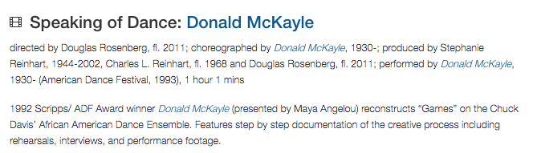


Slide 8
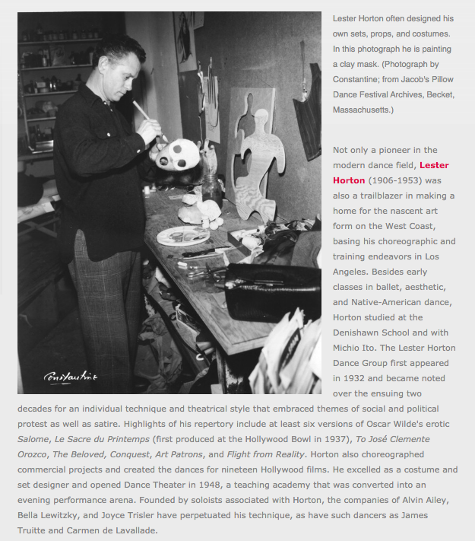
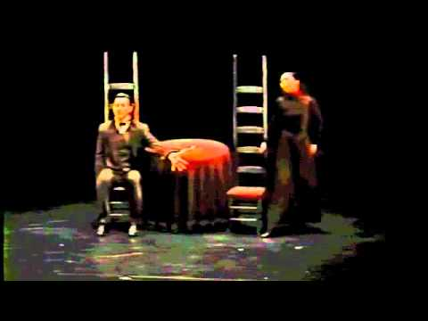
Lester Horton (1906–1953)

Slide 9
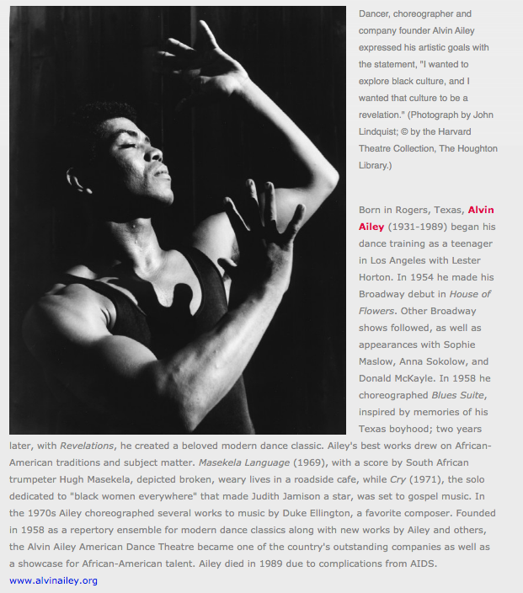
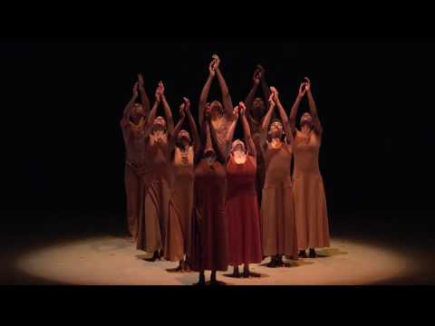
Alvin Ailey (1931–1989)
Alvin Ailey: A History

Slide 10
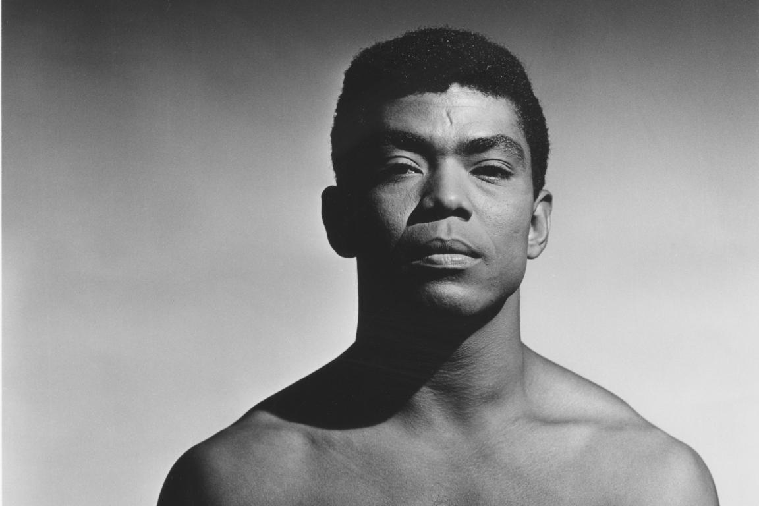
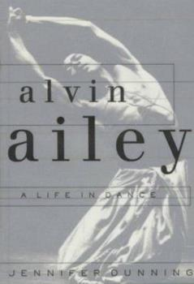
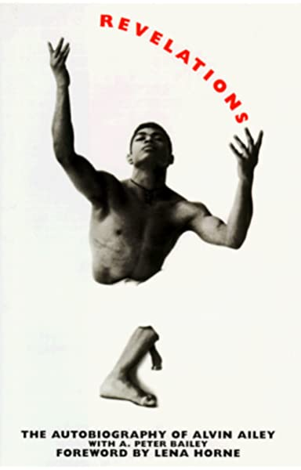
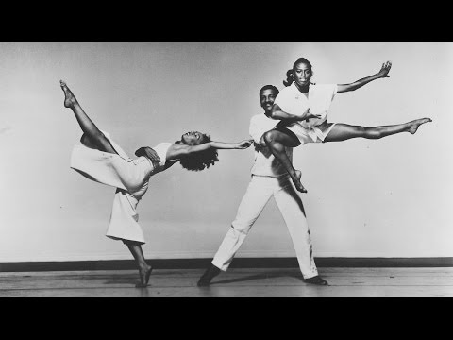
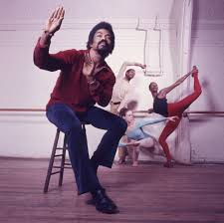

Slide 11
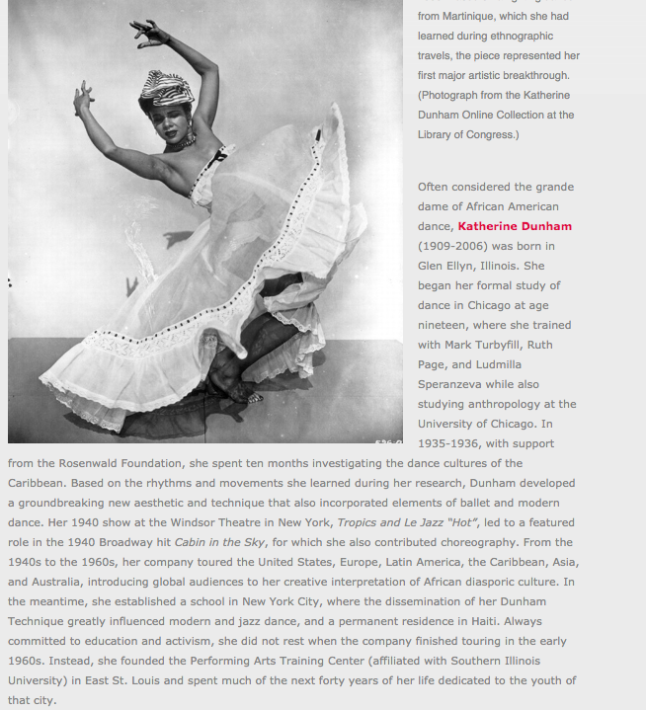

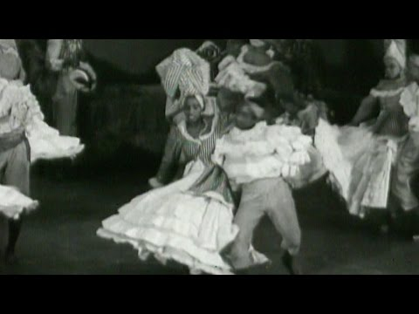
Katherine Dunham
(1909-
2006)
/

Slide 12
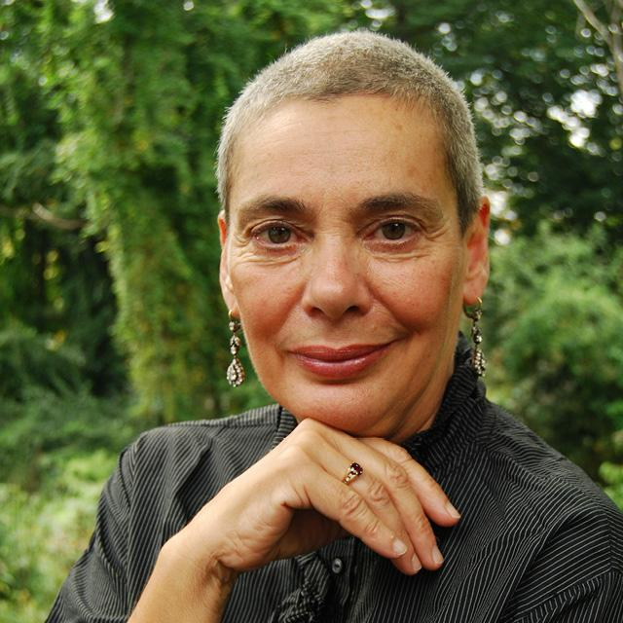
Constance Valis Hill
Five College professor emerita of dance, has a Ph.D. in Performance Studies from New York University; M.A. in Dance Research and Reconstruction from City College of the University of New York; Bronze Certificate from the International Society of Ballroom Dance; Neutral and a Character Mask certificate from Pierre LeFevre at the Juilliard School.
Professor Hill has taught at the Alvin Ailey School of American Dance, Conservatoire d'arts Dramatique in Paris, and New York University's Tisch School of the Arts. Her writings have appeared in such publications as Dance Magazine, Village Voice, Dance Research Journal, Studies in Dance History; Discourses in Dance, and in such edited anthologies as Moving Words: Re-Writing Dance; Dancing Many Drums: Excavations in African-American Dance; Ballroom, Boogie, Shimmy Sham, Shake: A Social and Popular Dance Reader; Taken By Surprise: A Dance Improvisation Reader, and Kaiso! Writings By and About Katherine Dunham. Her book, Brotherhood in Rhythm: The Jazz Tap Dancing of the Nicholas Brothers (2000) received the Deems Taylor ASCAP Award; and her most recent book, Tap Dancing America, A Cultural History (2010), for which she received the Tap Preservation Award from the American Tap Dance Foundation, was supported by grants from the John D. Rockefeller and John Simon Guggenheim foundations.As a Five College Professor of Dance at Hampshire College, Professor Hill teaches courses in dance history, performance theory, jazz studies, choreography on camera, and feminist performance; and is working with her colleagues to establish a black studies core curriculum.

Slide 13
Discussion

Slide 14
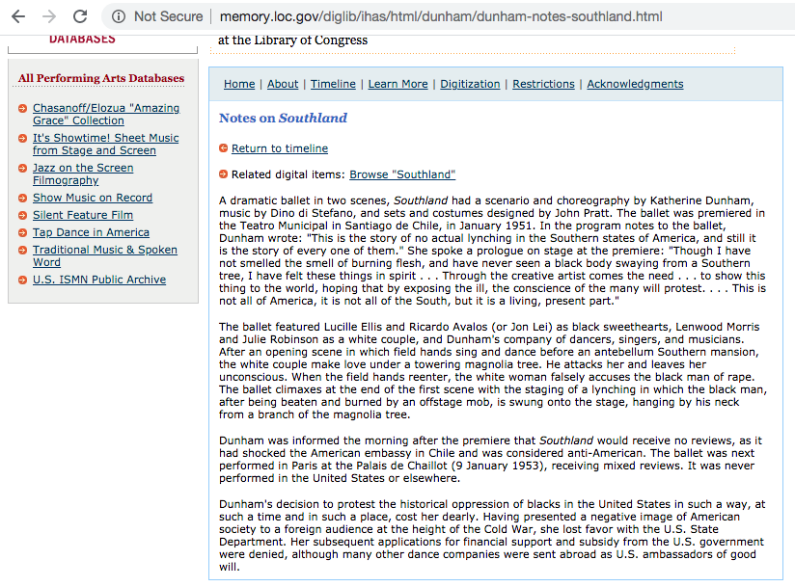
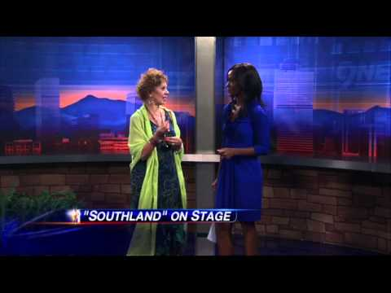
Recreating Katherine Dunham’s Southland (1951)

Slide 15
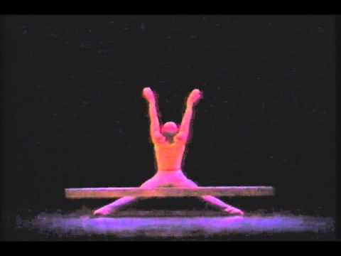
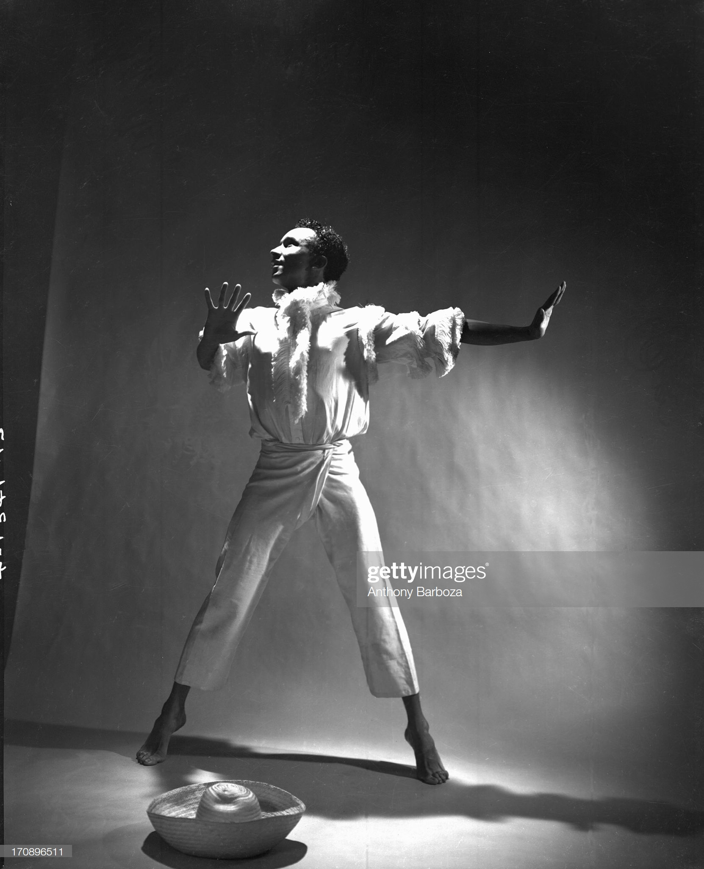
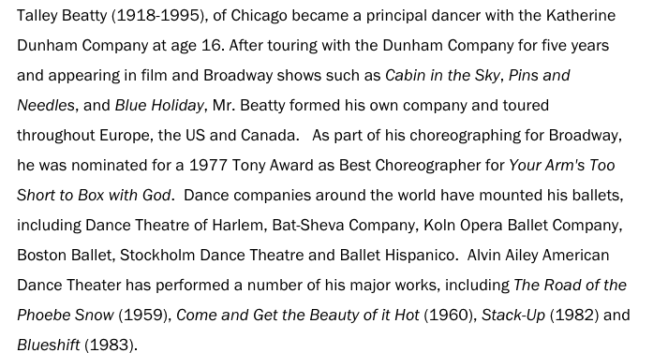
Talley Beatty
(1918–1995)
https://danceinteractive.jacobspillow.org/themes-essays/african-diaspora/talley-beatty/

Slide 16
