Slide 1
Urban Culture and Society (185)
Sustainability and Environmental Justice

Slide 2
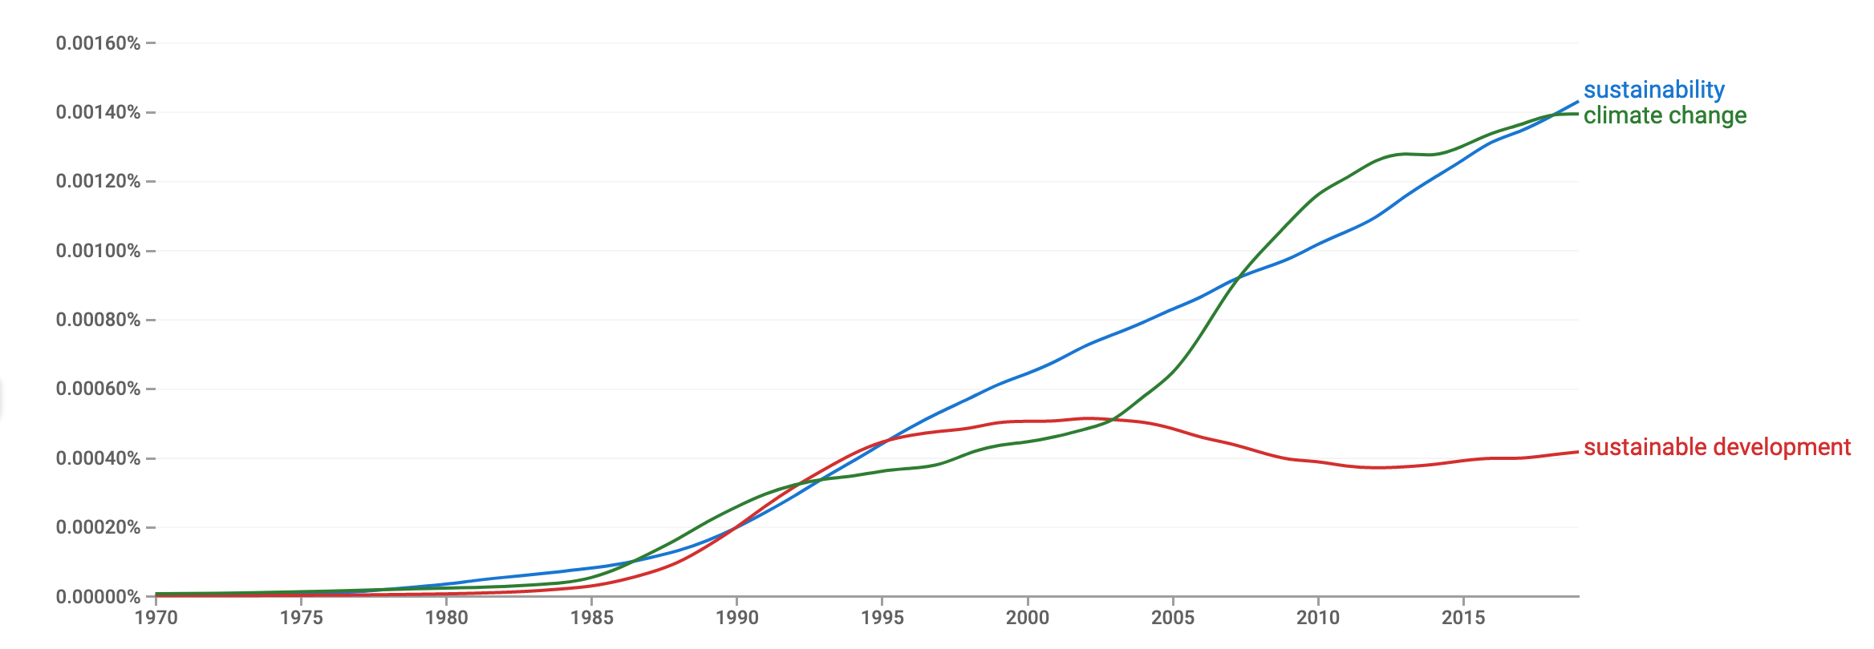
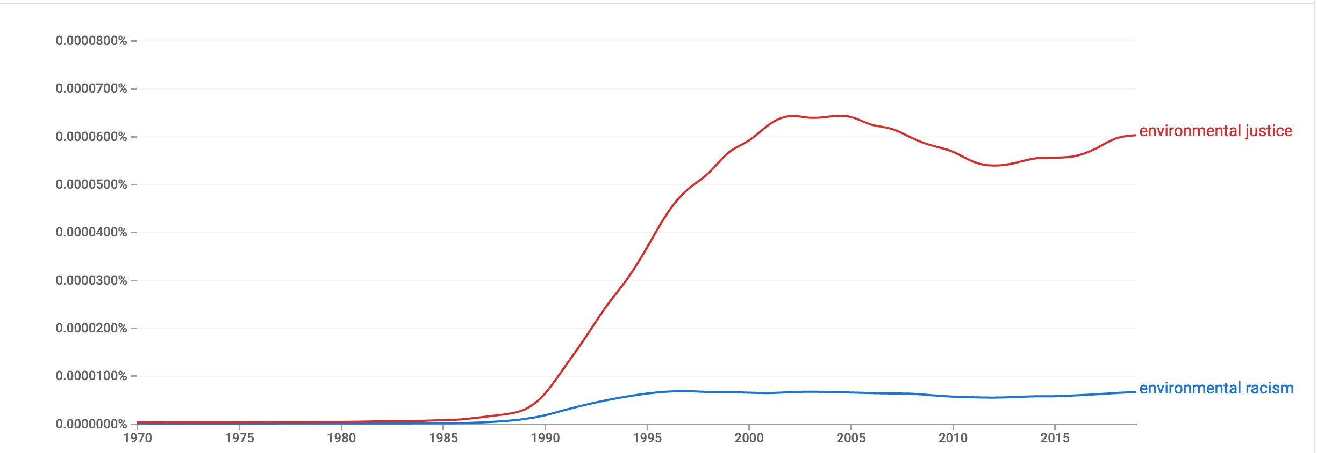
Google Ngram Viewer – frequency of terms in Google books

Slide 3
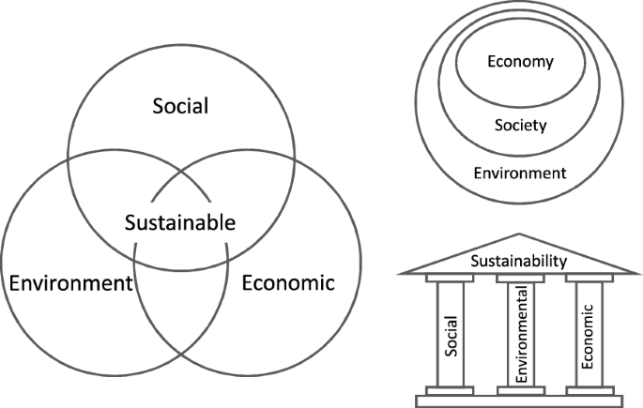
What is sustainability?
From Our Common Future, sometimes called the Brundtland Report (1987):
"Sustainable development is development that meets the needs of the present without compromising the ability of future generations to meet their own needs."

Slide 4
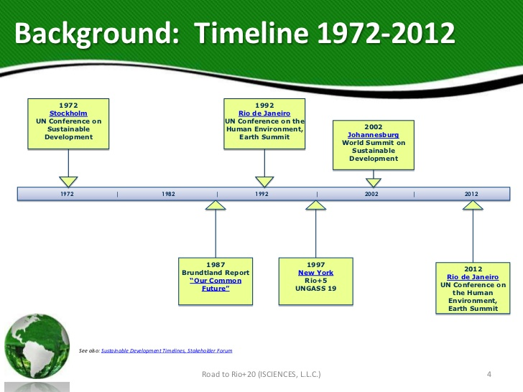

Slide 5
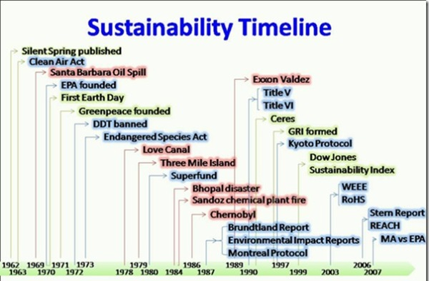
https://tadhgsbesteffort.wordpress.com/2011/02/23/week-2-sustainable-development/

Slide 6
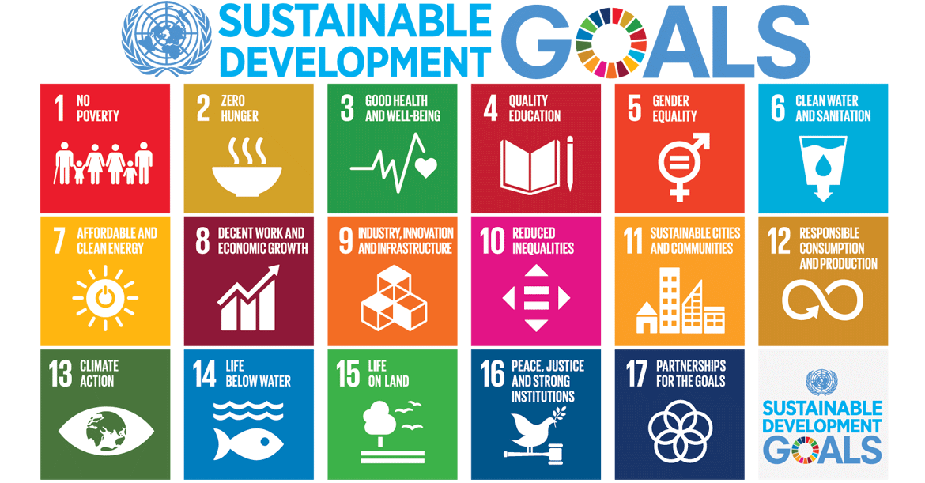
Agenda 2030

Slide 7
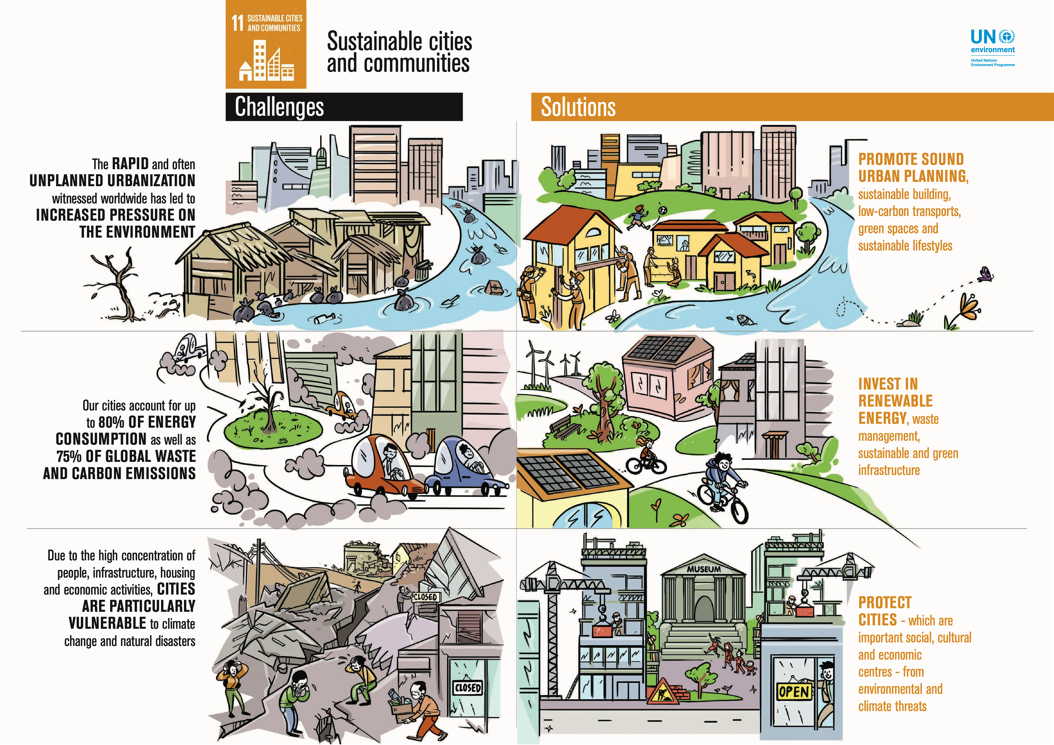
Cities are important sites for sustainability

Slide 8
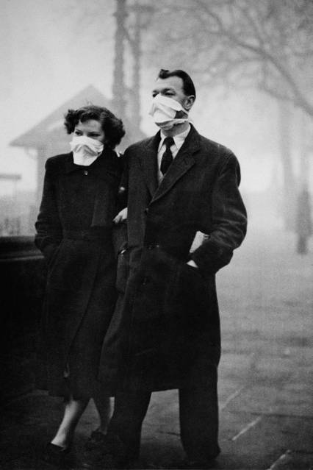
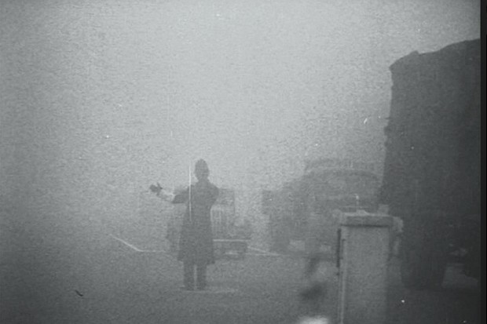
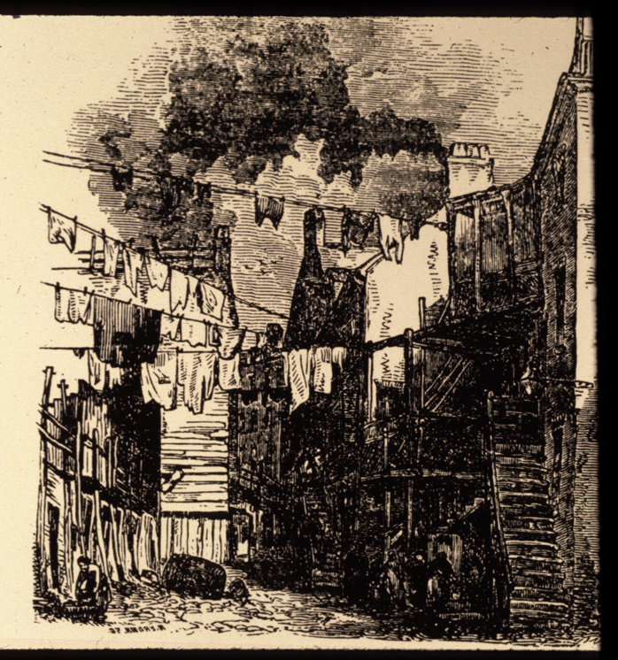
Cities have been sites of environmental problems . . .
“For five days in December 1952, a fog that contained pollutants enveloped all of London. By the time the dense fog cover lifted, more than 150,000 people had been hospitalized and at least 4,000 people had died. Researchers now estimate that the total death count was likely more than 12,000 people, as well as thousands of animals.”
https://www.cbsnews.com/news/londons-1952-killer-fog-cause-revealed/

Slide 9
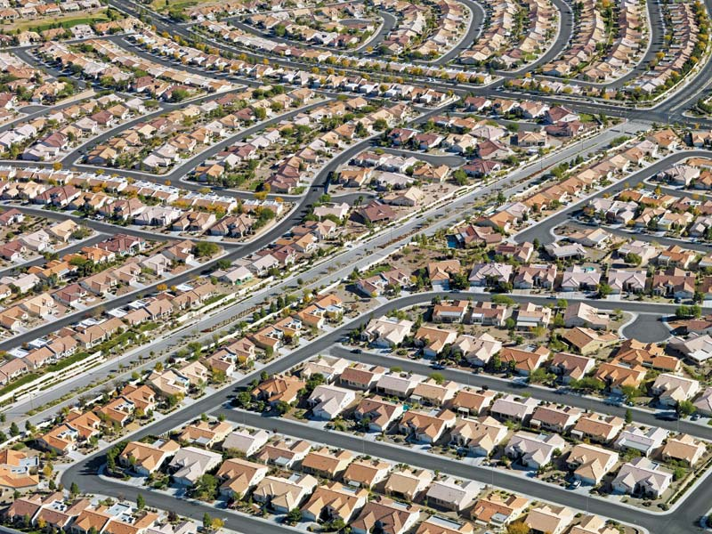
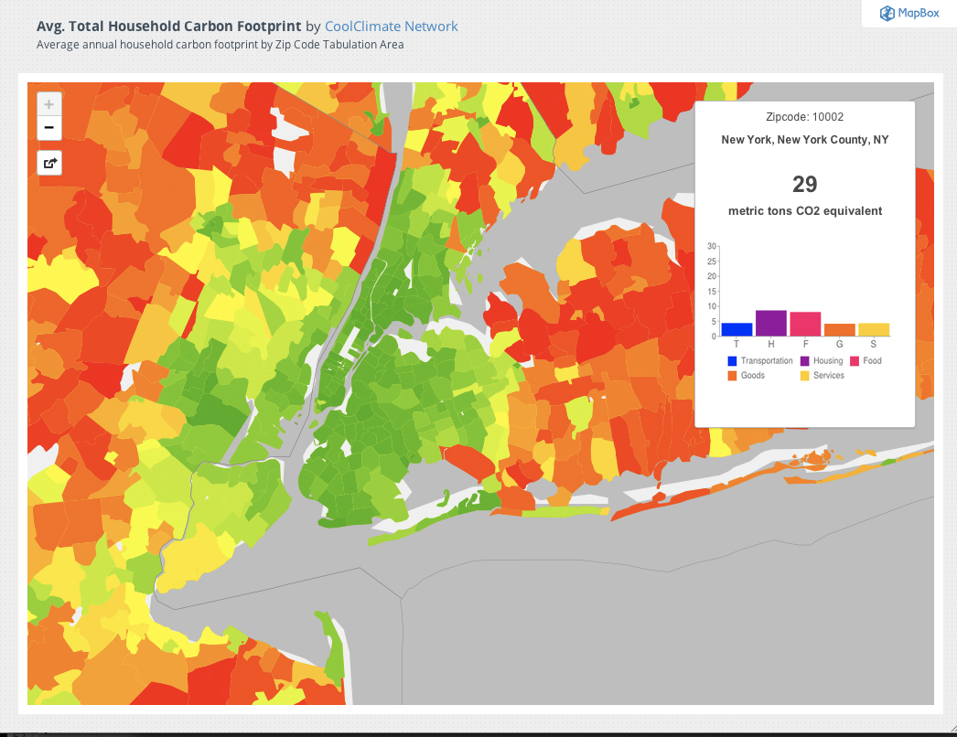
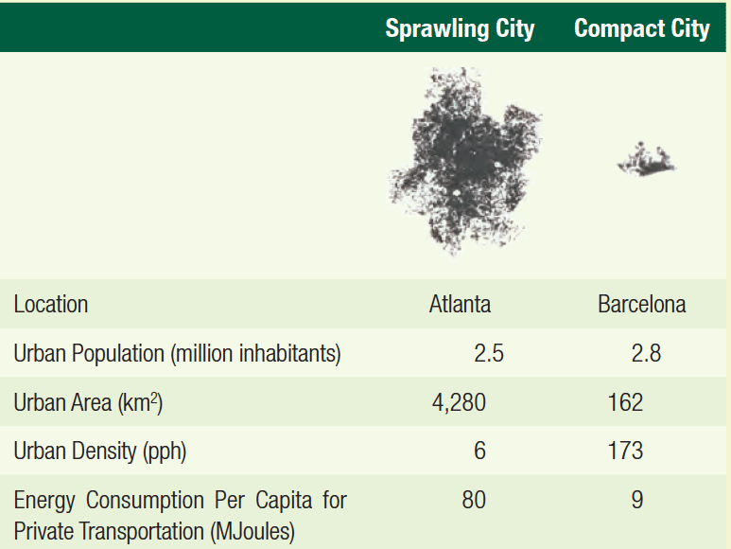
And it’s not just old industrial cities that contribute to environmental problems . . .

Slide 10
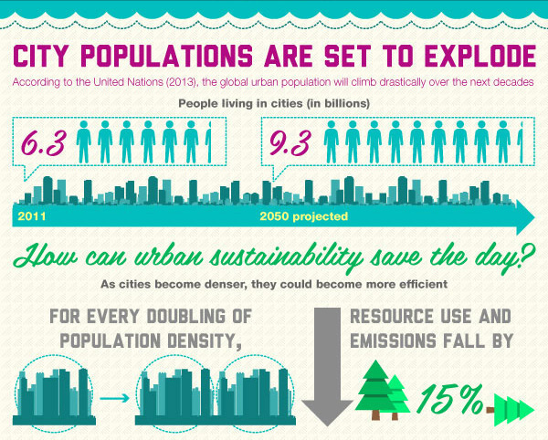
. . . but cities can also be solutions
https://inhabitat.com/infographic-how-green-cities-can-help-sustain-the-future/

Slide 11
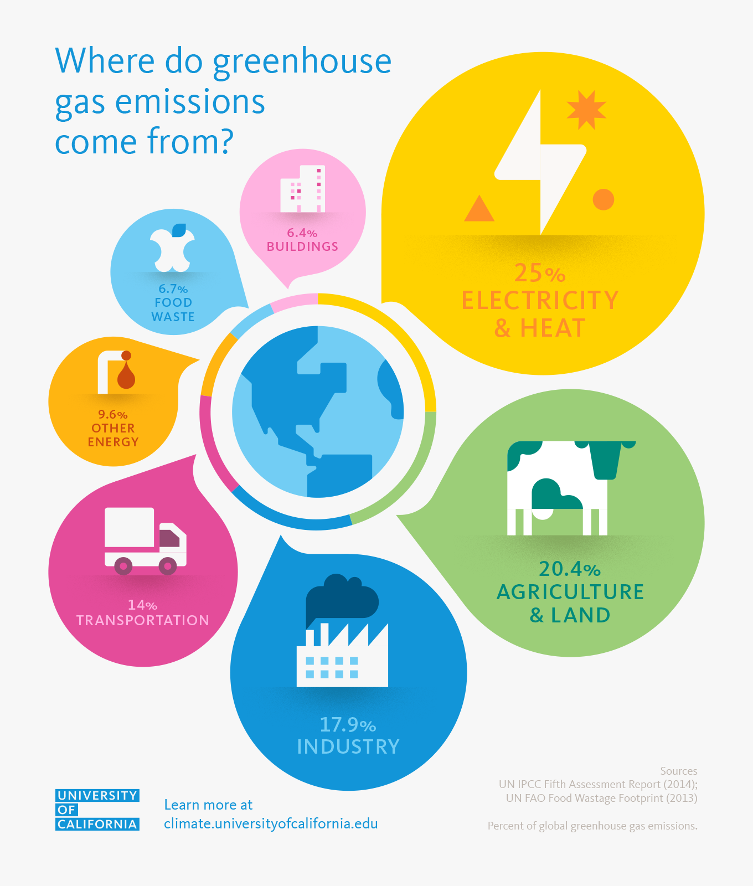
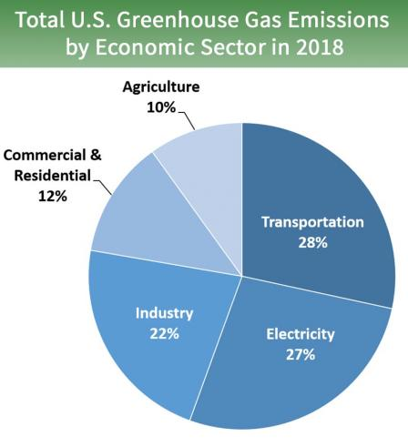
Transportation 14%
Elect & Heat 25%
Buildings 8.4%
Global Sources

Slide 12
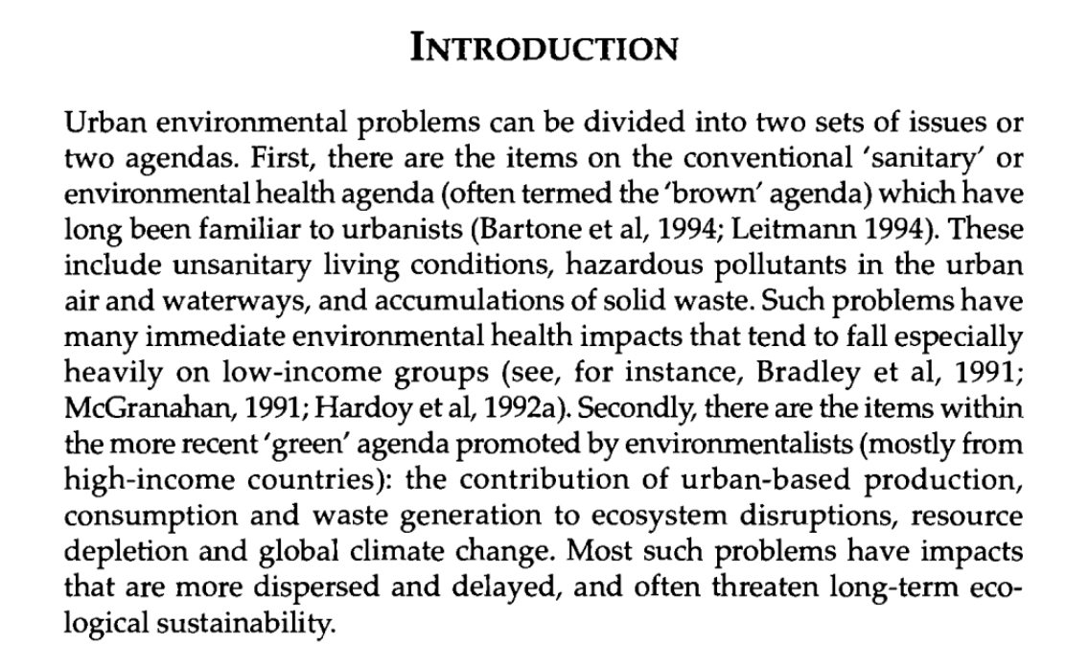
McGranahan, G., & Satterthwaite, D. (2000). Environmental health or ecological sustainability? Reconciling the brown and green agendas in urban development. Sustainable cities in developing countries, 73-90.

Slide 13
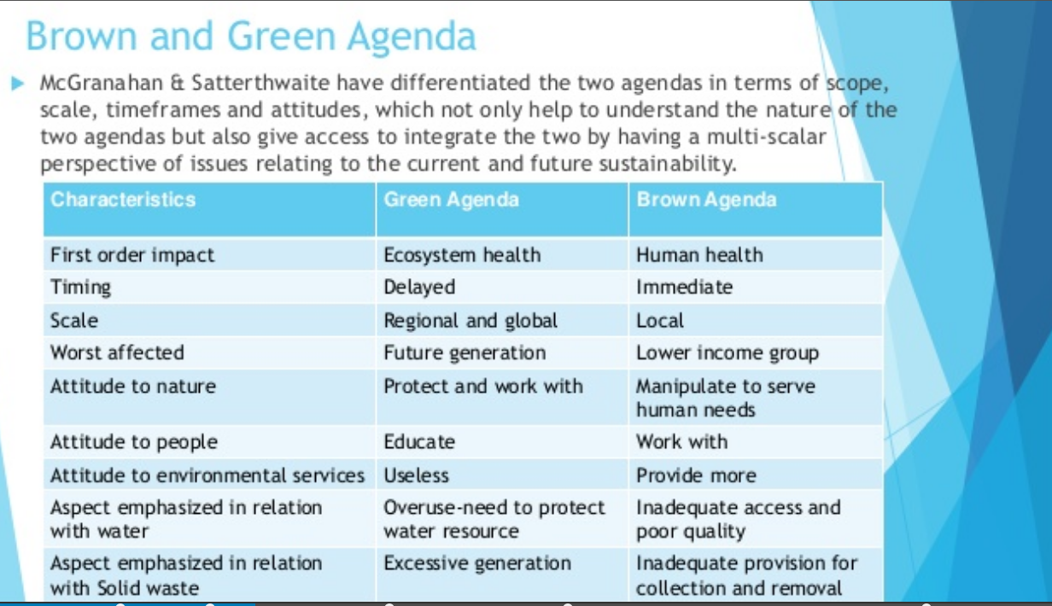

Slide 14
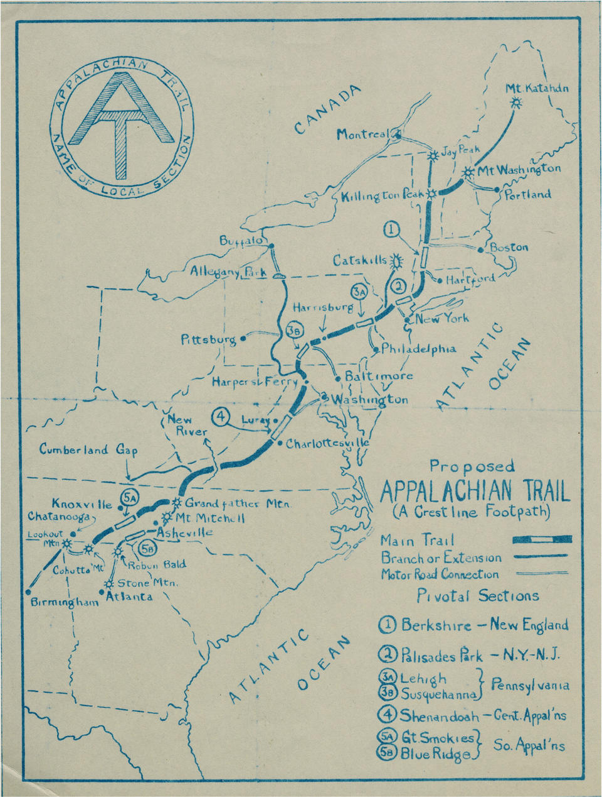
Roots of Regional Planning
Benton MacKaye’s sketch of his Appalachian Trail proposal, as presented to the newly formed Appalachian Trail Conference in 1925. (Appalachian Trail Conservancy)

Slide 15
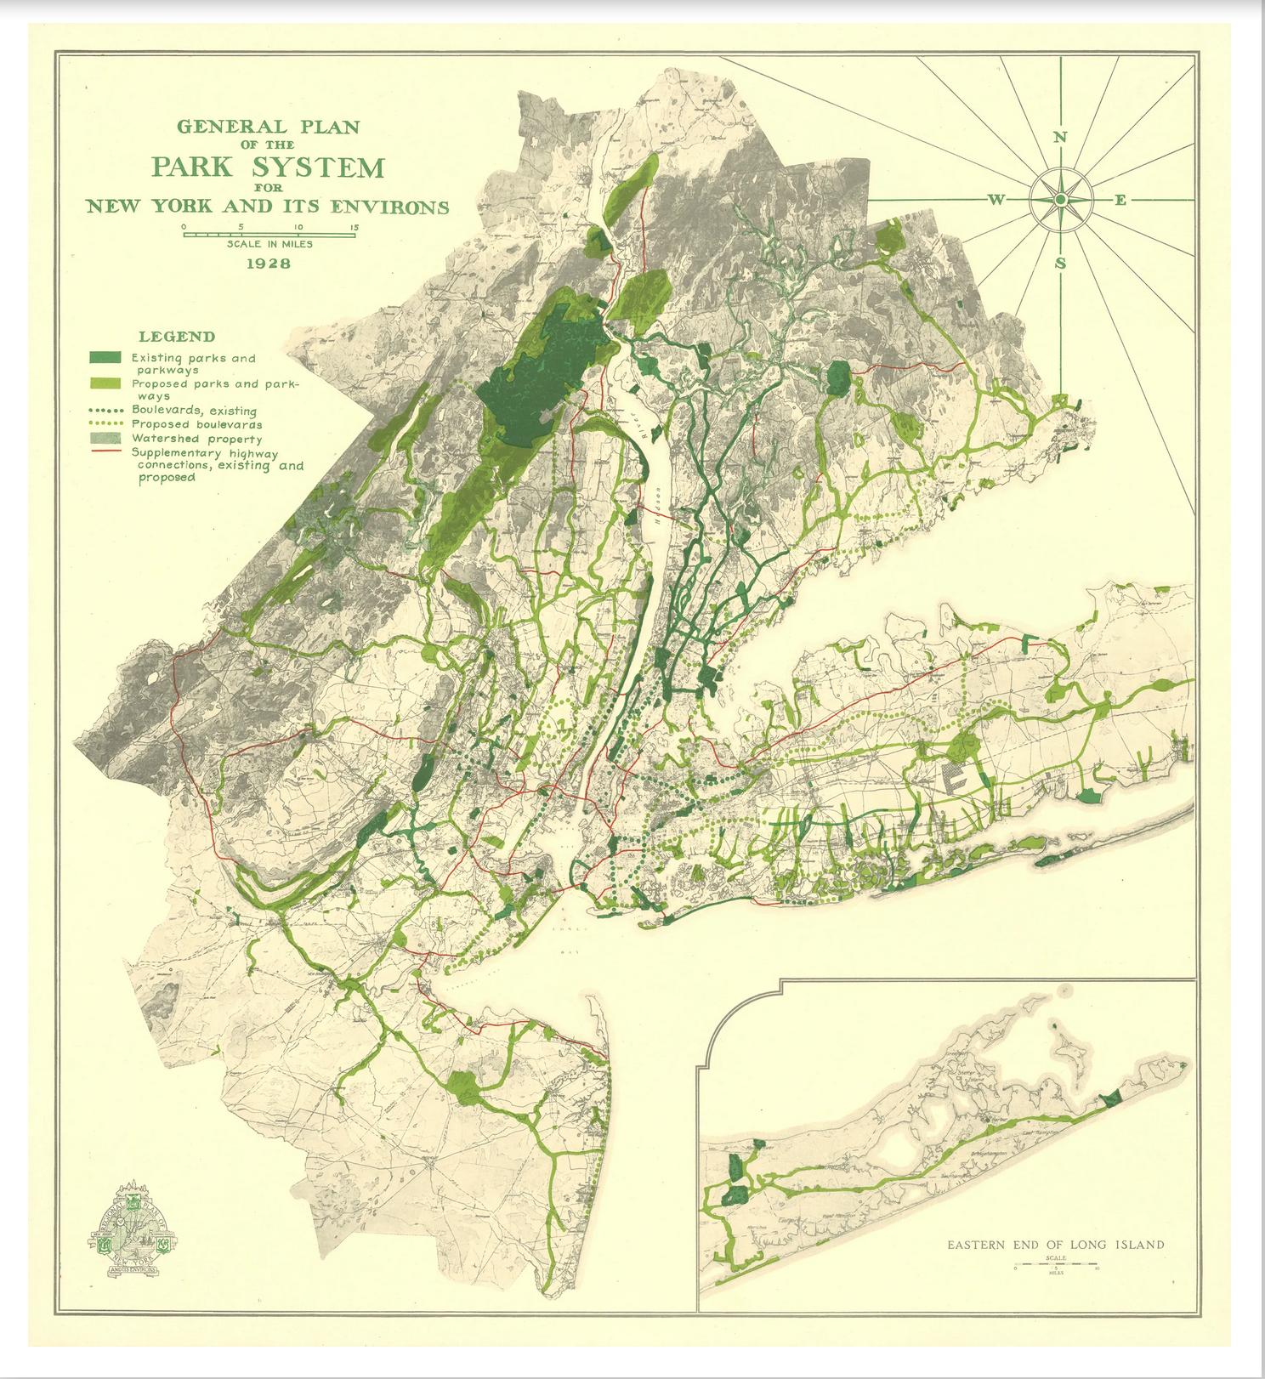
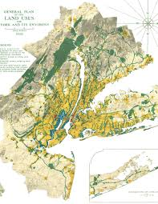
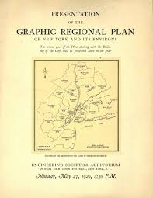
Regional Plan Association
New York

Slide 16
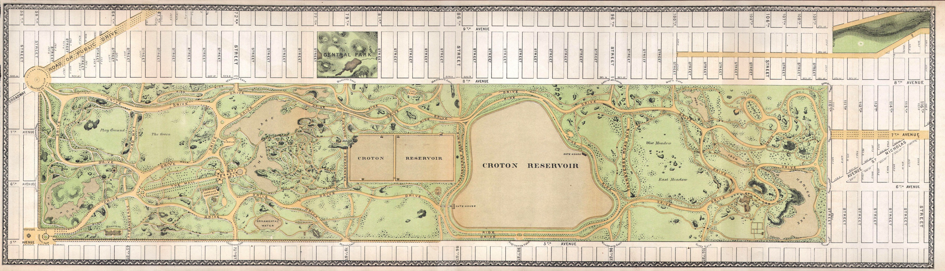

Slide 17
What did Olmsted value?
Cleaning air and providing healthy setting
Accessible active recreation
Passive reception (spiritual contemplation)
Sociability and democracy “you may thus often see vast numbers of persons brought closely together, poor and rich, young and old, Jew and Gentile”
Note time as well: parks not produced complete in themselves but grow…

Slide 18
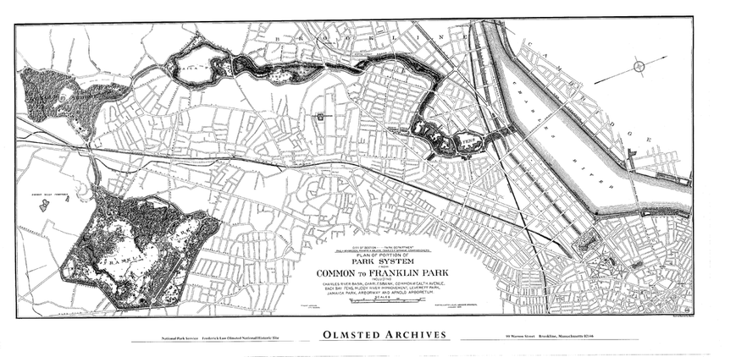

Slide 19
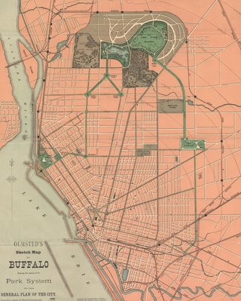
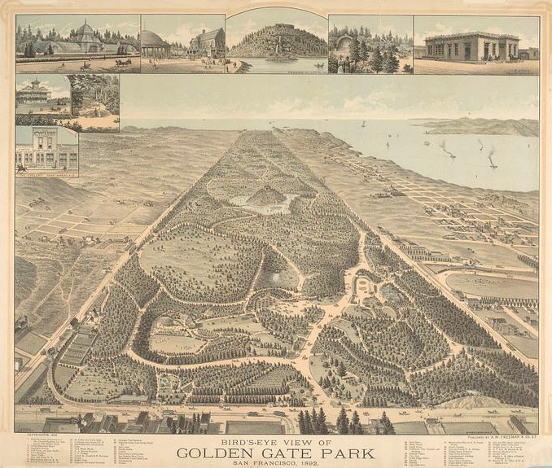

Slide 20
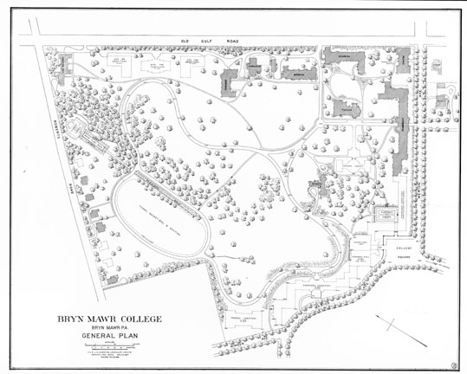
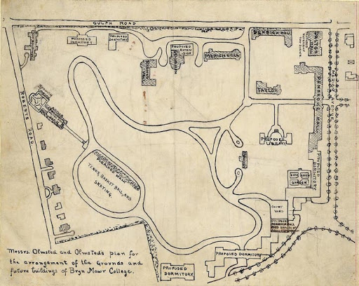

Slide 21
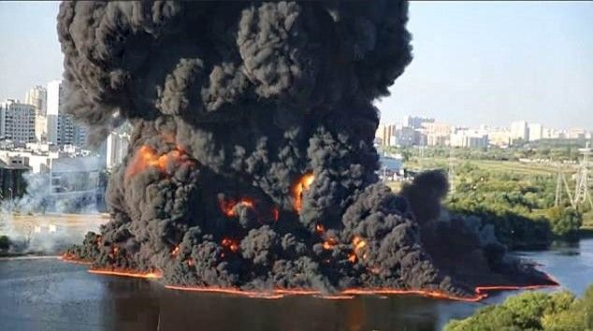
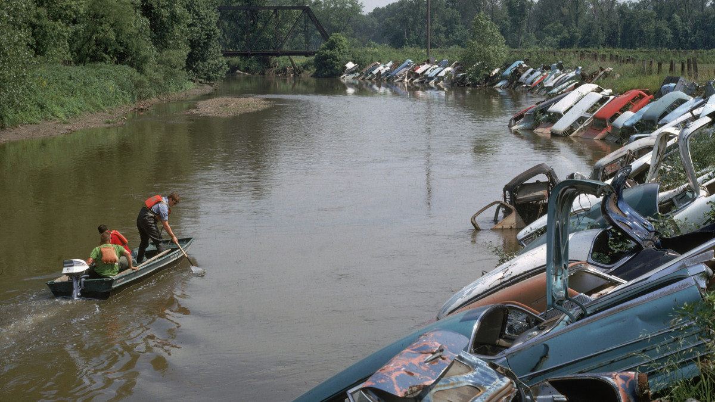
Remember the Clean Water Act?
Cuyahoga River Fire, 1969
For more:
https://www.circleofblue.org/2012/world/clean-water-act-photo-gallery/

Slide 22
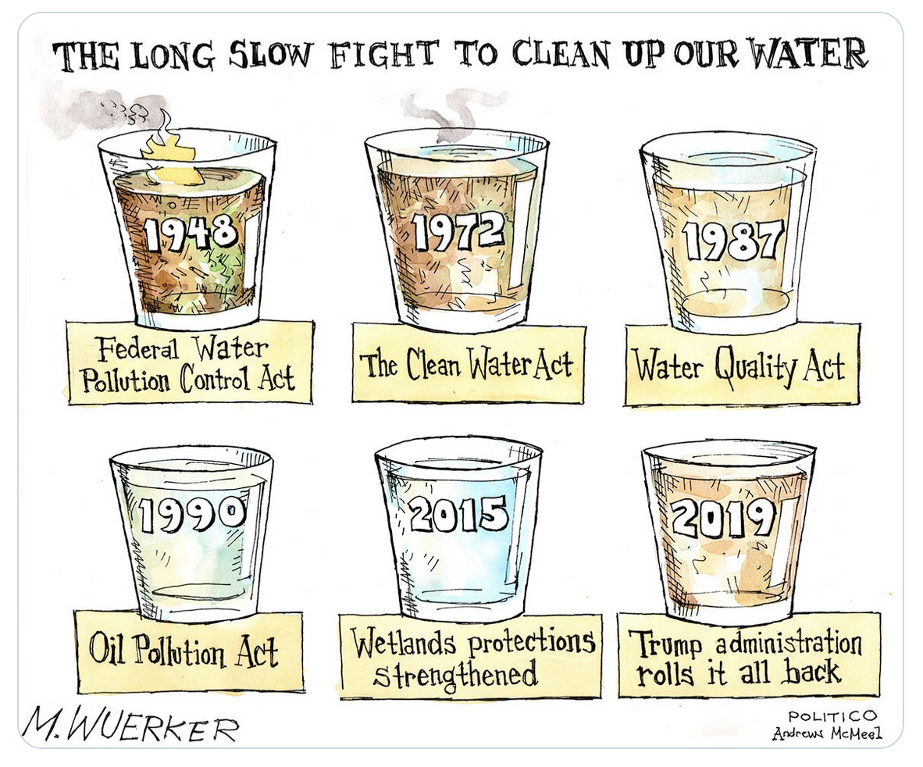
Many early efforts to develop large urban park systems were driven by concerns about clean drinking water

Slide 23
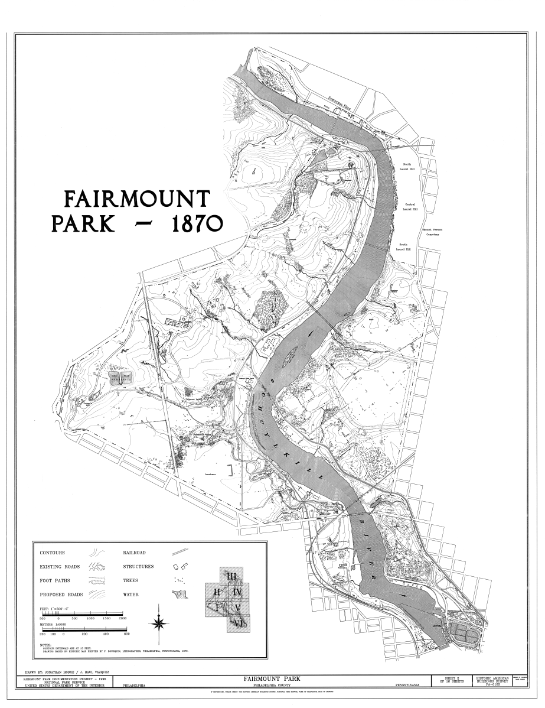
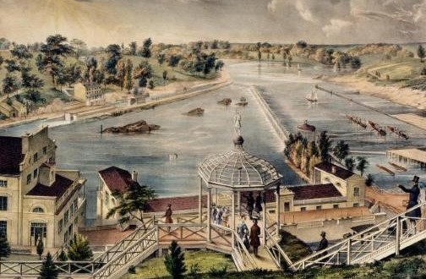
By 1811, a young engineer, Frederick Graff (1775-1847), was superintendent of the waterworks. He recommended that a new and much larger facility be built at Fairmount, just to the northwest of the city boundary and at the Schuylkill’s edge. Water could be pumped up to reservoirs to be constructed on the hill’s summit. From there, gravity would do the rest, allowing water to flow through pipes down into the city. The Watering Committee agreed, a plot of land was acquired at Fairmount, and construction began on August 1, 1811.
https://philadelphiaencyclopedia.org/archive/fairmount-water-works/

Slide 24
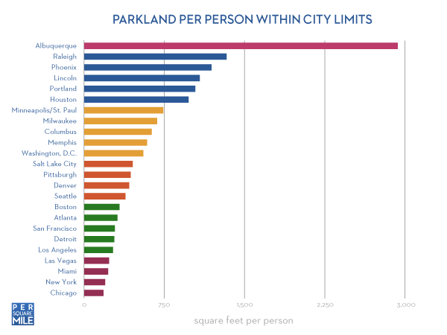
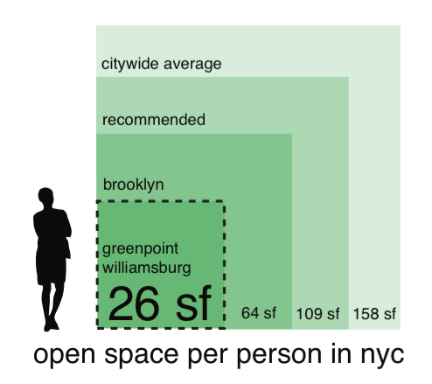
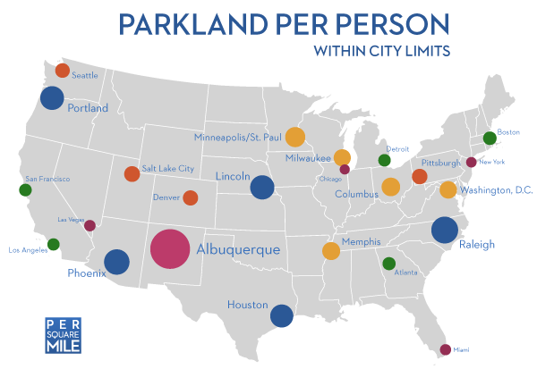
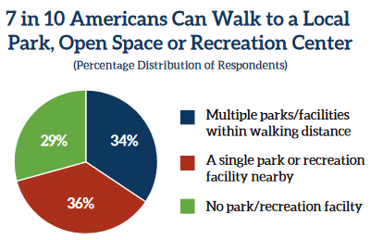
Rising awareness of connection between development patterns, access to parks, and health issues like obesity and asthma

Slide 25
Google Ngram Viewer – frequency of terms in Google books

Slide 26
What is environmental justice?
From US Environmental Protection Agency:
Environmental justice (EJ) is the fair treatment and meaningful involvement of all people regardless of race, color, national origin, or income with respect to the development, implementation and enforcement of environmental laws, regulations and policies.
Fair treatment means no group of people should bear a disproportionate share of the negative environmental consequences resulting from industrial, governmental and commercial operations or policies.
Meaningful involvement means:
People have an opportunity to participate in decisions about activities that may affect their environment and/or health;
The public's contribution can influence the regulatory agency's decision;
Community concerns will be considered in the decision making process; and
Decision makers will seek out and facilitate the involvement of those potentially affected.
https://www.epa.gov/environmentaljustice/learn-about-environmental-justice

Slide 27
Environmental Justice Timeline

Slide 28
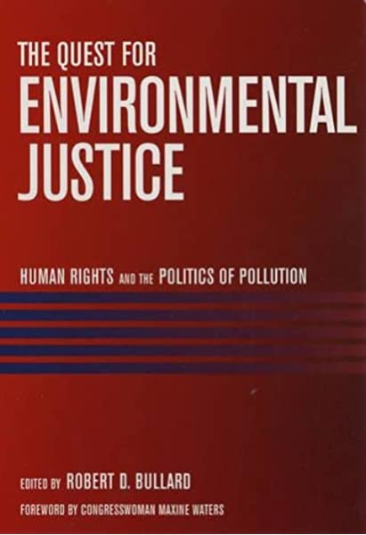
Role of Different Actors
Grassroots activists
Professional NGOs
Polticians
Lawyers and the Courts
Planners

Slide 29
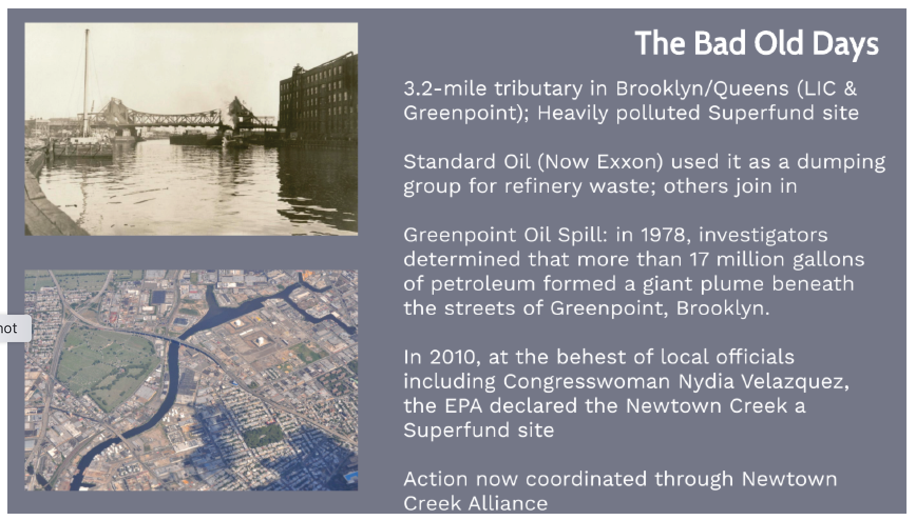
EJ Case: Greenpoint - origin

Slide 30
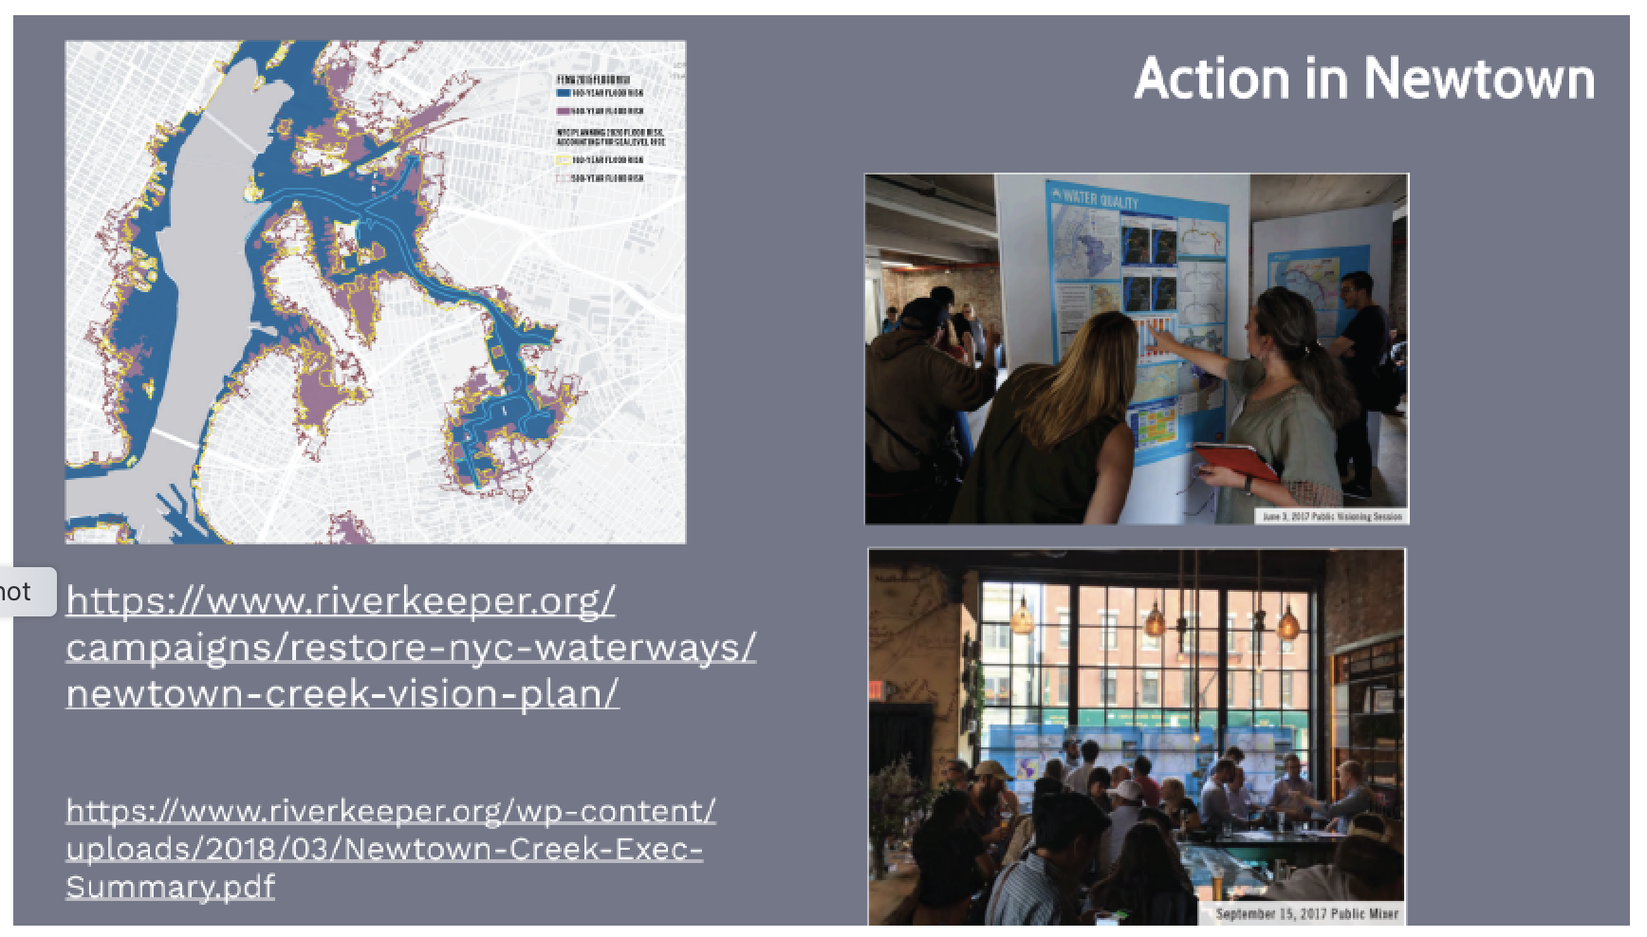
EJ Case: Newtown Riverkeeper today

Slide 31
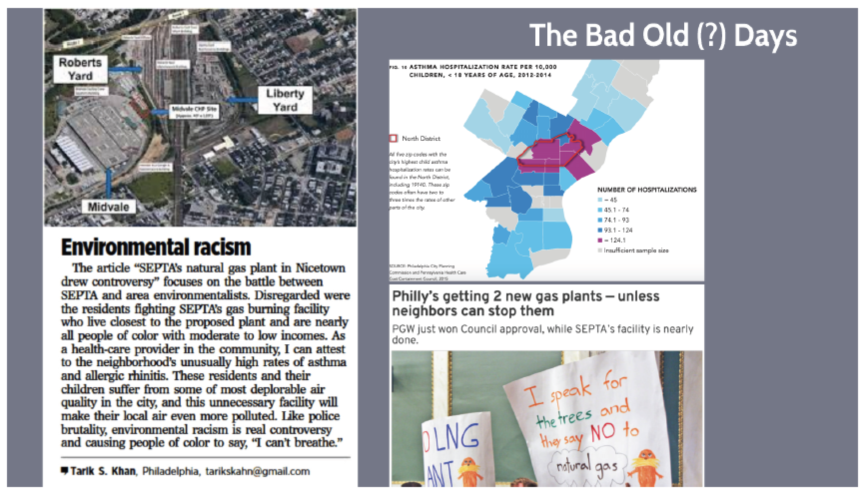
EJ Case: Nicetown

Slide 32
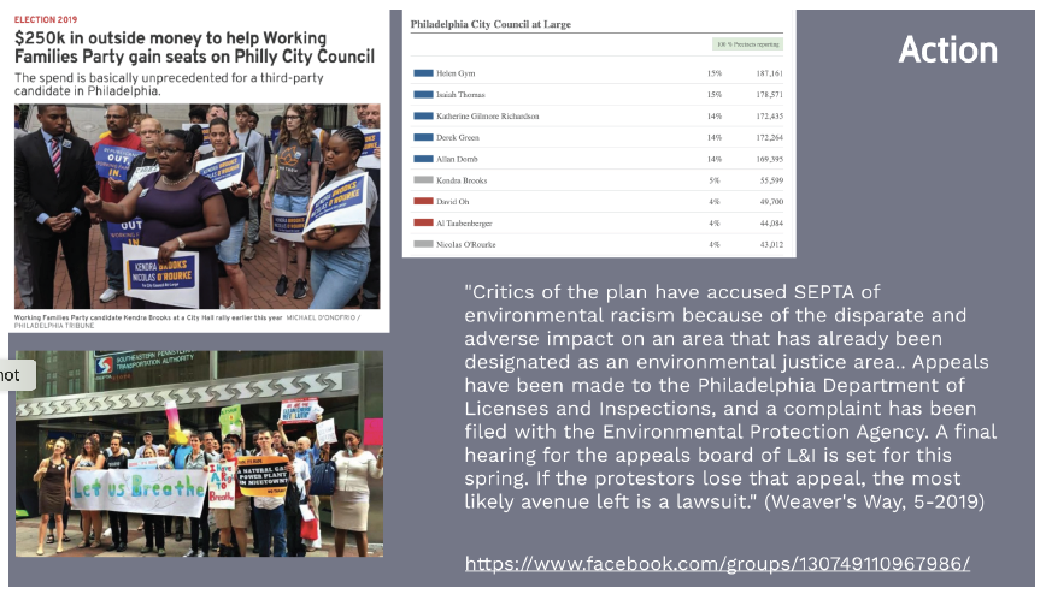
EJ Case: Nicetown Action

Slide 33
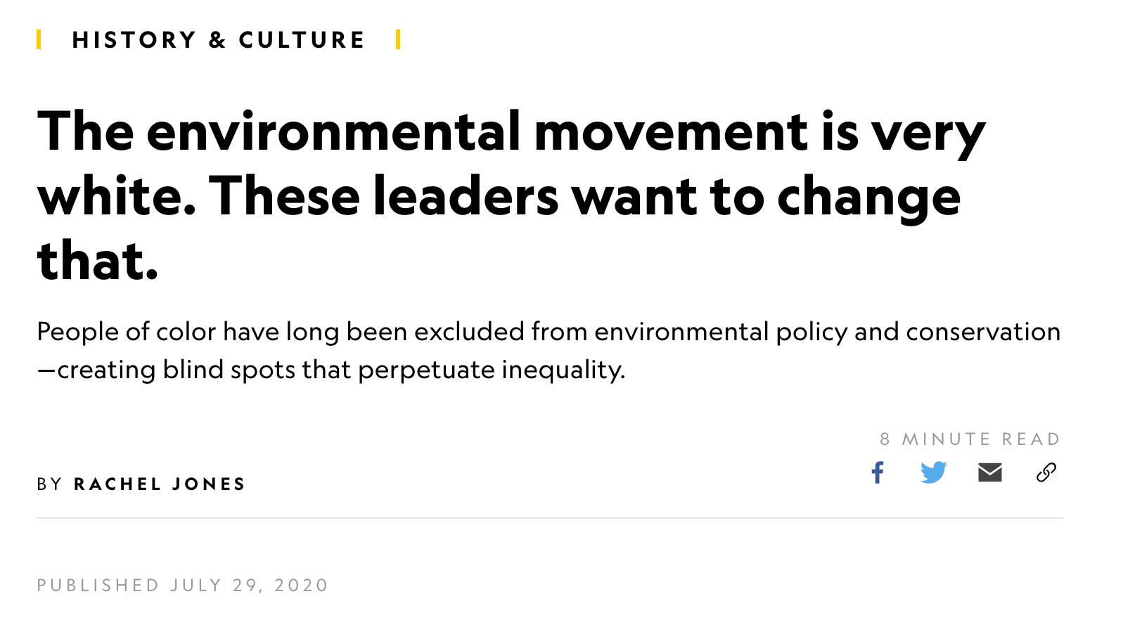
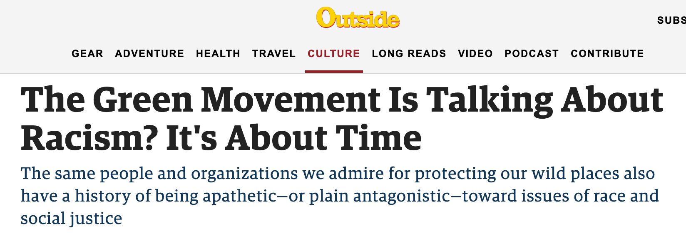


Slide 34
Ludlow, CO
1914
https://groundworkusa.org/wp-content/uploads/2018/05/NV-EJ-Timeline-Activity.pdf

Slide 35
California
1962
UFW founded
https://groundworkusa.org/wp-content/uploads/2018/05/NV-EJ-Timeline-Activity.pdf

Slide 36
Warren County, NC
1982
https://groundworkusa.org/wp-content/uploads/2018/05/NV-EJ-Timeline-Activity.pdf

Slide 37
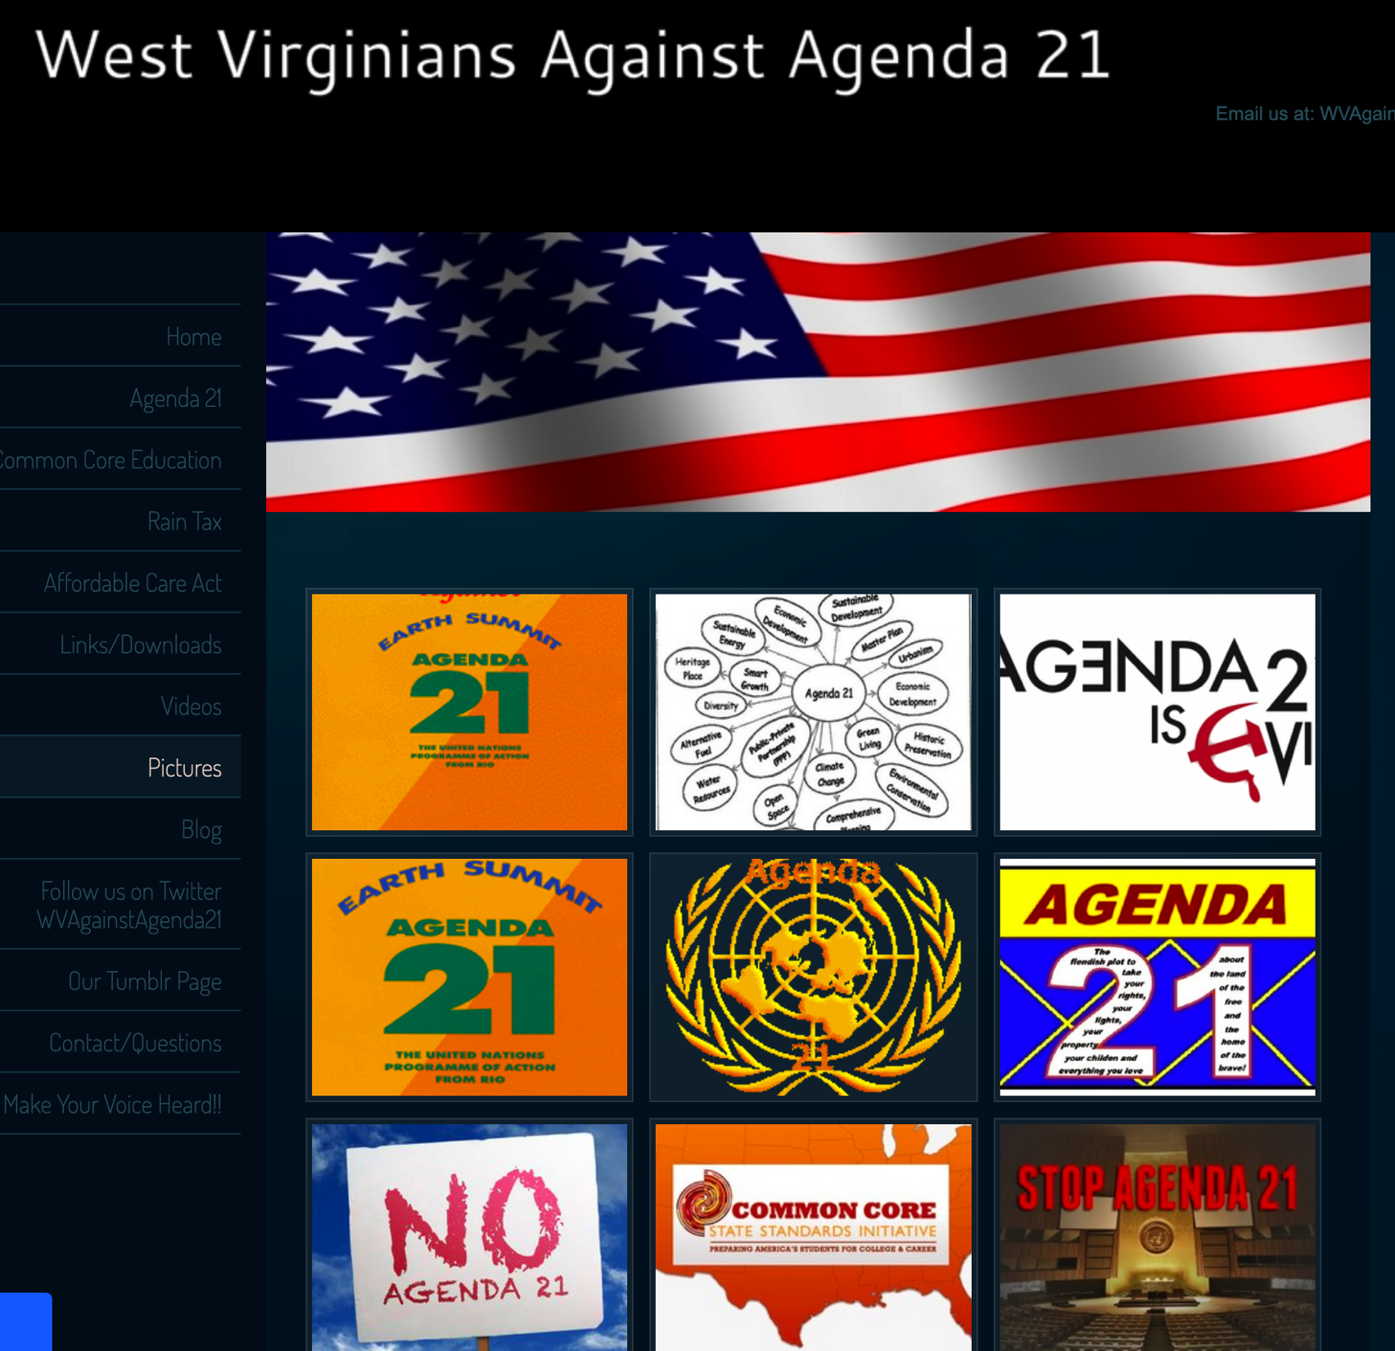
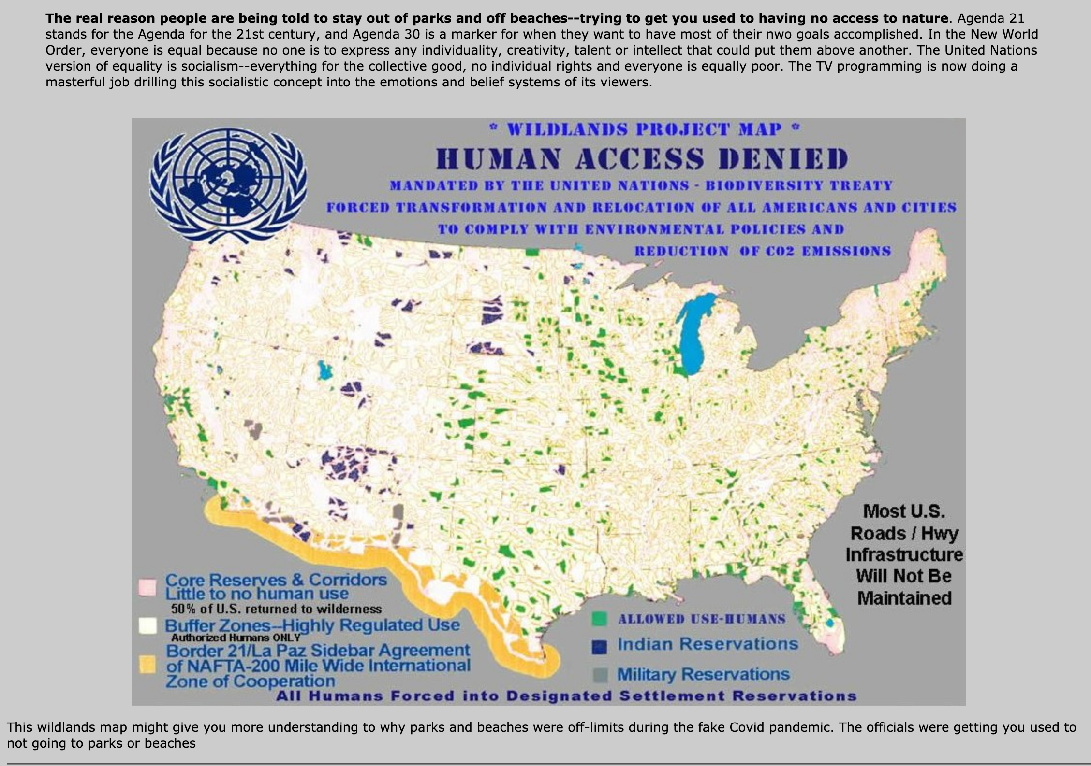
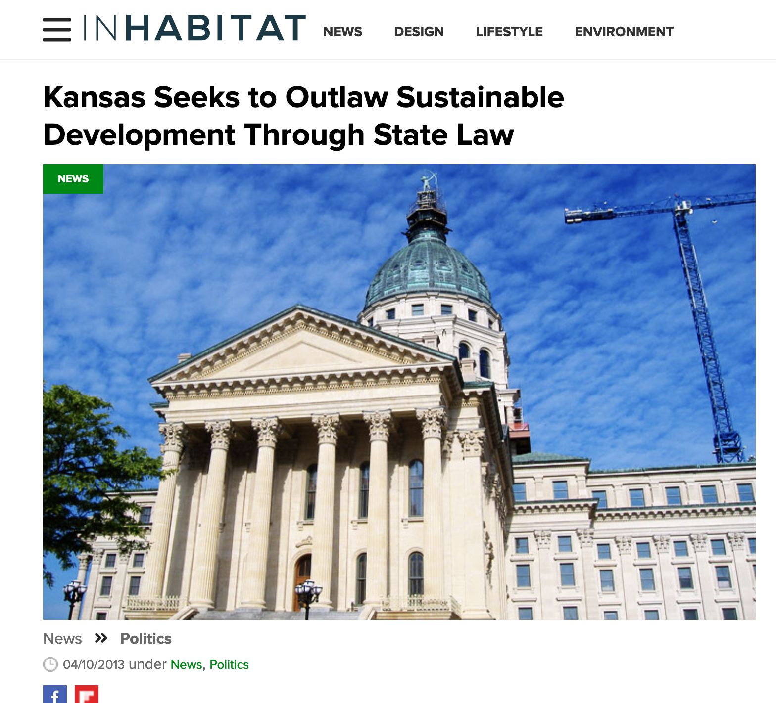
Backlash Against Sustainability

Slide 38
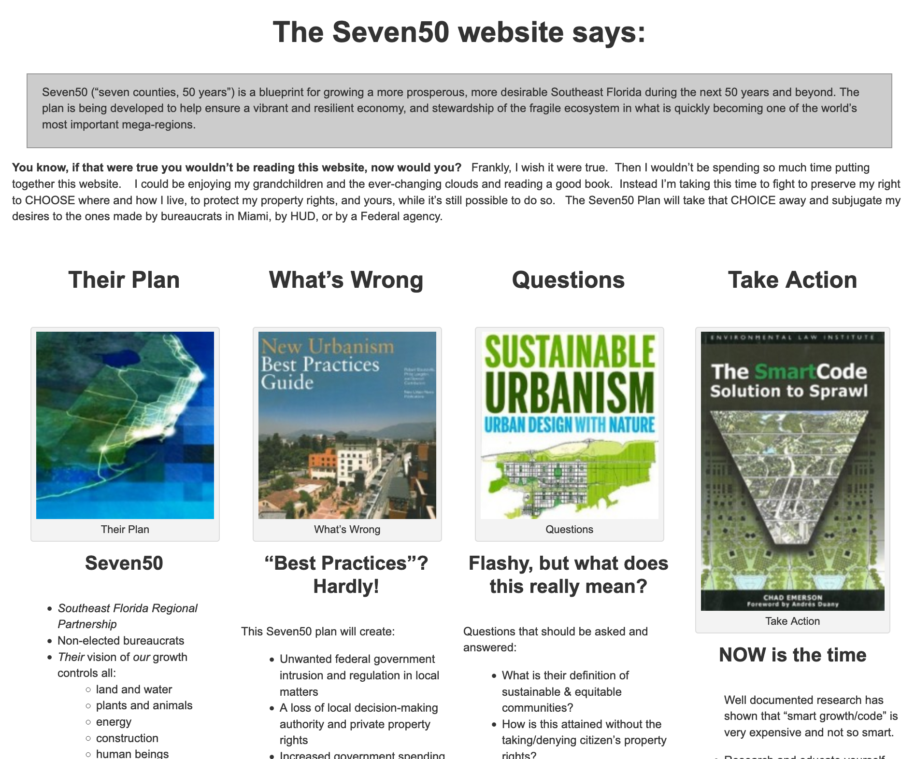
Backlash disrupts local and regional planning
https://www.facebook.com/Seven50Revealed/videos/437334316387540

Slide 39
Cities are important sites for sustainability . . .
Issues of environment and human health have been part of urban planning since the beginning, even if the specific concerns have changed over time . . .
Access to healthy environments is shaped by social inequalities . . .
Brown and black people have always been part of the fight for healthier environments (labor history and environmental history are tied together) . . .
Global agreements have implications for action at the local level, and local actors do not always see things the same way . . .

