Slide 1
Descriptive Writing Peer Feedback

Slide 2
First, carefully read through your peer’s passage. You may want to do this twice to really absorb it. Maybe even read it out loud.
Second, highlight words, phrases, or images that are particularly descriptive. You may want to copy and paste them into your feedback/comments.
Third, ask for MORE of something in particular: details about music, space, costuming, gesture, emotion or mood, speed, rhythm, or timing? relationships between dancers? more vivid adjectives or adverbs? more action verbs? attention to the dance’s structure? deeper interpretation/analysis of the work or event’s meaning?

Slide 3
Modernism and Modern Jazz
Creating Techniques (Codification)

Slide 4
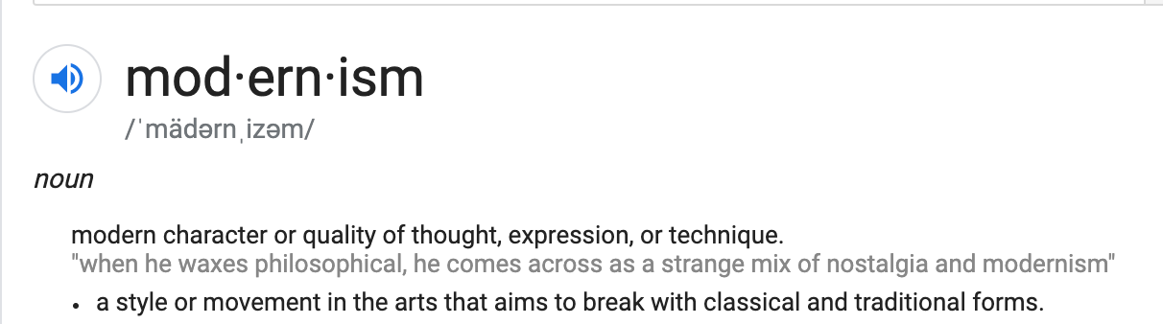
“Jazz dance” becomes a modernist art form?

Slide 5
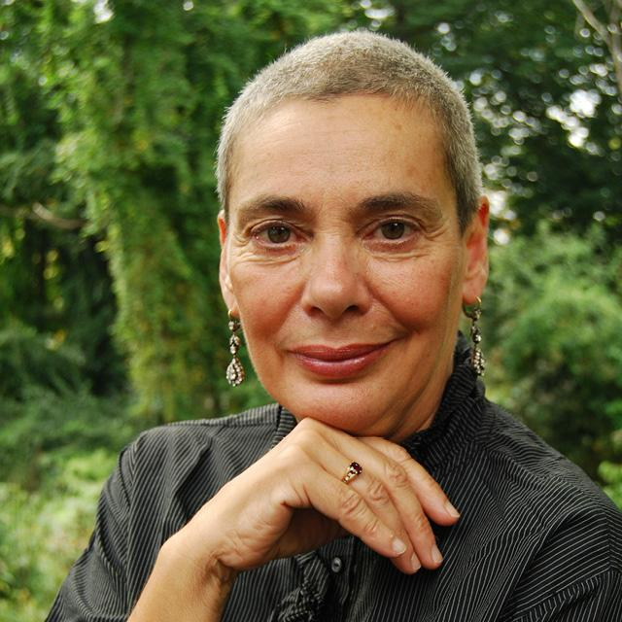
Constance Valis Hill
Five College professor emerita of dance, has a Ph.D. in Performance Studies from New York University; M.A. in Dance Research and Reconstruction from City College of the University of New York; Bronze Certificate from the International Society of Ballroom Dance; Neutral and a Character Mask certificate from Pierre LeFevre at the Juilliard School.
Professor Hill has taught at the Alvin Ailey School of American Dance, Conservatoire d'arts Dramatique in Paris, and New York University's Tisch School of the Arts. Her writings have appeared in such publications as Dance Magazine, Village Voice, Dance Research Journal, Studies in Dance History; Discourses in Dance, and in such edited anthologies as Moving Words: Re-Writing Dance; Dancing Many Drums: Excavations in African-American Dance; Ballroom, Boogie, Shimmy Sham, Shake: A Social and Popular Dance Reader; Taken By Surprise: A Dance Improvisation Reader, and Kaiso! Writings By and About Katherine Dunham. Her book, Brotherhood in Rhythm: The Jazz Tap Dancing of the Nicholas Brothers (2000) received the Deems Taylor ASCAP Award; and her most recent book, Tap Dancing America, A Cultural History (2010), for which she received the Tap Preservation Award from the American Tap Dance Foundation, was supported by grants from the John D. Rockefeller and John Simon Guggenheim foundations.As a Five College Professor of Dance at Hampshire College, Professor Hill teaches courses in dance history, performance theory, jazz studies, choreography on camera, and feminist performance; and is working with her colleagues to establish a black studies core curriculum.

Slide 6
Constance Valis Hill (2009)
“From Bharata Natyam to Bop: Jack Cole’s ‘Modern’ Jazz Dance”

Slide 7
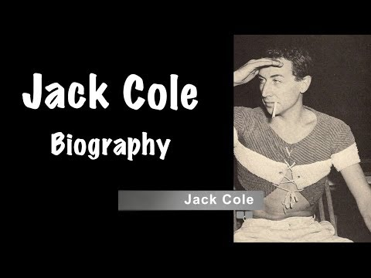
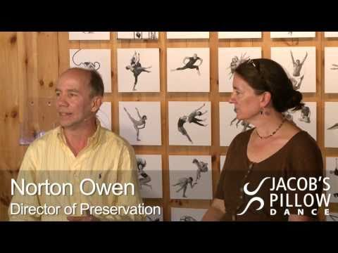
Jack Cole (1911–1974)
“The Father of Modern Jazz Dance”

Slide 8
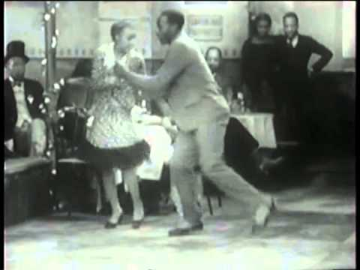
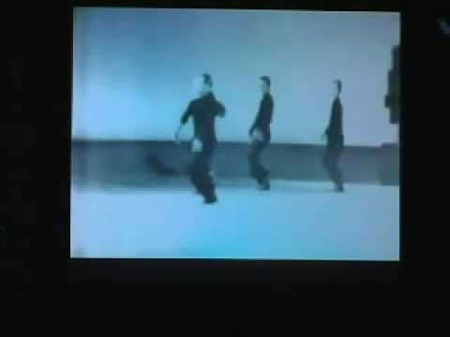
Lindy hop/Swing Dance: From “Social” to Stage
"Shorty" George Snowden and his dancers from the Savoy Ballroom, dancing to music by Chick Webb And His Orchestra, in the 1929 film After Seben.
Sing Sing Sing danced by Ron Field, Jim Hutchenson, Tom Osteen and Jack Cole from the Perry Como Show, circa early 1950s.

Slide 9
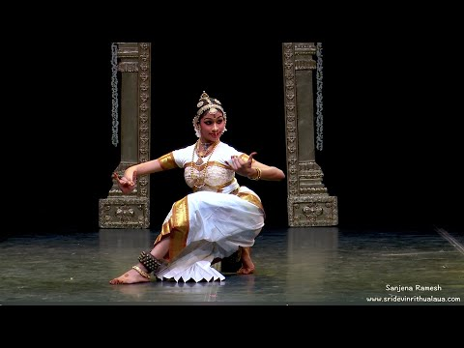
“East Indian Dance”
Jack Cole studied Bharatanatyam under La Meri at her Ethnologic Center

Slide 10

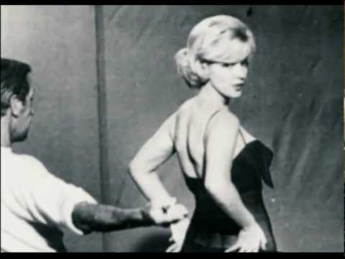
Remembering “Unsung Genius” Jack Cole
through the restaging his works and a documentary film

Slide 11

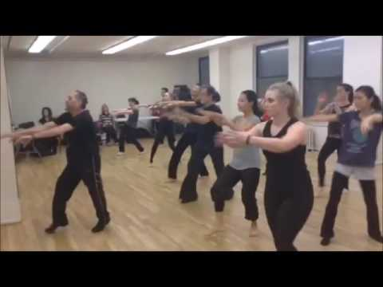
Jack Cole Technique (as taught by Chet Walker)
How Chet Walker Teaches Jack Cole Jazz
Consists of elements of:
Afro-Cuban
East Indian(Bharatnatyam)
Ballet (Cechetti)
Swing dance (“Lindy”)

Slide 12
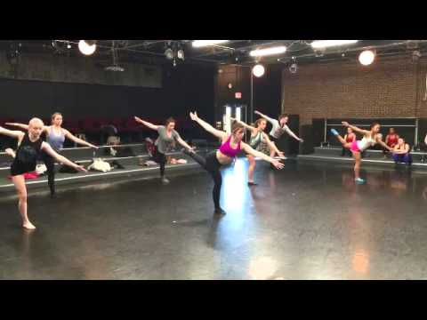
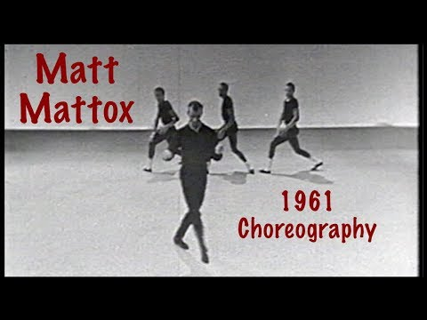
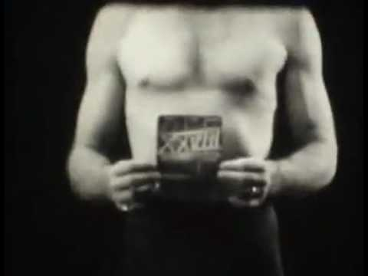
Mattox Technique
Matt Mattox

Slide 13
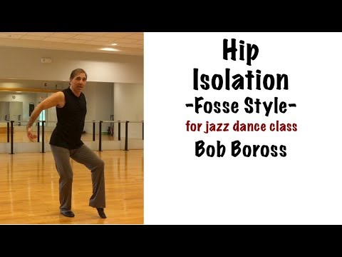
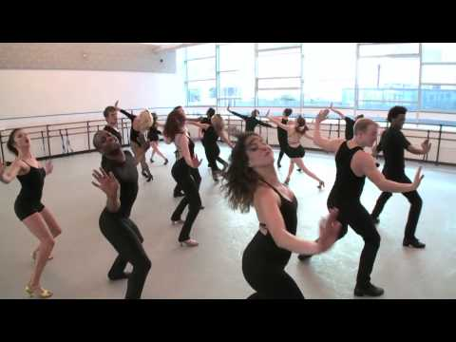
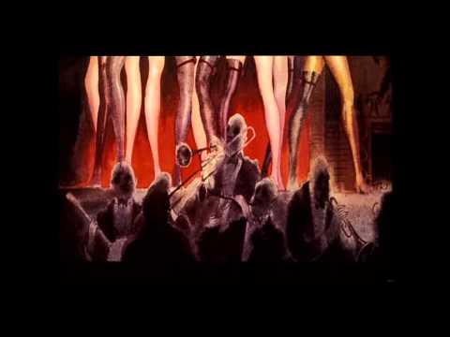
Fosse Technique
Bob Fosse

Slide 14
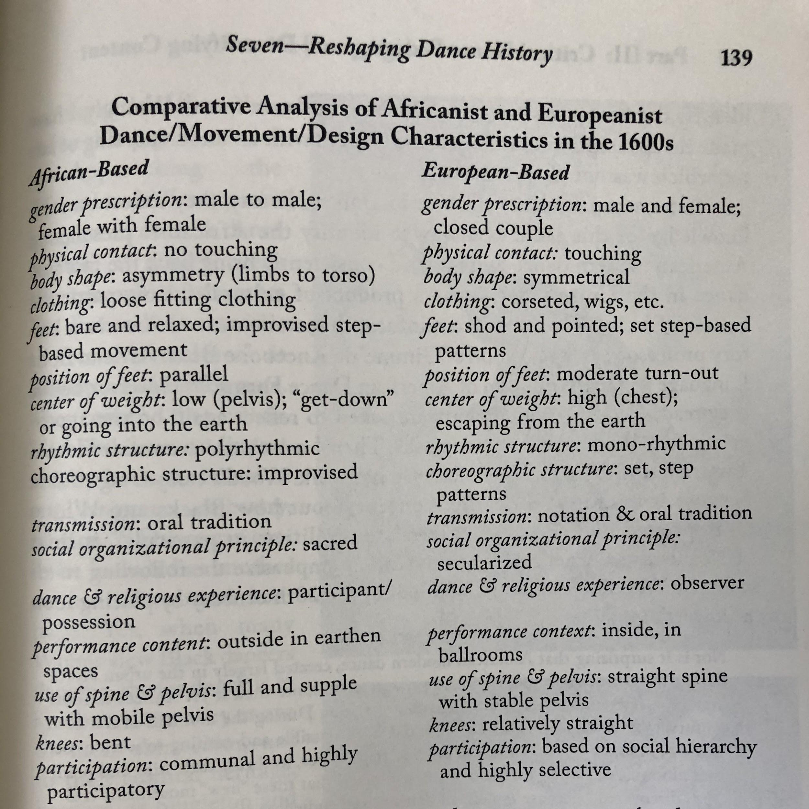
The Aesthetic of the Cool
Definition: (Hill 2009, 242)
Kerr-Berry, Julie. 2017. “Reshaping Dance History by Deconstructing Whiteness,” in Dance Pedagogy for a Diverse World: Culturally Relevant Teaching in Theory, Research, and Practice, edited by Nyama McCarthy-Brown, pp. 127–153. Jefferson, NC: McFarland.

Slide 15
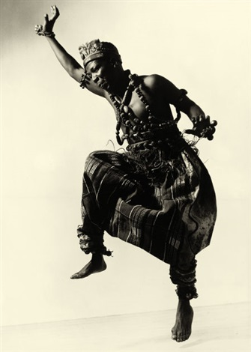
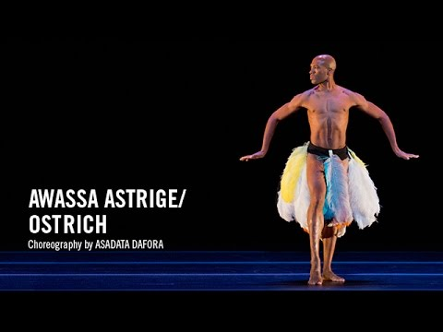
Asadata Dafora (1890–1965)
Asadata Dafora: Shagola Dances of West Africa

Slide 16
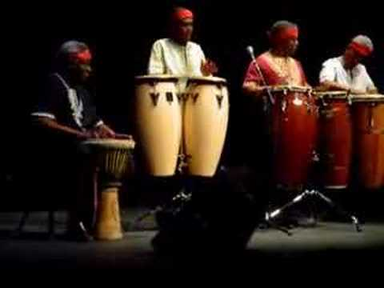
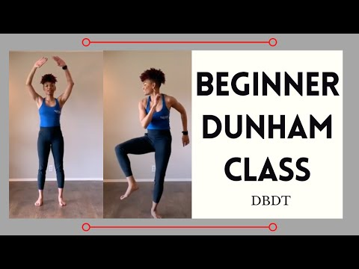
ISOLATIONS
One of the defining elements of “Africanist aesthetics” in dancing
Central to Dunham Technique
Central to Modern Jazz Dance
14 minute-mark

Slide 17
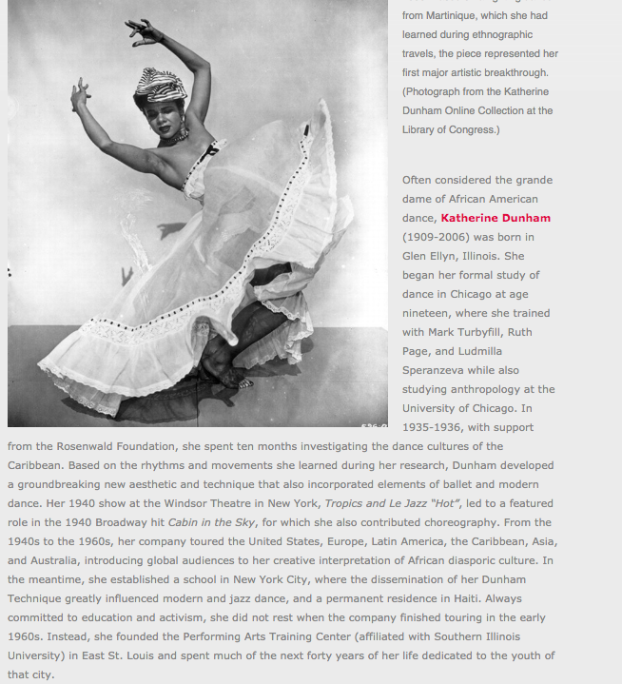

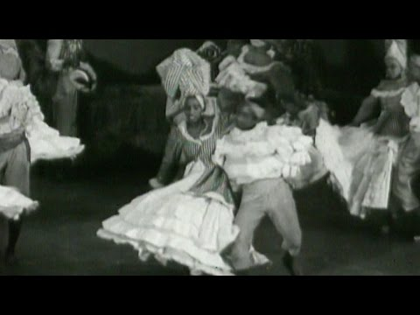
Katherine Dunham
(1909-
2006)
/

Slide 18
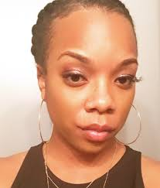
Saroya Corbett
Saroya Corbett is a certified Dunham Technique instructor and the chair of History and Theory for the Institute for Dunham Technique Certification. The dance companies in which she has performed for are the Katherine Dunham Museum Workshop, the Spelman College Dance Theatre, Kariamu and Company, and Flyground. She has also served as an instructor for the Spelman College Children's Drama and Dance Program, the Katherine Dunham Museum Children's Workshop, Studio Dionne, Drexel University and Temple University. Her choreography has been featured on Spelman Dance Theatre, CityDance Ensemble, and dance artists of Philadelphia. Saroya has a Masters in Fine Arts degree in Dance from Temple University and received her B.A. from Spelman College in economics. Also, she is on the steering committee for the Coalition of Diasporan Scholars Moving (CDSM). Currently, Saroya is a Ph.D. candidate at UCLA in the World Arts Cultures/Dance department.

Slide 19
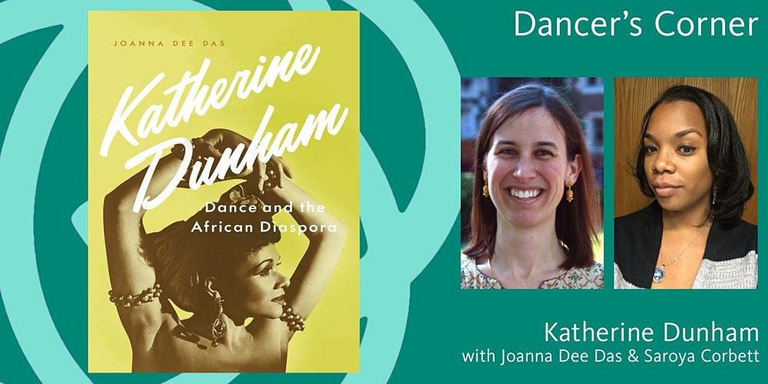
Conversation hosted by NYPL Performing Arts Library: Jerome Robbins Dance Division, just last week!!

Slide 20
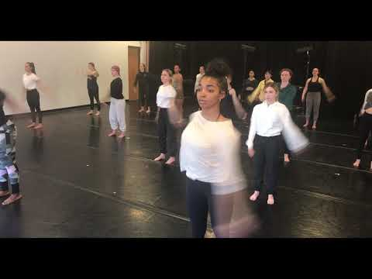
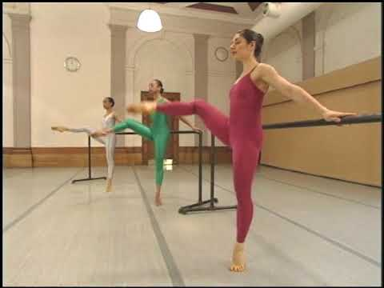
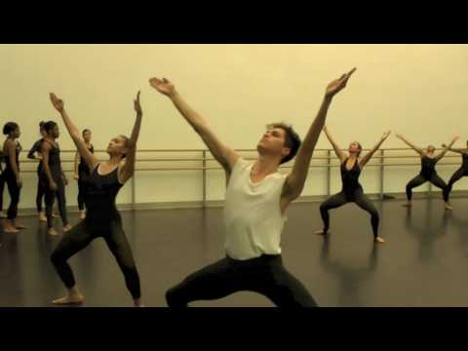
Dunham Technique

Slide 21
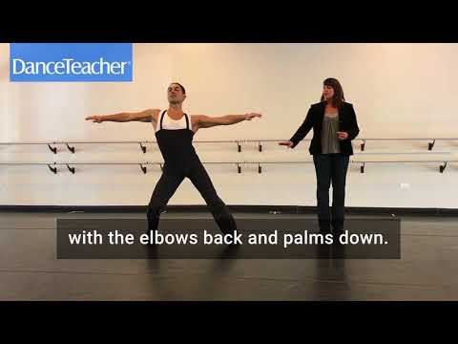
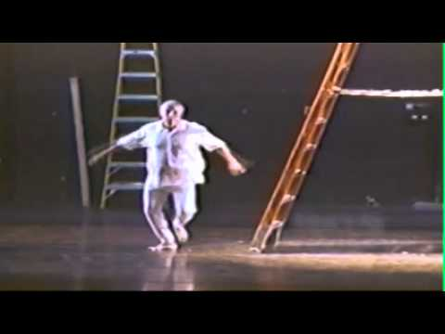
Giordano Technique
Gus Giordano

Slide 22
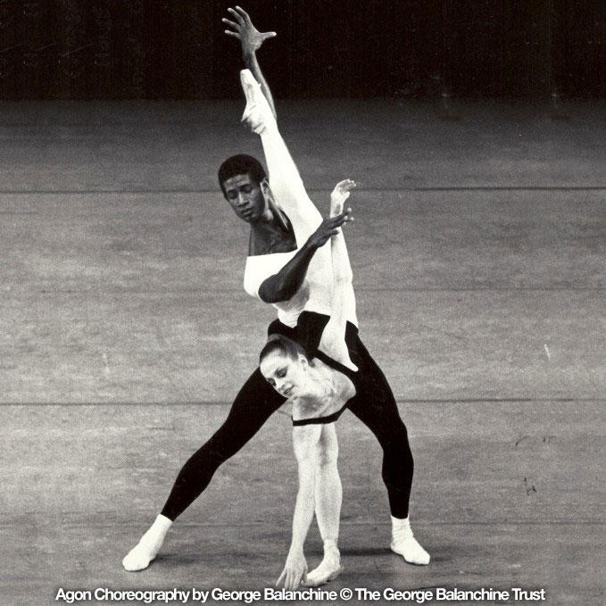
For Saturday:
Read: Jack Anderson (1992)
“The Rise of American Ballet.”
AND
Brenda Dixon Gottschild (2004) “Stripping the Emperor: The Africanist Presence in American Concert Dance.”

