Slide 1
A note to students:
These materials are intended for use by students in Bi-Co German courses. These resources are not comprehensive nor do they provide a full historical or political overview of anti-Black racism or systemic racism more broadly in Germany. These are headlines and links to articles that cover some of the larger manifestations of anti-Black racism and systemic in Germany as they pertain to higher ed and far right extremism. These resources are a starting point for exploration into a complicated and urgent matter in another national context. They will be updated, and of course please feel welcome to suggest others as well. Links are included.
Some of the articles contain descriptions of racially motivated violence, discrimination, police brutality, accounts of everyday racism, and racial slurs (in recounting an individual’s experience or for discussion on the term’s use). If you have questions, you and your peers are welcome and encouraged to reach out to your instructor for further discussion.

Slide 2
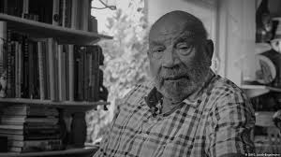
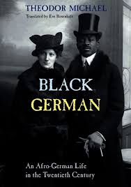
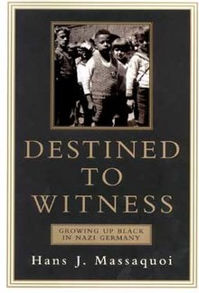
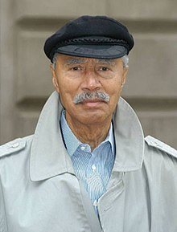
Recommended Readings:
Theodor Wonja Michael:
Young adult during the Nazi era, was in Völkerschau or Human zoos in early 20th century
Hans Massaquoi: bi-racial child during the Nazi era, later editor of Ebony magazine
https://www.dw.com/en/a-life-against-racism-theodor-wonja-michael/a-50935425

Slide 3
ÖH: Österreichische Hochschülerinnen- und Hochschuleschaft
Student Union in Austria
Discrimination occurs in many forms, be it through individuals and their words and actions or on the structural level. The forms of racisms are very different. Institutional racism (structural discrimination) means the unequal treatment by public offices and large organizations on the basis of origin, “ethnicity,” or appearance. Even post secondary institutions in Austria are anything but a space free of racism. In the following text we explain how and where it happens at the University of Vienna. [Longer translation of the document with specific ways forthcoming]
https://www.oeh.univie.ac.at/politik/standpunkte/rassismus-der-universitaet

Slide 5
Note: a referat can be an oral presentation, but in this context it is an organized group within a university with a specific purpose
The autonomous BIPOC referat aims to set the precedent, that the university can be an institution that consciously deconstructs its colonial history and assumes the responsibility. The goal of the referat is to support marginalized and racialized d groups at the university.
The work of the referat is to mobilize people, who would like to support the creation of a racism-critical university. The referat strives to create a room for a respectful dialog and place of meeting, independent of race, class and gender. It is concerned with addressing racist issues and ongoing reflection. The work of the BIPOC Referat takes place in with awareness to the fact that, because of the colonial past, even the spaces of the BIPOC Referat cannot lay claim to being free of racism. The Referat represents the goal, to recognize and encourage actions and thoughts that are racism-critical.
The referat should create a safe space for students, who are confronted with racism, in which they can speak about conflicts that they encounter….

Slide 6
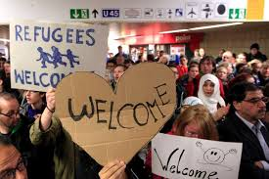
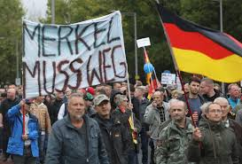
Germany’s Migration Crisis (c. 2015 ): Two Reactions under Merkel’s Leadership
Willkommenskultur : Welcome Culture
Far Right nationalism, ,,Merkel must go”
Organizations and political parties: PEGIDA (Patriotic Europeans against the Islamisation of the Occident/Patriotische Europäer gegen die Islamisierung des Abendlands) – Okt 2014
AFD (Alternativ für Deutschland/Alternative for Germany) –2013

Slide 7

Das politische System in Deutschland
Parteien in Deutschland
Sitzverteilung im Bundestag
Division of Seats in Bundestag
Germany does not have a two party system. There are many political parties, but only those with the most votes make it to the Bundestag.

Slide 8
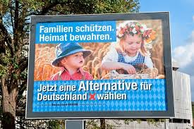
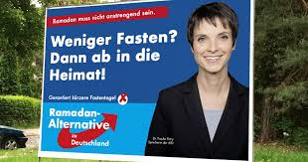


Das Wahlplakat für AfD → Election Poster
Protect families, preserve Heimat
Choose an alternative for Germany now!
Less fasting? Then go to the Heimat!
Ramadan
Alternative
German core/mainstream culture!
Islam-free schools
Colorful diversity? We have it already.
*bunt can also mean amalgamated, mixed

Slide 9
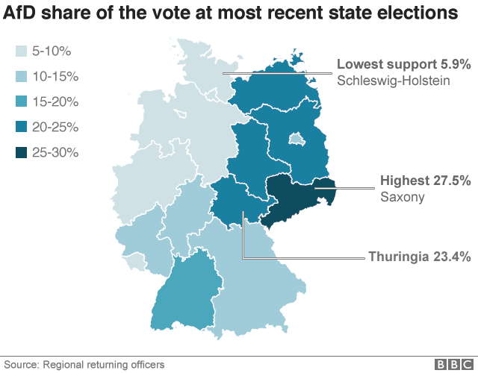
Greatest support for the AfD is in former East Germany, in particular in the state Saxony, where Dresden and Leipzig are located.
Brandenburg
Berlin
Sachsen
Thüringen

Slide 10
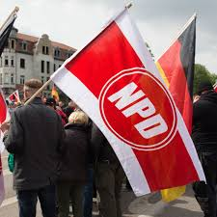
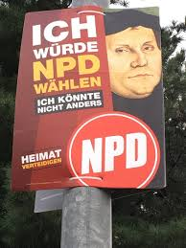
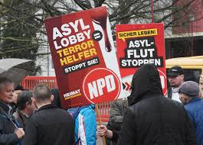
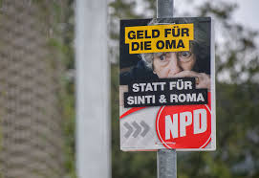
Nationaldemokratische Partei Deutschlands (NPD)
Does not have representation in Bundestag
Money for grandmas instead of sinti and roma.
I would vote for NPD. I couldn’t vote any other way!
Defend Heimat

Slide 11
https://abcnews.go.com/International/wireStory/recent-deadly-racist-attacks-germany-69104703
For a list of dates and descriptions of events, please see the link. The article was published in the wake of the far-right extremist attack in Hanau in 2020.

Slide 12
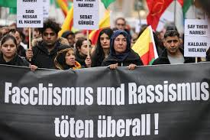
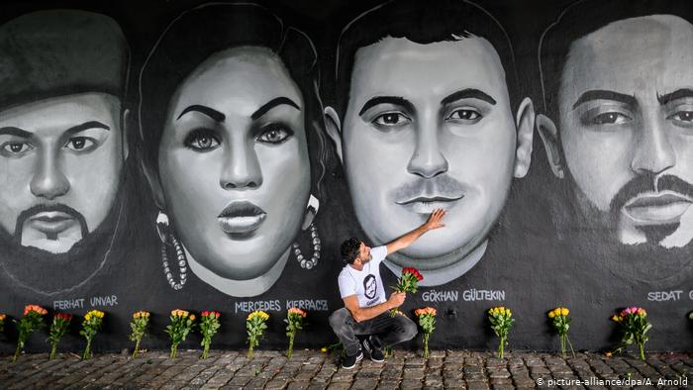
Say their names
Facism and Racism kill everywhere
https://www.dw.com/en/how-will-hanaus-victims-of-far-right-terror-be-remembered/a-54644557

Slide 13
https://www.nytimes.com/2020/10/06/world/europe/germany-police-far-right-report.html

Slide 14
Nebenbedeutungen: ,,Vaterland”

Slide 15
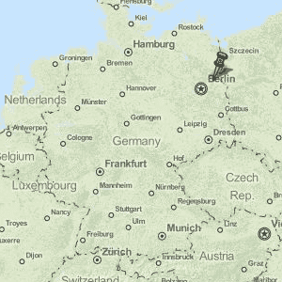
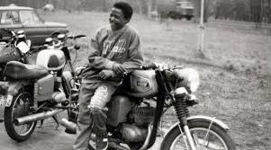
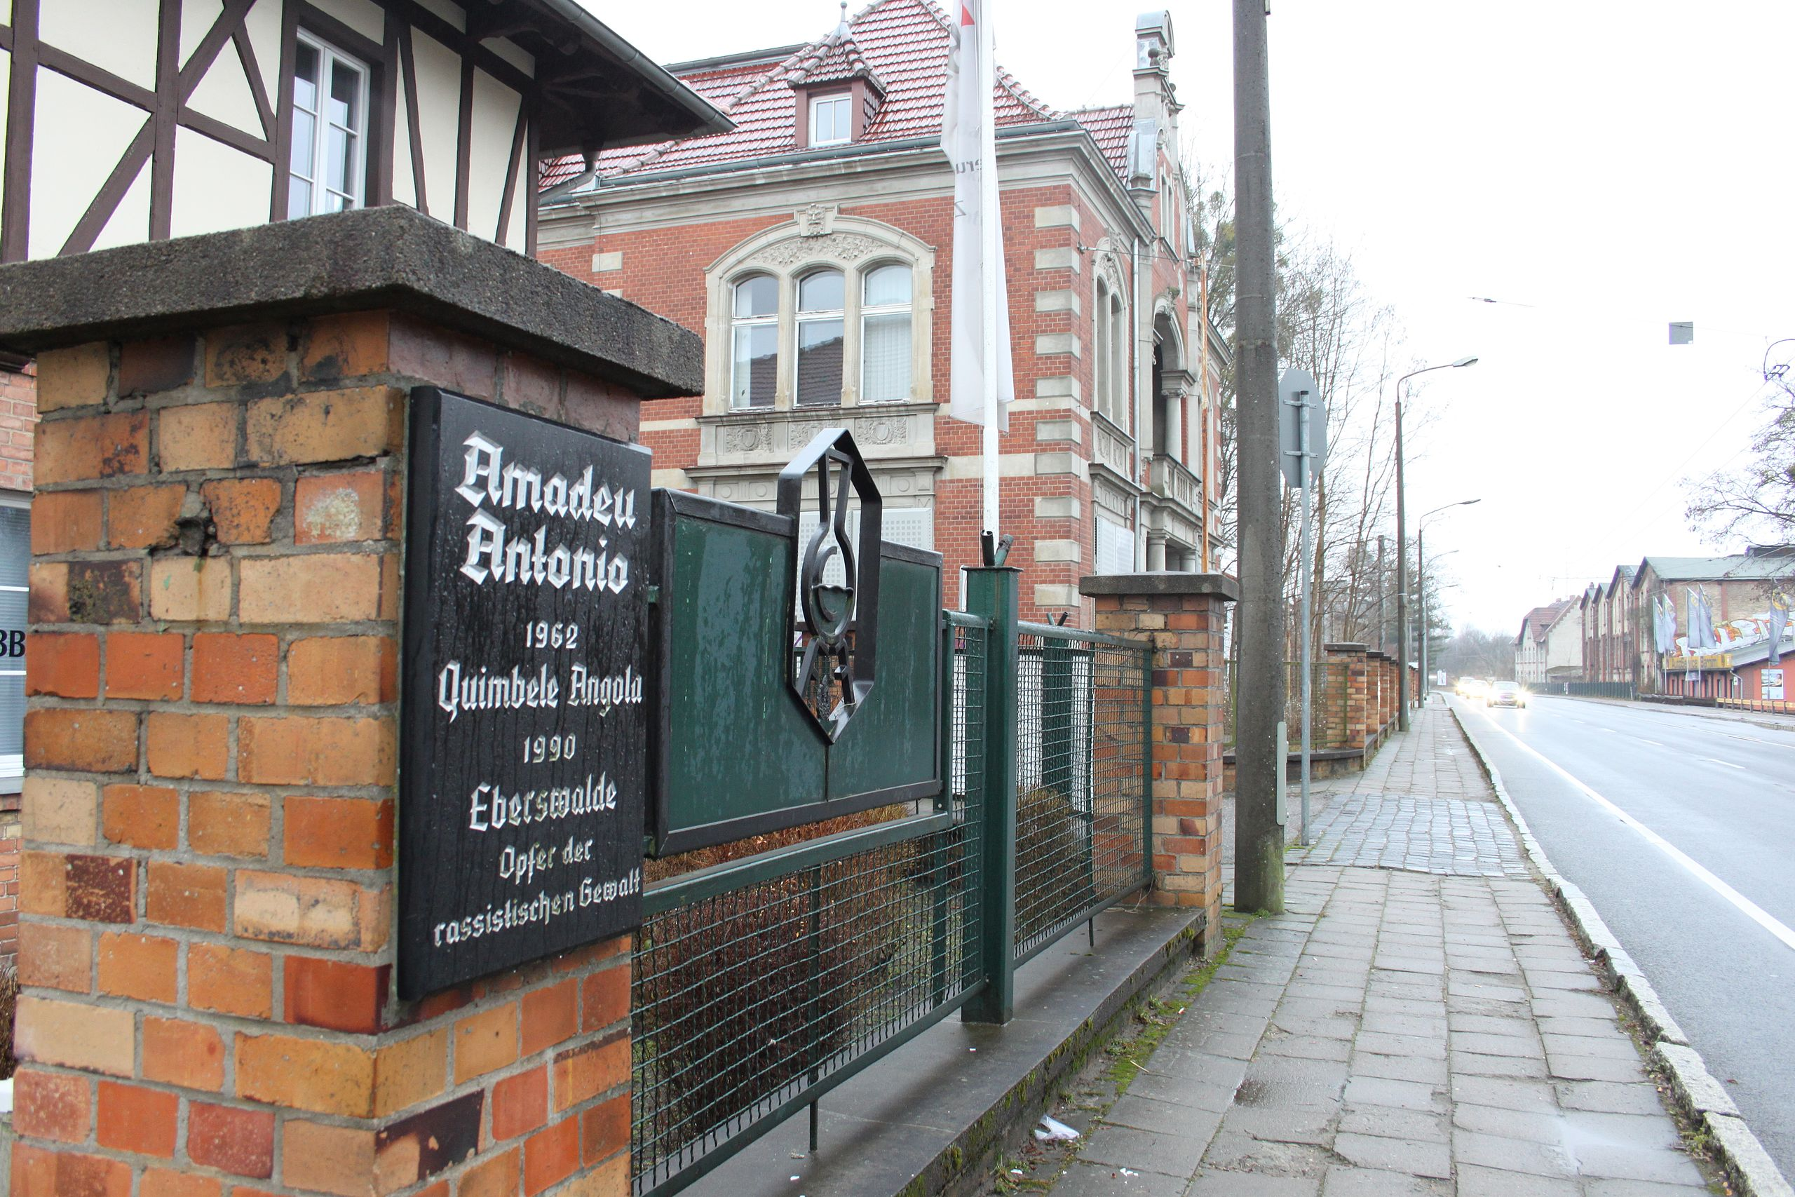
Eberswalde was a bad nest
Eberswalde
Amadeu Antonio
Amadeu Antonio Schimansky next to the memorial plaque for his father Amadeu Antonio. The Angolan was so badly attacked by a right-wing mob on November 25, 1990 that he died 11 days later.

Slide 16
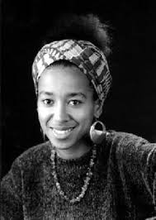

See Ayim PDF in Moodle, for poem deutschland im herbst
May Ayim

Slide 17
Stiftung = organization
https://www.amadeu-antonio-stiftung.de/en/

