Slide 1
GLOBALIZATION/CONNECTION: A WORLD OF FLOWS

Slide 2
Dealing With CURRENT EVENTS
Discussion and engagement with current events are part of a liberal arts education –and Cities as a field of discussion. We the need to assess and act on responsibilities as citizens in multiple communities. There are many ways of acting; we encourage you to follow your conscience without concern for consequences from us. And to engage in discussions in and out of class.
At the moment, as BMC faculty, we will continue to teach and store information on Moodle for those who do not attend. By the end of the week we will face other choices on the basis of dialogues we hope to foment.

Slide 3
MAPPING THE REST OF THE TERM: GROUP PROJECTS
All projects assigned and read. ASSIGN ROLES
This week: (1) Reach out to organizations
(2) Online search
(3) Maps
Alums can be last point since it will be more experience than data
Next week: Presentations

Slide 4
SCHEDULE OF PRESENTATIONS
M November 9 CENTER: Race St. Meeting Hous, Mother Bethe, Bassett’s, Trocadero
Th Nov 12 SOUTH: Spark’s Shot Tower, Geno’s, Hoa Binh, Wing Phat
M Nov 16WESTWARD Boyd Theater, Tandoor Restaurant, Bushfire, Eglise de Dieu
Th Nov 19 Finishing/Discussion OR MOVED BACK

Slide 5
UNGRADED PRESENTATIONS SHOULD BE DONE AS POWERPOINTS 10 Minutes
(1) SHOWING AND DISCUSSING THE SITE: visual materials, interviews, news
(2) SETTING IT INTO N’HOOD CONTEXT What is the neighborhood like? Does the site fit in it or have links beyond it?
(3) CENSUS MATERIALS AND CHANGE OVER TIME (including first project)
5 minutes questions and comments; written comments follow from fac.
GROUP WRITTEN PROJECT (MOODLE) DUE NOVEMBER 25 5PM

Slide 6
PROJECT 3 –Due December 10+ (Last day of classes)
Take A SINGLE issue from the course and examine it through your hometown. We will also allow you to do research and writing on Philadelphia issues if that is important to you.
Use specific readings on class, race, education, police, environment, transportation (remember Favela as smart contrast)
Use analytic tools as well –census, arcGis, visual and textual readings
Post Topic on Moodle by November 12 so we can comment

Slide 7
VIRTUALMAJOR INFORMATION SESSION NOV 11?
More information will be forthcoming. Courses for next semester will be posted.

Slide 8
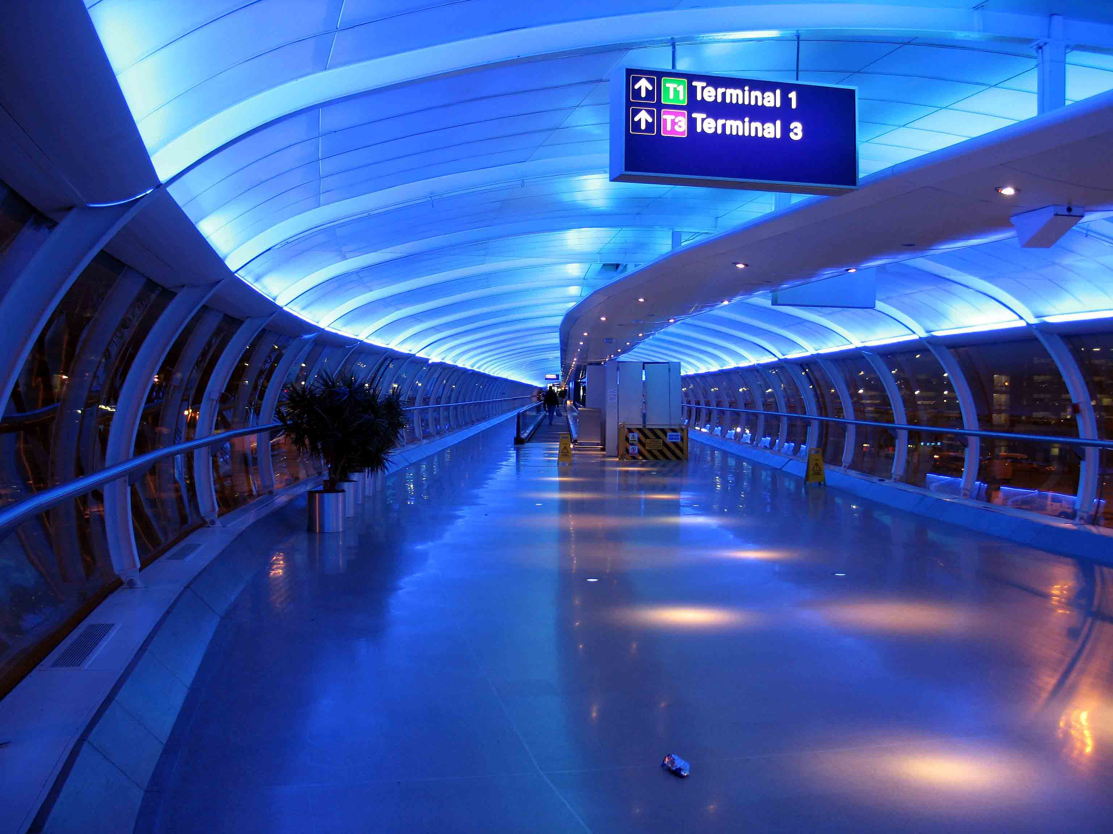

Slide 9
Cities are both intensely local and intensely global: the global paradox OF FLOWS (CASTELLS MEETS PERLMAN AND AUDIRAC)
Cities are centers of human mobility (Burgess) but do not control laws of flows (immigration) or wider socio-cultural divisions of people.
Cities are centers for finance and capital flows but do not contro lbanks or national trade policies/tariffs.
Cities are centers for flows of ideas but do not control national and cultural firewalls .
Cities are deeply divided so the experiences of global flows are refracted by class, race, gender and space –which may also challenge these divisions.
We live simultaneously in the space of flows and in the everydayness of the local as Castells notes. LET US CONSIDER SOME HISTORIES OF CONNECTION, TRANSPORTATION AND COMMUNICATION

Slide 10
WallS and gateS: What Is moved and kept out?
Beijing
Fez
Dubrovnik

Slide 11
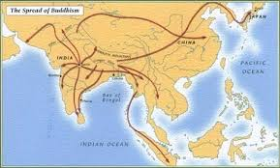
And yet culture moveD: BUDDHISM 5th century BCE to 7th century CE (Japan)

Slide 12
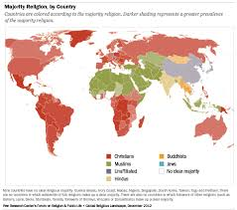
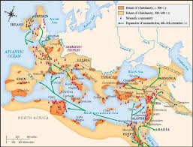
CHRISTIANITY (1st Century CE-) MiSSIONARIES AND CONQUeRORS

Slide 13
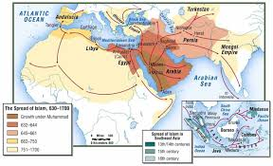
ISLAM AND CHRISTIANITY

Slide 14
AND SO DID DISEASE: BUBONIC PLAGUE

Slide 15
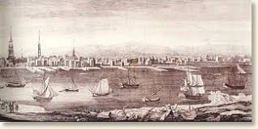
MODERN portS: LONDON AND PHILADELPHIA AS COLONIAL CONNECTIONS

Slide 16
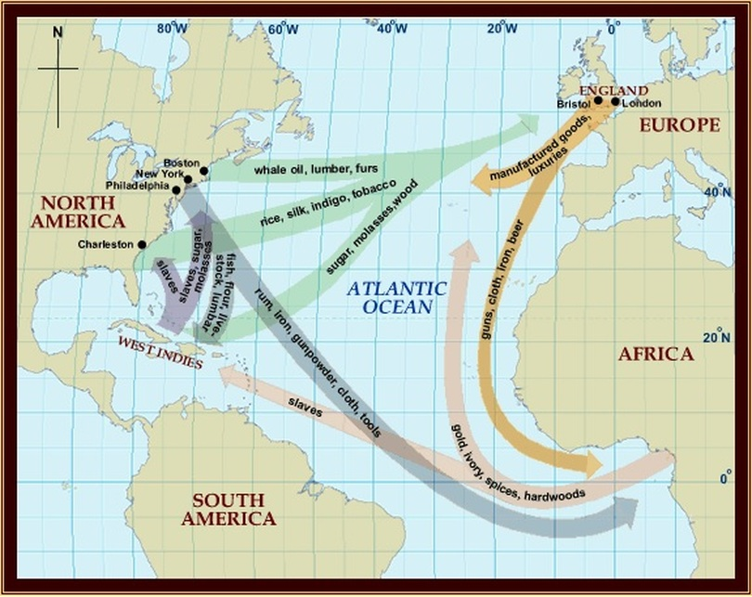
What moved? HOW?
BUILDING INEQUALITY

Slide 17
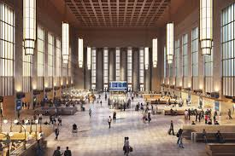
19TH C. Train stationS: CAPITALISM REBUILDS THE CTIY

Slide 18
Key to Pennsylvania’s success was the establishment and use of its rail network. The Commonwealth’s rail freight network consists of more than 5,000 miles of track served by 64 operating railroads. According to 2015 estimates, more than 200 million tons of goods and commodities, worth more than $250 billion, are carried on Pennsylvania’s rail freight network. To maintain such a thriving network, Pennsylvania also administers one of the largest rail freight grant programs in the U.S. https://www.penndot.gov/Doing-Business/RailFreightAndPorts/Planning/Documents/Rail%20Freight%20and%20the%20Commonwealth%27s%20Economy-%20FINAL.pdf

Slide 19
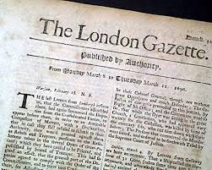
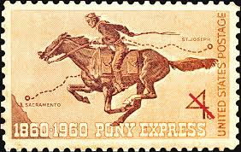
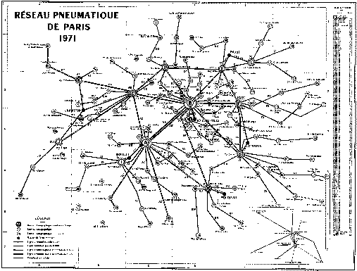
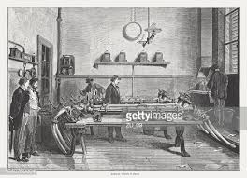
Moving Information

Slide 20
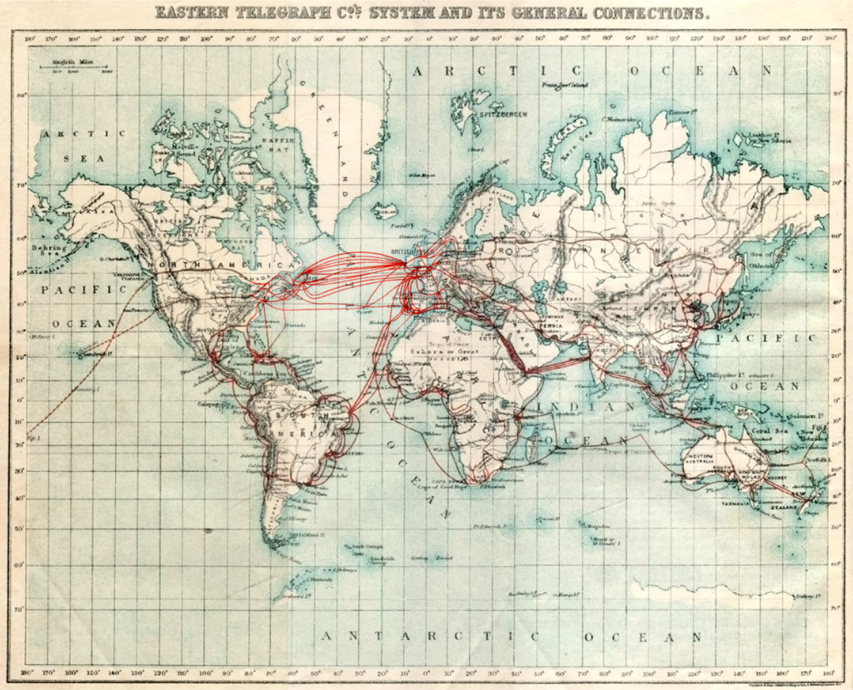
WHEN DOES INFORMATION TRAVEL FASTER THAN OthER GOODS: Submarine Telegraph cables

Slide 21
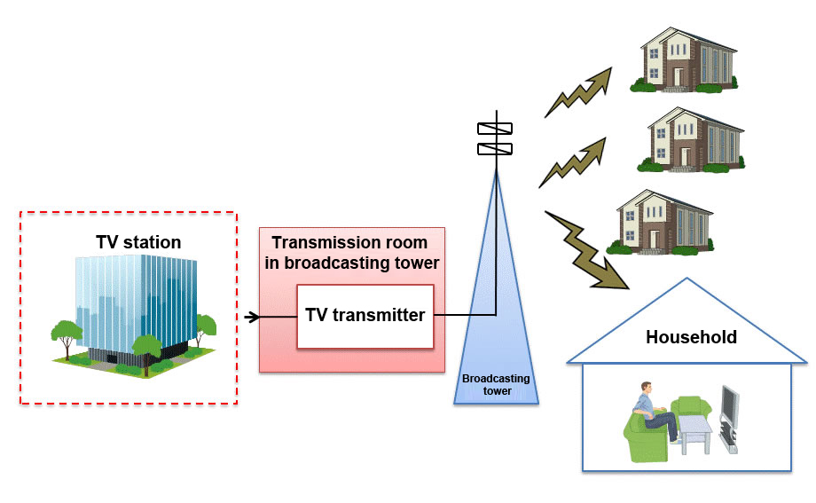
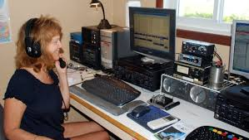
Sending and receiving messages

Slide 22

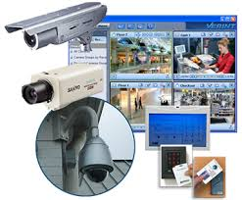
WHO HOLDS POWER AND HOW?

Slide 23

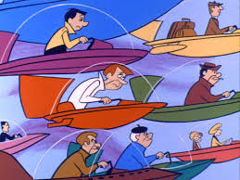
LOCAL SYSTEMS AND GLOBAL SYSTEMS
Walking, Horses, Bicycles, Trolleys , Trains, and Busses serve urban public or mass transportation and interurban transportation, even though systems of connection differ…. AND JENNIFER WILL TALK ABOUT THE LOCAL REGIONAL ON TH
What about airplanes?

Slide 24
airportS
Almost all airports in the U.S., like that in Philadelphia, are owned by cities that began to develop them in the 1920s to modernize transportation (PHL is in the same site). Its $400,000,000 annual budget now comes from fees from airlines and other services. It also adds $14 billion per year to the local economy. But is it a non-place?

Slide 25
ARE AIRPORTS NON-PLACES?

Slide 26
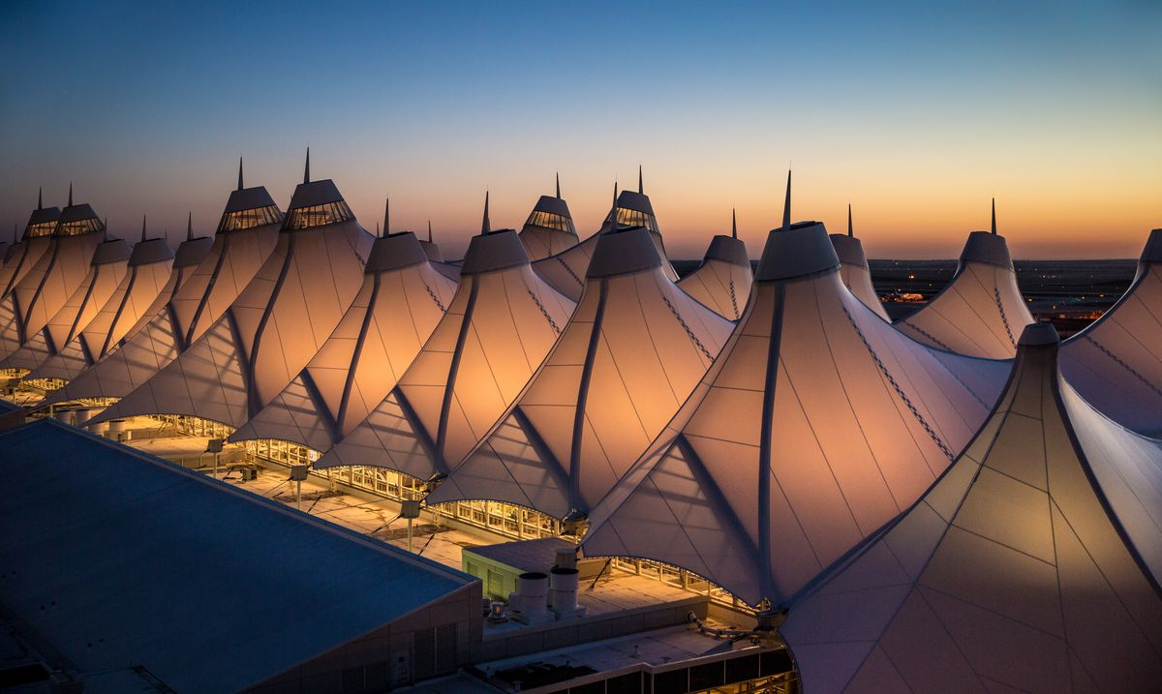

Slide 27
CAN AIRPORTS LOOK DIFFERENT?
Kuala Lumpur
Bangkok

Slide 28
HONG KONG: the airport as icon and site of protest

Slide 29
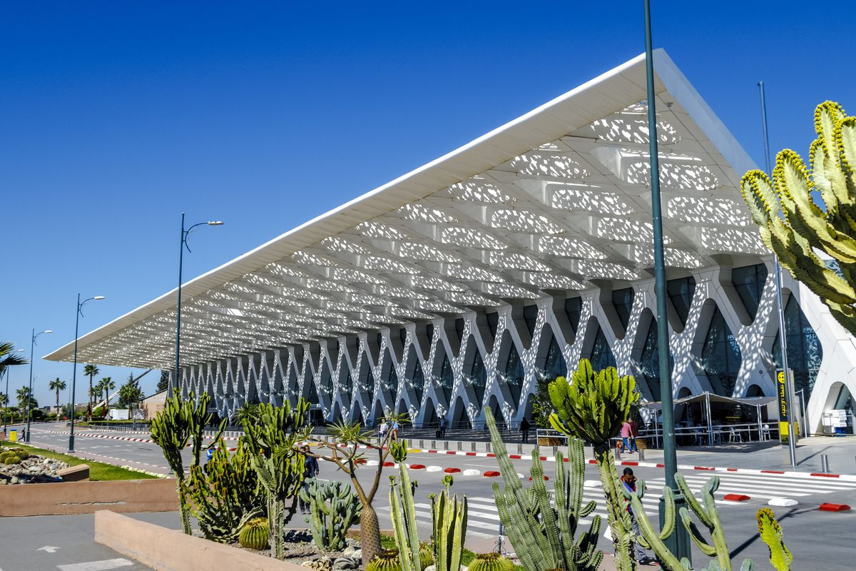

Slide 30
What else moves through airports?

Slide 31
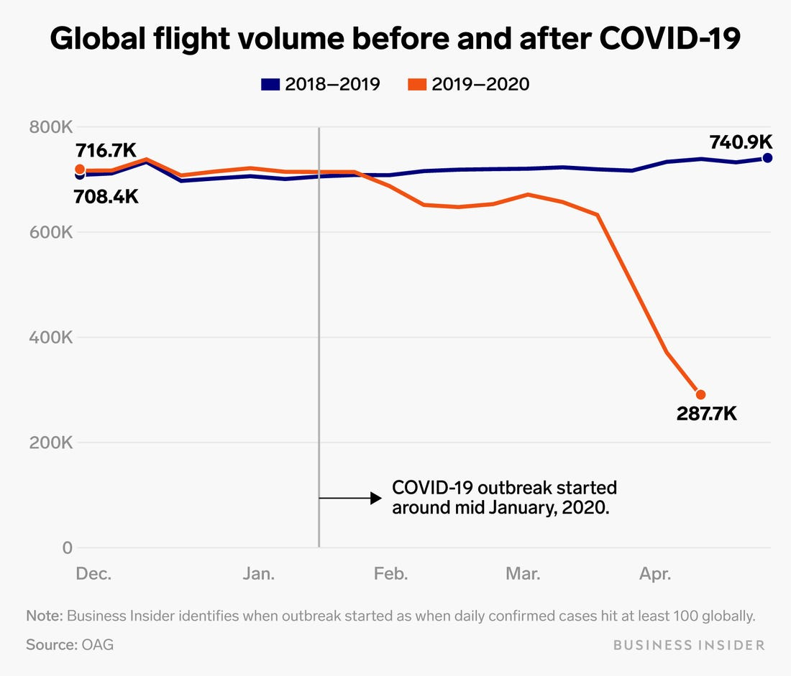
Final Notes on aiports and connections
In the past, almost twice as many illegal immigrants entered the U.S. through airports (overstaying) than across the Southern Border. But has the world changed?
In the past, almost twice as many illegal immigrants entered the U.S. through airports (overstaying) than across the Southern Border. But has the world changed?

Slide 32
httpsresearch-insight/blog/airports-are-facing-a-new-re
://www.gensler.com/

Slide 33
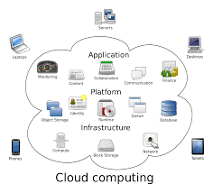
Or will we just zoom? Does thE INTERNET change CITIES, LOCALIZATION AND globalization?
Equality/Inequality of Service and Opportunity
How has Access?
To What?
How Fast?

Slide 34
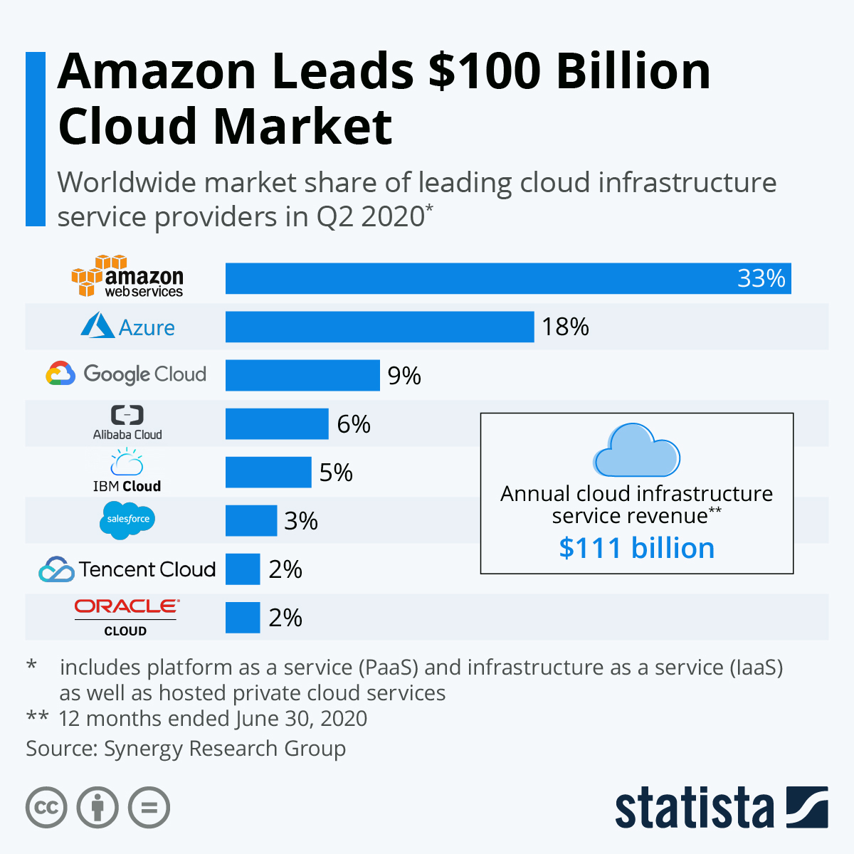

Slide 35
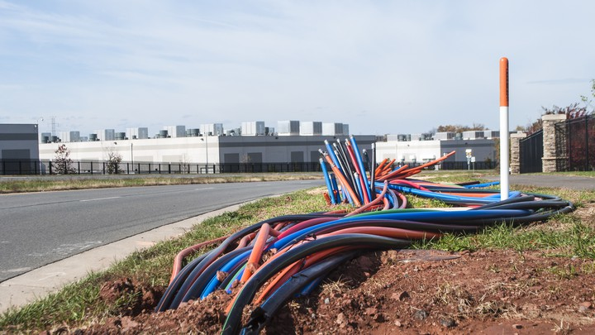
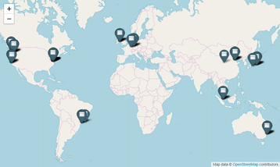
https://www.theatlantic.com/technology/archive/2016/01/amazon-web-services-data-center/423147/

Slide 36
GLOBALIZATION AND INEQUALITY?
How has Globalization Created Opportunities and Scarcities?
Ideas
Goods
Human Experience
How are these divided?
What else moves?

Slide 37
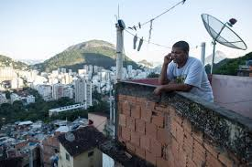
Nine out of ten residents of the favelas in Rio de Janeiro, under the age of 30, access the World Wide Web. The majority access the Internet on a computer from home and prioritize social media, such as Facebook, when online. https://www.rioonwatch.org/?p=6847

Slide 38
AND WHAT HAVE FAVELA RESIDNETS SEEN OF THE WORLD?
Goods, Race, Consumption, Public Health, Power
How can we be empathetic?

Slide 39
Labor and waste in an internet agE: GLOBAL INEQUALITIES

