Slide 1
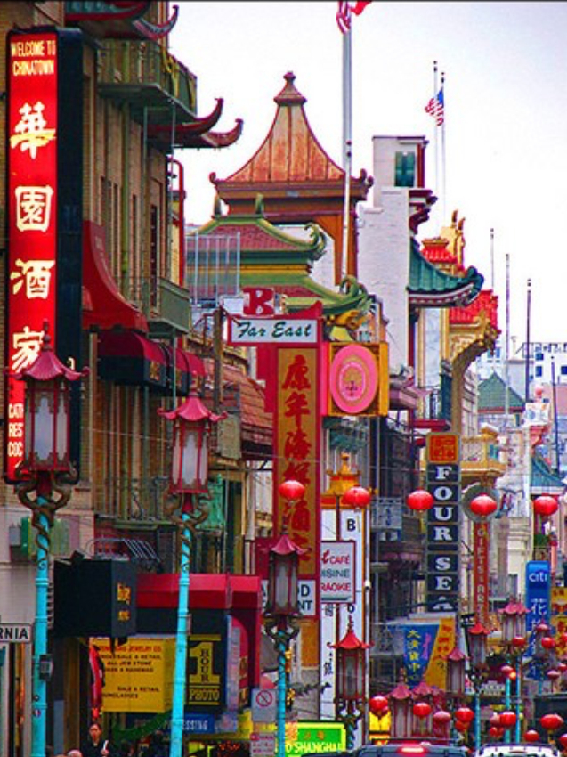
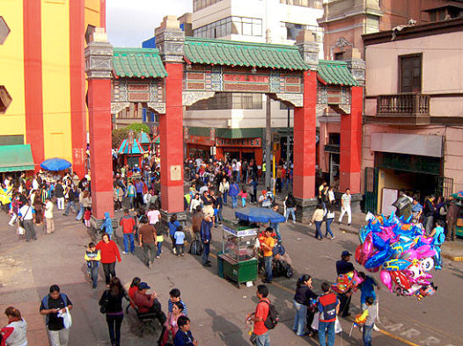
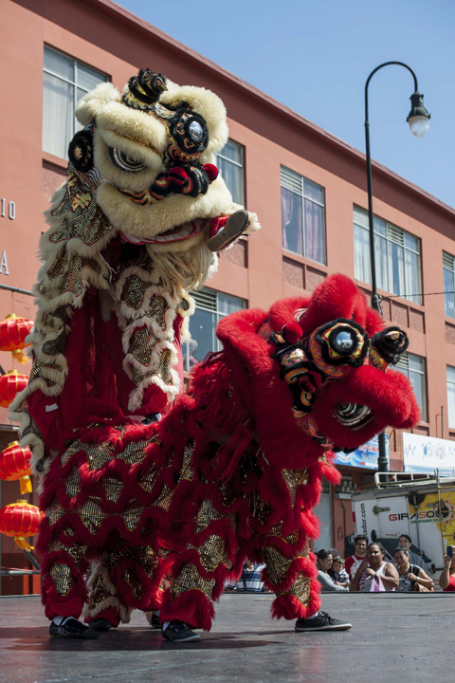
https://www.youtube.com/watch?v=-V-dsK4behw

Slide 2
Have you been to a Chinatown?
How did you know that
https://video.foxnews.com/v/5154040766001#sp=show-clips

Slide 3
Practical Matters
Assuming the Bryn Mawr Strike ends you may complete the class in one of two ways:
Paper 1 50% and Final Paper (Assignment 3) 50% due on last day of class.
OR
Paper 1 (35%), Individual analysis of Group project (5-8 pages) 30% and Paper 3 (30%). Both due on last day of class.
The second allows you to learn about Philadelphia.

Slide 4
Final Paper
Take a concrete issue from the class based in readings and ask what it means for our hometown.
E.G. Water in my hometown has been provided by public services but they have also decided to turn off water to those who cannot pay. What do protests tell us about rights and public responsibility in ctiies?
My office hours are not working so email for an appointment if you wish.

Slide 5
Next Semester
First Year: City 190 Form of the City (Econ, Survey of Western Architecture in History of Art)
Second or Third Year Majors: 229 The Colonial and Post-Colonial City
History of Art 253 Western
201 GIS
Advanced Courses include New Urbanism , Housing and Dwelling (new course by alum), Collegiate Architecture, London

Slide 6
Defining Chinatowns
Chinatowns are widely-identified “othered” spaces in metropolitan areas, often near central cores, that have served to both set apart descendants of the Chinese diaspora and allow for the construction of community and connection by these people and others. They combine residential, commercial-economic and cultural functions and may also have political roles including order and social services. While Chinatowns very from nation to nation over time, they also constitute a global network in dialogue with an ever changing China itself as an empire to a nation-state.
AND
They pose general questions to urban studies about the construction of space, race, citizenship, community development and other critical themes of urban society and culture.

Slide 7
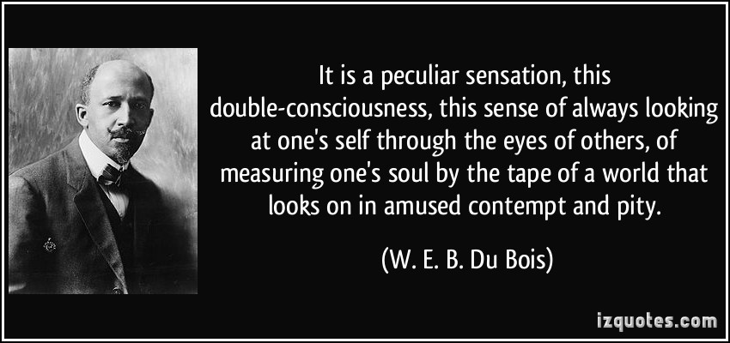
CHINESE ARE NOT ALONE
Some Brazilians long considered themselves White. Now many identify as Black as fight for equity inspires racial redefinition. NYT 11/9/20

Slide 8
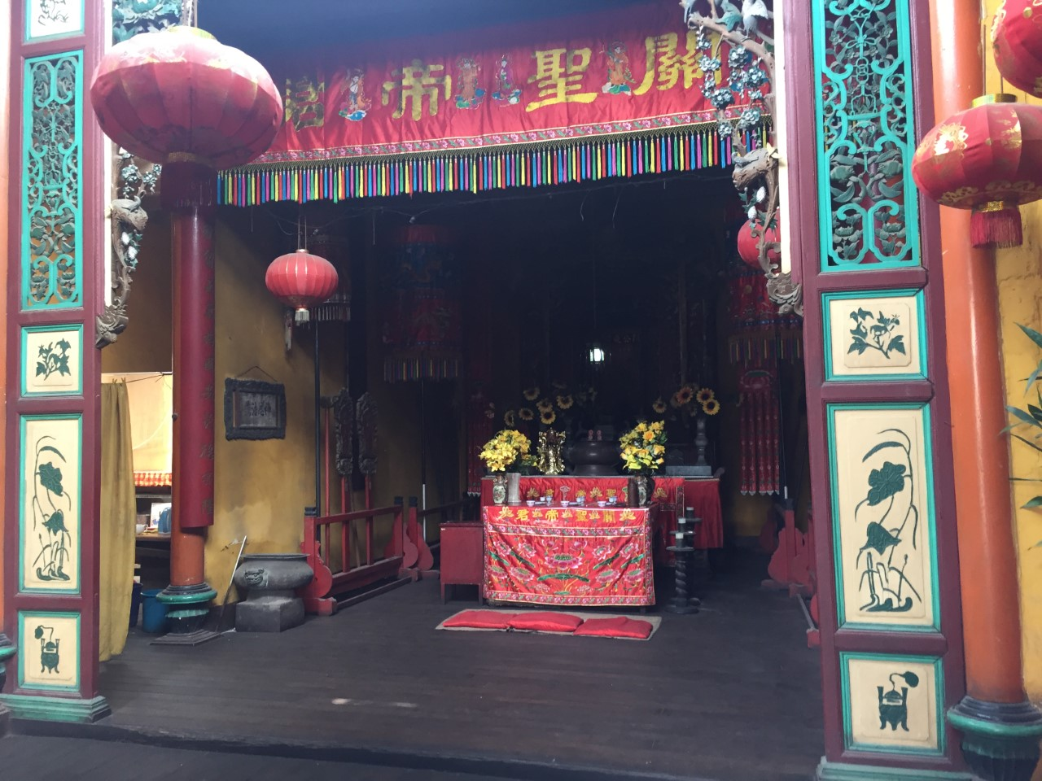
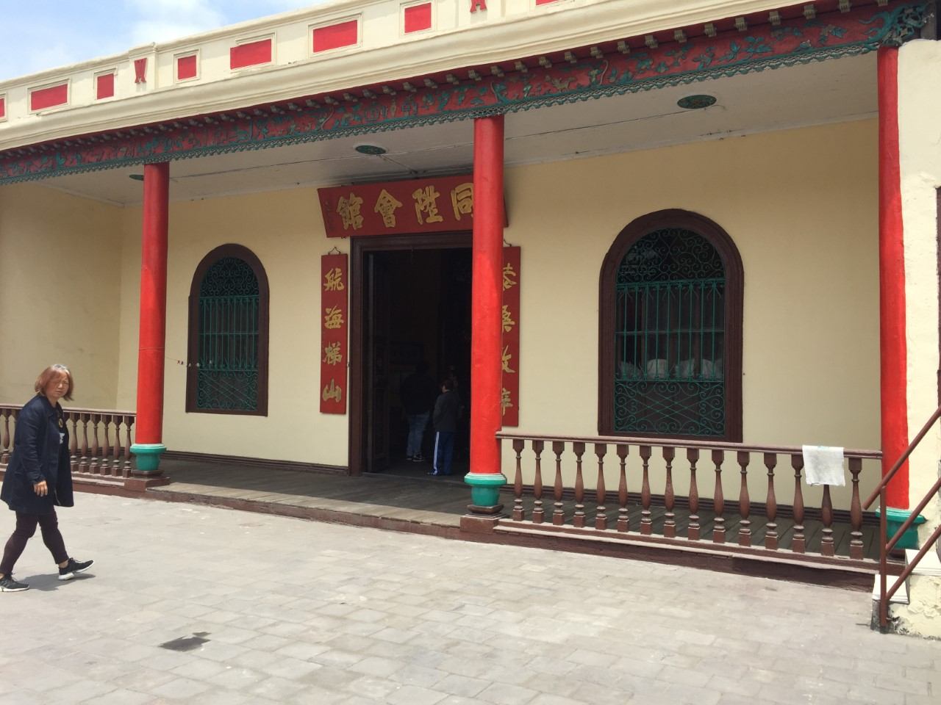
AVOIDING ESSENTIALISM
Brilliance and exuberance of construction makes it easy to reduce to a racialize and racializing space. Race is integral but not essential, but it is also constructed
Visiting a temple in Peru…

Slide 9
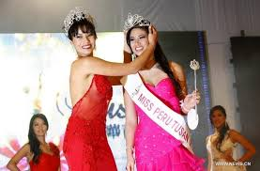
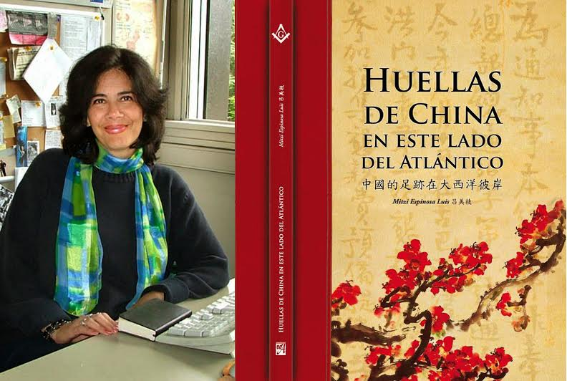
Mestizaje

Slide 10
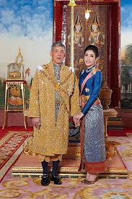
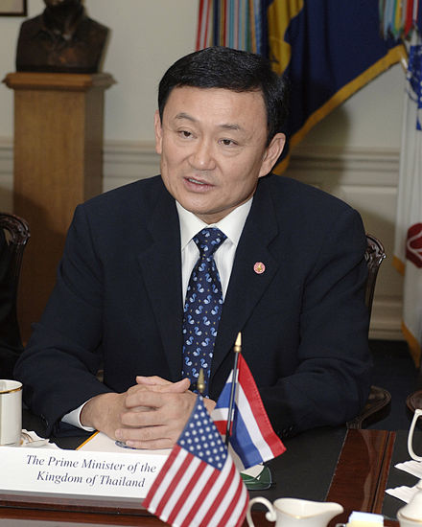
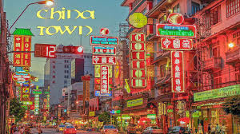
Thailand
Thaksin Shinawatra
King Maha Vajiralongkorn

Slide 11
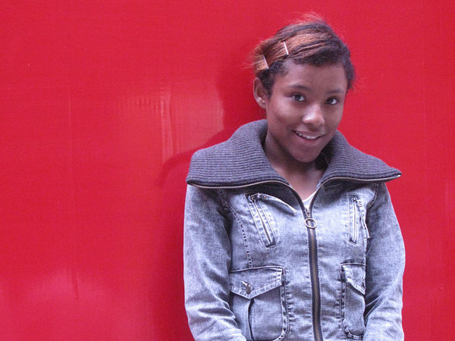
China: Lou Jing 2009 https://www.theguardian.com/world/2009/nov/01/lou-jing-chinese-talent-show

Slide 13

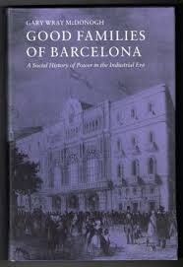
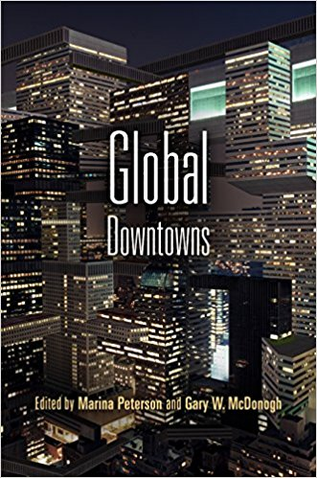
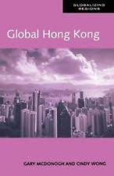
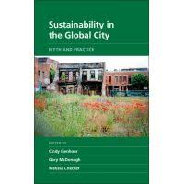
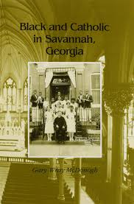
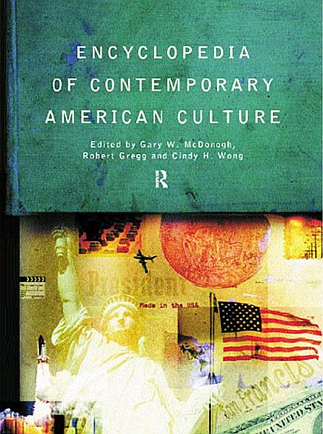
Research as a Sort of Life

Slide 14
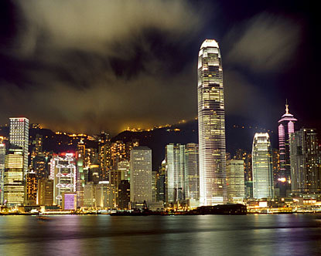
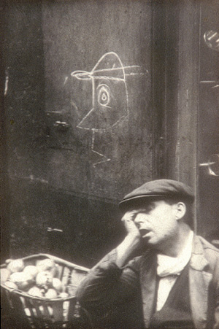
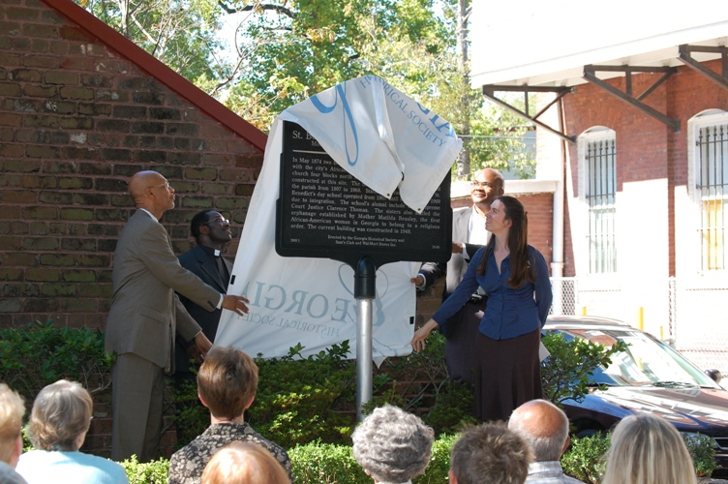
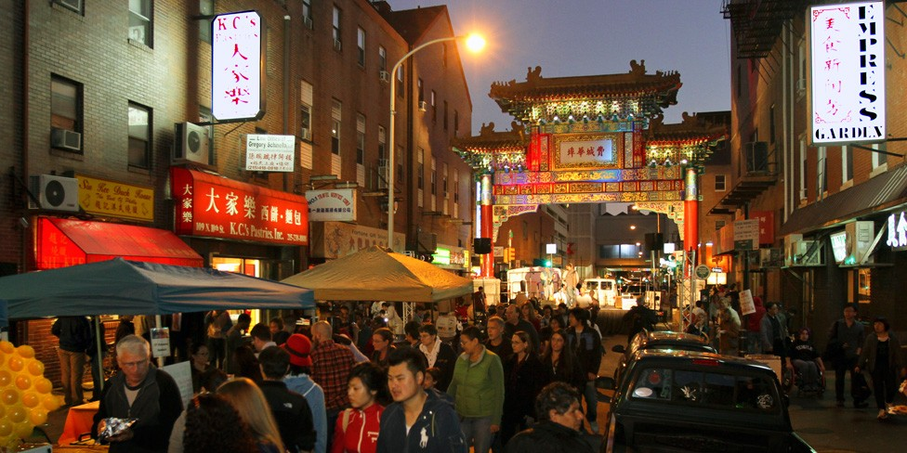
My Histories
In terms of Cities….

Slide 15
Chinatowns: From Experience to Questions…

Slide 16
THEMES
URBAN CONFLICT
DIVISIONS OF RACE, CLASS, STATUS
URBAN IMAGINARIES
COMPARATIVE URBANISMS AS REFLECTION

Slide 17
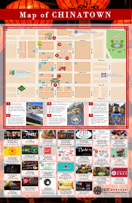
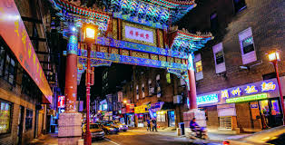
Images of Distinctive
Places: Philadelphia

Slide 18
CHOLON, HO CHI MINH CITY
VIETNAM

Slide 19
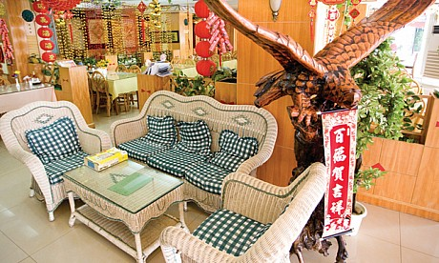
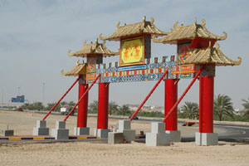
Dubai

Slide 20
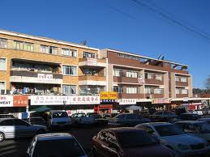
Johannesburg
JOHANNESBURG, SOUTH AFRICA

Slide 21
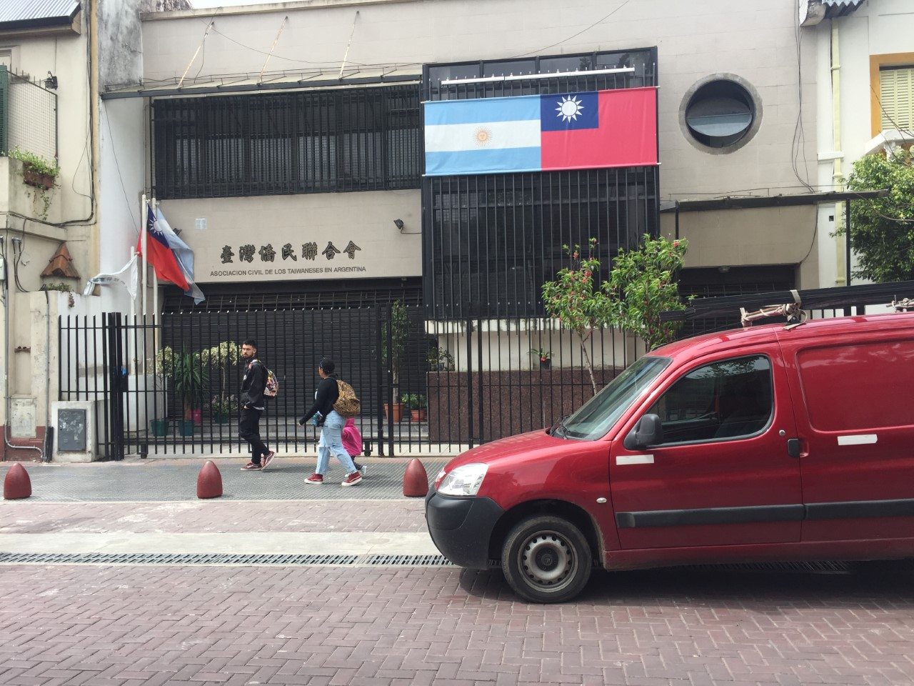
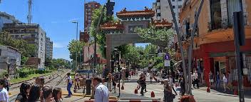
BUENOS AIRES, ARGENTINA

Slide 22
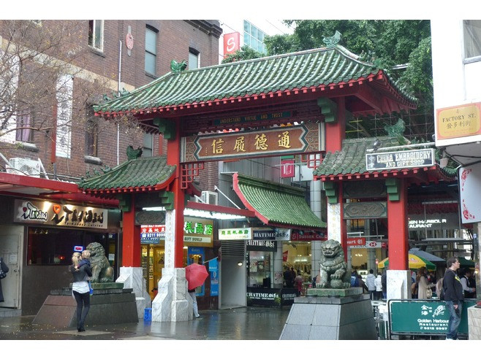
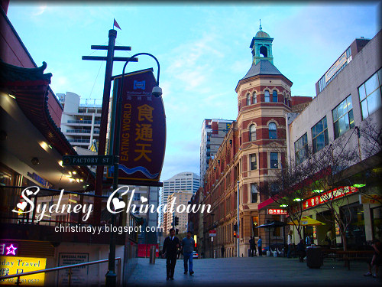
SYDNEY, AUSTRALIA

Slide 23
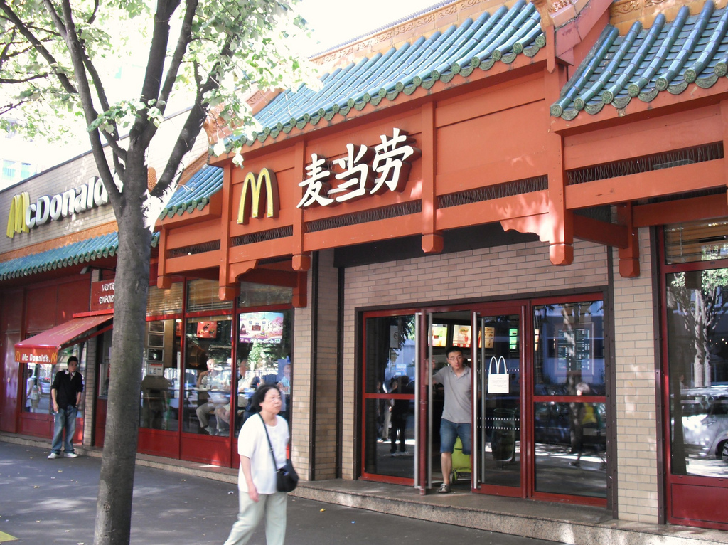
PARIS, FRANCE

Slide 24
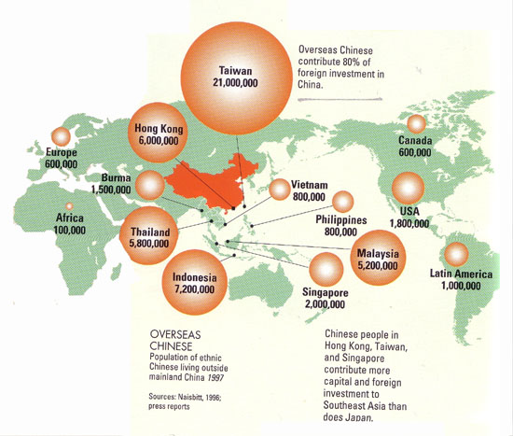
The need for global context

Slide 25
Defining Spatial Citizenship
By spatial citizenship, we mean the legitimated connection of people and space, including legal residence, secure ownership and lives and cultural meanings that include a dialectic of identity and hybridity, nuanced by –and reshaping national laws, urban place and individual and family lives. Drawing on Lefebvre, Mitchell and our own work, this includes legal citizenship (immigration), security in place (Chinatowns), cultural representation and identity and political activity using place. RACE IS ONE COMPONENT OF THIS BUT IS ALSO CONSTRUCTED IN DIALOGUE WITH OTHER FEATURES

Slide 26
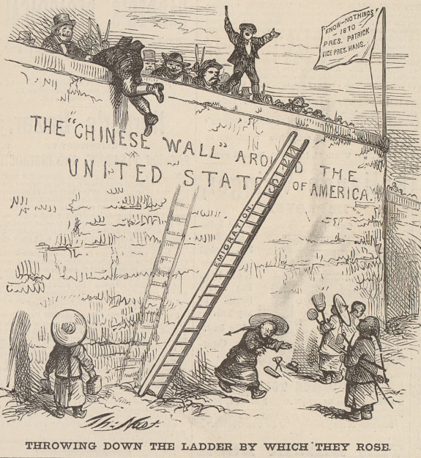
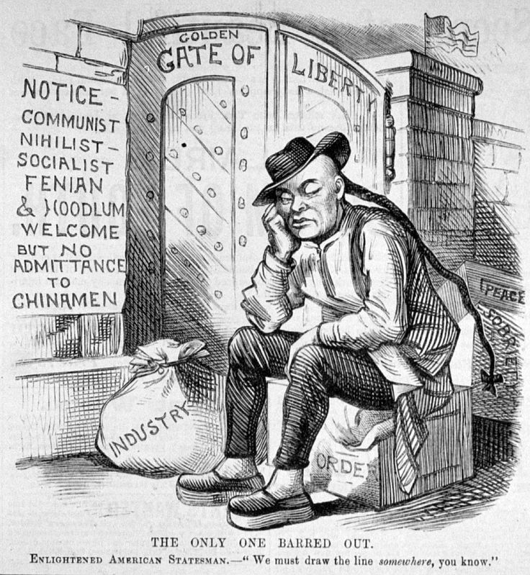
DEFININGLegal Limitations on Citizenship: the U.S

Slide 27
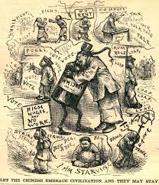
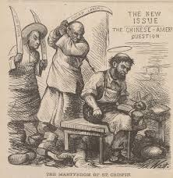

Slide 28
Racializing U.S. Citizenship AGAINST CHINESE
Establishing Fundamental Categories of White, Black and Indian over early decades.
Challenges to Whiteness, Blackness and Indigenous Citiaenship
Arrival and success of Chinese met by Exclusion 1881-1945, with modifications and debate.
Race defined by phenotype: whiteness and passing BUT ALSO Cultural citizenship

Slide 29
AMERICAN RACIAL CATEGORIZATION VS. MESTIZAJE

Slide 30
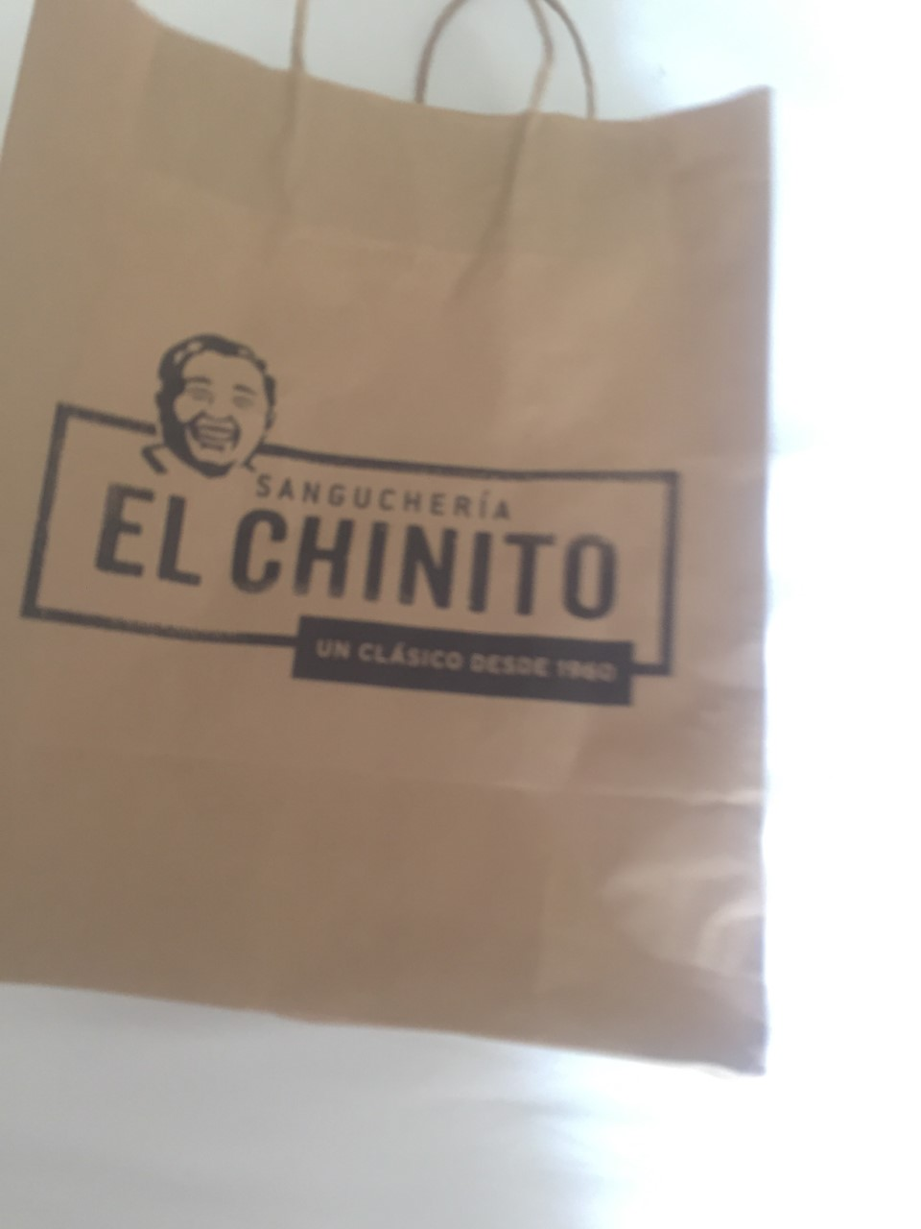
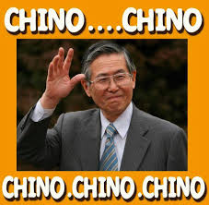

Slide 31
Changint Influences IN U.S.
Bachelor society in U.S. and disappearance of Chinatowns
Families & Chain Migration after 1960s
Class patterns of Model Minority: Old and New Immigrants
BUT CHINESE ARE NOT THE SAME AS CHINATOWNS

Slide 32
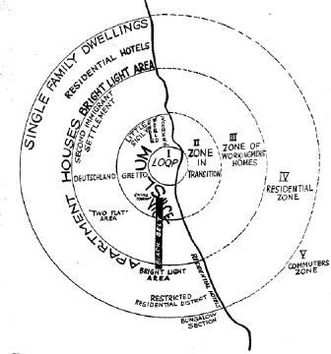
LOCATING Chinatowns and Movement:1920s American Sociology
Chinatown
The Chicago School Model

Slide 33
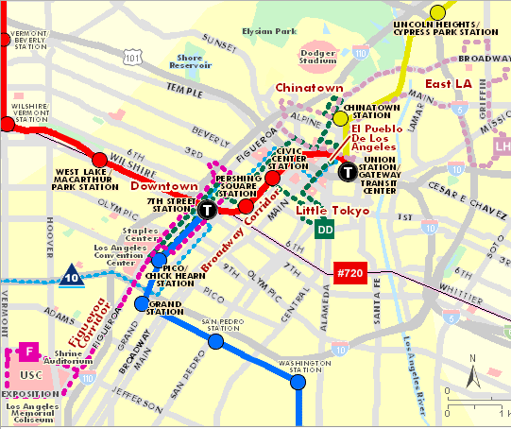
Los Angeles

Slide 34
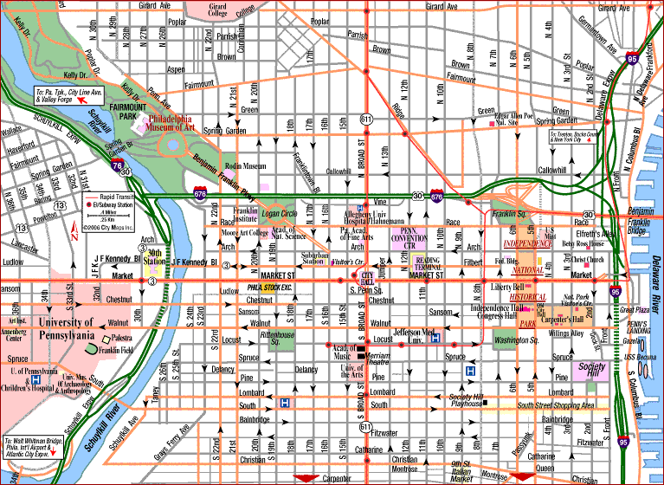
Philadelphia, USA
Chinatown

Slide 35
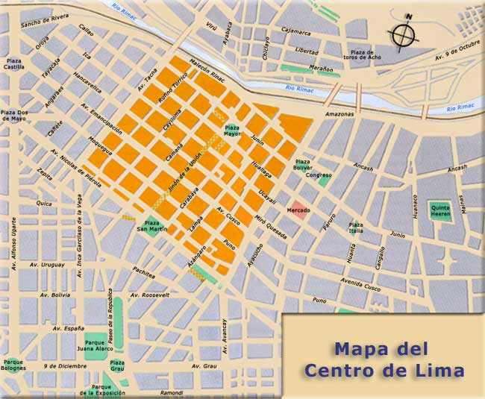
Lima, Peru
barrio chino

Slide 36
Lima, Peru
barrio chino

Slide 37
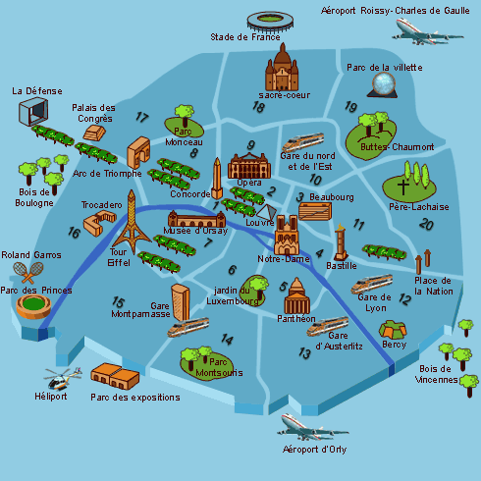
Paris, France
Origins at center
Postcolonial refugees near wider center
Commercial investment competes
New Suburbanites
4
2
3
1
2

Slide 38
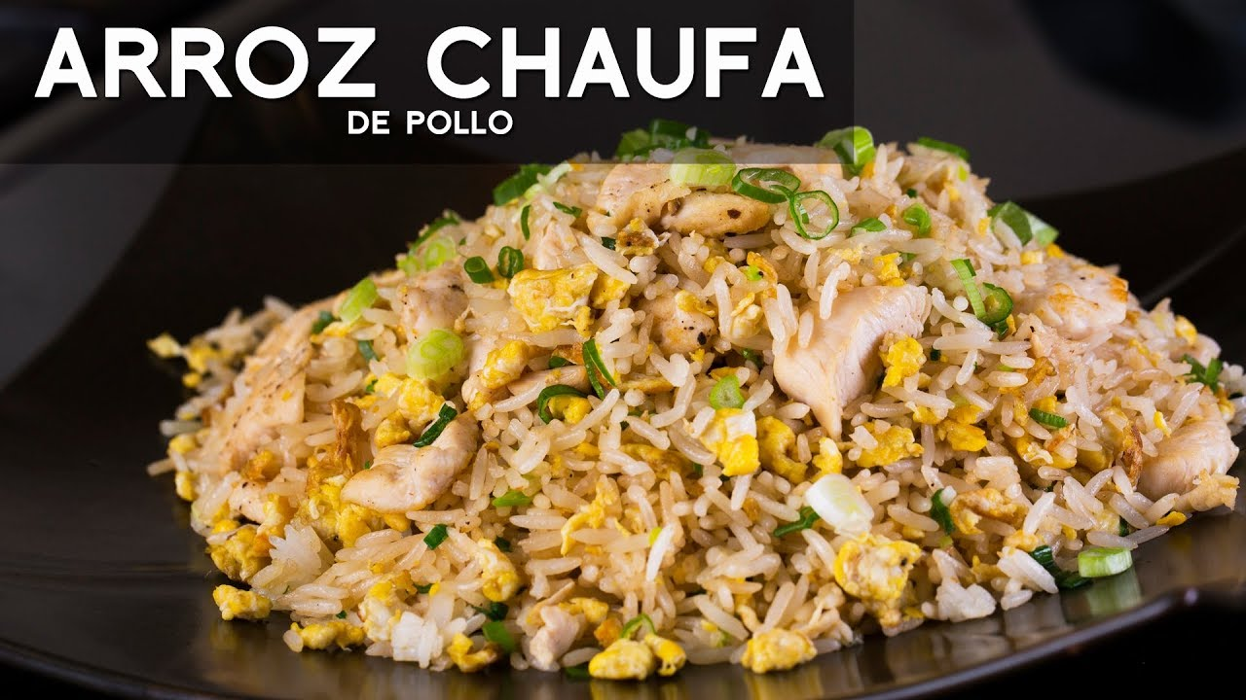

Slide 39
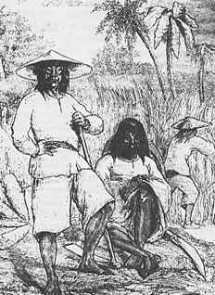
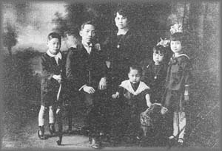
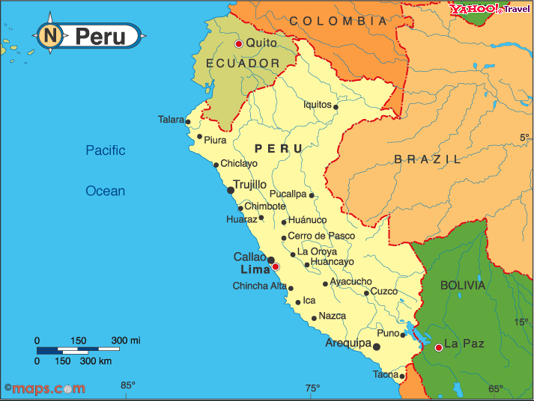
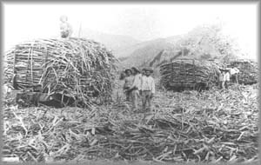
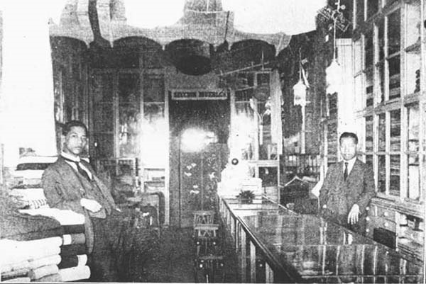
Peru: Movements from fields (and abroad) to cities in 19th C. Peru created Chinatown over time

Slide 40
Mapping Chinatown
barrio chino

Slide 41




LIMA, PERU

Slide 42
Lima, Peru
barrio chino

Slide 43


Peru: Middle class Business and Family: seeking legitimacy as modern foreigners in the 20th century

Slide 44



Suburban Chinese
Today

Slide 45



Lima: Institutions and Restaurants in the suburbs

Slide 46


Institutions for the Future
Colegio X Octuber
Colegio Juan XXIII

Slide 47
Conclusions
Labor Migration redefines its position through elite migration and
Upward mobility over generations .
Old Chinatown remains central space of memory and supplies; Chinese as indviduals permeate society.
New Chinatown around new migrants. “authentic food”

Slide 48
Paris, France
Origins at center
Postcolonial refugees near wider center
Commercial investment competes
New Suburbanites
4
2
3
1
2

Slide 49



The Center As Transport Hub, 1920s

Slide 50





Post-Colonials on the Edge of the City: Choisy, 1970s & Belleville, 1980s
B
C

Slide 51


Wenzhounese Claiming the Retail Downtown: Marais &Sedaine-Popincourt

Slide 52



”Chinagora” Paris (1980s/90s)

Slide 53




Paris Chinese Suburbs/ Banlieues 2000+

Slide 54


Aubervilliers: Global China in the
21st Century

Slide 55
Paris, France
Origins at center
Postcolonial refugees near wider center
Commercial investment competes
New Suburbanites
4
2
3
1
2

Slide 56
Philadelphia, USA
Chinatown

Slide 57




Urban Walls

Slide 58

Gentrification: A Spatial Threat to Many Chinatowns
“Distinctive condo building in convenient Chinatown location. 90 Condos In Recently Renovated Building. Must See!! This Is A 24 Hour Doorman Bldg. Parking Available Nearby. Available With Decks.

Slide 59
Why Aren’t Chinese Gentrifiers?
Think about implicit bias in models of change –do social scientists and planners value certain “kinds” of change and ignore others?
Why is Chinese gentrification not stable?
Real estate, location, imagery….

Slide 60
Philadelphia, USA
Chinatown

Slide 61


Protests

Slide 62



Political Citizenship: Figures

Slide 63

Wider Engagement: LA Protests against Walmart (2013-2016)

Slide 64
IMAGERY

Slide 65

19th C. San Francisco: Vice as an alternative to nearby downtowns

Slide 66


Slide 67



Changing and Conflicting Images: Gangs and Model Minorities
)

Slide 68




Chinese (Global) Media as Response

Slide 69

VISIONS OF NEW CHINATOWN Guayaquil, 2005
http://pepezurita.blogspot.com/2006/05/chinatown.html

Slide 70

San José, Costa Rica

Slide 71


Wholesale cities
Badalona, Barcelona

Slide 72


Post-Modern Ties: the Future of Chinatowns and Downtowns

Slide 73


Johannesburg

Slide 74
What is a Chinatown?
https://www.youtube.com/watch?v=Wmw9Y6OPI0M
https://www.youtube.com/watch?v=mthEKl0LMpA
https://www.youtube.com/watch?v=IEtG4vfxLJA
https://www.youtube.com/watch?v=S_wR3PuB7vc

