Slide 1
Enviromental justice and environmental privilege

Slide 2
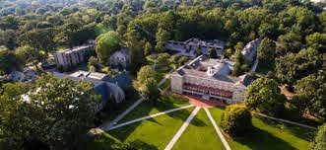
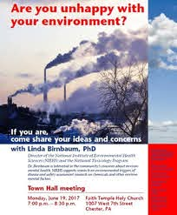
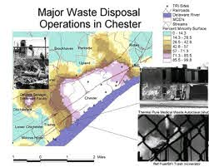

Slide 3
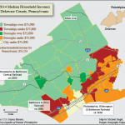

Slide 4
Once a muscular city of 66,000, Chester lost a third of its population -- and more than 40,000 jobs -- between the end of World War II and the coming of Ronald Reagan. Elected Mayor, the town's leading mortician suggested turning out street lights -- actually letting the city go dark -- to save money. Many streets are desolate. Young prostitutes prowl the doorways of burned-out buildings. In addition to these misfortunes, Chester has become the waste-processing capital of Pennsylvania -- and a national battleground on the issue of environmental justice.
The city was already polluted from a long history of steel and heavy manufacturing. The desperate need for new jobs made the situation much worse. Chester began to accept waste-treatment facilities that rich neighbors like Swarthmore and Bryn Mawr wanted no part of…
“Life in the Toxic Zone” NY TIMES September 1996

Slide 5
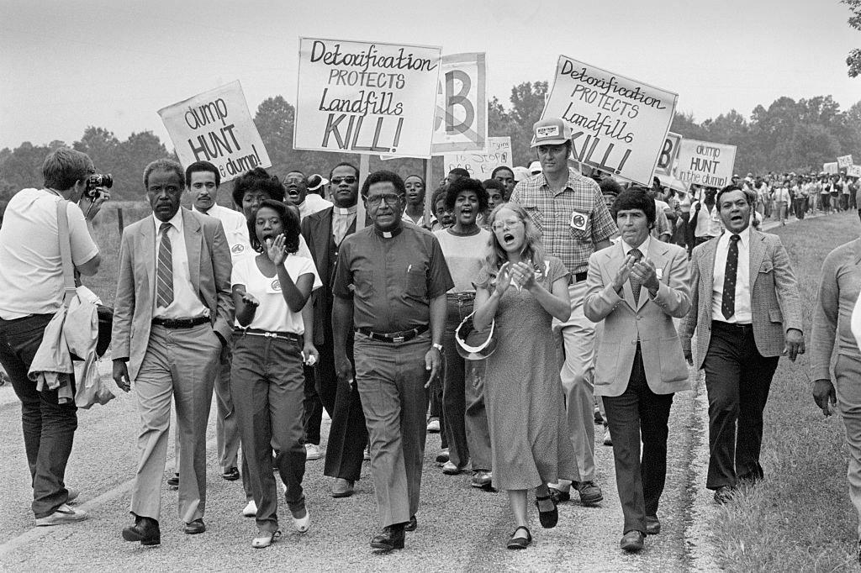
1ST RECOGNITION as ethical issue: “TOXIC WASTES AND RACE IN THE UNITED STATES”(1987) UCC CommISSION FOR on racial justice & Charles Lee & LoCAL CHURCH PROTESTS in North carolina (1982)
From the Preface: “Racism Is racial prejudice plus power. Racism Is the Intentional or unintentional use of power to Isolate, separate and exploit others. This use of power Is based on a belief in superior racial origin, Identity or supposed racial characteristics. flacism confers certain privileges on and defends the dominant group, which in turn sustains ix and perpetuates racism. Both consciously and unconsciously, racism is enforced and maintained by the legal, cultural, religious, educational, economic, political, environmental and military institutions of societies. Racism Is more than just a personal attitude; it is the institutionalized form of that attitude.”
Protestors led by Reverend Joseph Lowery march against a proposed toxic waste dump in Warren County, North Carolina, in October 1982

Slide 6
A Wealth of Scholarship And Activism
So
Laura Pulido
Robert Bullard
South AfricanActivists

Slide 7
Environmental racism and Environmental justice are not just about pollution but is about systems, pOWEr AND INCLUSION –issues we have insisted on through the course
Models of production and consumption
Distribution of rights and costs:
Divisions of authority
Finance
Power
Proximity
Models of Community as exclusive and resistant spaces: environment is spatialized but race and class may be more complex

Slide 8
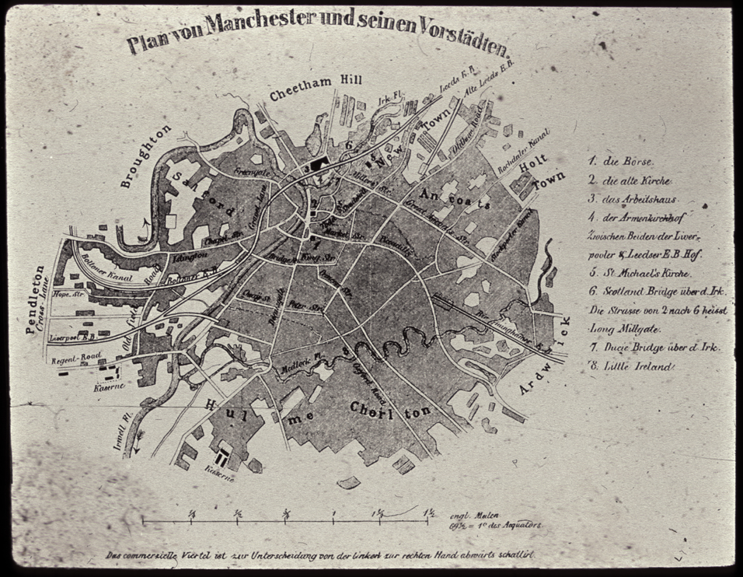
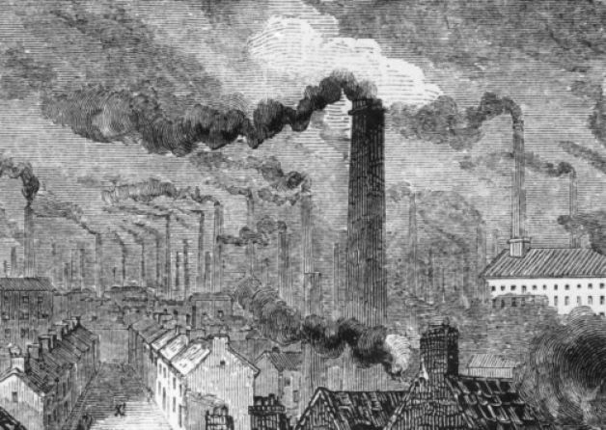
Living in a capitalist system
Demands not only production but also consumption

Slide 9
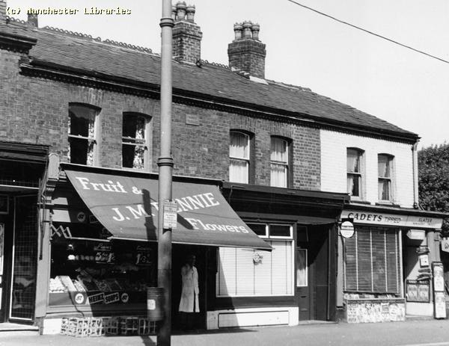
GETTING AWAY FROM SMOKE (1): Mercantile Streets
“The members of this aristocracy can take the shortest road through the middle of the laboring districts to their places of business without ever seeing that they are in the midst of grimy misery….For the thoroughfares leading from the Exchange in all directions out of the city are lined, on both sides, with an almost unbroken series of shops and are so kept in the hands of the middle and lower bourgeoisie”

Slide 10
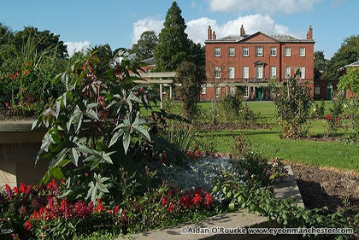
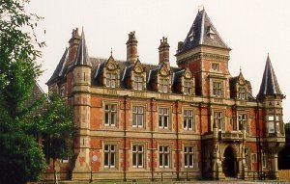
Suburban Mansions not unlike the Main Line: part of a Metropolitan Ecology (How are Suburbs like Corporations?)
Platt Fields, early 20th c.
Now a public park.
The Towers, 1874

Slide 11
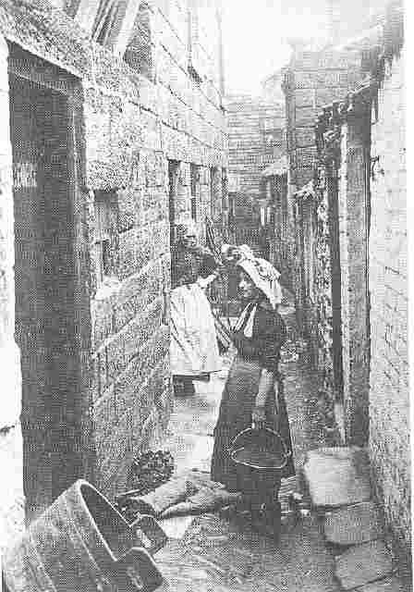
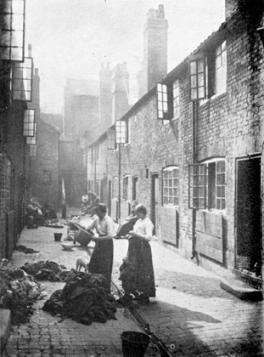
Who is Left Behind: Immigrant Families

Slide 12
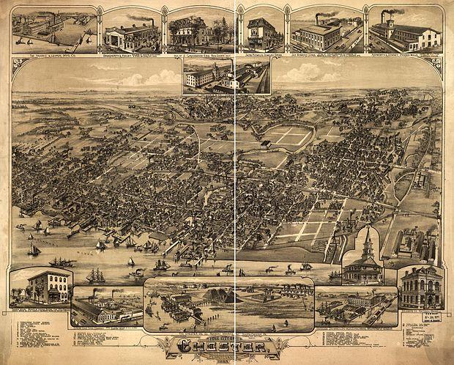
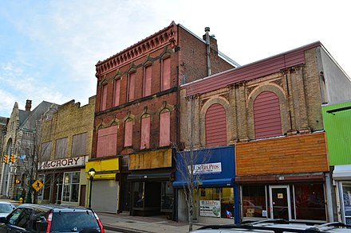

Slide 13
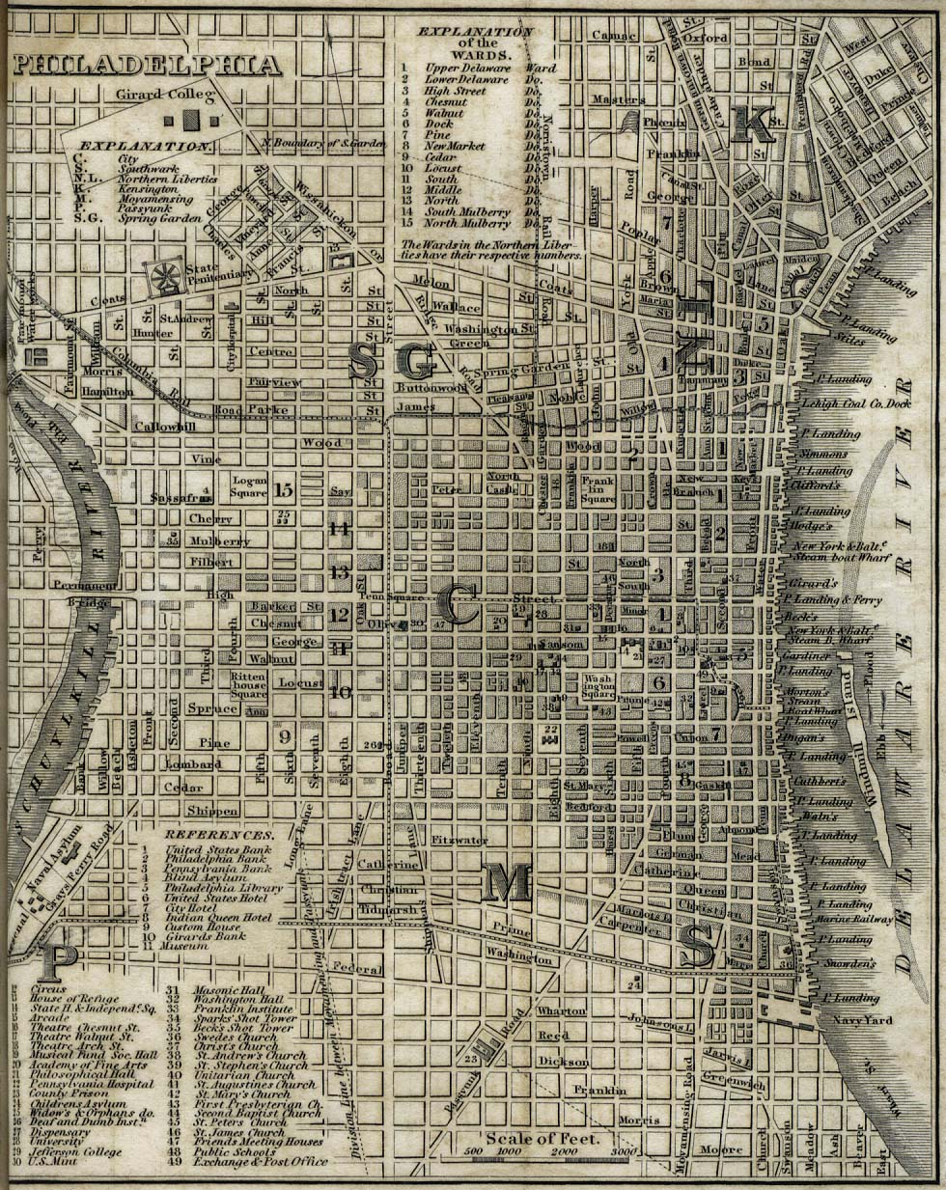
Elitee
Slavic and Russian
C’town
Elites
Society Hill
Seventh Ward
Italian and Jewish South Philly

Slide 14
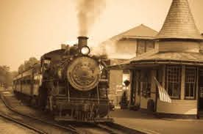
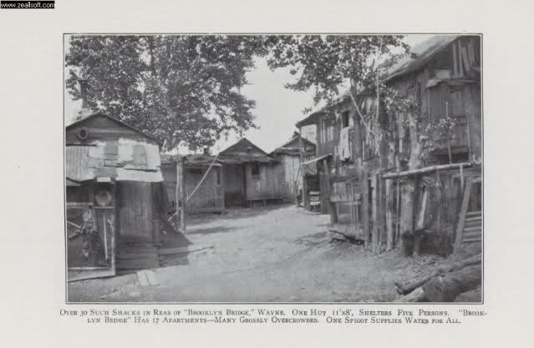
Why slums on the main line?

Slide 15

How distant can we be from production?

Slide 16
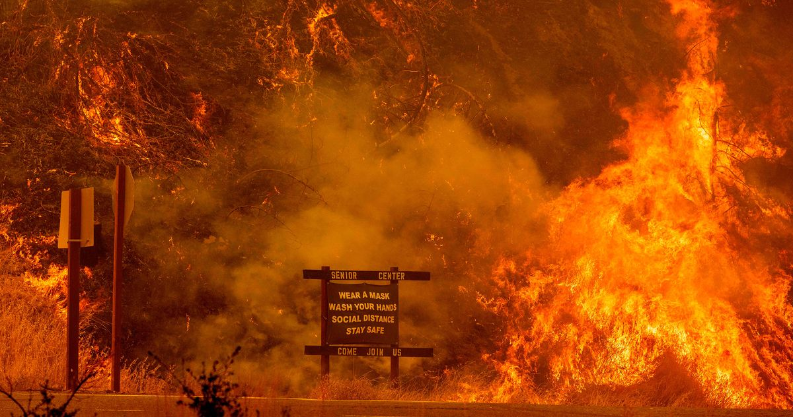
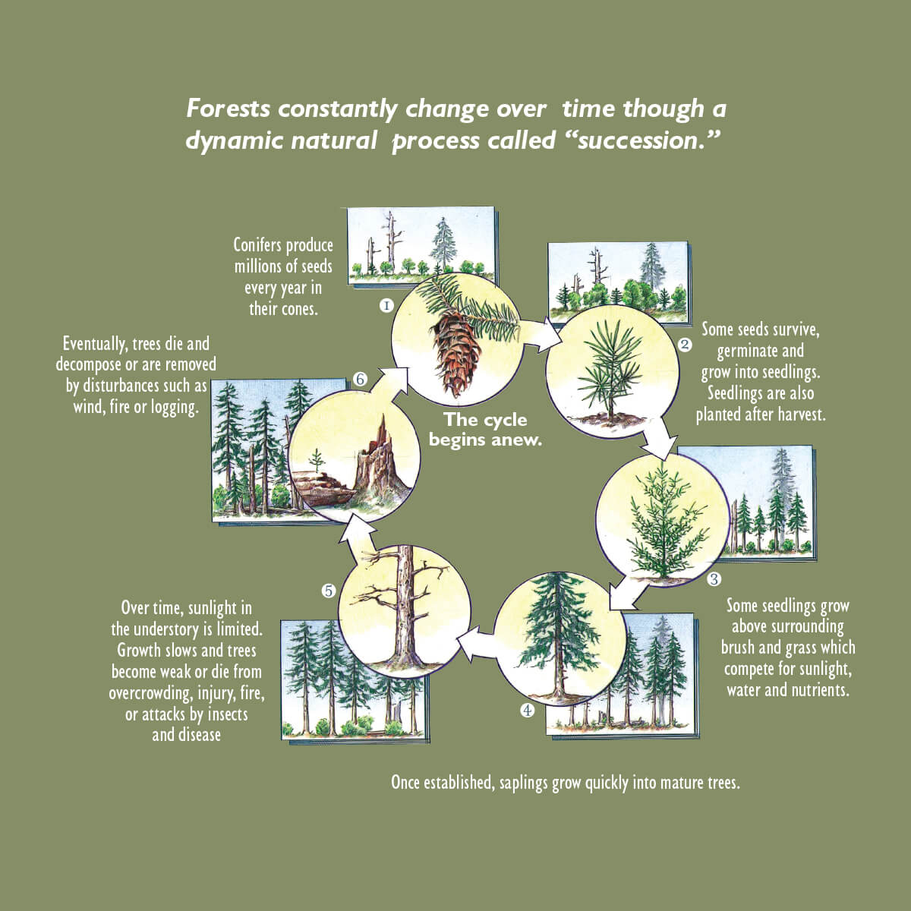
What about fire?
pPOWER AND NATURE (M. Davis 1998)

Slide 18
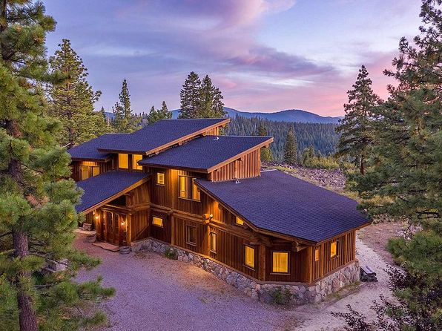
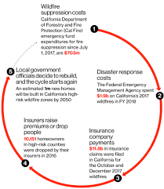
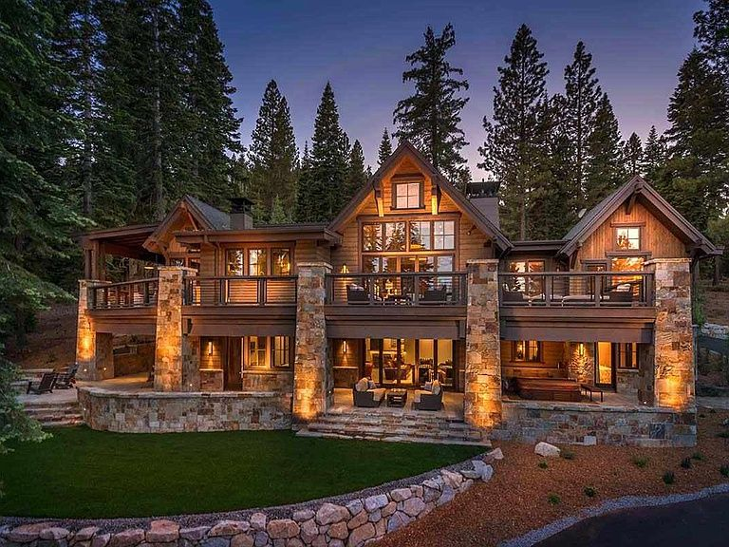
Another Fire Cycle (UCLA CENTER FOR ENVIRONMENT AND SUSTAINABILTY

Slide 19
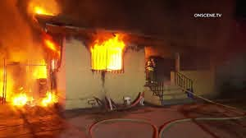
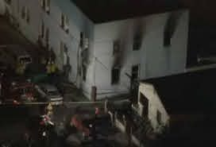
How do we naturalize the cultural/

Slide 20
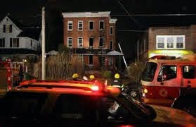
PHILADELPHIA — A duplex fire apparently caused by fuel spilling from an overfilled kerosene heater killed seven people in a basement that had only one exit, a survivor and firefighters said. DENVER POST 27/12/2008

Slide 21
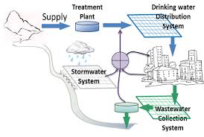
WhAT ABOuT OTHER NATURAL goods in place: REMEMBER HOW Water IS part of an Urban System?

Slide 22
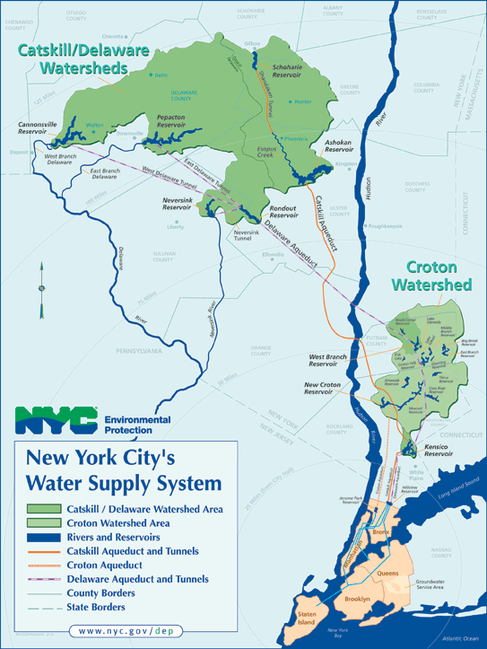
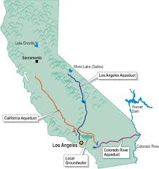
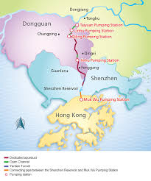
Where does Water Come From? WHO OWNS IT? (Orfield, barber)

Slide 23
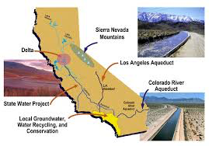
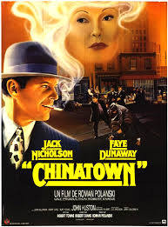
LA Water

Slide 24
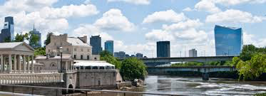
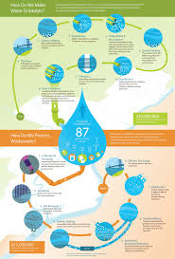
Philadelphia: A proud Public System

Slide 25
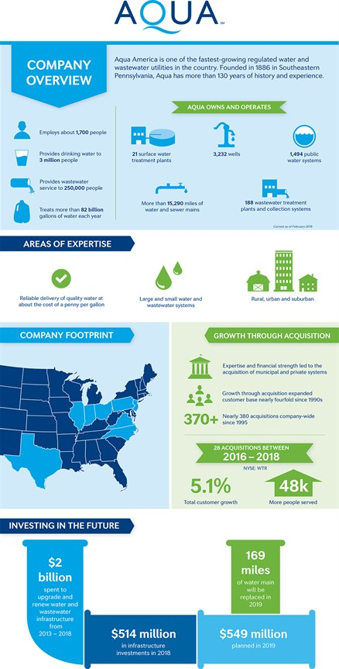
LOWER MERION/MONTGOMERY
Philadelphia Suburban Water Company was founded in 1868 by three Swarthmore professors….
It serves 820,000 people in Montco, which also has 38 other water systems. St. Luke’s Knoll serves 50 people. And there are wells

Slide 26
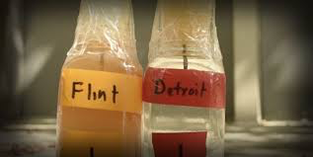
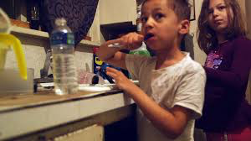
BUT Flint: Another PUBLIC SystemBUT

Slide 27
Carla Campbell,^{1,*} Rachael Greenberg,² Deepa Mankikar,³ and Ronald D. Ross
“A Case Study of Environmental Injustice: The Failure in Flint” Int J Environ Res Public Health. 2016 Oct; 13(10): 951.
⁴
The Flint disaster was due to the switch in water supply from Lake Huron to the Flint River, which was then not treated with an anti-corrosion chemical to prevent lead particles and solubilized lead from being released from the interior of water pipes, particularly those from lead service lines or those with lead solder. This water was known to be very corrosive, so corrosive that, in fact, it was not used by the nearby auto industry [2]. The General Motors plant switched to water from the neighboring Flint Township when General Motors noticed rust spots on newly machined parts [2]. This corrosive new water supply was then not treated with the anti-corrosion treatment, in noncompliance with the Environmental Protection Agency’s (EPA) Lead and Copper Rule, which calls for action when a water supply is found to be corrosive to prevent the potential release of metals from water service lines [5].
A national water expert, Dr. Marc Edwards, a professor of civil and environmental engineering at Virginia Tech University, has stated that the published instructions by EPA for collection of water samples for lead analysis were biased in the direction of underestimating the lead content of the water samples. He had spent years communicating this problem to EPA without a subsequent change in these instructions [6]. Dr. Edwards testified before Congress in spring 2016 that the Regional EPA Administrator was not alert to what was happening in Flint. Dr. Edwards also published papers previously bringing to the public attention the lead contamination of drinking water in Washington, DC. After Washington, DC made a change in its water disinfectant from chlorine to chloramine, residents were exposed to water with high levels of lead (140 ppb and above) from 2001 to 2004 [7,8]. This resulted in an increase of blood lead levels in young children (many from high-risk neighborhoods) of four times the amount that it was prior to the change in water disinfectant [7,8]. Dr. Edwards was a key player in ensuring that this issue was brought to light and those responsible parties were held accountable [9]. For comparison, the EPA standard for maximum contaminant level for lead in water is 15 ppb [5].

Slide 28
Pulido –what is environmental racism, WHITE privilege and white supremacy?
White Racism focuses us on agency and victimhood
White Privilege conceals agency and distances victimhood – the everyday life of the Main Line.
White Supremacy means knowledgeable action to disfranchise or hurt people so that others profit, through a collusion of corporations and goverment

Slide 29
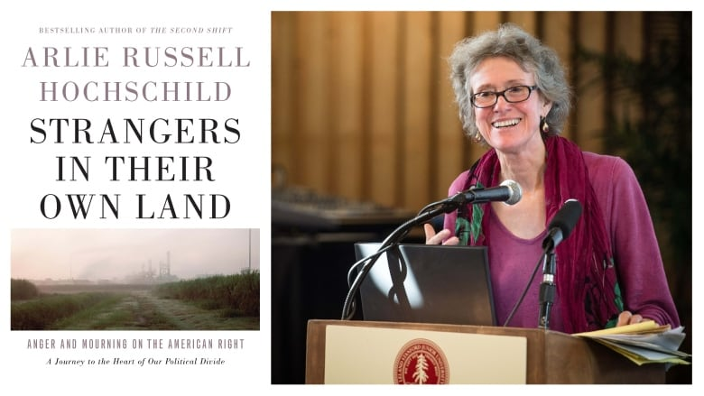
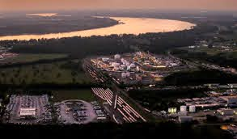
Intersections of race and class
Intersections of race and class

Slide 30
Disposing of waste : The Long Island Garbage scow of 1987 https://www.retroreport.org/video/voyage-of-the-mobro-4000/

Slide 31
Global connections

Slide 33
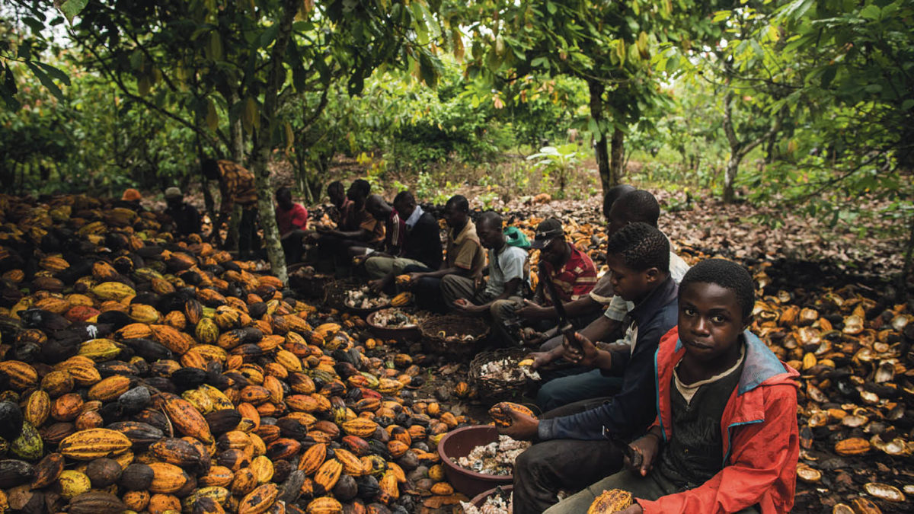
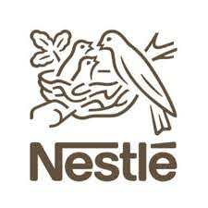
Supreme Court weighs child-slavery case against Nestlé USA, Cargill
Despite years of promises by the chocolate industry, child labor remains widespread on cocoa farms Washington post December 1, 2020
Children from Burkina Faso take a break last year on a cocoa farm near the village of Niambly, Ivory Coast. (Salwan Georges/The Washington Post)

Slide 34
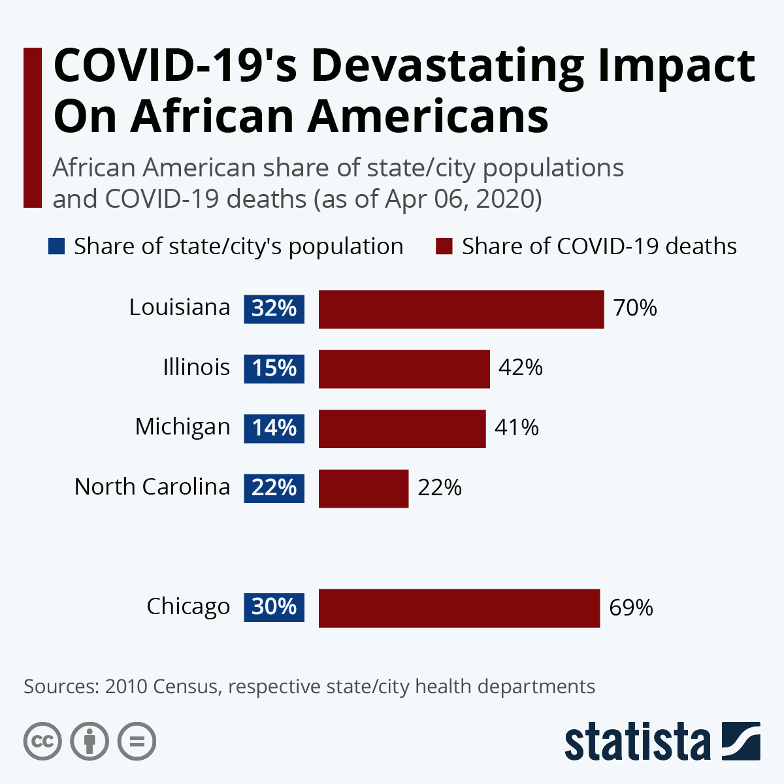
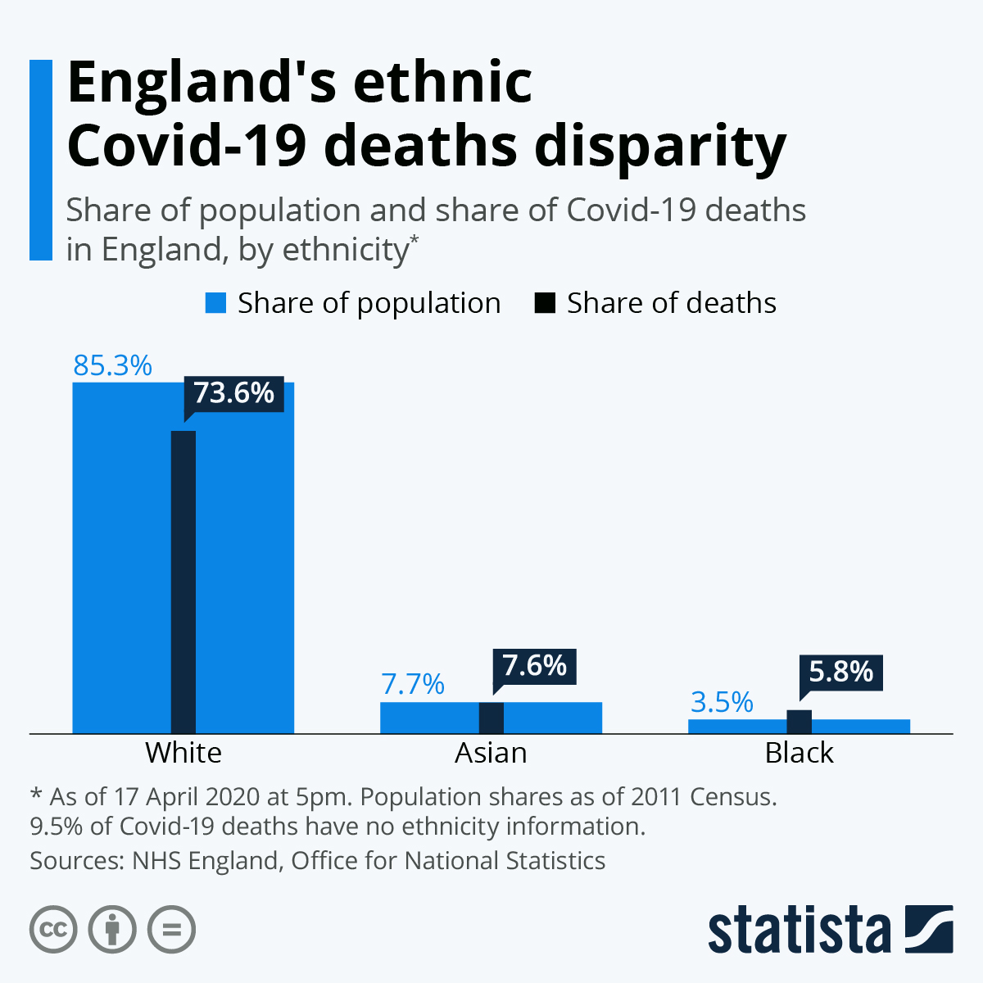
And with covid?

Slide 35
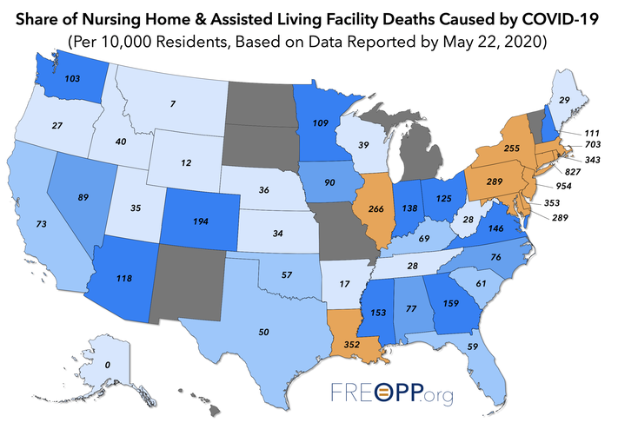

Slide 36
But if we use less for longer, what happens to the economy?
Not a simple question, locally or globally as the pandemic has shown us.
Emissions are down but poor communities and communities of color have also suffered economically disproportionately while being exposed to risk.

Slide 37
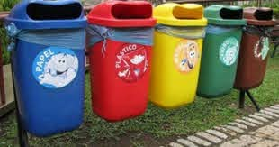
So what do we do? Recycling

Slide 38
What does recycling do to privilege?

Slide 39
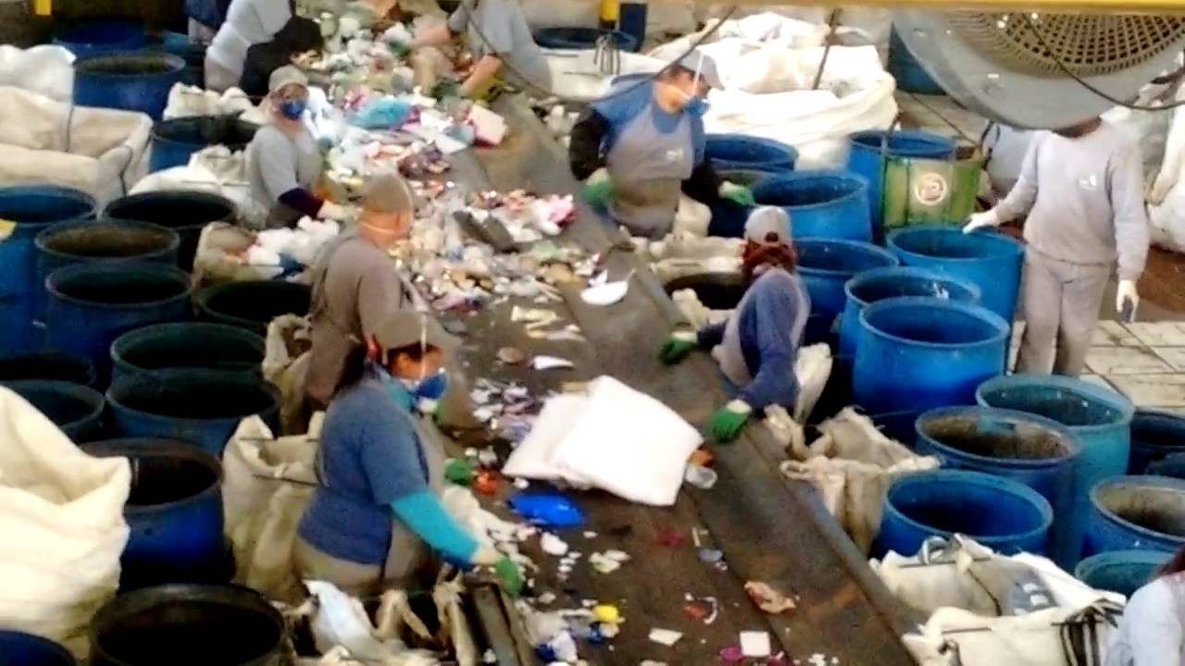
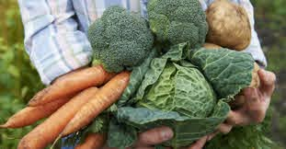
Curitiba brazil: incorporating homeless into system of production and food

Slide 40
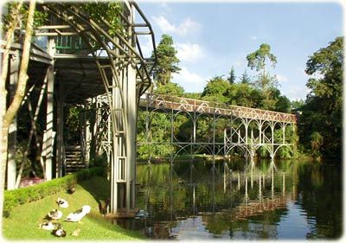
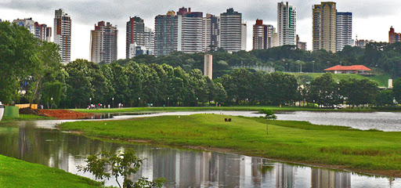
Think creatively over time: Curitiba
Curitiba Brazil

Slide 41
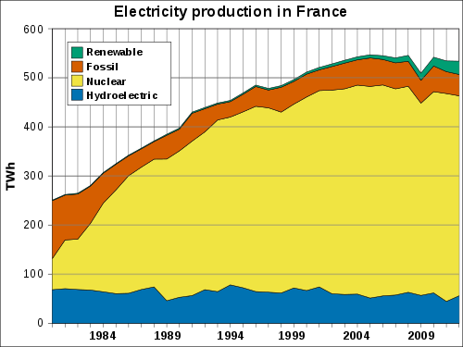
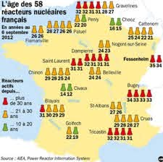
Tough but informed choices:learning from other cities as well

Slide 42
FINAL NOTE: COURSE EVALUATION LINK IS AVAILABLE ON THE MOODLE PAGE

