Slide 1
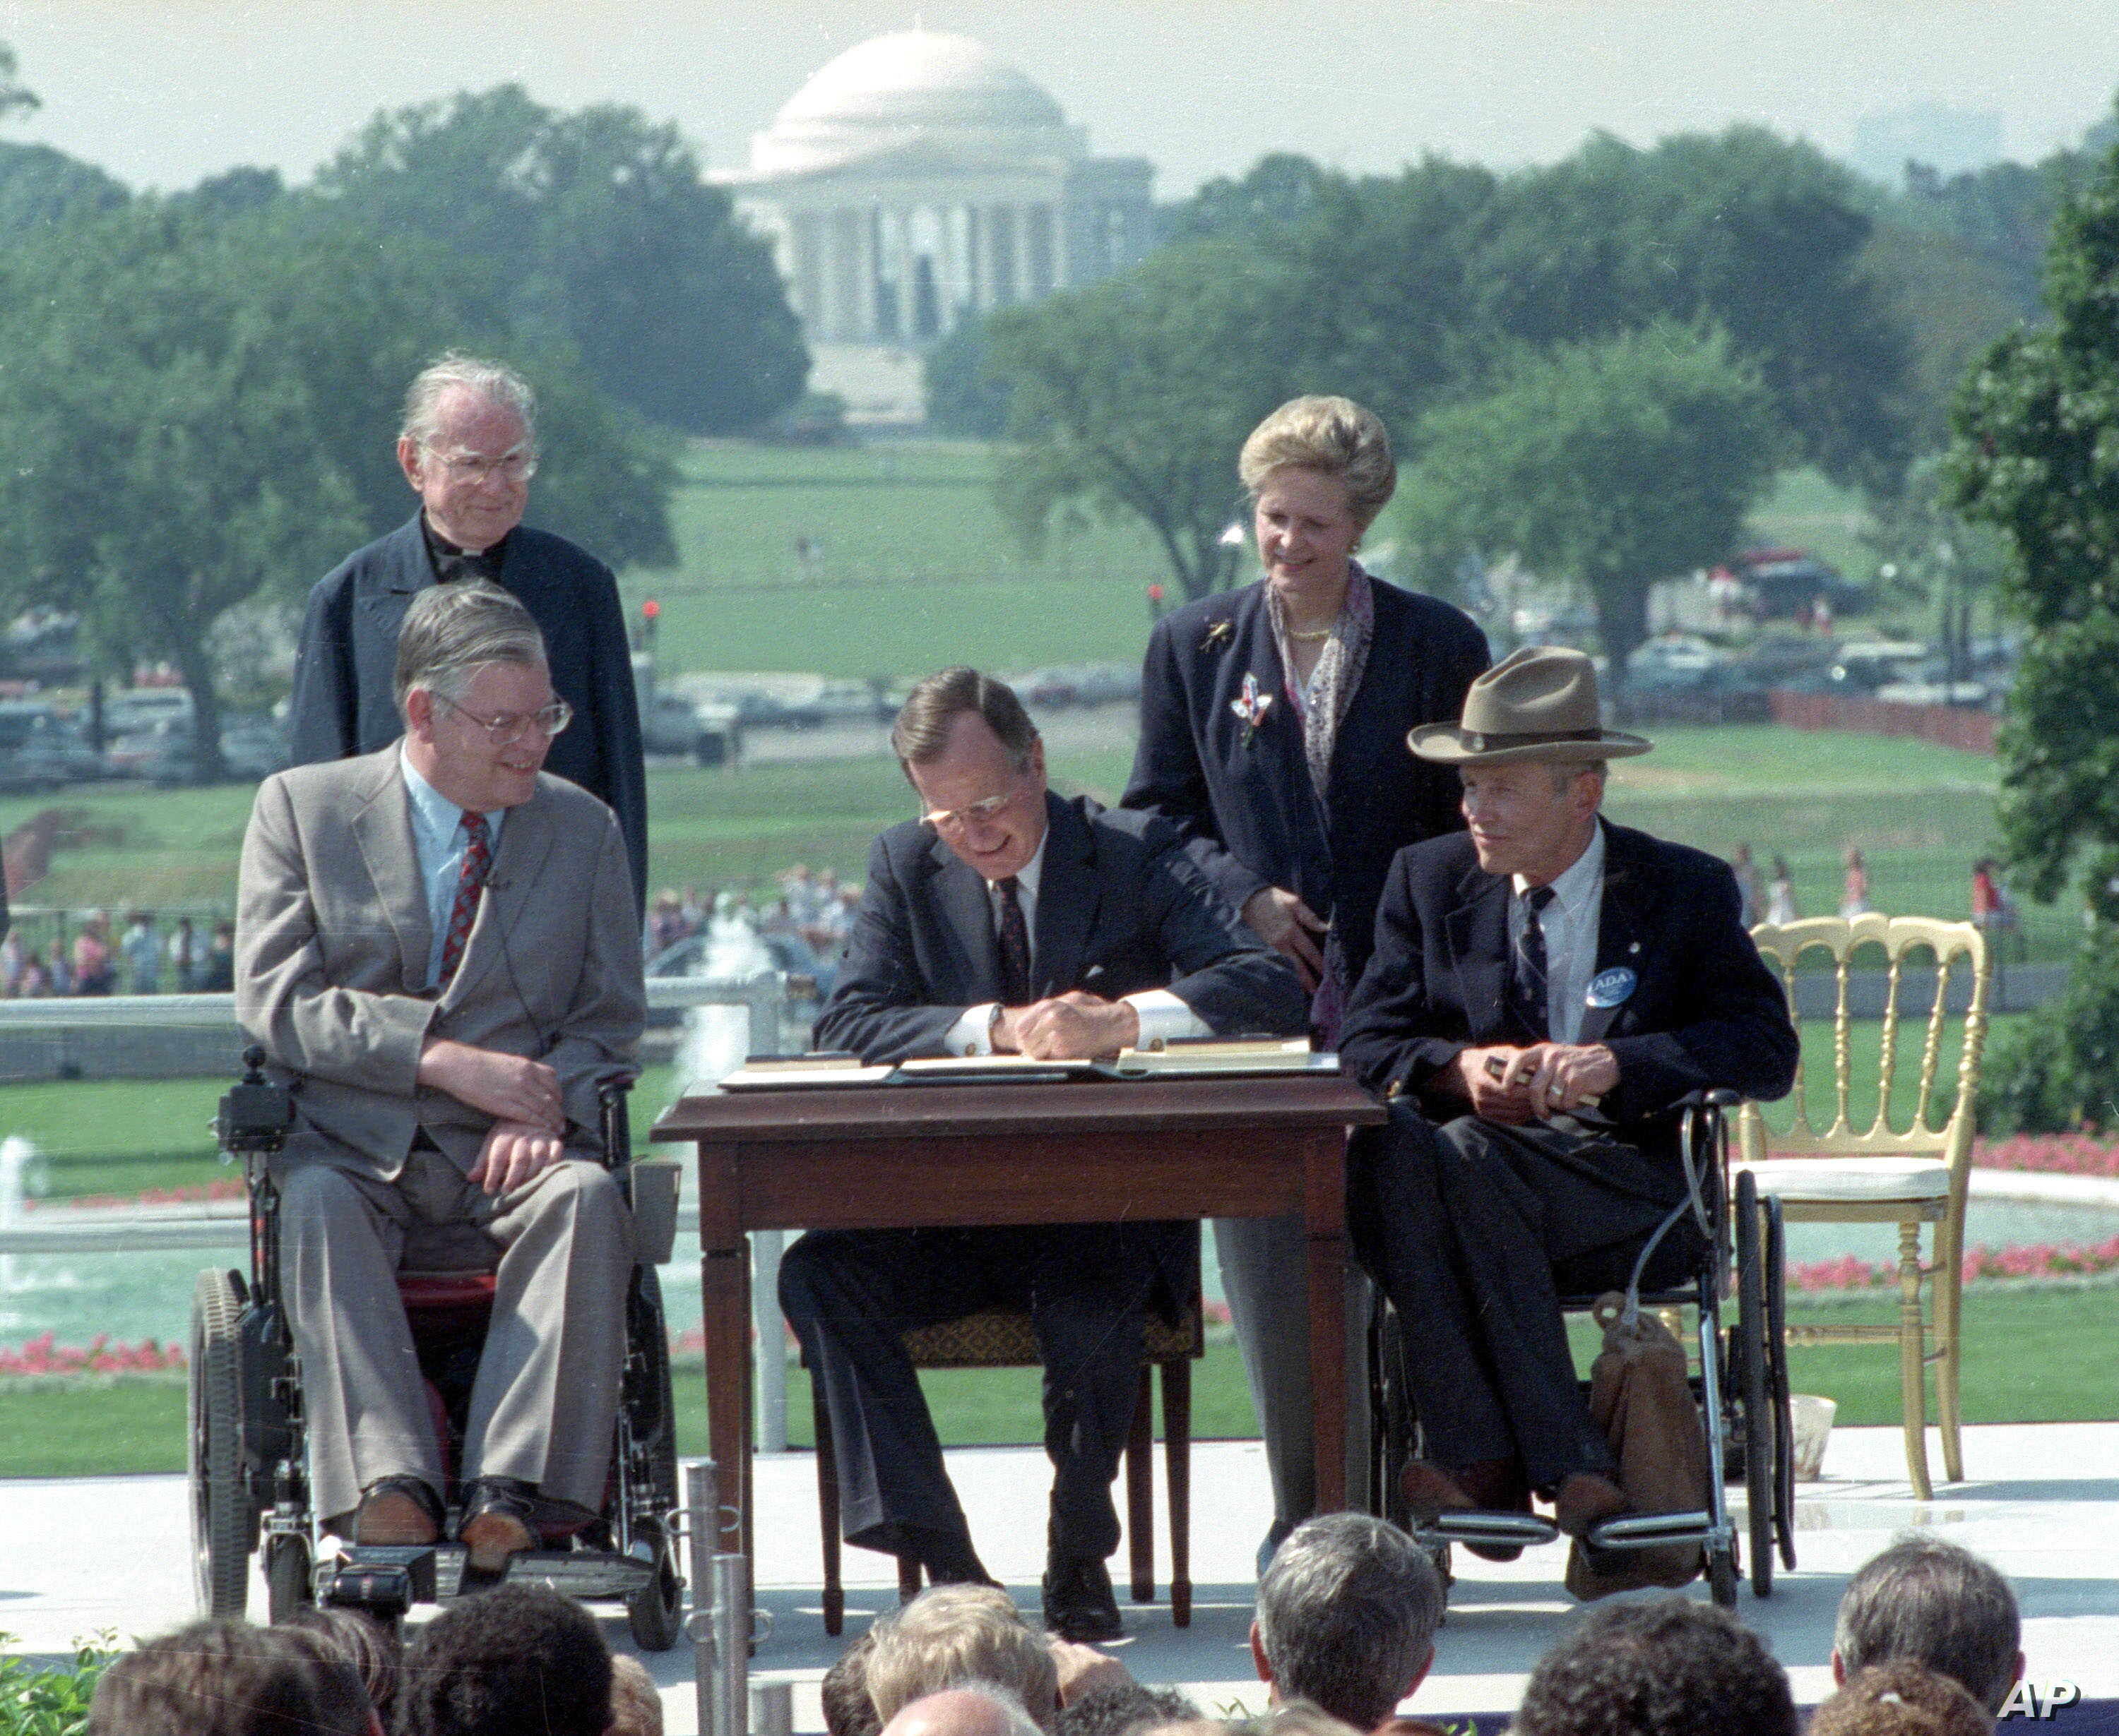
Accessibility, ADA, Universal Design
City 185
JENNIFER HURLEY

Slide 2


Slide 3
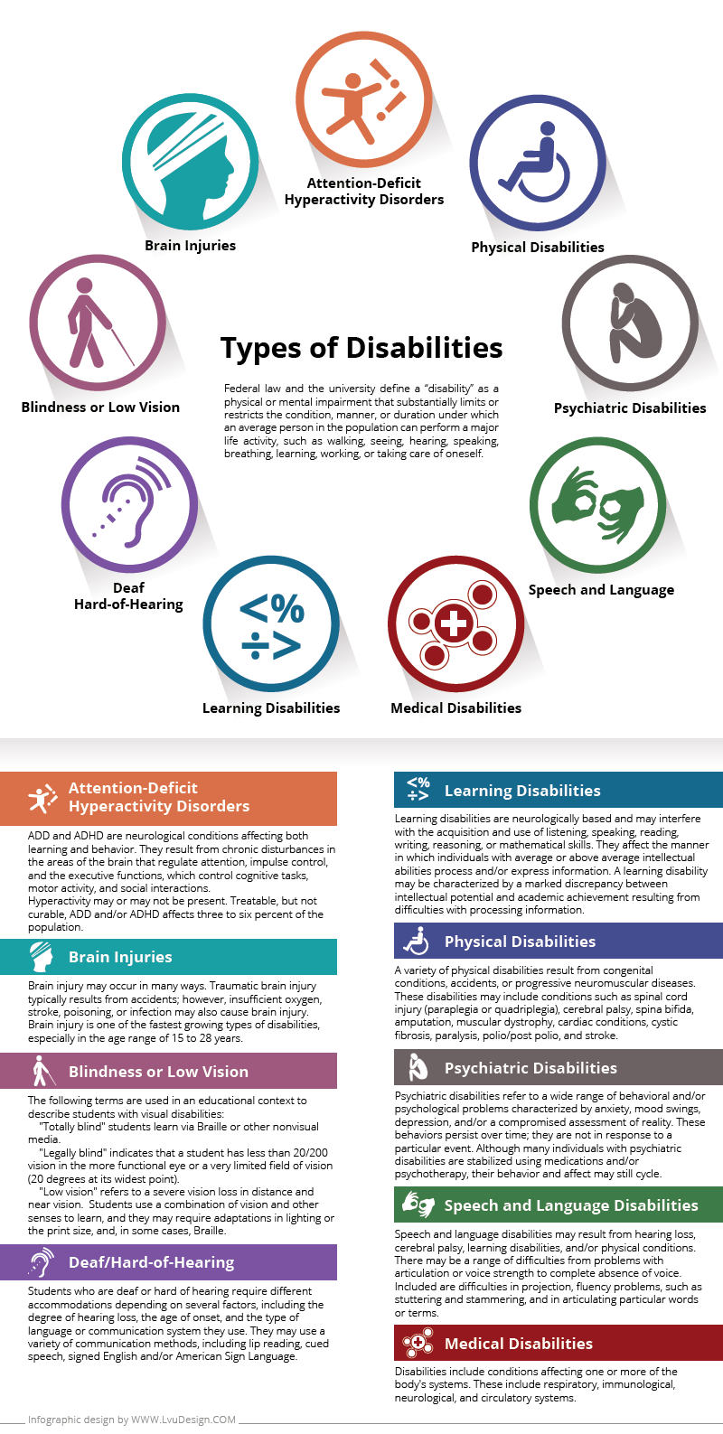

Slide 4
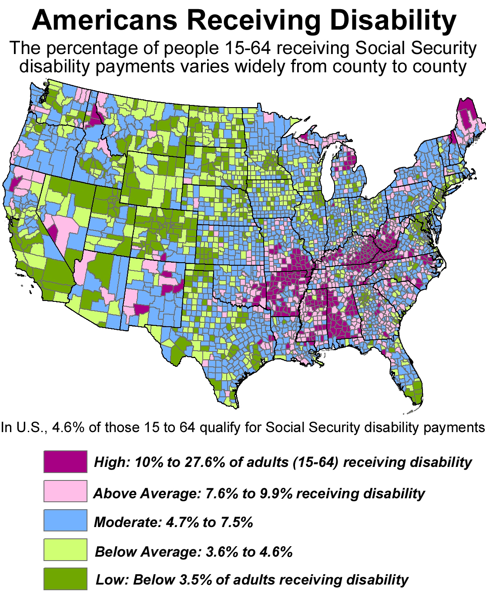

Slide 5
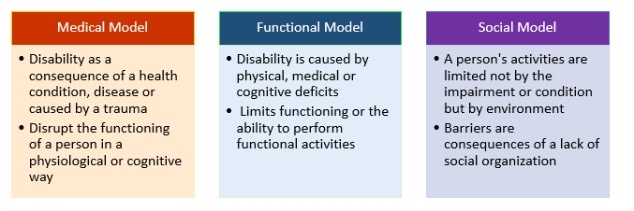
Definitions of Disability

Slide 6
“Commonly held beliefs that those with disabilities are less capable than others (Cantos 2007, 1) and represent a drain on society contributed to the long-time segregation and isolation of people with disabilities. Seen as burdens to society, in years past individuals with severe disabilities were often institutionalized. This isolation contributed to persistent stereotyping, misunderstandings, misconceptions and fear while also instilling a sense of inferiority.”
Sherman & Sherman, 2012

Slide 7
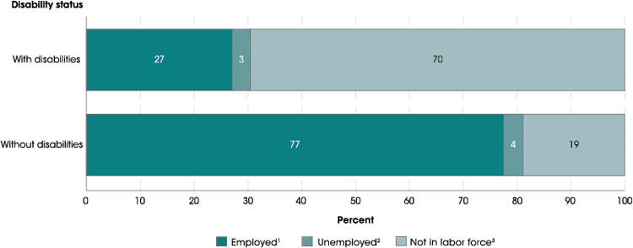
Impact of disability: Higher unemployment

Slide 8
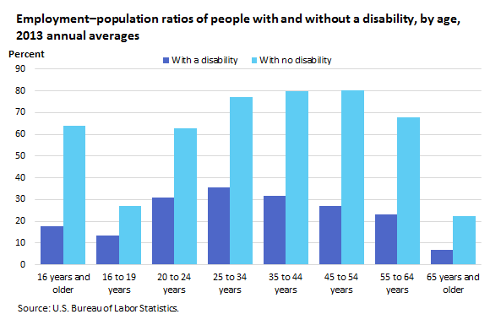

Slide 9
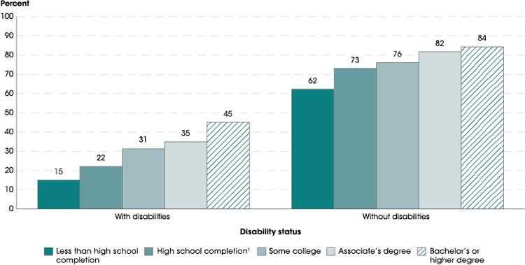

Slide 10
“The roots of the ADA lay in the success of the civil rights movement of the 1960s, which provided the impetus for other civil rights movements, including women’s, gay and lesbian, and welfare rights. Even though minorities—and later women—won hard-fought protections through federal civil rights legislation passed by Congress in the 1960s and 1970s, it was only much later that the rights of persons with disabilities were also protected by federal legislation.”
Karger & Rose, 2010

Slide 11
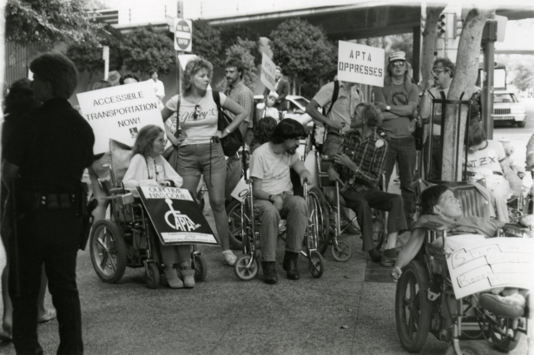
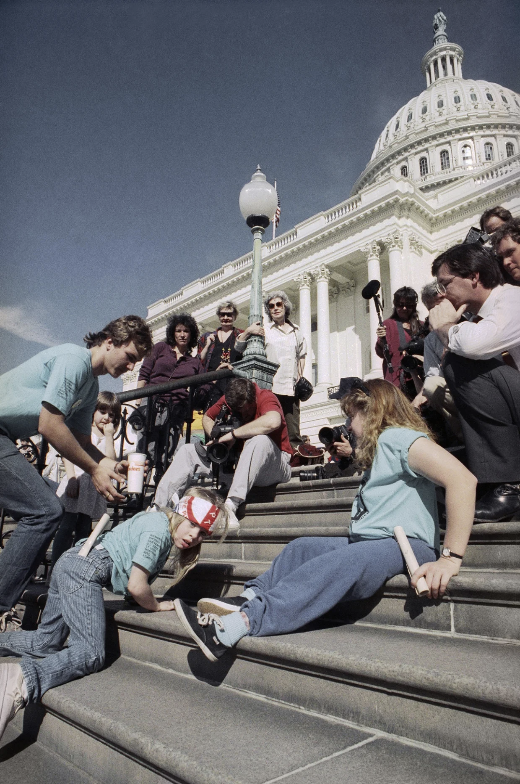
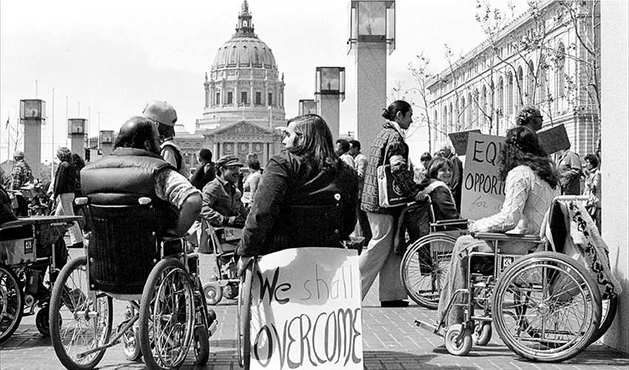
ADAPT members march in Los Angeles to protest the American
Public Transportation Association (APTA) in October of 1985.
In 1977, activists occupied the San Francisco Federal Building for 26 days to fight for disability rights. Photo by Anthony Tusler.
March 13, 1990, “Capitol Crawl”

Slide 12
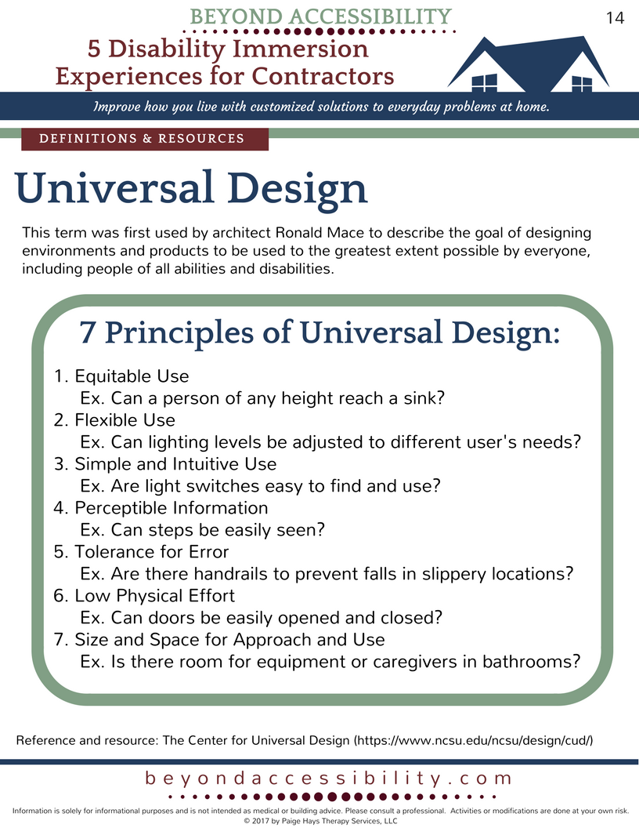
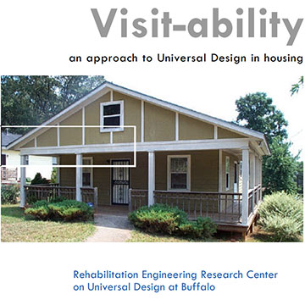
Accessibility, universal design, visitability

Slide 13
History of US Legislation
Civil Rights Act of 1964 – did not cover people with disabilities
Voting Rights Act of 1965 – did not cover people with disabilities
Civil Rights Act of 1968 (Fair Housing Act) – did not cover people with disabilities
Architectural Barriers Act of 1968 – required all federally-funded built environments intended for public use be accessible
Rehabilitation Act of 1973, Section 504 – prohibited discrimination against people with disabilities, but did not protect those with disabilities from discrimination by employers, by private-sector accommodations, by publicly-funded programs, and by those providing federal financial assistance
1988 Fair Housing Act – covered people with disabilities
1990 Americans with Disabilities Act – prohibited discrimination on the basis of disability in private-sector employment, in state and local government activities, and in public accommodations and services, including transportation

Slide 14
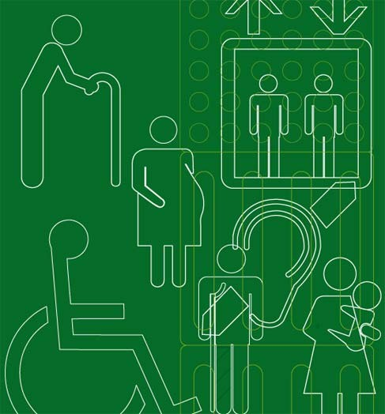
The Americans with Disabilities Act
The Americans with Disabilities Act (ADA) is a civil rights law that mandates equal opportunity for individuals with disabilities.

Slide 15
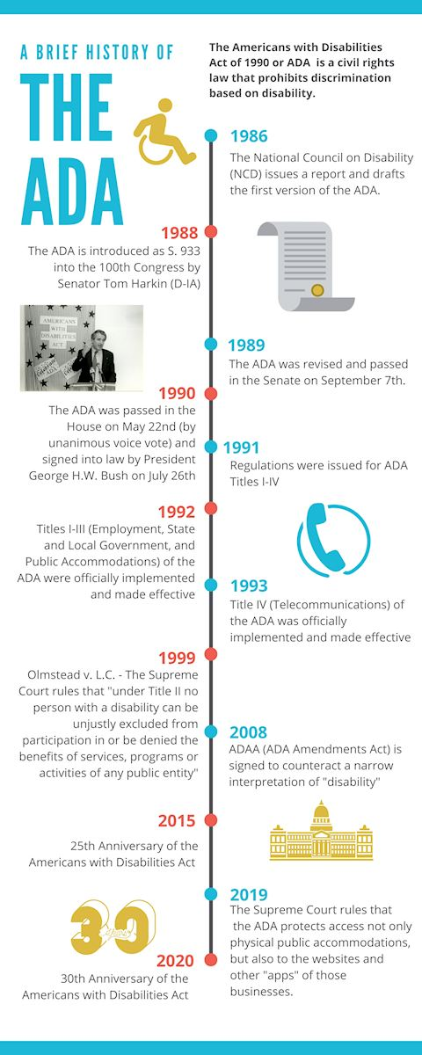

Slide 16
Disability under the ADA
❖ The ADA defines a disability as “a physical or mental impairment that that substantially limits one or more major life activities, a person who has a history or record of such an impairment, or a person who is perceived by others as having such an impairment”
❖ Qualified candidates or applicants with disabilities are individuals who can perform the job in question with or without reasonable accommodation
❖ Covers most private and public entities, including all businesses with 15 or more employees

Slide 17

The ADA
Title I: Employment
Title II: Public Transportation and State and Local Government Services
Title III: Places of Public
Accommodations
Title IV: Telecommunications
Title V: Miscellaneous
Notes:
Title I: Employment: Prohibits discrimination in employment against
people with disabilities and requires employers to make reasonable
accommodations.
. Title II: Public Services: Requires local and state governments to make their
programs and services accessible to people with disabilities.
. Title III: Public Accommodations: Privately owned entities cannot exclude
or segregate individuals with disabilities, unless the requirements are
necessary for the operation of the public accommodation.
. Title IV: Telecommunications Services: Telephone companies must provide
devices for the hearing impaired and all federally funded television
programs must include closed captioning.
Title V: Miscellaneous Provisions: Addresses the ADA’s relationship with
other federal and state laws, and requirements relating to insurance,
construction, and design regulation.

Slide 18
Examples of Reasonable Accommodation?
Title I applies to workplaces with 15 or more employees
modified work schedules (i.e and. employee needs to attend dialysis on a daily or weekly basis)
making all areas accessible to disabled individuals (i.e. installing ramps and
wheelchair lifts)
Making all areas accessible to a service animal assisting a disabled individual
providing interpreters, readers, modified equipment and/or training material (i.e. a sign language interpreter for a person with a hearing and/or speaking impairment

Slide 19
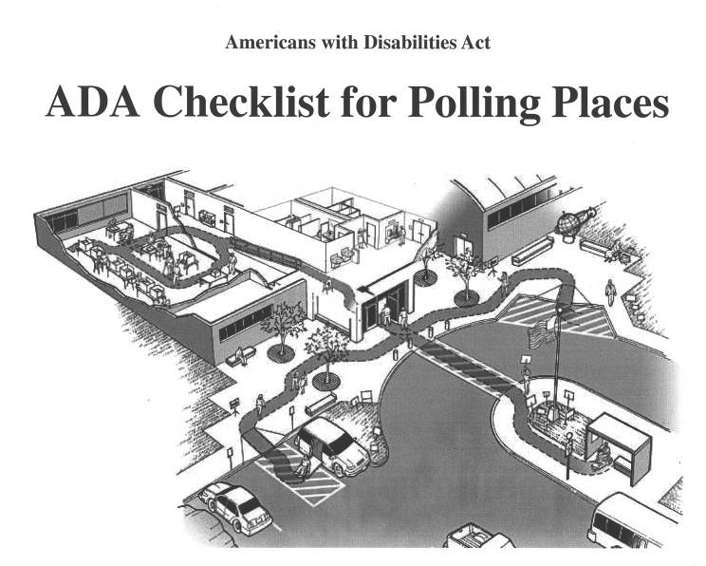
Equality in Access
The primary responsibility of public agencies with regard to the ADA is to provide
equal access to PROGRAMS, SERVICES, & ACTIVITIES

Slide 20
Outreach and Printed Information
Provide notices of non- discrimination on materials
Provide alternative formats upon request
Inform the public that assistance is available
Handle requests on an individual basis
Increase outreach to persons with disabilities
Provide accessible web resources

Slide 21

Public Meetings
Schedule meetings in accessible locations
Make reasonable modifications so people can participate
Display a notice on meeting announcements and agendas about requesting assistance

Slide 22
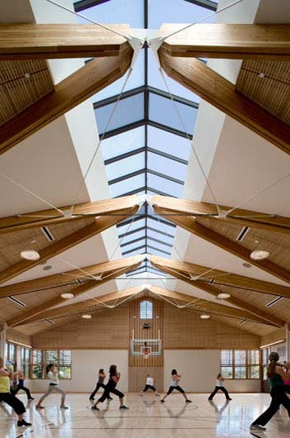
Services in Existing Facilities
Options:
Make alterations to the facility
Provide the same Town service in another accessible location
Provide auxiliary aides or services to assist the individual

Slide 23
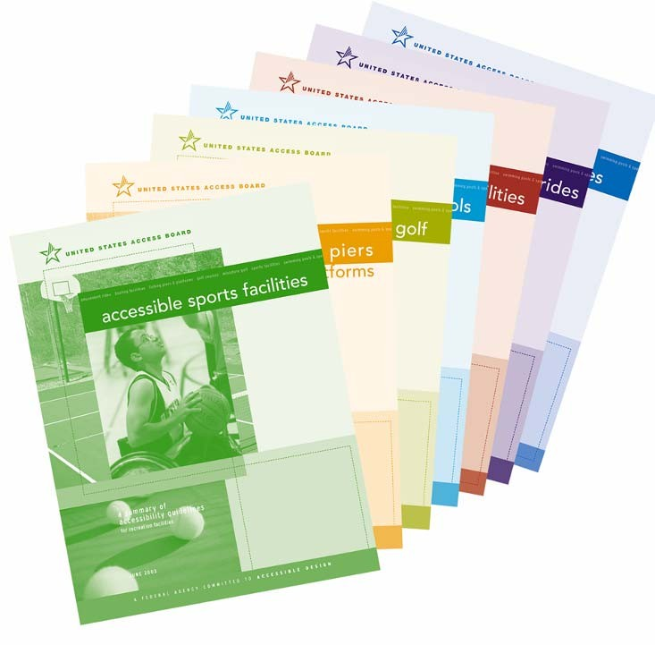
Building and Construction Practices
New construction and alterations must be accessible
California state codes and the Federal ADA guidelines must be followed

Slide 24
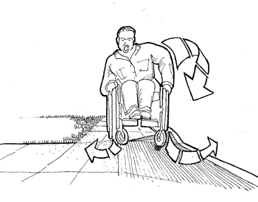
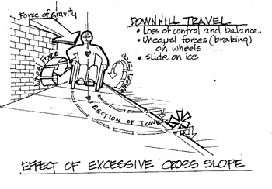
Pedestrian Rights-of-Way
The Town is conducting a survey of pedestrian facilities including sidewalks and curb ramps
The project will identify Town ROW programs and design standards

Slide 25
Prioritizing Sidewalks and Curb Ramps
Criteria established by the ADA for prioritizing access improvements within the pedestrian Rights-of-Way:
State and local government offices
Transportation facilities
Commercial and business areas
Places of employment
Residential neighborhoods

Slide 26
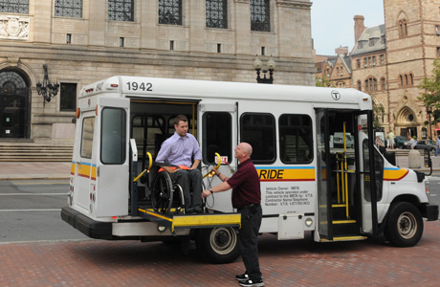
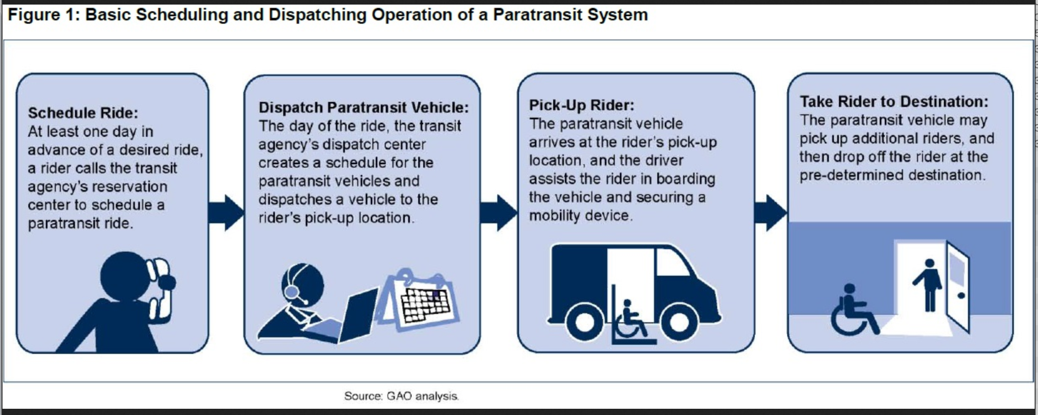
Paratransit (demand response) services

Slide 27
ADA requires paratransit services
“The ADA of 1990 required transit systems progressively to make bus and rail systems accessible to persons with disabilities. Moreover, the ADA recognizes some disabled persons lack the functional ability to use conventional transit irrespective of accessibility aids; accordingly, transit agencies must provide an alternative in the form of paratransit comparable to fixed-route service.”
The Federal Transit Administration (FTA) is responsible for enforcing these requirements and has set six criteria for paratransit services:
1. A service area defined as within 3/4 mile of a fixed-route;
2. The same hours and days of service as the fixed-route;
3. Fares that may not exceed twice the fare a comparable user of the fixed-route would pay at a similar time of day;
4. Response time that allows for reservations made before the close of business the day prior to a requested trip;
5. No restrictions or priorities based on the type of trip or purpose of trip; and
6. No capacity constraints by rationing trips, maintaining waiting lists, delaying trips due to untimely pickups, denying substantial numbers of trips, or forcing customers to take part in trips of excessive length.
Citizens Budget Commission, 2016

Slide 28
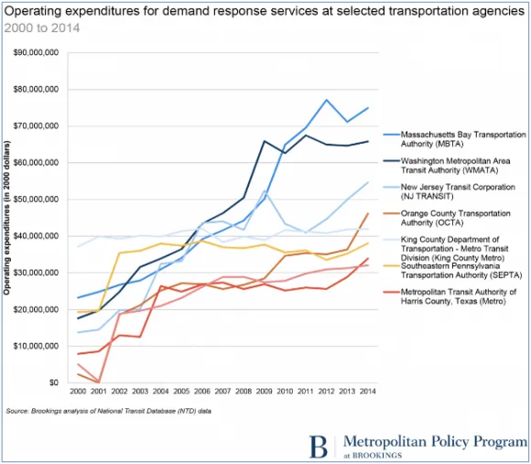
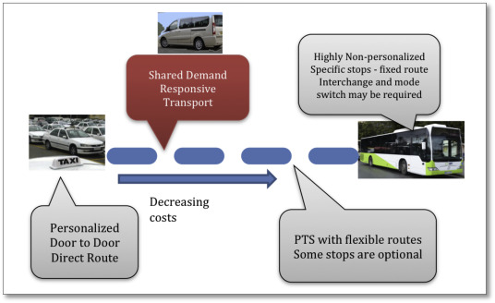
Paratransit (demand response) services – most expensive transit

Slide 29
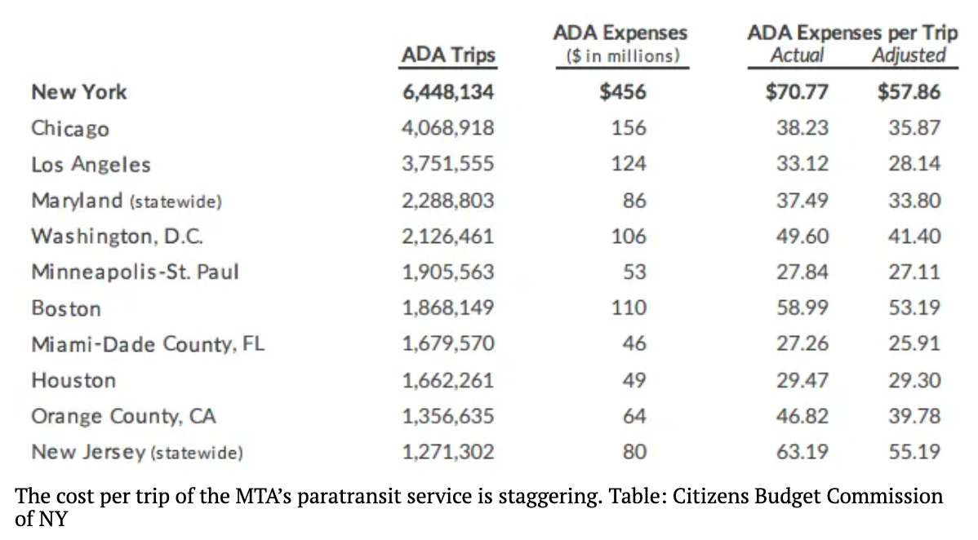
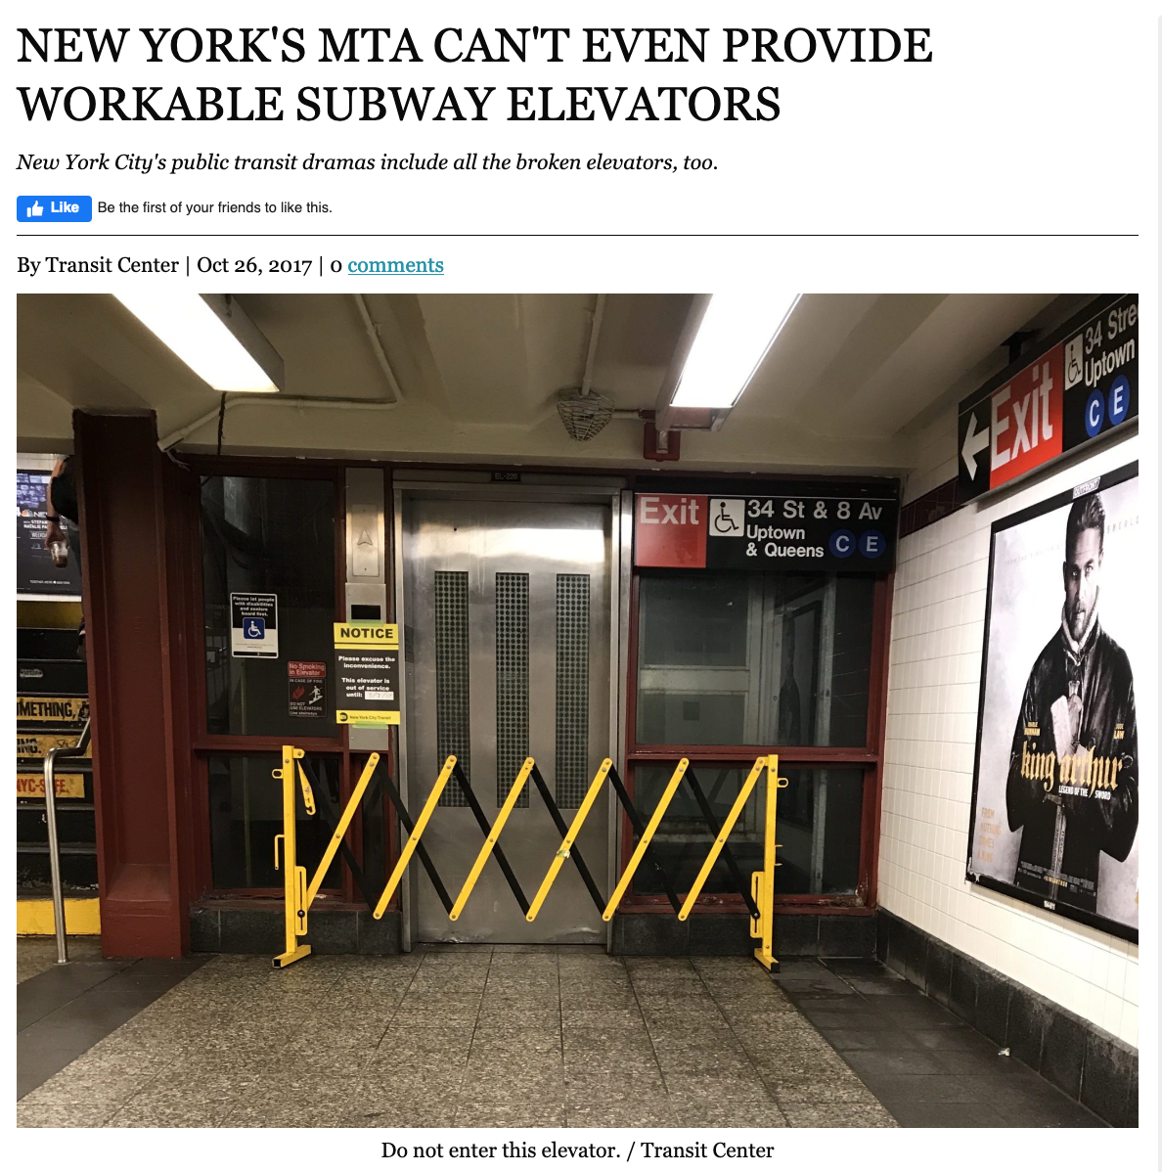
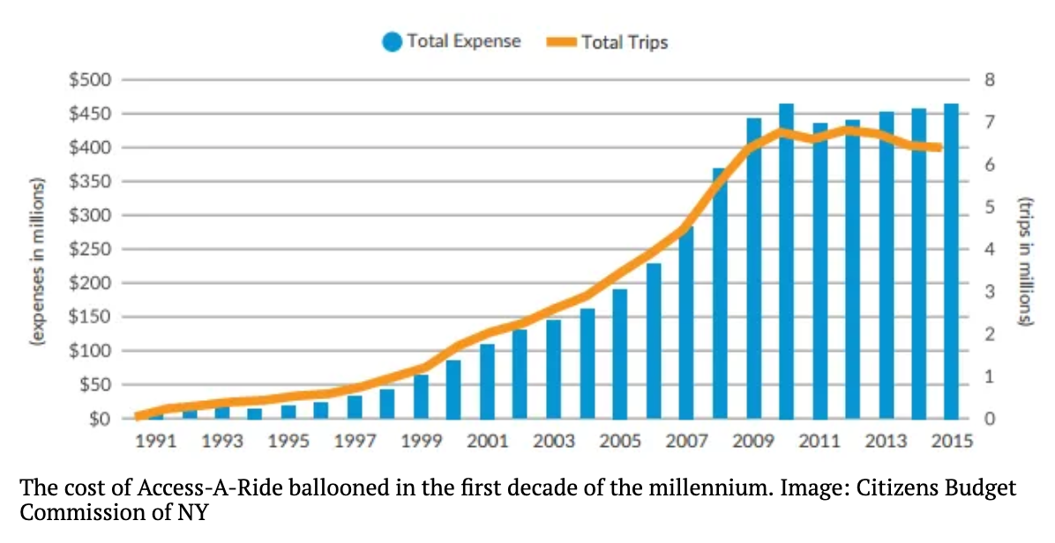
What’s the right mix of spending on services and improvements?

Slide 30
Has it been effective?
Difficult to fully untangle effects, because rates of disability are greatest among older people, African Americans, people with low incomes, and blue-collar workers
Disability is positively correlated with low rates of education, age, poverty, unemployment and underemployment, lack of health insurance
People with disabilities still experience economic hardship at rates higher than people without disbilities
Self reports from people with disabilities about whether or not their lives have improved from the ADA or in the last 10 years are mixed
Criticism and backlash from people and companies that have to make accommodations
Relies on self-requests for accommodation
Some concern that ADA has raised employment barriers from employers concerned about possible lawsuits

Slide 31
Enforcement
The Department of Labor is one of the enforcement agencies responsible for enforcing the Americans with Disabilities Act.
The other four agencies are:
The Equal Employment Opportunity Commission
The Department of Transportation
Federal Communication Commission
Department of Justice
These agencies may file suit on an employee or applicant’s behalf if there is evidence of discrimination.

Slide 32
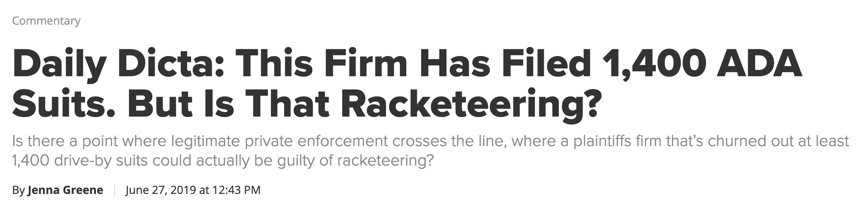
What does it mean that ADA is a Civil Rights law?
Enforcement requires law suits
Some claims that law firms are taking advantage of small businesses
Provisions in law criticized as being too vague
Lack of clarity/fear of unknown liability makes employers and other potentially responsible parties avoidant
Provisions in law criticized as being too vague
Lack of clarity/fear of unknown liability makes employers and other potentially responsible parties avoidant

Slide 33
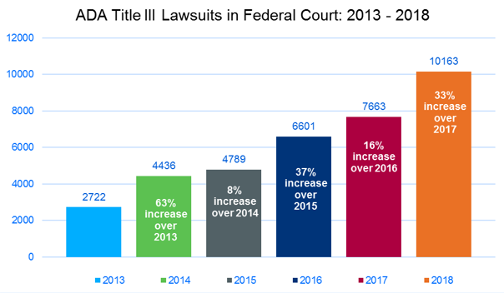

Slide 34
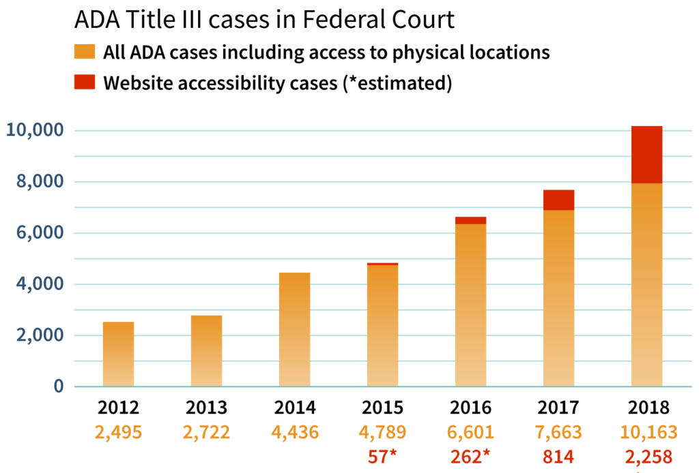
2019 Supreme Court Case confirmed that ADA accessibility requirements apply to websites, apps, and other electronic forms of business and publci accommodation

Slide 35

Map Accessibility & GIS low vision dementia autism
Justine Stiftel
Citations and further reading provided in PowerPoint notes.
Notes:
We will be discussing map design and how we can design maps that are accessible. Followed by some examples of ways that GIS has been used to improve accessibility in cities.
Wide range of disabilities out there. We’ll be focusing on these three: low vision, dementia, and autism. This selection introduces some physical impairments and some cognitive impairments. This does require some degree of generalization, which can be dangerous. Take this information as a jumping off point, and consider your personal experiences as you hear what is being shared.
For low vision we’ll look at color blindness as well as more typical vision loss. Remember “low vision” is a spectrum of visibility needs.
Dementia is unusual considerations, however it is considered because:
a) highly correlates with vision loss,
b) results in memory loss and confusion (where visual ques become a key to interpreting the world)
c) anxiety
Autism presents its own cognitive and sensory impairments, which will be addressed.
Photo citations: Powerpoint Stock Images

Slide 36
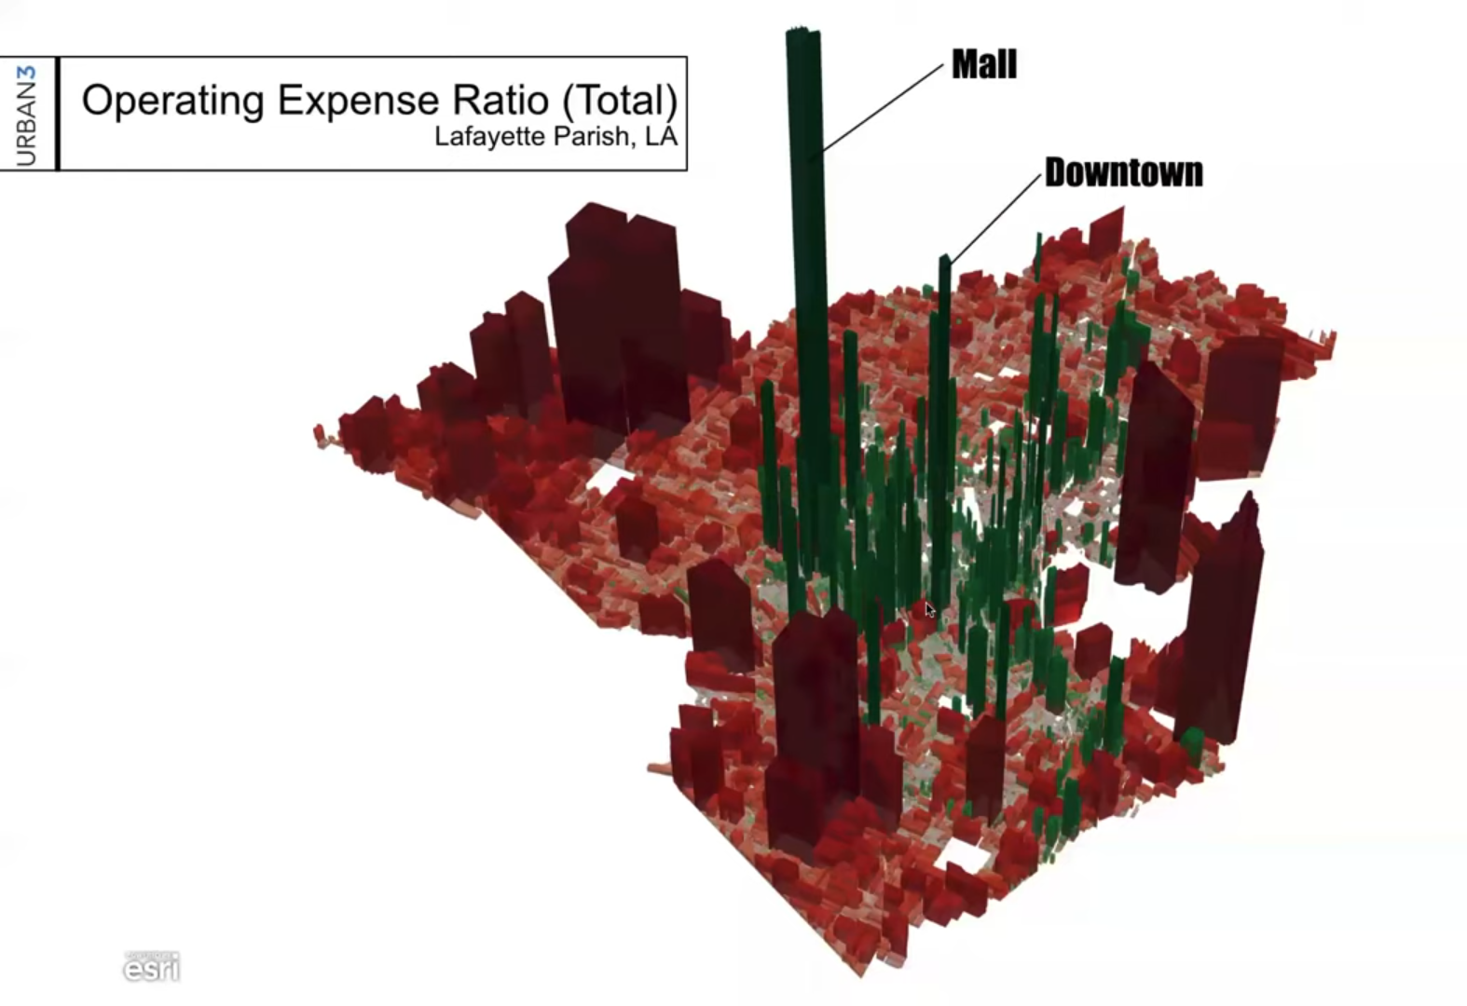
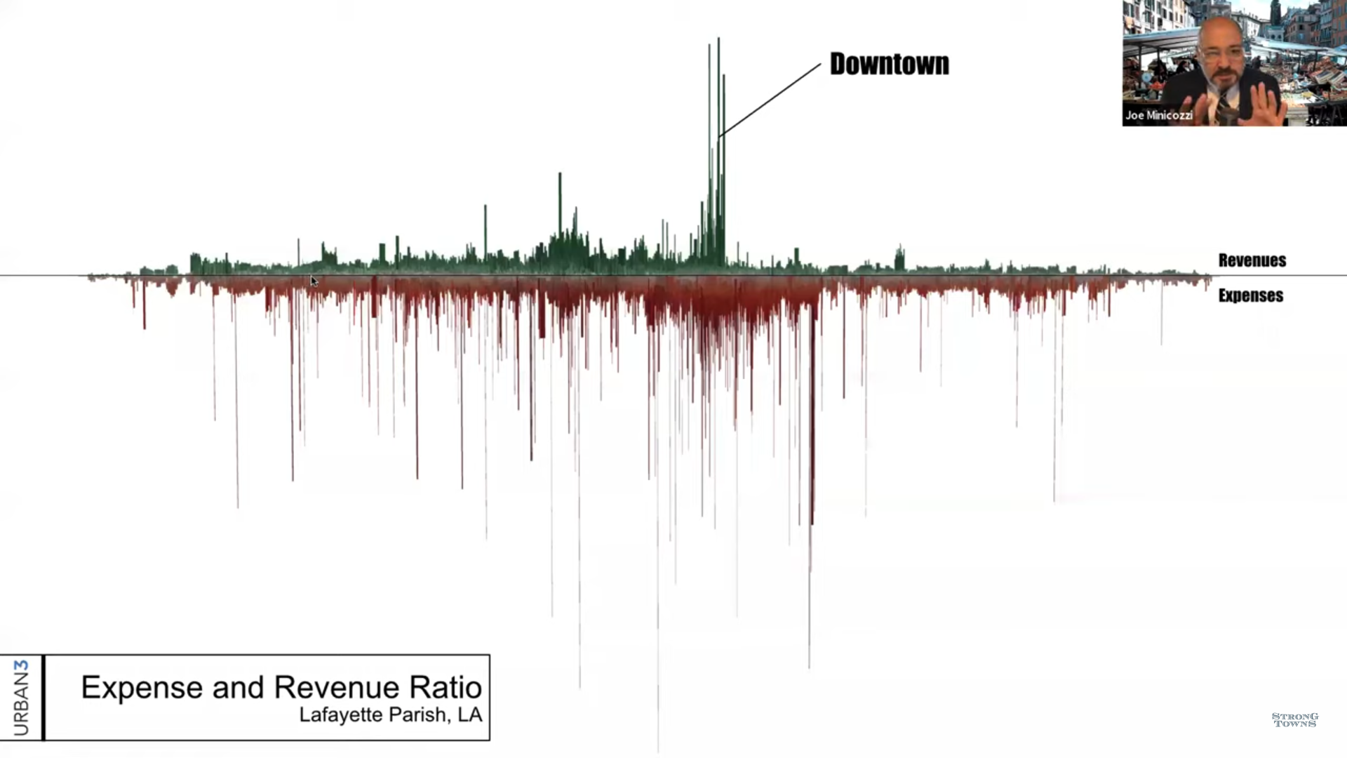
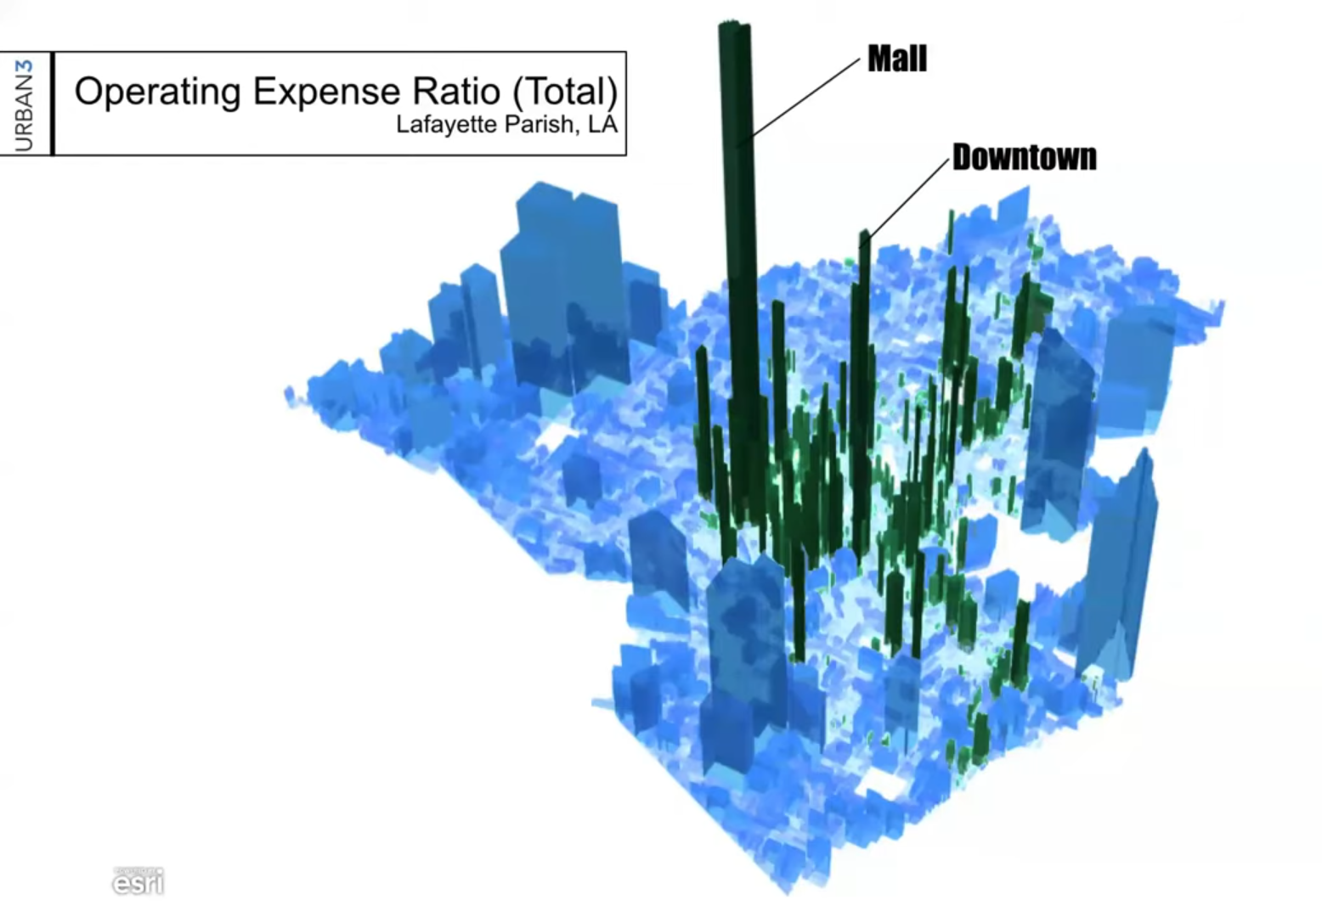
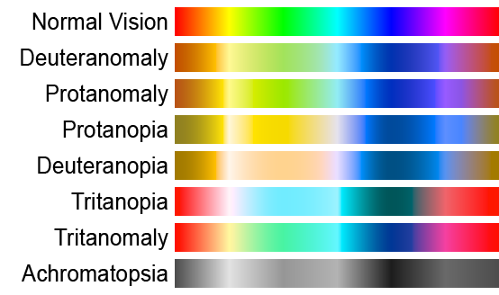
Considerations for
Color Blindness
Be wary of red/green contrast (also blue/yellow)
Combine symbols, location, and color when relaying information
Example of how colors can appear:
Red/green
Blue/yellow
Notes:
Photo Citations:
Three maps: Joe Minicozzi, Economics of Development presentation
Color band image: Wikimedia commons

Slide 37
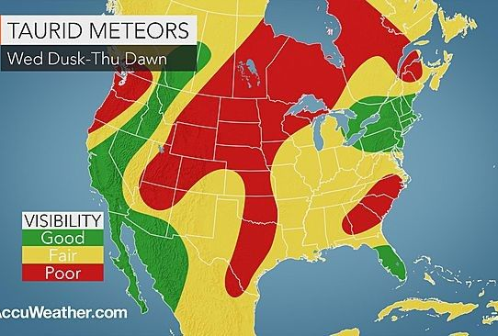
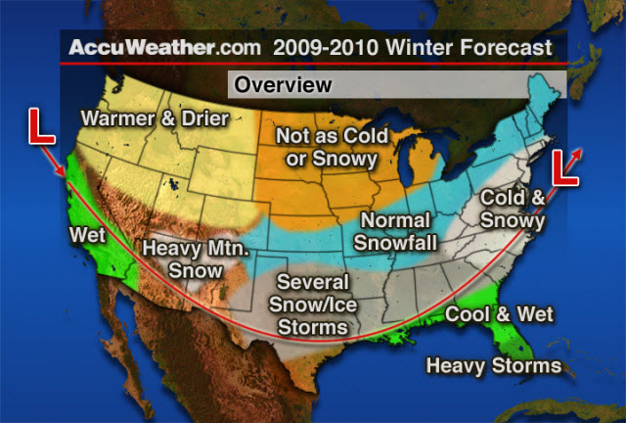
Considerations for
Low Vision Maps
Size: the bigger, the better
  Publish maps in a format that can be zoomed in
High color contrast
When providing online access, don’t bury information in downloads.
Notes:
The upper map provides clearer distinction between areas with clear lines and distinct colors. The lower map does a good job of having text pop from the page.
Photo citations:
Both maps: Accuweather.com

Slide 38
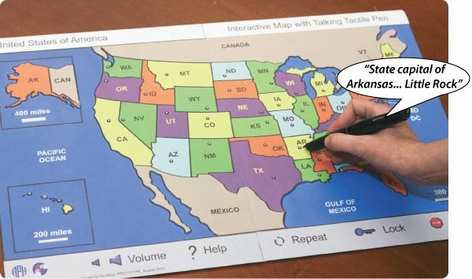
Alternatives to
Sight-based Maps
Digital Text Readers
  Provide image Alt text and transcribe videos
  Logical information flow
  Descriptive headings and links
Text Reading devices
  Cell phone apps
  “Pens”
Notes:
Photo Credit: Touch Graphics Inc.

Slide 39
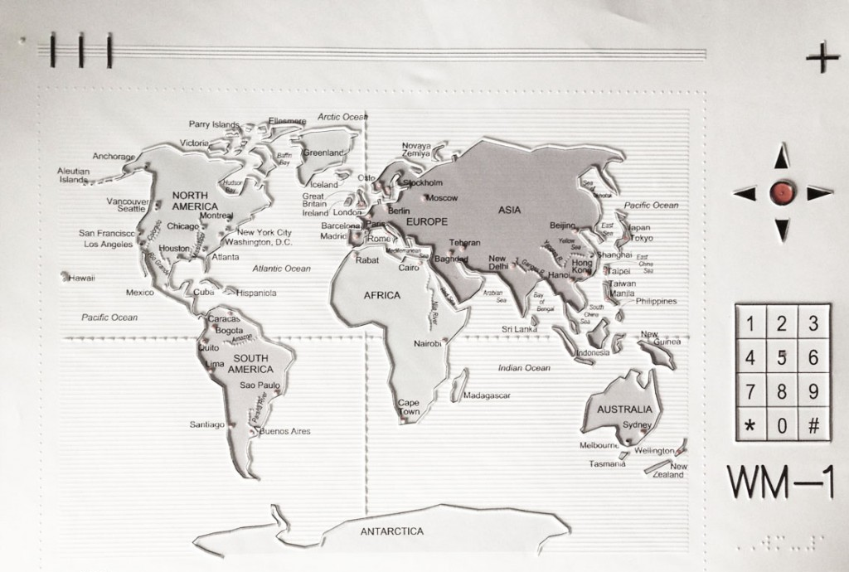
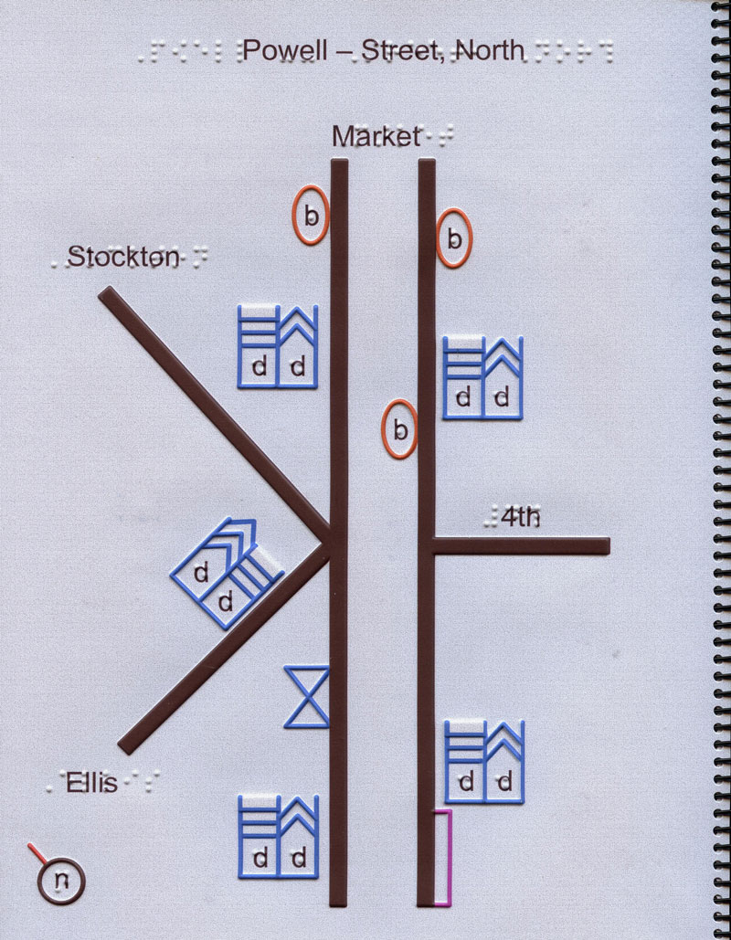
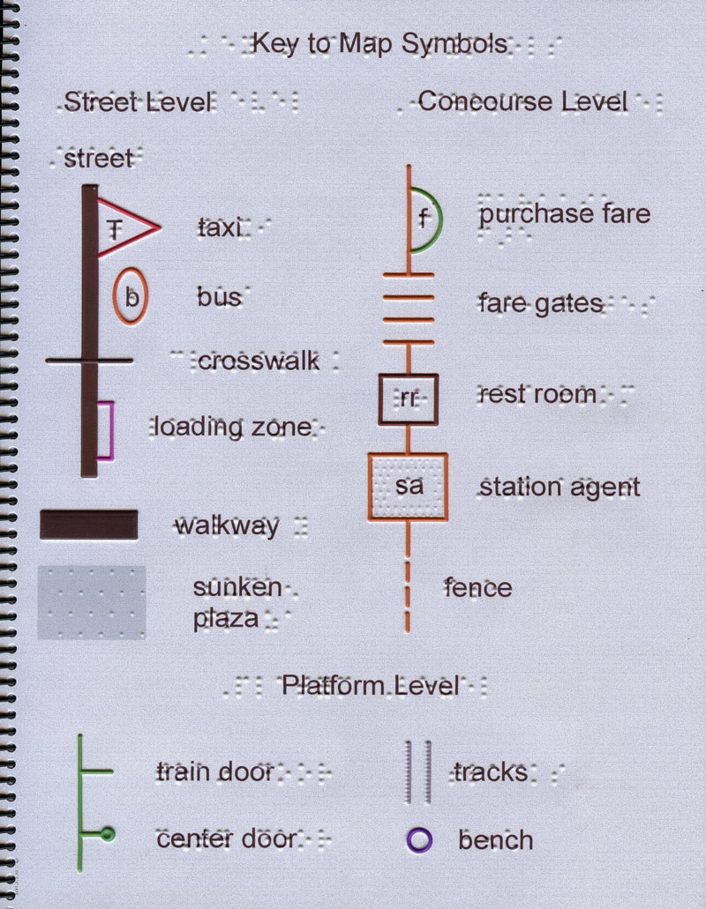
Alternatives to
Sight-based Maps
Notes:
Tactile maps!
Here are two examples of TMAP. A world map and a map of the BART. GIS can be used to create these maps. They are not as true to physical space as map-makers are used to. Use of space is more “elastic.” This reflects a different perspective of the world. Only the BART map makes use of braille. Some people read it, although in recent years it has become less and less popular. 8.6% (5,333) were registered as braille readers, 31% (19,109) as visual readers, 9.4% (5,795) as auditory readers, 17% (10,470) as pre-readers, and 34% (21,032) as non-readers. There are other languages available.
If working on a map that serves as data representation, it is useful to know about tactile color cues, which are raised bumps in unique shapes that represent different colors.
Photo credit:
Touch Graphics Inc.

Slide 40
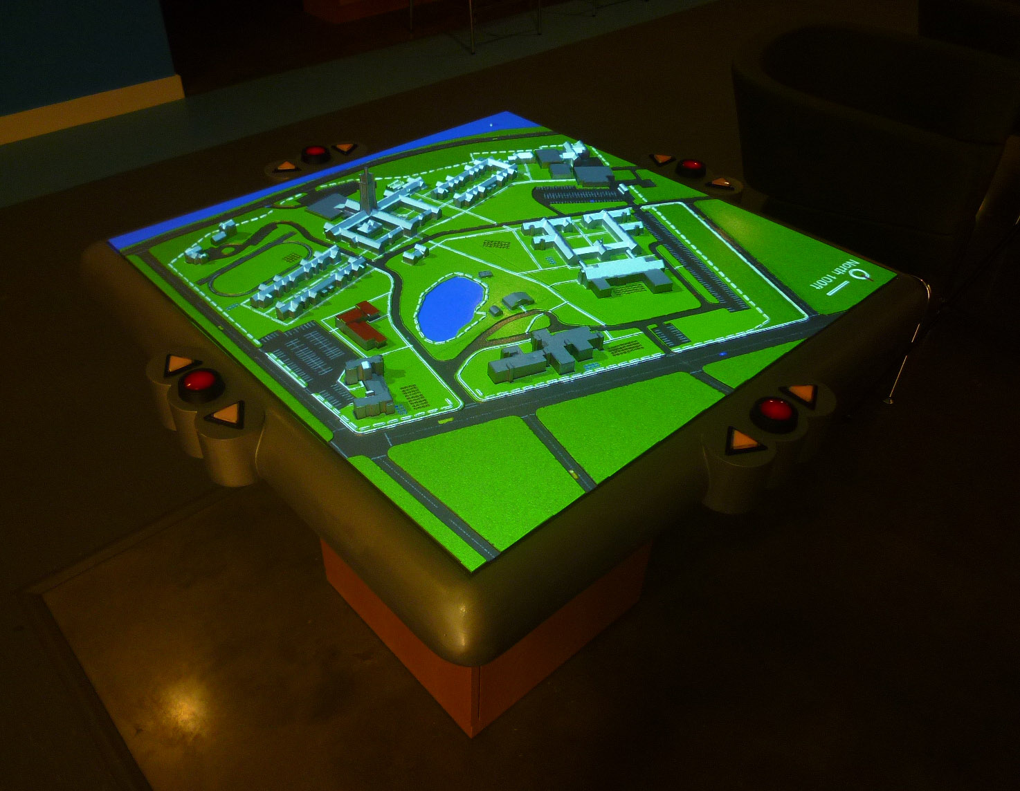

Alternatives to
Sight-based Maps
Notes:
Other types of tactile maps!
This school for the blind features a map of the campus that is mostly flat but offers 3D features for the buildings. Users can tap the buildings to hear their name, or double tap to hear information about them. Different colorings of the area can be projected onto the map for visibility and information preference.
3D printing is cheap and easy – a great way to call attention to details in land or data.
Photo credits:
Touch Graphics Inc.
Grand Canyon image is from an Etsy store that I can’t find again.

Slide 41
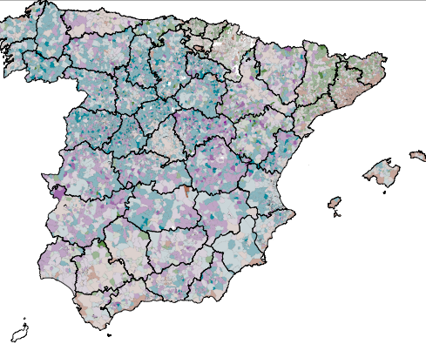
Considerations for
Dementia
Unique sight impairments
Beauty and calm
Notes:
Globally, 5% of people over 60 have dementia.
Vision loss is distinct from general population, because it is often accompanied by cognitive decline. Often these individuals can’t read braille.
Anxiety is common. Give users time with each idea, trying not to rush them. Color is also a key to navigating emotion, thus one should make use of calming colors.
Photo credit: David Smith, “Creating beautiful maps with R” from R-bloggers

Slide 42
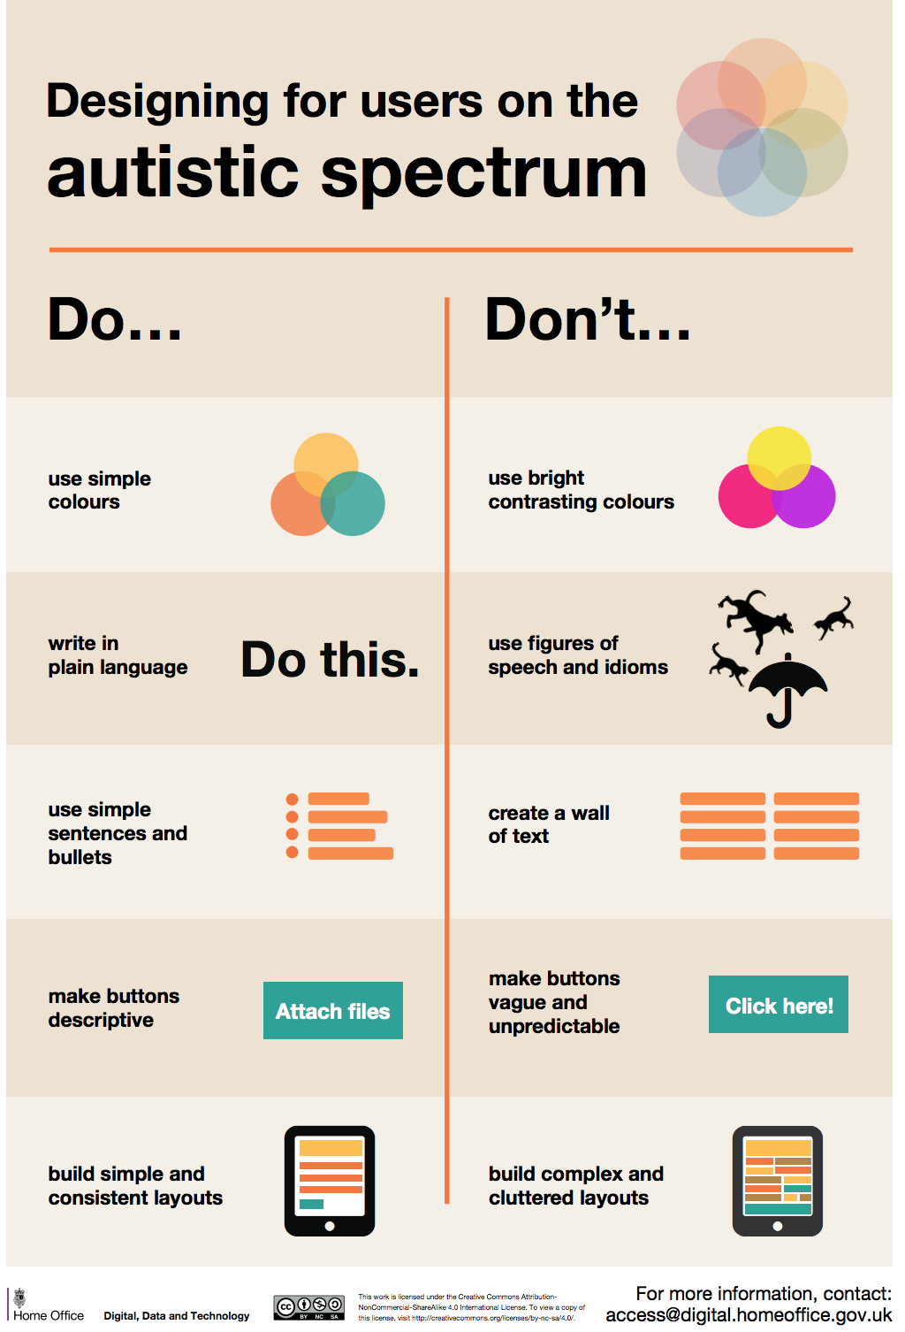
Considerations for
Autism
Build presentations with structure
Use calm colors
Notes:
Autism is deeply individual. What may help one user may hinder another. Generally, it’s a good idea to use stimulating imagery and colors, but to be wary of sensory overload.
Photo credit: UK Home Office

Slide 43
Resources
Citizens Budget Commission. 2016, Sept. 20. Access-A-Ride: Ways to Do the Right Thing More Efficiently. Accessed at https://cbcny.org/research/access-ride.
Howard Karger & Steven R. Rose (2010) Revisiting the Americans with Disabilities Act after Two Decades, Journal of Social Work in Disability & Rehabilitation, 9:2-3, 73-86, DOI: 10.1080/1536710X.2010.493468
Sarah Sherman & Jean Sherman (2012) Design professionals and the built environment: encountering boundaries 20 years after the Americans with Disabilities Act, Disability & Society, 27:1, 51-64, DOI: 10.1080/09687599.2012.631797

Slide 44
References and Further Reading RE Accessibility & GIS
Abe, Akihiro, Nobuyuki Maita, Yasunori Ooshida, y Toru Kano. 2007. «Proposal for a System Based on the Universal Design Approach for Providing Tourism Information by Linking RFID and GIS.» Advances in Information Systems Development 247-258.
Ahmetovic, Dragan, Roberto Manduchi, James M. Coughlan, y Sergio Mascetti. 2015. «Zebra Crossing Spotter: Automatic Population of Spatial Databases for Increased Safety of Blind Travelers.» 17th International ACM SIGACCESS Conference. ASSETS. 251–258.
Alzheimer's Research UK. 2020. 1 de 5. https://www.dementiastatistics.org/.
Biggs, Brandon, James M. Coughlan, y Peter Coppin. 2019. «DESIGN AND EVALUATION OF AN AUDIO GAME-INSPIRED AUDITORY MAP INTERFACT.» The 25th International Conference on Auditory Display (ICAD 2019). Northumbria University. 23-27.
Center for Disease Control. 2020. Data & Statistics on Autism Spectrum Disorder. 1 de 5. https://www.cdc.gov/ncbddd/autism/data.html.
Dautenhahn, Kerstin. s.f. Design Issues on Interactive Environments for Children with Autism. Hatfield: University of Hertfordshire.
Gual, Jaume, Marina Puyuelo, y Joaquim Lloveras. 2015. «The effect of volumetric (3D) tactile symbols within inclusive tactile maps.» Applied Ergonomics 1-10.
—. 2011. «Universal Design and visual impairment: tactile products for heritage access.» INTERNATIONAL CONFERENCE ON ENGINEERING DESIGN (ICED11). Technical UNIVERSITY OF DENMARK.
Hammel, Joy, Robin Jones, Janet Smith, Jon Sanford, Cathy Bodine, y Mark Johnson. 2008. «Environmental barriers and supports to the health, function, and participation of people with developmental and intellectual disabilities: Report from the State of the Science in Aging with Developmental Disabilities Conference.» Disability and Health Journal 143-149.
Hammel, Joy, Susan Magasi, David B. Gray, Allen W. Heinemann, Susan Stark, Pamela Kisala, Noelle E. Carlozzi, David Tulsky, Sofia F. Garcia, y Elizabeth A. Hahn. 2015. «Environmental Barriers and Supports to Everyday Participation: A Qualitative Insider Perspective From People with Disabilities.» Archives of Physical Medicine and Rehabilitation 96:578-88.
Hamraie, Aimi. 2018. «Mapping Access: Digital Humanities, Disability Justice, and Sociospacial Practice.» American Quarterly 455-482.
Kulyukin, Vladimir, James Marston, Joshua Miele, y Aliasgar Kutiyanawala. 2010. «Automated SVG Map Labeling for Customizable Large Print Maps for Low Vision Individuals.» RESNA Annual Conference. Las Vegas: RESNA.
Logan, Thomas. 2020. Inclusive Design Presentation – Let’s Make Maps Widely Accessible. 1 de 5. https://equalentry.com/inclusive-design-presentation-lets-make-maps-widely-accessible/.
Lupton, Ellen, y Andrea Lipps. 2018. The Senses: Design Beyond Vision. Hudson: Copper Hewitt; Smithsonian Design Museum; Princeton Architectural Press.
Magasi, Susan, Alex Wong, David B. Gray, Joy Hammel, Carolyn Baum, Chia-Chiang Wang, y Allen W. Heinemann. 2015. «Theoretical Foundations for the Measurement of Environmental Factors and Their Impact on Participation Among People With Disabilities.» Archives of Physical Medicine and Rehabilitation 96:569-77.
Miele, Joshua A., Steven Landau, y Deborah Gilden. 2006. «Talking TMAP: Automated generation of audio-tactile maps using Smith-Kettlewell’s TMAP software.» The British Journal of Visual Impairment 93-100.
Mostafa, Magda. 2008. «An Architecture for Autism: Concepts of Design Intervention for the Autistic User.» Archnet-IJAR, International Journal of Architectural Research 189-211.
National Federation for the Blind. 2020. Blindness Statistics. 1 de 5. https://www.nfb.org/resources/blindness-statistics.
National Institute of Health. 2020. Color Blindness. 1 de 5. https://www.nei.nih.gov/learn-about-eye-health/eye-conditions-and-diseases/color-blindness.
Pullin, Graham. 2009. Design Meets Disability. Cambridge: MIT Press.
Serrano-Mira, J., J. Gual-Orti, G. Bruscas-Bellido, y J.V. Abellan-Nebot. 2017. «Use of additive manufacturing to obtain moulds to thermoform tactile graphics for people with visual impairment.» Manufacturing Engineering Society International Conference 2017 (MESIC 2017). Procedia Manufacturing. 810-817.
Stupar, Aleksandra, Vladimir Mihajlov, Ksenija Lalovic, Ratka Colic, y Filip Petrovic. 2019. «Participative Placemaking in Serbia: The Use of the Limitless GIS Application in Increasing the Sustainability of Universal Urban Design.» Sustainability.
United Kingdom, Home Office. s.f. Designing for Accessibility. Github.
White, Timothy L., y Andrea S. Krausman. 2015. «Effects of inter-stimulus interval and intensity on the perceived urgency of tactile patterns.» Applied Ergonomics 121-129.
World Health Organization. 2020. Health topics: Disabilities. 01 de 05. https://www.who.int/topics/disabilities/en/.

